Slide 1

uTCA White Rabbit Timing and Trigger System for Distributed Deterministic Control
EPICS CM 2026
20.04.2026
Antonio Miguel López

Slide 2
Agenda
01
04
|
|
What is a timing system?
Tests & Results
02
05
|
|
Safran Solution: Timing System
Next Steps
03
|
Safran Solution: MPS Application

Slide 3
01 What is a timing system?
Applications: every installation requires timing and synchronization
Crucial component used to synchronize and control the operations and events that occur during experiments or beam delivery in a particle accelerator
Main functions are:
Timing/Synchronization: ensuring that all the components operate at the correct time relative to each other.
Trigger and gate generation: generation of deterministic signals to initiate and coordinate subsystem actions, including precise pulses that define the timing of operations such as particle bunch generation.
Deterministic Distribution: Timing and trigger signals need to be distributed throughout the accelerator facility with minimal delay and jitter (this is especially critical in lasers).
Control and supervision: configuration and monitoring through the control system.
Other possible functions:
RF distribution: allows the reconstruction of the RF signal in the end-nodes (synchrotrons)
Interlocks distribution: enables the stop of the complete installation in case of failure.

Slide 4
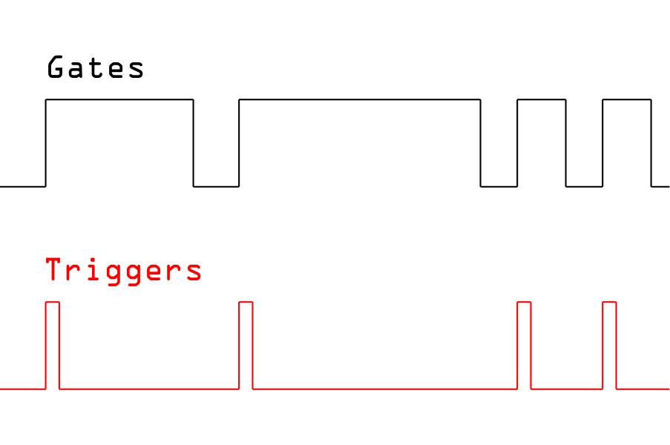

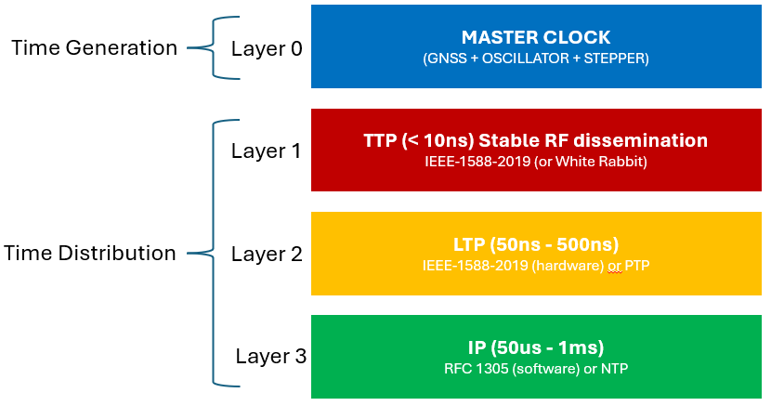

01 Why White Rabbit for facility timing?
Main Advantages
Sub-nanosecond synchronization: provides a common and highly accurate time base across distributed nodes.
Deterministic timing over fiber: enables precise trigger distribution and coherent operation of time-critical subsystems.
Scalable and low-maintenance infrastructure: new nodes can be added easily thanks to plug-and-play optical links and automatic link calibration.
Unified timing base: the same infrastructure supports synchronization, timestamping, and trigger generation for systems such as LLRF, BPM, MPS and diagnostics.

Slide 5
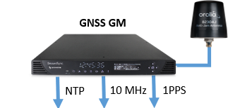
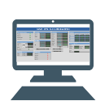
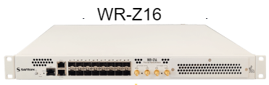
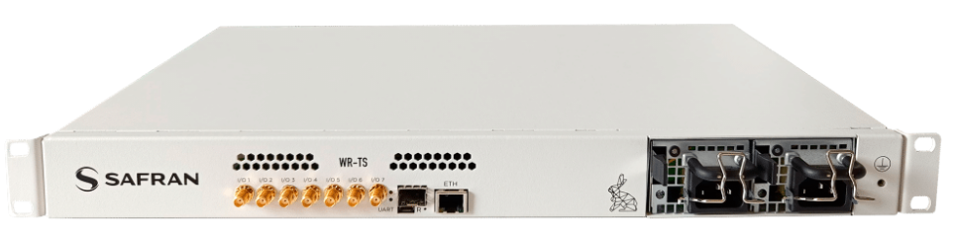
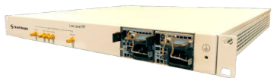
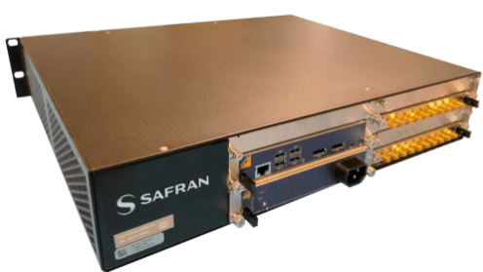
01 Why White Rabbit for facility timing?
System Diagram
ETH
Optic fiber
Interlock
Triggers for LLRF systems
Triggers for BPMS systems
Triggers for other systems
…
WR-TTS
WR-TTS
WR-TTS
WR-TTS
WR-TTS
WR-TTS
WR-TTS
…
BPM
LLRF
…
+
+
+
+
+
Source
RF cavities
Target
SCT / Safran Navigation & Timing

Slide 6
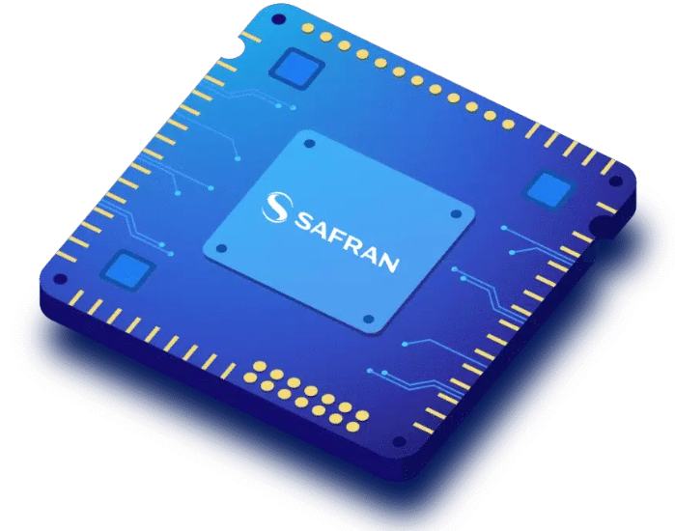
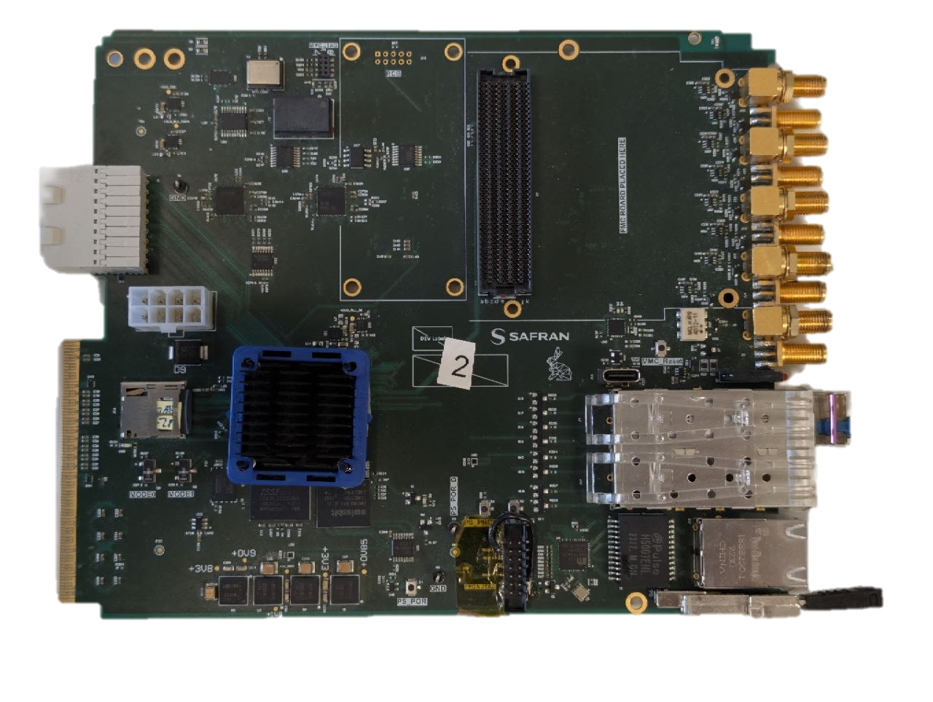
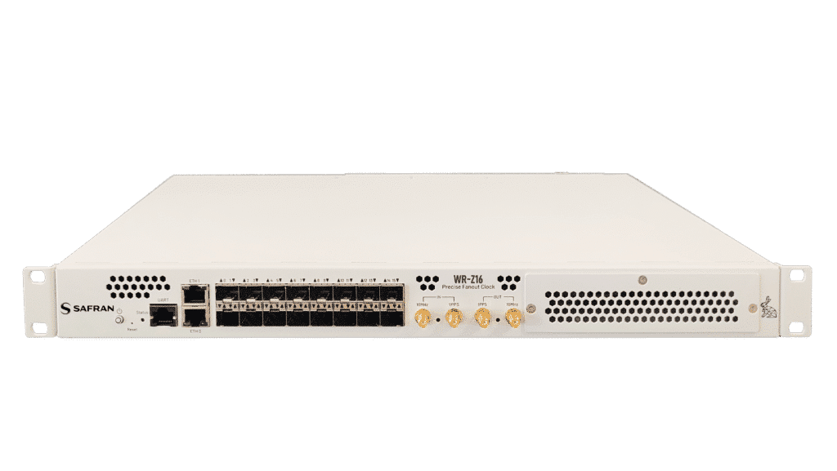
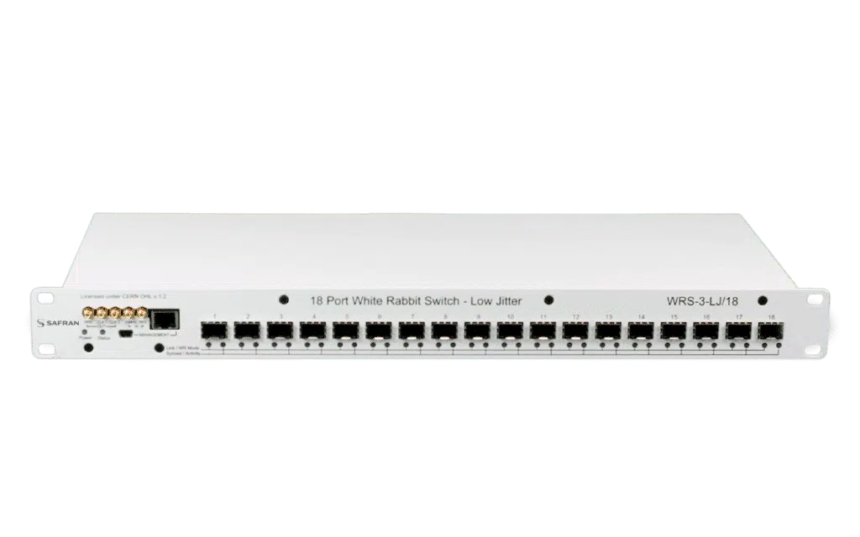
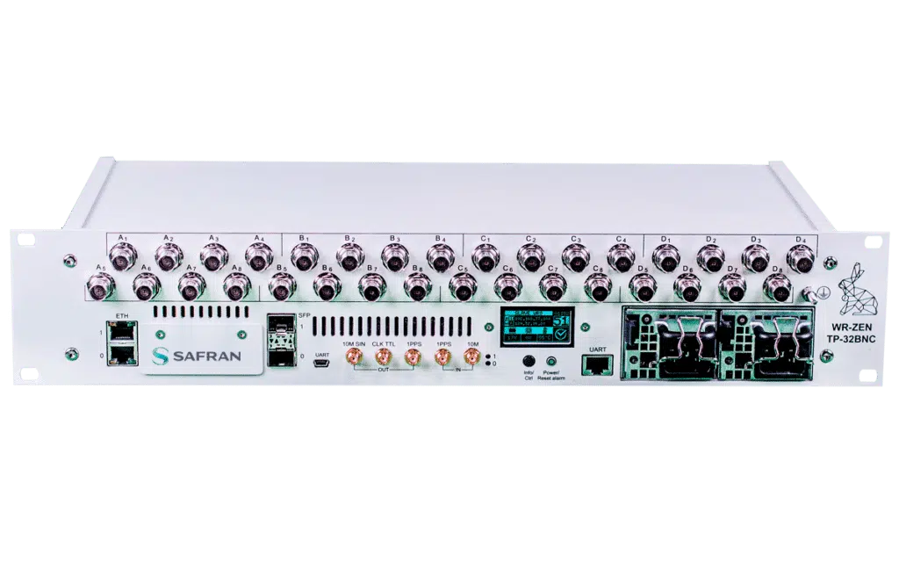
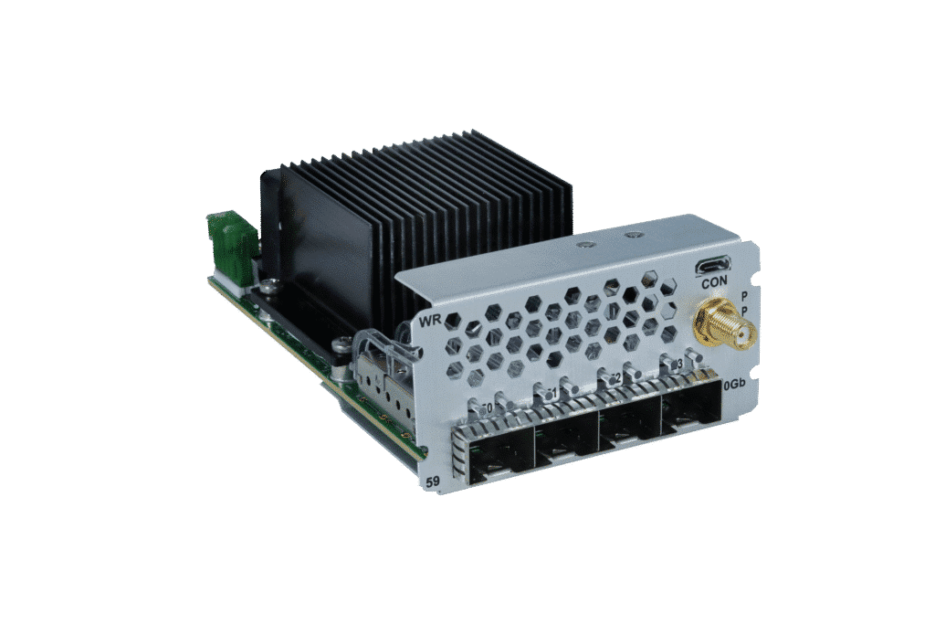
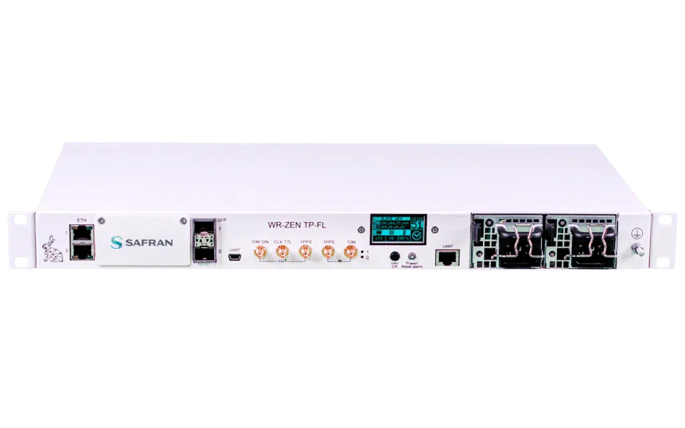
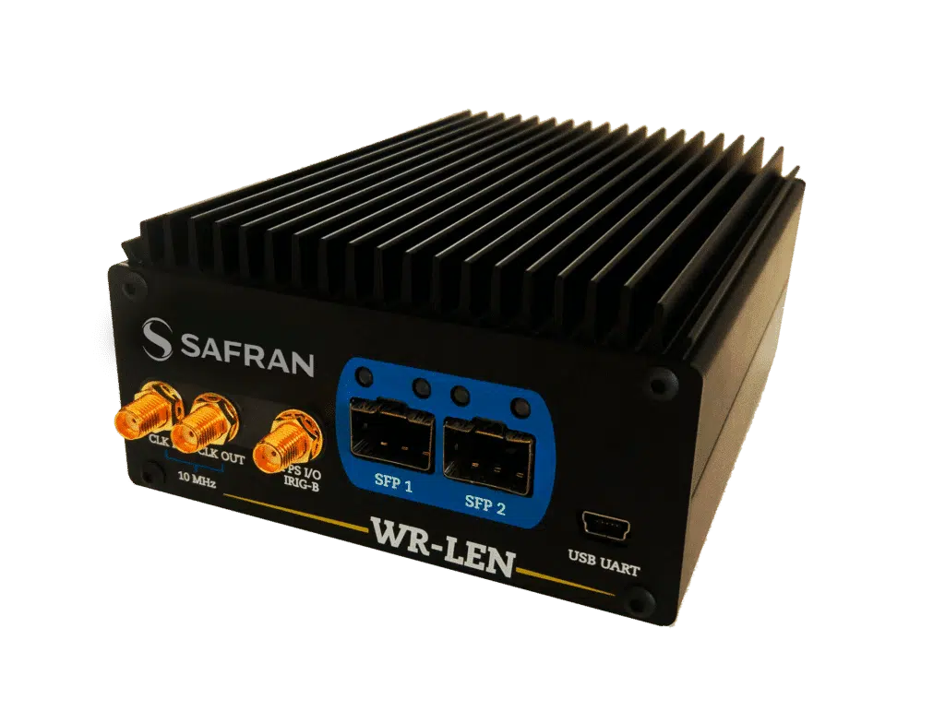
02 Safran Solution
HATI IP CORE
WR-TTS: Platform
FIRST VERSION based on
White Rabbit Timing & Triggering system
White Rabbit Commercial Products
WR-Z16
WR-SWITCH-LJ
WR circuitry
WR-ZEN TP-32BNC
WR-WROX
WR-ZEN TP-FL
WR-LEN

Slide 7
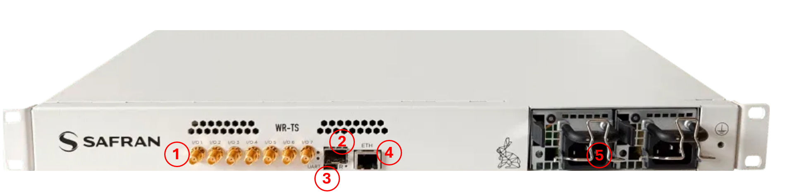
02 Safran Solution
WR-TTS: Platform
Platform:
Ultrascale + SoC FPGA-based architecture enabling deterministic real-time processing
White Rabbit technology
Sub-nanosecond time accuracy
Very high scalability and large distance links support
Nanosecond timestamping
10MHz and PPS outputs
Master/Slave Mode
uTCA form factor.
Up to 9 configurable in/out ports
2 x SFP ports (WR and fast communications)
1 x ETH port (control, monitoring and management)
1 x USB port (management)
Event Generation and Detection (nanosecond resolution)
FMC and RTM expansion connector for custom I/O and subsystem interfacing
EPICS/TANGO Controls integrated
Notes:
The system is based on an ultrascale+ SoC, can be distributhe either in a standalone chasis or uTCA but the important thing here is that this is not simply a final node and can act as WR master since it has 2 SFP ports, 10MHz outputs and PPS to propagate the WR network.

Slide 8
02 Safran Solution
WR-TTS: Same Platform, Different purposes
Timing & Triggering System
Machine Protection System
TS Master IOC
MPS Master IOC
+
+
WR-TTS Plat.
WR-TTS Plat.
+
+
TS Gateware
TS Overlays
Hybrid Approach??
MPS Overlays
MPS Gateware
TS IOC
MPS IOC

Slide 9

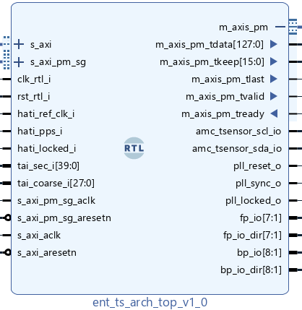
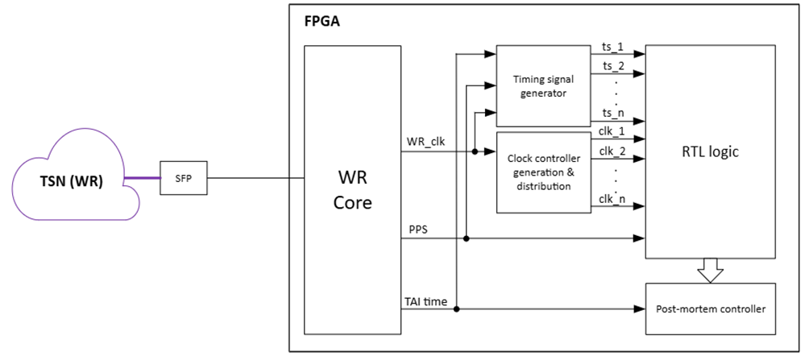
02 Safran Solution
WR-TTS: Timing + Triggering
Sub-nanosecond time accuracy
Picosecond level precision
Distance range: over 80 km using fiber
DWDM compatible
Dynamic compensation of asymmetries caused by weather conditions
Programmable single shot or sequence triggers
Resolution of 4ns.
Programmable rate, delay and duty cycle.
Notes:
Here we hace some implementation details of the FPGA part, the idea here is to take the WR clocks and PLLs as base for the generation of the gates an triggers of the system, getting a resolution up to 4ns.

Slide 10

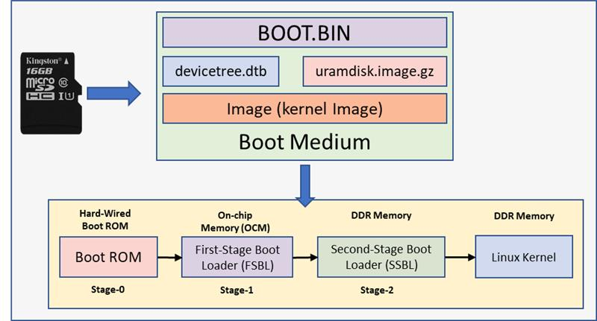
02 Safran Solution
WR-TTS: Embedded Software
Buildroot-based OS – WR-ZYNQ-OS
BOOT.bin: FPGA image
Uboot: instructions to boot the devices
Devicetree: mapping of devices of the system/hw plattform.
Image: Custom Linux kernel image
Root filesystem:
Linux services for configuring all the components on the platform (PLL, DMA, ADC, I2C devices…)
Builds a CC Toolchain for:
SoC Communication Drivers (AXI)
Specific configuration tools (PLL, ADC, DAC, Sensors…)
EPICS base and EPICS components (asyn, seq, autosave..)
EPICS IOC

Slide 11
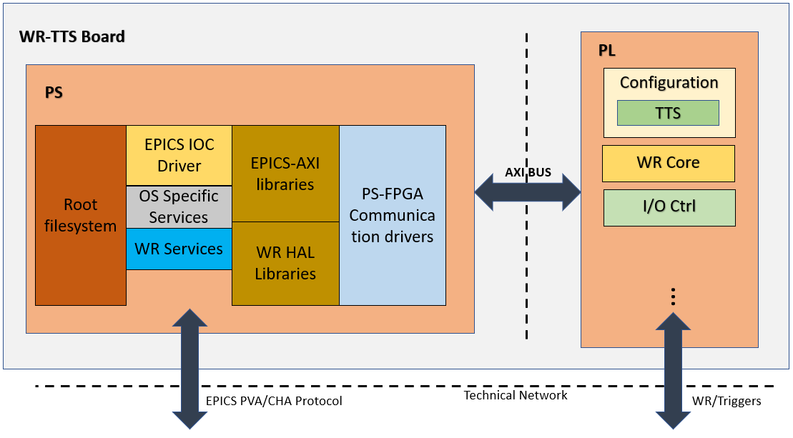
02 Safran Solution
WR-TTS: Embedded Software

Slide 12
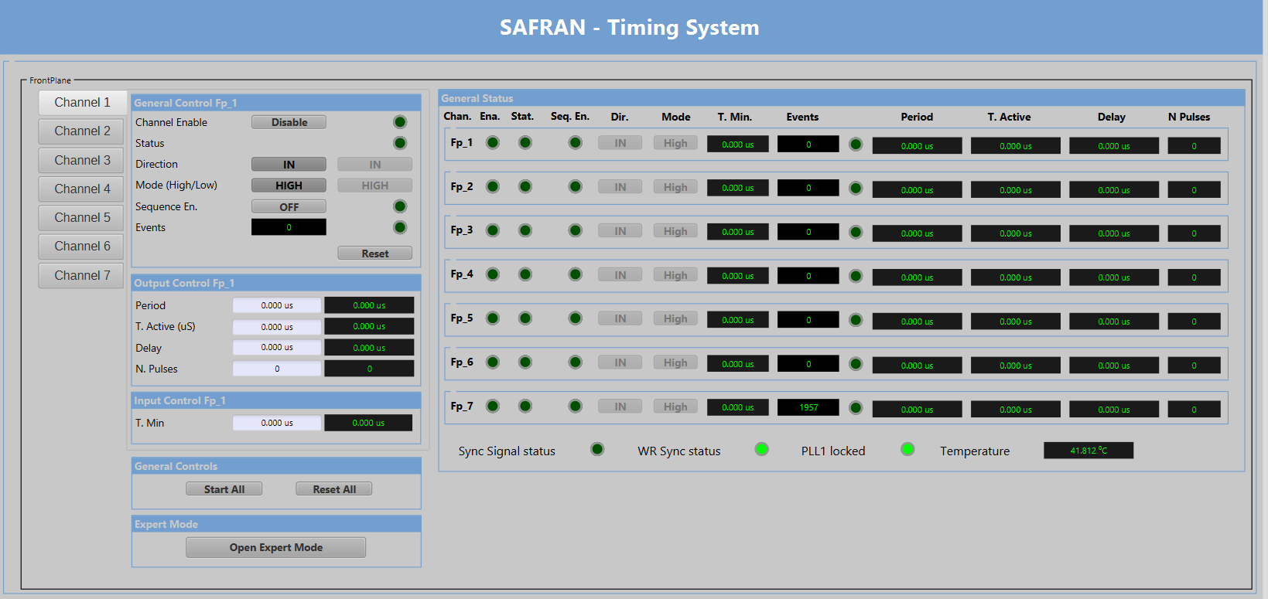
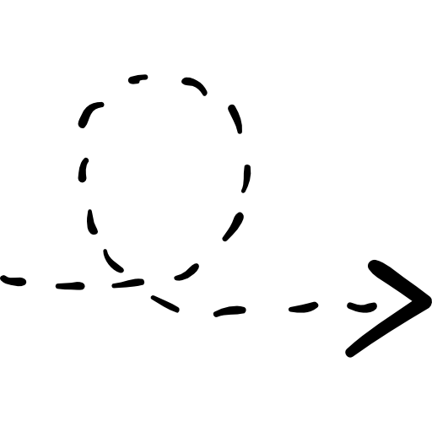
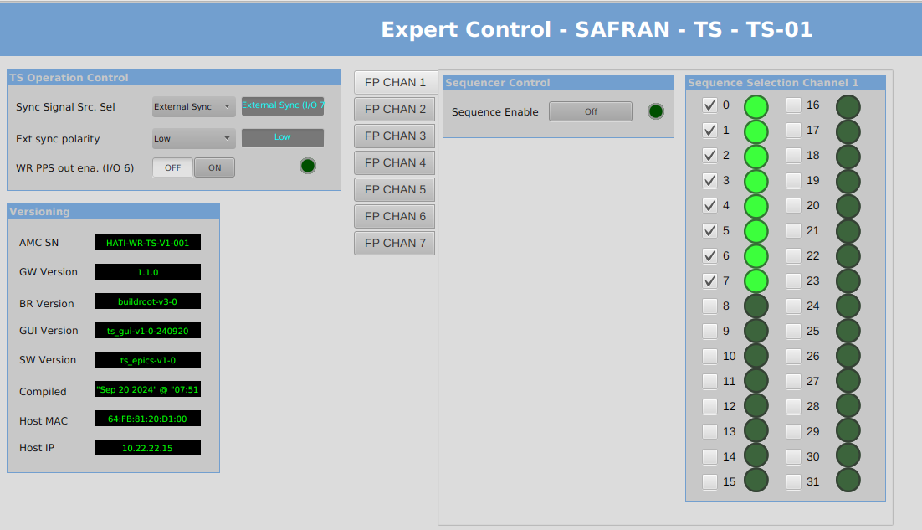
02 Safran Solution
WR-TTS: Embedded Software

Slide 13
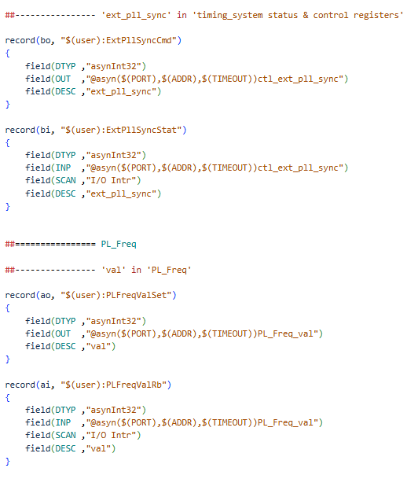
02 Safran Solution
WR-TTS: Embedded Software
EPICS IOC
EPICS 7
Asyn 4.44-based driver using AXI bus for FPGA-Processor communications
WBGen to define FPGA addressing and EPICS Asyn connectors
AXI Register MAP matched with EPICS DB (trough asyn)
Specific functionalities integrated on the EPICS driver (Postmortem, Device components control…)
Notes:
EPICS, for sure…

Slide 14
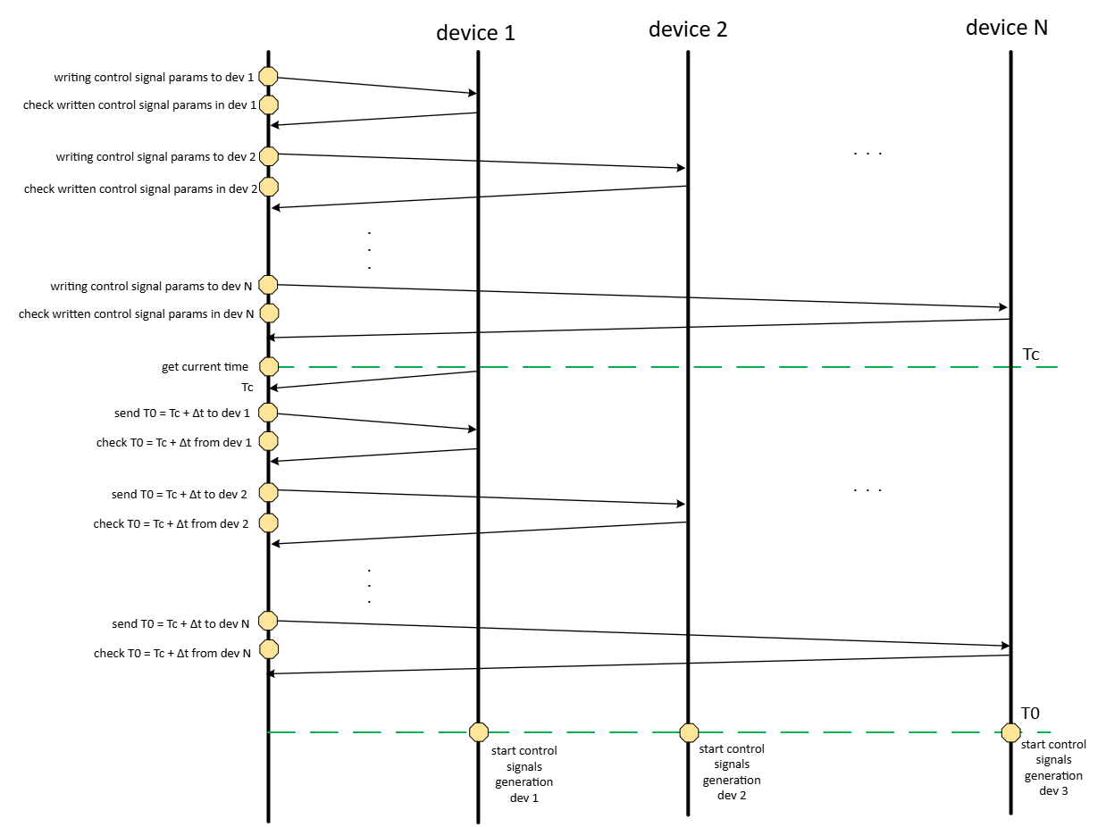
02 Safran Solution
WR-TTS: Master-Slave
One WR-TS node acts as master node.
M
S
start
all
start
all
WR-TS
WR-TS
…
…
Notes:
The WR Timing system usually works in master/slave mode and all the configurations of the slaves can be controlled from the master node through EPICS. When all the nodes are configured, the master program a T0 in the future, propagates it to all the slaves ensuring they are ready and command the start, then when all the nodes reach T0, they wait until a PPS or an external signal is receive to start generating.

Slide 15
02 Safran Solution
WR-TS: Graphic User Interface
Input configuration:
T.Min: Minimum time to consider a pulse valid.
Output configuration:
Period: Time between pulses.
T. Active: Time that the signal will be High/Low.
Delay: Time between the starting trigger and the generation of the pulse
N. Pulses: Number of pulses to generate (∞ if 0).

Slide 16
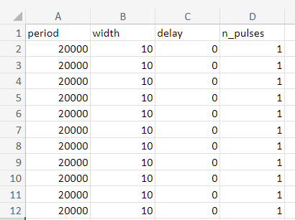
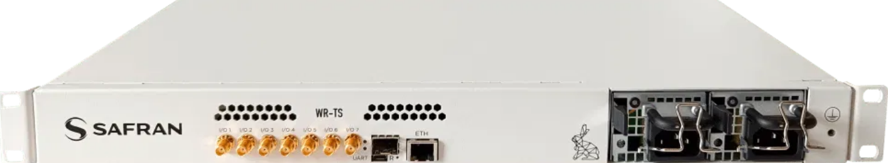
02 Safran Solution
WR-TTS: Sequences of events
Sequences of events can be defined in .csv files.
The system loads these sequences in a double buffer in the WR-TS nodes. The WR-TS node executes one sequence of events during the current frame while receiving the sequence data for the following frame.
/home/epics-user/data/sequencer/
Event 1
Event 2
Event 3
……
……
Event 640
Frame N
Event 1
Event 2
Event 3
……
……
Event 640
Frame N+1
Notes:
The Timing system can also work in sequence mode, that means that it can load the sequences from CSV files in all the nodes and execute them once, in loop, depending on the operation…

Slide 17
02 Safran Solution
WR-TS: Graphic User Interface
Sequences of events mode
Up to 32 selectable sequences of events.
Internal PPS or external synchronization signal.
Notes:
This is an example of the graphical user interface were the operator can select the sequeces being executed in the nodes and in the channel of each node.

Slide 18
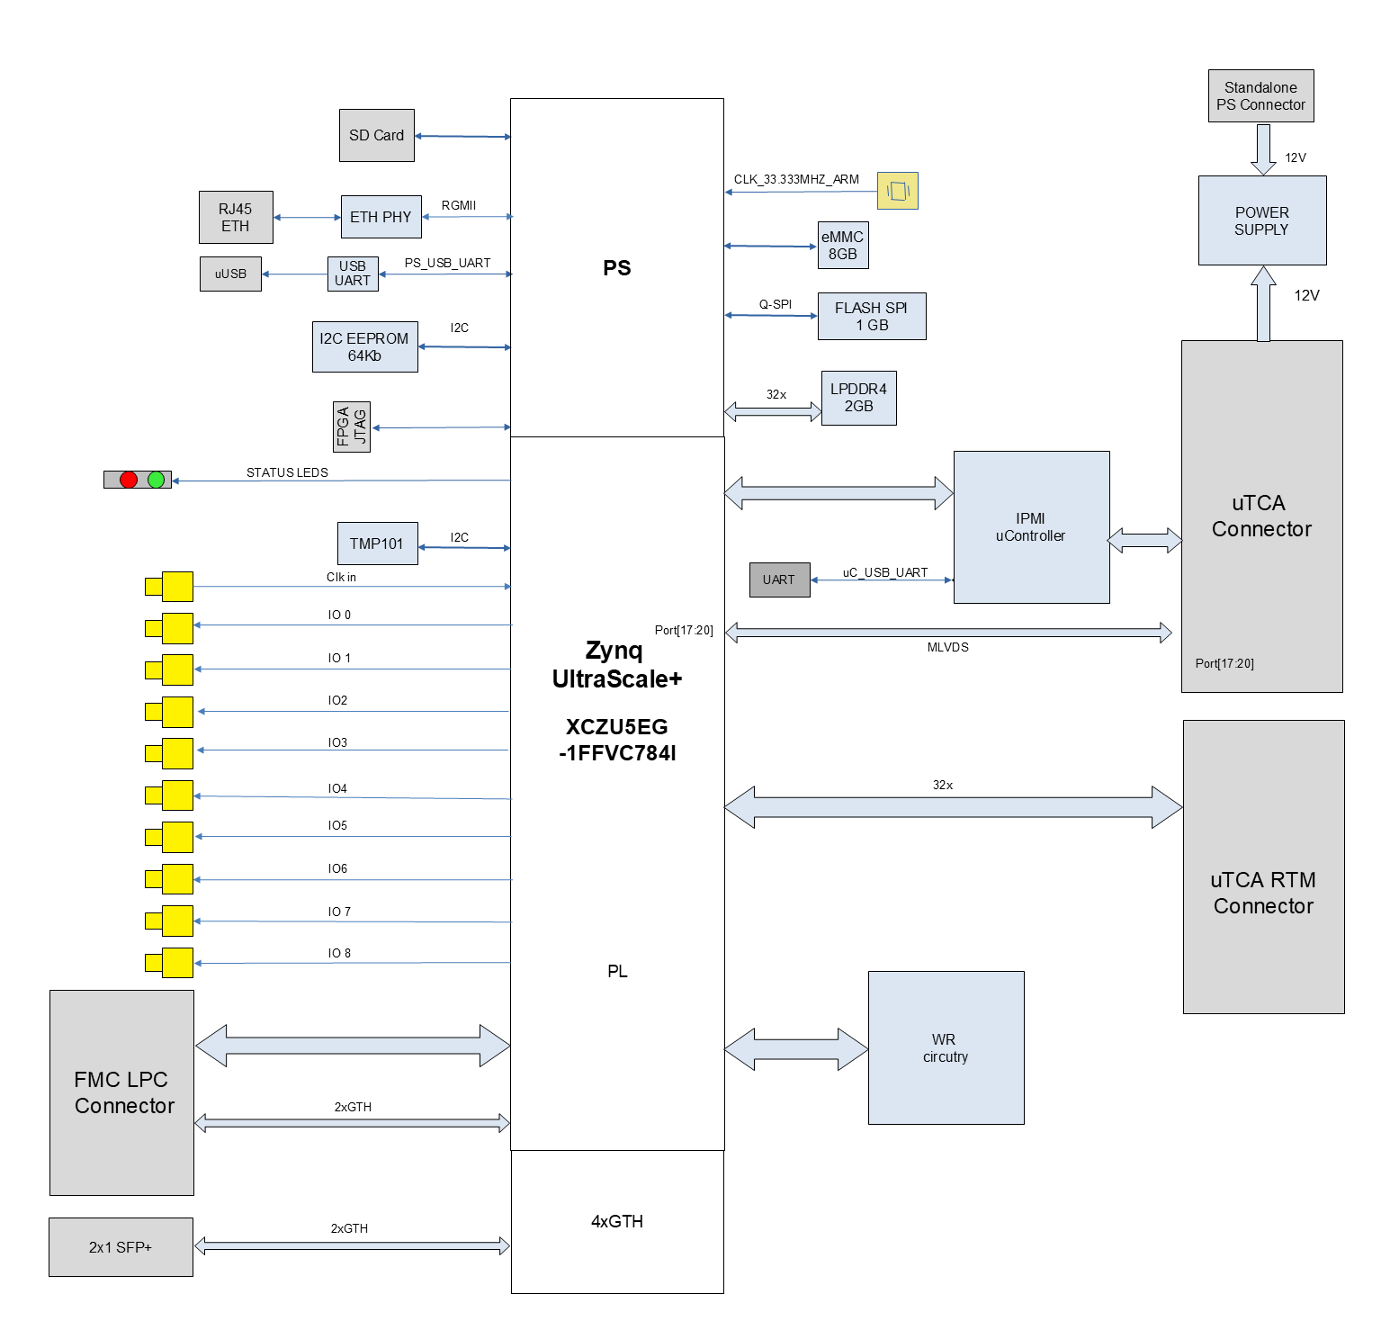
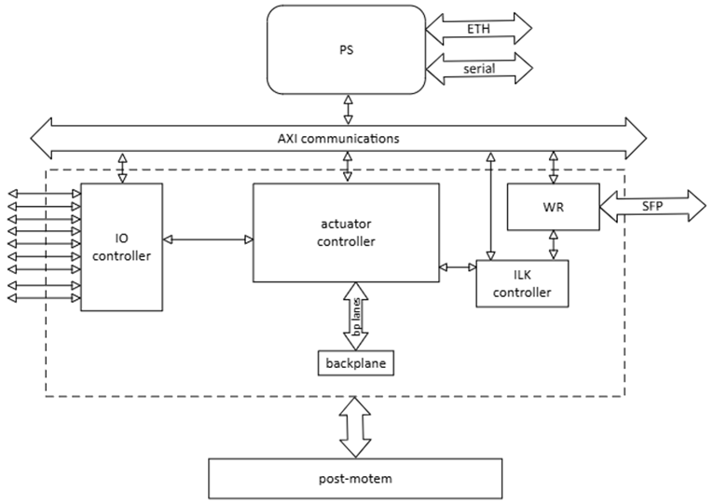
03 Safran Solution
WR-TTS: Machine protection System
Notes:
As I mentioned before, this system can also work as Machine protection system, just changing the FPGA behaviour and the IOC controller on the uTCA board. Here you can find the design detailed but the important thing is that…

Slide 19
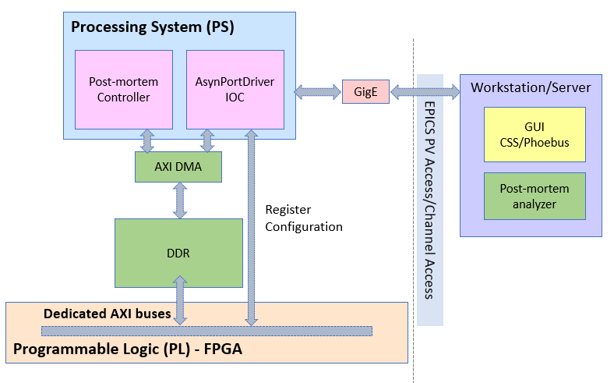
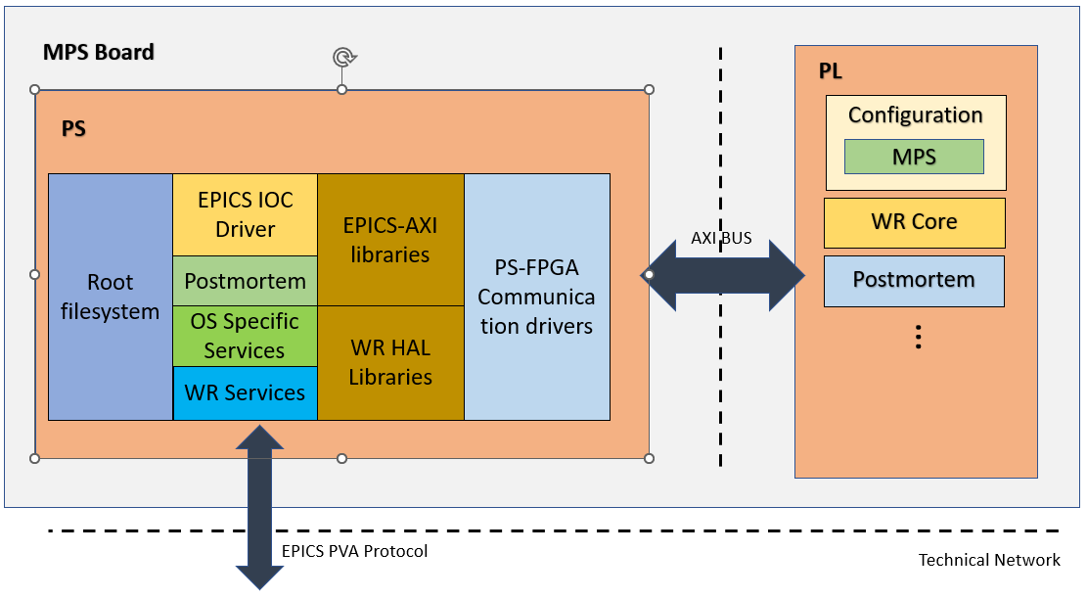
03 Safran Solution
WR-TTS: Embedded Software
Custom AXI Libs
Asyn Driver
EPICS 7.X
PVA
Phoebus GUI
Postmortem
Phoebus & Python PM Analyzer
Notes:
Well, this part of the software is pretty much the same that in the case of the Timing system. The only difference to mention here is the postmortem functionality that give us the possibility to analyze the event chain of the nodes with the WR timestamping. And analyze them in Phoebus or python-based tools.

Slide 20
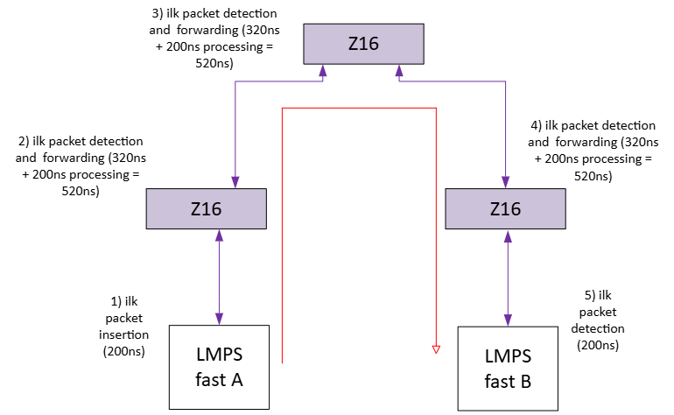
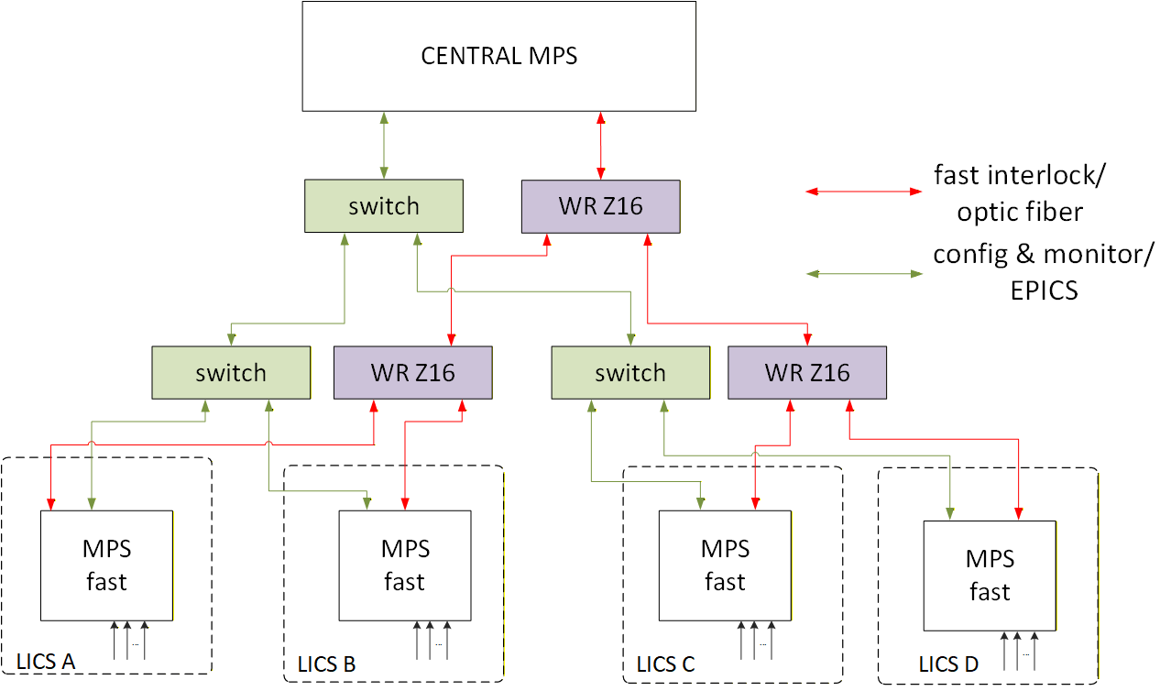
03 Safran Solution
WR-TTS: Machine protection System; performance
Ultra-fast response: Optical fibers enable near-light-speed signal transmission with nanosecond reaction times (~500ns per hop) (commas insertion on WR flow)
EMI immunity and galvanic isolation: Fiber optics are unaffected by electromagnetic interference and ensure complete electrical isolation between systems
Long-distance communication: Signals can travel hundreds of meters with minimal attenuation
Scalability and flexibility: Fiber systems can be easily expanded and reconfigured
ILK Detection
Pckt. Insertion in WR net
Flood WR Net
PACKET Detection
~200ns
~200ns
~520ns*N hops
Notes:
Well, the important thing, performance. The WR TTS used as machine protection system can achieve an ultra fast response around 500 nanoseconds per hop, taking into account the detection and the insertion time of the interlock. This is achieved using the WR comma characters inserted on the lower layer of the communication without disturbing the regular use of the WR network.

Slide 21
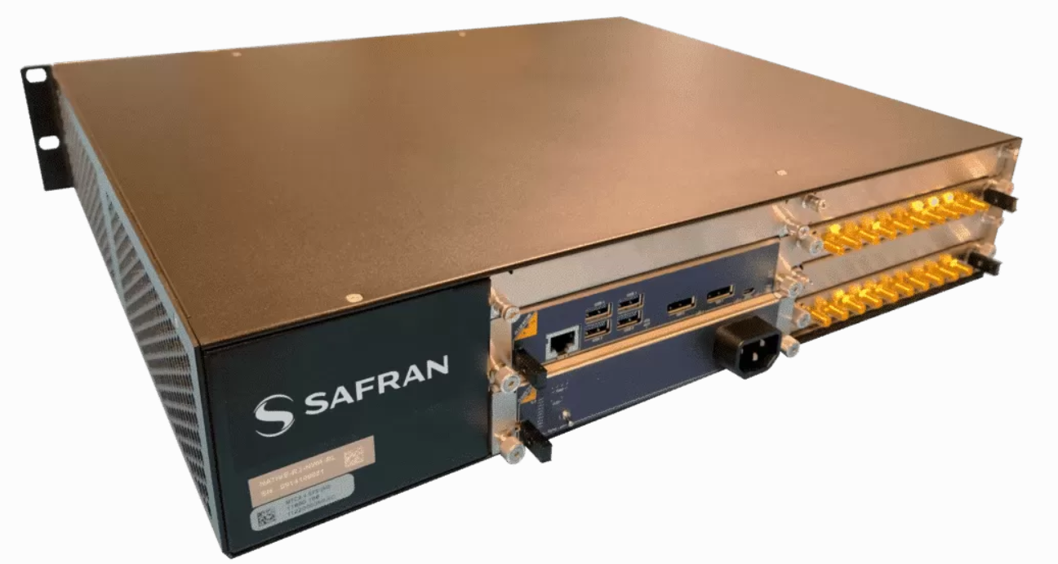
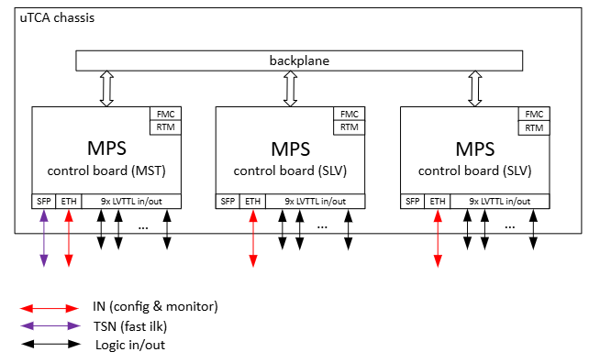
03 Safran Solution
WR-TTS: Machine protection System
Master-Slave Mode in uTCA Crate
Notes:
In order to simplify the WR communications, inside of a uTCA crate the MPS system can work in master slave mode communicating the 10MHz and pps signals to make WR work through the backplane of the crate.

Slide 22
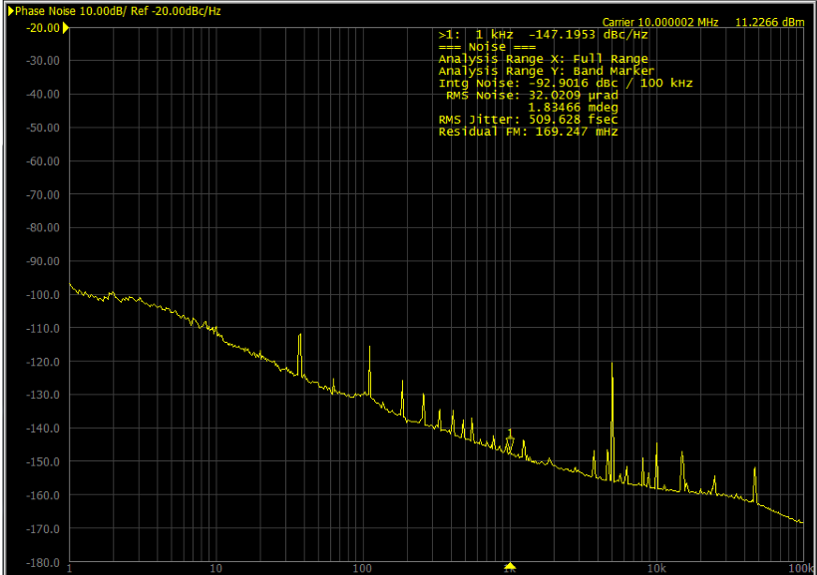
04 Tests & Results
WR-TTS: Jitter Measurements
~500 fs of RMS jitter measured at the 10MHz output
RMS jitter 10MHz output

Slide 23
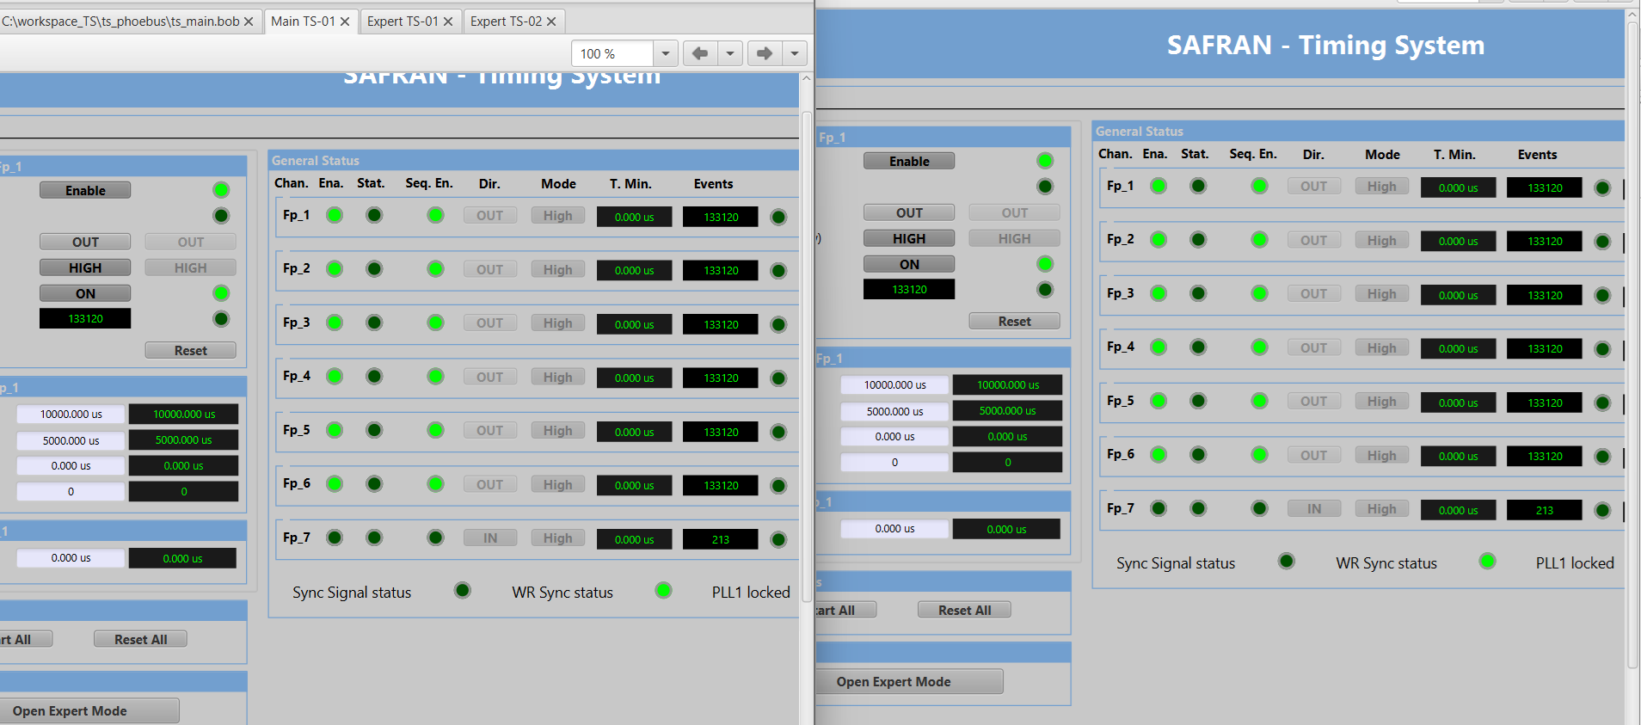
04 Tests & Results
WR-TS: Sequence of events generation
Long term test
Notes:
These are some tests to check the event losses in master/slave communications and we can see that after a long term test the master and slave are aligned in the number of events generated.

Slide 24
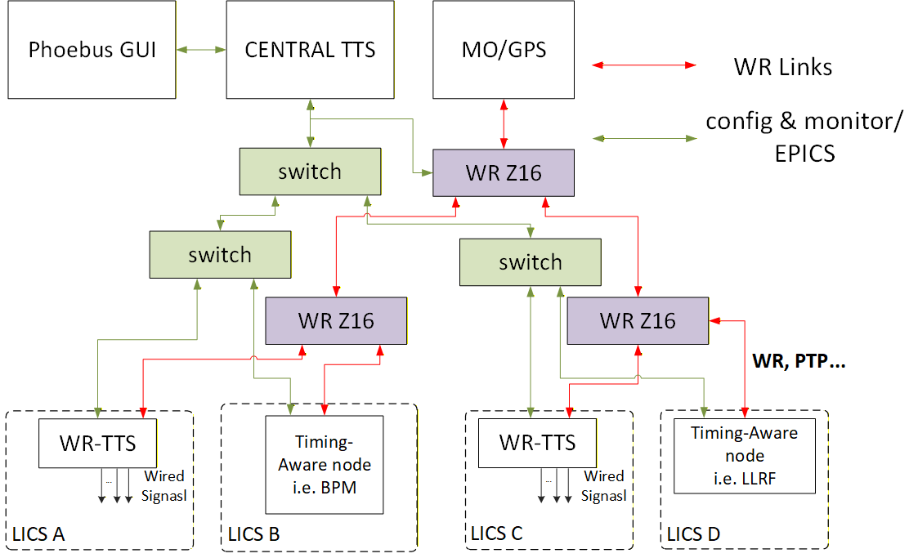
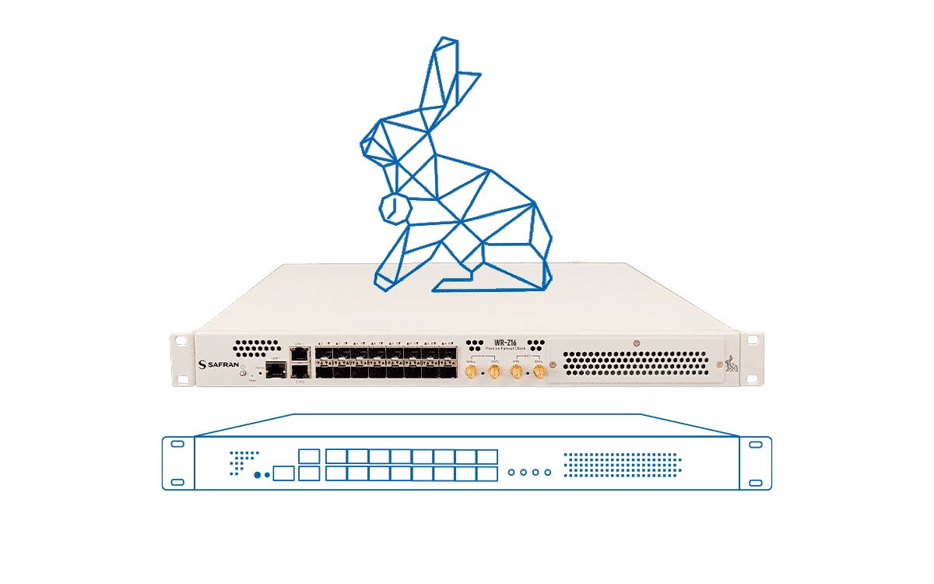

05 Next Steps
Work in Progress… Phoebus & EPICS-based Central Timing & Synchronization Entity
Auto-Discover Timing-aware nodes: Using EPICS discover tools to get the PVa nodes and their timing-related PVs and LLDP for WR nodes.
Visual Trigger Programming: Setup all the gates and triggers and check their shapes and organization in a chart before executing them.
Centralized Monitoring: Monitor the health of the WR-TTS and timing-aware nodes.
Alarms Management: Full TTS ecosystem integrated into the Phoebus Alarm System.
MPS Integration: Fast interlock in case of a timing issue to avoid damages.
Recommendations and advice are Welcome!
Feel free to stop by our booth in the exhibition hall!
Notes:
We are currently working on a software entity to centralize the control of al the WR TS and the timing-aware nodes. The idea is to have auto-discover of the nodes using their timing PVs and LLDP for the WR nodes. A visual interface to show how the programmed triggers will behave. Centralized monitoring of all the nodes, Alamar management, an its integration with the Machine protection system that is also quite important.

Slide 25
SCT / Safran Navigation & Timing

