Slide 1
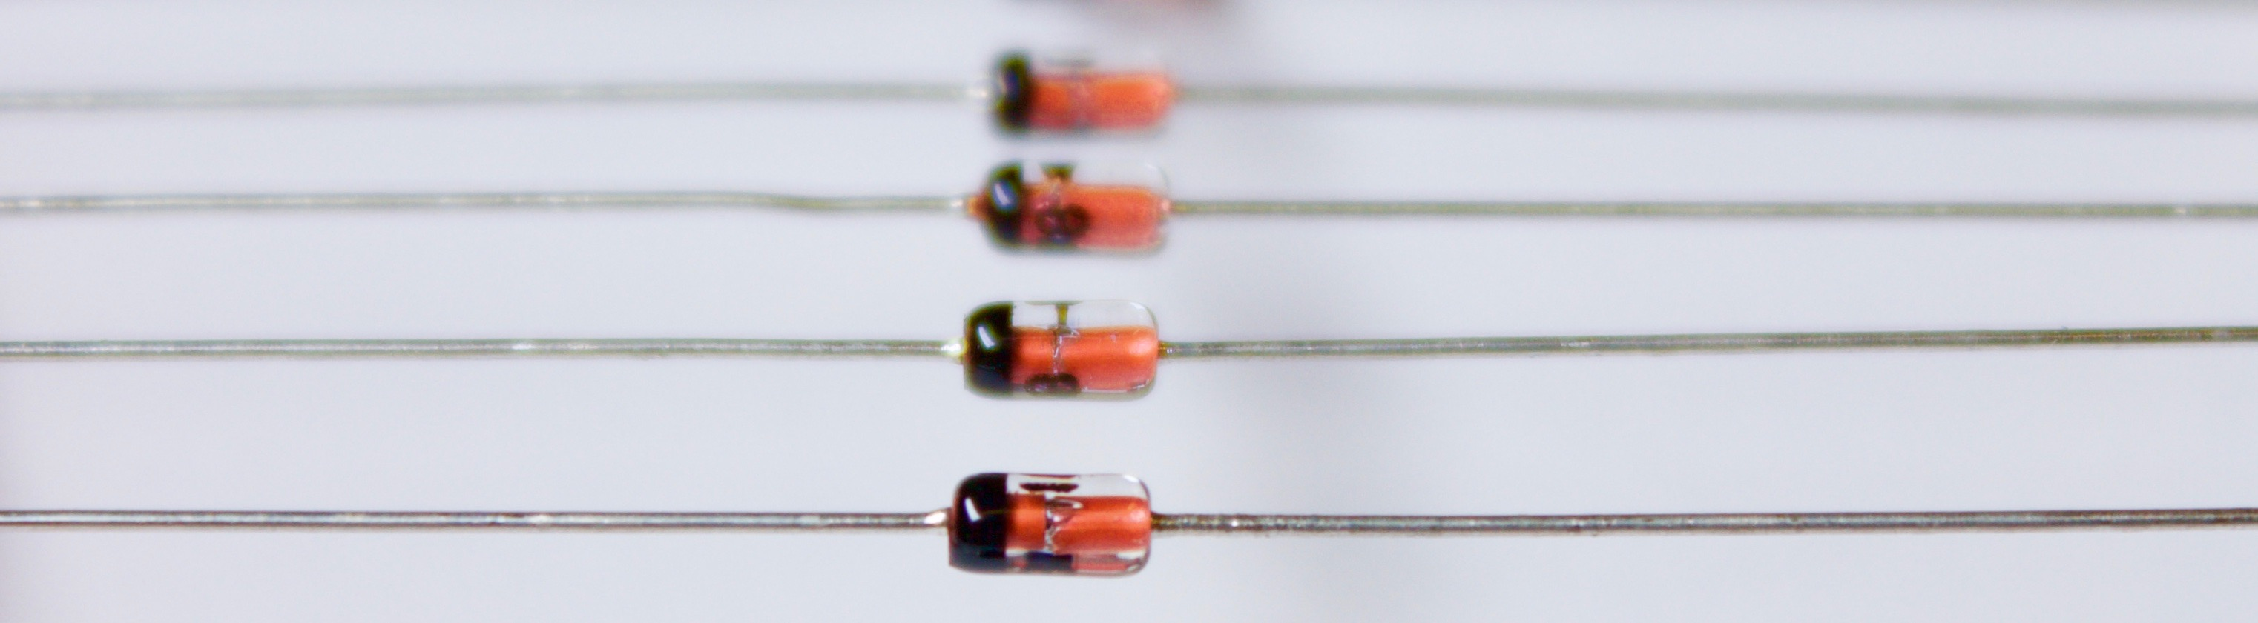
EPICS Diode
Gearing Up for Production Use
Denis Stepanov, ITER Organization
R.Lange (ITER), L.Lobes (ITER RF-DA), M.Rojo, M.Sekoranja (Cosylab)
EPICS Collaboration Meeting, 20-24 April 2026, ENS Paris-Saclay, France

Slide 2
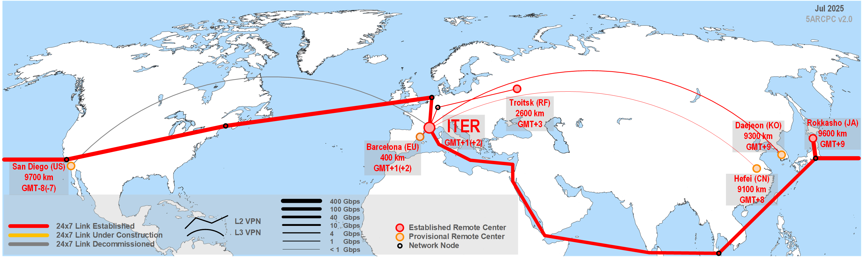
ITER Remote Centers – Serving EPICS Traffic Overseas
2020 - “Fusion for Energy” developed an HTTP-based “EPICS Data Diode” used in the framework of fusion’s “Broader Approach” IFMIF facility between Rokkasho and Barcelona
  G.Ferro “The EPICS Data Diode” // EPICS Collaboration Meeting Fall 2020
2022 - ITER tested EPICS CA usability over long distances (up to 10.000km) with Russia and USA using permanent VPN links
  L.Lobes “Study on EPICS Communication over Long Distance” // EPICS Collaboration Meeting Fall 2022
2024 - ITER released v1 of its UDP-based EPICS CA Diode
  R.Lange “EPICS Diode – One-Way Data for Secure Remote Participation” // EPICS Collaboration Meeting Fall 2024

Slide 3
ITER plant network (POZ)
ITER Experiment Remote Participation (RP) Scheme
Operator Terminal
CODAC Service
ITER remote center network
Data Terminal
CODAC Service / Data Replica
Data Terminal
RPC CODAC Service
“Proxy” Service for RP
VPN
Up to 10.000 km
ITER data network (XPOZ / SDCC)
(optional)
(optional)
Any Client
Public networks (Internet)
DMZ
Web Service
More info: Fusion Engineering and Design vol.211, 114787, 2025
https://doi.org/10.1016/j.fusengdes.2024.114787

Slide 4


ITER plant network (POZ)
… translating to the EPICS Eco-System
Operator Terminal
Plant IOCs
ITER remote center network
Data Terminal
Focus of this talk
EPICS Gateway
or
EPICS Diode
Data Terminal
VPN
Up to 10.000 km
ITER data network (XPOZ / SDCC)
Web Browser
Public networks (Internet)
DMZ
SSE
ITER Dashboard

Slide 5
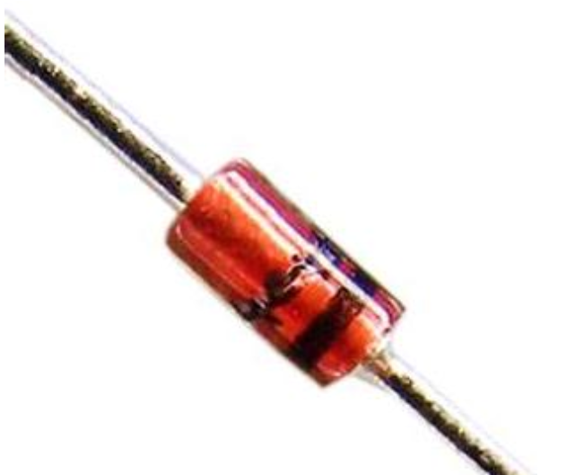
Recap on Requirements
Principal use case: animation of read-only operator terminals outside of the plant network.
One-way UDP
50.000 simple PVs per diode instance @ 10 Hz update
Support of CA (incl. arrays) and PVA (structures)
Propagation delay ≤ 100 ms
Detection of stale connection (dead sender)
No modification of source IOCs and servers
Can be turned on / off without impact on plant controls
High integrity coding for the sender (plant) side
No requirement on channel meta-data auto-configuration. Only value updates are transferred; DB (re-)configuration is considered as a maintenance action not in scope

Slide 6

Why UDP?
Perhaps, the simplest OSI transport layer protocol
High confidence that it could be supported by any [inexpensive] network diode; no vendor lock
Local setup – both the transmitter and the receiver are in the same rack – no latency issues crippling long distance UDP communication
Pre-qualified by ITER IT security for plant network outgoing traffic – no need to obtain separate permission
… having said that,
UDP has demonstrated its own shortcomings for this task, which could be alleviated with careful tuning
We are not against if someone contributes TCP transport, compatible with hardware diodes

Slide 7

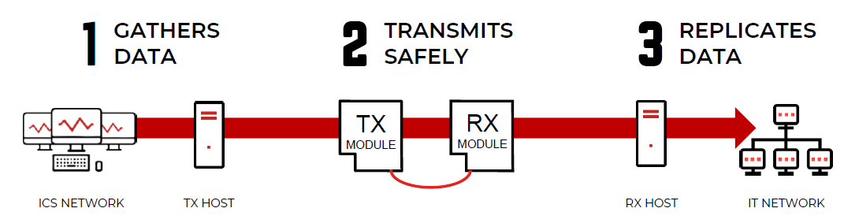
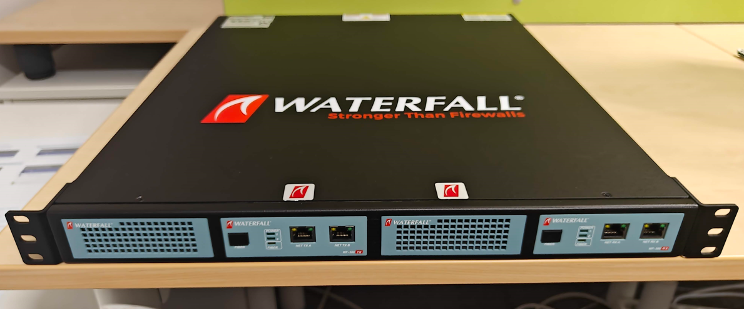
Requirements to a Hardware Diode
UDP support
≥ 200 Mbps throughput
Latency ≪ 100 ms
Nice to Have
Rack-mountable form-factor
Support for other protocols of interest for ITER (OPC UA, PostgreSQL, NFS, …)
ANSSI (French cybersecurity agency) certification
For this phase, Waterfall WF-500 diode^{(*)} has been selected
^{(*)} we are not promoting the company, just describing our setup
Waterfall WF-500. 1 Gbps UDP. Embedded hosts available as option

Slide 8
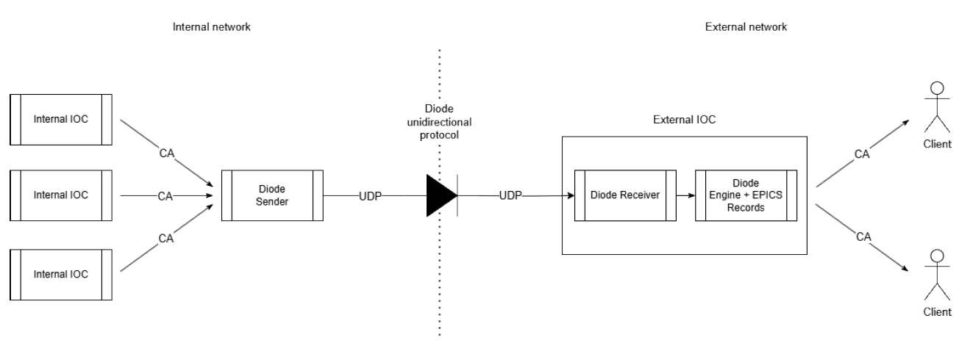
text
text
text
EPICS Diode v1 (2024)
CA support for any record type
Separate app on the sender end, “hollow IOC” on the receiver end
Heartbeat
Speed limits
UDP packet segmentation for large payloads
IOC shell integration
Tools to synchronize channel metadata
Functional demo with a hardware diode
RPM packaging
text

Slide 9
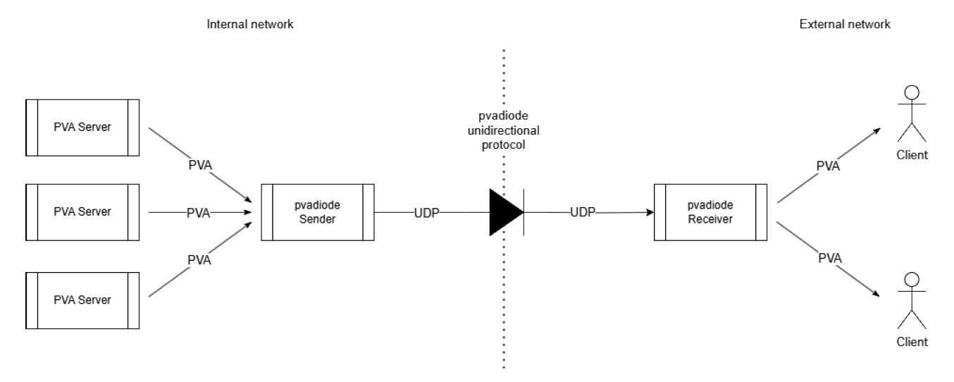
text
text
text
EPICS Diode v2 (2026)
PVA support for any type of structures
PVXS-based apps on both ends; no IOCs
Embedded structure definitions
Structure partial updates
Performance tuning
Stress and qualification tests
text

Slide 10
Deployment Options
Arrows represent data flow

Slide 11
Network Issues
2024 tests shown rather low performance – mostly linked to network – especially in combination with the hardware diode. The problems were traced to two causes:
Problems in the lab network resulting in packet losses
Permutations in the UDP packet order, seen by the diode software as “losses”
2025 mitigation measures:
Changes in the test stand to eliminate packet losses
Network interfaces tuning along the chain to achieve “laminar” UDP packet flow instead of “turbulent”
Changes in the diode software to tolerate adjacent packet permutations (most frequent case)

Slide 12
System and Network Tuning
Specific settings implemented in the systems to decrease disturbances:
significant increases in kernel network buffer sizes (at least 1 MB, up to 25 MB)
use of jumbo frames (MTU 9000)
“network-latency” TuneD profile
disabling “irqbalance” service
assigning specific threads to CPU cores and increasing thread priority
Most important: limit transmission rate on the sender to no more than a half of the network capacity. This places the hardware diode in a “laminar” mode with no UDP packet permutations. Empiric formula:
Recommended rate limit = Number of records * Record processing frequency * 64
For 50k records at 10 Hz this gives 32 MB/s == 256 Mbps, well below the 1 Gbps physical capacity.

Slide 13


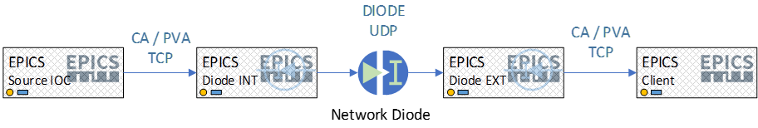
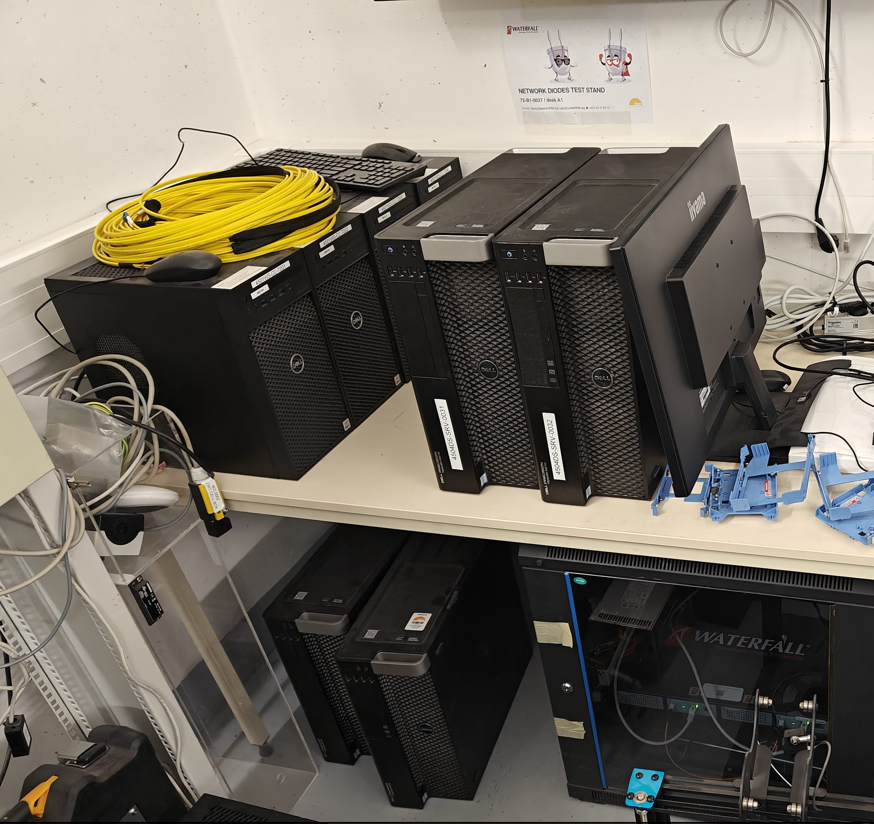
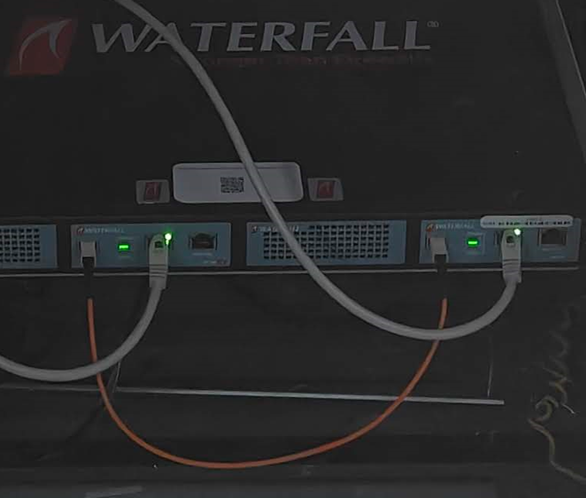
Hardware Diode Test Stand
Internal network (TX)
External network (RX)
Diode host INT
Diode host EXT
Uni-directional fiber connection
EPICS source host INT
2025 changes:
Changed EPICS machines from virtual to physical
Connected all machines to the same network switch
EPICS client host EXT
Hardware Diode

Slide 14
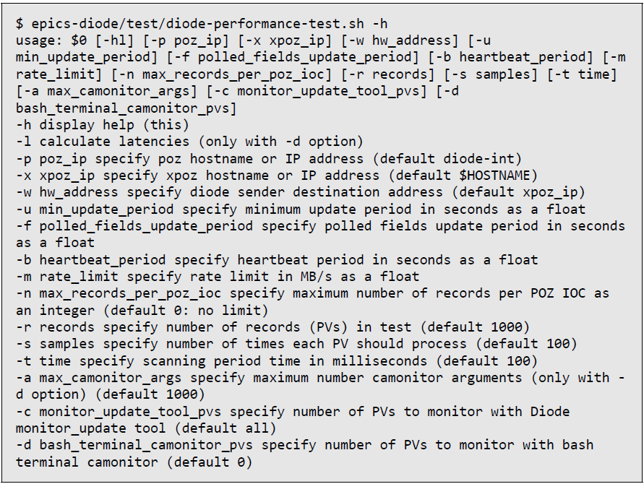
Specific Tooling for Performance & Stress Testing
We found the standard “camonitor” tool to be not optimal for this type of testing.
For long runs (like 24h) and large number of PVs its logging slows down the test and impacts its results.
So we made a tailored utility “monitor_updates” which produces much less output and is oriented towards tracking of traffic anomalies.

Slide 15
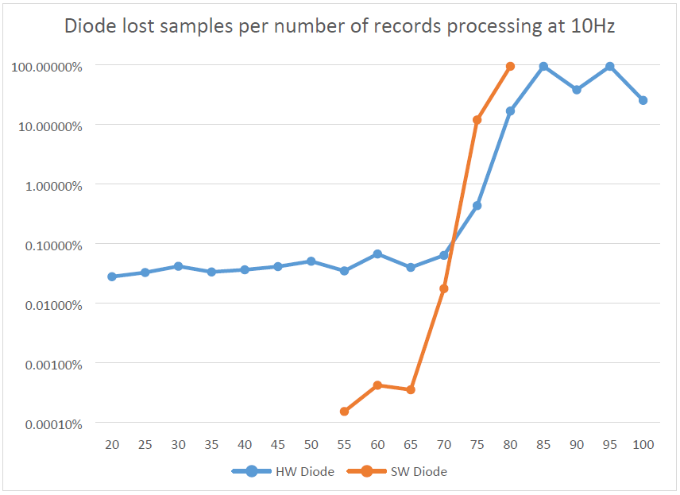
Sample Losses Study
If we limit the sender rate to 32 MB/s:
With the software diode with 50k PVs very few losses were observed in 24h tests. Transfer rate success ≥ 99.999%
With the hardware diode, when lowering the number of PVs to 40k we managed to obtain strictly zero losses in 24h tests ➔ qualified configuration
Each point is a 1h test
x 1.000 PV
(Unlimited sender rate)

Slide 16
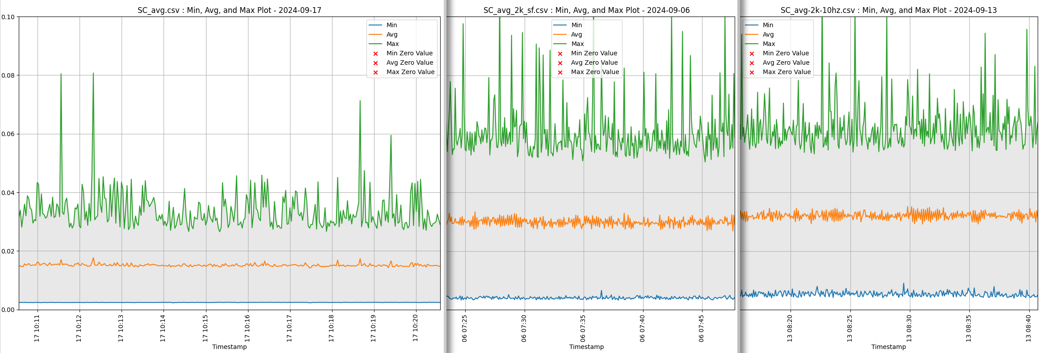
Latency Test: 2.000 PV at 10 Hz CA
Time (s)
Reference (direct): 15 ms
Software diode: 30 ms
Hardware diode: 32 ms
For 4.000 PVs 30 ms become 42 ms. For 10.000 PVs still remains largely within 100 ms
Could be further improved by increasing buffer flush frequency in the diode or with partitioning

Slide 17
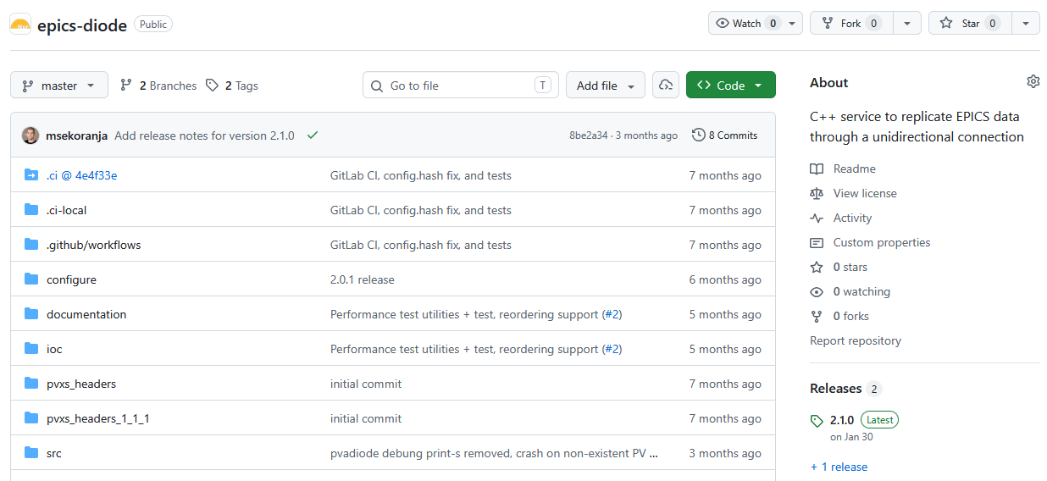


Going Open Source
Software has nearly no ITER specifics and is believed to benefit from public review / contributions
Went through a “publication” procedure to publish the software as open source
Since 2025 available on GitHub, along with extensive documentation: https://github.com/iterorganization/epics-diode
The latest version is 2.1.0, issued in January 2026

Slide 18
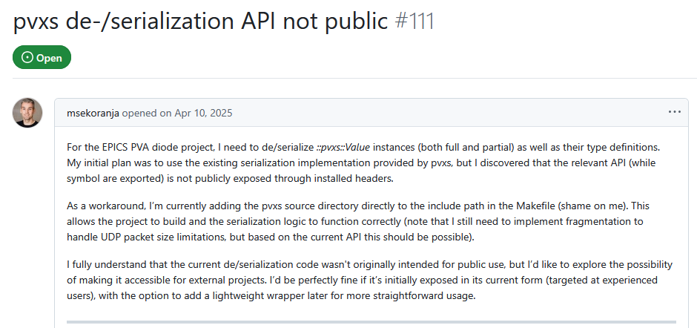
PVXS Dependency
We re-used PVXS (de)serialization functions which are not part of PVXS public API. This results in somewhat ugly build procedure with copying files from PVXS source. There was a discussion on making these calls available as a part of “expert API” one day.
https://github.com/epics-base/pvxs/issues/111

Slide 19
Status and Conclusions
Development for the original scope completed
Stress and qualification tests against the original set of requirements completed
Operation over hardware diode confirmed
Open-source publication done
The intention is to put it in production environment (plant network), divert part of the traffic for non-critical use and collect feedback from the field
Credits
ITER – coordination, design, EPICS expertise
Cosylab – EPICS expertise, detailed design, development, verification & qualification testing
Project Center ITER (RF-DA) – feasibility studies, test stand, validation testing
Thank you!

Slide 20
BACKUP SLIDES

Slide 21
IOC Databases
Inside (no modification of existing records):
record(calc, "MSC:T-0") {
field(CALC, "B?0:val+1")
field(SCAN, "0")
field(FLNK, "MSC:T-1")
field(INPB, "MSC:RESET")
}
record(calc, "MSC:T-1") {
field(CALC, "B?0:val+1")
field(SCAN, "Passive")
field(FLNK, "MSC:T-2")
field(INPB, "MSC:RESET")
}
...
Outside (optional markup of records with a non-standard sequence number):
record(calc, "MSC:T-0") {
field(CALC, "B?0:val+1")
field(SCAN, "0")
field(FLNK, "MSC:T-1")
field(INPB, "MSC:RESET")
}
record(calc, "MSC:T-1") {
info(diode_cix, "1")
field(CALC, "B?0:val+1")
field(SCAN, "Passive")
field(FLNK, "MSC:T-2")
field(INPB, "MSC:RESET")
}
...
A diode_dbgen tool could be used to query the IOC on the inside and produce a DB file for the IOC on the outside. The info field “diode_cix” is only required if the name of the PV on the outside is different from the one inside / in the config.

Slide 22
Configuration and Startup
Both sender and receiver are configured using the same JSON file.
{
// Minimum sender update period in seconds. (min = 0.025)
"min_update_period": 0.025,
// Polled fields update period in seconds. (min = 3.0)
"polled_fields_update_period": 5.0,
// Heartbeat period in seconds. (min = 0.1)
"heartbeat_period": 15.0,
// Maximum sender sent rate in MB/s, 0 for no limit.
"rate_limit_mbs": 64,
// Array of channels to export (order matters!).
"channel_names": {
"MSC:T-0":{},
"MSC:T-1":{},
...
}
}
IOC shell integration (receiver):
# Configure records read-only
asSetFilename("$(DIODE_ROOT)/cfg/readOnly.acf")
# Load DBD
dbLoadDatabase("$(DIODE_ROOT)/dbd/testDiode.dbd")
testDiode_registerRecordDeviceDriver(pdbbase)
# Trace = 0, Debug = 1, Config = 2, Info = 3 (default),
# Warning = 4, Error = 5
diodeLogLevel(3)
# Load DB
dbLoadRecords("$(DIODE_ROOT)/db/db_test_2000.db")
# Start the receiver thread with the listening port & IP
diodeReceiverStart("$(DIODE_ROOT)/cfg/diode.json", 5080, "10.130.1.102")
# Start the IOC
diodeIocInit()

Slide 23
Hardware Specs
EPICS INT Host:
Intel(R) Xeon(R) CPU E5-1650 v4 @ 3.60GHz
6 physical CPU cores, 12 virtual
32 GB (8+8+8+8) RIMM DDR4 4xHMA81GR7AFR8N-UH
Ethernet Connection I217-LM 1Gb/s
HW Diode TX Host:
Intel(R) Xeon(R) CPU E5-1650 v4 @ 3.60GHz
6 physical CPU cores, 12 virtual
32 GB (8+8+8+8) RIMM DDR4 4xHMA81GR7AFR8N-UH
Ethernet Connection I217-LM 1Gb/s (Network interface)
I350 Gigabit Network Connection 1Gb/s (HW Diode interface)
EPICS EXT Host:
Intel(R) Core(TM) i7-6700 CPU @ 3.40GHz
4 physical CPU cores, 8 virtual
16GB (8+8) DIMM DDR4 2xHMA81GU6AFR8N-UH
Ethernet Connection (2) I219-LM 1Gb/s
HW Diode RX Host:
Intel(R) Xeon(R) CPU E5-1650 v3 @ 3.50GHz
6 physical CPU cores, 12 virtual
16GB (8+8) DIMM DDR4 2xHMA81GU6AFR8N-UH
Ethernet Connection I217-LM 1Gb/s (Network interface)
I350 Gigabit Network Connection 1Gb/s (HW Diode interface)
This hardware are powerful but old re-purposed systems just for the lab testing. The production level hardware will be purpose-built rack-mountable systems.

