Slide 1
RTEMS 6 Migration and Driver Development for Motorola VME Boards
Ran Hong*, Andrew Johnson, Brendan chandler
Advanced Photon Source
Argonne National Laboratory
9700 S Cass Ave, Lemont, IL 60439
Apr 20th, 2026

Slide 2
Outline
Backgrounds about the migration from VxWorks to RTEMS at APS
Overview of RTEMS and the application development workflow
RTEMS migration goals and milestones at APS
RTEMS and libBSD development at APS
EPICS-base development for RTEMS
IOC prototypes and benchmark tests
On-going efforts and near-future plans

Slide 3
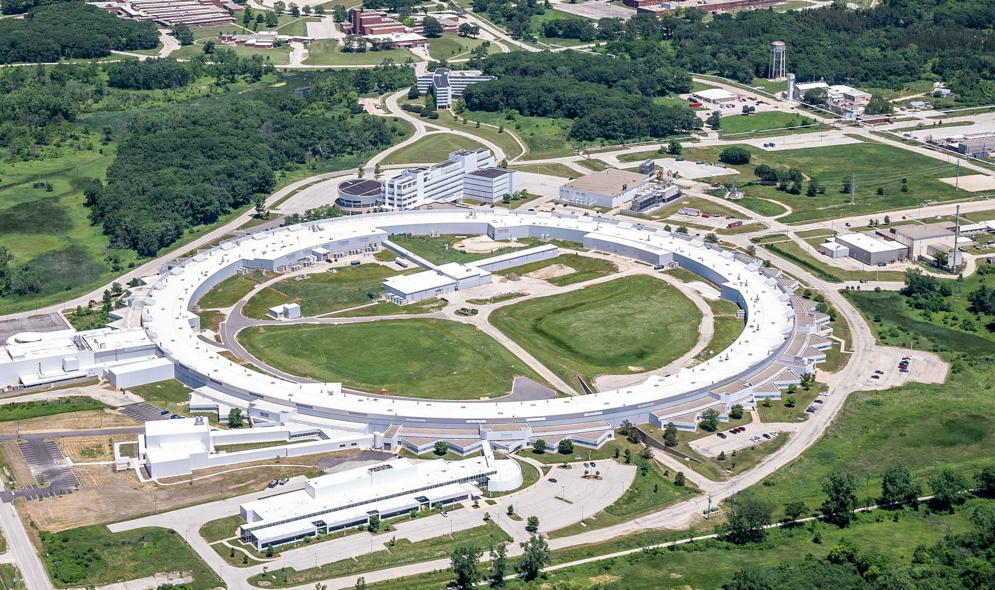
Backgrounds
More than 100 VME-based IOCs running on VxWorks at APS, in both the SR and the injector complex. Many more on beamlines.
Motivations for switching to RTEMS
Real-Time Executive for Multiprocessor Systems (RTEMS)
High-performance real-time operating system
Designed for deterministic embedded applications
Open source: transparent, configurable, no licensing costs and vendor lock-in
POSIX API support: easier porting code from unix-like systems.
Proven reliable in past space missions (Orion, Mars rovers, etc.)
EPICS Supports for RTEMS
EPICS IOCs widely implemented with RTEMS4 and 5
Modernization: upgrade to RTEMS6 or 7
Modern network stack and protocols: NFSv4, TLS 1.3 , etc.
Modern toolchain: GCC 10+ and LLVM
Security: audit-ready and pre-qualified
APS-U Storage Ring
Linac
Booster
PAR
Board | Quantity Storage ring and injector complex only
MVME3100 | 60
MVME2500 | 25
MVME5100 | 14
MVME2100 | 11
MVME6100 | 1
MVME2700 | 1

Slide 4
RTEMS and application development workflow
Application Development Workflow (Project repository: gitlab.rtems.org)
Build tool suite (cross-compilers and etc.) using RTEMS Source Builder (RSB)
Build RTEMS BSPs
Configure and build RTEMS BSP
Build Packages needed by the application
libBSD: libraries for FreeBSD (open-source Unix-like OS derived from Berkeley Software Distribution)
Network stack and device drivers
Network services: NTP, etc.
Build Application
Build the application code: RTEMS initialization function, main function, shell, etc.
Deploy Application
Deploy compiled application binary file to the target device via tftp, pre-loaded image file, etc.
Targets with qoriq_e500 BSP also needs a compiled device tree blob (dtb) file to boot
Build Tool suite
Build BSP
Build Packages
Build Application
Deploy

Slide 5
EPICS on RTEMS
Legacy RTEMS releases
EPICS 3.14 and 3.15 support RTEMS4.10
EPICS 7.0 supports RTEMS 5
Current RTEMS releases
EPICS 7.0.9+ supports RTEMS 6.x (current stable standard)
Issues with current RTEMS 6 and libBSD releases
Lacks BSPs (e.g. mvme5100)
Lacks drivers for certain BSPs (e.g. network driver for mvme3100)
Issues with current EPICS release
Boot configuration is not standardized
Static IP is not supported when using libBSD networking
Performance issues: slow in establishing channel access link.
RTEMS Development branch
RTEMS 7 (main branch of the rtems repository)
Next release: EPICS 7.0.11 (7.0 branch of the epics-base repository)
Repositories at APS are forked from the official repositories (upstream)
RTEMS Tools
RTEMS BSP
libBSD
Packages…
EPICS Base
Support Modules
IOC
RTEMS Application
Deploy to Hardware

Slide 6
Milestones and Goals for APS
RTEMS tool suite and
BSPs
Packages
libBSD
Netservice
…
EPICS Modules
IOC for test and evaluation
IOC Roll-out
EPICS Base
For each IOC with BSPs
For each BSP
For each BSP
For each BSP
For each BSP
mvme3100
mvme3100
mvme3100
mvme3100
mvme3100
mvme3100
mvme2500
mvme2500
mvme2500
mvme2500
mvme2500
mvme2500
mvme6100
mvme6100
mvme6100
mvme6100
mvme6100
mvme6100
mvme2100
mvme2100
mvme2100
mvme2100
mvme2100
mvme2100
mvme2700
mvme2700
mvme2700
mvme2700
mvme2700
mvme2700
mvme5100
mvme5100
mvme5100
mvme5100
mvme5100
mvme5100
0%
25%
50%
75%
100%

Slide 7
RTEMS and libBSD Developments
mvme3100
qoriq_e500 (mvme2500)
New Development
New Development
tsec network interface driver for libBSD
Modified the tsec driver for qoriq
Add tsec driver to the device tree
RTEMS 6.1 and 7
libBSD: 6-freebsd 12, 6-freebsd-14 and 7-freebsd-14
Network latency evaluated
Not yet merged to upstream
U-boot environment interface
API for uboot environment is added, same as that for gen5200 BSP.
RTEMS configure option added
Still under development
Issues
6-freebsd-12: nfsv4 bugs (deprecated)
6-freebsd-14: name conflicts (does not build)
7-freebsd-14:
Link errors: Fixed upstream
Missing macros in mpc85xx : Fixed upstream
One device method ofw_pcib.c is not supported in RTEMS: Fixed at APS
Issues
I2C driver loading issue:
Still under optimization

Slide 8
EPICS-base Development
BSP Independent
BSP Dependent
Update the RTEMS init function so that static IP can be used
Obtain configurations (network, NFS mount, etc) from environment
Keeping it compatible with legacy network stack
Fixed the issue of slow establishing CA link
Non-volatile memory access
Revising the function setBootConfigFromNVRAM.c
Add supports to boards with u-Boot
Revising and standardizing environment variable names
VME support for qoriq in libBSD
Tsi148 option should be turned on when compiling libbsd
Added Till Straumann’s VME driver functions to devLibVMEOSD.c in epics-base.

Slide 9
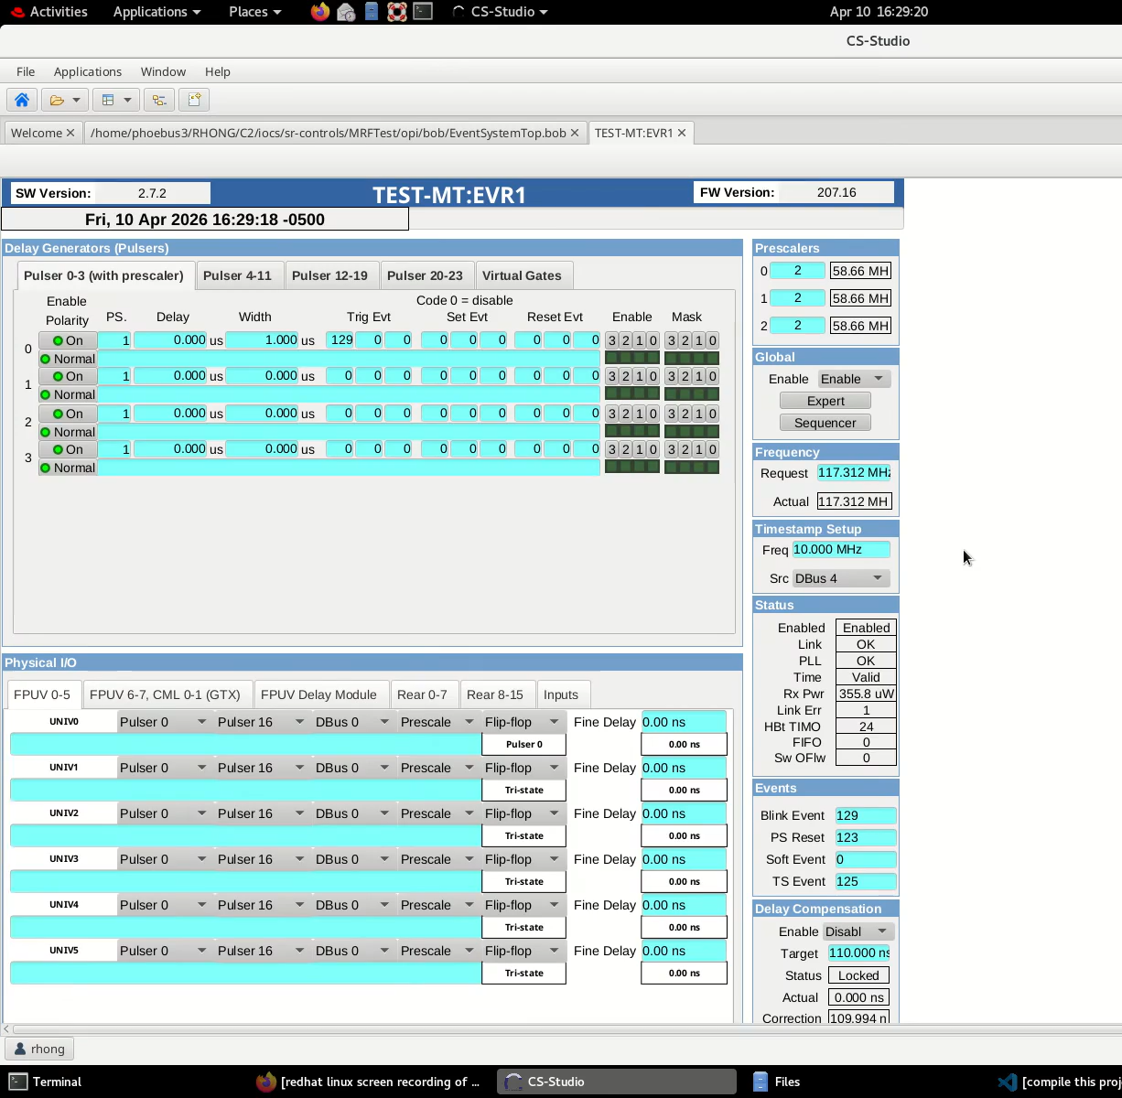
EPICS-base Development
Slow establishing CA links
Symptom: long channel access establishing time, long loading time when opening or refreshing a screen, etc.
Cause: long executing time of malloc_info call when found the requested PV
Before replying whether or not to establish a CA link, check if there is enough memory
Function malloc_info scans the entire memory to obtain the statistics, which is slow
Fix: replace malloc_info with malloc_free_space
Not yet merged into the repository.

Slide 10
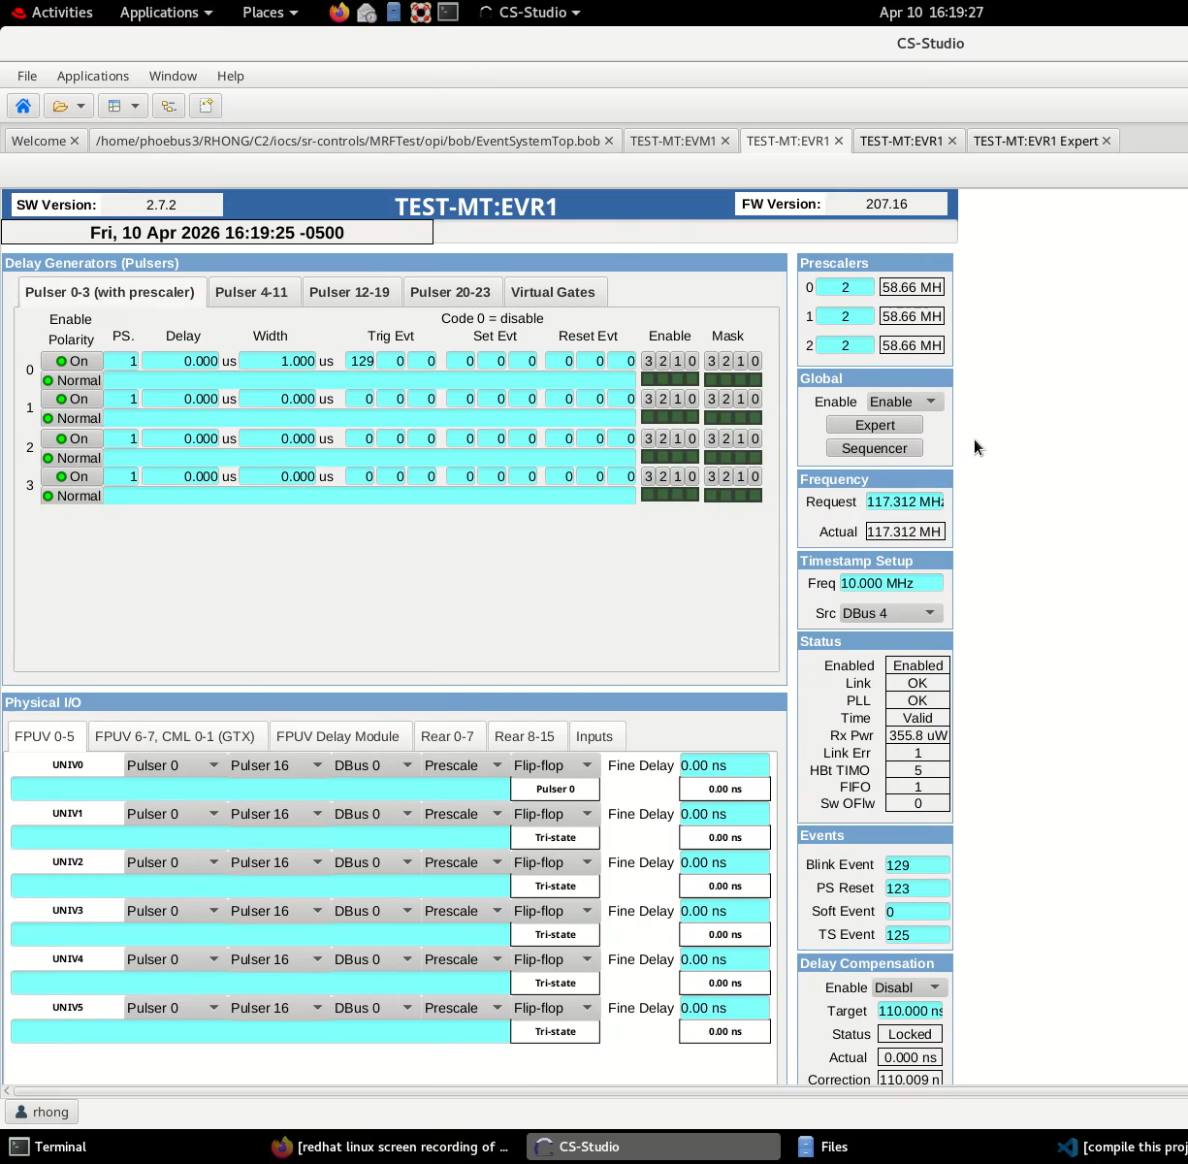
EPICS-base Development

Slide 11
EPICS Modules Developments
EPICS Modules Github | Gitlab at APS Only
devlib2* | a16vme
iocStats* | iocstd*
mrfioc2* | acromag-9440
asyn | aps-mrf
busy | aps-fct
sequencer | gtr
autosave | pulserecord
calc | …
ipac
sscan
stream
…
Compiled and Tested
Compiled Successful
Test in progress
Under development
* Module includes OS-dependent code that needs midofying for RTEMS
Need “USR_CFLAGS += -std=c99” in CONFIG_SITE to compile many modules

Slide 12
Performance Benchmark: Network Latency
Office/Lab network
Switch
Switch
Linux Host
mvme2500
mvme3100
…
tcp client
tcp server
tcp server
udp client
udp server
udp server
tcp/udp servers: running on mvme2500 and mvme3100 boards, echoing messages
tcp/udp clients: sending messages to a server and measure the response time

Slide 13
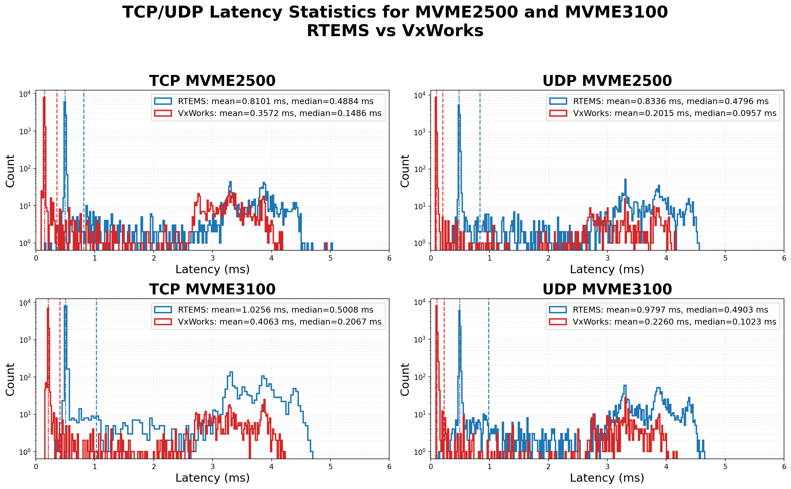
Performance Benchmark: Network Latency
Same Switch

Slide 14
Performance Benchmark: Float Point Calculation
Addition (1,000,000 floats)
Addition (1,000,000 doubles)
BSP | mvme3100 | mvme2500
VxWorks: soft float | 103 ms | 153 ms
VxWorks: hard float | - | 5 ms
RTEMS: soft float | 179 ms | 148 ms
BSP | mvme3100 | mvme2500
VxWorks: soft float | 123 ms | 267 ms
VxWorks: hard float | - | 7 ms
RTEMS: soft float | 234 ms | 201 ms
Multiplication (1,000,000 floats)
Multiplication (1,000,000 doubles)
BSP | mvme3100 | mvme2500
VxWorks: soft float | 86 ms | 178 ms
VxWorks: hard float | - | 5 ms
RTEMS: soft float | 197 ms | 164 ms
BSP | mvme3100 | mvme2500
VxWorks: soft float | 117 ms | 300 ms
VxWorks: hard float | - | 8 ms
RTEMS: soft float | 310 ms | 253 ms

Slide 15
RTEMS IOC Prototype in a Test Stand
Software modules
RTEMS 7 (main branch)
libBSD (7-freebsd-14 branch)
Local: mvme3100 tsec driver, u-boot supports
epics-base (7.0 branch)
Local: malloc_info fix, rtems_init, VME for qoriq, …
devLib2 (v2.13, locally modified)
mrfioc2 (v2.7.2 , locally modified)
acromag-9440 (v1.5, APS Only)
iocStat (v4.0.0 , locally modified)
iocstd (v4.5.0, APS Only, modified)
Function and stability tests
Tested all timing functions of MRF components
Tested event-based time stamps
Long-term stability: >1.5 weeks
MRF EVR 300
AVME 9440
VME CPU
VTM 200
MRF EVM 300
MRF EVM 300
MRF EVR 300
MRF EVR 300
MRF EVR 300
MRF EVR 300
MRF EVR 300
CPU: mvme3100 or mvme2500
VTM 200: console interface module
MRF Timing modules
Event Masters x2
Generating events
Event Receivers x6
Pulse output upon events
Event-based time stamps
VME interrupts upon events
…
AVME 9440: digital IO

Slide 16
On-going efforts and near-future plans
Merge recent development to the upstream repositories
Compile and test more device support modules with EPICS7 and RTEMS for mvme3100 and mvme2500
Test IOCs deployed to production environment in non-critical IOCs
Standardize the development and deployment of RTEMS IOCs at APS
Development plans for other CPUs
Mvme2100, 2700 and 6100: test existing BSPs and libBSD, and then EPICS and support modules
Mvme5100: develop BSP from scratch
Exploring the dynamic loading
Updating the EPICS RTEMS Initialization
Working towards a new rtems_init function and boot configuration standard
Working group formed with EPICS + RTEMS developers across several sites
Starting regular meetings (currently at 21:00 UTC so our Australian expert can attend)
Contact Andrew Johnson for details

Slide 17
Summary
RTEMS migration is on-going at APS
Building RTEMS and EPICS for varieties of VME CPUs (mvme3100, mvme2500, etc)
Added drivers and fixed bugs
Benchmarking performances
Testing IOC functions and stabilities
Plans to support more VME boards and new RTEMS features

Slide 18
Acknowledgements
We thank Chris Johns, Heinz Junkes, Vijay Banerjee, Jeremy Lorelli, Mick Stepp for help in development and trouble-shooting.
This work is supported by the U.S. Department of Energy, Office of Science, Office of Basic Energy Sciences, under Contract No. DE-AC02-06CH11357.

Slide 19
Back-up slides

Slide 20
RTEMS and libBSD Developments
Three-Speed Ethernet Controller (tsec) driver development for libbsd:
Network interface tsec is not added to the Nexus bus (the root device) for mvme3100
Added tsec configurations to nexus device header (Thanks to Jeremy Lorelli!)
Modified the tsec driver config struct to add multiple tsec interfaces (Thanks to Jeremy Lorelli!)
Fix the tsec driver source code (developed at APS)
Obtain the correct base and physical addresses from the driver configuration struct
Implemented the interrupt service routines and call back functions for Tx/Rx/Error Compatible with mvme3100 bsp.
The existing tsec driver is tuned to the QorIQ BSP, which handles the interrupts differently
The fix is under extensive tests.

Slide 21
Performance Benchmark: Network Latency
Office/Lab network
Switch
Switch
Linux Host
mvme2500
mvme3100
mvme2500
tcp client
tcp server
tcp server
tcp server
udp client
udp server
udp server
udp server
tcp/udp servers: running on mvme2500 and mvme3100 boards, echoing messages
tcp/udp clients: sending messages to a server and measure the response time

Slide 22
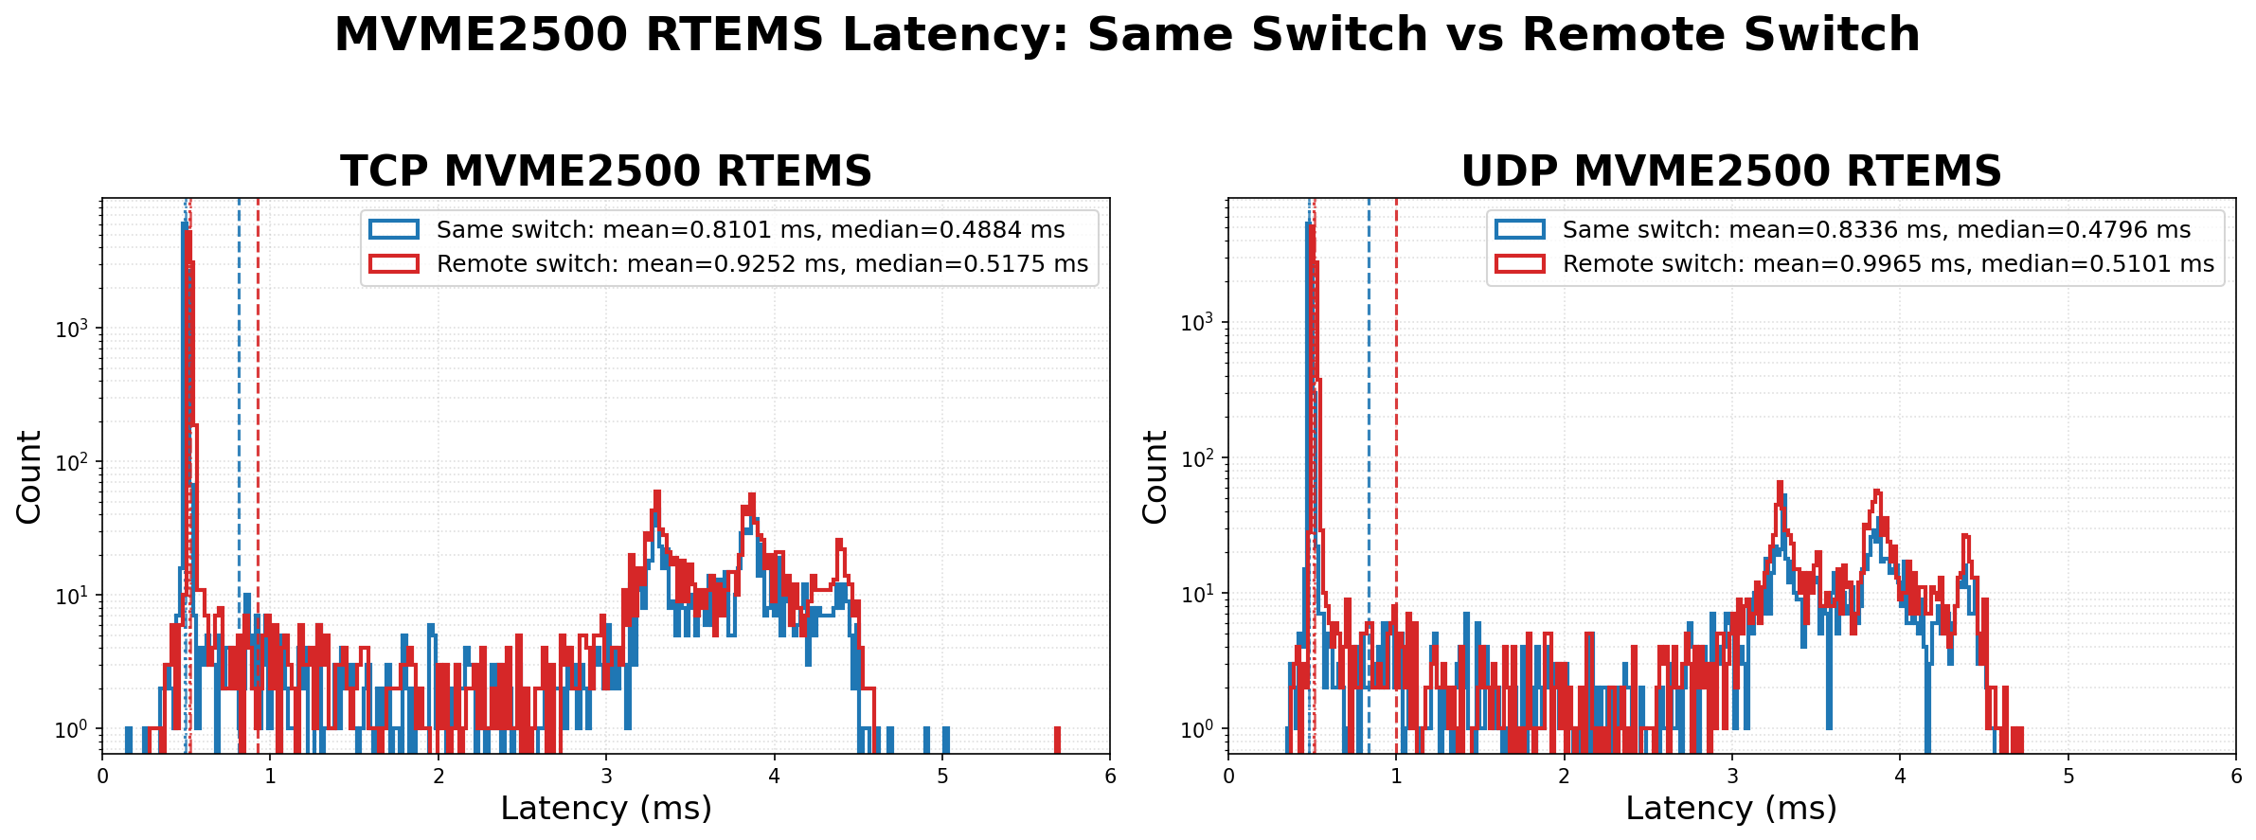
Performance Benchmark: Network Latency

Slide 23
Channel Access Latency Benchmark
Office/Lab network
Switch
Linux Host
mvme2500
mvme3100
caget client
EPICS IOC
EPICS IOC
caput client
EPICS IOC: running test IOC with soft AO and AI records
Client: python scripts executing caget and caput and measure the response time

Slide 24
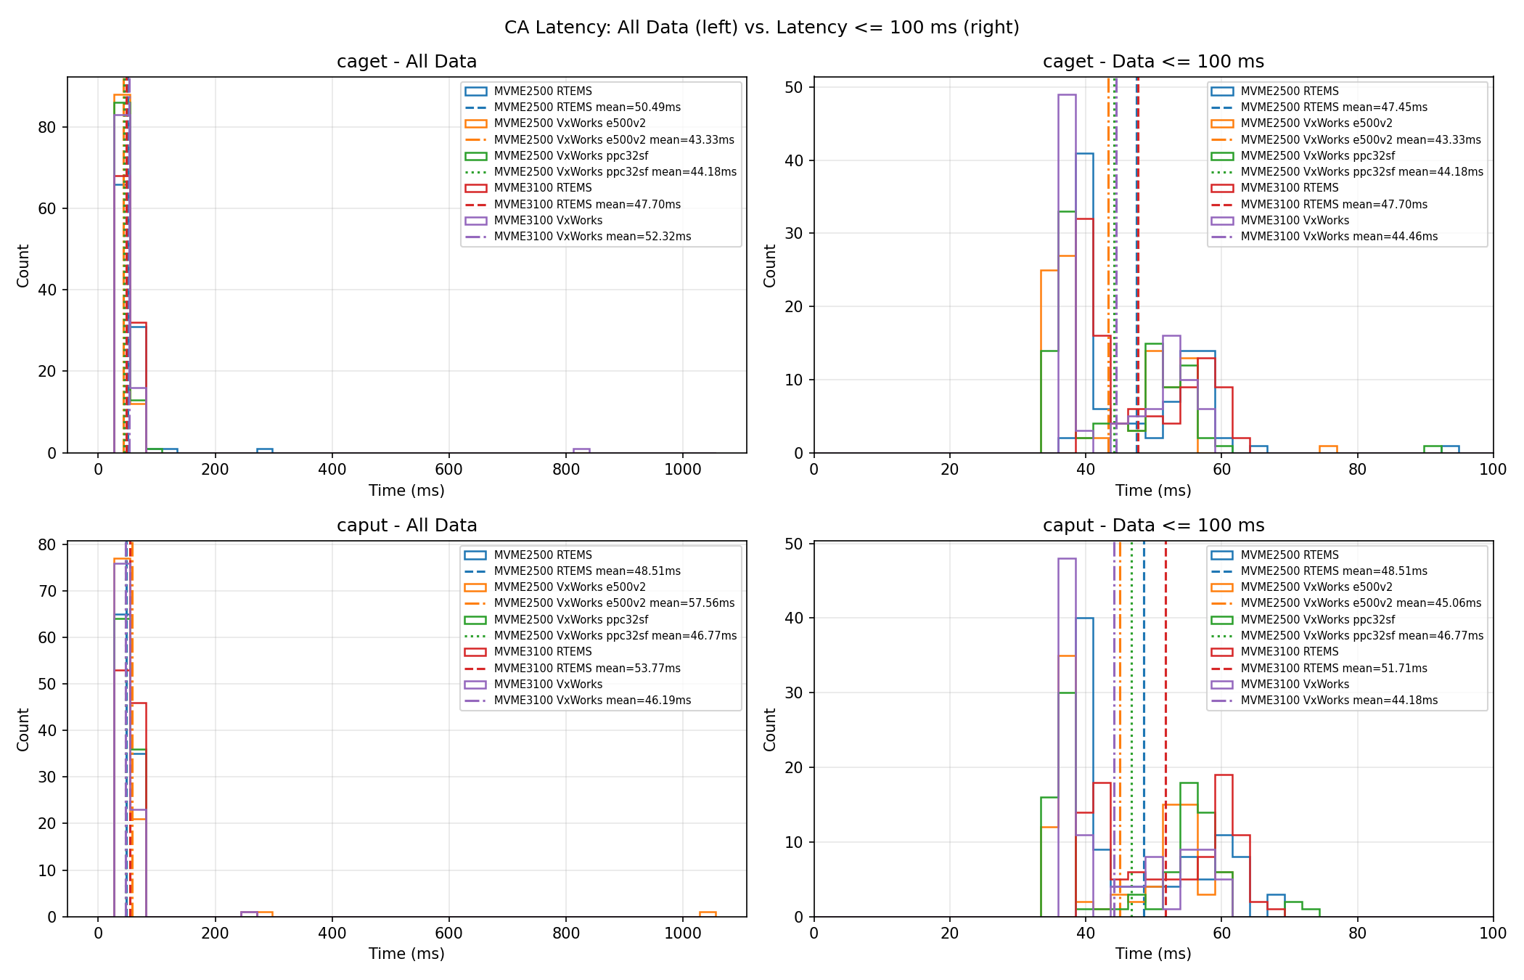
Performance Benchmark: Channel Access Latency

