Slide 2
Archiver Version 2.3.1+
Parquet support and more
PRESENTED BY SKY BREWER

Slide 3
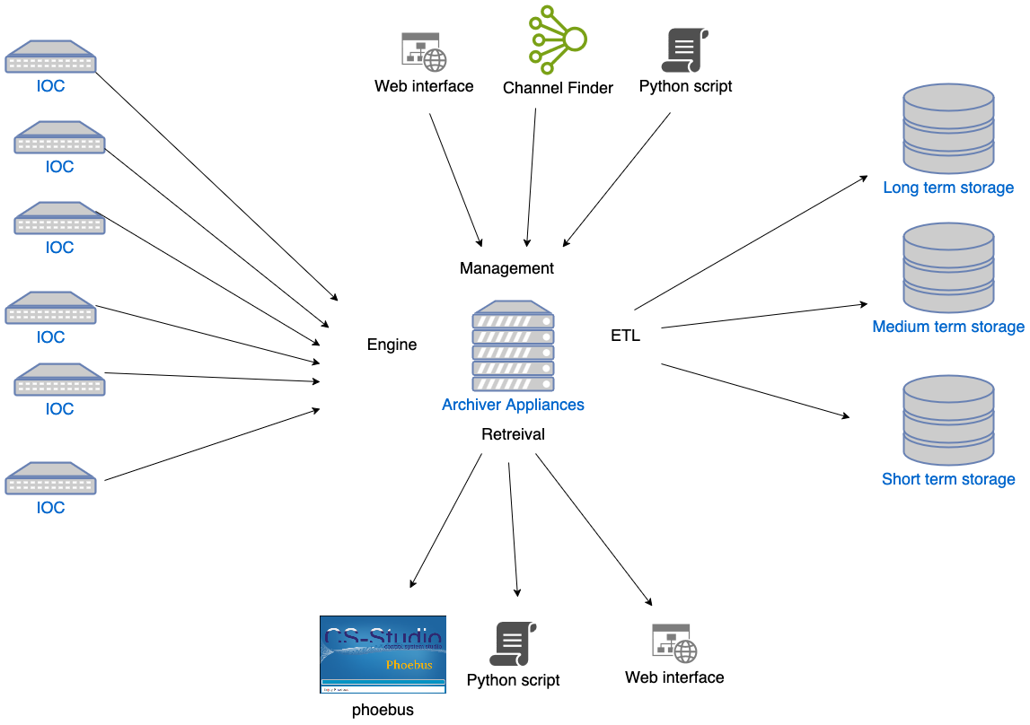
Archiver Appliance
Tool for archiving millions of PVs

Slide 4
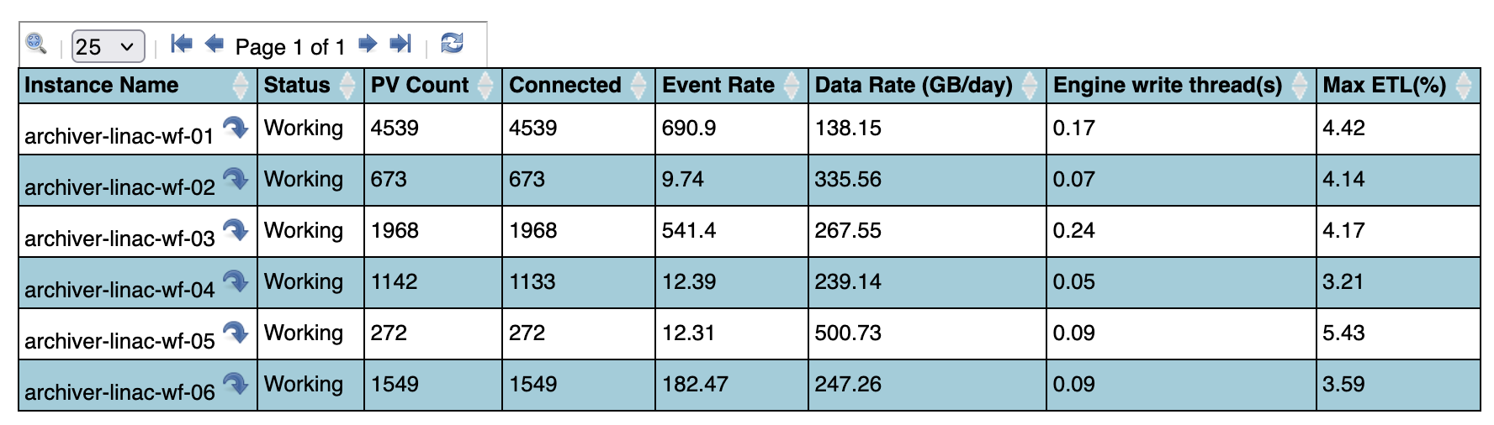
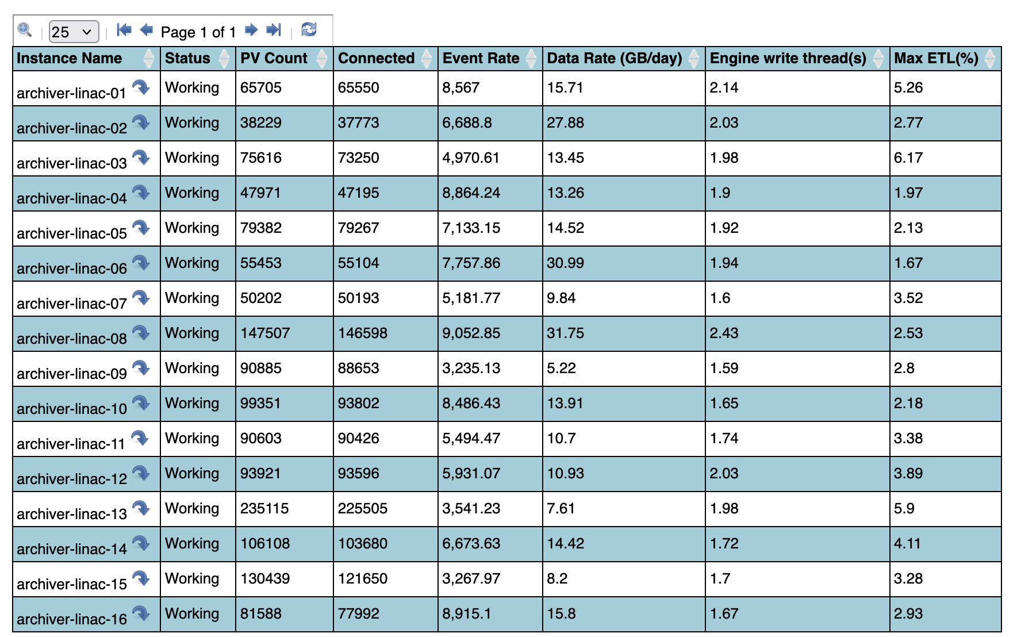
ESS Example

Slide 5
Recent New Features

Slide 6
New Features
Parquet (2.3.0)
Open source, column-oriented file format for efficient data storage and retrieval. Supported by many languages and analytics tools.
Columnar
Data is stored in columns instead of rows,
i.e. a list of timestamps, a list of value, with the same index
Data Storage
Supports multiple encoding options
- Dictionary
- Run length encoding
- Delta encoding
Supports multiple compression algorithms
- zstd
- lzo
- snappy
Retrieval
Push down predicate filtering
i.e. you can ask for all entries with x < 5 and it won’t read the whole file

Slide 7
New Features
Parquet Conversion results
Lab cryo double PV
66% smaller
1.1 GB → 372 MB
zstd level 3
Converted via API, 7 files in 2 min
Test array data file
96% smaller
2.19 GB → 78 MB
zstd level 10
Converted via CLI, 1 file in < 1 min

Slide 8
New Features
Parquet Advantages and Disadvantages
Disadvantages
Not designed for STS layer - files are immutable once written
Protobuf is the native data type - encode/decode overhead at conversion
Retrieval ~10% slower (aim to improve for files > 1GB)
When to Use Parquet
Best suited for MTS and LTS layers where files are written once and read many times
Ideal for large datasets (> 1GB) where compression savings are significant
Advantages
Built-in compression (zstd, snappy, lzo)
Standard format - readable by many tools without custom parsers
Push-down predicate filtering for efficient queries

Slide 9
New Features
Dynamic Reassignment (2.1.1)
Alternative to resharding that avoids data transfer when storage is shared between appliances (e.g. all appliances mount the same LTS).
How it works:
Changes the applianceIdentity on the PVTypeInfo. Configure STS and MTS with consolidateOnShutdown so data moves to the shared LTS when ETL jobs shut down on the source appliance.
Endpoint:
reassignAppliance?pv=PVNAME&appliance=NEW_APPLIANCE_ID
PV must be paused first. Not transactional — verify after reassignment.
Much cheaper than resharding. Good for dynamic capacity planning and bulk operations.

Slide 10
New Features
Get Data At Time (2.1.1)
Returns the value for multiple PVs at a single point in time, in a single request.
Example call:
curl -XPOST "http://localhost:17665/retrieval/data/getDataAtTime
?at=2018-10-22T10:40:00.000-07:00&includeProxies=true"
-d '["VPIO:IN20:111:VRAW", "ROOM:LI30:1:OUTSIDE_TEMP"]'
Response:
{ "ROOM:LI30:1:OUTSIDE_TEMP": { "val": 60.36, "secs": 1540229999 },
"VPIO:IN20:111:VRAW": { "val": 5.53, "secs": 1540229999 } }

Slide 11
New Features
Packing (Unreleased)
Packing compresses all files for a single PV in a storage layer using a URL scheme prefix.
Supported URL schemes:
jar:file:///arch/lts → jar pack (zip-based)
tar:///arch/lts → tar pack
tar:s3:///arch/lts → tar pack on S3
/arch/lts → plain file (no packing)
(Replace normal rootFolder here in datastorage urls in policy.py)
Result: Individual .pb files per day get bundled into a single monthly archive:
PV_NAME_DAY:2026_01_01.pb → PVNAME_DAY:2026_01.tar
PV_NAME_DAY:2026_01_02.pb (containing all daily .pb files)
PV_NAME_DAY:2026_01_03.pb

Slide 12
Configuration & Tips

Slide 13
New Configuration
Server IOC drift Seconds (2.0.8)
Maximum number of clock drift in seconds between appliance and IOC.
Configuration:
org.epics.archiverappliance.engine.epics.server_ioc_drift_seconds=1800
Samples from the second sample onwards (after a PV connect) more than this seconds in the past are discarded for data quality reasons.

Slide 14
Lesser Known Features
pp vs reducedata in datastore urls
reducedata - decimates data by a post processor
mts_plugin_url = "pb://...&reducedata=firstSample_10&hold=31&gather=1"
lts_plugin_url = "pb://...&reducedata=stats_600"
pp (post processor) - generates and caches extra files for common post processors
You can add multiple pp post processors (e.g. mean_5). The archiver pre-computes these so the data does not need to be recalculated on each request.
Thanks to Vincent for pointing this out on Matrix chat.

Slide 15
Future
Apache Arrow in-memory data type
Low priority
Becoming a common standard interface to databases and big data tools. Enables zero-copy reads for faster retrieval.
Simplify the build and customization layer
High priority
Lower the barrier for deploying and customizing the archiver at different facilities.
Add core-pv support
High Priority
Enable archiving from more data sources beyond EPICS Channel Access.

Slide 16
Questions

Slide 17
Finish presentation

