Slide 1

EPICS Module for Gating EPICS Alarms (and more)
21.04.2026
E. Blomley – Spring EPICS collaboration meeting 2026

Slide 2
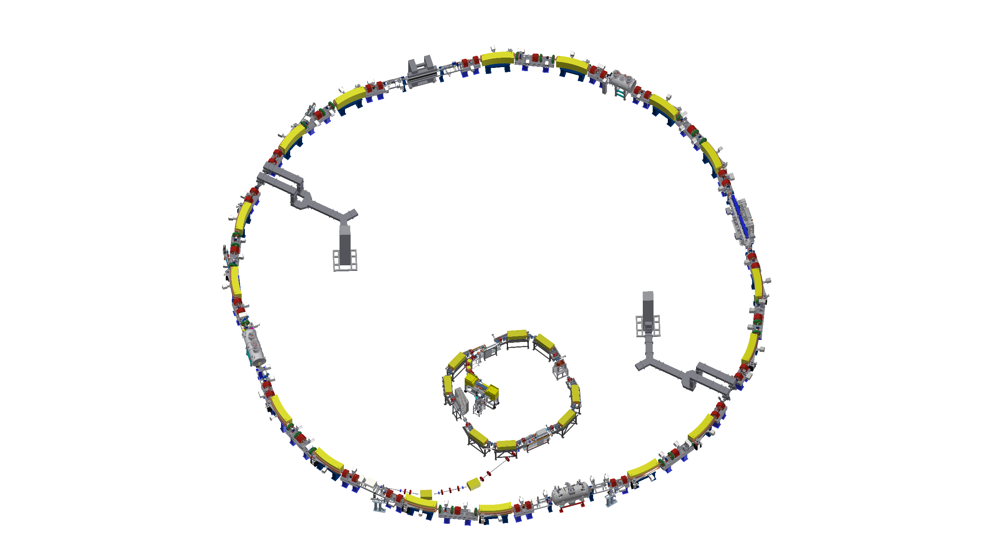

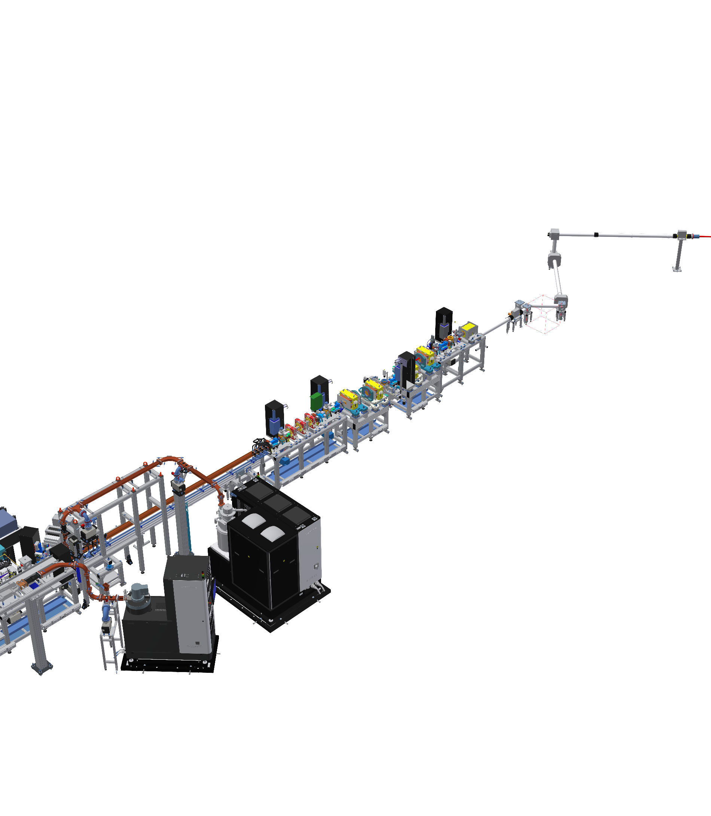
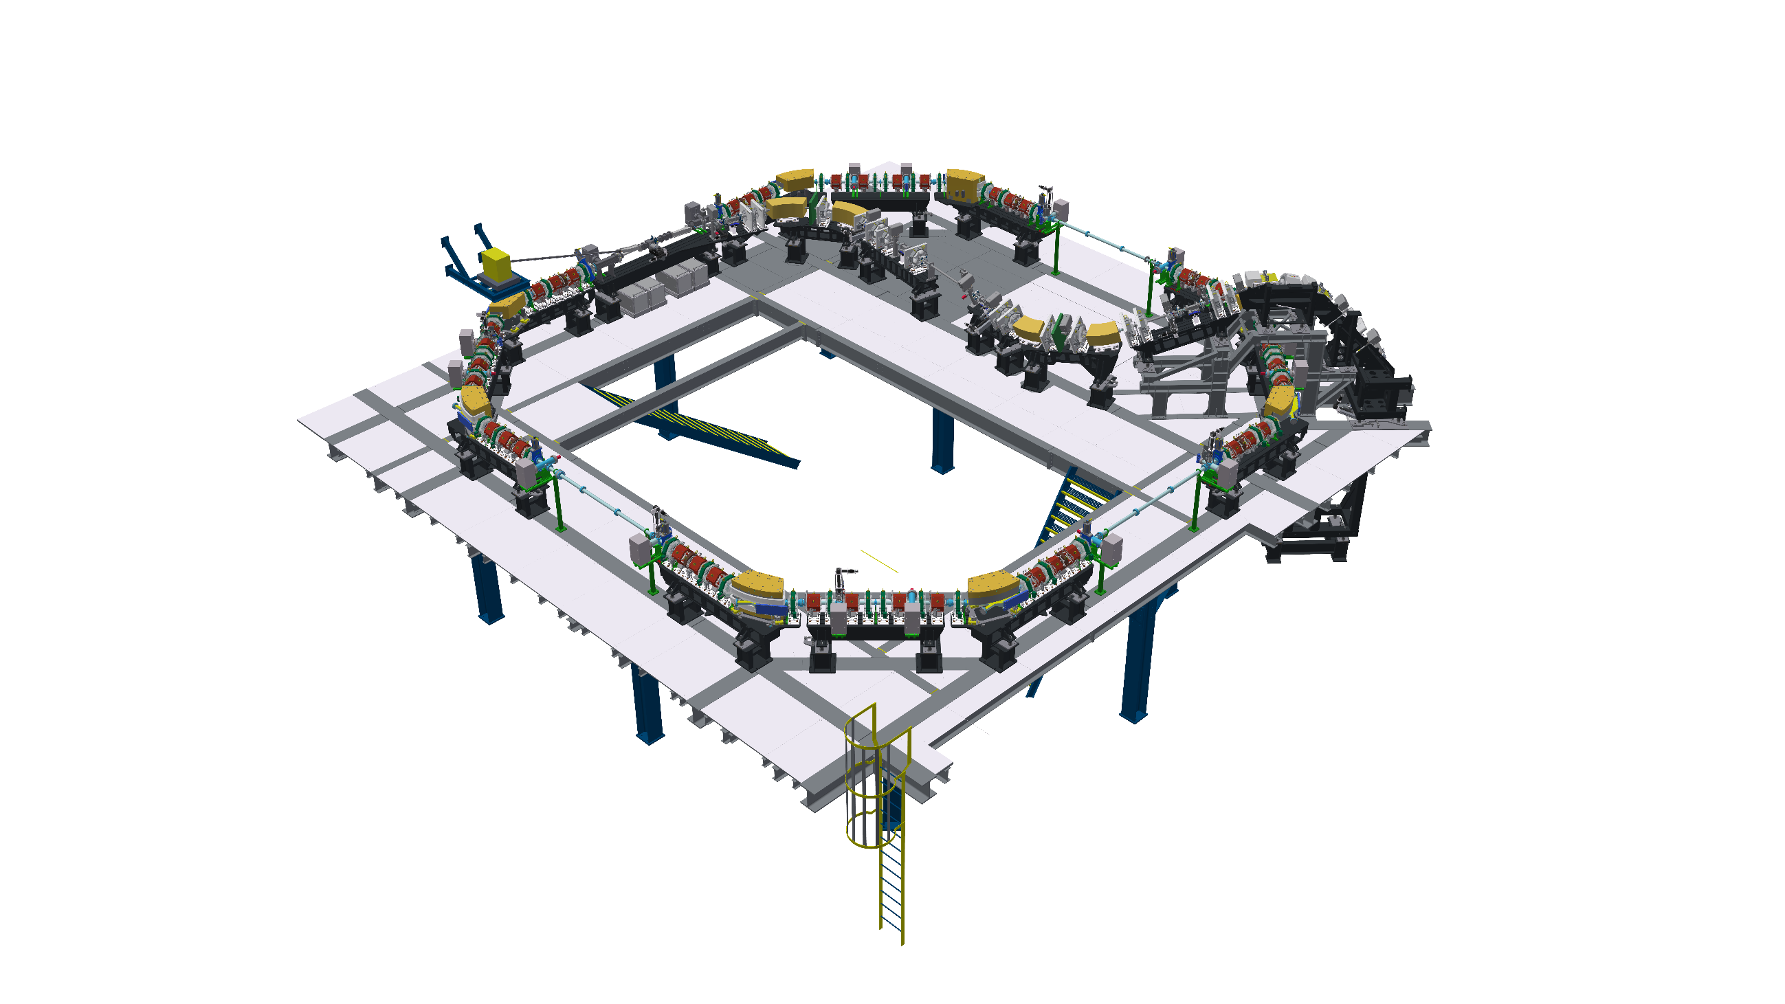







KIT Accelerators
KARA (Karlsruhe Research Accelerator)
Mix of user operation and accelerator research
Injection: 1h, energy ramp 3 min, operation: 23h
FLUTE (Ferninfrarot Linac- und Test-Experiment)
Experiments with very different operational setups
cSTART
Storage ring for non-equilibrium physics
Injector: FLUTE OR laser plasma accelerator
Installation starts ~ Mid 2026, commissioning ~ 2027
Many different operational modes

Slide 3
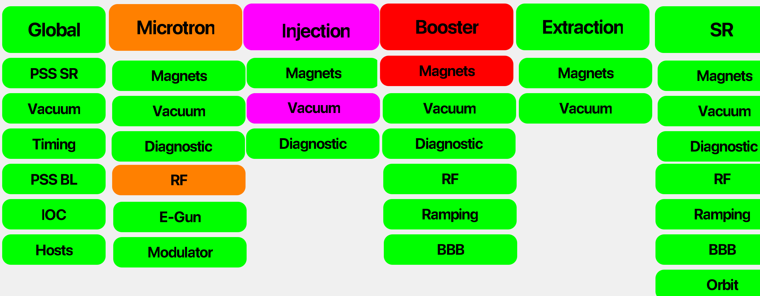
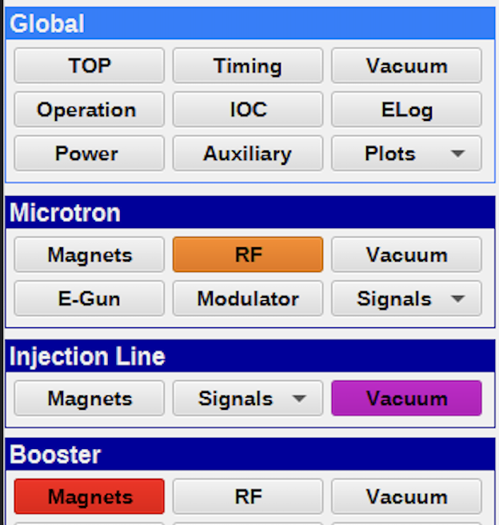
Motivation: Alarms Guide the Operator
Alarm summaries mapped to navigation menu
Support operator to quickly identify potential issues
Lead to panel where the issue can be fixed
1. and 2. level alarm hierarchy reflects our navigation
Panel shows at least one minor alarm

Slide 4
Gating Alarms?
record(bi, Kicker:Status:On) {
field(ZSV, “MAJOR“)
field(OSV, “NO_ALARM“)
}
“Alarms” in EPICS and this talk:
The alarm severity and alarm threshold fields of records
Make “alarms” (dis)appear based on certain conditions
Kicker magnet OFF → Alarm, ON → No alarm
Kicker magnet OFF → No alarm, ON → Alarm,
record(ai, Magnet:Current) {
field(LOLO, “5“)
field(LLSV, “MAJOR“)
field(LOW, “8“)
field(LSV, “MINOR“)
field(HIGH, “14“)
field(HSV, “NO_ALARM“)
}
Not talking about actual (hard-wired) alarms & interlocks: machine protection, personal safety systems, …
Gating Alarms → Dynamic EPICS notifications to support operators

Slide 5

Possible System Designs
Configuration
Deploy
Execute
Central application
Part of IOC(s)
Condition
Per record
New Alarm PVs
Change existing records
Global file
File per IOC
Adjustment
Best approach? Depends…
System we used for the last 10 years
Setup we are moving to

Slide 6
Introducing New EPICS Module: Conditional Field Adjuster
Features
Use info fields for configuration
Only requires EPICS base
Passive while IOC is running
In-place, compact & easy to understand and use.
Scales with IOC.
STATUS:PV == 0: Injection
record(bi, Kicker:Status:On) {
field(ZSV, “MAJOR“)
field(OSV, “NO_ALARM“)
info(cfa:select, „STATUS:PV CP“)
info(cfa:1:ZSV, „NO_ALARM“)
info(cfa:1:OSV, „MAJOR“)
}
STATUS:PV == 1: Operation

Slide 7
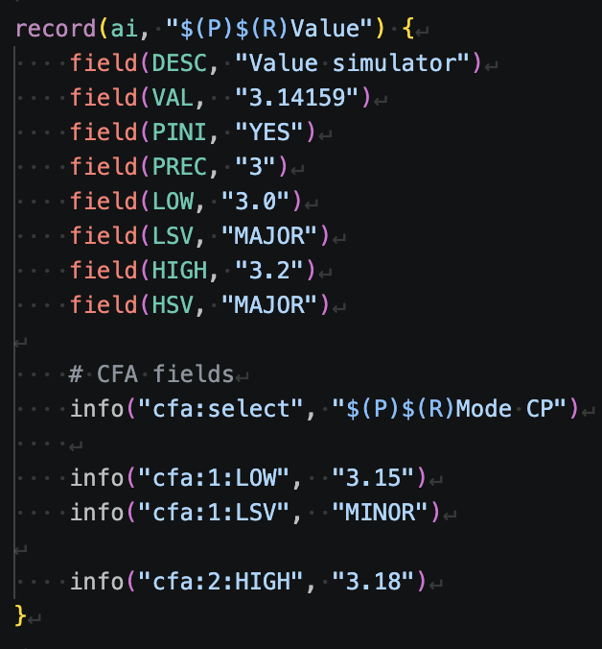
Configuration & Usage
Configuration
- configure/RELEASE
- myIocApp/src/Makefile
myIoc_DBD += conditionalFieldAdjuster.dbd
myIoc_LIBS += conditionalFieldAdjuster
No st.cmd modifications
info(cfa:select, “<PV> CP”) - gate PV, expects positive integer
info(cfa:<int>:<field>, “<value>”)
<int>: integer to match the select PV
<field>: any field which exists for the record and is writable while IOC is running
Default values are the actual record fields
info(cfa:scan, “Passive”) – optional

Slide 8
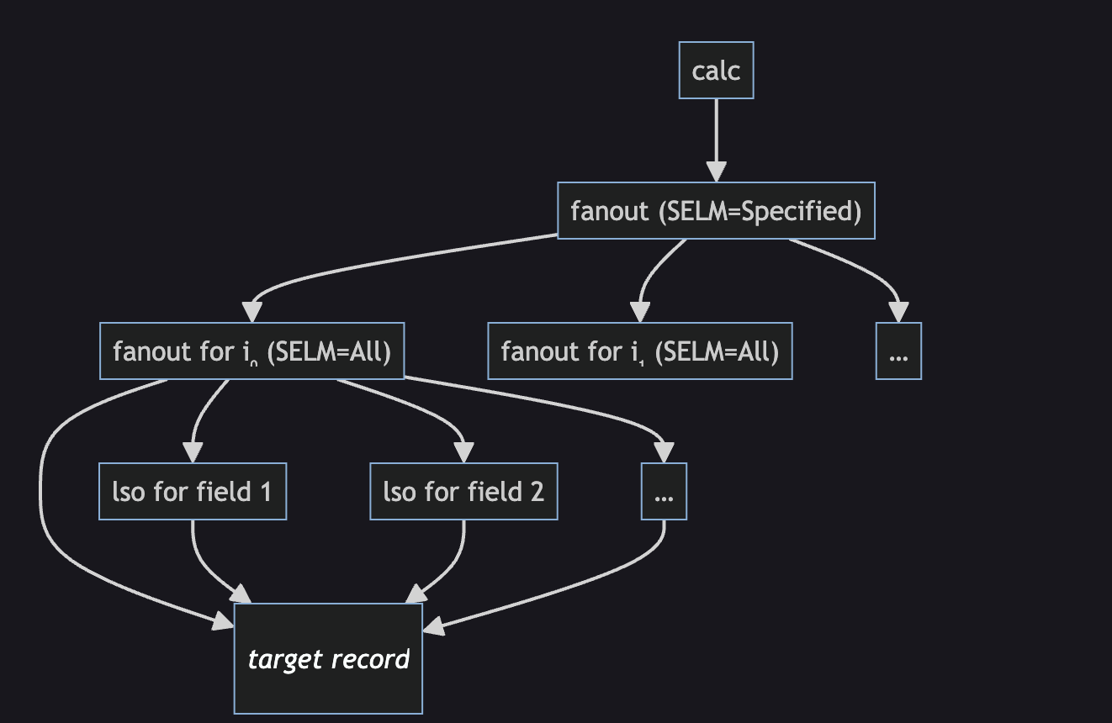
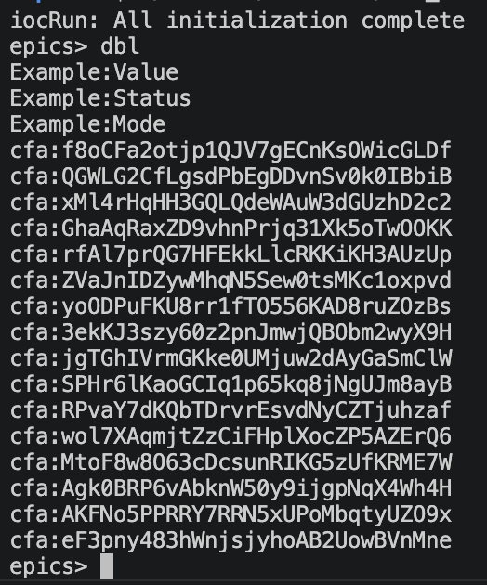
Backend
Auto-generated records injected into IOC during startup
initHookAfterInitDevSup
Record naming:
cfa:<30 random characters>
Avoid potential PV length conflicts
Considering to add configuration options for record naming

Slide 9
More on the Gate PV
RF IOC
PV:GlobalOperation:Mode
PV:InternalState
Error:PV2
Error:PV1
Magnet IOC
Error:PV3
Error:PV4
Error:PV4
Vacuum IOC
Error:PV5
Error:PV5
Timing IOC
Error:PV6
Error:PV6
Global Approach
Local Approach

Slide 10
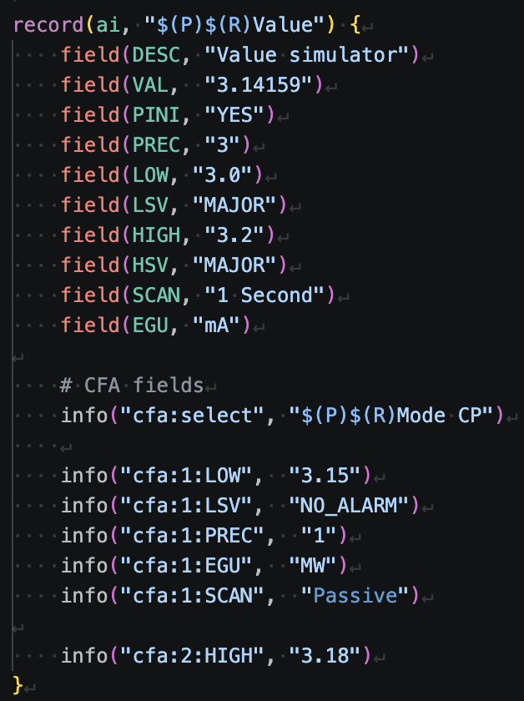
Only for Alarms?
Adjust SCAN rate?
Precision?
LOPR/HOPR?
CALC parameters?
…
Can be used for any writable EPICS field
Limitations:
Using as a central application
Embedded systems
Python-based IOCs
Changes require IOC redeployment

Slide 11
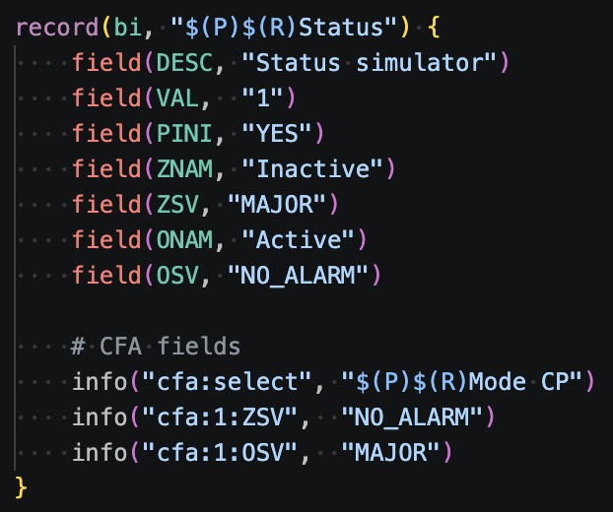
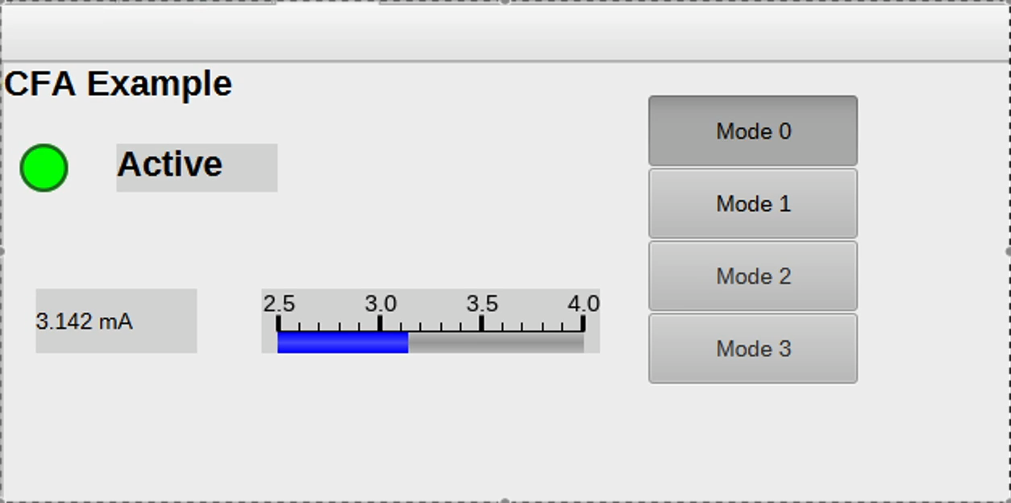
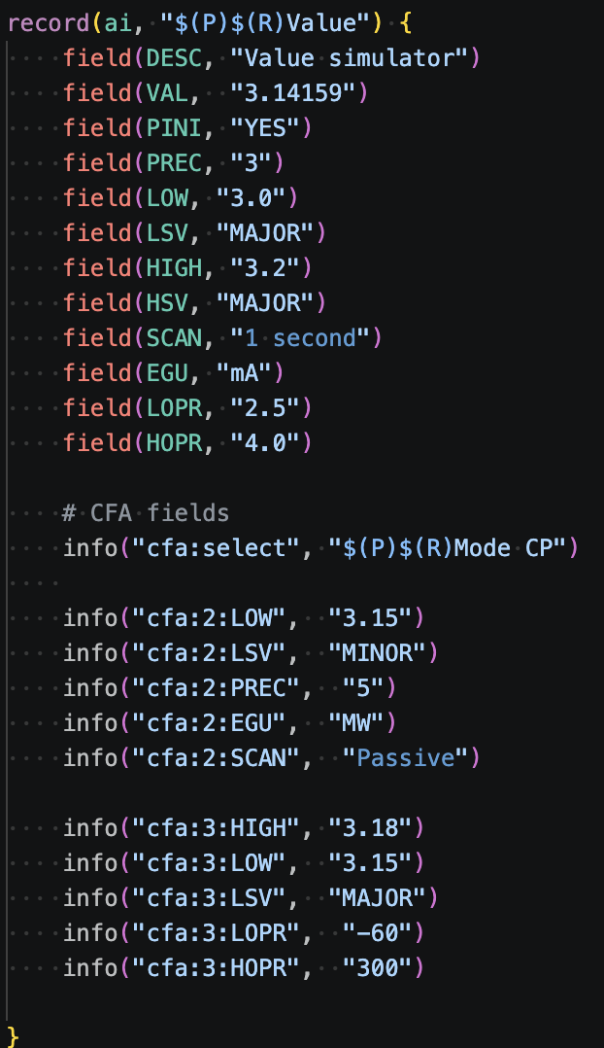
Demonstration

Slide 12

Summary
Introducing new EPICS module: Conditional Field Adjuster (CFA)
Allows to define (alarm) fields in a more flexible way
Use cases beyond alarming
Phoebus properly displays the field adjustments
Next steps
More real-word testing
Add tests
Add more examples
Start using in production
Release 1.0
Try current preview version!
More technical description in README
https://github.com/KIT-IBPT/conditional-field-adjuster

Slide 13
Backup - Demonstration

Slide 14
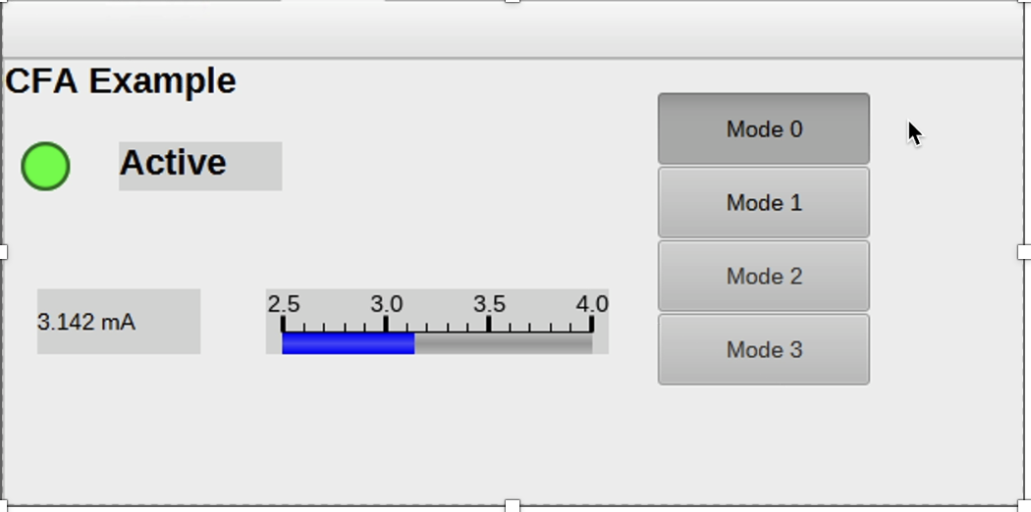
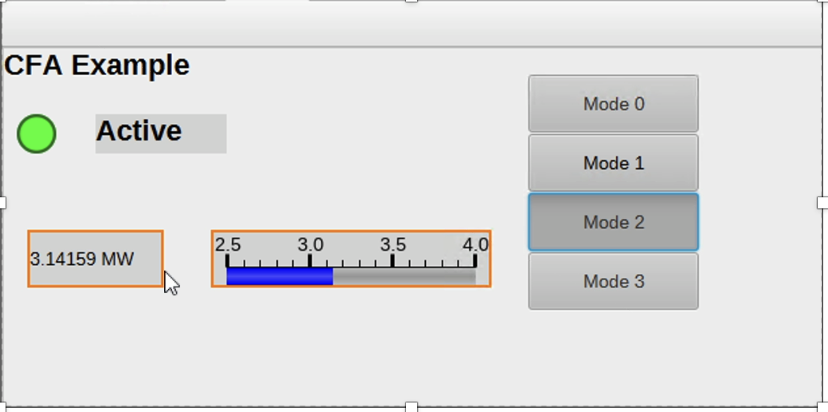
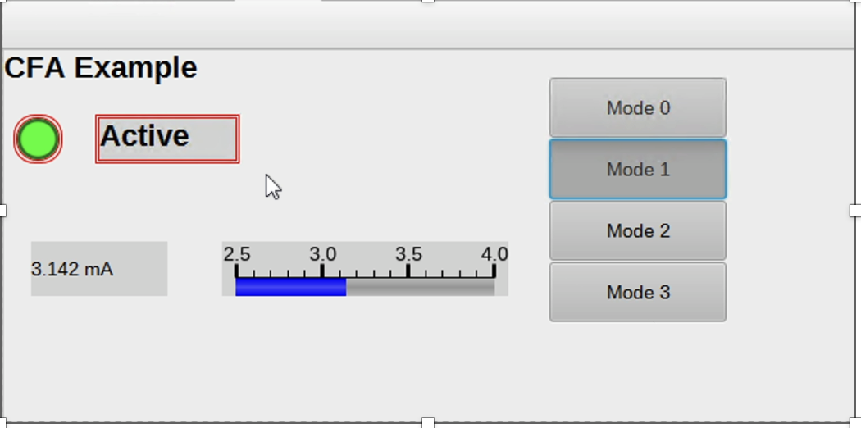
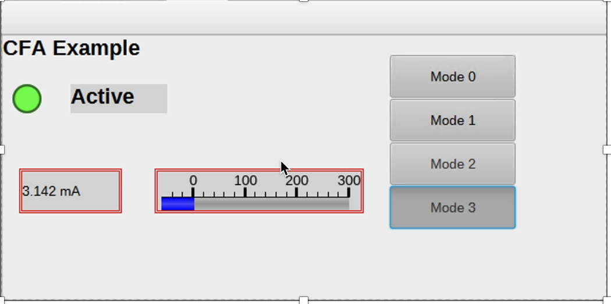
Demonstration Backup

