Slide 1
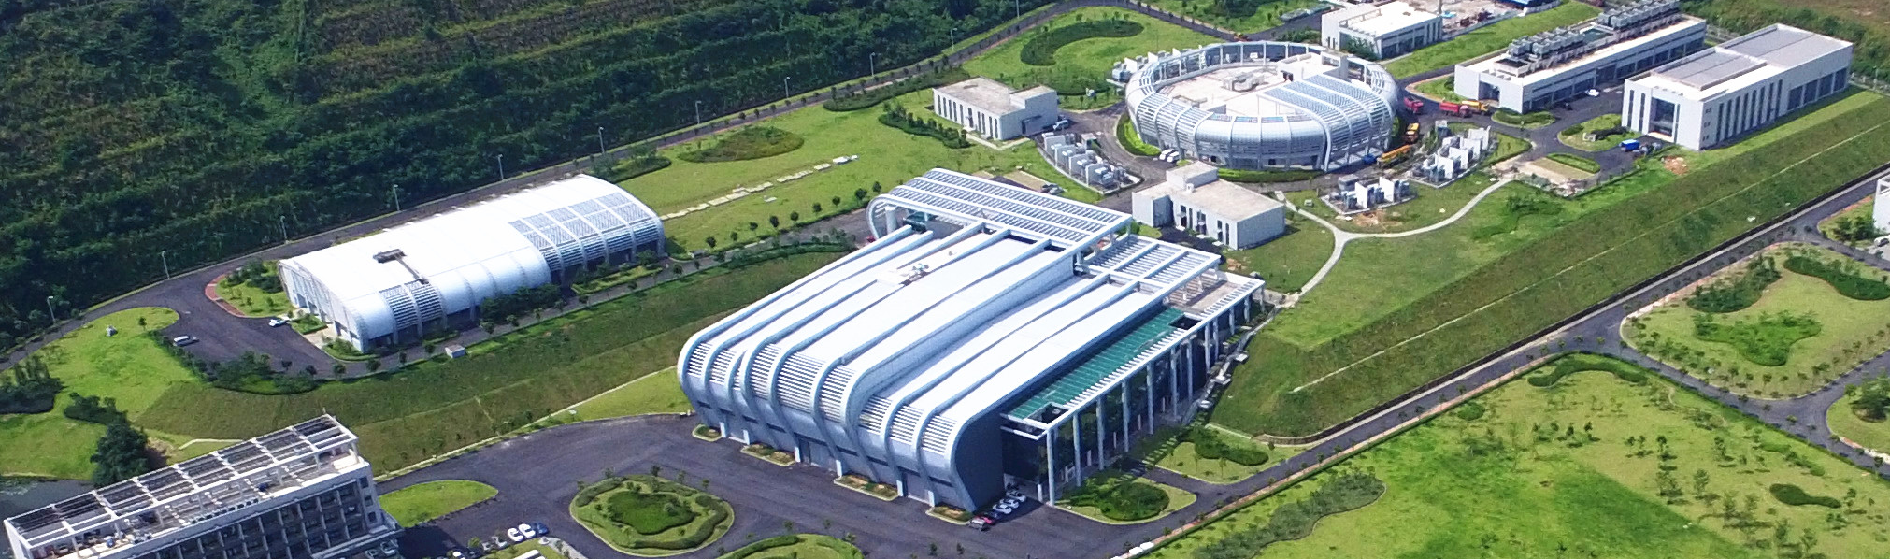

The Beam Synchronous Data Acquisition System for CSNS Accelerator
Yuliang Zhang, Sinong Cheng, Zhihong Xu
Institute of High Energy Physics, CAS
2026 Spring EPICS Collaboration Meeting

Slide 2
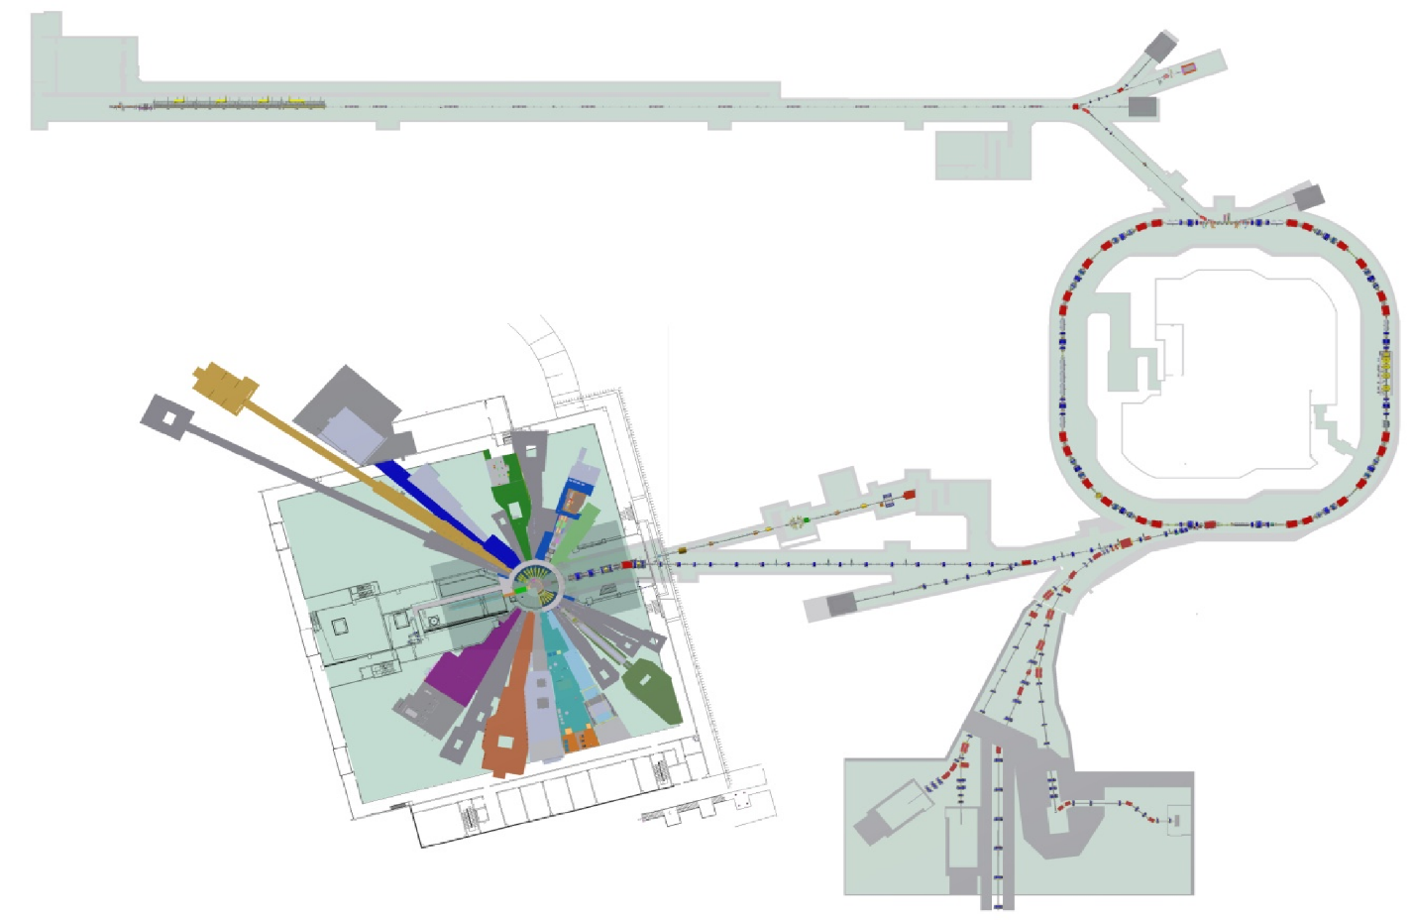
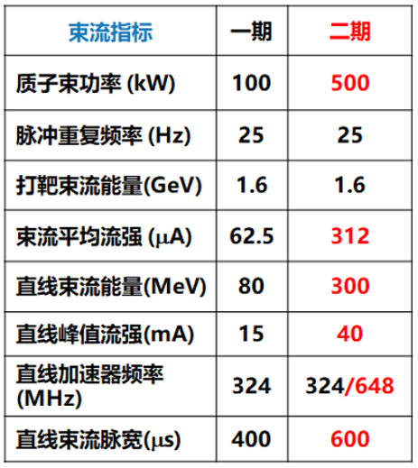
Brief Introduction of CSNS and CSNS-II
CSNS is an accelerator-driven pulsed neutron source
In Jan. 2024, construction of the upgrade project CSNS-II began
Parameters
CSNS
CSNS-II
Beam Power（KW）
Linac upgrade from 80MeV to 300MeV
Rep-Rate（Hz）
Beam Energy（GeV）
Avg Current (µA)
Linac Energy(MeV)
Linac Pk Current (mA)
Linac RF Frequency（MHz）
Proton & muon
Experimental station
Linac Beam Width(µS）

Slide 3
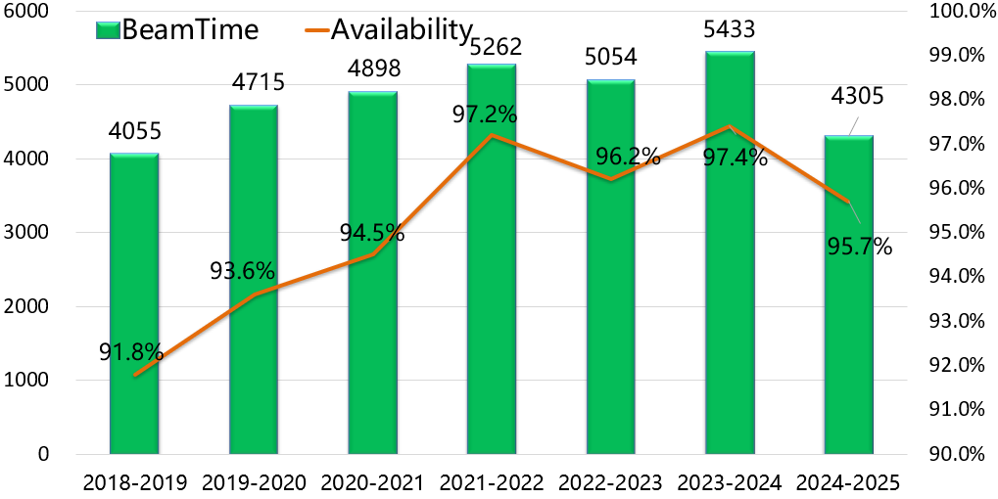
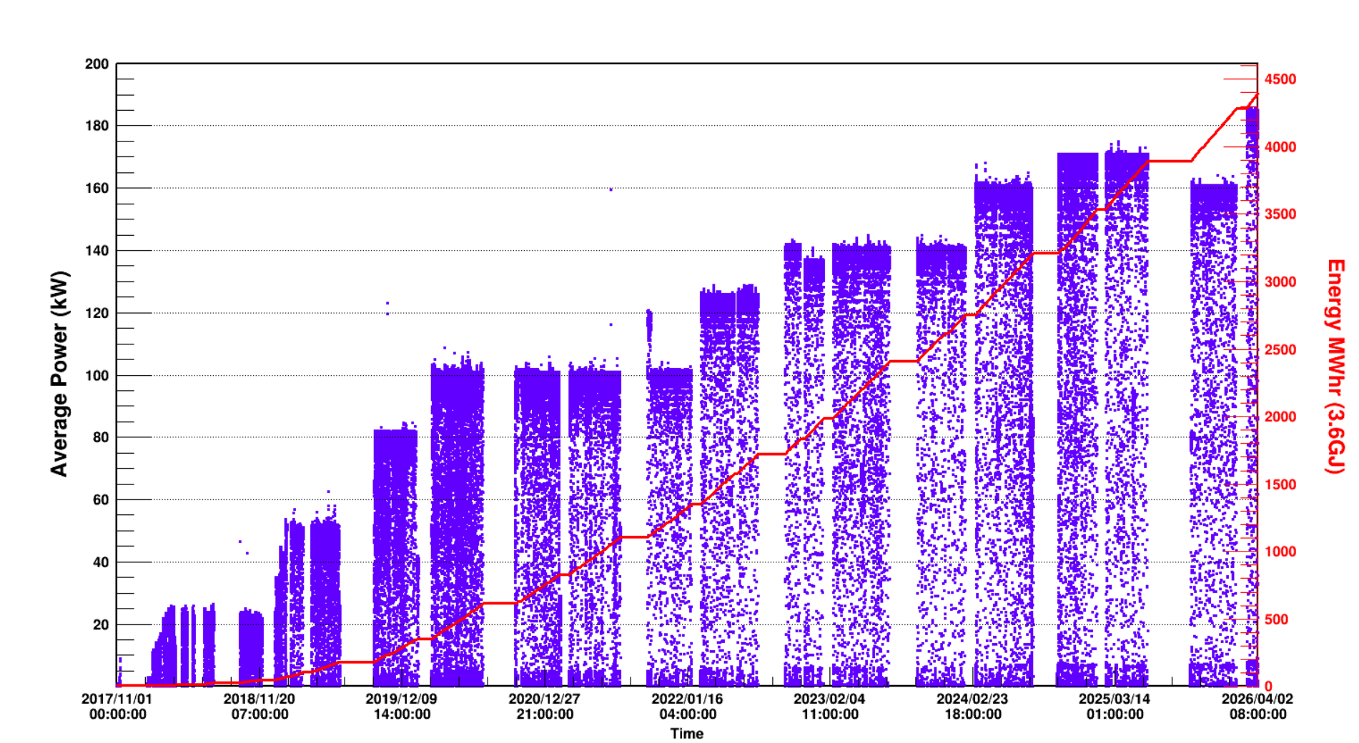
CSNS Operation Overview
In recent years, the beam availability of CSNS has remained above 95%
In March 2026, the beam power reached 185kW and maintained stable operation

Slide 4


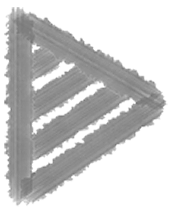
How we did business without BSA
Full data storage of every pulse(only very few PVs)
This approach would consume excessive network bandwidth and storage resources.
Single shot mode, trig once and freeze data(take a photo of the accelerator )
Only one beam cycle of data is saved.
We were unable to take a short video of accelerator

Slide 5
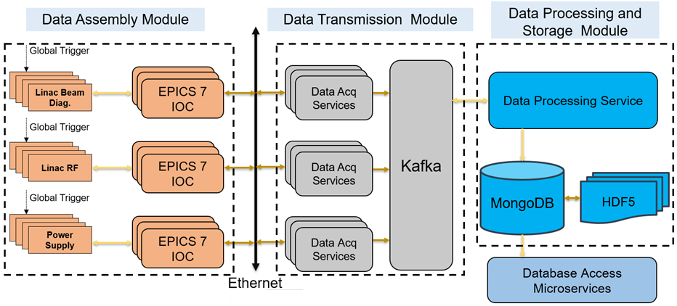
CSNS BSA System overview
BSA system collects data, particularly waveforms, in synchronization with beam cycle, thereby provide time correlated data
Periodic triggered mode
Ideal for Machine Learning research (time-stamp aligned data)
Random triggered mode
Includes manual trigger (on-demand accelerator status check) and fault trigger (post mortem analysis)

Slide 6
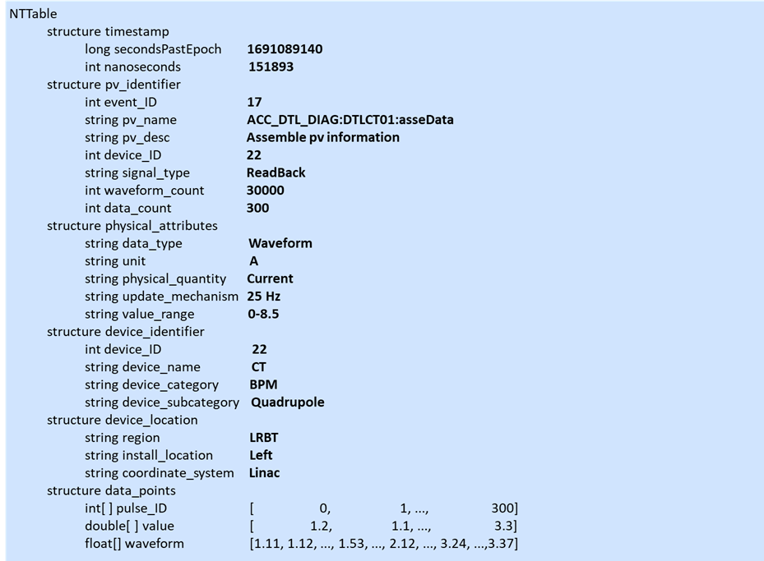
Data Assembly Module
To ensure a comprehensive and precise representation of data attributes, EPICS 7 Normative Types is utilized to assemble the metadata and waveform data.
Data composition：
Metadata：describes the attributes of the waveform data
Waveform Data：raw data collected from hardware devices
Definition of the structure data (PV)
EPICS 7 IOCs
Structured Data
Structured Data
Structured Data
timeStamp
attribute
value(Arrays)
timeStamp
attribute
value(Arrays)
attributes
data_points(Arrays)
secPastEpoc
nanosec
pvName
secPastEpoc
nanosec
pulseID
device data1
device data2
...
pvName
pulseID
device data1
device data2
...
pv_identifier
evt_ID
pv_name
...
pulse_ID
eventID
eventID
phy_attribute
unit
data_type
...
device data1
sampleRate
sampleRate
dev_identifier
dev_ID
dev_name
...
device data2
numCount
numCount
device data3
dev_location
region
inst_locat
...
timeStamp
secPastEpoc
nanosec
...
Metadata
Waveform Data

Slide 7
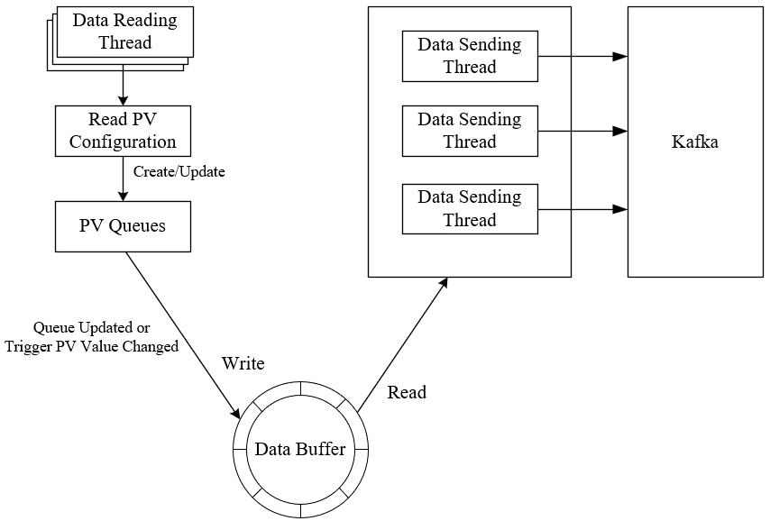
Data Transmission Module
Large amount of data:
Cache data for multiple consecutive cycles (e.g., 125 pulses)
Large number of waveform PVs
Technology used:
PVAccess protocol: provides an efficient mechanism for data transmission
Multi-threaded queuing technology：creates and manages multiple worker threads, increases the data processing efficiency
Kafka : decouples, manages peaks in data traffic
The application of multithreading and Kafka message queue improves data transmission efficiency while ensuring its integrity and reliability.

Slide 8
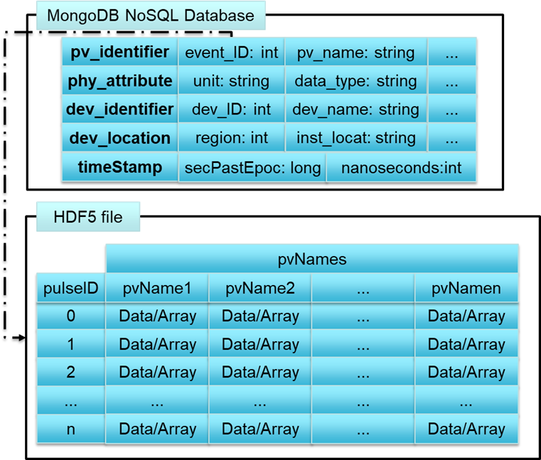
Data Processing and Storage Module
Hybrid storage strategy:
Metadata: stored in MongoDB
Waveform data: stored in HDF5 files
Efficient Data Retrieval:
The system queries only necessary metadata in MongoDB.
It avoids loading extensive waveform data from HDF5 files.
This ensures fast and efficient performance
Raw Data
Data Processing
Data Type Conversion
Data Classification
Schematic of hybrid data storage

Slide 9
Data Access Microservice Module
The data access microservice provides data retrieval, processing, and visualization functionalities via an HTTP RESTful interfaces.
Main Functional Modules
Data Processing: Raw data processing & plotting
HTML Generation: Graphics to HTML conversion
Background Tasks: Background computing for faster response
REST API: Access & download for waveform & metadata
Data Reading: Function invocation for targeted data view
Data Access Microservice
Data Reading
Data Processing
Background Tasks
HTML Generation
REST API

Slide 10
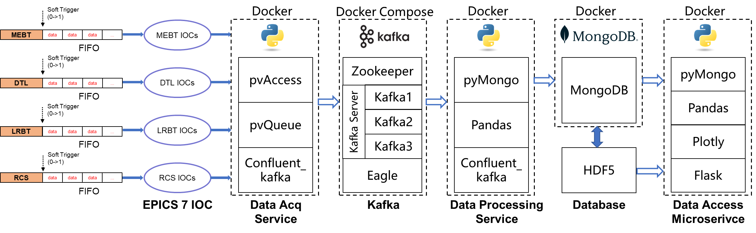
Prototype of BSA and application at the CSNS accelerator
A BSA prototype has been deployed at the CSNS Linac accelerator to collect cached critical waveforms, such as beam intensity, beam loss, beam position, and Linac RF.
Fast Protection System’s (FPS) interlock output PV was used as a global trigger.

Slide 11






Prototype Deployment & Containerization
All core modules are deployed as containerized services on a unified Docker platform.
Server Host
Docker Compose
Rapid Deployment: One-click deployment using Docker Compose, reducing setup time from hours to minutes.
Environment Consistency: Eliminates the "it works on my machine" problem by bundling all EPICS 7 and Python dependencies into images.
Decoupled Architecture: Each service runs in an isolated container, improving system reliability and fault tolerance.
Scalable & Maintainable: Easy to scale individual modules (e.g., adding more data processing workers) and supports seamless online updates.
Data Source
Data Acq / Processing
Messaging Cluster
Data Acq / Processing
Internal Network
Database
Data Service
Containerization ensures the BSA system can be rapidly iterated and reliably deployed within the complex network environment of the CSNS accelerator.

Slide 12
How we do business now with BSA
BSA data use cases:
Intra-pulse beam chopping by the FPS
Automatic recovery of beam after FPS mitigation beam stop
Beam loss due to off-energy beam following VSWR protection
Time overhead statistics for FPS due to VSWR protection input
RF amplitude waveform capturing during cavity arc
Time structure of the CSNS Linac beam pulse

Slide 13

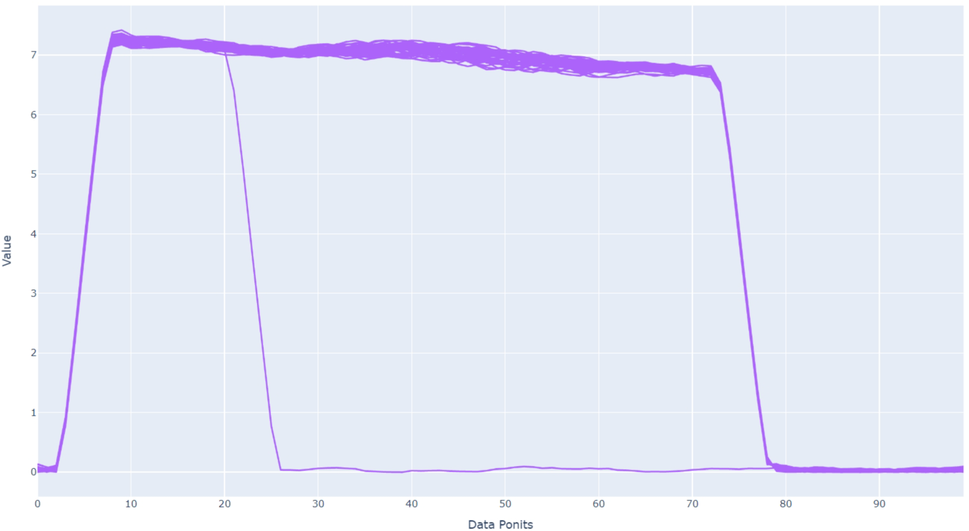
Intra-pulse beam chopping phenomenon by the FPS
Intra-pulse beam chopping: FPS utilizes the LEBT chopper to deflect beam, thereby preventing downstream transmission, with a response time of FPS is within several microseconds.
MEBT CT01
MEBT CT02
LRBT CT01
LRBT CT01
Consecutive multi-cycle mode
Infinite persistence mode

Slide 14
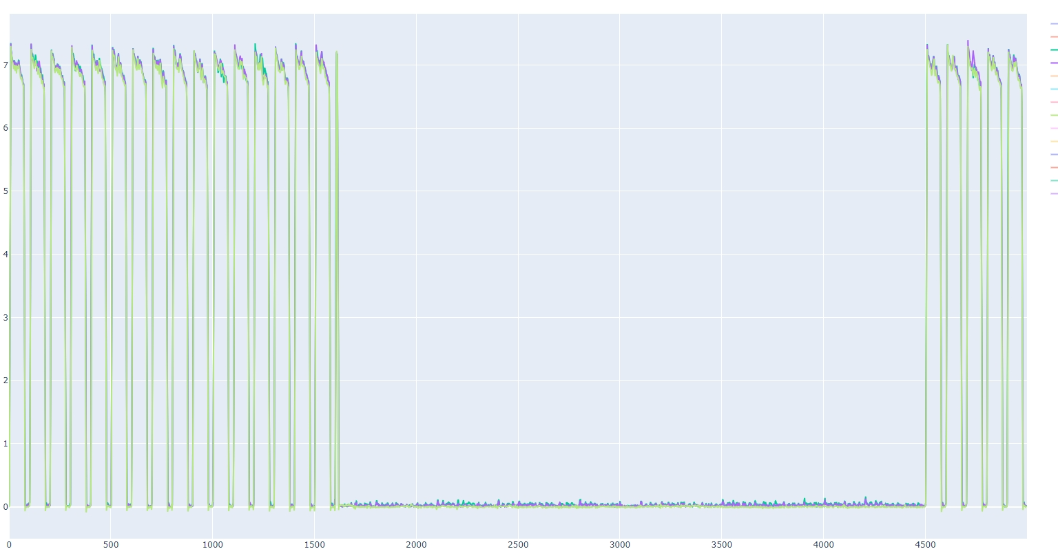
Automatic beam recovery following FPS mitigation action
After the beam stopped for 29 cycles, it automatically recovers
The beam quality post-recovery is consistent with its pre-stop condition
MECT02
DTLCT02
LRCT02
29 pulse cycles, 1.16s

Slide 15
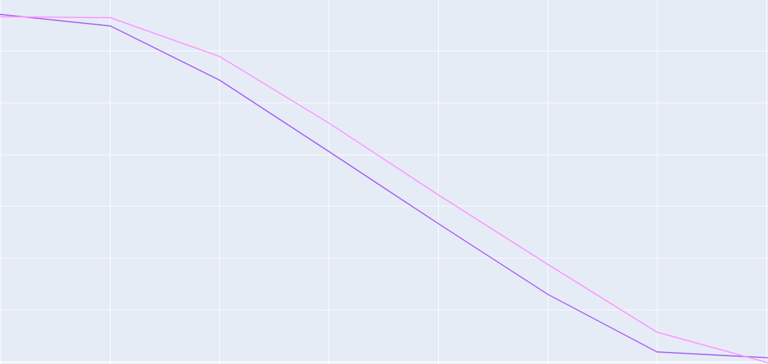
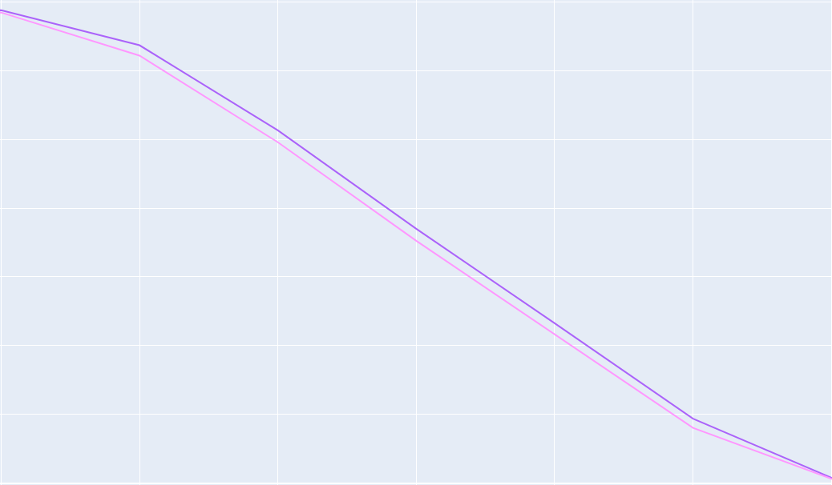
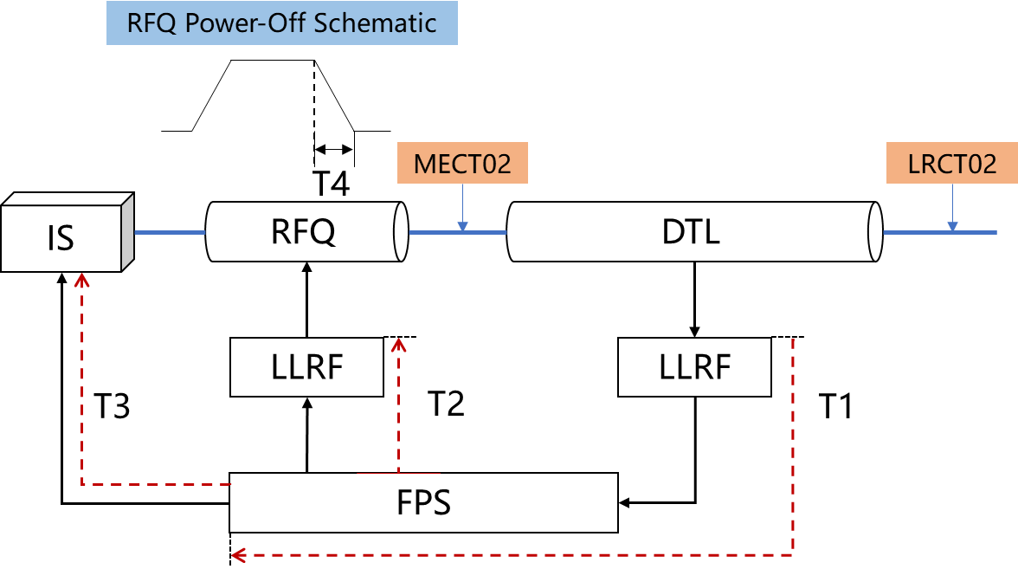
FPS Time overhead due to RF cavity VSWR protection
Estimate the FPS overhead time
By comparing the waveform falling edges of the Normal mode and intra-pulse chopping
Normal
intra-pulse chopping
LRCT02
MECT02
MECT02
LRCT02
ΔT=T1+T2+T4≈3.8μs
The estimated FPS overhead time: 3.8μs

Slide 16
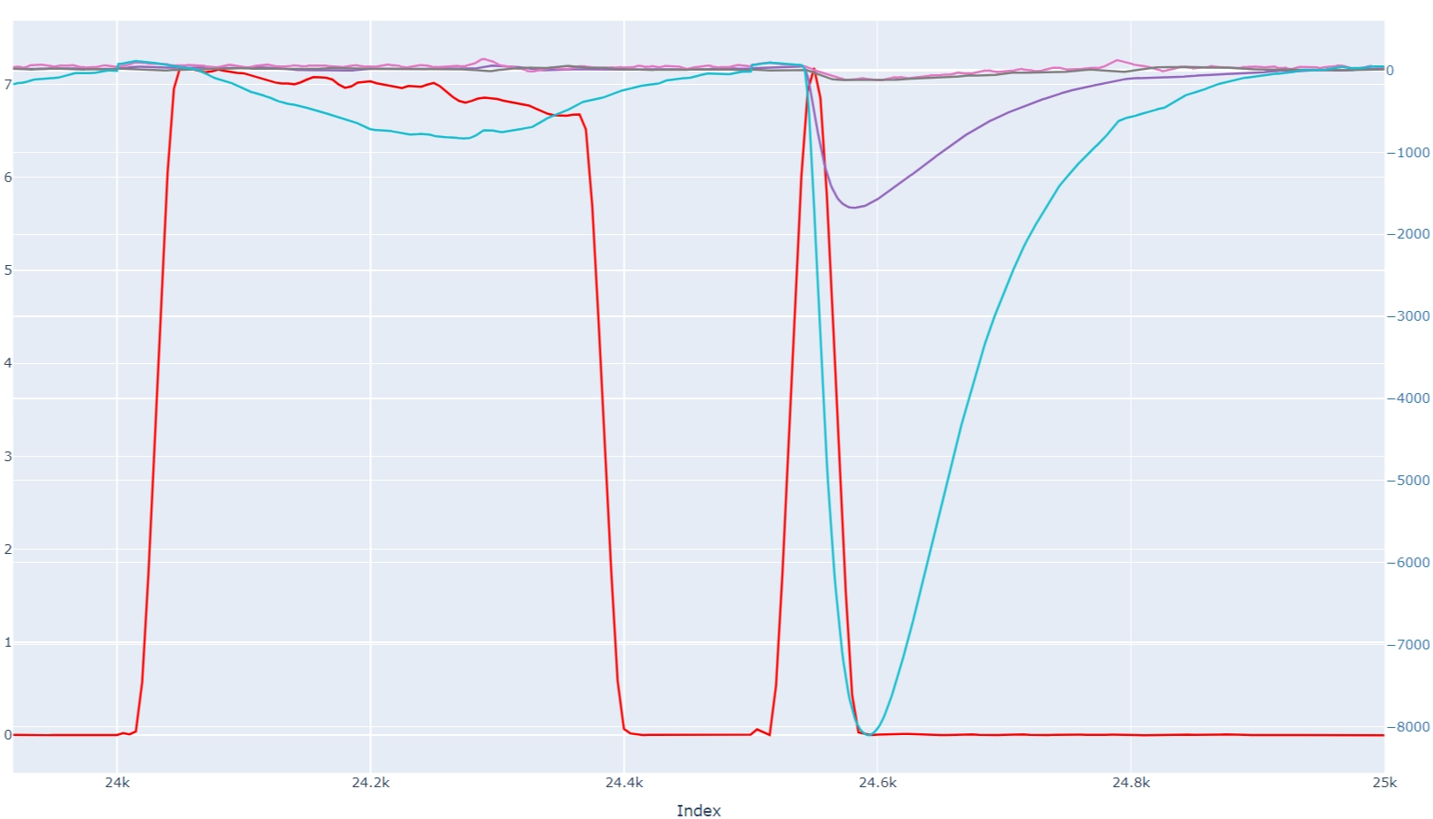
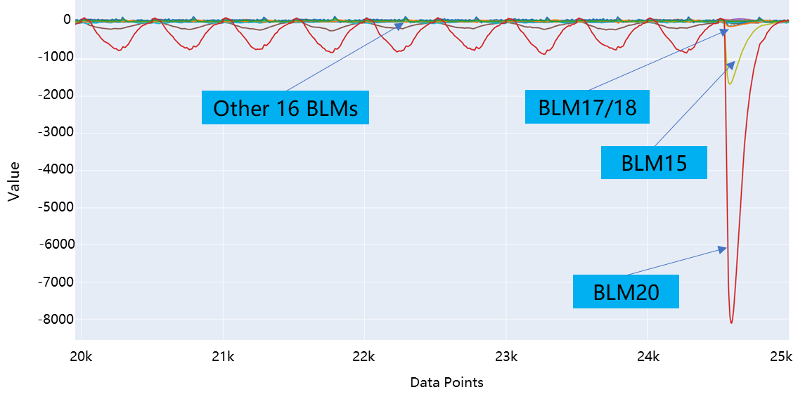
Beam loss trip due to off-energy beam
Example：DTL3 VSWR protection caused off-energy beam
Even several microseconds off-energy beam can lead to beam loss trip
Data from the first 20 Linac BLMs over 50 consecutive cycles
MECT02 and BLM data during VSWR protection events
BLM17/18
BLM15
MECT02
BLM20
The last cycle showed a marked increase in beam loss, correlating with the VSWR protection event in DTL3. From BLM15 onwards, the beam loss was evident.

Slide 17
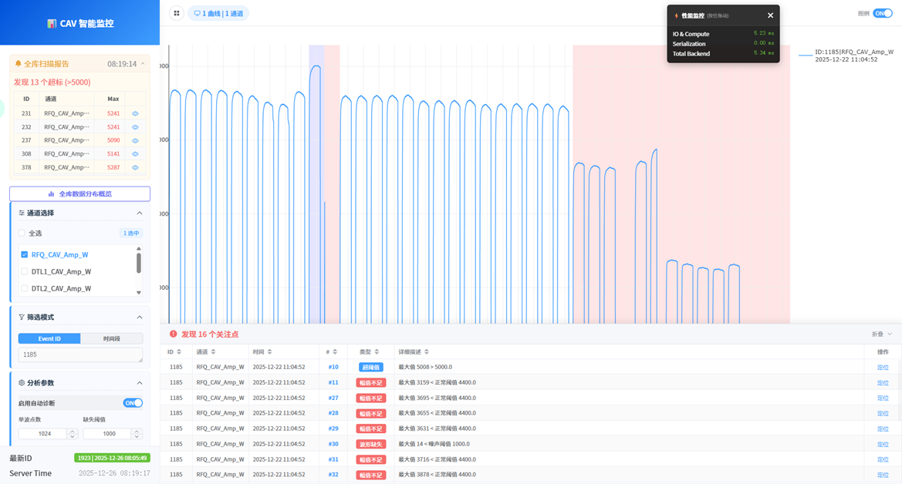
Capture of RF Cavity Amplitude During VSWR Protection
Capture the cached data from LLRF of DTL1–4 and RFQ when VSWR protection event occurs.
By configuring parameters including data points, maximum values and pulse width points, qualified events are identified and flagged.
Efficiently identifies abnormal VSWR protection events across multi-systems via configurable parameters.

Slide 18

Thank you for your attention!
Welcome and Acknowledgements

