Slide 1
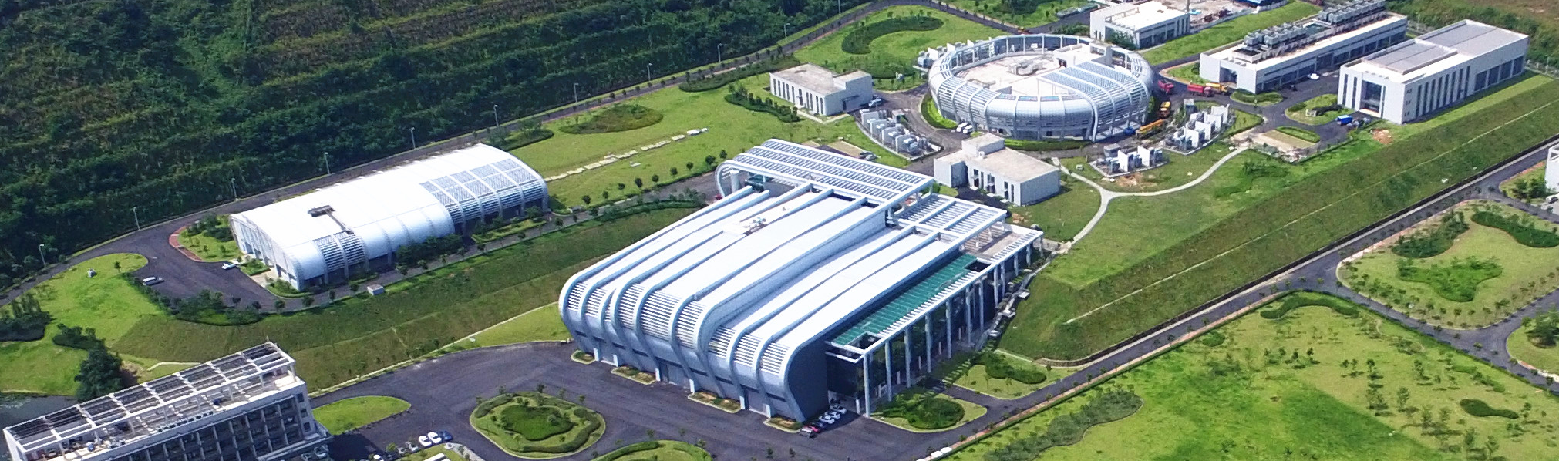

Design and Implementation of the CSNS-II Accelerator Control Network Management System
Kangjia Xue
Institute of High Energy Physics, CAS / China Spallation Neutron Source
Spring EPICS Collaboration Meeting 2026

Slide 2
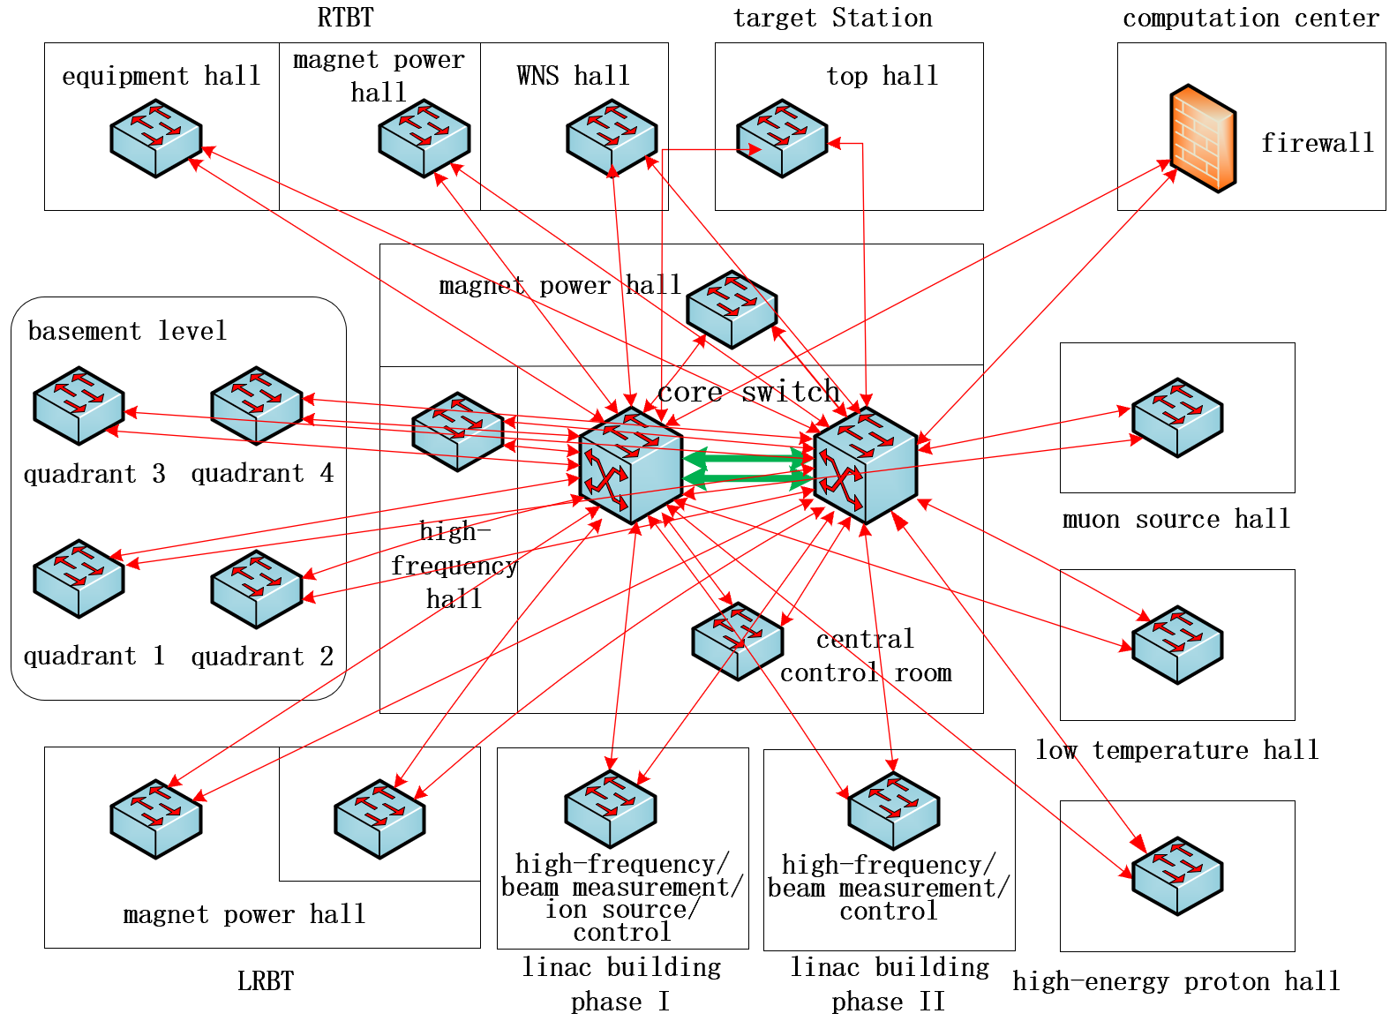
Background
CSNS now has about 650 online control-network devices; CSNS-II will exceed 1,500. Previously, each subsystem allocated IP addresses from its own range, which caused several problems.
Subsystems used inconsistent records, often missing information needed for operation and maintenance.
IP data was kept in Excel files, making management difficult and leaving no approval workflow.
No network access control was available.
CSNS-II Network Topology

Slide 3
Main Functions
Many accelerator devices, such as serial servers and power supplies, cannot request network access by themselves.
MAC-address binding is not suitable because it complicates device replacement after failures.
Accelerator networks require detailed device records, not just the IP user.
Network Features
Goal: build a system for accelerator operation and maintenance, covering IP address management and network access control.
IP Address Management
Switch Information
Port Information
Main Functions
Device Online Status
Subnet Information
Device Location
Network Access Control

Slide 4
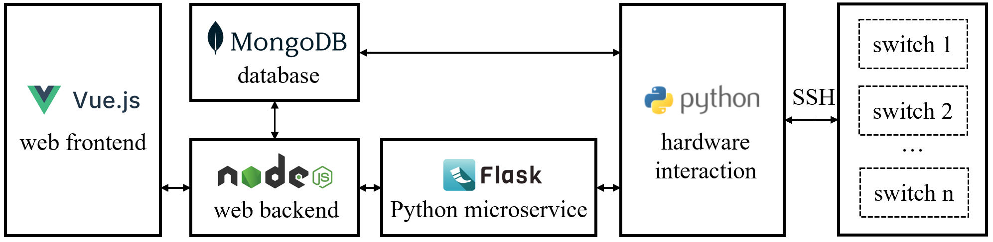
System Architecture
User interface: Web-based application built with Vue.js and the PrimeVue component library.
Back-end services: Node.js and MongoDB.
Hardware interaction: Python, using the Netmiko library to connect to switches.
System Architecture

Slide 5
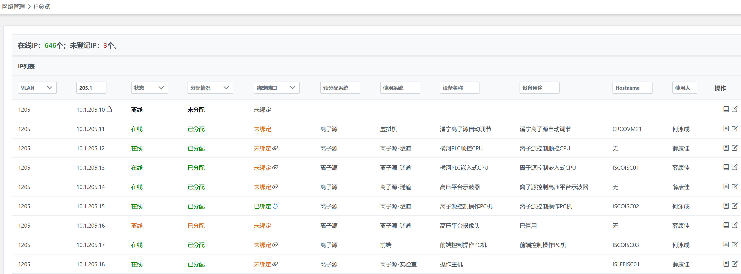
IP Address Management
Centralized IP management — records device name, purpose, manufacturer, and model for each IP address.
Online IPs
Unregistered IPs
Online Status
Port Binding
Using Subsystem
Device Purpose
User
Allocation Status
Reserved Subsystem
Device Name
Actions
IP Overview Page

Slide 6
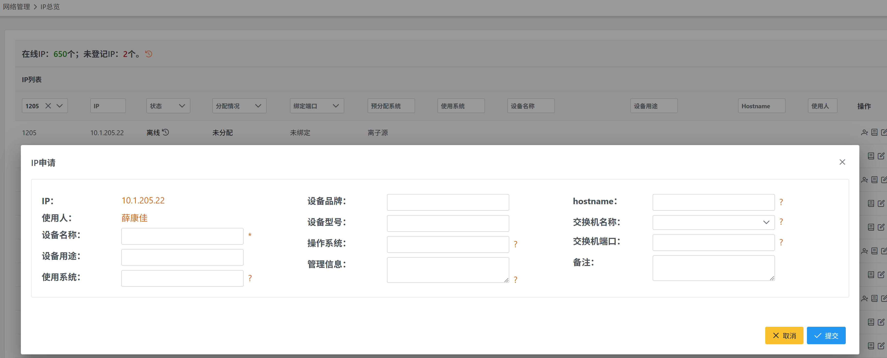
Users can select an unassigned IP address and submit an application.
Manufacturer
User
Device Model
Switch Name
Device Name
Operating System
Switch Port
Device Purpose
Remarks
Using Subsystem
Maintenance Information
IP Address Application Form

Slide 7
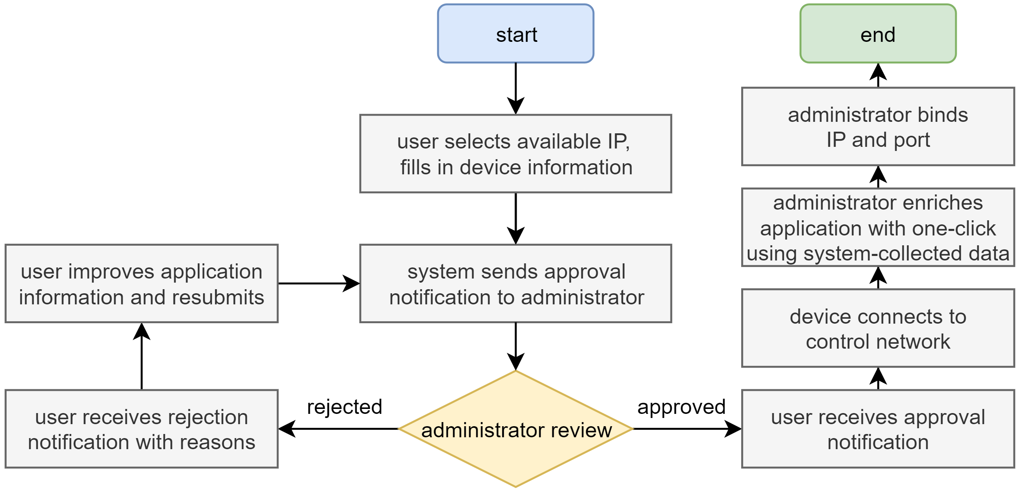
The application and approval workflow ensures that every networked device has complete maintenance information.
IP Address Application Workflow

Slide 8
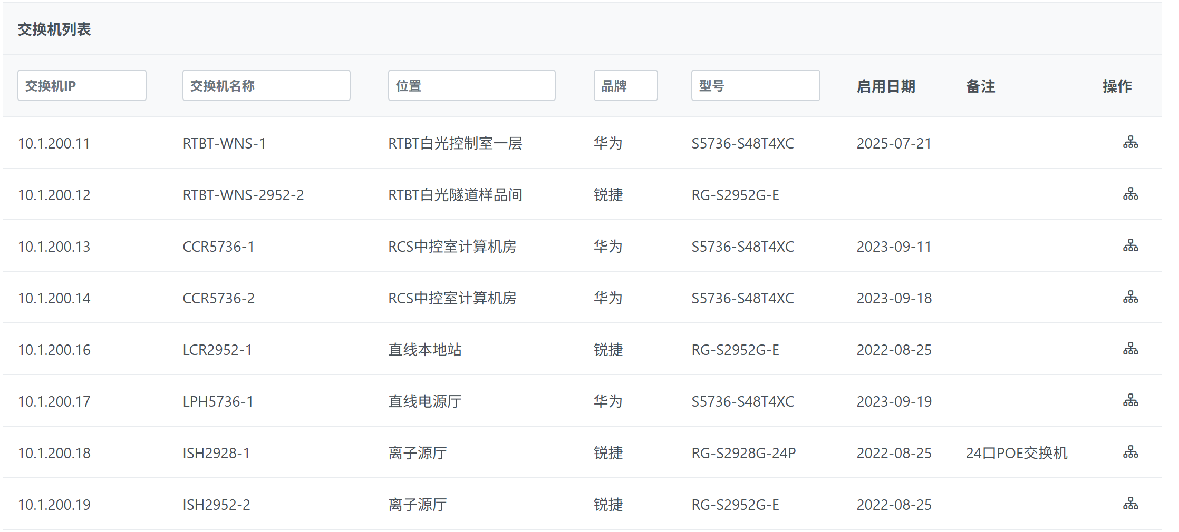
Switch Information Query
Static data imported by administrators.
Including information such as the name and location of the switch.
Remarks
Switch IP
Switch Name
Location
Manufacturer
Model
Commissioning Date
Actions

Slide 9
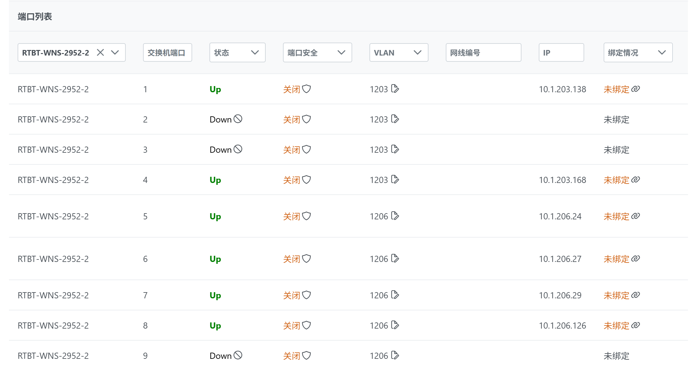
Port Information Query
By collecting interface data and MAC tables from access switches, the system reports link status, VLAN ID, and connected MAC address for each port.
Switch Port
Link Status
Port Security
Cable ID
Binding Status

Slide 10
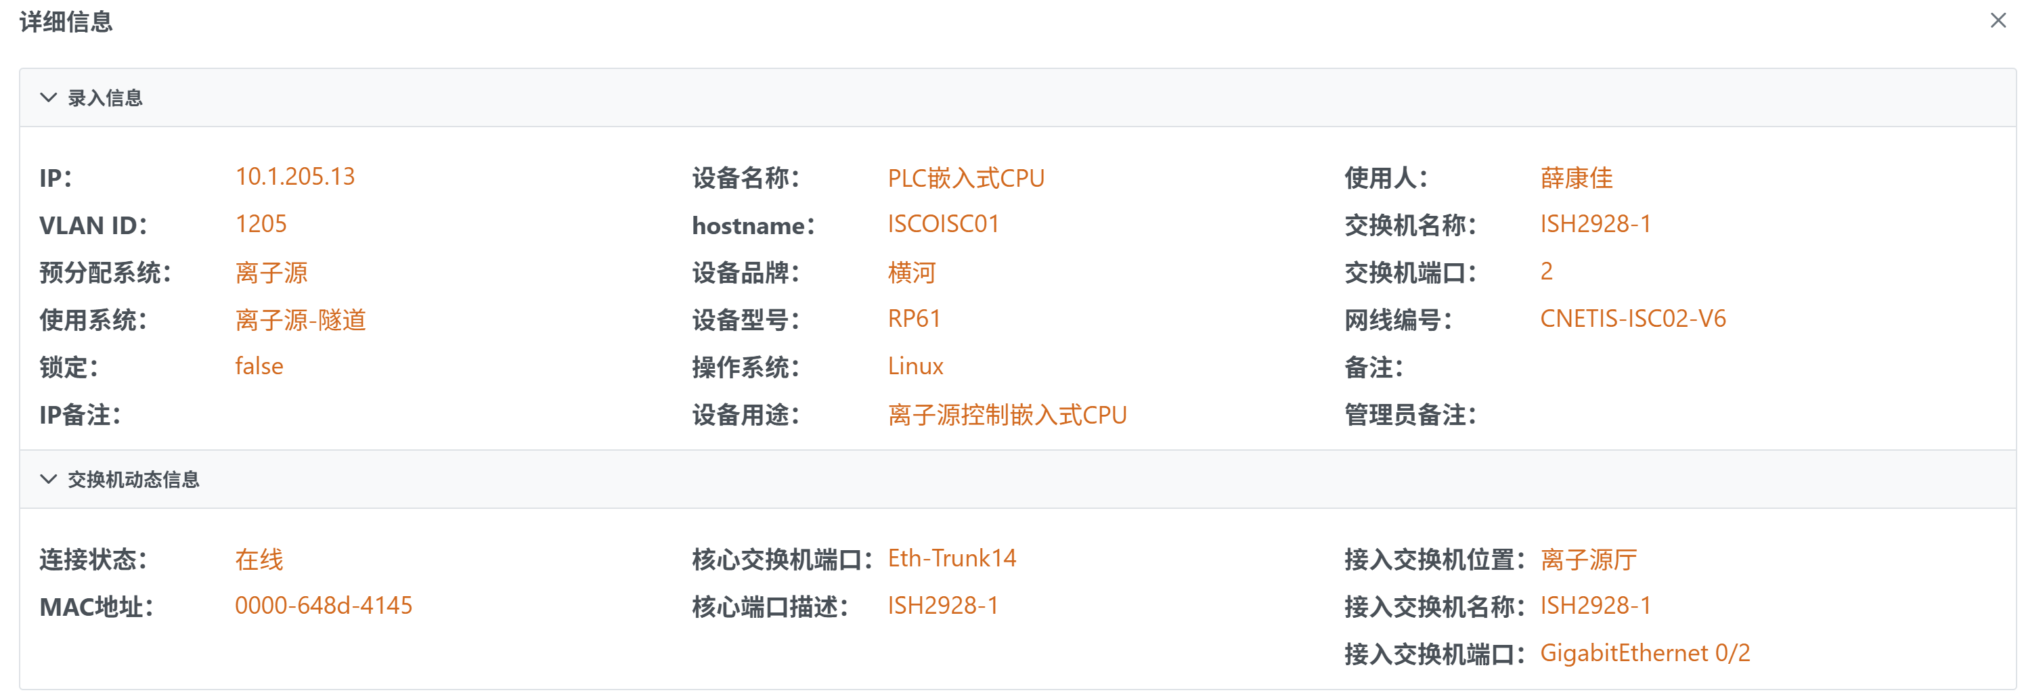
Locating Connected Devices
Using IP-to-MAC mappings from the core-switch ARP table, the system maps a device to its switch port.
Because switch locations are recorded, the physical location of any connected IP address can be found directly.
Registered Information
Switch Dynamic Information
Access Switch Location
Access Switch Name
Access Switch Port

Slide 11
Real-Time Online Status
By reading the core switch ARP table, the system can identify whether an IP address is online.
Switch Dynamic Information
Online Status
MAC Address

Slide 12
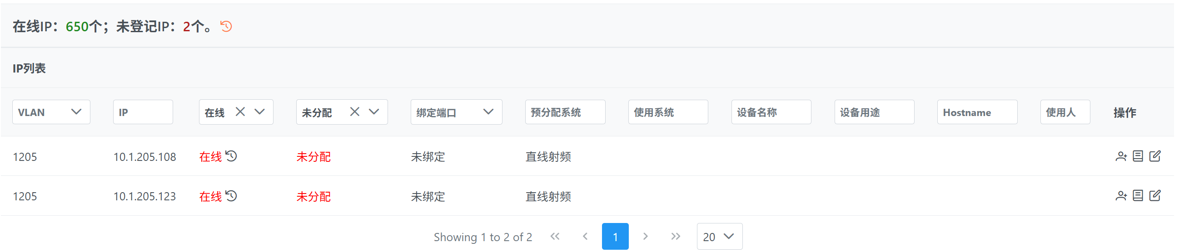
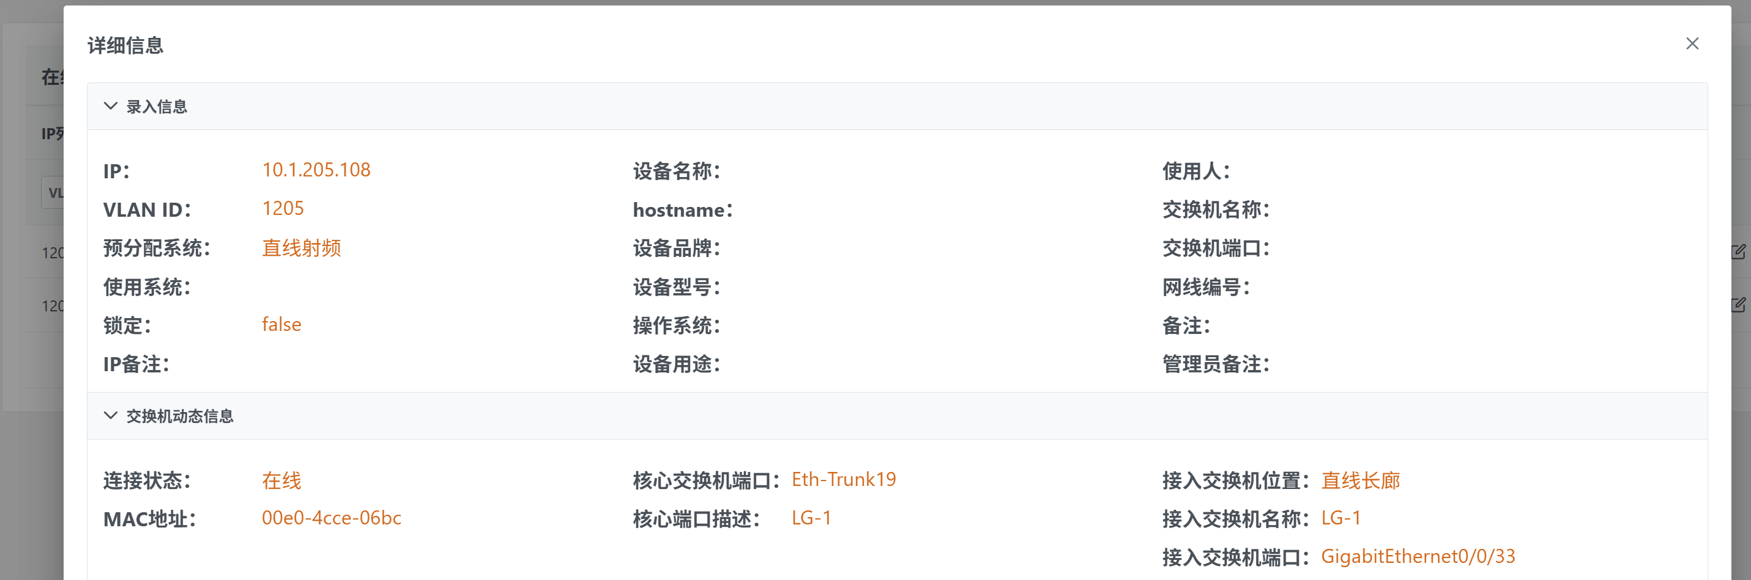
Using Filters to Identify Abnormal Conditions.
For example, filtering for online and unassigned IP addresses identifies unauthorized devices connected to the control network and shows their physical location.
Online
Unassigned

Slide 13
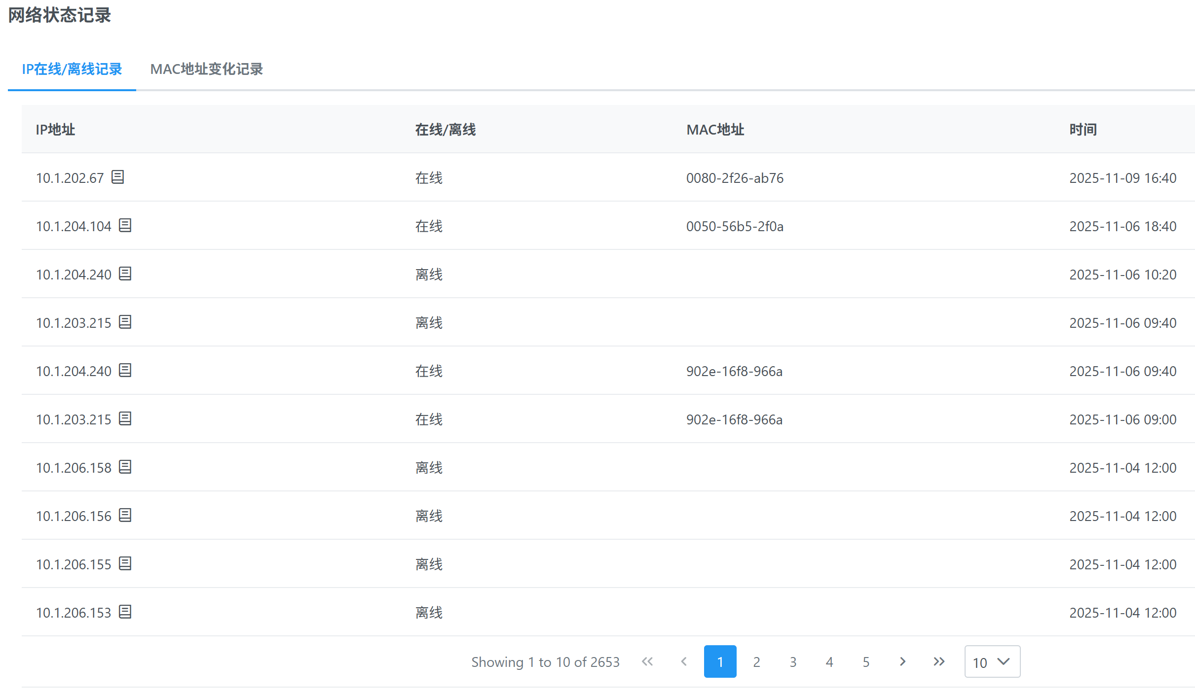
IP Online / Offline Logs
Derived from changes in the core switch ARP table.
Provides an overview of all IP online/offline events, or detailed history for a single IP addresses.
IP Address
Online / Offline
MAC Address
Time

Slide 14
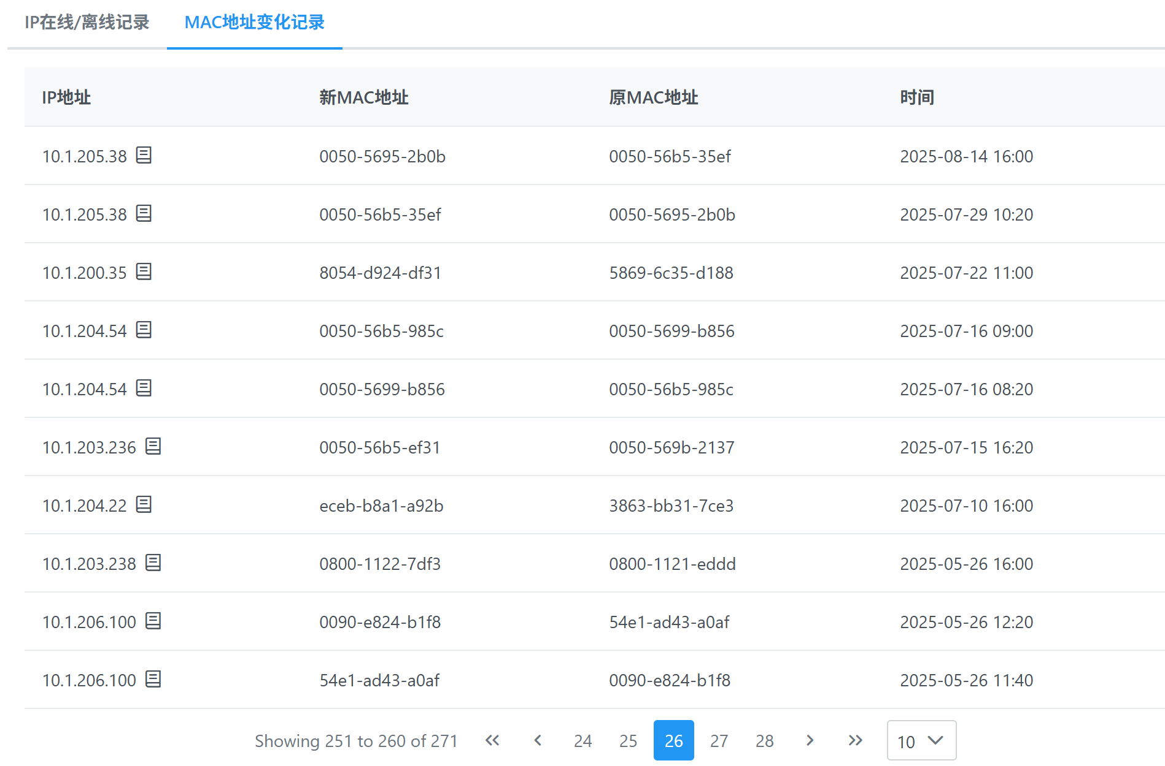
MAC Address Change Logs
Similarly, the system records MAC address changes.
Used to detect device changes.
IP Address
New MAC Address
Previous MAC Address
Time

Slide 15
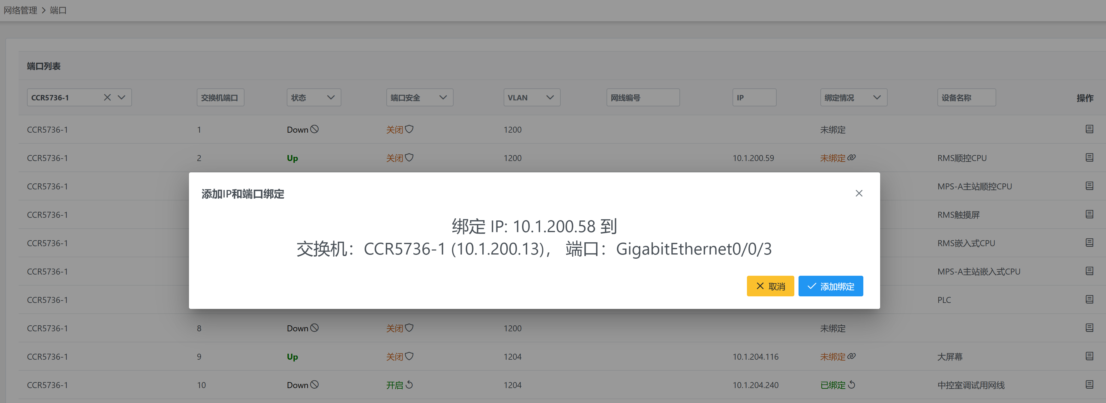
Network Access Control
Access control based on IP-port binding.
With MAC address binding, replacing a device requires re-registration.
With IP-and-port binding, a replacement device simply needs to be configured with the same IP address and connected to the same port.
Bind IP 10.1.200.58 to switch CCR5736-1 (10.1.200.13), port GigabitEthernet0/0/3

Slide 16
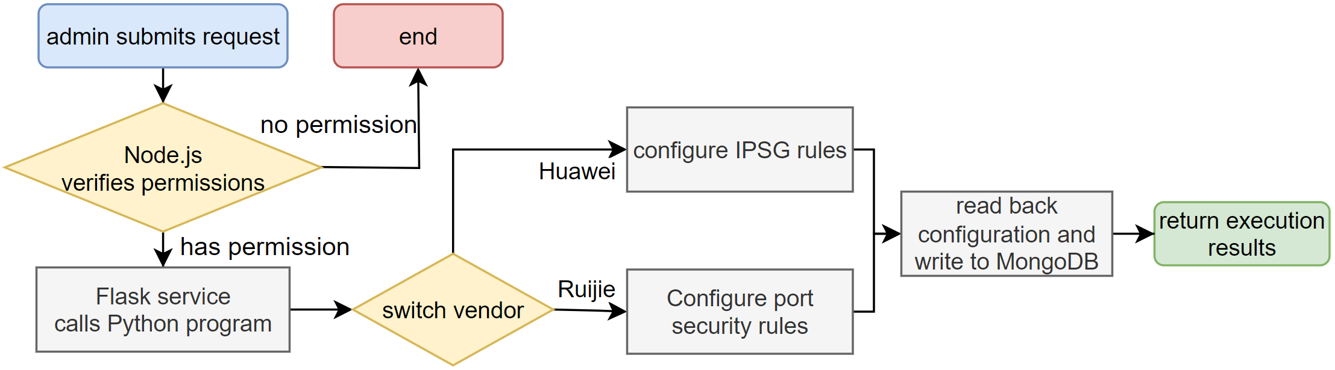
IP-port binding depends on switch hardware: Huawei switches use IPSG rules, while Ruijie switches use port-security rules.
IP Address and Switch Port Binding Workflow

Slide 17
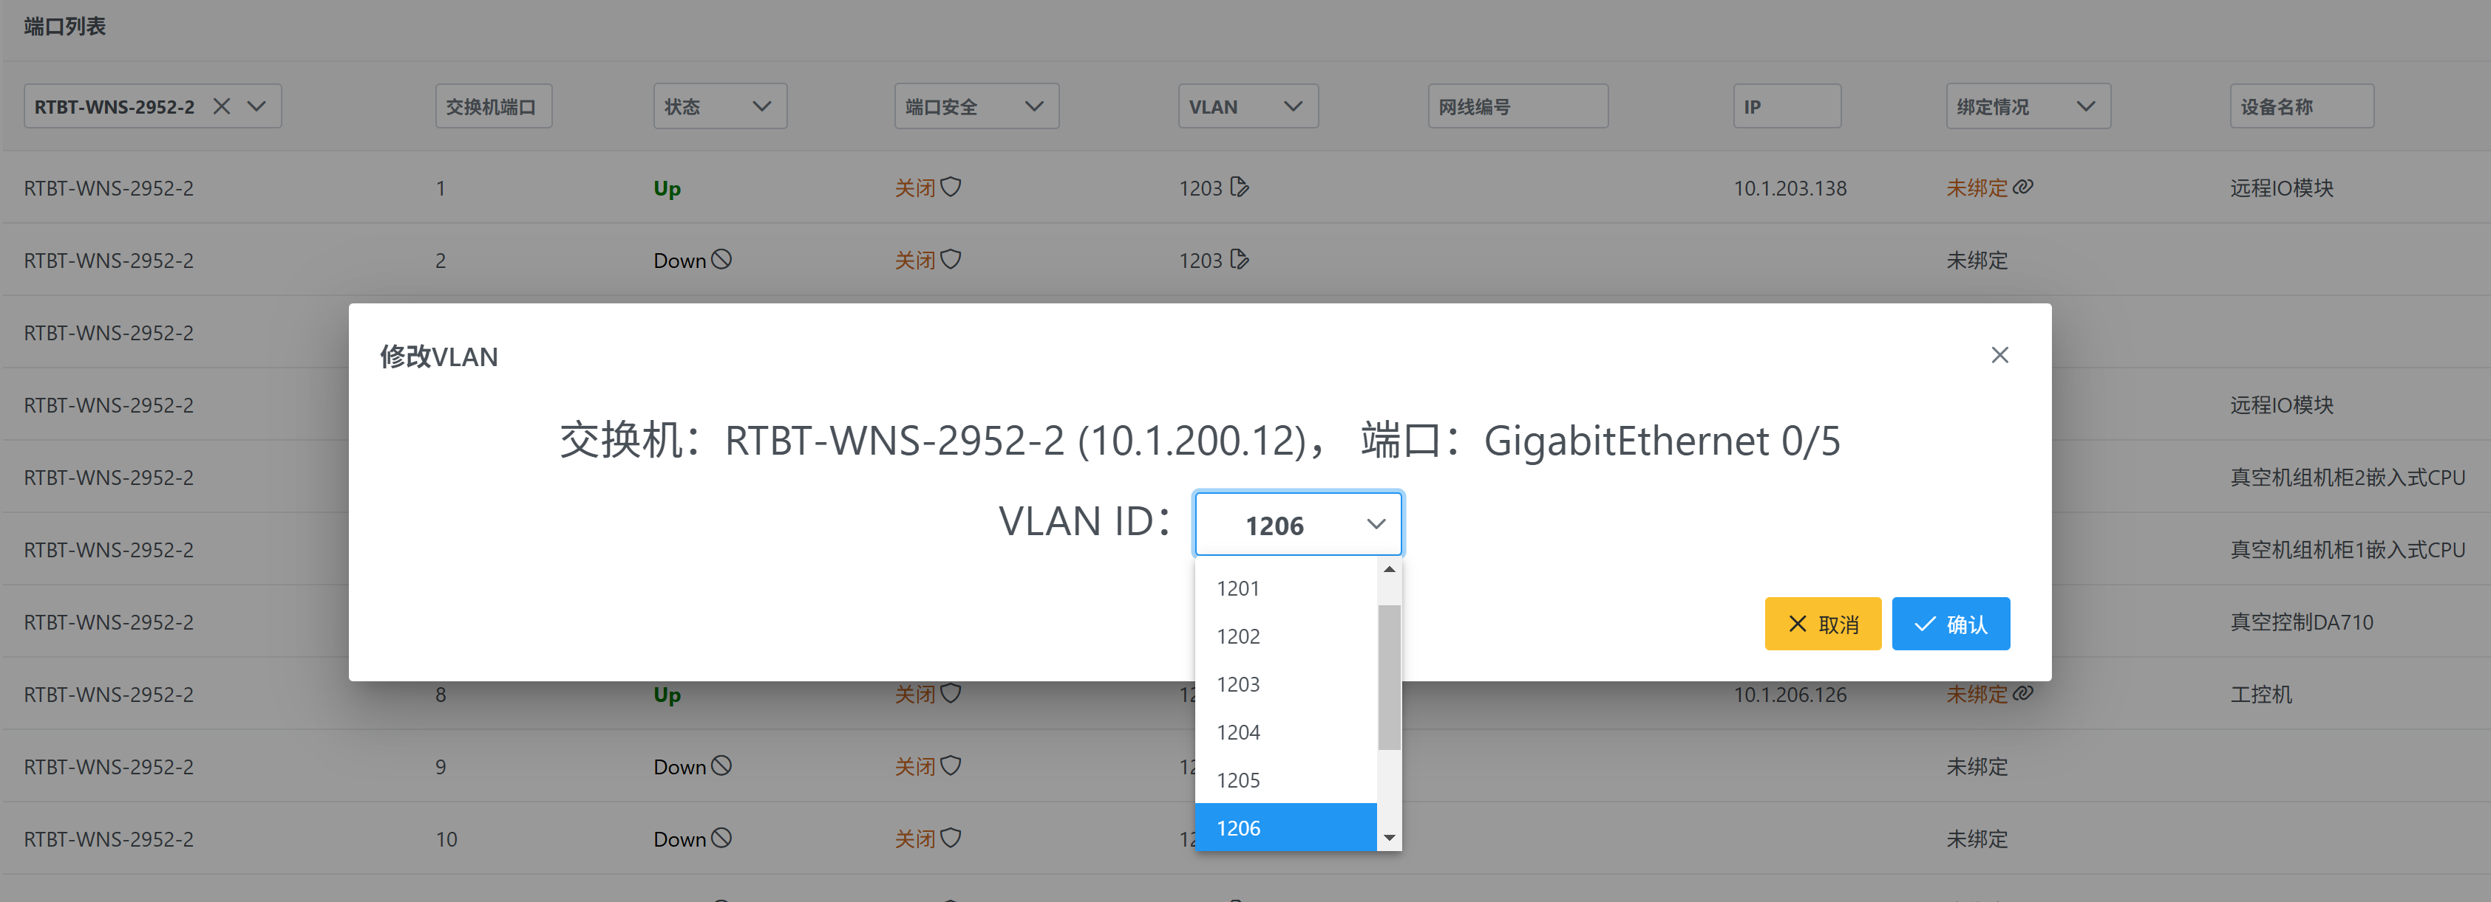
Change Port VLAN
Unlike generic tools, this page also shows whether the port is assigned, plus the related IP address and device information.

Slide 18
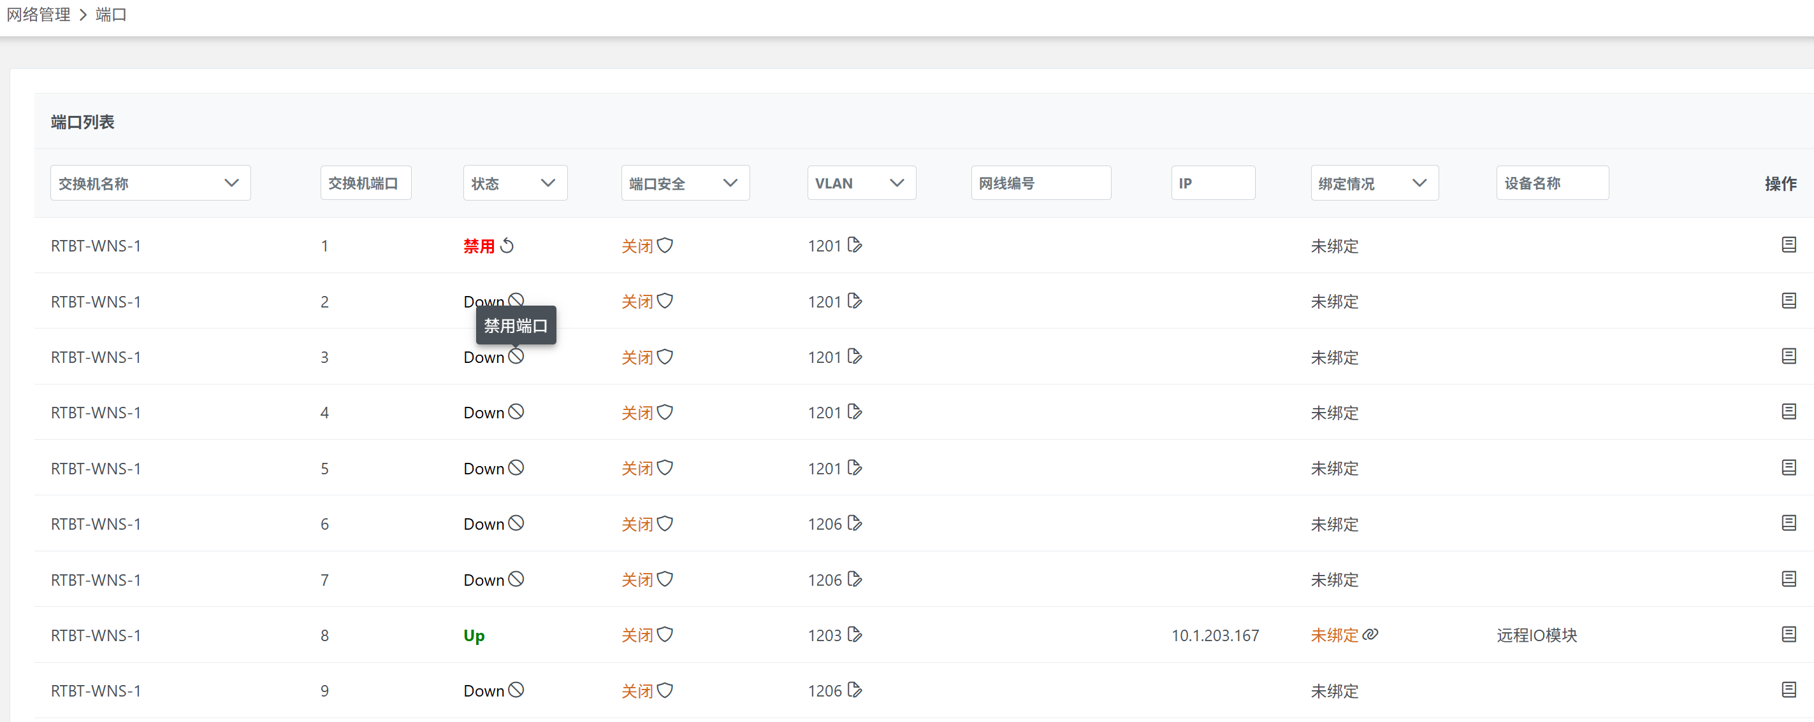
Disable / Enable Ports
Unassigned ports can be viewed and disabled on the page to reduce security risks.
Disabled Port

Slide 19
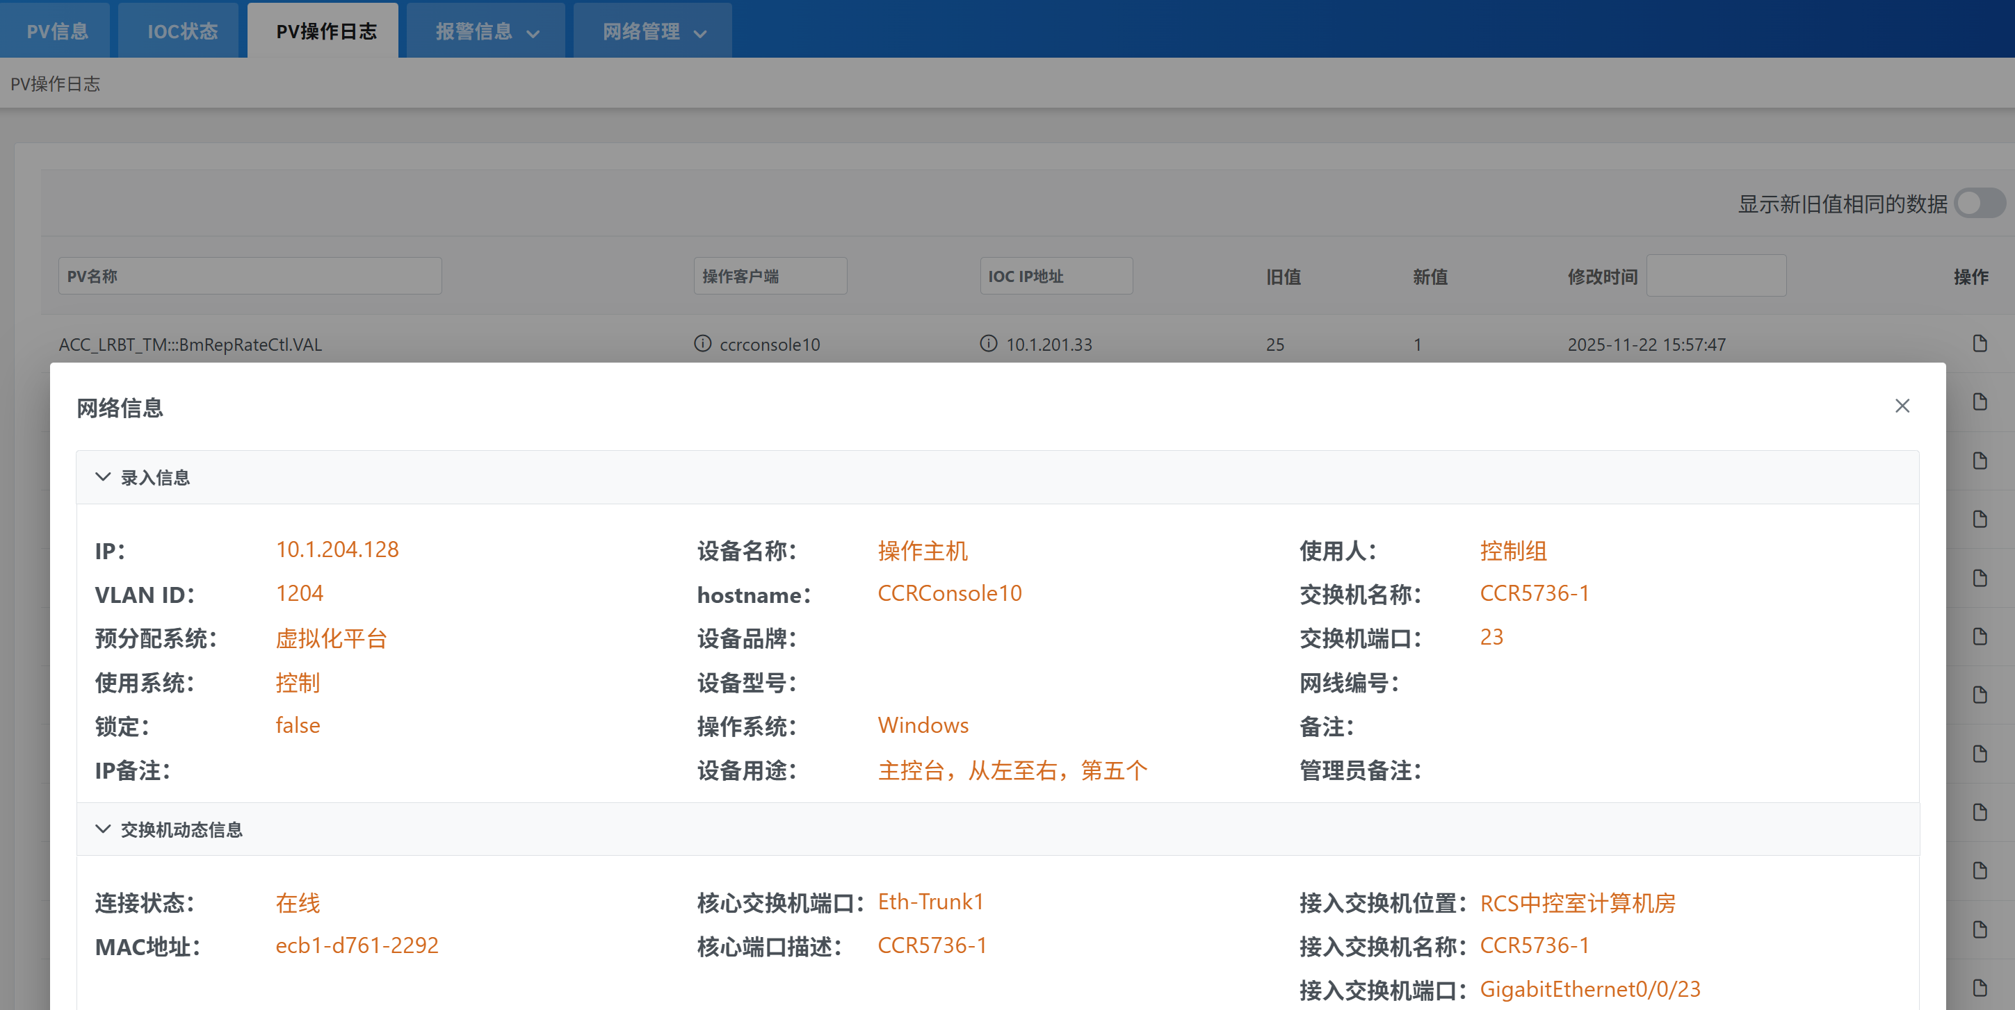
Integration with Other Systems
For example, caPutLog mainly records the hostname of the operating host. After linking with this system, a hostname can be mapped to the exact control-room computer.

Slide 20
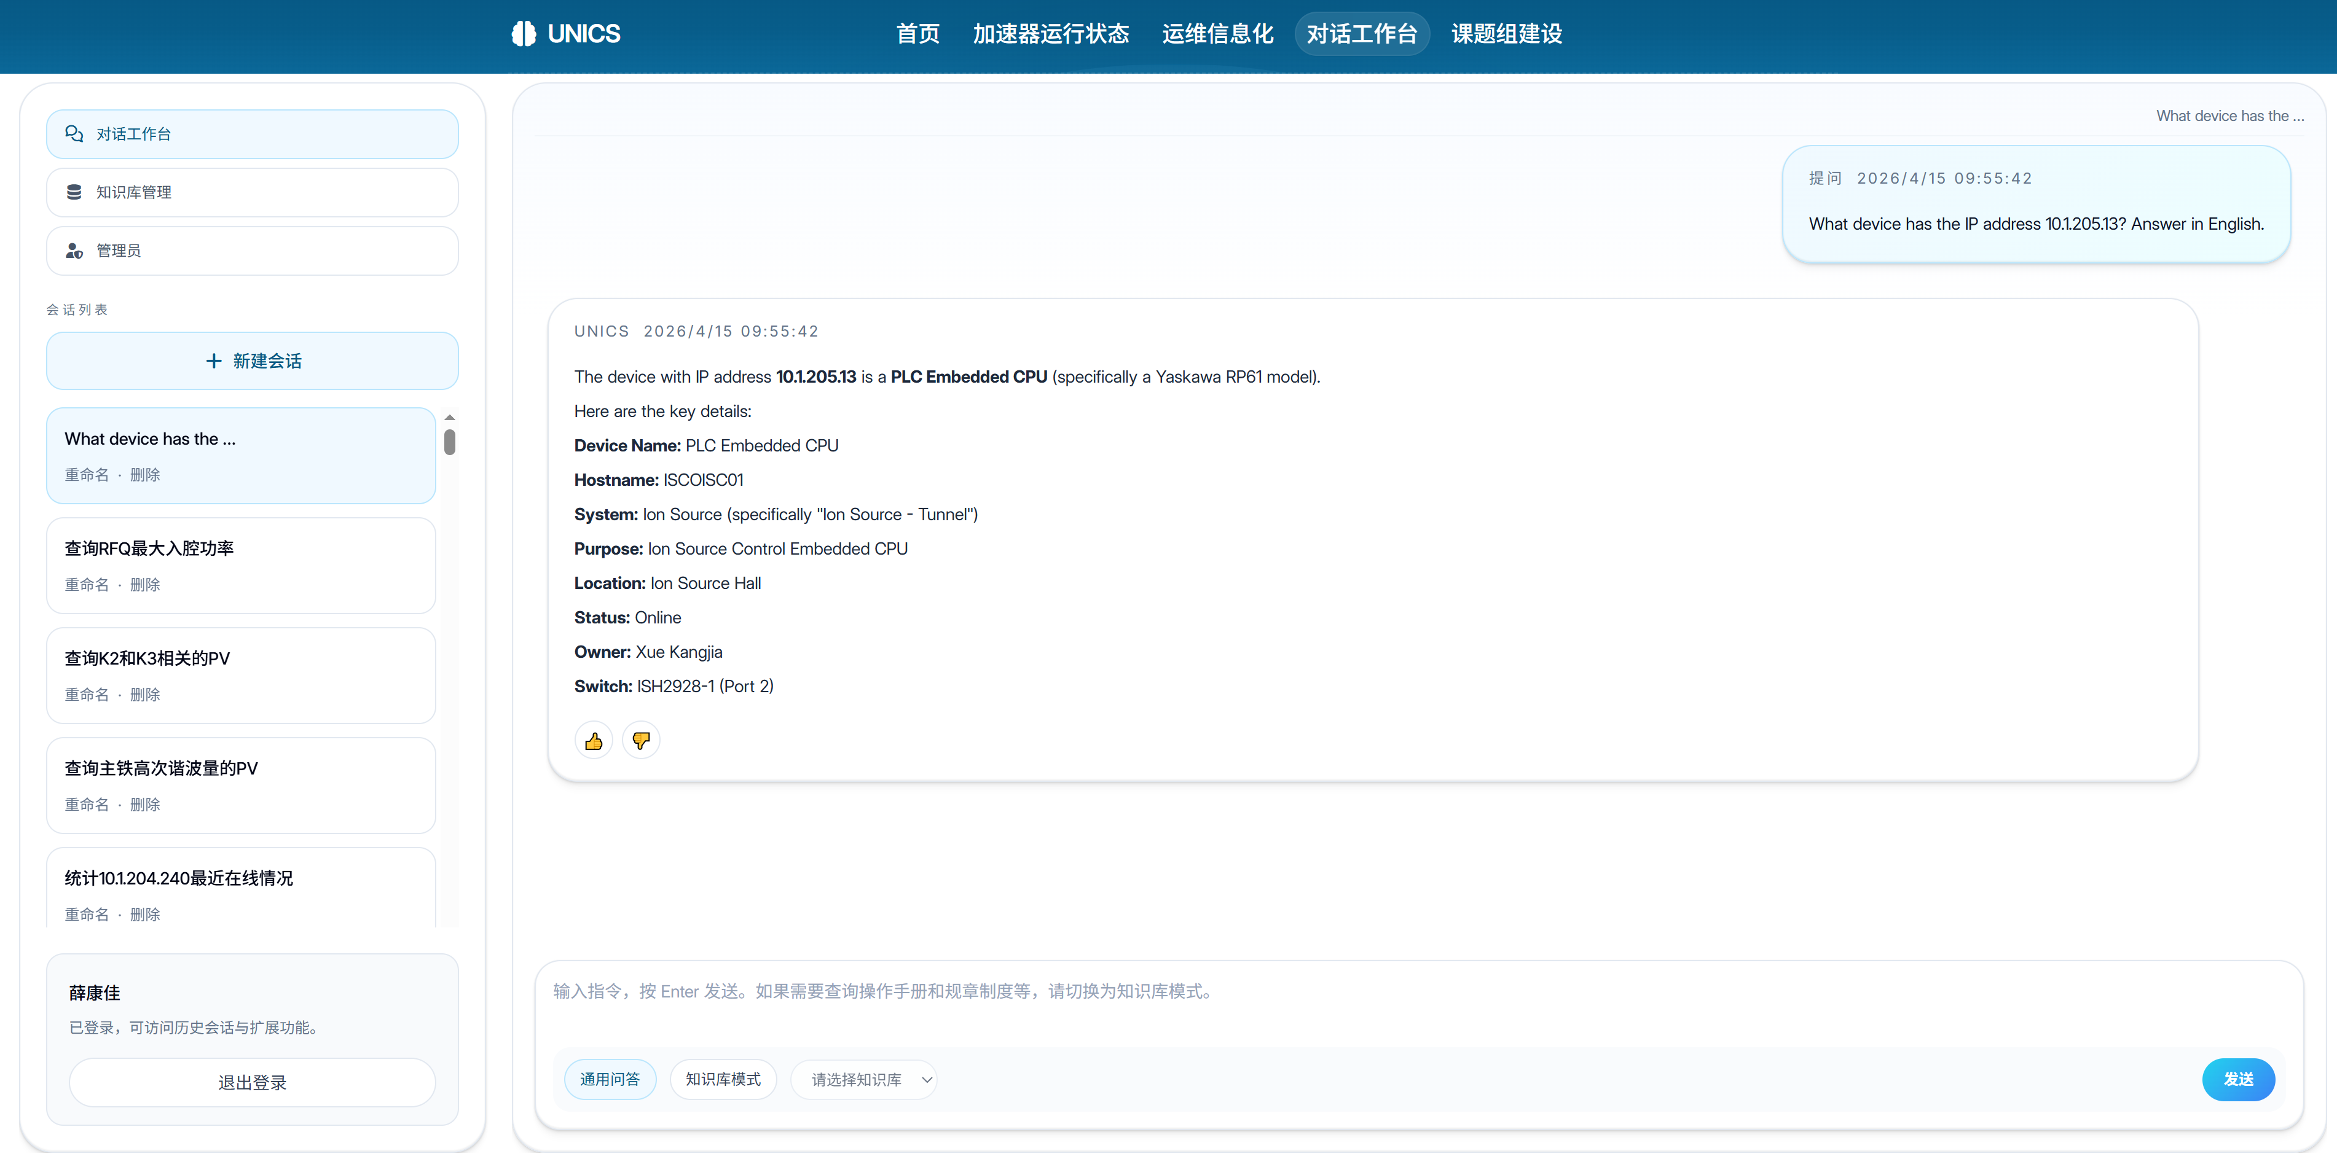
The system also provides an API for AI-assisted queries.

Slide 21
Thank You

