Slide 1


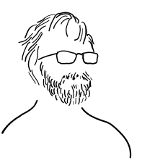
Timing, MPS and control of the beam operation at SARAF
Alexis Gaget IRFU / DIS /LDISC

Slide 2
SARAF
1

Slide 3

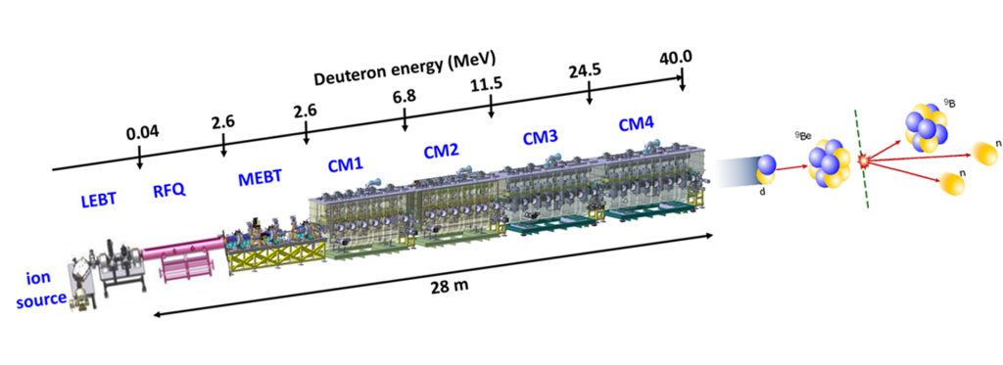

SARAF Accelerator
04
Phase 1
Phase 2

Slide 4

Timing System
2

Slide 5
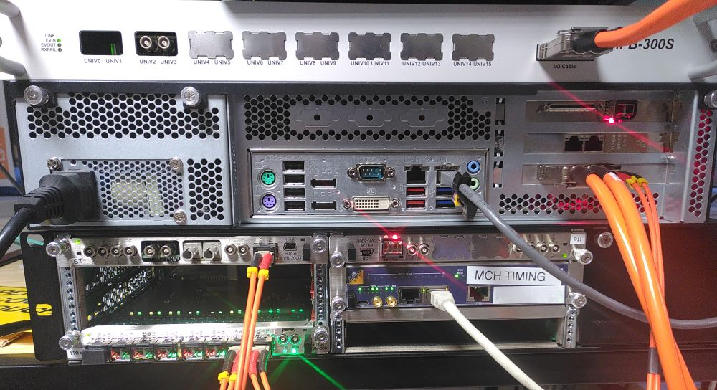
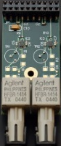
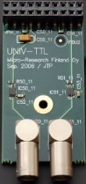
Micro Research Finland (MRF) based
Industrial PC
IFB300SAM
IPC Kontron
PCIe-EVR300DCS
MTCA.4
NAT R2 crate + MCH PHYS80
+ MCH-COMEXe3
MTCA-EVR-300U
MTCA-EVM-300
Universal Modules
TTL 5V output
TTL input
Optical fiber
« You don’t know MRF ? Come to the Timing Workshop on Thursday »

Slide 6
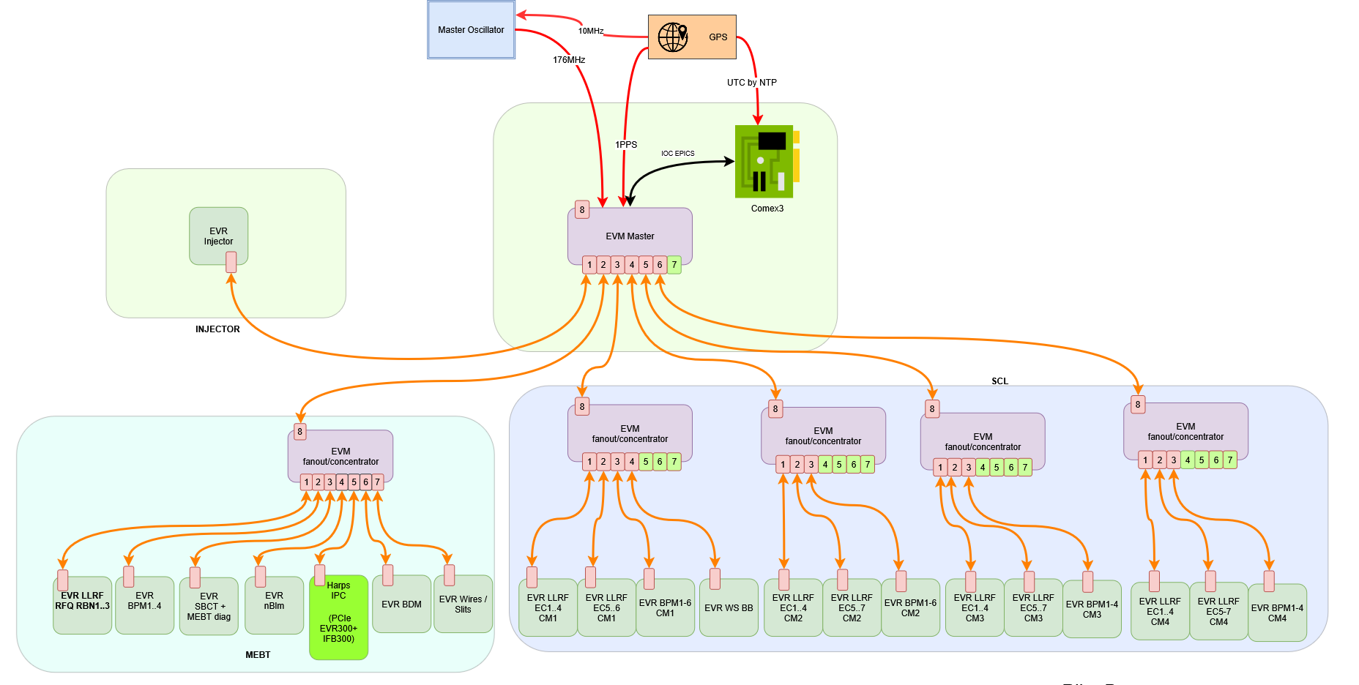
Timing Topology
Timing System, Micro Research Finland (MRF) based:
5 EVMs
20 EVRs
176MHz Clock + Meridian GPS (PPS, 10MHz, NTP server)
Distribute timestamping and synchronization
HEBT is not in our scope (but room planned for it)
10/02/2023

Slide 7
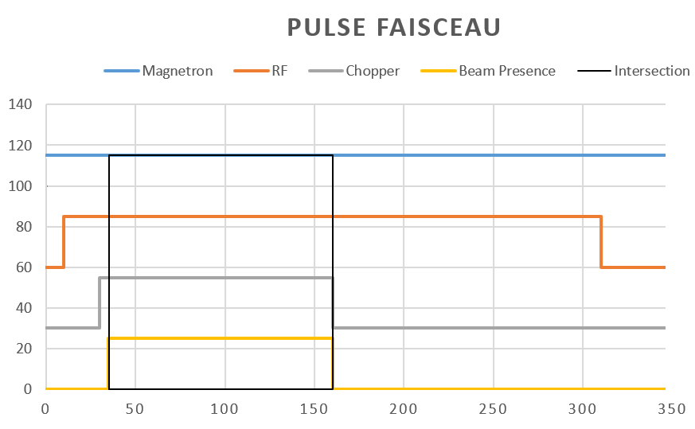
Pulse Generation
Produced by EVM sequencer

Slide 8
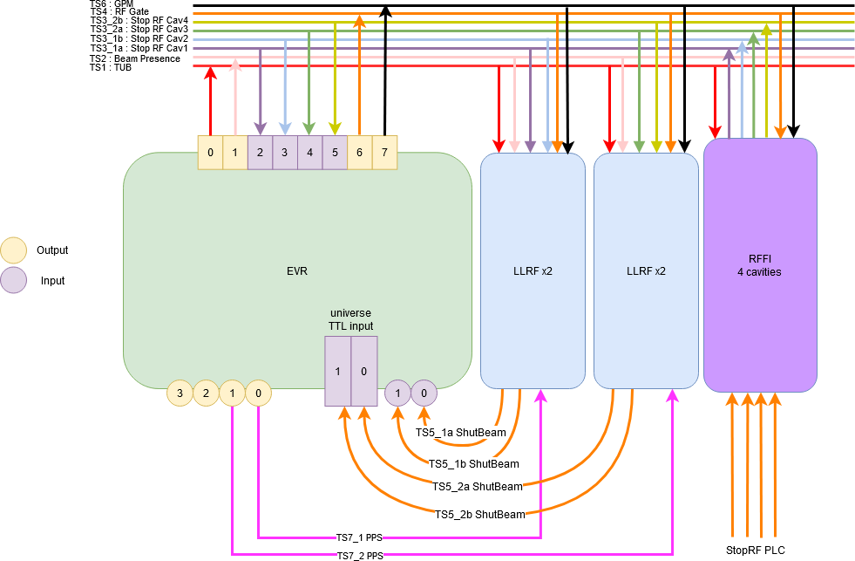
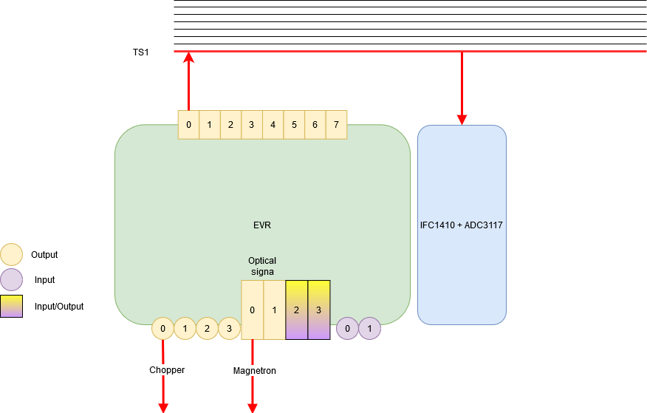
Some MTCA EVR examples
MTCA Backplane
MTCA Backplane
EVR Injector
EVR LLRF

Slide 9
Machine Protection System
2

Slide 10
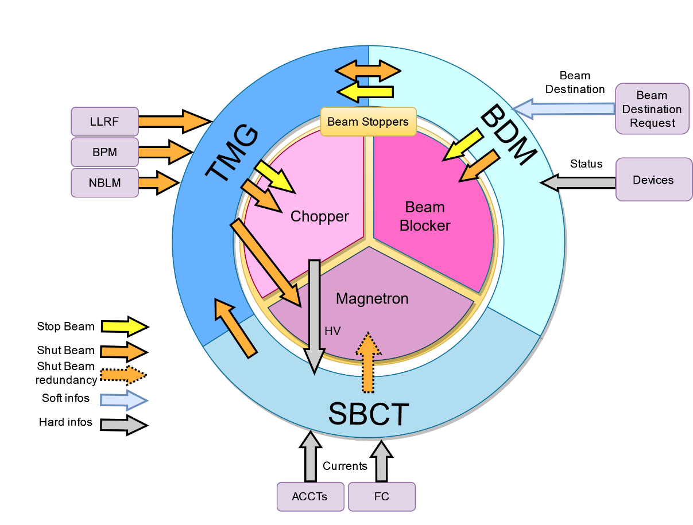
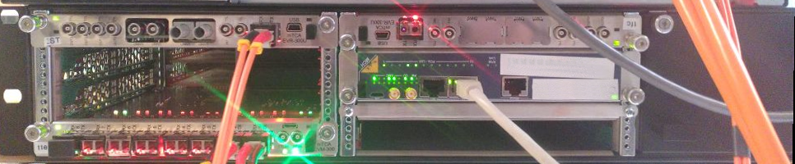
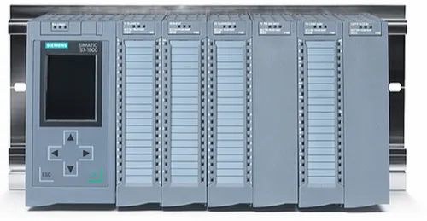
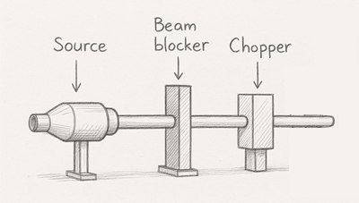
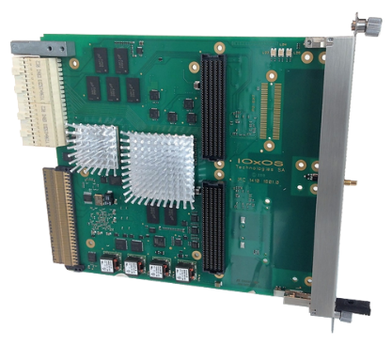
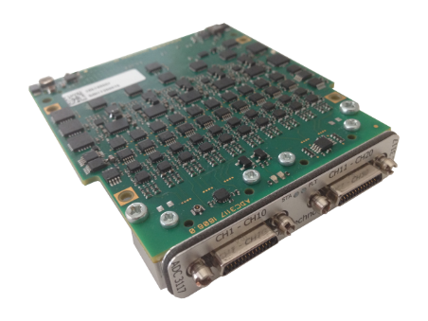
Machine Protection System
Beam destination master (BDM) controls that conditions to get the beam to a destination are checked. Linked to all PLC all along the accelerator through Profinet
Timing (TMG) is the heart of the MPS creating or shutting the beam pulse through chopper and magnetron and being the messenger of the shutbeam event
Section Beam Current Transmission is checking current of the beam all along the accelerator and compare them.

Slide 11
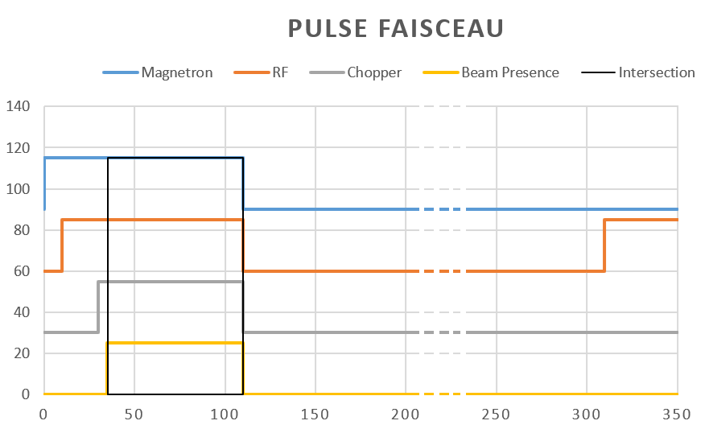
Machine Protection System
During a shutbeam
All the pulses are immediatly interrupted
Sequence continue, but Beam Presence and Chopper pulses are masked
Shutbeam

Slide 12
Timing + MPS
Each of these EVRs is part of the MPS.
The EVR Injector is the one that will shut down, chopper and magnetron,
The EVR BDM is the link with the PLC BDM; requests to shut the beam will come from there.
The EVRs LLRF will cut the RF and request a shutbeam.
The EVRs SBCT and BPM will request a shutbeam.
10/02/2023

Slide 13
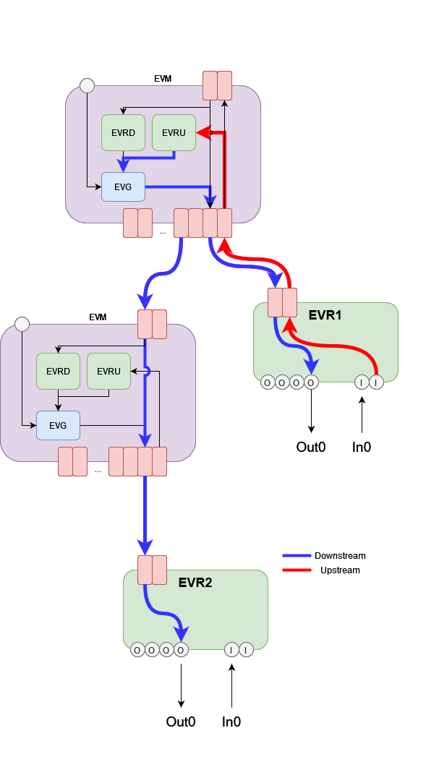
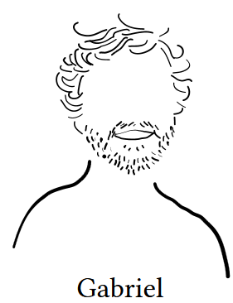
Timing + MPS
Use of the upstream event principle
An input of the EVR is triggered, and an event is sent upstream and redistributed by the EVM Master to all EVRs.
Cons: Cannot use delay compensation because MPS events cannot be delayed.
=> Recently solved by Jukka: creation of a priority event that is not delayed. Presentation and demonstration during the Timing Workshop. Gabriel (CEA) has almost finished integrating this new function into the mrfioc2 EPICS driver.

Slide 14

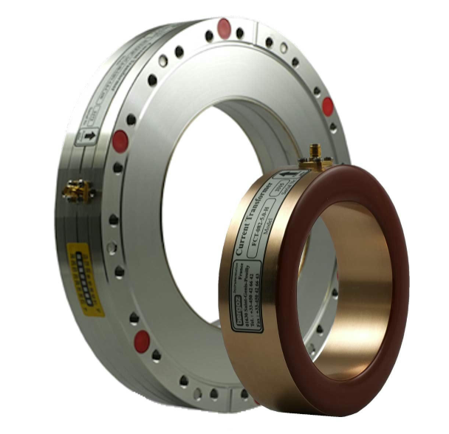
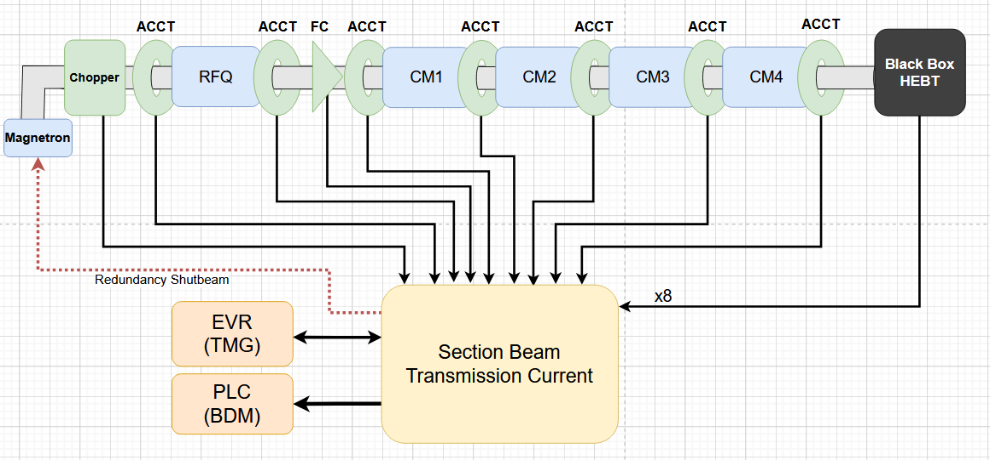
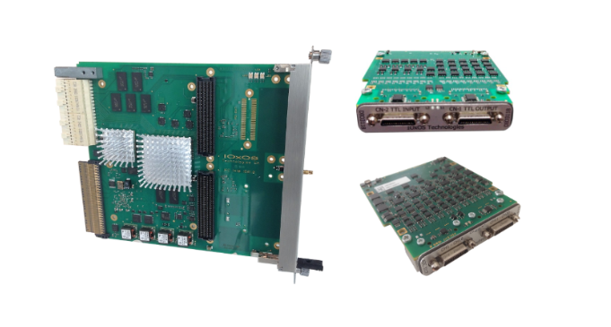
Section Beam Current Transmission (SBCT)
The Section Beam Current Transmission checks the beam current along the accelerator and compares the measurements (ACCTs, Faraday cups, chopper…).
MTCA IOxOS based :
ADC3117 : 20 channels, 5 MSamples/sec, ±10 V
DIO3118 datasheet : 16 I/O
MTCA.4 AMC : IFC1410 (FPGA Xilinx Kintex Ultrascale + CPU PPC)

Slide 15
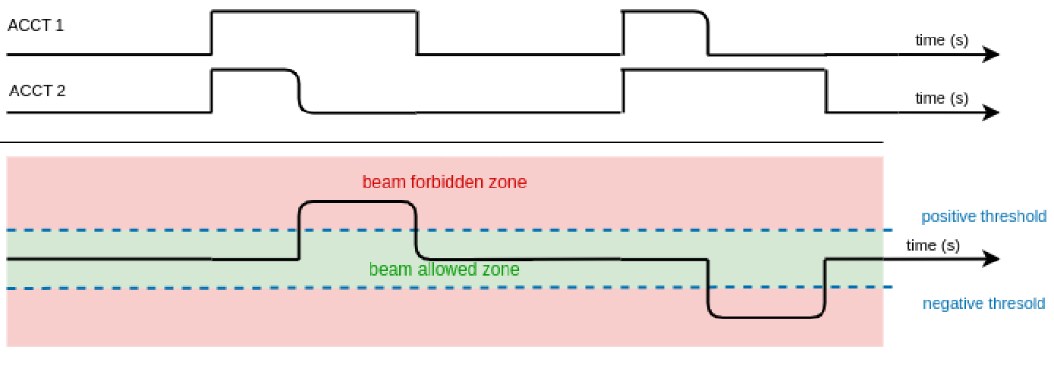
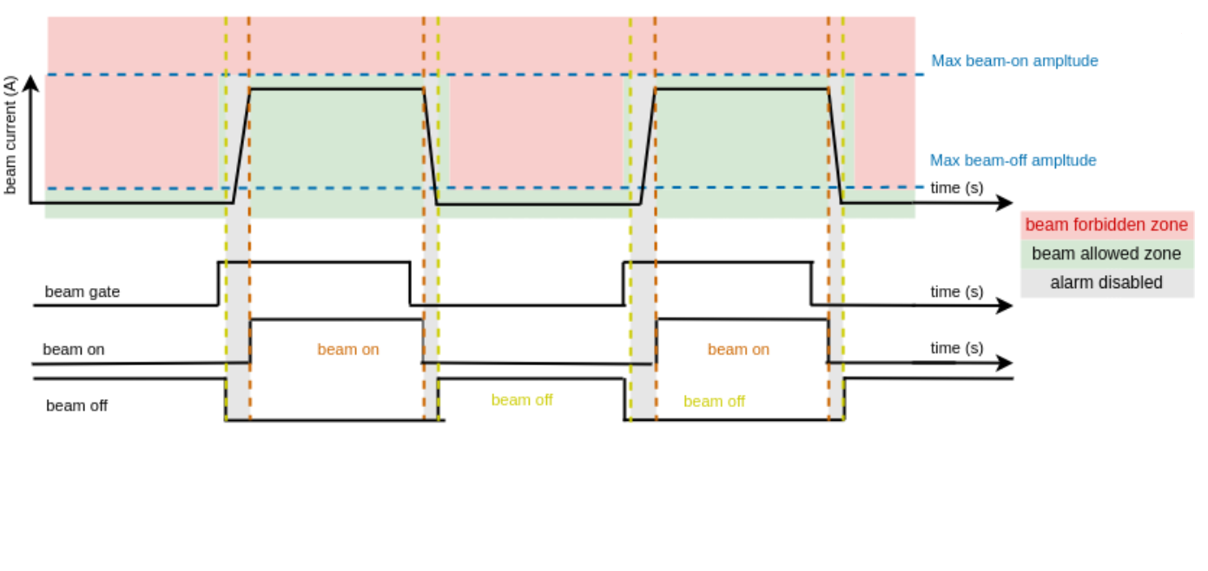
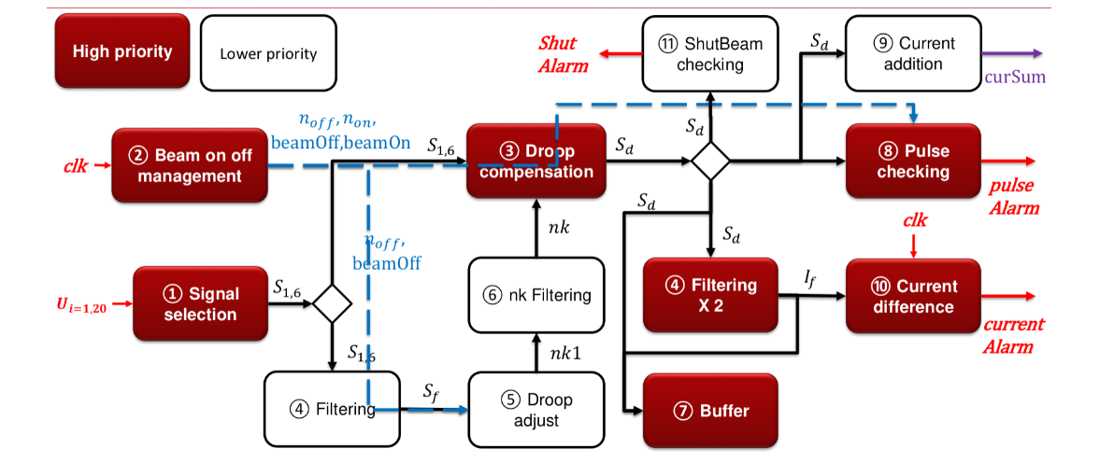
Section Beam Current Transmission (SBCT)
Different functions implemented
Current differences
Beam Amplitude checking
Beam On/Off management
Etc …

Slide 16
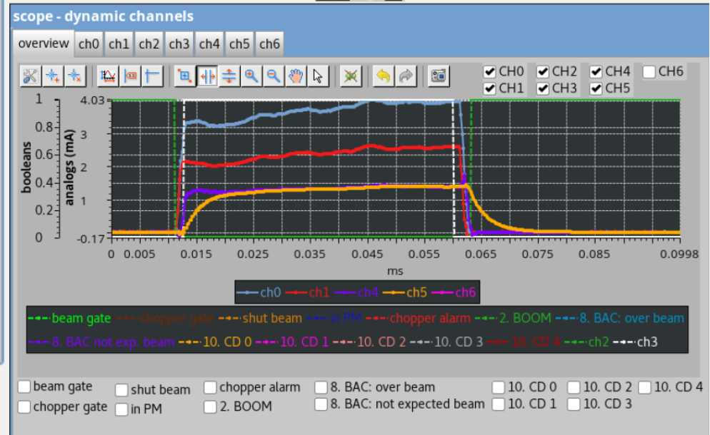
Section Beam Current Transmission (SBCT)
EPICS
epicsComGen or “Epics comme j’aime” : generates communication between FPGA registers and EPICS PVs
1300 PVs EPICS

Slide 17
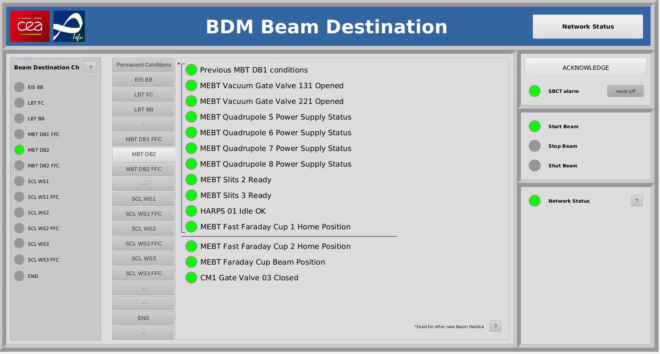

Beam Destination Master (BDM)
Beam destination master (BDM) controls that conditions to get the beam to a destination are checked. Linked to all PLC all along the accelerator through
Siemens PLC based
S7PLC (read) / Modbus (write) (no opc-ua yet at the time)
PLCParsertool generate communication between PLC registers and EPICS PVs

Slide 18
Beam control
2

Slide 19
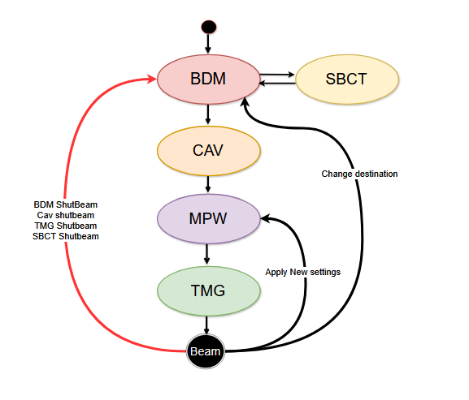
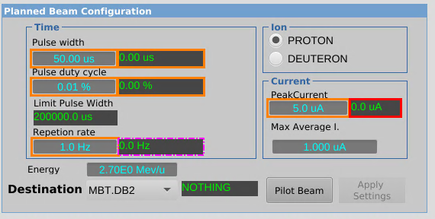
Beam control
When the operator asks for a pilot beam (default configuration: 1 Hz, 50 µs), the following SNL sequence is launched.
Example of configuration for destination MEBT Diagnostic box 2

Slide 20
Beam control
When the operator asks for a pilot beam (default configuration: 1 Hz, 50 µs), the following SNL sequence is launched.
Beam Destination master (BDM)
Check Beam condition for a beam destination
Example of configuration for destination MEBT Diagnostic box 2

Slide 21
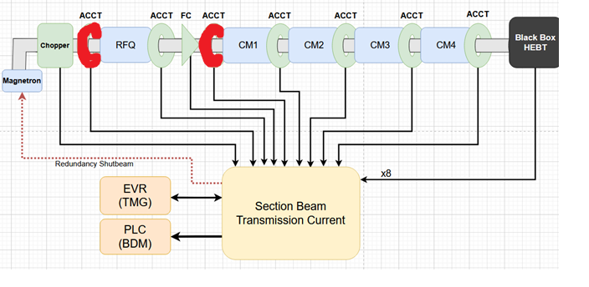
Beam control
When the operator asks for a pilot beam (default configuration: 1 Hz, 50 µs), the following SNL sequence is launched.
Beam Destination master (BDM)
Check Beam condition for a beam destination
Section Beam Current Transportation (SBCT)
Configure security to reach a beam destination.
Example of configuration for destination MEBT Diagnostic box 2

Slide 22
Beam control
When the operator asks for a pilot beam (default configuration: 1 Hz, 50 µs), the following SNL sequence is launched.
Beam Destination master (BDM)
Check Beam condition for a beam destination
Section Beam Current Transportation (SBCT)
Configure security to reach a beam destination.
Cavity Application (CAV)
Check that every cavity up to the beam destination is up and ready.
A cavity is READY for operation if :
the LLRF is ON,
the LLRF is in regulation mode,
the measured accelerating voltage has reached the target accelerating voltage and is stable enough,
the external alarm is enabled.
Example of configuration for destination MEBT Diagnostic box 2 : RFQ + 3 Rebunchers

Slide 23
Beam control
When the operator asks for a pilot beam (default configuration: 1 Hz, 50 µs), the following SNL sequence is launched.
Beam Destination master (BDM)
Check Beam conditions for a give beam destination
Section Beam Current Transportation (SBCT)
Set correct configuration to reach a beam destination.
Cavity Application (CAV)
Checks that every cavity up to the beam destination is up and ready.
Max Pulse Width (MPW)
According to the destination and inserted elements, authorize a maximum current to avoid damaging any equipment.
For destination MEBT Diagnostic box 2 FFC , the beam hits a Fast Faraday Cup, which is a fragile equipment, so only a very low beam current is authorized.

Slide 24
Beam control
When the operator asks for a pilot beam (default configuration: 1 Hz, 50 µs), the following SNL sequence is launched.
Beam Destination master (BDM)
Check Beam condition for a beam destination
Section Beam Current Transportation (SBCT)
Configure security to reach a beam destination.
Cavity Application (CAV)
Check that every cavity up to the beam destination is up and ready.
Max Pulse Width (MPW)
According to destination and element inserted will authorize a maximum current in order to do not damage any equipment.
Timing (TMG)
Checks that the optical fiber network up to this destination is working properly.

Slide 25
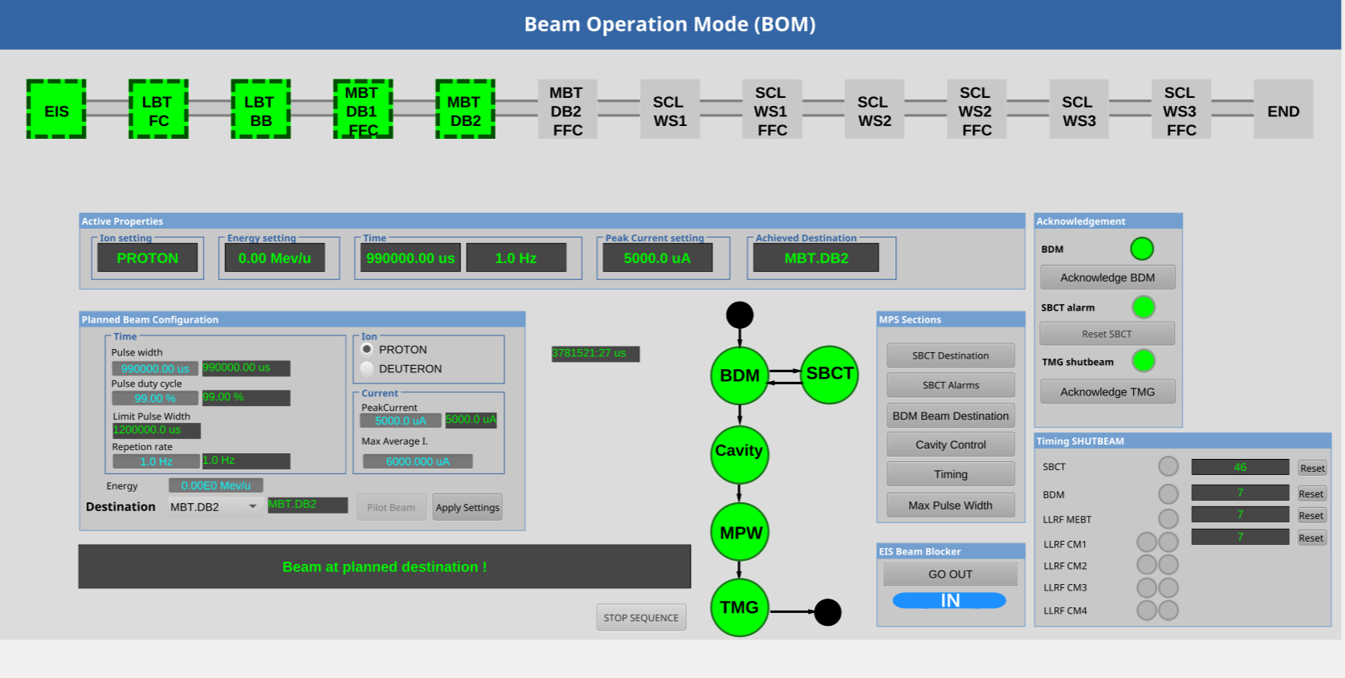
Beam control

Slide 26

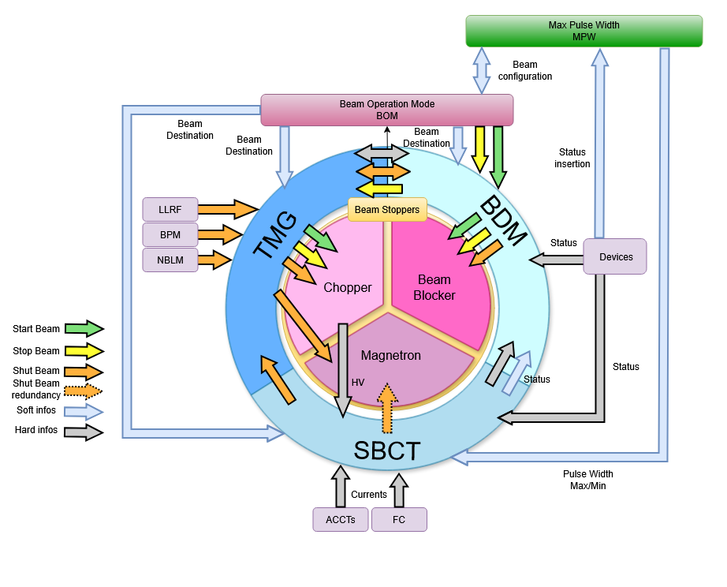
Conclusion
For now it gives great satisfaction for the commissioning of the MEBT of SARAF.
SBCT is still in active development and testing.
We hope to test everything soon with the first cryomodule.
Perspective
MRF will be used for Titan accelerator in Saclay (MPS not included this time)
MRF + MPS architecture has been proposed for pre-project for ICONE accelerator.
(“Introduction to the software and hardware platforms for the Pre-Project of the ICONE Accelerator – Spring EPICS Meeting 2025)

Slide 27


Merci
MRF TIMING SYSTEM DESIGN AT SARAF
October 2021
DOI: 10.18429/JACoW-ICALEPCS2021-THPV022
MACHINE PROTECTION SYSTEM AT SARAF
October 2023
DOI:
10.18429/JACoW-ICALEPCS2023-THPDP102
EPICS CONTROL SYSTEM FOR BEAM OPERATION AT SARAF LINAC ACCELERATOR
September 2025
DOI:
10.18429/JACoW-ICALEPCS2025-THPD098
CEA SACLAY
alexis.gaget@cea.fr

Slide 28
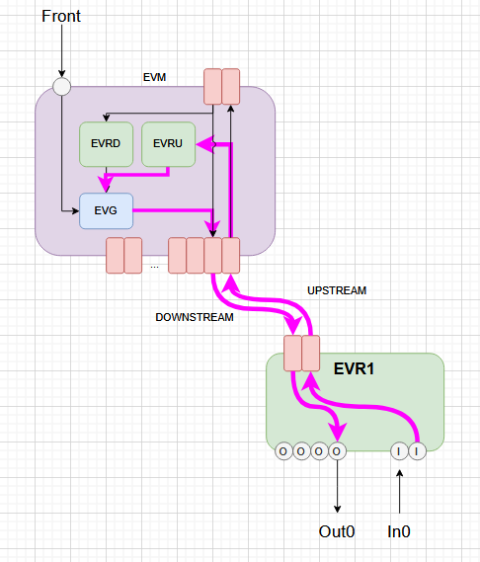
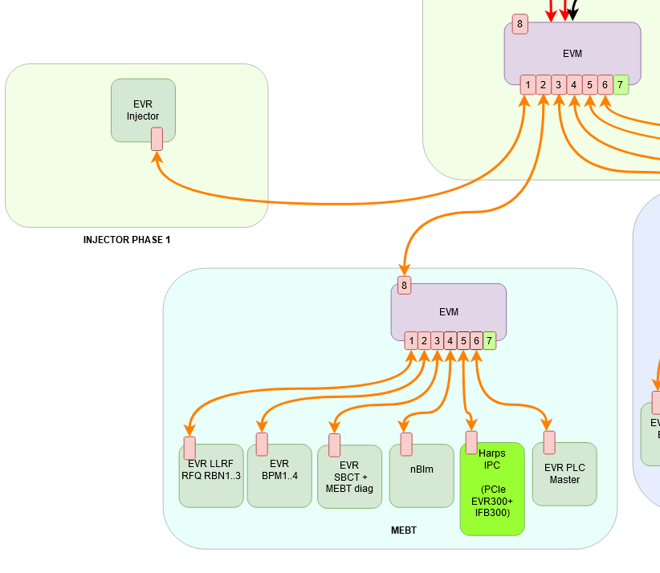
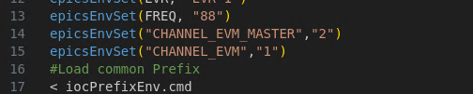
Check Optical fiber connection
Check TX (upstream) connexion.
Native in the driver through PV $(PREFIX):Link-Sts
Check RX (downstream) connexion
Not native in EVR, we need to use EVM informations and knowing in which positions are connected the EVR. Indicated in the cmd of the EVR
When more than 1 floor we need to know the « full path ». EVM Master + EVM Fanout
LLRF EVR configuration

Slide 29
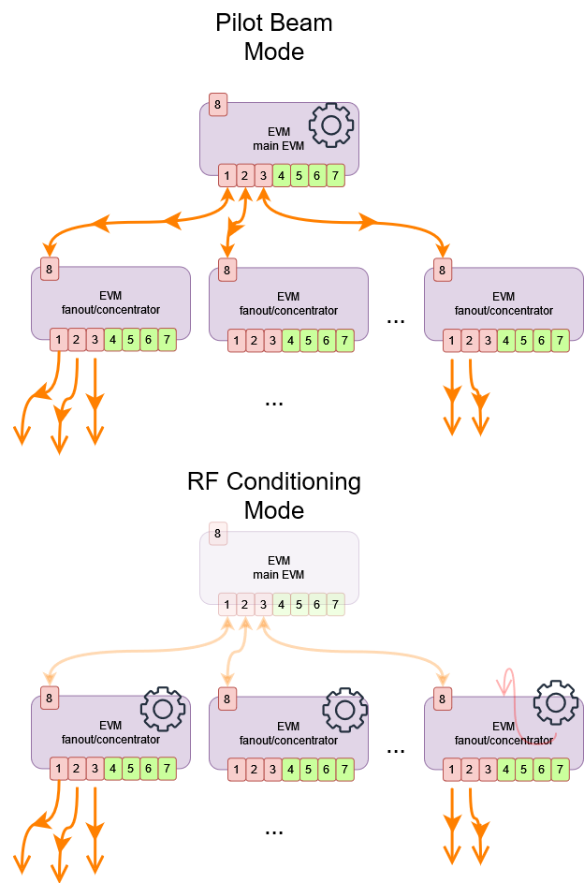
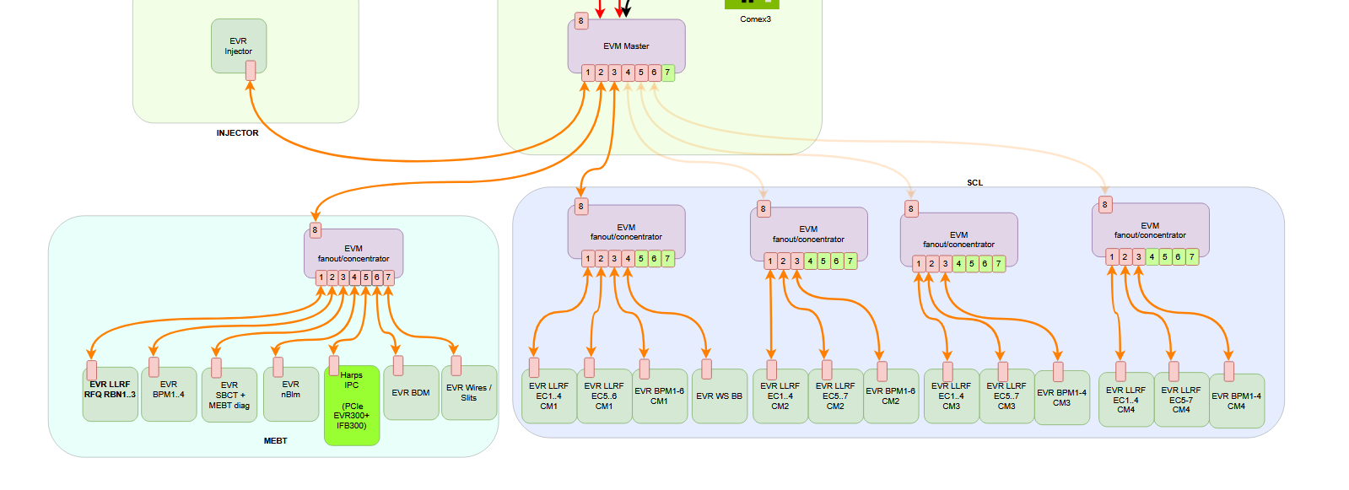
RF conditioning
Pilot Beam Mode
Standard mode where all EVMs and EVRs are connected as one tree.
Beam
RF Conditioning Mode
We can dissociate any EVM from the rest to make it autonomous.
Allows independant RF conditioning operation.
RF conditioning for cryomodule 2-3-4

