Slide 1
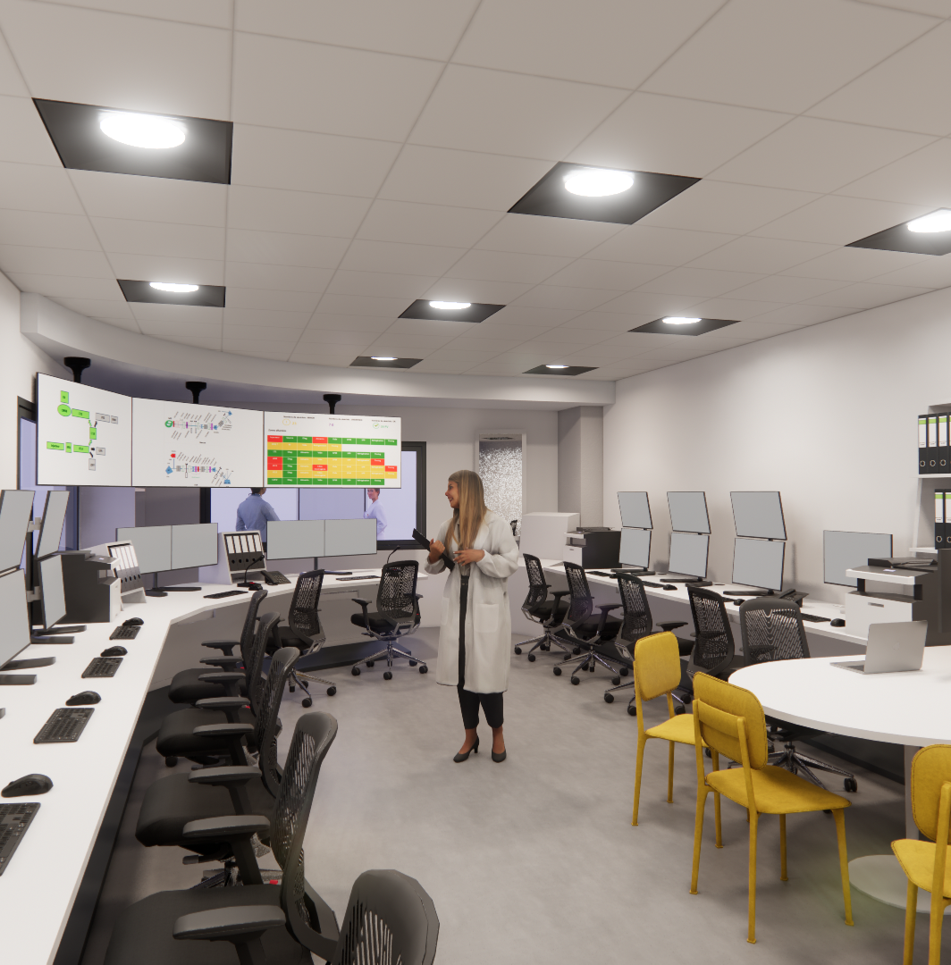

Titan accelerator status report Y. MARIETTE

Slide 2
Outlines
Project presentation
C/C presentation
C/C Status
Remaining work

Slide 3
Project presentation
1

Slide 4
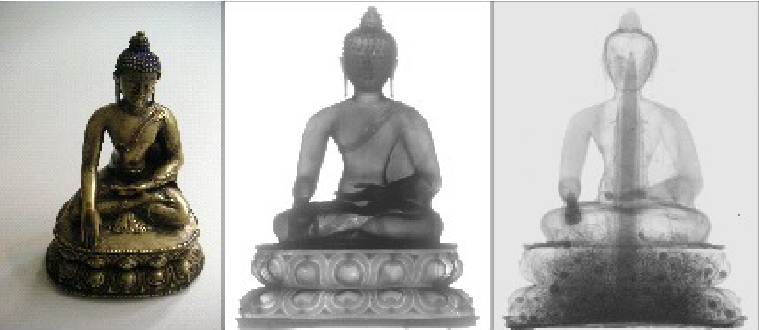
Project objective
Providing neutrons to industry
Evolving a research accelerator named IPHI (3MeV, 100 mA) built 30 years ago into an industrial accelerator
This accelerator must be designed for 30 years of operation
The Titan project aims to have two thermal neutron sources. The first source is dedicated to neutronography :
Beam parameters :
Sakyamuni, Bhumisparsa Mudra, Tibet, 14th-15th century
Wood
Dried flowers
Bronze and copper
X Ray
Neutrons (Organic/ligthweight matter)
Target | Mercury target | Mars target
Energy | 3 MeV
Power | 50 kW
Frequency | 100 Hz
Pulse duration | 7 ms | 3 ms
Mean current | 24 mA | 55 mA

Slide 5
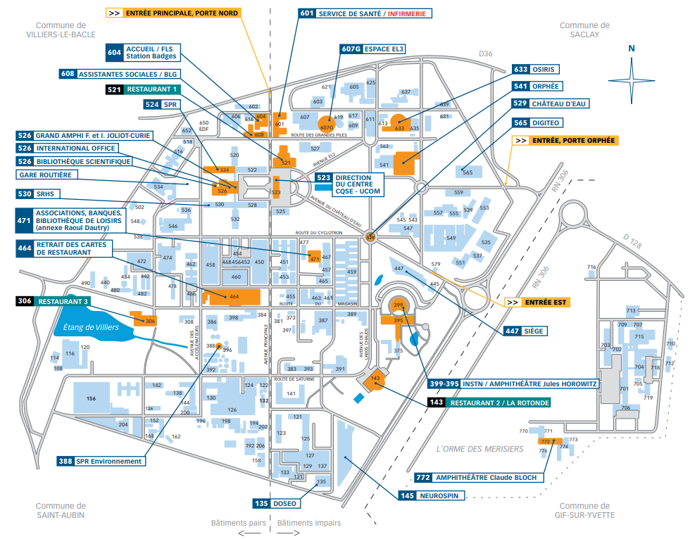
Location in CEA Saclay site
Main entrance
DIS - 472
Titan - 126

Slide 6
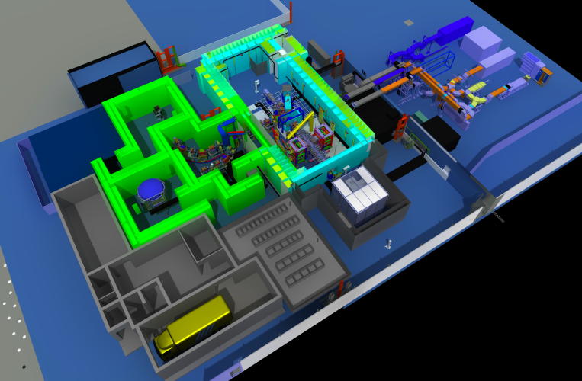
The Titan accelerator
Mars : Beryllium target
Mercury : Lithium Liquid Target
RF source (SSA)
Neutronography room
Initial IPHI accelerator space
50kW of protons at 3MeV
Notes:
Solid State amplifier

Slide 7
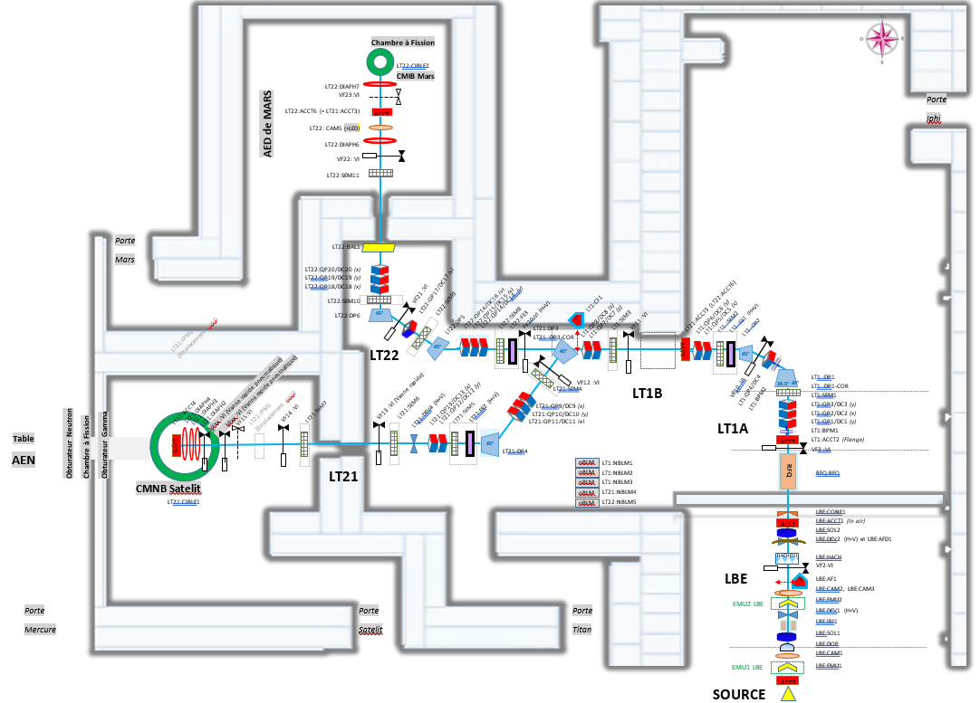
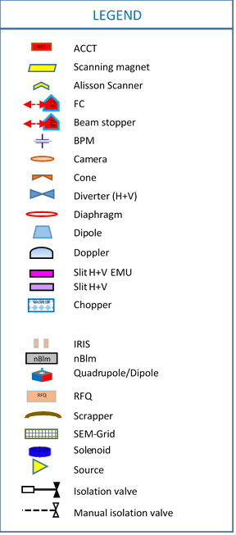
Synoptic of the accelerator processes
Mars :Beryllium target
Titan accelerator has :
36 magnets
39 diagnostics (13 types)
> 370 Components for the Vaccum
> 29 vaccum chambers
…
Mercury : Lithium Liquid Target test

Slide 8
Planning
The project started in 2019 with the study phase
Since 2021, we have been in the process of building the accelerator and, in parallel, we have manufactured the prototype of the lithium liquid target and carried out tests on this target (T4-2024)
Next milestones :
T2-2027
Start of proton commissioning
T4-2028
End of neutron commissioning
T1-2029
Start of operations
Continue the realization and installation phase
2026
2027
2028
T4-2027
End of proton commissioning
Notes:
Thermal neutron flux x2 compared to simulations !
Maintenance periods are impossible because of the target activation

Slide 9
Control-command presentation
2

Slide 10
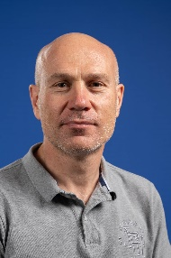
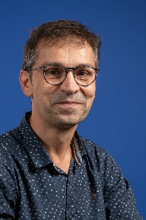
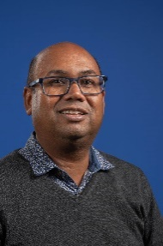
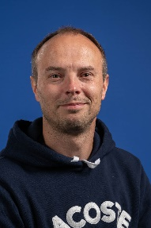
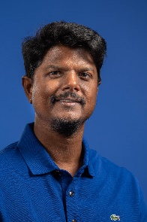

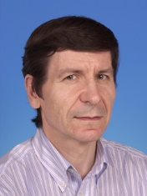
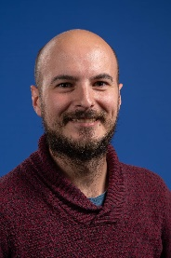
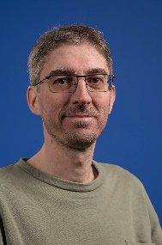
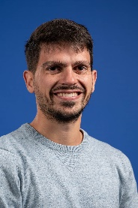


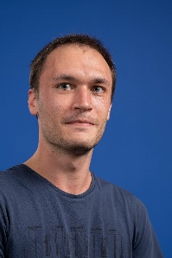

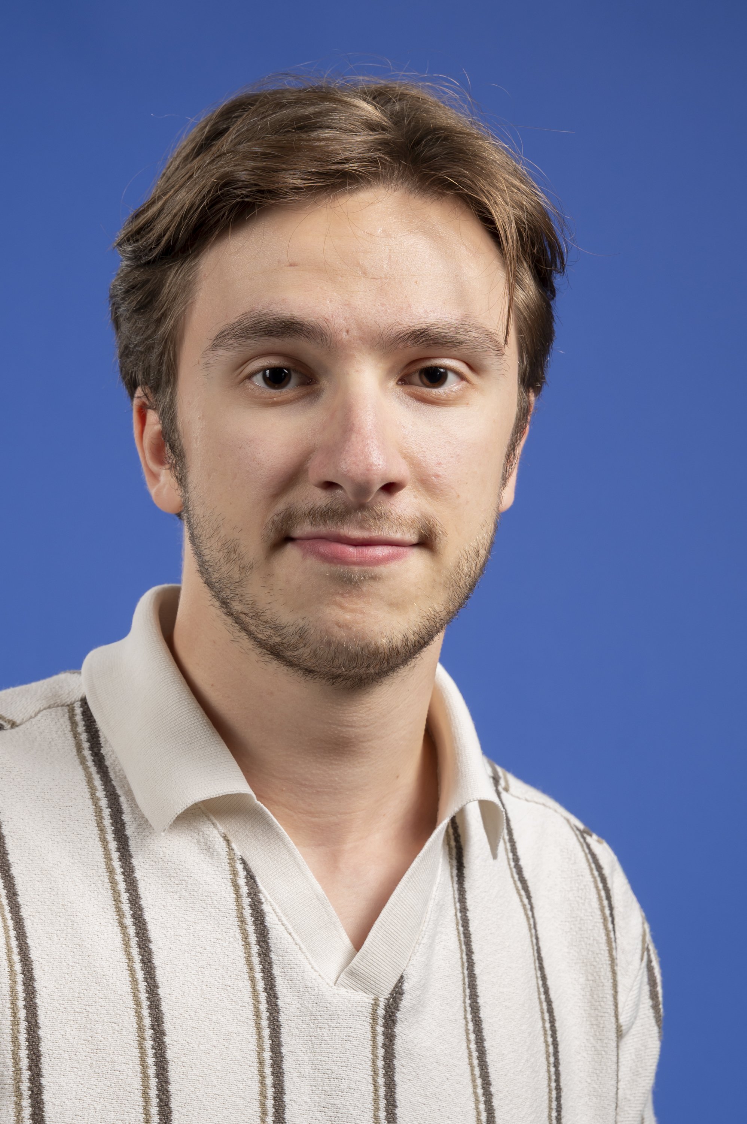
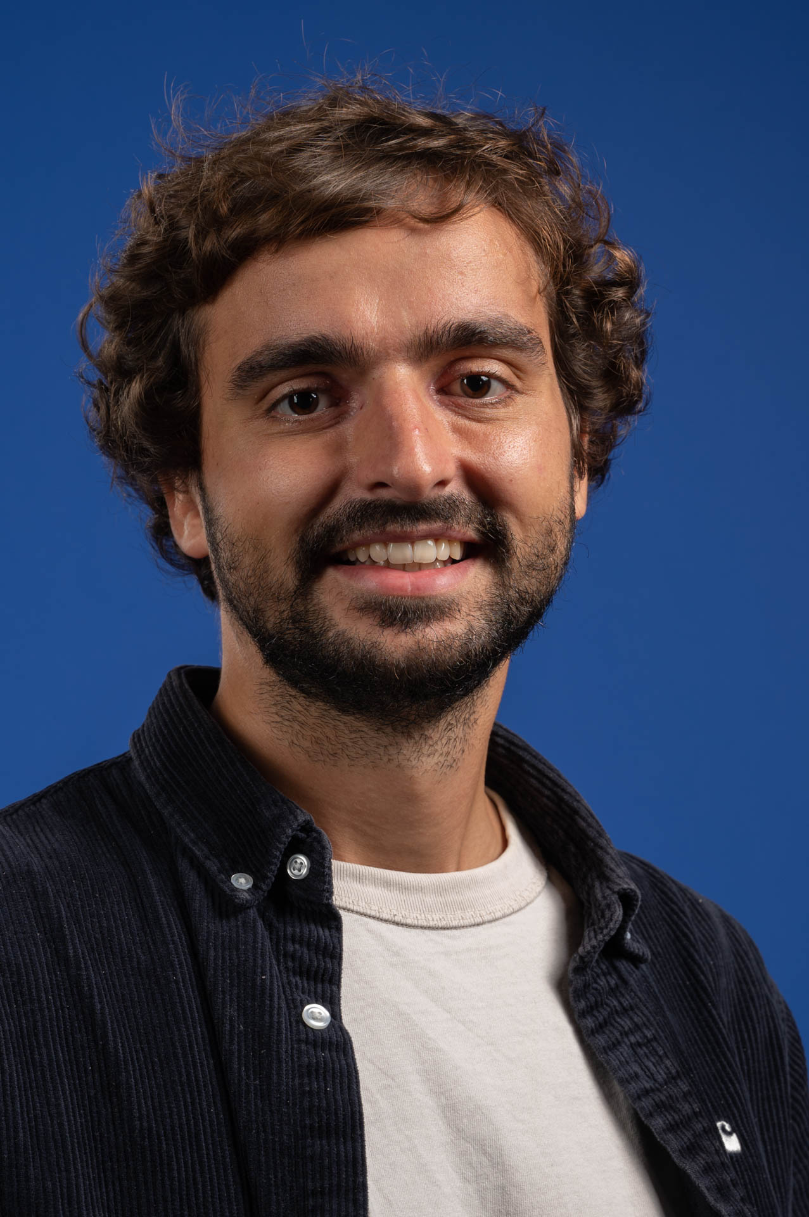

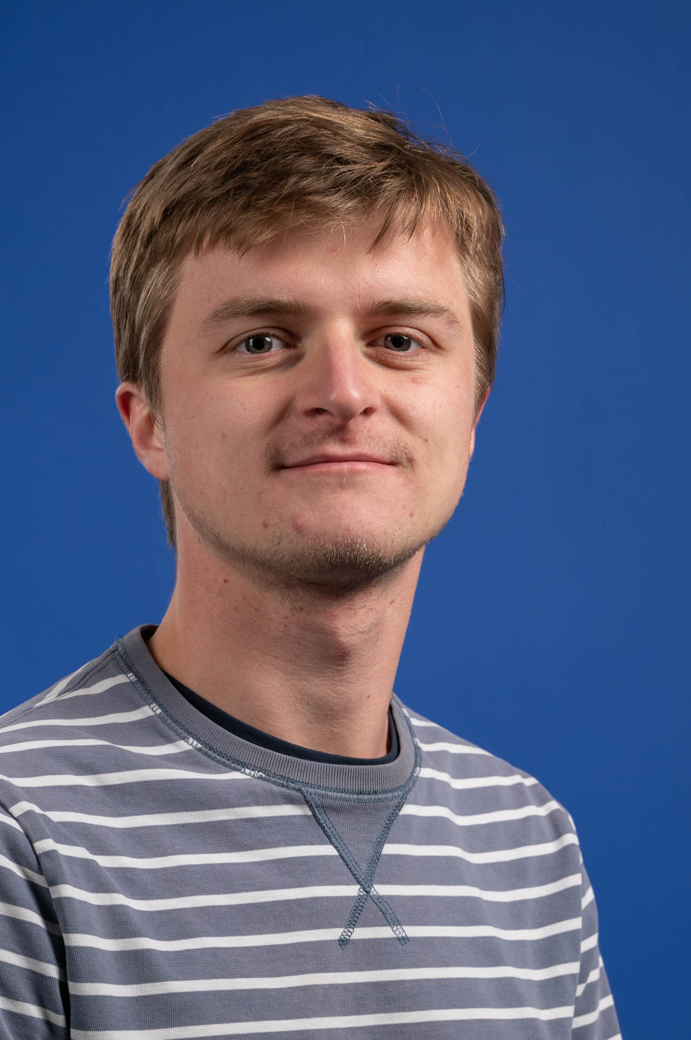
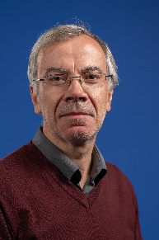
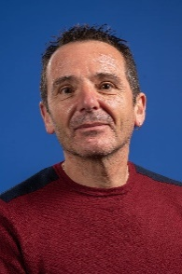
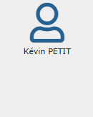
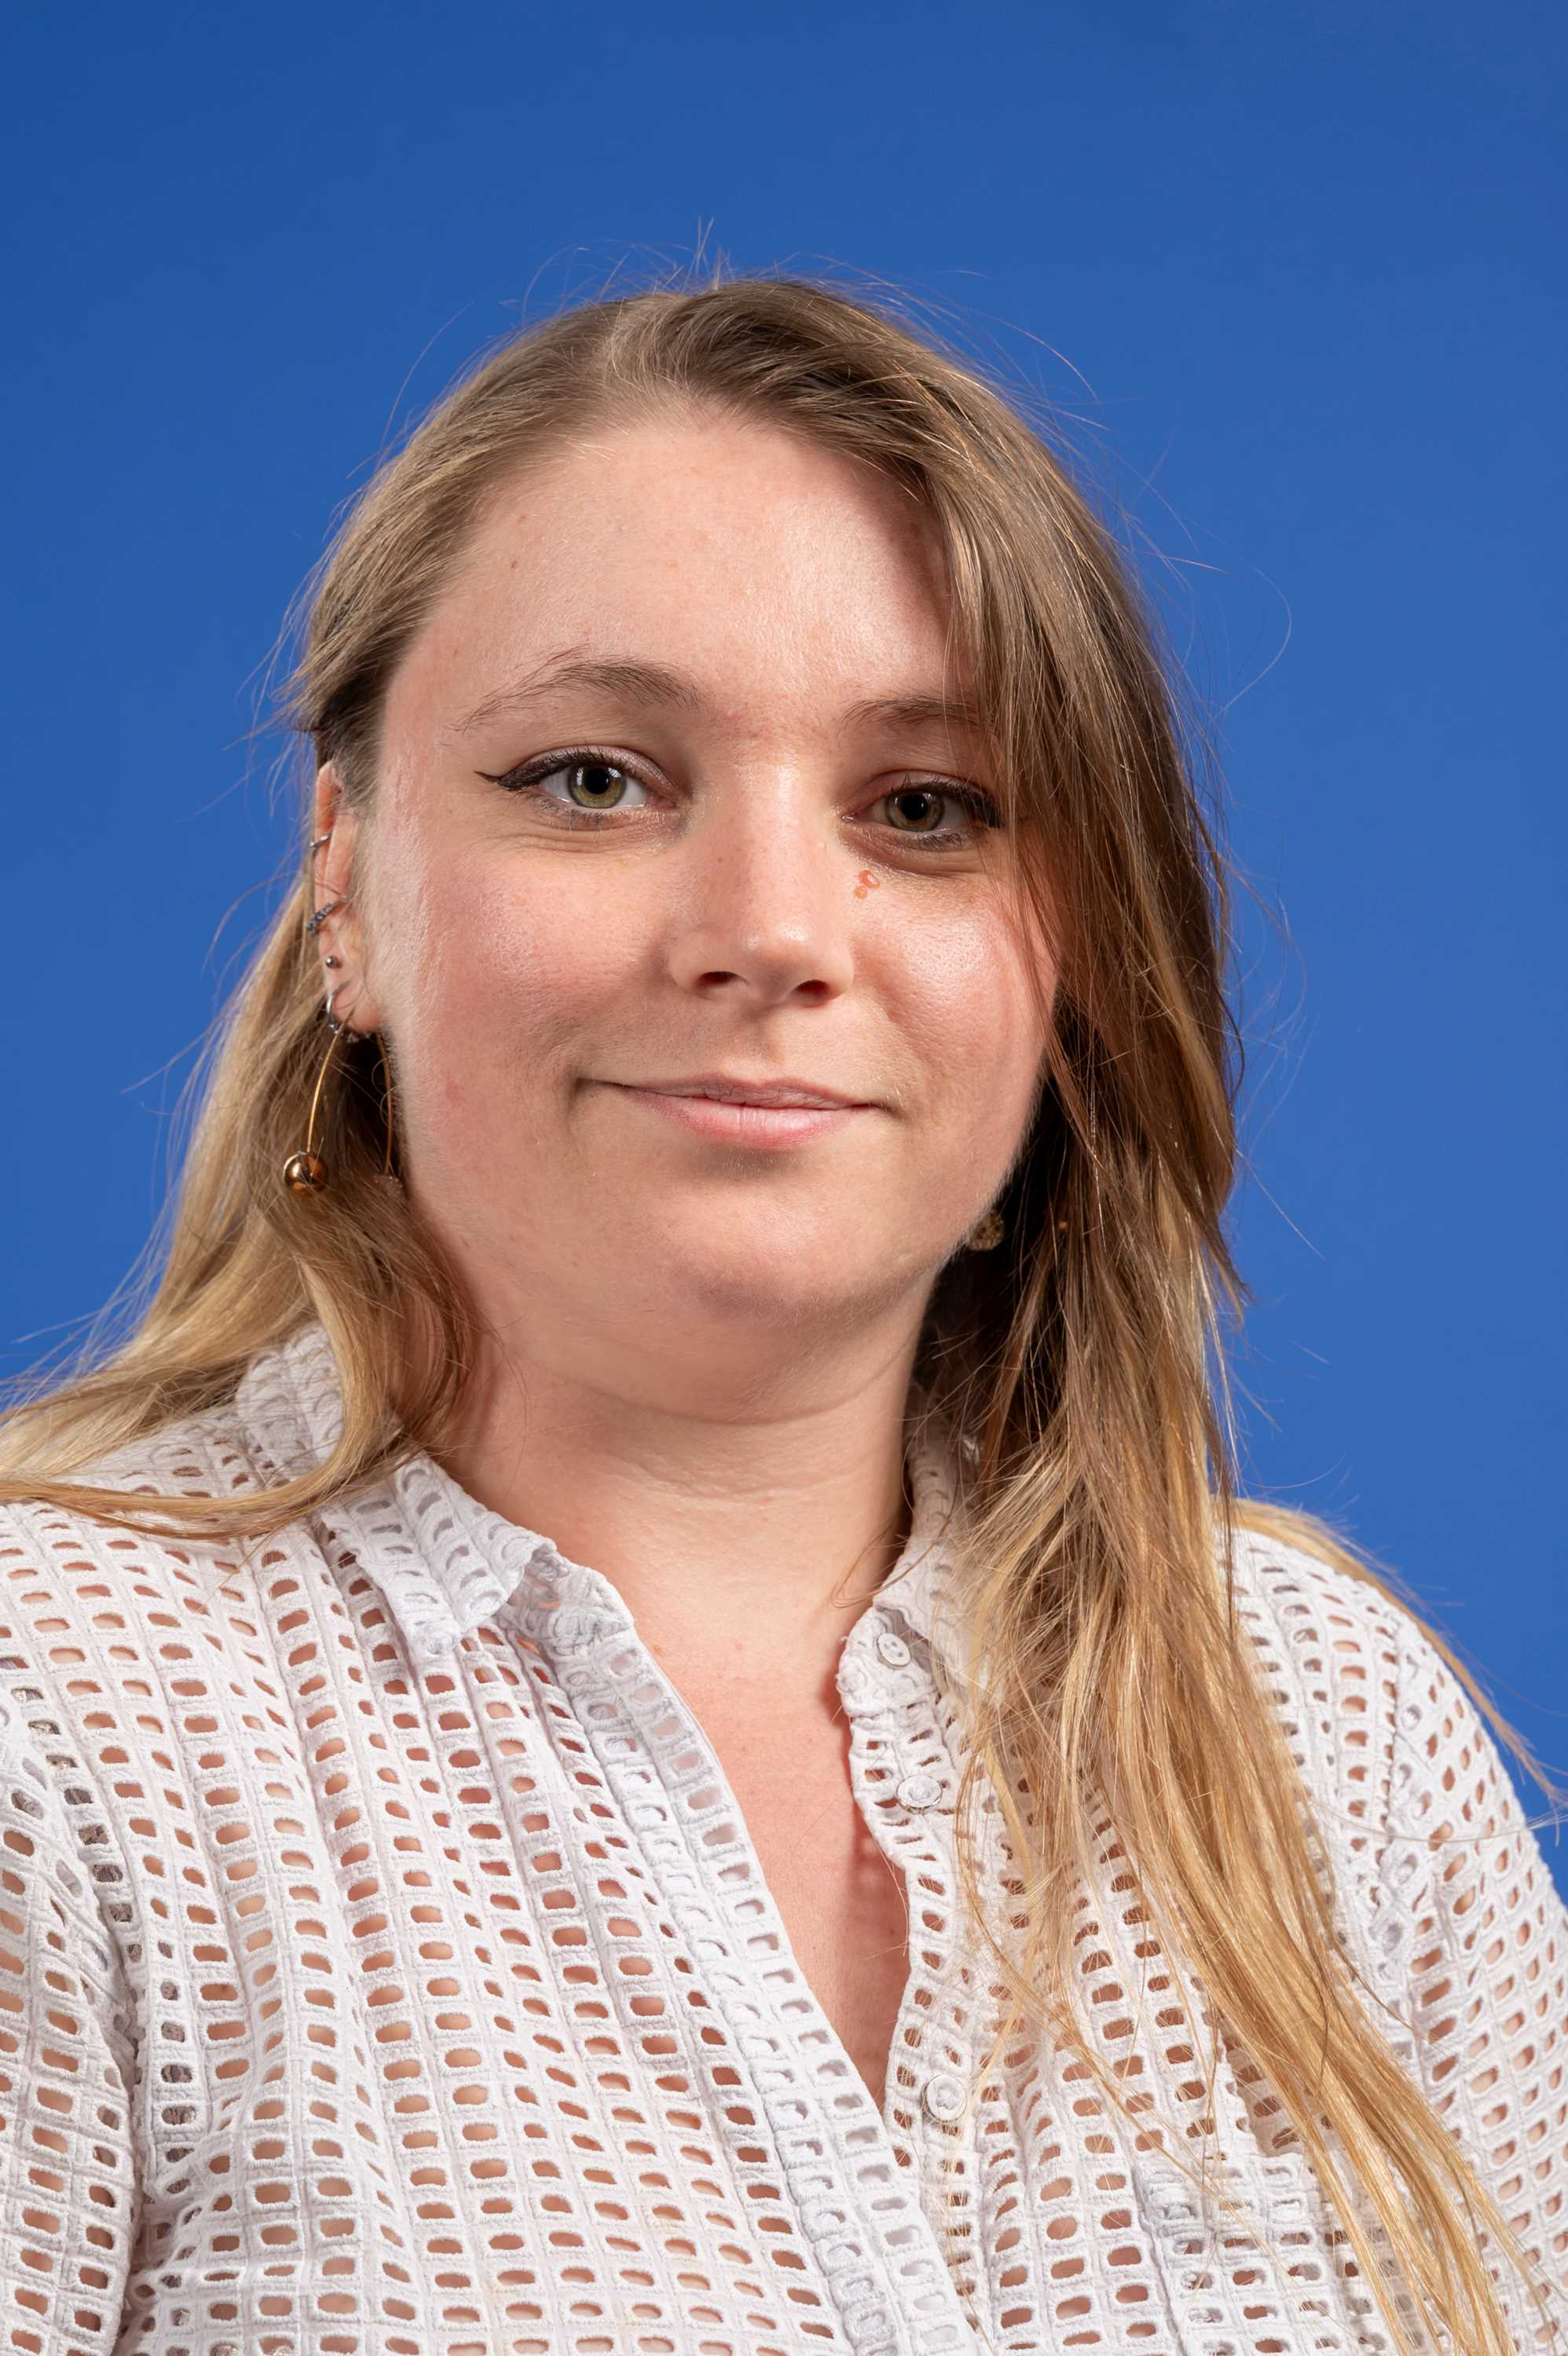

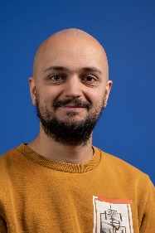
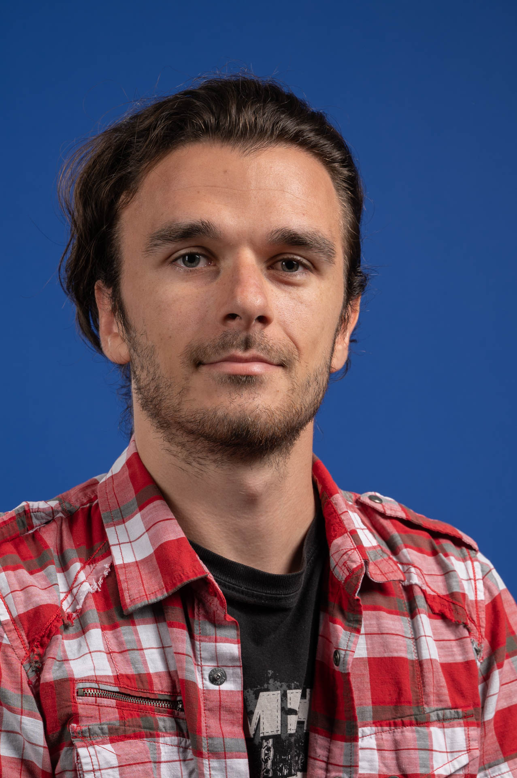
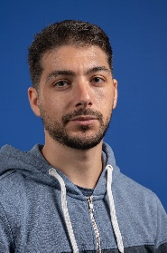


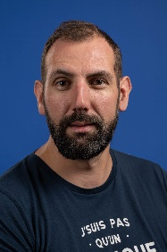
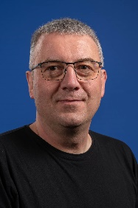
WP8 team : control-command
Coordination
Approximately 30 people involved in the DIS (not full-time)
Electrotechnical Studies and Projects
Operational Technology
Homemade !
Few subcontractors
Idriss BEN OUNAIES
FPGA technology
Information Technology
Automation
CDD
Sécurité informatique

Slide 11
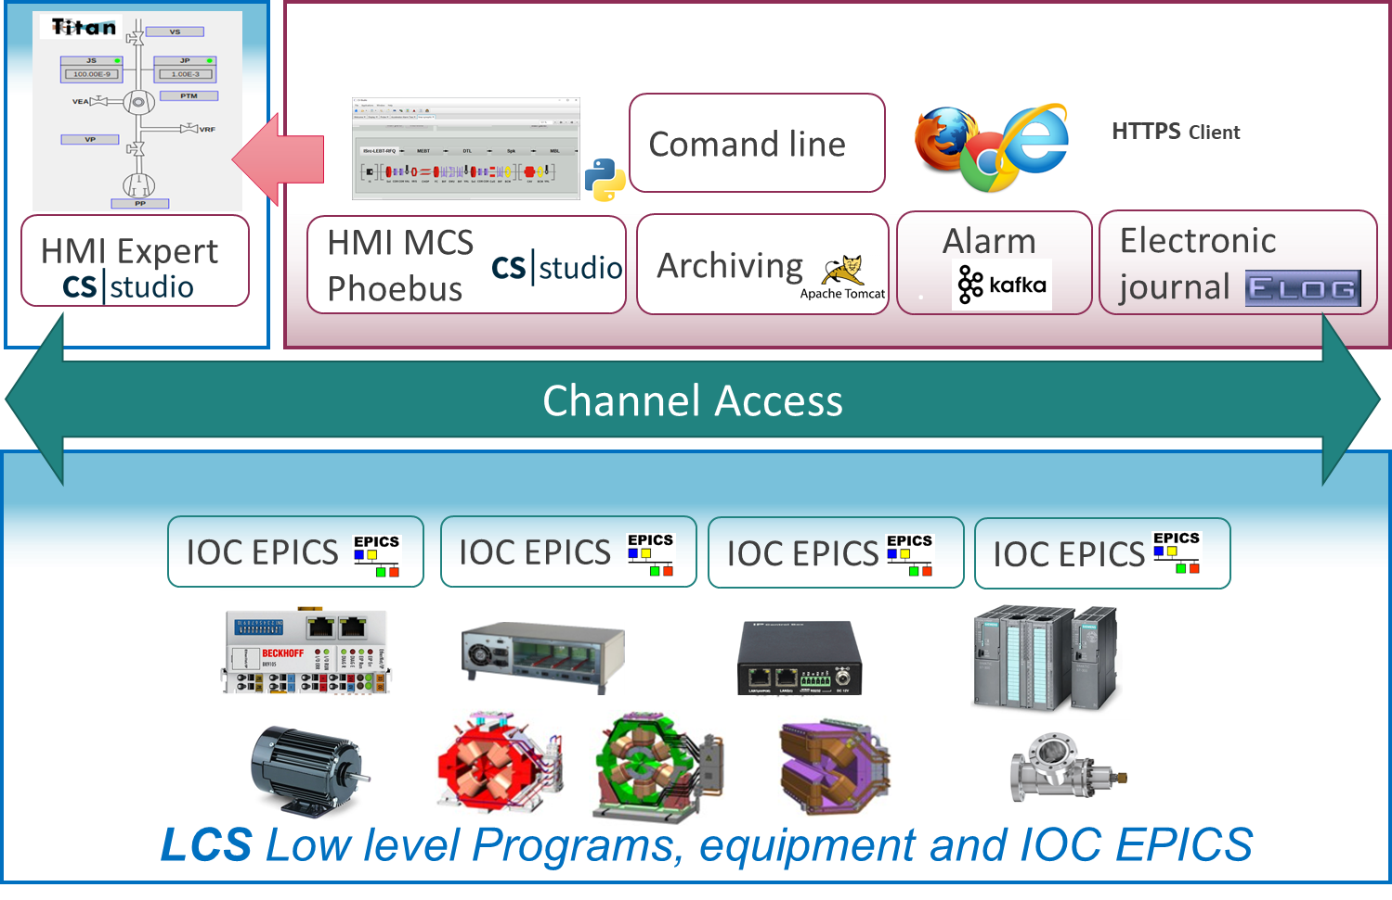
control and command framework
Equipment standardization :
Triggers and timestamping electronics : MRF, Meinberg
Slow acquisitions : Siemens, Beckhoff, JMConcept, KISS
Fast acquisitions : NAT, IOxOS, D-tAcq
Server and switches : DELL, HP
SCADA : EPICS
72 cabinets
600 control channels for the Machine Protection System
2200 control channels for diagnostics
800 alarms for the vacuum
10 servers
6 industrial PC, 9 MTCA rack, 10 PLC, 150 Beckhoff modules
1600 cables, approximately 66 km long, and 400 network cables

Slide 12

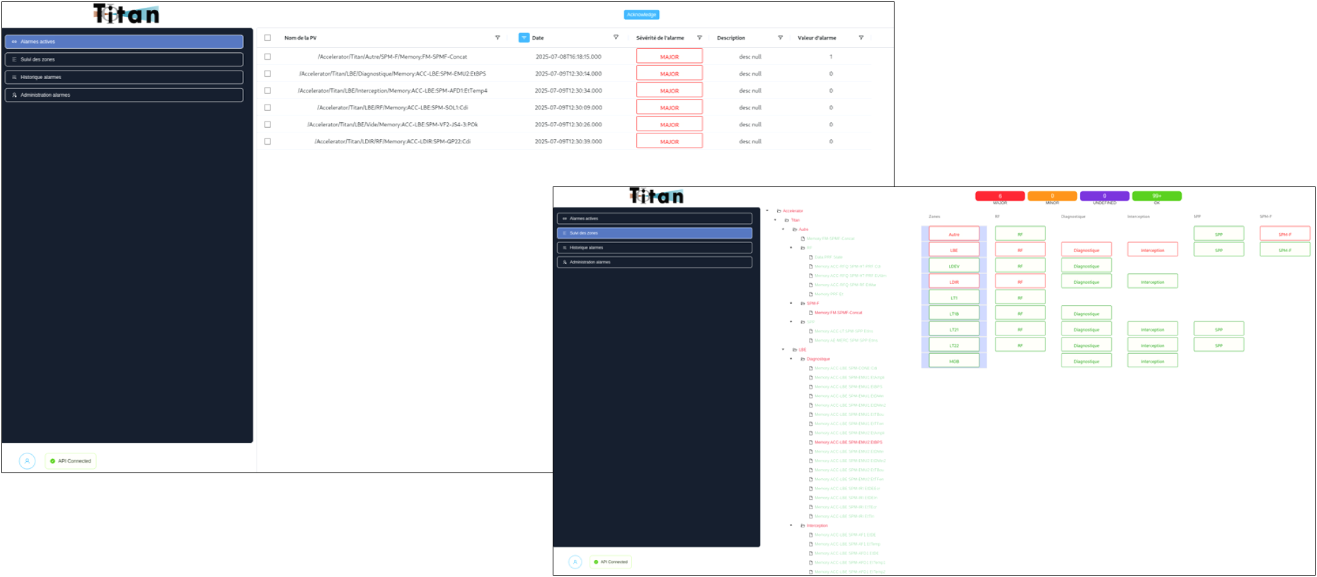
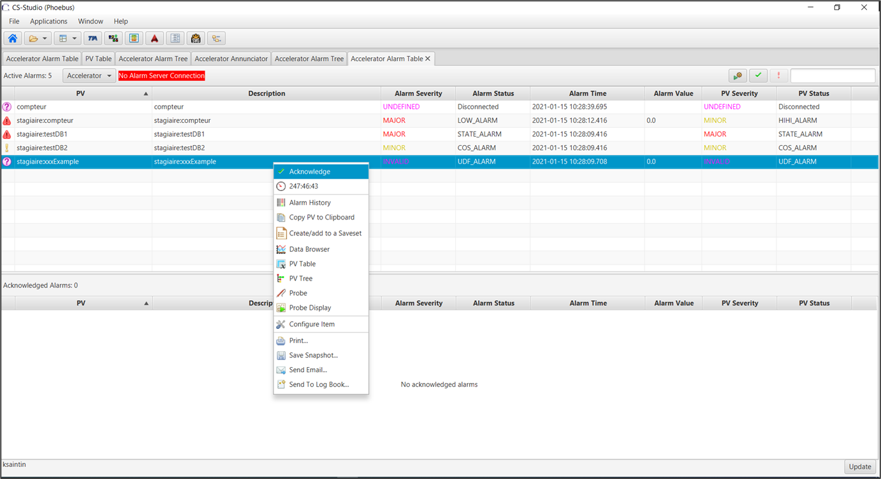
technical choices and guidance for Titan and the lab
New EPICS development environment : EPNix
Using the Nix package manager to package and deploy EPICS servers and clients, as well as operating systems, on virtual machines and equipments
Communication with PLC and many devices with OPC-UA
VM managed with Proxmox and cluster clone for redundancy
2 cabinets (with most C/C equipments) are dedicated for development and test before deployment in production
Alarm web manager :
Workshop on Friday

Slide 13
New domains in the lab
Cybersecurity studies and certification
VHDL development for FPGA gateware
System and network administration
Admin IT (cybersecurity, switchs configuration, active directory, services configuration, etc.)
Admin OT (continous integration, proxmox admin, production software update, troobleshooting, assistance)
Operations management
Non-regression tests for critical systems
Hardware management database with NetBox
Documentation with Gitlab and Xwiki
Source management and CI with Gitlab
Issue management with GitLab
Software and Hardware update

Slide 14
C/C Status
3

Slide 15
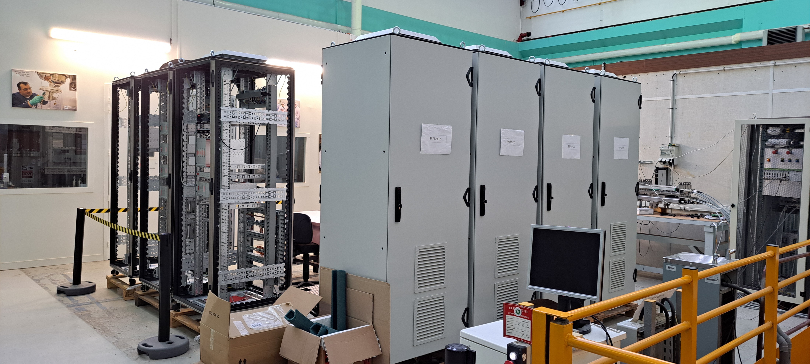
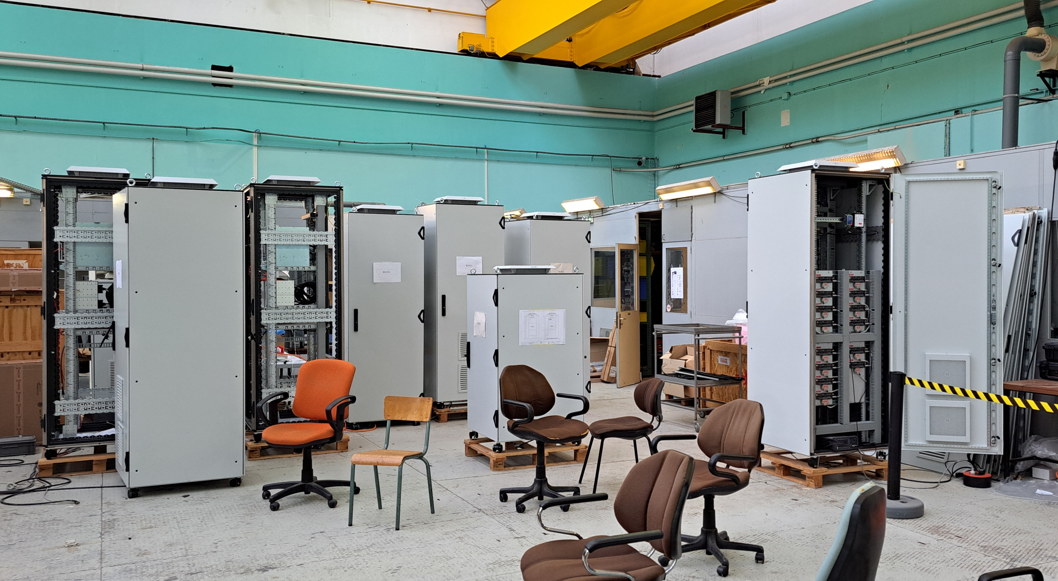
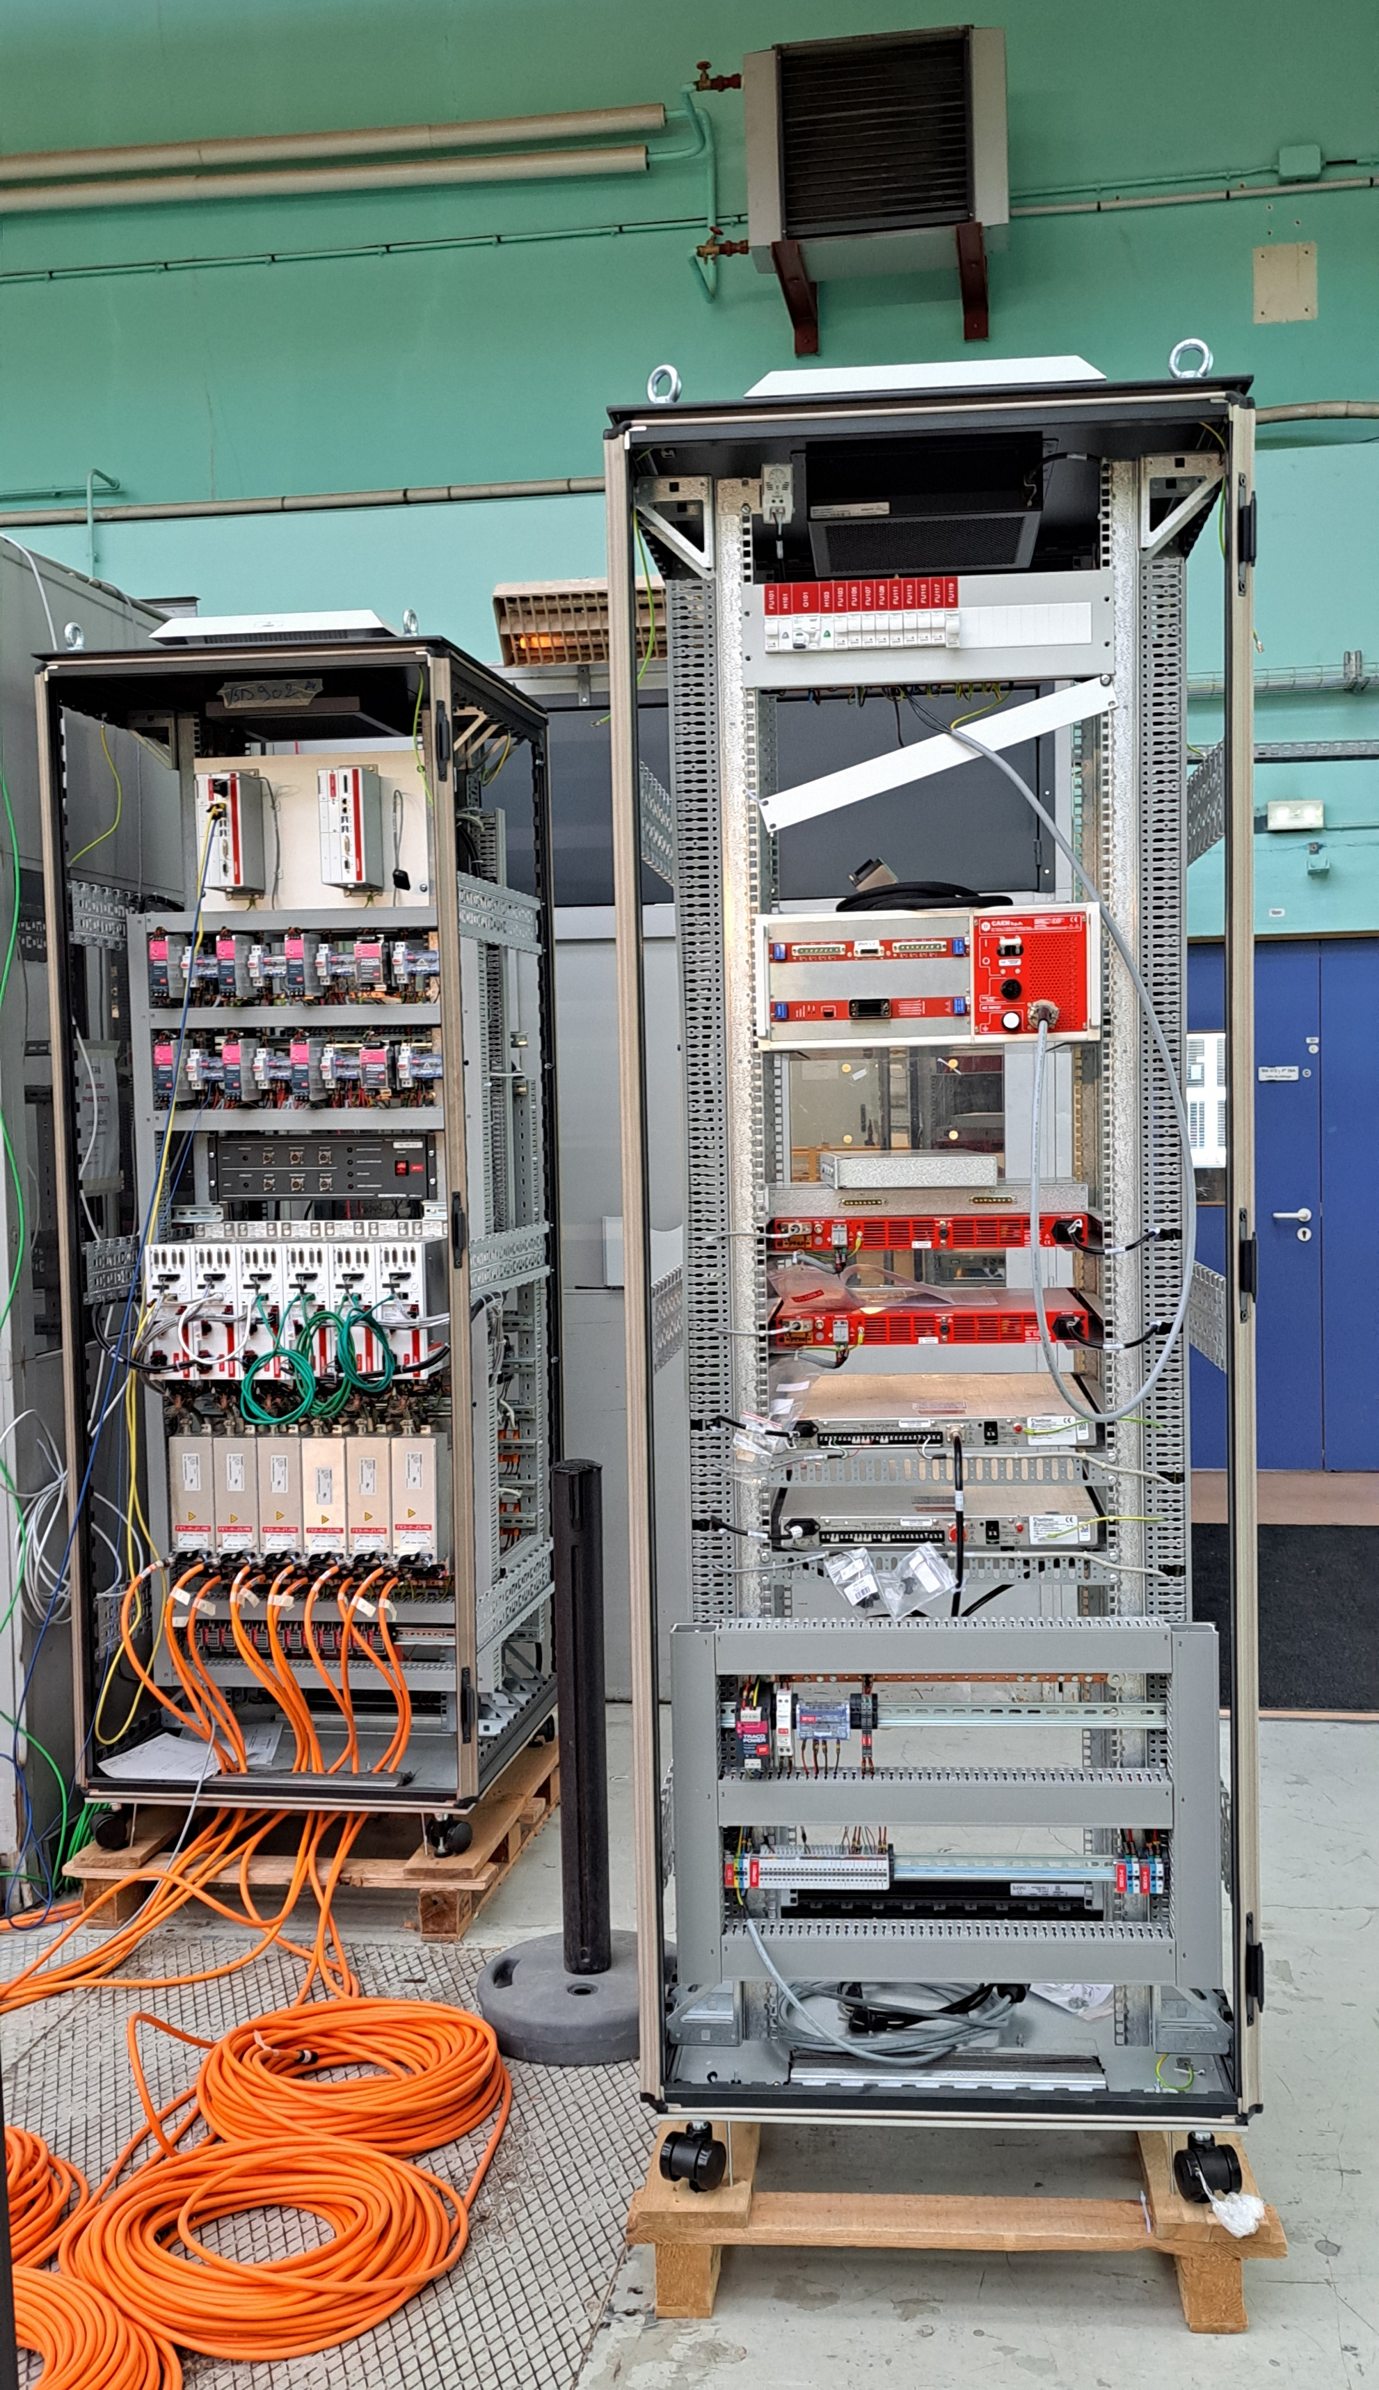
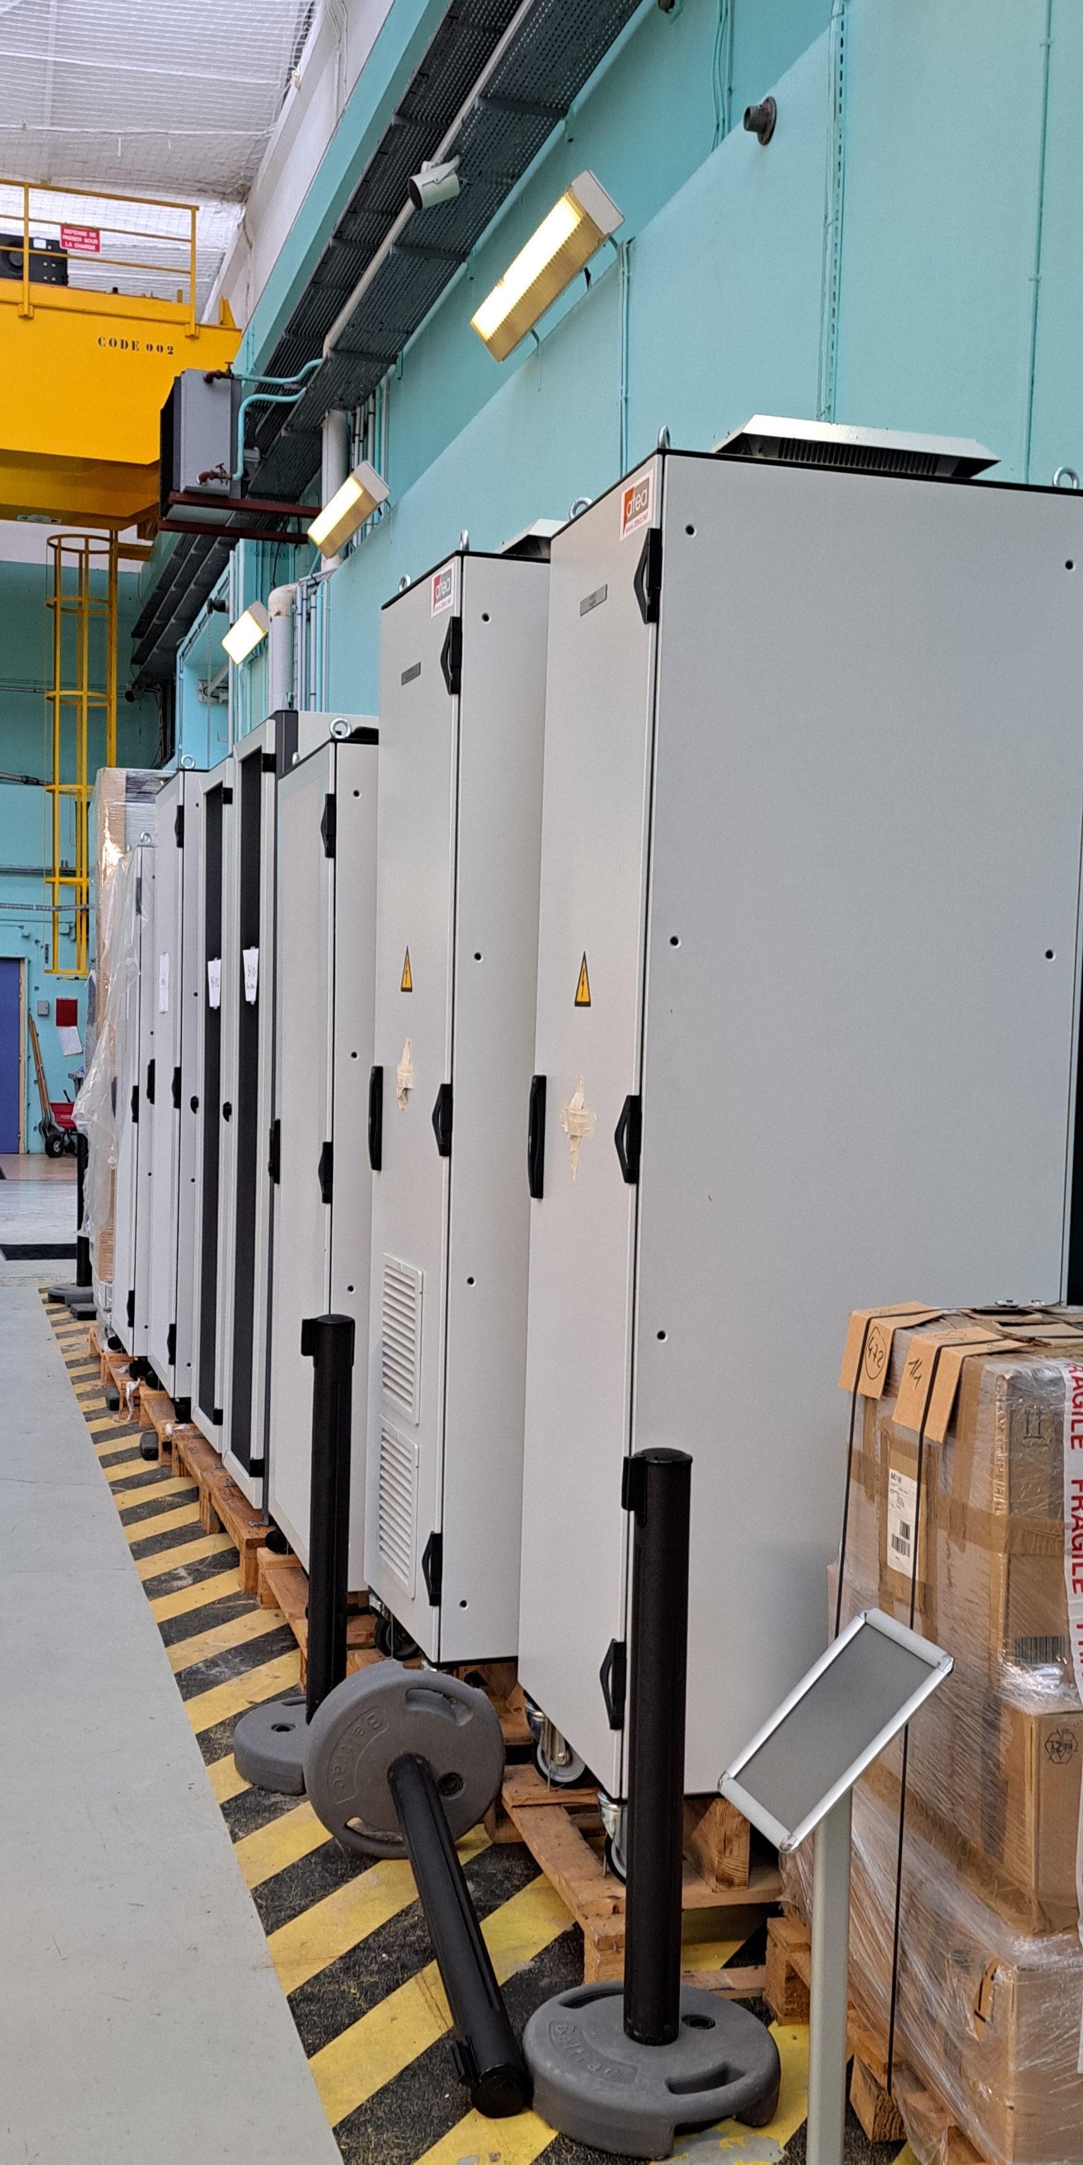
Electrotechnical status
All the cabinets for the Vaccum have been completed
All Diagnostic cabinets have been completed
All MPS cabinets have been completed
Servers and switches cabinets have been completed
Cabinets for the proton source have been delivered
Some cabinets for the power supply for magnets have been delivered
The cooling, RF power supply and Personal Safety cabinets are subcontracted and under realization
~50 cabinets completed !

Slide 16
Software status
MPS is in progress
MCS, OT and IT are in progress
Many LCS are in progress : Diagnostics, power supply, Mars target
Cybersecurity studies are in progress
The C/C of the proton source was taken over by the team and tested
LCS for the Vaccum is quite completed

Slide 17
Remaining work
4

Slide 18
Remaining work
Power supply cabinets procurement
Mercure target cabinets procurement
Cabinets installation on site
Install and connect the cabinets
Finalize the software developments
Deploy the software, configure the services and switches
Tests and comissionning
Notes:
Fenêtre entre installation et mise en service technique très courte : Il faut anticiper le max de tests

Slide 19
Thanks for your attention

