Slide 1
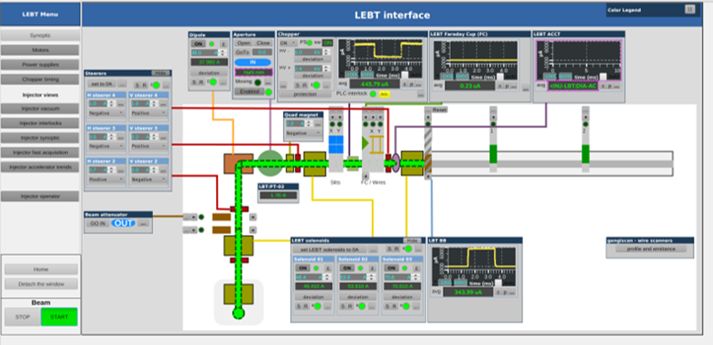
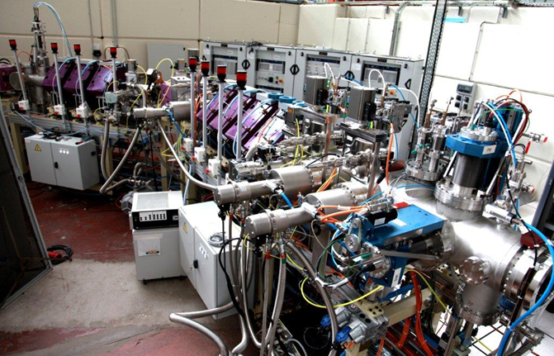
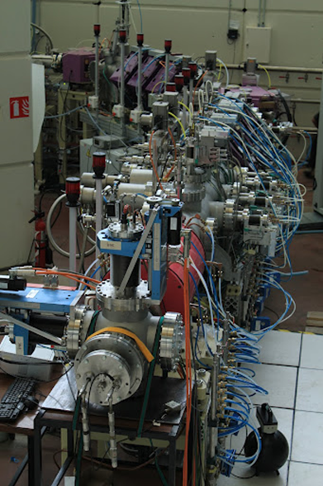
EPICS legacy at Saclay 1993 to 20xx… and focus on recent projects
Françoise Gougnaud – CEA Paris-Saclay

Slide 2
Joining the EPICS community in 1993
1

Slide 3
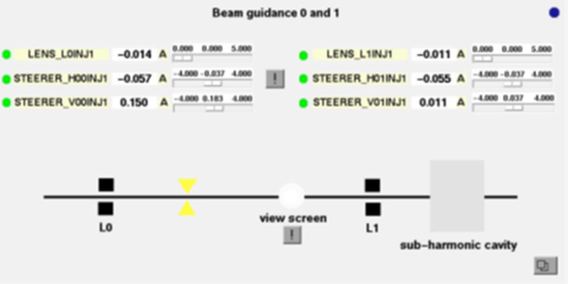
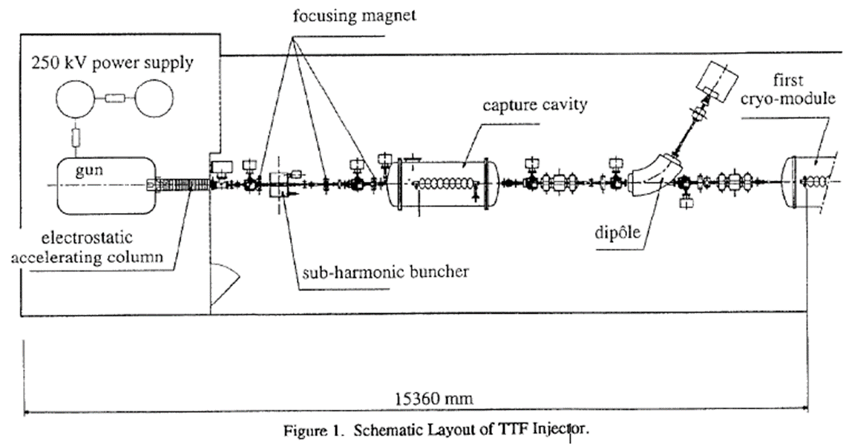
First steps with the Tesla Test Facility Injector control
TTF (DESY): project to demonstrate the feasibility of a large superconducting positron electron collider
French collaboration in charge of the Injector including an electron gun, a subharmonic buncher, a superconducting capture cavity … and beam diagnostics
2 French Labs LAL (Orsay) and (Dapnia) Saclay for the control
Schematic Layout of TTF Injector
Synoptic Display for the Injector

Slide 4
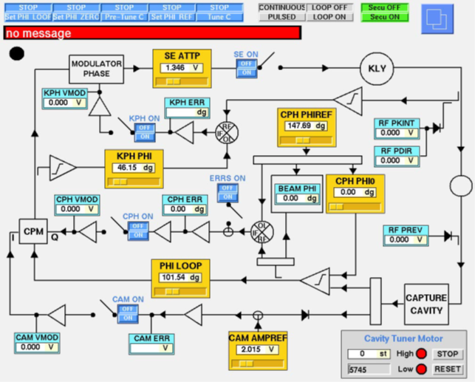
EPICS platform used
DESY pushed for EPICS
With VME/VxWorks and an MVME162 Motorola CPU
Saclay chose the ADAS boards already used
ICV150 (A/D) 14 bits
ICV712 (D/A) 12 bits
ICV196 (BI/BO)
Fast A/D OMNIBYTE COMET
SUNOS workstations, SUNDIALS knobs
medm, km, dct, and some EPICS tools of that time
SNL sequencer also widely used
Superconducting Capture Cavity Control

Slide 5
TTF Injector controls
TTF Injector completely installed late 1997
Software development was rather fast
The community was small but very supportive
Finally only the French Labs and the DESY cryogenics group used EPICS
Then DOOCS, the DESY control framework was used for TTF
Parameter Page

Slide 6
Spiral2 in 2007
2
Rare Ion Beam Facility

Slide 7
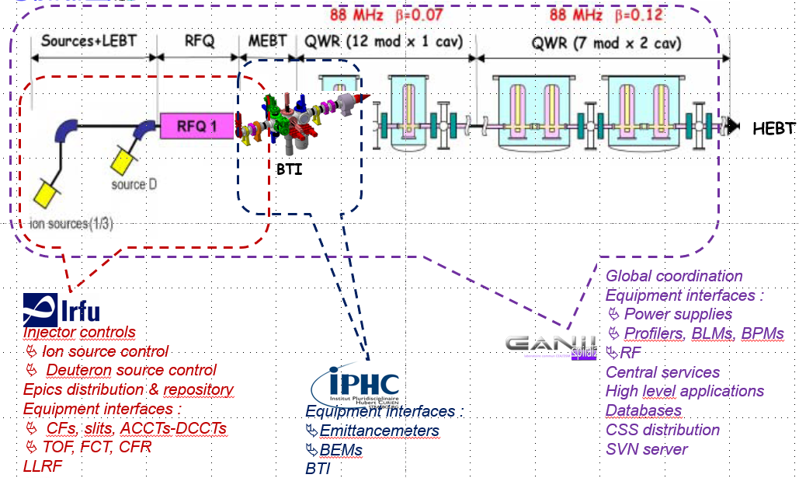
Next significant step: Spiral2 collaboration
Spiral2 aims to produce and study rare ions currently running at Caen in Normandy
2 kinds of sources, preaccelerated by an RFQ, rebunchers and a superconducting Linac
EPICS selected in 2010, control system has always been under the responsibility of Ganil
Efficient collaboration between 3 French laboratories: Ganil, IPHC and Irfu Saclay

Slide 8

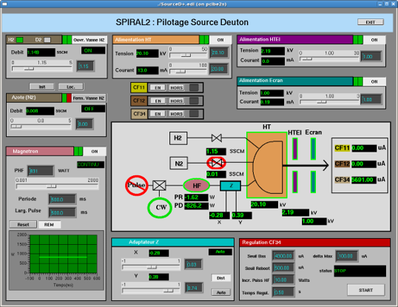
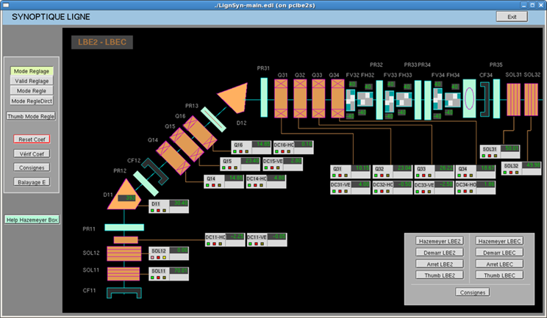
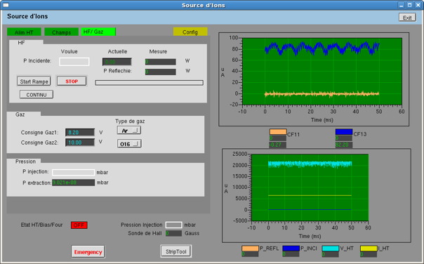
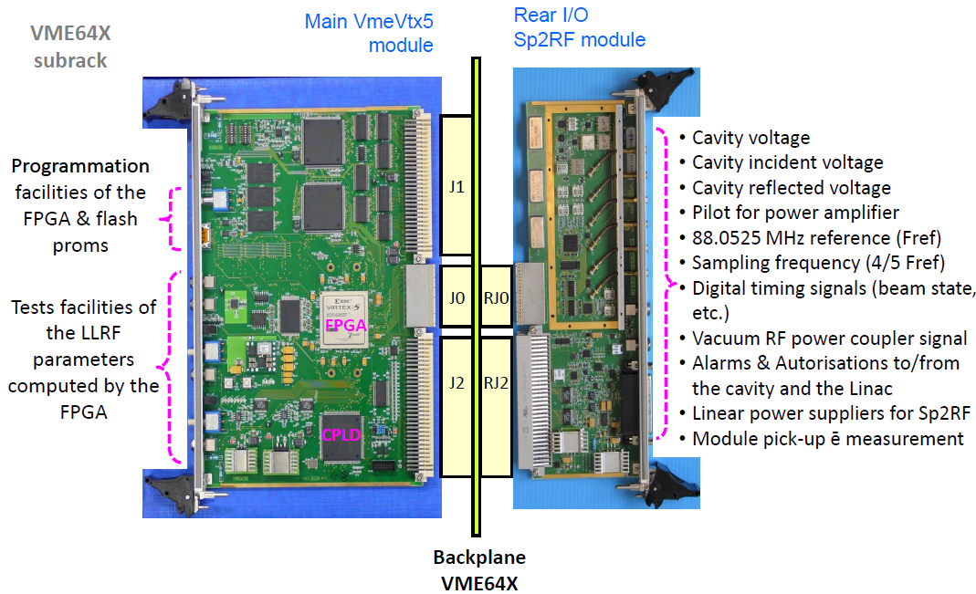
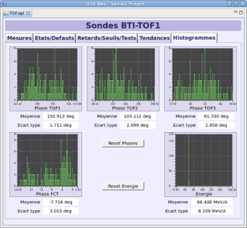
Injector lines, some diagnostics & LLRF
LBEC Slits
Deuteron source & LBE2 & LBEC tested at Saclay
Ion source (q/A=1/3)& LBE1 tested at Grenoble
VME64X digital LLRF
TOF tested at Ganil

Slide 9
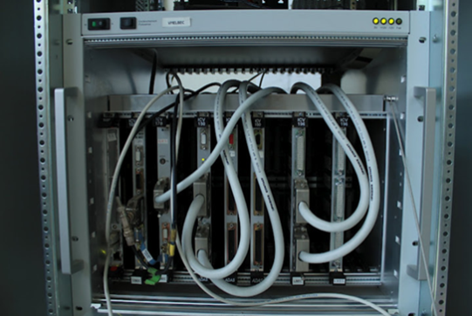
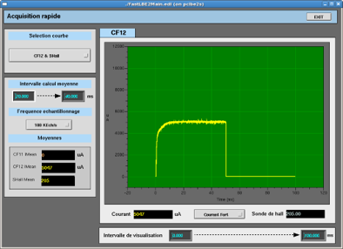
Common Hardware Platform
EPICS platform for the whole project
Based on VME (Emerson MVME 5500)/VxWorks and Linux PCs
Still used NEXEYA/ADAS previous boards (150, 712, 196)
A new set of boards for faster acquisition
ICV108: a controller board with RAM 4 Mbytes, external trigger
ICV178 : 8 ADCs, 16 bit resolution, 50 K Samples/s up to 1.2 M Samples/s
An EPICS driver was developed for the synchronized intensity measurement based on ICV108+ICV178

Slide 10
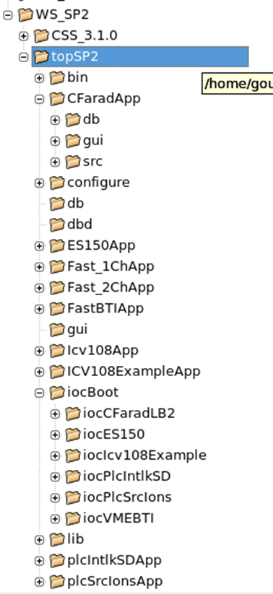
Common EPICS software platform for the 3 labs
Homogeneous development to ease integration
Automatic installation of VxWorks tools and EPICS distribution
VxWorks 6.9
EPICS 3.14.12.4
Rules for naming PVs, files and global functions
A development model used by each developer:
Top directory topSP2: in-house architecture
An automatic building of IOCs:
makeBaseApp templates for Apps and IOCs
Available from SVN server at Ganil
EDM→ CSS BOY in 2011
Saclay ceased to be involved in 2012

Slide 11
Spiral2: my feeling
The 3 control teams had different cultures.
The choice of EPICS, the common platform, a positive attitude within the control teams, led to having an injector, including its diagnostics, up and running quite quickly.
Christophe Haquin who is the head of the Spiral2 control will provide us with a status presentation of Spiral2 this morning.

Slide 12
Collaboration with ESS in 2014
3

Slide 13
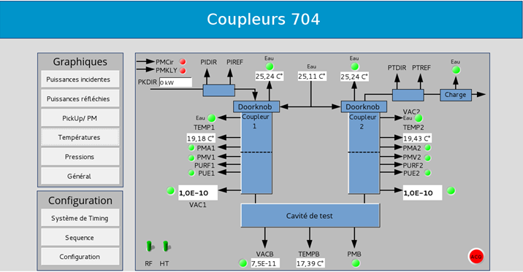
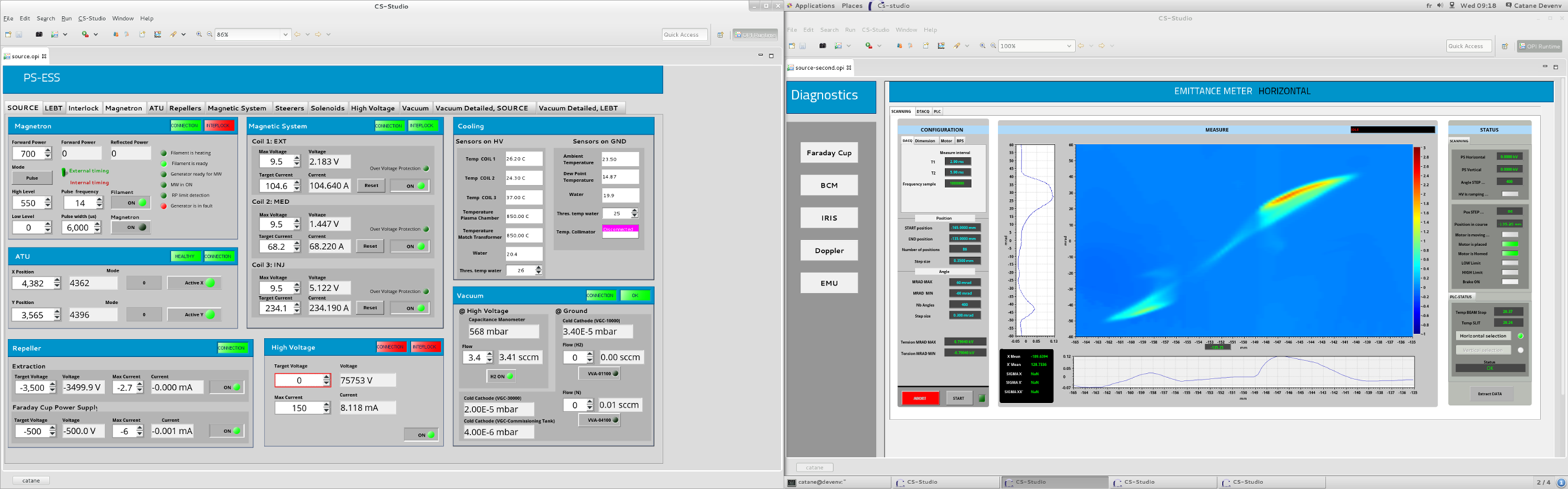
Collaboration with ESS
For 5 years Irfu has been involved in several in-kind contracts
Source and LEBT controls at Catania (Sicily, Italy)
Cold RF test stands for ESS cryomodules at Saclay
ESS recommended we use VME Linux based solutions on IOxOS boards.
First step to give up VxWorks
In parallel ESS decided to migrate to MTCA.4
We could observe their progress with the IOxOS boards and the advantages to use both MTCA.4 and MRF Timing
RF test stand at Saclay
Allison Emittancemeter at Catania

Slide 14
Saraf-Linac and migration to MTCA.4 in 2018
4

Slide 15
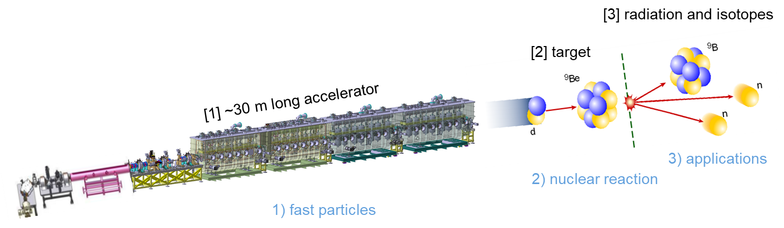

Saraf-Linac context
Saraf is being built in Soreq
Collaboration between CEA-Irfu and IAEC-SNRC for the upgrade of the Saraf accelerator
Saraf-Linac
Irfu is in charge of design, building and commissioning of the Medium Energy Line and the superconducting Linac
Main goals of this programme:
Develop an experimental infrastructure in the field of nuclear sciences
Produce radioisotopes for medical use
Expand research and applications based on neutrons
5 mA CW, Energy: 40 MeV and beams of protons and deuterons
Phase II

Slide 16
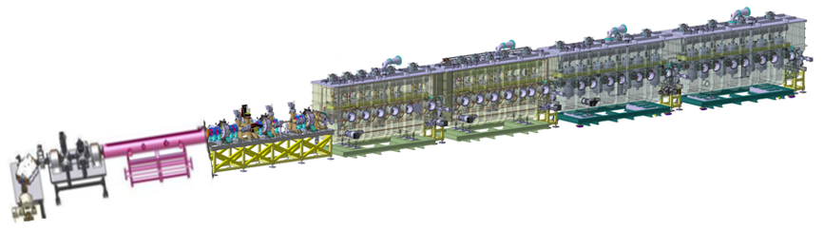
Saraf-Linac
The MEBT includes 3 rebunchers (3 warm cavities, 176 MHz), 8 quadrupoles and 8 steerers
The superconducting Linac: 4 cryomodules comprising 28 cavities, 20 solenoids and 20 BPMs
Cryomodules are separated by warm sections
EPICS chosen in 2017 and the fast acquisition system and synchronization based on MTCA.4 in summer 2018
20 MTCA crates, 19 PLC crates and 32 cabinets of instrumentation
Super Conducting Linac
MEBT
Injector

Slide 17
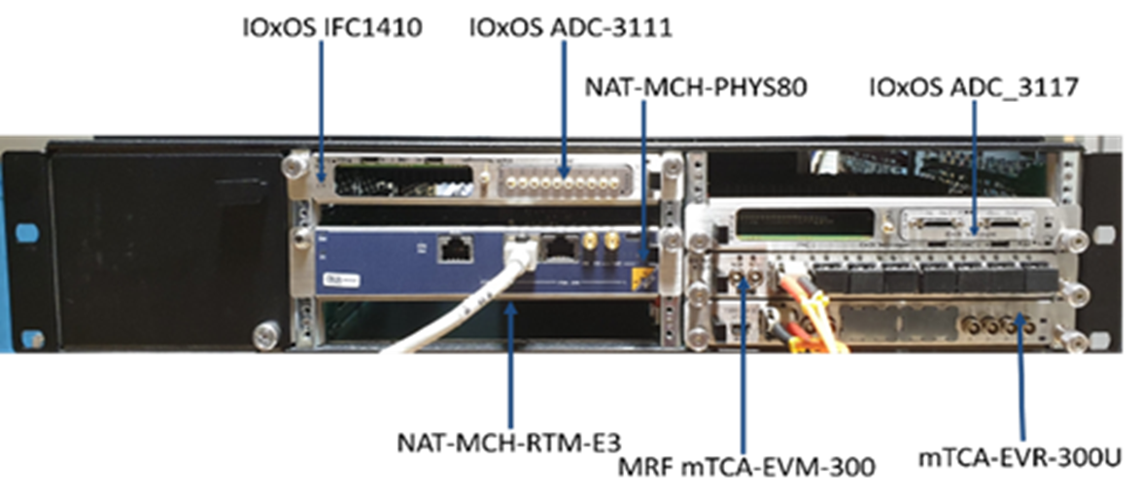
Migration to MTCA.4
In 2018 SNRC and CEA agreed to migrate to an MTCA.4 platform for the Saraf EPICS control system
This platform is based on the very compact NATIVE-R2 crate with a common core in each crate:
NAT-MCH-PHYS80 board (80-port PCIe Gen3 switch) combined with
Rear Transition Module CPU: RTM-COMex-E3 then RTM-COMex-Ce16
A set of IOxOS boards was also added (ADC-3117, ADC-3111, DIO-3118)
MRF boards for the Timing System

Slide 18
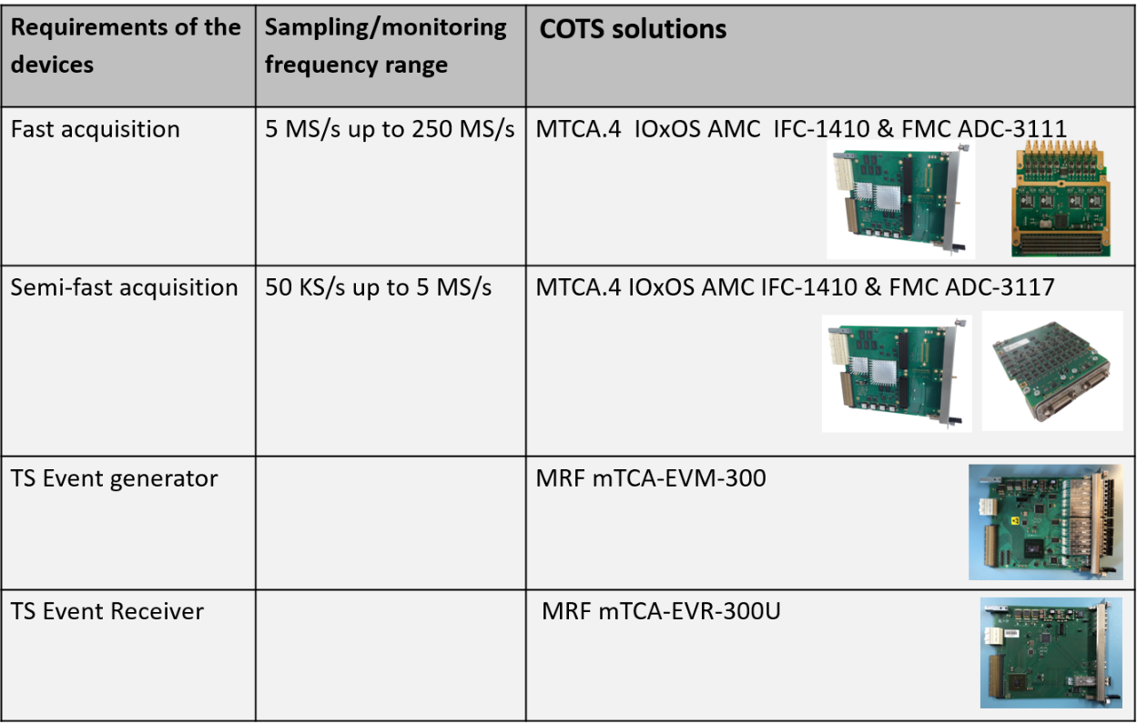
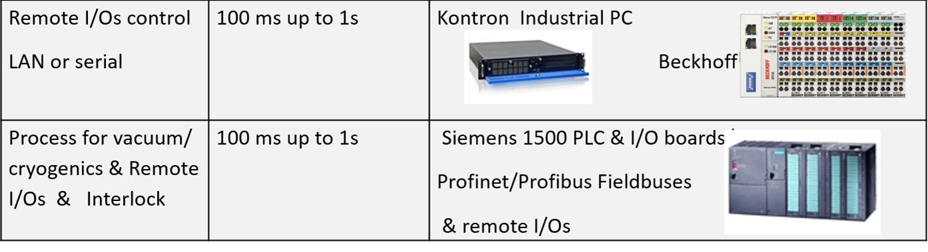
Standardization based on COTS solutions
neutron Beam Loss Monitors (SCL)
Saclay EPICS driver
Faraday cups , ACCTs, slits, B-Blockers
Saclay EPICS driver
Community EPICS driver
Event generators generate events at a repetition frequency
Event receivers generate an electrical signal when an event occurs
Communication through Optical Fibre
Event generators generate events at a repeat frequency
Event receivers generate an electrical signal when an event occurs
Communication through Optical Fibre

Slide 19
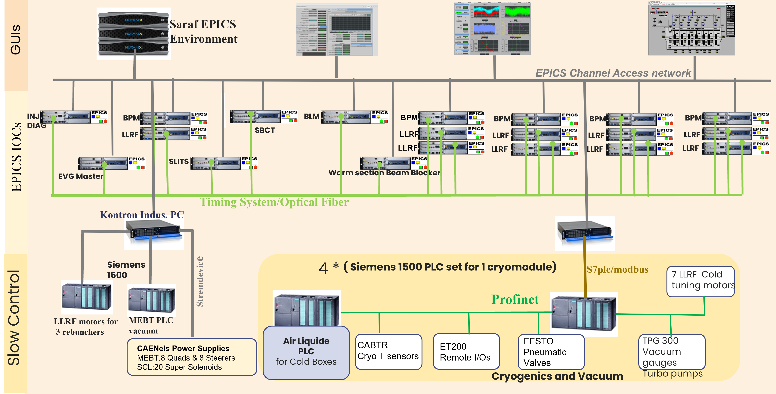
Saraf-Linac overview

Slide 20
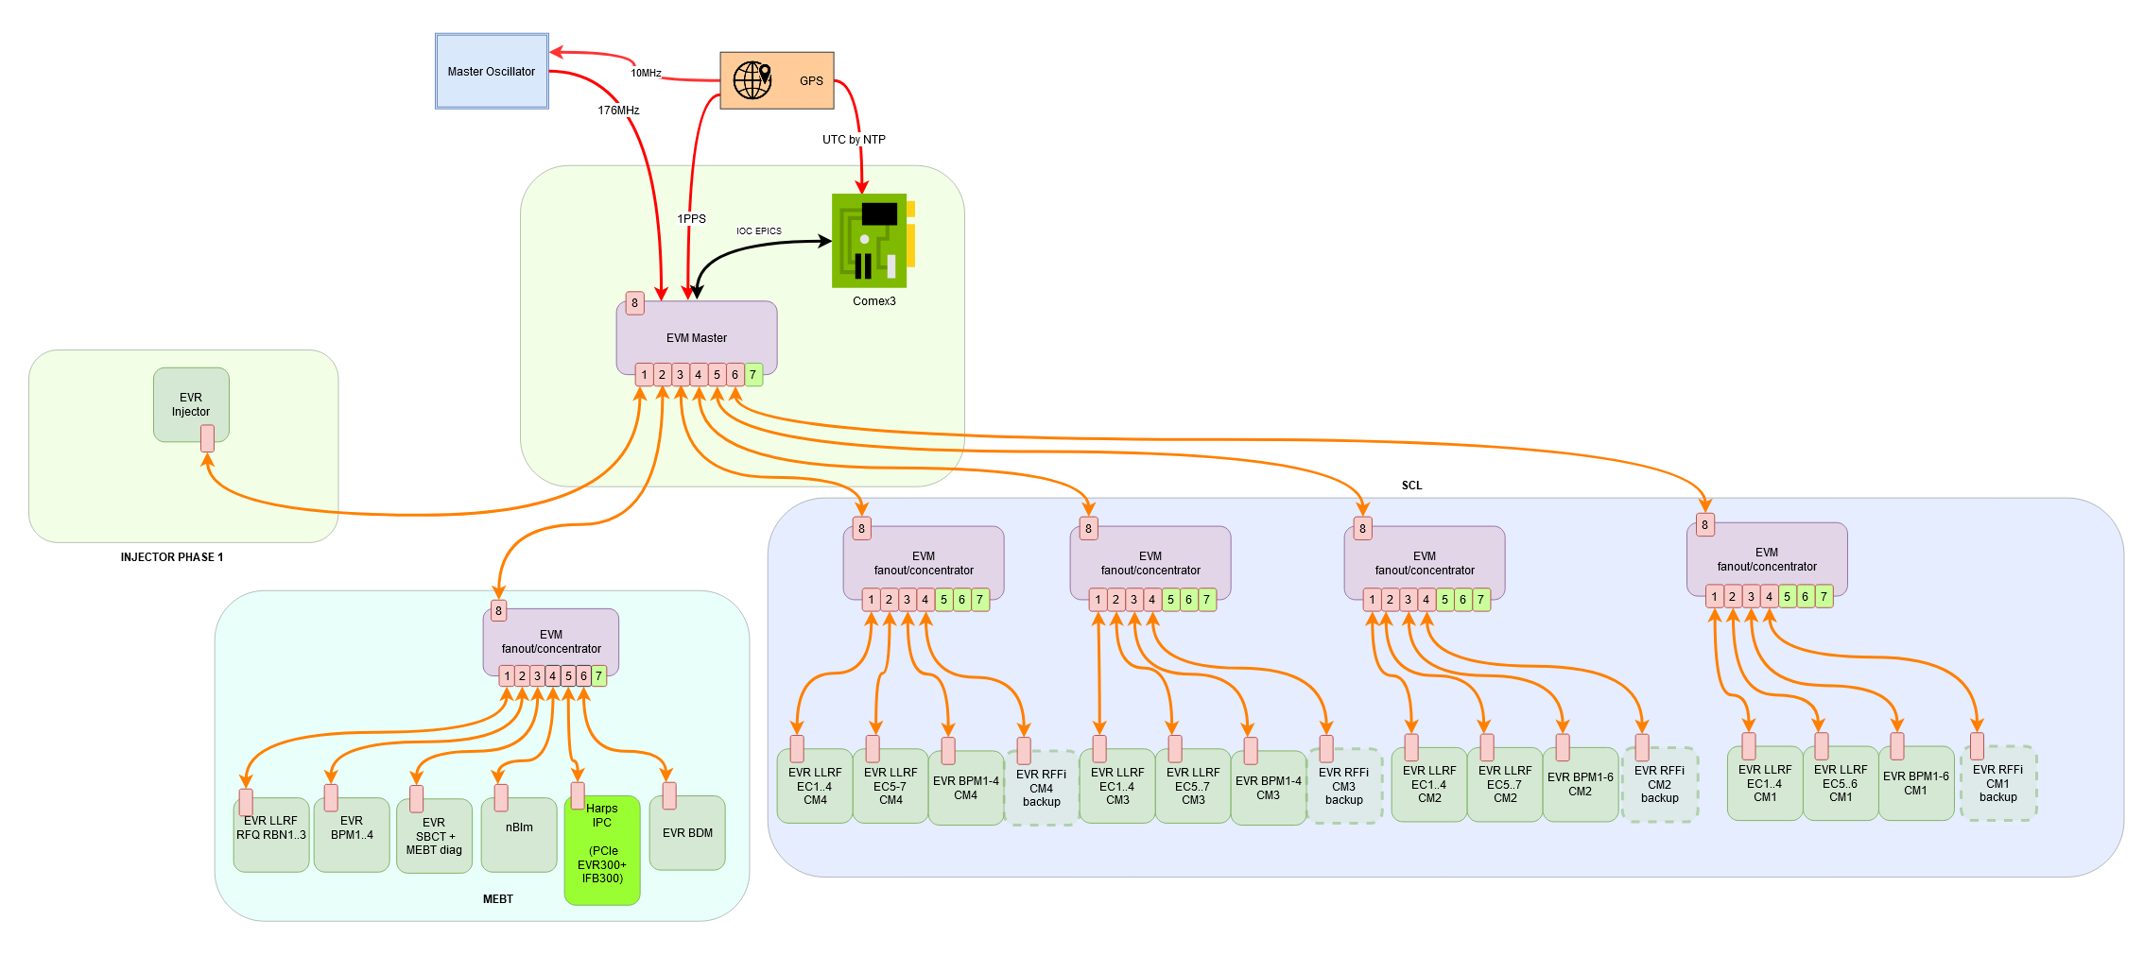
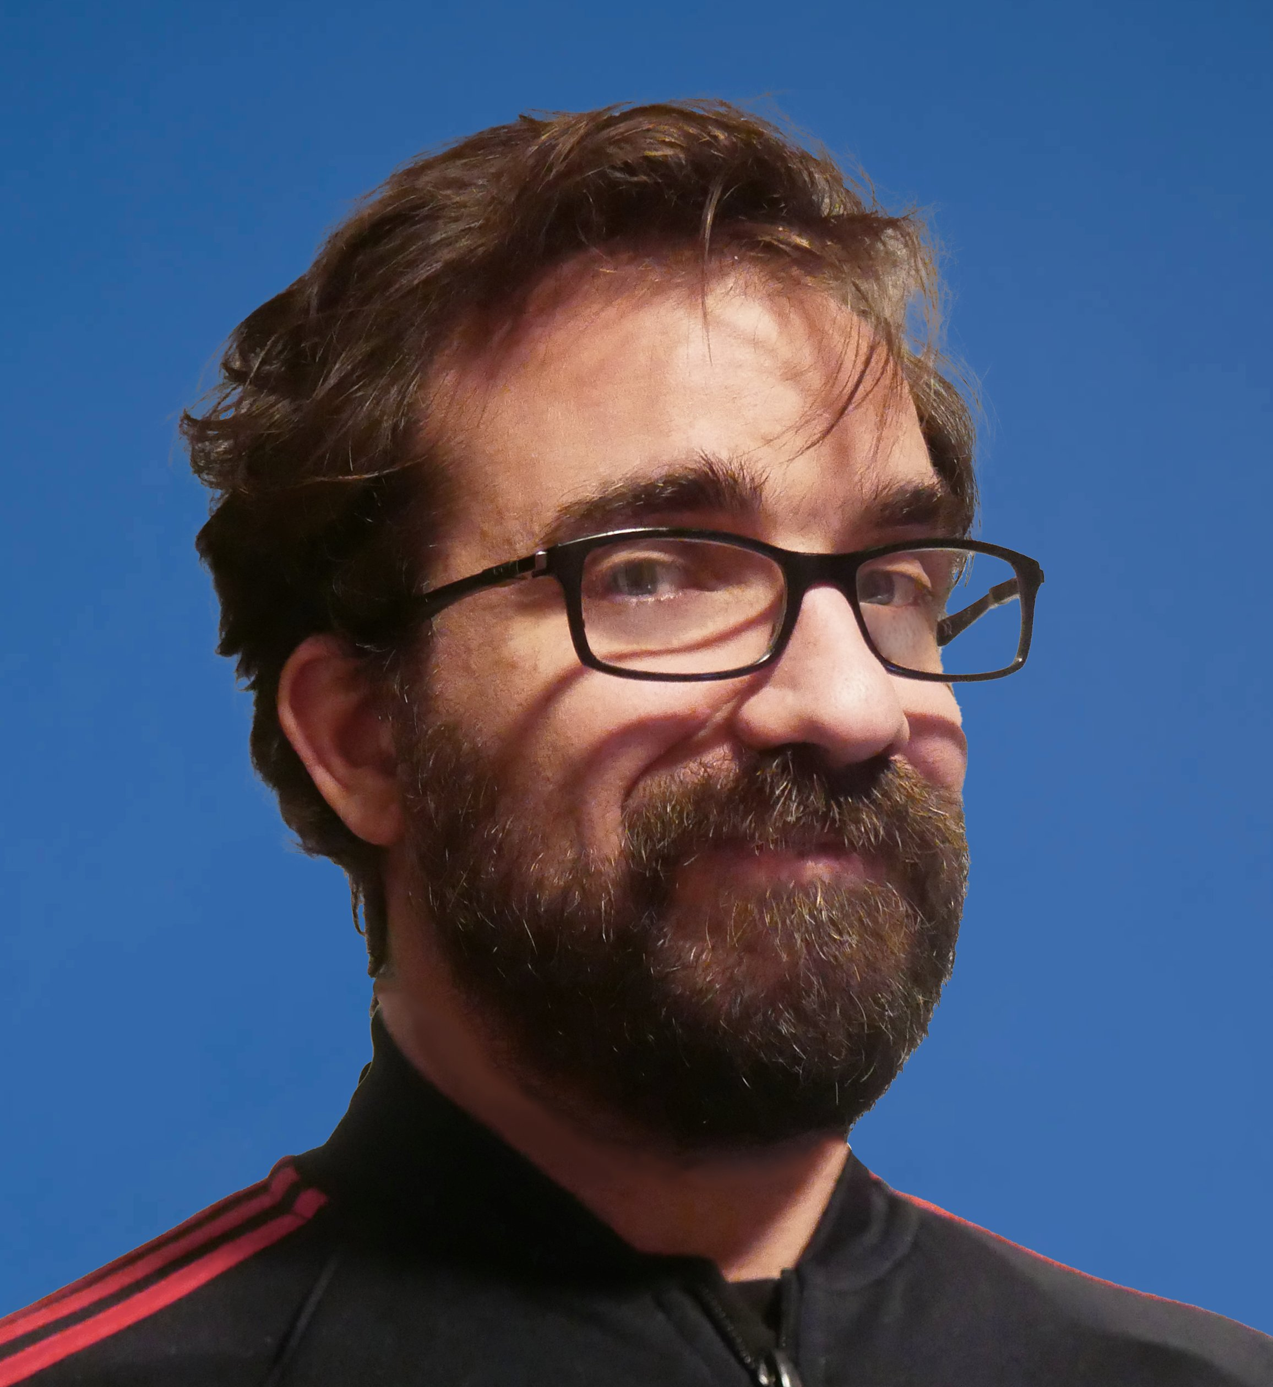
Saraf: MRF Timing System Architecture
EVM Master is synchronized by the Master Oscillator (distributes reference frequency) and by GPS (Pulse Per Second & Universal Timing Coordinated)
Comex synchronized by NTP server from GPS
EVR receives PPS from EVM Master
One receiver board in each MTCA crate
Events generated at the repetition frequency from the Master event generator and transferred to all receivers through Optical Fibre
Receivers analyse the events and generate the requested signals
Upstream communication (Saraf Machine Protection System)
Presentations by Alexis Gaget on Tuesday and Thursday on the Timing

Slide 21
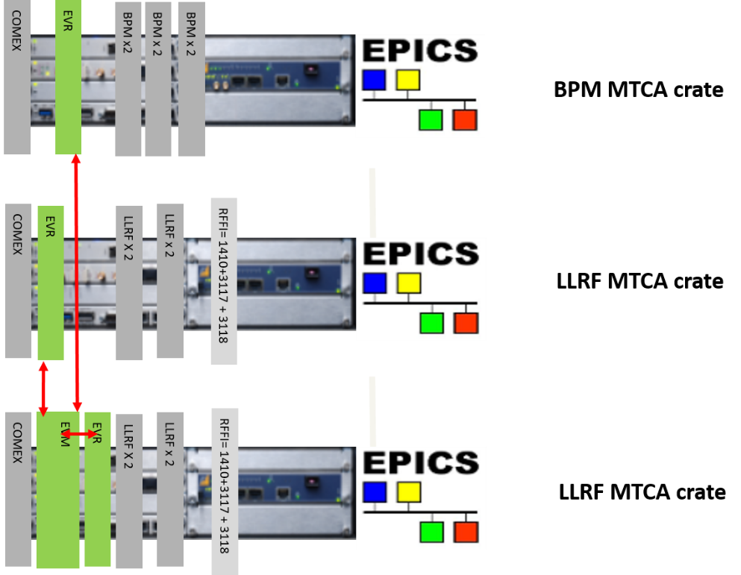
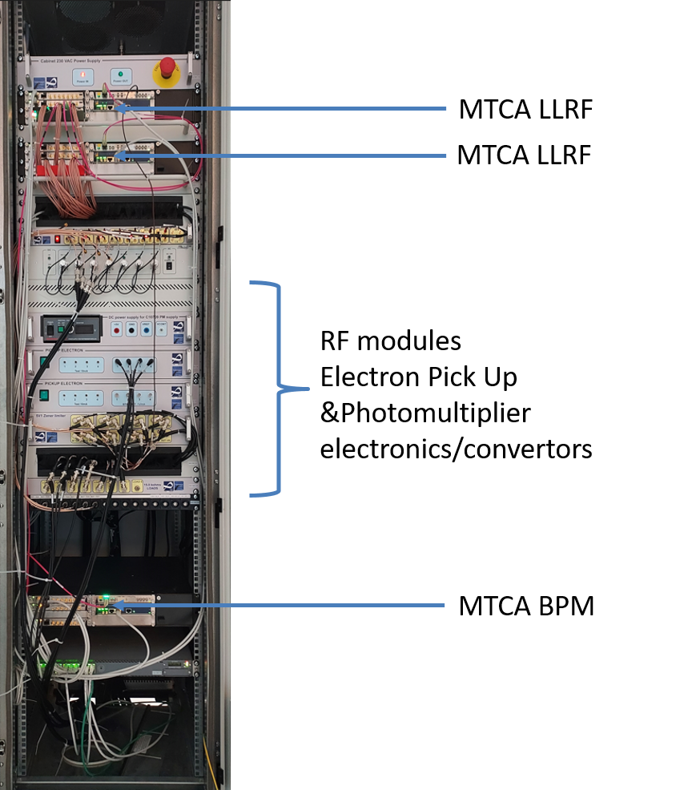
Saraf:LLRF & BPM outsourced
Outsourced to Seven Solutions/Safran
Each LLRF MTCA Native-R2 crate includes 2 LLRF boards:
2 LLRFs/board so 4 LLRFs/crate
1 RF Fast Interlock (RFFI in-house development) system based on IOxOS 3117 + 3118
RFQ, 3 rebunchers and 27 LLRFs on the Cryomodules
Each BPM MTCA Native-R2 crate includes 3 Seven Solutions BPM boards
2 BPMs /board
BPMs on MEBT and Cryomodules

Slide 22

Use case of MTCA backplane: RF Fast Interlock
(Cavity+Coupler)
*4
Use of MTCA backplane: allows many wire connection problems to be avoided
More reliability and flexibility
RFFI: stops RF if PM or PUE overrun to protect couplers and cavities
Sensors: PM (PhotoMultiplier), PUE (Peak-Up Electron)
Acquisition range IOxOS-3117: 5 Mhz, +/-10V
Ts3_2b
Ts3_2a
Ts3_1b
Ts3_1a
4 * PUe
4 * PM
3118 3117 3117
COMEX
LLRF x 2
IOxOS 1410
EVR
Analogue converters
LLRF X 2
Simplified schematic
Cut Off
the RF command
U Amp

Slide 23
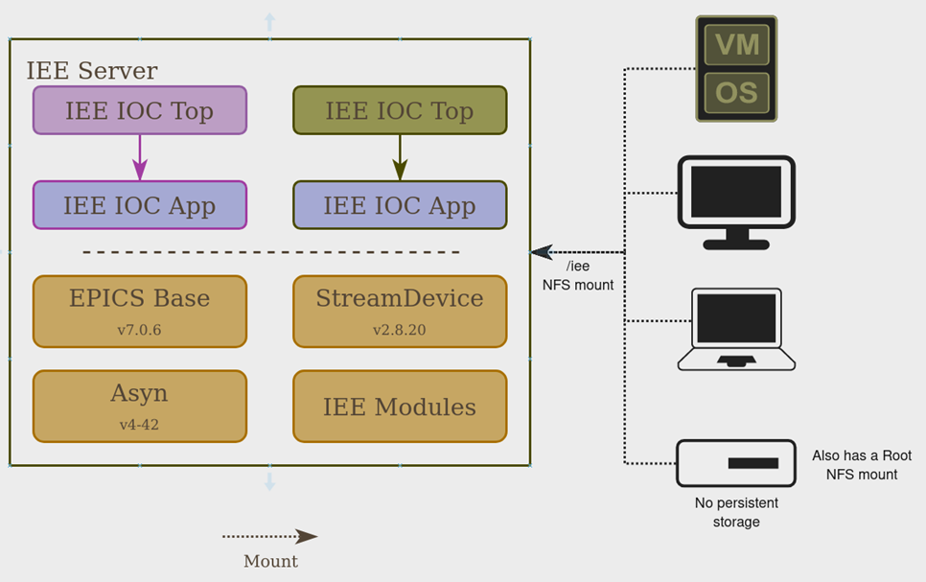
Irfu EPICS Environment (IEE) server
CEA team updated the Irfu EPICS Environment for MTCA.4 and IOxOS boards
IEE server to share:
EPICS environment as NFS folders
Same environment mounted on MTCA boards, IPC …
DHCP, NTP, TFTP and NFS to boot embedded devices (IPC or MTCA boards)

Slide 24
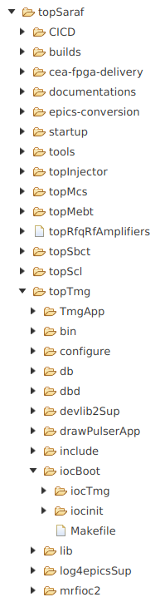
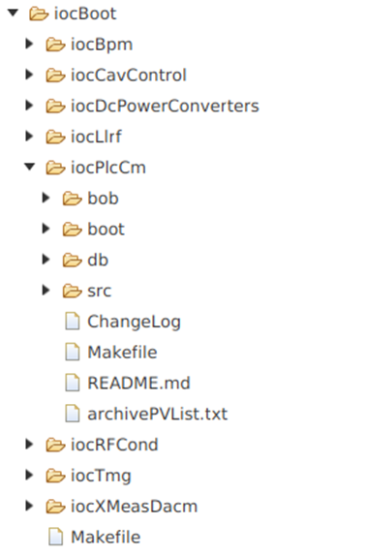
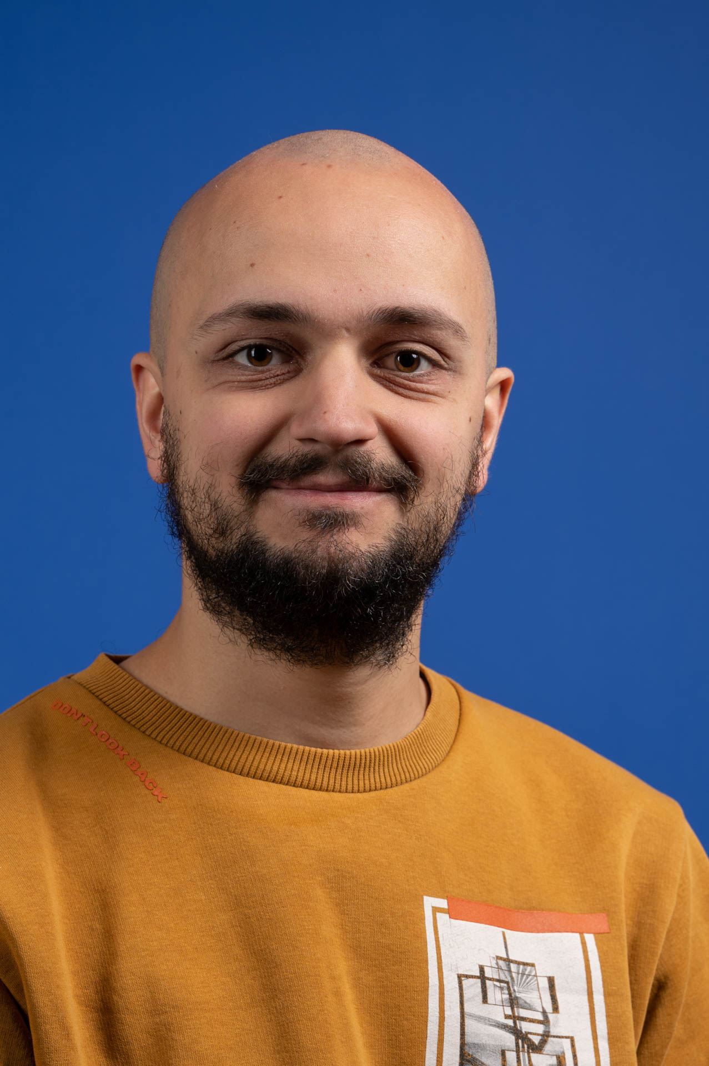
IEE Development Environment
for developers to implement new EPICS modules and IOCs using the EPICS environment shared by the IEE server
provides the EPICS folders mounted by NFS:
/iee/base, /iee/extensions, /iee/modules, /iee/support, …
IEE was used by developers of the Lab, for Saraf and its test stands,by our subcontractors and the IPHI facility
but now only by Saraf because there is EPNIX!
See Rémi’s presentation « Why EPNix? »
on Tuesday

Slide 25
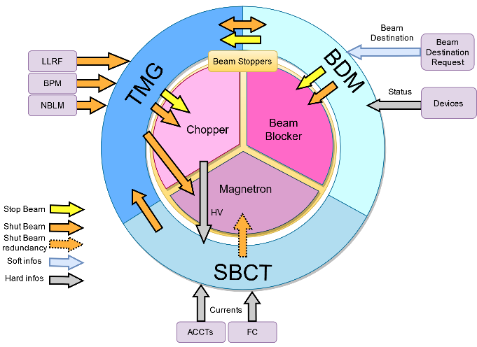
Saraf Machine Protection System
Relies on 3 sets:
Beam Destination Master (PLC master)
Section Beam Current Transmission
TiMinG system
Tested on the MEBT since 2024
Presentation « Timing, MPS and control of beam operation at Saraf»
by Alexis Gaget

Slide 26
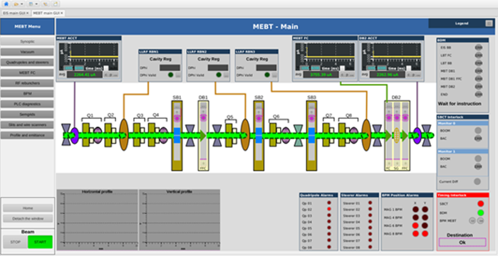

Saraf Main Control System
Specific work to:
Standardise the appearance of the displays: graphical guidelines, display sizes…
Standardise the control for navigation
Same menu and same location in each display (left side panel)
LEBT
MEBT

Slide 27
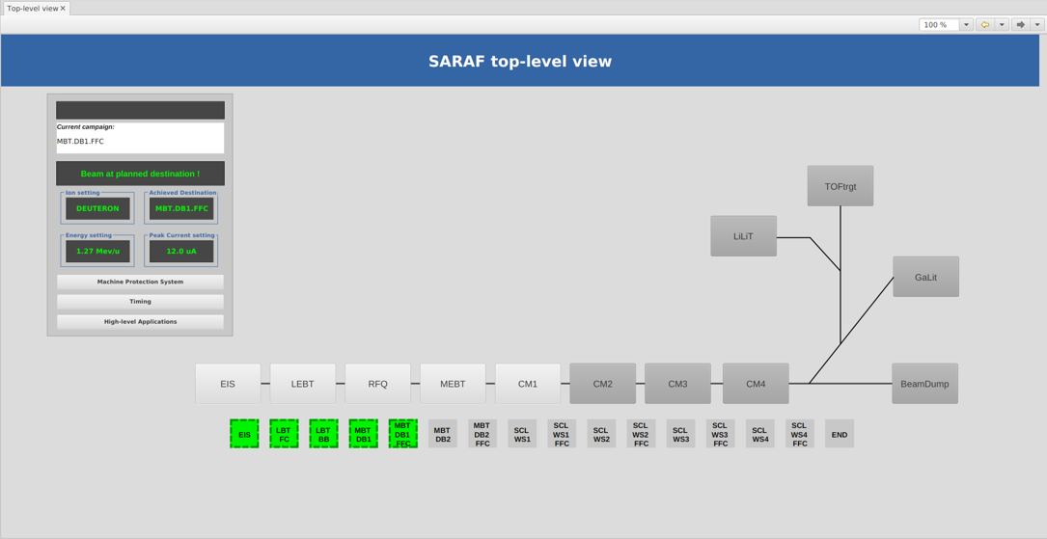
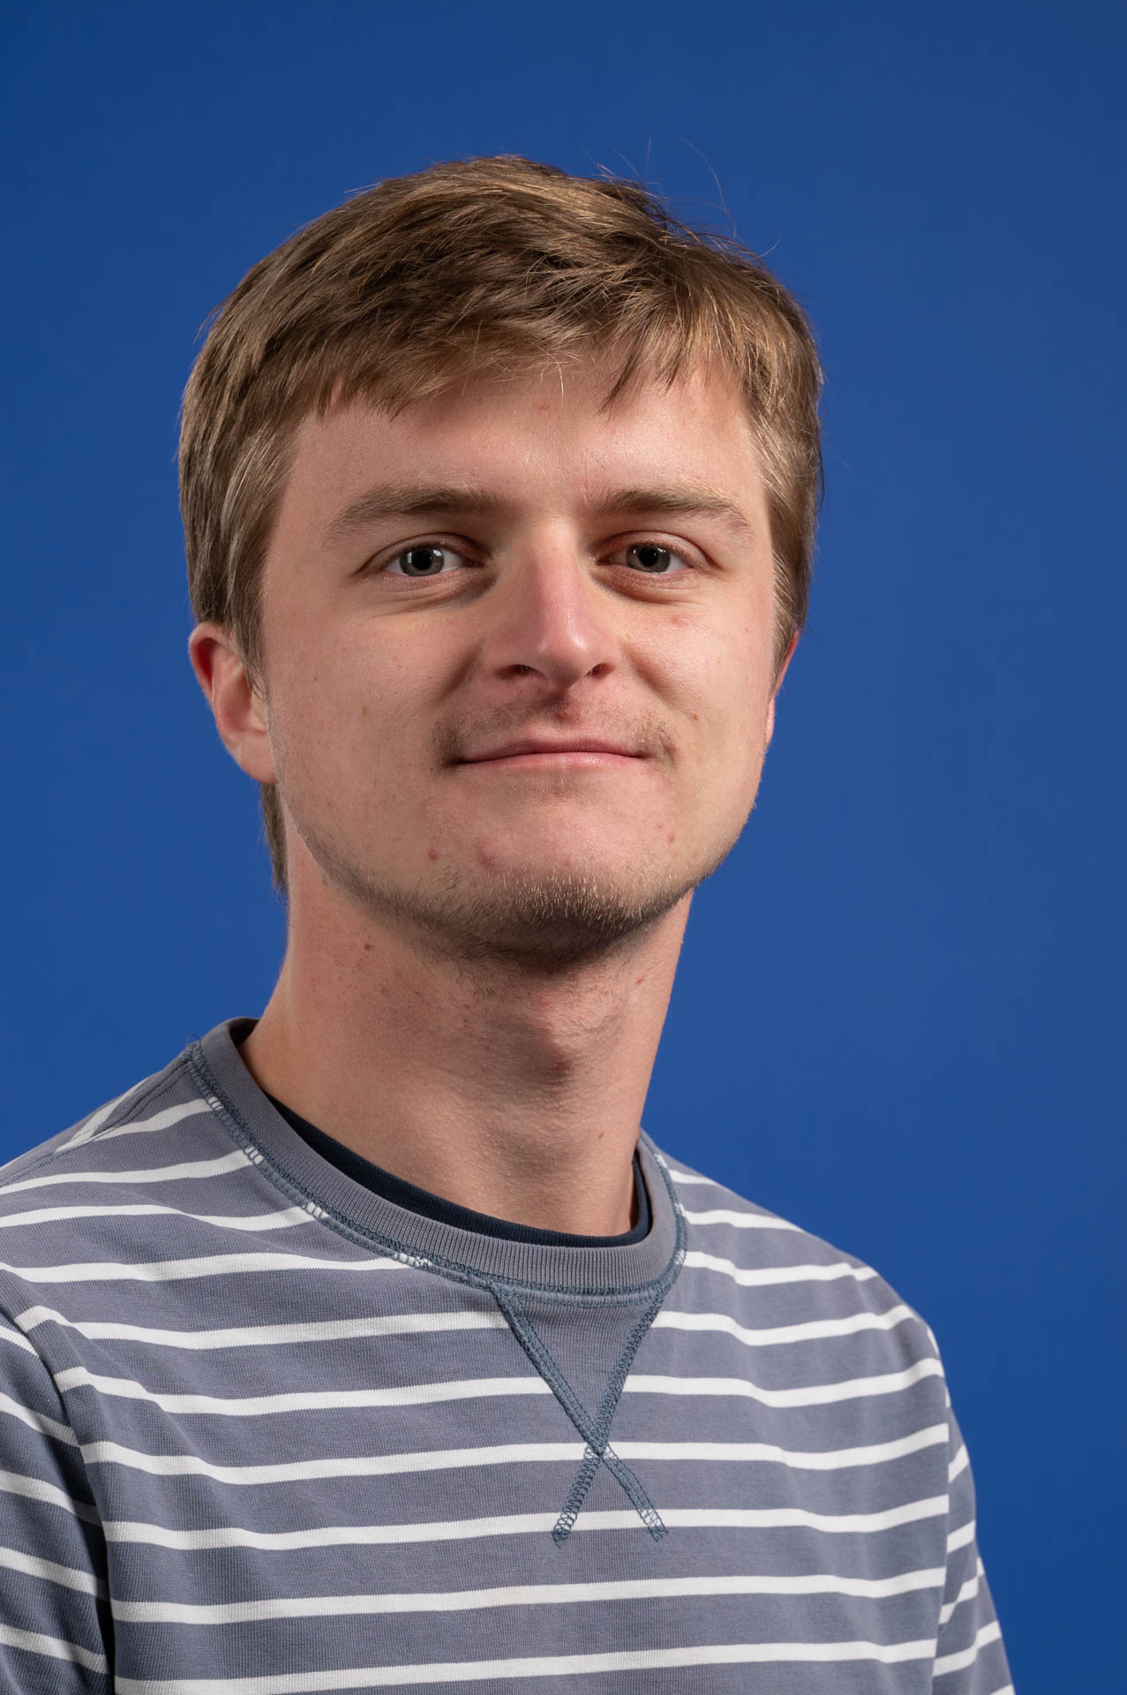
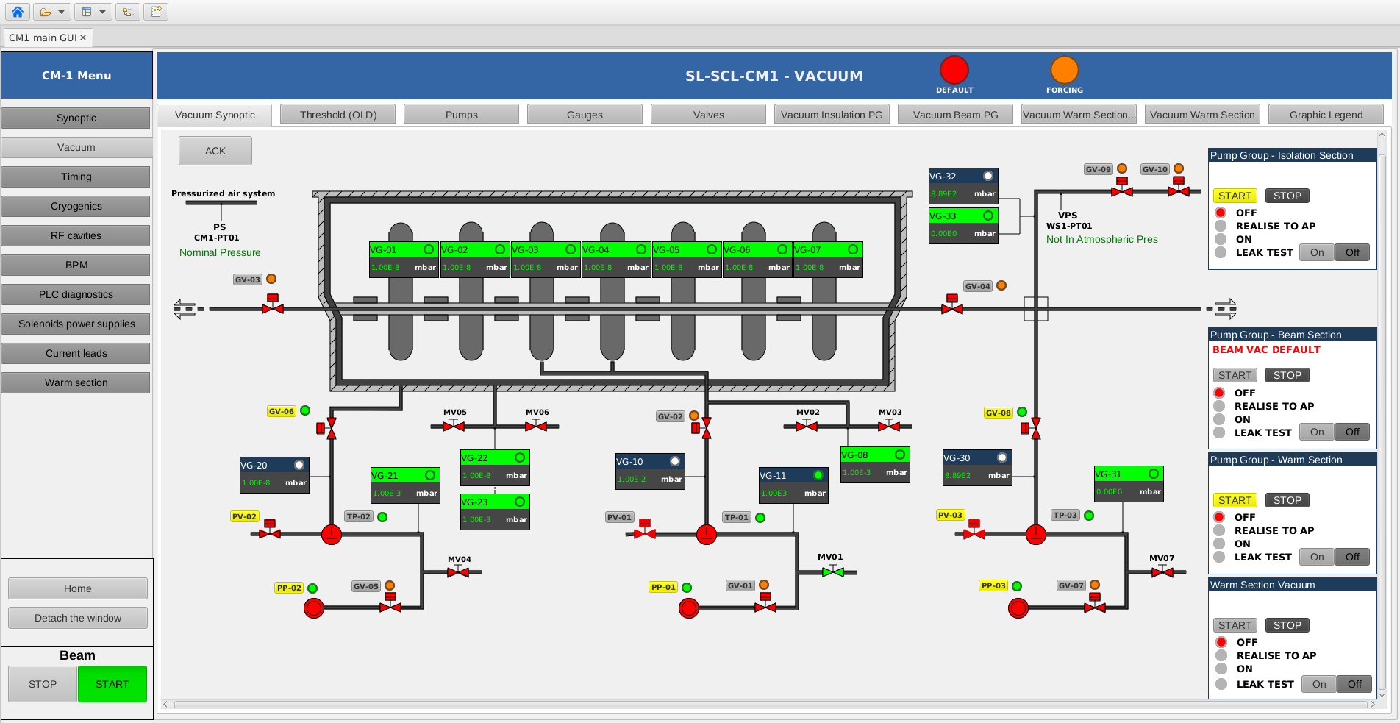
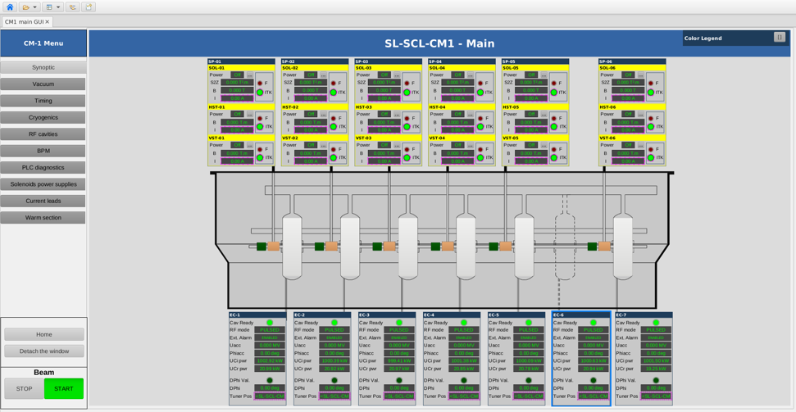
Saraf MCS drill down structure
Top Level View
HOME button to go back to the Top Level View
Migration from CSS to Phoebus summer 2023
Phoebus tools integrated: Alarm, Olog, Save-and-Restore, Archiver Appliance, Channel Finder
« SARAF-Linac high-level applications »,
Antoine Choquet
HOME
button
Cryomodule Vacuum
Cryomodule Cavities and Solenoids

Slide 28
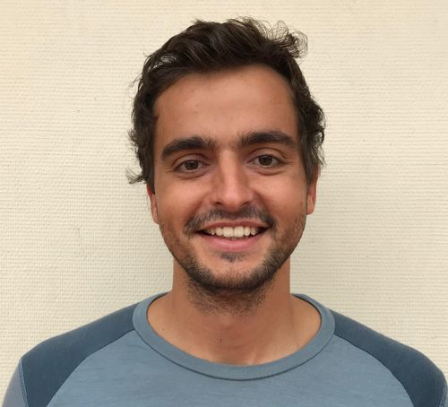
Saraf status
Injector completely commissioned in 2023.
DC 20% 4 mA on DB2 (end of the line) MEBT in November 2024.
Currently CryoModules CM1 and CM4 entirely installed,
CryoModule CM2 in progress and CryoModule CM3 pending.
CM1 including 6 cavities, 7 solenoids and 7 BPMs warm tested.
Issues with the cryogenic part.
See presentation: « Remote commissioning of an EPICS-controlled accelerator »
by Gabriel Desmarchelier

Slide 29
Titan
4

Slide 30
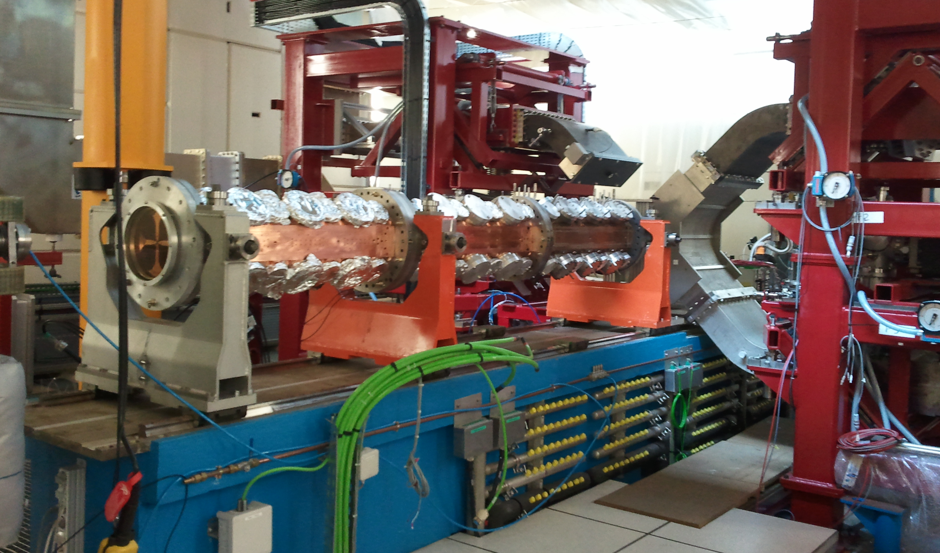
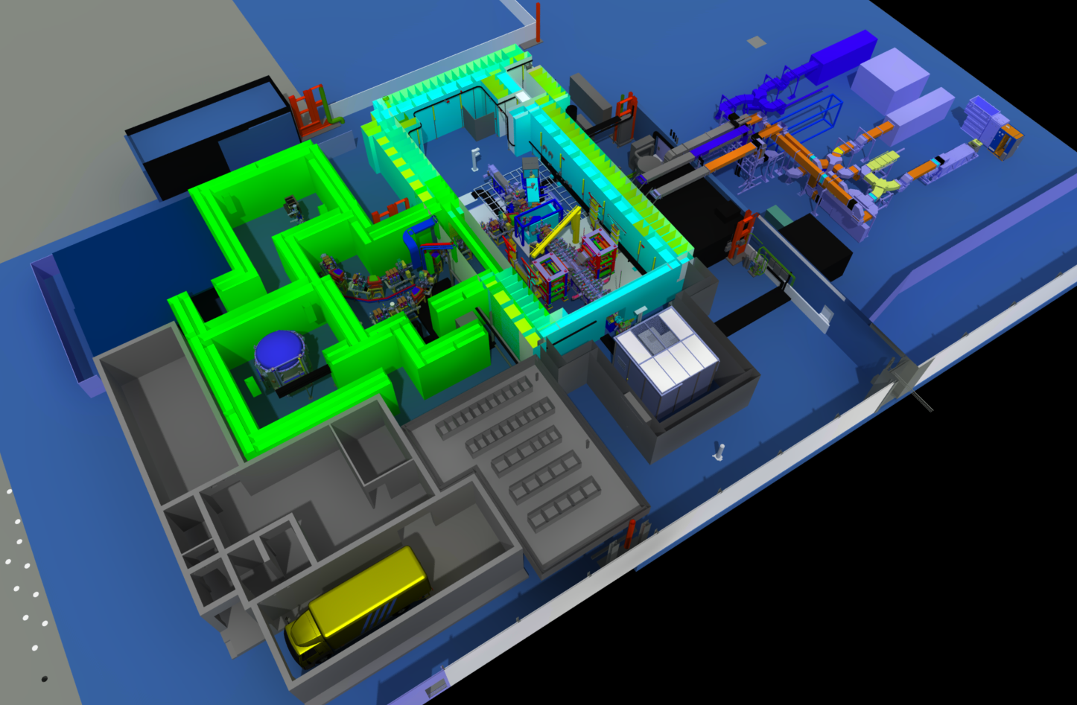
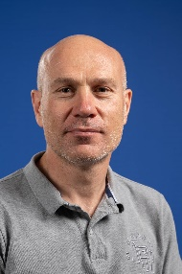
Linac IPHI -> Titan
IPHI (Injector of Proton with High Intensity): started in 1996
Proton source (SILHI) + LEBT + RFQ + Diagnostics
Continuous beam of 100 mA protons accelerated up to 3 MeV (beam power: 300 kW)
Test tool for our collaboration to other projects and acquisition of technological expertise
VME (with VxWorks) and SIEMENS PLC technologies
Controlled with EPICS in 2000. HMI with MEDM
Titan: started in 2019
Improvement and extension of the IPHI high-intensity proton accelerator with targets to produce neutrons
Industrial tool for neutronography
9 MTCA (with Linux), 10 SIEMENS PLCs, MRF timing technologies
EPNix environment. HMI with Phoebus. VM managed with Proxmox
Presentation of Titan control system by Yannick Mariette
on Tuesday

Slide 31
CEA workpackage for PIP2
4
Phase II

Slide 32
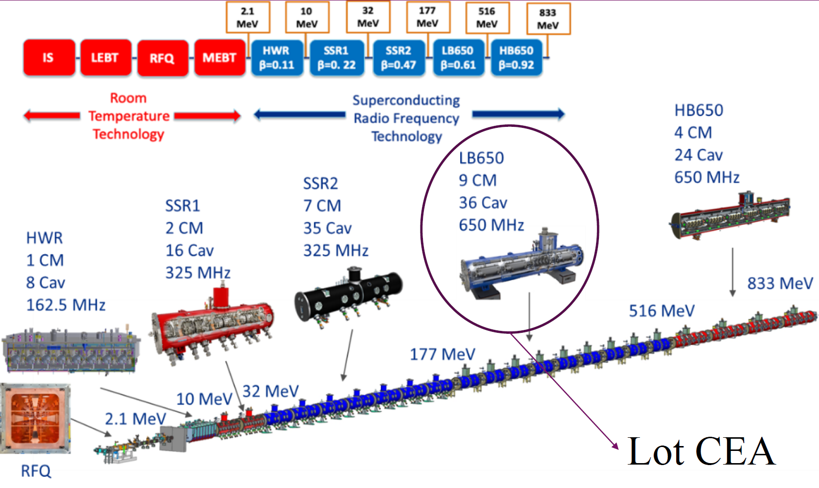
PIP2 CEA workpackage
RF cold tests of 10 cryomodules
each one including 4 Low-Beta cavities
EPICS control based on:
MTCA.4 standardized platform
EPNix environment

Slide 33
Thank you

