Slide 1

Spring EPICS collaboration meeting 2026
Welcome and introduction
Pierre MANIL,
Head of CEA/Irfu’s Systems engineering department
20/04/26

Slide 2
Welcome and warm thanks for joining this EPICS collaboration meeting!

Slide 3
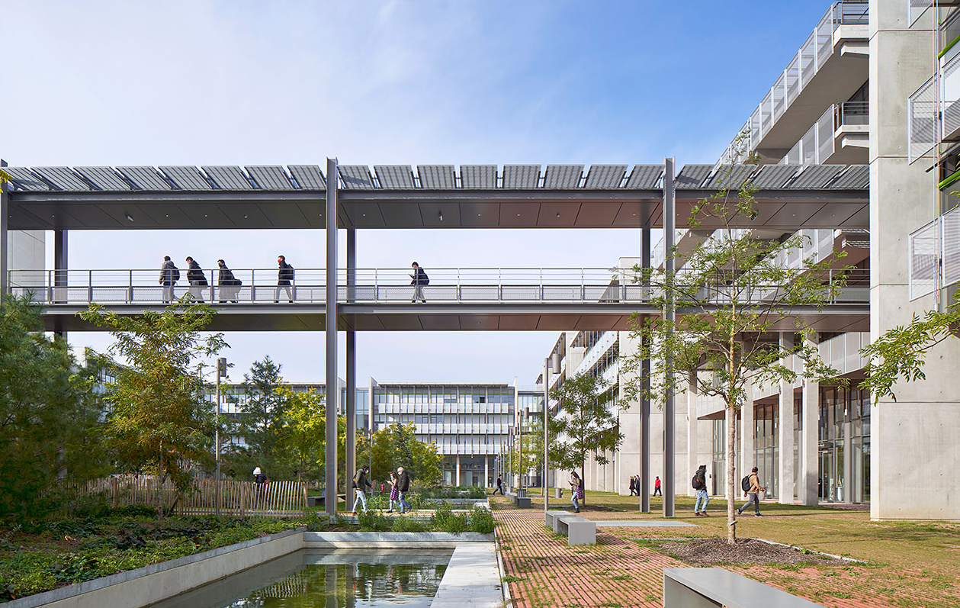

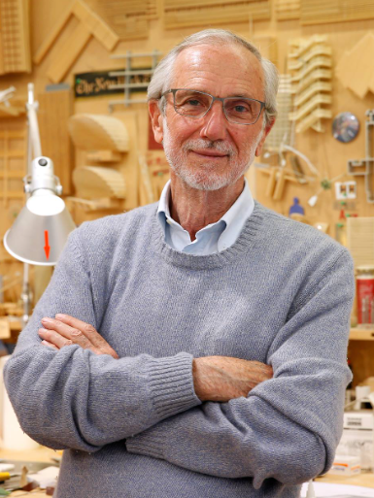

Welcome at the heart of
RENZO
PIANO
We are here
ENS Paris-Saclay

Slide 4
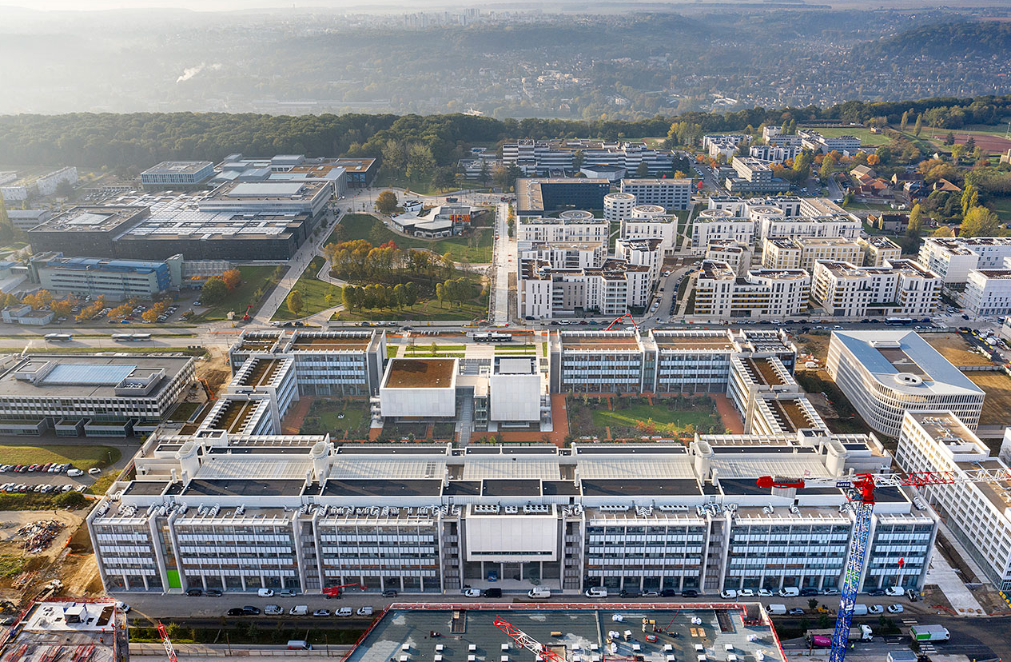
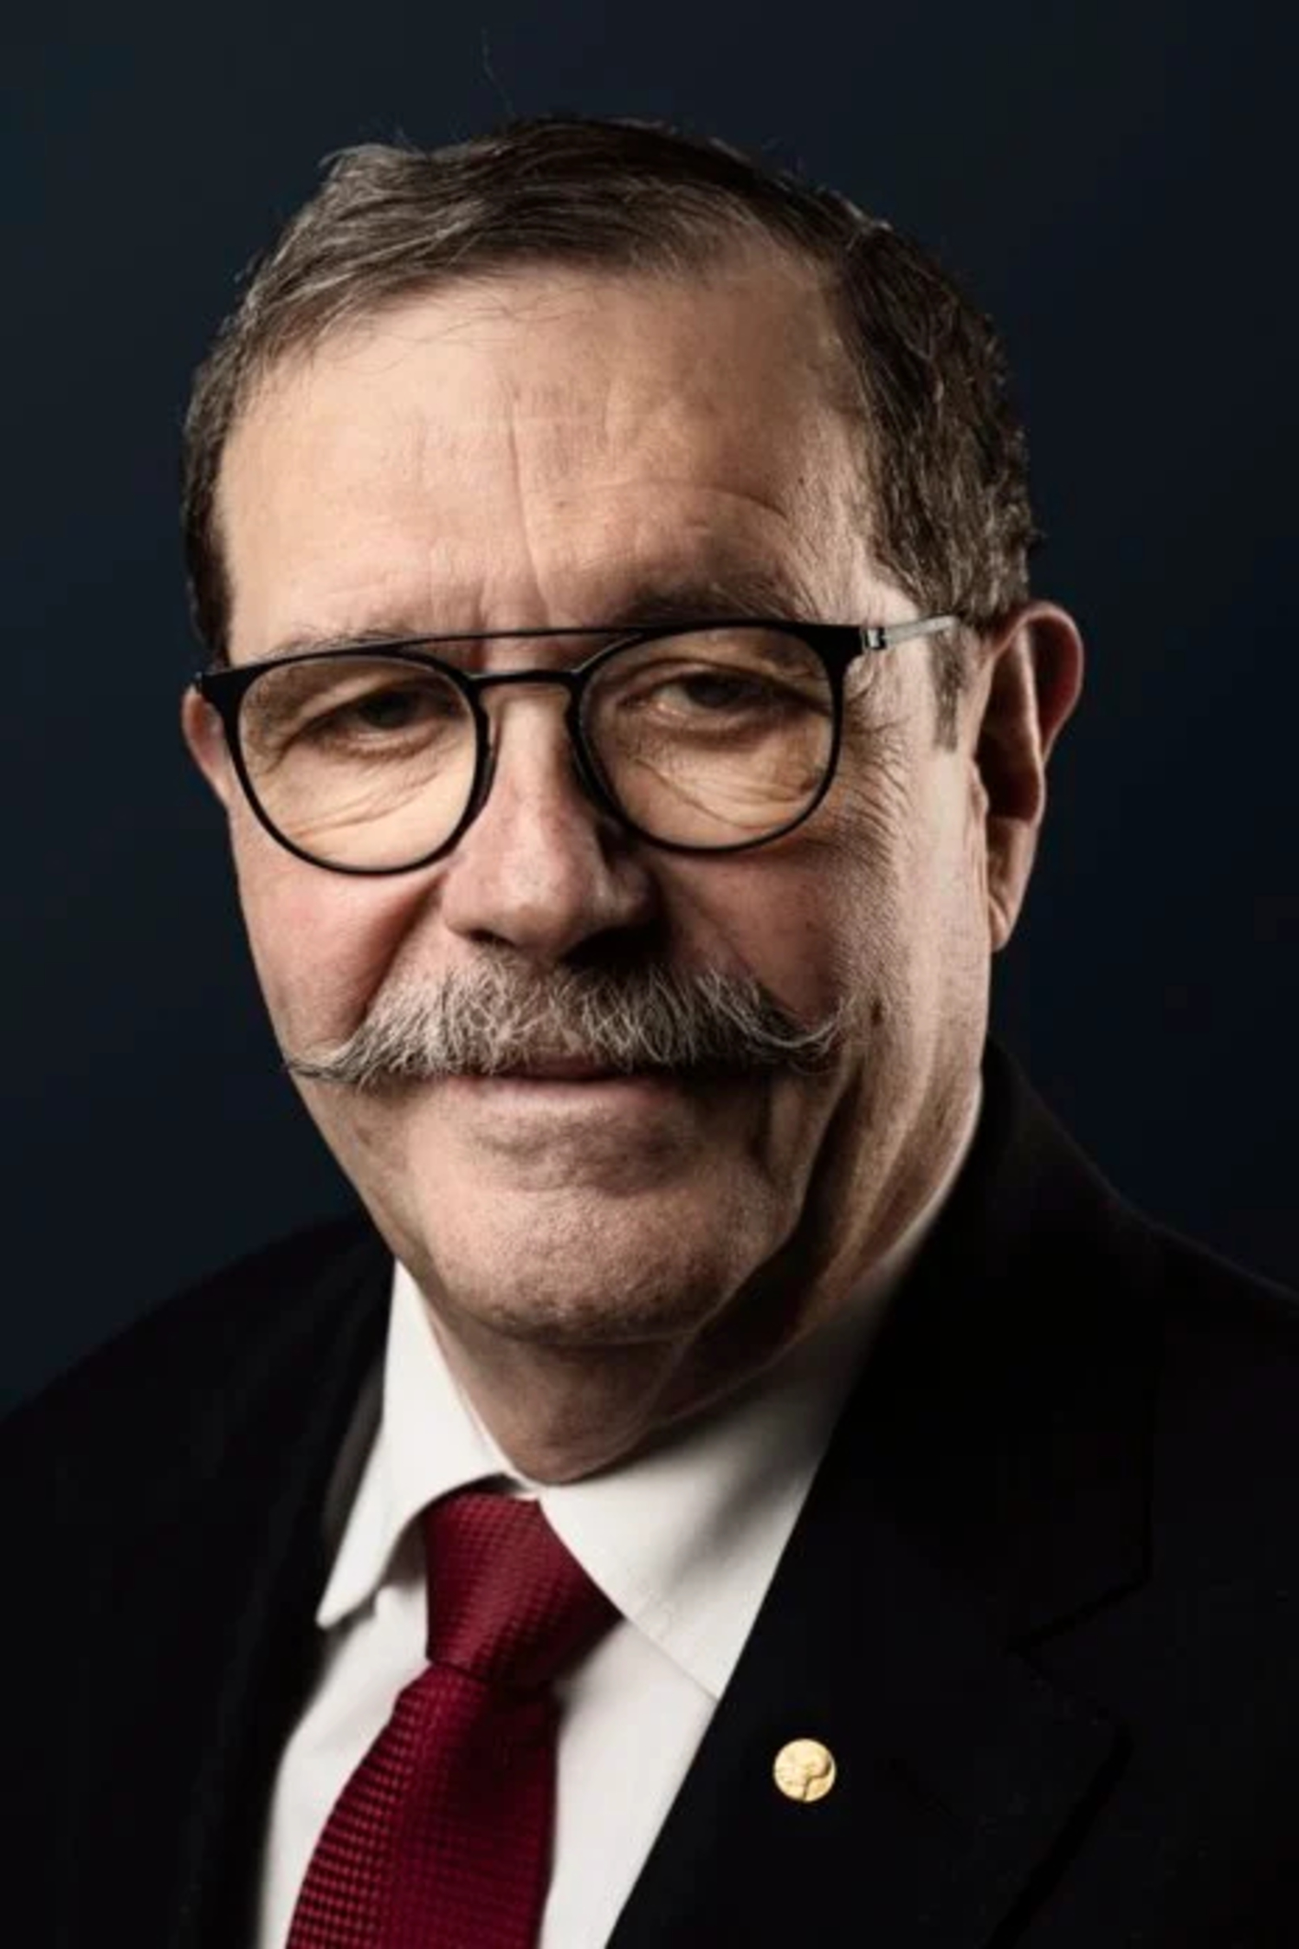
Orsay
Gif-sur-Yvette
Vallée de Chevreuse
Hotel
University headquarters
CentraleSupélec
We are here
ENS Paris-Saclay
ALAIN
ASPECT

Slide 5

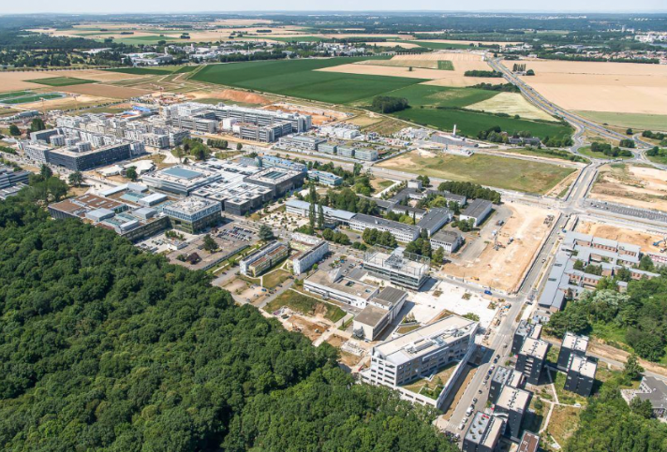
We are here

Slide 6
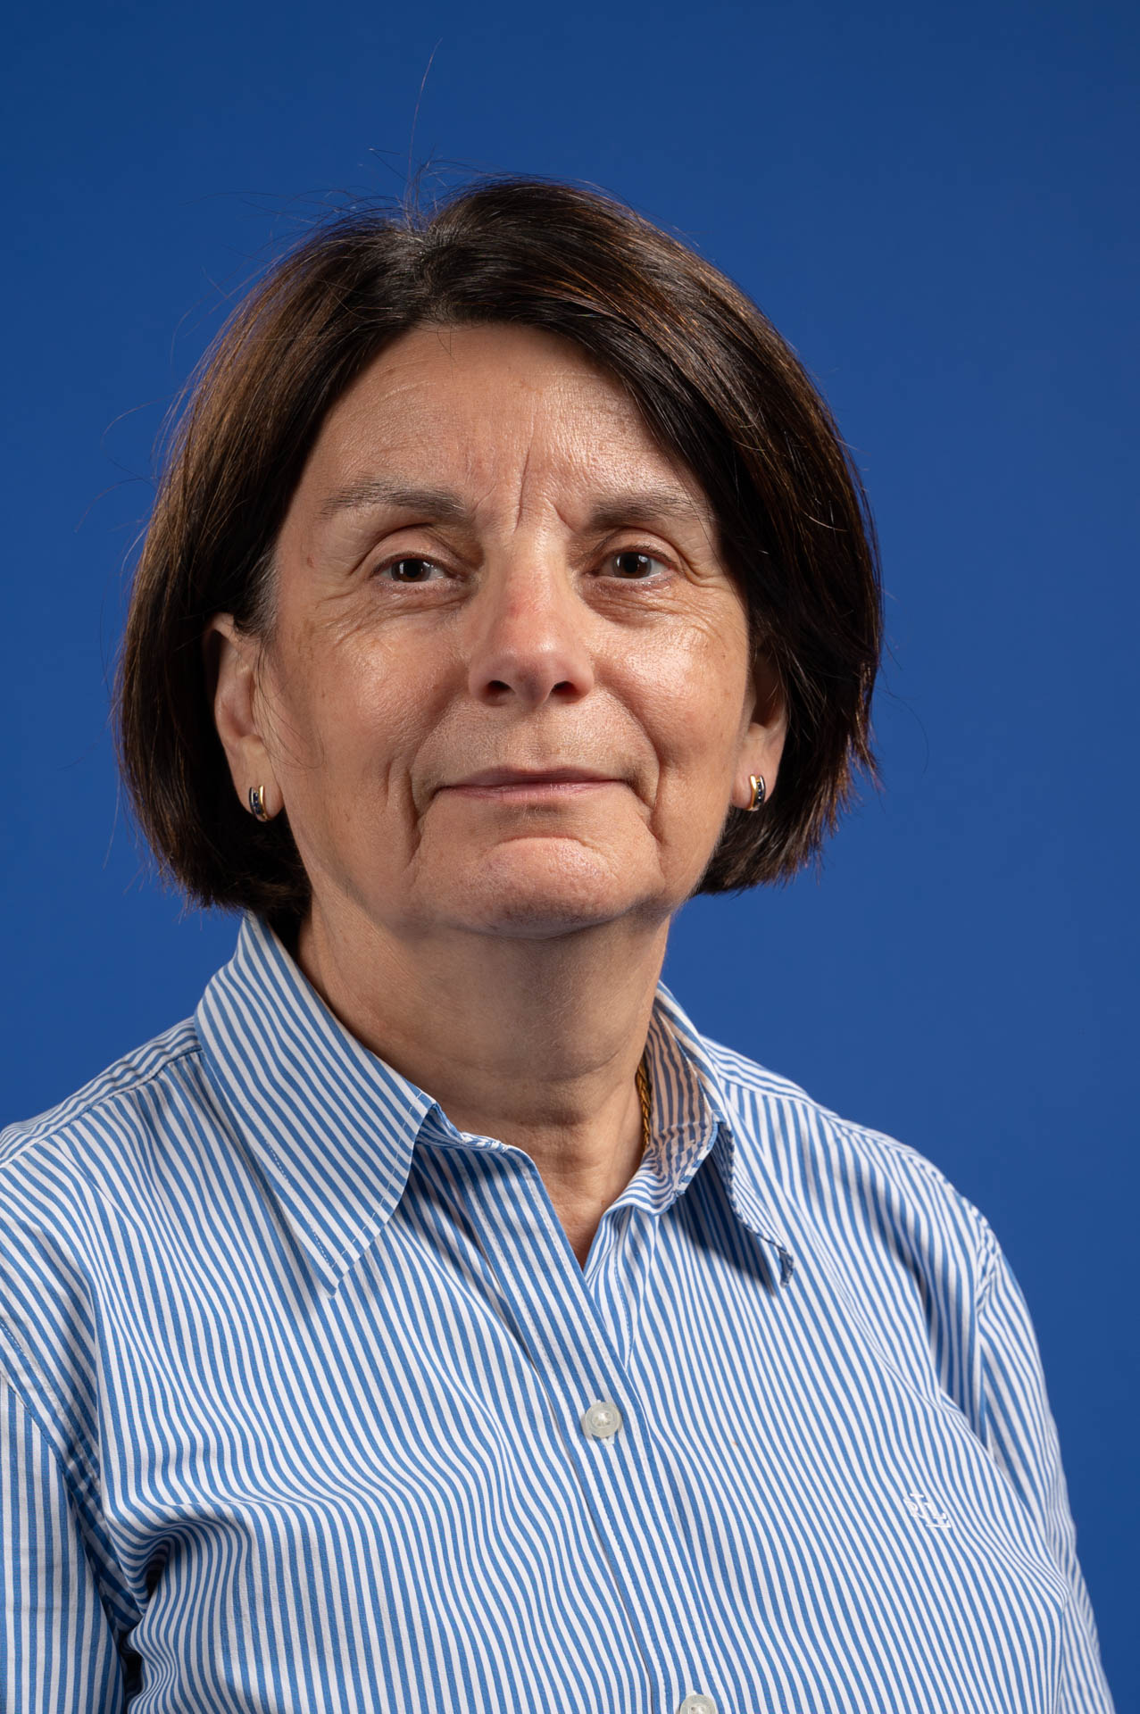
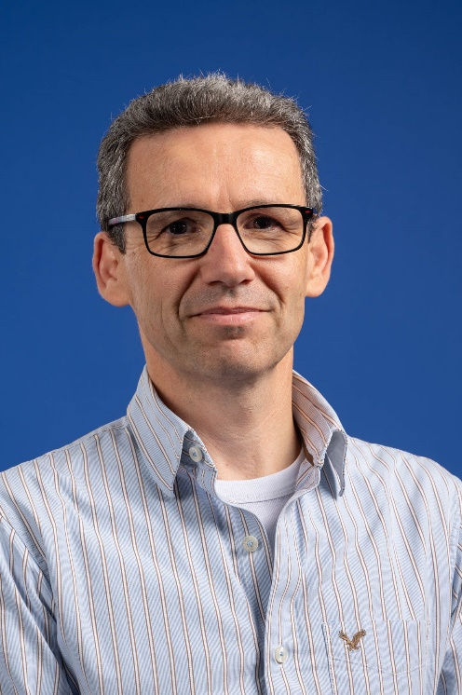
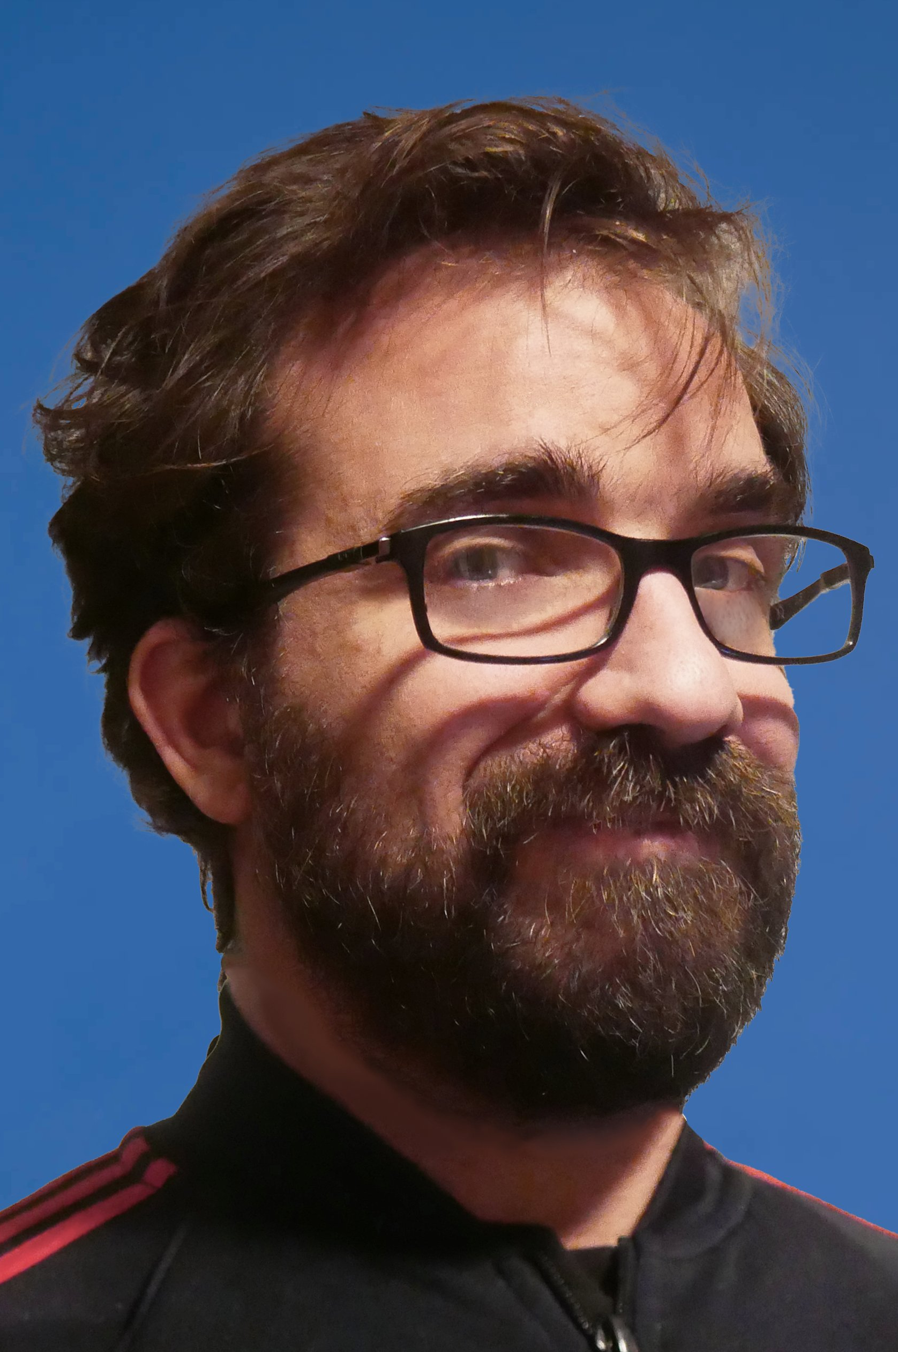
Our scientific committee
PAUL
LOTRUS
FRANÇOISE GOUGNAUD
ALEXIS
GAGET
Organization comity and practical information to be introduced in next talk

Slide 7

Indico page of the meeting
https://indico.in2p3.fr/event/37441/

Slide 8
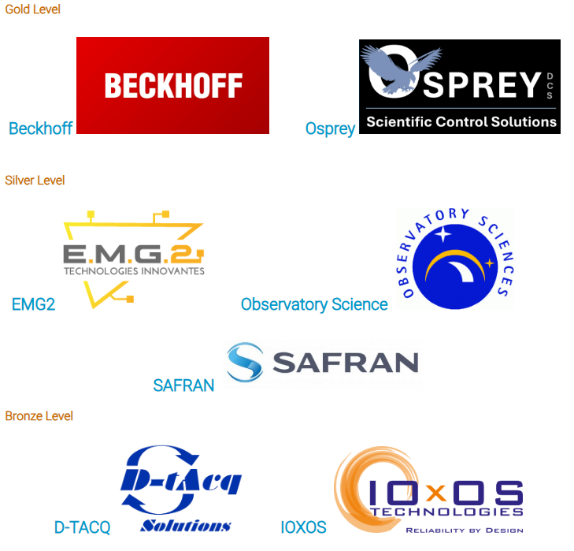
Our sponsors

Slide 9
Exploring the fundamental laws of the Universe
CEA Irfu missions

Slide 10
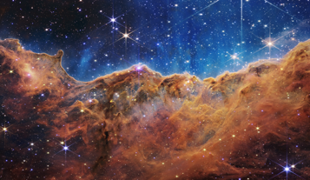
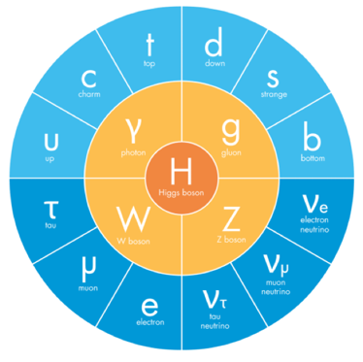
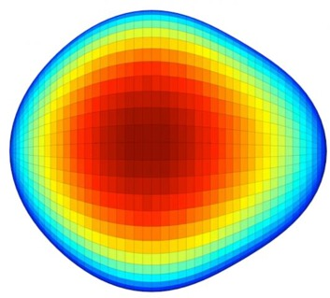
CEA Irfu missions
Energy content of the Universe
Evolution of the structures, galaxies, stars
Stars and planetar systems
Exploration of transient Universe
Structuration of the Universe
Elementary
components
of matter
Properties of
nuclear matter
© F. Sabatié
Coherence of the standard model
Structural tests of the standard model
Nuclear structure and dynamics
Quark and gluons dynamics

Slide 11
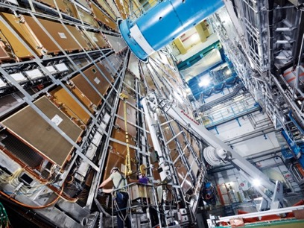
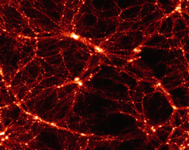
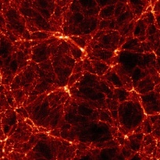
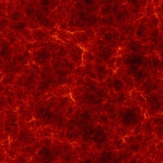
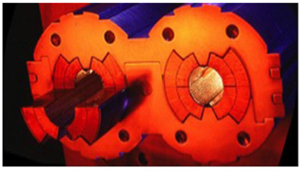
CEA Irfu missions
Structuration of the Universe
Detector
systems
Simulation,
data
Infrastructures et
Plateformes
Elementary
components
of matter
Properties of
nuclear matter
Accelerator and cryomagnetic
systems
© F. Sabatié

Slide 12
Designing and commissioning instruments for physics
Systems engineering at Irfu

Slide 13
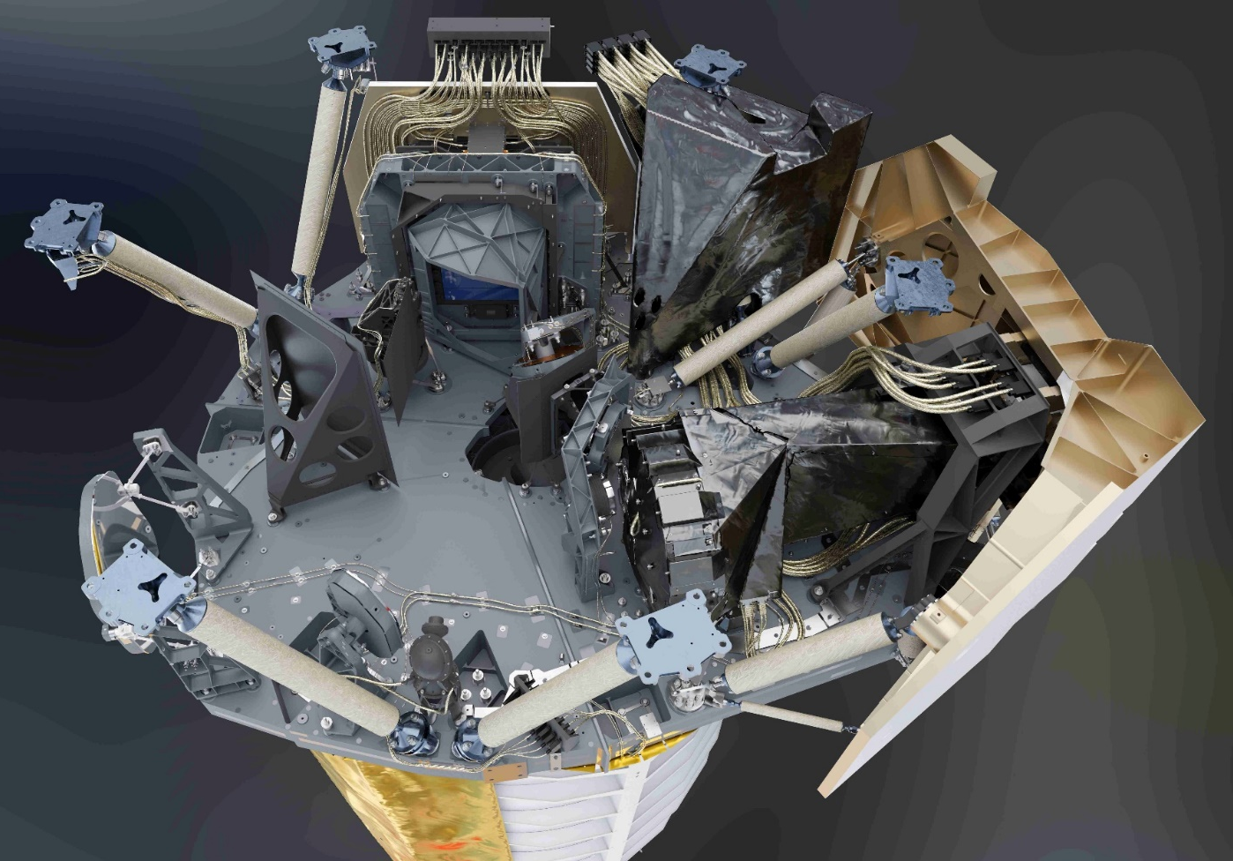
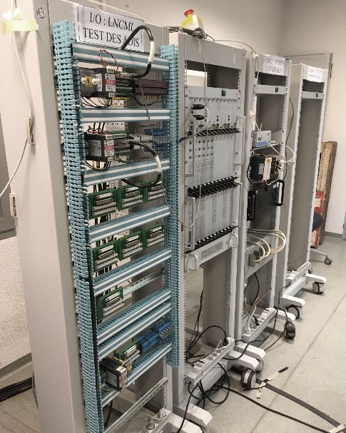
Systems engineering at Irfu
Mechanical & thermal
engineering
Instrumentation, contrOL
Systems
engineering

Slide 14
Irfu’s systems engineering teams
40
69
15
23
31
DIR
LCAP
LEIGE
ÉQUIPE
SUPPORT
CHARGÉ(E)S
9
DE MISSION
CONCEPTION, ÉTUDES,
GÉNIE
LRI
AVANT-PROJET
LEI
ÉLECTRIQUE
6
LDISC
RELATIONS
ÉLECTRONIQUE
INDUSTRIELLES
13
INSTRUMENTALE
SYSTÈMES
DE CONTRÔLE
9
33
124
Spring EPICS collaboration meeting 2026 – Pierre MANIL

Slide 15
Irfu’s control experts
40
69
15
23
31
DIR
LCAP
LEIGE
ÉQUIPE
SUPPORT
CHARGÉ(E)S
9
DE MISSION
CONCEPTION, ÉTUDES,
GÉNIE
LRI
AVANT-PROJET
LEI
ÉLECTRIQUE
6
LDISC
RELATIONS
ÉLECTRONIQUE
INDUSTRIELLES
13
INSTRUMENTALE
SYSTÈMES
DE CONTRÔLE
9
33
124
Spring EPICS collaboration meeting 2026 – Pierre MANIL

Slide 16
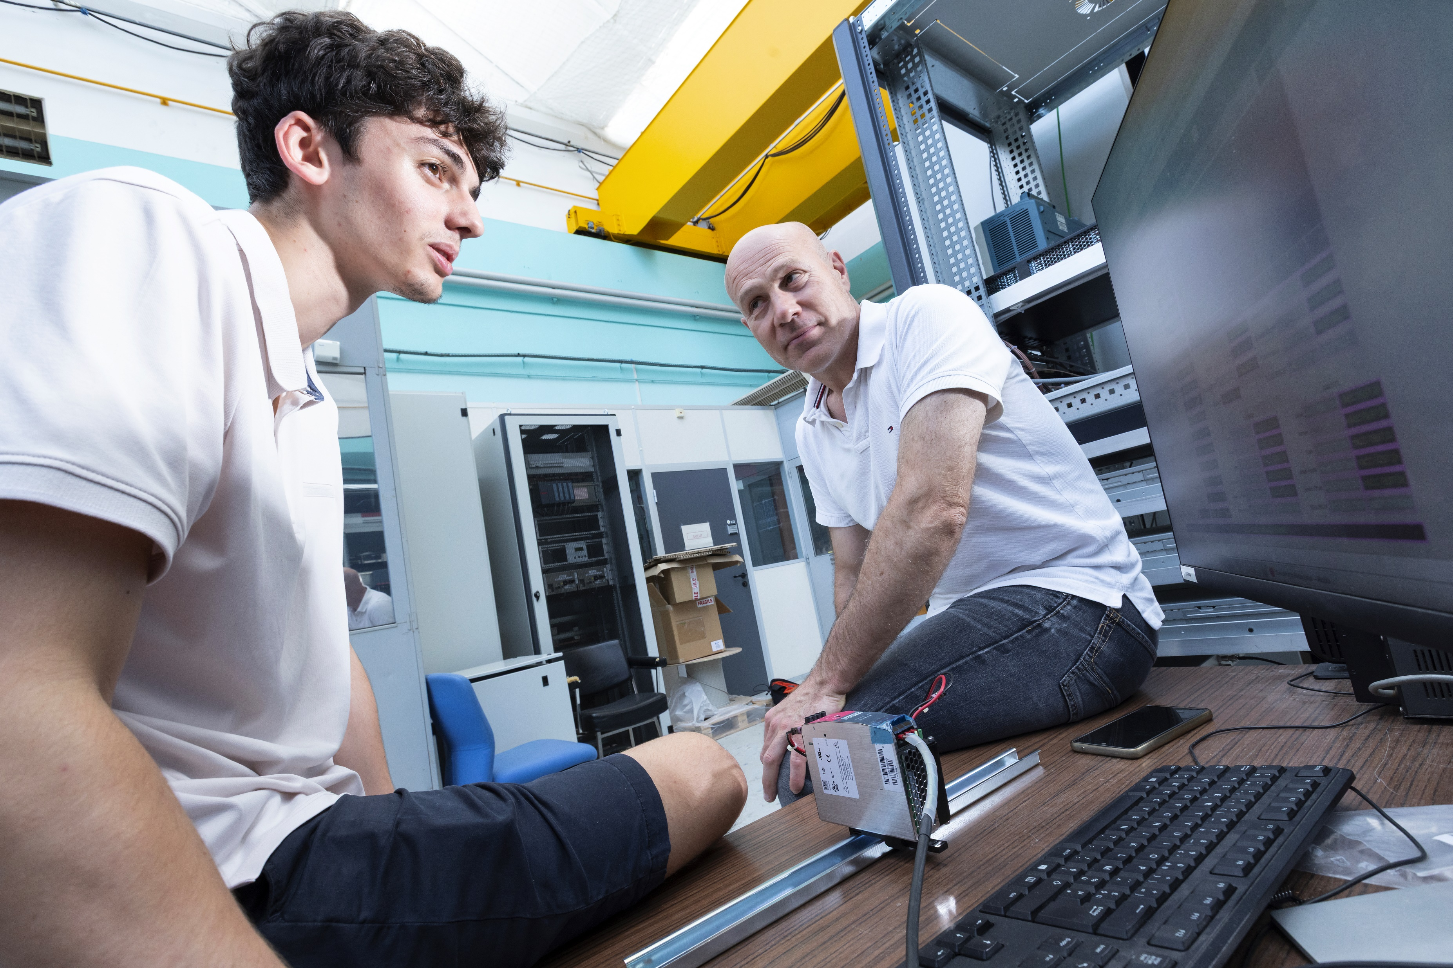
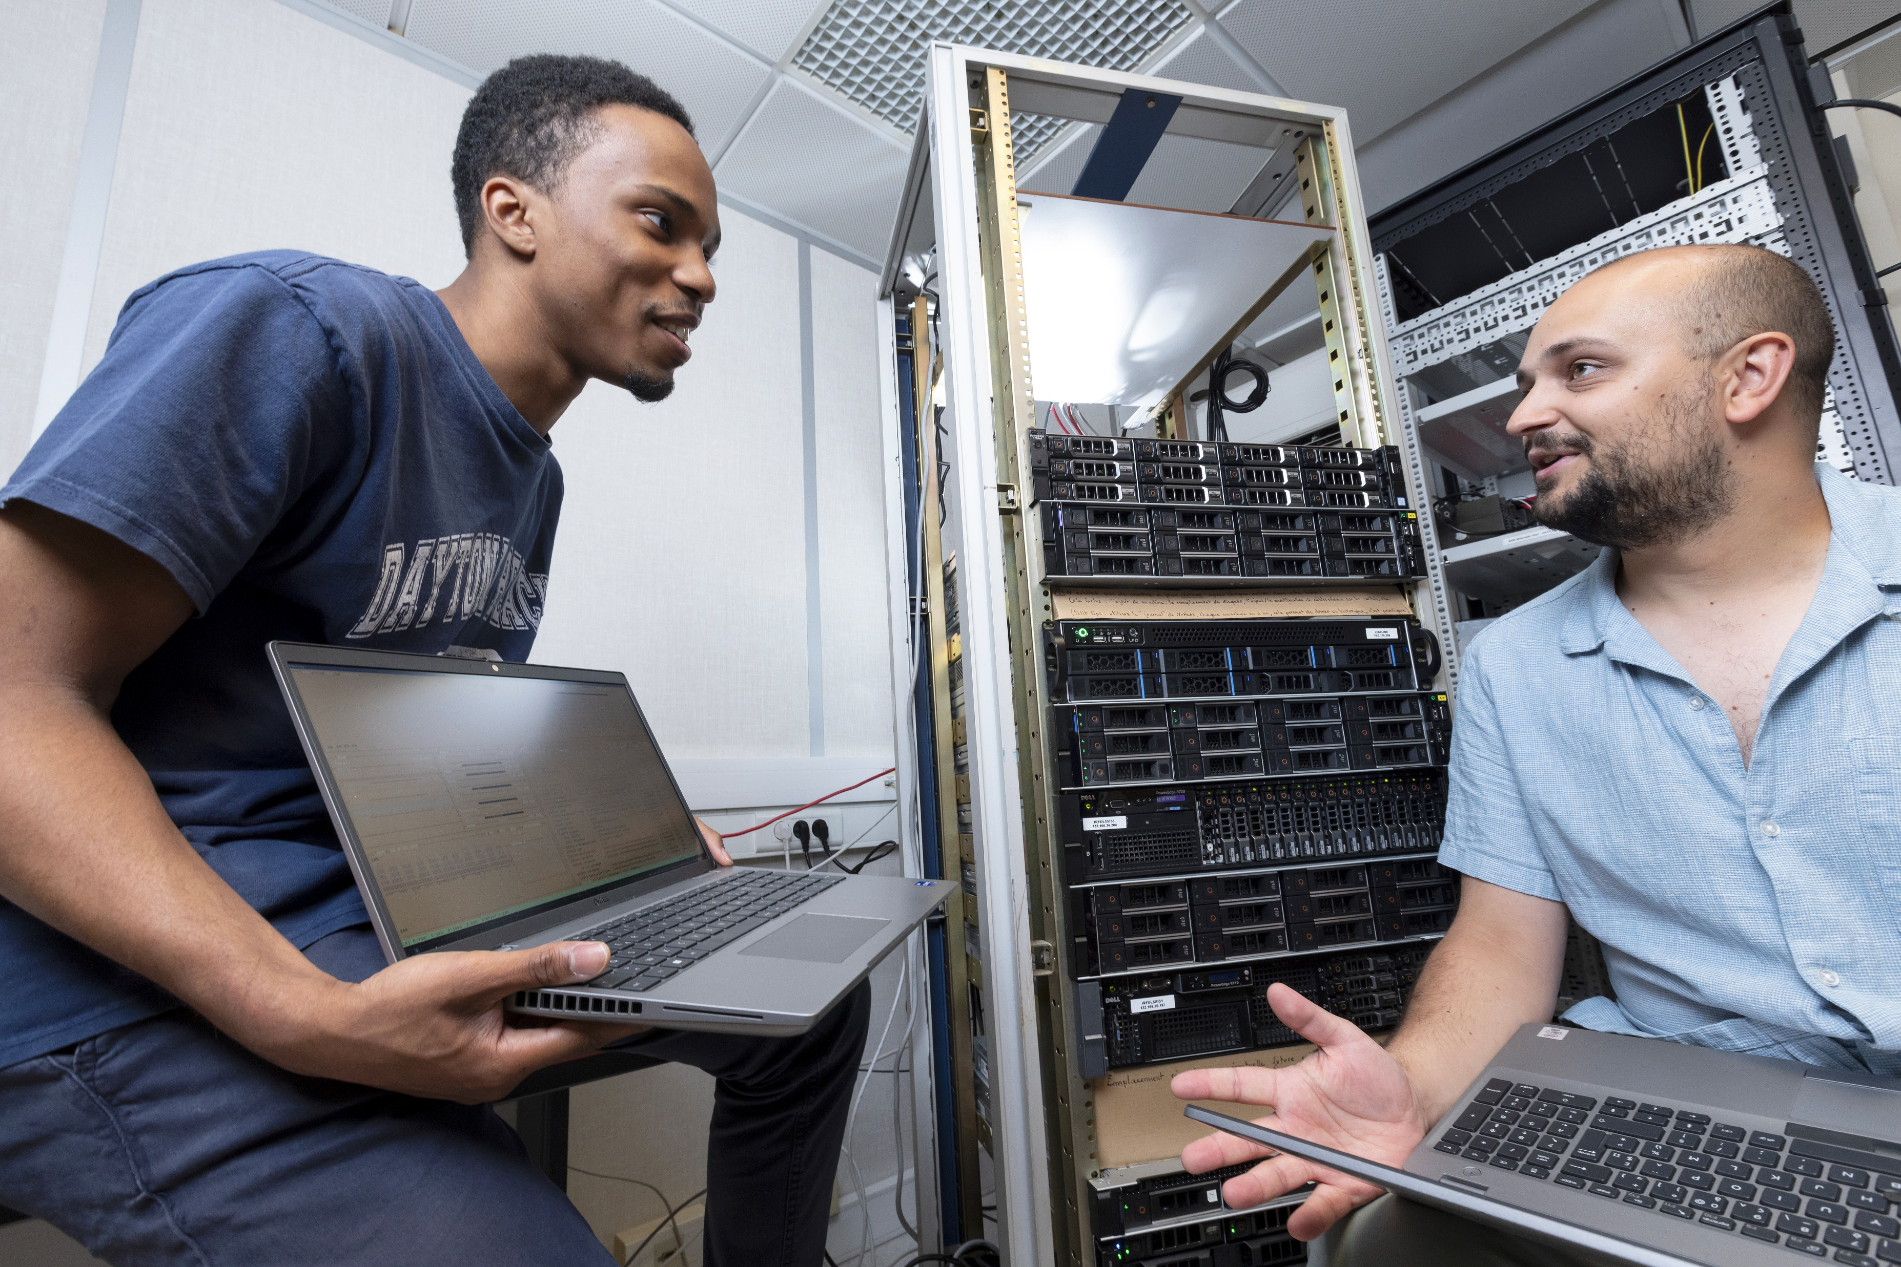
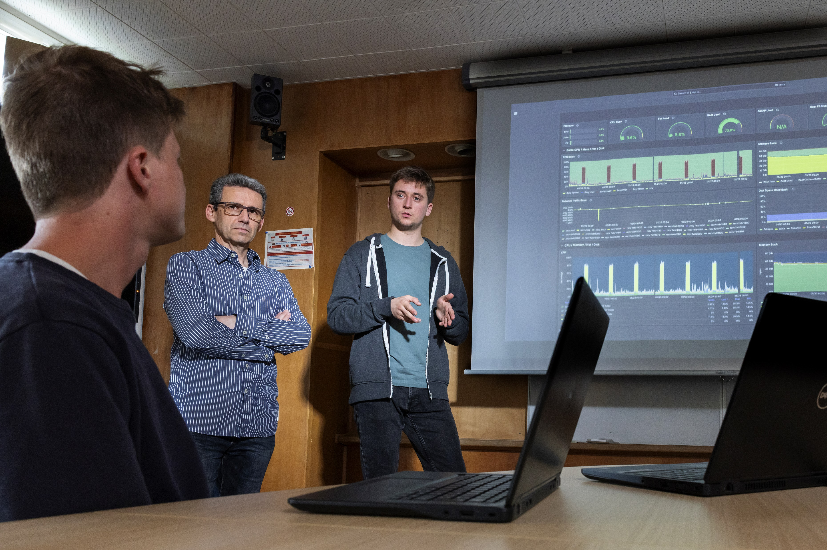
Irfu’s control experts
a strong experience on EPICS
a culture of service and transmission
an integrated roadmap including EPICS and home-made SCADA for specific (lightweights) projects
Spring EPICS collaboration meeting 2026 – Pierre MANIL

Slide 17
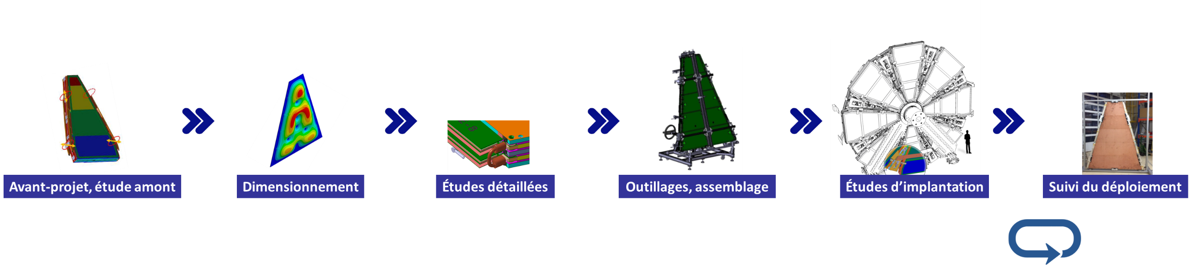
Following the whole project lifecycle
Upstream studies
Modeling
Detailed studies
Tooling studies
Integration, commissionning
Operation support
Realization
17
Notes:
Quand on regarde les objectifs de conception…par exemple
Projets de physique
Accélérateurs : prob thermiques (cryogénie très froids, hauts flux thermiques
On voit bien ce que peut apporter la FA (« pas de surcout » à la complexité)
D’autant plus qu’on est drivé par la performance (on fera pas un objet qui existe déjà)

Slide 18

Our domains of application
CRYOMAGNETIC
SYSTEMS
SPACE DETECTOR SYSTEMS, TELESCOPES
ACCELERATOR SYSTEMS
DETECTOR SYSTEMS
INTERNAL R&D
Spring EPICS collaboration meeting 2026 – Pierre MANIL
18

Slide 19
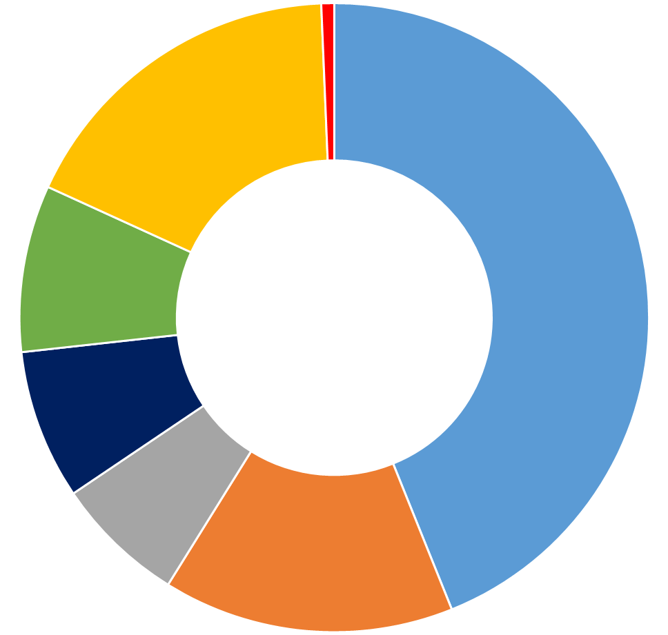
Our involvement per domain
SCADA
GUI
EPICS developments
Data acquisition
Cybersecurity
AI
ESS
SARAF
TITAN
PIP-II…
Spring EPICS collaboration meeting 2026 – Pierre MANIL
19

Slide 20
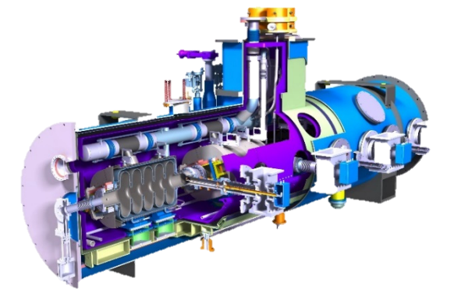
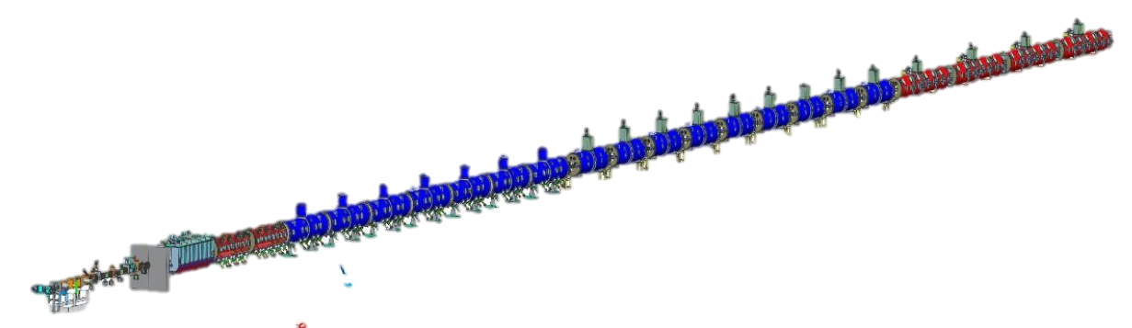
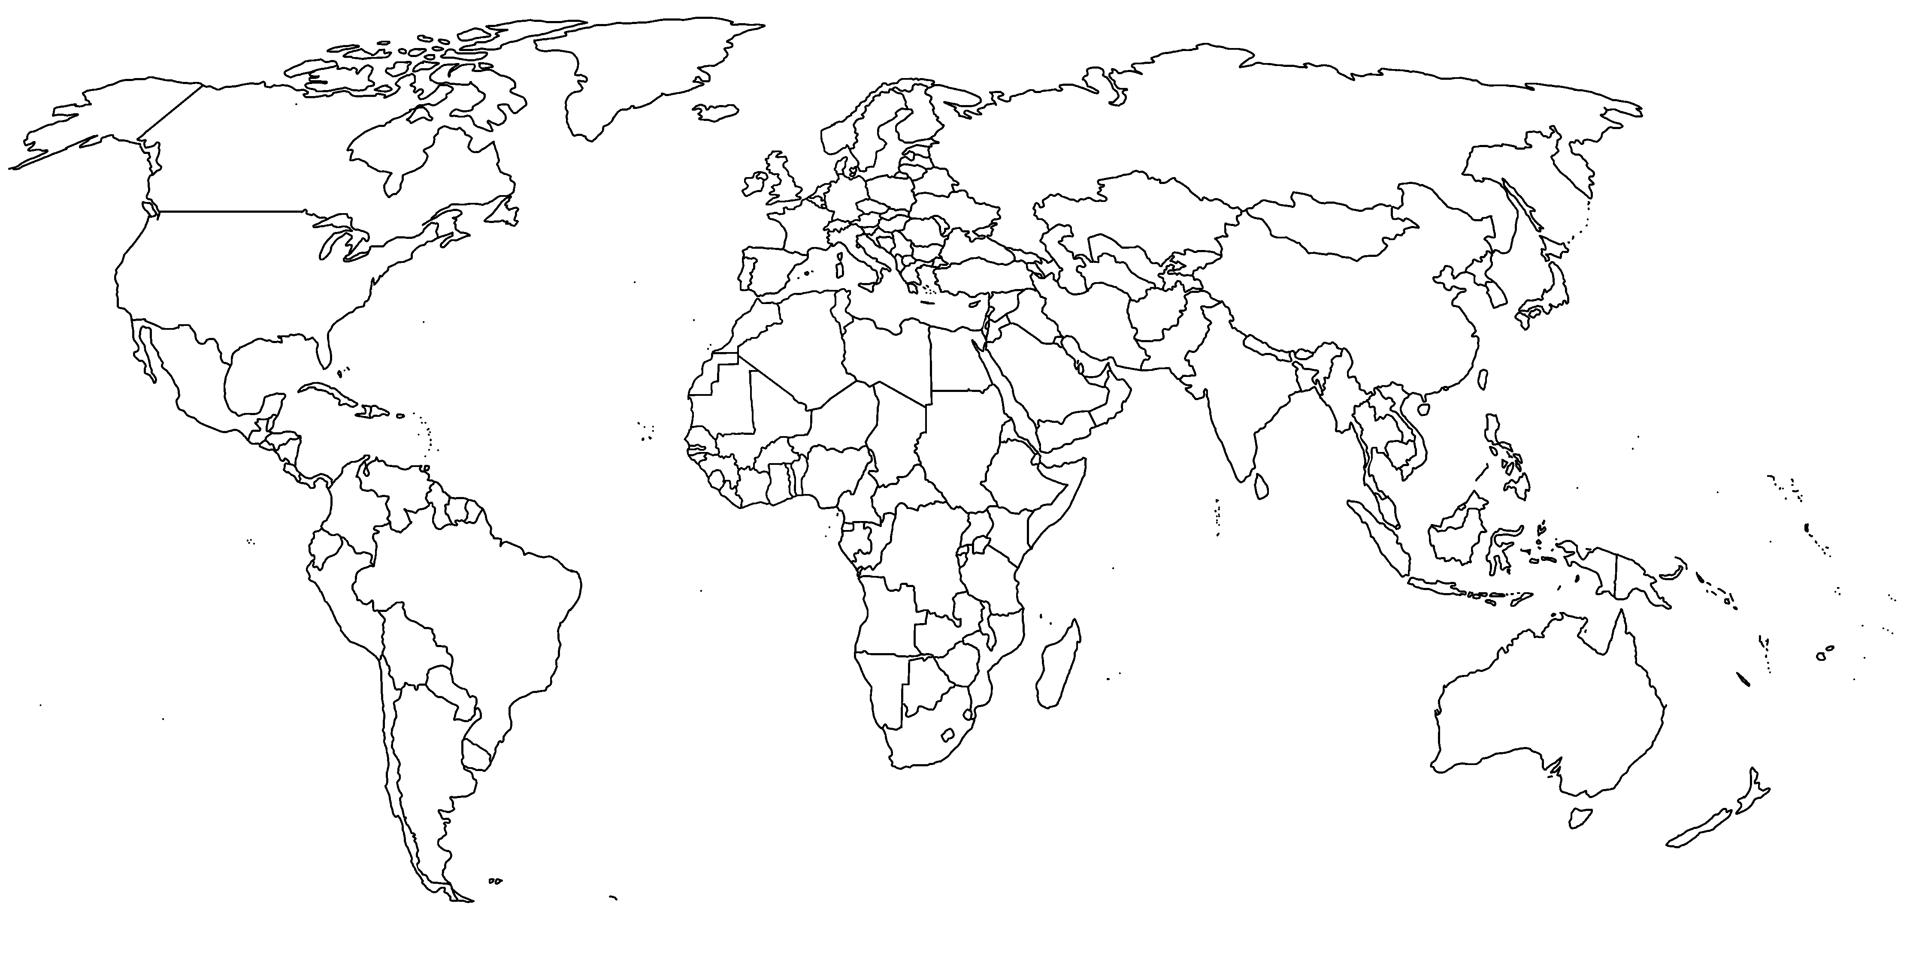
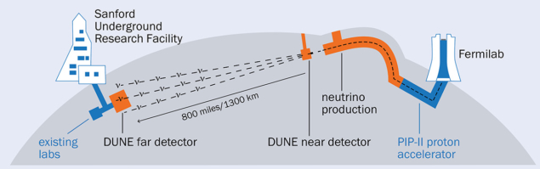
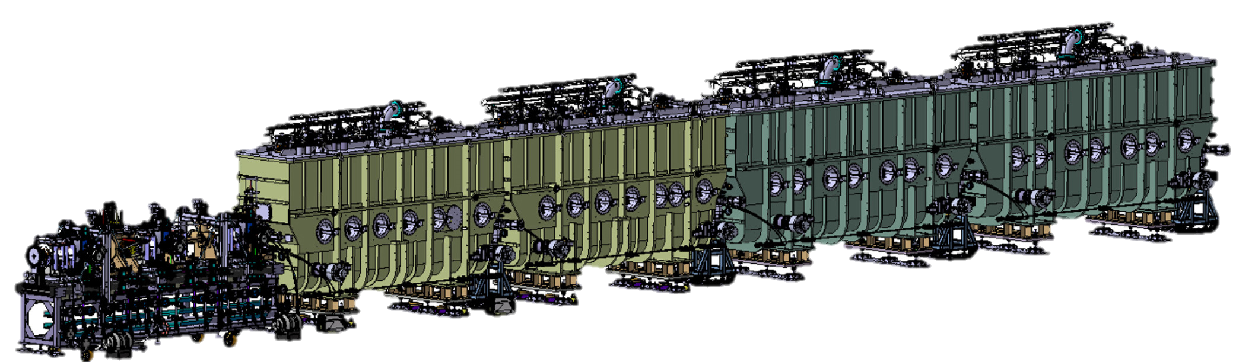

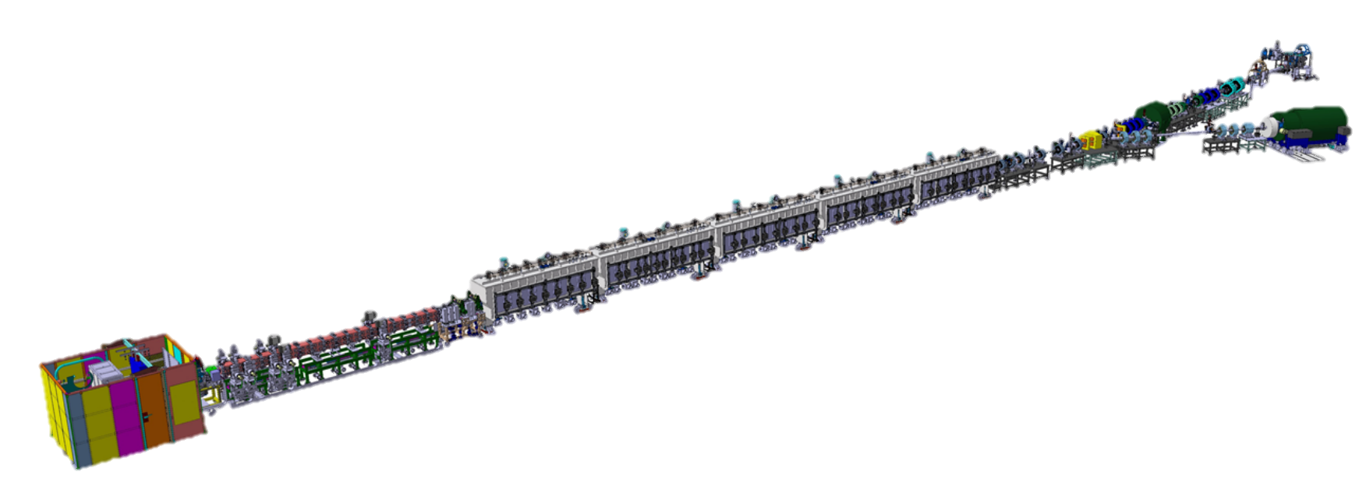
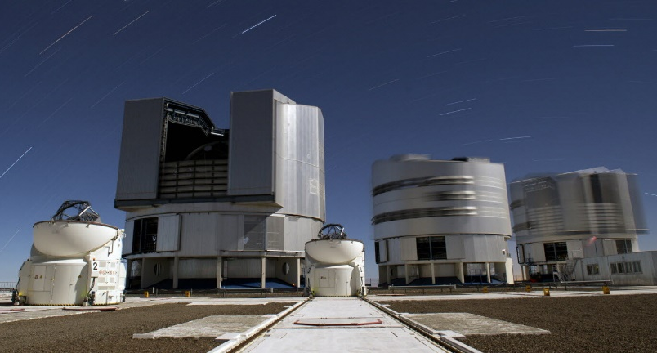
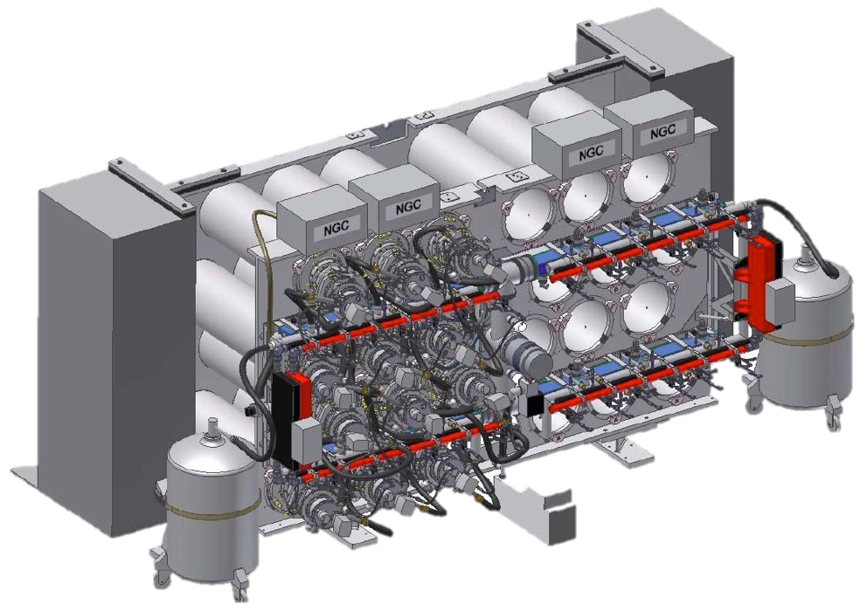
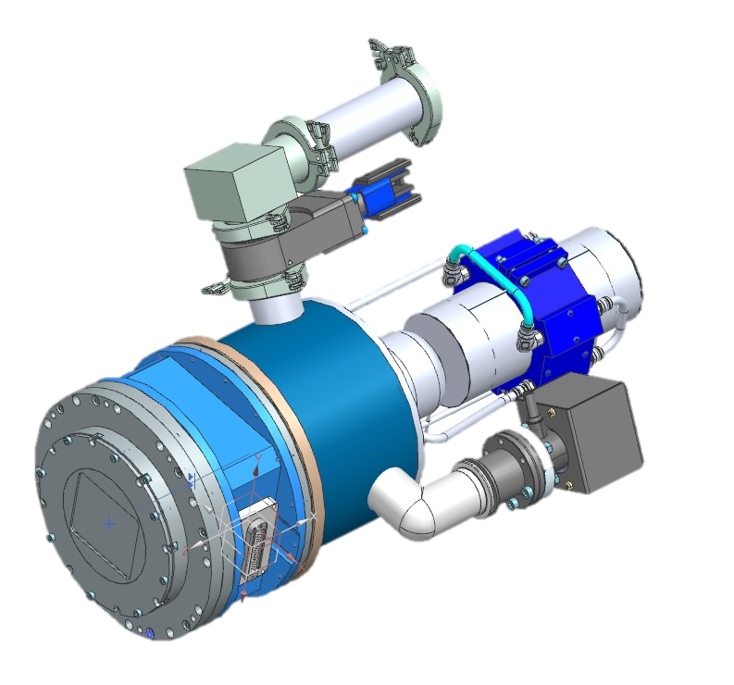
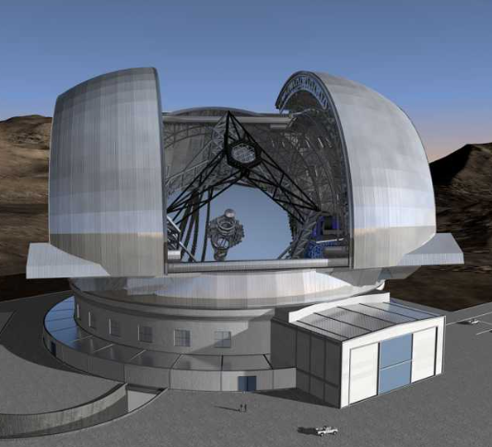
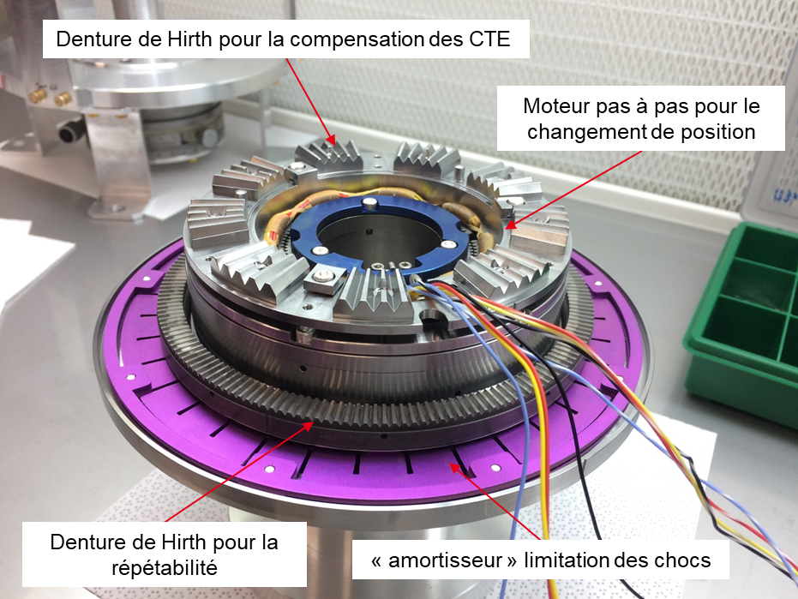
Contributions worldwide…
PIP-II
ESS
Lund
SARAF
Hambourg
New York
IFMIF-DONES
Tokai
Chicago
Granada
EIC
Soreq
DESI
T2K
BlueMUSE telescope
EIC Spin
In space :
EUCLID
SVOM
JWST
To be launched:
ARIEL
THESEUS
…
ELT-METIS (Extremely Large Telescope)
(Mid-infrared ELT Imager and Spectrograph)
Atacama
Cerro Armanzones
© F. Rossi
Spring EPICS collaboration meeting 2026 – Pierre MANIL
20

Slide 21
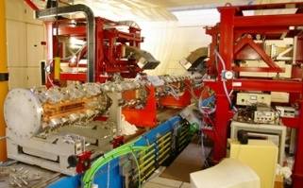
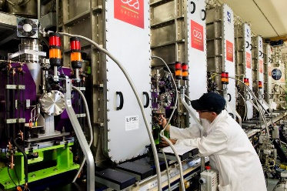
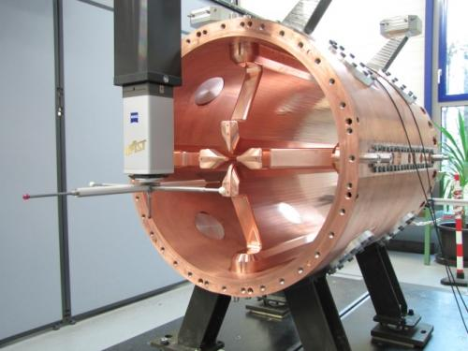
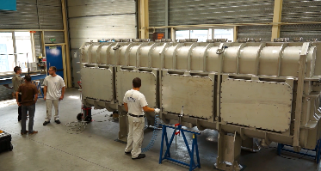
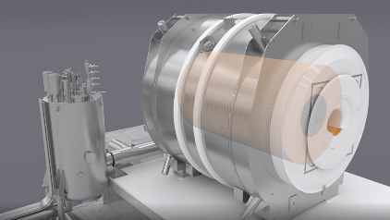
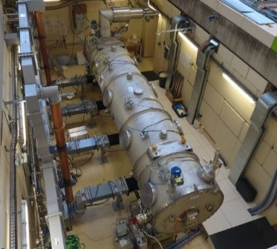
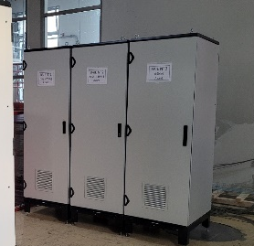
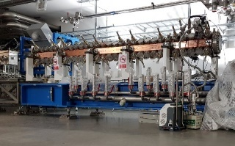
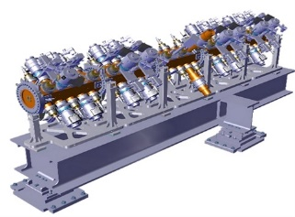
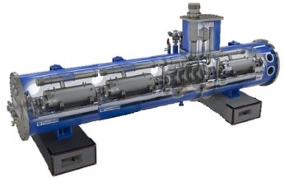
Developping long-term technological lignes
Radiofrequence quadrupoles
Cryomodules
Magnet safety systems
Control
systems
IPHI
JT-60SA
Q4
Spiral 2
IFMIF
ISEULT
Spiral 2
ESS
LNCMI
ESS
Spiral 2 Injecteur A/Q=7
STAARQ
…
PIP II
21
Notes:
Quand on regarde les objectifs de conception…par exemple
Projets de physique
Accélérateurs : prob thermiques (cryogénie très froids, hauts flux thermiques
On voit bien ce que peut apporter la FA (« pas de surcout » à la complexité)
D’autant plus qu’on est drivé par la performance (on fera pas un objet qui existe déjà)

Slide 22
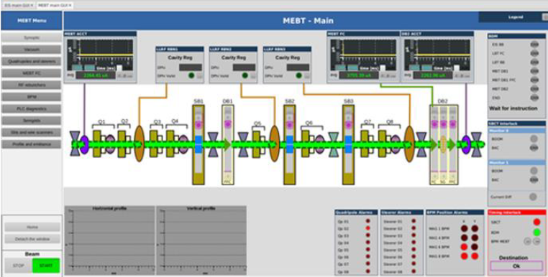
Developping long-term technological lignes
Radiofrequence quadrupoles
Cryomodules
Magnet safety systems
Control
systems
IPHI
JT-60SA
Q4
Spiral 2
1993:
TTF
IFMIF
ISEULT
Spiral 2
2007:
SPIRAL2
ESS
LNCMI
2014:
ESS
ESS
Spiral 2 Injecteur A/Q=7
2018:
SARAF
STAARQ
…
PIP II
EPICS journey started 30 years ago at Irfu
Notes:
Quand on regarde les objectifs de conception…par exemple
Projets de physique
Accélérateurs : prob thermiques (cryogénie très froids, hauts flux thermiques
On voit bien ce que peut apporter la FA (« pas de surcout » à la complexité)
D’autant plus qu’on est drivé par la performance (on fera pas un objet qui existe déjà)

Slide 23
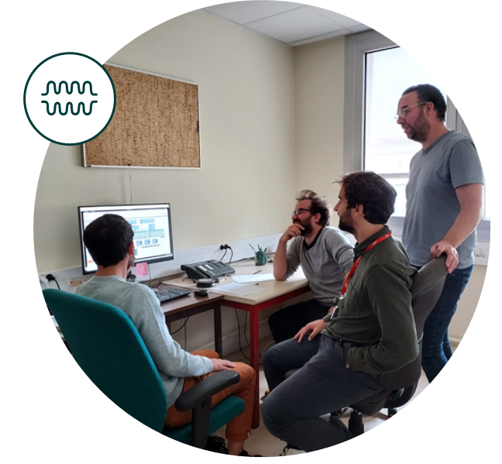
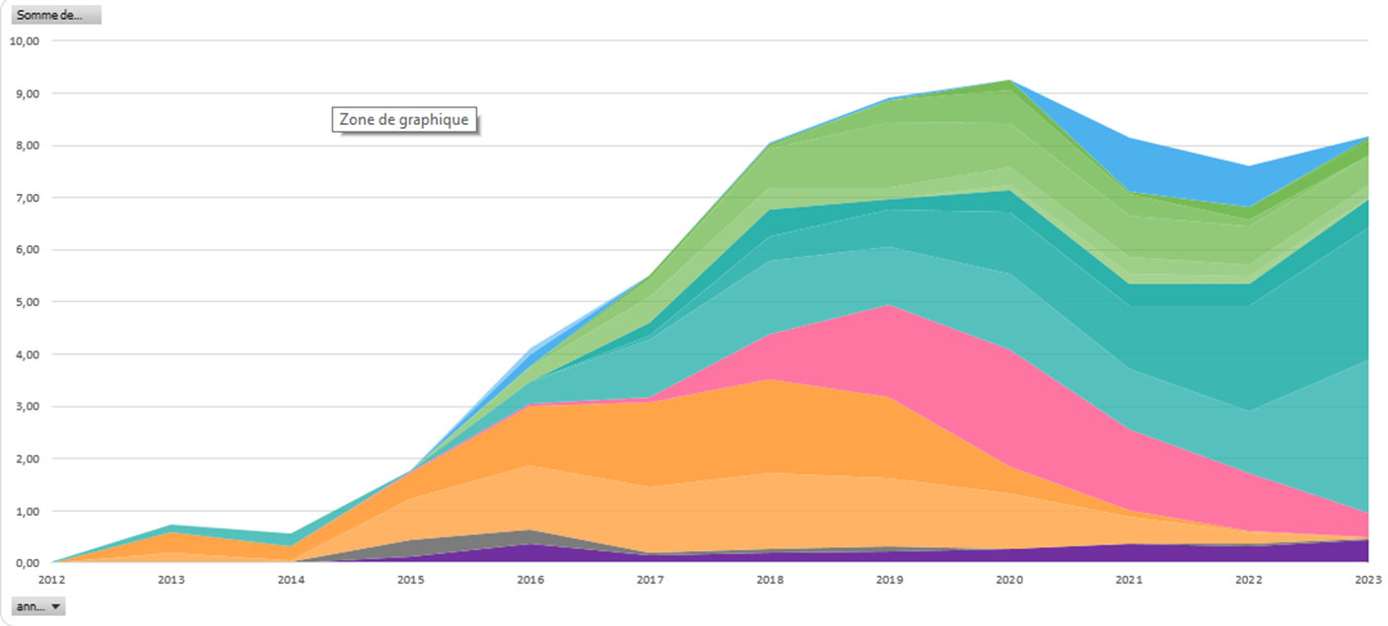
Our involvment for accelerator projects
EPICS developers are strongly involved up to the very end of our projects
Manpower dedicated to
SARAF accelerator
(general engineering only)
Remote support
Electrical
Electronics
System adminsitration
Control
PLCs
Industrial
follow-up
Main control system
Mechanics

Slide 24
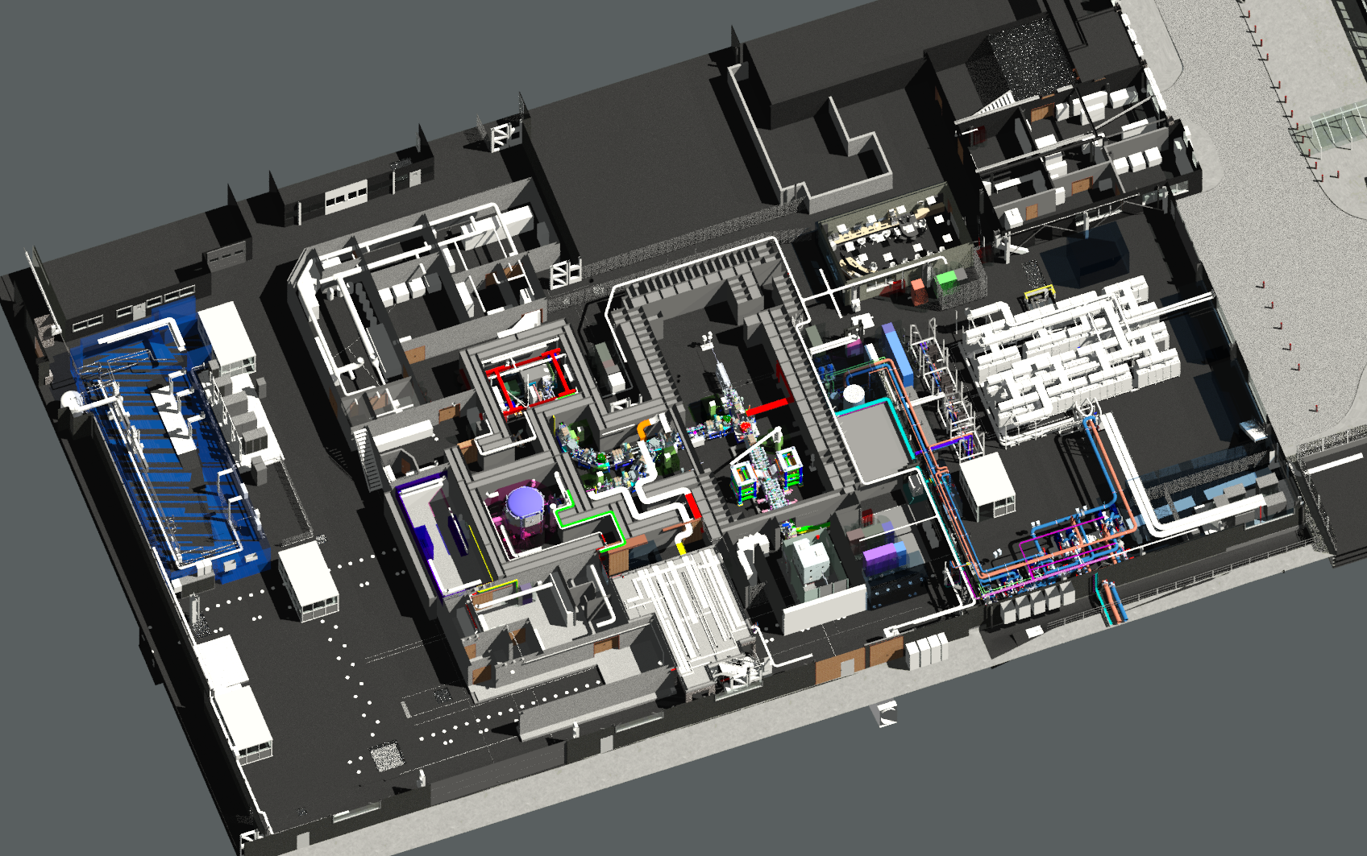
What’s next?
Transfer line
RFQ (IPHI)
Experimental areas
Proton source
Neutron source at Saclay: TITAN
Delivering not only a full accelerator complex, but an operational installation including experimental areas
EPICS at the core of the development and operation
Next projects: ICONE, DONES...

Slide 25
Key messages
Our usage of EPICS has been uninterrupted and growing since 1993 at Irfu
Pionners have paved the way for a strong, integrated and rejuvenated EPICS team
EPICS if our baseline framework for any accelerator project
EPICS will be deployed for other applications
Strong desire to pursue and reinforce our involvement in the EPICS community

Slide 26
More than a meeting
Industrial exhibition
Workshops
Technical visits
Community events
Fostering collaboration

Slide 27
