Slide 1

Variable Stars in the VO
Olga Vozyakova
UPJŠ Košice, Slovakia
ivo://astro.upjs

Slide 2
Lightcurves of variable stars
Use cases:
data for supervised machine learning
long-term behaviour (period changes)
historical outbursts of transients
Where are lightcurves?
Large surveys
Small archives spread across:
personal disks
institutional archives,
sometimes only as figures in papers,
sometimes in VizieR,
sometimes somewhere in the internet
We have published:
our timeseries and images from Kolonica observatory
personal collections (first “seed” datasets from individual observers)
OGLE Collection of Variable Stars (re-published in VO-compliant format)
These data should be discoverable and accessible

Slide 3
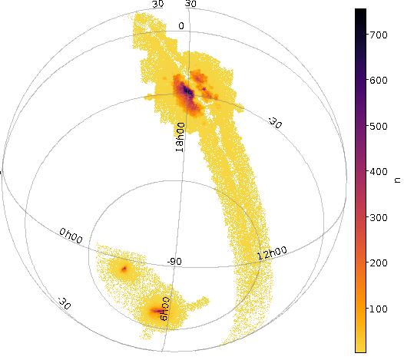
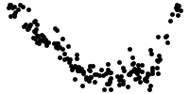
OGLE Collection of Variable Stars
Optical Gravitational Lensing Experiment running since 1992
~2 billion measurements in I and V bands >1 million variable stars shipped in about 200 files (without light curves) https://www.astrouw.edu.pl/ogle/ogle4/OCVS/ Now is accessible via TAP, Cone Search, SSA, ObsCore with previews of folded and unfolded lightcurves

