Slide 1

The ESO Astroquery module and its Jupyter Notebooks examples
Juan M. Carmona L., Ashley Barnes, Alberto Micol
ESO Science Archive Group

Slide 2

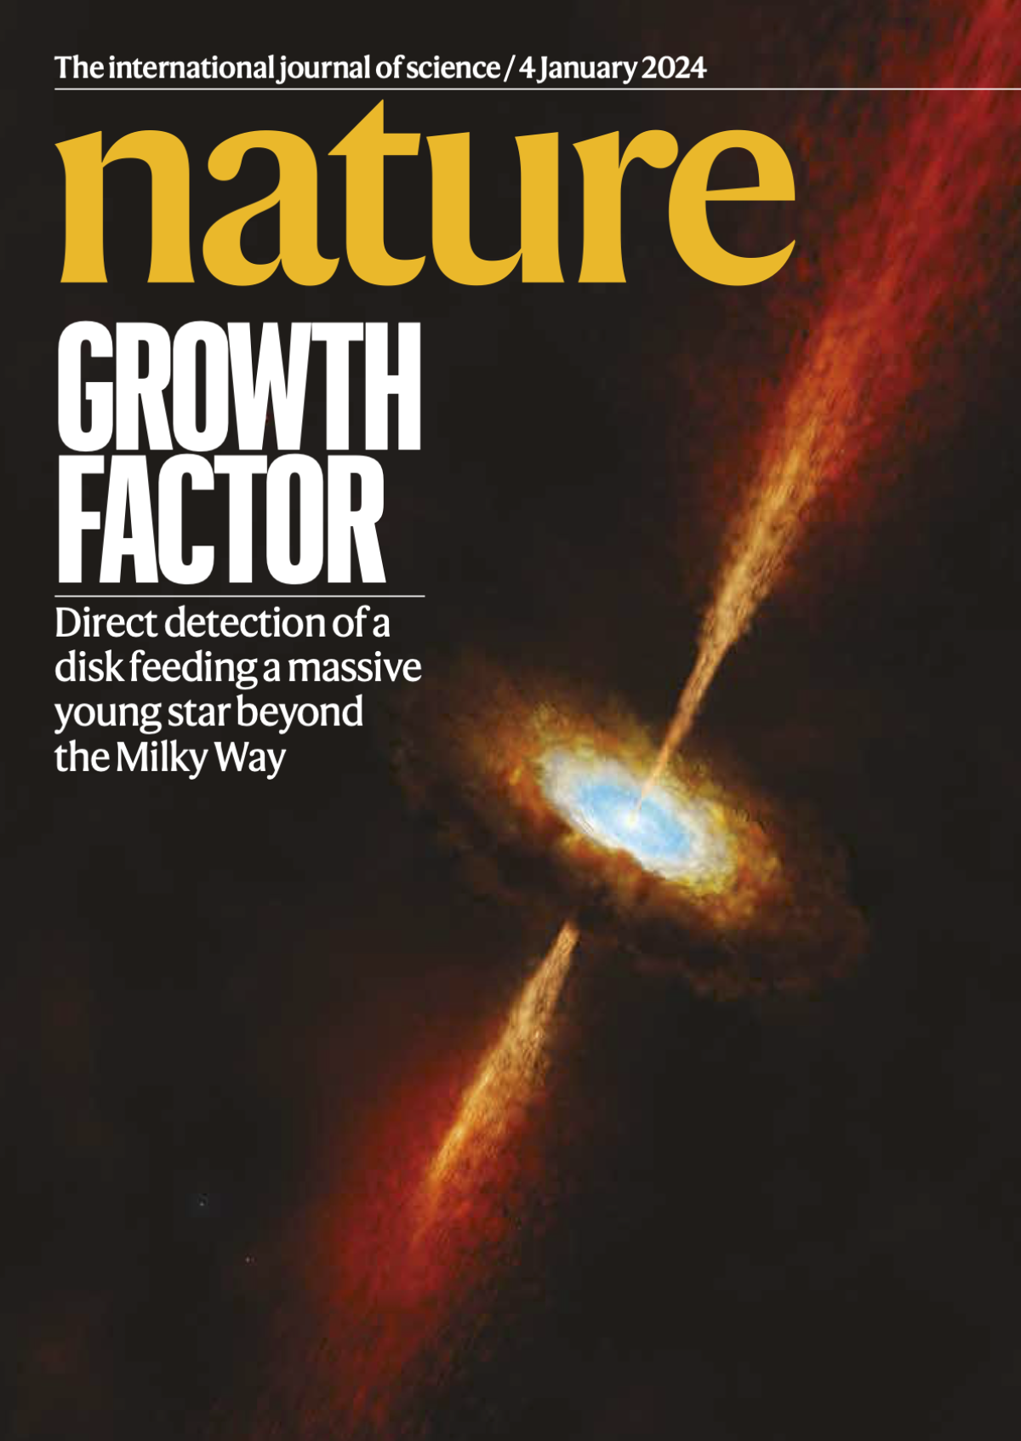





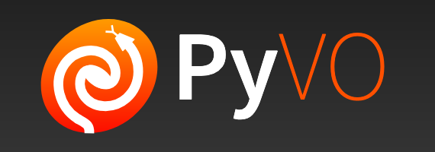



The ESO archive enables smooth data journeys
“By adopting VO standards, reproducible science is possible – Go further together”
LLM

Slide 3




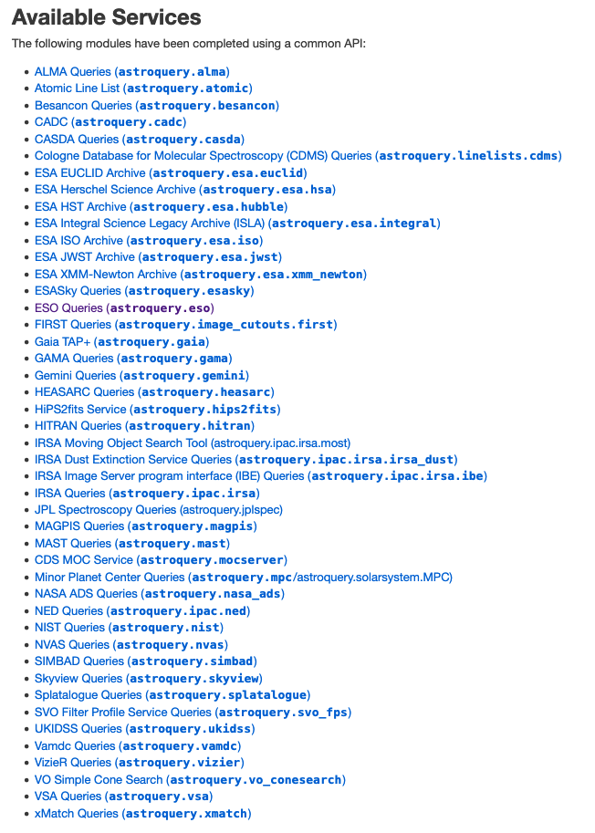
Astroquery enables end-to-end analyses
“Astroquery is a set of tools for querying astronomical web forms and databases.”
  Documentation: astroquery.readthedocs.io
  Code and issue tracker: https://github.com/astropy/astroquery
  Paper: Ginsburg, Sipőcz, Brasseur et al 2019.

Slide 4

The ESO module delivers complex datasets quickly
“Simple python functions to script your access to the ESO archive via TAP.”
  ESO astroquery fork: https://github.com/eso/astroquery
  ESO example notebooks: https://github.com/eso/astroquery_examples
The ESO astroquery module allows users to search for raw and reduced data, retrieve metadata, and download data products. Proprietary access is also supported.
The new ESO module enables faster, larger and more complex dataset analyses by using the the Table Access Protocol (TAP), an International Virtual Observatory Alliance (IVOA) standard.
WEB scraper (OLD) | TAP (“New”)
Limited query interfaces with predefined queries | Full read-only access to ESO databases
Users can only enter constraints on predefined queries | Users can write their own custom queries
No direct query language | Uses ADQL 2.0 (SQL-based, VO standard)
Users cannot modify underlying queries | Users fully control query structure
Catalogues not accessible | Catalogues accessible via dedicated interface
Simplified access for specific, common queries | Advanced, flexible querying for complex data retrieval

Slide 5

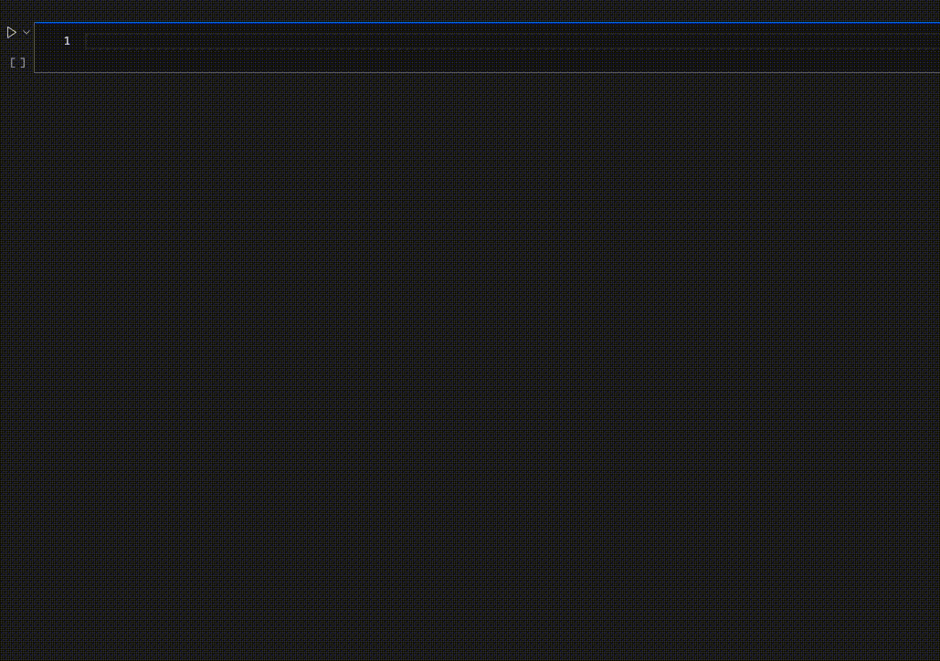
Functionality
  List instruments and data releases.
  Instrument-specific and instrument-independent raw data search.
  Search across / by data releases.
  Automatic calibration selection (raw).
  Get extended FITS header information.
  Download datasets by their identifiers.
  “Auth & Auth” access to your assets.
  Run custom / complex ADQL queries.
  → Find, Access, Interoperate, Reuse ←

Slide 6
Where to find it?

Slide 7
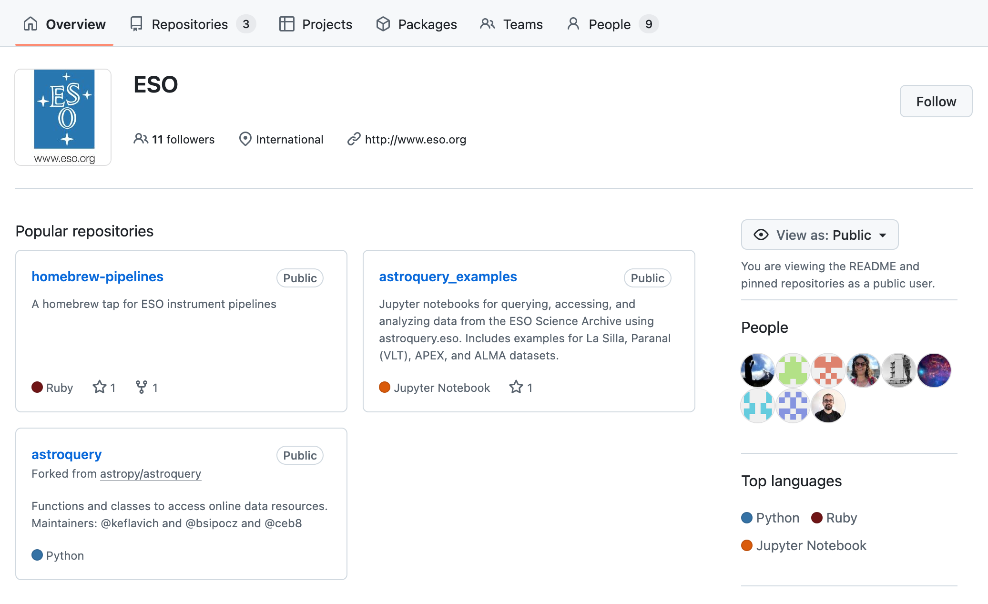
Get the ESO module and Jupyter notebooks from GitHub
github.com/eso
github.com/eso/astroquery
Fork of the official astroquery repository
Latest ESO features not yet part of an official astroquery release
github.com/
eso/astroquery_examples
Jupyter notebooks with tutorials and real application examples
Submit your own! ;)

Slide 8
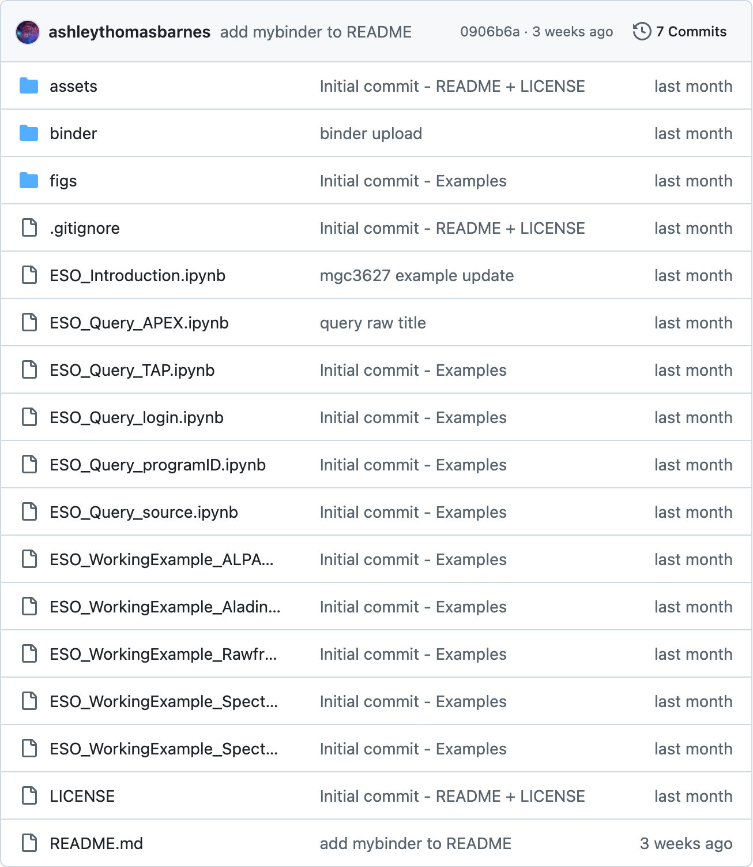
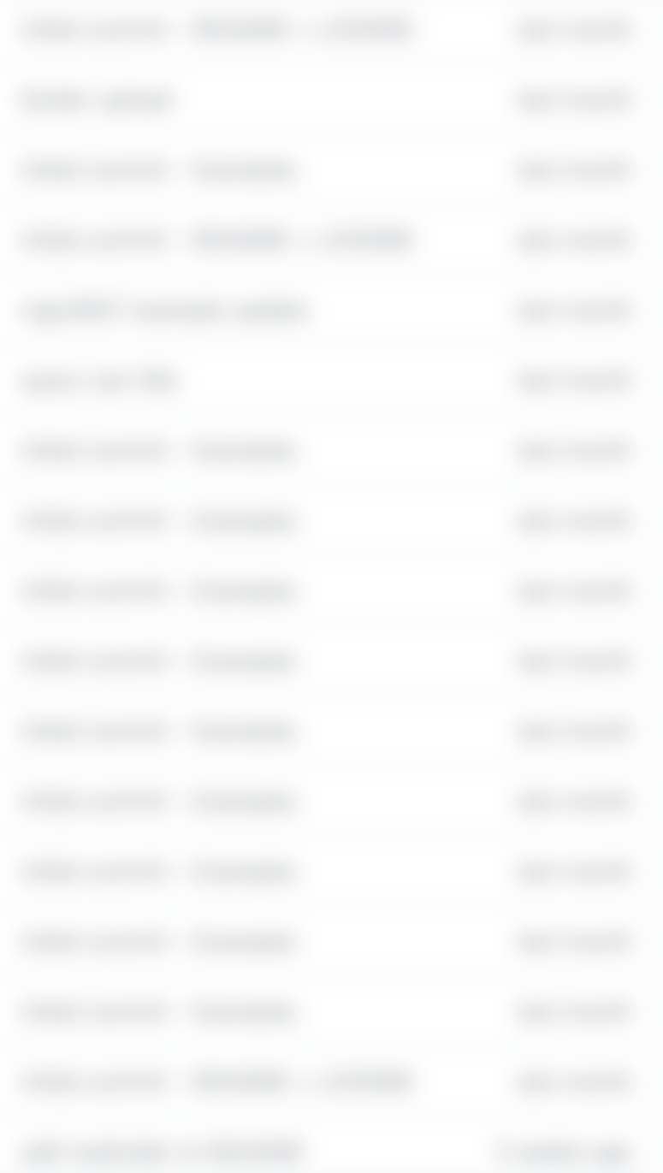
>github.com/eso/astroquery_examples
  Query the archive for raw* and reduced data
  Perform a simple cone search
  Obtain extended information on data products
  Download datasets from the archive
  *Either instrument-specific or generic
Introduction to basic functionality
  Searching via ADQL (SQL-like syntax)
  Downloading datasets by identifier
  Searching a source by name
  …
Tutorials on basic functionality
  Investigate ESO data using Aladin
  Download raw data for a reduced data product
  Examine Spectral Data as function of time
  ESO observatories light contamination trends
Real life examples and use cases

Slide 9
What’s next?

Slide 10
What’s next?
  astropy release v0.4.12 (currently in pre-release)
  Catalogues
  Atmospheric data (ASM)
  Cutouts
  Increase number of notebooks and tutorials
  Turn simple specific use-cases into general science-ready blue-prints
  → Submit your notebooks! ←

Slide 11
Recap
  We enable reproducible science by…
    Speaking VO since 2018.
    Developing astroquery.
    Fostering adoption via Jupyter notebooks.

Slide 12
Juan M. Carmona L.
jcarmona@eso.org
Ashley Barnes
ashley.barnes@eso.org
Alberto Micol
amicol@eso.org
@ESOAstronomy
@esoastronomy
@ESO
european-southern-observatory
@ESOobservatory

