Slide 1
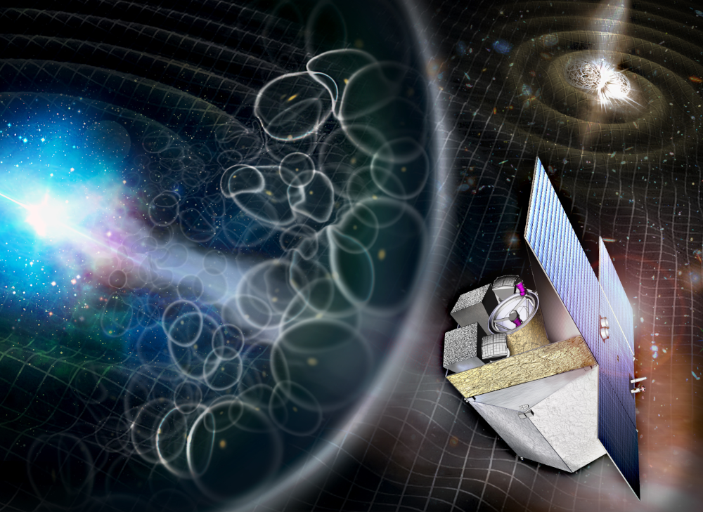
IRT AIT: Optical system alignment
Methodology and subsystem requirements

Slide 2
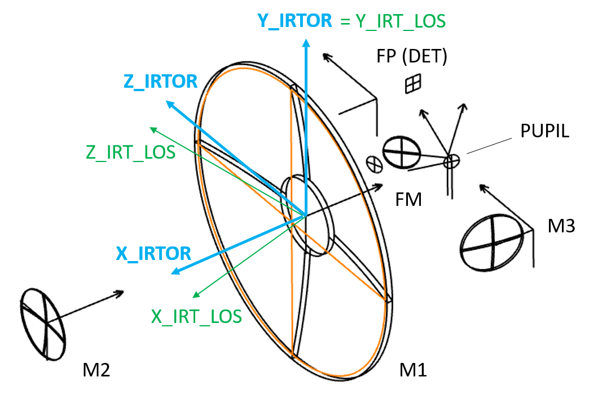
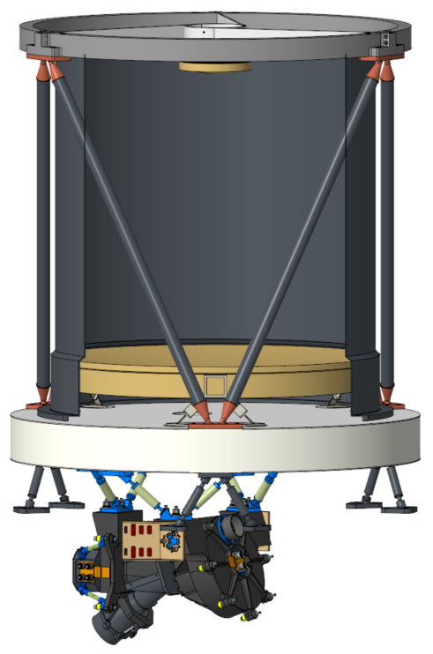
IRT Optical system configuration
Telescope subsystem under INAF responsibility: includes M1, M2, field stop, FM, M3 + Optical bench
Camera subsystem under CEA responsibility: includes pupil, grism (or filters) and FP (detector)

Slide 3
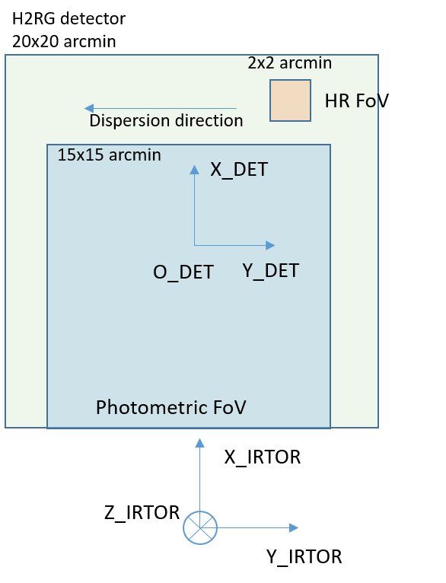
Performance requirements (THS-CEA-IRT-RS-0001)
Image quality
The image quality requirement is a result of the flowdown from SNR and R top-level requirements. This performance breakdown involves also the IRT throughput, the IRT background and the IRT line of sight stability. See presentation H. Triou. The driver is the SNR for spectroscopy.
IRT-PER-0310: The in-orbit IRT image quality shall be better than 1,85 arcsec EED80 at 1.1 μm.
Line of sight and field of view
IRT-PER-0070: The IRT instrument in photometry mode shall have a Field of View of at least 15x15 arcmin² (with a goal of 20.4 x 17.4 arcmin²).
IRT-PER-0080: The IRT instrument in spectroscopy mode shall have a Field of View of 2 x 2 arcmin².
IRT-PER-0090: The photometry mode Field of View and the spectroscopy mode Field of View shall be imaged at once with at least a 1 arcmin separation on the detector.
Remark: there is no clear requirement today on the alignment precision of the IRT LOS.
Rq: AIT requirement to clarify for IRT in spacecraft to align IRT with Earth baffle.

Slide 4
Goals of the presentation
Share the alignment strategy of the full Optical system
Identify the necessary compensations / tuning during AIT: when? How? How much?
For the image quality
For the line of sight
Build AIV planning / development plan in agreement with the alignment strategy
Write subsystem technical requirements
Assess our capability to reach the performance requirement
Impacted documents for MSR :
Development Plan
IRT Requirement Specification
IRT Optical analysis

Slide 5
Alignment strategy
Decouple as much as possible TELESCOPE and CAMERA alignment procedures and AIV plans.
Align at room temperature, desalign to compensate for operating temperature and verify by tests at operating temperature.
Do not impose constraints when it is not necessary:
Use margin in the Y axis due to the detector area and the required field of view
Use on-board astrometry to relax requirements on absolute knowledge of the IRT Line of sight.

Slide 6
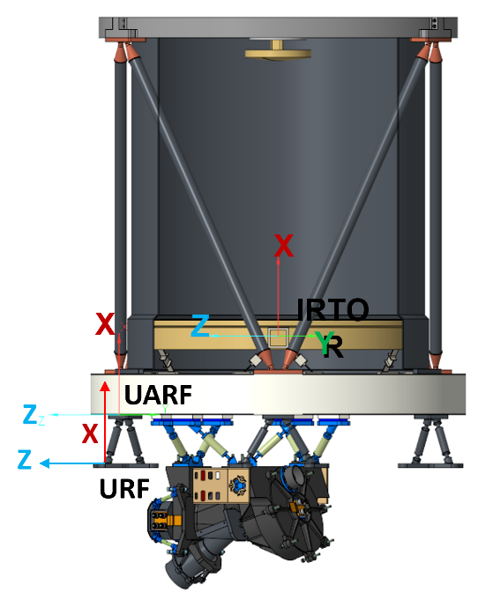
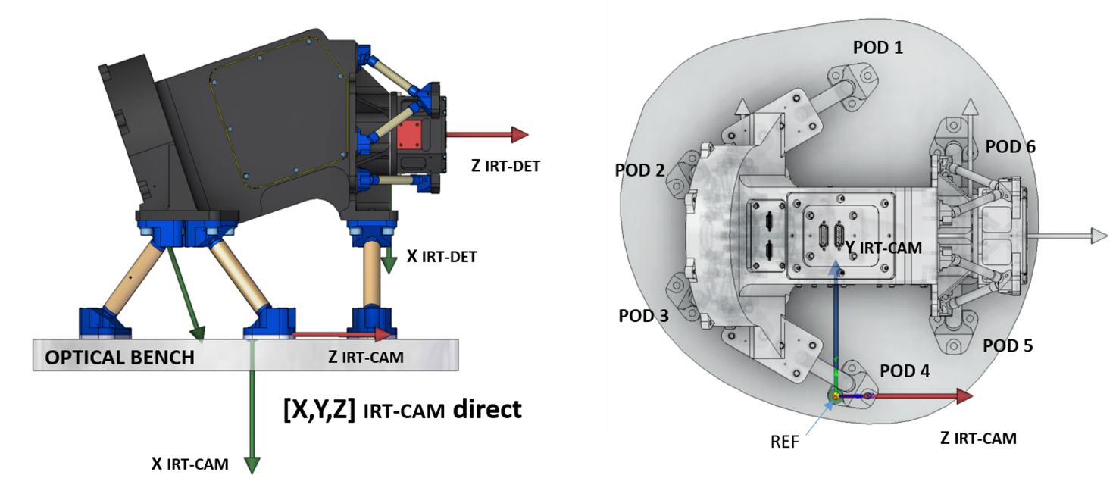
Alignment possibility for CAM
RX
RY
TX
CAM system:
Use shims below the pods to (finely) correct for TX errors and RY, RZ (tip-tilt).
Pinpoint the camera on the Optical bench and ensure stability after launch. No possibility to adjust along TZ, TY or RX.
Preferred option

Slide 7
Alignment possibility for TEL
TZ
RX
TEL system:
Use M1, M2 to align the Focal plane (FP) along Z (focus), RX (CAM rotation).
Possibly use the Camera mounting holes to (finely) correct for RX, TZ errors.
Possibly use the field stop to correct for TX, TY alignment.
Proposal to separate the degrees of freedom of both subsystems

Slide 8
Alignment requirements
For the Telescope, align the telescope optical beam on the camera reference frame (on optical bench)
For the Camera, align the focal plane with the Camera reference frame (on the pods):
Parameter | Value
Δx | +/-200μm
Δy | +/-200μm
Δz | +/-70μm (TBD)
Δα, Δβ | +/-5’
Parameter | Value
Δx, Δy, Δz | +/- 70μm
Δα, Δβ | +/-4’
The alignment reference frame is on the Bottom plane of the Optical Bench, close to the Camera mounting frame.

Slide 9
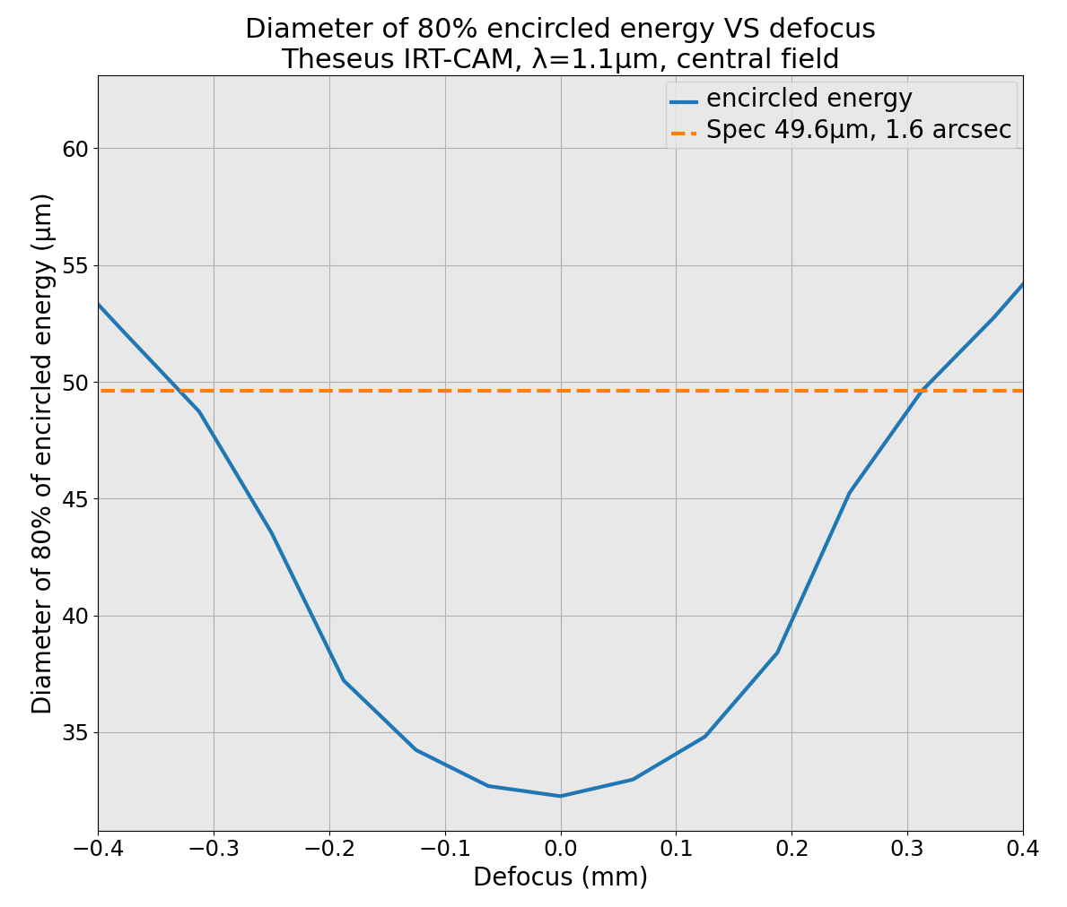
Defocus curve
Budget of +/- 70 µm for TEL
And +/- 70 µm for CAM to get better than Δz = +/- 100 µm (quadratic sum) or +/- 140 µm (linear sum for margin).
To be confirmed with a complete optical tolerances analysis
+/- 140 µm
+10%
+6%
+/- 100 µm

Slide 10
Back-up option
If the TEL integration procedure is too constrainted by these requirements, the alternative option is to implement Shims at the level of the FPA to add error corrections along TZ, RX, RY, RZ.
Risk on Schedule: wait for TEL integration to start CAM final integration and qualification, delay on shims to consider.
That can’t be the baseline for phase A. A decoupled strategy is preferred.

Slide 11
AIV Sequence: TEL
Integration TEL
Run Optical characterisation
INAF responsibility
Optical quality with reference detector
Tune optical elements
FP position in IRT alignment frame
Meet performance and alignment requirements?
Gravity release + Operational temperature compensation
(computation + implementation)
Handling / Computation / Fabrication
Measurement
Integration in TVAC chamber
Run TEL functional validation
Change compensator displacement
Optical quality with reference detector
Meet performance expected by gravity effect?
Exact position of FP in IRT alignment frame
Telescope delivery Italy -> France
(CNES)

Slide 12
AIV Sequence: CAM
CEA responsibility
Operational temperature compensation
(computation + implementation)
Integration CAM
Metrology: exact position of DET in CAM frame @ RT
Handling / Computation / Fabrication
Integration in TVAC chamber
Measurement
Metrology: exact position of DET in CAM frame @ Op. T.
Camera delivery CEA -> CNES

Slide 13
AIV Sequence: IRT
CNES responsibility
Integration TEL
Integration CAM
Exact position of FP in IRT alignment frame
Metrology: exact position of DET in CAM frame @ Op. T.
Telescope delivery Italy -→ France (CNES)
Compute and manufacture CAM shims
Camera delivery CEA → CNES
IF shims
Handling / Computation / Fabrication
Start IRT integration
Measurement
Mount CAM on TEL OB
with IF shims
Run full functional validation
Change compensator displacement
Optical quality with reference detector
Meet performance expected by gravity effect?
IRT delivery France -> ESA

Slide 14
Open points for phase B
TEL Alignment procedure to be defined with the industrial partner:
Confirm that the preferred option with locating pins on the camera is possible
Detail the alignment sequence (implement the camera holes on the bench before or after optics alignment?).
Define the alignment hardware between TEL and CAM: where are the large holes, the centering holes, the centering pins?

