Slide 1
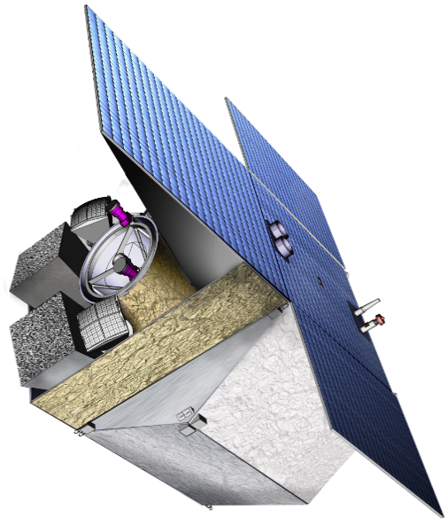










InfraRed Telescope
Performance requirements
Performance studies status
Henri TRIOU
On behalf of the IRT Performance Team

Slide 2
Performance Team
Performance Team : Link between the Science Team and the System Team
Lead of the Performance Team : Henri TRIOU (CEA)
PI : Diego GOTZ (CEA)
Calibration Scientist : Stéphane BASA (LAM)
System Team Lead : Aline MEURIS (CEA)
Telescope Lead : Bortolino SAGIN (INAF)
Telescope Performance (Optical and Mechanical) team : Matteo GENONI, Giorgio PARIANI, Luca OGGIONI, Luca TERENZI (INAF)
Optical Performance : Samuel RONAYETTE & Pierre-Antoine FRUGIER (CEA)
Detection chain Performance : Thibaut PICHON (CEA)

Slide 3
Outline
Top level performance requirements
Performance Requirements breakdown
Ongoing Analysis and Status of actions
Conclusion

Slide 4
3 – Ongoing Analysis and Status of actions

Slide 5
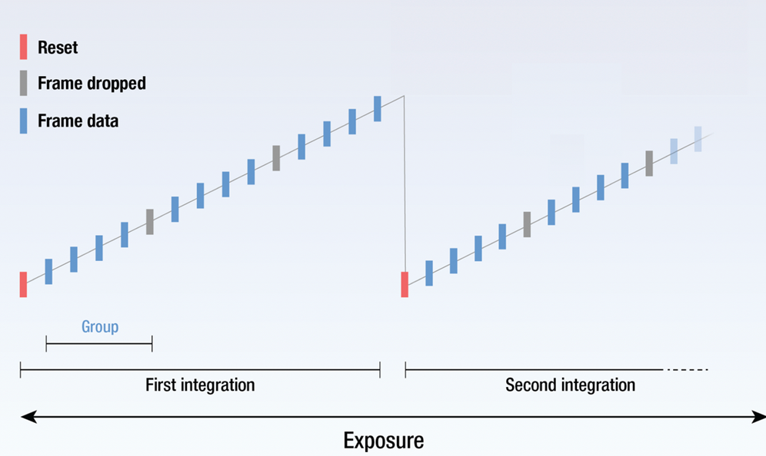
Performance actions related to IRT Processing
Action PERF-OP-01 - CEA (Henri)
Consolidate the performance analysis in photometry
Consolidate the integration time value (25 s ramp duration in photometry) by considering the brightest sources and the detector full well capacity
The baseline is to make astrometry calculations every 25s (TBC) in photometry to minimize the impact of the drift. We need to check the feasibility of this wrt the onboard processing capabilities.
To consolidate
Done
Consolidate readout performance (spectro and photo)
IRT detectors are read out using a non-destructive up-the-ramp readout or DCS technique But arriving at an exposure time is not as simple as requesting a total time. Rather, the exposure time is derived from the selection of a Readout Pattern and specifying 2 other parameters:
the number of groups per integration
the number of integrations per exposure.
Proposal
11 groups of 3 integrations in spectrscopy
5 groups of 3 integrations on photometry
Actions
Consolidate the performance (SNR increase)
Assess the feasibility of on board processing

Slide 6
Sensitivity performance in spectrometry (MAAC versus DCS)
~17 % gain in SNR at limit magnitude

Slide 7
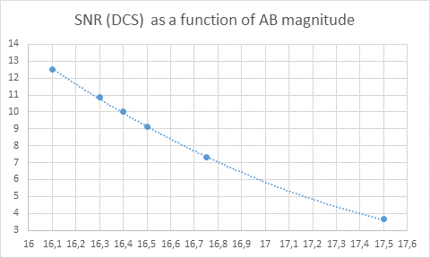
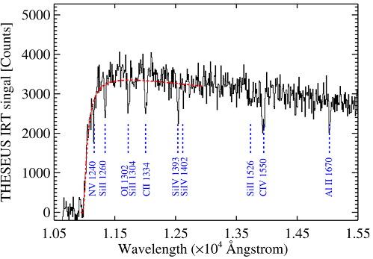
Sensitivity performance in DCS as a function of AB magnitude

Slide 8
Performance issues related to IRT Processing
Action PERF-OP-04 - CEA (Damien, Diego)
Consolidate the size of the star catalog for astrometry (justified by the robustness of convergence) and the size of the deep catalog to find the transient source (justified by the IRT sensitivity)
Action PERF-OP-05 - IAAT
Manage the accesses to a gitlab to share IRT codes
Action PERF-OP-06 - CEA (Henri, Diego, Thibault, Damien)
Make a sequential diagram (flow chart) of the processing operations to be performed in photometry (with timing indications). This flowchart shall detail the sequences of operations to be performed on the data from the raw images to the “cleaned” ones and to the science products such as redshift, absolute coordinates of the transient source and source flux.
Done ?
Done ?
Done

Slide 9
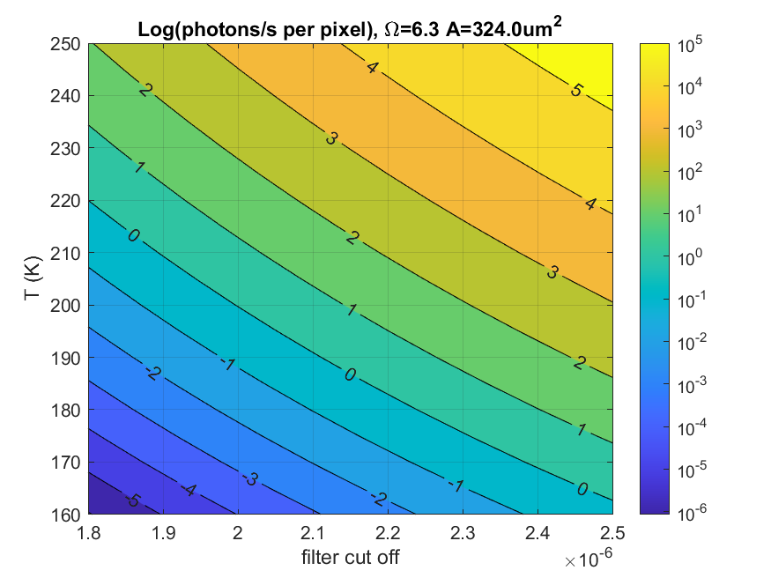
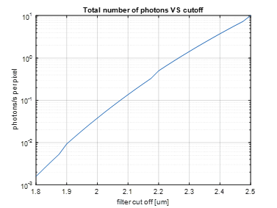
Background issues
Action PERF-10 – CEA/INAF (Luca. O, Giorgio)
Consolidate the out field stray-light analysis by modeling the Earth baffle with the main veins and the geometry
Estimation of In field Straylight (bright stars in field of view)
Sensitivity of Baffle/Telescope alignment to the out field straylight
Action PERF-11 – CEA/INAF (Luca. O, Giorgio)
Assess telescope thermal emission.
Action PERF-12 – CEA/INAF (Luca. O, Giorgio)
Assess camera thermal emission.
In progress
Done ?
Done

Slide 10
Optical, Mechanical, Overall Performance actions
Performance assessments in photometry and spectrometry:
Impact of the jitter and drift effects on the performance in spectrometry
Luca
Impact of the jitter and drift effects on the performance in photometry
Henri
Done
Ongoing
Complete the Optical performance analysis and issue alignment requirements to the system team
Luca, Samuel
Ongoing
Ongoing
Thermomechanical performance Impact on the top level performance : drift like effects of the LOS Bortonino, Matteo, Luca
Filter wheel stabilization performance impact on the performance in spectroscopy Samuel
Done
Performance margins analysis and performance budget Henri
Ongoing

Slide 11
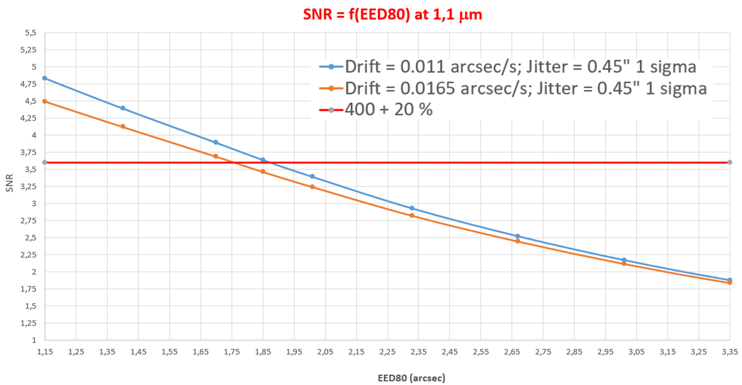
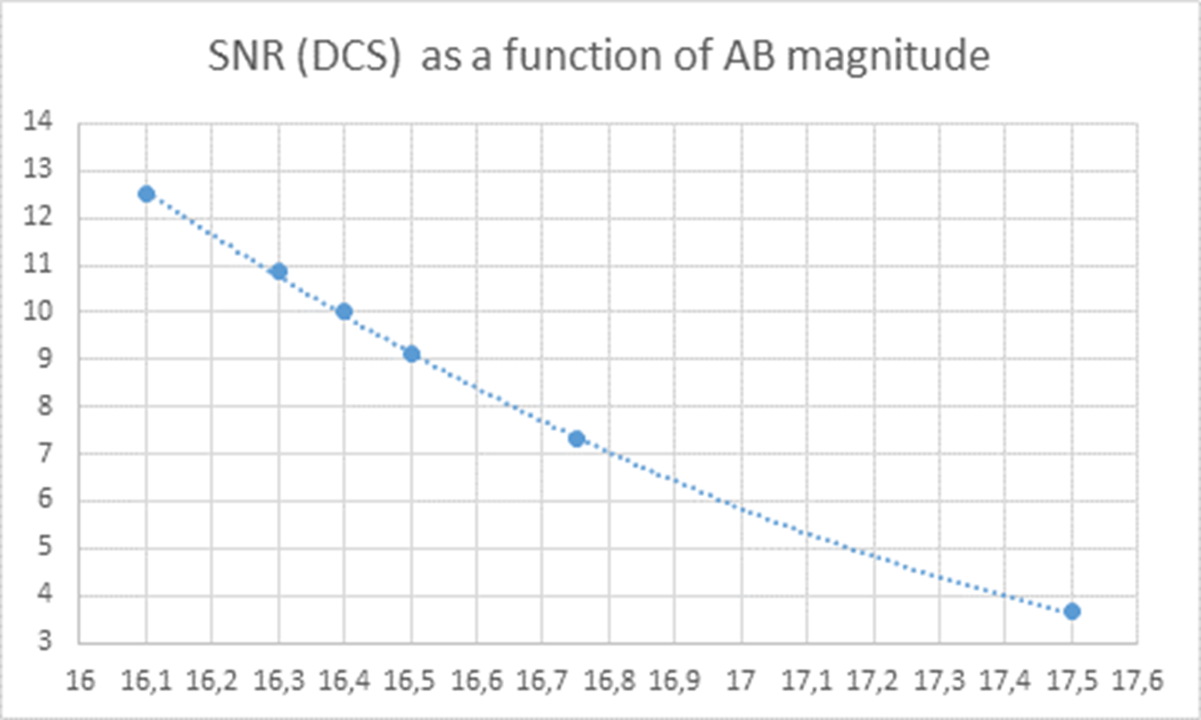
Requirements and margin discussion : SNR as driver
EED limit : 1,85 => 2,15 arcsec
Keeping the requirement at 1,85 arcec provides margin on limit magnitude

Slide 12
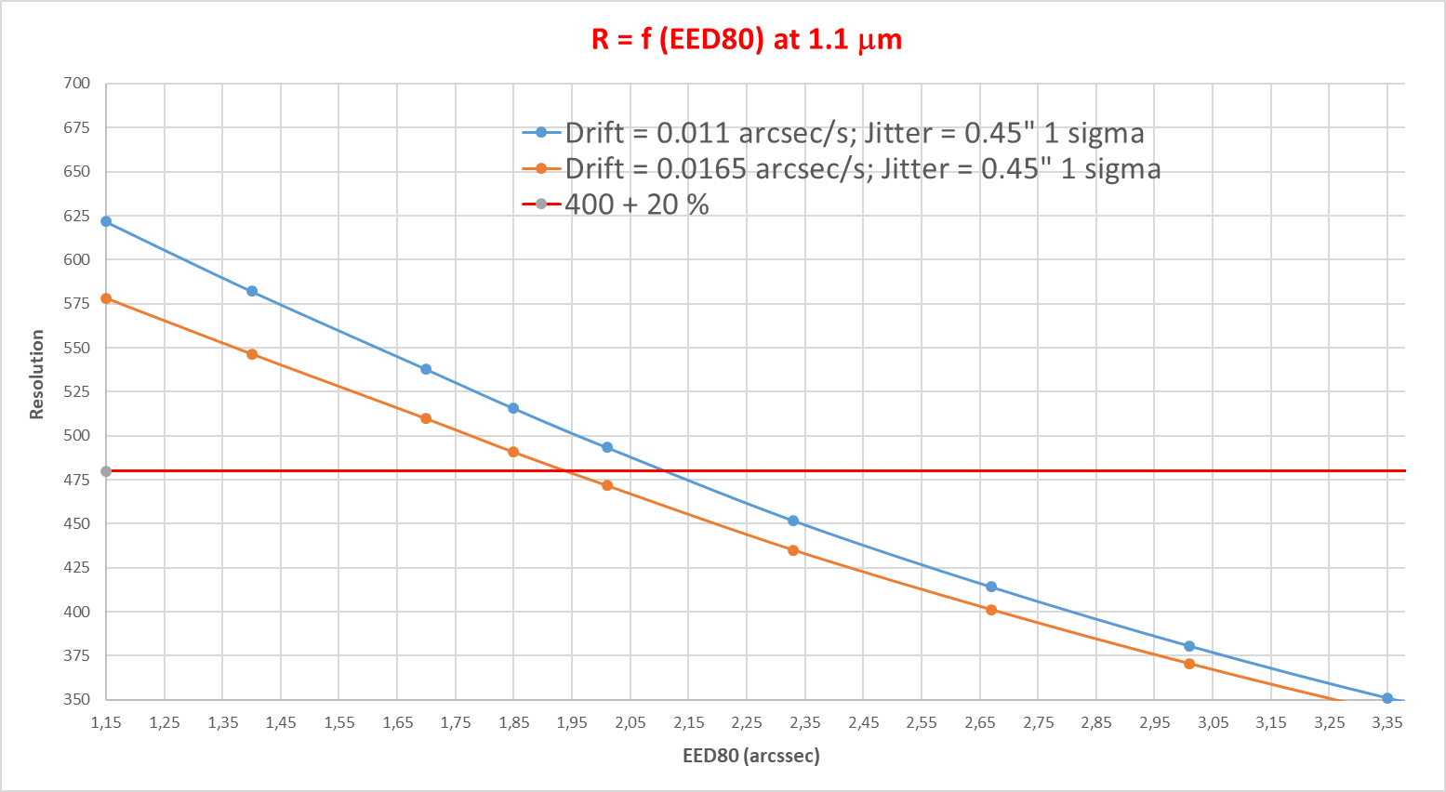
Requirements and margin discussion : R as driver

Slide 13
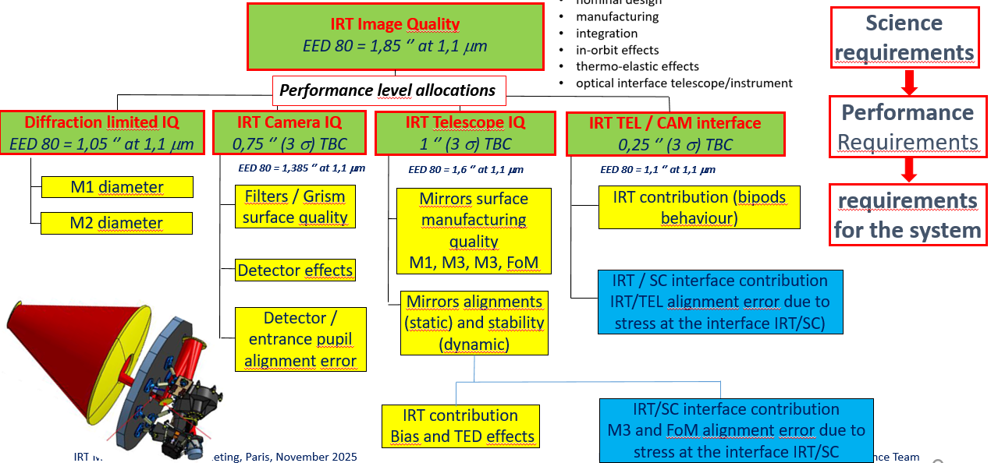
Margins discussion
Sufficient margins in photometry
Can be improved by optimization of the bands definition
Can be improved by using MAAC readout (especially for faint sources)
Margins in spectrometry
Requirements may be relaxed but need to take some margins on all system requirements / parameters (yellow boxes)
Additional margin of about 17 % using MAAC readout (TBC)

Slide 14
Conclusion

Slide 15
Main Performance group actions and trade-offs analysis
Consolidate readout modes and onboard processing feasibility (especially in spectroscopy, number of groups/redouts per acquisition in MAAC)
Assess the on ground signal processing required to generate the spectra with required R, SNR performance
Consolidate data processing steps for astrometry and its onboard implementation
Assess data processing steps and critical points
Consolidate straylight / background analysis and optical design and performance
Perform margin assesment and performance budget based on the feedback from subsystems

Slide 16
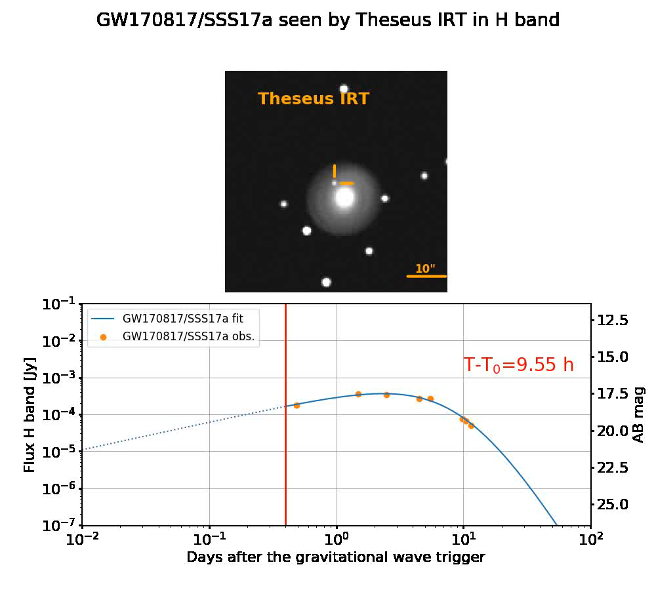
Simulation tools : Simulating instrumental effects and simulatiing a GRB
For MSR, we could develop a simulator that will simulate the signal on the detector:
simulation of platform effects: jitter and drift effects using real time series
simulation of stacking in photometry: simulation of the method used on board
intra-pixel response,
realistic stray-light sequences (subcontractor inputs and instrument level simulations)
Realistic simulation of a GRB with time

Slide 17
Performance actions related to IRT Processing
Action PERF-OP-01 - CEA (Henri)
Consolidate the performance analysis in photometry
Consolidate the integration time value (25 s ramp duration in photometry) by considering the brightest sources and the detector full well capacity
The baseline is to make astrometry calculations every 25s (TBC) in photometry to minimize the impact of the drift. We need to check the feasibility of this wrt the onboard processing capabilities.
Action PERF-OP-02 - CEA (Henri & Aline)
Carry on the work related to performance requirements:
The justification of the Instrument level system requirements from the science requirements
The flow down of the requirements to derive the technical requirements from the top level performance requirements
Assess margin analysis
Example: Accuracy on redshift -> accuracy on photometry -> linearity, need for cosmic ray deglitching, (flux calibration)
Action PERF-OP-03 - CEA (Diego)
Provide inputs on the algorithms behind the functions or equivalent functions in not embedded software when available to be used as definitions and examples for the software developers.
To consolidate
Done
Done
Done
Done

