Slide 1
Stray Light Assessment for IRT A phase, M7 proposal
State of work
INAF - OABr

Slide 2
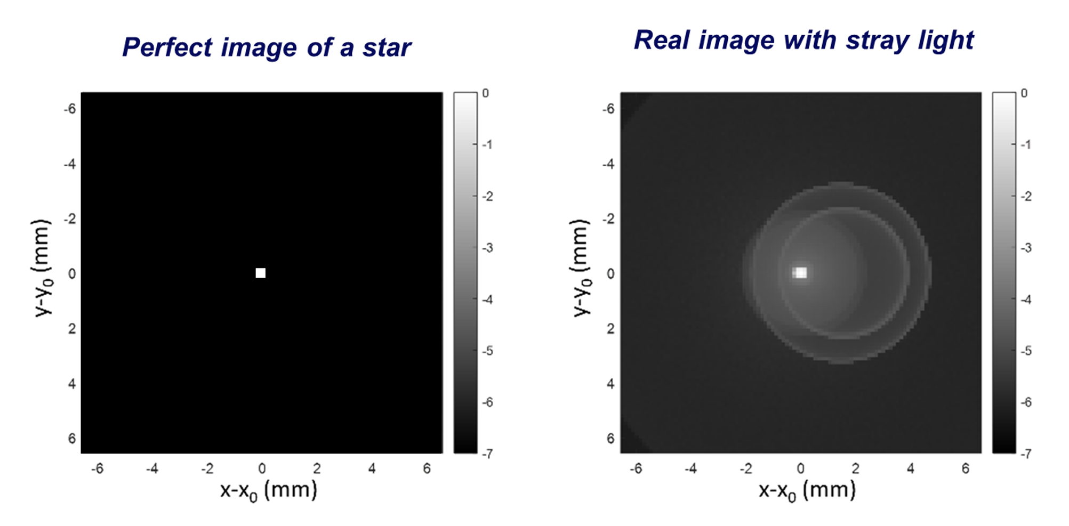
Introduction: Real Image degrading effect
INAF - OABr

Slide 3




Introduction: Real Image degrading effect
Perfect Image
Diffraction
In field scatter
Irradiance plot
INAF - OABr

Slide 4
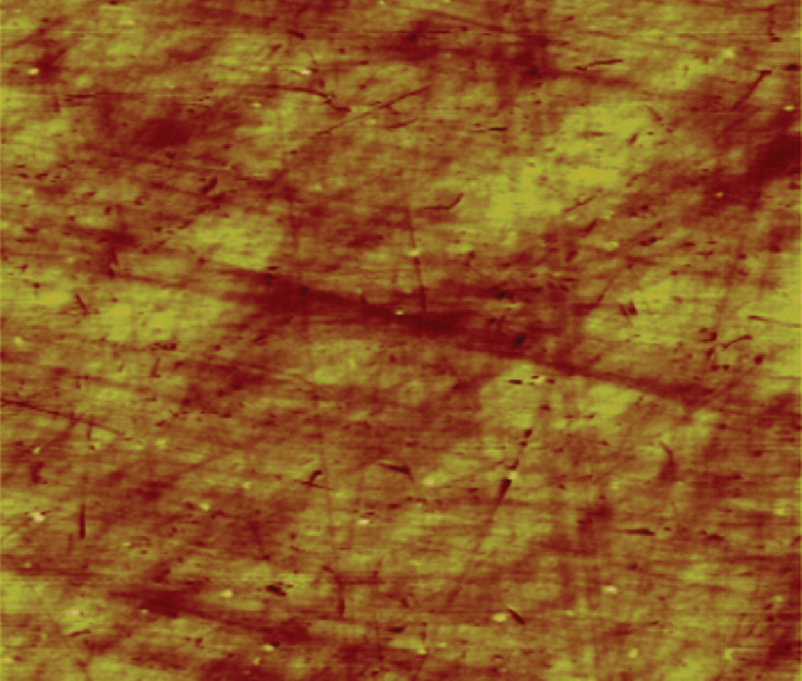
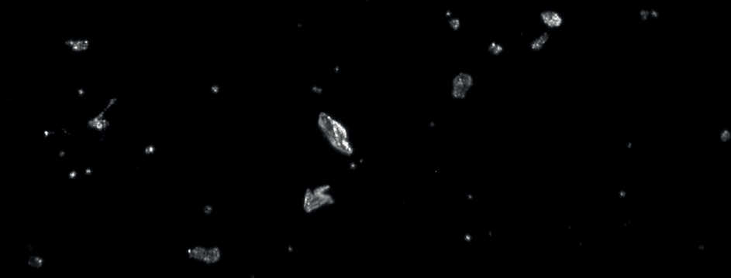
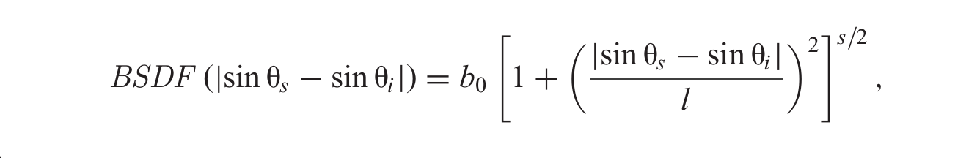
Introduction: In Field Scattered light
Caused by microscopic mirror imperfection
Divided in two categories:
Surface roughness
Particle Contamination
Light Scatter Cone
Scattered Light Distibution (BSDF) modelled by Harvey – Shack Parameters
(b0,l,s)
INAF - OABr

Slide 5
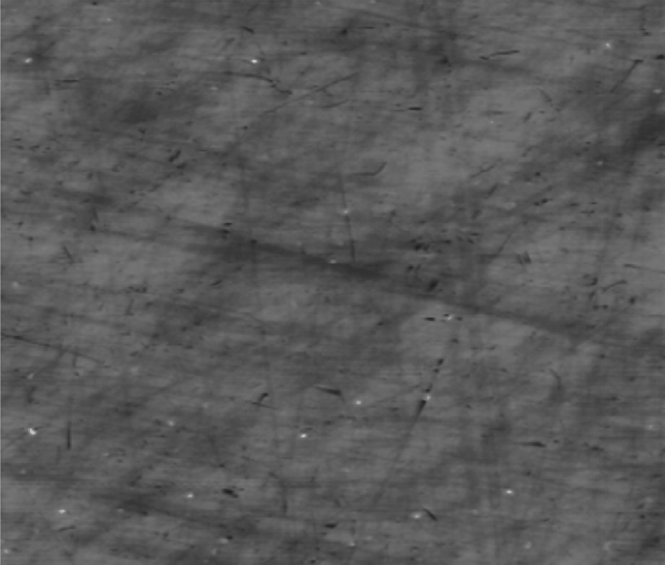
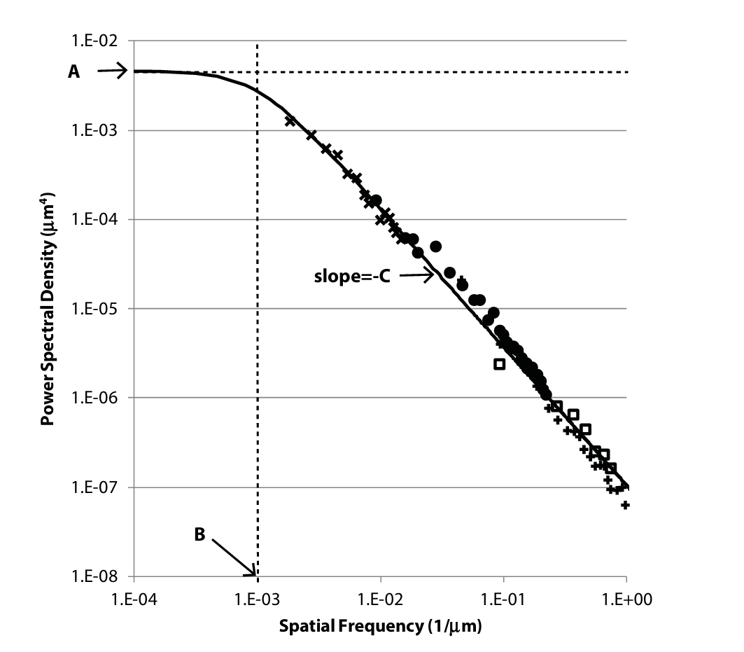
Modelling Modeling Parameters and Approach:
1: Surface roughness
Surface power spectum distribution is modelled with empirical machining data (ABC -model)
RMS
b0,l,s (Scattering Cone)
Harvey Parameters are determined empirically from RMS
Value of 2 nm RMS was used
INAF - OABr

Slide 6
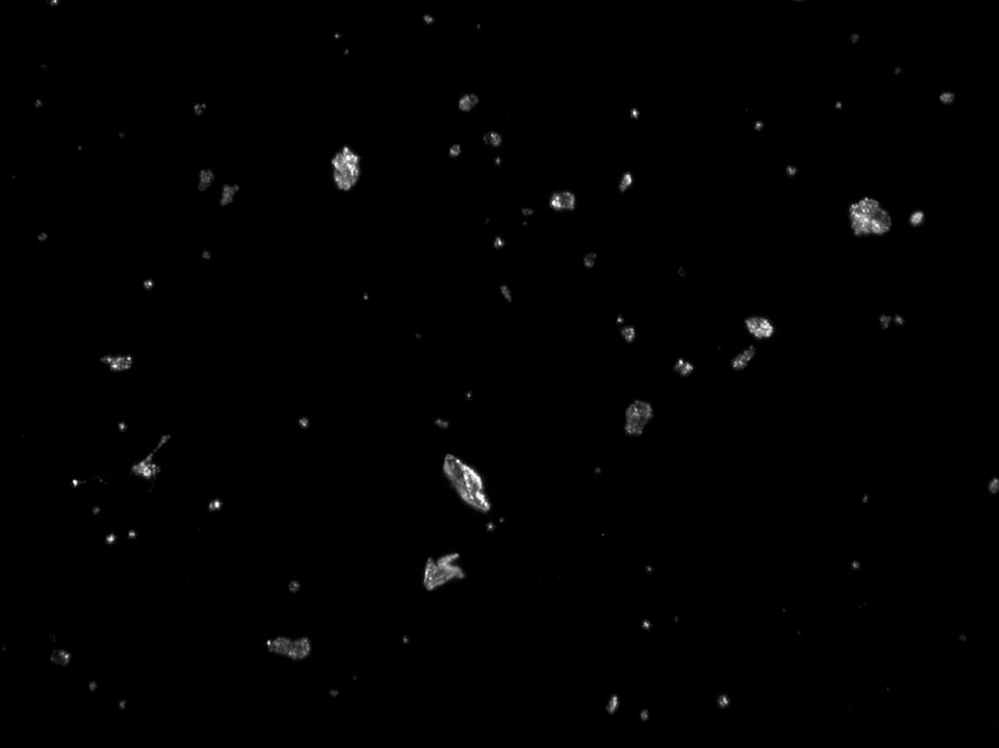
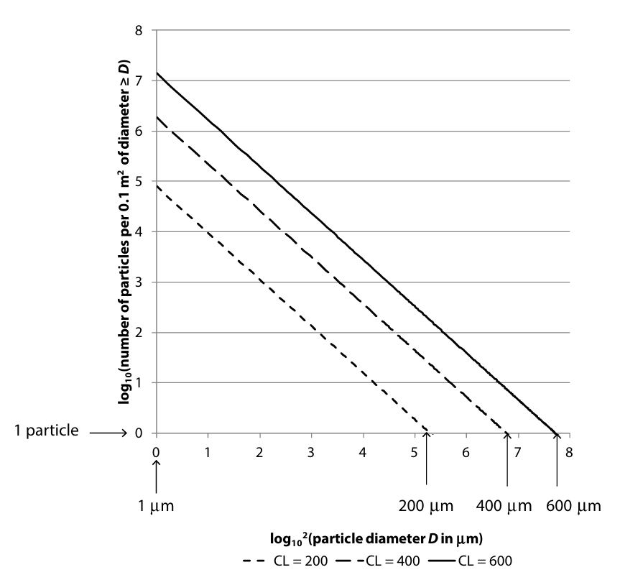
Modelling Modeling Parameters and Approach:
2: Particle Contamination
Parameters in the model:
Total Scattered Energy (TIS)
PAC: % of dust area coverage
Calculated from cleanroom fallout and exposure time
Scattered Light Distribution
Particle diameter distribution
Empirical: different model are available
INAF - OABr

Slide 7
Modelling Modeling Parameters and Approach:
2: Particle Contamination: approach
Determine the expected PAC
from cleanroom fallout and exposure time
Make a hypothesis on the distribution two are presented
INAF - OABr

Slide 8
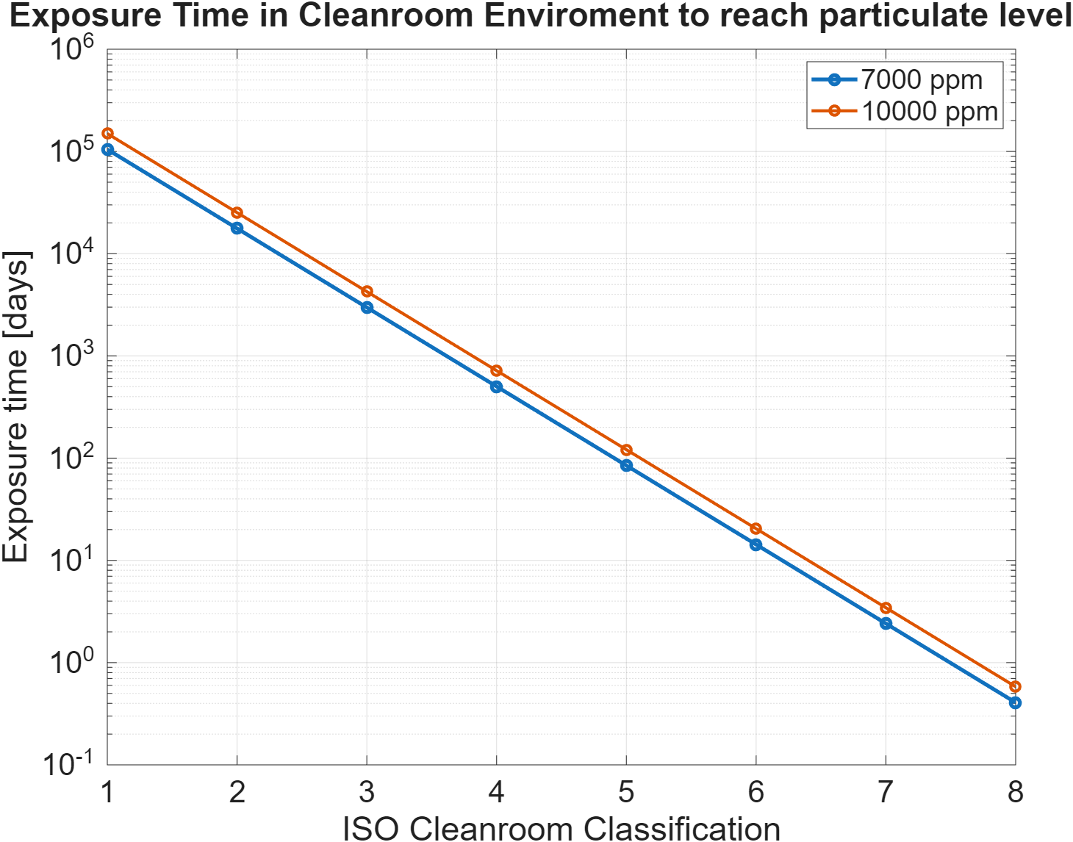
Modelling Modeling Parameters and Approach:
2: Particle Contamination: approach
Expected PAC : 7000 ppm
Time in Cleanroom | 7000 ppm | 10000 ppm
ISO - 5 | 84 days | 121 days
ISO - 4 | 502 days | 717 days
ISO - 3 | 2900 days | 4250 days
IRT Telescope Design Description, Trade-off and Analysis Report , Airbus , 2023
INAF - OABr

Slide 9
Modelling Approach: IRT Telescope
Scattering Model (e.g. Roughness)
Scattering Model (e.g. Dust)
M1
Peterson model
(NA, D)
M1
+
+
M2
M2
+
+
…
…

Slide 10
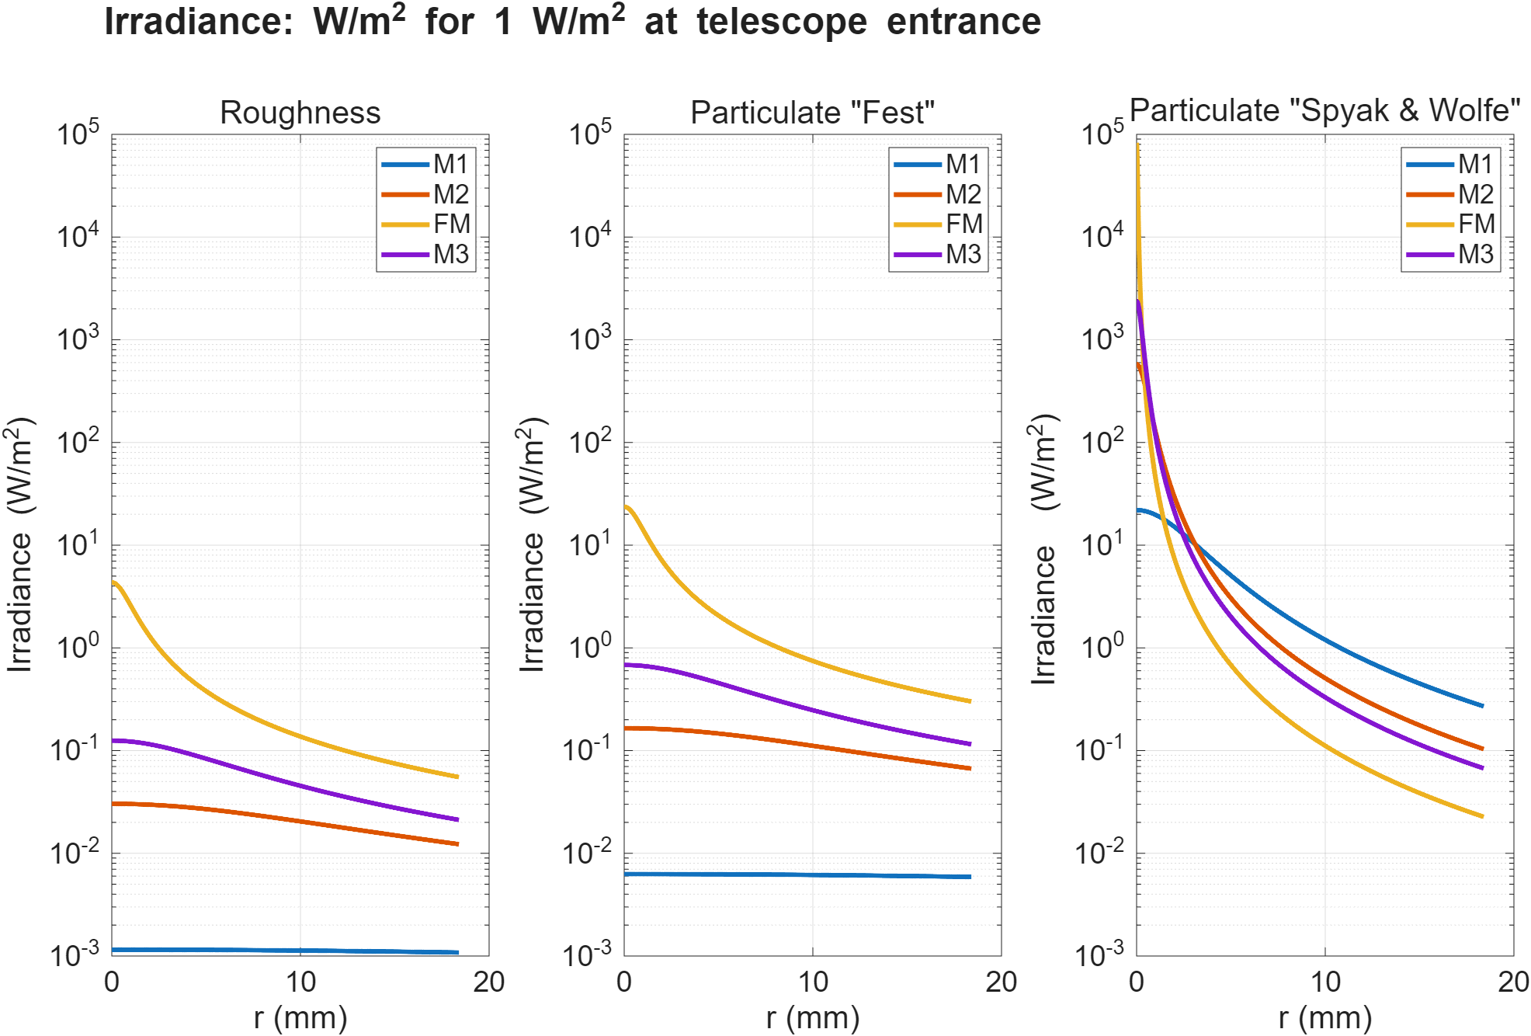
Results: Effect Comparison

Slide 11
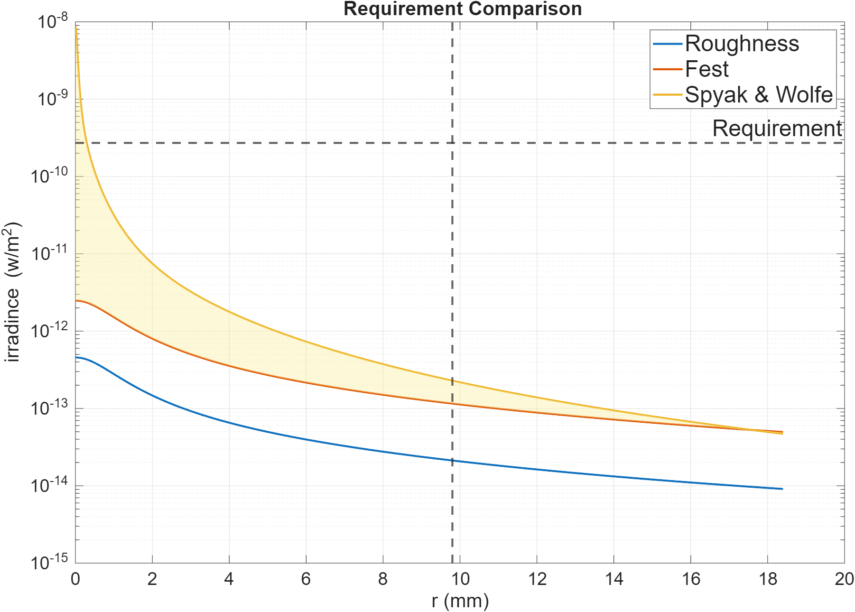
Results: IRT Optical System
Two particle distributions are plotted
~3 OoM below general system requirement

Slide 12
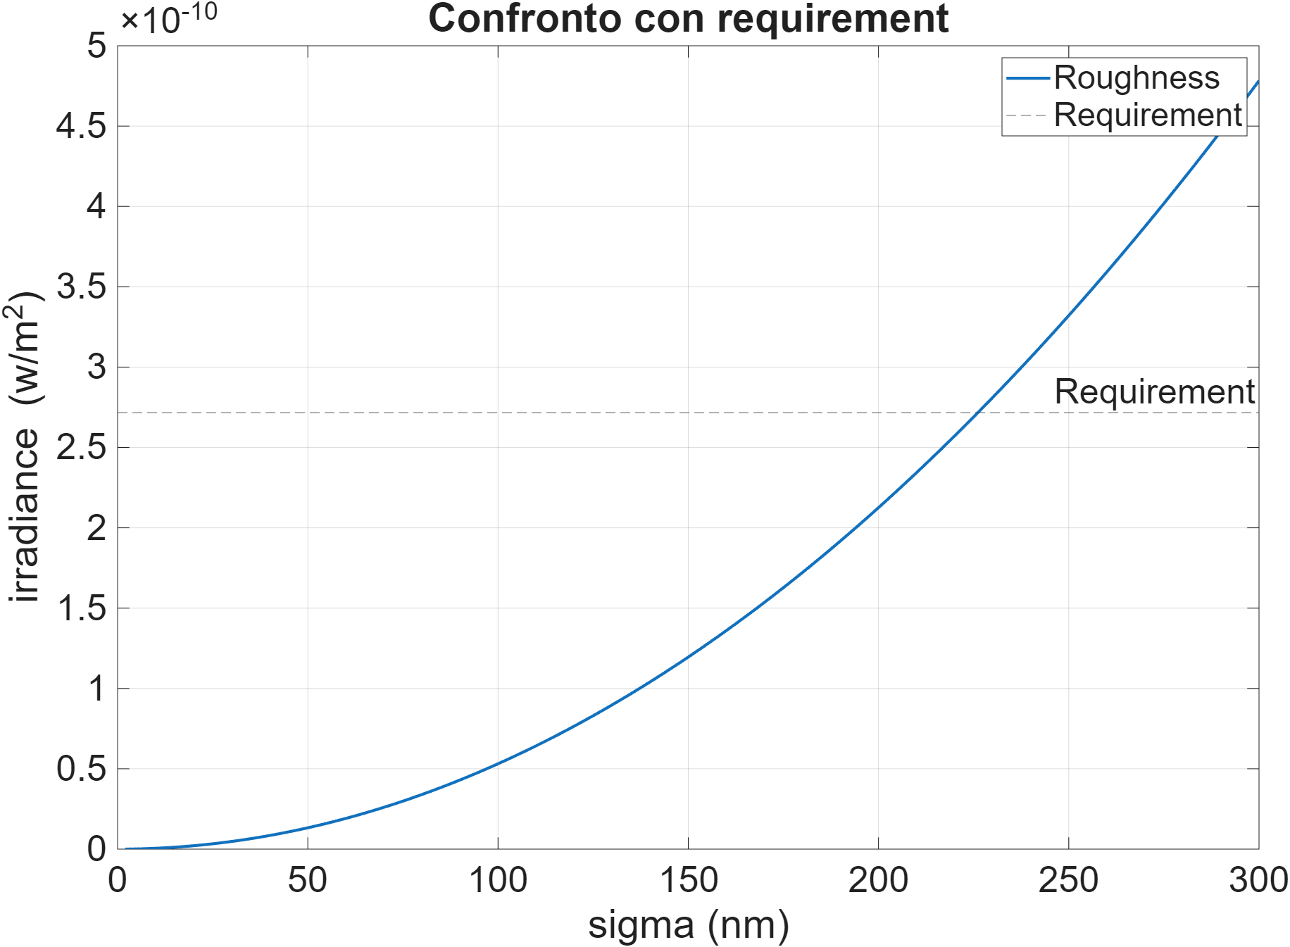
Results: Roughness sensitivity
Parabolic sensitivity
General Requirement met at 230 nm RMS

Slide 13
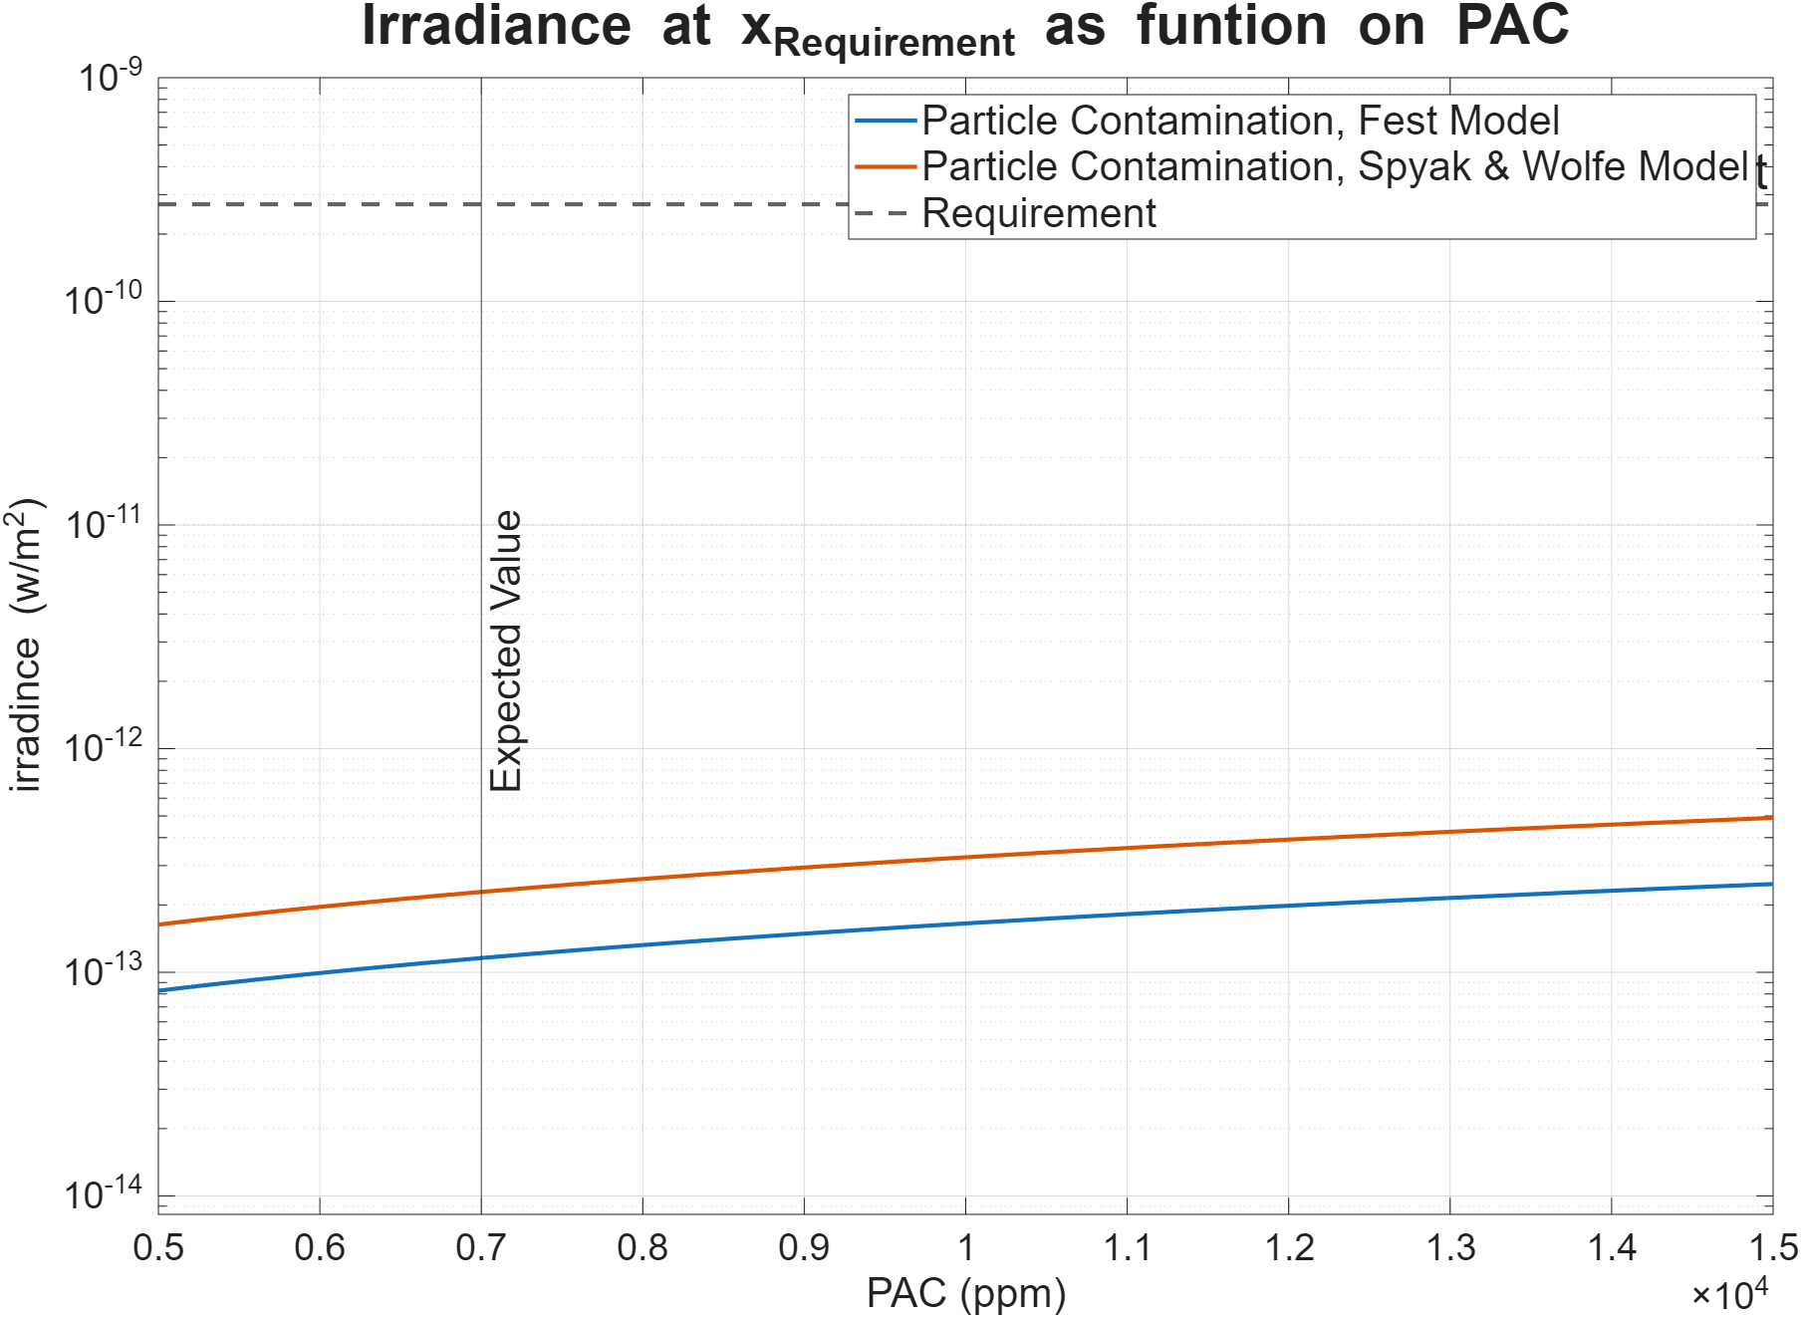
Results: Sensitivity to contamination
Linear Sensitivity curve

Slide 14
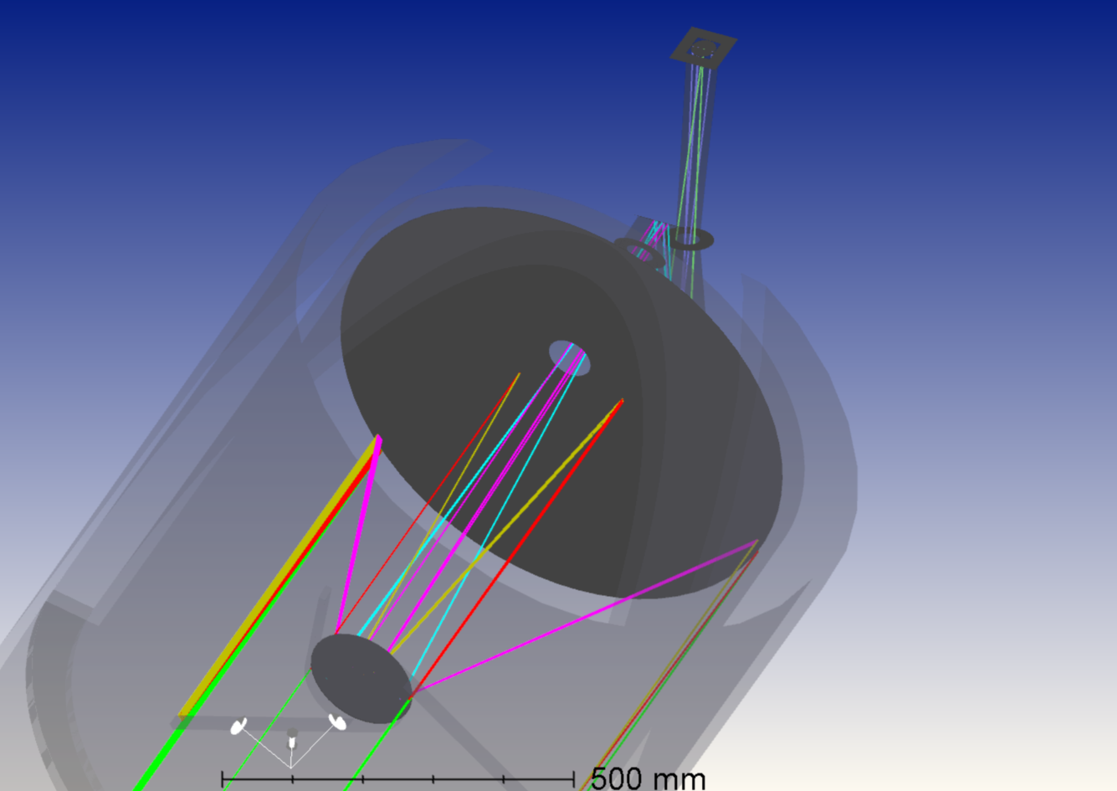
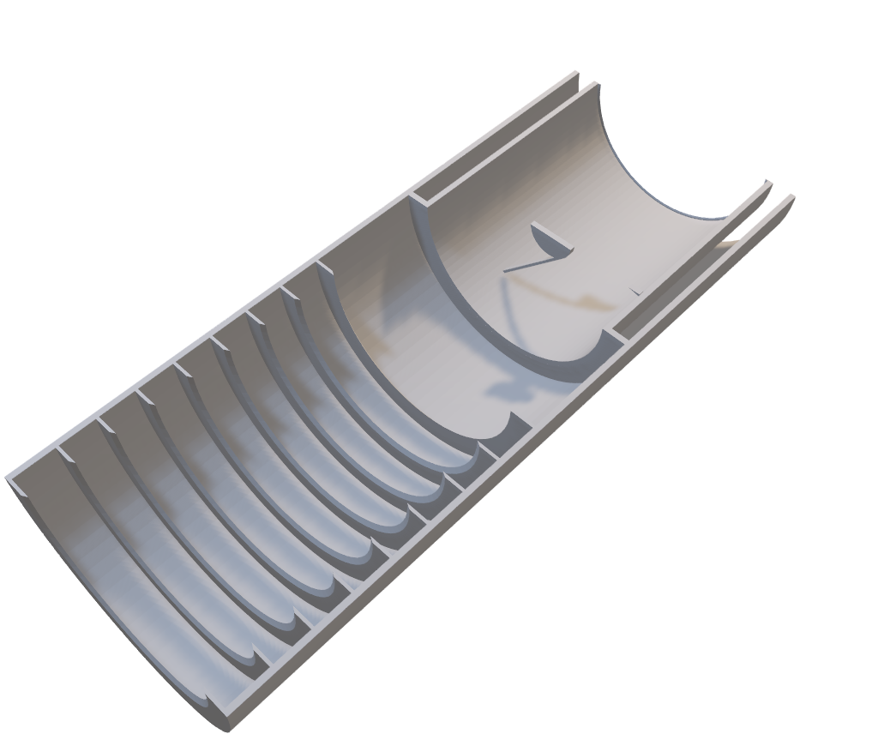
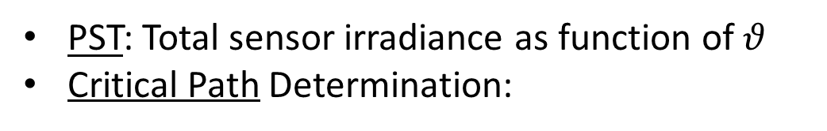

Next Steps: Out of Field contribution
$$θ>θ_{FOV}$$
PST: Total sensor irradiance as function of $θ$
Critical Path Determination:
Outside lluminated
Detector FoV

Slide 15
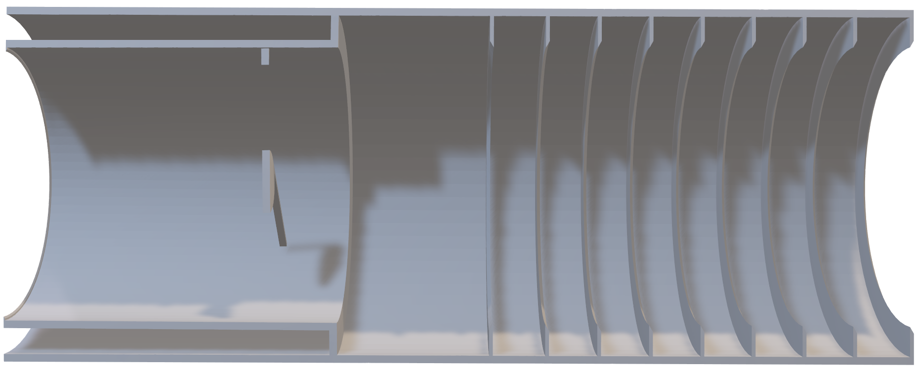
Next Steps: Out of Field contribution
Build Stray light model:
Black Surface Treatment
Detailed Mechanical model: Mirror Edges, Spider-M2 interface

Slide 16
Next Steps: Roadmap
Build Stray light model:
Black Surface Treatment
Detailed Mechanical model: Mirror Edges, Spider-M2 interface
First Order Analysis:
Critical Path Determination (and mitigation proposal)
Higher Order Analysis:
PST: wide band/low resolution
PST: emphasis on targets exclusion angle (Earth/Sun/Moon)

