Slide 1
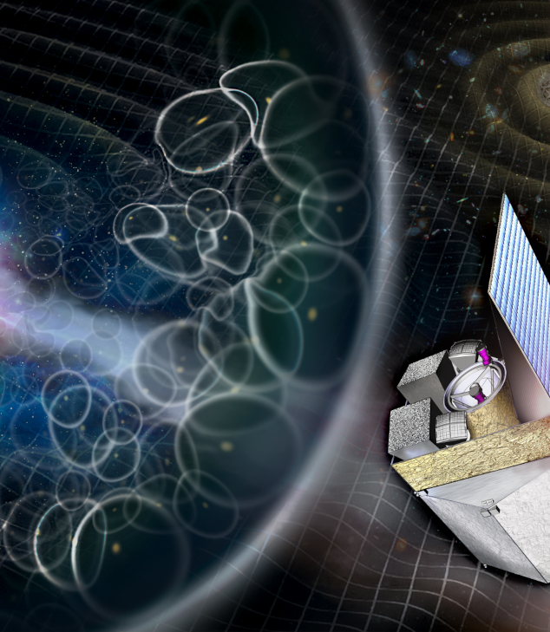
Camera Thermal Models for global IRT
THESEUS IRT consortium meeting #5 | 4-5 November 2025

Slide 2
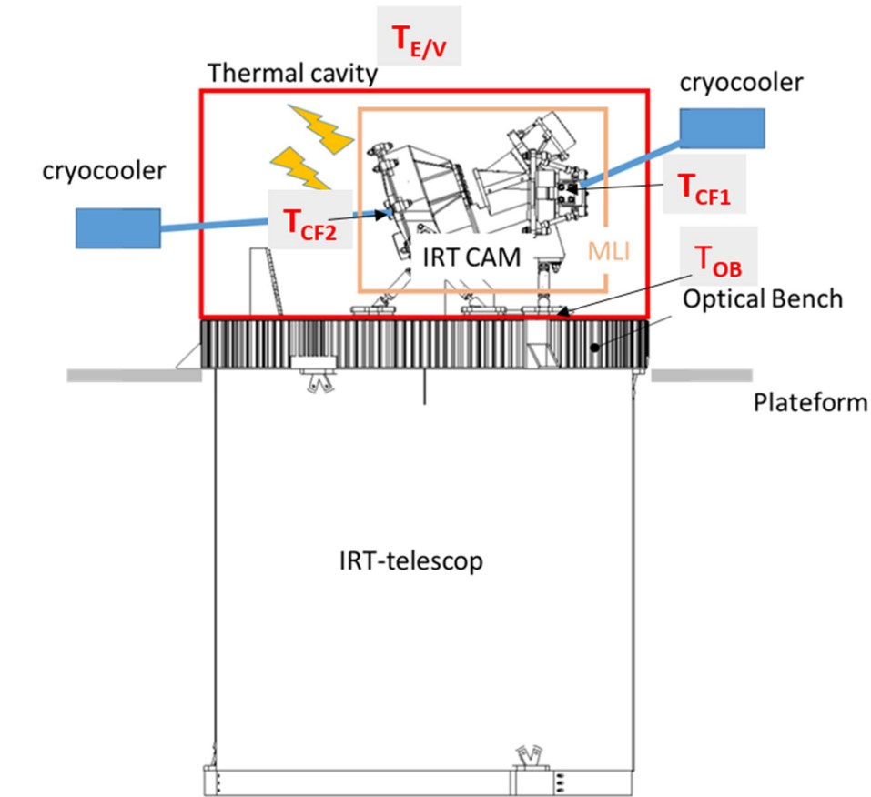
Configuration of IRT-CAM thermal model
The IRT-CAM FPA is connected to a cold finger CF1
The IRT-CAM MSA is mounted on another cold finger CF2

Slide 3
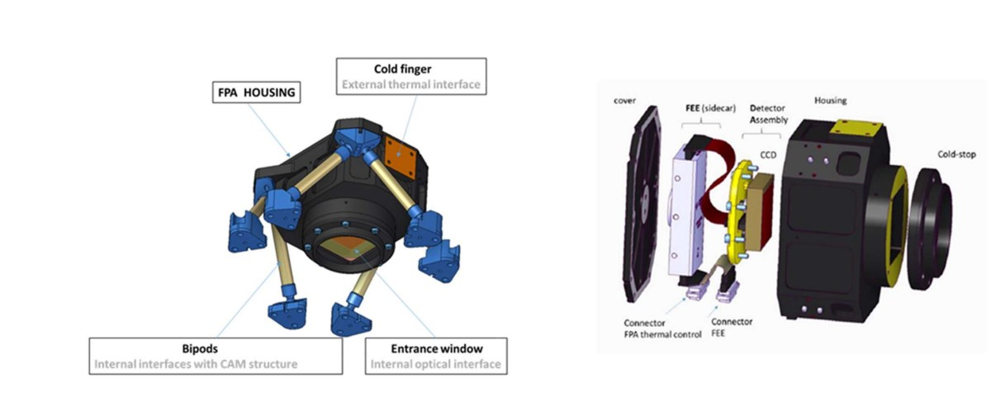
IRT-CAM FPA definition
Functional requirement :
Temperature of Detector < 120 K
Temperature of SideCar > 130 K

Slide 4
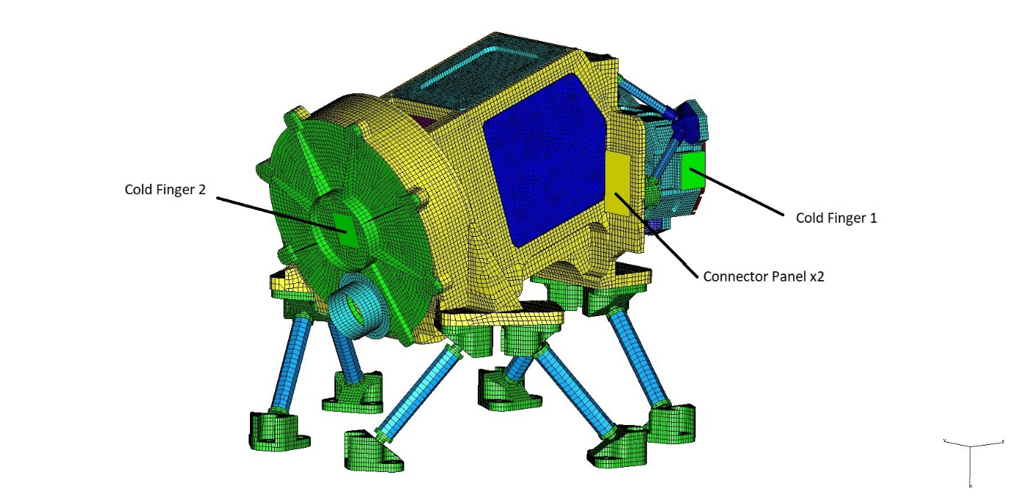
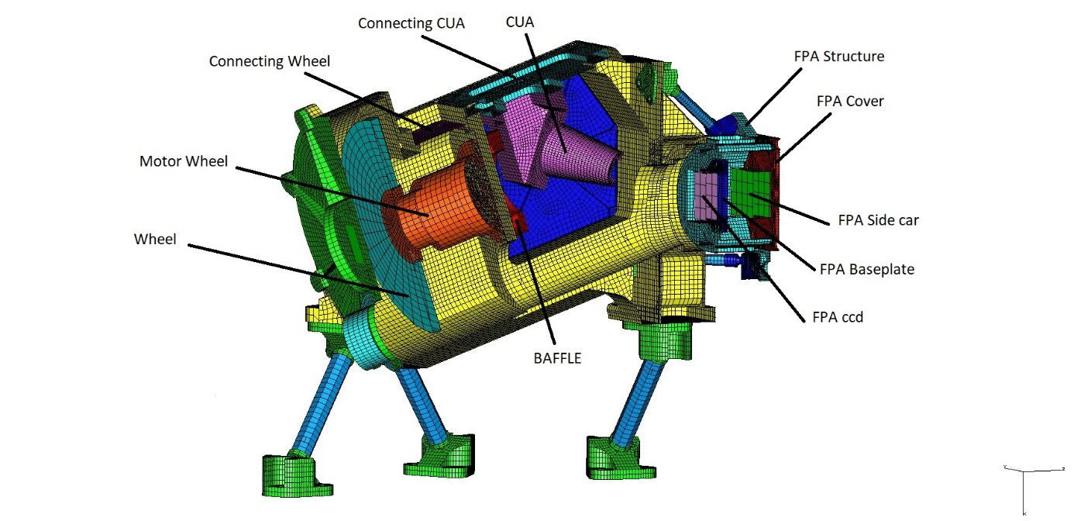
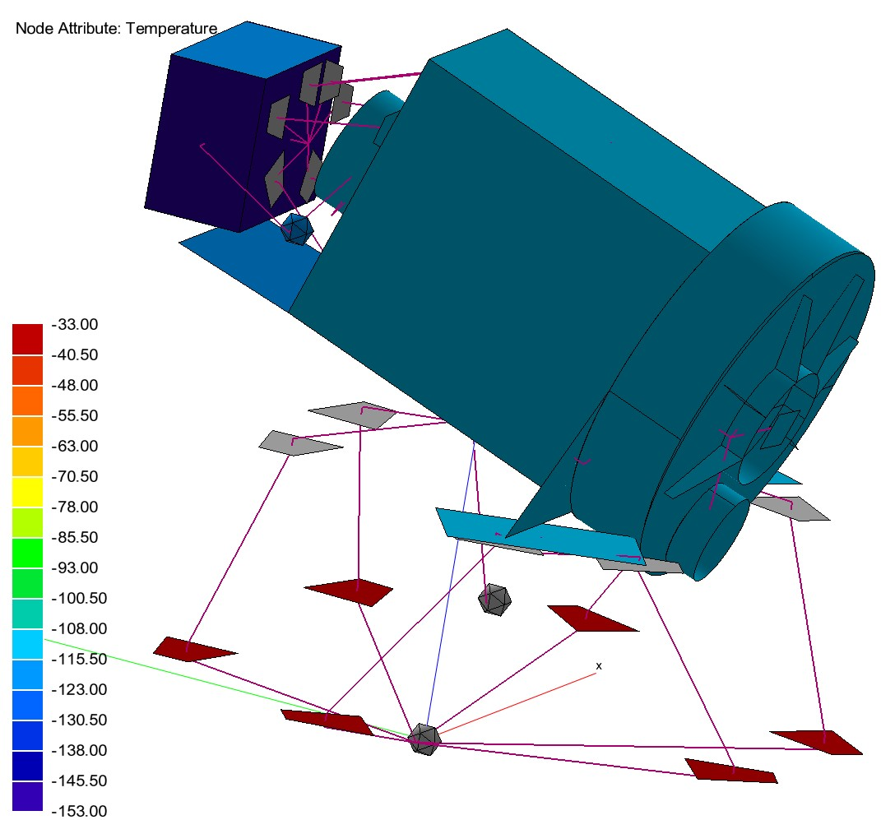
Thermal Model Development and Correlation
Overview:
We developed two thermal models:
A detailed model using TMG
A reduced model using ESATAN
Process:
The reduced ESATAN model was correlated with the detailed TMG model.
We then compared the results according to ESA doc: Model Correlation Criteria.
Finally, a steady-state Hot Case was performed to get ::
Temperatures at the different subsystems of the camera
Heat flow at the interfaces : CF1, CF2, Optical Bench, environnement
To validate the correlation.
Results:
All elements show good agreement
Exception: small discrepancy at Cold Finger 2

Slide 5
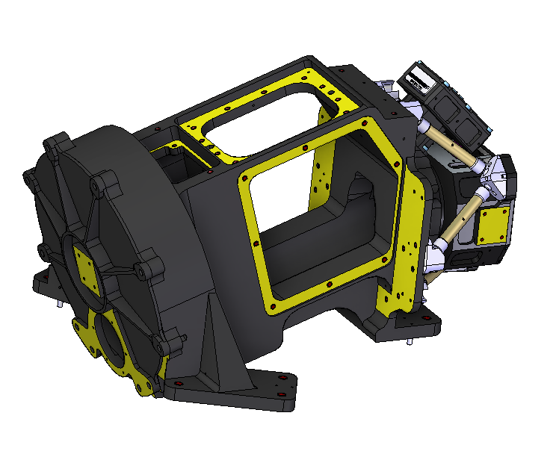
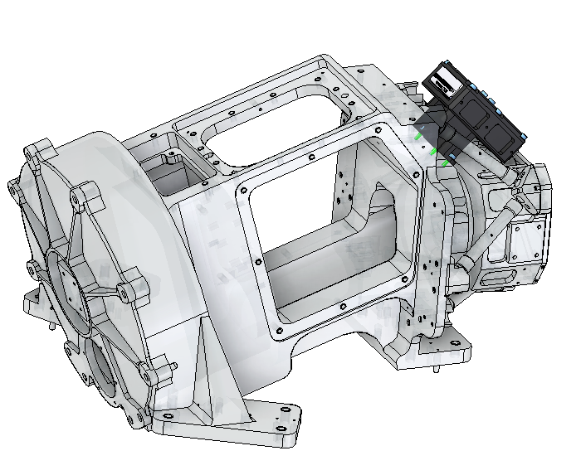
Version x2 cold-finger with FEE on structure
FEE
CF1
structure
FPA
Cold-finger
CF2
Cold-finger
Same design : thermomechanical decoupling
of the detector as in the previous version
Requirements | CF1 | CF2
Tdet @120K T_{FEE} @162K (>130K) T_{structure} @158K | 520 mW @ 119 K | 2.6 W @ 158 K
Tdet @100K T_{FEE} @162K (>130K) T_{structure} @ 158K | 620 mW @ 99 K | 2.5 W @ 158 K
∆_{mass} = +200 g vs nominale version

Slide 6
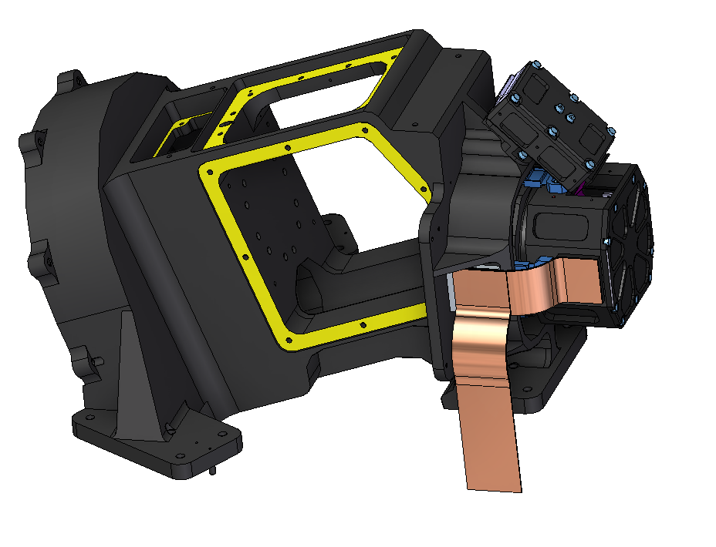
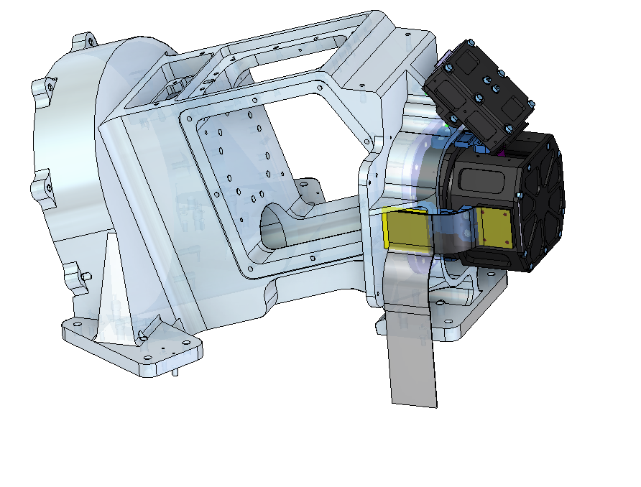
Version x1 cold-finger with FEE on structure
FEE
Thermal link
FPA-CF
FPA
structure
CF (Cold-finger)
Thermal link to cryocooler
Requirements | CF
Tdet @120K T_{FEE} @ 162K (>130K) T_{structure} @ 160K | 3.11 W @ 113 K
Tdet @100K T_{FEE} @ 163K (>130K) T_{structure} @ 160K | 3.105 W @ 90 K
New design for thermomechanical decoupling of the detector
∆_{mass} = +340 g vs nominale version

Slide 7
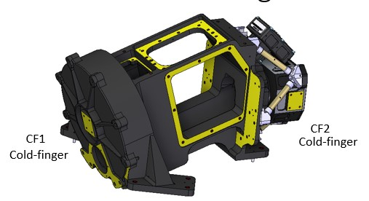
Remaining thermal activities
Next Steps:
Update the detailed (TMG) and reduced (ESATAN) thermal models with the new configuration:
Two Cold Fingers
FEE mounted on the structure
Analysis to be performed:
Steady-State Analysis:
Hot Case
Cold Case
Transient analysis:
ΔT environment = ±10 K
ΔT Cold Finger 1 (CF1) = ±1 K
ΔT Cold Finger 2 (CF2) = ±1 K
ΔT Optical Bench (OB) = ±5 K
=> Output: ΔT at the detector
FEE

Slide 8
IRT-CAM Design – Breadboard tests and updates

Slide 9
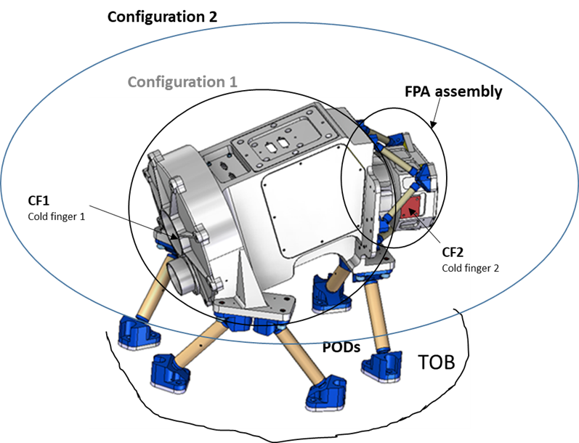
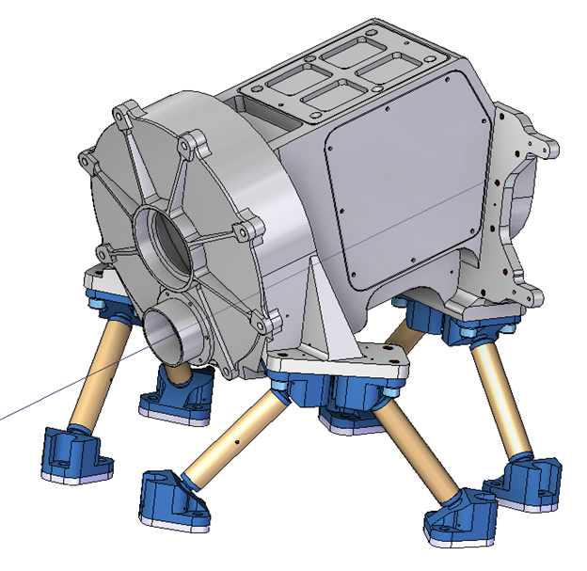
IRT-CAM Breadboard Configurations
Configuration 1: Structure only + GFRP pods.
Configuration 2: Structure + Focal Plane Assembly (FPA) + internal dissipation.
Calibration unit if
Wheel
connector panel
Wheel cover
Lateral panel
pod
Test optical bench
Goal: Characterisation the material structure at wheel and FPA assembly interfaces,
Goal: Characterisation of FPA detector plane displacements and deformations.
Thermo-mechanical analyses were performed on the camera structure using the same design, comparing SiC and Aluminum 6061 T6. The analyses were based on the breadboard model conditions (same as flight condition but with environnement temperature = 293K) , using steady-state thermal loads.

Slide 10
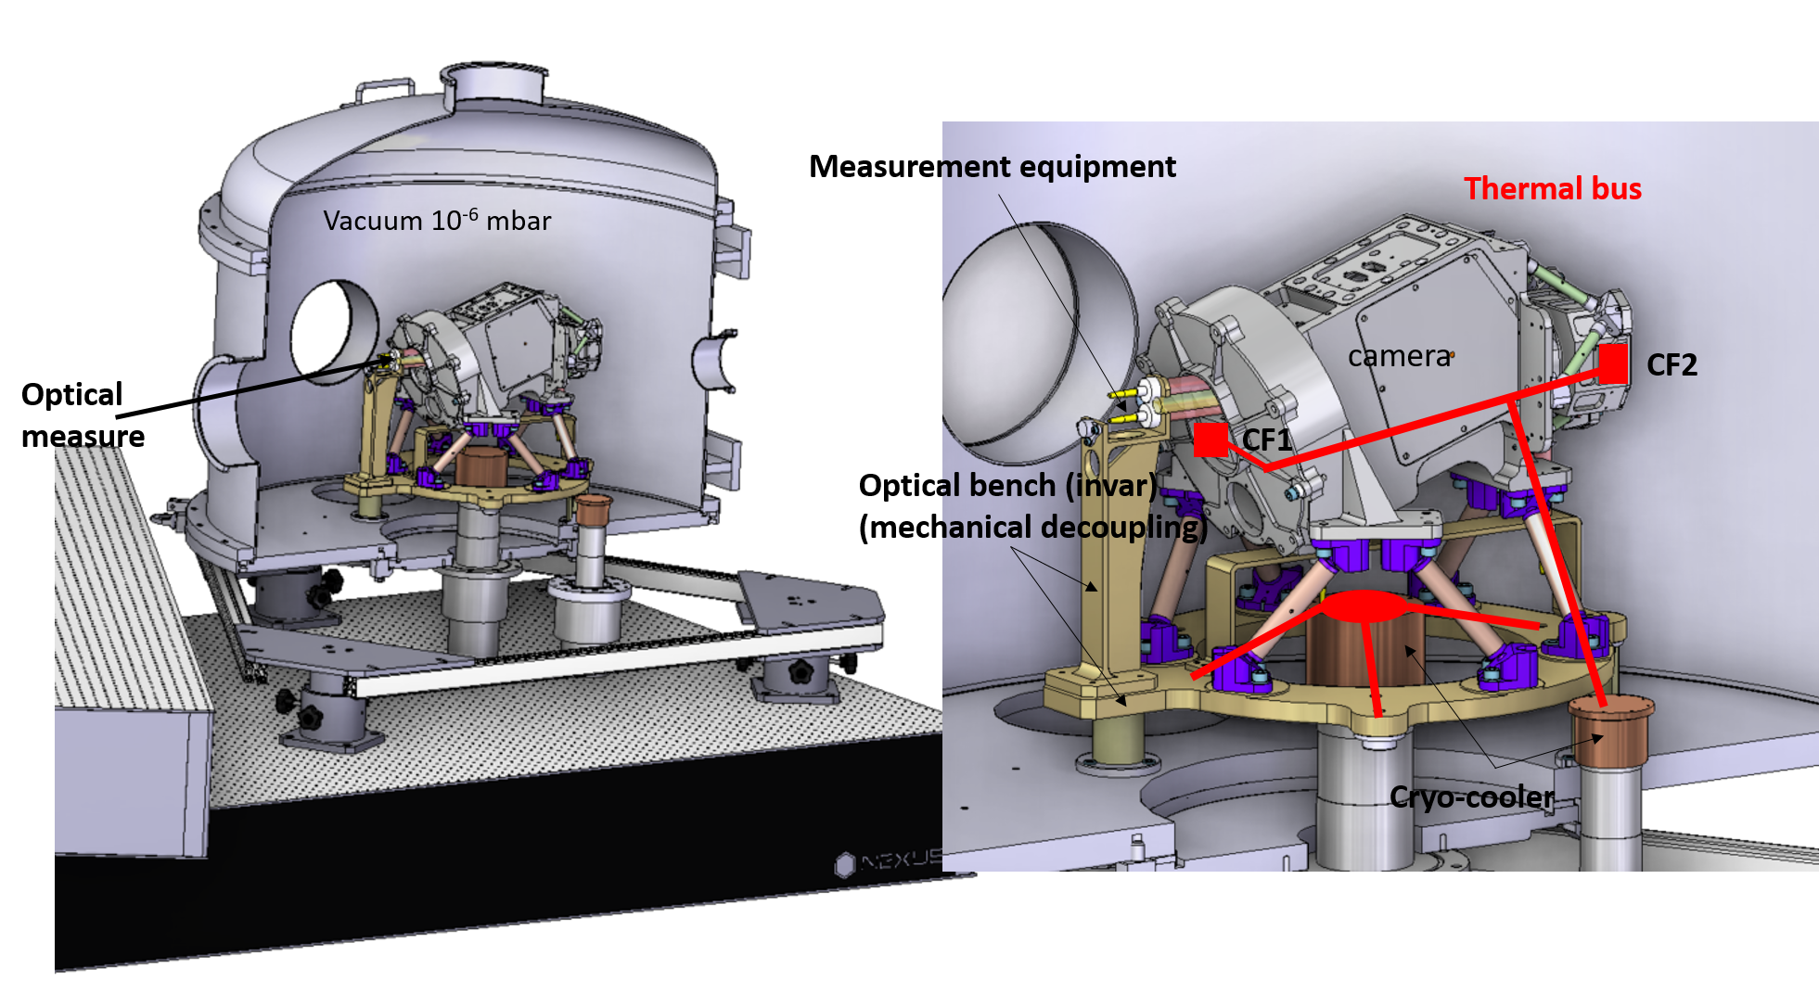
Thermoelastic characterisation of the camera
Goals:
Measurement of the relative displacements between the mechanical interfaces (pupil, wheel, FPA structure) – Configuration#1
Measurement of the variation in the line of sight (pupil/centre of detector) – Configuration#2
Comparison with thermo-elastic analysis
Representative thermal conditions:
Optical bench @240 K
CF1 @160K
CF2 @ 120K

Slide 11
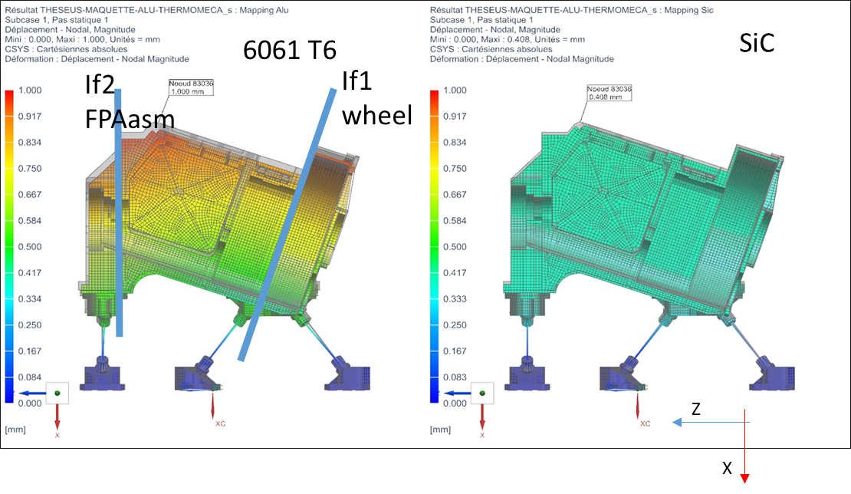
Configuration 1 results
Objective: Compare thermo-mechanical behavior of SiC vs Aluminum 6061 T6 structure under identical design and conditions. Structure at 160 K, connected to optical bench (240 K)
Configuration 1:
Aim: quantify deformations at interfaces IF1 & IF2 (wheel and focal plane)
Sensitivity study: Optical Bench varied (230 K / 250 K), and Cold Finger 2 varied (155K/165K)
Material | T_{OB} | ∆X | ∆Y | ∆Z
6061 T6 | 250K | -18µm | 0 | 0
 | 240K | ref | ref | ref
 | 230K | +18µm | 0 | 0
SiC | 250K | -18µm | 0 | 0
 | 240K | ref | ref | ref
 | 230K | +18µm | 0 | 0
Material | T_{CF2} | ∆X | ∆Y | ∆Z
6061 T6 | 155K | +15µm | +3µm | +5µm
 | 160K | ref | ref | Ref
 | 165K | -15µm | -3µm | -5µm
SiC | 155K | +7µm | 0 | 0
 | 160K | Ref | ref | ref
 | 165K | -7µm | 0 | 0
Optical bench ±10K variation → only ±18 µm displacement in X axis.
Cold Finger2 ±5K variation → only ±15 µm displacement in X axis and ±5 µm in Z-axis for Al-6061-T6 version
No tilt at wheel (IF1) or FPA (IF2) interfaces.
No tilt at wheel (IF1) or FPA (IF2) interfaces.

Slide 12
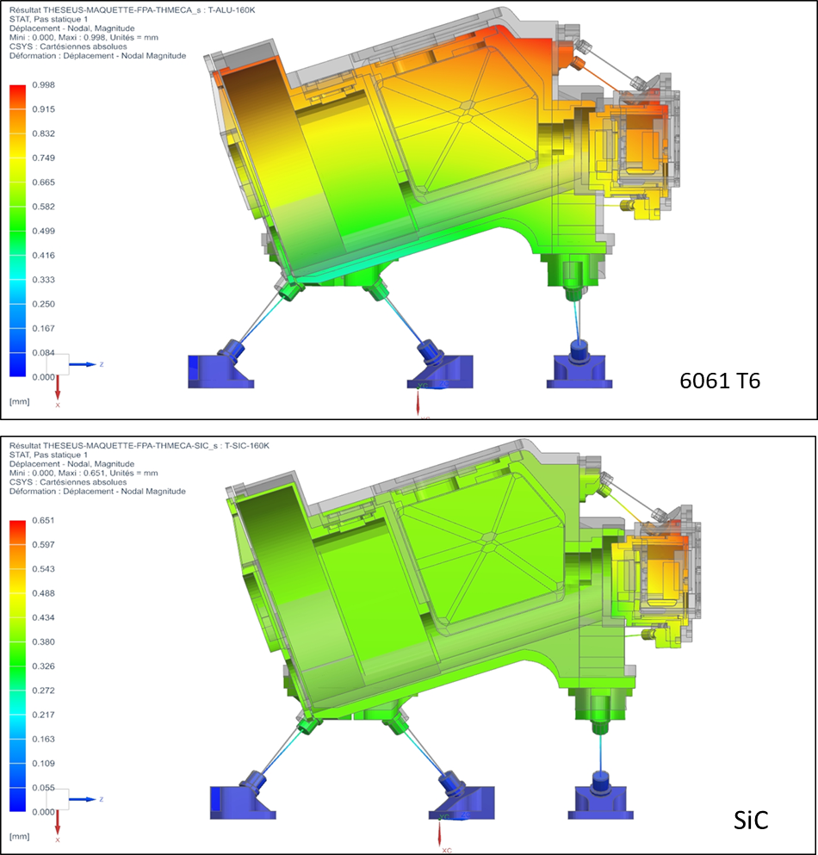
Configuration 2 Results
The configuration 2 is composed of the elements of the previous configuration 1 completed by the FPA assembly and the internal heat dissipations.
For this analysis configuration, we have mainly analyzed the results for the detector.
 | CF2 Temperature | Detector Tilt
Al_6061_T6 | 155 K | -1’’
 | 160K | ref
 | 165K | +1’’
 | CF2 Temperature | Detector Tilt
SIC | 155 K | -3’’
 | 160K | ref
 | 165K | +3’’
Aluminum shows:
Lower XZ-plane tilt (due to same material for structure and FPA housing).
Slightly higher displacements but within acceptable range.
Thermal fluctuations better damped than with SiC.

Slide 13
Conclusion
The displacements caused by OB and CF2 temperature variations remain within acceptable limits : +2µm/K for OB and 3µm/K for CF2
The total angular deformations of the detector are comparable for both materials.
Choosing an aluminum structure poses no greater risk than a SiC structure in terms of dimensional stability.

Slide 14
Mechanical and Thermo-elastic activities on IRT_CAM

Slide 15
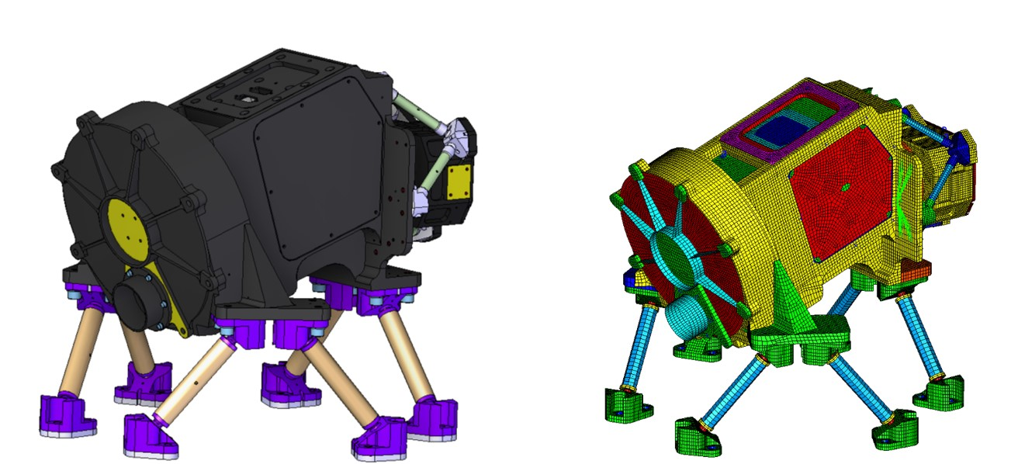

IRT-CAM Finite Element Analysis
This Finite Element model is based on the current version of the CAD model of the IRT-CAM
We have performed :
A modal Analysis
Design limit load Analysis
Random vibration analysis
Thermo-elastic analysis (test bench conditions same previous config. 2 )

Slide 16
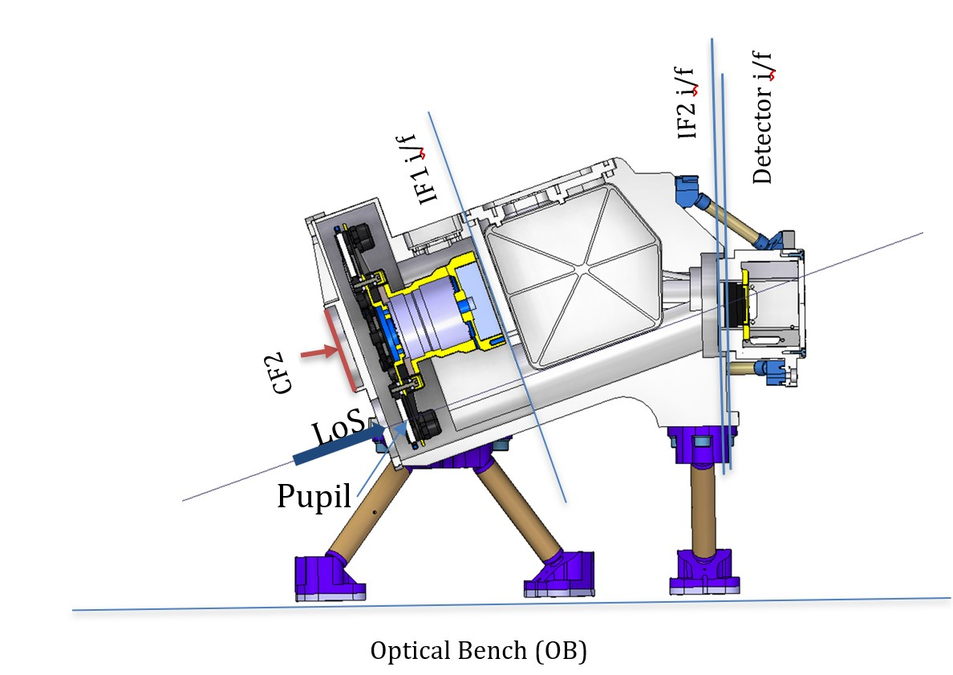
Thermo-elastic FEM Analysis
Context:
Study performed as part of the Aluminium vs SiC camera trade-off.
Test conditions = flight conditions, except that:→ The external temperature is ambient, not the actual cavity temperature.
Objectives of the FEM analysis
Estimate the structural contractions of the Aluminium configuration in order to size the compensation shims under the pods.
Assess potential detector and critical interface tilts to determine possible line-of-sight (LOS) shifts under thermal variations.

Slide 17
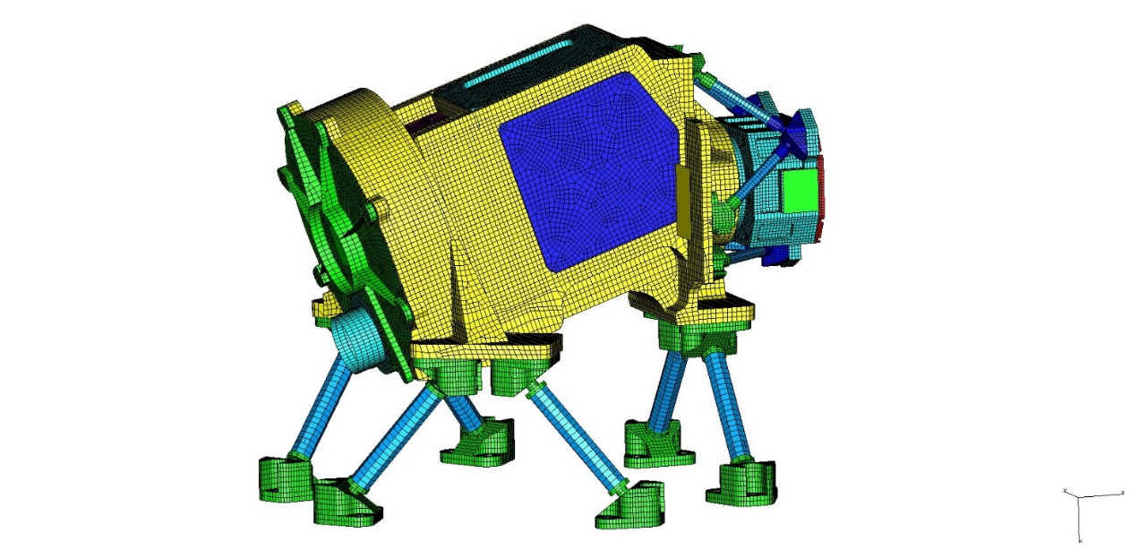
Method overview
The aim of the FEM analysis is to determine the displacements of critical interfaces due to thermal loads. Workflow:
1. Perform thermal analysis to obtain temperature gradients.
2. Import temperature map into mechanical FEM.
3. Extract nodal displacements at three reference nodes per critical interface.
4. Python post-processing to generate Δθ, Δx, Δy, Δz tables
Number of nodes | 170 321
Number of elements | 216 037
Shell | 103 379
Beam | 264
Solid | 112 394

Slide 18
Structural reaction during cooldown
Angular displacements:
IF2–Detector: Δθ’’ ≈ 41
Translational displacements (µm):
X-axis shrinkage dominated by G10 thermal contraction
Z-axis displacements can be compensated
Y-axis displacements can not be compensated but are negligible ( between 2 and 8 µm)
Interface | dx | dy | dz
IF1 | ~690 | 4 | +63
IF2 | ~680 | 2 | −300
Detector | ~660 | 8 | −390
LoS shift after compensation of X-axis and Z-axis displacements tilt~ 3’’

Slide 19
Conclusion
Cooling the camera causes some displacement mainly due to material contraction, but these effects are well controlled.
Movements along the X and Z axes can be compensated, while those along the Y axis remain negligible.
At operating temperature, moderate thermal variations have no significant impact on internal stability or line-of-sight accuracy.

Slide 20
Planned activities

Slide 21
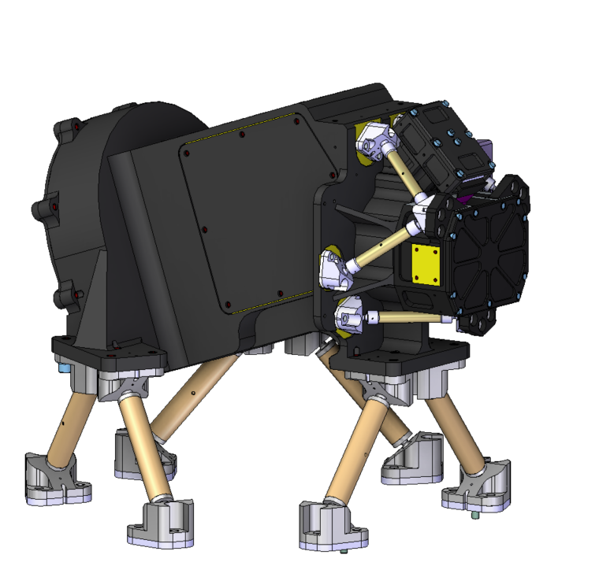
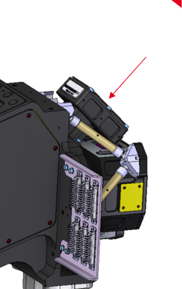


Mass updates/ New Mechanical Design
Sidecar
Perform with the updated mass new :
Modal Analysis
Design limit load Analysis
Random vibration analysis
Perform a new thermo-mechanical analysis using the operational external temperature (instead of ambient) to:
Refine the dimensioning of the compensation shims, and
Improve the prediction of the detector focal plane position.
 | Mass with no marge (Kg) | Nominal Mass (Kg)
New Mass | 19 | 27,36
ESA- Interface document EID-A

