Slide 1
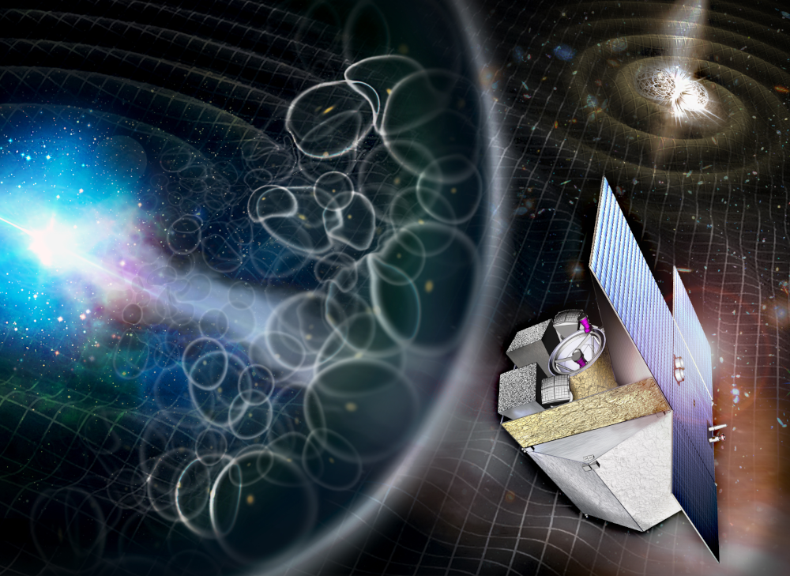
Meeting wrap up
IRT Consortium meeting
Paris, 4-5 November 2025

Slide 2
Trade-off status
Decisions!

Slide 3
TEL trade off
Item | Status | Baseline for MSR | Justification
Mounting hardware | Closed | Short bipods | Decoupling from platform (Thermally and mdechanically) to better manage performance
M2 refocus | Open | Refocusing mechanism | Derisk uncertainties on quality of optics and alignment

Slide 4
CAM trade off
Item | Status | Baseline for MSR | Justification
Structure material | Closed | Aluminium 6061 | Flexibility in design and manufacturing, low gradient between detector and cold finger, satisfying thermo elastic behavior for optical alignment stability
FEE / detector thermal coupling | Closed | FEE Thermally decoupled from FPA | limit power on cold finger#1 (coldest one), allows warmer FEE and colder detector than 120 K
Cold finger configuration | Open | 2 cold fingers | Advanced design and analyses, compliant with EID A

Slide 5
ICS trade off
Item | Status | Baseline for MSR | Justification
Mechanical configuration | Closed | 2 boxes | Heat management (Increase of fonctions and power wrt M5)
Astrometry on board | Closed | Yes (CLAMPS algorithm) | Relax long term stability requirement of telescope
Readout mode | Open | MACC | Can give more performance margin or relax noise spécifications for detector and ASIC
Software environment | Open | RTEMS | Not enough time to evaluate KOSMOS

Slide 6
Action items

Slide 7
Actions at system level
Work on the presentation of the mass budget with system margins
Clarify temperature limits with ESA for thermal analysis

Slide 8
Actions at subsystem level
Feasibility study of MACC readout mode in the preprocessing layer (DCU, CEA) and in the processing layer (DPB, IAAT): use PowerPoint requirement and rapidly contact Henri and Aline if inputs are missing.

