Slide 1
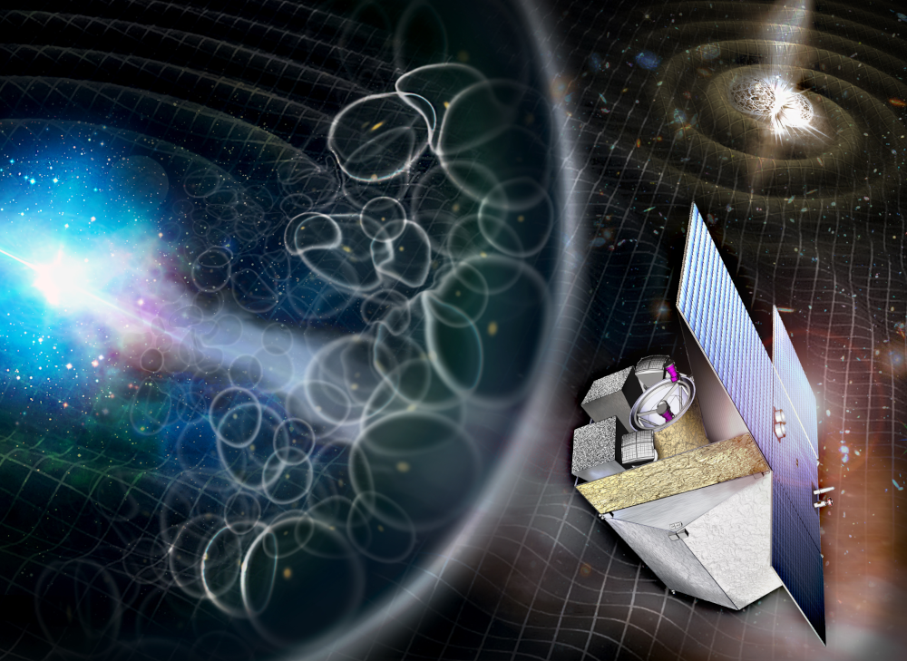
IRT system status
IRT Consortium meeting
Paris, 4-5 November 2025

Slide 2
System budgets
Track of updates since last review

Slide 3
Mass budget
Instrument optical system
10% system margin added to the subsystems budget given the maturity of the system design. May be removed at the end of phase A.
Instrument control system Any update after mechanical analysis?
Remark: Mass of the harness is in IRT budget but the length is responsibility of the Prime. Current assumptions is 3 meters between telescope and first box which implies ~6.8 kg mass only for this part.
Subsystem | Mass without margin | Mass with 20 % design margin (kg)
IRT-TEL | 93.2 to be updated? | 116.48 111.8 kg
IRT-CAM | 21.2 21.4 kg | 25.5 to be changed or in the margin?
Total IRT-IOS without system margin |  | 141.98
Total IRT-IOS with 10% system margin |  | 156.2 shall we maintain this margin?
Subsystem | Mass with 20 % design margin (kg)
IRT-DHU | 6.1
IRT-ECU | 7.45
IRT-HA | 13.7
Total IRT-ICS | 27.3

Slide 4
(Electrical) Power budget
Budget in watts with 20% margin presented at MCR:
Power allocation of 2-12W for the M2 mirror refocusing system: Do we confirm 12W budget after NPMC activity?
Power allocation of 10 W for the thermal control of critical elements of the telescope: The optical seems stable within 5K, do we keep this allocation?
ECU/DHU functions: No change in power budget update .
Power supplies efficiency: We keep assuming 70% efficiency.
Unit | Stand-by | Average | Maximum
ECU power budget | 27 | 35 | 48
DHU power budget | 18 | <30 | 36
IRT power budget | 45 | <64 | 84

Slide 5
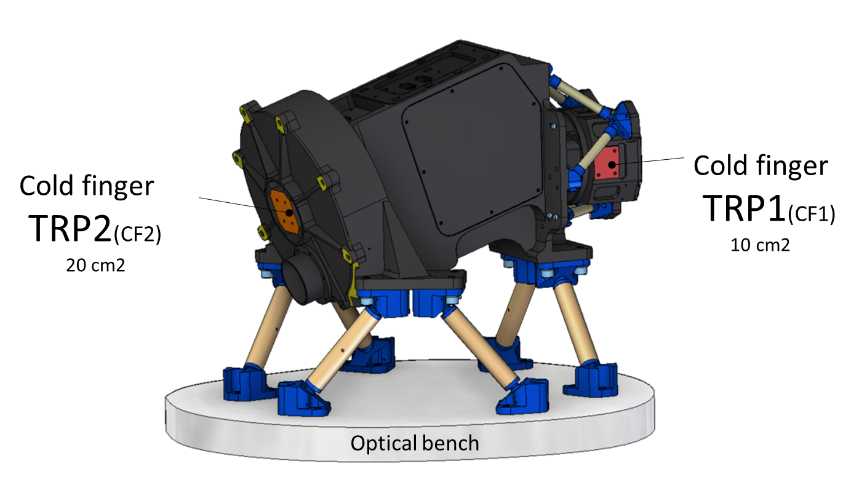
(Thermal) Power budget at the cold fingers
MCR Values, See updates this afternoon
TRP # | CF Temp. | Operational MCR
 |  | Cold | Hot
1 | 118 K | 2.4 W | 2.6 W
2 | 158 K | 3.55 W | 5.4 W
Change environment hypothesis (300 K → 240 K)
Change harness to bronze bronze SST
Much better!
Requirements | CF1 | CF2
Tdet@120K | 1.15 W @ 119 K | 2 W @ 158 K
Tdet@100K | 1.26 W @ 99 K | 1.87 W @ 158 K

Slide 6
Telemetry budget
Agreed with ESA end of March. No work since then.
IRT documents to update accordingly

Slide 7
Interfaces
Track of updates since last review

Slide 8
Change in interfaces?
No change noticed on mechanical, thermal, electrical interfaces on our design.
Change in ICD: Alignment reference frame on the optical bench (bottom side) and Unit Reference frame on the mounting plane of the telescope (below the bipods)
Interface requirements may change after thermal analysis by the Primes.
Missing inputs for your analysis?

