Slide 1
On the entropy of black holes
presented by
Thanawat Anusonthi
Srinakarinwirot University, Bangkok, Thailand
at
The 32nd Vietnam School Of Particle physics and dark matter (VSOP)
ICISE, Quy Nhon nam, Vietnam
Thursday 23 July 2026

Slide 2
Black holes
Black hole Thermodynamics
Thermodynamic stability of Black hole
Black hole’s Entropy
Conclusion

Slide 3
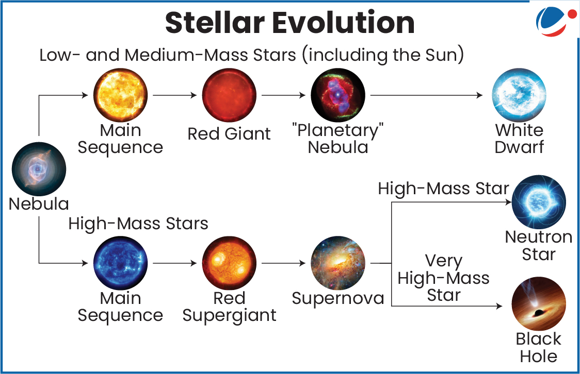
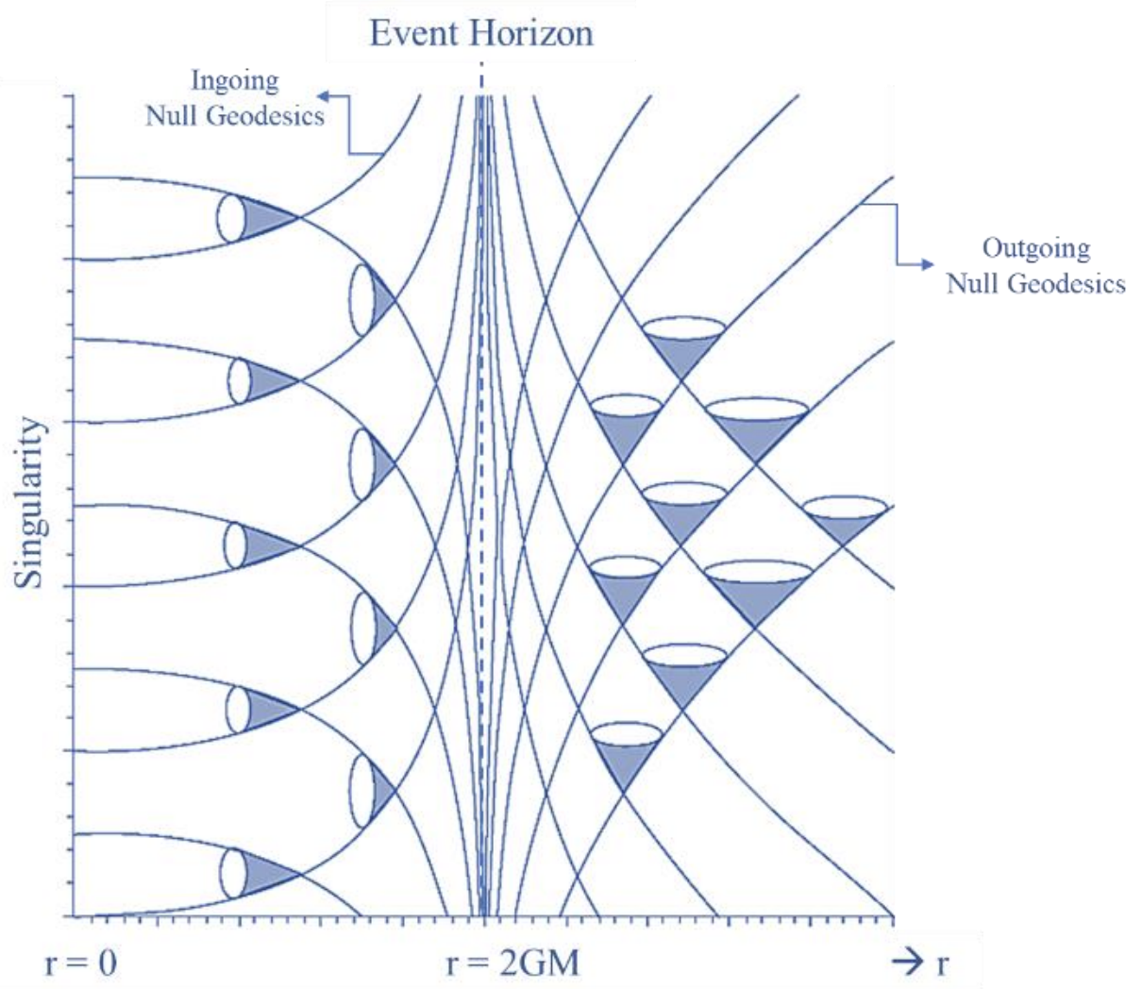
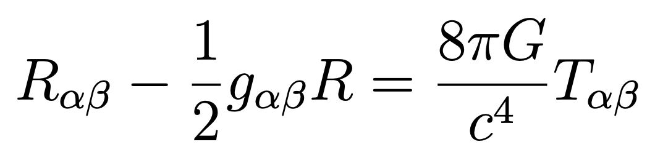
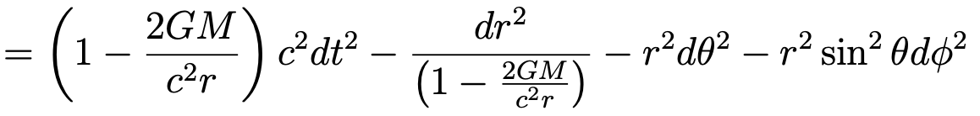
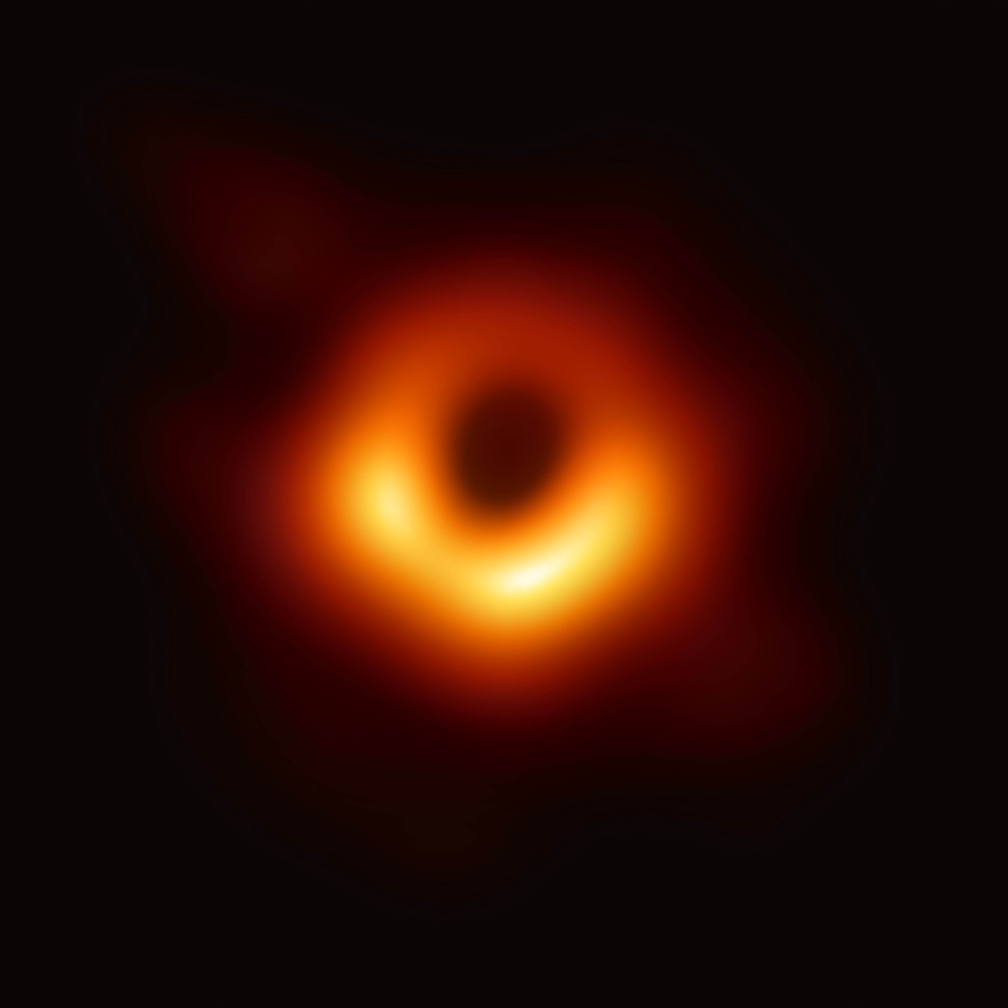
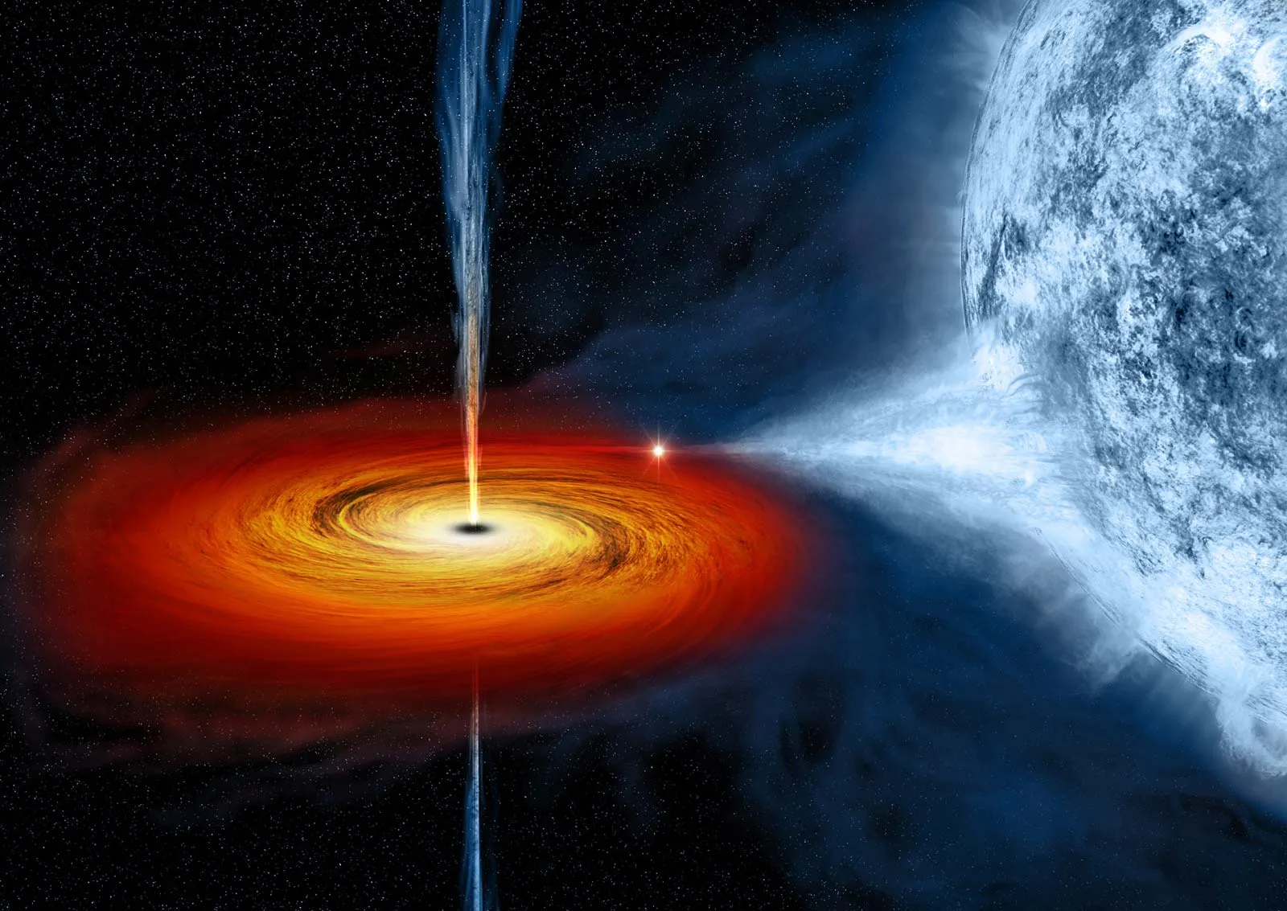
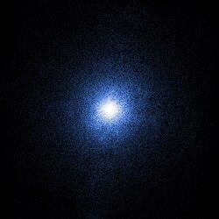
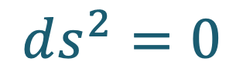
Black holes
What is Black hole ?
What implies ?
A black hole is the final stage in the life cycle of a massive star.
Light-cone structure
$$ds^{2}=0$$
A black hole is a region in space where gravity is so strong that nothing, not even light, can escape from it.
The solution of Einstein’s field equation solved by Karl Schwarzschild.
Spherical symmetric and static spacetime
DOI: 10.6084/m9.figshare.21814713.v1
Evidences of black holes
Flipping of future light-cone.
Messier 87
supermassive black hole
Cygnus X-1, a visible component of black hole

Slide 4
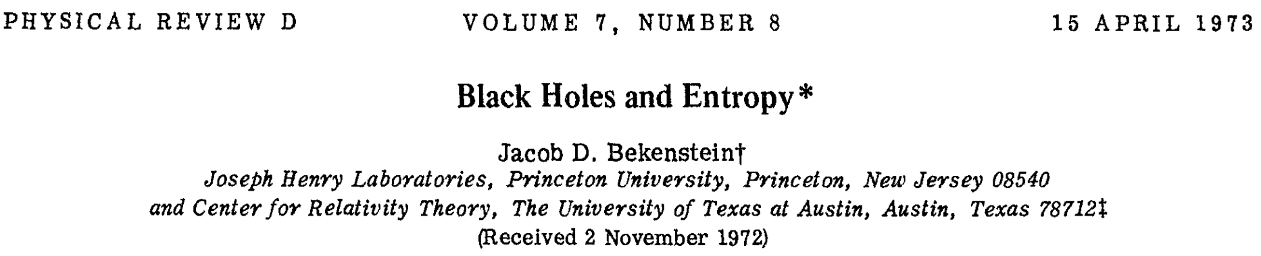
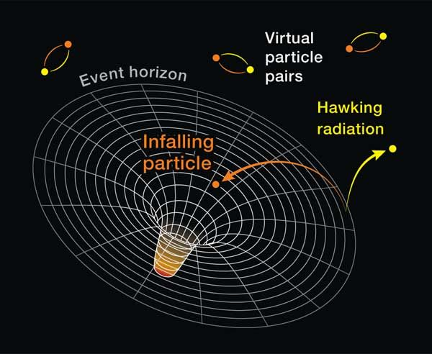
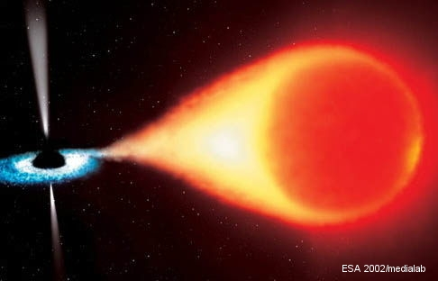
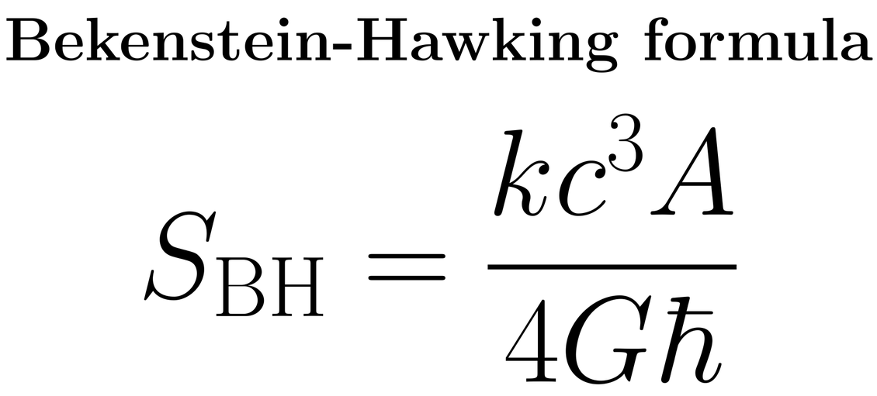
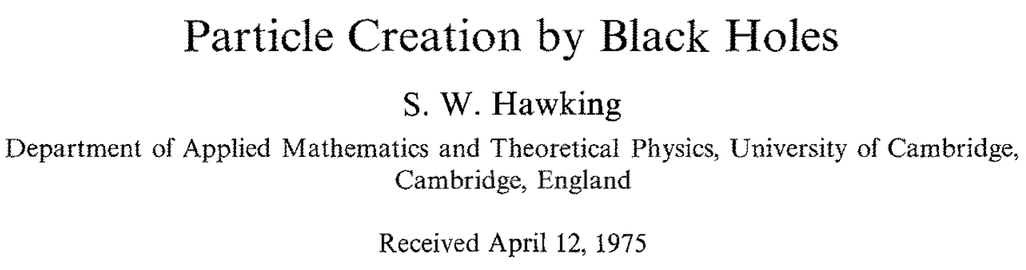
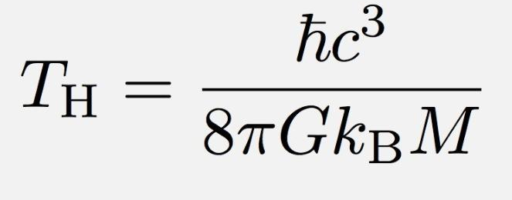
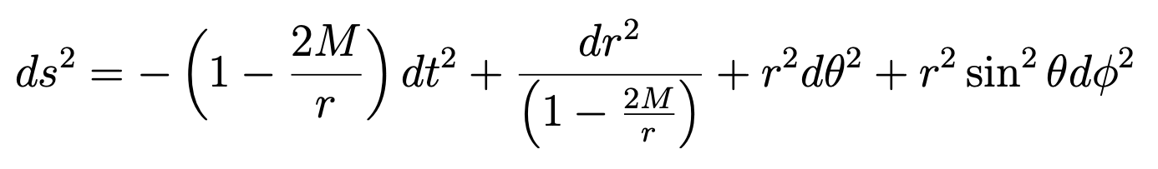
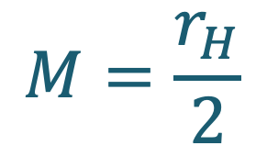



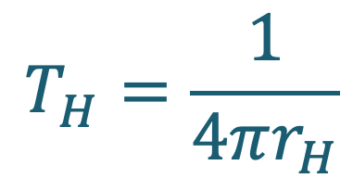

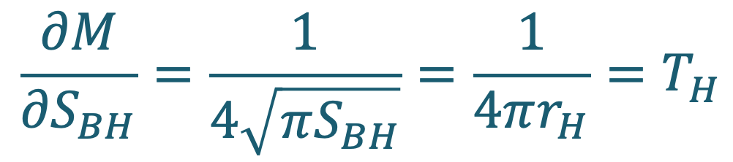
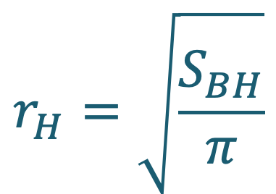


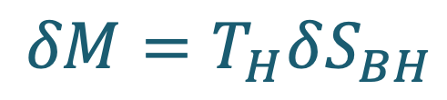
Black hole thermodynamics
The second law of thermodynamics
Birth of Black hole thermodynamics
$$ΔS>0$$
$$ΔS_{sys}<0$$
$$ΔS_{bh}>0$$
The thermodynamic first law of black hole
$$r_{H}=\sqrt{\frac{S_{BH}}{π}}$$
The first law of thermodynamics is the definition of an internal energy.
$$δU=TδS−PδV$$
$$T_{H}=\frac{1}{4πr_{H}}$$
Considering the singularity
Differentiate the mass function w.r.t. entropy
$$1−\frac{2M}{r}=0$$
$$M=\frac{r_{H}}{2}$$
$$M=\frac{1}{2}\sqrt{\frac{S_{BH}}{π}}$$
$$\frac{∂M}{∂S_{BH}}=\frac{1}{4\sqrt{πS_{BH}}}=\frac{1}{4πr_{H}}=T_{H}$$
$$δM=T_{H}δS_{BH}$$

Slide 5

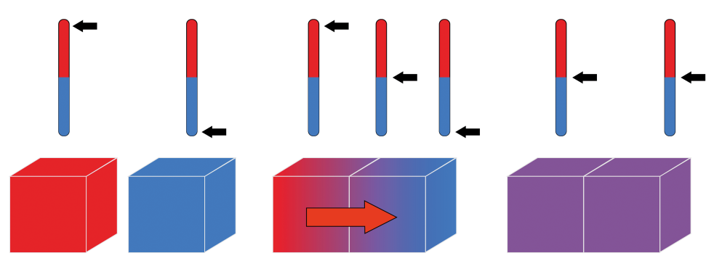
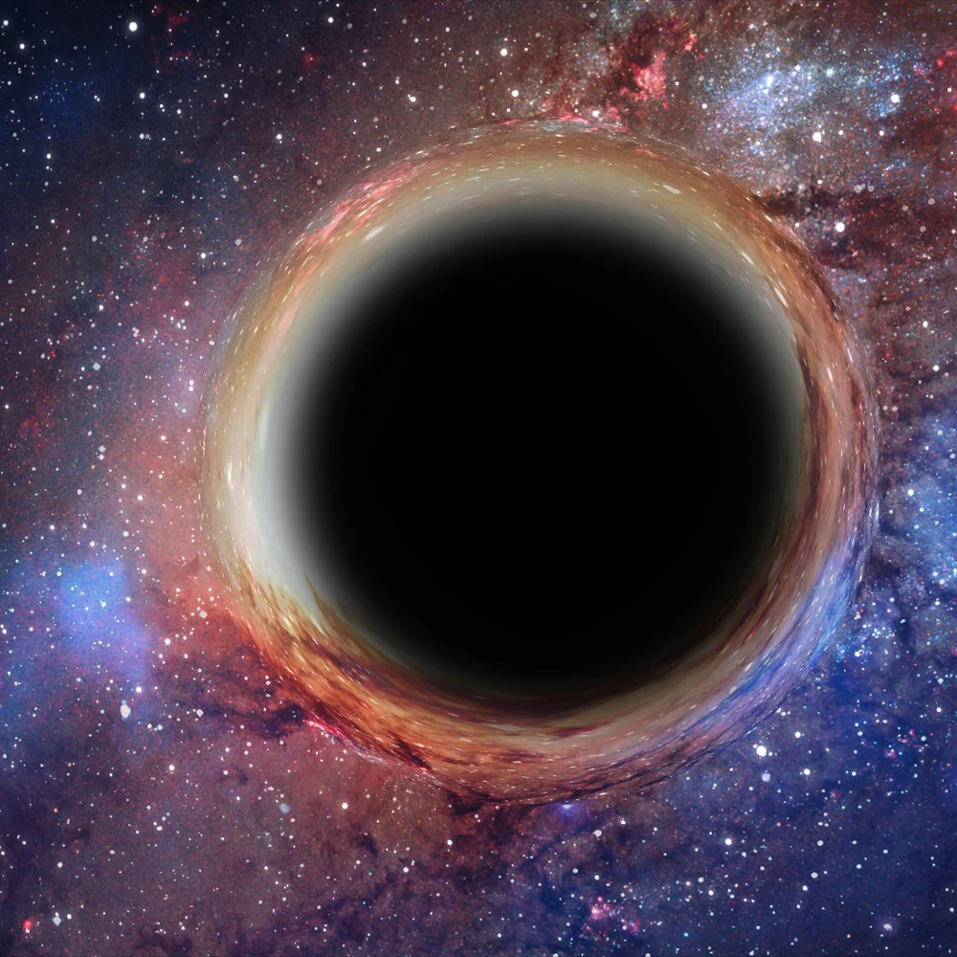
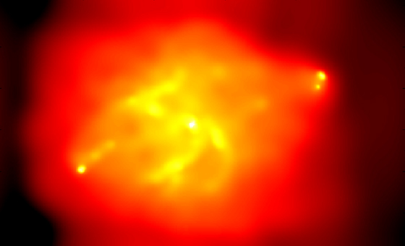
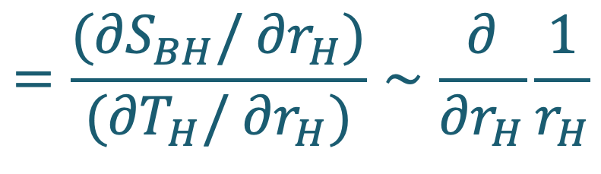
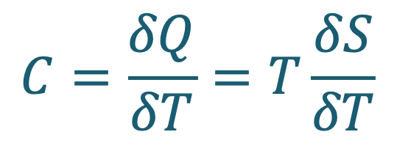
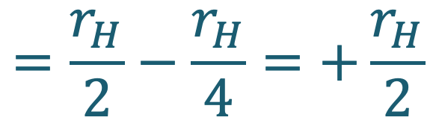
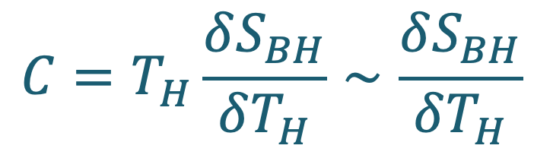
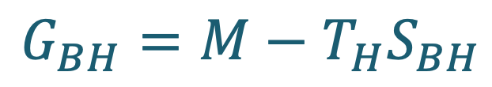
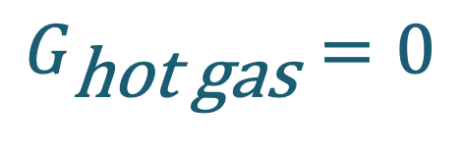
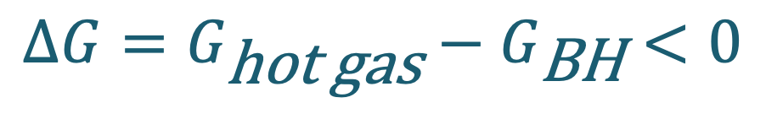
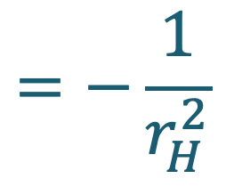
Black hole thermodynamics
Is it thermodynamically stable ?
Stability of black hole
Thermodynamic stability
Local stability
Positive heat capacity
$$C=\frac{δQ}{δT}=T\frac{δS}{δT}$$
Global stability
Negative free energy
$$ΔG=G_{\text{hot} \text{gas}}−G_{\text{BH}}<0$$
Heat capacity
$$C=T_{H}\frac{δS_{BH}}{δT_{H}}∼\frac{δS_{BH}}{δT_{H}}$$
$$=\frac{(∂S_{BH}/∂r_{H})}{(∂T_{H}/∂r_{H})}∼\frac{∂}{∂r_{H}}\frac{1}{r_{H}}$$
$$=−\frac{1}{r_{H}^{2}}$$
Negative heat capacity
Global stability
$$G_{\text{hot} \text{gas}}=0$$
$$=\frac{r_{H}}{2}−\frac{r_{H}}{4}=+\frac{r_{H}}{2}$$
Positive free energy
[1511.06963]
$$G_{BH}=M−T_{H}S_{BH}$$
Black hole is thermodynamic unstable.
It decays fast when its temperature differs from environment.
The black hole’s system cannot be formed to be black hole.
Is the black hole actually unstable ?
OR
There is something wrong about black hole’s entropy.

Slide 6
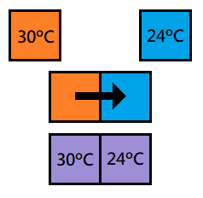
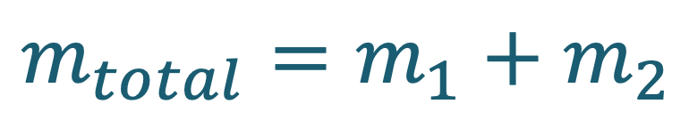
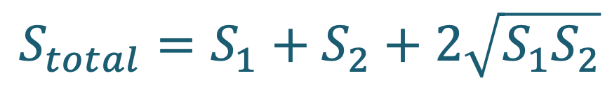
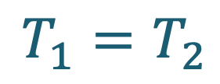
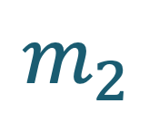
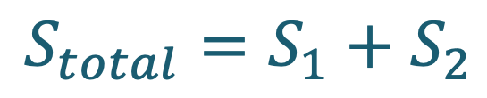
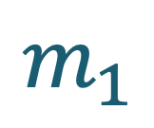


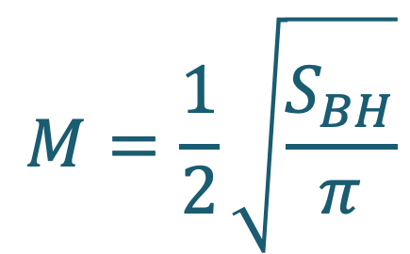
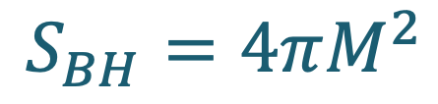

Thermodynamics inconsistency
Statistical entropy
Bekenstein-Hawking entropy corresponds to Gibbs-Boltzmann entropy.
Maxwell-Boltzmann statistics
$$M=\frac{1}{2}\sqrt{\frac{S_{BH}}{π}}$$
$$S_{BH}=4πM^{2}$$
$$S_{total}=4πM_{total}^{2}$$
$$=4π(M_{1}+M_{2})^{2}=4π(M_{1}^{2}+M_{2}^{2}+2M_{1}M_{2})$$
$$m_{1}$$
$$m_{2}$$
$$m_{total}=m_{1}+m_{2}$$
$$S_{total}=S_{1}+S_{2}+2\sqrt{S_{1}S_{2}}$$
Bekenstein-Hawking entropy is non-additive and non-extensive quantity.
$$S∝Area$$
Gibbs-Boltzman entropy is additive and extensive quantity.
$$S∝Volume$$
$$S_{total}=S_{1}+S_{2}$$
The Bekenstein-Hawking entropy seem to not correspond to Gibbs-Boltzman statistics.
The zeroth of thermodynamics needs additive entropy.
$$T_{1}=T_{2}$$
[1511.06963]

Slide 7
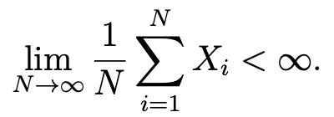
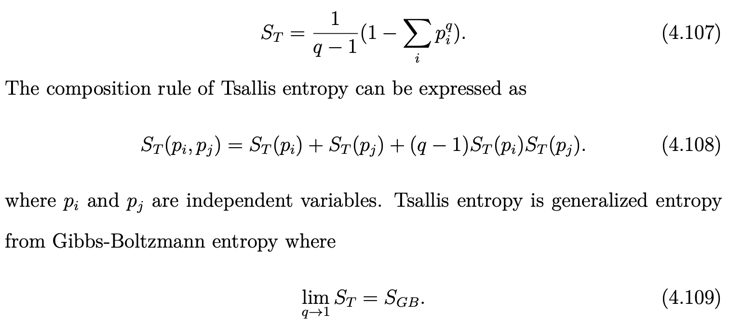
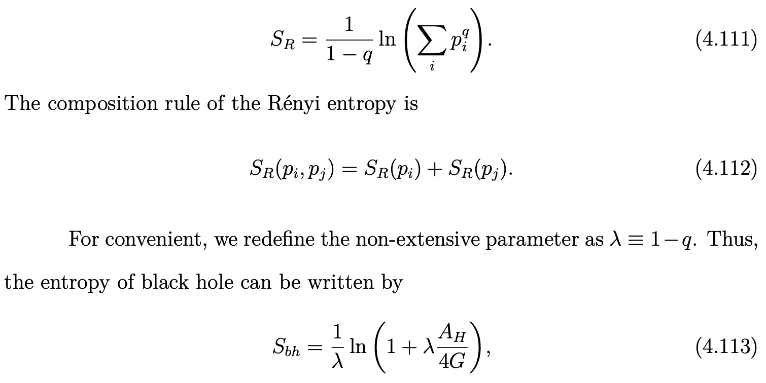


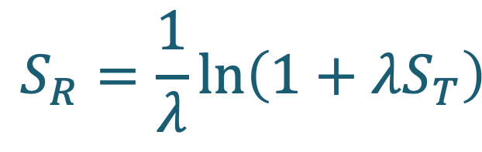
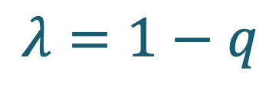
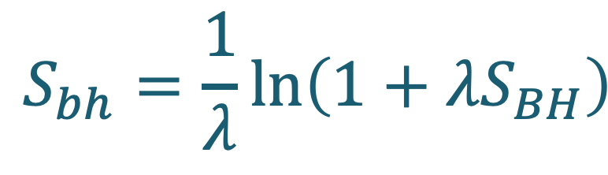

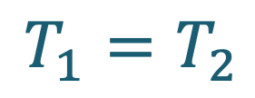
Black hole’s entropy through an non-extensive entropy
Non-extensive entropy
An extensive variable
Tsallis entropy
Additional rule
Bekestein-Hawking entropy
Tsallis entropy
$$S_{BH}∝Area$$
is non-extensive.
The zeroth law of thermodynamics is required.
$$T_{1}=T_{2}$$
Additive entropy
Renyi entropy
Additional rule
Black hole’s entropy
Renyi entropy
$$S_{R}=\frac{1}{λ}ln\left(1+λS_{T}\right)$$
$$S_{bh}=\frac{1}{λ}ln\left(1+λS_{BH}\right)$$
Additive
$$λ=1−q$$
The zeroth law of thermodynamics
[1511.06963]

Slide 8
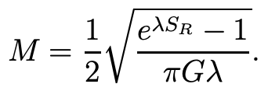









Black hole’s entropy through an non-extensive entropy
Thermodynamic stability
[2211.05989]
First law of black hole
Local stability
Positive heat capacity
Schwarzschild black hole is thermodynamic stable with Renyi entropy.
Global stability
[1702.05341]
Negative free energy
If we found the static black hole, then it might be thermodynamically described by Renyi entropy.
There is another black hole which is stable by Renyi entropy. That is (rotating) Kerr black hole.
[1511.06963]

Slide 9





Black hole’s entropy in Modified gravity
General Relativity
Modified Gravity
Wald’s entropy
Question : What is the statistics ?
Microscopic
Entropy
Macroscopic
$$S=k_{B}lnΩ$$

Slide 10





Conclusion
General Relativity
Black hole’s entropy
Bekenstein-Hawking entropy
Gibbs-Boltzmann entropy
Non-additive
Additive
Non-extensive
Extensive
Renyi entropy
Tsallis entropy
First law of thermodynamics
$$S_{R}=S_{R}(S_{T})=S_{R}(S_{BH})$$
Black hole is thermodynamically stable with this entropy.
What is the proper entropy of Black holes ?
Schwarzschild black hole
[1702.05341]
Kerr black hole
[1511.06963]
Schwarzschild-de Sitter black hole
[2501.04378]
Addition rule of Bekenstein-Hawking entropy
Addition rule of Tsallis entropy
!
There still be no statistical entropy which is consistent to Bekenstein-Hawking entropy.
Modified Gravity
Wald entropy
?
?
!
Additive
Extensive
There is no statistics behind the Wald entropy.

Slide 11

THANK YOU FOR YOUR ATTENTION

