Slide 1





EICROC status and plans
EAP 26 sep 2025
F. Bouyjou, H. Chanal, E. Delagnes, P. Dinaucourt, F. Dulucq, M. El Berni, S. Extier, M. Firlej, T. Fiutowski, K. Guillossou, F. Guilloux, M. Idzik, N. Kajkachi, B.-Y. Ki, A. Laffite, C. de La Taille, J. Moron, D. Marchand, C. Munoz, L. Royer, N. Seguin-Moreau, L. Serin, A. Sharma, A. Soulier K. Swientek, D. Thienpont, A. Verplancke

Slide 2
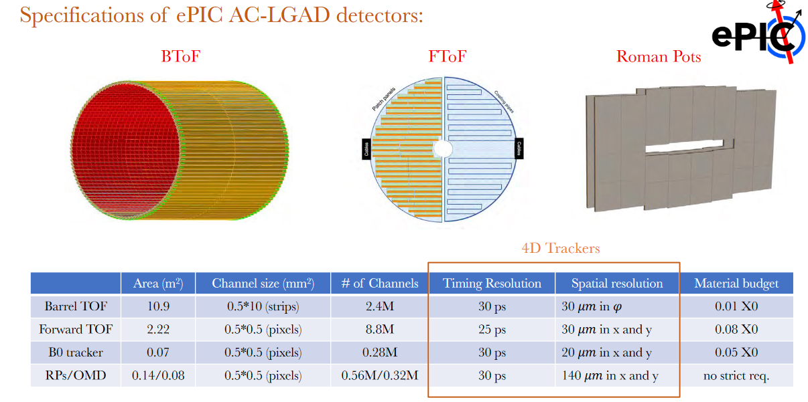
ePIC AC-LGAD detectors

Slide 3
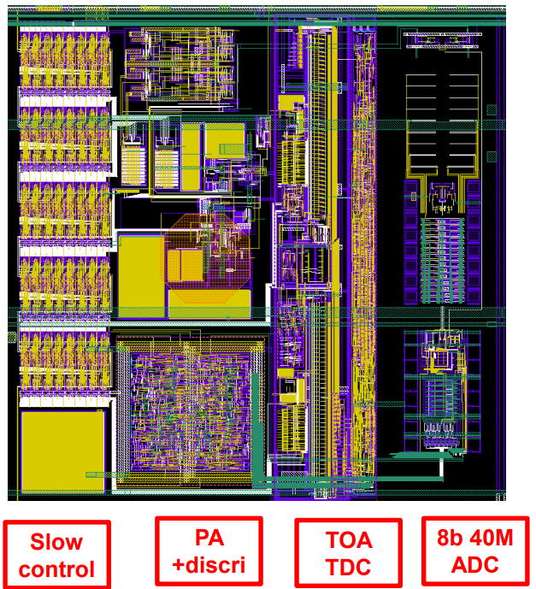
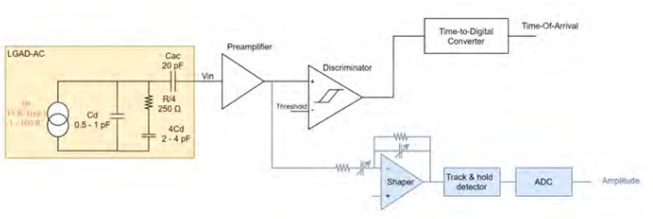

EICROC0
Analog frontend similar to ATLAS ALTIROC but 0.5x0.5 mm²
  Cd = 1 pF (max 3 pF)
ADC instead of ToT for charge measurement : 8bit 40 MHz from AGH Krakow
TDC taken from HGCROC by CEA Saclay
Simple digital readout but SEE-proof I²C slow control
~2 mW/pixel
Fabricated in spring 2022 in TSMC 130nm

Slide 4
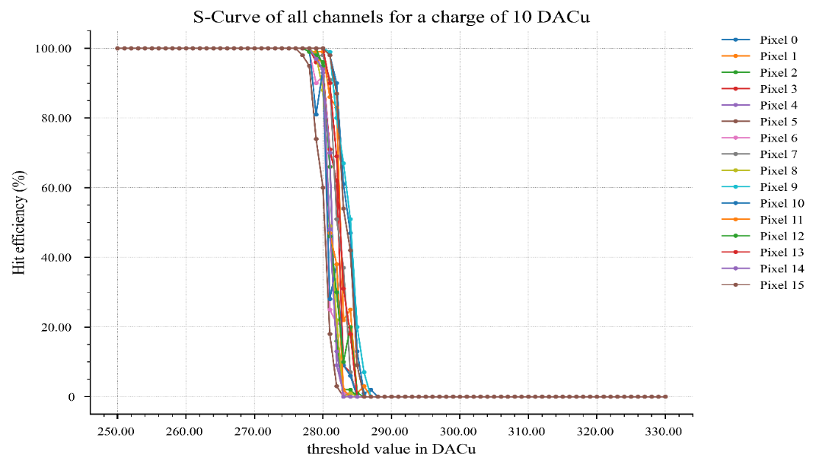
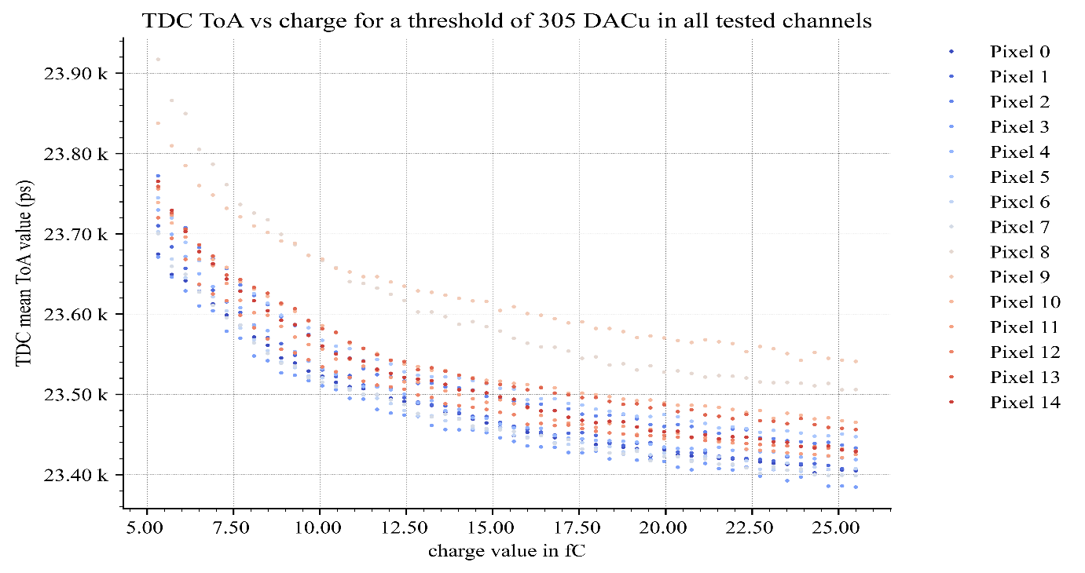
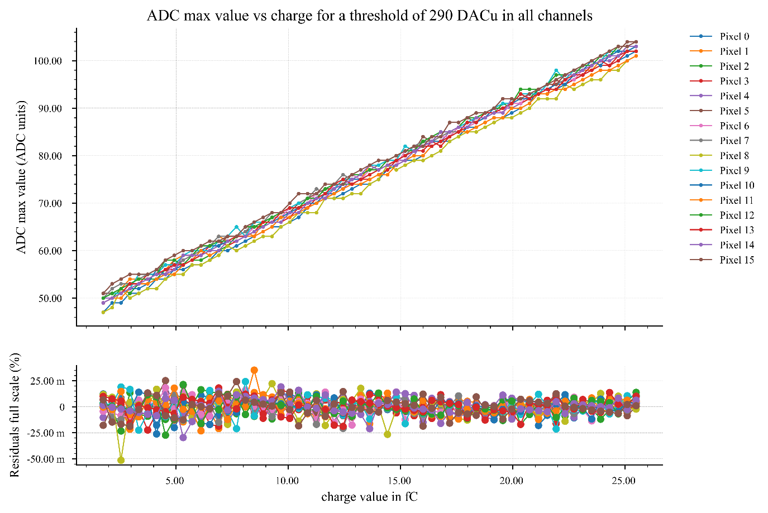
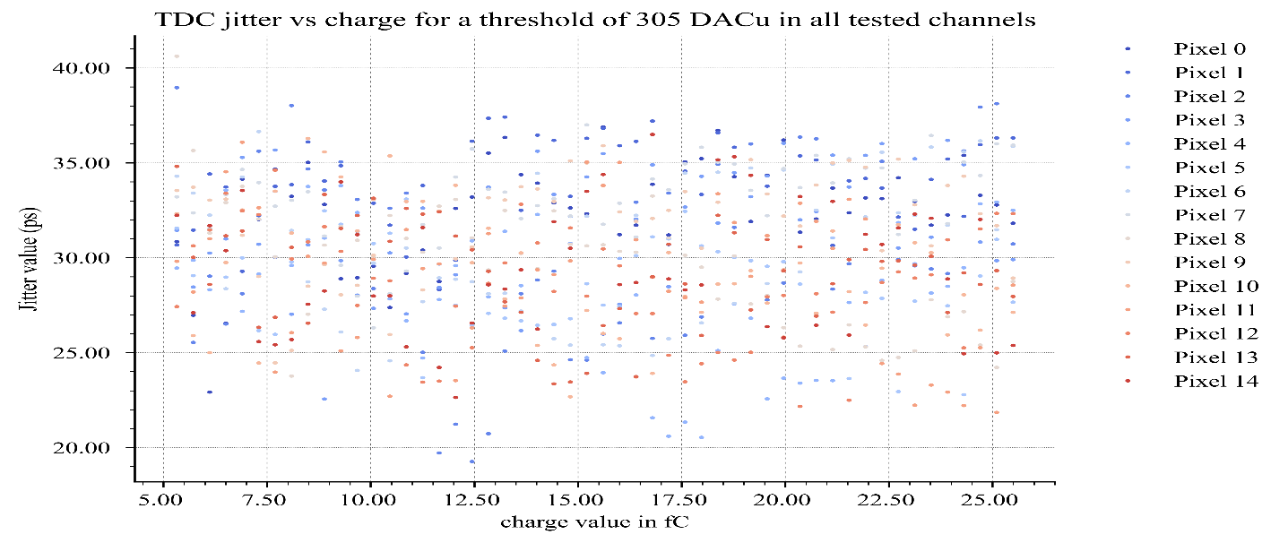
EICROC0 performance (ASIC alone) [A. Verplancke]

Slide 5
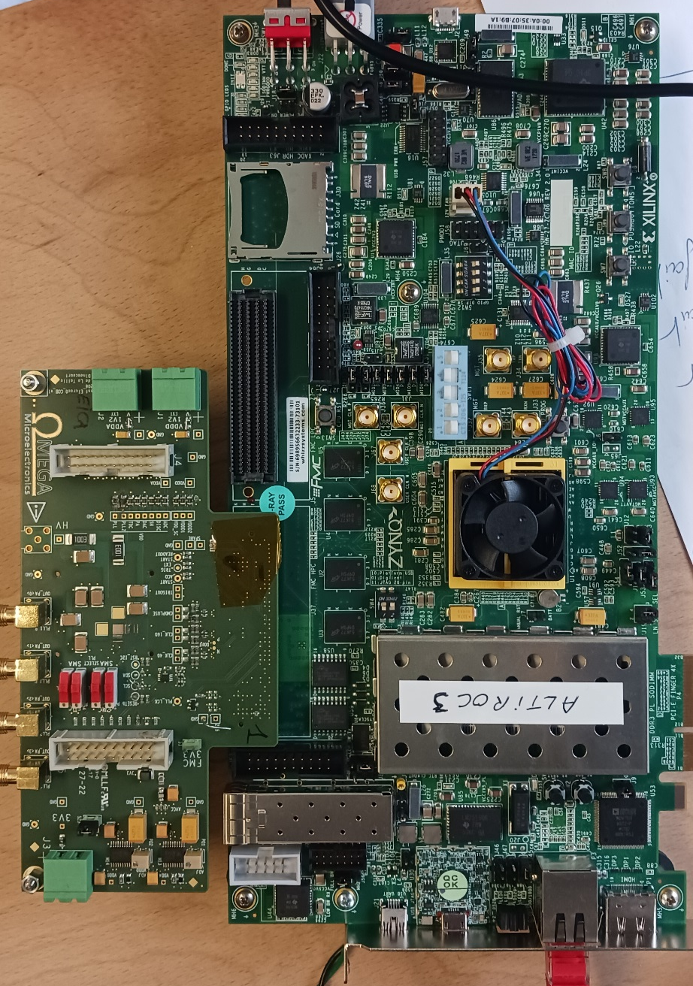
2025 : EICROC0 variants
EICROC0A : same as EICROC0 with more testability
  Each pixel can be by-passed by SC (clock is then turned off)
  Buffers in SC to allow extension to 4x32
  Larger dynamic range in pulse injection
EICROC0B (4x4)
  Same preamp/discri/TDC/integrator
  ADC and driver replaced by peak sensing and Wilkinson ADC
  Currently ADC path ~1 mW/ch becomes 200 uW/ch
EICROC1A : 4x32
  Same I/Os than EICROC0, same testboard
Will be fabricated with EICROC1 below

Slide 6
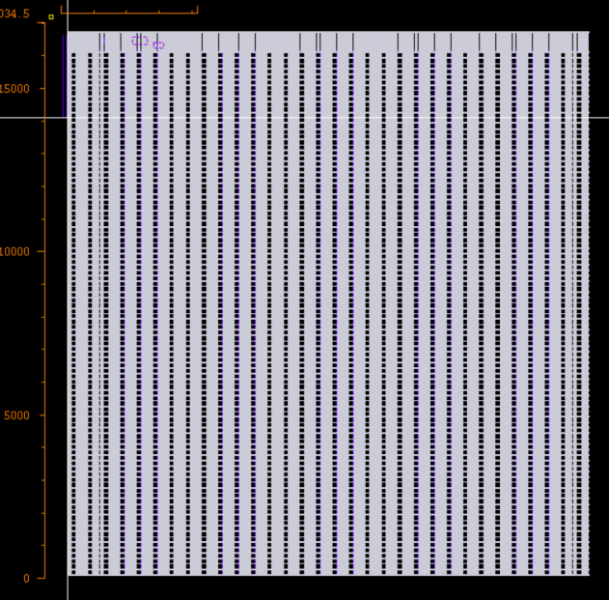
2025 : EICROC1
32x32 chip : final dimensions
Goal :
  test full-scale chip analog performance (IR drops)
  Allow final sensor characterization
  Test interface with DAQ : fast commands and 320 Mb/s data output
  Progress on module/front-end boards
Caveats ;
  Not (yet) zero-suppressed data
  Still 2mW/ch
  Still analog-on-top

Slide 7
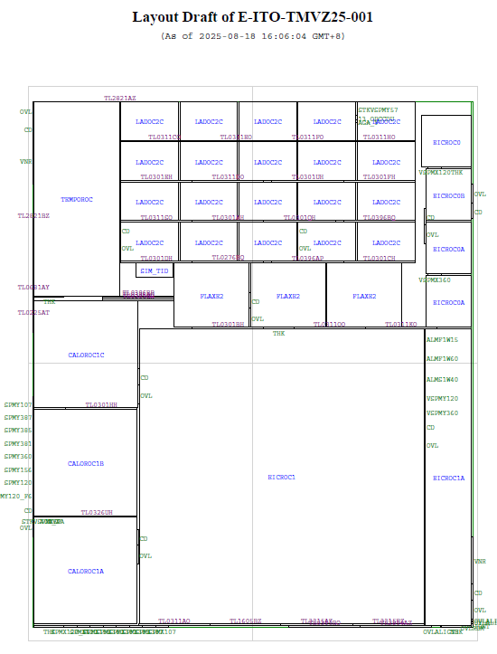
EICROC reticle 2025
EIC/ATLAS engineering run (may 25)
  Just started this week (long administrative issues)
EIC chips 63% of wafer area
  EICROCs 48% = 130 k€
  100 k€ of EICROC1 paid by ANR
  Rest paid by 2024 money
chip | area | Fraction | # |  | cost
CALOROC1A/B/C | 113,807 | 15,3% | 3 | C4 | 40 500 €
EICROC0/A/B | 27,807 | 3,7% | 3 | WB | 9 895 €
EICROC1 | 283,860 | 38,0% | 1 | WB | 101 015 €
EICROC1A | 47,810 | 6,4% | 1 | WB | 17 014 €
LADOC2C | 160,992 | 21,6% | 20 | WB | 57 291 €
TEMPOROC3 | 56,927 | 7,6% | 1 | C4 | 20 258 €
FLAXE2 | 52,650 | 7,1% | 3 | WB | 18 736 €
SM_TID | 2,170 | 0,3% | 1 | WB | 772 €
Total | 746,022 | 100% | 33 | 0 | 265 482 €

Slide 8
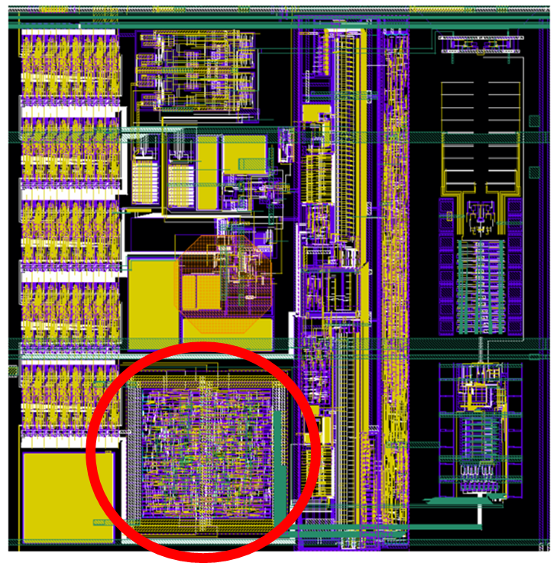
Future EICROC2 (2026)
What is missing in EICROC1 ?
  Larger rate compatibility ?
  Derandomizer for successive events (how many ?)
  Digital on Top (DoT) design for digital power reduction and timing verification on large area : more powerful tools available (UVM)
  Auto-trigger and zero_suppressed data
  Power reduction if possible down to ~1 mW/ch
Our colleagues from Clermont Ferrand now joining to help on the DoT
  Already participated in ATLAS ALTIROC
  The design and verification should take ~1 year from now
Technology choice ?
  Depends mostly on rate estimates and complexity of digital

Slide 9
2026 : requests and plans
Test of EICROCO/A/B/1/1A
  Chips should arrive end 2025. Dicing and bonding to foresee
  Testboards and test equipment (5 k @LPC)
  Tests with sensors (Ijclab/BNL)
Design of EICROC2 with Clermont
  Simulations, choice of technology
  Prototype analog blocks EICROC0 in 65 nm (MPW 3x3 mm² = 9*4190€ ~ 40 k€ via ANR)
  Travel to/from Clermont
Start to send the money to CERN for the next engineering run
  300 k€ in 130nm and/or 650 k€ in 65 nm
Travels : (5+2) persons/2 and 2 meetings/yr = 12 k€ Ω + 3 k€ LPC

Slide 10
EICROC timeline & FTEs
Sept 2025 : EICROC1 fabrication
2026 : test of EICROC1 and design of EICROC2 DOT + EICROC0/65n
Beg 2027 : fabrication of EICROC2
Mid 2027 : test of EICROC2
2028 : more system tests and possibility for an iteration EICROC3
2029-2030 : fabrication (6 wafers are enough for RPs)
FTEs
  Design : 2-3 OMEGA + 2-3 LPCF : 2026-2031 + 0.25 IRFU
  Test : 1 OMEGA + 1 LPCF
  Production test on wafer : to be subcontracted

Slide 11
summary
EICROC now reached full scale 32x32 with EICROC1
  Important for analog performance and sensor test
  Also allows to progress on system design (1 yr of tests foreseen = 2026)
Small scale EICROC0s 4x4 still under test to improve performance and reduce power
  Foresee also version in 65n in case digital does not fit in 130n
EICROC2 now needs its digital design : ~1 year design time from now
  With the most welcome help from LPC Clermont Ferrand
  Main driving specification is the hit rate : 50 Hz/pixel OK ?
  Engineering run foreseen Q1 2027
Administrative agreement to pay for the runs should be handled by IN2P3
  We lost 6 months in 2025 due to administrative delays…

Slide 12
backup

Slide 13
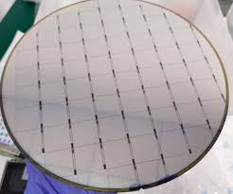
Path towards production and QC
For roman pots ~500 chips would be needed (500 k ch) = 6 wafers
  Small quantity (200 wafers done for ATLAS or CMS)
Final version would be an EICROC3 to fix possible bugs in EICROC2
  ~1 year after EICROC2 tests and system tests complete
Wafer probing station and test setup will be needed
  Can be inspired from ALTIROC setup

Slide 14
EICROC1 max rate
Payload and readout speed
  Each pixels provides 8 samples of 24 bits (12b TDC 12b ADC) at 40 MHz + header
  200 bits * 25 ns = 5 us/pixel
  128 pixels * 5 us = 640 us => ~1.5 kHz maximum rate per block of 4x32 ~10 Hz/pixel
  Same rate for full chip with serialized 320 MHz output
  Spec is 15 Hz/pixel (max 28 Hz)
Future improvements
  Payload reduction to 12b TD C + 5 samples of 8b ADC = 64 bits => ~30 Hz/pixel max rate
  Zero-suppression : read only channels with hits and their (4-8) neighbours (for barycenters)
  With 1 hit/column gives ~10 improvement => ~300 Hz/pixel max rate
  A derandomizer would also be needed

Slide 15
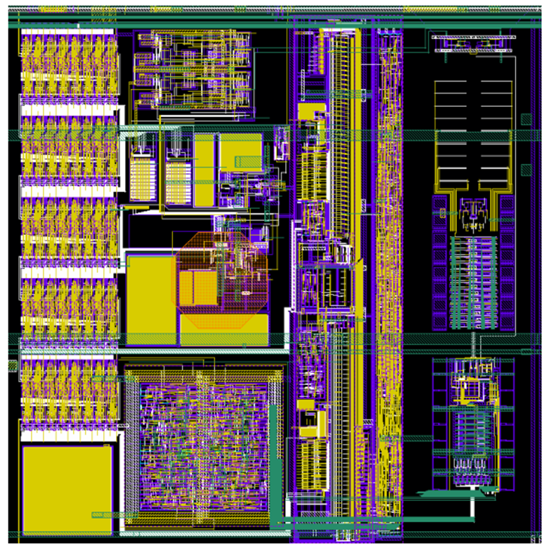
Technology choice 65/130n
Little impact on analog/digital performance
  Analog similar in 65/130
  Possibly more significant on TDC
  Digital much simpler than LHC chips
Update of digital part
  Little space available => main reason for 65 !
sizeable cost impact : ER 700 k$ vs 300 k$
  But possibly more partners (but EICROC 50% of reticle)
Prepare for design in 65 nm
  Make an EICROC0/65n to test analog part and TDC

Slide 16
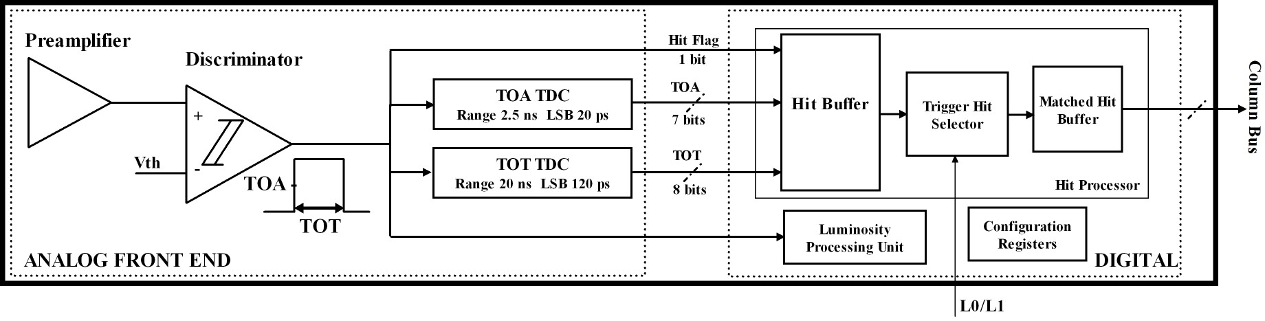
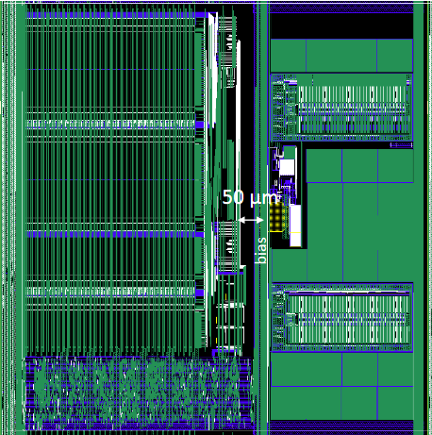
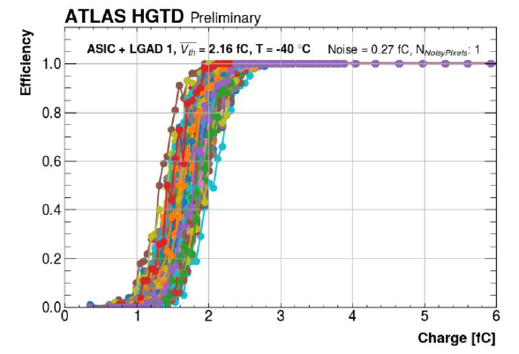
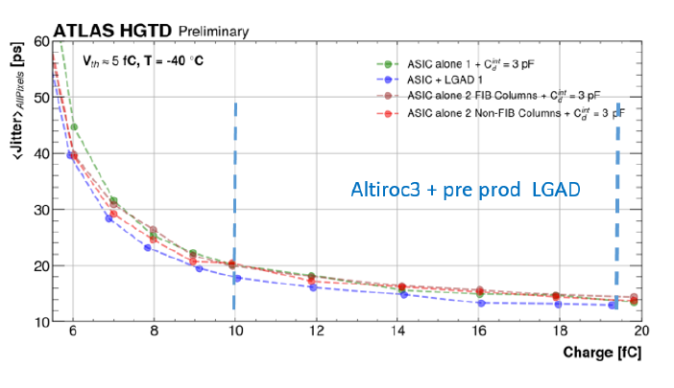
ALTIROC pixel scheme and layout
1 GHz preamplifier and discriminator
2 vernier TDCs for ToA and ToT
Hit buffer: SRAM 1536 x 19 bit (38 µs latenccy)
One pixel : 1.3x1.3mm²

Slide 17
Chips versions
Chip | date | Techno | size | Analog | Digital | goal
EICROC0 | Jun 2023 | 130n | 4x4 | Conservative | Simple | Study sensor
EICROC0A/B | beg 2025 | 130n | 4x4 | Low power | same | Study analog
EICROC1 | beg 2025 | 130n | 32x32 | Conservative | Same | Study power distribution
EICROC0_65n | end 2025 | 65n | 4x4 | final | Simple | Study analog in 65n
EICROC2 | End 2026 | ? | 32x32 | Low power | Final | First final prototype
Chip | date | Techno | size | Analog | Digital | goal
CALOROC1A | beg 2025 | 130n | 36ch | Conservative | Final | Study sensor
CALOROC1B | beg 2025 | 130n | 36ch | Low noise | final | Study analog
CALOROC2 | End 2026 | 130n | 36/72 | final | final | First final prototype

