Slide 1



Design of a sub-0.5 mm resolution PET using GATE with staggered 3-layer DOI detectors
2025 IEEE NSS/MIC in Yokohama
GATE User Meeting
Han Gyu Kang¹, Hideaki Tashima¹, and Taiga Yamaya¹
1. National Institutes for Quantum Science and Technology (QST), Japan
kang.hangyu@qst.go.jp
Date: Thursday, 6-Nov-2025
Time: 13:15-13:30 (12 min presentation + 3 min Q&A)
Place: G216 on Level 2, PACIFICO Yokohama North building
Session: GATE User Meeting
Notes:
Good afternoon. I’m Han Gyu Kang, a researcher at QST in Japan.
It is my great pleasure to present my research works in this session.
The title of my presentation is “Design of sub-0.5 mm resolution PET using GATE with staggered 3-layer DOI detectors”.

Slide 2
Outline
Factors affecting PET resolution
Optimal design of a sub-0.5 mm resolution PET
Preliminary experimental results
Conclusions
Notes:
Here is the outline.
First, I’ll explain the factors affecting PET resolution.
Second, I’ll present the optimal design of a sub-0.5 mm resolution PET.
Third, I’ll be presenting the preliminary experiment results such as front-end electronics and PET gantry design.
Lastly, I’ll summarize my presentation and discuss the future plan

Slide 3
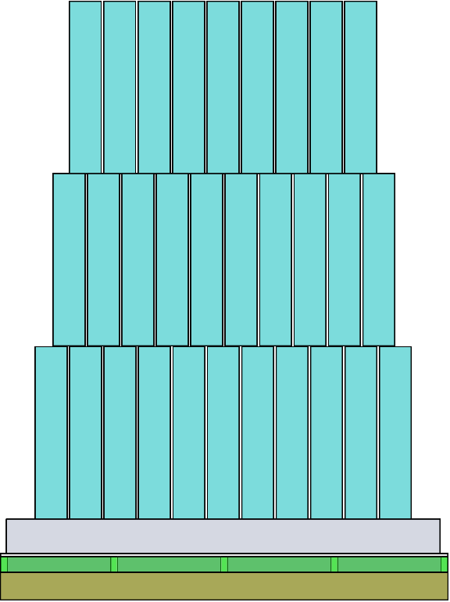
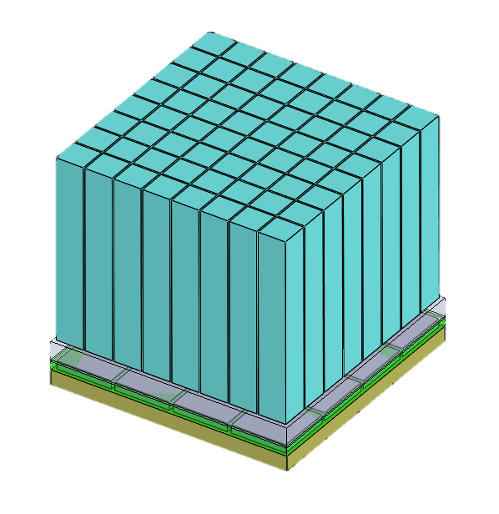
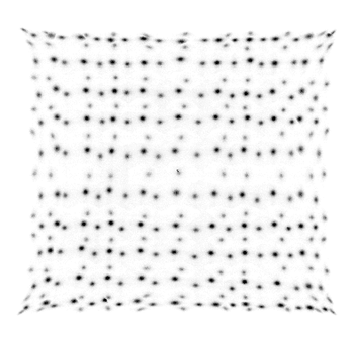
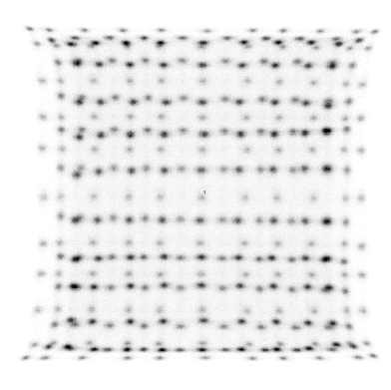
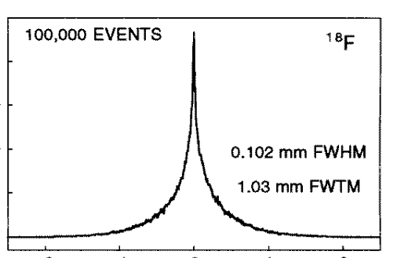
Factors affecting the PET resolution
Photo sensor
② Acollinearity
Crystal
Scintillation detector
④ Crystal pitch
③ Parallax error
⑤ Block effect
ESR
Crystal
BaSO₄
Ring diameter
β⁺
e⁻
① Positron range
Photo sensor
β⁺
Positron
e⁻
Multiplexing
Electron
Annihilation（511 keV）
A PET scanner that considered these factors
$$Resolution=1.25\sqrt{{\left(Positron range\right)}^{2}+{\left(Acollinearity\right)}^{2}+{(Parallax error)}^{2}+ {\left(Crystal pitch/2\right)}^{2}+{\left(block effect\right)}^{2}}$$
¹⁸F
Small ring diameter
(e.g. <50 mm)
Depth encoding
(e.g. 3-layer)
Fine crystal pitch
(e.g. <1 mm)
Opaque reflector
(e.g. BaSO₄)
Solution>
0.1 mm FWHM
Notes:
This slide illustrates the factors affecting the PET resolution.
PET resolution is defined as a convolution of several different factors as shown in this equation.
The first factor is the positron range which has about 0.1 mm in full width at half maximum for F-18.
The second factor is acollinearity which can be reduced by using small ring diameter of less than 50 mm.
The third factor is parallax error, in which the radial resolution is blurred at the periphery of a PET FOV.
The parallax error can be reduced by using depth encoding detectors such as staggered 3-layer configuration.
The most important factor is the crystal pitch, which dominates the overall PET resolution.
The PET resolution can be substantially enhanced by using fine crystal pitch of 1 mm or even smaller.
To encode a large amount of finely pixelated crystal array, multiplexing readout is commonly used.
However, for multiplexing readout, the block effect arises thereby degrading the crystal decoding accuracy.
The block effect can be effectively reduced by using optically opaque reflector such as barium sulfate powder rather than using the ESR film.
Last year, we developed a PET scanner that addressed these issues to achieve submillimeter-resolution.

Slide 4
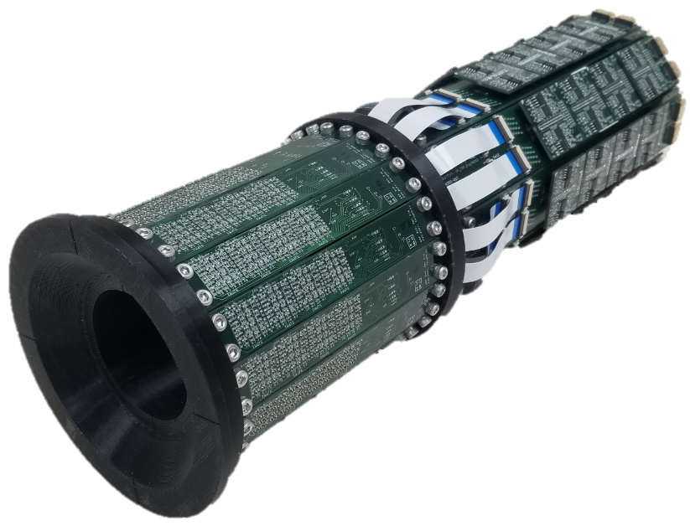

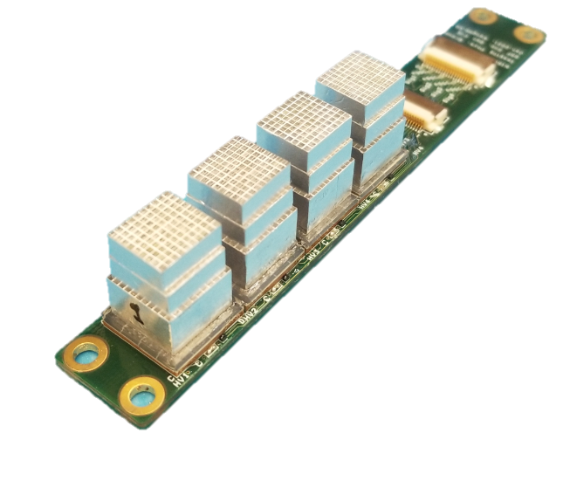
SR-PET achieved 0.55 mm resolution (2022 MIC)
PET image
SR-PET (Submillimeter-Resolution PET)^{[2]}
0.8
Goal: Design of a Sub-0.5 mm Resolution PET with 3-layer DOI detectors
0.75
0.85
Pitch=1 mm
1st layer
2nd layer
0.55
0.45
3rd layer
Axial FOV
=51.5 mm
0.5
SR-PET achieved the 0.55 mm resolution
Sub-0.5 mm resolution was NOT achieved due to
Large crystal pitch
Unoptimized crystal layer
[2] Kang et al., 2023 Journal of Nuclear Medicine
Crystal pitch = 1 mm
Crystal layer = 4+4+7 mm (1st+2nd+3rd)-> DOI
Notes:
The submillimeter-resolution PET, which is named as SR-PET has a 1 mm crystal pitch.
The 3-layer LYSO crystal arrays were stacked with staggered configuration to encode DOI information.
With the SR-PET, a resolution approaching 0.5 mm was achieved in a phantom study.
However, sub-0.5 mm resolution was not achieved due to the large crystal pitch and unoptimized crystal layer.
Therefore, the goal of this study is to design a sub-0.5 mm resolution PET with 3-layer DOI detectors.

Slide 5
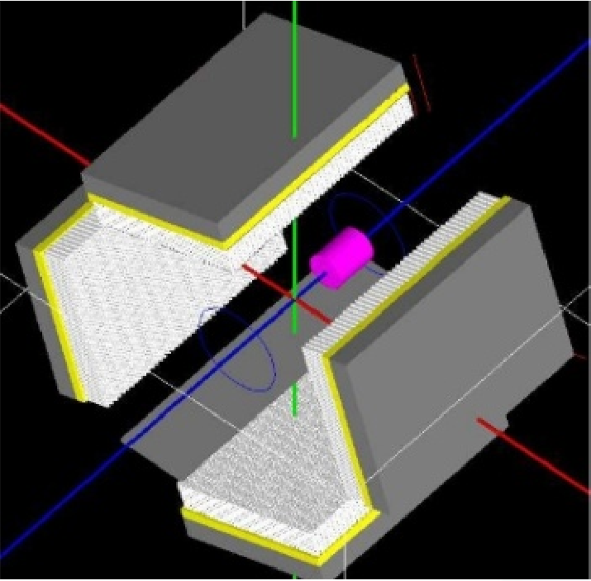
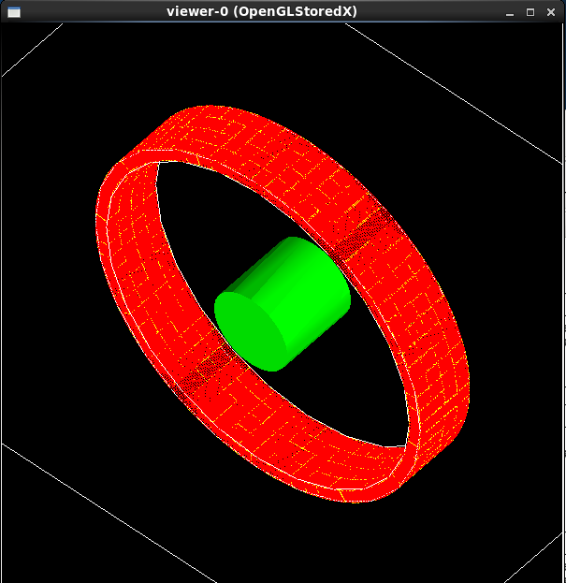
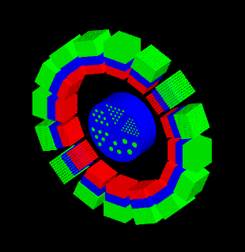
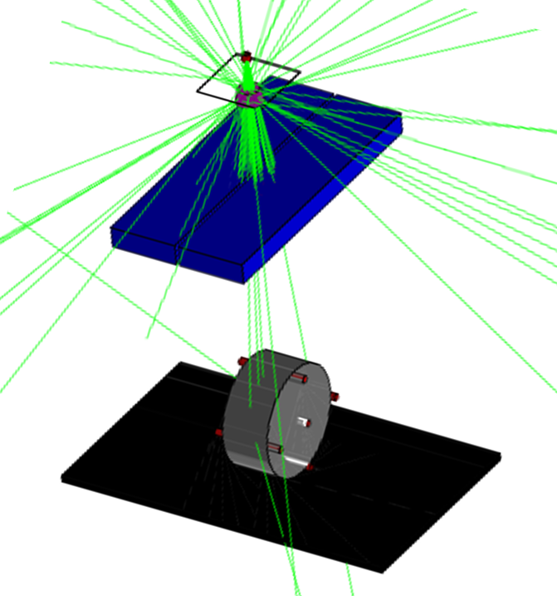
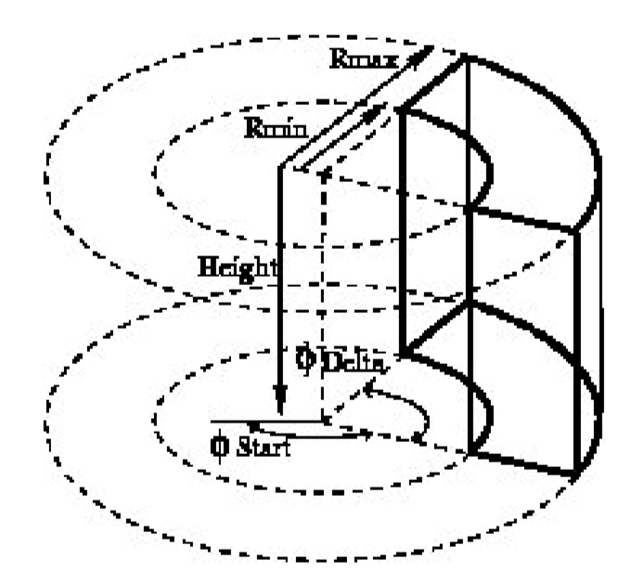
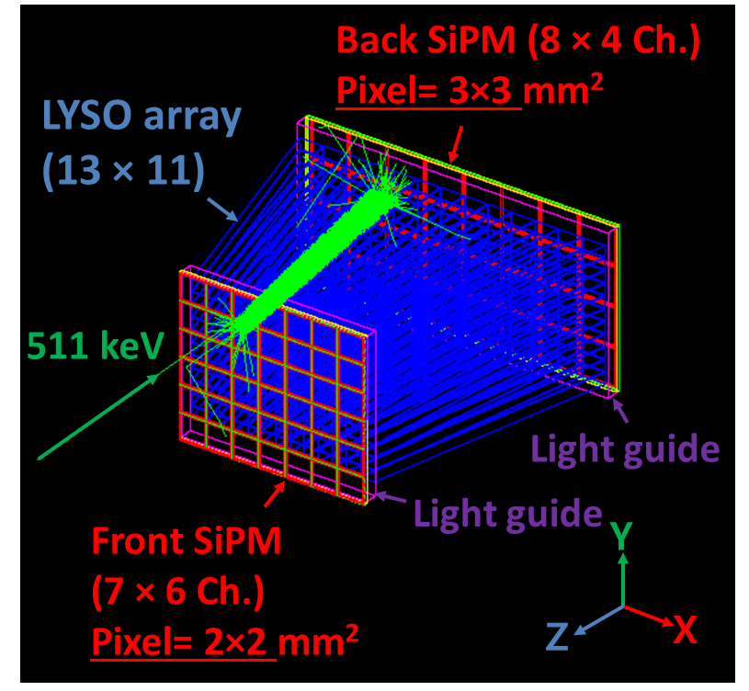
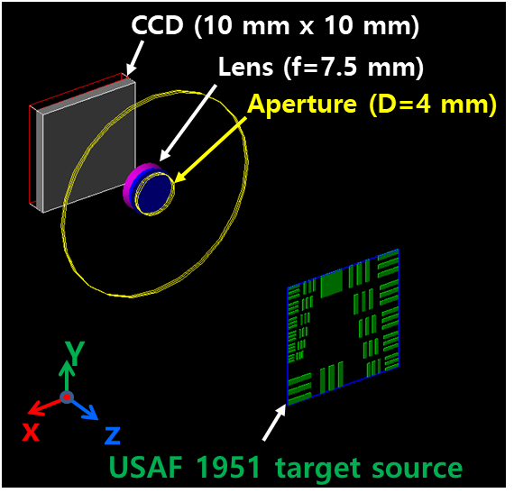
Predefined PET systems in GATE
SPECThead
ECAT
CylindricalPET
PETscanner
CTscanner
Scanner
Optical System
SPECThead
ecat
cylindricalPET
PETscanner
CTscanner
scanner
OpticalSystem
crystal
block
rsector
level1
module
level1
crystal
pixel
crystal
module
level2
cluster
level2
pixel
crystal
level3
pixel
level3
layer0
level4
level4
layer1
level5
level5
No DOI
2-layer DOI
3-layer DOI
Notes:
GATE provides various types of predefined PET systems such as ECAT, CylindricalPET and PET scanner.

Slide 6
Predefined PET systems in GATE
SPECThead
ECAT
CylindricalPET
PETscanner
CTscanner
Scanner
Optical System
SPECThead
ecat
cylindricalPET
PETscanner
CTscanner
scanner
OpticalSystem
crystal
block
rsector
level1
module
level1
crystal
pixel
crystal
module
level2
cluster
level2
pixel
crystal
level3
pixel
level3
layer0
level4
level4
layer1
level5
level5
PETscanner was used for 3-layer DOI PET
Notes:
Here, we used the “PETscanner” for the simulation of the 3-layer DOI PET scanner.

Slide 7
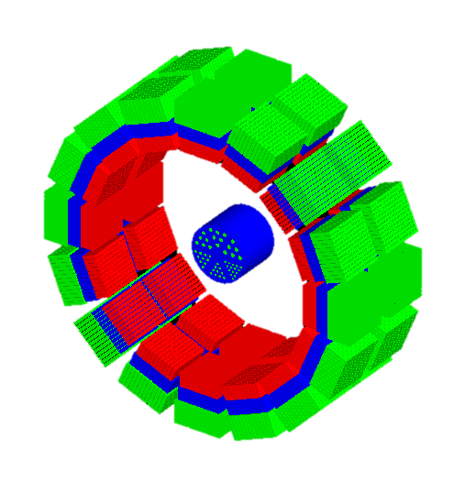

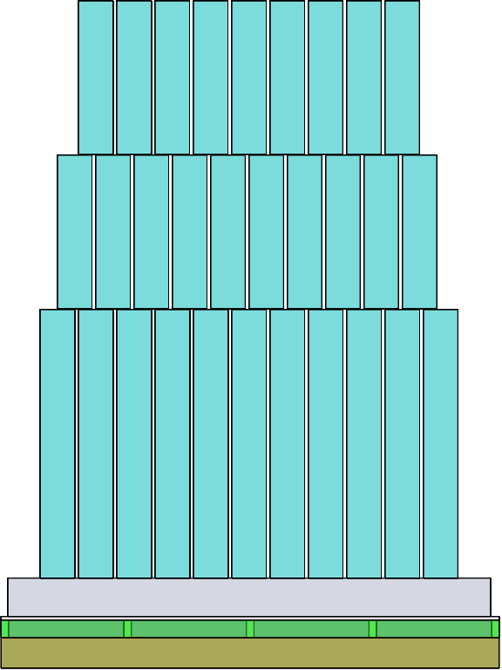
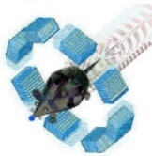
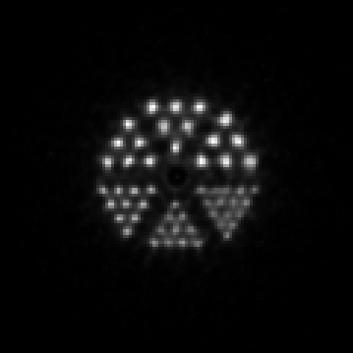

From GATE simulation to image reconstruction
GATE PET simulation
Block (level1ID)
1st (level2ID)
2nd (level3ID)
Image Reconstruction
(In house software*)
3rd (level4ID)
Reconstructed PET image
10 mm
ROOT output
0.8
0.75
0.85
List-mode data
Block ID
Crystal ID
DOI ID
0.55
0.45 mm
0.5
Custom-written code
E.W=440-560 keV
GATEv9.1
*Developed by Dr. Hideaki Tashima (QST)
Notes:
This slide shows the procedure from the GATE simulation to image reconstruction.
First, we conducted the GATE PET simulation with 3-layer DOI detector configuration.
Second, the ROOT output file was imported by using a custom-written ROOT code to generate list-mode data.
An energy window of 440 to 560 keV was used.
Lastly, the list-mode data were reconstructed by using an in-house software developed in our lab.

Slide 8
Sub-0.5 mm resolution PET design
Notes:
First, let me describe PET design.

Slide 9
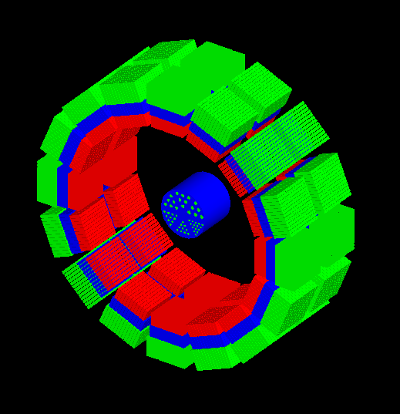
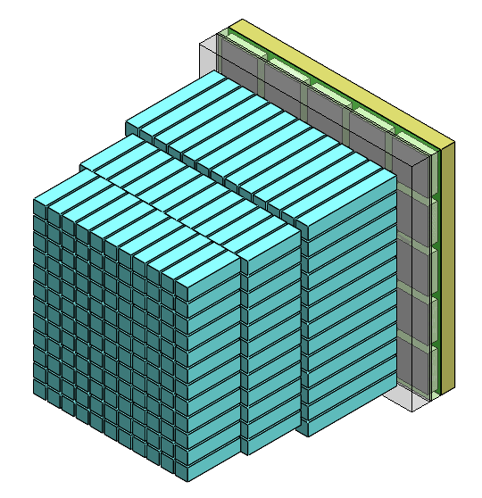
Sub-0.5 mm resolution PET
<3D view of the PET>
<Staggered 3-layer DOI detector>
SiPM (5 × 5 array)
Lightguide
2.4 mm
14×14
13×13
Phantom
13×12
LYSO array
3rd layer
Crystal pitch
=0.8 mm
2nd layer
ID=48 mm
23.4 mm
1st layer
Notes:
The PET scanner has an inner diameter of 48 mm and axial coverage of 23.4 mm.
The PET scanner has two rings, each of which has 16 DOI detectors.
Each DOI detector consists of 3-layer LYSO crystal array to encode DOI information.
The crystal pitch was 0.8 mm to achieve sub-0.5 mm resolution.
The 3-layer LYSO array was optically coupled to an SiPM 5x5 array with a pitch of 2.4 mm.
A 1 mm thick lightguide was inserted between the crystal and SiPM.

Slide 10
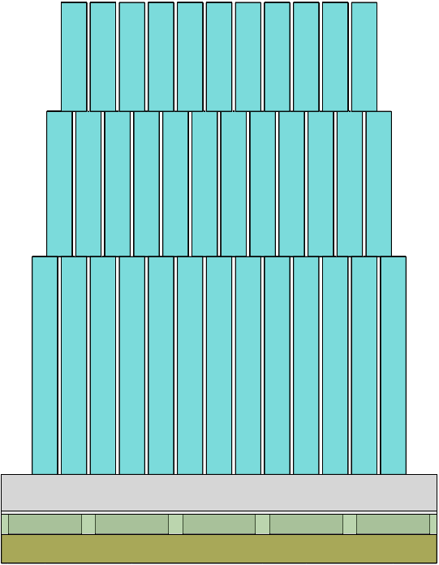
Crystal layer designs
(A) 4+4+7 mm
(B) 3+4+4 mm
(C) 3+3+5 mm
1st layer
4 mm
15 mm
1st layer
1st layer
2nd layer
4 mm
3 mm
3 mm
11 mm
11 mm
2nd layer
4 mm
2nd layer
3 mm
3rd layer
7 mm
3rd layer
4 mm
3rd layer
5 mm
SiPM 5×5 array
SiPM 5×5 array
SiPM 5×5 array
Notes:
We used three different crystal layer designs.
The first design-A has the crystal thickness of 4, 4 and 7 mm for the 1st, 2nd, and 3rd layers thereby resulting a total thickness of 15 mm.
The second design-B has the crystal thickness of 3, 4 and 4 mm, resulting in a total thickness of 11 mm.
The design-C has the crystal thickness of 3, 3 and 5 mm for the 1st, 2nd, and 3rd layers.
The relatively short crystal thickness was used for the design B and C to improve the DOI resolution at the expense of sensitivity.
The crystal thickness of each layer was chosen to make a uniform detection efficiency for each layer.

Slide 11
Spatial resolution
Notes:
Let me move on to spatial resolution

Slide 12
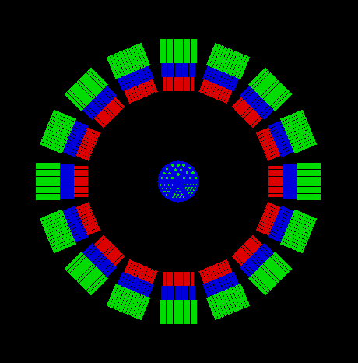
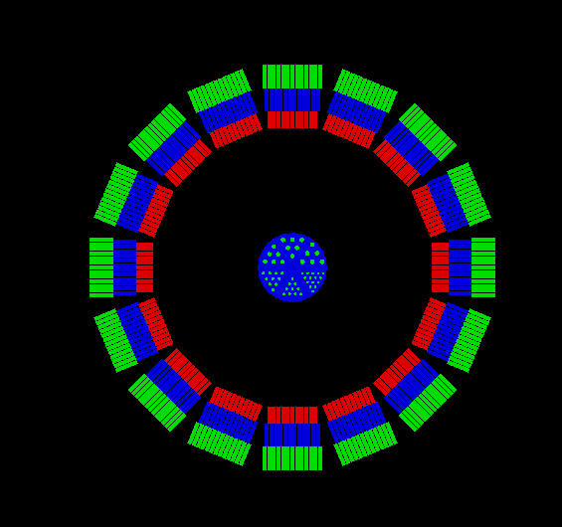
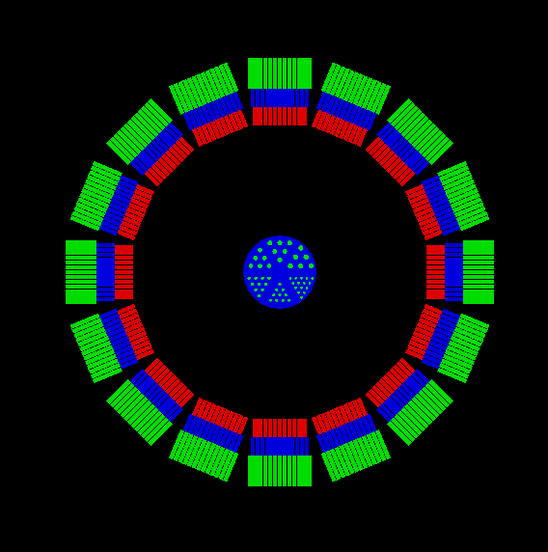
Spatial resolution with the NEMA ²²Na sources
(A) 4+4+7 mm
(B) 3+4+4 mm
(C) 3+3+5 mm
5 mm
²²Na source
²²Na source
²²Na
15 mm
15 mm
15 mm
11 mm
48 mm
11 mm
48 mm
15 mm
52.5 mm
Sensitivity
1.61%
1.29%
1.32%
E.W=440-560 keV
Notes:
The spatial resolution was evaluated by using a NEMA Na-22 source with a diameter was 0.25 mm.
The Na-22 sources were placed from the center to radial offset position of 15 mm with a spacing of 5 mm.
The spatial resolution was evaluated for three different crystal layer designs of A, B, and C.

Slide 13
Spatial resolution (FBP)
(a) Radial FWHM
(b) Radial FWTM
Design C showed the most uniform spatial resolution up to the radial offset of 15 mm
Notes:
This slide shows the spatial resolution as a function of radial offset.
Design C showed the most spatial resolution up to the radial offset of 15 mm.
The full width at tenth maximum was over 1 mm for all designs.
Design C provided uniform FWTM across the radial offset.

Slide 14
Resolution phantom imaging
Notes:
Let me move on to the resolution phantom imaging.

Slide 15

Resolution phantom imaging
<3D view of the PET>
Resolution phantom
0.8
0.75
0.85
Phantom
10 mm
0.55
11.9 mm
0.45 mm
11.9 mm
0.5
ID=48 mm
23.4 mm
Total activity of ¹⁸F= 0.95 MBq
Acquisition time = 10 min
Notes:
To evaluate imaging performance, a resolution phantom was placed at the center of the FOV.
The phantom has an outer diameter of 11.9 mm, and axial length of 10 mm.
The resolution phantom has 6 different sections, and the smallest rod diameter was 0.45 mm.
All the rods of the phantom were filled with 18F of 0.95 MBq.
The acquisition time was 10 min.

Slide 16
Normalization by rotating a ⁶⁸Ge source
Normalization
⁶⁸Ge cylindrical source
Diameter: 2 mm
Length: 23.4 mm
Activity: 0.72 MBq
Scan time: 2 hr
⁶⁸Ge
20.4 mm
Notes:
For normalization a cylindrical 68Ge source with an activity of 0.72 MBq was used.
Coincidence events were obtained for 120 min during the rotation of the source.

Slide 17
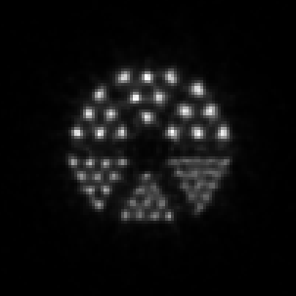
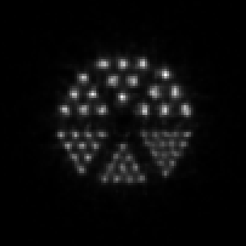
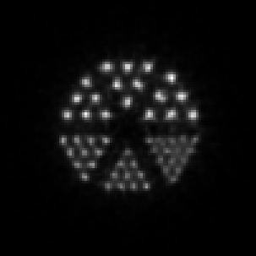



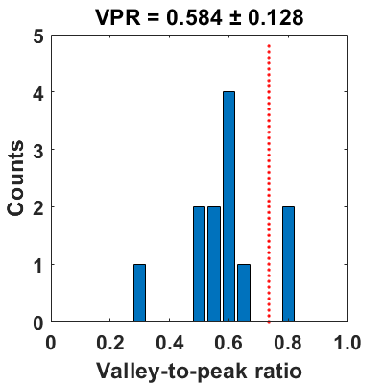
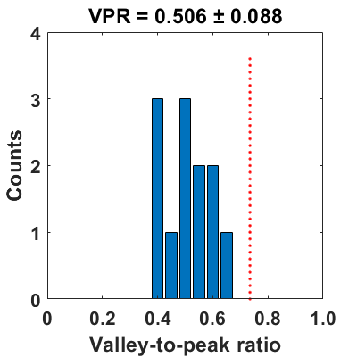
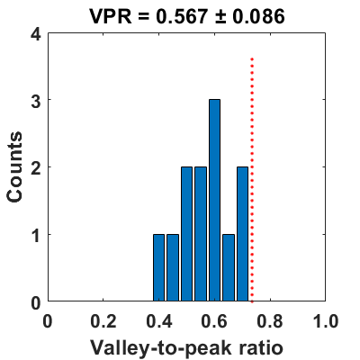

Resolution Phantom (OSEM)
We chose design C considering the uniform spatial resolution across the FOV
$$Resolvability=\frac{No. of VPR under 0.735}{Total No. of VPR}$$
A (4+4+7 mm)
B (3+4+4 mm)
C (3+3+5 mm)
0.8
0.8
0.8
0.75
0.85
0.75
0.85
0.75
0.85
0.55
0.45
0.55
0.45
0.55
0.45
0.5
0.5
0.5
5 mm
5 mm
5 mm
10
2
12
0
12
0
Resolvability=83.3%
Resolvability=100%
Resolvability=100%
Subset=8
Iterations=50
Notes:
Here you see is the reconstructed PET image using OSEM with design A.
All the submillimeter rod structures were clearly resolved.
For quantitative analysis, line profiles were drawn in three different directions.
Subsequently, valley-to-peak ratio histogram was obrtained.
The resolvability was defined as the ratio of the number of VPR under 0.735 to total number of VPRs.
The resolvability of design A was 83.3% as two line profiles were above the 0.735.
With designs B and C, the resolvability of the same rod structure were 100% thanks to the reduced crystal layer thickness.
We chose design C considering the uniform spatial resolution across the FOV.
(A) 4+4+7 mm: 7,908,790
(B) 3+4+4 mm: 8,006,160
(C) 3+3+5 mm: 8,217,194

Slide 18
PET system development
Notes:
Based on the simulation results, we recently developed a prototype PET scanner.

Slide 19
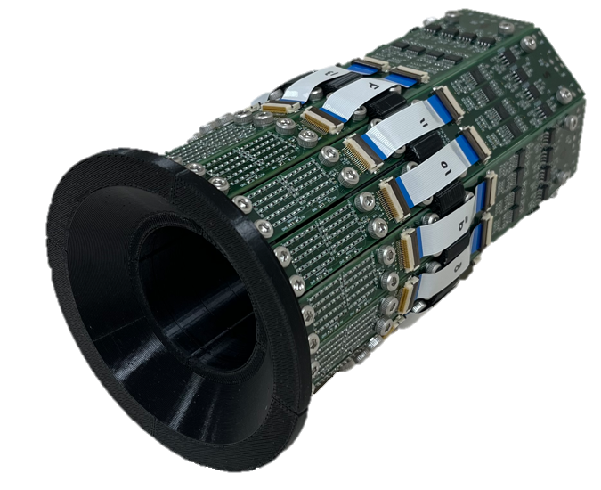
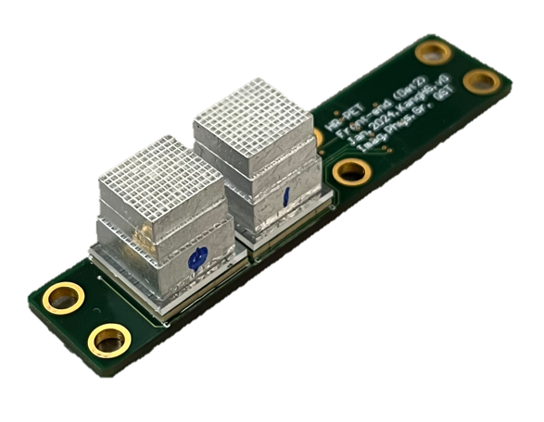
Half-millimeter Resolution PET (HR-PET)^{[2]}
Amplifier board
<Staggered 3-layer DOI detector>
Front-end board
LYSO 3-layer
Pitch=0.8 mm
1st layer
2nd layer
3rd layer
48 mm
23.4 mm
[2] Kang et al., 2025 IEEE TMI
Notes:
We developed a half-millimeter resolution PET, which is named as HR-PET.
The HR-PET has an inner diameter of 48 mm, and the PET consists of front-end and amplifier boards.
Each front-end board has 3-layer LYSO crystal arrays with a crystal pitch of 0.8 mm.
The axial FOV is 23.4 mm.

Slide 20

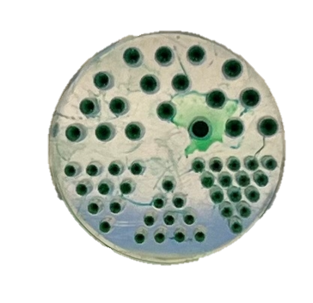
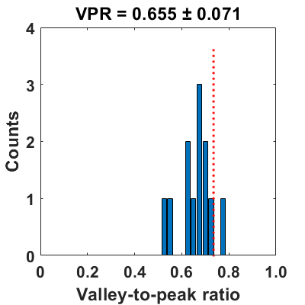

Resolution phantom (Experiment^{[2]} vs. Simulation)
Experiment
Simulation
Resolution phantom
0.8
0.8
Experimental results showed slightly worse resolvability than simulation mainly because of the crystal decoding error and other unmodeled factors
0.8
0.75
0.85
0.75
0.85
0.75
0.85
11.9 mm
0.55
0.45
0.55
0.45
0.55
0.45
0.5
0.5
0.5
¹⁸F = 1.2 MBq
Scan=60 min
Iteration=50
11
1
12
0
Resolvability
= 91.7%
Resolvability=100%
$$Resolvability=\frac{No. of VPR under 0.735}{Total No. of VPR}$$
[2] Kang et al., 2025 IEEE TMI
Notes:
For imaging performance evaluation, a resolution phantom was filled with 18F of 1.2 MBq and scanned for 60 min.
The images were reconstructed using OSEM with 50 iterations.
With experiments, the 0.45 mm rod structure was identified with a resolvability of 91.7%, which was slightly worse than simulation results.

Slide 21

Conclusions
We designed a sub-0.5 mm resolution PET with GATE
Design (C) 3+3+5 mm was chosen due to the uniform resolution over the FOV
The 0.45 mm rod structure can be resolved clearly in simulation and experiment
Phantom image (GATE simulation)
Design (C)
1st layer
3 mm
0.8
2nd layer
3 mm
0.75
0.85
3rd layer
5 mm
0.55
0.45
0.5
Notes:
Let me summarize my presentation.
We designed a sub-0.5 mm resolution PET with GATE.
Design C was chosen due to the uniform resolution over the FOV.
The 0.45 mm rod structure can be resolved clearly in both simulation and experiment.

Slide 22
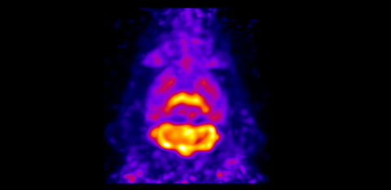
Future works
Full validation of GATE simulation results with experimental data
Physical and in vivo imaging performance evaluation of the HR-PET (Talk on Friday 10 AM, M-13-01)
10 mm
MIP image of mouse brain
(¹⁸F-FITM)
Matrix= 240×240×117
Voxel= 0.2×0.2×0.2 mm³
DRF=1 mm, Iter=10
Notes:
Future works includes the validation of GATE simulation results with experimenta data
Tomorrow I will give a talk about the physical and in vivo imaging performance evaluation of the HR-PET.

Slide 23
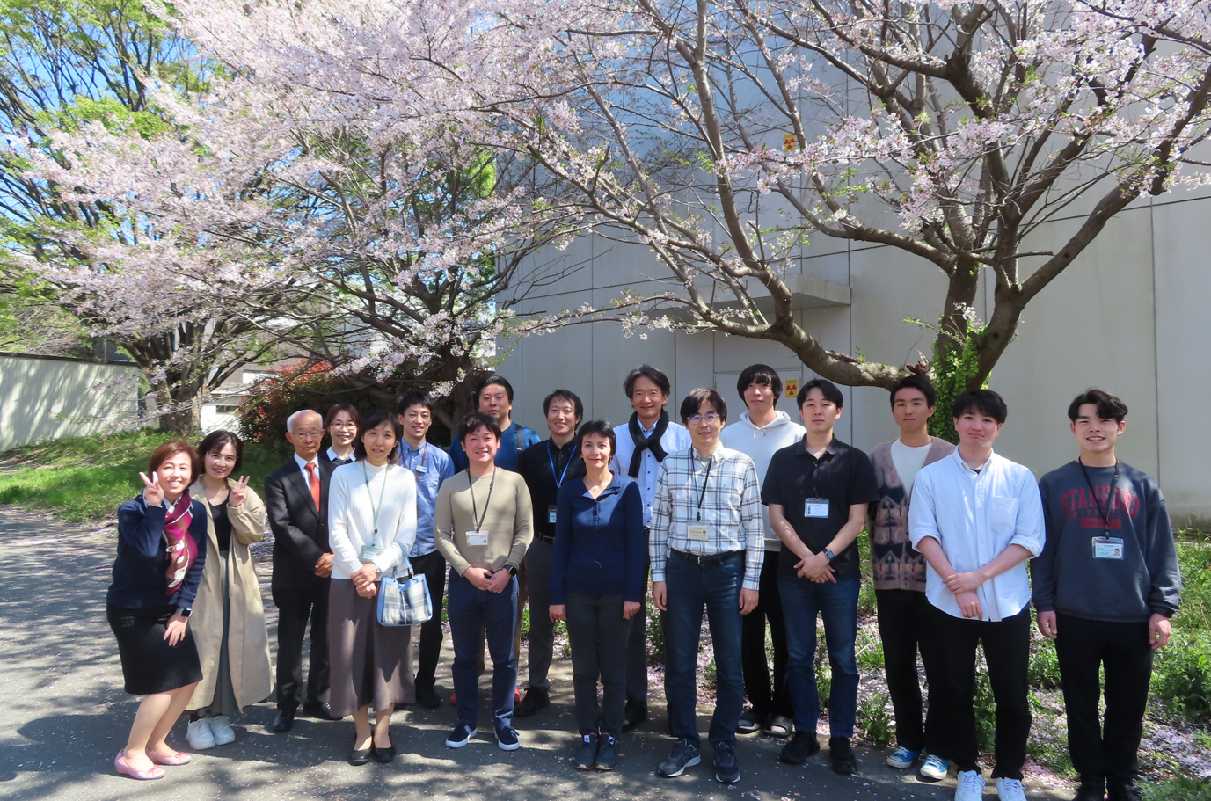
Thank you for your kind attention!
April-2024 in QST
2024 Imaging Physics Group
Yamaya
Tashima
HanGyu
17/17
Notes:
This is end of my presentation.
Thank you for your kind attention.

Slide 24
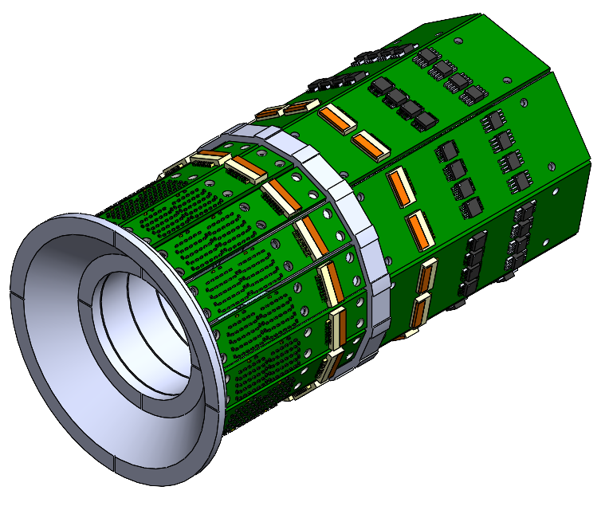
Progress of the PET development
GATE simulation
Front-end development
3D CAD gantry design
Amplifier
Front-end
Phantom
ID=48 mm
23.4 mm
Optimize the crystal layer
Optimize the PET detector
Notes:
Based on the GATE simulation, a PET detector was developed and gantry design was finished.
Next year, I would like to show you the imaging performance of the proposed PET scanner.

Slide 25
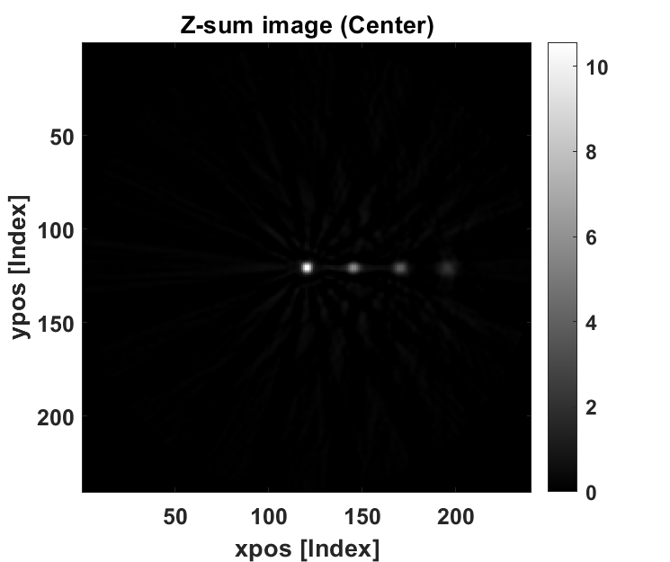



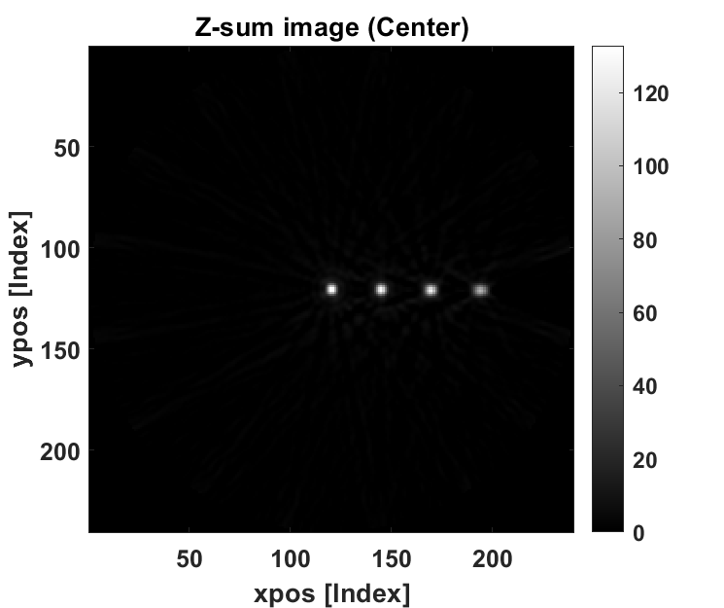

Fig. 4
A (4+4+7 mm)
B (3+4+4 mm)
C (3+3+5 mm)
(a)
FBP
FBP+GF
(b)

Slide 26
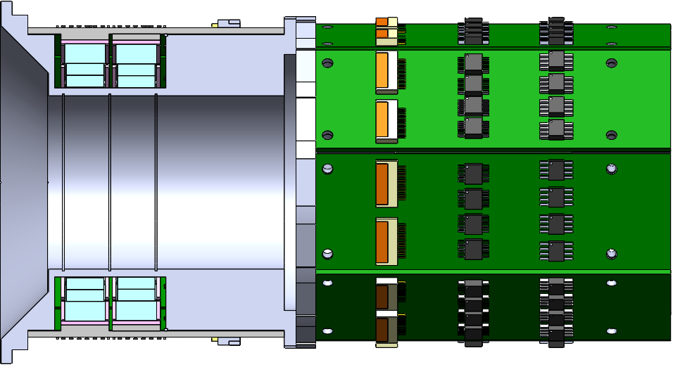
Design of the HR-PET
(a) Front view
Signal (18 pin)
(b) Cutaway side views
HV&TMP(18 pin)
Front-end board
Amplifier board
LYSO
FOV
44 mm
OD=92 mm
1
2
48 mm
23.4 mm
3D printed jig
OP-AMP
Mini-HDMI
Notes:
The SR-PET scanner has an inner diameter of 52.5 mm, and the crystal thickness of 15 mm.
The number of blocks is 16, each of which consists of 3-layer LYSO array.
The number of rings is 4, thereby resulting in an axial FOV of 51.5 mm.
The bore diameter is 48 mm, and the outer diameter is 107 mm.
The PET scanner consists of front-end board and amplifier board.
The SiPM signals and power lines were transferred by using flexible flat cables.

Slide 27



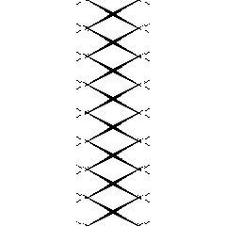
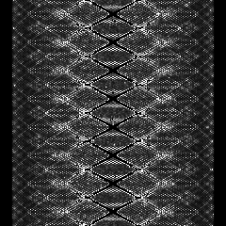

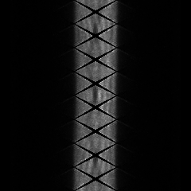
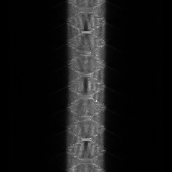

Fig. 3
(a) Norm. activity image
(b) Norm. activity sinogram
(c) Norm. sinogram
(d) Sensitivity mask
(e) Norm. Factor
2 mm
P
y
20.4 mm
φ
φ
φ
φ
x
r
r
r
r
(f) Sinogram (Phantom)
(g) Norm. Factor
(h) Normalized sinogram
(i) Interpolated sinogram
(j) FBP with GF
GF
FBP
φ
φ
φ
φ
y
r
r
r
r
x
10 mm

Slide 28


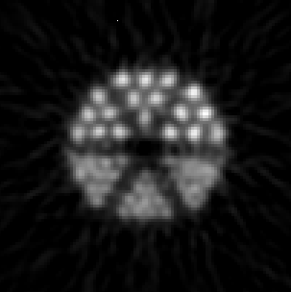
Resolution phantom (FBP)
A (4+4+7 mm)
B (3+4+4 mm)
C (3+3+5 mm)
0.8
0.8
0.8
0.75
0.85
0.75
0.85
0.75
0.85
0.55
0.45
0.55
0.45
0.55
0.45
0.5
0.5
0.5
5 mm
5 mm
5 mm
VPR=0.928±0.026
VPR=0.876±0.081
VPR=0.864±0.054
Notes:
The resolution phantom images were reconstructed using FBP with three different crystal layer designs.
Design C provided best valley-to-peak ratio of 0.864, which was over the Rayleigh criterion of 0.752.

Slide 29

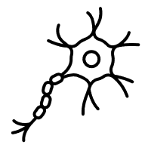



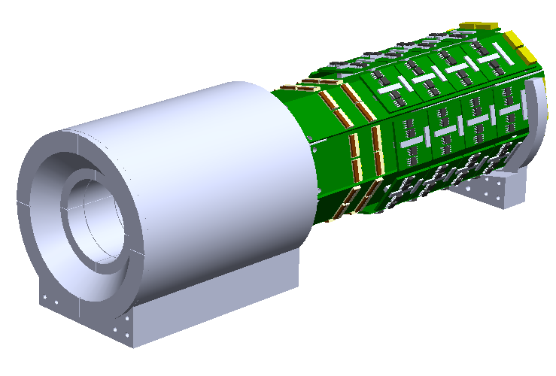
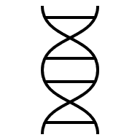


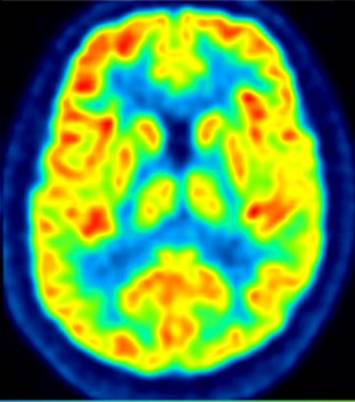
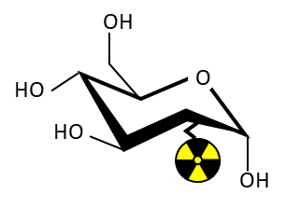


Preclinical PET for translational research
Clinical study
Basic research
Preclinical research
Human
Cell
Rodent (Mouse, rat)
Microscope
Preclinical PET is a bridge between the basic research and clinical study
Clinical PET
Preclinical PET
Find molecular biomarkers (e.g., gene, protein, metabolism)
Develop new radiotracers
Human brain
Mouse brain
Small molecule
Peptide
Antibody
1 cm
1 cm
Notes:
Let me briefly introduce about the role of preclinical PET for translational research.
In basic research, microscopes are commonly used to find molecular biomarkers in cell or DNA levels.
Then new radiotracers are developed for molecular imaging with rodent models.
Preclinical PET is used to visualize the functional information of mice for preclinical research to test the efficacy of the radiotracers.
After preclinical research, we can move on to the clinical study with human subjects.
Therefore, preclinical PET is essential for translational research as a bridge between the basic research and clinical study.

Slide 30

PET resolution prediction and validation
Levin and Hoffman, 1999 PMB
Kang et al., 2023 JNM
LYSO pitch
=1.0 mm
52.5 mm
Res.
0.6 mm
0.8
0.75
0.85
$$Resolution=\sqrt{R_{PR}^{2}+R_{180゜}^{2}+R_{det}^{2}+R_{block}^{2}}$$
¹⁸F
0.55
0.45
If $R_{PR}$=0.1 mm, D=53 mm, $R_{det}$=1.0 mm, $R_{block}$=0, then resolution = 0.55 mm
0.5
OSEM (50 iterations)

Slide 31



Front-end electronics
Amplifier board
miniHDMI
Front-end board
Flexible Flat Cable
2.4 mm
DAQ
Power
Top
14 mm
SiPM5×5
SiPM5×5
Resistive network
SiPM biasing
A
Anode 25 Ch
B
Cathode (+HV)
Position
4×4=16 ch
Timing
4×1=4 ch
Bottom
SiPM
Anode (Signal)
Pole-zero-cancellation circuit
D
C
Rf
Rpz
Timing signal
Rg
-
Output
Input
+
50Ω
200 mV
AD8000
Cpz
200 ns
<150ns
Notes:
The front-end board has SiPM5x5 array with a pitch of 2.4 mm.
The SiPM bias was applied to a common cathode and signals were extracted from anode.
The 25 anode signals were multiplexed into 4 positional signals by using a resistive network.
The multiplexed signals were transferred to an amplifier board via flexible flat cable.
The position signals were amplified with quad channel amplifiers.
The timing signals were amplified by using a fast amplifier followed by a pole-zero-cancellation circuit to obtain fast decay time of less than 150 ns.
The amplified signals were transferred to a DAQ via miniHDMI cables.
The power lines were supplied by using the same cables.

Slide 32

Staggered 3-layer DOI detector
<SiPM with front-end board>
<Staggered 3-layer DOI detector>
LYSO 3-layer
SiPM
5×5
Pitch=0.8 mm
Pitch=
2.4 mm
1st layer
2nd layer
3rd layer
12.5 mm
14 mm
Acrylic lightguide
(12.2×12.2×1 mm³)
Notes:
Two LYSO 3-layer arrays were mounted on top of the SiPM.
A 1 mm thick lightguide was inserted between the crystal and SiPM.

Slide 33


Crystal map (Experiment)
²²Na
Crystal map
511 keV
Pitch=0.8 mm
1st layer
3rd layer
2nd layer
3rd layer
2nd layer
1st layer
Front-end
The crystal map of a 3-layer LYSO crystal array with 0.8 mm pitch was well identified.
Notes:
Currently, the front-end electronics are under development.
We plan to develop a full-ring PET system within this year.

