Slide 1



Towards Patient-Realistic PET Simulations:
Benefits and Challenges of 4D Extended Cardiac-Torso Phantom Integration into OpenGATE Simulation Frameworks
W. Lan¹, E. Olyaei^{1,2}, S. Weigel¹, C. la Fougère^{1,3}, F. P. Schmidt^{1,2}
¹Department of Nuclear Medicine and Clinical Molecular Imaging, University Hospital Tübingen, Tübingen, Germany
²Werner Siemens Imaging Center, Department of Preclinical Imaging and Radiopharmacy, University of Tübingen, Tübingen, Germany
³Cluster of Excellence iFIT (EXC 2180) “Image Guided and Functionally Instructed Tumor Therapies”, University of Tübingen, Tübingen, Germany
Wenhong Lan & Elnaz Olyaei

Slide 2
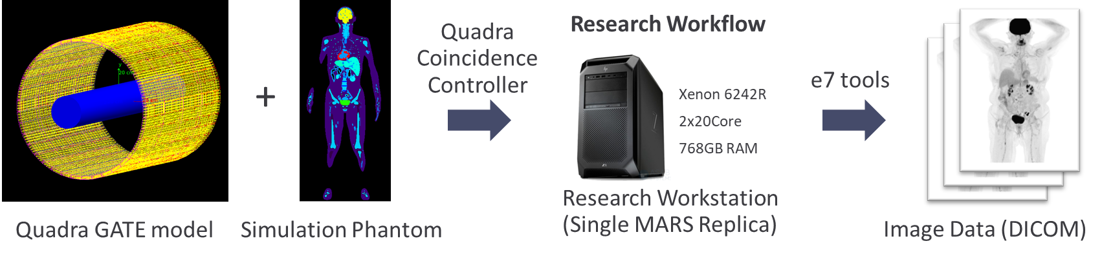
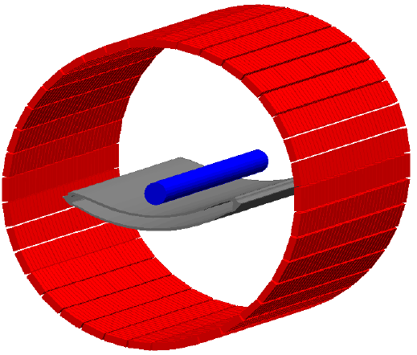



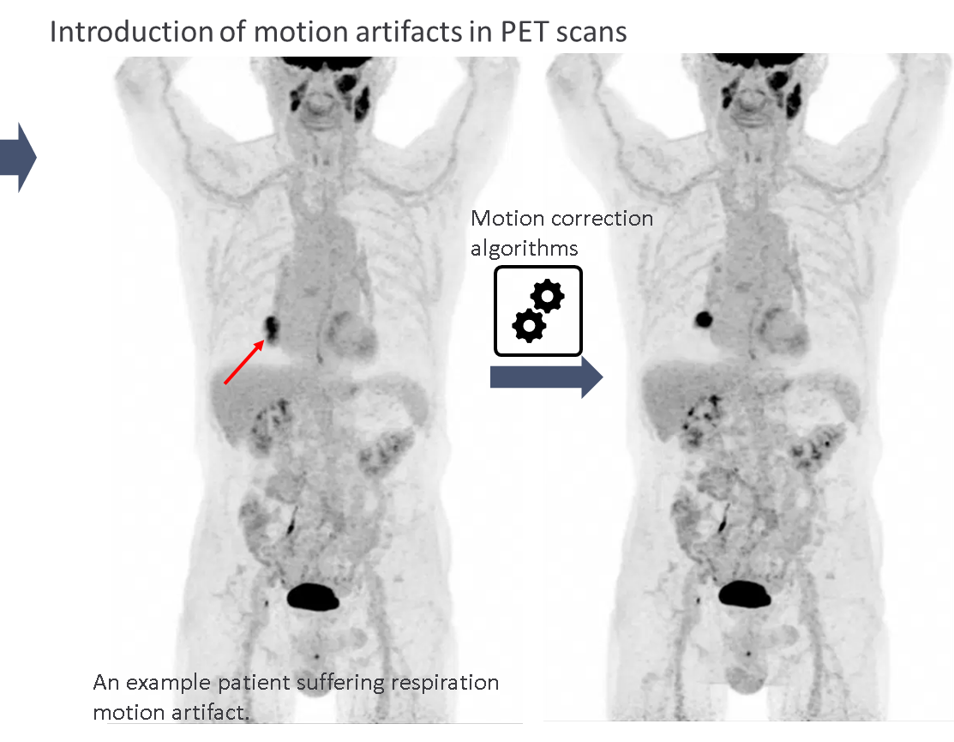
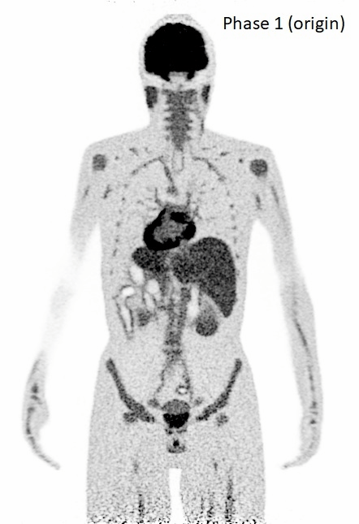
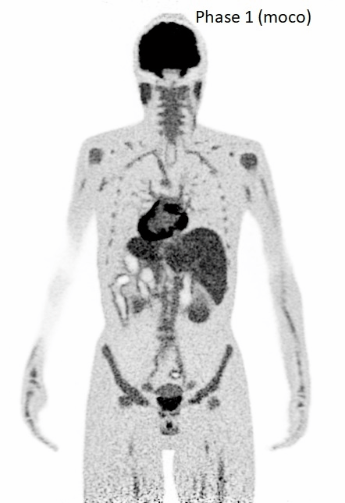
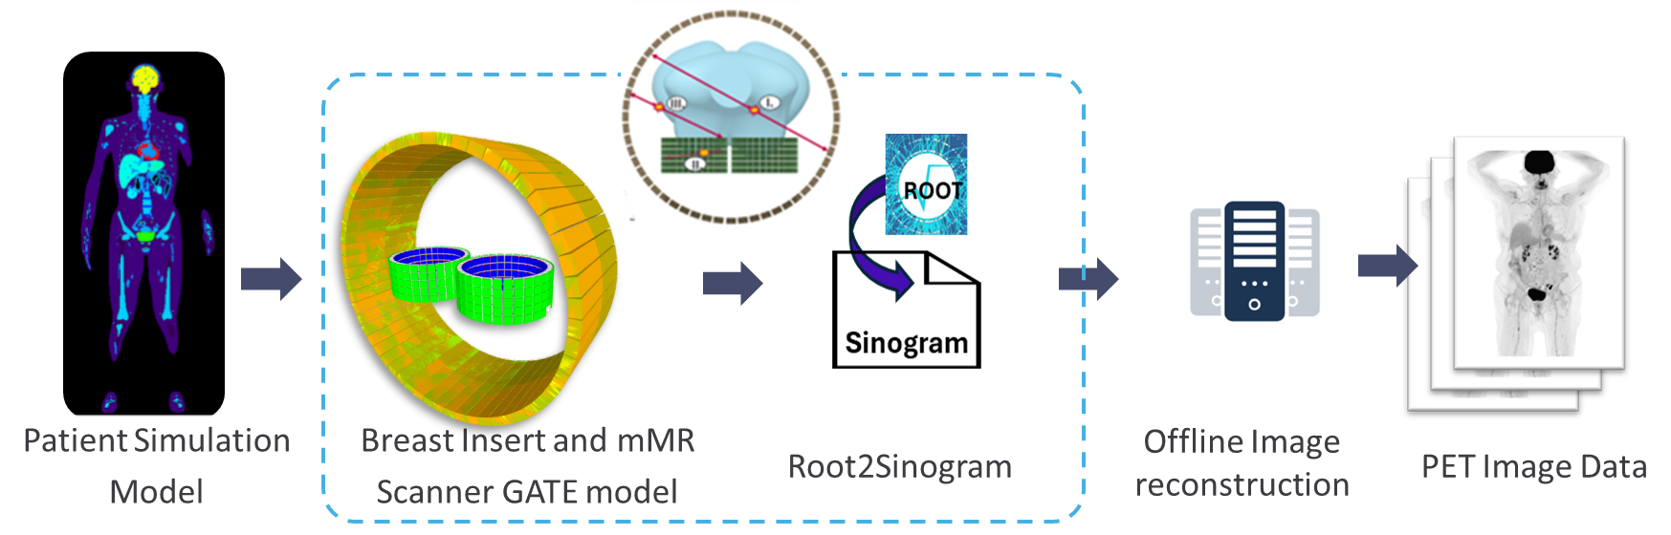
Motivations of XCAT simulation
Listmode data
(proprietary)
Offline Image reconstruction
Root2lm
PET Image Data
Patient Simulation Model
GATE model
(1) Ground truth for motion correction development
(2) Novel insert development
Real patient
Motion corrected
With respiration motion
Motion corrected
Image Data

Slide 3
Simulation strategies optimization with XCAT phantom

Slide 4
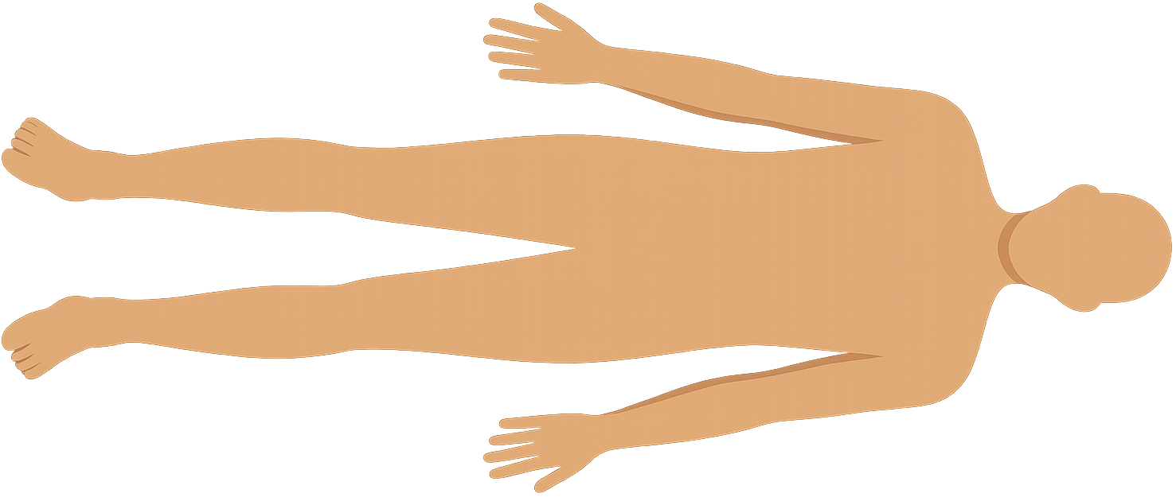
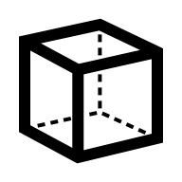
Challenges of OpenGate simulation with XCAT phantom
Listmode data
(proprietary)
Offline Image reconstruction
Root2lm
Image Data
Patient Simulation Model
GATE model
Challenge 1: dramatical increase of particles
From simple geometries to patient-like phantom [4]
Challenge 2: from static to dynamic
we need >600 frames of the high precise patient-like 3D matrices.
One frame: 1 GB data size.
Phantom generation takes long time.
Simple geometric cube:
100ml with 2kBq/ml activity → 200×10³ particles / sec;
60 million particles
Patient-like phantom:
3MBq/kg → 189 million particles / sec. (300s)
56 billion particles (900 times more)
Static
Dynamic
[4] W. P. Segars, G. Sturgeon, S. Mendonca, J. Grimes, and B. M. W. Tsui, ‘4D XCAT phantom for multimodality imaging research’, Med Phys, vol. 37, no. 9, pp. 4902–4915, Sept. 2010, doi: 10.1118/1.3480985

Slide 5
Challenges of OpenGate simulation with XCAT phantom
Listmode data
(proprietary)
Offline Image reconstruction
Root2lm
Image Data
Patient Simulation Model
GATE model
Challenge 3: heavy I/O demand for data conversion
Data chunking:
Data conversion:
300s
Listmode data format
…
1GB
2MB
0.3s
×1000 pieces
The whole 300s simulation

Slide 6
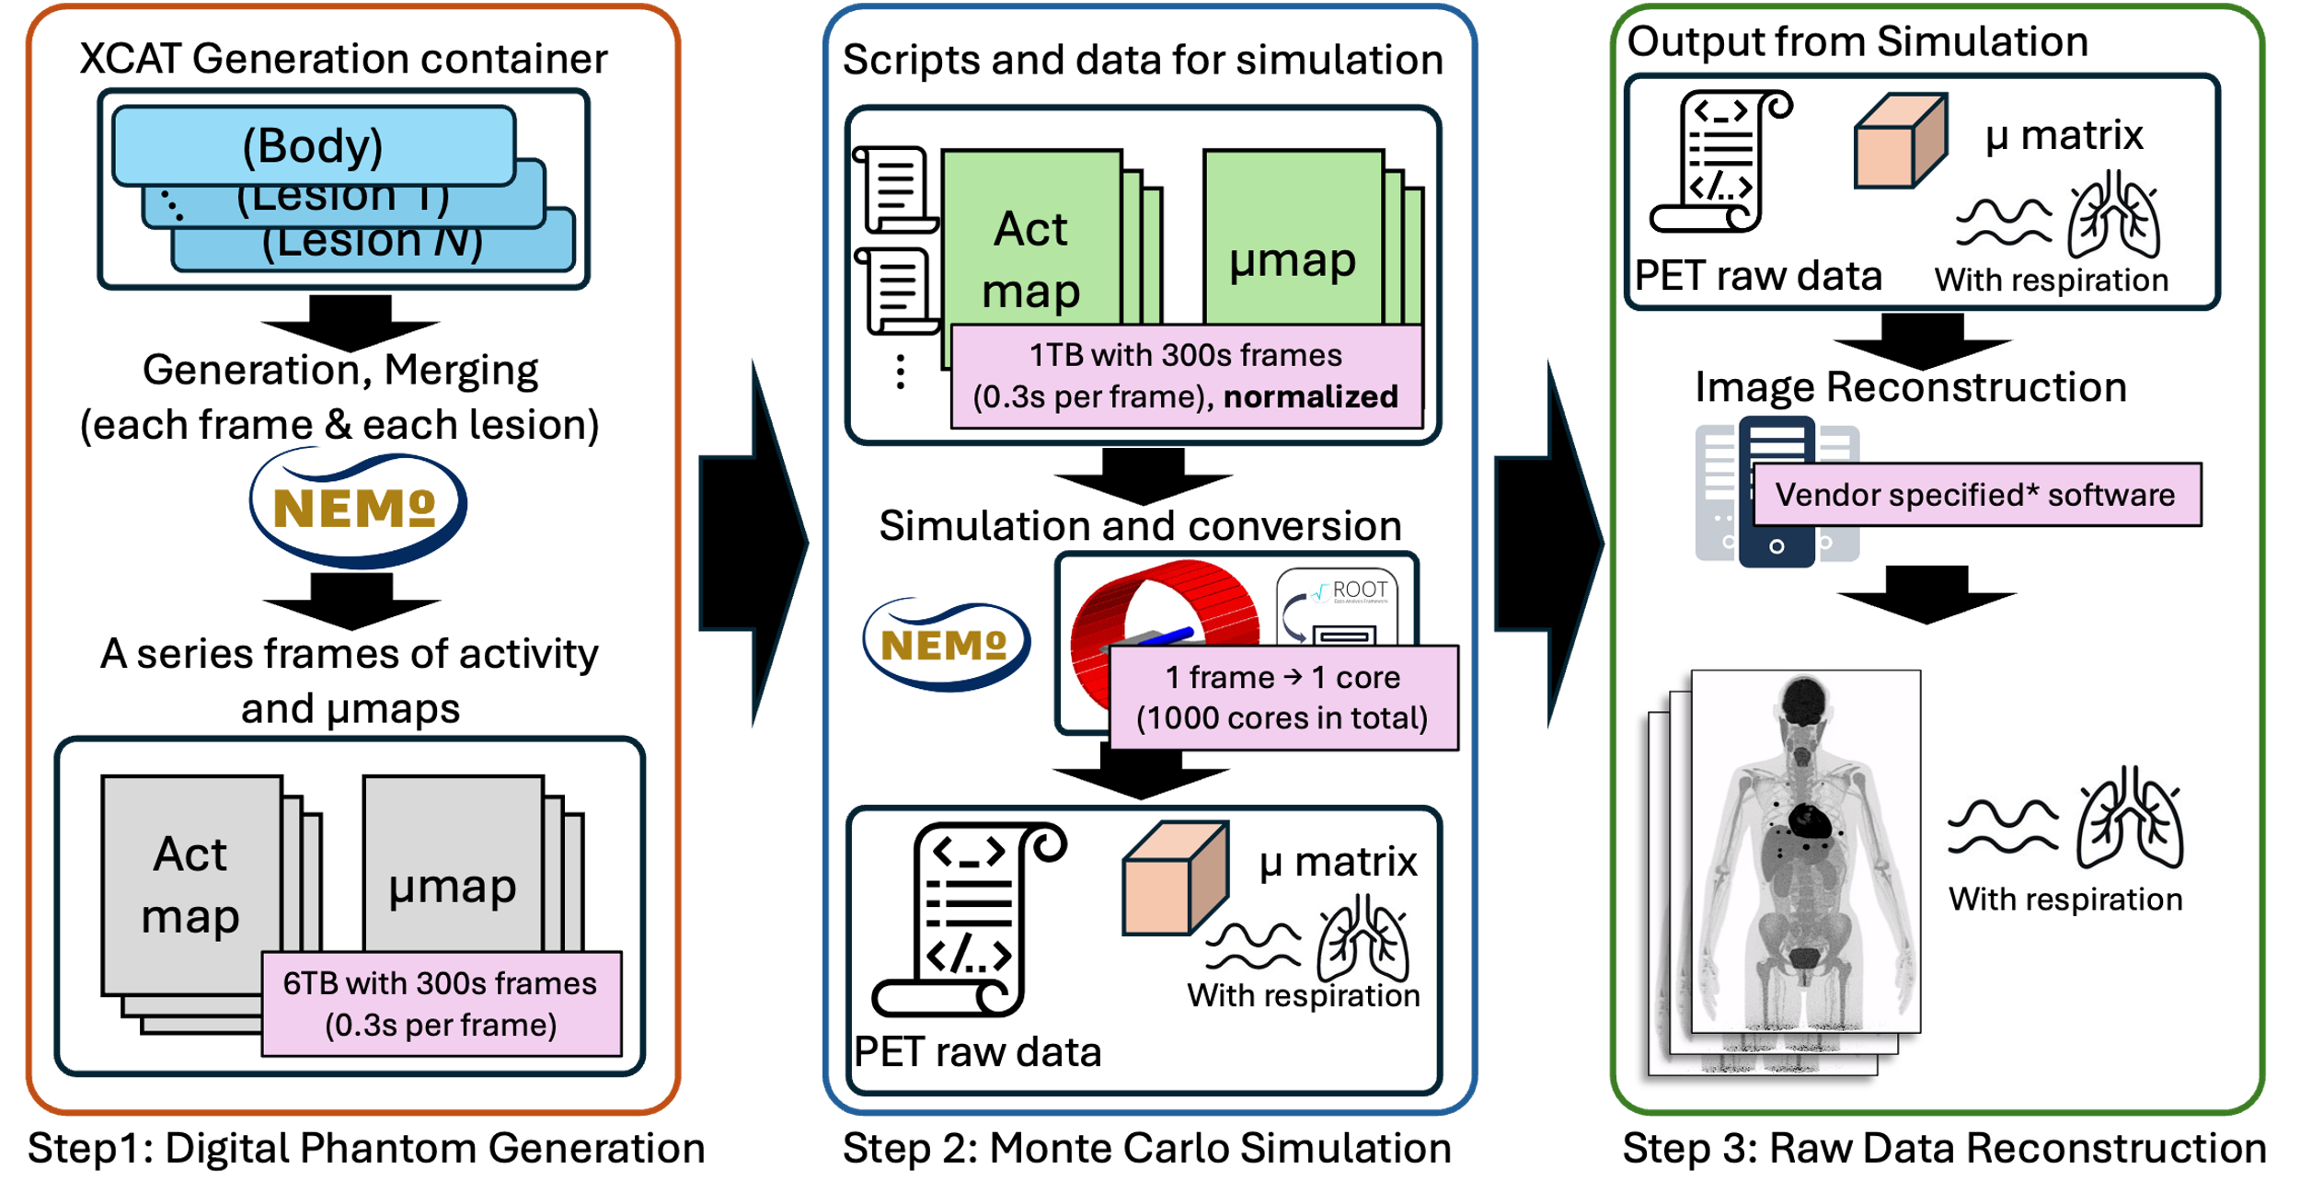
High performance computing with XCAT simulation

Slide 7
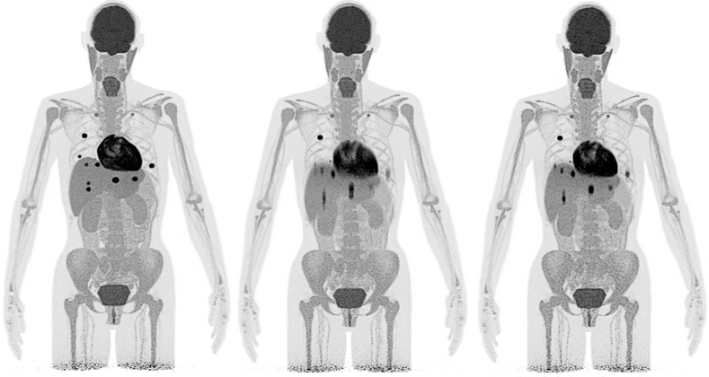

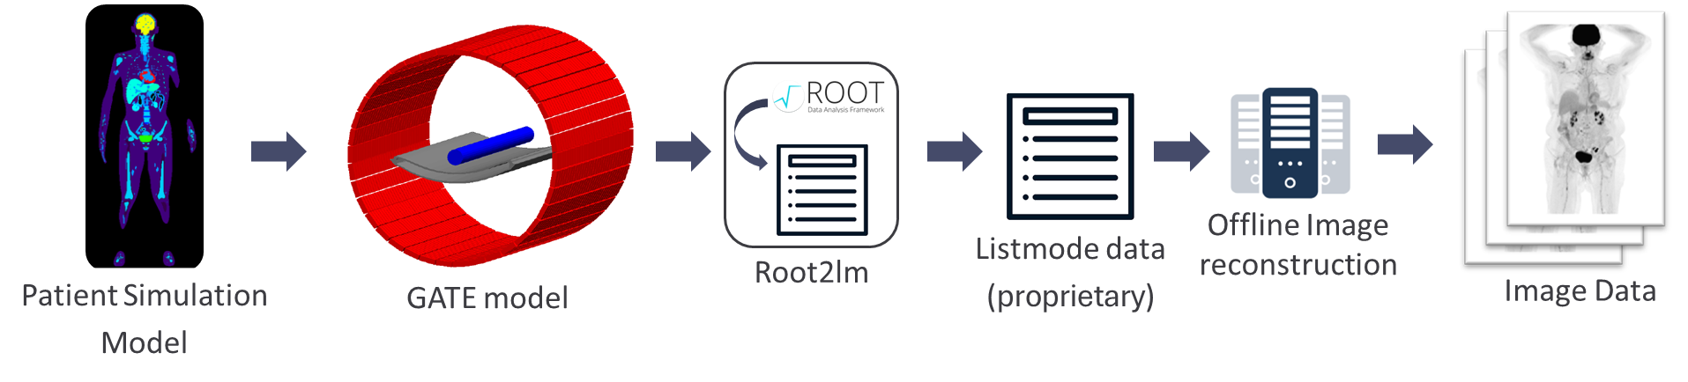
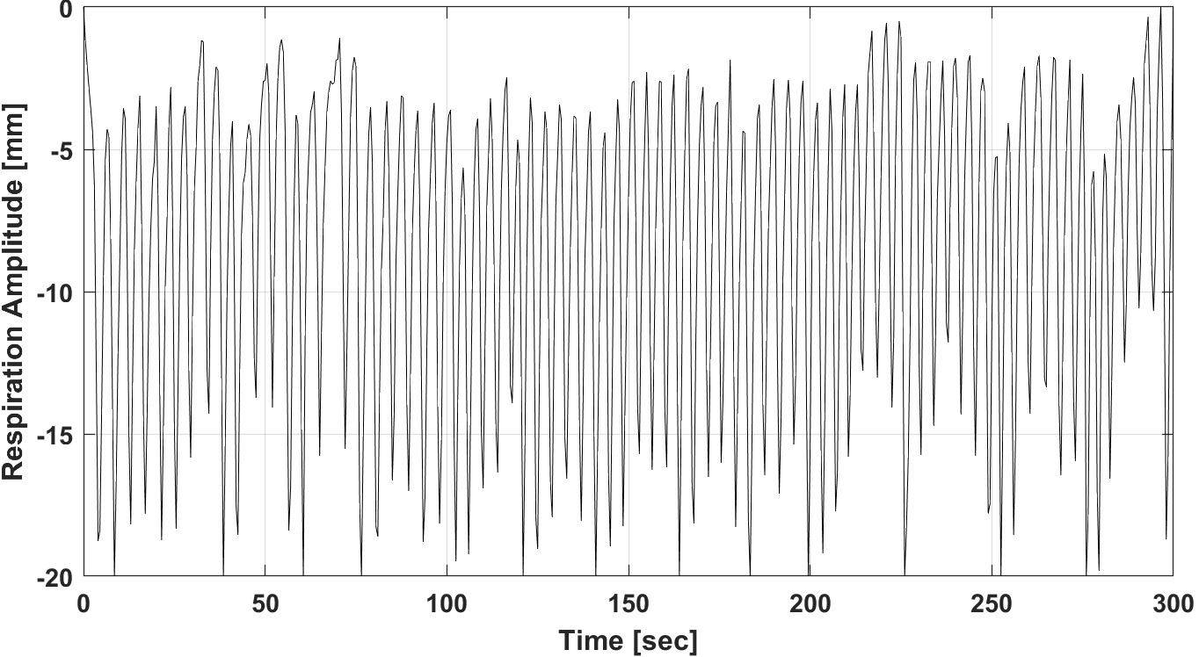

Benchmark for computation time
+
Local workstation
Patient-like phantom: female XCAT
Height: 163 cm; weight: 66 kg;
Lesion number: 14;
Real patient respiration motion;
End-to-end test:
From phantom generation to LM file output
Local workstation
CPU | Core i9-14900kf
RAM | 128GB DDR4
ROM | HDD 8TB CMR
NEMO2

Slide 8

Results of Benchmark
 | Voxel size | XCAT generation | Monte Carlo Simulation | Postprocessing
Local workstation | 3.1 mm³ | 73 h | 21 days | 1.5 days
NEMO2 | 1.5 mm³ | 5 h | 15 h | 40 mins
In total, NEMO HPC is 29 times faster than local workstation.
Implementation of selected motion correction algorithm:
no motion
with motion
motion corrected

Slide 9
Voxelization on XCAT phantom

Slide 10
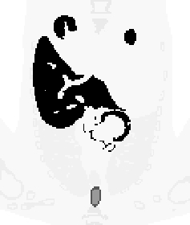
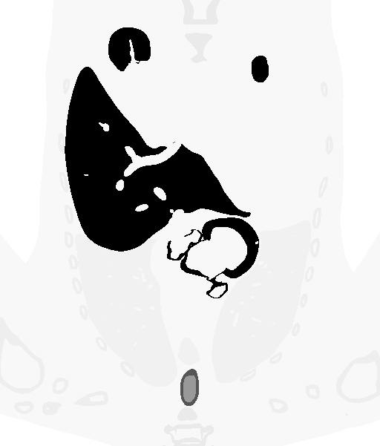

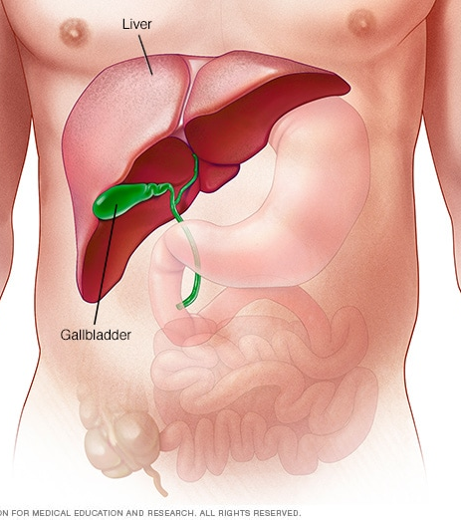


Motivation: Voxelization in Simulation
Large voxels
Small voxels
Real Patient
Voxelization in simulation
Small voxels
Large voxels
(Voxelizaion: To replicate the complex structure)
After reconstruction:
Under different Voxel sizes:
How good of performance of replication in Image Quantification?
How good of the reproduction of motion, such as respiration, heart beating?

Slide 11
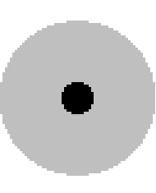

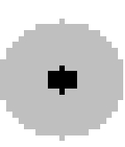
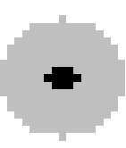

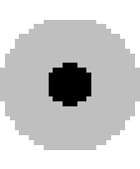
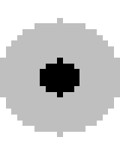
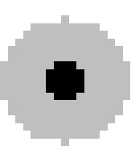
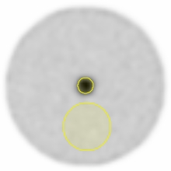
Spheres mimicking lesions
Voxel size
[mm]
Reference*
0.75
1.0
1.25
1.5
1.75
2.0
2.25
2.5
2.75
3.0
3.125
Ø = 10 mm
…
…
…
Ø = 15 mm
…
…
…
Cold BG
Warm BG
Reference*: Geometric sphere defined at OpenGate.
Mean activity Concentration;
Contrast Recovery (CRC)
To Answer:
How much biases are introduced during the voxelization?
Sphere VOI
Background VOI

Slide 12
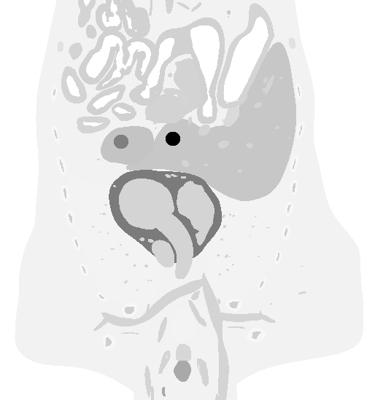
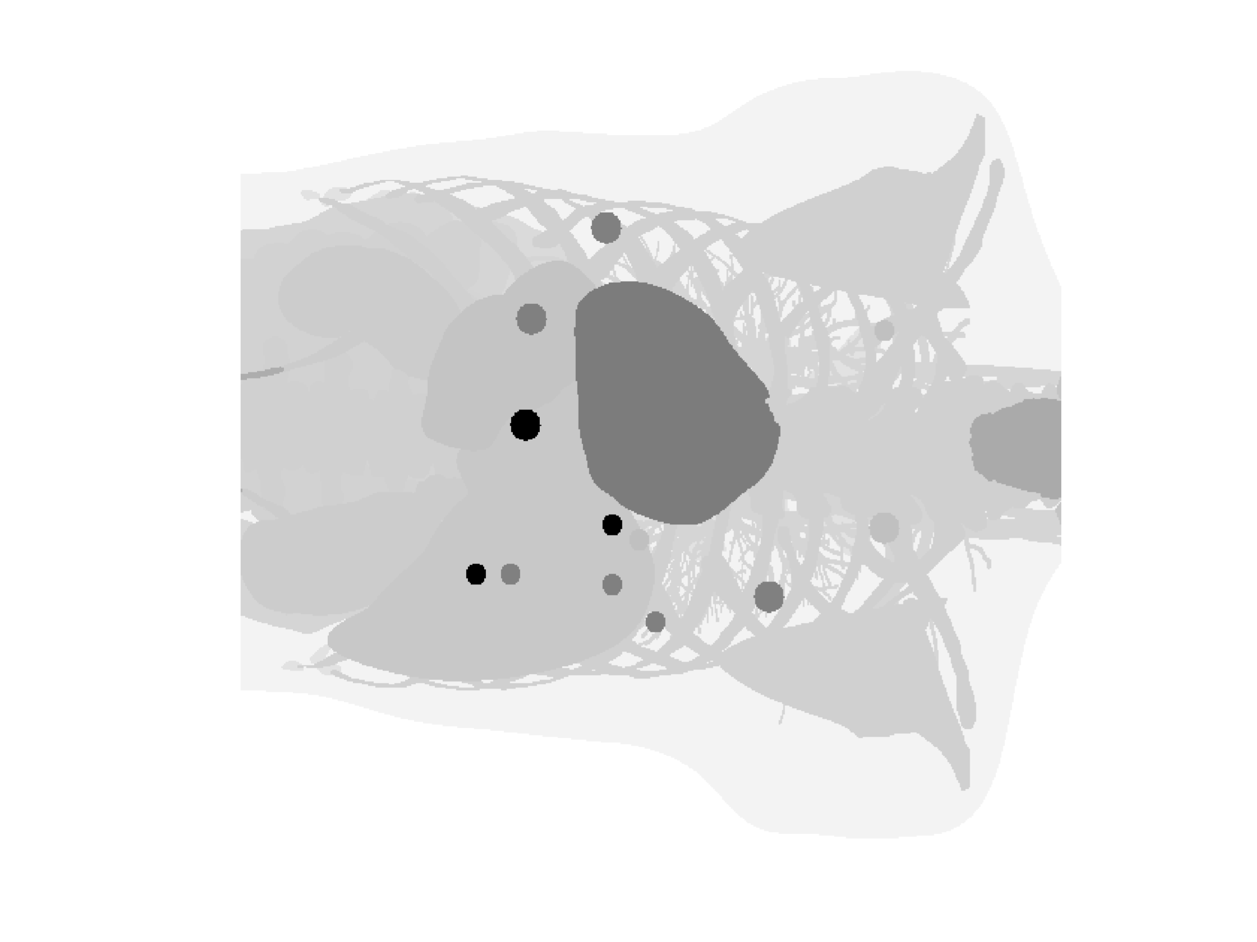
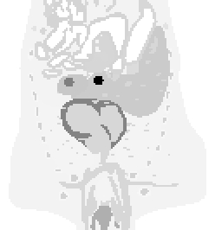
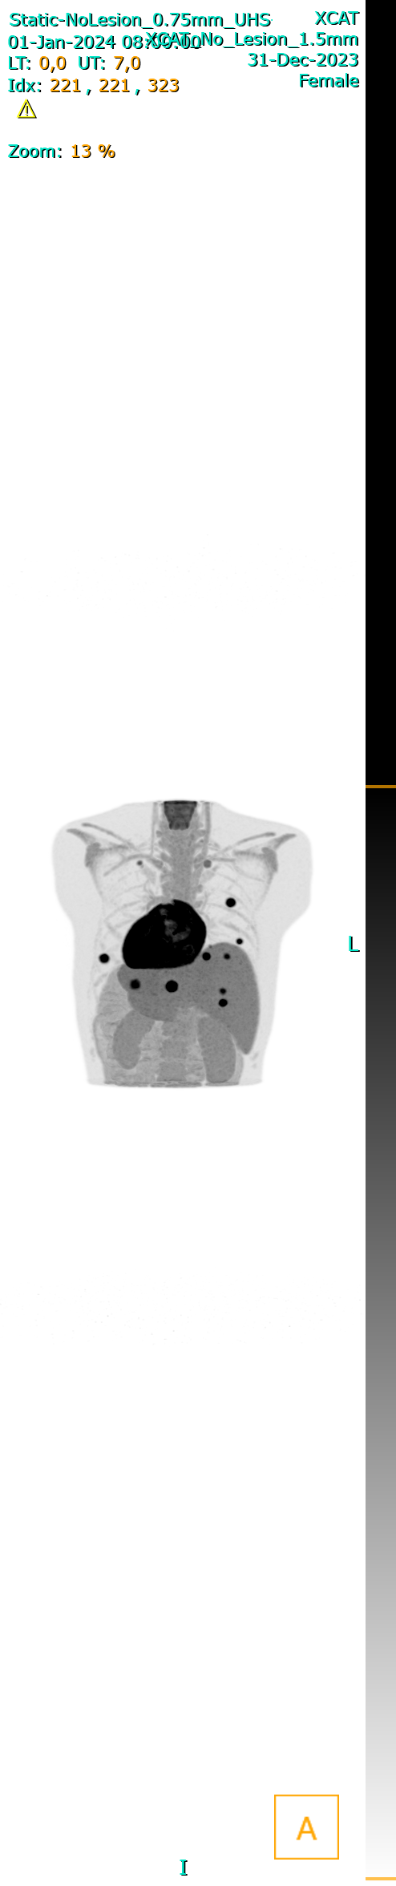
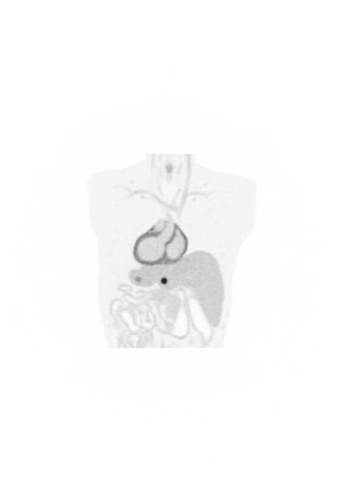
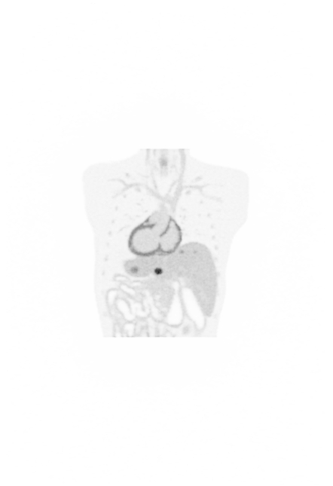
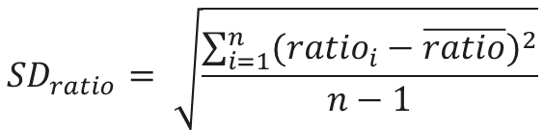

Partial adult female XCAT phantom
Partial adult female XCAT phantom
(163 cm, 66 kg, [¹⁸F]FDG, 2 MBq/kg)
0.75 mm voxel size
14 lesions from 20 patients.
Lesion:
SUV values: 3.5, 7 and 14;
Ø = 10 & 15 mm
Lung & liver area
3.125 mm voxel size
Reference*: Geometric lesions defined at OpenGate + voxelized partical XCAT
Voxel size: 0.75, 1.0, 1.25, …, 3.0, 3.125 mm
$${SD}_{ratio}= \sqrt{\frac{\sum_{i=1}^{n}{{({ratio}_{i}−\overline{ratio})}^{2}}}{n−1}}$$
$$ratio= \frac{{SUV}_{voxelized lesion}}{{SUV}_{geometric lesion}}$$
To answer:
Which voxel size performs the most robust lesion representation?
Geometric lesions
(Reference)
Voxelized lesions
(3.125 mm)
Reconstruction protocol:
5 mins scan
4i, 5s
OP-OSEM + PSF-TOF
No post-filter

Slide 13
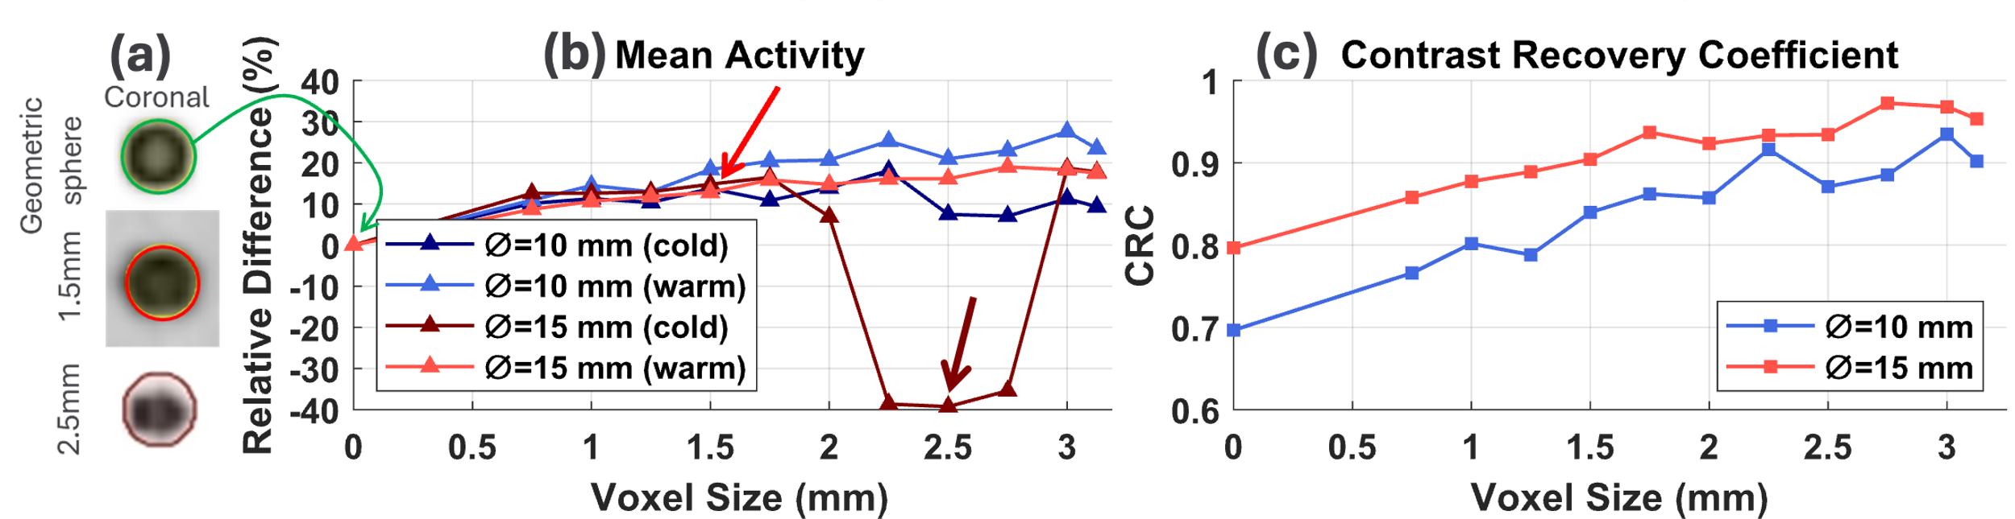
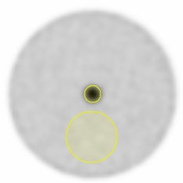
Absolute change of Mean activity concentration and CRC
How much biases are introduced during the voxelization?
Geometric lesion
Voxelization
Mean activity concentration biases:
0.75 → 1.25 mm: 11.6% ± 1.1%;
1.5 mm: 14.9% ± 2.1%;
1.75 → 3.125 mm: (up to 19.0 ± 8.2%).
sphere
CRC:
1.5 mm: 0.80 → 0.90 (Ø=15mm); 0.70 → 0.84 (Ø=10mm);
1.75 → 3.125 mm: ( up to 0.9, ↑29%, Ø=10mm).
Background

Slide 14
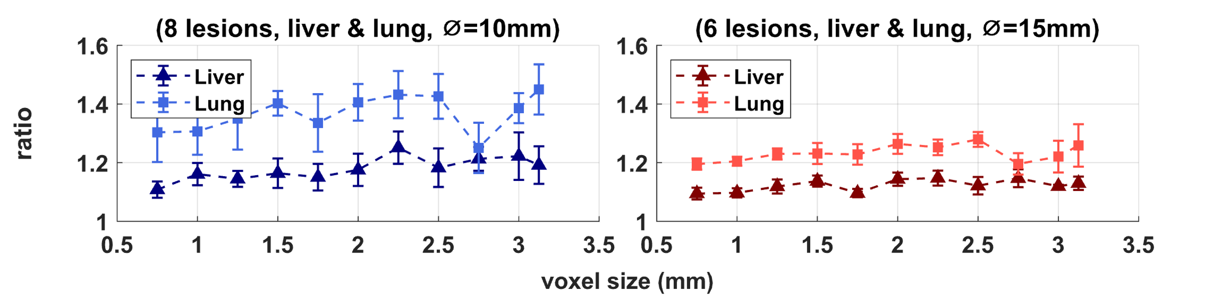


Relative change of SUV at delineated lesions
Which voxel size performs the most robust lesion representation?
$$ratio= \frac{{SUV}_{voxelized lesion}}{{SUV}_{geometric lesion}}$$
$${SD}_{ratio}= \sqrt{\frac{\sum_{i=1}^{n}{{({ratio}_{i}−\overline{ratio})}^{2}}}{n−1}}$$
Lower standard deviation → more robust configuration of voxel size
Geometric lesions
(Reference)
Voxelized lesions
(3.125 mm)
14 lesions (lung and liver regions)
Ø = 10 mm lesion:
std = 0.03 (liver, 1.25mm)
std = 0.05 ( lung, 1.5 mm)
Ø = 15 mm lesion:
std = 0.01 (liver, 0.75 mm)
std = 0.01 (lung, 0.75 mm)
Balancing the computation and lesion fidelity
1.5 mm voxel size.

Slide 15
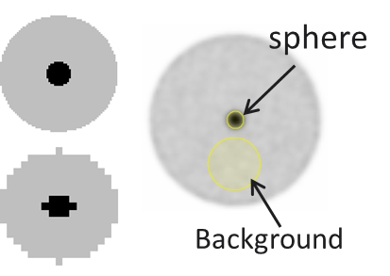
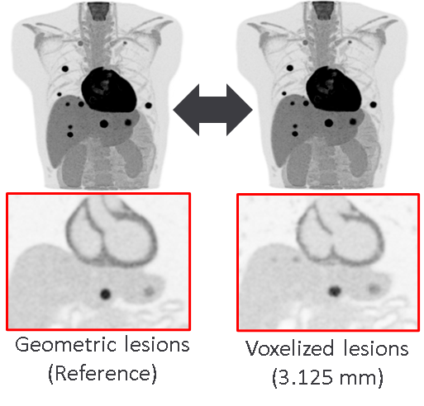
Conclusion and outlook
Spheres mimicking lesions
Voxel size of digital phantom → lesion fidelity.
For lesion Ø=10 & 15mm,
Voxel size of 1.5 mm: balancing lesion fidelity ↔ computation feasibility
Future work:
Varying respiratory patterns
More lesion types
Partial XCAT

Slide 16
XCAT motion modelling

Slide 17
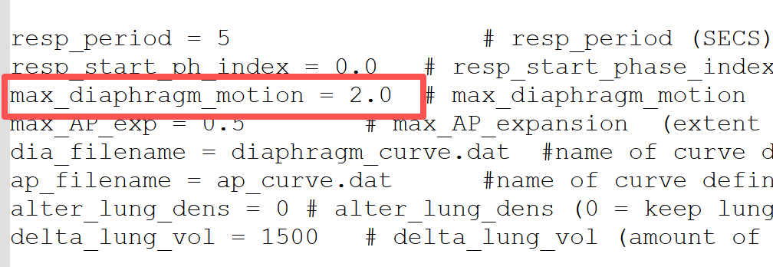
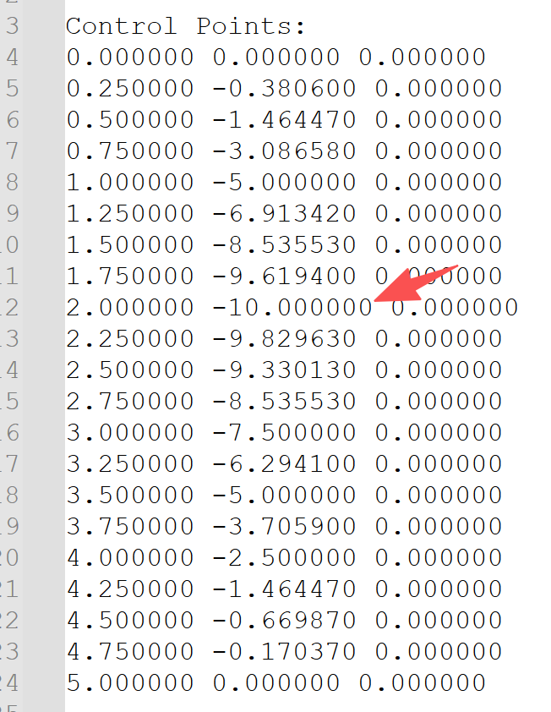
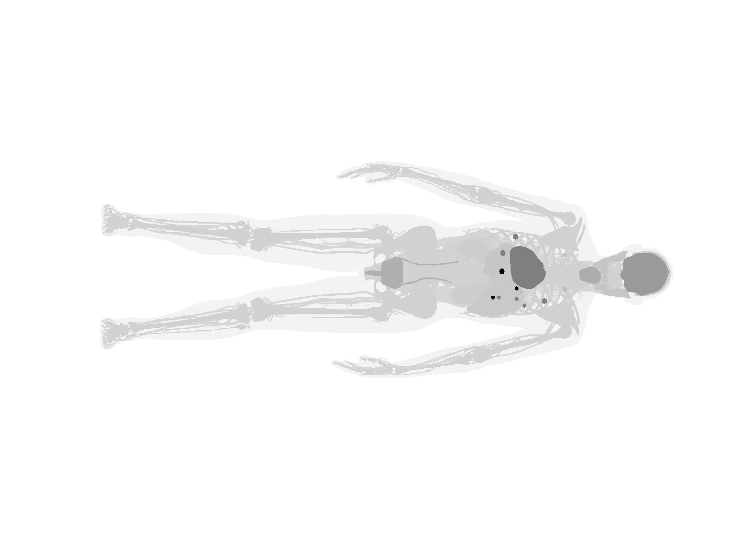
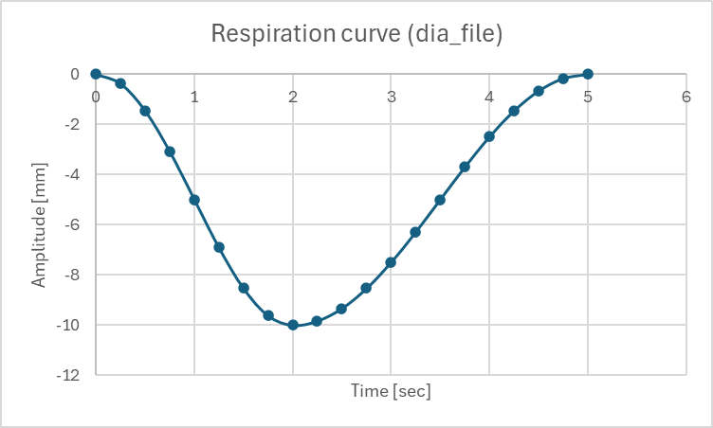
Motion definition at XCAT
Two parameters:
max_diaphragm_motion (at parameter input tab)
Respiration curve files
max_diaphragm_motion [cm]
With respiration motion
How do they interact and define motion?
Which motion config closer to real patient?
Maximum amplitude: -10 mm
Respiration curve control points

Slide 18
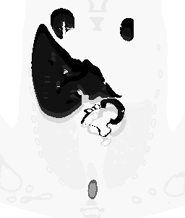
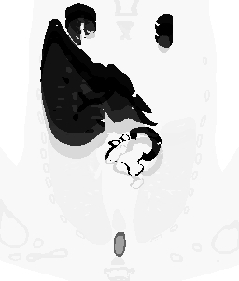
Change of max_diaphragm_motion
Max amp [mm] | max_diaphgram_motion [cm] | Diaphragm Moving [mm]
-10 | 1.0 | 10 mm
-10 | 1.5 | 15 mm
-10 | 2.0 | 20 mm
-10 | 4.0 | 40 mm
-10 | 8.0 | 80 mm
20 mm
20 mm
10 mm
40 mm
Maximum amplitude: -10 mm
max_diaphragm_motion:
1.0 cm
2.0 cm
DiaMax: 4.0
DiaMax: 2.0 (default)

Slide 19
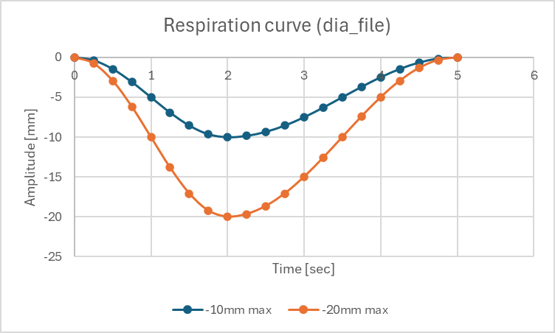
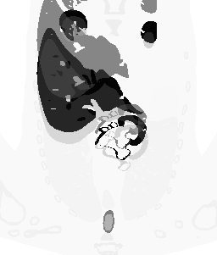
Change of Respiration curve
$${Moving}_{diaphgram}=\left\|max⁡_dia_motion\right\|×\left\|Curve\right\|$$
Maximum amplitude: -20 mm
Curve max. [mm] | max_diaphgram_motion [cm] | Diaphragm moving [mm]
-10 | 1.0 | 10 mm
-10 | 1.5 | 15 mm
-10 | 2.0 | 20 mm
-20 | 2.0 | 40 mm
-10 | 4.0 | 40 mm
-20 | 4.0 | 80 mm
-10 | 8.0 | 80 mm
-20 | 8.0 | 160 mm
20 mm
80mm
Max_diaphragm_motion: 4.0 cm, Curve max.: -20 mm
Max_diaphragm_motion: 2.0, Curve max.: -10 mm

Slide 20
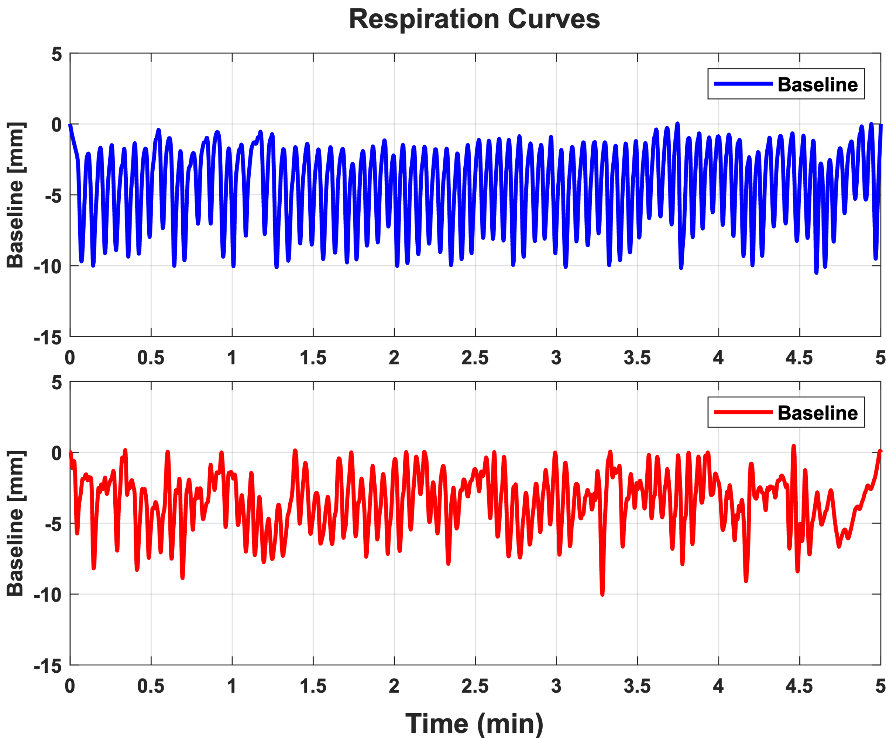

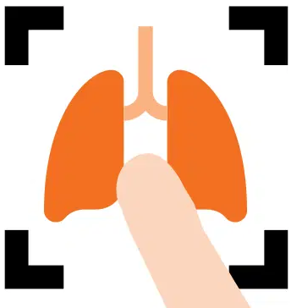
Head-to-toe XCAT phantom with respiration motions
Head-to-toe adult female XCAT phantom
(163 cm, 66 kg, [¹⁸F]FDG, 2 MBq/kg)
max_diaphragm_motion = 2.0 cm
Respiration curve, max. = 10 mm
*
Voxel size: Optimized setting
+
Motion correction [1]:
End-to-end verifications
Respiration replication
*Extracted from real patients by vendor specific software.
[1] Paul J Schleyer et al 2009 Phys. Med. Biol. 54 1935; (Deviceless motion management for PET imaging, Siemens Healthineer)

Slide 21
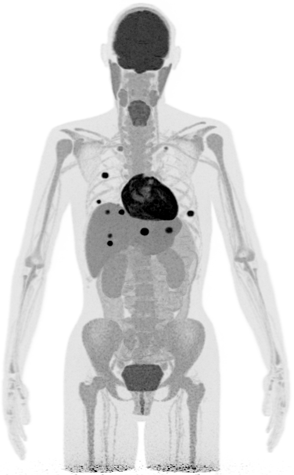
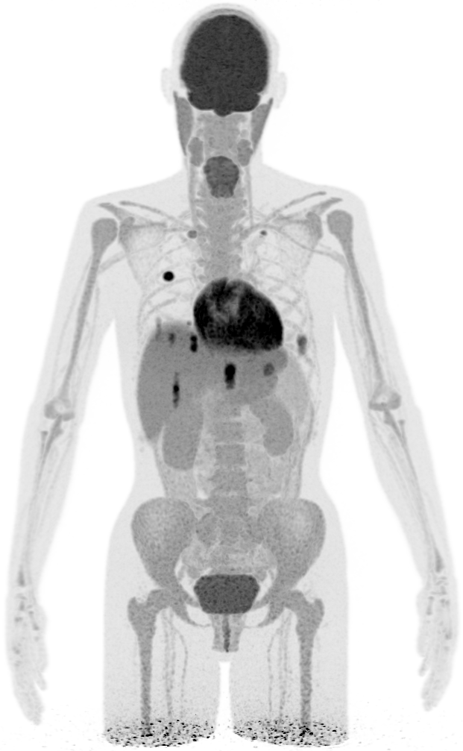
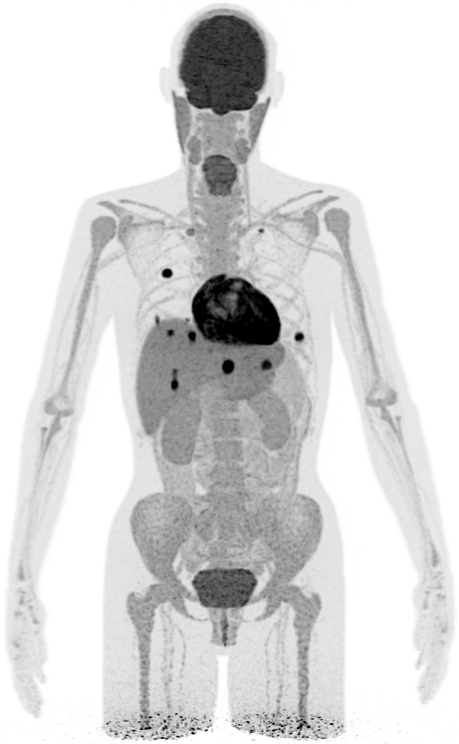
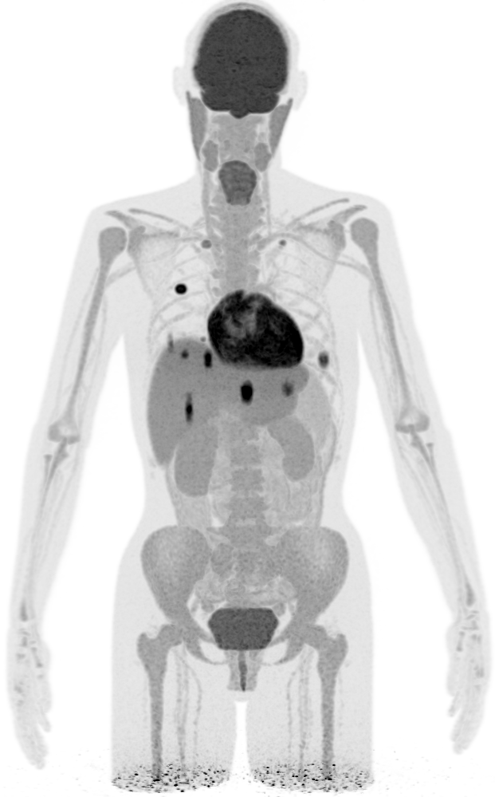

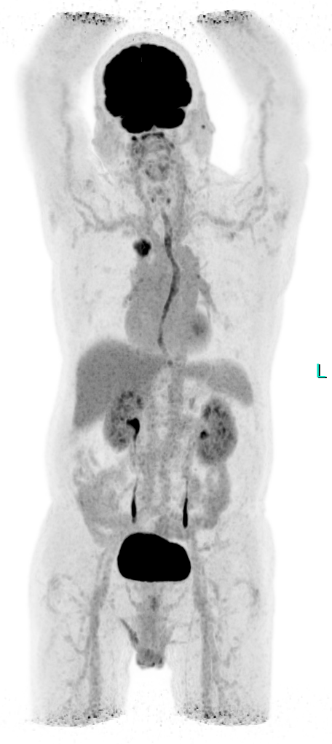
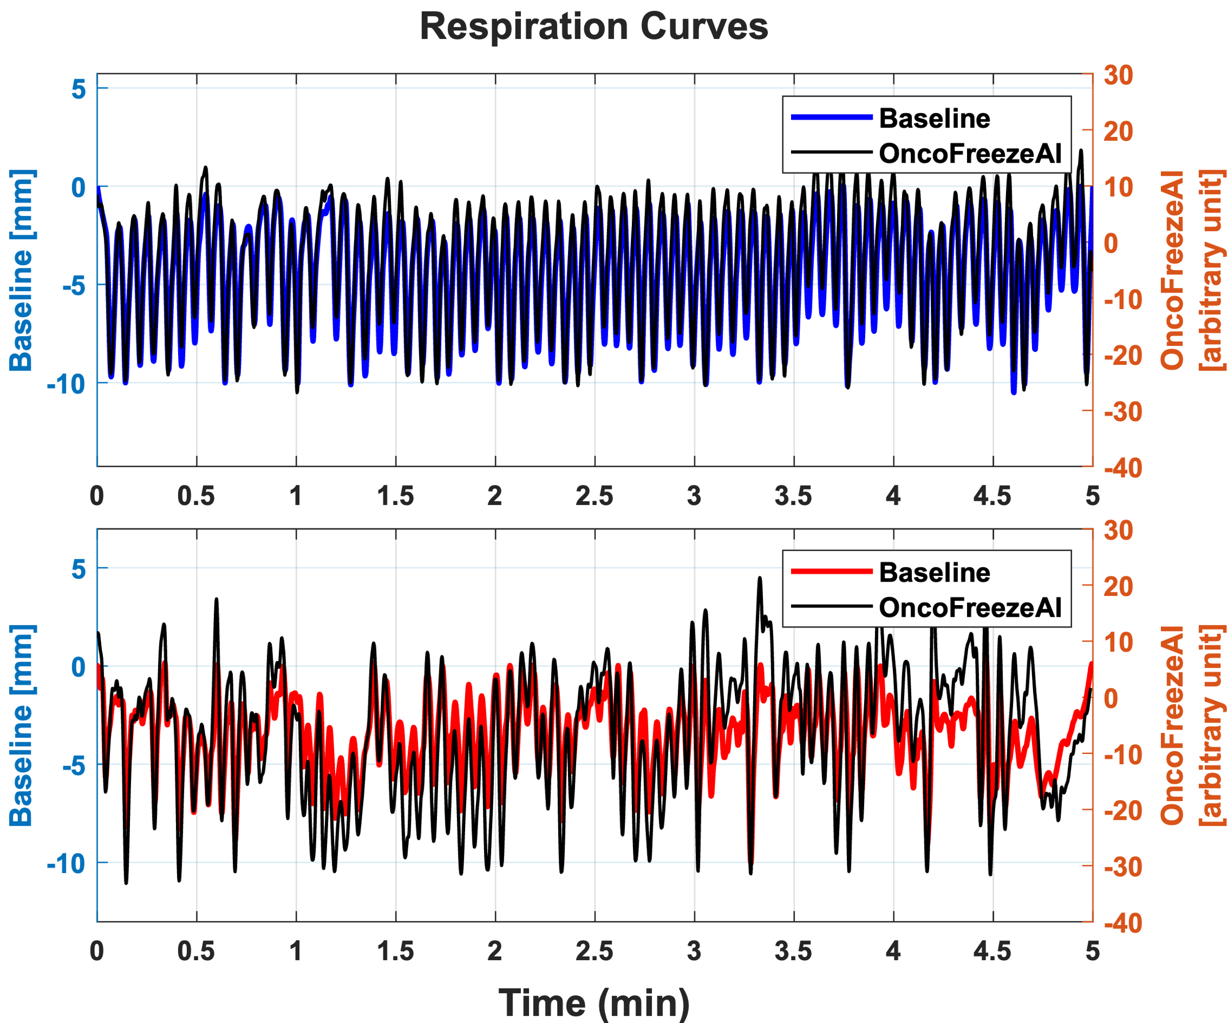
End-to-end verification with XCAT phantom
Voxel size: 1.5×1.5 ×1.5 mm³
Reference
With motion
Motion corrected
With motion
Motion corrected
Real patient scan
Respiration Curves
Frequency spectrum correlation = 1.00
Frequency spectrum correlation = 1.00
[mins]
[mins]

Slide 22

End-to-end verification with XCAT phantom
Reference
With motion
Motion corrected
max_diaphragm_motion = 2.0 cm
Respiration curve, max. = 40 mm
max_diaphragm_motion = 2.0 cm
Respiration curve, max. = 20 mm
A proper configuration for 163 cm XCAT:
max_diaphragm_motion = 2.0 cm
Respiration curve, max. = 10 mm

Slide 23
Tackling overlapping object, truncation and towards more realistic breast phantoms

Slide 24





Integration of XCAT Phantom into Other Scanners
Main Goal
Offline Image reconstruction
Patient Simulation Model
Breast Insert and mMR Scanner GATE model
Root2Sinogram
PET Image Data
Developing a dedicated breast PET/MR insert integrated with the Biograph mMR to improve breast cancer diagnosis.
2 Cylinders , 5 Rings , 32 Detectors per ring
We aiming for building a patient based realistic breast phantom to study in the simulation of the hybrid system (mMR and Breast Insert)
Get advantage of XCAT phantom for primary studies and as a foundation to develop a realistic breast phantom
Partial adult female XCAT phantom
(163 cm, 66 kg, [¹⁸F]FDG, 2 MBq/kg)
Voxel size: 1.5×1.5 ×1.5 mm³

Slide 25

Integration of XCAT Phantom into Other Scanners
Main Goal
Offline Image reconstruction
Breast Insert and mMR Scanner GATE model
Root2Sinogram
PET Image Data
Primary Workflow
Partial adult female XCAT phantom
(163 cm, 66 kg, [¹⁸F]FDG, 2 MBq/kg)
Voxel size: 1.5×1.5 ×1.5 mm³
mMR Scanner GATE model
Offline Image reconstruction
Root2Sinogram
PET Image Data

Slide 26
Integration of XCAT Phantom into Other Scanners
Insertion of XCAT phantom into the GATE mMR – Only scanner to solve the primary challenges of Overlapping
Study the effect of the Breast Insert in the terms of lesion detection and activity recovery
Primary Workflow
Partial adult female XCAT phantom
(163 cm, 66 kg, [¹⁸F]FDG, 2 MBq/kg)
Voxel size: 1.5×1.5 ×1.5 mm³
mMR Scanner GATE model
Offline Image reconstruction
Root2Sinogram
PET Image Data

Slide 27


Challenges of XCAT inside Smaller Scanners
mMR Biograph Bore Size: ~60cm
Quadra Scanner bore size: 78 cm and Axial FOV: 106cm
Partial adult female XCAT phantom
(163 cm, 66 kg, [¹⁸F]FDG, 2 MBq/kg)
Challenge One
Voxel size: 1.5×15 ×1.5 mm³

Slide 28


Challenges of XCAT inside Smaller Scanners
~25.8 cm
mMR Biograph Bore Size: ~60cm
Quadra Scanner bore size: 78 cm and Axial FOV: 106cm
Partial adult female XCAT phantom
(163 cm, 66 kg, [¹⁸F]FDG, 2 MBq/kg)
Axial PET FOV: 258 mm
(i.e., ~25.8 cm)
Challenge Two
Voxel size: 1.5×15 ×1.5 mm³
How to tackle these issues ?

Slide 29

Suggested Solutions to avoid Overlaps and have a full body simulation
Challenge 1 Solution
Air Box
Slice 1
~25.8 cm
~25.8 cm
Slice 2
XCAT Phantom ready to be inserted in the Simulation
~25.8 cm
Challenge 2 Solution
Slice 3,…

Slide 30







Acknowledgments
Christian la Fougère
Fabian Schmidt
Stefan Weigel
Wenhong Lan
Fabian Schmidt
Elnaz Olyaei
Lukas Rauscher
Janina Hohnholz
Christian Pommranz
Jorge Cabello
Maurizio Conti
Noah Birge
Paul Schleyer
The authors would like to thank the state of Baden-Württemberg for its support of bwHPC and the German Research Foundation (DFG) for funding under "Project number 455622343" (bwForCluster NEMO 2).
Thanks for your attention

