Slide 1



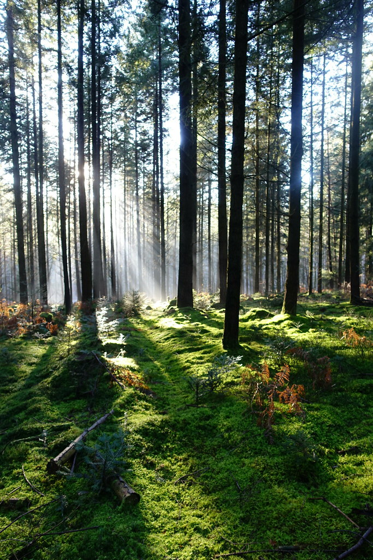
Lignocellulosic biomass fractionation with deep eutectic solvents: a tunable step towards lignin applications
2eme journée scientifique et technique de l’IPHC
09 Décembre 2025
Maud VILLAIN-GAMBIER
Maître de conférences-HDR, Université de Strasbourg
Équipe de Reconnaissance et Procédés de Séparation Moléculaire (RePSeM)
Département des Sciences Analytiques
Institut Pluridisciplinaire Hubert Curien (IPHC) UMR CNRS 7178
09/12/2025

Slide 2


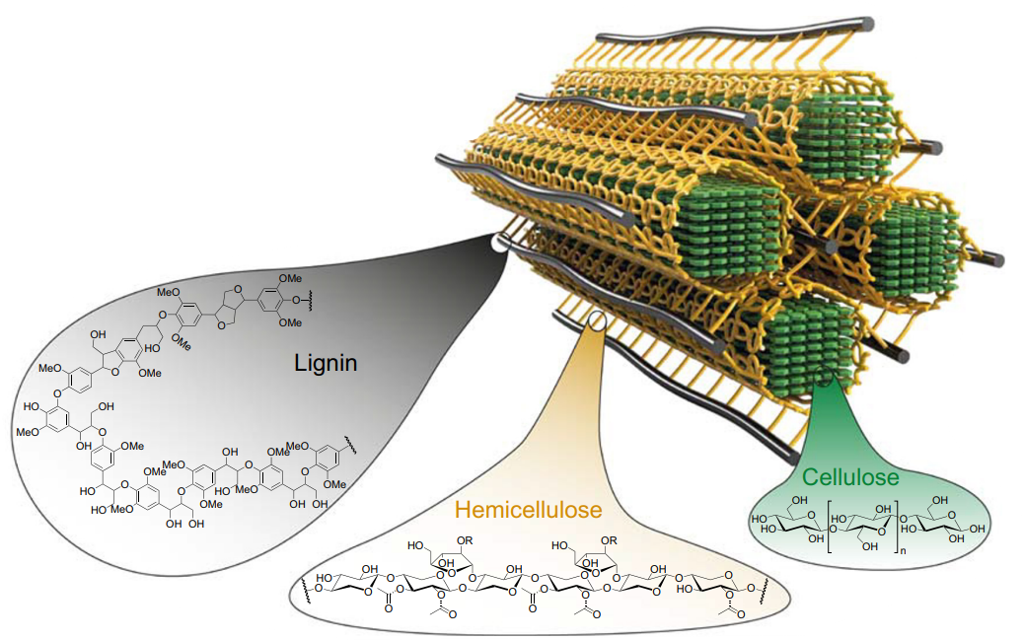
I.
Lignocellulosic biomass
Plant cell
II.
Lignocellulosic complexe
300 billion tons of lignin in the biosphere ^{[2]}
The most abundant natural source of aromatic molecules on Earth ^{[3]}
Major by-product of the paper, sugar, and biofuel industries ^{[4]}
III.
IV.
V.
VI.
5-35%
Lignin
40-50%
25-35%
Cellulose
Hemicellulose
2
Main biopolymers from plant cell wall [1]

Slide 3

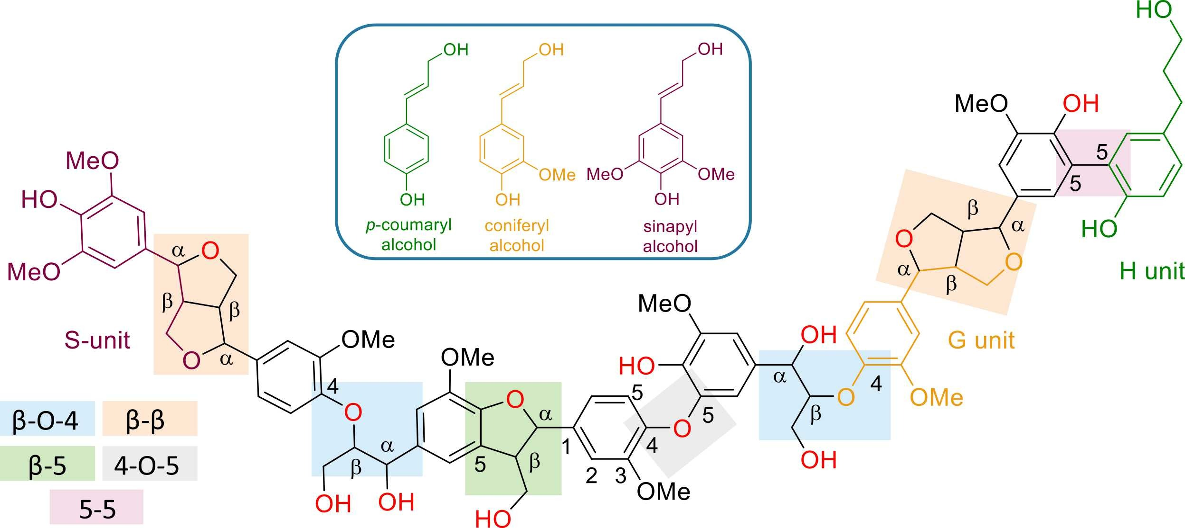







I.
Lignin structure
Varies depending on plant species, tissue, stage of development, or growing conditions ^{[6]}
H sub-unit
II.
5-5
p-coumaryl Alcohol
β-β
IV.
β-β
V.
S sub-unit
VI.
G sub-unit
Sinapyl alcohol
β-O-4
β-O-4
Coniferyl alcohol
β-5
4-O-5
Example of native lignin structure from [5]
3

Slide 4
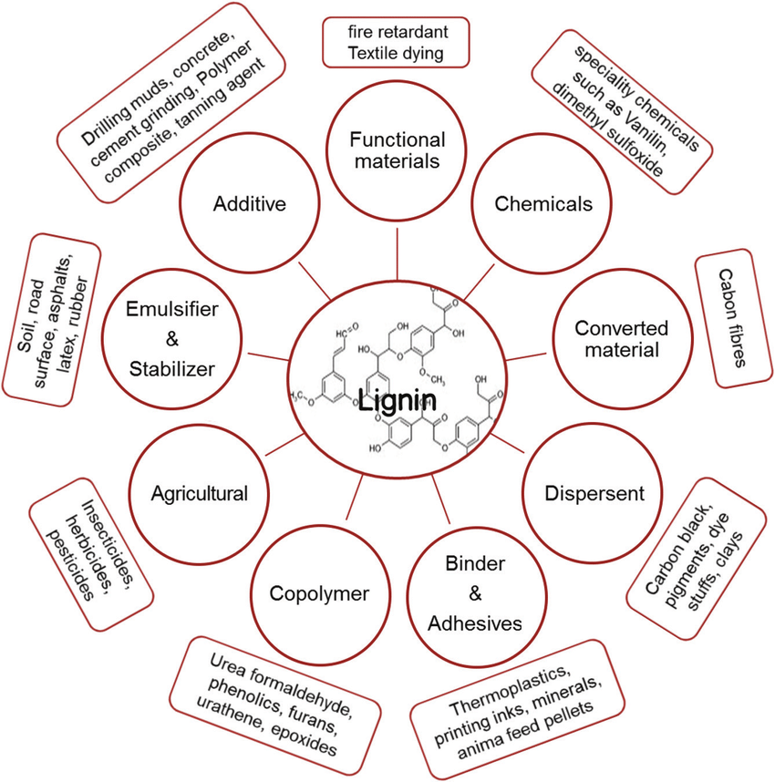
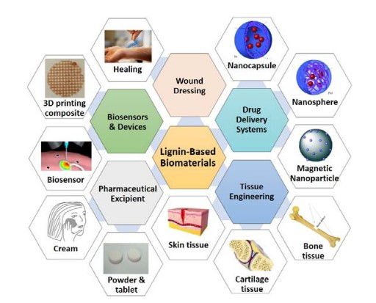
Why lignin is so interesting?
Can be used:
as macromomecule
after depolymerization
as lignin nanoparticles (LNPs)
Lignin current and potential medical applications [8]
Lignin current and potential global applications [7]
4

Slide 5

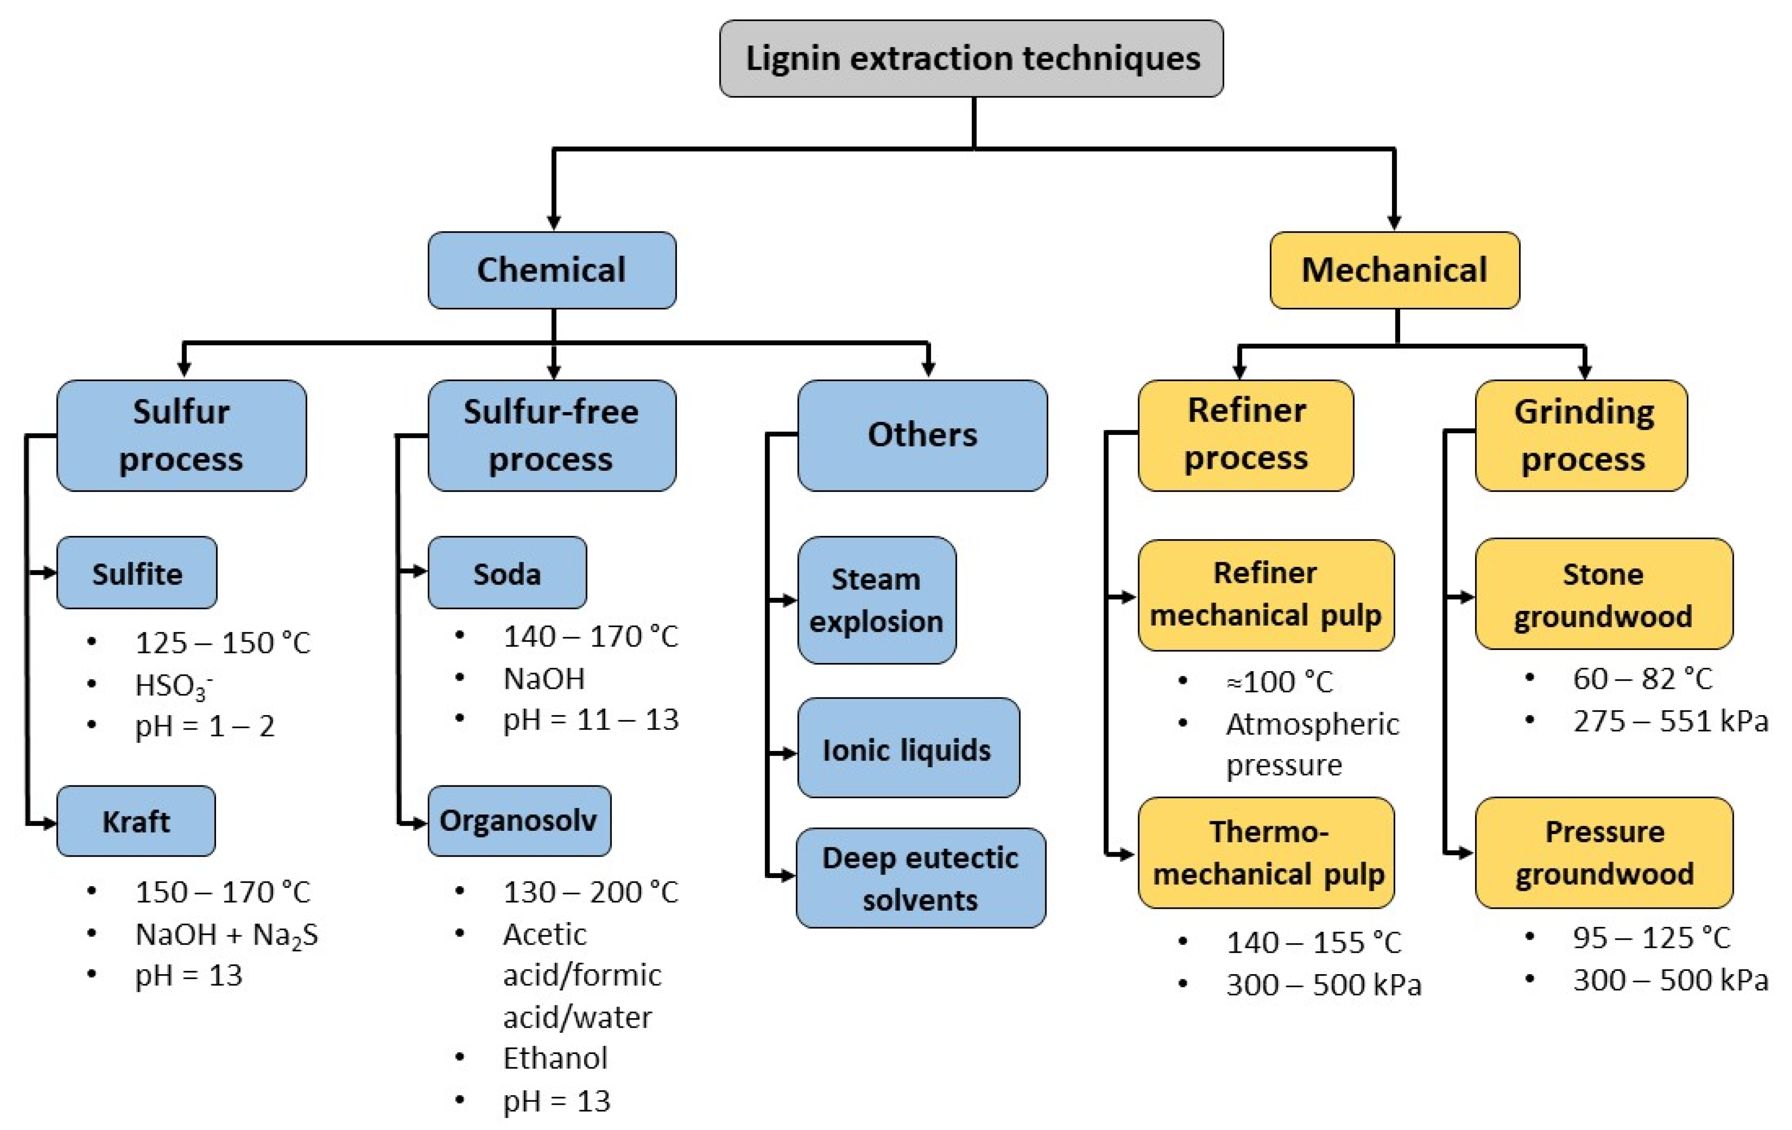
Lignin extraction in Cellulose 1st biorefineries
Concept focuses on cellulose recovery of high purity
Drawbacks
Harm for the environment
Concentrated acid process is corrosive
Large amount of water is needed for washing (Alkali NaOH)
Solvents recycling complexity
High cost of chemicals and toxicity of some ionic liquids
High energy demands for combined methods
Lignin of low quality
From [9] and [10]
5

Slide 6
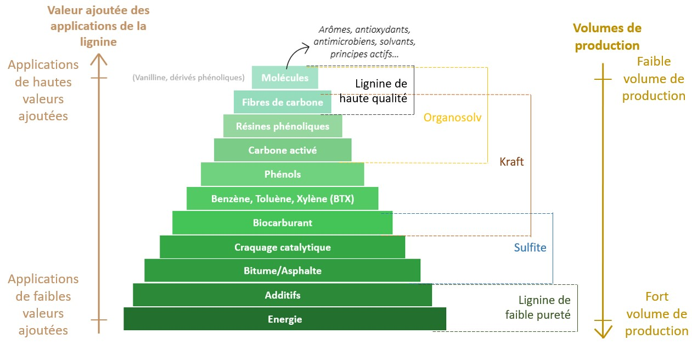
I.
Relationship between lignin added value and fractionation process
II.
III.
IV.
V.
VI.
Industrial valorisation of lignin and relation with fractionation process from [11]
6

Slide 7

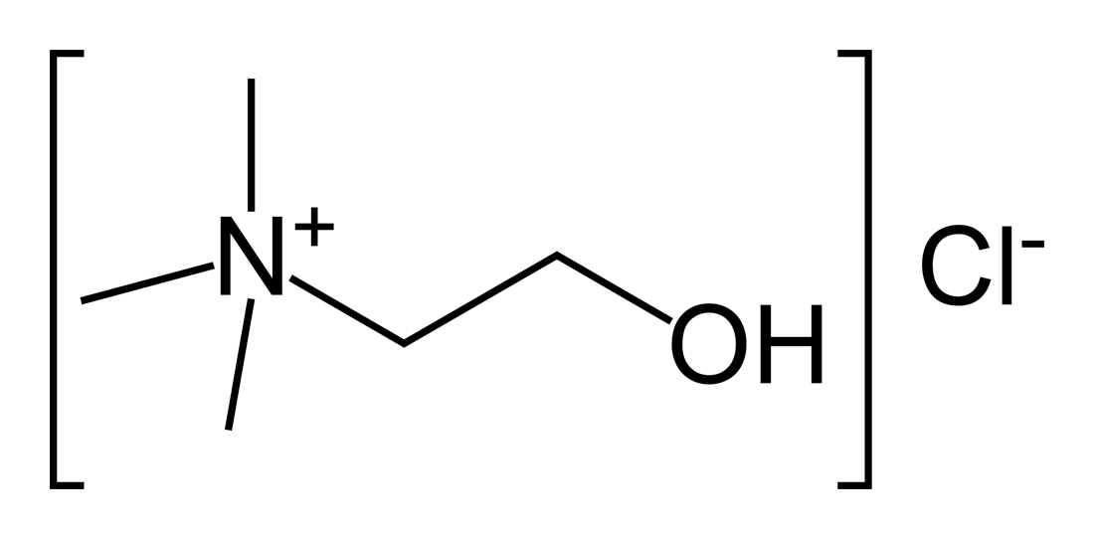
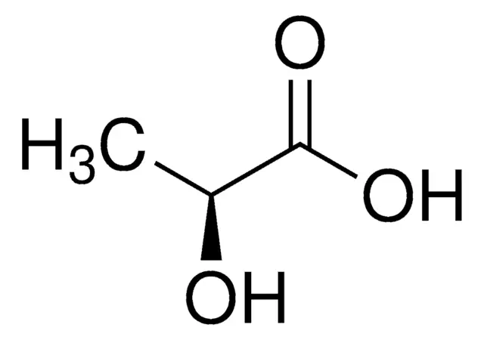
I.
Deep eutectic solvents (DES)
Easy to prepare
Biodegradable
Non-toxic
Mild conditions
Sustainable
Low cost
DES = Mix at a specific molar ratio of a least 1 Hydrogen bond acceptor (HBA) + 1 Hydrogen bond donor (HBD)
III.
Temperature
Temperature
IV.
V.
Melting T° of A
Liquid
Melting T° of B
Solid A + liquid
VI.
Solide B + liquid
Eutectic point
Eutectic temperature
Compound A: Solid
Compound B: Solid
Example: choline chloride
Compound A: HBA
eutectic molar ratio
Compound B: HBD
Example: L-(+)-lactic acid
Phase diagram of a eutectic mixture from [12]
7

Slide 8
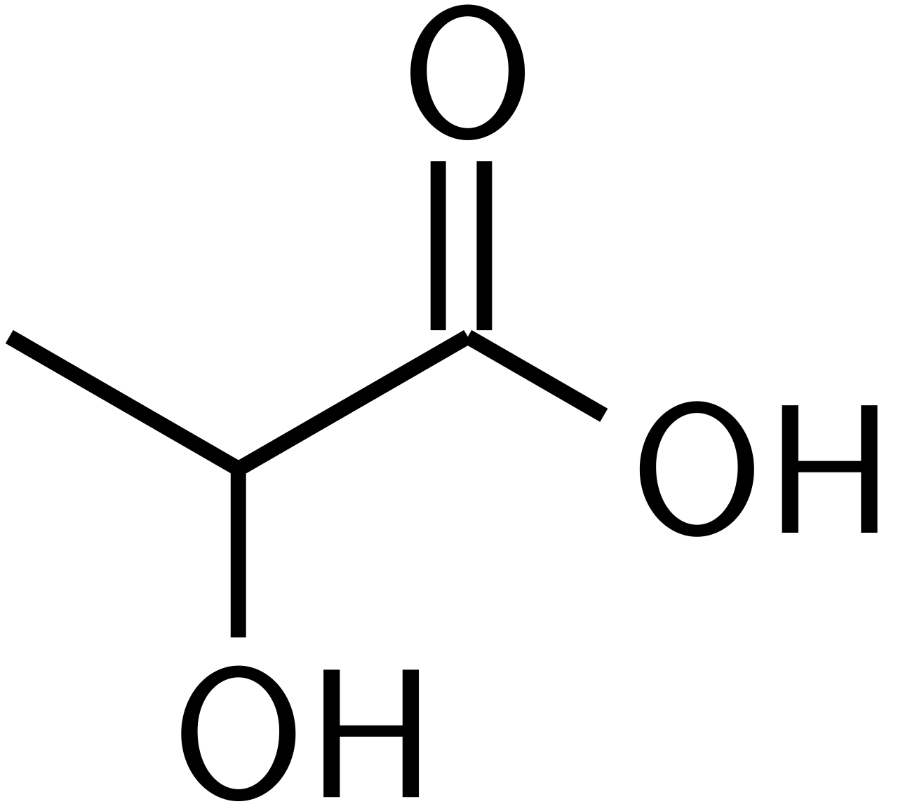
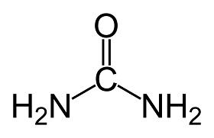
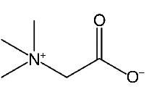
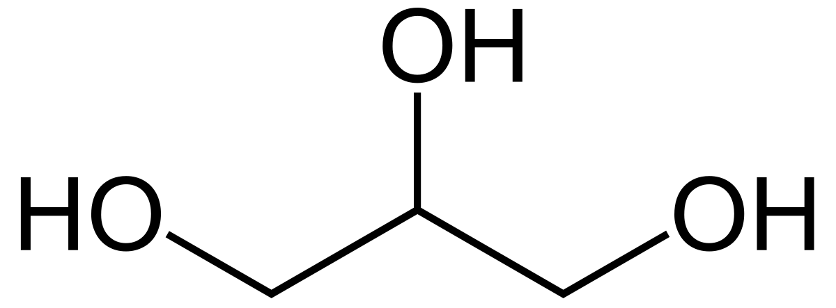
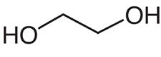
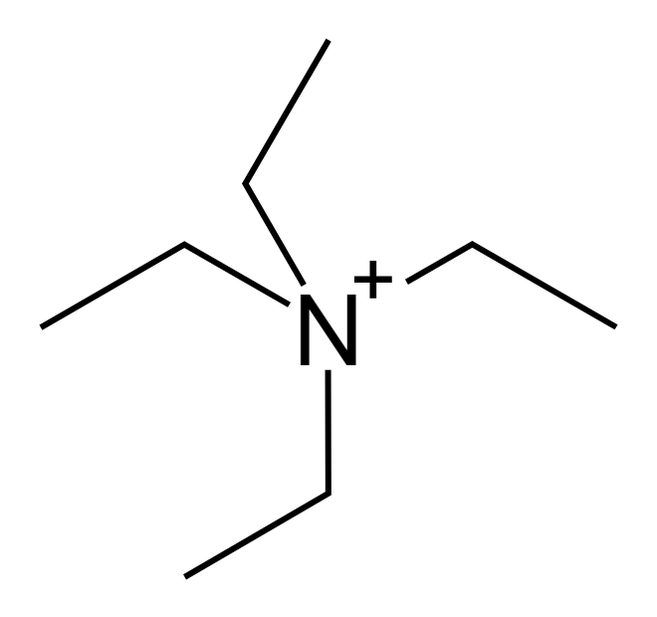

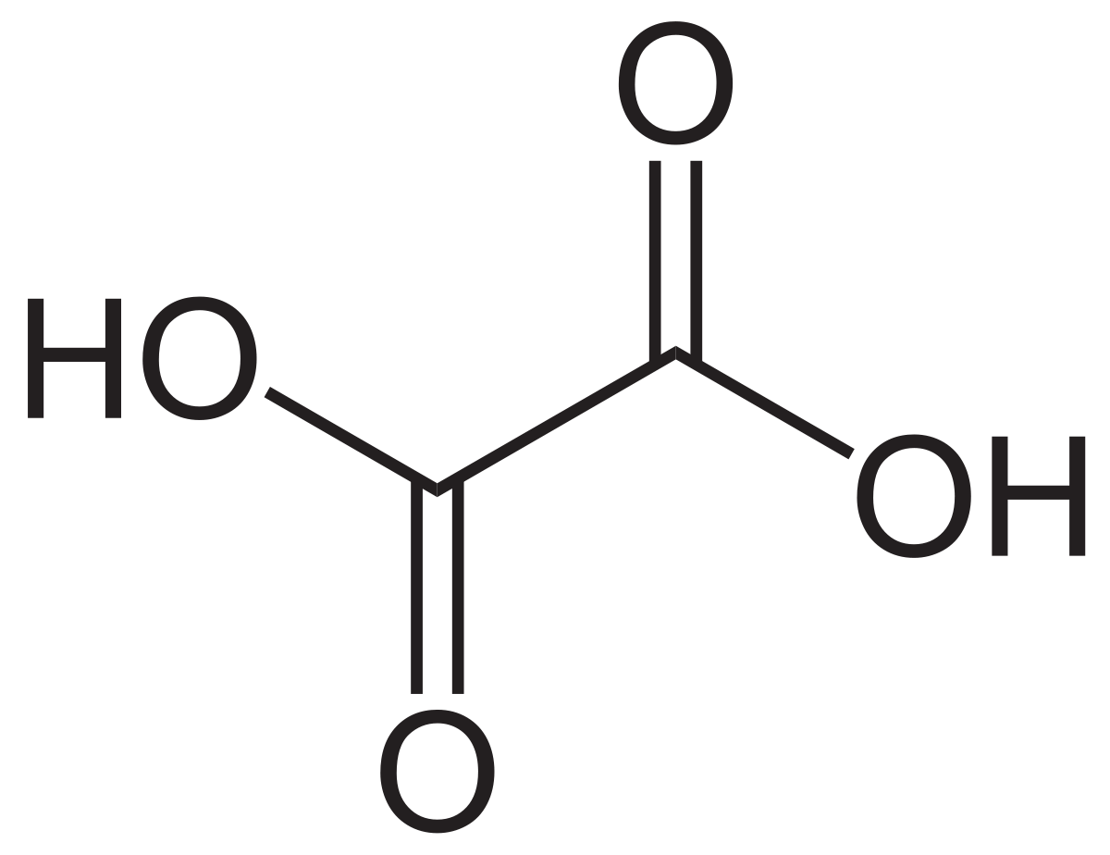
Examples of DES composition
Hydrogen bond acceptor
Hydrogen bond donor
Choline chloride (B4 vitamin, pet food)
Lactic acid (organic compound necessary for carbohydrate metabolism))
Urea (molecule resulting from the breakdown of proteins)
Betaine (beetroot pigment essential for liver function)
Glycerol (molecule naturally present in all oils and fats)
Ethylene glycol (mainly used in the manufacture of antifreeze and polyester fibers)
Malonic acid (a cellular poison found after oxidation of apple juice)
Oxalic acid (bleaching agent)
Tetraethylammonium chloride
DES examples from [13]
8

Slide 9
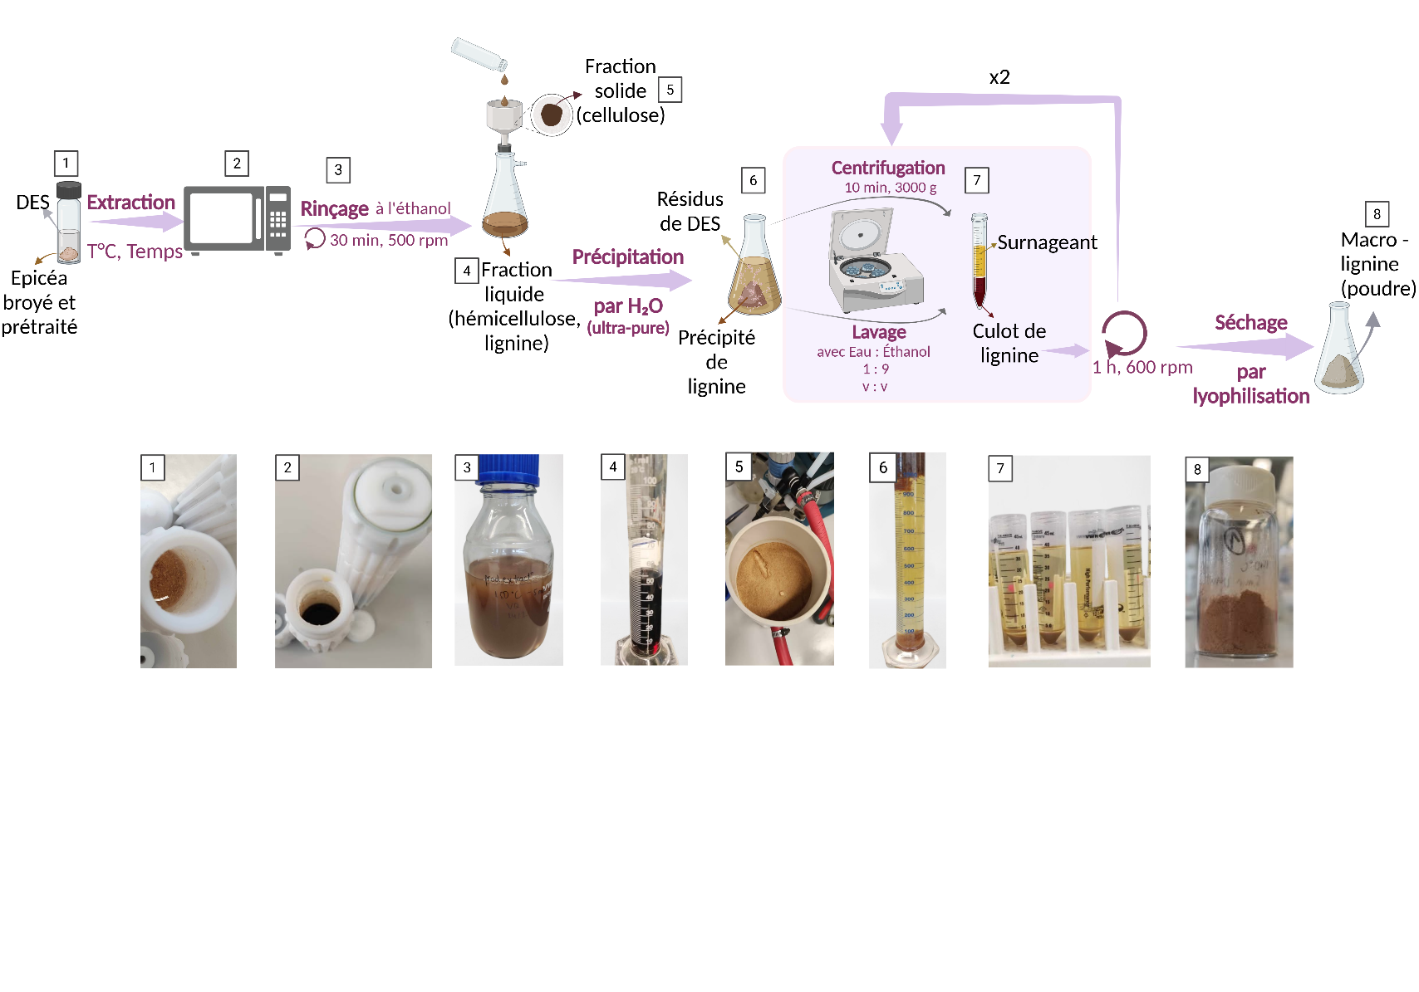
I.
Lignin fractionation process
9

Slide 10
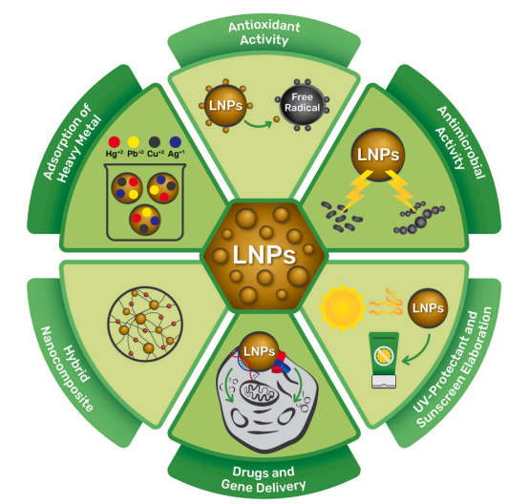
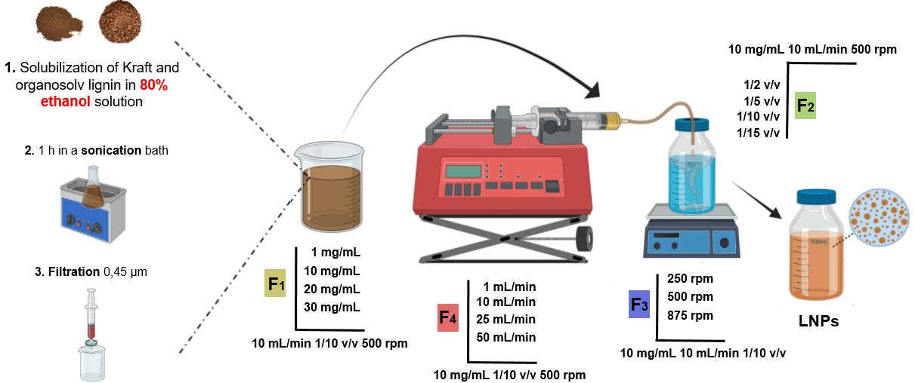
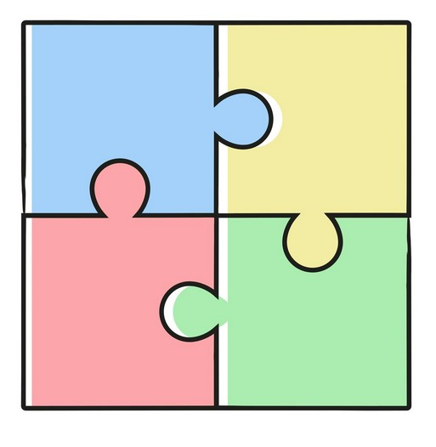


I.
Lignin nanoparticles (LNPs) production and applications
II.
IV.
V.
from [14]
Adhesive for construction sector
VI.
Biomass type
DES process
Main objectives of
Iliass Kadmiri’s PhD thesis
Adhesives properties
LNPs properties
10

Slide 11
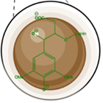
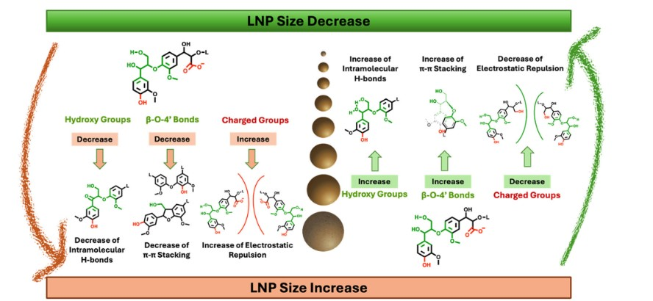
I.
LNPs properties: What are we looking for?
II.
Good Lignin fractionation yield
IV.
High Lignin purity
V.
High Hydroxy groups content
VI.
High B-O-4’ Bonds
Parameters affecting LNPs size from [15]
11

Slide 12
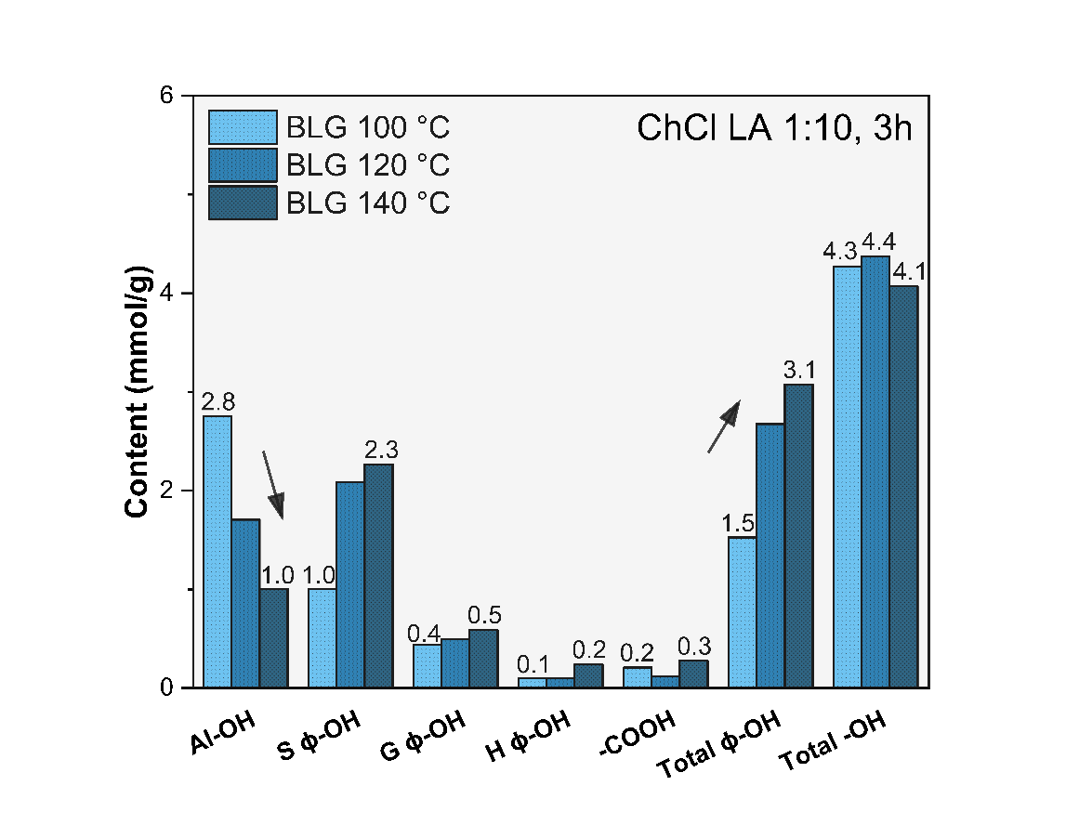
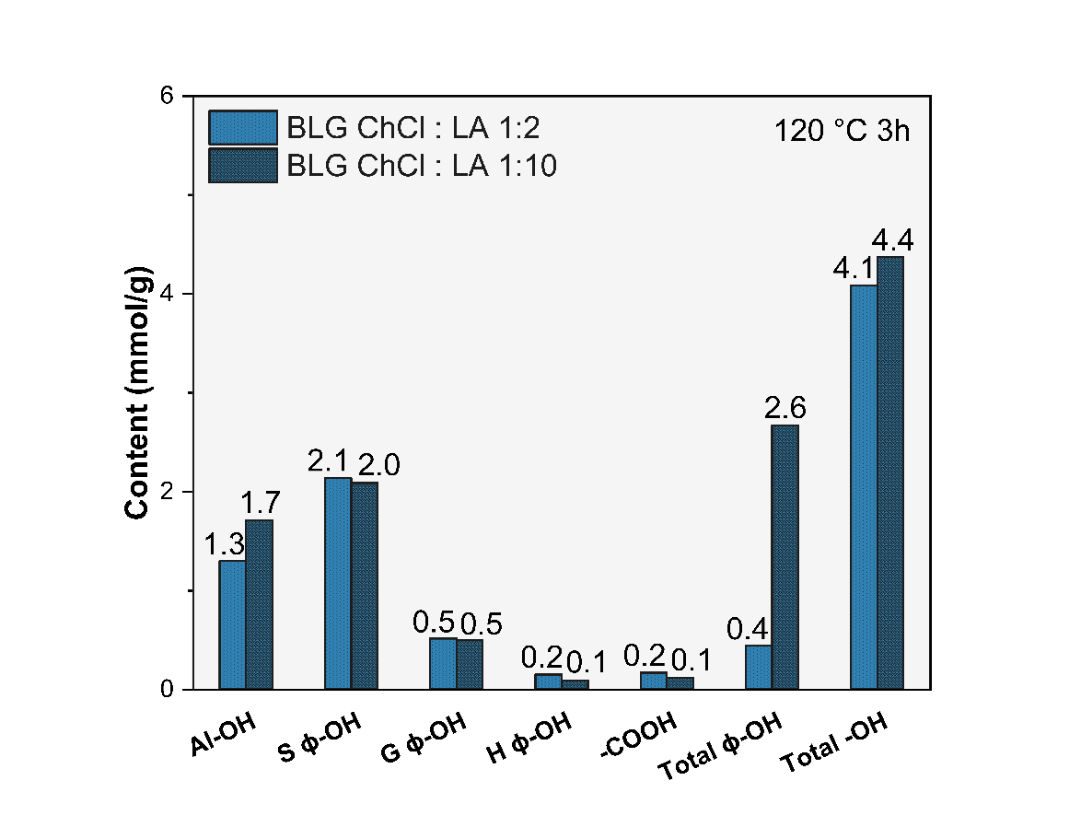
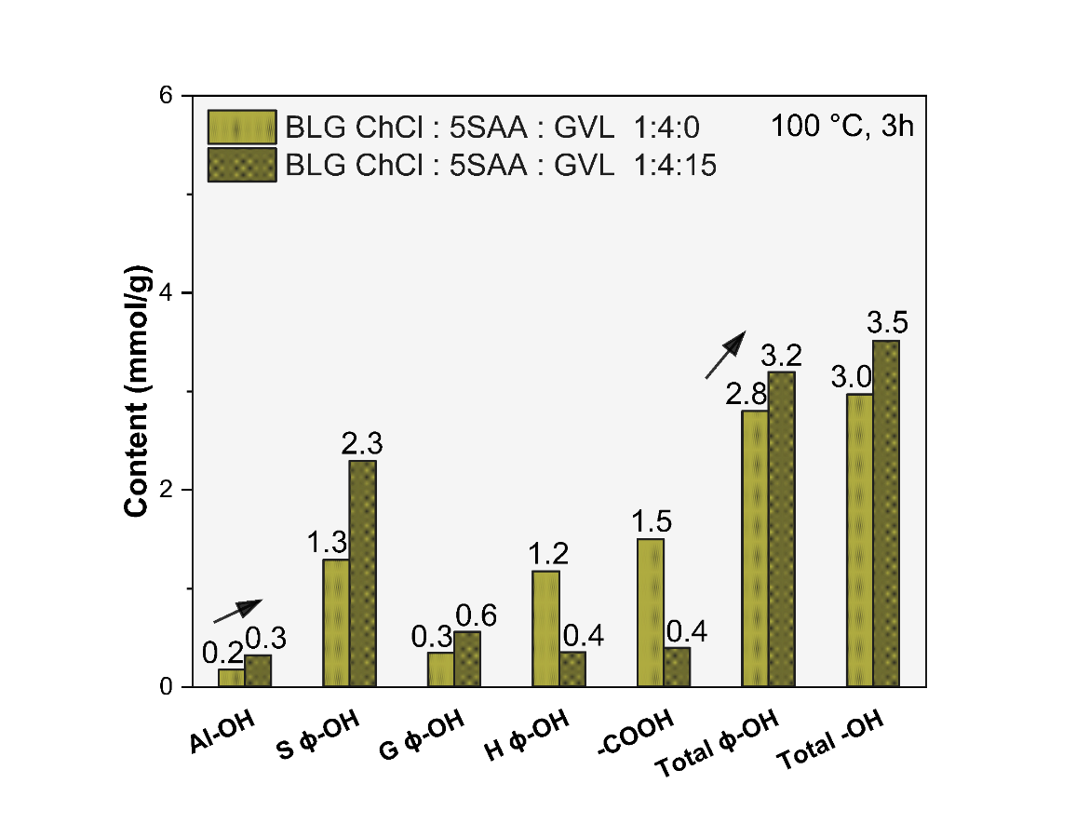
I.
Example of ³¹P NMR results
II.
Good Lignin fractionation yield
IV.
High Lignin purity
High Hydroxy groups content
V.
High B-O-4’ Bonds
VI.
Inverted correlation of aliphatic and phenolic groups with increasing temperature.
Biomass type
DES process
Harsh conditions increase the yield but also the phenolic content of the lignin
Production of tailored DES (composition, process parameters) depending on application
Adhesives properties
LNPs properties
12

Slide 13
Thanks for your attention
2eme journée scientifique et technique de l’IPHC
09 Décembre 2025
Maud VILLAIN-GAMBIER
Maître de conférences-HDR, Université de Strasbourg

Slide 14
Références bibliographiques
[1] Brethauer, S., Shahab, R., & Studer, M. (2020). Impacts of biofilms on the conversion of cellulose. Applied Microbiology and Biotechnology, 104(12), 5201-5212. https://doi.org/10.1007/s00253-020-10595-y
[2] Ludmila, H., Michal, J., Andrea, S., & Ales, H. (2015). Lignin, potential products and their market value. Wood Research, 60(6), 973-986. https://www.researchgate.net/publication/286449542_Lignin_potential_products_and_their_market_value
[3] Li, C., Zhao, X., Wang, A., Huber, G., & Zhang, T. (2015). Catalytic transformation of lignin for the production of chemicals and fuels. Chemical Reviews, 115(21), 11559-11624. https://doi.org/10.1021/acs.chemrev.5b00155
[4] Hatakeyama, H., & Hatakeyama, T. (2009). Lignin structure, properties, and applications. Advances in Polymer Science, 232(1), 1‑63. https://doi.org/10.1007/12_2009_12
[5] Gracia-Vitoria, J., Rubens, M., Feghali, E., Adriaensens, P., Vanbroekhoven, K., & Vendamme, R. (2022). Low-field benchtop versus high-field NMR for routine 31P analysis of lignin, a comparative study. Industrial Crops and Products, 176(1), 114405. https://doi.org/10.1016/j.indcrop.2021.114405
[6] Vanholme, R., Demedts, B., Morreel, K., Ralph, J., & Boerjan, W. (2010). Lignin biosynthesis and structure. Plant Physiology, 153(3), 895-905. https://doi.org/10.1104/pp.110.155119
[7] 10.5772/intechopen.72963
[8] https://doi.org/10.3390/biomedicines10040747
[9] D. Lobato-Peralta, E. Duque-Brito, H. Villafán-Vidales, A. Longoria, P.J. Sebastian, A. Cuentas-Gallegos, C. Arancibia-Bulnes, U. Okoye, A review on trends in lignin extraction and valorization of lignocellulosic biomass for energy applications, Journal of Cleaner Production, Volume 293, 2021.
[10] Rezania, Shahabaldin & Md Din, Mohd Fadhil & Mohamad, Shaza & Sohaili, Johan & Mat Taib, Shazwin & Yusof, Mohd & Kamyab, Hesam & Darajeh, Negisa & Ahsan, Amimul. (2017). Review on Pretreatment Methods and Ethanol Production from Cellulosic Water Hyacinth. Bioresources.

Slide 15
Références bibliographiques
[11] El Bekkari, N., Leroux, C., Picard, L. (2023). La filière lignine. Procédés d’extraction, de fractionnement chimique et de valorisation des agromolécules. Université de Champagne-Ardenne. Mini projet de Master. BCVB0901. https://acrobat.adobe.com/link/track?uri=urn:aaid:scds:US:35244134-01e2-450b-af13-f18696b95176
[12] Robert, M. (2017). Les solvants eutectiques comme milieu d’extraction de composés polaires bioactifs à partir de sons céréaliers. INRA Montpellier. https://hal.science/hal-01603214
[13] Yu, D., Xue, Z., & Mu, T. (2022). Deep eutectic solvents as a green toolbox for synthesis. Cell reports physical science, 3(4), 100809. https://doi.org/10.1016/j.xcrp.2022.100809
[14] Schneider, W. D. H., Dillon, A. J. P. & Camassola, M. Lignin nanoparticles enter the scene: A promising versatile green tool for multiple applications. Biotechnology Advances 47, 107685 (2021). https://doi.org/10.1016/j.biotechadv.2020.107685
[15] 10.1038/s44296-024-00037-5

