Slide 1


Measure to protect: Instrumentation for modern radiation protection
On behalf of the DeSIs team
Djokhar BETELGUERIEV
(djokhar.betelgueriev@iphc.cnrs.fr)
Journées R&T CNRS/IN2P3 – 09/12/2025

Slide 2







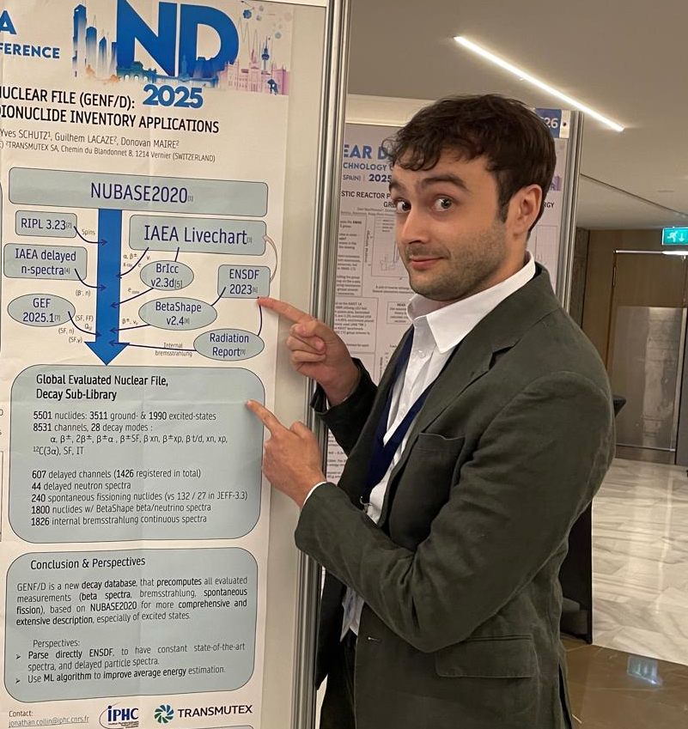


Our Team
Permanent researchers
Nicolas ARBOR (PR)
Alexandre BIGOT (MCF)
Christian FINCK (50%)
Daniel HUSSON (MCF)
Abdel-Mjid NOURREDDINE (PR)
Marie VANSTALLE (Team leader - MCF)
Permanent engineers/technicians
Séverine CHEFSON (AI)
Stéphane HIGUERET (Technical manager – IR)
Thê-Duc LÊ (AI)
Djokhar Betelgueriev (IR-CDD)
PhD students
Jonathan COLLIN, ATER – Dir. A. Nourreddine – 2022-2025
Lucia Garcia-Garcia, CNRS – Dir. N. Arbor – 2024-2027
Giovanna Rezende, CNRS-CNES – Dir. M. Vanstalle – 2024-2027

Slide 3
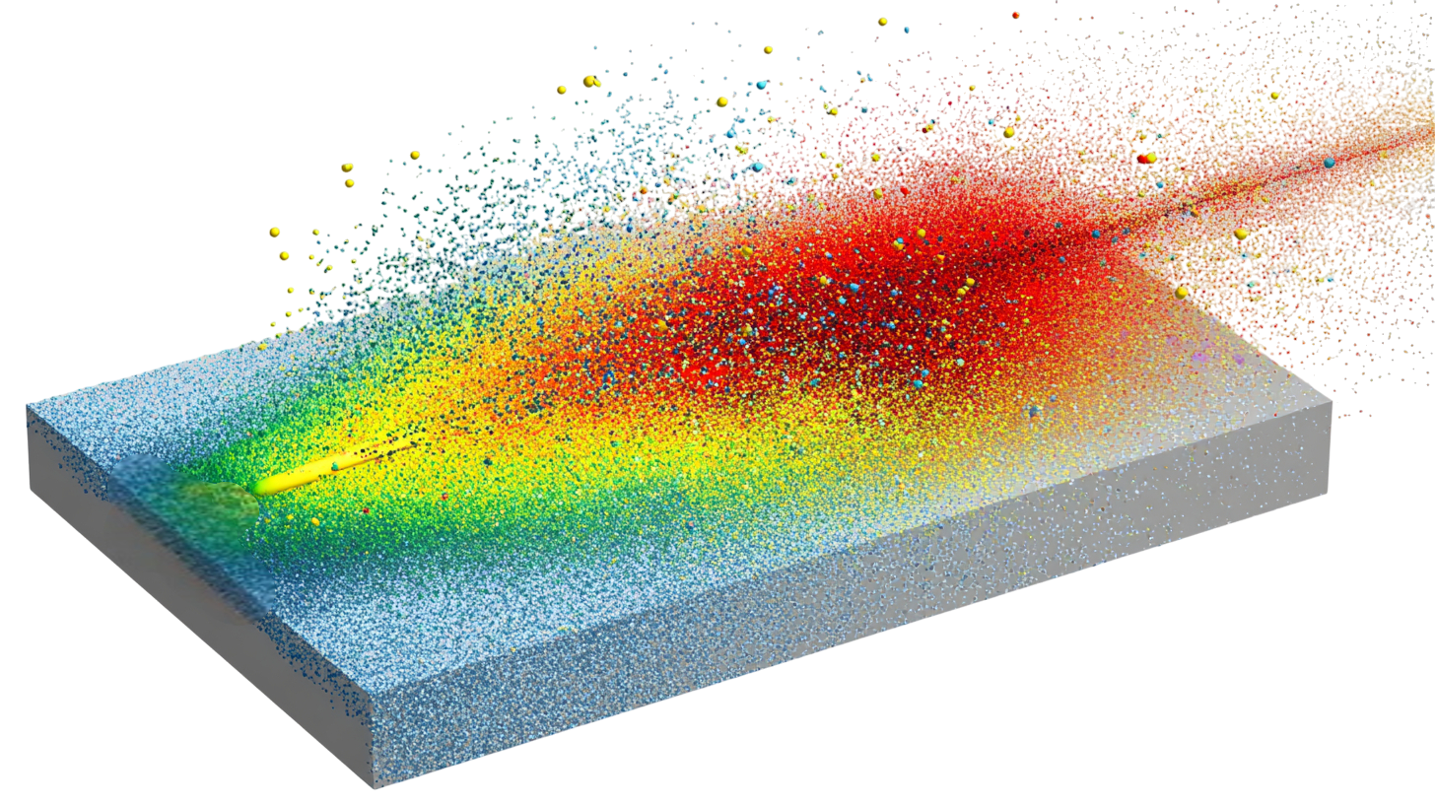
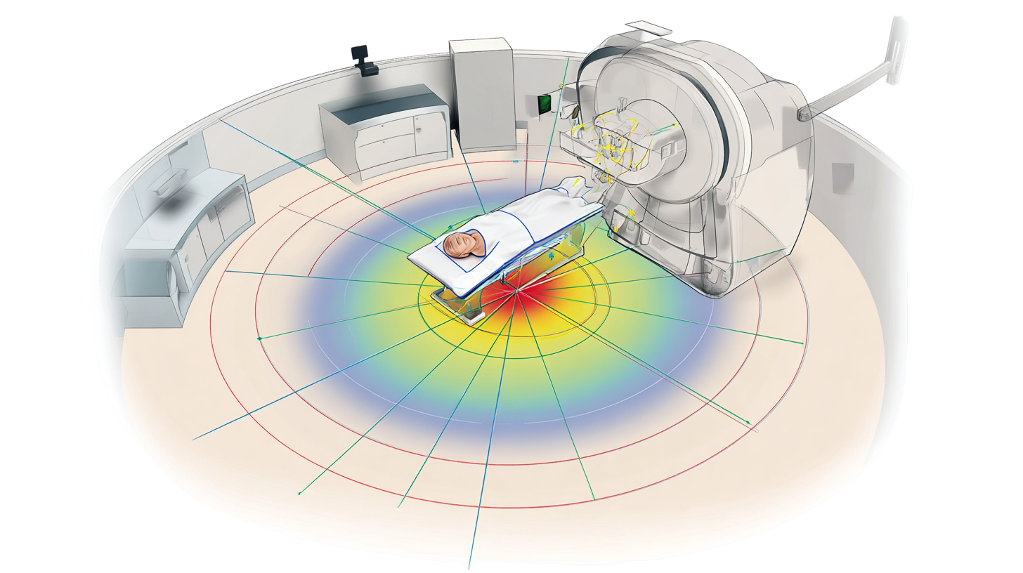
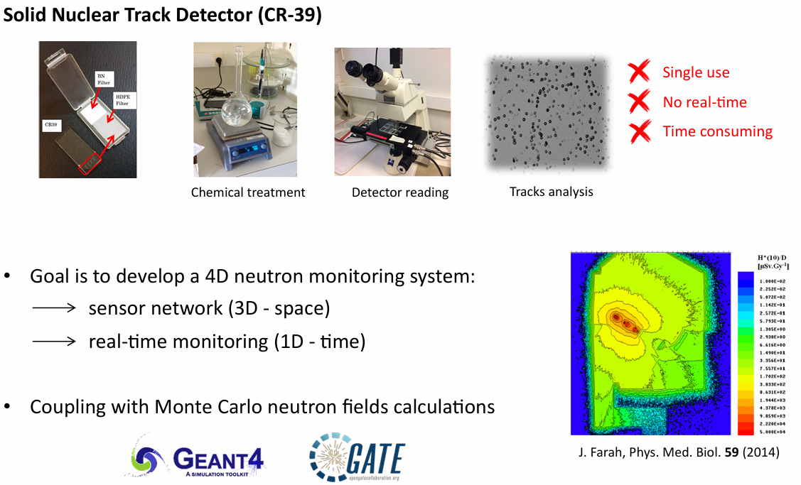
DeSIs – Dosimetry, Simulation & Instrumentation
Hadrontherapy & Space radiation Measure and model secondary particles produced by heavy ions.
Dosimetry
Accurately measure the dose in treatment systems.
Radioactivity
Detect and map contaminations and activations
Partnerships and collaborations
Hospitals (radiotherapy, radiobiology) • Heavy ion facilities (HIT, CNAO, GANIL, GSI...) • Academic laboratories • Nuclear industry & instrumentation

Slide 4
Measurement and modeling of secondary particles produced by heavy ions
FOOT: FragmentatiOn Of Target experiment
Heavy ion
Beam monitoring
Target
TOF Plastic
scintillator
Inner
Tracker
Magnet 2
Silicium
Microstrips
BGO
C₂H₄
Vertex
Magnet 1
💥​
💥​
¹²C
¹¹C
Monitor where
do the ions hit
🎯
🧲
🎯
🧲
🎯
⏱️
🔋
🎯
Measure the track before and
after bending, enabling precise
reconstruction of the particle’s
trajectory
🧲
Bends the fragment
trajectory according to its
momentum-to-charge
⏱️🔋
Measure the time-of-flight
of the fragment and
the deposited energy
Track + p/Z + ΔE → Element & isotope identification
→ Measure the differential production cross sections of nuclear fragments produced by ion–matter interactions

Slide 5
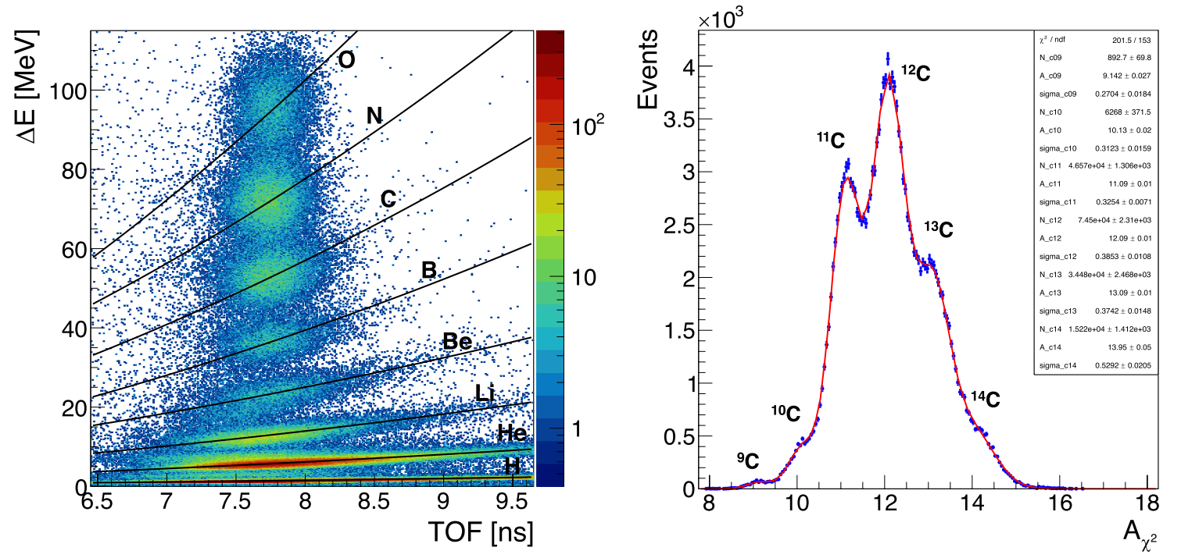
Measurement and modeling of secondary particles produced by heavy ions
FOOT: the FragmentatiOn Of Target experiment

Slide 6
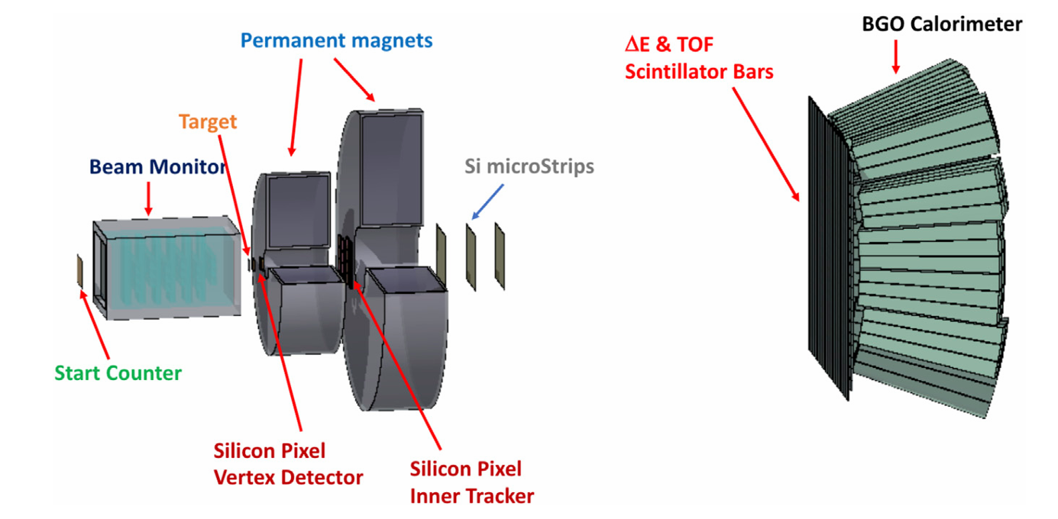
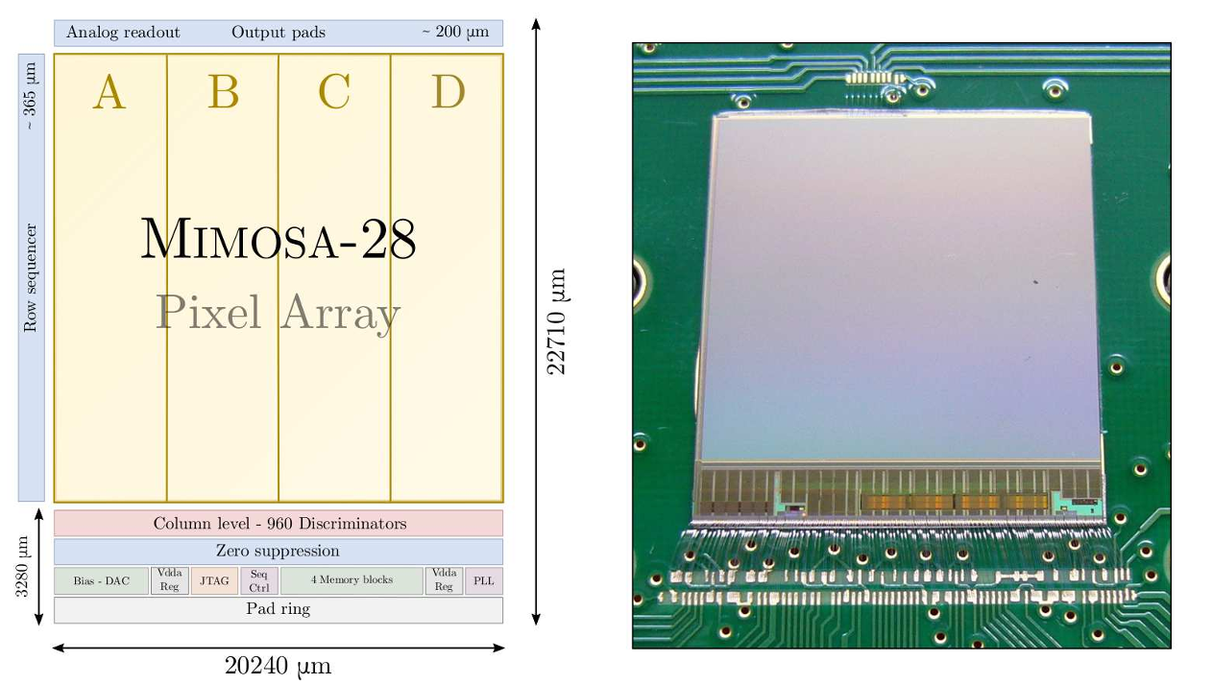
Measurement and modeling of secondary particles produced by heavy ions
MIMOSA (Monolithic Active Pixel Sensor)

Slide 7
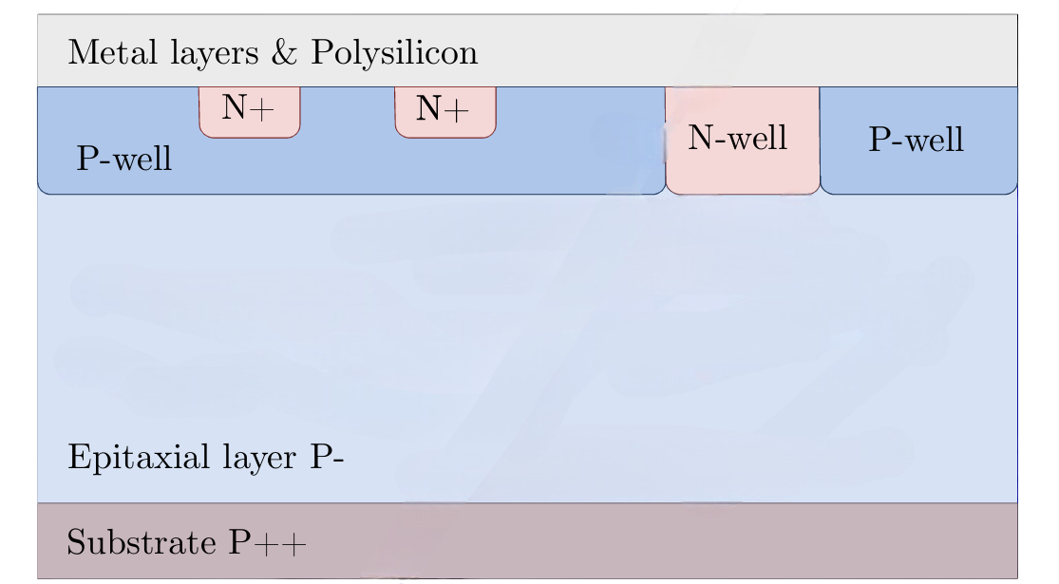
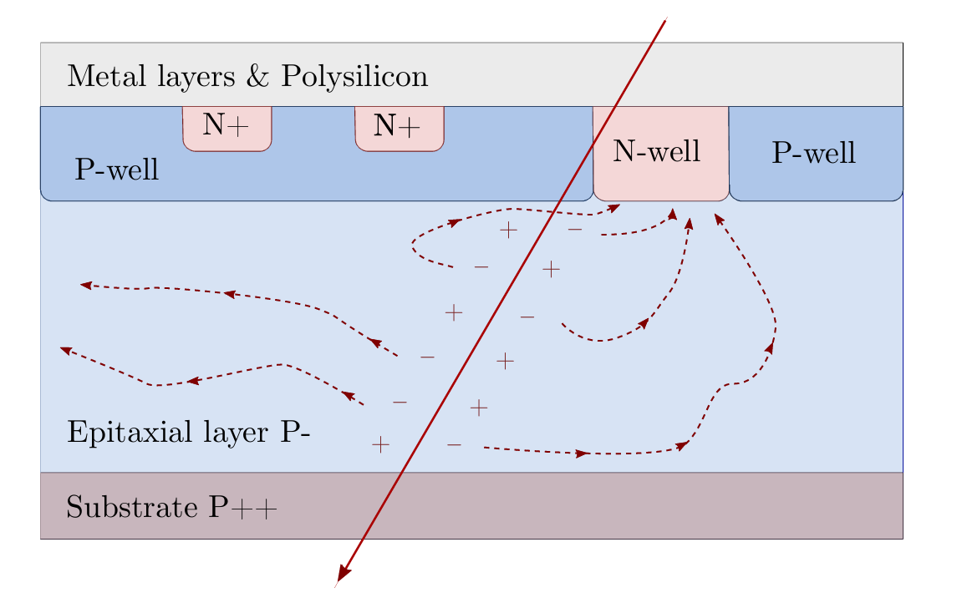
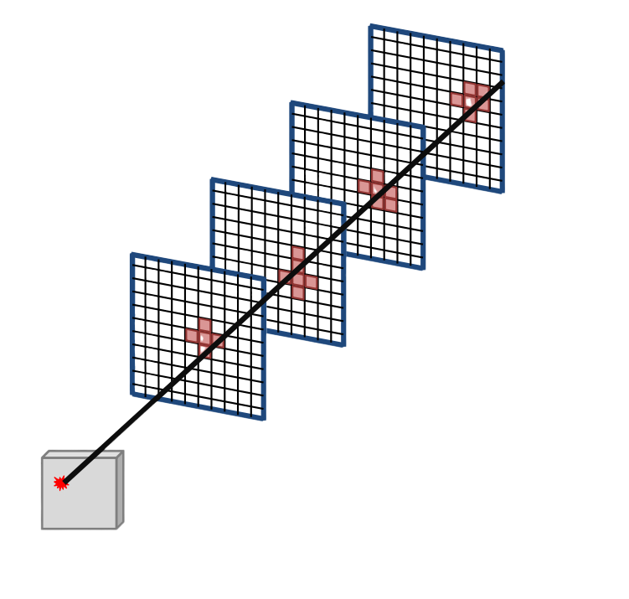
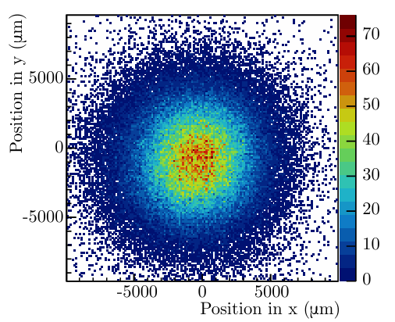
Measure and map charged particles and secondary neutrons with high spatial and temporal precision.
MIMOSA (Monolithic Active Pixel Sensor)
MIMOSA surface :
Pixel 1
Pixel 2 …
Spatial resolution : 4 µm

Slide 8
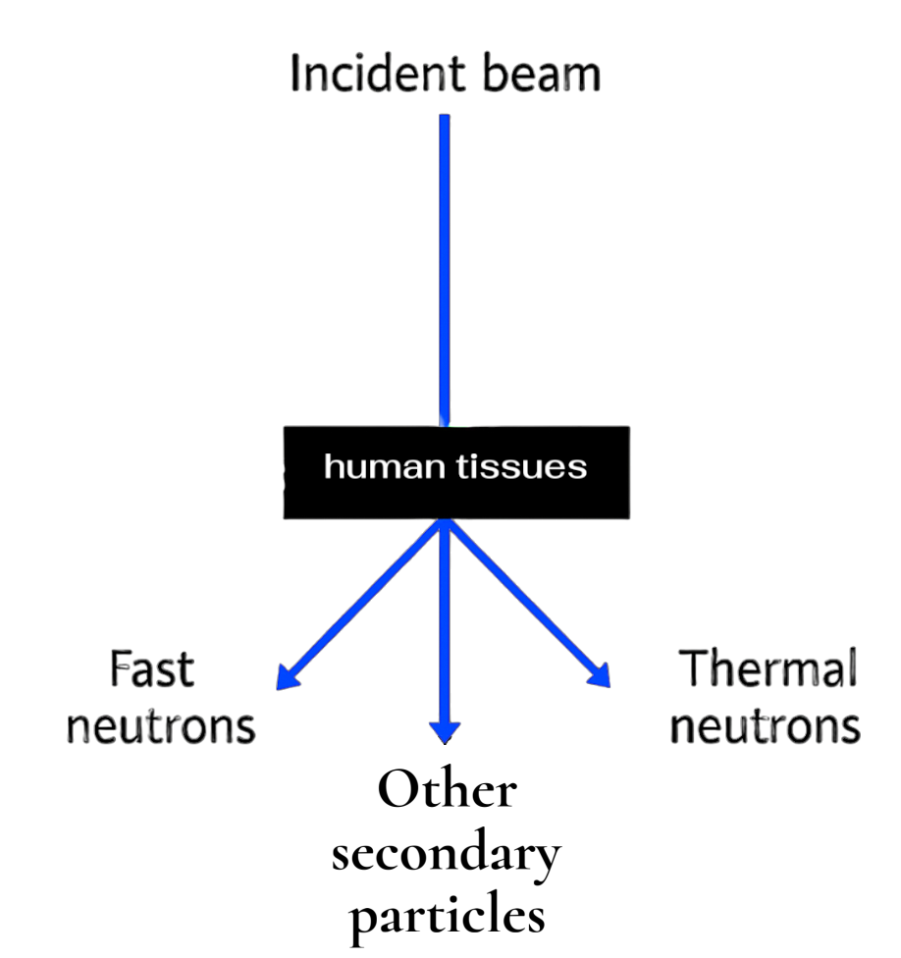
Measure and map charged particles and secondary neutrons with high spatial and temporal precision.
Off-target dose
Unwanted neutron dose delivered outside the treatment field.
Risk of secondary cancers
Neutron exposure can increase the probability of long-term radiation-induced malignancies.
Activation and radiation protection
Neutrons can activate surrounding materials, creating residual radioactivity that must be monitored for safety.
Difficult to quantify
  Neutrons have no electric charge, so they cannot be directly detected, making their measurement and modelling challenging.
Fast neutrons
Thermal neutrons

Slide 9
Measure and map charged particles and secondary neutrons with high spatial and temporal precision.

Slide 10
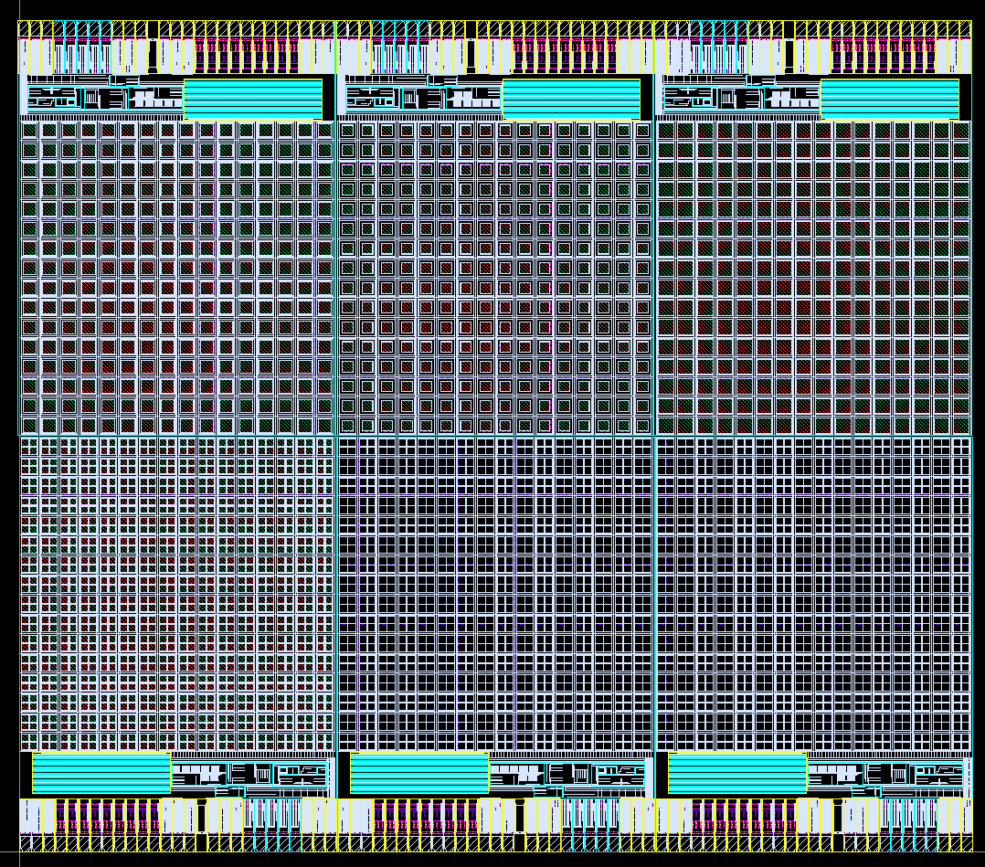
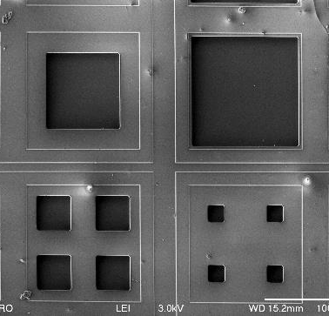
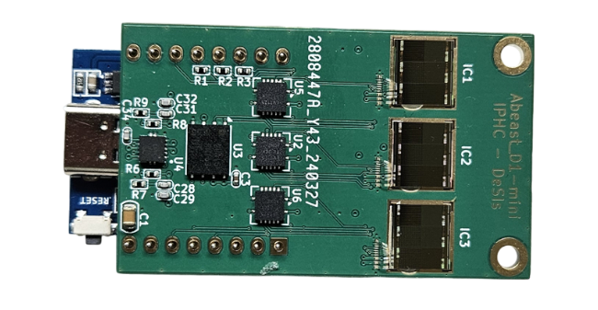
Measure and map charged particles and secondary neutrons with high spatial and temporal precision.
Alphabeast
137,63µm
The silicon oxide layer acts as a surface filter, reducing leakage and surface noise.
The size of the collection well is optimized to balance signal and noise

Slide 11
Measure and map charged particles and secondary neutrons with high spatial and temporal precision.
Alphabeast : Thermal neutron & Fast neutron detection collab C4PI Techno XFAB 0.35
Thermal neutron
Fast neutron
💥​
💥​
¹⁰B
PE
α
Recoil proton
SiO₂
SiO₂
SiO₂
SiO₂
-
-
-
-
+
+
+
-
+
-
Epitaxial layer
Epitaxial layer
+
-
+
Bulk
+
Bulk
-
+

Slide 12
Measure and map charged particles and secondary neutrons with high spatial and temporal precision.
Alphabeast
IC1
IC2
TH0
TH1
TH2
TH0
TH1
TH2
Counter
0
Counter
1
Counter
2
Counter
0
Counter
1
Counter
2
IC3
No converter
PE converter
Bore converter
TH0
TH1
TH2
Counter
0
Counter
1
Counter
2

Slide 13
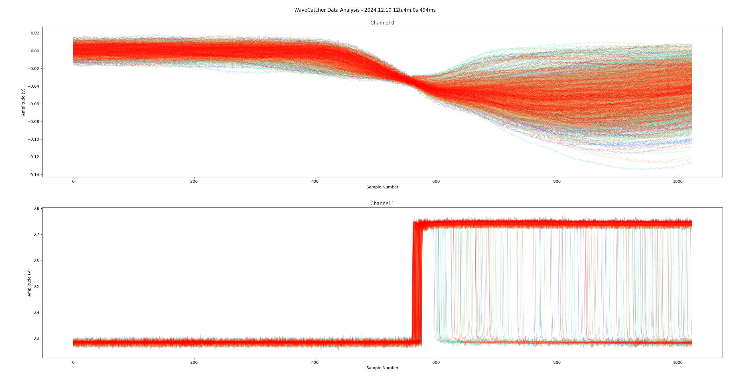
Measure and map charged particles and secondary neutrons with high spatial and temporal precision.
Alphabeast : Example of use 38 mm airgap
0 V
350 keV
Counter 0 = 8000
-56,323 mV
700 keV
Counter 1 = 935
-123,545 mV
1 MeV
Counter 2 = 4
-176,823 mV

Slide 14
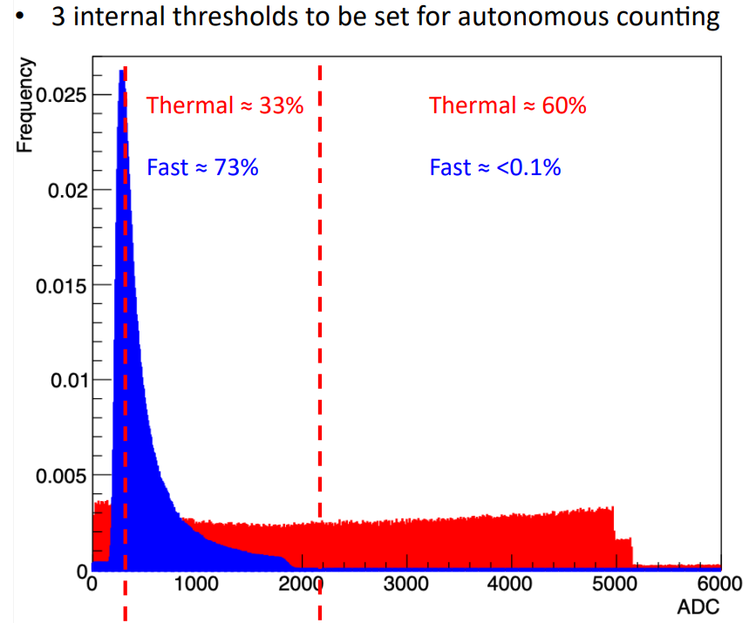
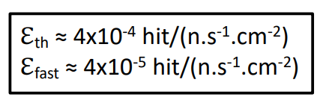
Measure and map charged particles and secondary neutrons with high spatial and temporal precision.
Alphabeast
200 keV
800 keV

Slide 15
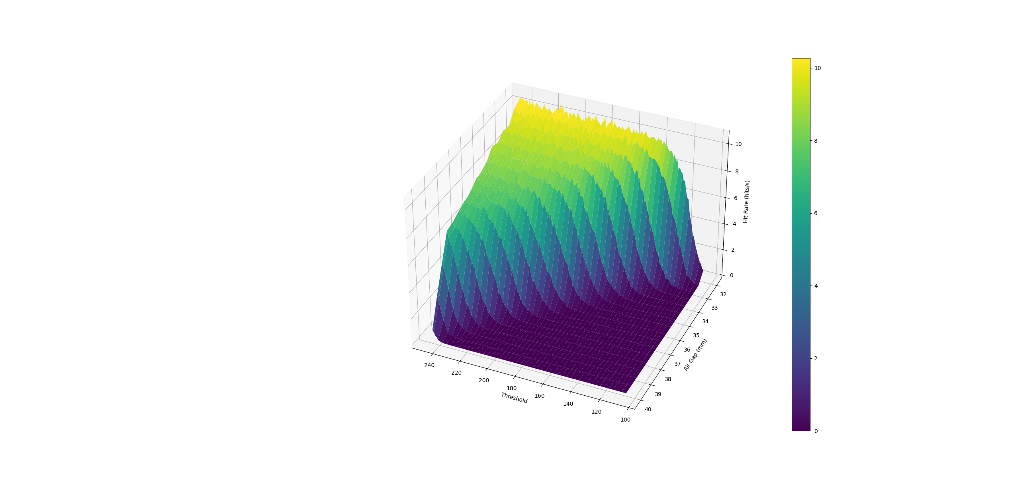
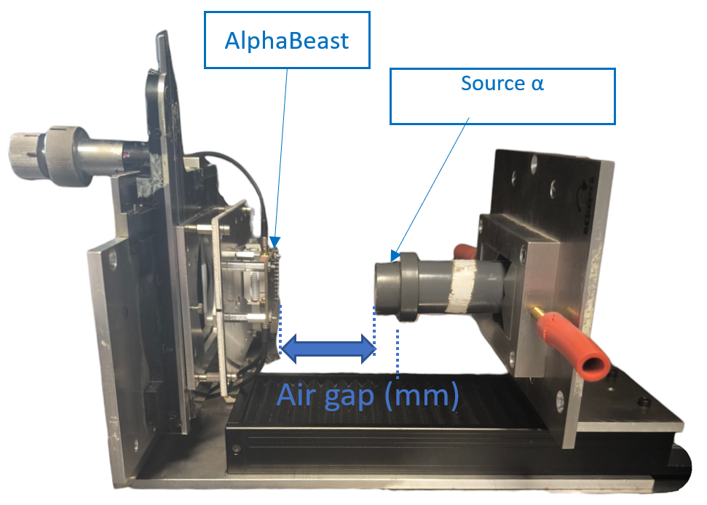
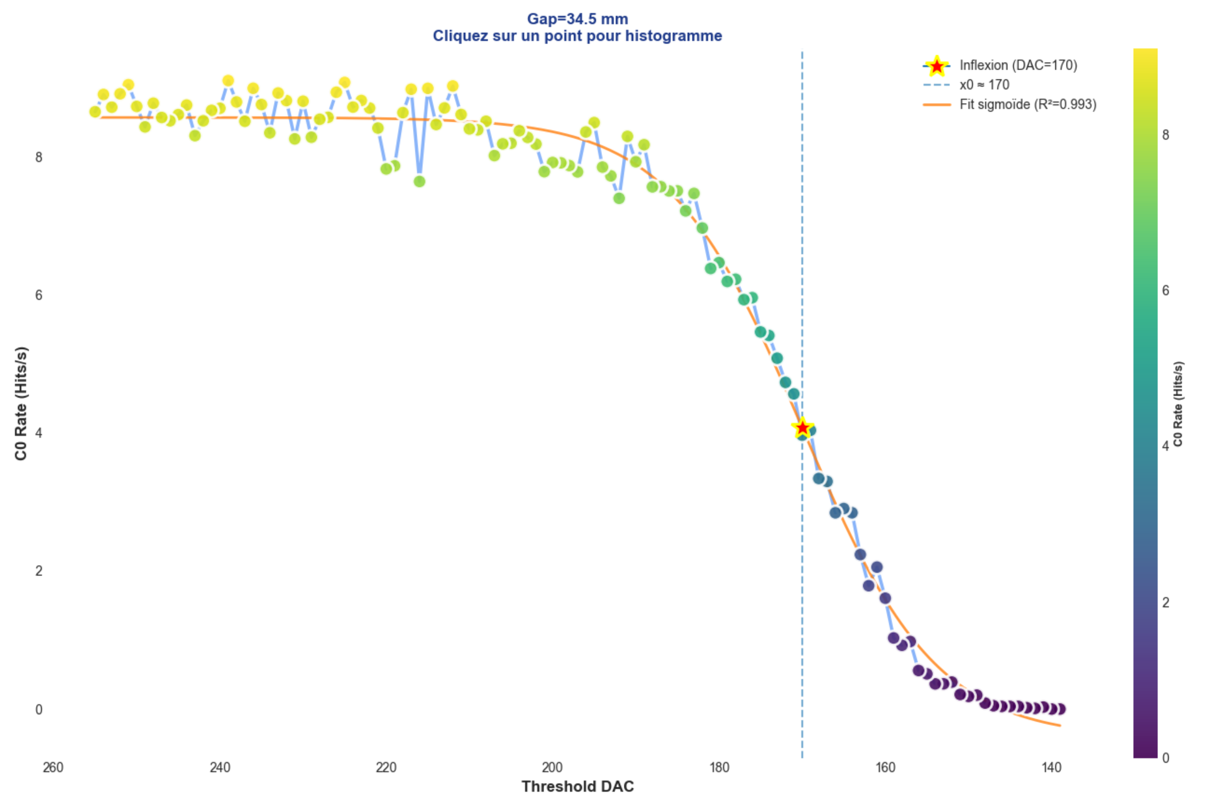
Measure and map charged particles and secondary neutrons with high spatial and temporal precision.
Hits/s
Inflexion of sigmoids

Slide 16
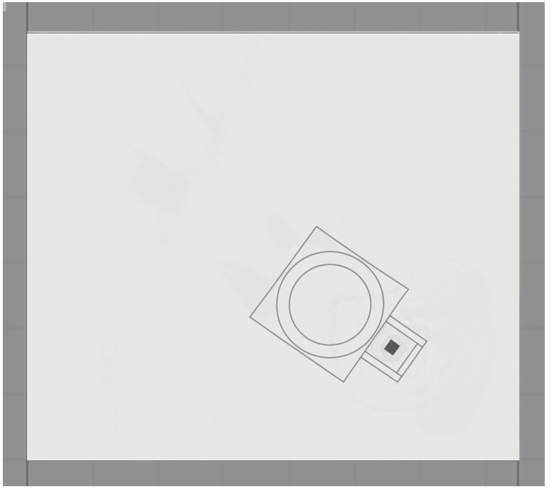

Perspectives and next developments
Peer to peer
Ethernet to the
monitoring room
TCP server
ESP + Alphabeasts module

Slide 17
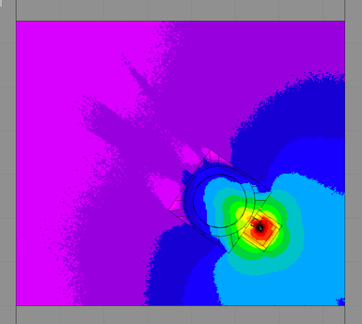
Perspectives and next developments
Real time 4D neutron heatmap
monitoring (x, y, dose proxy, time)
TCP server
Direct comparison with GEANT4/GATE

Slide 18
Merci
Thank you for your attention

