Slide 1

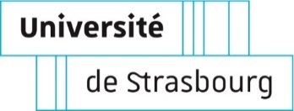



Development of immunopeptidomics as one of the most promising tool for immunology and cancer research
Aurélie Hirschler
Jeewan Babu Rijal, Christine Carapito
Équipe LSMBO, IPHC
Journée scientifique et technique de l’IPHC
9th December 2025

Slide 2

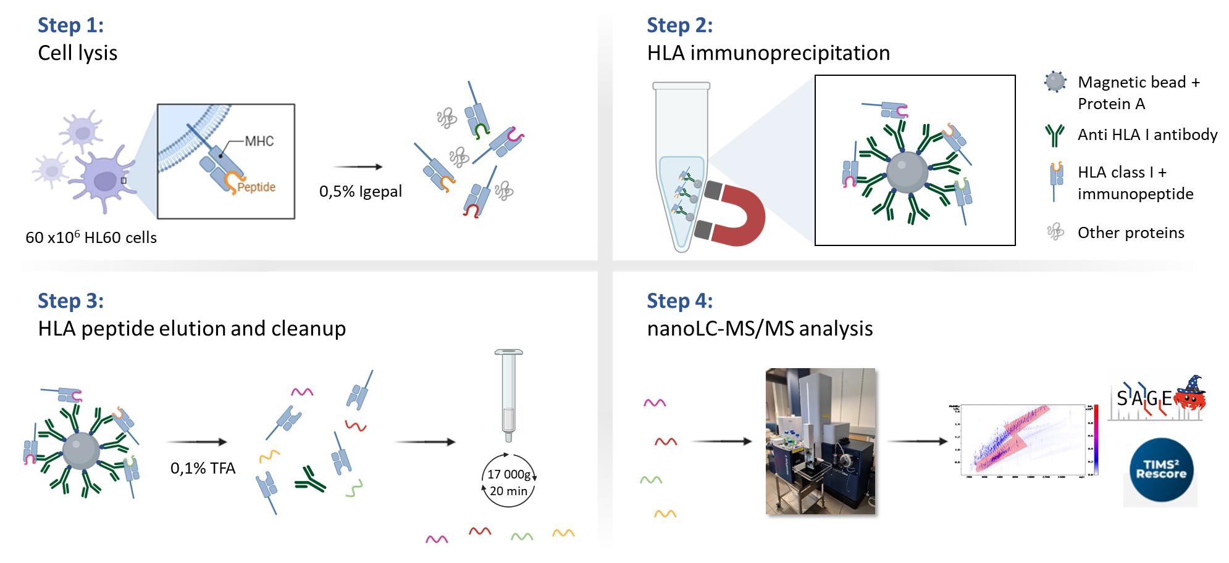
From bredeles to immunopeptidomics
2

Slide 3
Why immunopeptidomics?
Challenges of immunopeptidomics analysis
Sample preparation optimisation using magnetic beads
Fine tuning of LC and MS methods
Immunopeptidomics
3

Slide 4
Why immunopeptidomics?
Challenges of immunopeptidomics analysis
Sample preparation optimisation using magnetic beads
Fine tuning of LC and MS methods
Immunopeptidomics
3

Slide 5
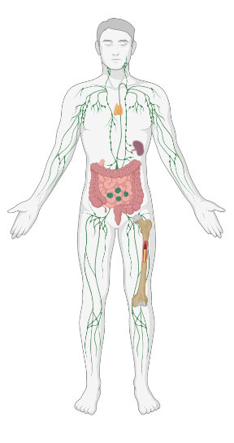



The immune system protects and defends us
with the ability to distinguish between:
Self
Cells, proteins
Non-self
Bacteria, virus, transplanted tissues
Self-modified
Mutated cells, cancer cells
4

Slide 6



The immune system protects and defends us
with the ability to distinguish between:
Self
Cells, proteins
Non-self
Bacteria, virus, transplanted tissues
Self-modified
Mutated cells, cancer cells
4

Slide 7
The immune system protects and defends us
with the ability to distinguish between:
Self
Cells, proteins
Non-self
Bacteria, virus, transplanted tissues
Self-modified
Mutated cells, cancer cells
Implication of Major Histocompatibility Complex (MHC) system,
Human Leukocyte Antigen (HLA) system for human
4

Slide 8
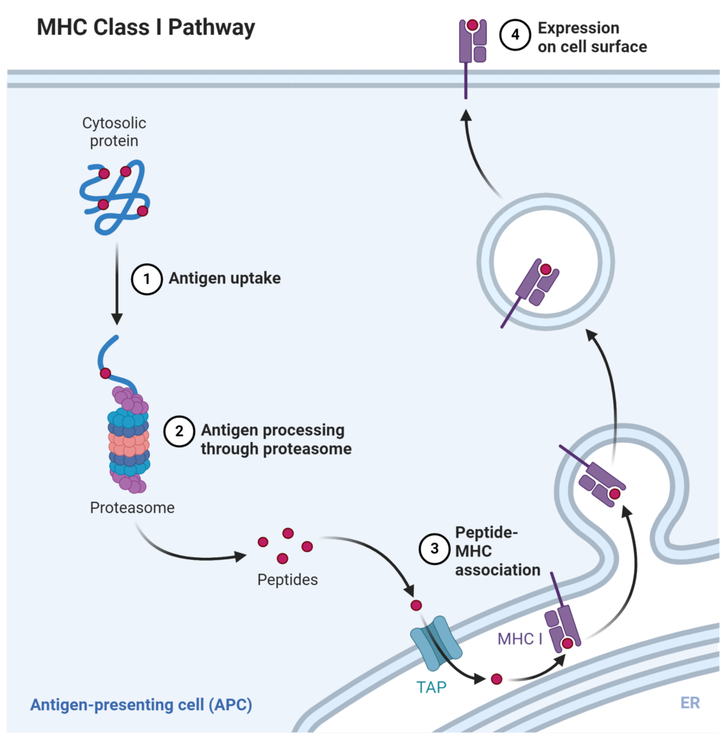
What is HLA ?
HLA Class I pathway
HLA I
Created with Biorender
5

Slide 9
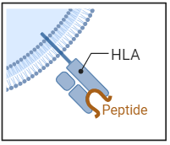
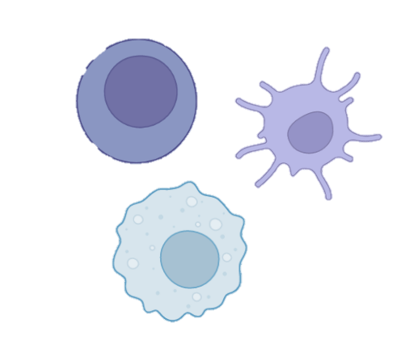
What is HLA ?
HLA Class I pathway
Immuno
peptide
Complex system of genes that encodes for surface membrane glycoproteins (HLA molecules).
Immunopeptides guide T cell recognition of self, pathogenic and modified proteins
For HLA class I, peptides are 8-12 amino acids long
HLA I
Created with Biorender
5

Slide 10
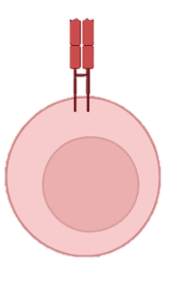
What is HLA ?
T cell
HLA Class I pathway
Immuno
peptide
Complex system of genes that encodes for surface membrane glycoproteins (HLA molecules).
Immunopeptides guide T cell recognition of self, pathogenic and modified proteins
For HLA class I, peptides are 8-12 amino acids long
HLA I
Created with Biorender
5

Slide 11
What is HLA ?
T cell
HLA Class I pathway
Immuno
peptide
Complex system of genes that encodes for surface membrane glycoproteins (HLA molecules).
Immunopeptides guide T cell recognition of self, pathogenic and modified proteins
For HLA class I, peptides are 8-12 amino acids long
HLA I
Created with Biorender
5

Slide 12
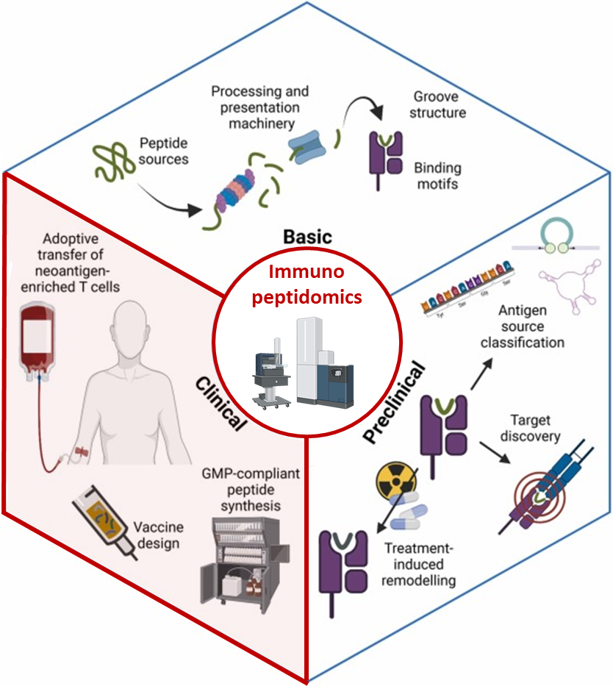
From discovery to therapy: The multiple applications of immunopeptidomic
Cancer immunotherapy
Neoantigen* discovery, personalized cancer vaccines, T-cell therapies
Vaccine development
Identification of pathogen-derived peptides for targeted vaccines
Infectious disease research
Understanding immune responses to viruses, bacteria, parasite
*mutated cancer peptides
Shapiro IE. et al., 2023, Seminars in Immunology
6

Slide 13
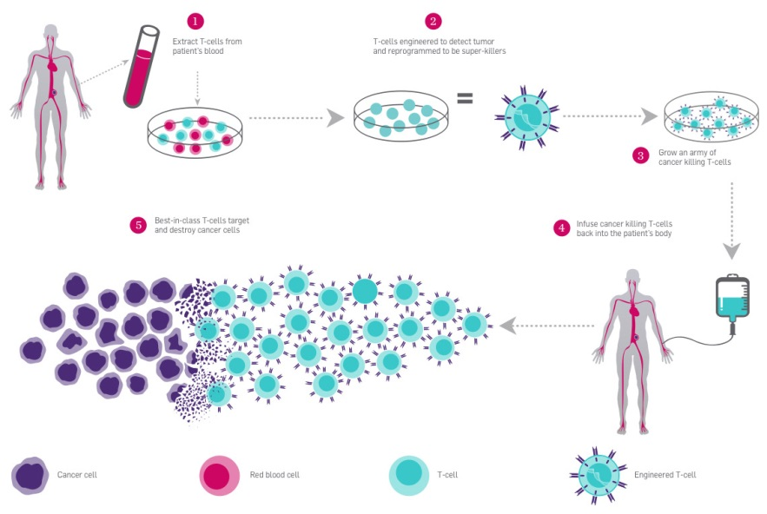
Personalized therapy as an example for immunopeptidomics application
Extract T cells from patient
T cells engineered to detect tumor (neoantigene) and reprogramed to be super-killer
Grow an army of cancer killing T-cells
T-cells target and destroy cancer cells
Infuse cancer killing T-cells back into the patient’s body
Parker institute
7

Slide 14



Identifying neoantigen requires extreme sensitivity
Neoantigens: promising targets to develop personalized therapy
Shapiro IE. et al., 2023, Seminars in Immunology
8

Slide 15
Identifying neoantigen requires extreme sensitivity
Analysis of all peptides presented by HLA is called
Immunopeptidomics
Neoantigens: promising targets to develop personalized therapy
Shapiro IE. et al., 2023, Seminars in Immunology
4

Slide 16
Why immunopeptidomics?
Challenges of immunopeptidomics analysis
Sample preparation optimisation using magnetic beads
Fine tuning of LC and MS methods
Immunopeptidomics
9

Slide 17

Immunopeptidomics analysis is challenging
HLA I peptide
10

Slide 18
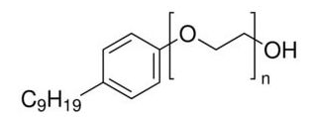
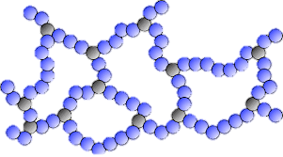
Immunopeptidomics analysis is challenging
Specific and tricky sample preparation
HLA I peptide
10

Slide 19
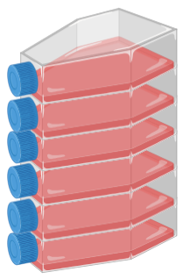



Immunopeptidomics analysis is challenging
Specific and tricky sample preparation
HLA I peptide
Low abundance of immunopeptides
sensitivity
10

Slide 20





Immunopeptidomics analysis is challenging
Specific and tricky sample preparation
Non tryptic nature of immunopeptides
HLA I peptide
Classical proteomics digestion
Trypsin digestion
R
R
K
K
K
R
Low abundance of immunopeptides
R
K
K
R
R
sensitivity
Immunopeptides
10

Slide 21
Immunopeptidomics analysis is challenging
Specific and tricky sample preparation
Non tryptic nature of immunopeptides
HLA I peptide
Classical proteomics digestion
All steps of the workflow still benefit from thorough optimization
R
Trypsin digestion
R
K
K
K
R
Low abundance of immunopeptides
R
K
K
R
R
sensitivity
Immunopeptides
11

Slide 22
Immunopeptidomics analysis is challenging
Specific and tricky sample preparation
Non tryptic nature of immunopeptides
HLA I peptide
Classical proteomics digestion
All steps of the workflow still benefit from thorough optimization
R
Trypsin digestion
R
K
K
K
R
Low abundance of immunopeptides
R
K
K
R
R
sensitivity
Immunopeptides
Sample preparation
LC-MS/MS analysis
Bioinformatic data treatment
11

Slide 23

Fortunately we have tools to confirm HLA ligand peptides
Peptide length
Majority of 9 amino acids
11
M. Nielsen, NAR (2020)

Slide 24
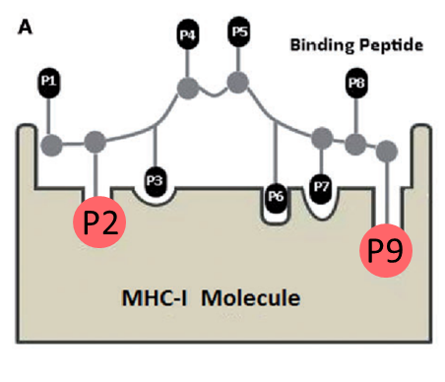
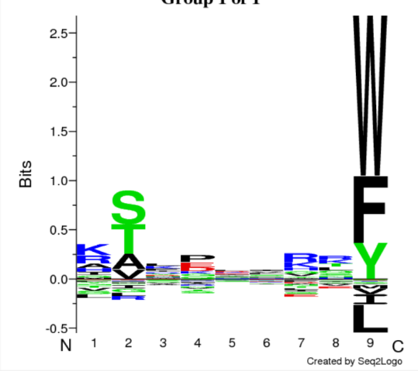
Fortunately we have tools to confirm HLA ligand peptides
Peptide length
Amino acid repartition
GibbsCluster–v2.0
Majority of 9 amino acids
Information on peptide specificity
11
M. Nielsen, NAR (2020)

Slide 25
Fortunately we have tools to confirm HLA ligand peptides
Peptide length
Bioinformatic prediction
binding affinity
Amino acid repartition
GibbsCluster–v2.0
NetMHCpan–v4.1
Majority of 9 amino acids
Information on peptide specificity
Information of binding specificity of the peptides for HLA-I
11
M. Nielsen, NAR (2020)

Slide 26
Why immunopeptidomics?
Challenges of immunopeptidomics analysis
Sample preparation optimisation using magnetic beads
Fine tuning of LC and MS methods
Immunopeptidomics
12

Slide 27

Implementation of a new immunopeptidomic sample preparation protocol
13
Lim Kam Sian et al, 2023, Frontiers in Immunology

Slide 28
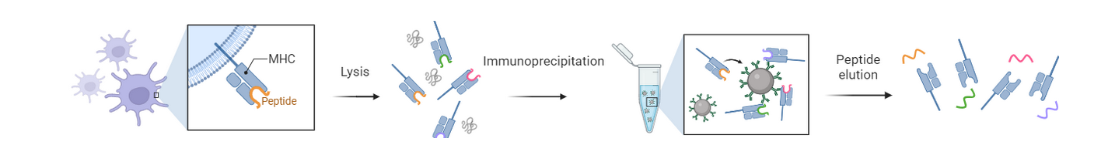

Implementation of a new immunopeptidomic sample preparation protocol
Step 1:
Cell lysis
0,5% Igepal
60 x10⁶ HL60 cells
13
Lim Kam Sian et al, 2023, Frontiers in Immunology

Slide 29
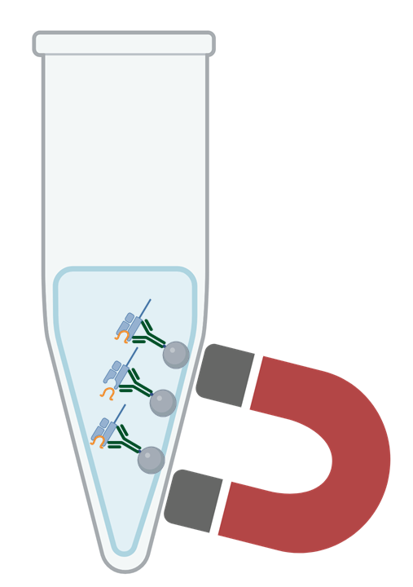
Implementation of a new immunopeptidomic sample preparation protocol
Step 1:
Cell lysis
Step 2:
HLA immunoprecipitation
0,5% Igepal
60 x10⁶ HL60 cells
13
Lim Kam Sian et al, 2023, Frontiers in Immunology

Slide 30
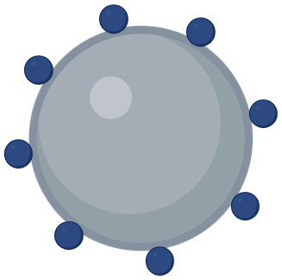
Implementation of a new immunopeptidomic sample preparation protocol
Step 1:
Cell lysis
Step 2:
HLA immunoprecipitation
Magnetic bead +
Protein A
0,5% Igepal
60 x10⁶ HL60 cells
13
Lim Kam Sian et al, 2023, Frontiers in Immunology

Slide 31

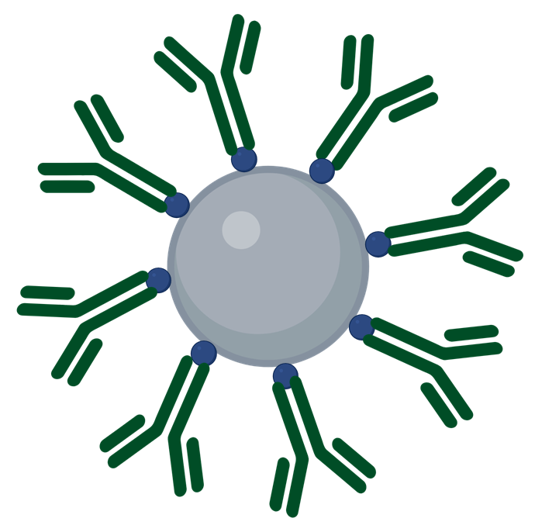
Implementation of a new immunopeptidomic sample preparation protocol
Step 1:
Cell lysis
Step 2:
HLA immunoprecipitation
Magnetic bead +
Protein A
Anti HLA I antibody
0,5% Igepal
60 x10⁶ HL60 cells
13
Lim Kam Sian et al, 2023, Frontiers in Immunology

Slide 32








Implementation of a new immunopeptidomic sample preparation protocol
Step 1:
Cell lysis
Step 2:
HLA immunoprecipitation
Magnetic bead +
Protein A
Anti HLA I antibody
HLA class I +
immunopeptide
0,5% Igepal
60 x10⁶ HL60 cells
Other proteins
13
Lim Kam Sian et al, 2023, Frontiers in Immunology

Slide 33
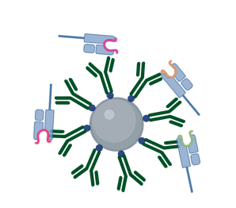








Implementation of a new immunopeptidomic sample preparation protocol
Step 1:
Cell lysis
Step 2:
HLA immunoprecipitation
Magnetic bead +
Protein A
Anti HLA I antibody
HLA class I +
immunopeptide
0,5% Igepal
60 x10⁶ HL60 cells
Other proteins
Step 3:
HLA peptide elution and cleanup
0,1% TFA
13
Lim Kam Sian et al, 2023, Frontiers in Immunology

Slide 34

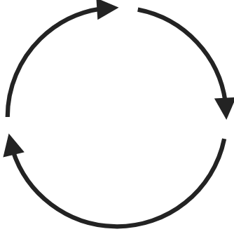



Implementation of a new immunopeptidomic sample preparation protocol
Step 1:
Cell lysis
Step 2:
HLA immunoprecipitation
Magnetic bead +
Protein A
Anti HLA I antibody
HLA class I +
immunopeptide
0,5% Igepal
60 x10⁶ HL60 cells
Other proteins
Step 3:
HLA peptide elution and cleanup
0,1% TFA
17 000g
20 min
13
Lim Kam Sian et al, 2023, Frontiers in Immunology

Slide 35

Implementation of a new immunopeptidomic sample preparation protocol
Step 1:
Cell lysis
Step 2:
HLA immunoprecipitation
Magnetic bead +
Protein A
Anti HLA I antibody
HLA class I +
immunopeptide
0,5% Igepal
60 x10⁶ HL60 cells
Other proteins
Step 3:
HLA peptide elution and cleanup
10x less starting material
(60 million vs 600 million cells)
2x faster
Automation on the Bravo Assay Map plateform
0,1% TFA
17 000g
20 min
13
Lim Kam Sian et al, 2023, Frontiers in Immunology

Slide 36

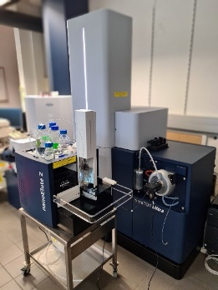


Implementation of a new immunopeptidomic sample preparation protocol
Step 1:
Cell lysis
Step 2:
HLA immunoprecipitation
Magnetic bead +
Protein A
Anti HLA I antibody
HLA class I +
immunopeptide
0,5% Igepal
60 x10⁶ HL60 cells
Other proteins
Step 3:
HLA peptide elution and cleanup
Step 4:
nanoLC-MS/MS analysis
0,1% TFA
17 000g
20 min
13
Lim Kam Sian et al, 2023, Frontiers in Immunology

Slide 37



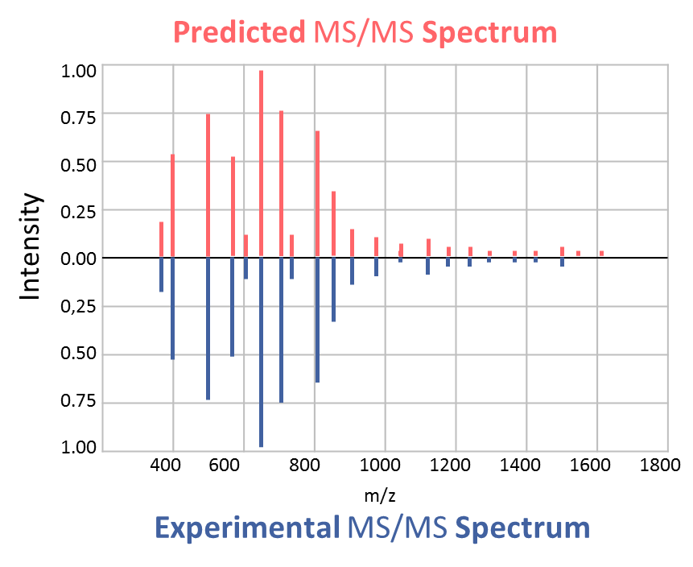
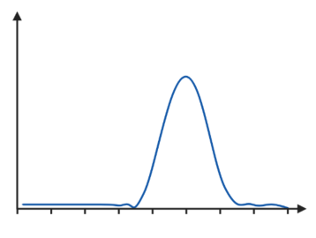


AI tool, MS²Rescore, leverages peak intensity and retention time prediction to increase identification
Search engine features
XIC
MS²Rescore
MS²Rescore
Percolator
Intensity
Experimental RT
Predicted RT
MS²Rescore: Declercq A. et al, 2022, MCP ; Declercq A. et al, 2023, NAR ; Buur L.M. et al., 2024, JPR
DeepLC: Bouwmeester R. et al, 2021, Nature Methods
MS²PIP: Gabriels R. et al, 2019, Nucleic Acids Research
14

Slide 38

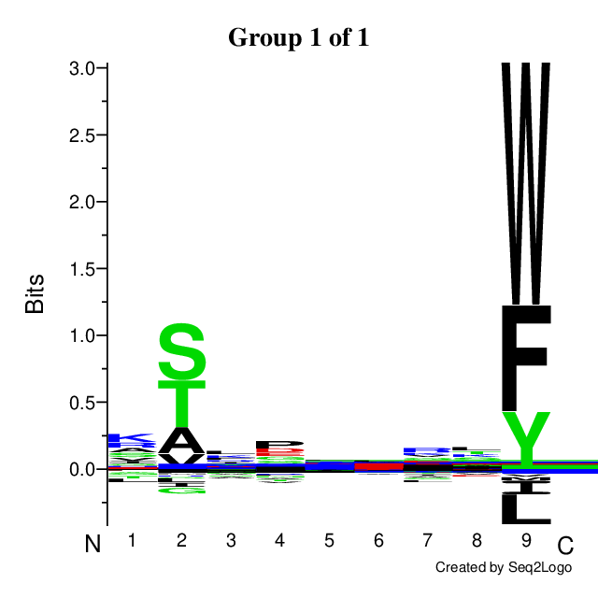

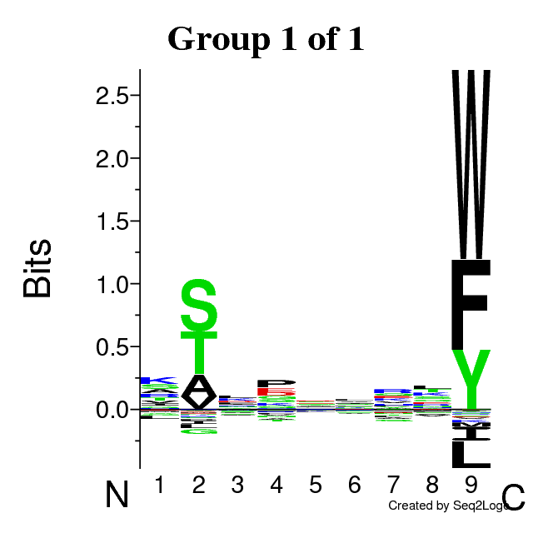
Optimised protocol outperforms previous protocol
Peptide length
Amino acid repartition
Jeewan Babu Rijal
10x less starting material
2x less injected cells
Optimised protocol
Standard protocol
Prediction
binding affinity
Optimised protocol
Optimised protocol
Optimised protocol
30 million cells
15 million cells
15

Slide 39
Why immunopeptidomics?
Challenges of immunopeptidomics analysis
Sample preparation optimisation using magnetic beads
Fine tuning of LC and MS methods
Immunopeptidomics
16

Slide 40
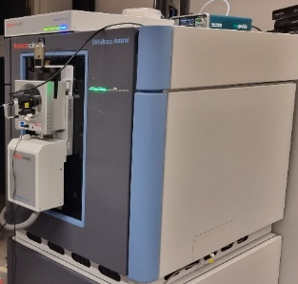
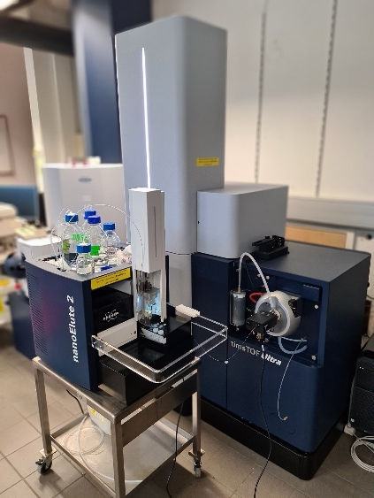
Ultra sensitive instruments used for immunopeptidomics
nanoElute 2 +
timsTOF Ultra 2 (Bruker)
Vanquish Neo +
Orbitrap Astral (Thermo Fisher)
17

Slide 41
Immunopeptidomics on timsTOF Ultra 2 intrument
nanoElute 2 +
timsTOF Ultra 2 (Bruker)
Vanquish Neo +
Orbitrap Astral (Thermo Fischer)
17

Slide 42


Immunopeptidomics tailored method is crucial
Standard polygon in classical proteomics
HLA tailored polygon
1+
2+
Ion Mobility (1/K₀)
Ion Mobility (1/K₀)
3+
Mass/charge (m/z)
Mass/charge (m/z)
Fragmentation of singly charged peptide ions are missing in standard proteomics due to the filter polygon shape.
A tailored polygon method is needed to acquire singly charged peptides.
The shape of the polygon should be narrow to avoid noise.
Gomez- Zepeda D., et al, 2024, Nature Communication
18

Slide 43

Up to 30 000 IDs on timsTOF Ultra!
30 million cells equivalent/injection
50 cm
PepSep (Bruker) C18 column
25 cm
Aurora 3 (IonOpticks) C18 column
5 cm
Aurora Rapid (IonOpticks) C18 column
19

Slide 44
Impact of column length and gradient time!
30 million cells equivalent/injection
50 cm
PepSep (Bruker) C18 column
25 cm
Aurora 3 (IonOpticks) C18 column
5 cm
Aurora Rapid (IonOpticks) C18 column
19

Slide 45
Highest sensitivity with 50 cm column using 100 minute gradient!
50 cm
PepSep (Bruker) C18 column
25 cm
Aurora 3 (IonOpticks) C18 column
5 cm
Aurora Rapid (IonOpticks) C18 column
19

Slide 46
More than 5000 IDs using 5 cm column in 10 minutes
50 cm
PepSep (Bruker) C18 column
25 cm
Aurora 3 (IonOpticks) C18 column
5 cm
Aurora Rapid (IonOpticks) C18 column
19

Slide 47
Highest throughput with 5 cm column
SPD
90
65
48
36
18
12
8
19

Slide 48
Dedicated workflows
Highest coverage
Highest throughput
SPD
90
65
48
36
18
12
8
19

Slide 49
Immunopeptidomics on Orbitrap Astral intrument
nanoElute 2 +
timsTOF Ultra 2 (Bruker)
Vanquish Neo +
Orbitrap Astral (Thermo Fisher)
20

Slide 50
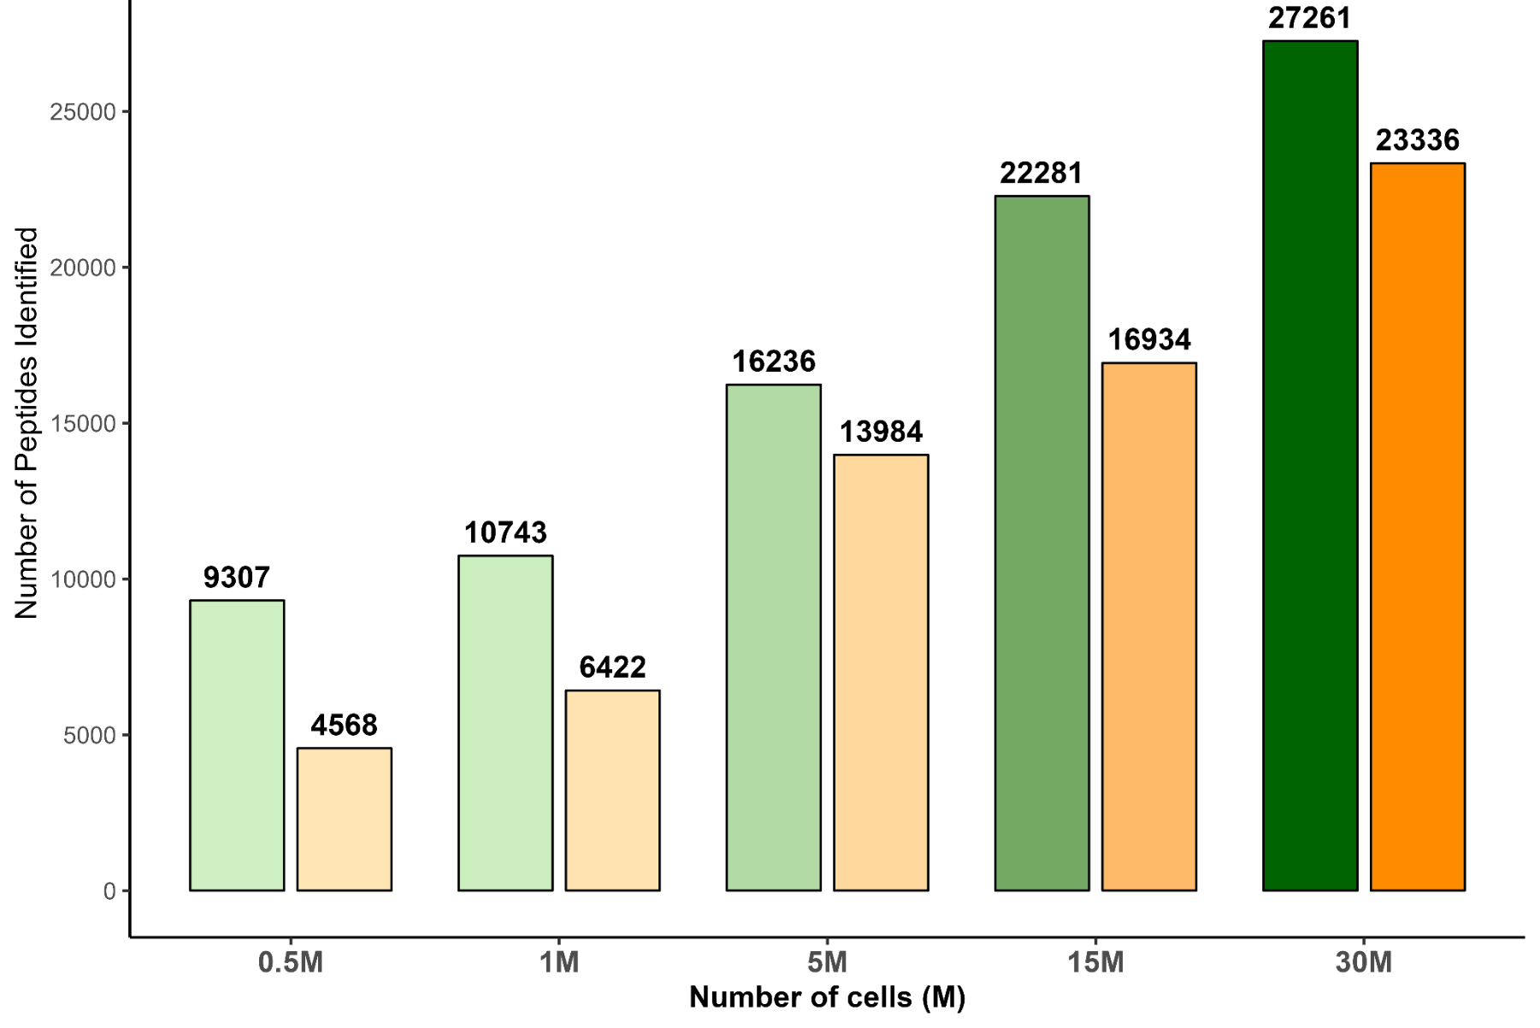
Excellent coverage even with lowered input
Jeewan Babu Rijal
Farida
Salimova
• µPAC neo 2.0 column • 120-minutes acquisition • Data analysis: MS Fragger
21

Slide 51
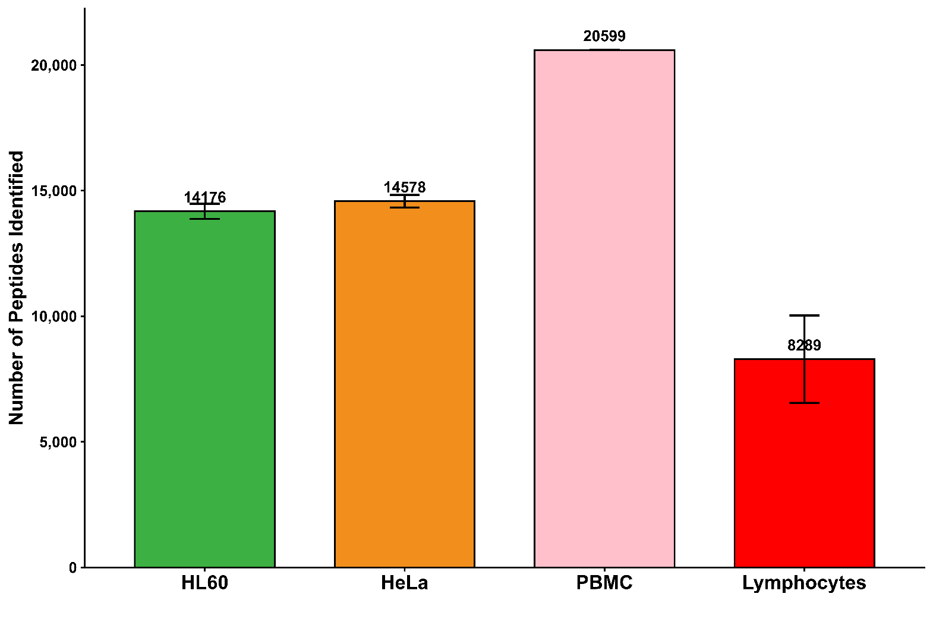
This optimised workflow is also applicable on other cell types
22

Slide 52




Conclusion
Fine-tuning of all steps of immunopeptidomic workflow
High throughput and sensitivity
Up to 30,000 immunopeptides identified
+10,000 immunopeptides identified from <1M cells
Ultra-sensitive workflow ideal for limited input
Mature and accessible technology
Unlocking new ideas to other research projects (astrocytes, B lymphocytes, mouse HLA class II) and clinical samples
Sample preparation
LC-MS/MS method aquisition
Data processing
23

Slide 53






Acknowledgments
LSMBO
All LSMBO team and especially,
Christine Carapito
Jeewan Babu Rijal
Charline Keller
Farida Salimova
Delphine Rolland
CompOmics (Ghent, Belgium)
Arthur Declercq
INSERM UMR_S 1109 (Strasbourg, France)
Perrine Spinnhirny
Seiamak Bahram
Raphael Carapito
Lennart Martens
24

Slide 55
Optimised MS parameters on timsTOF Pro 2 instrument
+27%
IM range (1/K0) | 0.6 – 1.6 | 0.6 – 1.6 | 0.6 – 1.6 | 0.6 – 1.6 | 0.6 – 1.7 | 0.6 – 1.7 | 0.6 – 1.7 | 0.65 – 1.75
Accumulation time (ms) | 100 | 200 | 166 | 200 | 200 | 200 | 166 | 200
PASEF scans | 10 | 6 | 10 | 6 | 6 | 6 | 6 | 6
CE ramp (eV) | 20-59 | 20-59 | 20-59 | 10-55 | 10-55 | 20-59 | 20-59 | 20-59
12

Slide 56
Identification improved with MS²Rescore
even more at 0.1% FDR
1% FDR
+10%
Without MS²Rescore
With MS²Rescore
14
Notes:
On a checké que les peptides qu’on voyait que avec MS2 rescore étaient des peptides HLA

Slide 57
Identification improved with MS²Rescore
even more at 0.1% FDR
1% FDR
0.1% FDR
+10%
+43%
Without MS²Rescore
With MS²Rescore
Without MS²Rescore
With MS²Rescore
14
Notes:
On a checké que les peptides qu’on voyait que avec MS2 rescore étaient des peptides HLA

Slide 58
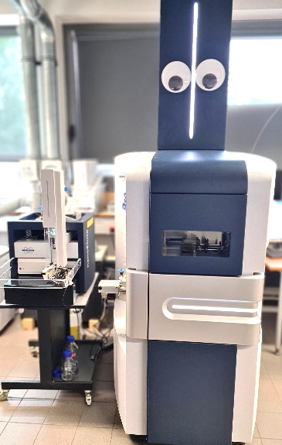
Different instruments used for immunopeptidomics
nanoElute +
timsTOF Pro 2 (Bruker)
nanoElute 2 +
timsTOF Ultra (Bruker)
Vanquish Neo +
Orbitrap Astral (Thermo Fischer)
11

Slide 59
Immunopeptidomics on timsTOF Pro 2
nanoElute +
timsTOF Pro 2 (Bruker)
nanoElute 2 +
timsTOF Ultra (Bruker)
Vanquish Neo +
Orbitrap Astral (Thermo Fischer)
11

Slide 60
Filter polygon optimisation increased IDs by 15%
+15%
16

Slide 61
Polygonal filter optimisation on singly charged IDs is valuable
Total binding affinity prediction
Peptide length
Unique peptides charges
5%
17

Slide 62
timsTOF Ultra increases sensitivity
5x shorter gradient time
2x less injected material
TimsTOF-Pro
100 min gradient
TimsTOF-Ultra
22 min gradient
Jeewan Babu Rijal
19

Slide 63
timsTOF Ultra increases sensitivity
TimsTOF-Pro
100 min gradient
TimsTOF-Ultra
22 min gradient
Jeewan Babu Rijal
19

Slide 64

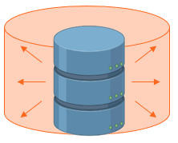
Large search space lowers the confidence of peptides identification and decreases the number of identifications
Classical trypsin digestion
1 000 amino acid protein
115 tryptic peptides
Search space
Peptides IDs
LKDIKAQWK
GTDGHPFGWK
LAAKLLAKYR
VVVPAEWIKNWR
Tryptic digestion
7

Slide 65

Large search space lowers the confidence of peptides identification and decreases the number of identifications
Classical trypsin digestion
1 000 amino acid protein
115 tryptic peptides
Search space
Peptides IDs
LKDIKAQWK
GTDGHPFGWK
LAAKLLAKYR
VVVPAEWIKNWR
Tryptic digestion
X100
Immunopeptides
1 000 amino acid protein
991 non-tryptic peptides
15 768 non-tryptic peptides
Big search space
Immunopeptide IDs
RLKDIKAQW
GTDGHPFGW
LAAKLLAKY
VVVPAEWIKNW
Non-specific digestion
Variable length
9 aa
8-12 aa
Low identification rate
Faridi P. et al., 2018, Proteomics
7

Slide 66

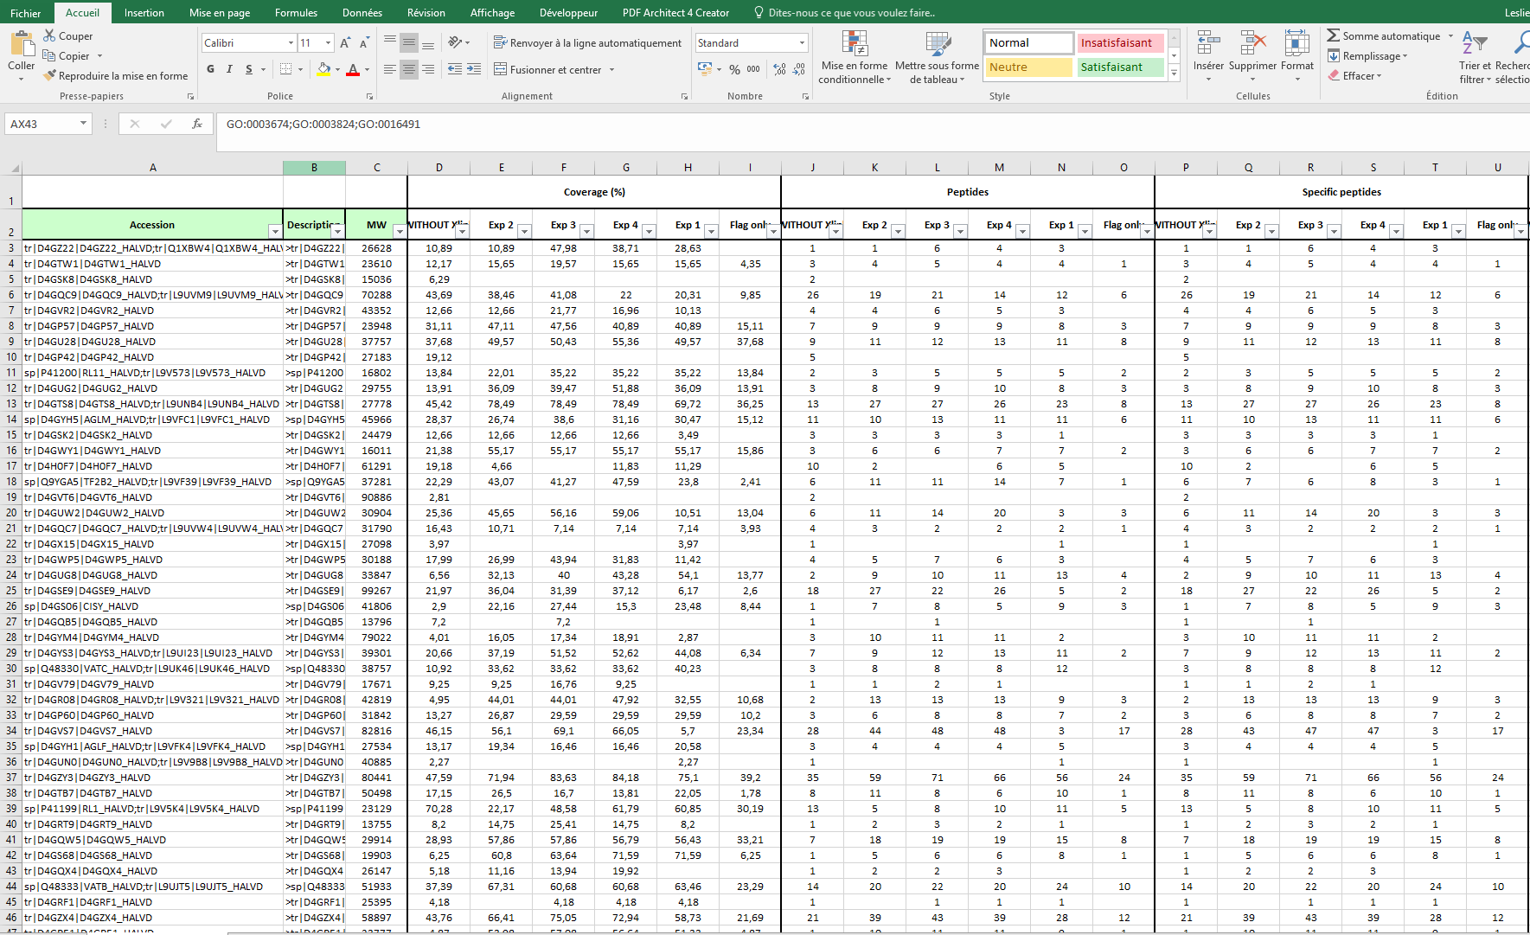
How does LC-MS/MS work?
intensity
LC (liquid chromatography)
time
Intensity
①
②
③
MS (mass spectrometry)
m/z
MS/MS
(tandem mass spectrometry)
Intensity
Intensity
Intensity
m/z
m/z
m/z
LC
MS
MS/MS
Identification of the peptide sequence using MS/MS signals
Global protein identification
10

