Slide 1
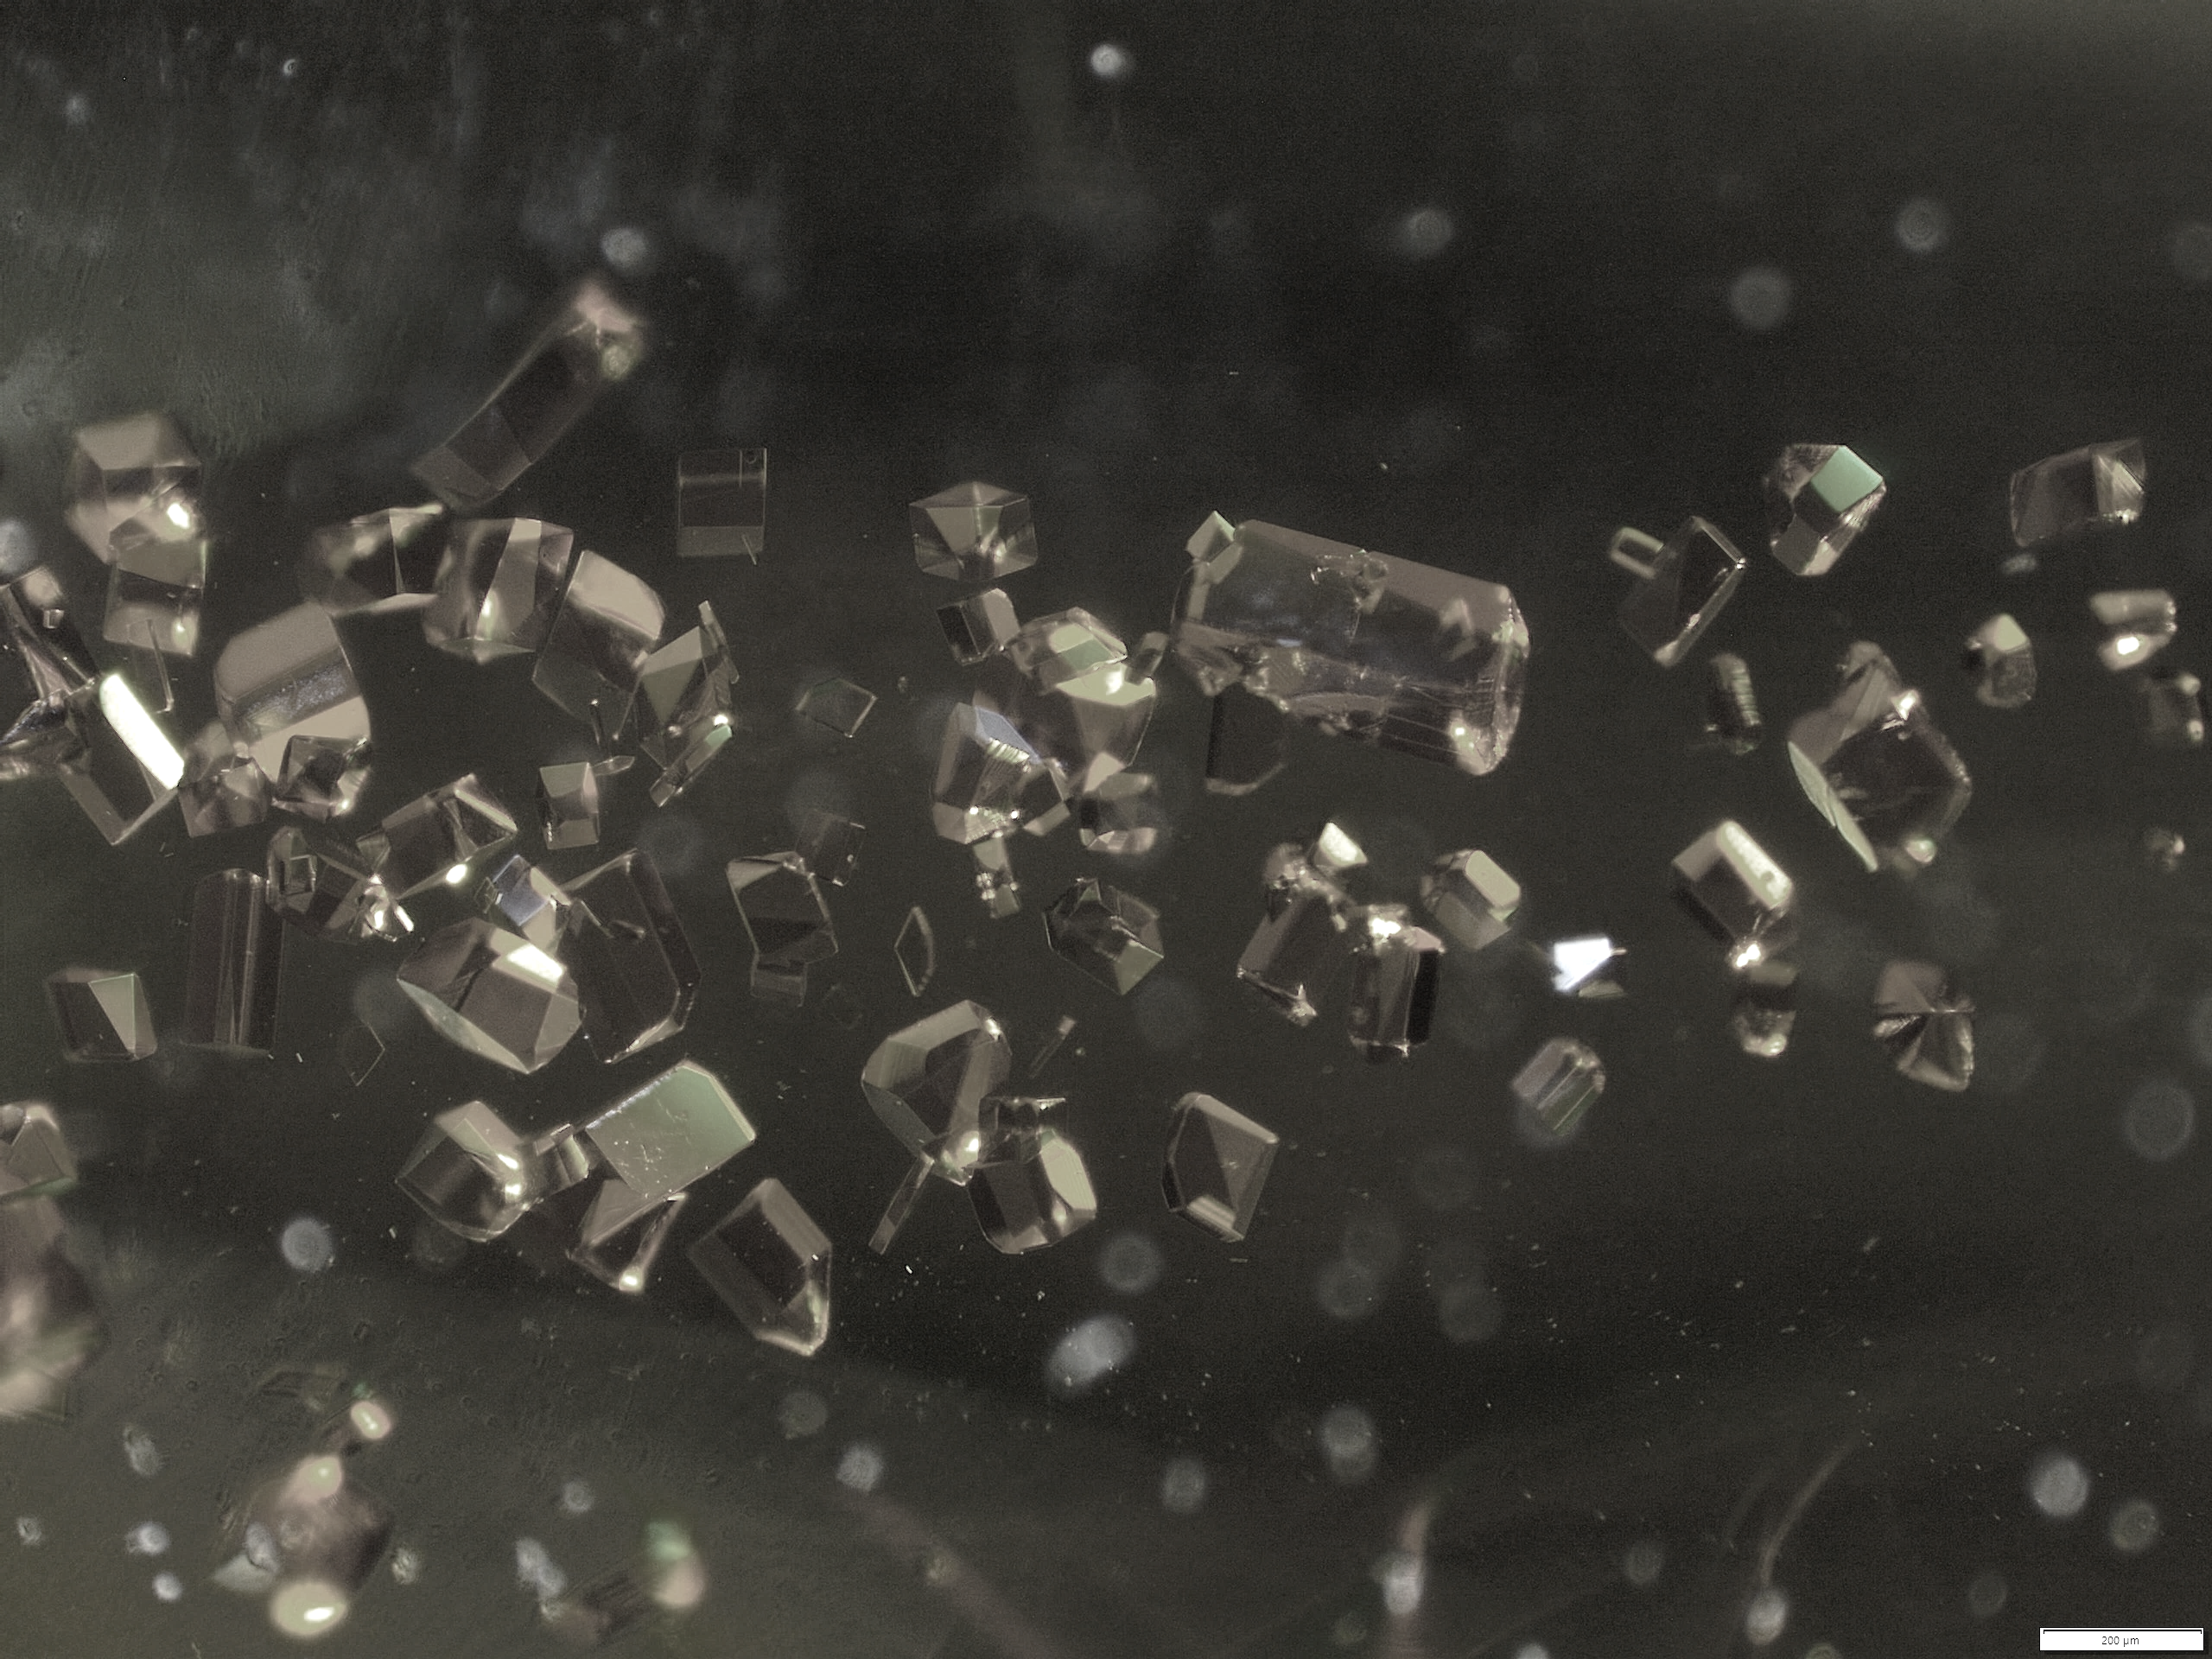


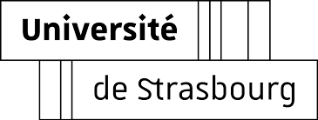
Luminescence of
Chiral Lanthanide Complexes
Journée scientifique et technique IPHC
Annika Sickinger
DSA, SynPA team

Slide 2
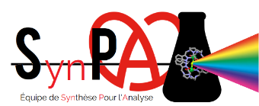
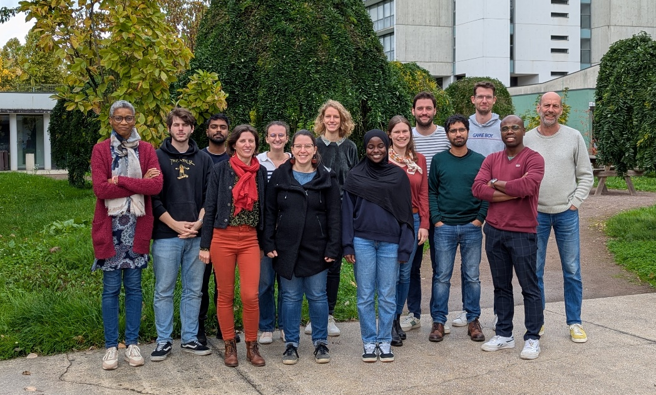

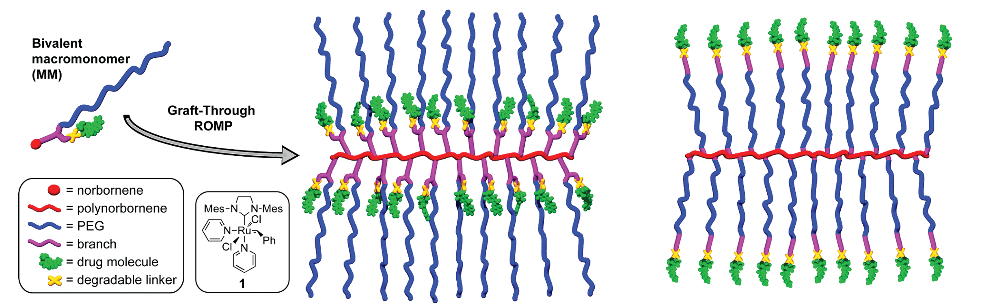
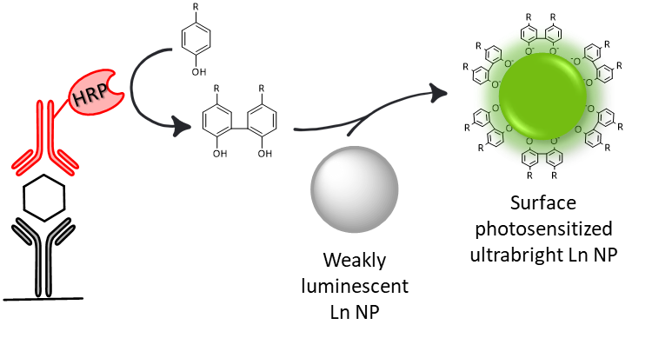
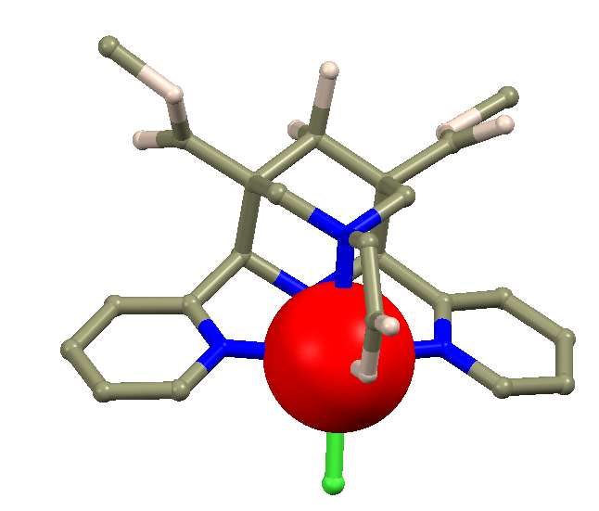
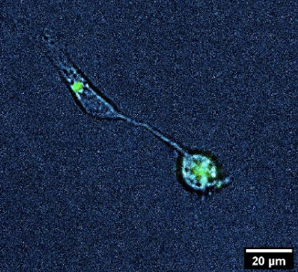
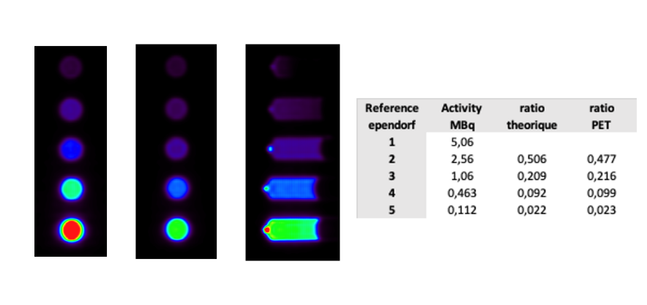
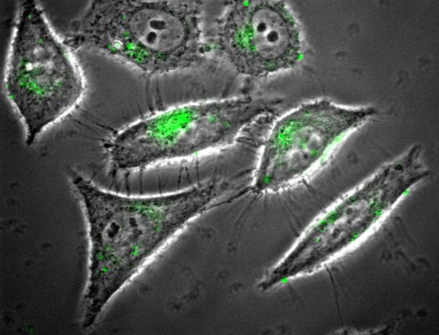
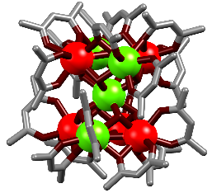
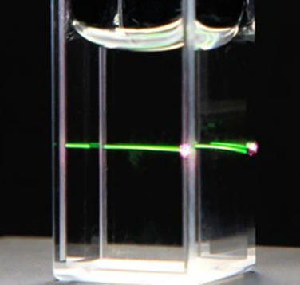
Synthèse pour l’Analyse (SynPA) Team
Coordination complexes for medical imaging
PET radiotracors
Mn-based MRI
contrast agents
Nanocarriers for drug delivery
Hybrid Lanthanide-Nanoparticles for bioanalytical applications
Bioassays
Luminescent lanthanide (Ln) complexes
PET and MRI imaging
Microscoy
Upconversion
1
Notes:
Coordination complexes, assemblies and nanoparticles (NPs)

Slide 3
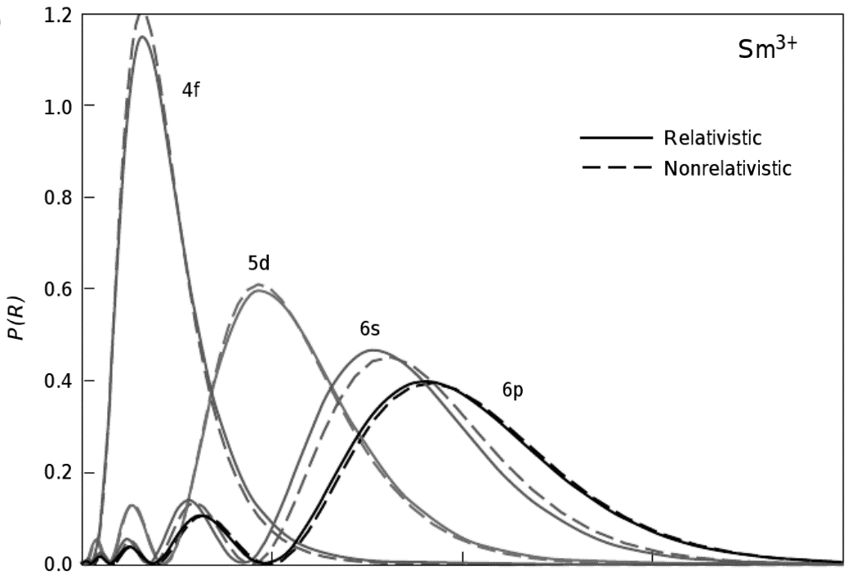
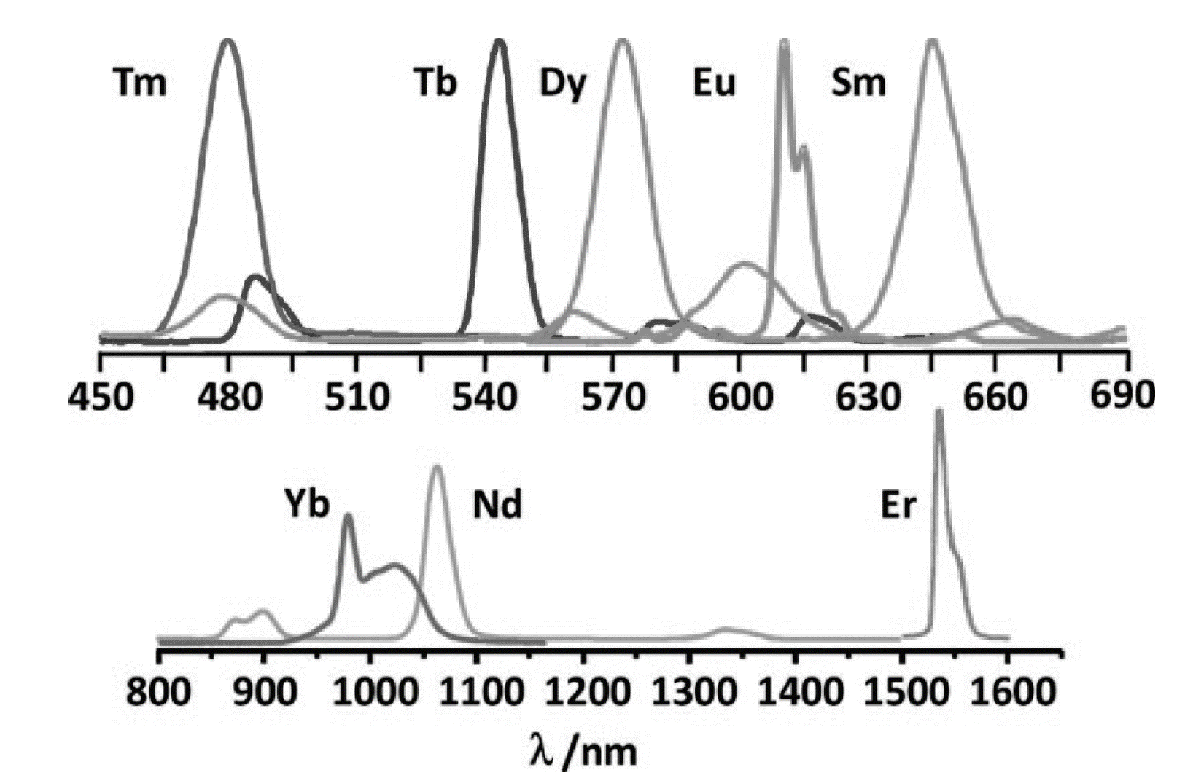
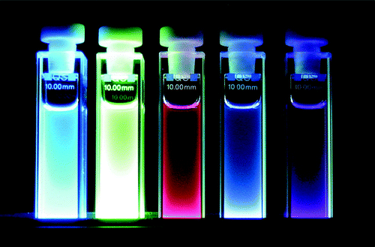
Ln(III) Complexes
Emission spectra
Properties of Ln(III) f-f transitions
4f
5d
- Long Excited State Lifetime
- Ladder-like Energy Diagram
- Narrow Emission Lines
- Pronounced MD Nature
6s
6p
Radial probability distribution
Upconversion Emission
Lanthanide Complexes
Eur. J. Inorg. Chem. 2005, 1425. Chem. Rev. 2010, 110, 2729. Los Alamos Sci. 2000, 26. Eur. J. Inorg. Chem. 2009, 4357-4371.
2
Notes:
Application: - Magnetic molecular materials
- Particular NMR applications
- MRI contrast agent
- Laser materials
- Visualization/Illumination devices
- Bioimaging & Biosensing

Slide 4
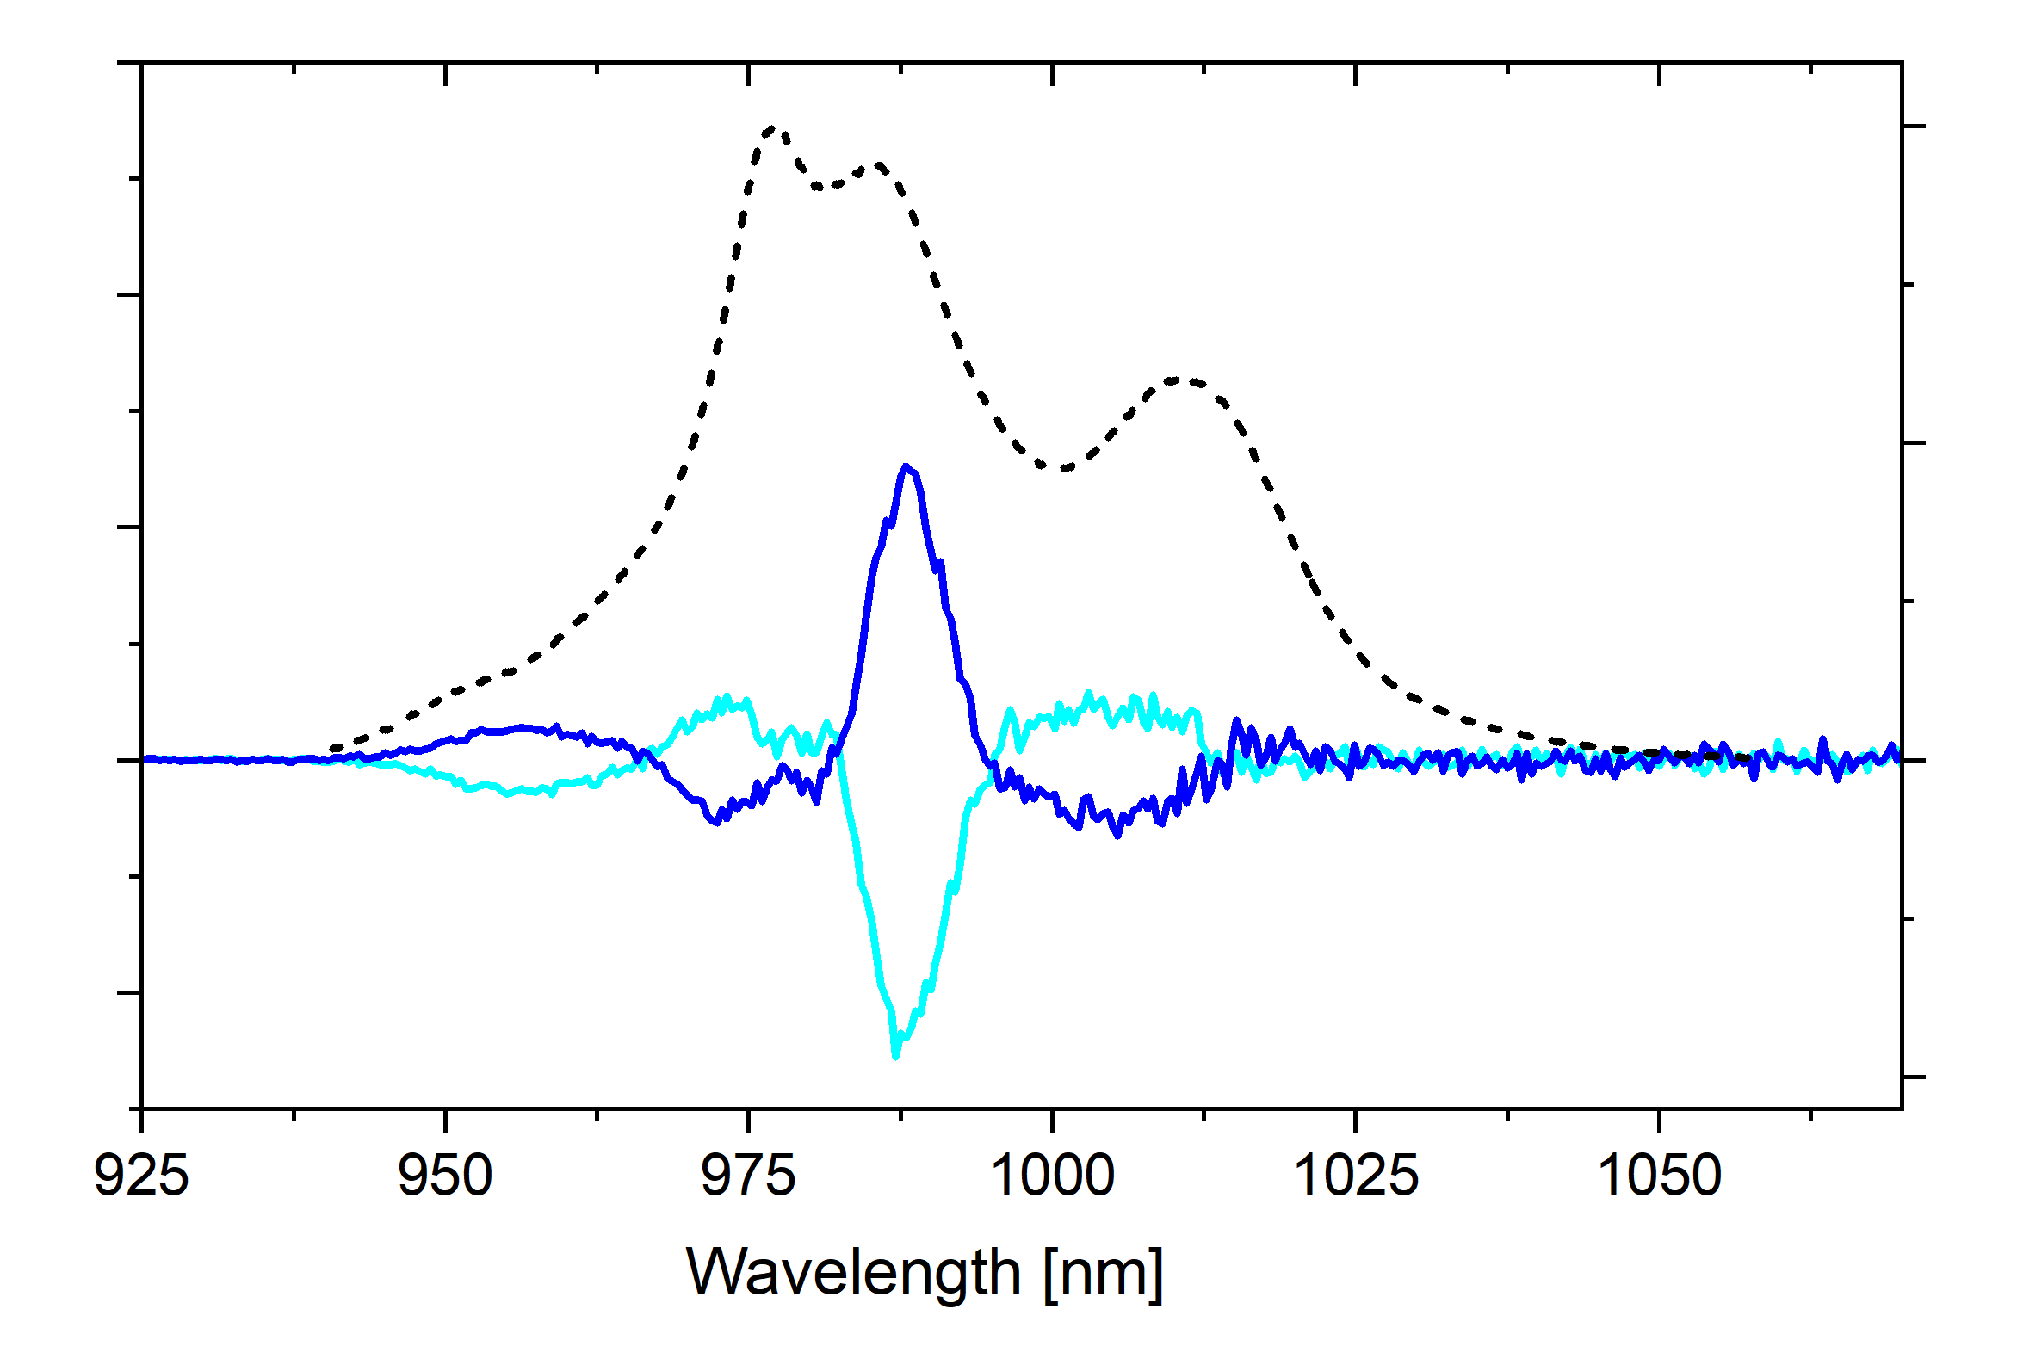
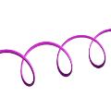
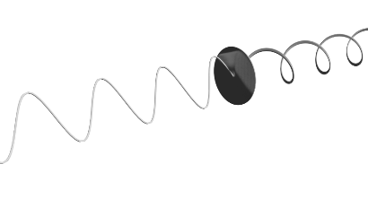
Ln(III) Complexes
Emission spectra
Properties of Ln(III) f-f transitions
4f
5d
- Long Excited State Lifetime
- Ladder-like Energy Diagram
- Narrow Emission Lines
- Pronounced MD Nature
6s
6p
Radial probability distribution
Upconversion Emission
Lanthanide Complexes
Upconversion Emission
Circularly Polarized Luminescence
E₂
hν_{UC} > hν_{exc}
UC Emission
hν_{UC}
Emission
E₁
E₁‘
Excitation hν_{exc}
CPL
hν_{lum}
E₀
Exemple of ESA mechanism.
Eur. J. Inorg. Chem. 2005, 1425. Chem. Rev. 2010, 110, 2729. Los Alamos Sci. 2000, 26. Eur. J. Inorg. Chem. 2009, 4357-4371.
3
Notes:
Application: - Magnetic molecular materials
- Particular NMR applications
- MRI contrast agent
- Laser materials
- Visualization/Illumination devices
- Bioimaging & Biosensing

Slide 5
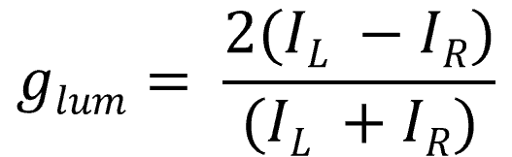
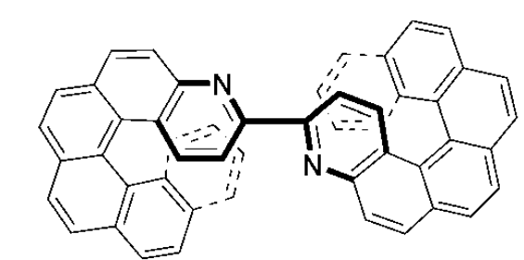
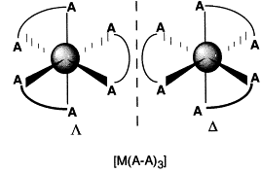
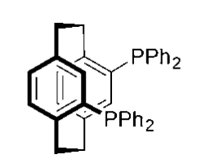
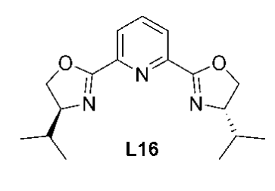
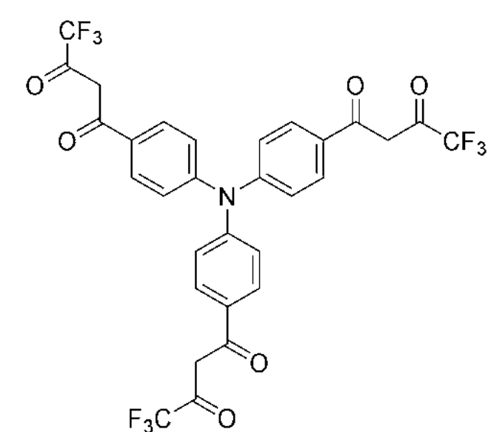
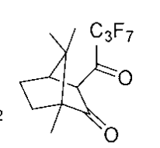
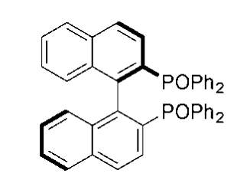
Circularly Polarized Luminescence (CPL)
→ Ability of chiral systems to rotate the plane of polarized light
→ Intensity difference of right- and left-handed circ. pol. light: ΔI = I_{L} - I_{R}
→ Quantification by dimensionless disymmetry factor (max. ± 2 )
Established ligand systems for chiral complexes:
Nat. Commun. 2023, 14, 1065. Chem. Rev. 1986, 86, 1. Space Sci. Rev. 2008, 135, 187. Front. Chem. 2020, 8, 1-27.
4

Slide 6
Circularly Polarized Luminescence (CPL)
→ Ability of chiral systems to rotate the plane of polarized light
→ Intensity difference of right- and left-handed circ. pol. light: ΔI = I_{L} - I_{R}
→ Quantification by dimensionless disymmetry factor (max. ± 2 )
And why Ln³⁺ ??
4 R_{ij}
→ Alternative description of g_{lum}
for transition i → j
→ CPL amplitude of transition i → j is governed by rotary strength
→ Normalization by global emission, ruled by overall transition oscillator strength
g_{lum} =
│D_{ij}│
electric transition dipole moment (ED)
R_{ij} = │µ_{ij}│·│m_{ij}│cos θ
angle between vectors
magnetic transition dipole moment (MD)
D_{ij} = │µ_{ij}│²·│m_{ij}│²
Nat. Commun. 2023, 14, 1065. Chem. Rev. 1986, 86, 1. Space Sci. Rev. 2008, 135, 187. Front. Chem. 2020, 8, 1-27.
4
Notes:
g_{lum} is constant for a given transition ij
Rij probability of emitting/absorbing a CP photon

Slide 7
Circularly Polarized Luminescence (CPL)
→ Ability of chiral systems to rotate the plane of polarized light
→ Intensity difference of right- and left-handed circ. pol. light: ΔI = I_{L} - I_{R}
→ Quantification by dimensionless disymmetry factor (max. ± 2 )
And why Ln³⁺ ??
4 R_{ij}
4 │µ_{ij}│·│m_{ij}│cos θ
☞
→ Alternative description of g_{lum}
for transition i → j
→ CPL amplitude of transition i → j is governed by rotary strength
→ Normalization by global emission, ruled by overall transition oscillator strength
g_{lum} = =
Ideal for high g_{lum}: │µ_{ij}│≈│m_{ij}│
│D_{ij}│
│µ_{ij}│² + │m_{ij}│²
R_{ij} = │µ_{ij}│·│m_{ij}│cos θ
D_{ij} = │µ_{ij}│²·│m_{ij}│²
mostly:│µ_{ij}│>>│m_{ij}│
Nat. Commun. 2023, 14, 1065. Chem. Rev. 1986, 86, 1. Space Sci. Rev. 2008, 135, 187. Front. Chem. 2020, 8, 1-27.
4
Notes:
g_{lum} is constant for a given transition ij
Rij probability of emitting/absorbing a CP photon
Negligible for organic chromophores, due to │µ_{ij}│>>│m_{ij}│, involving parity-allowed ED- and MD-forbidden transitions

Slide 8
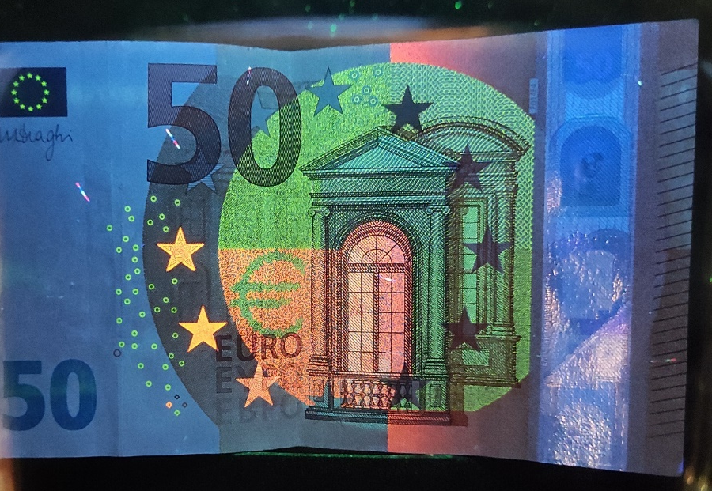
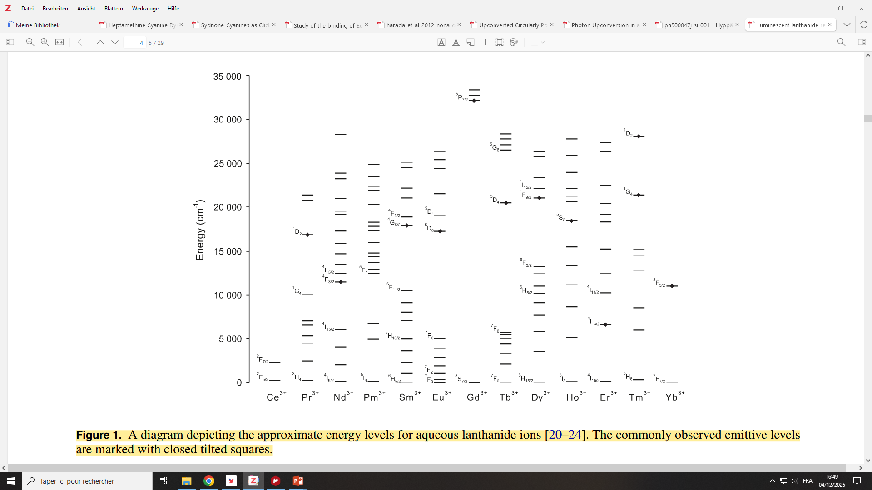
CPL of Eu³⁺ Complexes
Energy diagram of Ln ions with spectroscopic levels.
Eu³⁺: ⁵D₀ → ⁷F_{J}
Methods Appl. Fluoresc. 2014, 2, 012001. Front. Chem. 2020, 8, 1-27.
5

Slide 9
CPL of Eu³⁺ Complexes
Eu³⁺: ⁵D₀ → ⁷F_{J} (J =0-6)
9-Coordinate dipicolinate complexes
Ln(III) emission
Excitation of Antenna, Sensitization of Ln(III)
Emission
J = 2
J = 3
J = 4
J =1
Inorg. Chem. Front., 2021, 8, 914.
6

Slide 10
CPL of Eu³⁺ Complexes
f-f transitions
ED transitions forbidden by Laporte’s rule → low │µ_{ij}│
MD transitions allowed for ΔJ= 0, +/-1 (except 0-0)
Eu³⁺: ⁵D₀ → ⁷F_{J} (J =0-6)
CPL
g_{lum} (J =2) ≈ 0.1
4 │µ_{ij}│·│m_{ij}│cos θ
g_{lum} =
g_{lum} (J =1) ≈ 0.2
│µ_{ij}│² + │m_{ij}│²
Emission
J = 2
J = 3
J = 4
J =1
Spectra acquired at rt in MeOH.
Inorg. Chem. Front., 2021, 8, 914.
6

Slide 11
CPL of Yb³⁺ Complexes
Energy diagram of Ln ions with spectroscopic levels.
Yb³⁺: ⁵F_{5/2} → ²F_{7/2}
Methods Appl. Fluoresc. 2014, 2, 012001. Front. Chem. 2020, 8, 1-27.
7

Slide 12
CPL of Yb³⁺ Complexes
Crystal field splitting
In ligand field, spherical symmetry of electronic structure and genereracy of spectroscopic levels is lifted (m_{j} sub-levels)
Yb³⁺: ⁵F_{5/2} → ²F_{7/2}
CFS
2’
1’
0’
3
Emission
2
1
0
Spectroscopic states
CFS states
Spectra acquired at 4K in PDMS.
Phys. Chem. Chem. Phys. 2024, 26, 15776–15783.
8

Slide 13
CPL of Yb³⁺ Complexes
→ Mirror-type spectra for two enantiomers
→ Improved discrimination of individual transitions
→ Each CFS transition has its own CPL response (intensity + sign)
Yb³⁺: ⁵F_{5/2} → ²F_{7/2}
0’→ 0
0’→ 1
0’→ 2
0’→ 3
CFS
2’
CPL
1’
0’
3
Emission
2
1
0
Spectroscopic states
CFS states
Spectra acquired at 4K in PDMS.
Phys. Chem. Chem. Phys. 2024, 26, 15776–15783.
8

Slide 14
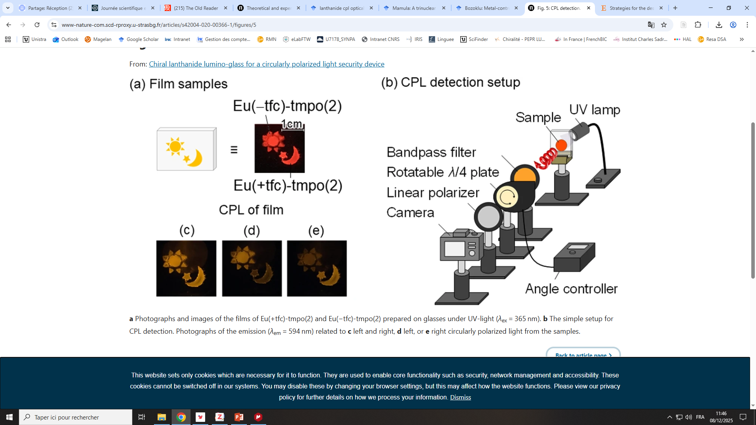
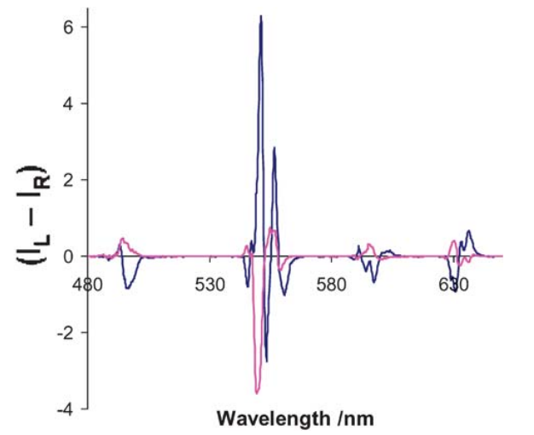
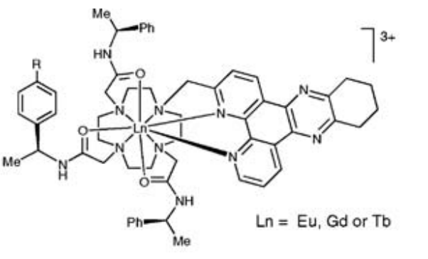
Lanthanide-CPL
Fundamental insight in Lanthanide photophysics
Applications
Anti-counterfeit devices / security inks
Display technologies
Molecular / Biological sensing
(induction/change of CPL in presence of chiral peptides)
Chem. Commun., 2008, 4261-4263.
Commun. Chem., 2020, 3, 119.
!
CPL response (and g_{lum}) is not constant for one emission band/wavelength
9

Slide 15
Lanthanide-CPL
Fundamental insight in Lanthanide photophysics
Yb³⁺-CPL at variable temperature
Er³⁺-CPL at variable bandwidth
CPL activity / g_{lum} values vary with :
Wavelength
Temperature (population of hot bands !)
Experimental bandwidth
Phys. Chem. Chem. Phys. 2024, 26, 15776–15783. J. Mater. Chem. C, 2024, 12, 4253-4260.
10

Slide 16
Lanthanide-CPL
Fundamental insight in Lanthanide photophysics
Yb³⁺-CPL at variable temperature
Er³⁺-CPL at variable bandwidth
!
Precise documentation of measurement conditions required for reproducibility
CPL activity / g_{lum} values vary with :
Wavelength
Temperature (population of hot bands !)
Experimental bandwidth
Phys. Chem. Chem. Phys. 2024, 26, 15776–15783. J. Mater. Chem. C, 2024, 12, 4253-4260.
10

Slide 17

Envisaged Project
E₂
Insight into chiral activity of higher excited states
Combination of Upconversion Emission (UC) and Circularly Polarized Luminescence (CPL) in one molecular complex
E₁
E₁‘
→ Fundamental knowledge in Ln³⁺
photophysics
→ Novel materials with unprecedented
properties
E₀
Upconversion Emission
Lanthanide Complexes
Upconversion Emission
Circularly Polarized Luminescence
E₂
hν_{UC} > hν_{exc}
UC Emission
hν_{UC}
Emission
E₁
E₁‘
Excitation hν_{exc}
CPL
hν_{lum}
E₀
Exemple of ESA mechanism.
11
Notes:
parity forbidden, and in many cases spin forbidden, nature of the 4f 씮 4f transitions and the fact that the 4f electrons, being effectively shielded by 5p and 6s electrons, are not involved in chemical bonding.
Application: - Magnetic molecular materials
- Particular NMR applications
- MRI contrast agent
- Laser materials
- Visualization/Illumination devices
- Bioimaging & Biosensing

Slide 18

Envisaged Project
E₂
Insight into chiral activity of higher excited states
UC
Ln³⁺ Complex
E₁
CPL
E₁‘
E₀
Excitation of
chromophore
Requirements on Complex Design
i) Induction of chirality
ii) Efficient sensitization
(antenna with high absorption cross-section)
iii) Maximum decrease of non-emissive deactivation
pathways (CN = 9, deuteration,…)
ET to Ln³⁺ Center (Antenna effect)
Ln³⁺
Emission of UC- CPL
Ln³⁺ = Er³⁺
12
Notes:
parity forbidden, and in many cases spin forbidden, nature of the 4f 씮 4f transitions and the fact that the 4f electrons, being effectively shielded by 5p and 6s electrons, are not involved in chemical bonding.
Application: - Magnetic molecular materials
- Particular NMR applications
- MRI contrast agent
- Laser materials
- Visualization/Illumination devices
- Bioimaging & Biosensing

Slide 19


Acknowledgements
Financial support
Dr. Aline NONAT
Dr. Loïc CHARBONNIERE
Dr. Clémence CHEIGNON
Dr. Câline CHRISTINE
Dr. Cyrille CHARPENTIER
Alexandre LECOINTRE
Dr. Mainak BANERJEE
Samuel SANCHEZ
Dr. Brigino RALAHY
Dr. Charlotte HEINRITZ
Abiram SELVARATNAM
Pol CASTILLO-TORRES
Manon COURSEYRE
ANR-25-CE07-6425
Soutien ITI QMat
Thanks for
your kind attention !
Annika Sickinger
sickinger@unistra.fr

Slide 20
Energy Transfer
ΔE [cm⁻¹]
²H_{11/2}
19150
⁴S_{3/2}
18450
Excitation
Chiral ligands
UC-CPL
hν ≈ 540/520 nm
⁴I_{9/2}
12250
Er³⁺
UC-CPL Emission
⁴I_{13/2}
6500
Excitation
hν ≈ 800 nm
NIR-Emission + CPL
hν ≈ 1500 nm
⁴I_{15/2}
0
Antenna, attached to tridentate ligand
Er(III)

Slide 21
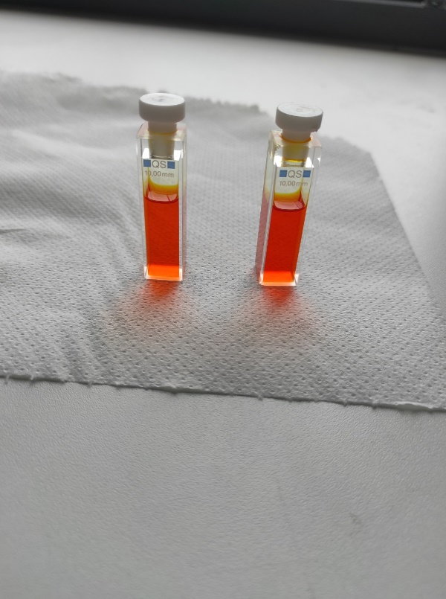

CPL setup
polarizer beam splitter
lense
mono-chromator
Excitation
λ/4
waveplate
lenses
CCD camera
Sample
‘hot band’ emissive levels

