Slide 1
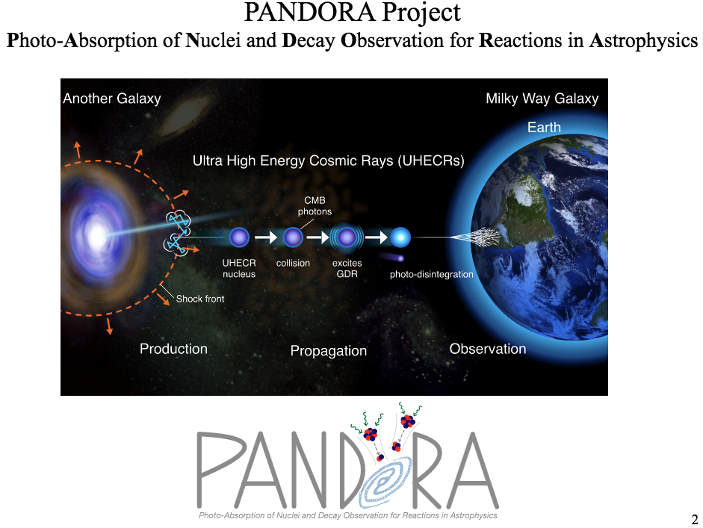
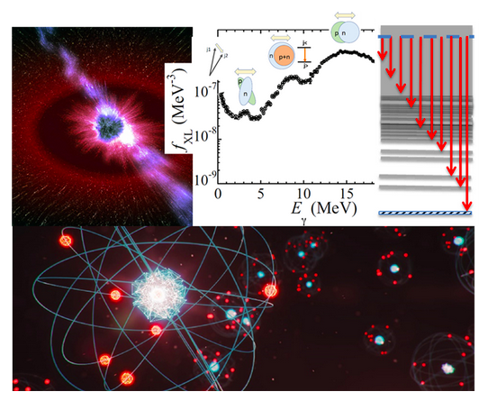




Dipole Excitations in Nuclei:
Bridging Femtometer Physics with Cosmic-Scale Questions
Kamila Sieja
Notes:
MERCI DE LAISSER LA PHOTO GENERIQUE EN PAGE 1.

Slide 2
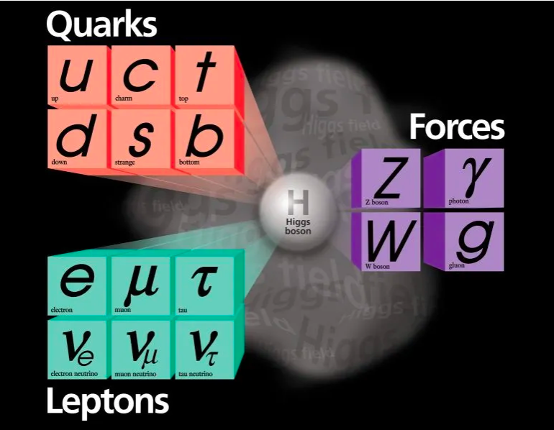
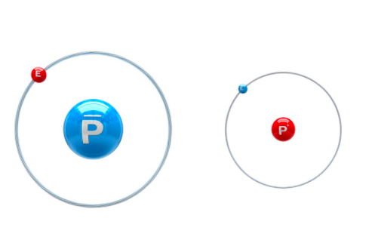
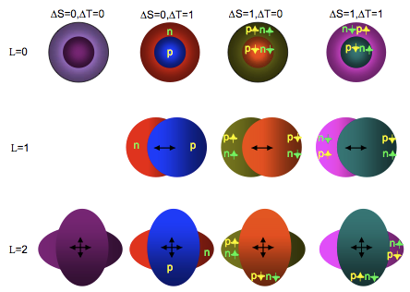
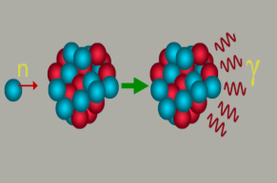
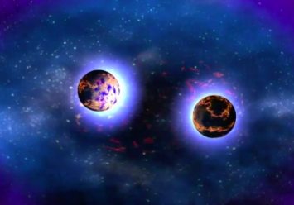
THEORY TEAM: ACTIVITIES
High-energy (particle) physics
1. Effective field theories, Lie algebras
2. Physics beyond the Standard Model: from formal
aspects to phenomenology
Low-energy (nuclear) physics
1. Few-body systems:
-Weakly-bound systems, resonances, physics of antimatter
2. Many-body systems:
-Exotic nuclei, weak processes, applications in astrophysics
-Exotic symmetries, superheavy systems

Slide 3
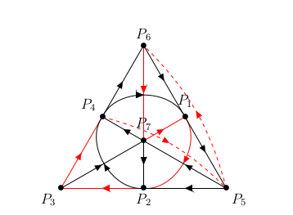
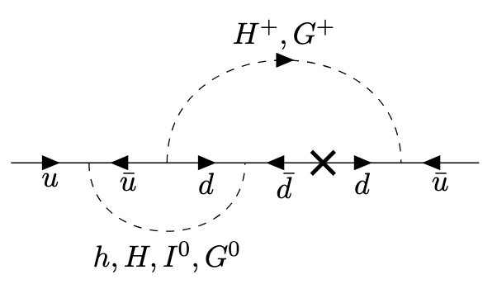

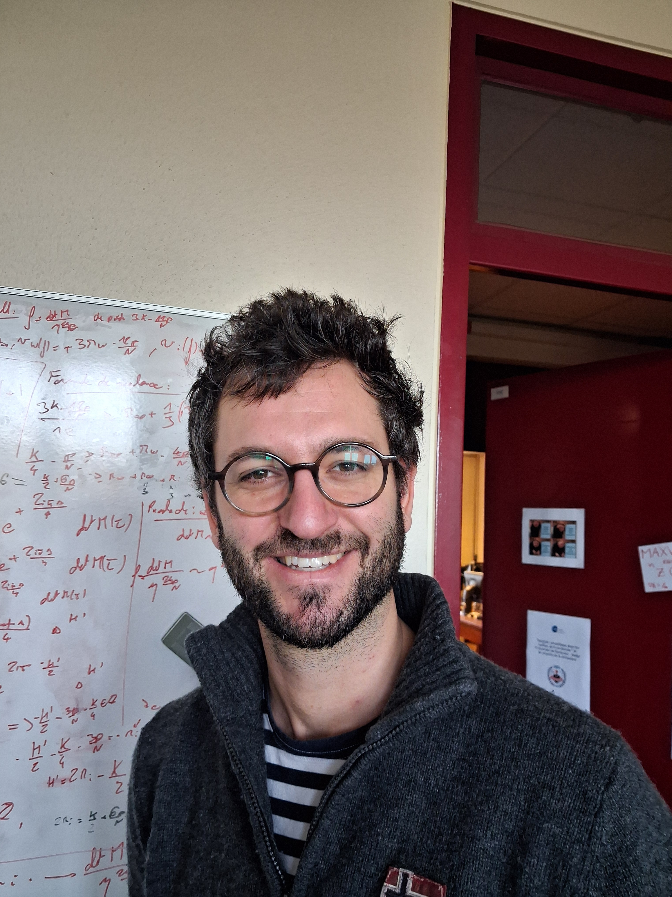

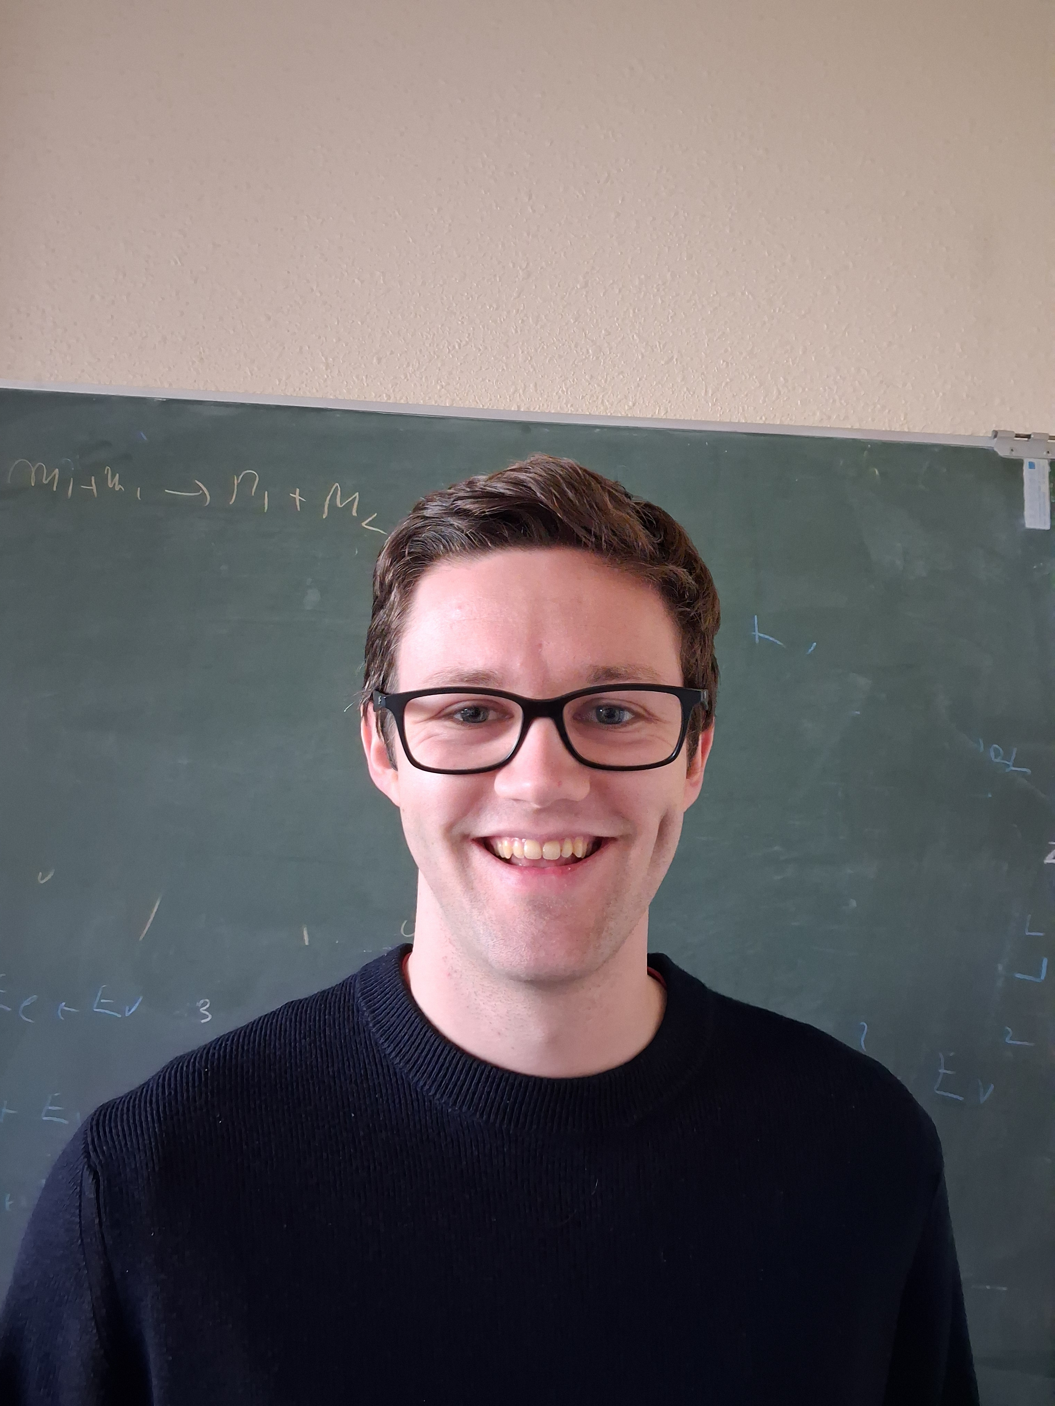

HIGH-ENERGY (PARTICLE) PHYSICS
PHYSICS SUBJECTS:
Supersymmetry, supergravity
Lie groups
Quantum field theory : effective field theories for particle physics, scattering amplitudes, symmetries
Particle physics beyond-the-Standard-Model : strong CP problem, axions, flavor
Early-universe cosmology : dark matter, cosmic strings
PhD thesis:
S. Beaudoin (PhD ongoing)
« Axions, cordes cosmiques et monopoles magnétiques »
V. Saulquin (PhD ongoing)
« Nouveaux modèles de physique des particules inspirés par le problème CP fort et les symétries de saveur »
Q. Bonnefoy M. Rausch
de Traubenberg
S. Beaudoin V. Saulquin
J. Polonyi (emeritus)

Slide 4
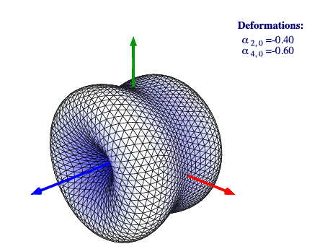
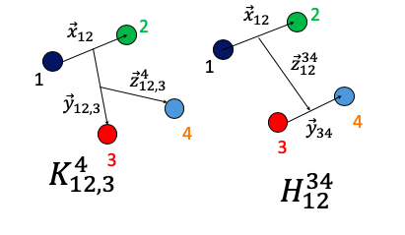
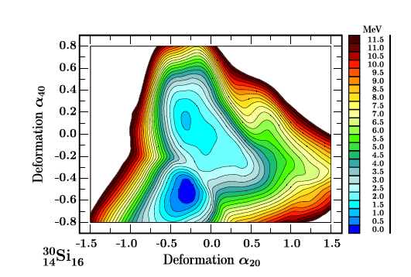
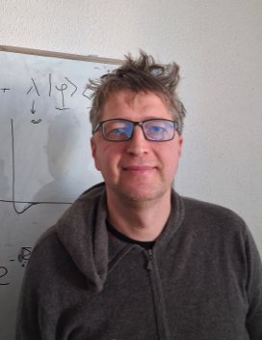


FEW-BODY SYSTEMS MANY-BODY SYSTEMS (1)
PHYSICS SUBJECTS:
3-5 particle systems atomic, molecular, nuclear
Weakly-bound systems, resonances
Physics of antimatter, interaction between
matter and antimatter
Experiments GBAR and PUMA @CERN
PHYSICS SUBJECTS:
K-isomers, shape isomers, Gallagher-Moszkowski splitting in odd-odd nuclei, fission
High-rank symmetries
Multidisciplinary applications: hyperfine structure
ANR FBCUBES
M. Dufour R. Lazauskas M. Schäfer (post-doc)
J. Bartel
(emeritus)
J. Dudek H.Molique
(emeritus)

Slide 5



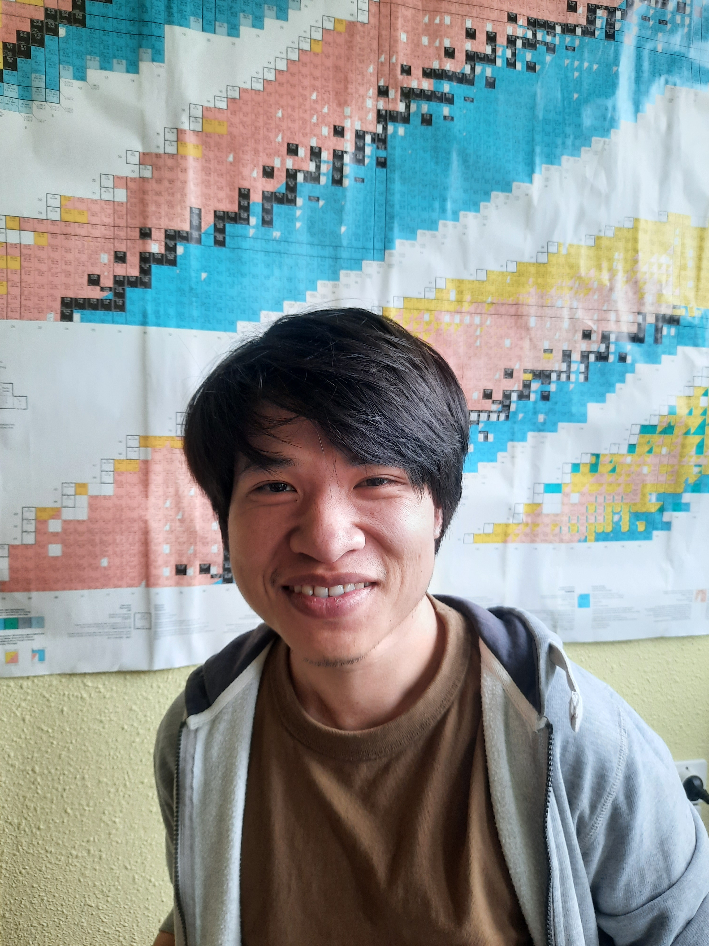
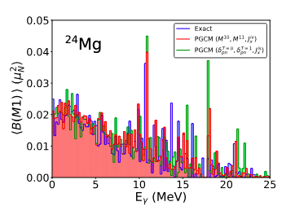
MANY-BODY SYSTEMS (2): valence-space approaches
PHYSICS SUBJECTS:
Exotic nuclei: spectroscopy, shell evolution, shape changes
Dipole excitations
Weak-decays (beta and duble-beta)
Reactions of interest for astrophysics (r-process, UHECR)
TOOLS:
Effective interactions
Codes CI-SM and DNO-SM (PGCM):
ANTOINE, NATHAN, CARINA
K. Sieja O. Le Noan
Dipole Excitations in Atomic Nuclei: Theoretical Models and Applications
(PhD O. Le Noan+ QMAT project 2024-2026)
D. D. Dao F. Nowacki

Slide 6
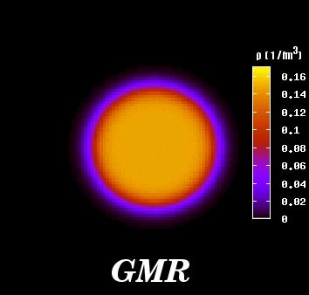
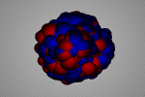
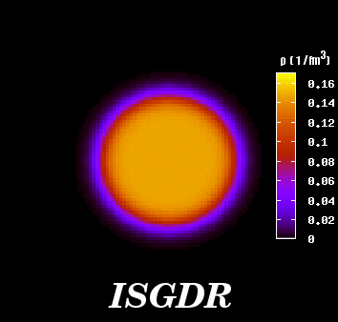
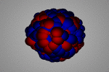
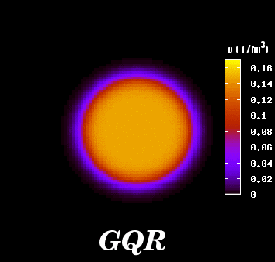
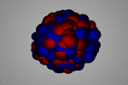
The Collective Response of the Nucleus: Giant Resonances
Isoscalar (In phase)
ΔT = 0
Isovector (Out of phase)
ΔT = 1
Monopole
ΔL = 0
(GMR)
Dipole
ΔL = 1
(GDR)
Quadrupole
ΔL = 2
(GQR)

Slide 7
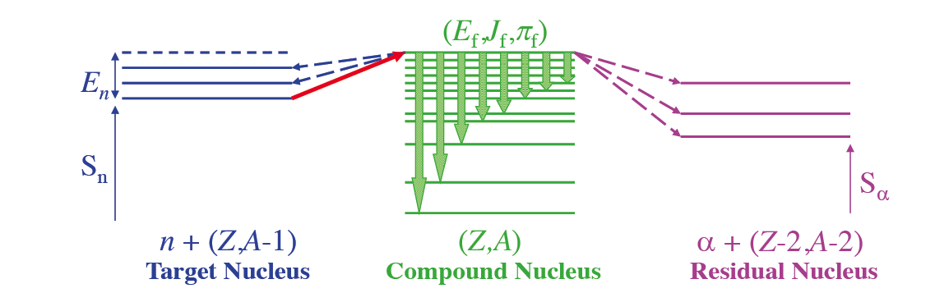
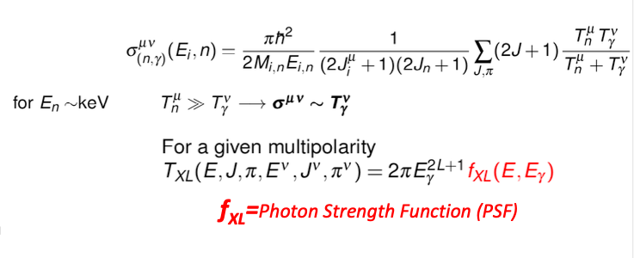
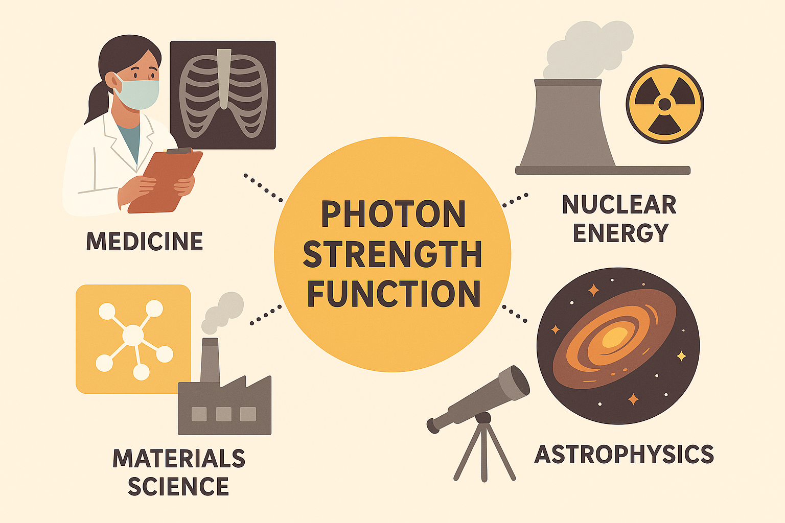
Nuclear Dipole Excitations: from Academic to Industrial Applications
Fundamental mode of nuclear excitations
Dominated by E1 mode (with a smaller contribution of the M1)
Basic input to nuclear reaction codes
TALYS code: Modeling of Nuclear Reactions
A. Koning, S. Hilaire, S. Goriely at al. Eur. Phys. J A59 (2023) 131
generated by AI

Slide 8
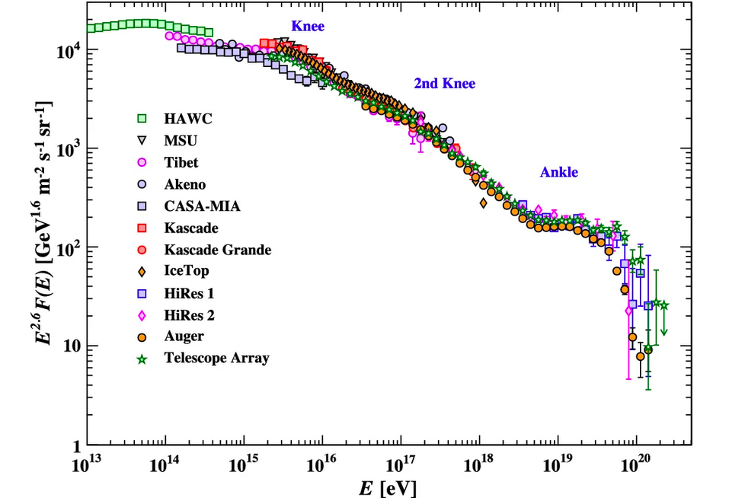
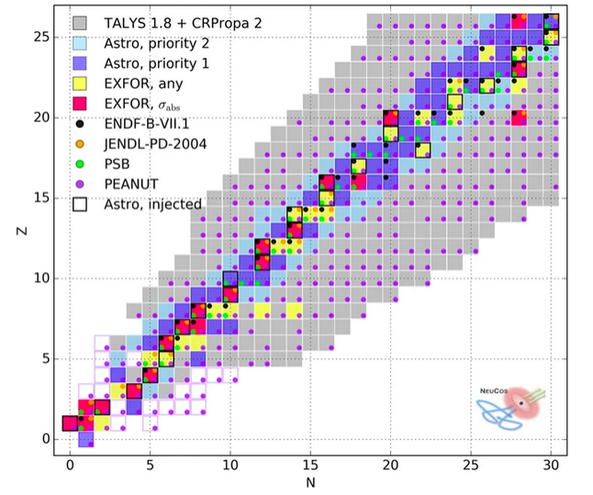
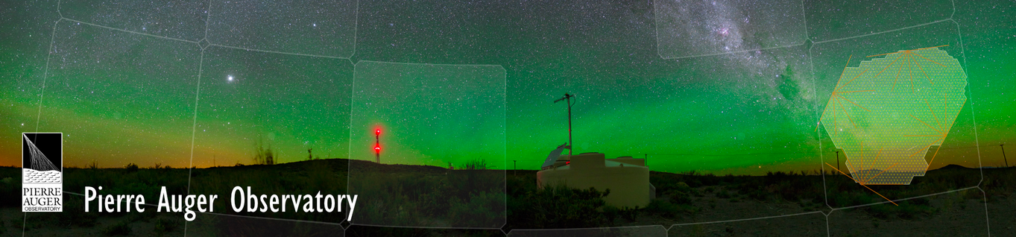
Nuclear Physics Meets the Sources of the Ultra-High Energy Cosmic Rays
A. Tamii et al, Eur. Phys. J.A59 (2023) 208
After >50 years of studying UHECR open questions remain :
Where do they come from?
How they are accelerated?
Boncioli, D., Fedynitch, A. & Winter, W., Sci Rep 7, 4882 (2017).

Slide 9
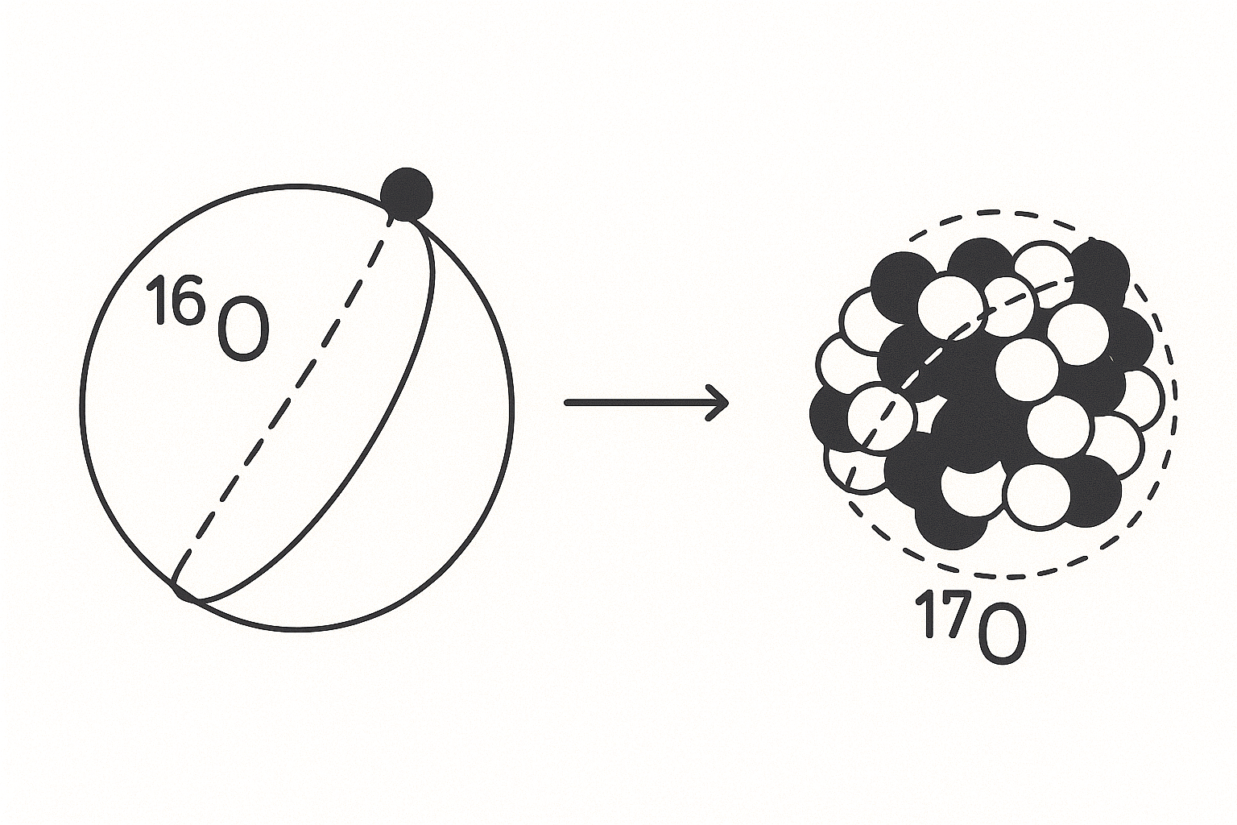


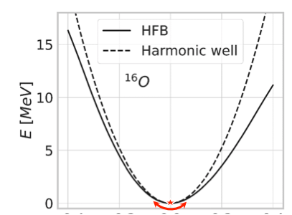





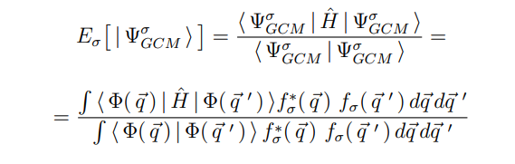
Many-body methods to compute dipole response
+...
Quasiparticle Random Phase Approximation (QRPA)
Configuration Interaction Shell Model (CI-SM)
Benchmark of many-body methods:
1. M. Frosini, W. Ryssens and K. Sieja, Phys. Rev. C 110, 014307 (2024)
2. S. Bofos, J. Martinez, B. Bally, T. Duguet, M. Frosini, T. Rodriguez and K. Sieja, Phys. Rev. C112, 064312
(2025)
Projected Generator Coordinate Method (PGCM)

Slide 10
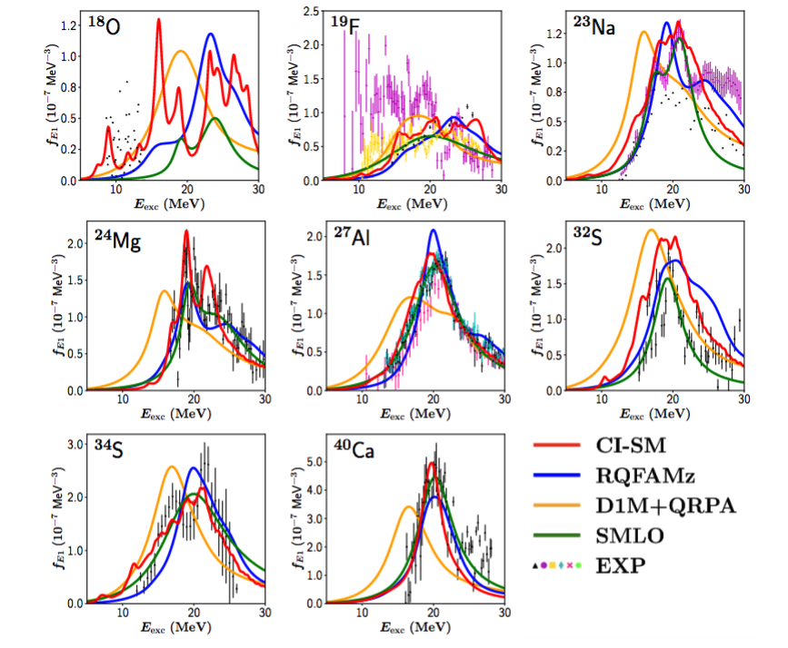
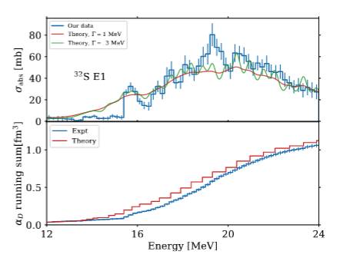
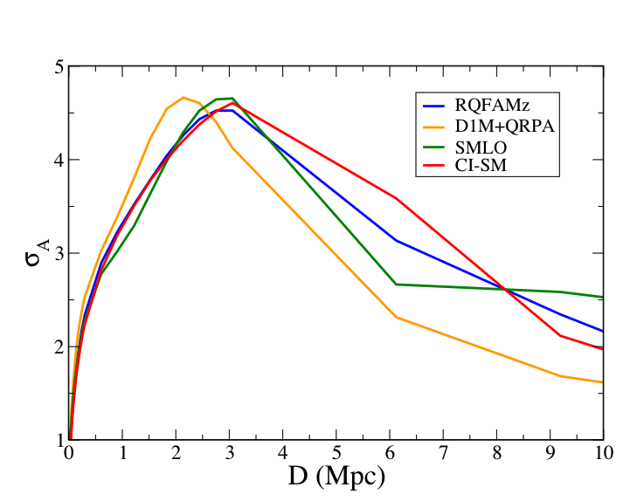
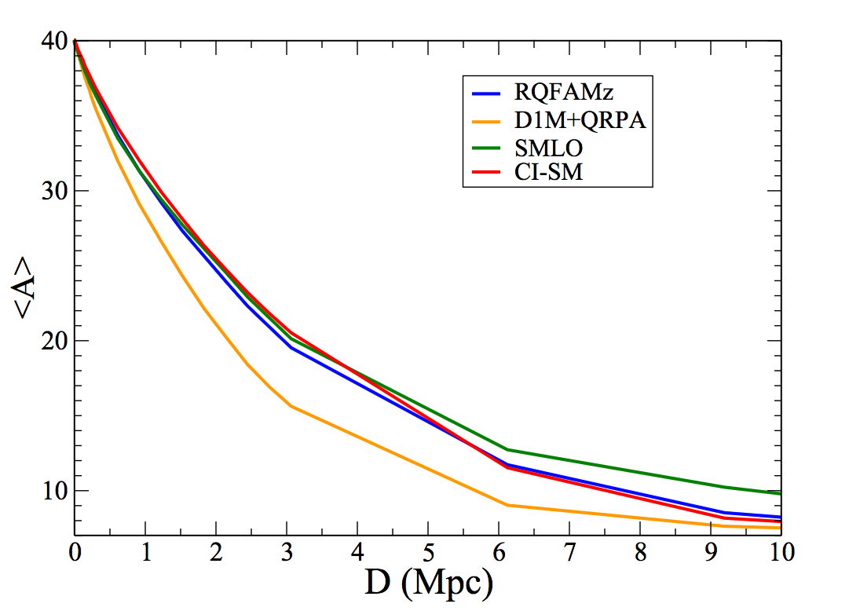
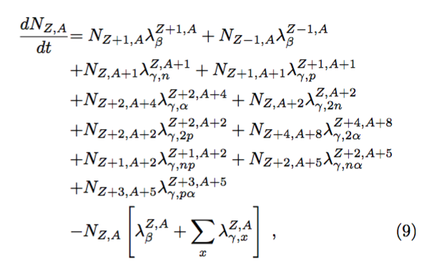
Impact of Photonuclear Reaction Models on Propagation Ultra-High Energy Cosmic Rays
R. Fearick, O. Le Noan, H. Matsubara, P. von Neumann-Cosel, K. Sieja and A. Tamii, in preparation.
O. Le Noan and K. Sieja, PRC111 (2025) 064308.
CI-SM PSF database for TALYS
O. Le Noan, S. Goriely, E. Khan and K. Sieja, to be submitted.

Slide 11

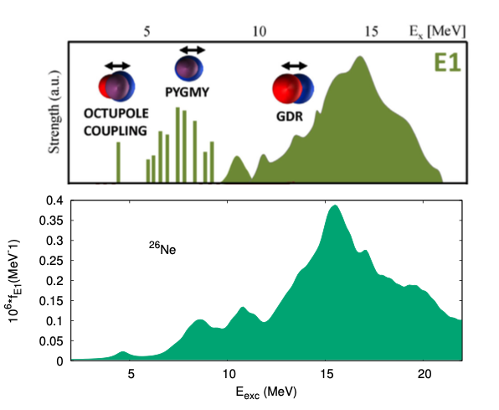
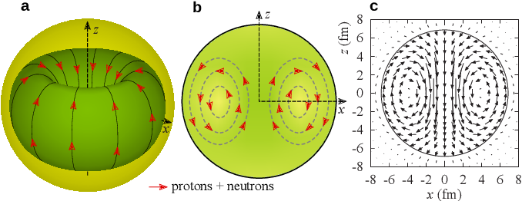
New Insights into the Nature of the Pygmy Dipole Resonance
O. Le Noan and K. Sieja, PRC111 (2025) 064308.
CI-SM computation
Motivations to study PDR:
PDR enhances probability of (n,γ) CS
=> influence on astrophysical r-process
PDR relates to neutron-skin thickness => relation to neutron stars
Open questions:
Evolution of PDR with angular momenta and deformation
Isospin mixing of PDR (IS vs IV)
Is PDR a toroidal mode?
P. von Neumann Cosel et al. Physics (2023)

Slide 12

Thank You !
Thanks to:
IPHC: O. Le Noan
CEA Saclay: T. Duguet
CEA Cadarache: S. Bofos, M. Frosini, A. Pastore
CEA DAM: S. Hilaire
IJCLab: E. Khan
TU Darmstadt: B. Bally
Universidad de Sevilla: T. R. Rodriguez
Universidad Autonoma de Madrid: J. Martinez-Larraz
Université Libre de Bruxelles: S. Goriely, W. Ryssens
University of Zagreb: N. Paar

