Slide 1
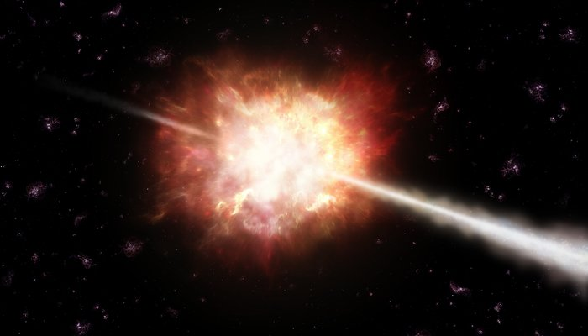
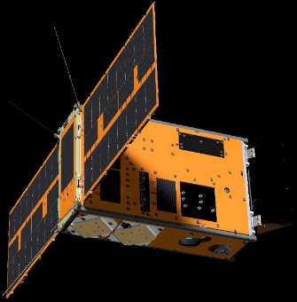

Enhancing Gamma-Ray Burst Localization
with CubeSat Constellations
Haritha Mullathody
The University of Melbourne
Supervisors : Prof Michele Trenti,
Dr Katie Auchettl
1

Slide 2
Gamma-ray Bursts (GRBs)
Brightest Explosion in the Universe !
Credit: ESO/A. Roquette
2
OzFink 2025 / Haritha Mullathody

Slide 3
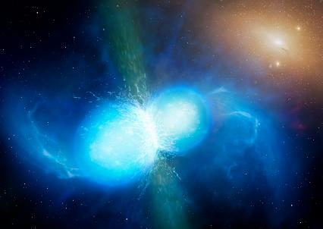
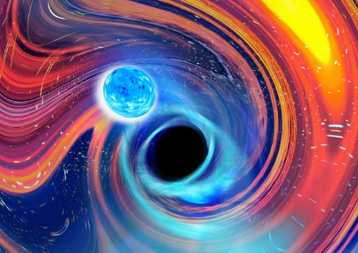
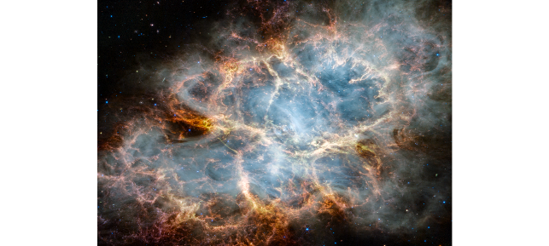
Gamma-ray Bursts (GRBs)
Short GRBs
T₉₀ < 2 secs
Merger of neutron star (NS) binaries or NS-black hole binaries.
Long GRBs
T₉₀ > 2 secs
Core collapse of a massive star
Credits: University of Warwick/Mark Garlick
Carl Knox, OzGrav / Swinburne University
NASA, ESA, CSA, STScI, Tea Temim (Princeton University)
3
OzFink 2025 / Haritha Mullathody

Slide 4
Why Localise GRBs?
OzFink 2025 / Haritha Mullathody
Notes:
: Observation requires specific pointing
Short lived

Slide 5
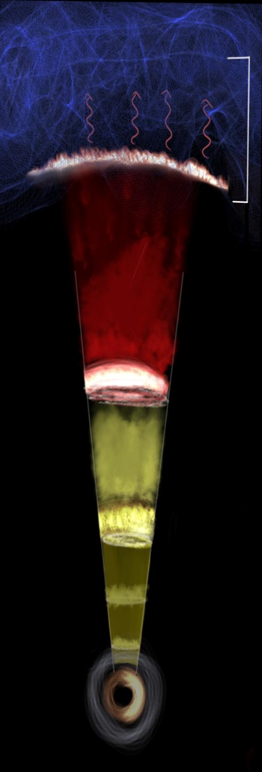
Gamma-ray Burst event
- Isotropical in distribution
Gamma rays
Prompt Emission
Short lived: Lasts from only milliseconds to minutes !
4
OzFink 2025 / Haritha Mullathody
Notes:
A GRB leaves an afterglow which quickly drops from high-energy X-rays down to low-energy
visible/radio waves that can be observed by ground based telescopes. However, afterglows are point
sources and are substantially less energetic than their prompt emissions (Reyes, 2017). To observe
the afterglow of a GRB, localisation needs to be made during the high-energy gamma-ray/X-ray
phase, hence making high-energy band detectors necessary.

Slide 6
Gamma-ray Burst event
- Isotropical in distribution
Gamma rays
Gamma rays
X-rays
Optical/UV
Prompt Emission
Radio
Short lived: Lasts from only milliseconds to minutes !
Afterglow
4
OzFink 2025 / Haritha Mullathody
Notes:
A GRB leaves an afterglow which quickly drops from high-energy X-rays down to low-energy
visible/radio waves that can be observed by ground based telescopes. However, afterglows are point
sources and are substantially less energetic than their prompt emissions (Reyes, 2017). To observe
the afterglow of a GRB, localisation needs to be made during the high-energy gamma-ray/X-ray
phase, hence making high-energy band detectors necessary.

Slide 7
Gamma-ray Burst event
Gamma rays
Gamma rays
X-rays
Optical/UV
Prompt Emission
Radio
Short lived: Lasts from only milliseconds to minutes !
Afterglow
Observing and localising GRB events are important:
Insights into physics of relativistic jets
4
OzFink 2025 / Haritha Mullathody
Notes:
A GRB leaves an afterglow which quickly drops from high-energy X-rays down to low-energy
visible/radio waves that can be observed by ground based telescopes. However, afterglows are point
sources and are substantially less energetic than their prompt emissions (Reyes, 2017). To observe
the afterglow of a GRB, localisation needs to be made during the high-energy gamma-ray/X-ray
phase, hence making high-energy band detectors necessary.

Slide 8
Gamma-ray Burst event
Gamma rays
Gamma rays
X-rays
Optical/UV
Prompt Emission
Radio
Short lived: Lasts from only milliseconds to minutes !
Afterglow
Observing and localising GRB events are important:
Insights into physics of relativistic jets
Long GRB afterglows to study the high redshift universe and the cosmic star formation rate
4
OzFink 2025 / Haritha Mullathody
Notes:
A GRB leaves an afterglow which quickly drops from high-energy X-rays down to low-energy
visible/radio waves that can be observed by ground based telescopes. However, afterglows are point
sources and are substantially less energetic than their prompt emissions (Reyes, 2017). To observe
the afterglow of a GRB, localisation needs to be made during the high-energy gamma-ray/X-ray
phase, hence making high-energy band detectors necessary.

Slide 9
Gamma-ray Burst event
Gamma rays
Gamma rays
X-rays
Optical/UV
Prompt Emission
Radio
Short lived: Lasts from only milliseconds to minutes !
Afterglow
Observing and localising GRB events are important:
Insights into physics of relativistic jets
Long GRB afterglows to study the high redshift universe and the cosmic star formation rate
Localisations of short GRBs may assist in more precise localisation of GW transient events
4
OzFink 2025 / Haritha Mullathody
Notes:
A GRB leaves an afterglow which quickly drops from high-energy X-rays down to low-energy
visible/radio waves that can be observed by ground based telescopes. However, afterglows are point
sources and are substantially less energetic than their prompt emissions (Reyes, 2017). To observe
the afterglow of a GRB, localisation needs to be made during the high-energy gamma-ray/X-ray
phase, hence making high-energy band detectors necessary.

Slide 10
Gamma-ray Burst event
Gamma rays
Gamma rays
X-rays
Optical/UV
Prompt Emission
Radio
Short lived: Lasts from only milliseconds to minutes !
Afterglow
Observing and localising GRB events are important:
Insights into physics of relativistic jets
Long GRB afterglows to study the high redshift universe and the cosmic star formation rate
Localisations of short GRBs may assist in more precise localisation of GW transient events
Faint!!
4
OzFink 2025 / Haritha Mullathody
Notes:
A GRB leaves an afterglow which quickly drops from high-energy X-rays down to low-energy
visible/radio waves that can be observed by ground based telescopes. However, afterglows are point
sources and are substantially less energetic than their prompt emissions (Reyes, 2017). To observe
the afterglow of a GRB, localisation needs to be made during the high-energy gamma-ray/X-ray
phase, hence making high-energy band detectors necessary.

Slide 11
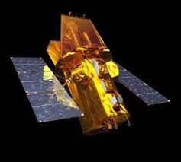
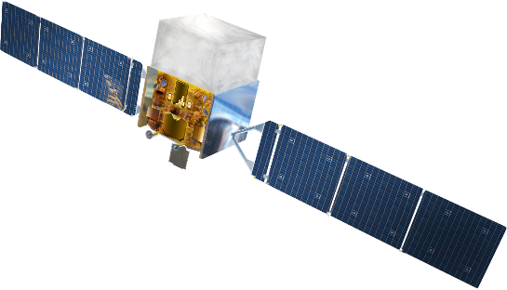
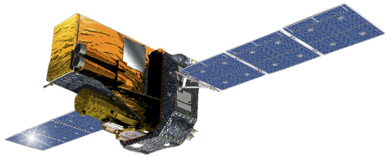
Space Telescopes
Gamma-ray, X-ray are blocked by Earth’s atmosphere
Fermi Gamma-ray Space Telescope
Neil Gehrels Swift Observatory
INTEGRAL
5
OzFink 2025 / Haritha Mullathody
Notes:
: Observation requires specific pointing
Short lived

Slide 12
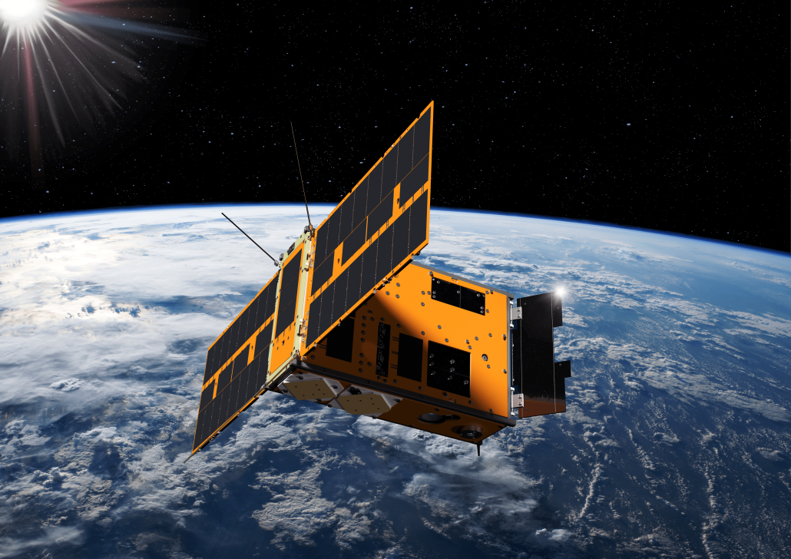

SpIRIT
Hermes detector
Shoe-box sized,
It’s only 11.5 kg!
6
OzFink 2025 / Haritha Mullathody
Credit: UoM and the SpIRIT team
Notes:
What makes spirit different nano satellite cost effective launched on December 1st
we look at photons coming in and , Detectors give us mainly their arrival time direction of their arrival and no of photons coming

Slide 13
How to Localise GRBs?
OzFink 2025 / Haritha Mullathody
Notes:
: Observation requires specific pointing
Short lived

Slide 14
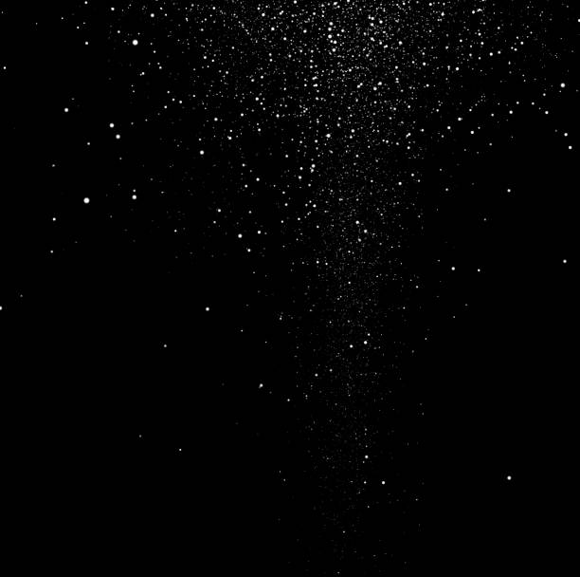

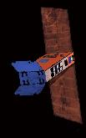
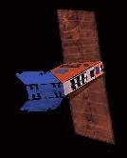



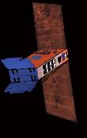

Localisation by Time Delay
GRB EXPLOSION
FLUX
TIME
7
OzFink 2025 / Haritha Mullathody

Slide 15

Localisation by Time Delay
Triangulation
d = c Δt
GRB EXPLOSION
Δτ
FLUX
7
OzFink 2025 / Haritha Mullathody

Slide 16

Localisation by Incident Flux
( RA, DEC )
Not to scale!!
8
OzFink 2025 / Haritha Mullathody
Notes:
How do we use the information on flux for localisation we offset the satellite pointings

Slide 17

Localisation by Incident Flux
δ
- Offset angle
9
OzFink 2025 / Haritha Mullathody
Notes:
How do we use the information on flux for localisation we offset the satellite pointings

Slide 18
Localisation by Incident Flux
Flux difference increases with larger offset angles!
Likelihood ( Time delay, Intrinsic Flux)
FLUX
ΔF
TIME
10
OzFink 2025 / Haritha Mullathody

Slide 19
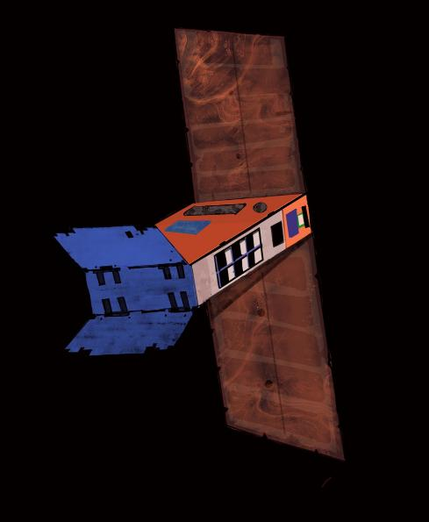
GRB
In FOV
Burst Incident angle ≤ 80°
Flux ≥$F_{lim}$
Flux ≥𝐹_𝑙𝑖𝑚
$N_{detection}$≥3
𝑁_𝑑𝑒𝑡𝑒𝑐𝑡𝑖𝑜𝑛≥3
IT’S A GRB DETECTION !!
o
80
Likelihood ( Time delay, Intrinsic Flux)
into MCMC
11
OzFink 2025 / Haritha Mullathody ©

Slide 20
Where to Place & How to Point the CubeSats?
OzFink 2025 / Haritha Mullathody
Notes:
: Observation requires specific pointing
Short lived

Slide 21
1. CO-POINTING
OzFink 2025 / Haritha Mullathody
Notes:
: Observation requires specific pointing
Short lived

Slide 22




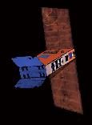





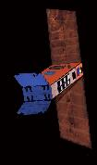

1. CO-POINTING
A CONSTELLATION OF
8 SATELLITES IN POLAR ORBIT
$${45}^{0}$$
Not to scale!!
12
OzFink 2025 / Haritha Mullathody
Notes:
How do we use the information on flux for localisation we offset the satellite pointings

Slide 23

( 180, 0 )
( 0, 0 )
13
Notes:
How do we use the information on flux for localisation we offset the satellite pointings

Slide 24
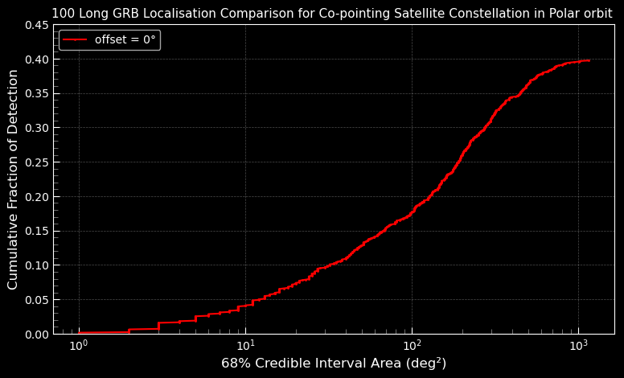
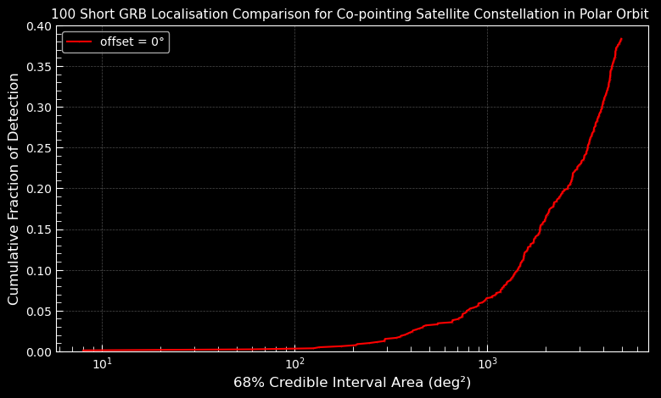
Result : Co-pointing Satellites – Time triangulation
14
OzFink 2025 / Haritha Mullathody

Slide 25
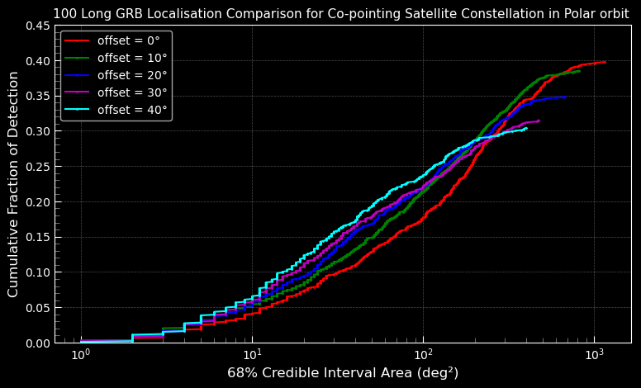
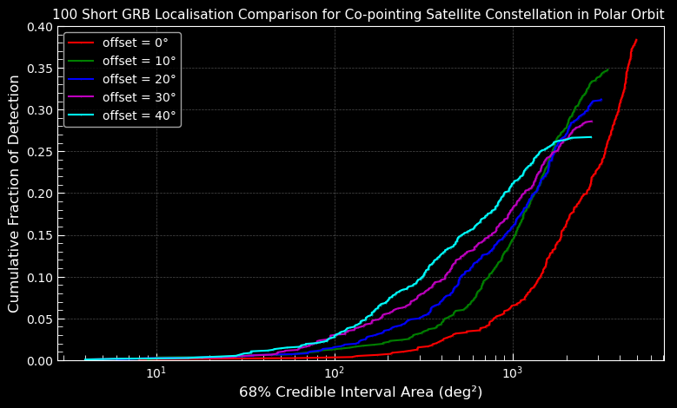
Result : Time triangulation + flux offset
14
OzFink 2025 / Haritha Mullathody

Slide 26
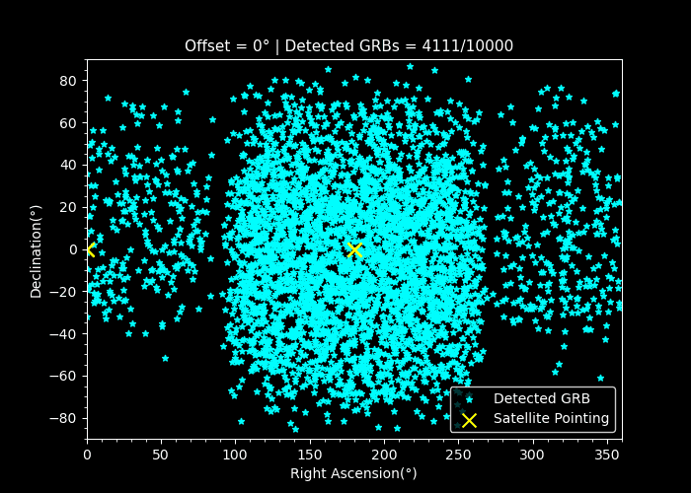

Likelihood ( Time delay, Intrinsic Flux)
Localisation by Incident Flux
Flux difference increases with larger offset angles, better localisation!
Success rate of detection drops with offset angle !!
FLUX
ΔF
$$F_{lim}$$
TIME
15
OzFink 2025 / Haritha Mullathody

Slide 27
2. ZENITH POINTING
OzFink 2025 / Haritha Mullathody
Notes:
: Observation requires specific pointing
Short lived

Slide 28
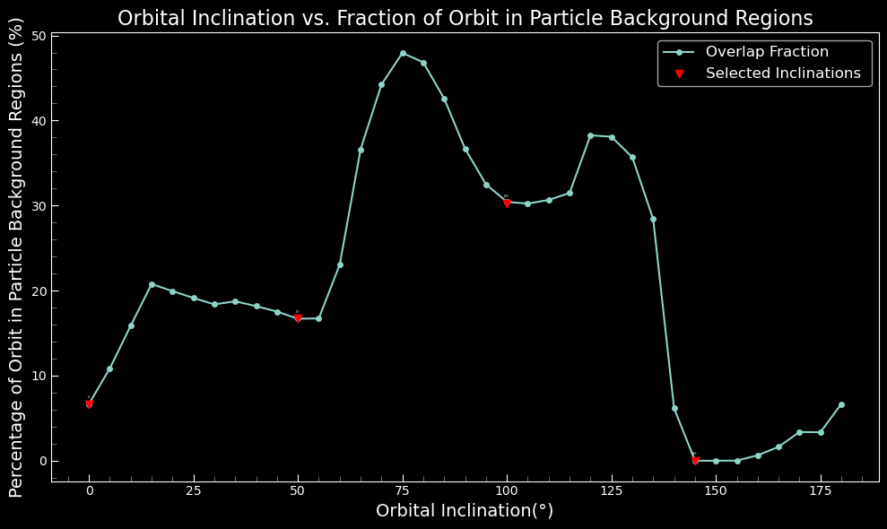
2. ZENITH POINTING
MULTI - PLANE CONSTELLATION
16
OzFink 2025 / Haritha Mullathody

Slide 29
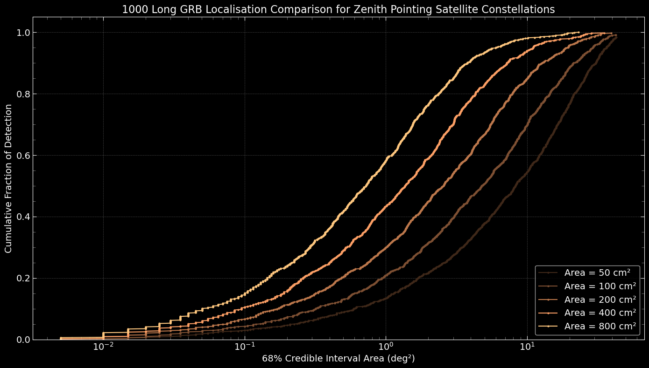
DETECTOR AREA
2. ZENITH POINTING
16 satellites : 4 sats each in 4 orbital planes
16
OzFink 2025 / Haritha Mullathody

Slide 30
2. ZENITH POINTING
NUMBER OF SATELLITES
v
17
OzFink 2025 / Haritha Mullathody

Slide 31
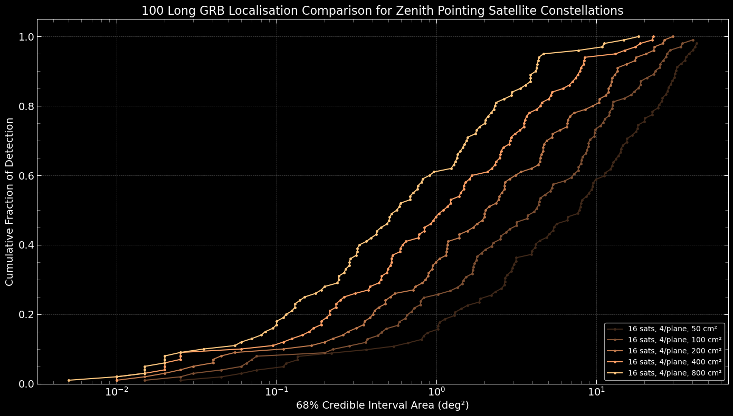
Result : Long GRBs
18
OzFink 2025 / Haritha Mullathody

Slide 32
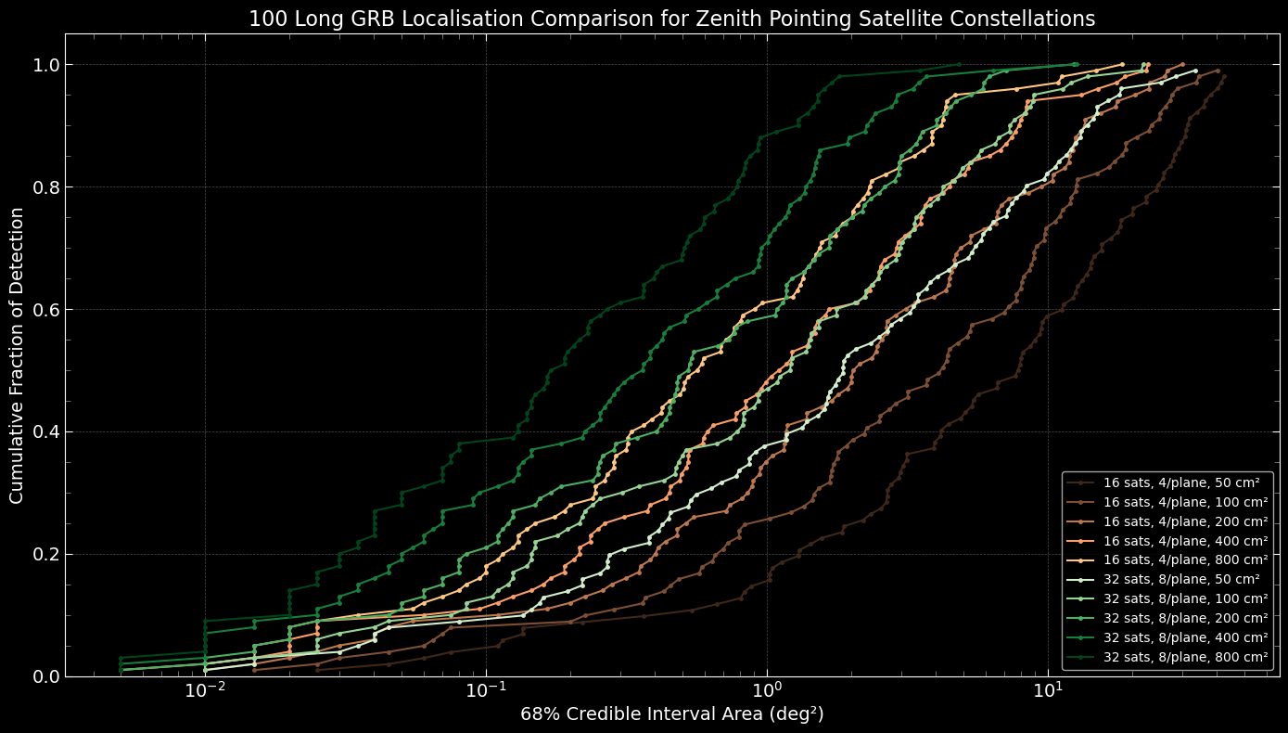
Result : Long GRBs
18
OzFink 2025 / Haritha Mullathody

Slide 33
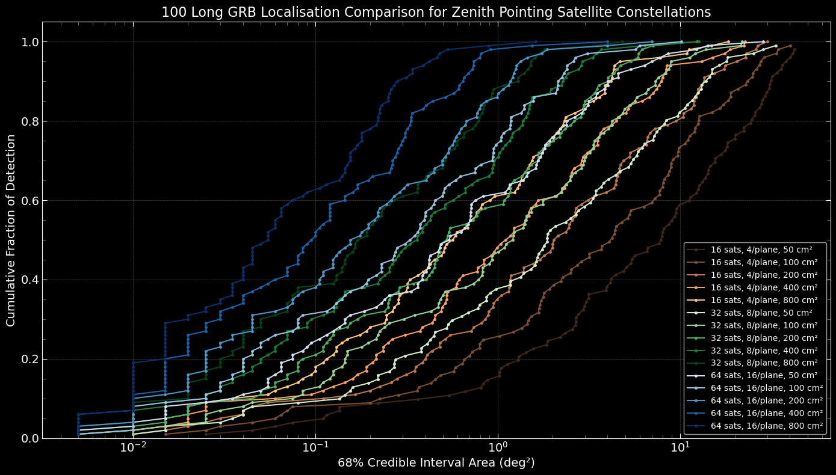
Result : Long GRBs
18
OzFink 2025 / Haritha Mullathody

Slide 34
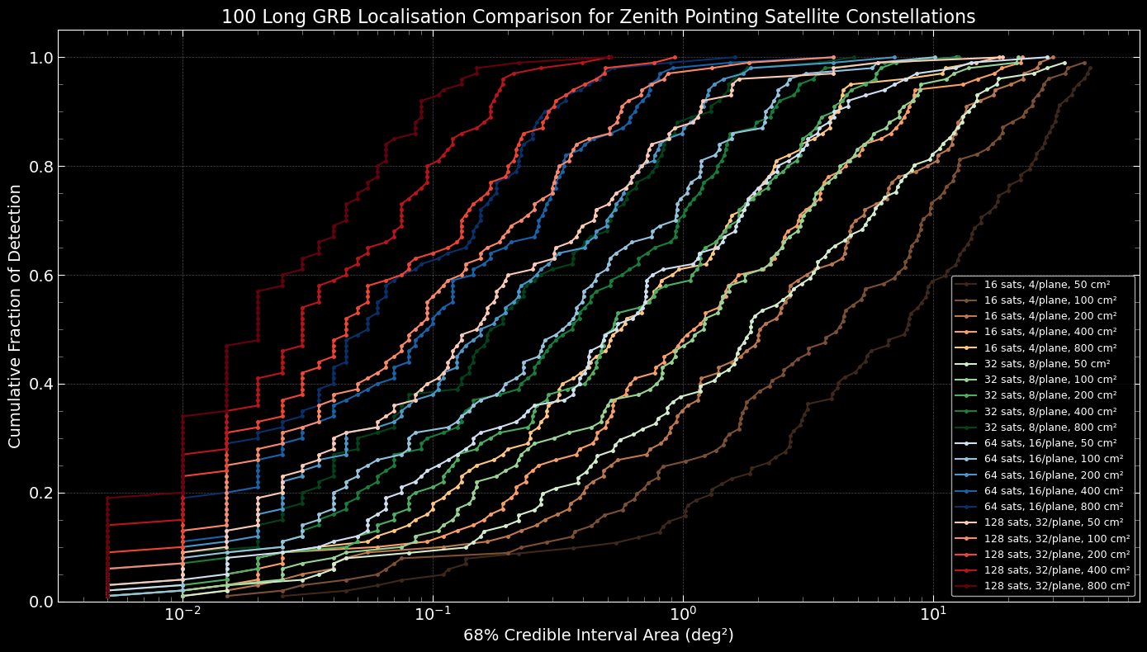
Result : Long GRBs
18
Ozfink 2025 / Haritha Mullathody

Slide 35
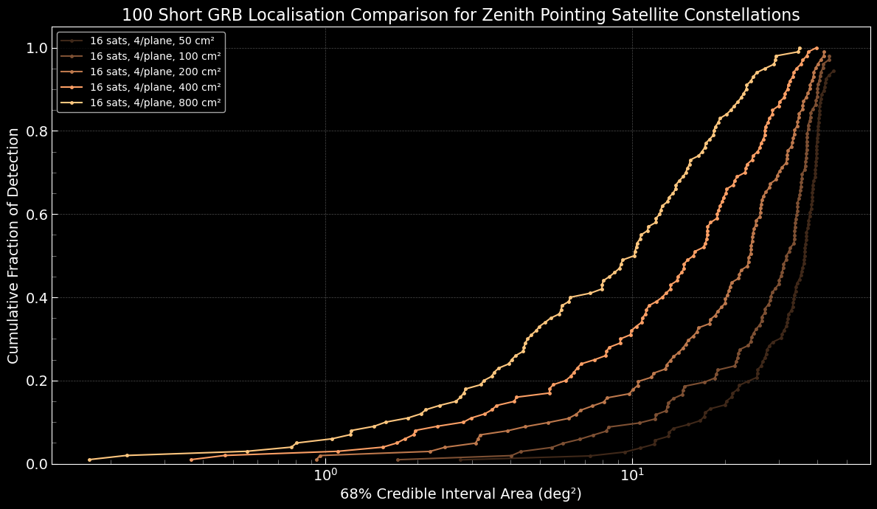
Result : Short GRBs
19
OzFink 2025 / Haritha Mullathody

Slide 36
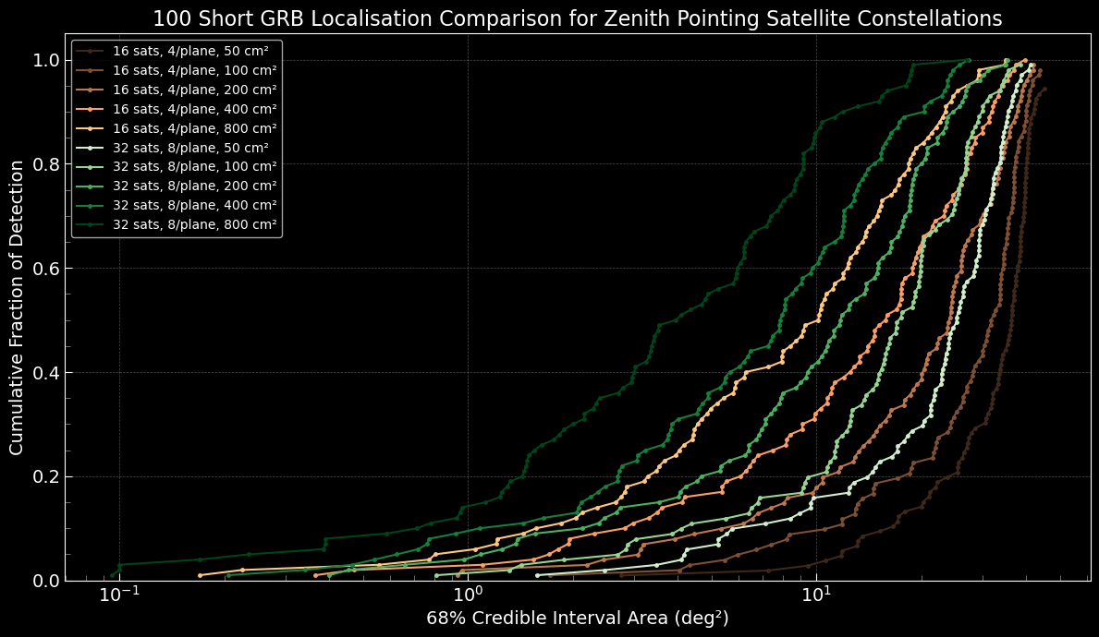
Result : Short GRBs
19
OzFink 2025 / Haritha Mullathody

Slide 37
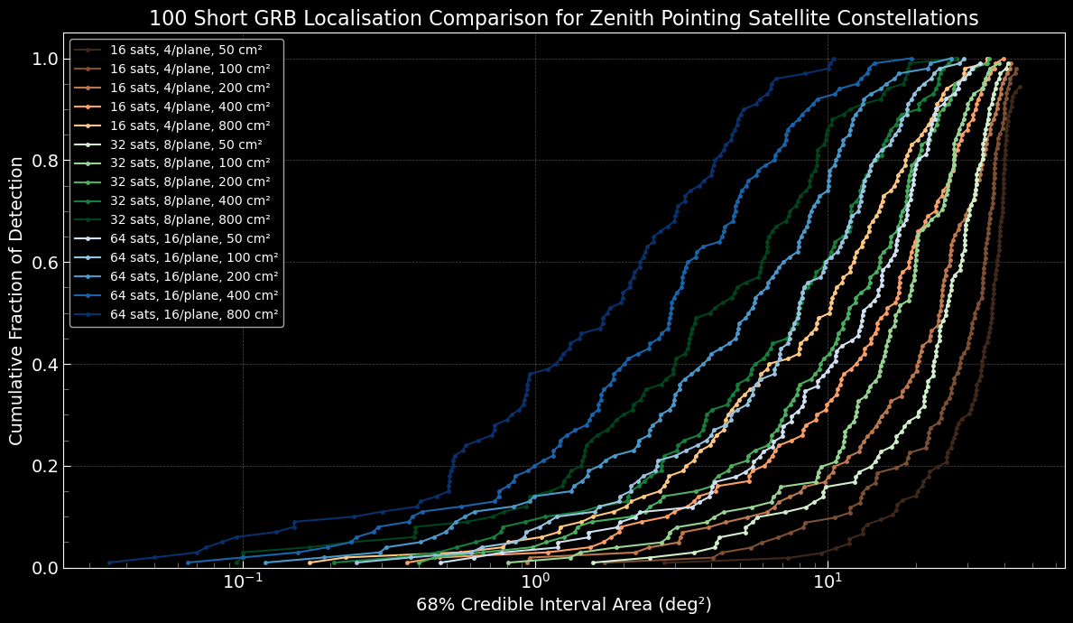
Result : Short GRBs
19
OzFink 2025 / Haritha Mullathody

Slide 38
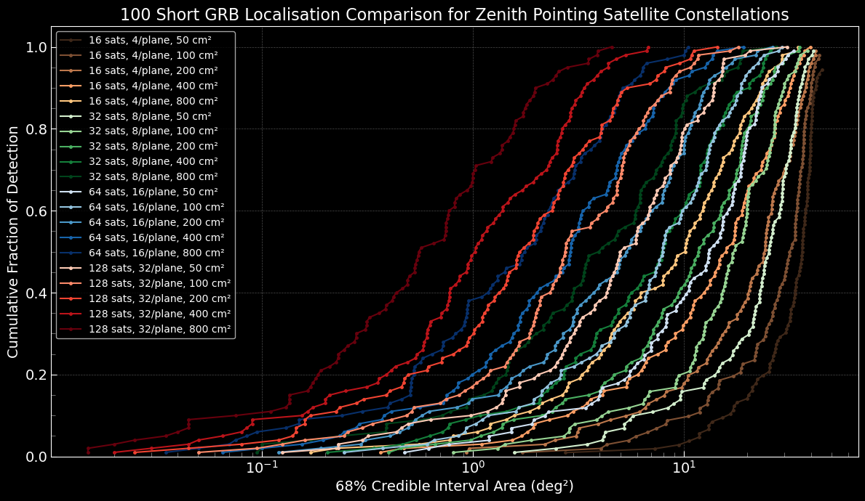
Result : Short GRBs
19
OzFink 2025 / Haritha Mullathody

Slide 39
What have we learnt?
OzFink 2025 / Haritha Mullathody
Notes:
: Observation requires specific pointing
Short lived

Slide 40
What have we learnt?
We can localise both short GRBs and long GRBs to a better precision by introducing the pointing offsets in satellites compared to localisation using only time delay.
Offset angle can be adjusted to achieve desired precisions/fraction of detection for smaller constellation.
Localisation and fraction of detection both improves with increase in area of the detector and with number of CubeSats in the constellation.
20
OzFink 2025 / Haritha Mullathody

Slide 41
What’s Next?
OzFink 2025 / Haritha Mullathody
Notes:
: Observation requires specific pointing
Short lived

Slide 42
What’s Next?
Mission Cost
Number of Orbital Planes
Number of Satellites
Detector Area
Optimize the constellation design for the best Localisation !
21
OzFink 2025 / Haritha Mullathody
Notes:
Other methods of localisation, whats the current best localisation, do we have a full sky coverage for it, what is ionising radiation belts and SAA,

Slide 43
What am I doing here?
OzFink 2025 / Haritha Mullathody
Notes:
: Observation requires specific pointing
Short lived

Slide 44
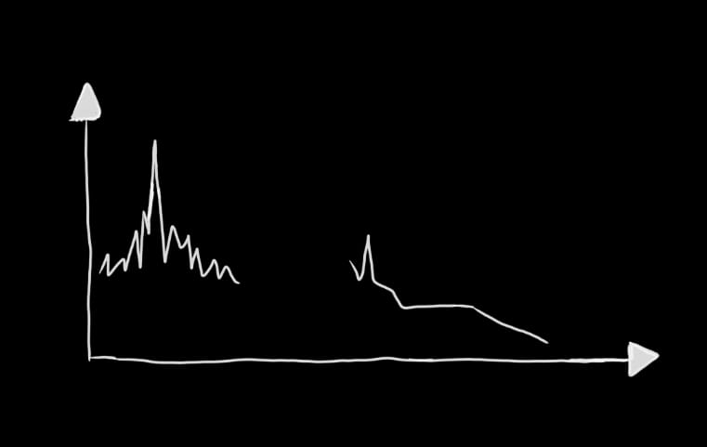
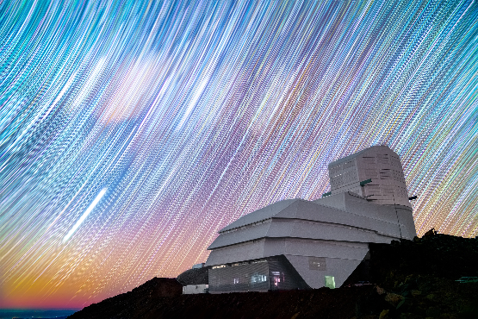
CubeSats + LSST: the future for rapid optical follow-up?
Prompt emission
Counts/s
Afterglow
A few seconds
hundreds of seconds to days
Time
OzFink 2025 / Haritha Mullathody
Notes:
revisits the same sky on multi-day timescales (few-day cadence), so serendipitous short-lived afterglows and early SN bumps are often missed without precise positions.If we know where the burst happened – if we can localise the burst – then we can do a follow up using LSST.
Fading afterglow can be detected if we know where to look
Small, cheap CubeSat constellations can provide fast all-sky high-energy detections and arcminute–arcsecond scale localisations by timing/triangulation across multiple nodes. This enables targeted, deep Rubin follow-up instead of blind searches.
Cubesats are the future of localising high energy transients
If we can tell Rubin where to look, we’ll catch what it would otherwise miss — CubeSats make that ‘where’ affordable and fast.

Slide 45
Thank you!
Notes:
Adding in source of noise
Positional error
Timing of detectors

