Slide 2
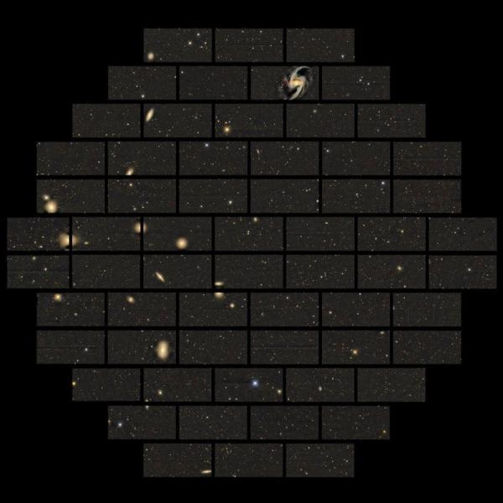
Credit: Dark Energy Survey Collaboration

Slide 3
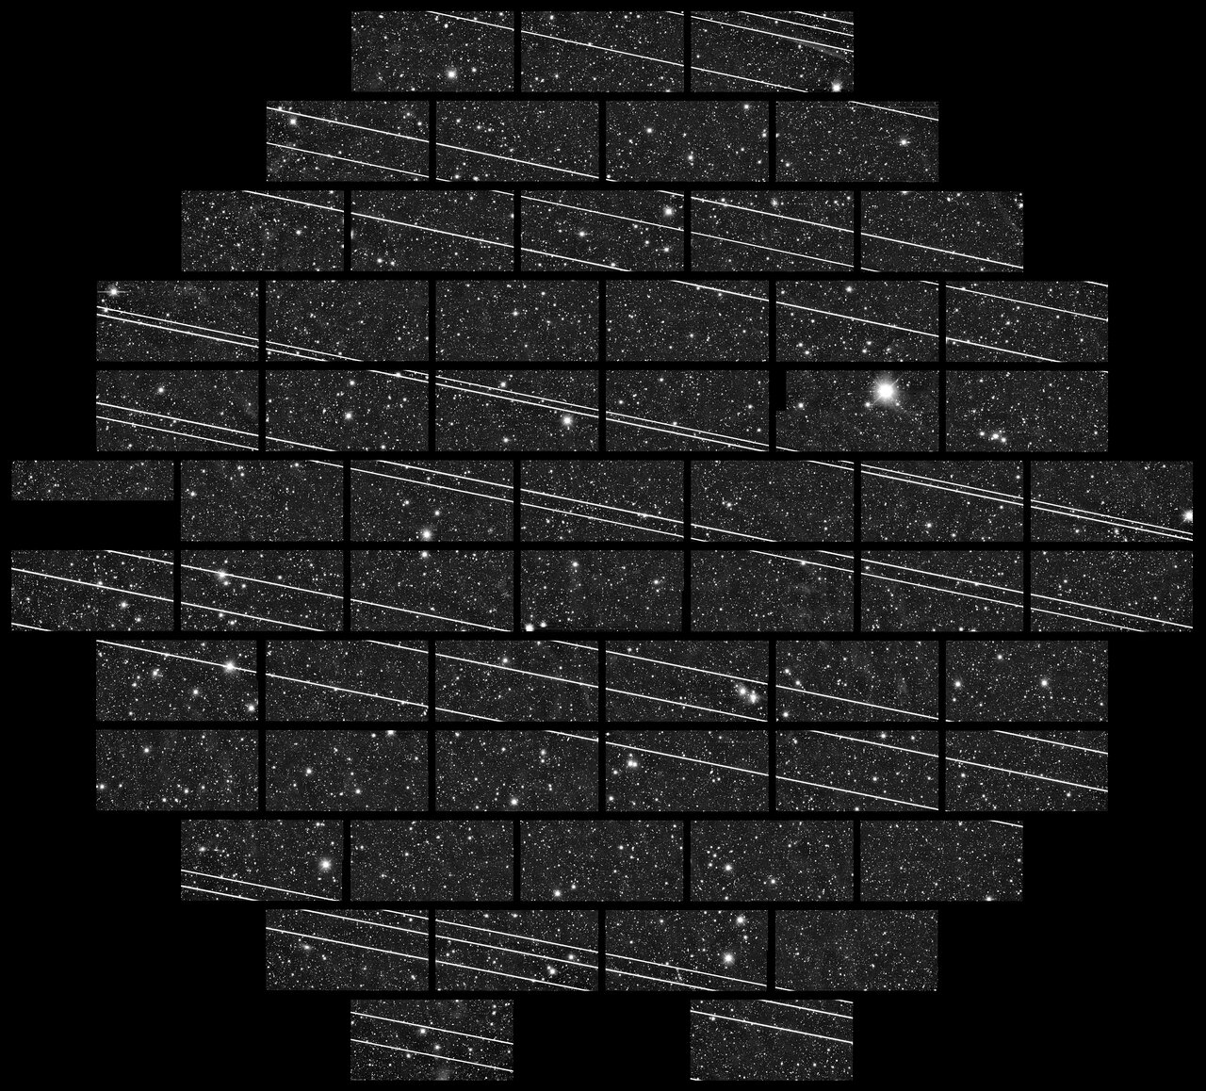
Credit: CTIO/NOIRLab/NSF/AURA/DECam DELVE Survey

Slide 4



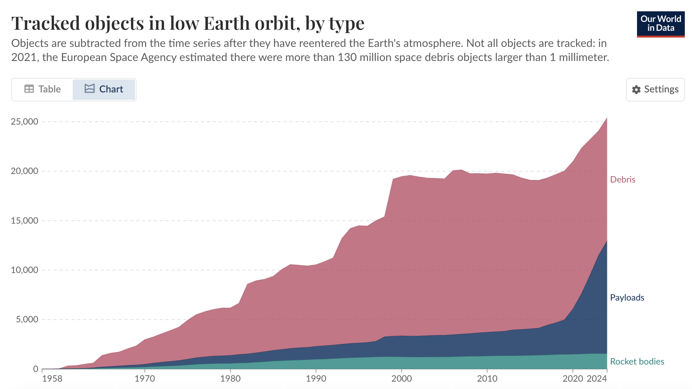
Slide 4
Resident Space Objects (RSOs)
Satellites
Space Debris
Credit: United States Space Force (2025) – with major processing by Our World in Data
Tallulah Waterson, OzFink 2025

Slide 5
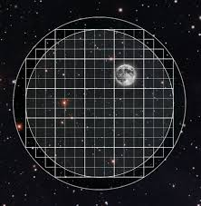
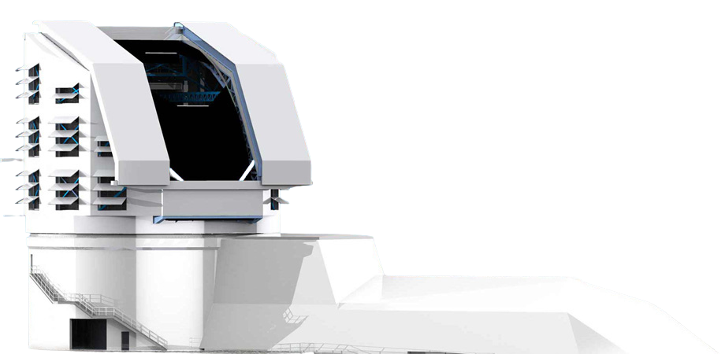
The NSF-DOE Vera C. Rubin Observatory
Largest Eye on the Sky: Deep and Wide-field Southern Sky Imaging
Science goals:
Probing dark energy and dark matter.
Taking an inventory of the solar system.
Exploring the transient optical sky.
Mapping the Milky Way.
Credit: Rubin Obs/NSF/AURA
Tallulah Waterson, OzFink 2025
[1]: Ivezić et al., 2019

Slide 6
The NSF-DOE Vera C. Rubin Observatory
Largest Eye on the Sky: Deep and Wide-field Southern Sky Imaging
Science goals:
Probing dark energy and dark matter.
Taking an inventory of the solar system.
Exploring the transient optical sky.
Mapping the Milky Way.
Monitoring RSOs?
Credit: Rubin Obs/NSF/AURA
Tallulah Waterson, OzFink 2025
[1]: Ivezić et al., 2019

Slide 7
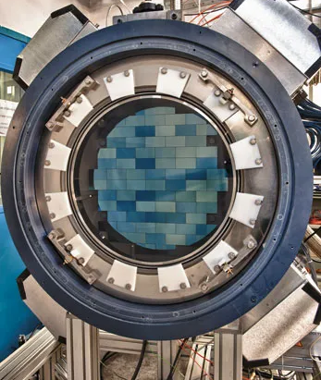
The Dark Energy Camera (DECam)
4 m primary mirror
0.57 Gigapixels
62 4k x 2k imaging CCDs
3 square deg field of view (2.2 deg angular diameter)
Credit: DOE/FNAL/DECam/R. Hahn/CTIO/NOIRLab/NSF/ AURA
Tallulah Waterson, OzFink 2025
[1]: Flaugher et al., 2015
Notes:
Most powerful camera before Rubin

Slide 8
The Dark Energy Camera (DECam)
4 m primary mirror → vs Rubin’s 8.4 m
0.57 Gigapixels → vs Rubin’s 3.2 Gigapixels
62 4k x 2k imaging CCDs → vs Rubin’s 189 4k x 4k
3 square deg field of view → vs Rubin’s 9 square deg
2.2 deg angular diameter → vs Rubin’s 3.5 deg
Credit: DOE/FNAL/DECam/R. Hahn/CTIO/NOIRLab/NSF/ AURA
Tallulah Waterson, OzFink 2025
[1]: Flaugher et al., 2015
Notes:
Stepping stone

Slide 9
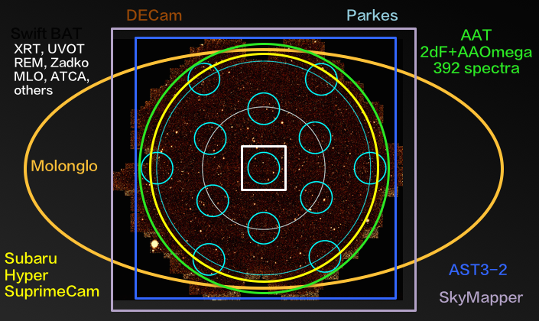
The Deeper, Wider, Faster Program (DWF)
Started in 2014
Simultaneous multi-wavelength observations across telescopes
Search for transient events
>11,000 DECam images
20s exposure times, 50s cadence
Credit: Andreoni and Cooke (2018)
Tallulah Waterson, OzFink 2025
[1]: Andreoni et al., 2017
Notes:
Multiple sensors
Across wavelengths

Slide 10
Why DWF?
 | DWF | LSST
Exposure time | 20s | 30s
Field of view | 3 sq deg | 9 sq deg
Magnitude limit (g-band) | 23 | 25
Pixel scale | 0.27”/pixel | 0.2”/pixel
Latitude | 30.17°S | 30.24°S
DWF = Deeper, Wider, Faster on DECam
LSST = Legacy Survey of Space and Time on Rubin
[1]: Andreoni & Cooke 2017, Andreoni et al. 2019, Dobie et al. 2023, Flaugher et al. 2015, Freeburn et al. 2024, Goode et al. 2022, Goode et al. 2025, Ivezić et al., 2019 Webb et al. 2020, Webb et al. 2021
Tallulah Waterson, OzFink 2025

Slide 11
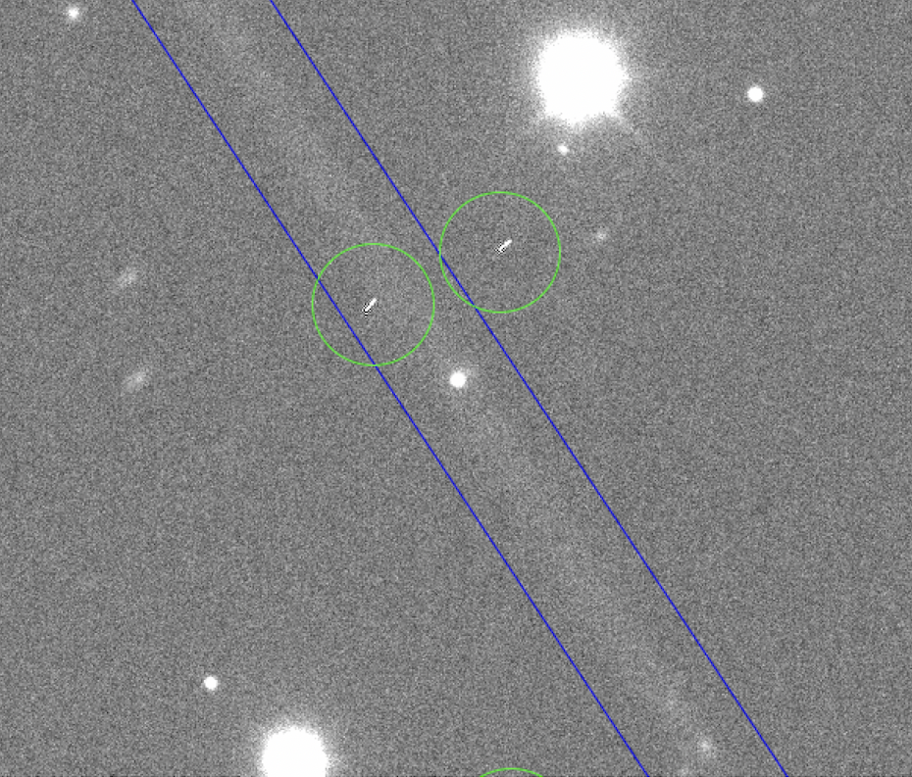
First steps for this opportunity
Finding, characterising streaks/tracks from Resident Space Objects in DECam data from the Deeper, Wider, Faster program
Tallulah Waterson, OzFink 2025
Notes:
Pilot study

Slide 12
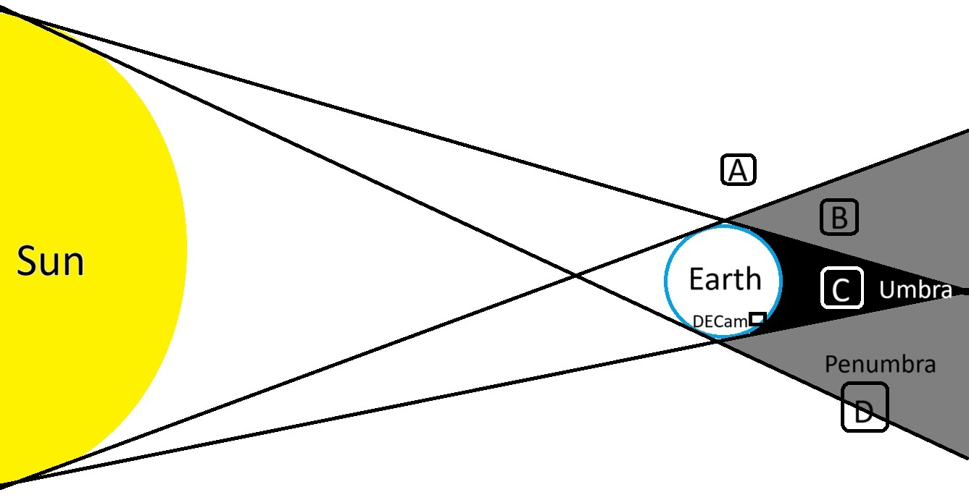
Are RSOs eclipsed?
E
* not to scale
Tallulah Waterson, OzFink 2025

Slide 13
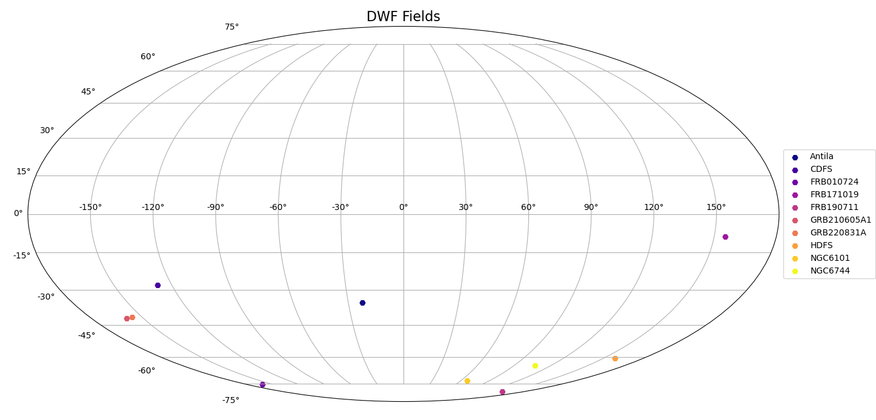
DWF field selection
Tallulah Waterson, OzFink 2025

Slide 14
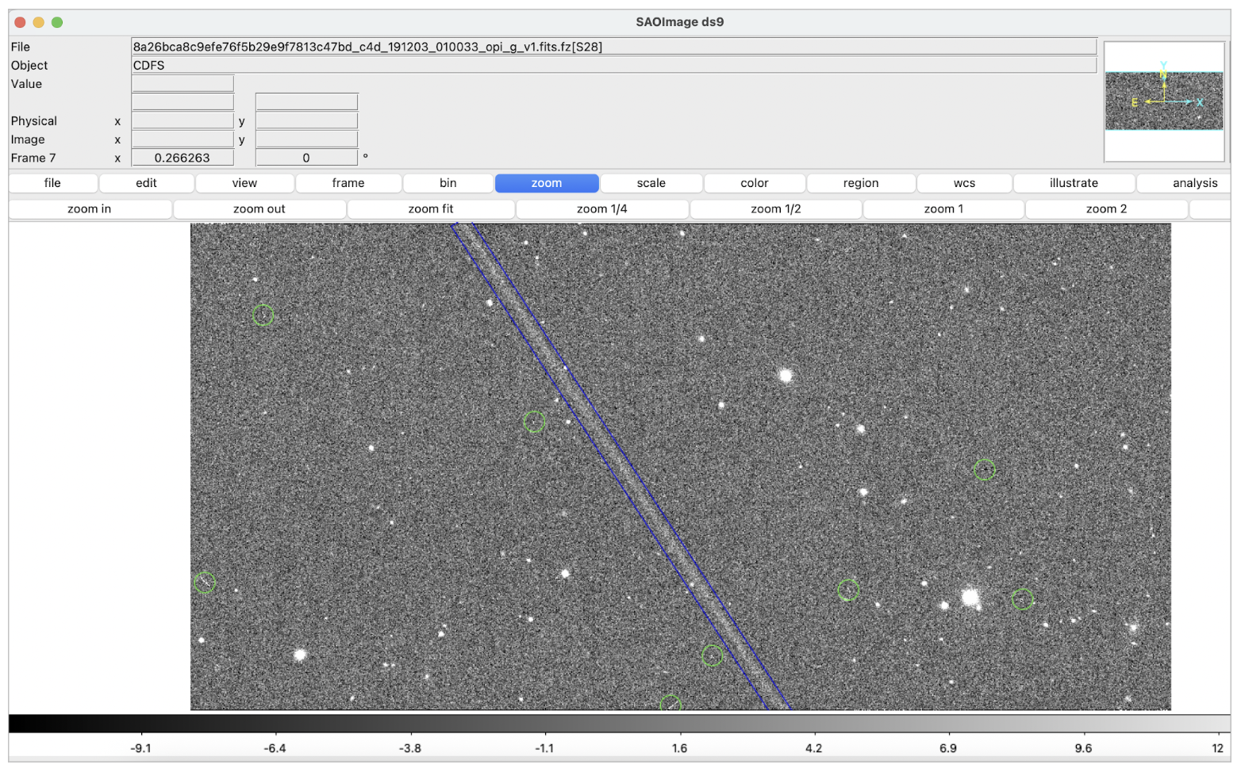
Visual inspection
x61
Notes:
Long streaks, short or other characteristics indicating cosmic rays or other image artifacts
Processed images, not raw FITS files

Slide 15
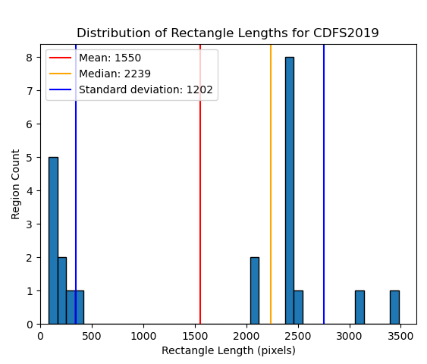
Results
 | CDFS | FRB171019
Total no. of streaks | 1096 | 612
No. of long streaks | 22 | 2
No. of CCDs with streaks | 61 | 53
Mean no. of streaks per CCD | 18±6 | 12±7
Tallulah Waterson, OzFink 2025

Slide 16
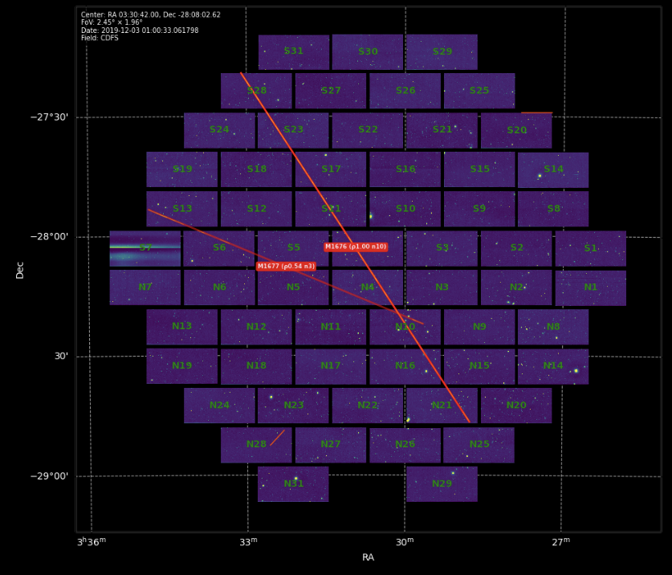
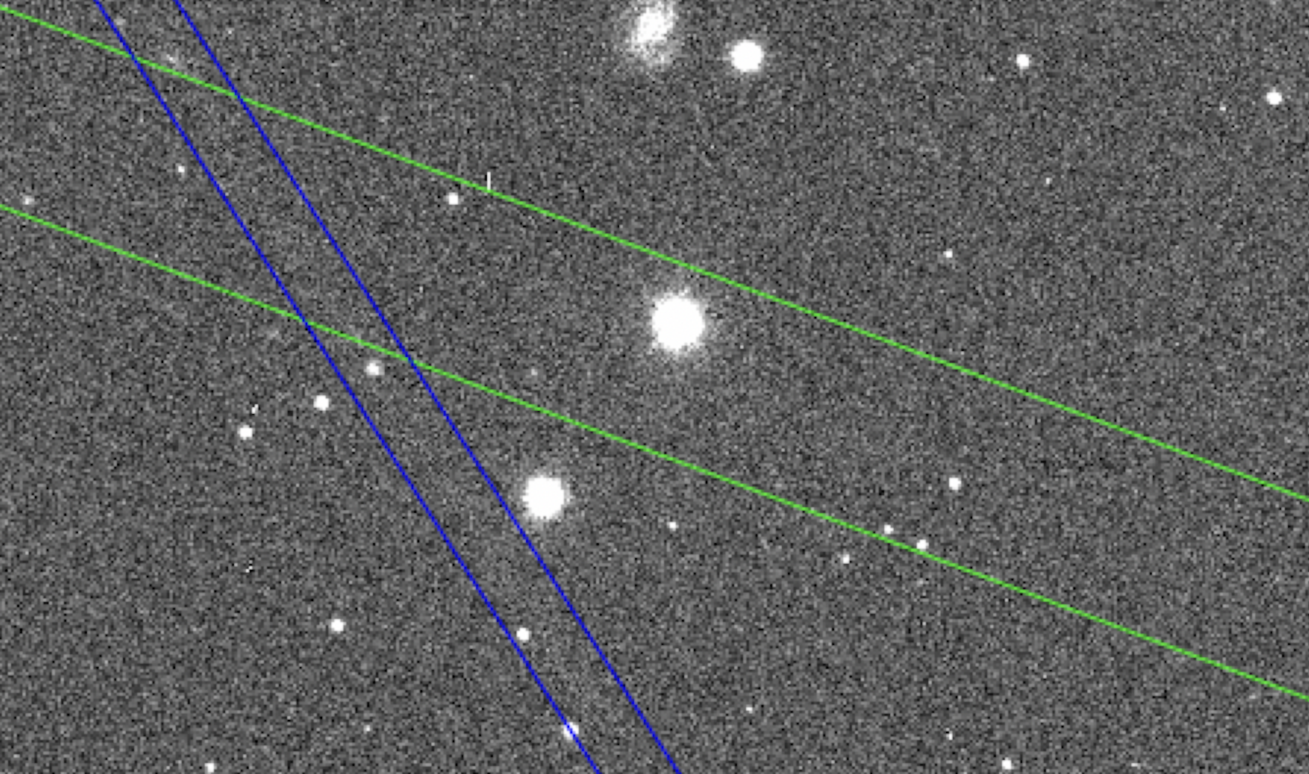
Intersecting streaks
Tallulah Waterson, OzFink 2025

Slide 17
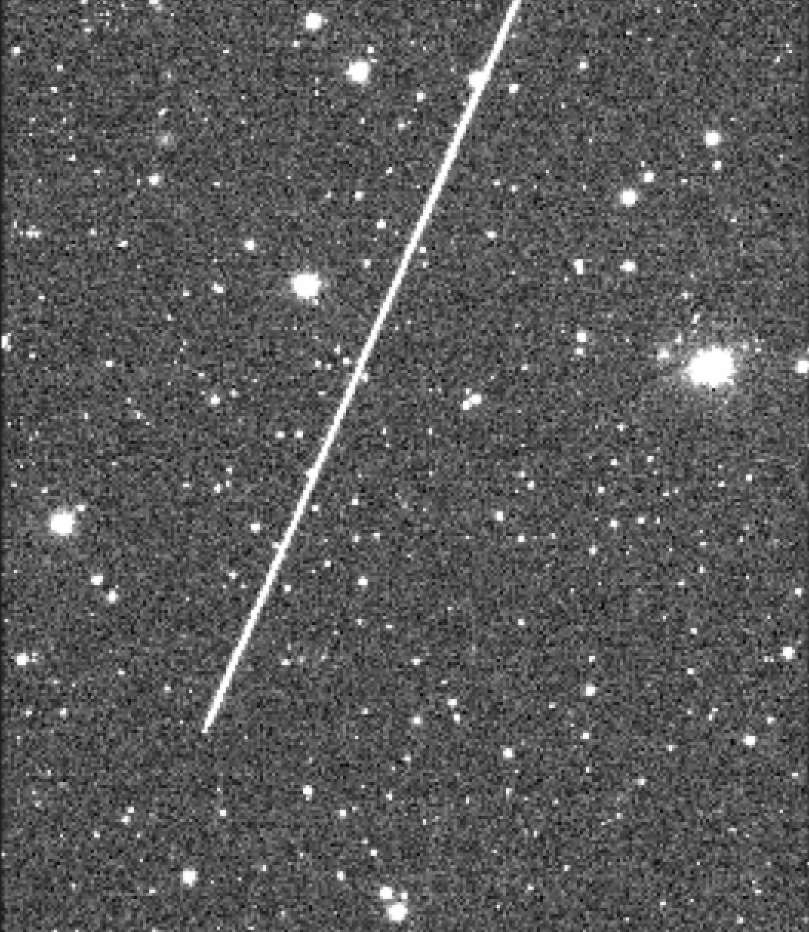
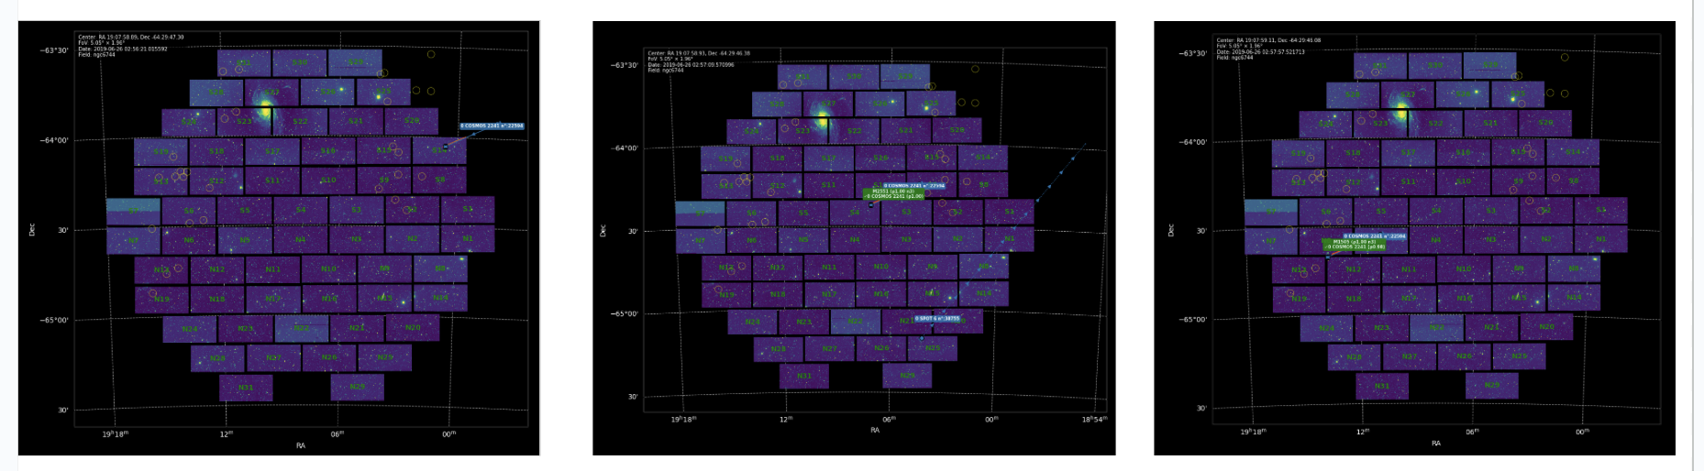
Repeat detections
Tallulah Waterson, OzFink 2025

Slide 18
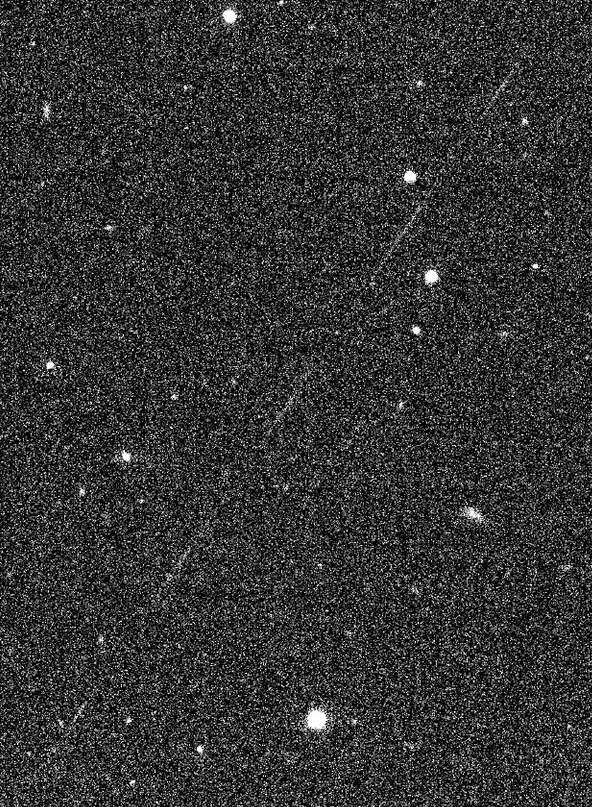
Next Steps
Machine learning to find all streaks in DWF data
Match streaks to public satellite catalogue
Create catalogue of RSOs in DWF data
Predict contamination in Rubin data
Investigate debris glints using Fink
Tallulah Waterson, OzFink 2025

Slide 19
Conclusion
Cataloguing streaks from RSOs in DWF data
Predicting contamination from streaks in Rubin Observatory data
Using Fink to differentiate RSO glints and transient events
Contact: twaterson@swin.edu.au
Tallulah Waterson, OzFink 2025

Slide 20
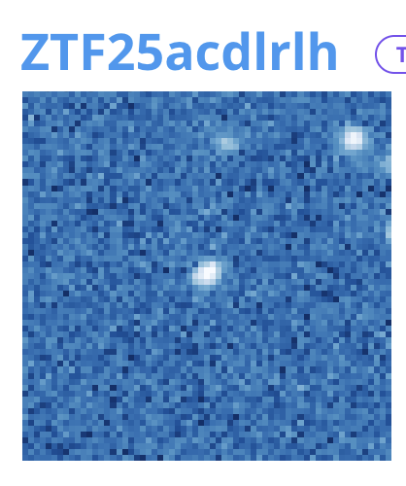
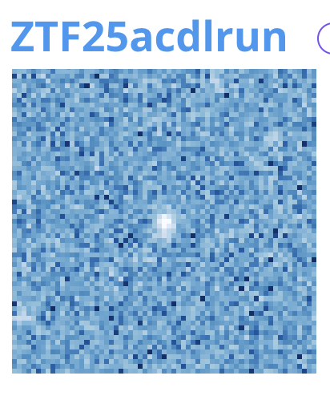
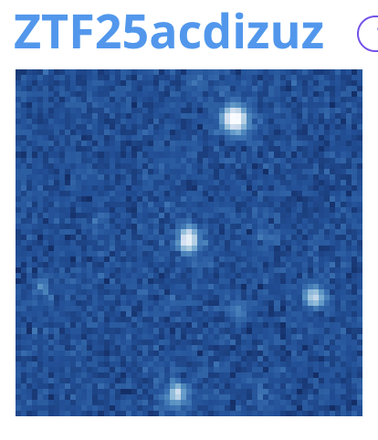
Glints in Fink - Tracklets

Slide 21
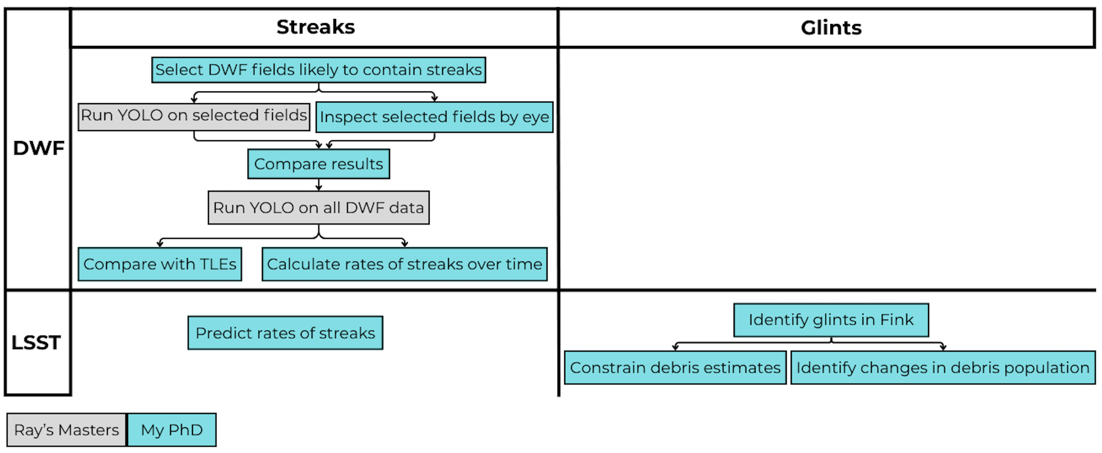
Project overview
Project 1
Projects 2 & 3

