Slide 1
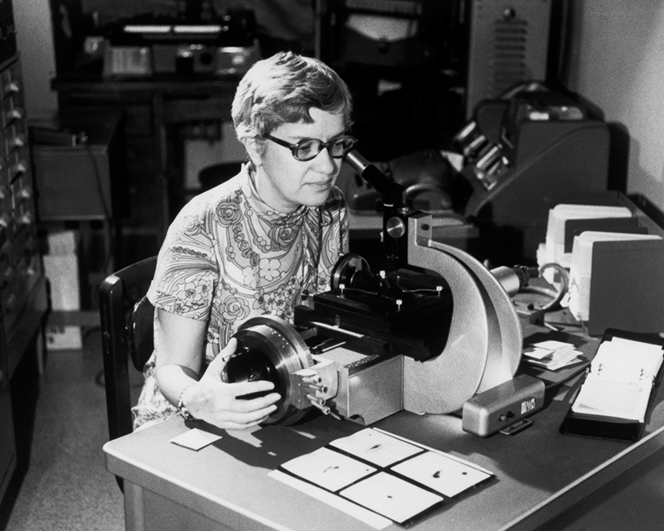


Rubin and
Microlensing

Slide 2
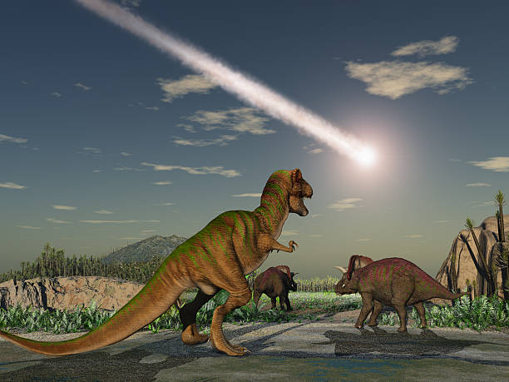
Is there an anthropic constraint on Primordial Black Holes ?
Jeremy
Mould
November
2024

Slide 3
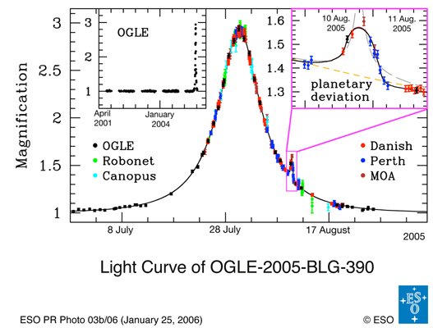
“Microlensing in a nutshell” Moniez
Δt(days) = 39 (V_{T}/200 km/s) (M_{D}/ M₀)^{0.5} (L/ 10 kpc)^{0.5} [x(1-x)]^{0.5}
(minutes) = 3.9 2.4 6 = 56 for M_{D} = 10⁻⁶
or 5.6 for M_{D} = 10⁻⁸
is how it scales for subsolar e.g. lunar masses
Since the 33 minute pair of measurements
involves different filters, the colours of all stars must be measured before event recording can begin.

Slide 4
LSST WFD Visits document date 5/24
Visits in the WFD are typically obtained in pairs - the 1st and 2nd visit to a pointing are separated by about 33 minutes. These pairs are obtained in different filters except for y band: u+g, u+r, g+r, r+i, i+z, z+y, y+y.
Using different filters for pairs allows determination of colors for variables and transients.
About 3% of all pairs (4% of all visits) receive a later (3-7 hours later) third visit in the same filter as one of the earlier pair. While these triplets are a small fraction of the overall visits, they provide valuable opportunities for fast transient identification.
In general, each pointing receives a return visit between 2 to 4 days later, when the pointing is in an active rolling season. Inactive seasons have a lower cadence. These return visits will often be in a different set of filters, but this depends on the lunar phase.

Slide 5
Microlensing events MACHO Δt = 20-200 days
LMC
Alcock et al 2000
See also Mroz et al 2025

Slide 6
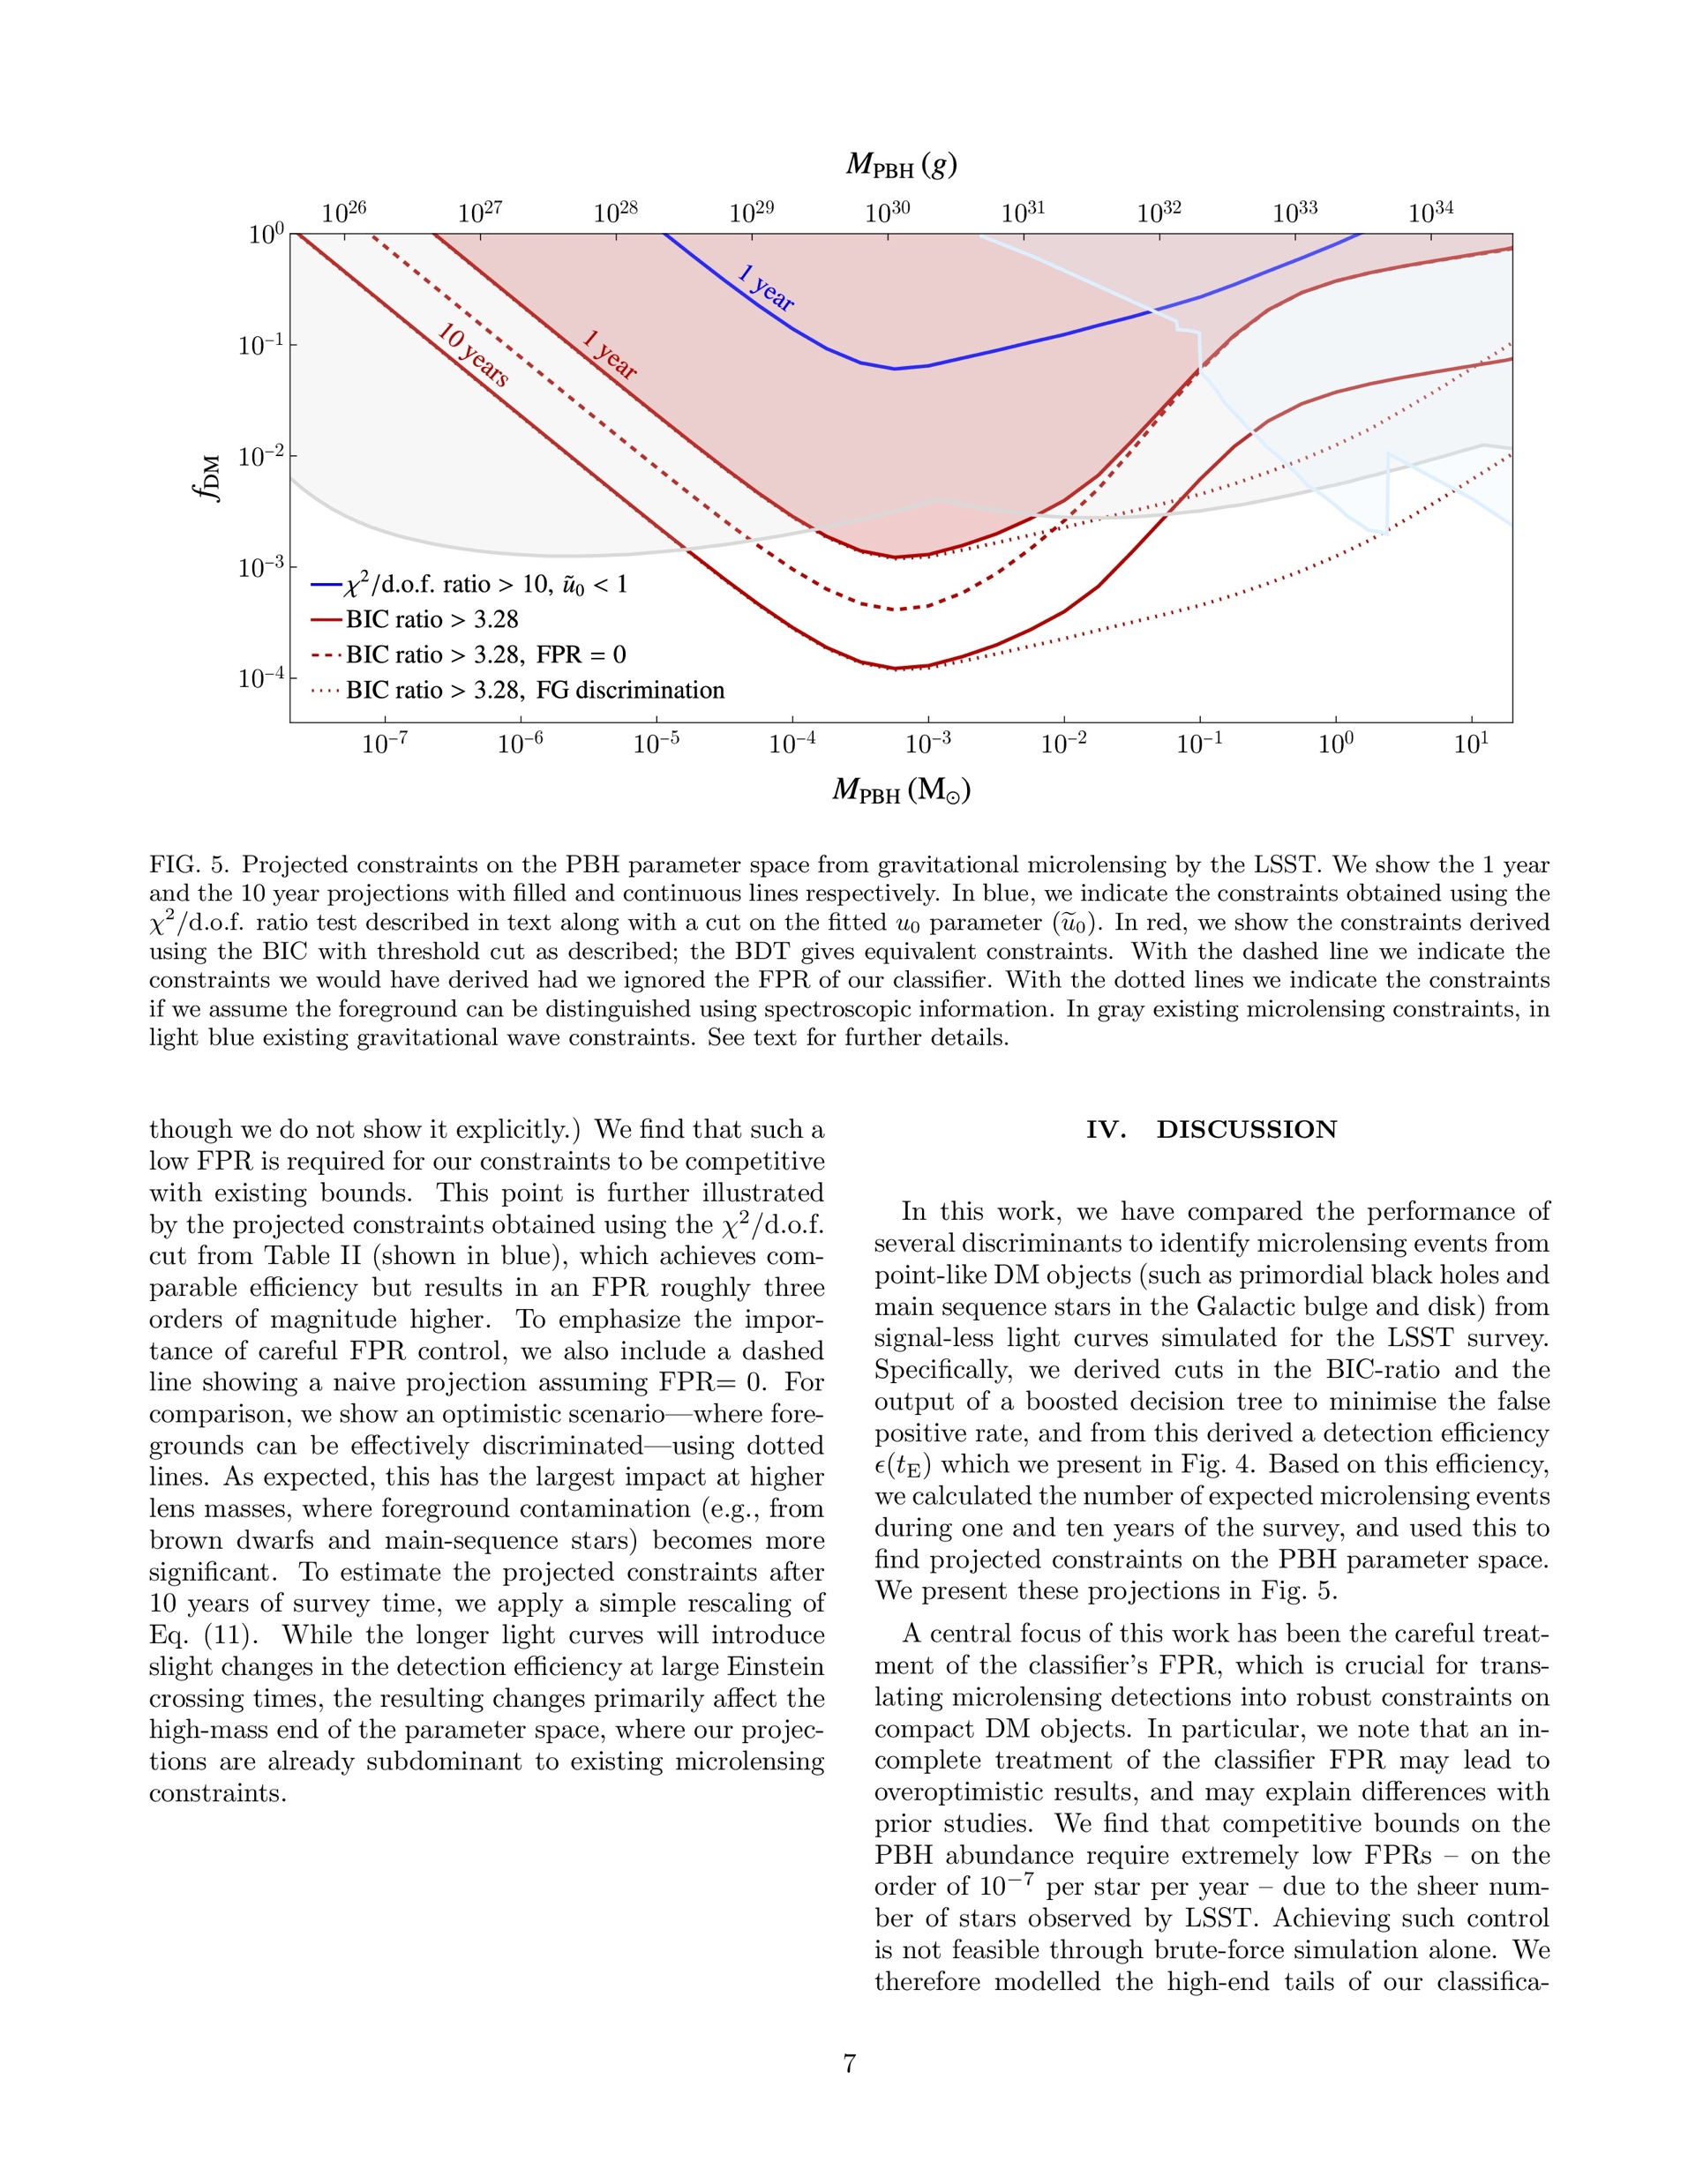
Romao, Croon, Crossey and Godines arxiv 2506.10709
Gray is
“existing”
Microlensing
constraints
BIC is
Bayesian
Information
Criterion

Slide 7
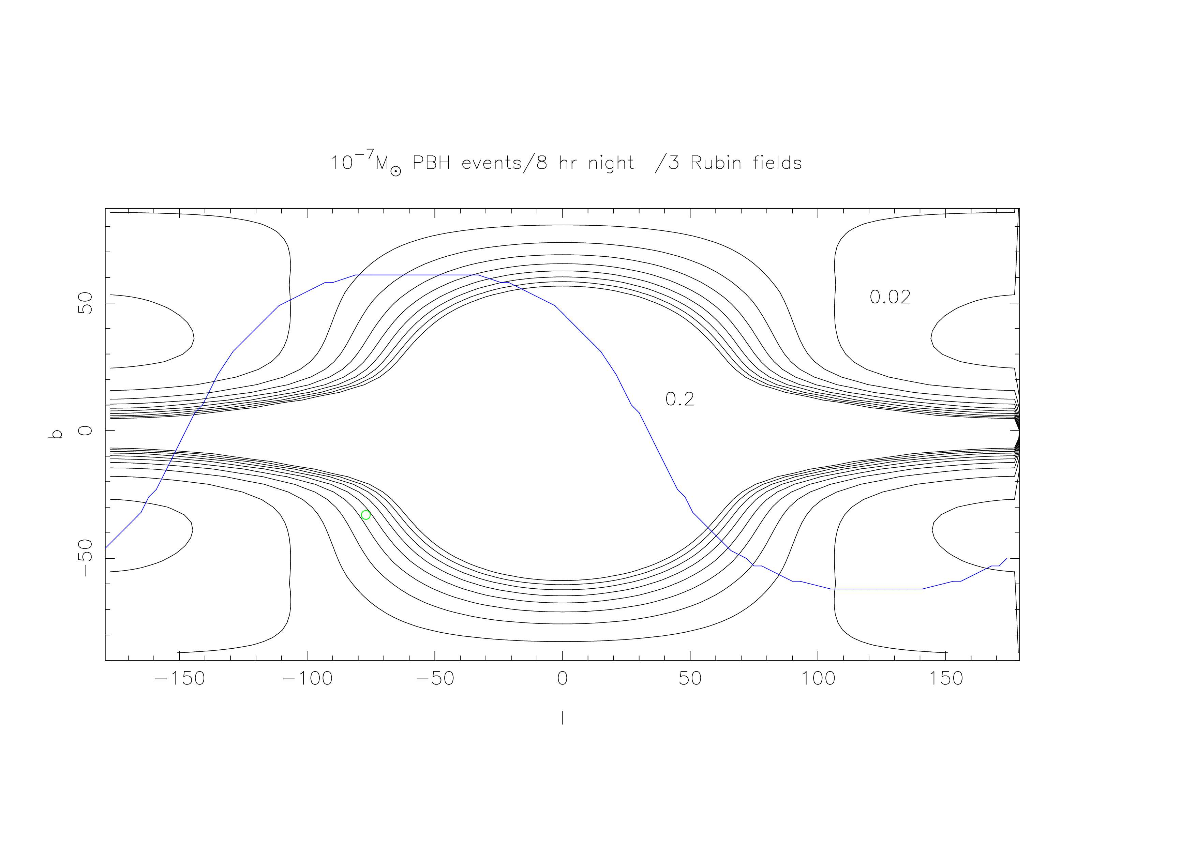
Event rate assuming stars beyond the Galactic Centre are sources
and f_{PBH} = 1
Latitude
Galactic longitude

Slide 8
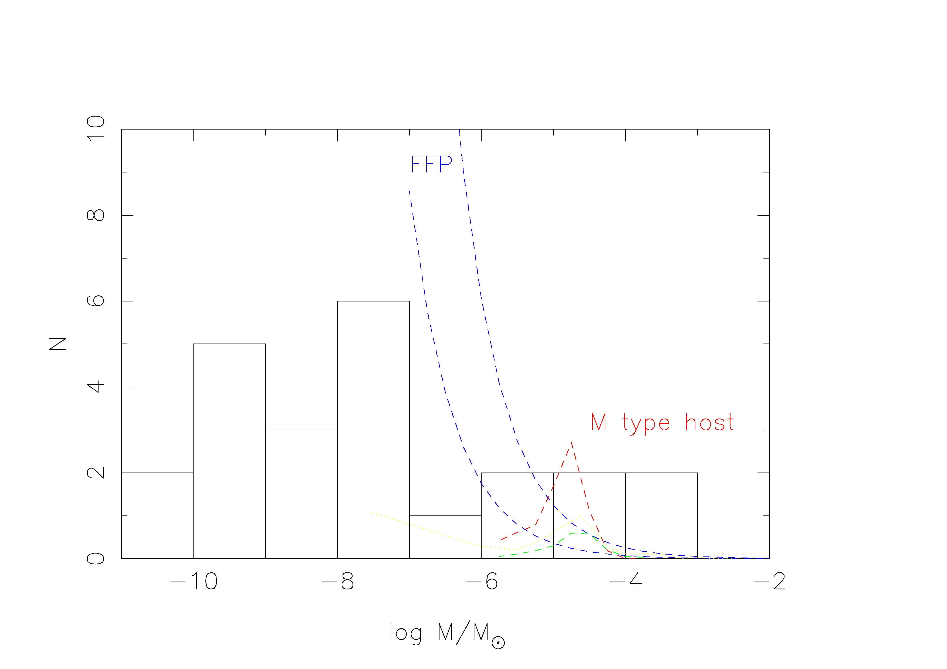
Mass distribution from microlensing Sumi+ 2023 AJ,166,108
MOA collaboration

Slide 9
Proposed Strategy actual LSST cadence
For every billion stars observed by Rubin ….
100 million will have g-r < 1.22
10 of these will be lunar mass PBH lensing events* for f_{PBH} = 10%
Some will be free floating planet (FFP) lensing events
100 flare stars will be false positives (repeaters)
~ 10⁵ will be short period RR Lyrae stars (periodic)
FFPs would be distributed like the disk, unlike the dark halo
* depends on the adopted threshold, 0.32^{m} => 1% yield; 0.06^{m} => 90%

Slide 10
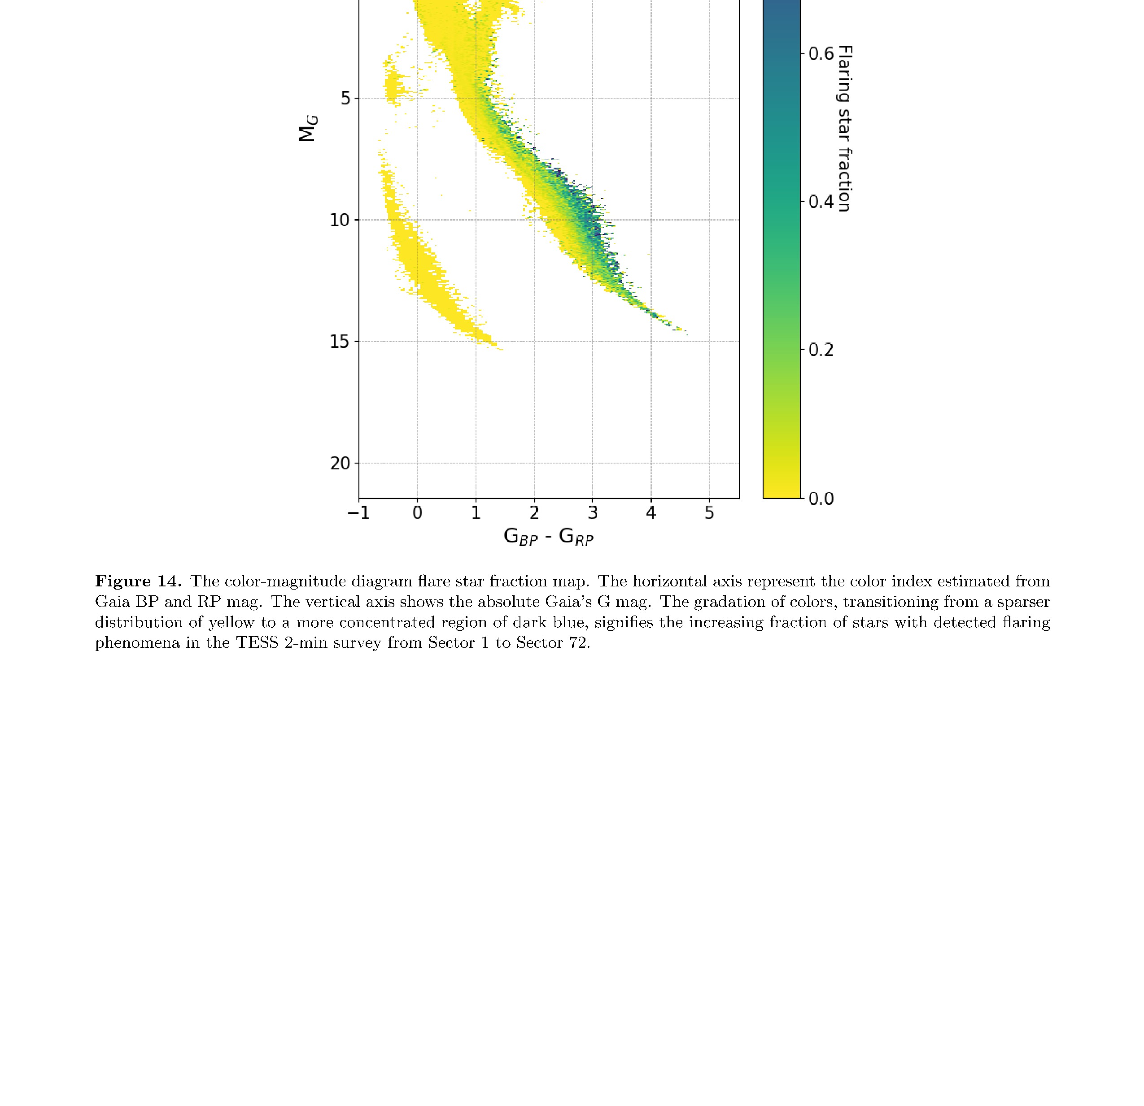
Flare stars in the HR diagram Gaia colours

Slide 11
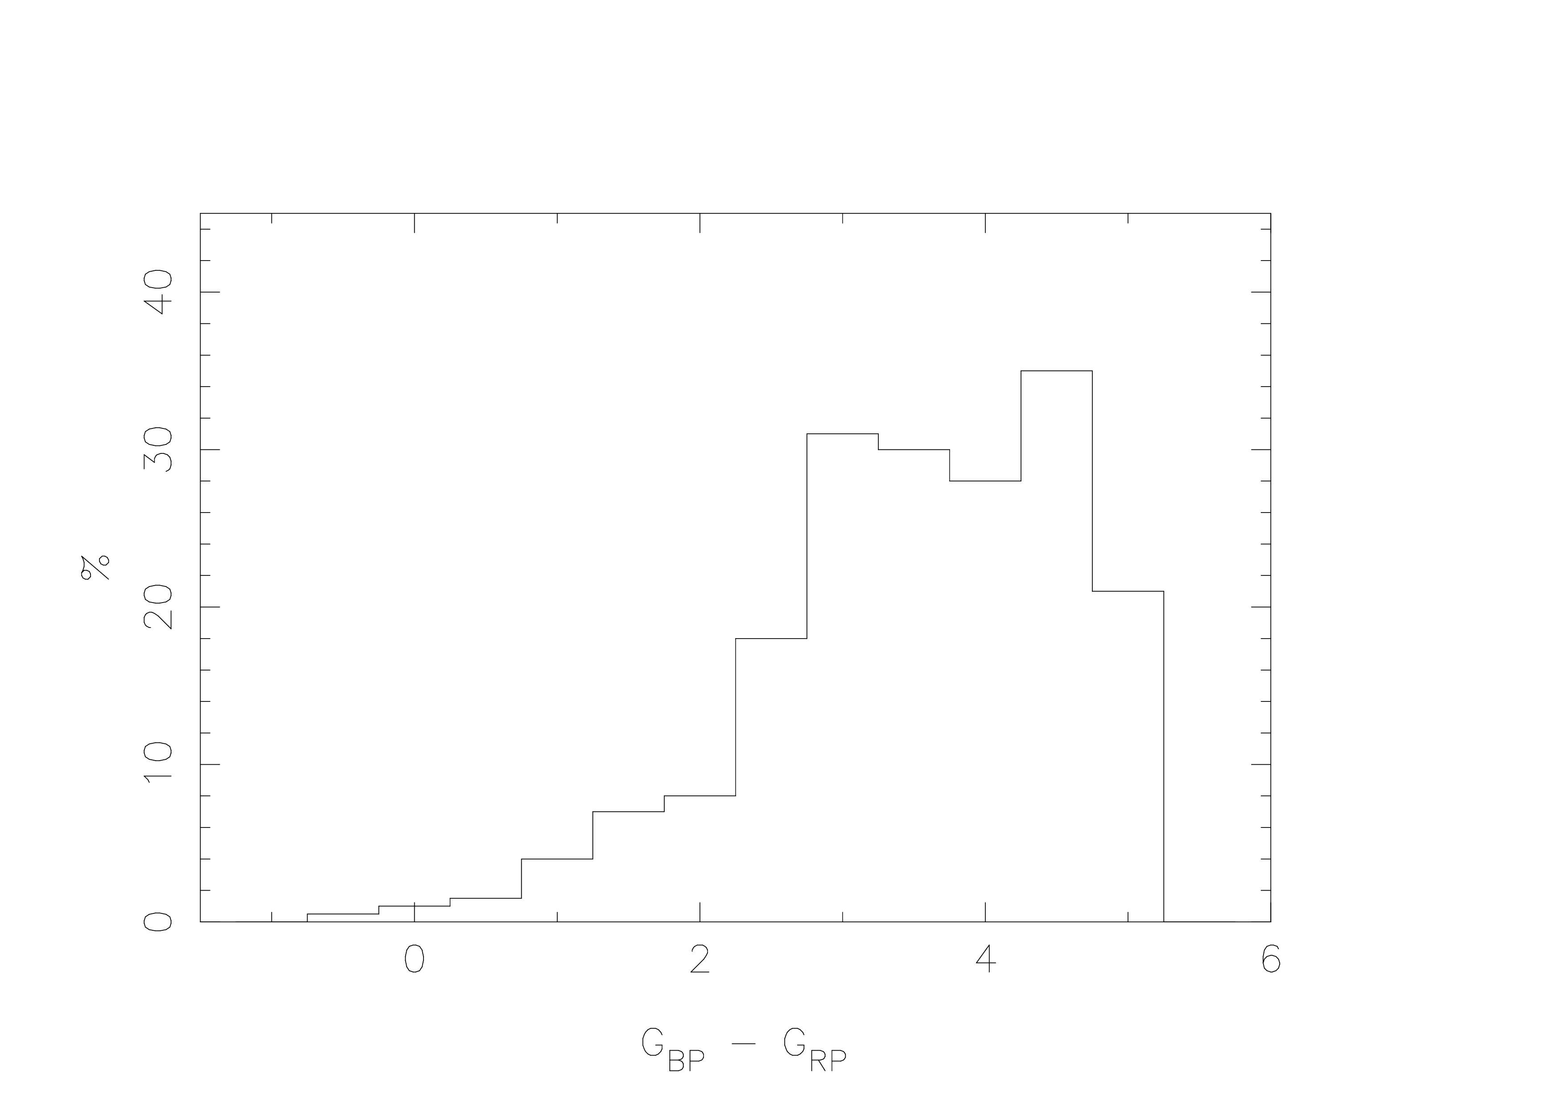
Flare stars Lin, Apai, Giampapa & Ip (2024)
G_{BP} – G_{RP} < 2
=> < 8% flare stars
g-r < 1.65/1.35 = 1.22

Slide 12
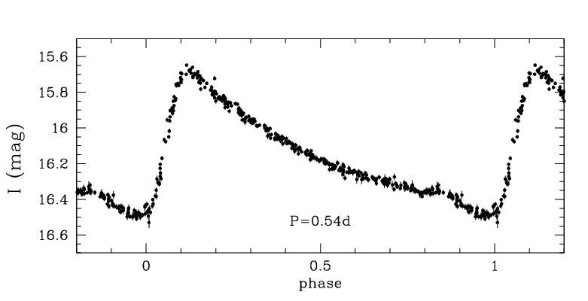
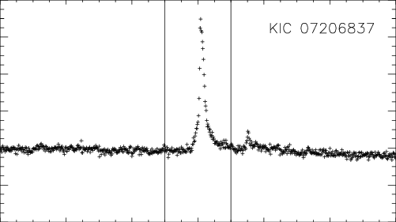
Other rapid rises
RR Lyrae Flare star
Repeat over 90% are red

Slide 13
The sceptics will say… e.g. OGLE
These are just stellar glitches
  the distribution of amplitudes of lensing events is predictable
Clouds are “false negatives”
  clouds affect all stars in the field
You need > 5σ photon statistics
  see next slide
How different is the expected FFP (l,b) distribution from PBH ?
  don’t know yet
Planetary transits are false negatives
  they are periodic

Slide 14
Discard stars fainter than….
Filter zeropoint 5σ error at mag
u | 26.52 | 20.316 | +/- 0.056 | 33 seconds
g | 28.51 | 22.306
r | 28.36 | 22.156
i | 28.17 | 21.966
z | 27.78 | 21.576
y | 26.82 | 20.616 | 5σ is 1: 3.5 x 10⁶

Slide 15
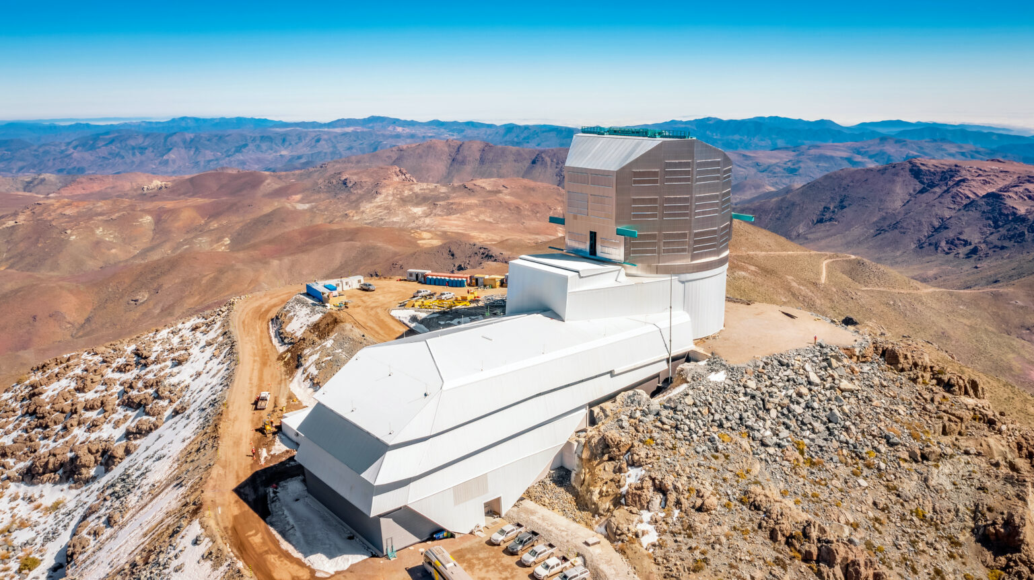
Question
Adopt this strategy with the help of OzFINK
Wait for a Rubin “special survey” call for proposals

Slide 16


How often does a PBH
enter the solar system ?
Local density 0.01 M_{Θ} / parsec³
Velocity PBH in 100 km/s units
M PBH mass in solar units
f PBH fraction of the DM
per
million
years
10 π f / m7 annually
for r = 10⁵ AU
r radius solar system in AU
a = 206265 #AU in a parsec

Slide 17
That’s for the Oort Cloud
but for inner solar system,
● rate is 10¹⁰ times lower i.e. π f per Gyr at r = 1AU.
● Oort Cloud has received a continuous bombardment
● but m7 PBH probably haven’t perturbed Earth’s orbit
more than once in lifetime of the solar system

Slide 18
there are many exoplanets in Galaxy
● this negligible impact hazard will have nevertheless allowed impacts on some Earth like planets.
● Energy deposited in planet might be, say, 1% of KE impactor
= a fraction 4.5 m7 x 10⁻⁹ v₁₀₀² of Earth’s orbital energy or
= 8 x 10³⁰ m7 v₁₀₀ ergs, equivalent to
● 2 x 10⁸ m7 v₁₀₀² MT where an MT is a megaton of TNT

Slide 19
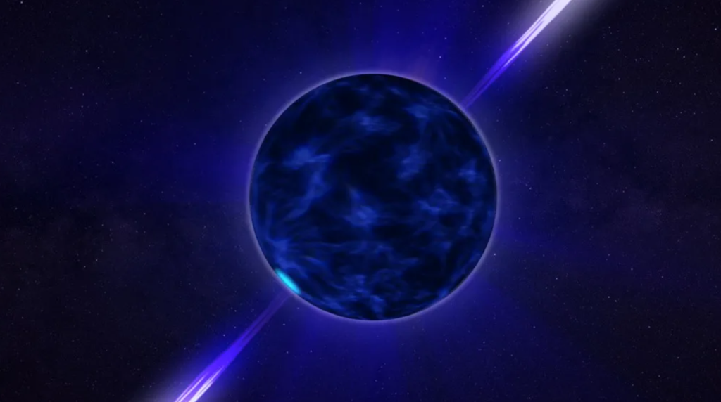
Like drilling a very small borehole through the planet
(0.1mm)

Slide 20

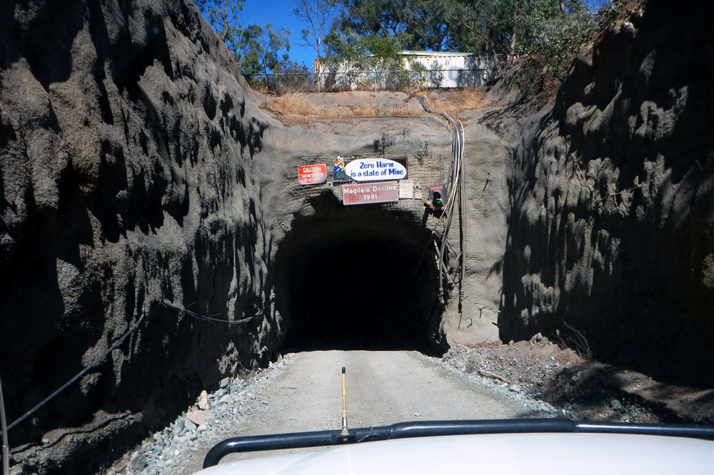
● Effect on an earth-like rocky planet =
borehole for blasting rock @ SUPL
● right thru Earth, tiny Schwarzschild radius
then detonating the TNT charge
● For 100 km/s impact, radius of hole / fragmented rock
= 5 x 10¹⁴ A m7^{0.8} km, where 0.6 < A < 22
● Hole > planet => planet destroyed

Slide 21

An anthropic constraint on PBH ?
● No, planet destruction is very unlikely for m7 PBH
● With more microlensing work, Renee Key and team
aim to find how many m9s exist (maybe 100 times as many)

