Slide 1
THE NEED FOR SPEED
FINDING FAST TRANSIENTS WITH TESS AND LSST
Clarinda Montilla¹, Ryan Ridden-Harper¹, Michael Albrow¹, Anais Moller^{2,3}, Armin Rest⁴, Hugh Roxburgh⁵, James Freeburn⁶, Jeffrey Cooke^{2,3} & Qinan Wang⁷
¹ University of Canterbury, ² Swinburne University of Technology, ³ OzGrav, ⁴ Space Telescope Science Institute,
⁵Curtin University, ⁶ University of North Carolina, ⁷ Massachusetts Institute of Technology

Slide 2




high temporal resolution, small gaps between observations
THE NEED FOR SPEED
FINDING FAST TRANSIENTS WITH TESS AND LSST
lifetimes on the scale of milliseconds to hours
observations from a range of different filters

Slide 3
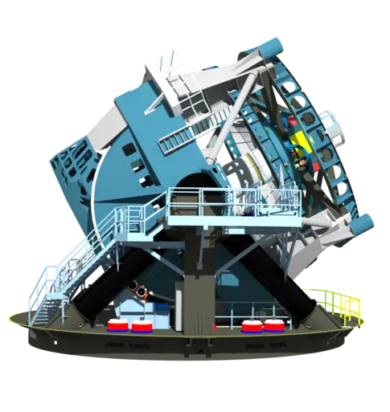













LSST

Slide 4


AT 2024zuk
AT 2021buv

Slide 5

How can we model these events?
the main model for GRB afterglows
afterglowpy
$θ_{core}$, $θ_{obs}$, $θ_{wing}$, $\log_{10}E_{0}$, $z$, $p$, $\log_{10}n_{0}$, $\log_{10}ε_{E}$, $\log_{10}ε_{B}$, $t_{exp}$
physical parameters
accounts for the coasting period

Slide 6
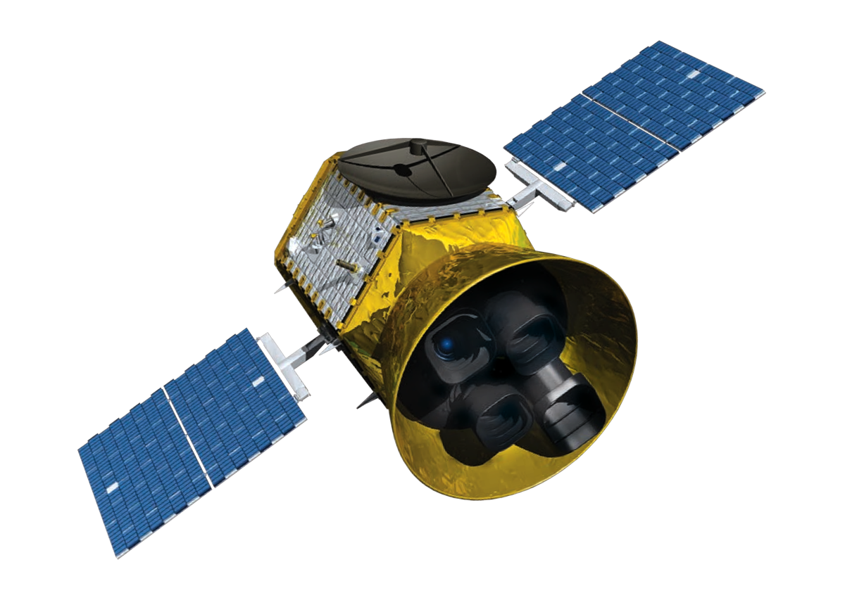
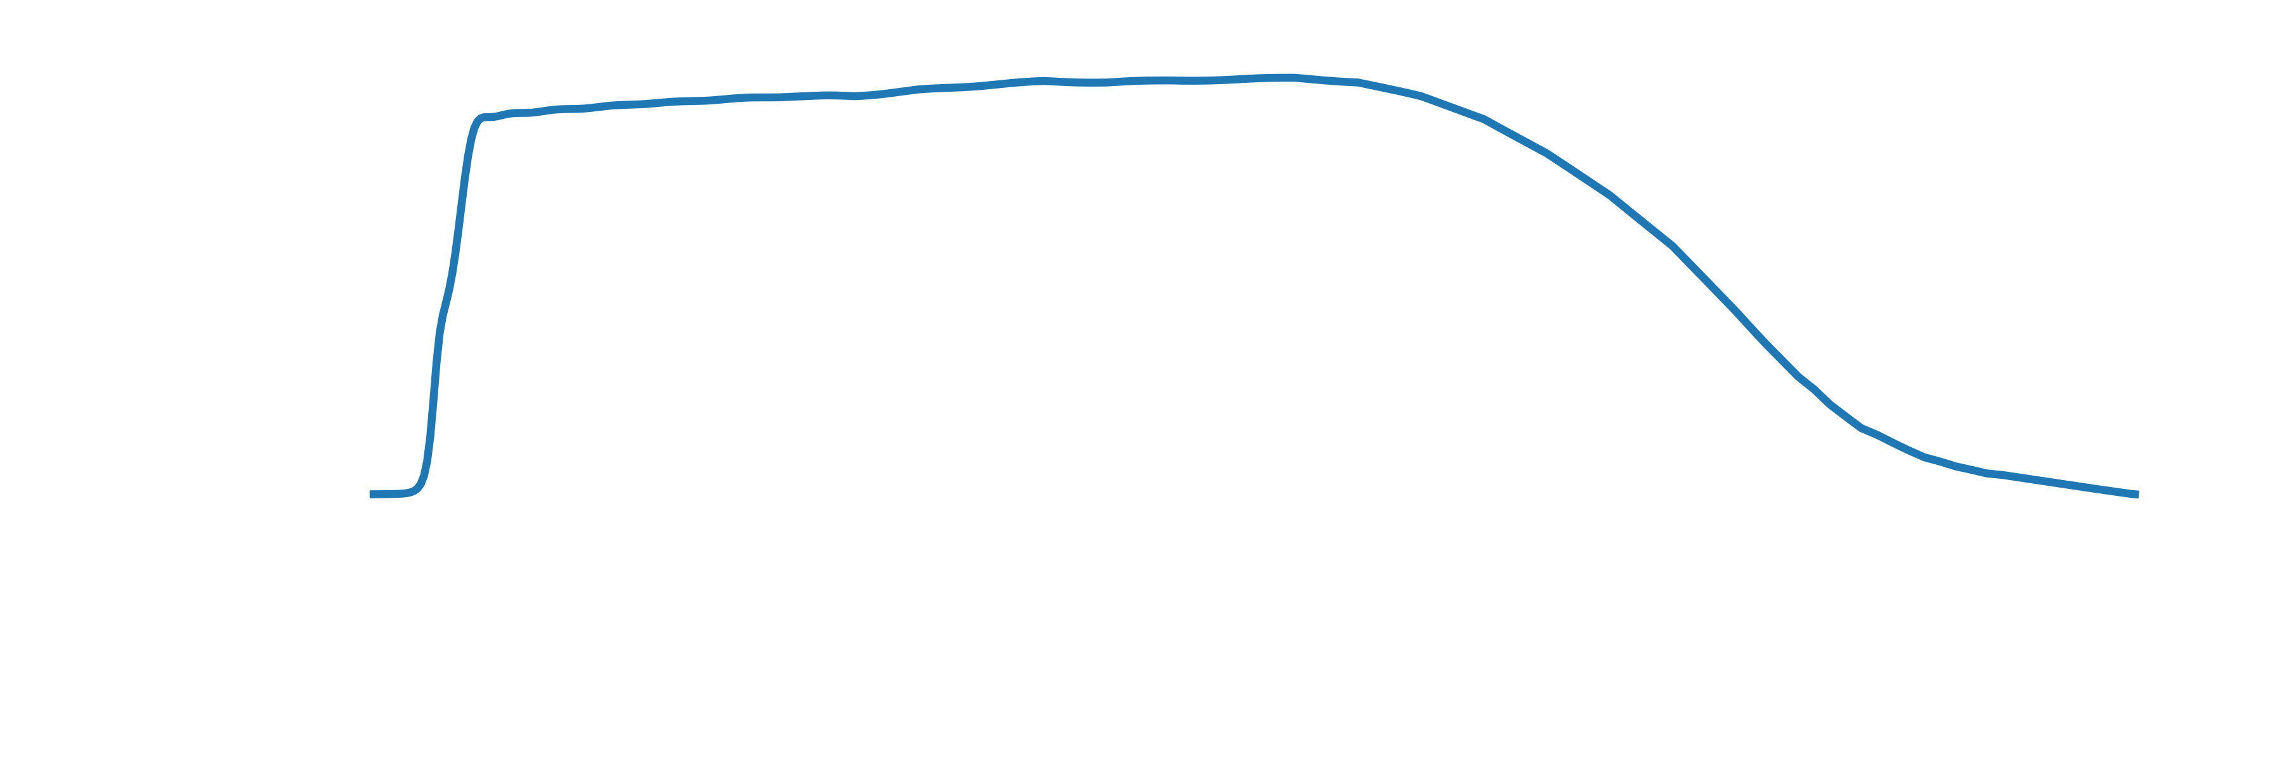
TESS
Pros:
Wide FoV > 2300 deg²
Rapid cadence
Large bandpass (650-1050nm)
Cons:
Large pixel size (21’’ length)
(and so it also has poor localization)
No colour information

Slide 7
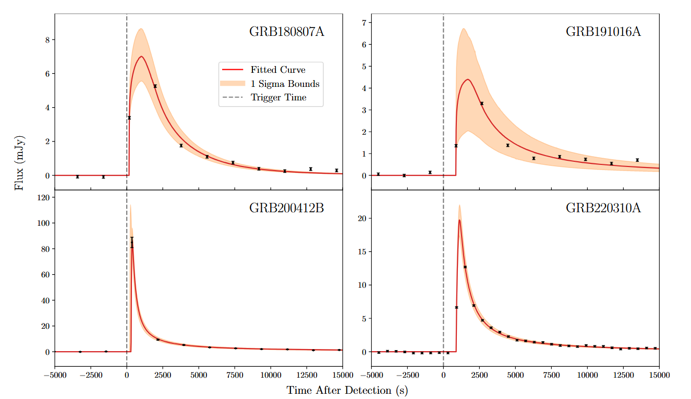
Modelling GRBs with TESS is possible!
H. Roxburgh, R. Ridden-Harper, Z. G. Lane, et al. A Comprehensive Investigation of Gamma-Ray Burst Afterglows Detected by TESS. The Astrophysical Journal, 963(2):89, 2024
Notes:
Talk about not including integration time
Even worse than it seems! we are misrepresenting the total energy in these plots

Slide 8
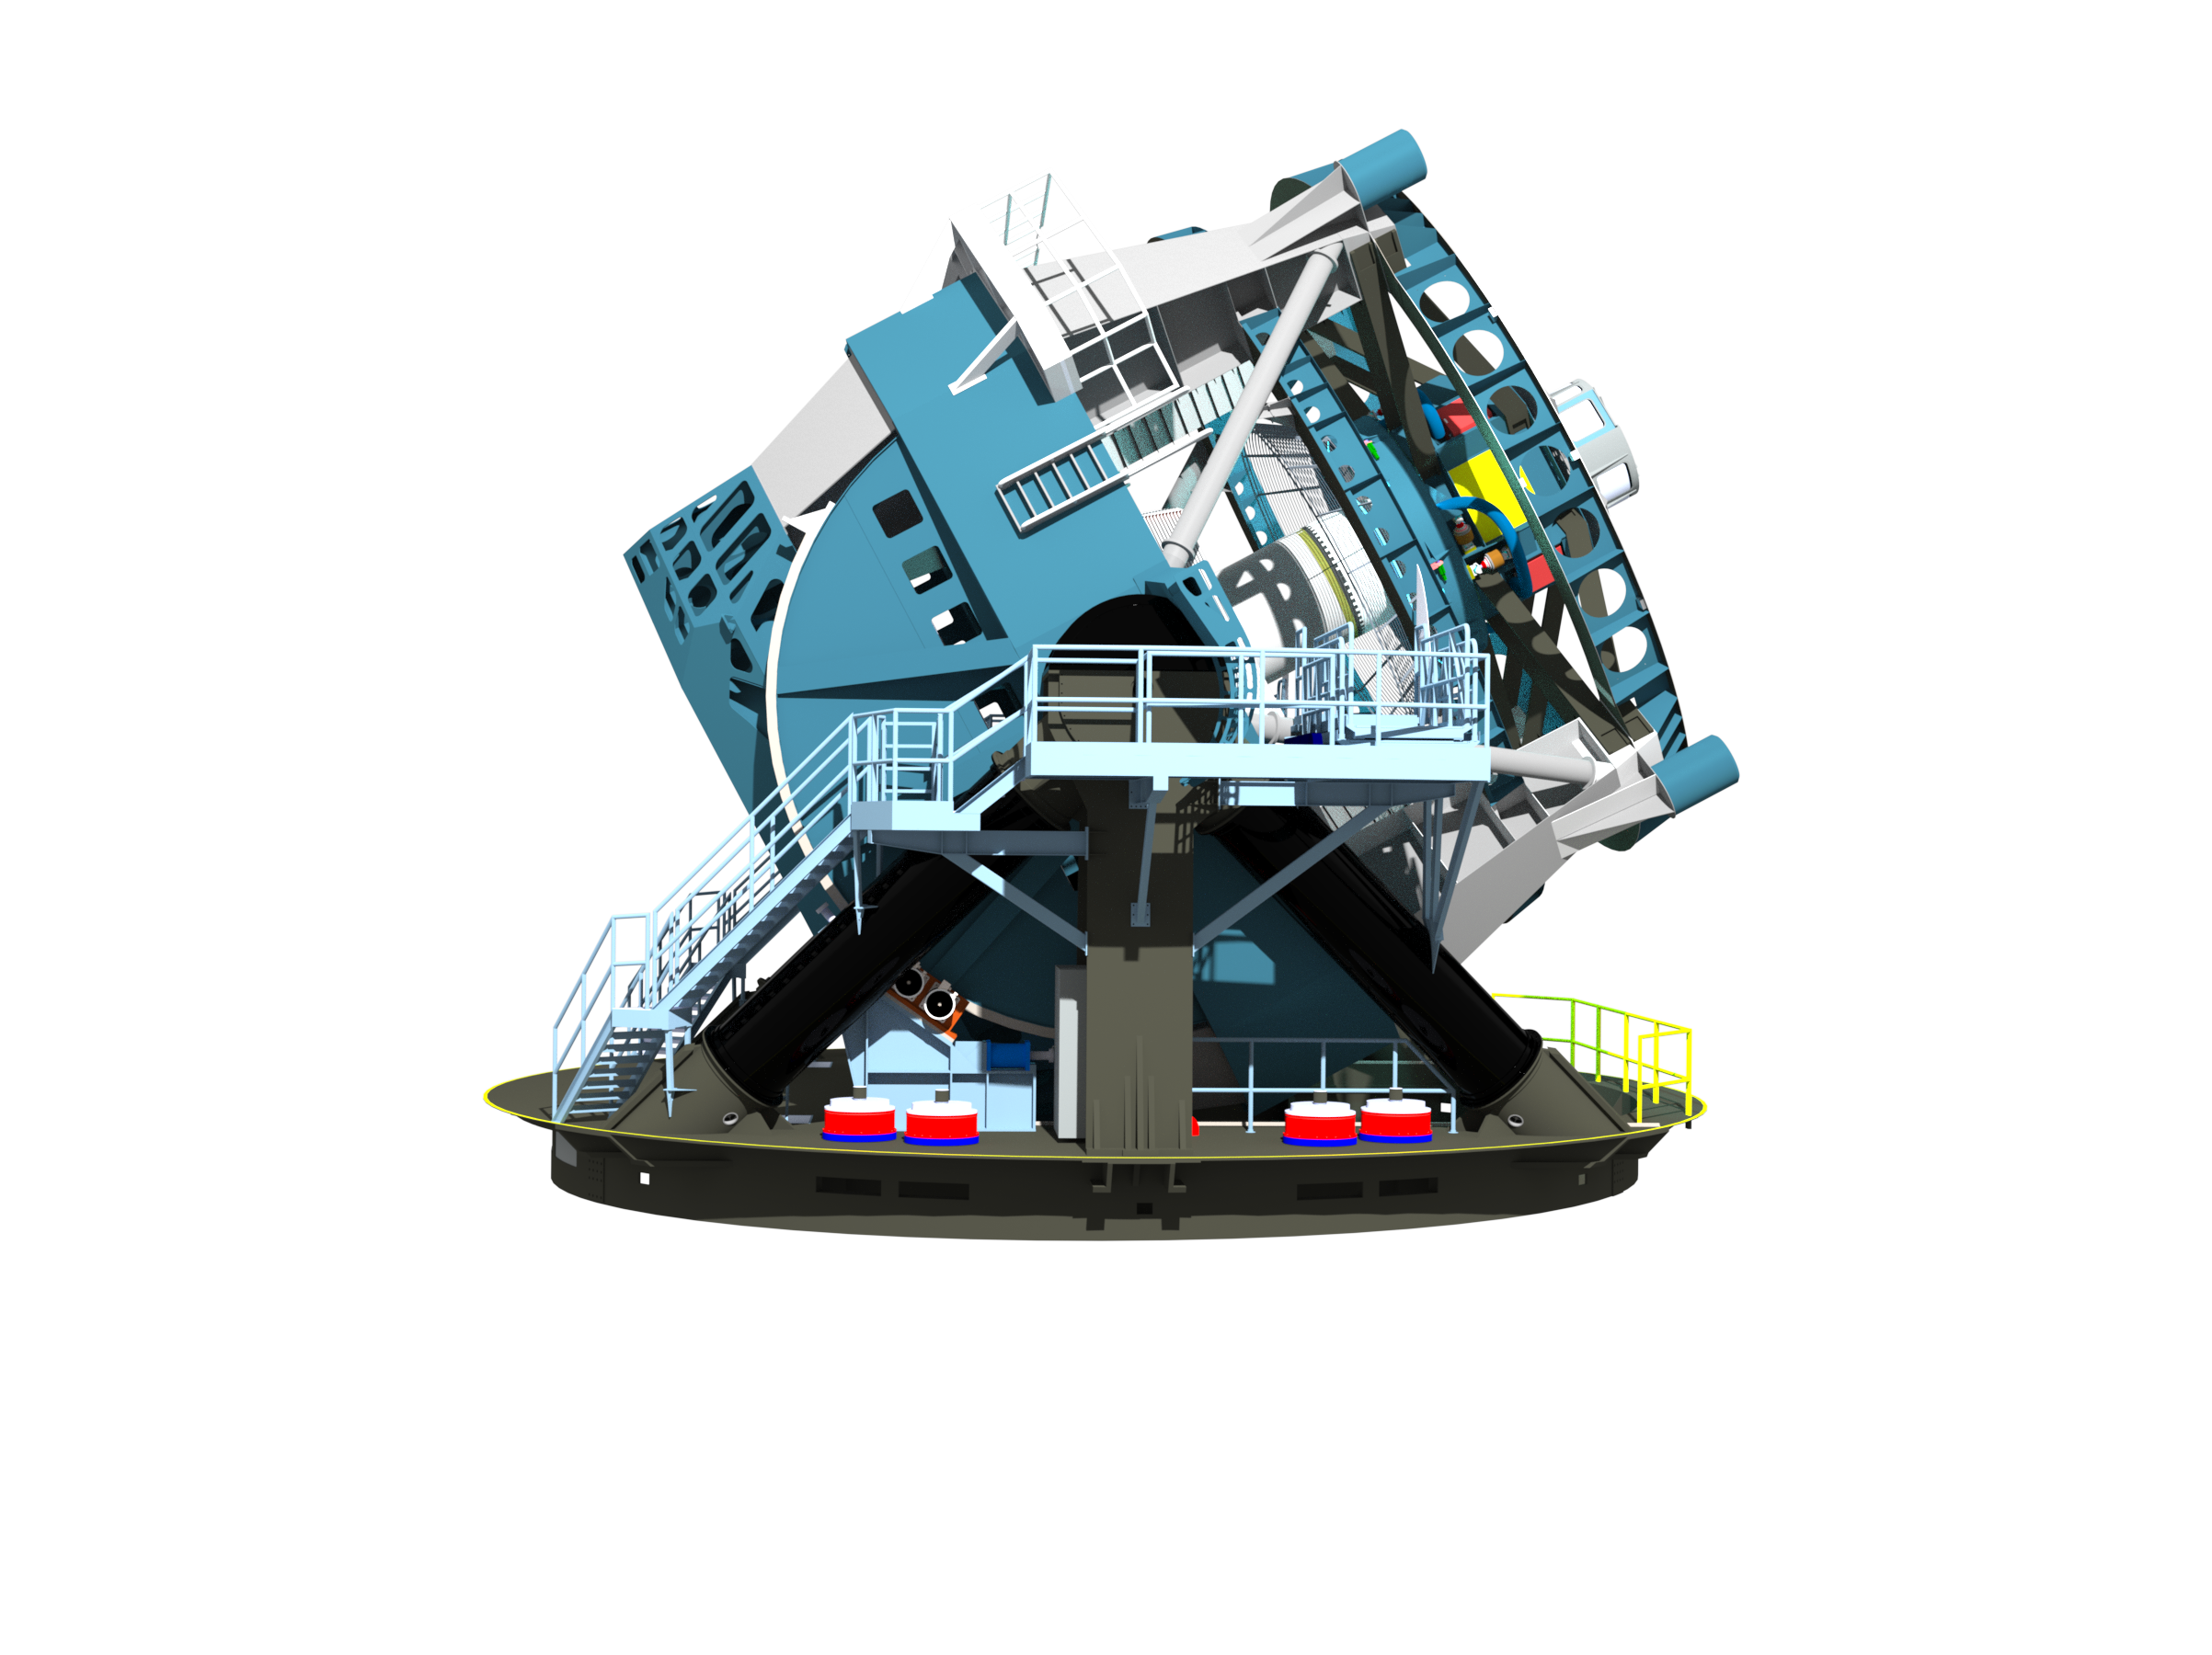
Pros
Cons
Wide FoV
High Cadence
Continuous observations
Poor spatial resolution
Lack of colour information
Great spatial resolution
Lots of colour information
More sensitive
Smaller FoV comparatively
Slow cadence
Subject to day/night and weather
Notes:
ew change this

Slide 9
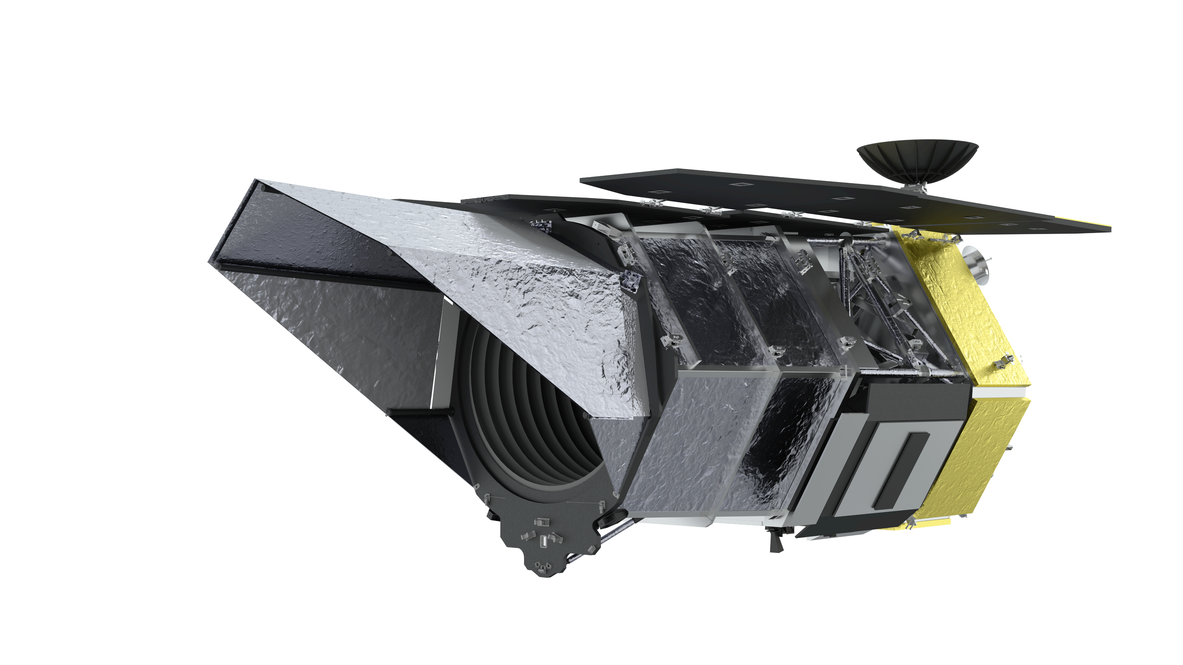
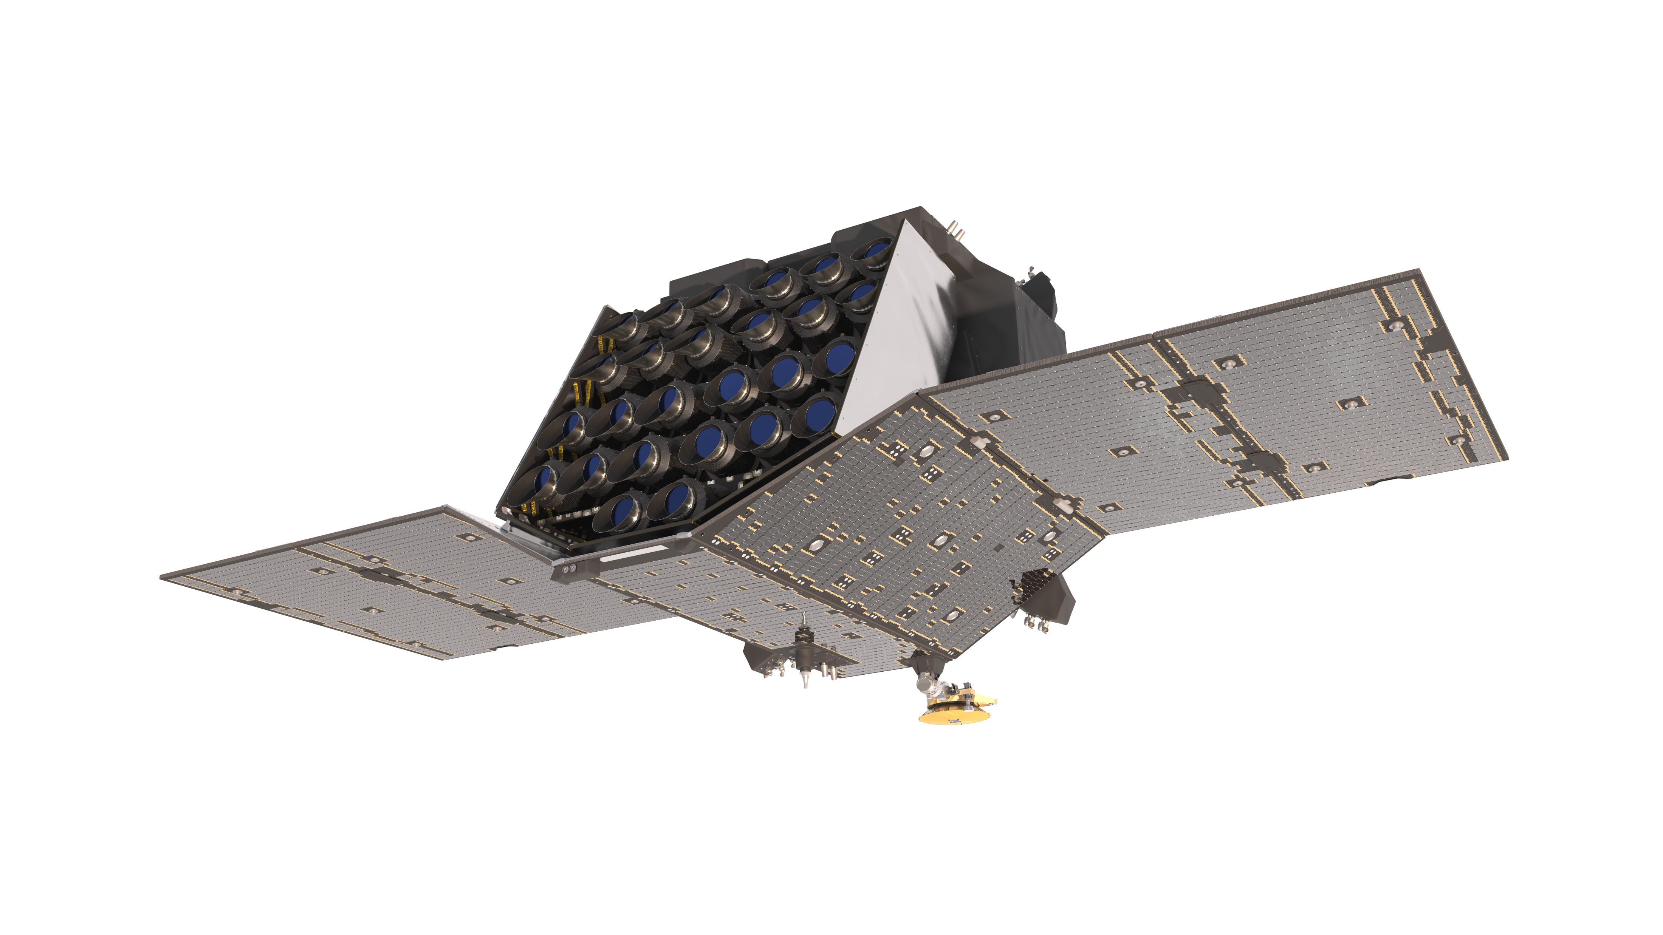
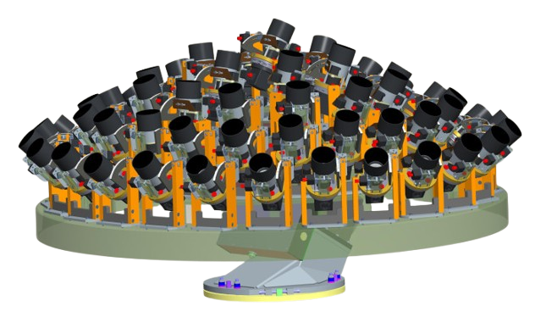
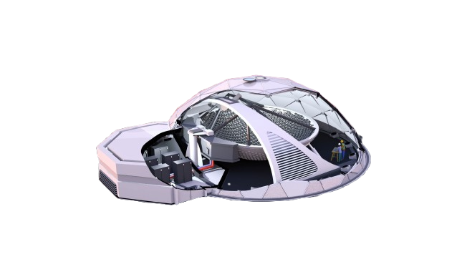













Roman
PLATO
LSST
HATpi
TESS
Argus Array

Slide 10
AT 2024zuk
AT 2021buv

Slide 11


AT 2024zuk
AT 2021buv

Slide 12

1800s cadence
600s cadence
200s cadence

Slide 13
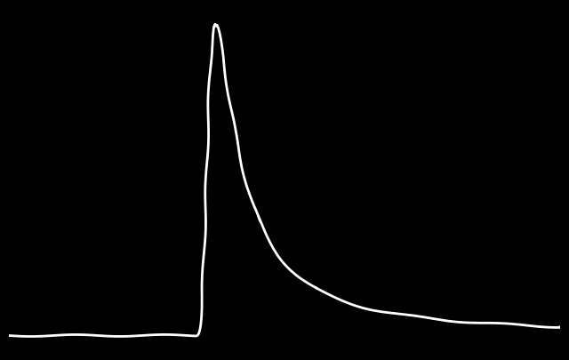


model flux
flux
time

Slide 14


exposure length
flux
time

Slide 15
flux
time

Slide 16
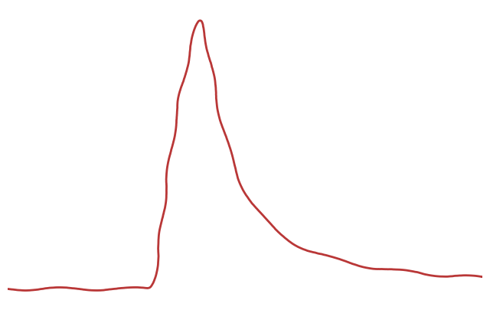
model flux
observations
flux
time

Slide 17
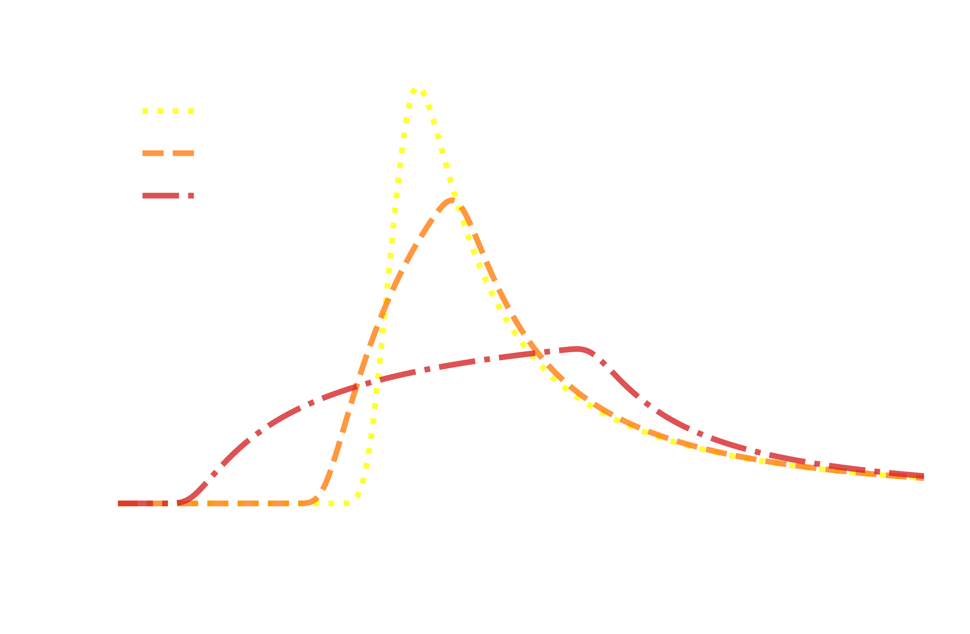

Slide 22
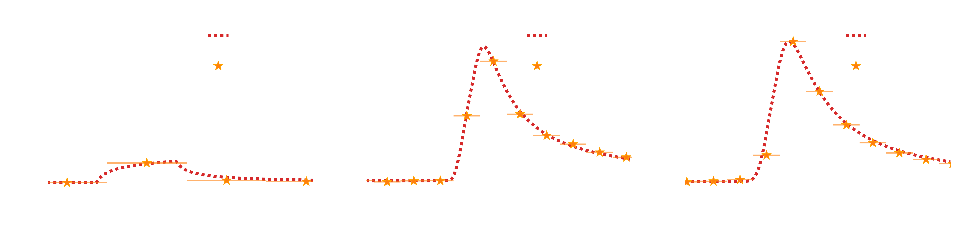
7:1
5:4
17:16

Slide 23
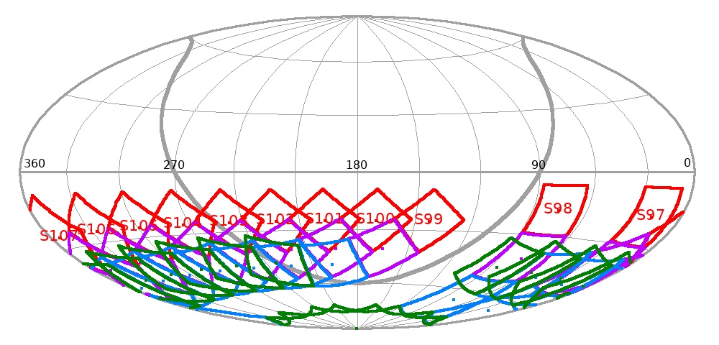
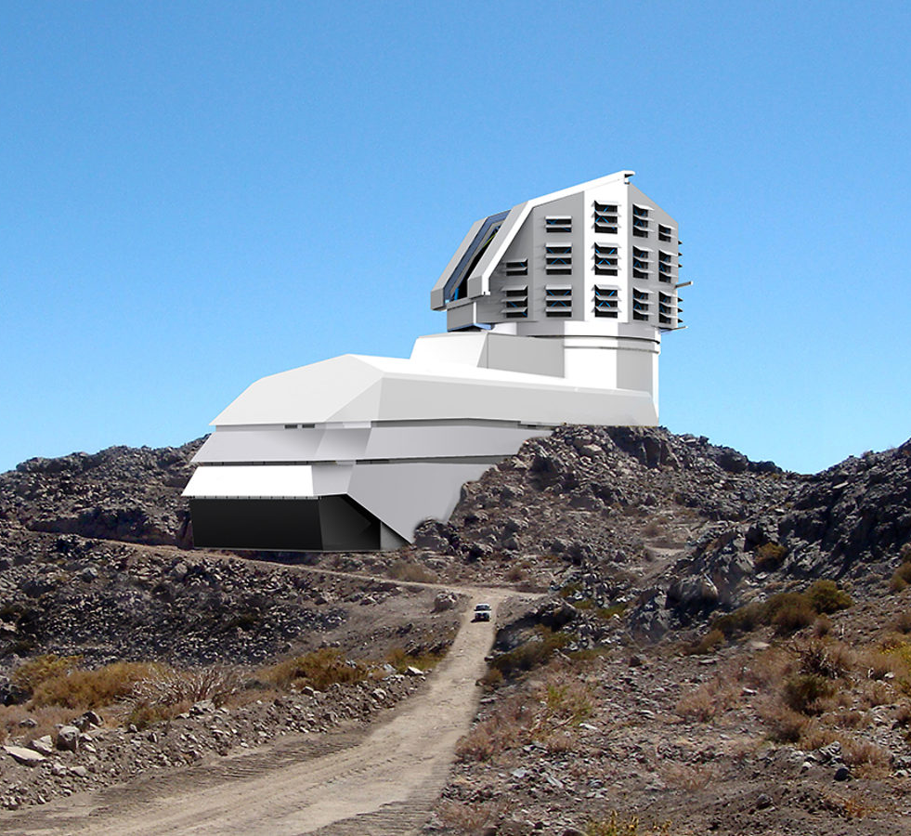
LSST will generate lots of detections of candidate transients – how can we keep up?
We can compare TESS and LSST observations to remove ambiguity in detections
https://tess.mit.edu/tess-year-8-observations/

Slide 24
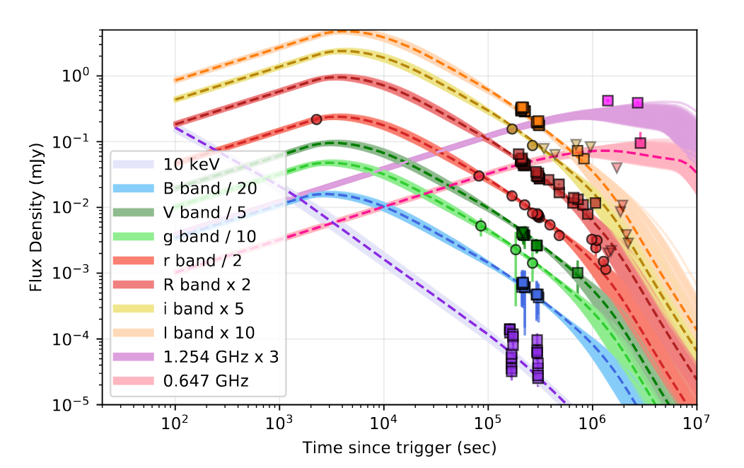

Late time fitting for AT2021buv provides some parameters.
$$z_{source}=0.876$$
One less parameter to fit?
Kumar, Harsh, et al. "The long-active afterglow of GRB 210204A: detection of the most delayed flares in a gamma-ray burst." Monthly Notices of the Royal Astronomical Society
Notes:
Can fit data but it is degenerate model
Don’t know true value
Buv redshift well defined but fitting w tess it doesn’t work so

Slide 25
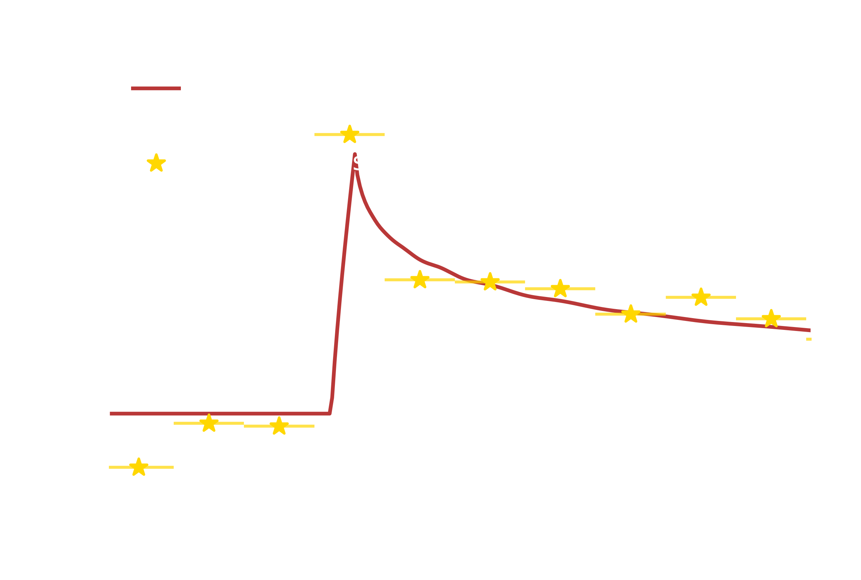
AT 2021buv
Flux (mJy)
Time since trigger (s)
TESS can’t get redshift
Ground can’t get early behaviour
Notes:
Can fit data but it is degenerate model
Don’t know true value
Buv redshift well defined but fitting w tess it doesn’t work so

Slide 26
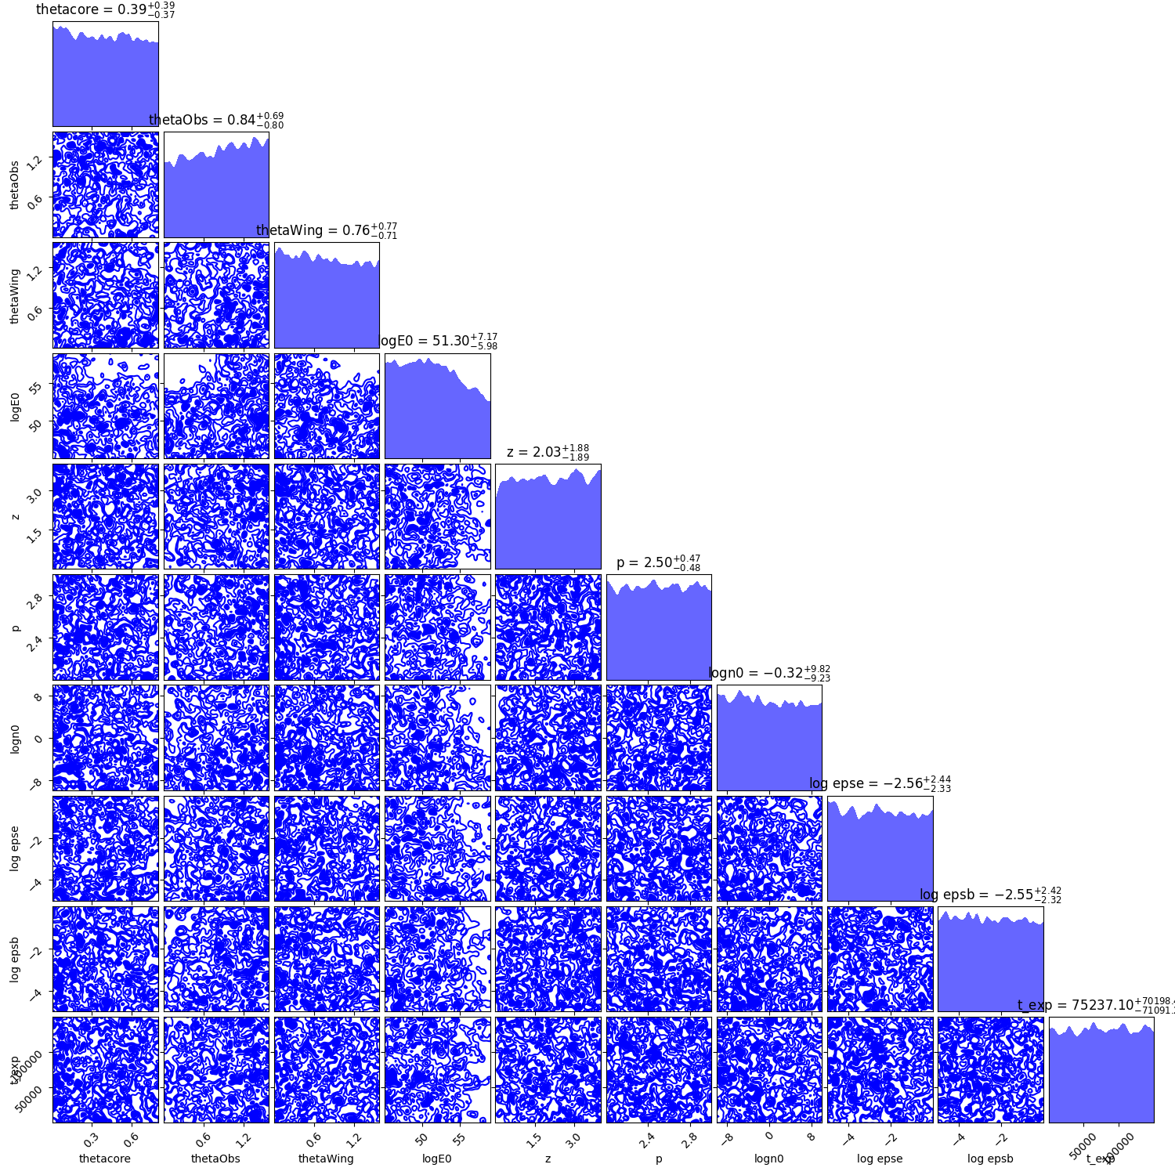
Wide FoV
High Cadence
Continuous observations

Slide 27
SUMMARY
This upcoming year will have full coverage between TESS and LSST.
Considering the integration time for telescopes means we
can more accurately determine physical parameters for fast transients.
Alone, LSST is unable to get detailed lightcurves of fast transients due to its cadence.
However, LSST will be vital in understanding these transients, as high-cadence telescopes can’t resolve all of the parameters.
Our current modelling tools are inadequate

Slide 28
kachow
bonus slides!

Slide 29
Why aren’t we using VegasAfterglow?
We are working on the implementation of TESS with VegasAfterglow!
VegasAfterglow has more physical parameters that it is able to fit to, which poses a problem with the high amount of degeneracy between parameters from TESS fitting, often leading to errors.
VegasAfterglow has a native implementation of MCMC, but we need to use nested sampling instead to deal with the large parameter space. With more parameters, there is more degeneracy, and so we need to decide what parameters to fix, so that our code can be run.

Slide 30
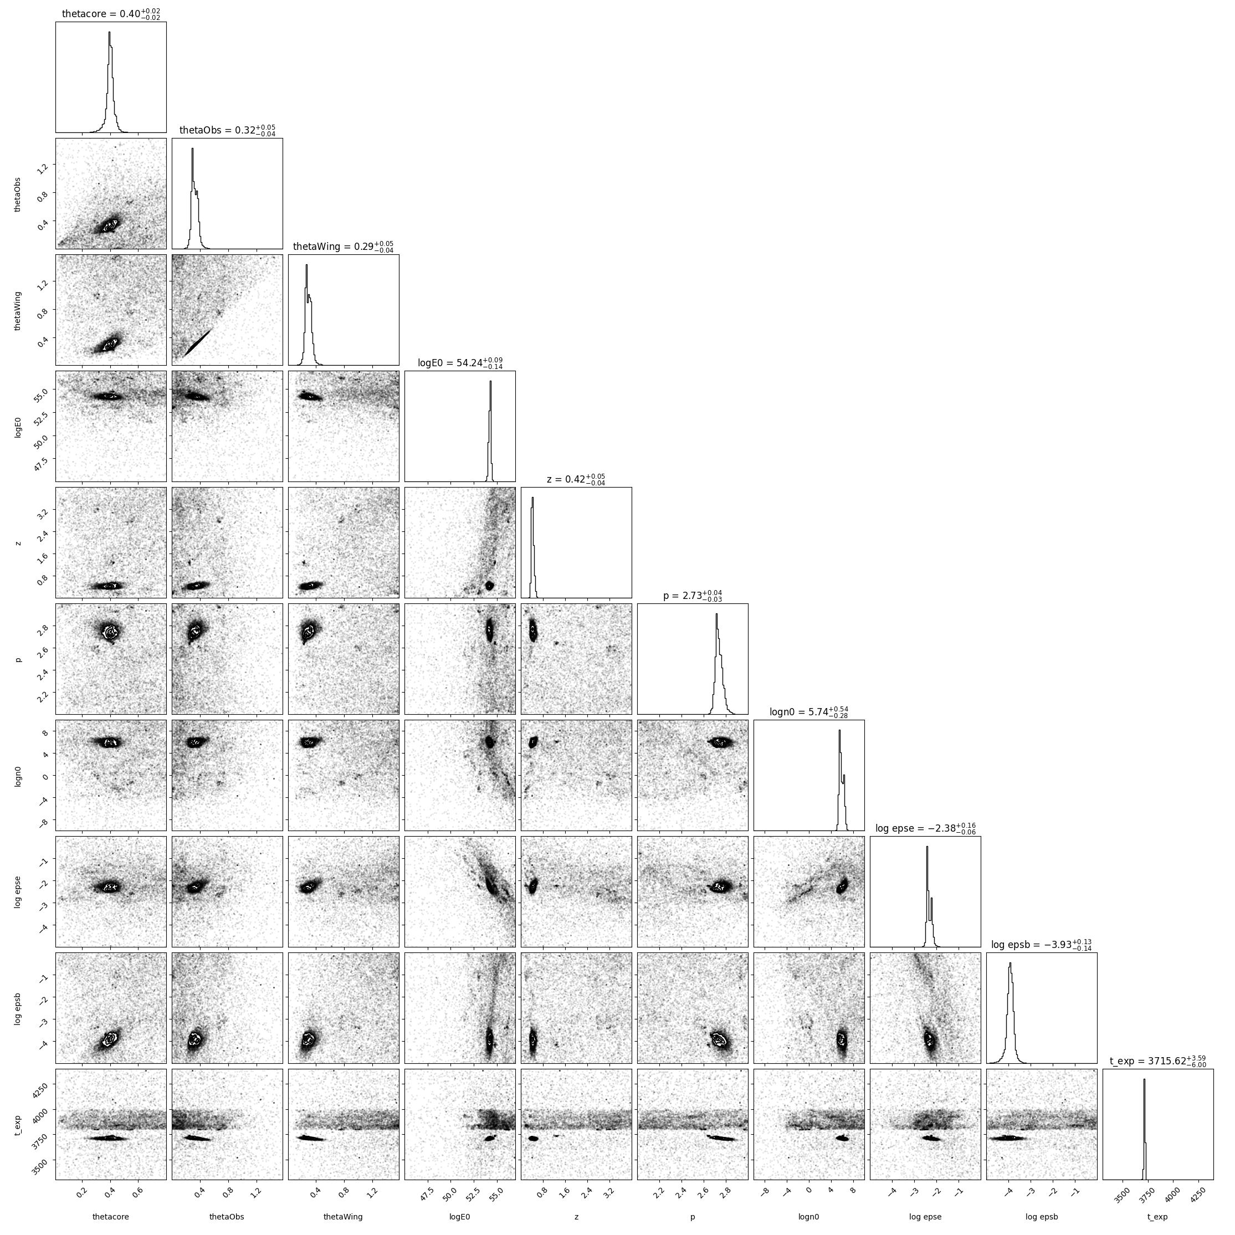
dynesty & afterglowpy

Slide 31
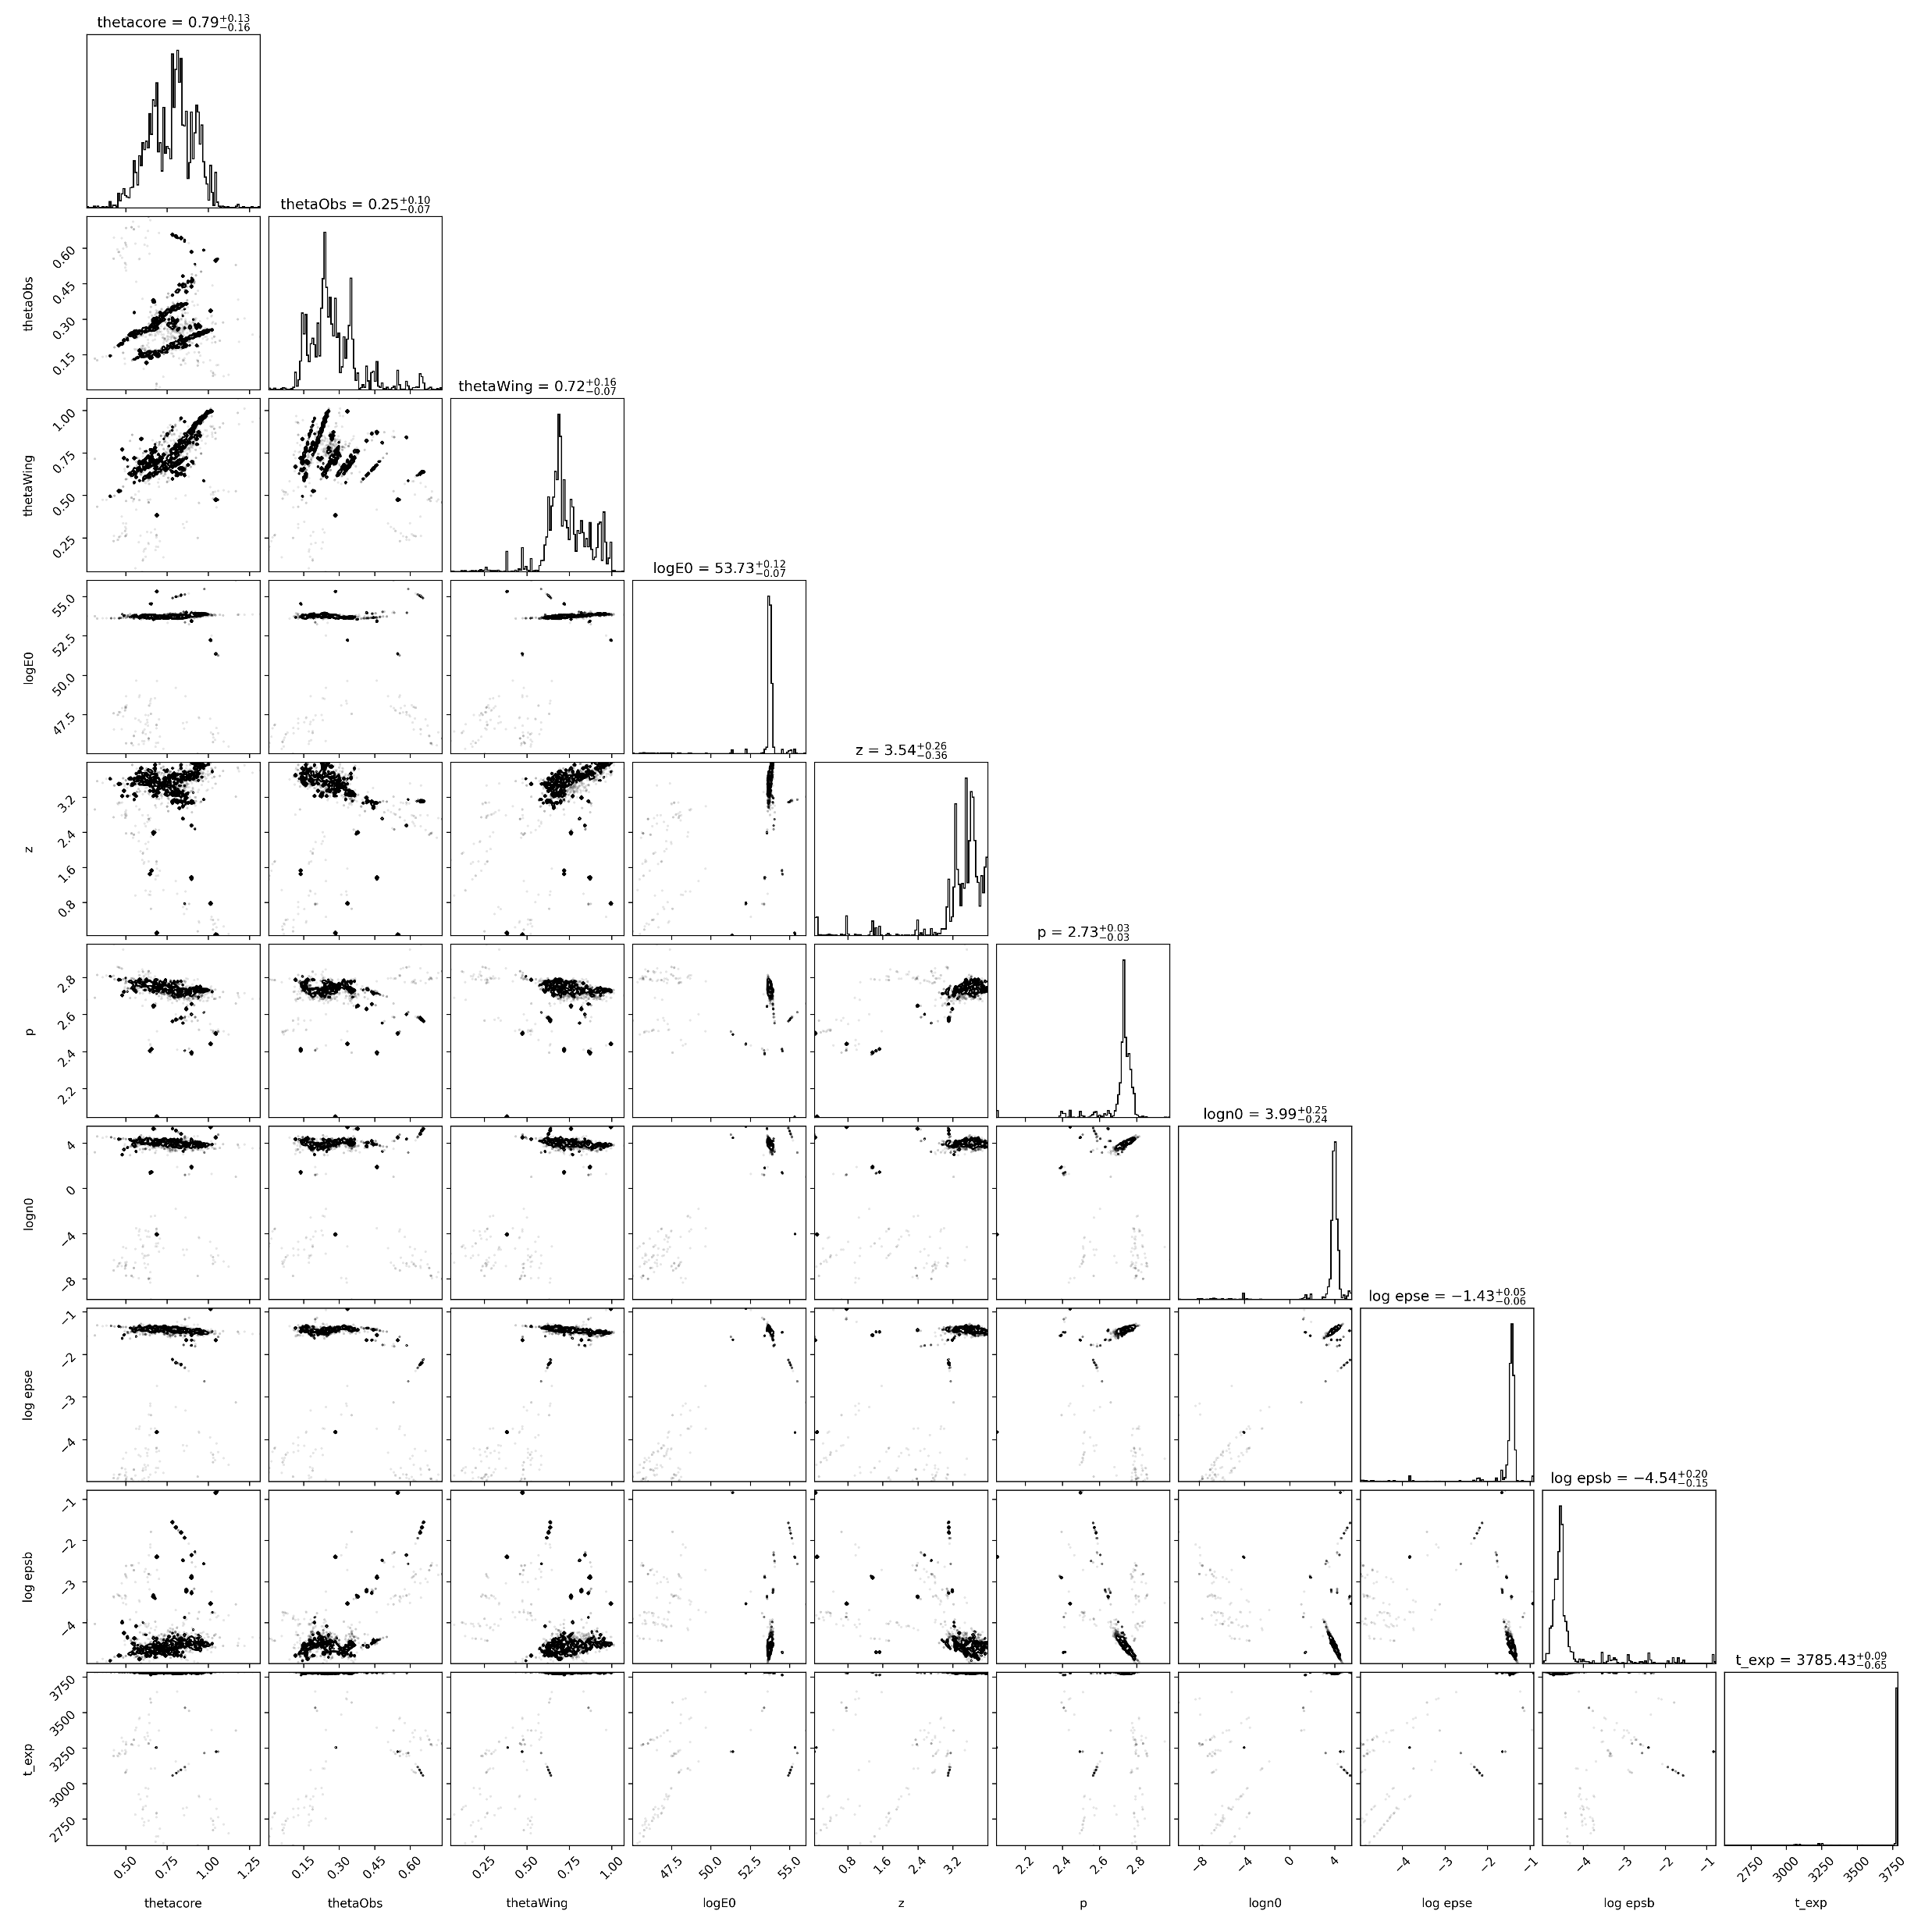
emcee &
afterglowpy

Slide 32
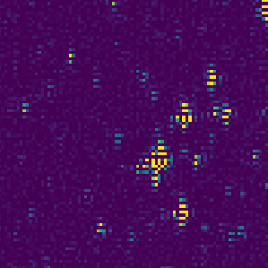
TESSELLATE & TESSreduce
TESSELLATE retrieves the TESS data and cuts it up into smaller 512x512 chunks
TESSreduce reduces these smaller data cubes
The detection methods implemented in TESSELLATE are run
time
We have a list of candidate transients!

Slide 33

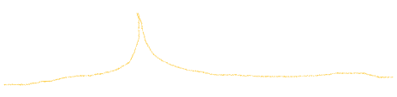



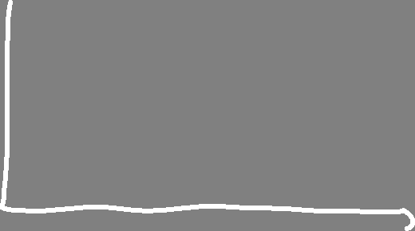
Comparing 2020har with time smear and no time smear on this slide?

Slide 34
Roman
PLATO
LSST
HATpi
TESS
Argus Array

