Slide 1
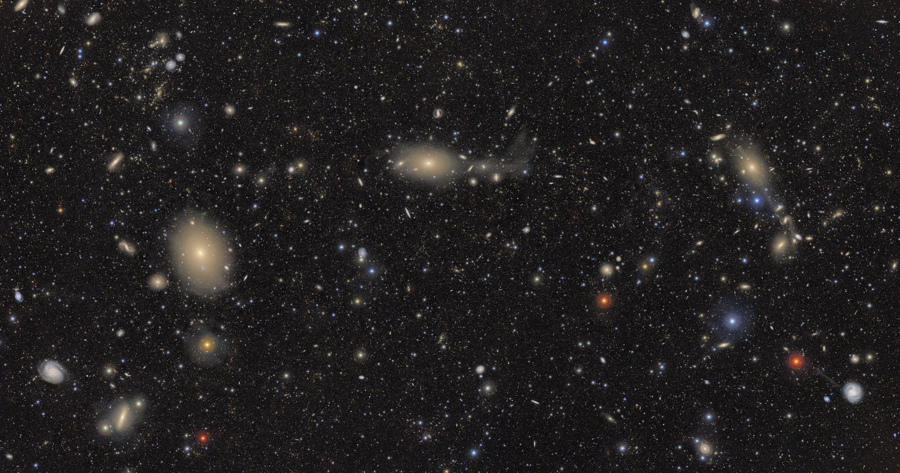



Changing look behaviour in 6dFGS AGN
Sruthi Suresh
II year Ph.d.
University of Melbourne
Supervisor – PROF. Rachel Webster
Image credits : NSF–DOE Vera C. Rubin Observatory

Slide 2
Overview
Introduction to
Active Galactic Nuclei (AGN)
Changing look AGN (CL AGN)
Finding AGN in the southern sky
Analysis of identified AGN – Peculiar behaviors
CL Triggers using ZTF

Slide 3
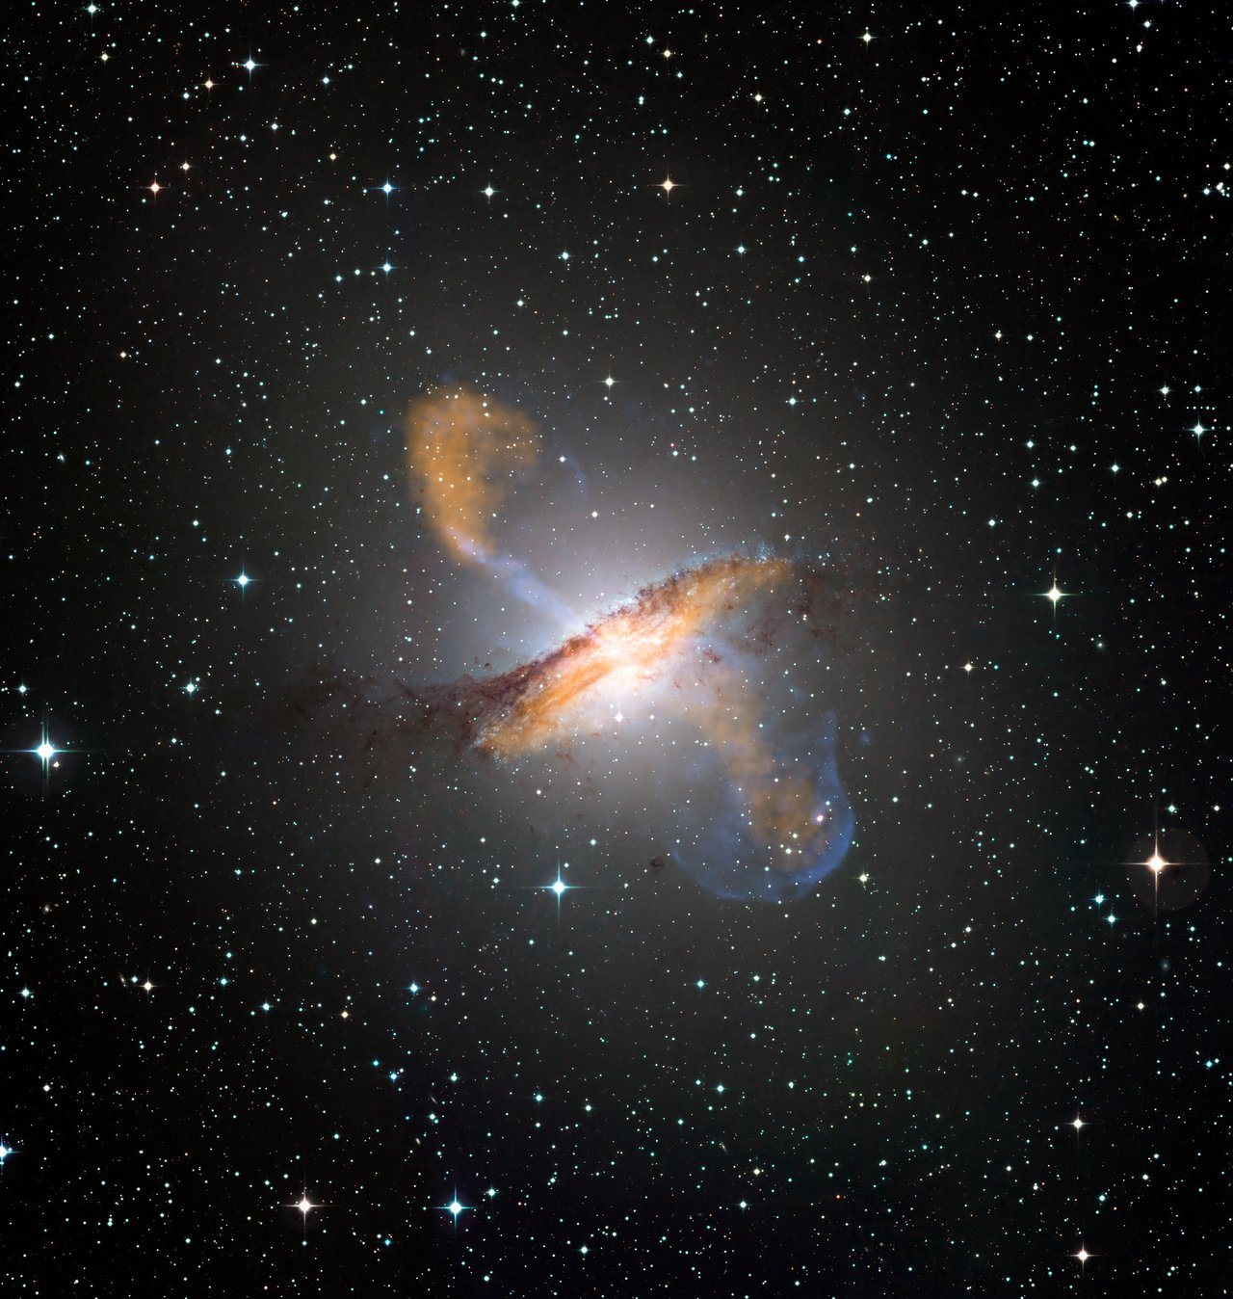
Active Galactic Nuclei (AGN)
ESO/WFI (Optical); MPIfR/ESO/APEX/A.Weiss et al. (Submillimetre); NASA/CXC/CfA/R.Kraft et al. (X-ray)
Closely packed region at the center of a galaxy
Compact core of emission
Active – Supermassive accreting BH
Has non stellar emission. Excess emission found in Infrared, Ultra-violet, radio and X- ray

Slide 4

Black hole
Accretion disk
Dusty torus
Broad line region
TYPE 2
Narrow line region
Jets

Slide 5
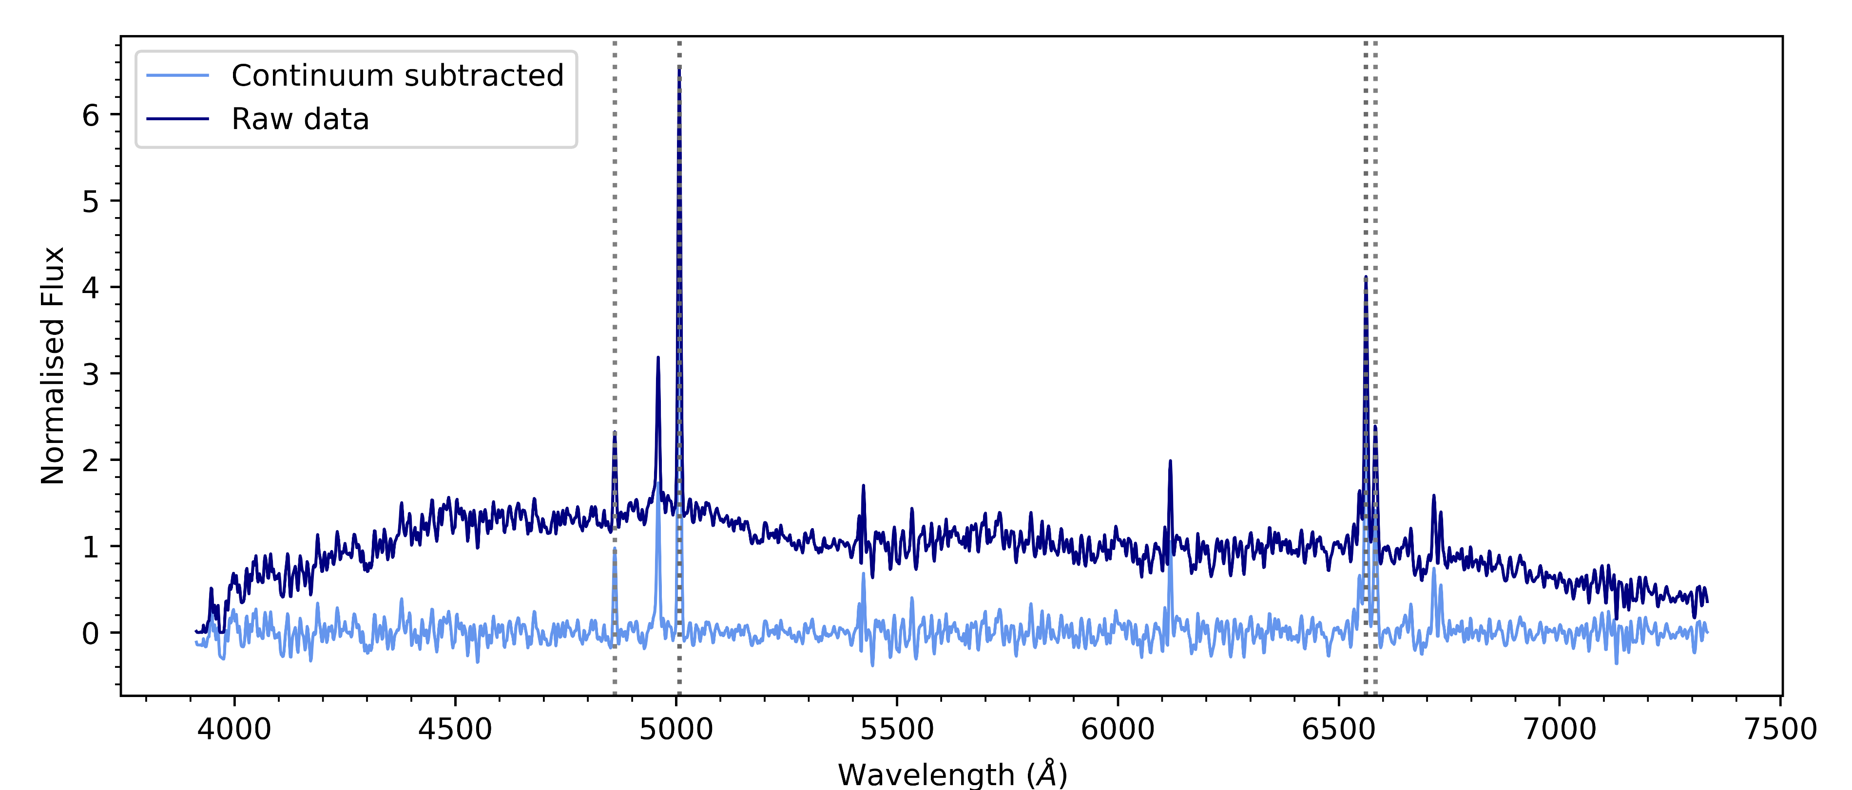
Black hole
Accretion disk
Dusty torus
Broad line region
TYPE 2
Narrow line region

Slide 6

TYPE 1
Black hole
Accretion disk
Dusty torus
Broad line region
Narrow line region

Slide 7
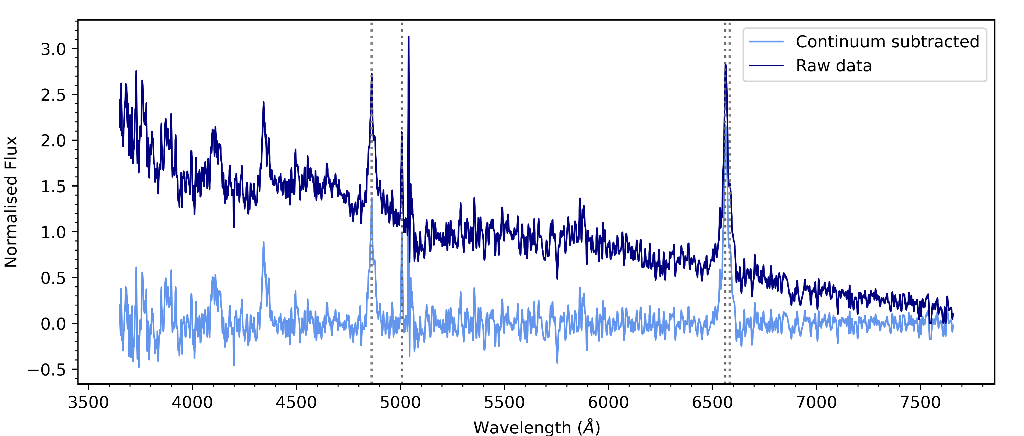
TYPE 1
Black hole
Accretion disk
Dusty torus
Broad line region
Narrow line region

Slide 8
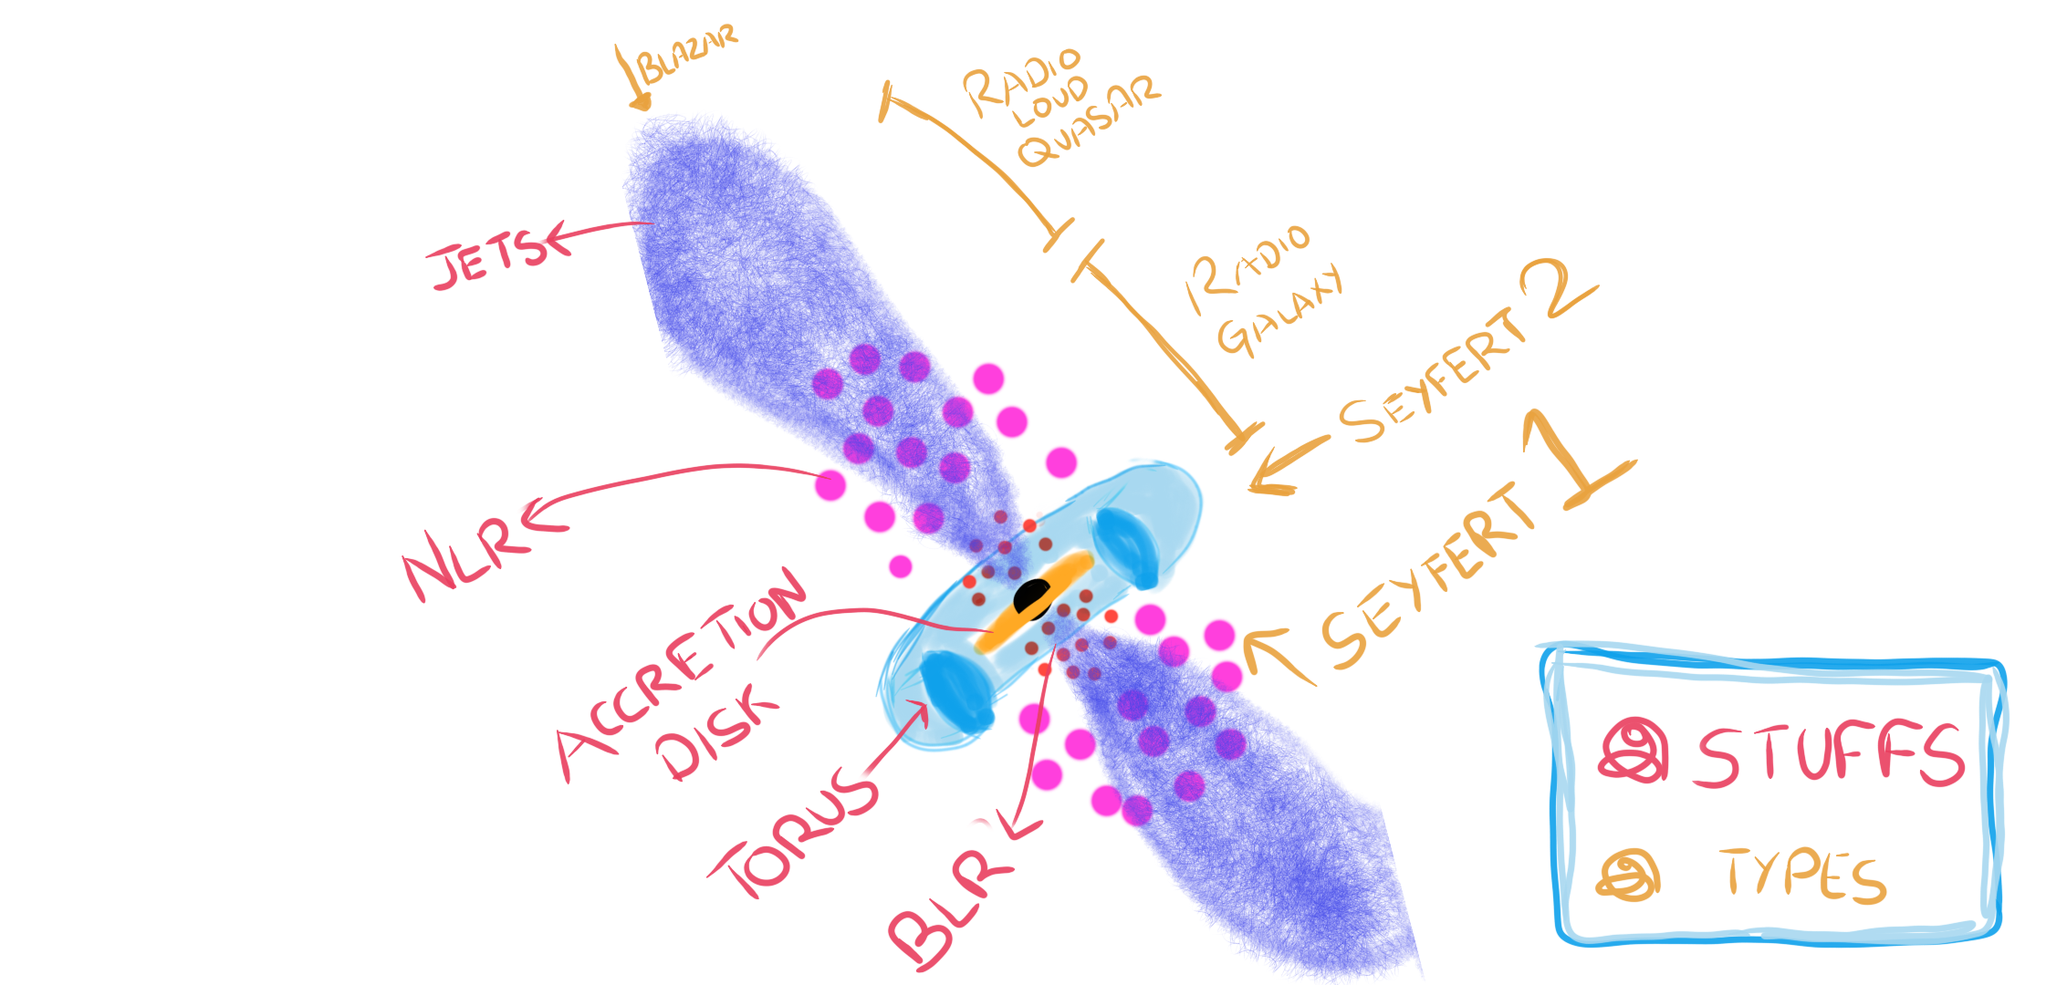
AGN Unification

Slide 9
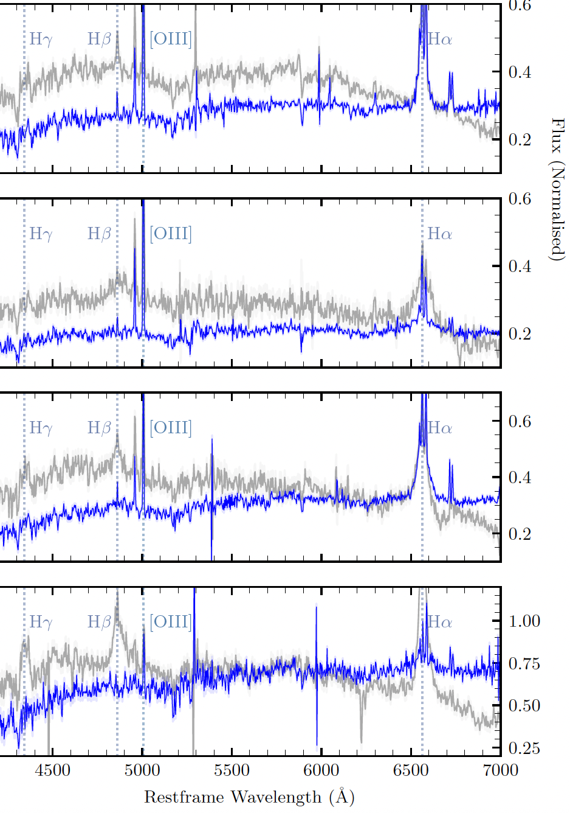
Changing look AGN
Show flux and spectral changes.
Changing Obscuration – variable clouds around AGN
Changing State – switch between Type 1 to Type 2
Credits: Neelesh Amrutha et. al., 2024

Slide 10

Changing look AGN
LSST will spot these transitions quickly
Need an AGN catalogue in the southern sky
Type 1 - Broad line AGN – Wei Jeat Hon et. al., 2025
Type 2 – Narrow line AGN – Sruthi Suresh et. al., 2025

Slide 11
Overview
Introduction to
Active Galactic Nuclei (AGN)
Changing look AGN (CL AGN)
Finding AGN in the southern sky
Analysis of identified AGN – Peculiar behaviors
CL Triggers using ZTF

Slide 12
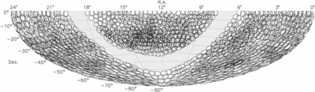
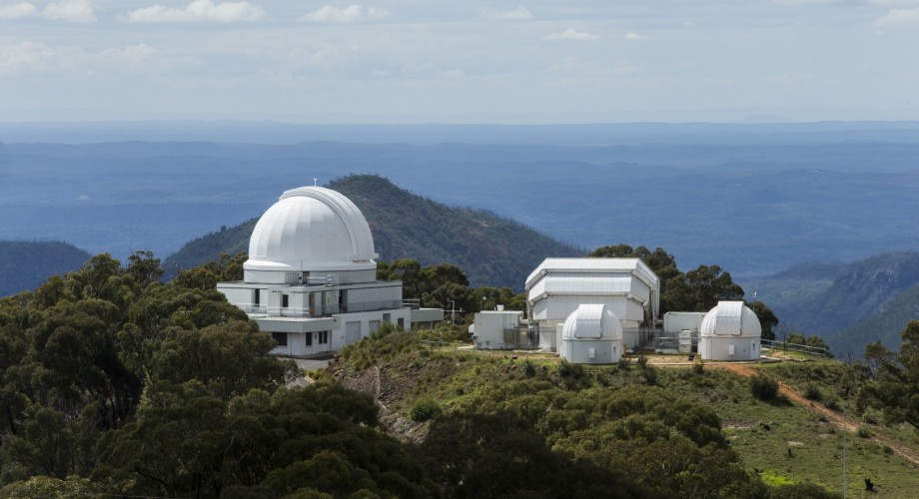
A catalogue of Type 2 Active Galactic Nuclei in the 6dF Galaxy Survey
The 6dF Galaxy Survey (6dFGS) - mapped half the sky (2001 – 2009)
Obtained 136,304 Galaxy spectra

Slide 13
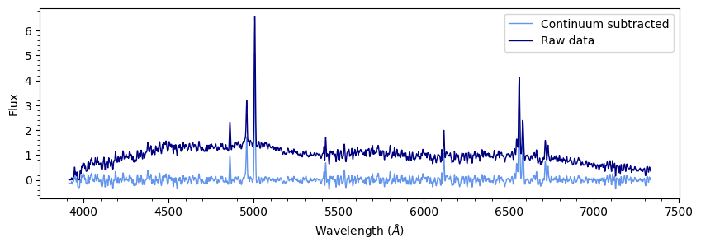
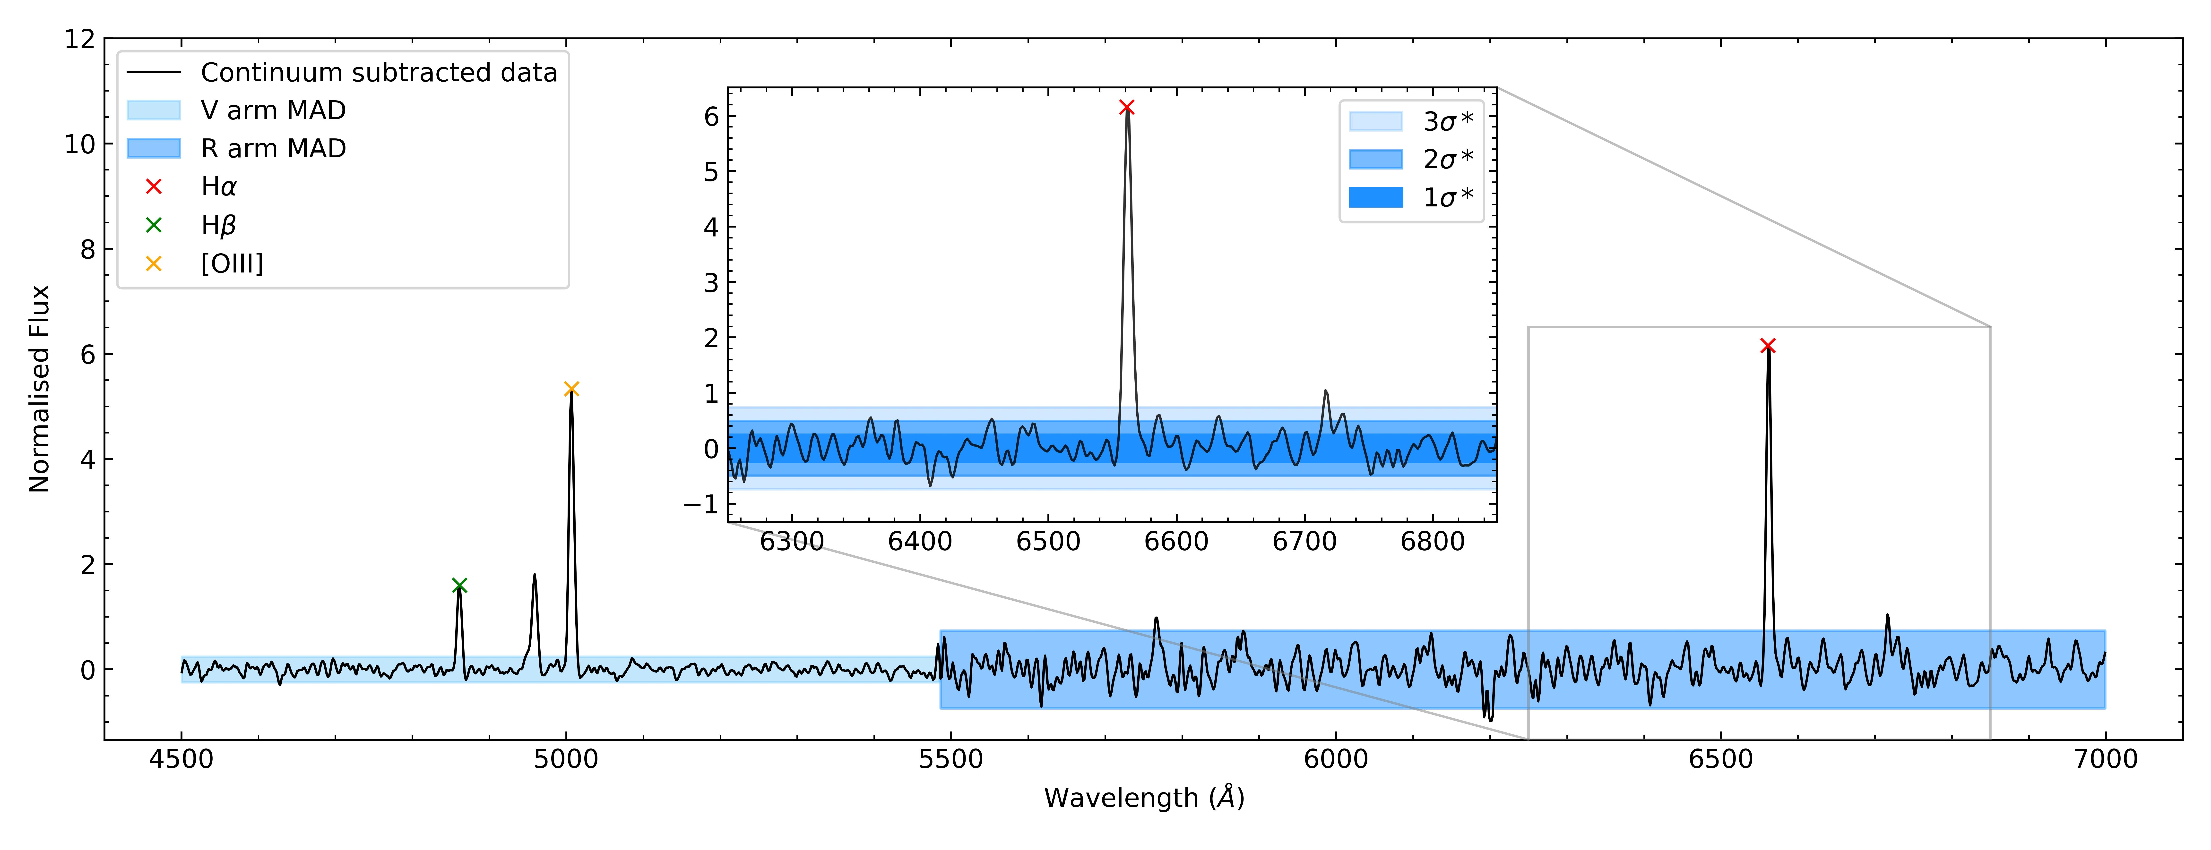
Subtract continuum and remove noisy ends
Use of Median Absolute deviation (MAD) to find ELG

Slide 14

Fit the spectrum using PyQSOFit
Get flux values
15,958 sources!
x3
Visual inspection

Slide 15
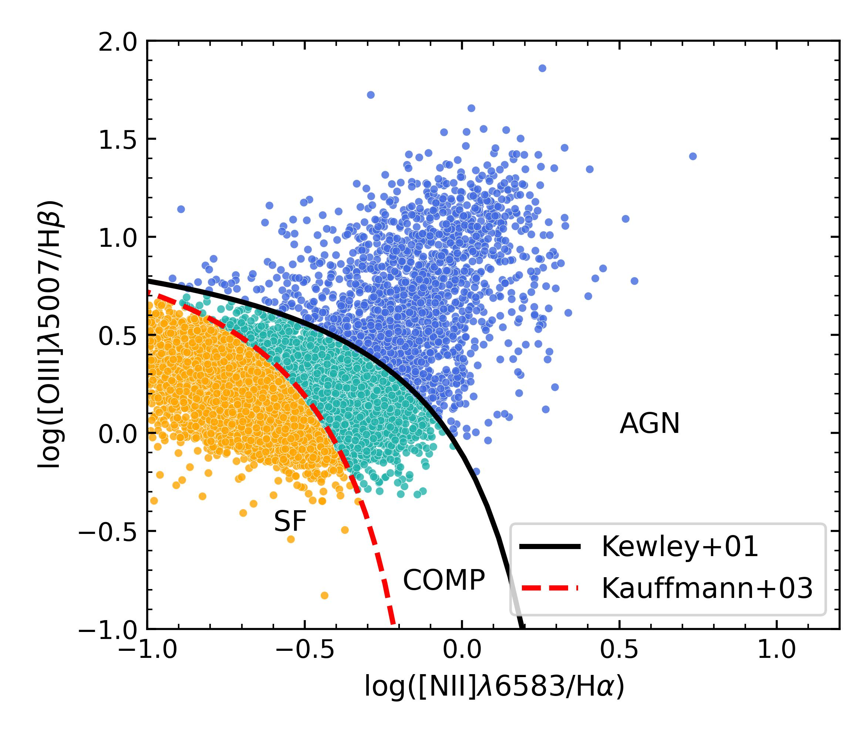


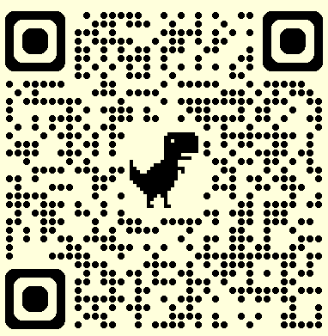
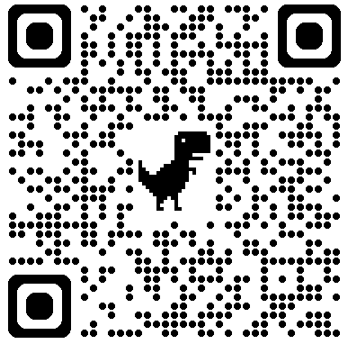
Results
10,492 Narrow emission line galaxies were identified
Classified them using BPT diagram
Found ~ 5,000 AGN (& composites)
This work
BEL AGN

Slide 16
Overview
Introduction to
Active Galactic Nuclei (AGN)
Changing look AGN (CL AGN)
Finding AGN in the southern sky
Analysis of identified AGN – Peculiar behaviors
Multiwavelength analysis of Type 1 and Type 2
CL Triggers using ZTF

Slide 17
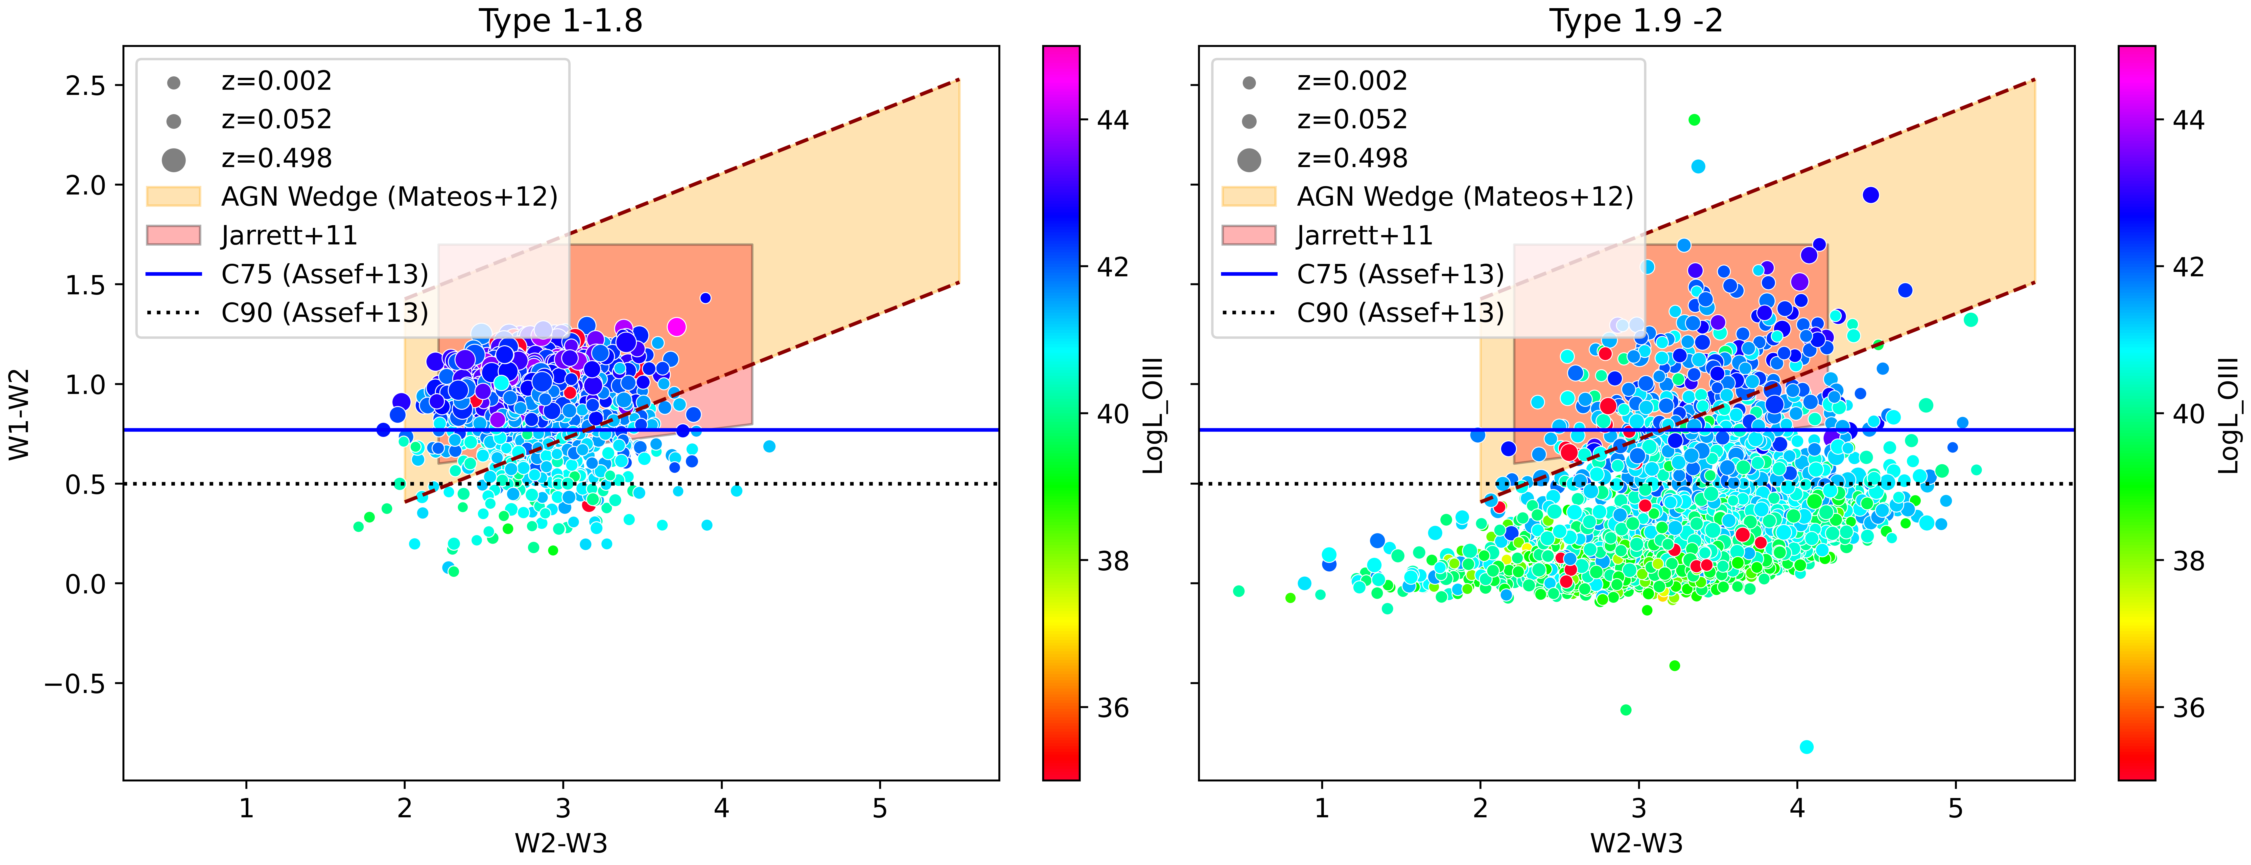
Crossmatch with IR data
WISE data - Color Color diagram – widely used to classify AGN (above W1-W2>0.5)
We find -
Trend in the types - classification is biased towards bright luminous sources
By theory : Type 2 –> thick torus –> more IR. But we see most of type 2 are not IR AGN – speculating thin torus

Slide 18
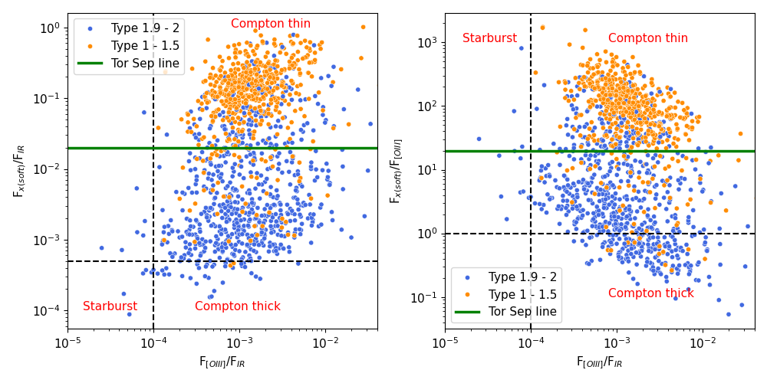
Crossmatch with X-ray data
Soft X-rays get absorbed by the torus
Typical Type 2 = More IR, less Xray
Ours – Not too thick torus!
Literature Review: Panessa et. al., 2006

Slide 19


”True” Type 2 AGN
Absence broad line region
Not because of orientation or presence of thick dusty torus
But because it does not exist in some AGN
We might have some of the ”True” Type 2 AGN

Slide 20
Overview
Introduction to
Active Galactic Nuclei (AGN)
Changing look AGN (CL AGN)
Finding AGN in the southern sky
Analysis of identified AGN – Peculiar behaviors
Multiwavelength analysis of Type 1 and Type 2
CL Triggers using ZTF
Preliminary results

Slide 21


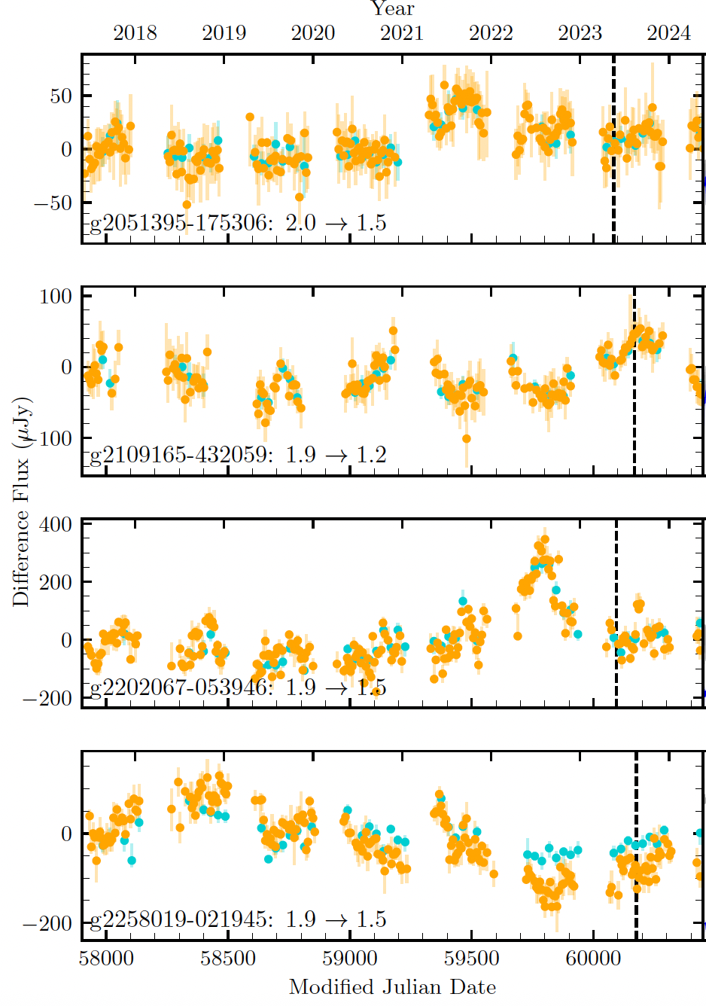
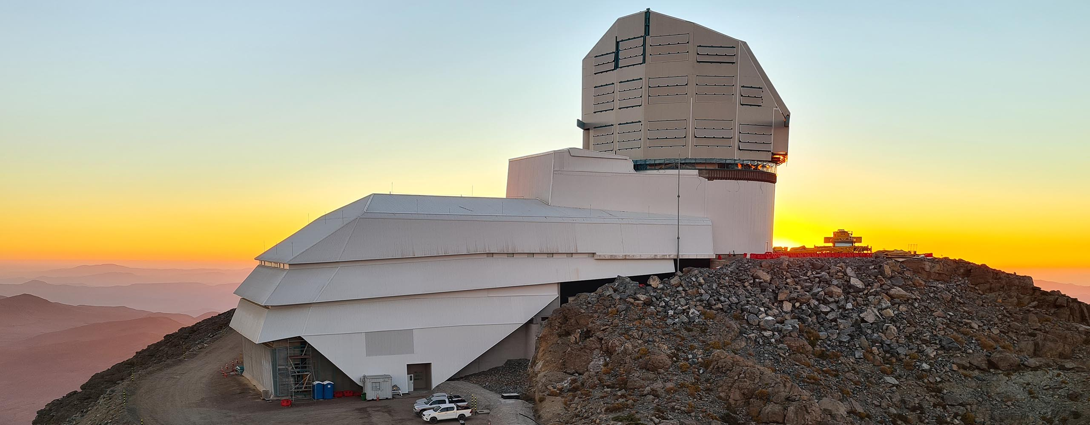
Identifying CL events
Best bet is to use LSST - scanning the sky every night for the next ten years
Alerts to start soon
Observe the light curve
Need to find the trigger
Preliminary results from ZTF (Zwicky Transient Facility)
Credits: Neelesh Amrutha et. al., 2024

Slide 22
Using ZTF
Light curve data
Crossmatch T1 & T2 with ZTF
Dec>-31º
Pre-processing
Epochs>10
Sigma clipping twice
Results
Is it varying?
Is it varying like a quasar?

Slide 23
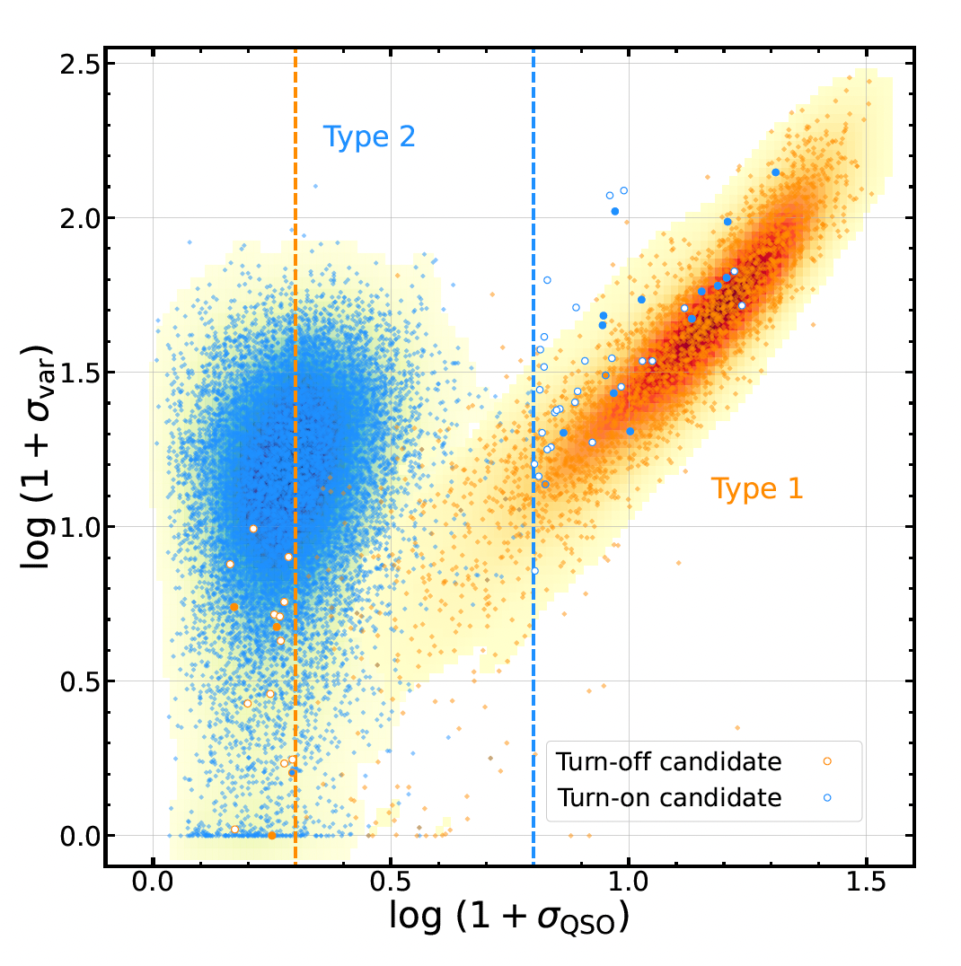
Using ZTF
Literature Review: Shu Wang et. al., 2024
Fit the curve using qso_fit code (Buttler & Bloom, 2011) - Damped Random Walk (DRW) Model
Inputs – time, magnitude, error
Models how correlated each point in the light curve is with its neighbours
Compares: → “Does this correlation pattern match a DRW process?” → “Or is it just noise?”
Use χ² tests and sigma significance -> classify

Slide 24
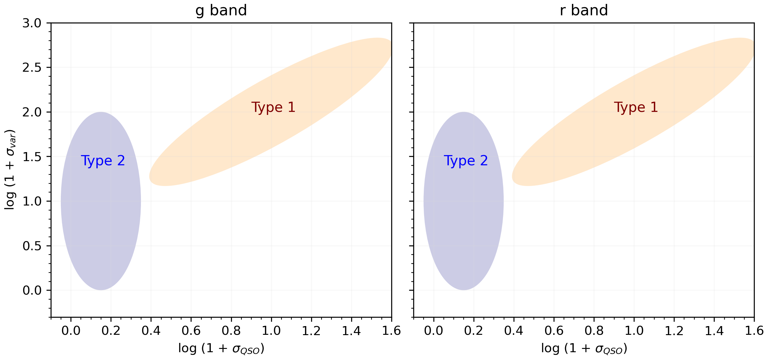

Slide 25
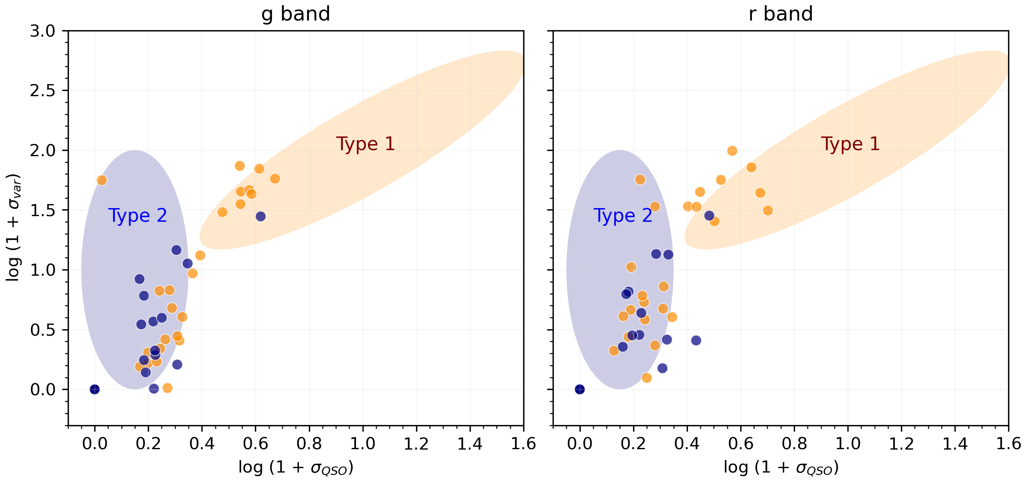

Slide 26
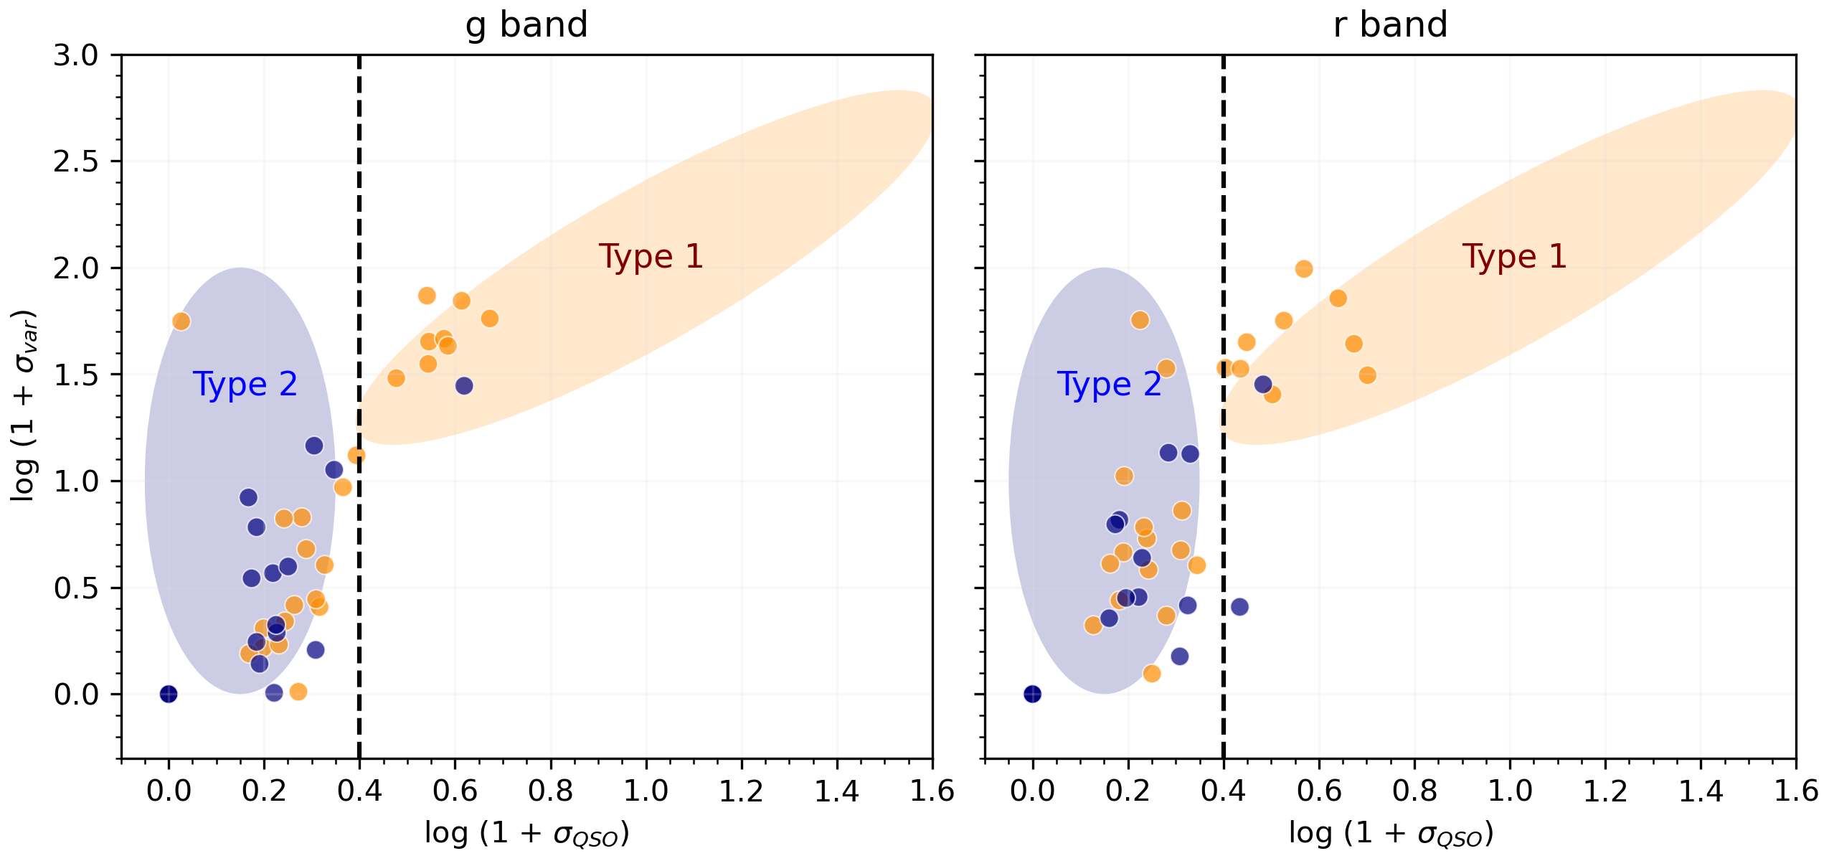

Slide 27
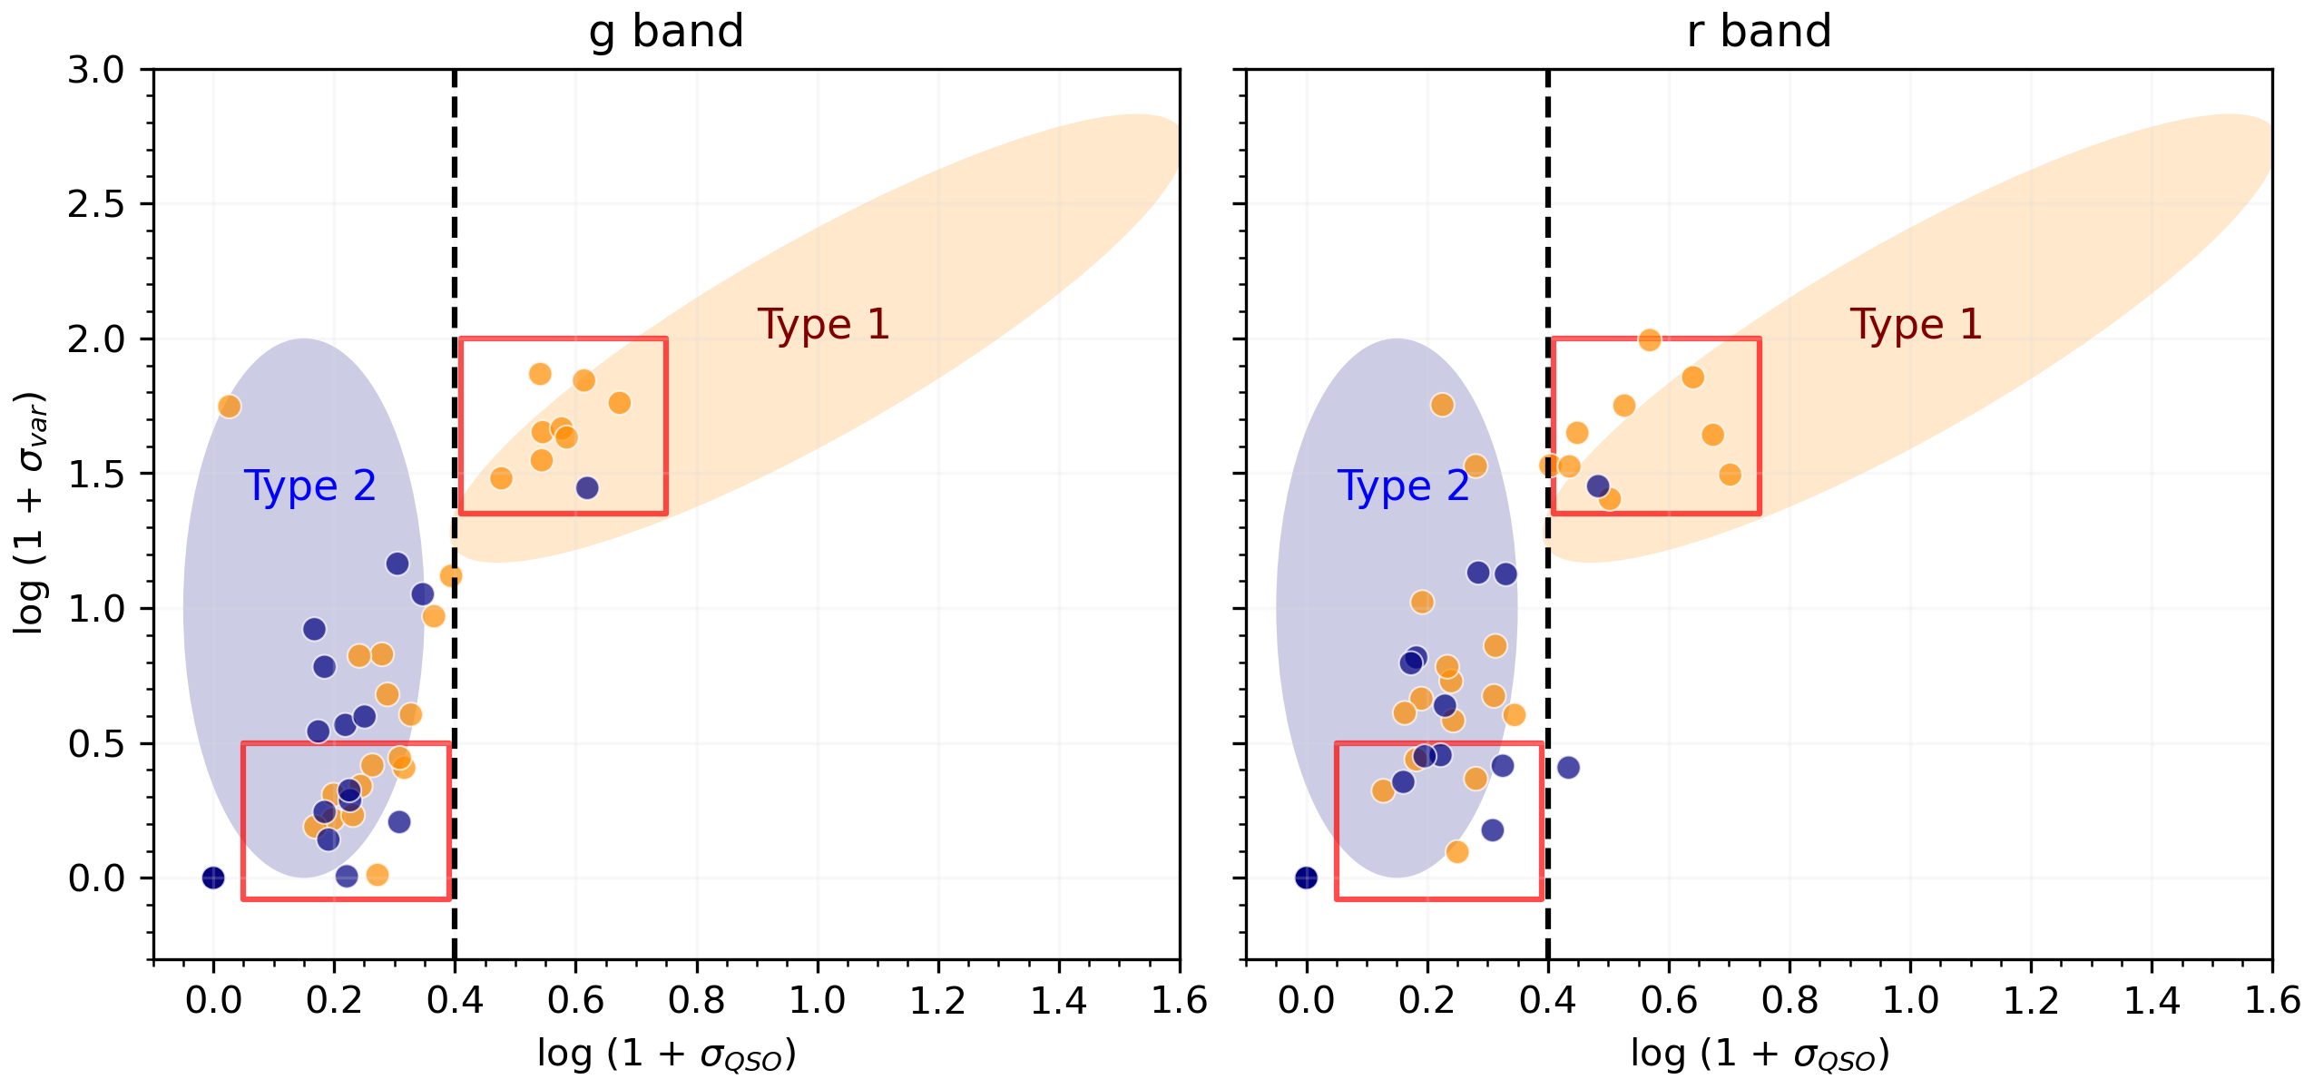

Slide 28
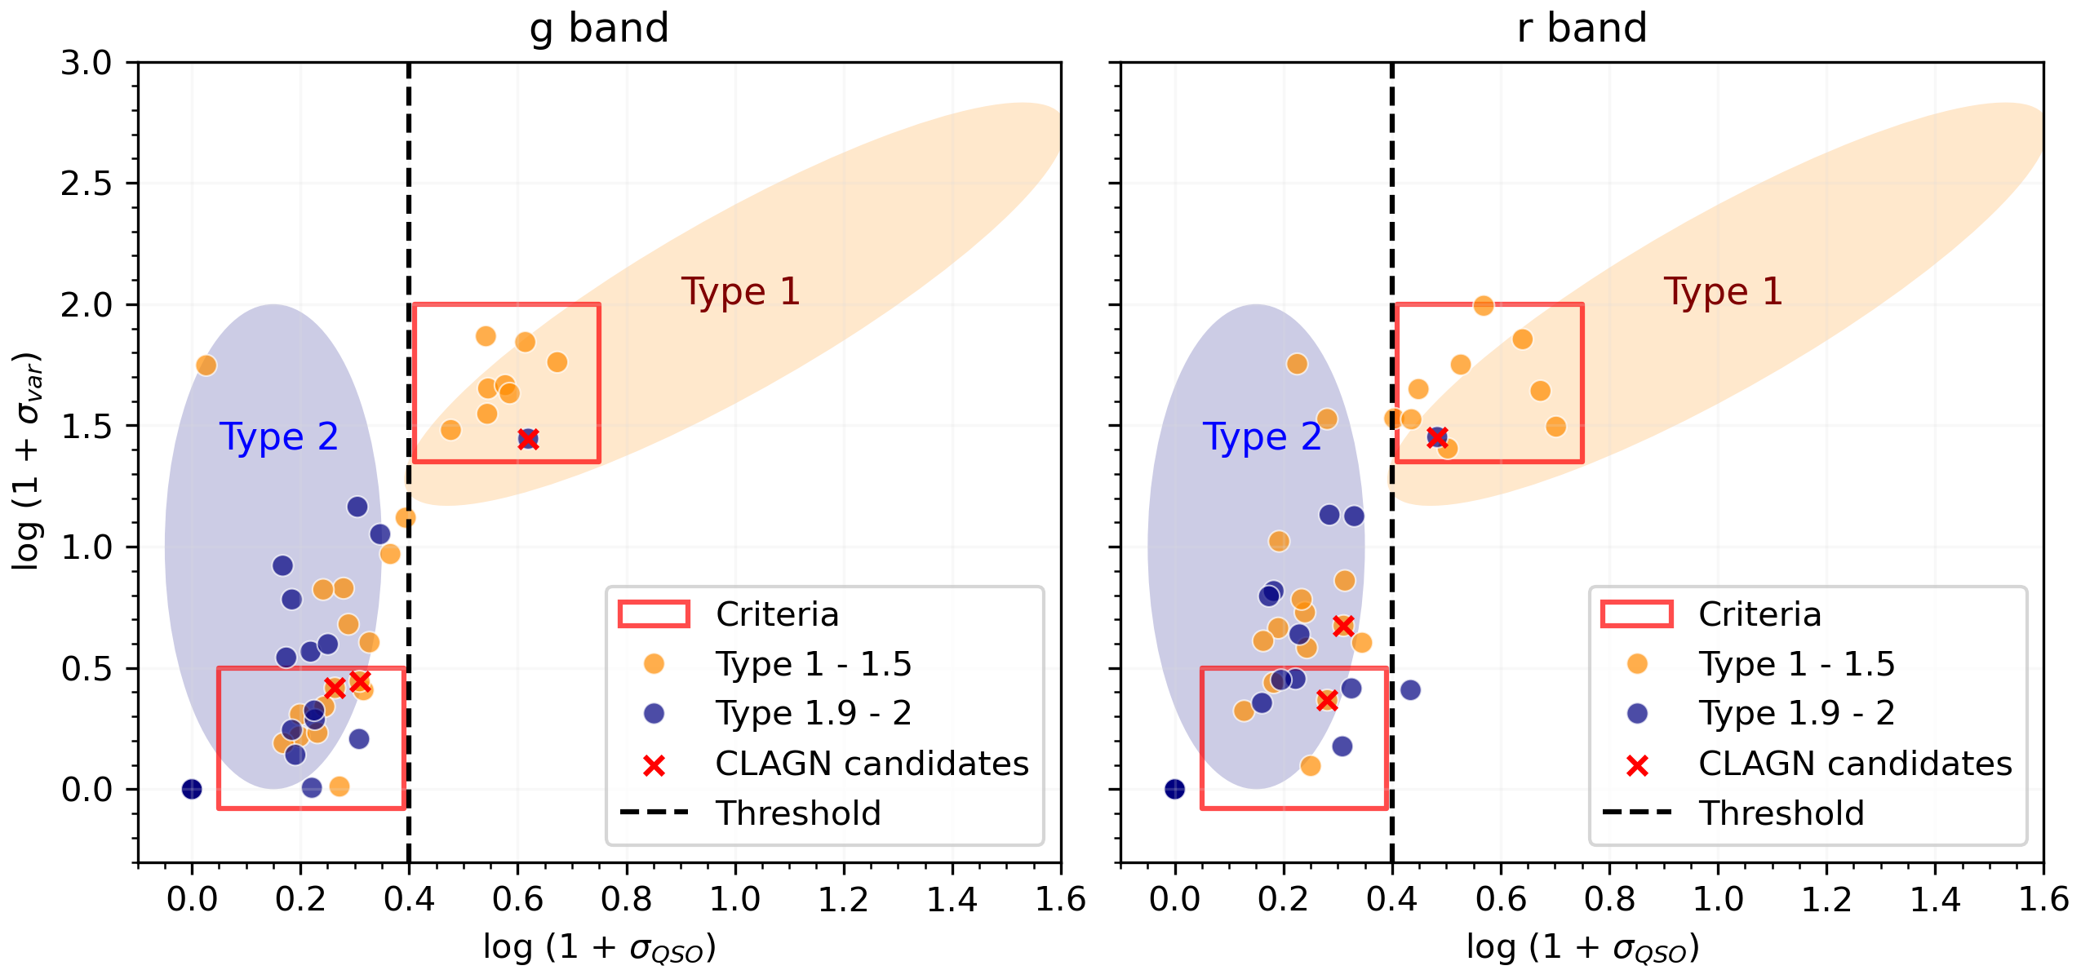

Slide 29
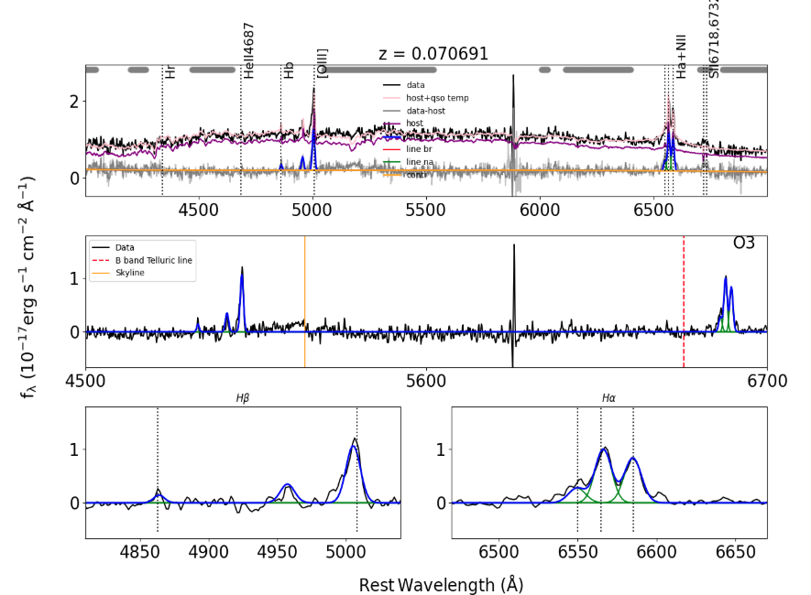
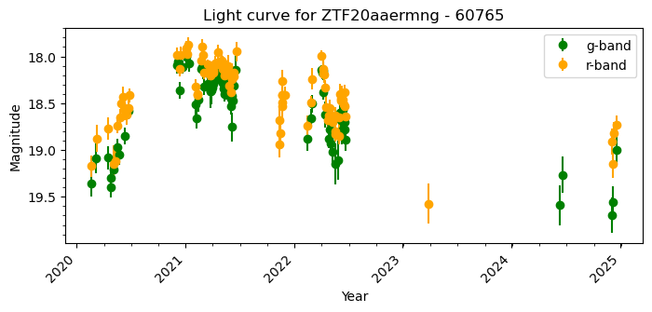
A possible Type 2 -> Type 1

Slide 30
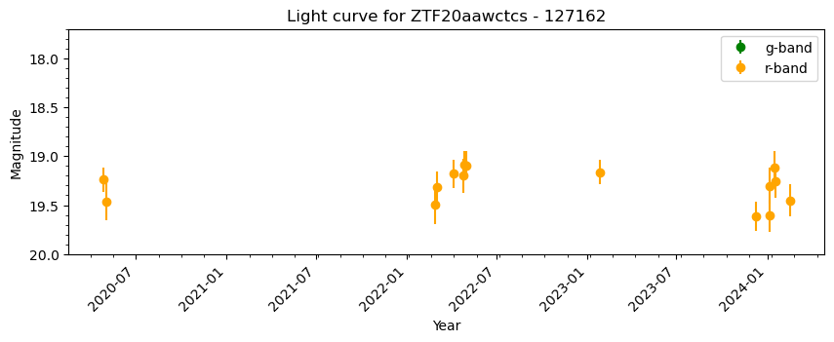
A possible Type 2 -> Type 1

Slide 31
Future work & Summary
Identify “True” Type 2 AGN and do further analysis
Explore different models to find triggers
Implement the same using LSST data
Confirm the CL candidates using spectroscopy
This work
BEL AGN

Slide 32
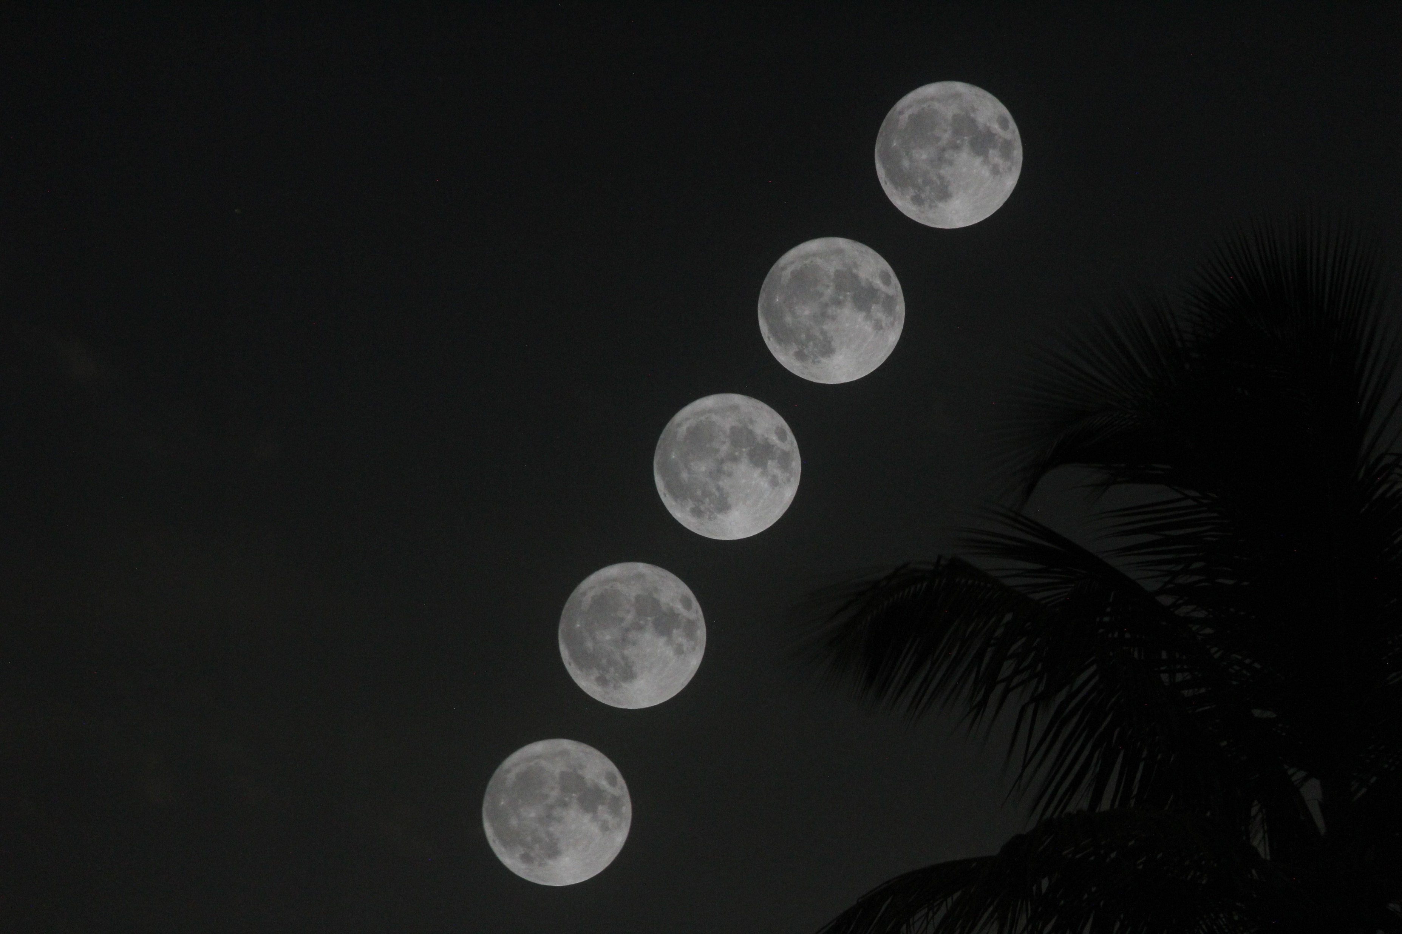
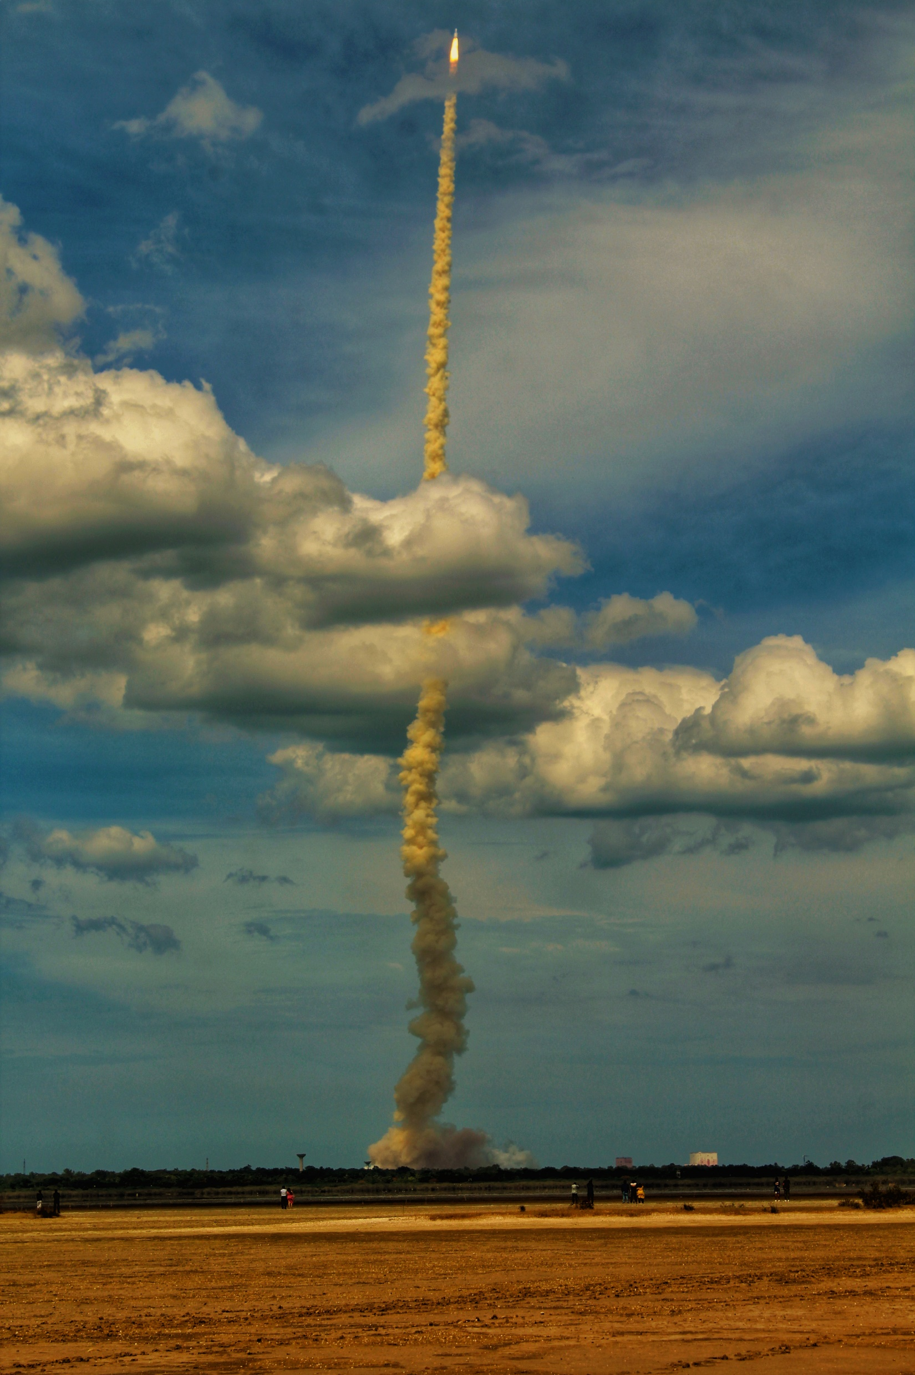
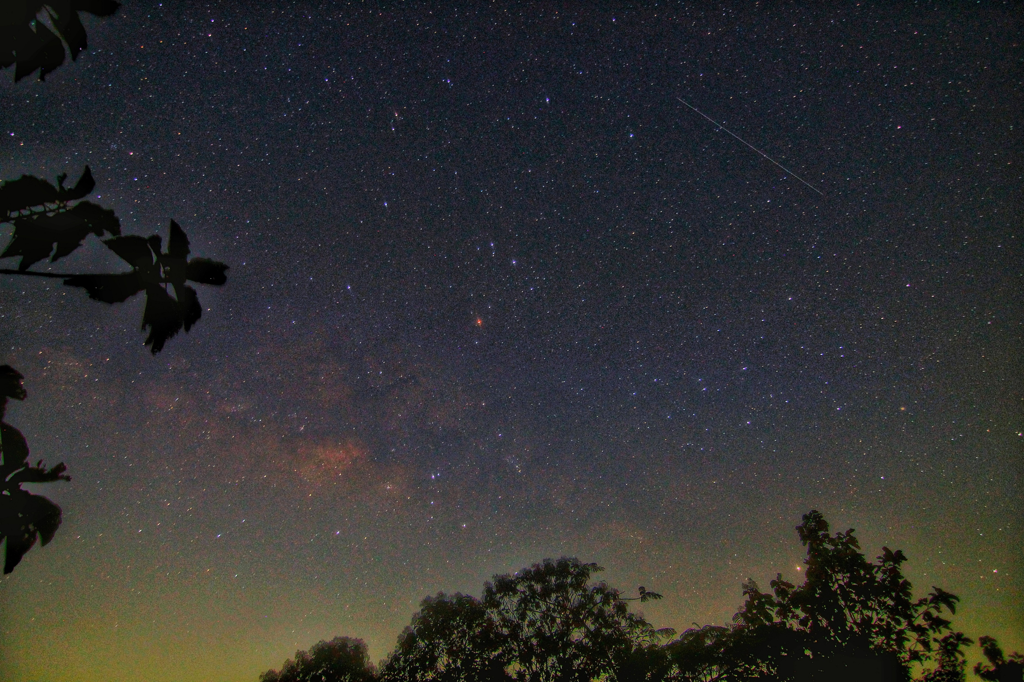
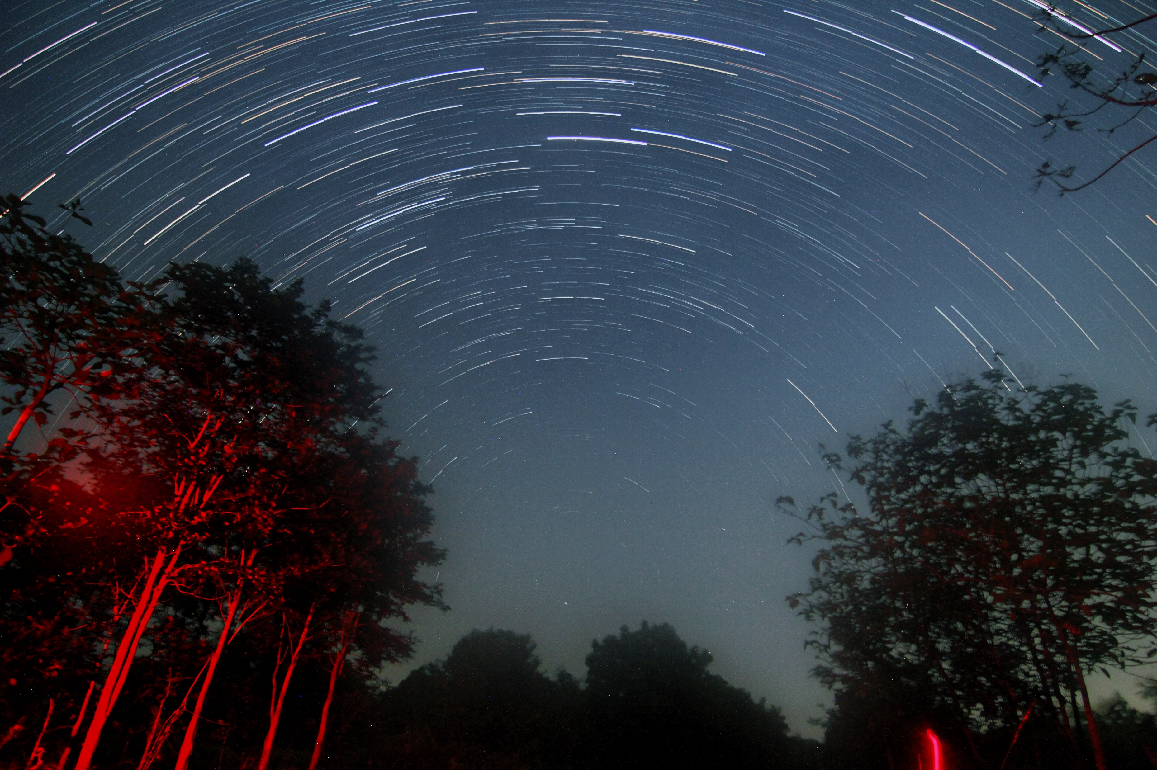
Future goals
Thank you!

Slide 33
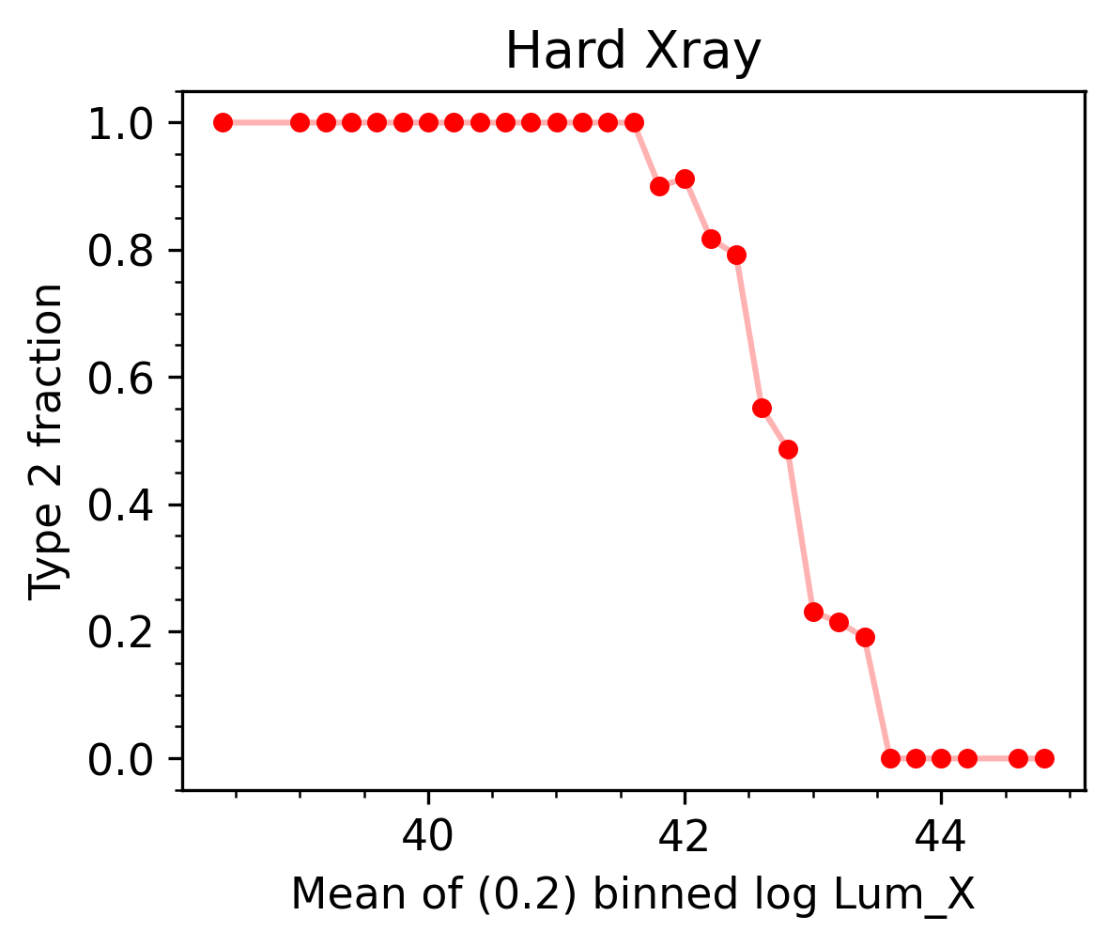
Opening angle vs luminosity
The torus has an opening angle
Thin torus = torus recedes = opening angle increases = which increases X-ray luminosity
As luminosity increases, type 2 fraction should reduce
Indicating that as BH accretes, opening angle widens, Broad line region starts appearing which reduces the fraction of Type 2 AGN

Slide 34
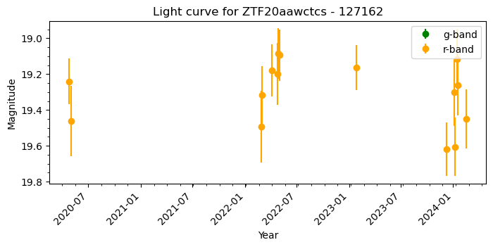
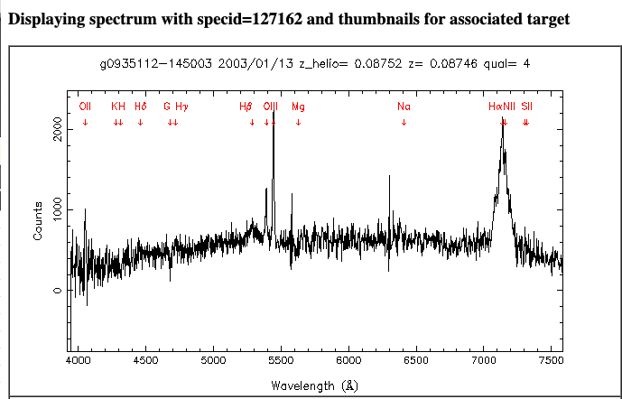
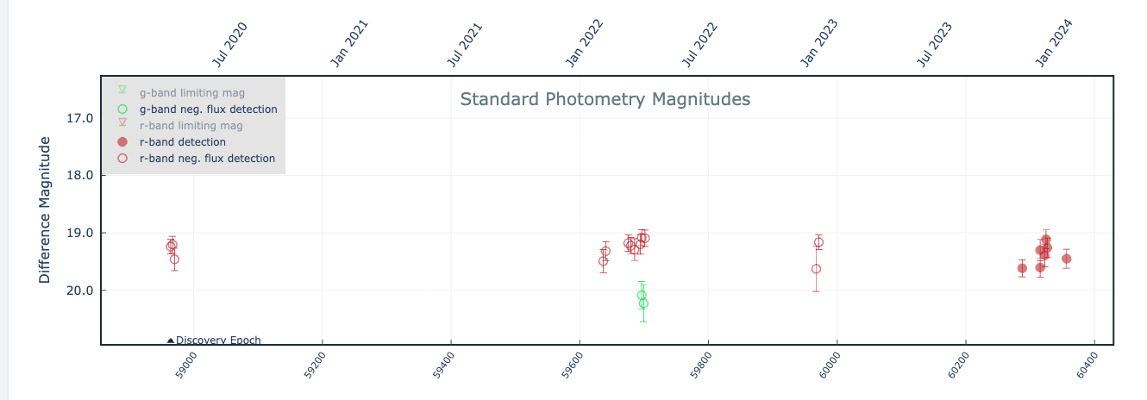
A possible Type 1 -> Type 2

Slide 35
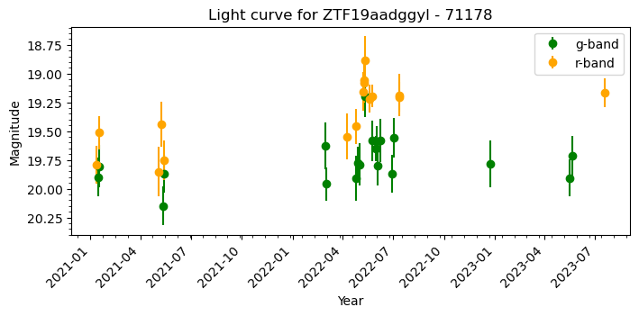
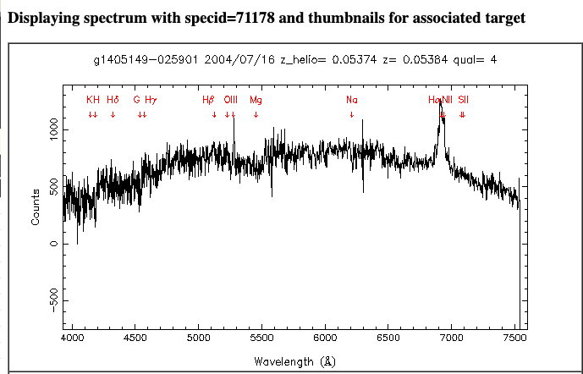
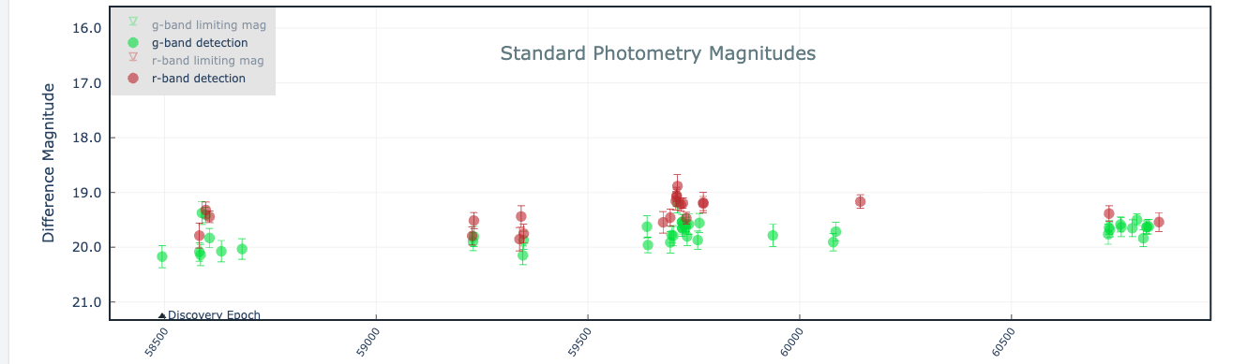
A possible Type 1 -> Type 2

