Slide 1
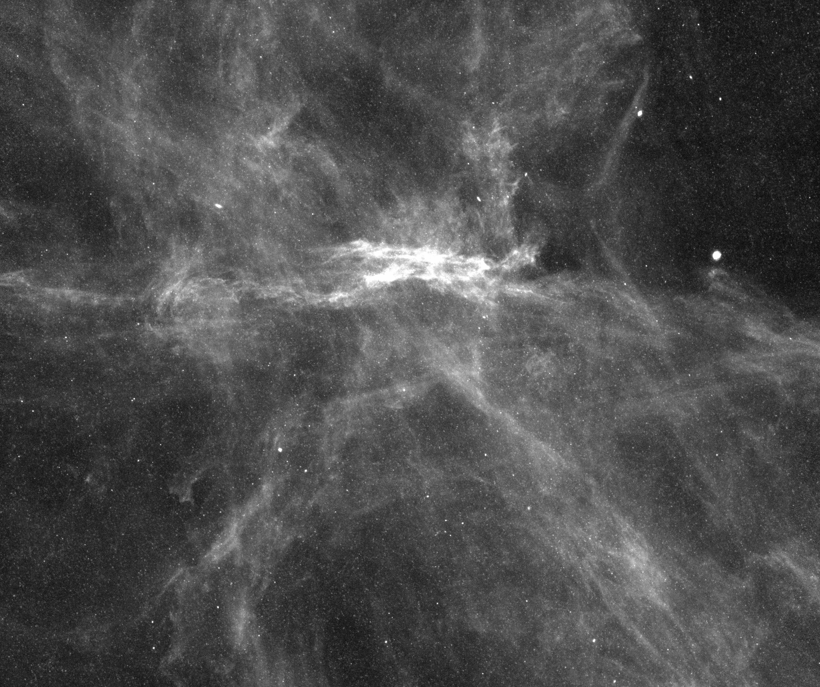



Finding kilonovae in LSST; Lessons learnt from blind optical KN searches
10/11/2025
Ozfink Workshop
Natasha Van Bemmel
PhD Candidate at Swinburne University of Technology, Australia
Supervisors: Jeff Cooke,
Anais Mӧller & Jielai Zhang

Slide 2
Fast transient:
Days – week in length in optical
Associated with gravitational waves and GRBs
Sites of r-process nucleosynthesis
Binary Neutron Star
Extreme physics of the Universe
Equation of state of dense matter
Potential origin of heavy elements in the Universe
Measure expansion rate of the Universe
Neutron Star-Black Hole
Notes:
Hypothesised for 50 years to be origin of r-process elements – to test this we need a large population of KNe, however…

Slide 3
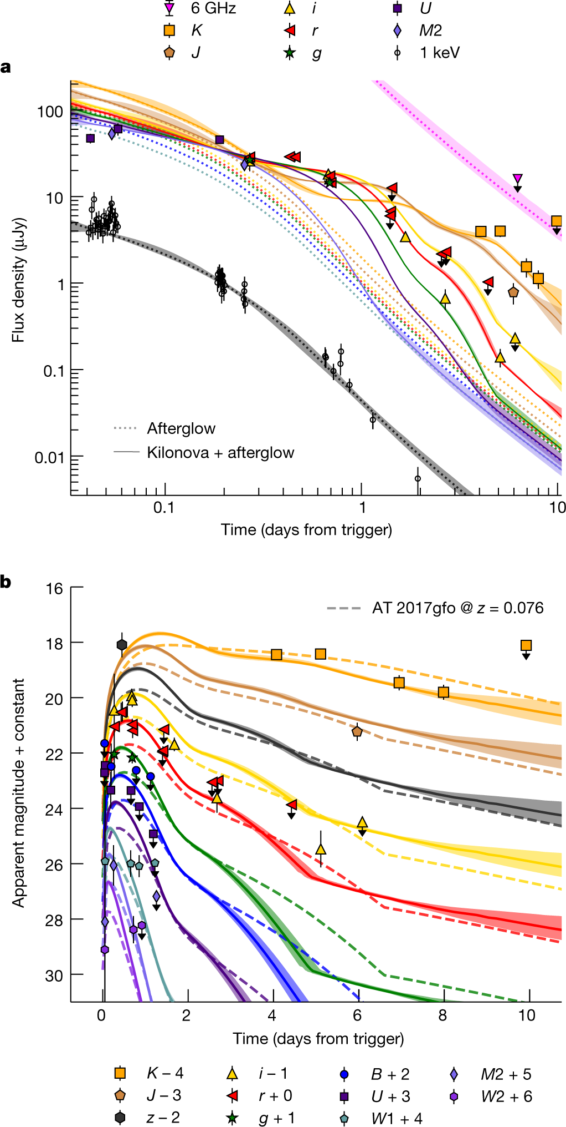
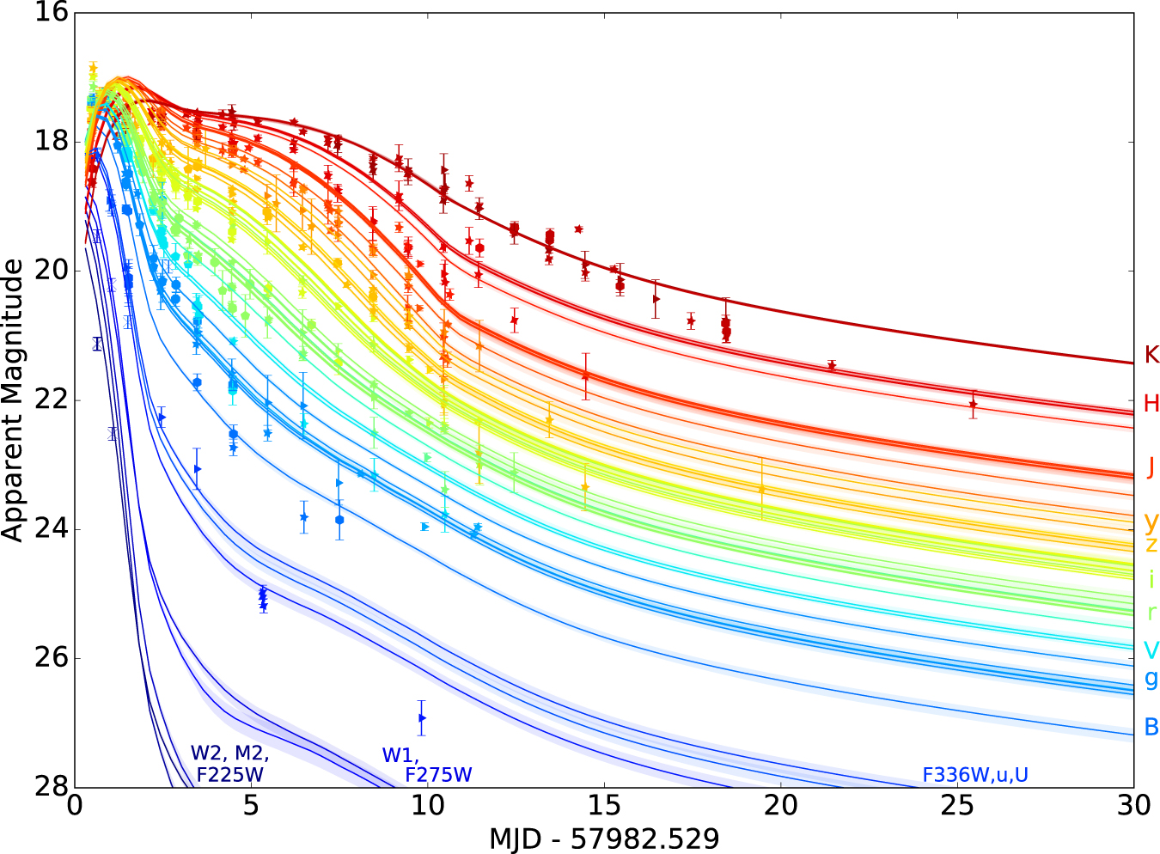
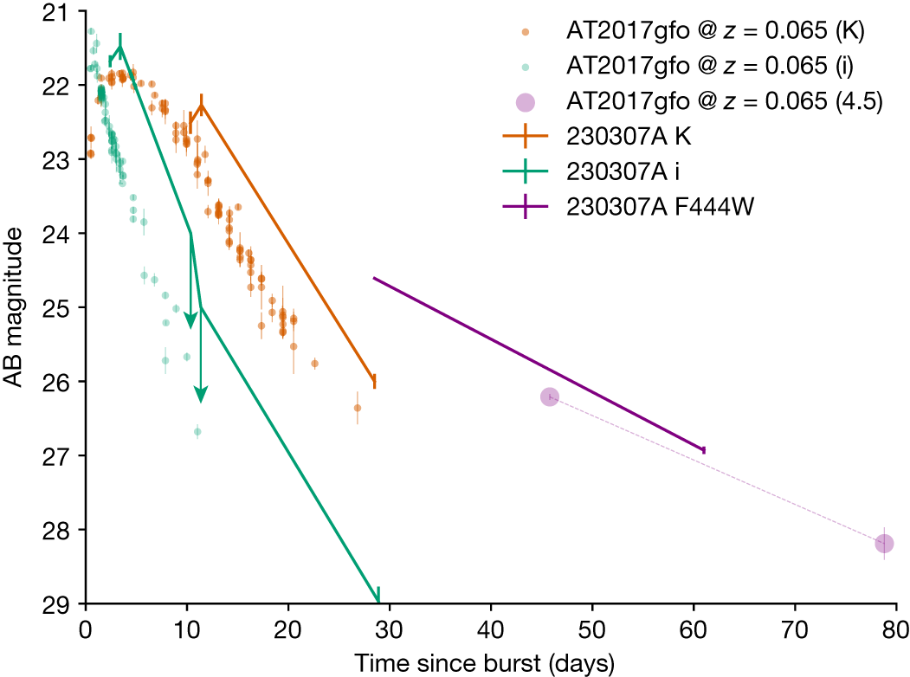
GW170817/ AT2017gfo
Rastinejad et al. (2022)
GRB211211A
GRB230307A
Villar et al. (2017)
Levan et al. (2024)
Notes:
No spectroscopic confirmation for GRB cands
Plus a handful of borderline KN candidates associated w/ GRBs in literature

Slide 4
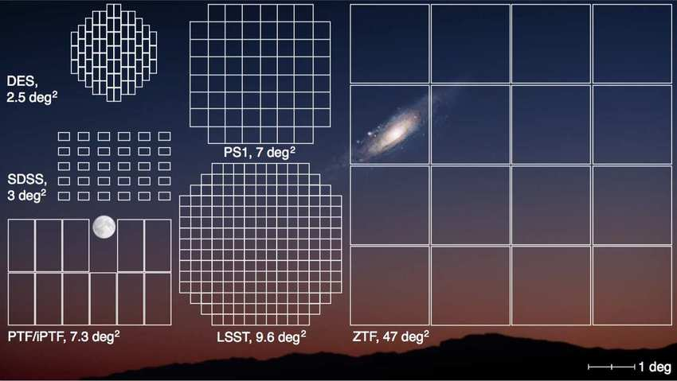
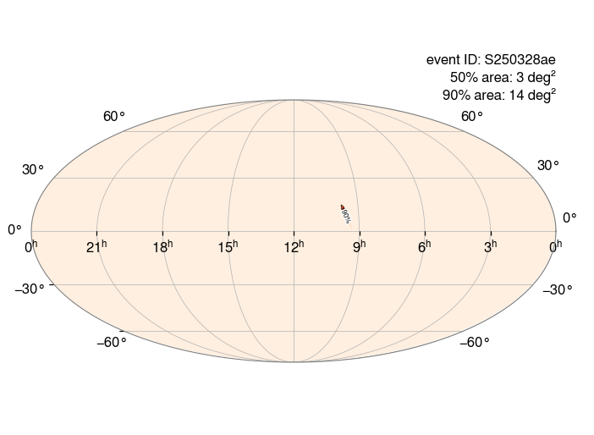
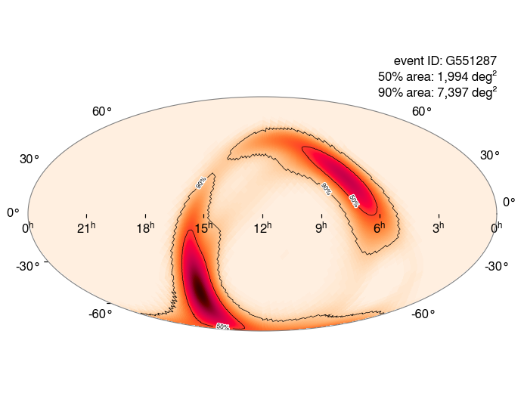
Laher, R. (2018)
Notes:
ZTF can only detect AT2017gfo-like sources up to ~200 Mpc (detect not identify – more like 130Mpc)
Sets up the value of untriggered optical searches

Slide 5
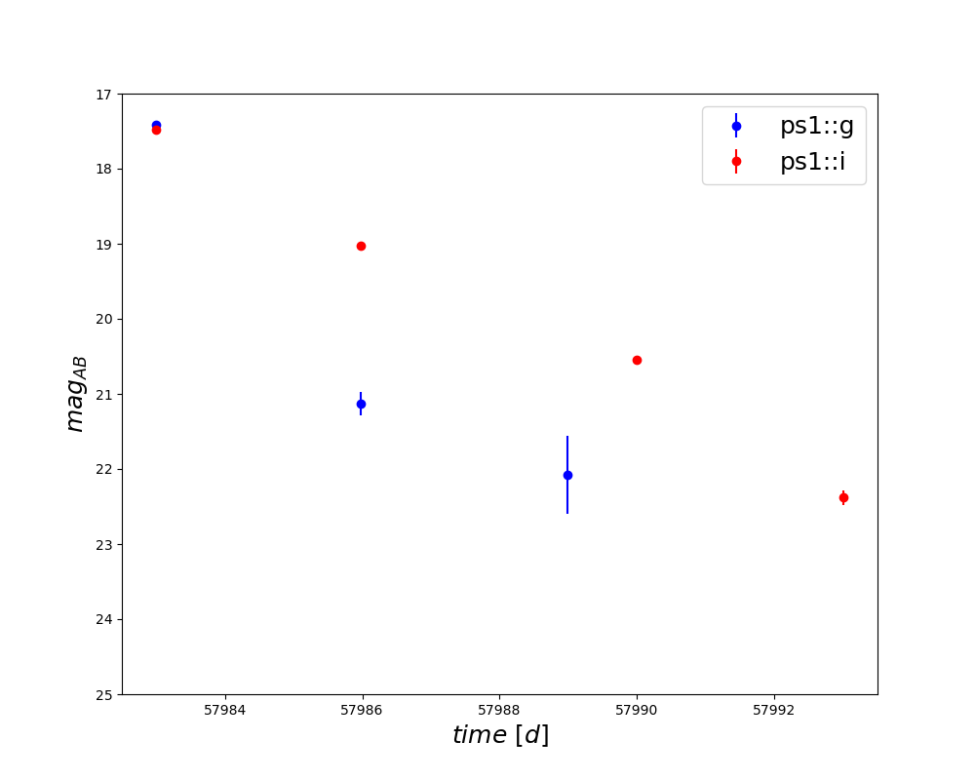
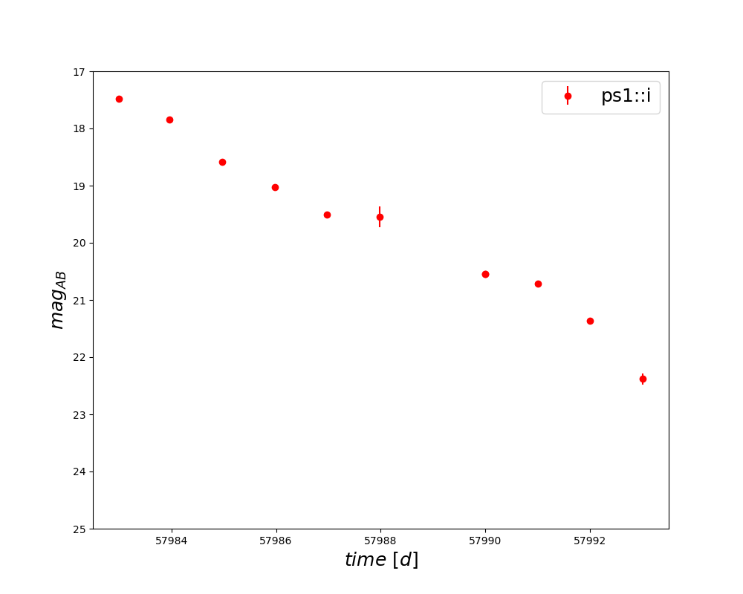
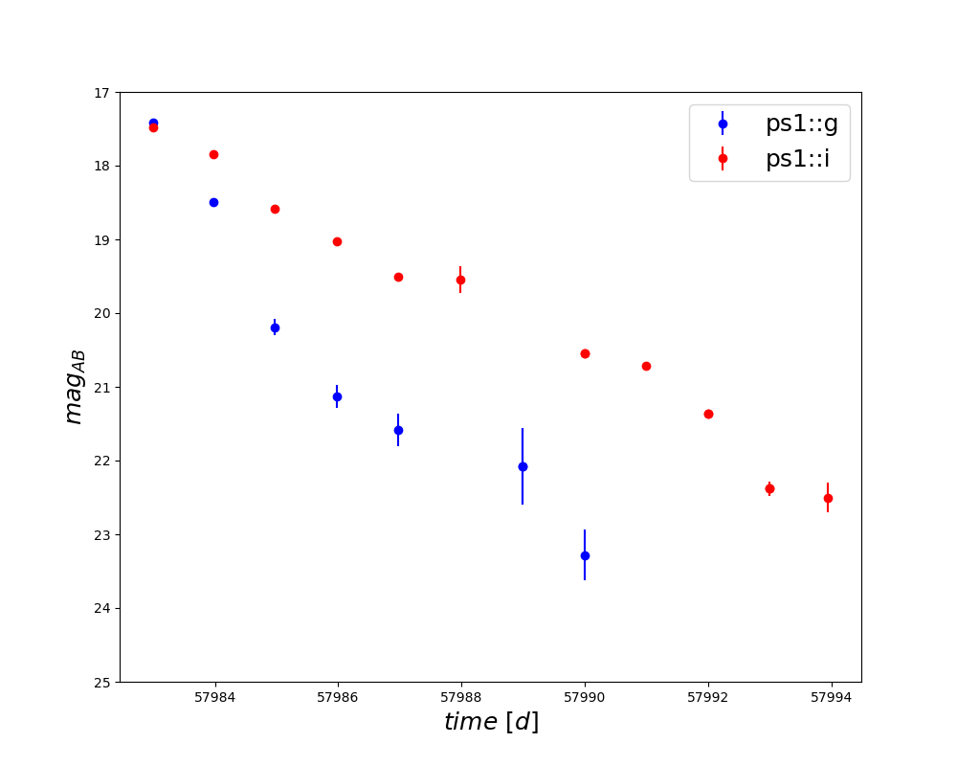
Nightly cadence
Multiple filters
Large cosmological volume
Deep
Large FOV
Long time
Fast processing pipeline for triggering follow-up
Villar et al. (2017)
Observations for above light curve obtained and provided by: Andreoni et al.(2017) ,Arcavi et al.(2017), Coulter et al.(2017), Cowperthwaite et al. (2017), Díaz et al.(2017), Drout et al.(2017), Evans et al.(2017), Hu et al.(2017), Kasliwal et al.(2017), Lipunov et al.(2017), Pian et al.(2017), Pozanenko et al. (2017), Shappee et al. (2017), Smartt et al. (2017), Tanvir et al. (2017), Troja et al. (2017), Utsumi et al. (2017), and Valenti et al. (2017b)
Notes:
Can mention current optical searches

Slide 6
The kilonova and transients program
k
N
TRA
P

Slide 7
k
N
TRA
P
(Van Bemmel & Zhang, 2025)

Slide 8
Uses the Dark Energy Camera (DECam)
Non-ToO, Untriggered search
31 fields per night, for 11 nights
Two optical bands: i (784 nm), g (473 nm)
m_{g} ~ 24.2 (140 seconds)
m_{i} ~ 23.7 (170 seconds)
Reach up to 1.1 Gpc (z = ~0.3) for AT2017gfo-like events
(for ref: current GW range is ~0.16 Gpc)
With a detection limit of 24 mag, KN rate of 250 Gpc⁻³ yr⁻¹ [1],
1 KNTraP run is expected to detect > 0.20 KN
Therefore, on average 5 KNTraP runs are expected to find ≥ l KN
With a detection limit of 24 mag, KN rate of 320 Gpc⁻³ yr⁻¹ [1],
1 KNTraP run is expected to detect > 0.30 KN
Therefore, on average 3 KNTraP runs are expected to find ≥ l KN
[1] Abbott et al. (2021)
[1] LIGO/Virgo/KAGRA Collaborations et al. (2025)
Notes:
At the time of survey design, this was the BNS rate

Slide 9
KNTraP can act as a precursor to LSST
m_{i, g} ~ 24.5 | Depth | m_{i} ~ 24, m_{g} ~ 25
4 m | Telescope size | 8.4 m
3 deg² | Field of view | 9.6 deg²
i, g | Filters | u, g, r, i, z, y
1 day | Cadence | 2 – 4 days
Deep Drilling Fields
Higher cadence (“nearly daily”)
Target 5 fields (7% of survey)
1 mag deeper (stacked)
Notes:
KN light curves will appear like the one shown previously (next talk will probably show simulations with KN models)

Slide 10
Crossmatches removed
CCD edge proximity cut
Initial
≥ 3 detections
First night removed
327,400
312,349
63,299
62,826
61,932
Data quality cuts
Remove known variables
Using Gaia DR3, Legacy Survey DR9, Million Quasars (Milliquas), and SIMBAD
Minimum number of detections
Not present in first night’s data
Not located on the edge of a CCD
Notes:
When Rubin comes online, Fink will help to filter candidates
Can apply custom filters for KNe (see Anais paper)
This is what we used for KNTraP…

Slide 11
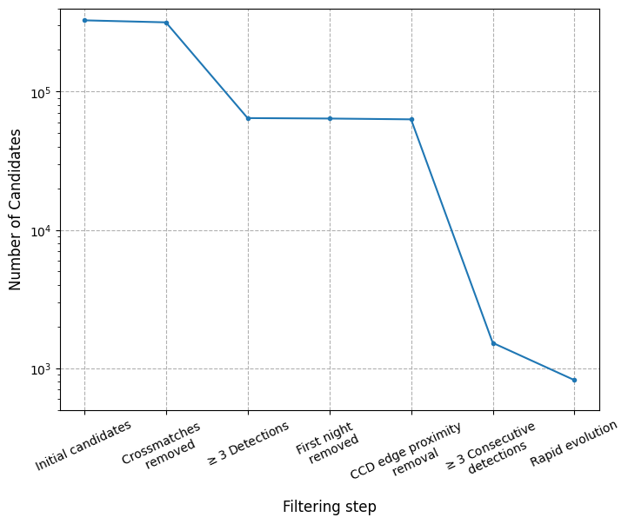
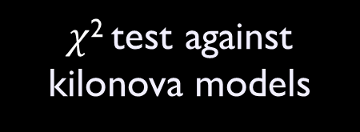
≥ 3 consecutive detections
Data quality cuts
$χ$² test against kilonova models
61,932
1434
Rapid evolution
776
Science cuts
Consecutive “good” detections
AT2017gfo-like candidates
Rapid evolution candidates
Notes:
Some of these will not work well for Rubin – consecutive cuts, >3 detections
Which is not ideal, as these are some of our most effective cuts

Slide 12
Interesting candidates

Slide 13
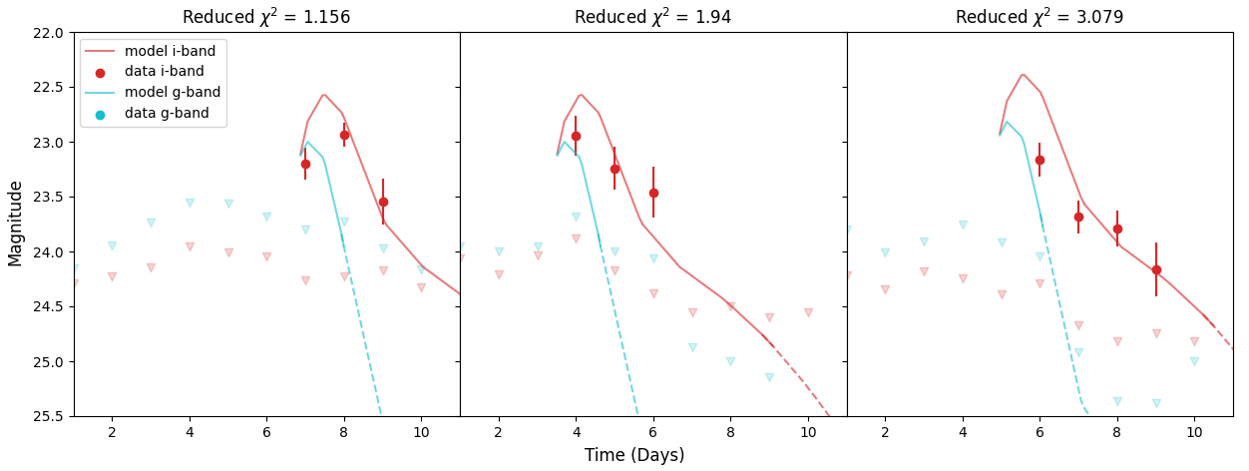
Notes:
Most of the bad subtractions/artefacts were removed through DQ cuts, however some made it through
These require by-eye checking

Slide 14
Initial 776
Artefacts 6%
Bad subtractions 52%
“Steady” sources 14%
Variable 27%
Fast fading ~1% (11 objects)
Notes:
Looks like a high percentage of bad subs/artefacts, though without SE cuts it would be ~XXX % (rough calculation)
Some stellar sources were not removed, because they were not in the catalogs, likely because we were looking deeper
(can test by doing a plot of mag distribution, xmatched vs not)

Slide 15
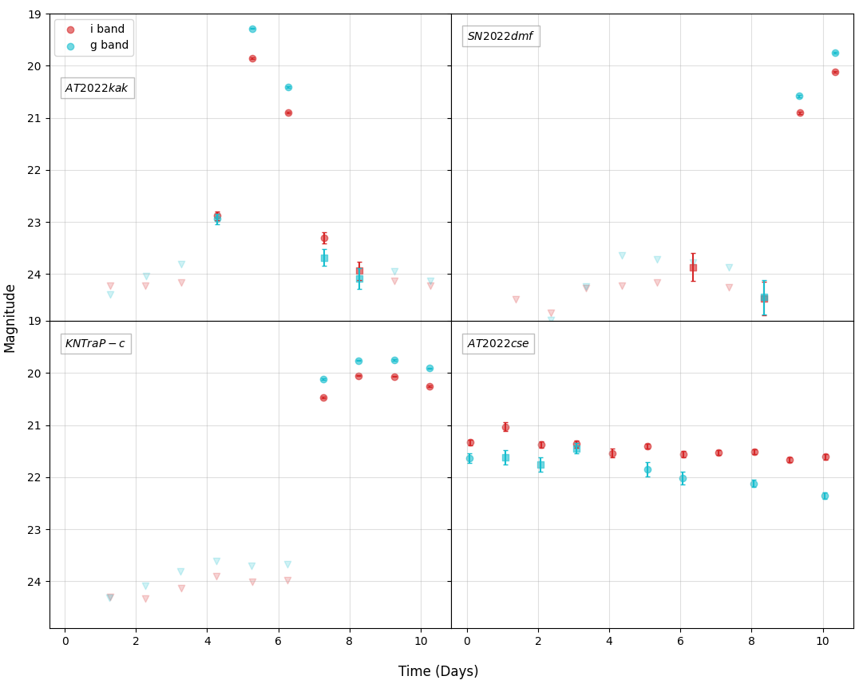
???
Early (and faint) type Ia supernovae
???
Likely supernovae candidate

Slide 16
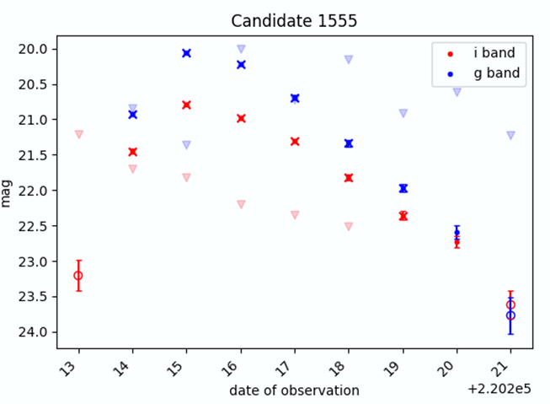
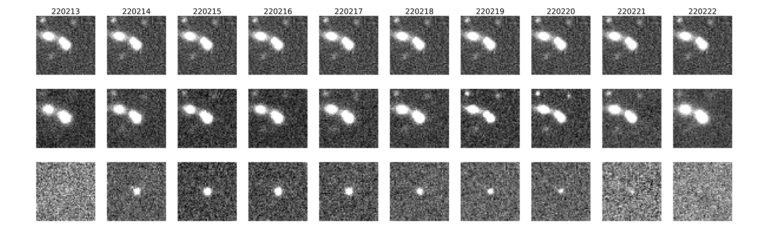
Template
Science
Difference
Notes:
Better automated filtering on crossmatching could remove this

Slide 17
KNe will be discoverable BUT hard to identify and follow-up in LSST (WFD)
Will find many contaminants
Catalogs (e.g. KS4) can help with crossmatching known objects and variables
Deep Drilling Fields potentially more helpful
Only 5 target fields, but deep with wide FOV
≥ time compared to KNTraP to find KNe
31 fields w/ 3 deg² vs 5 fields w/ ~10 deg² each observing night
(~100 deg²) (~ 50 deg²)
More KNTraP style runs to complement Rubin KN searches
Especially as O4 ending soon, and O5 beginning in 2028

Slide 18
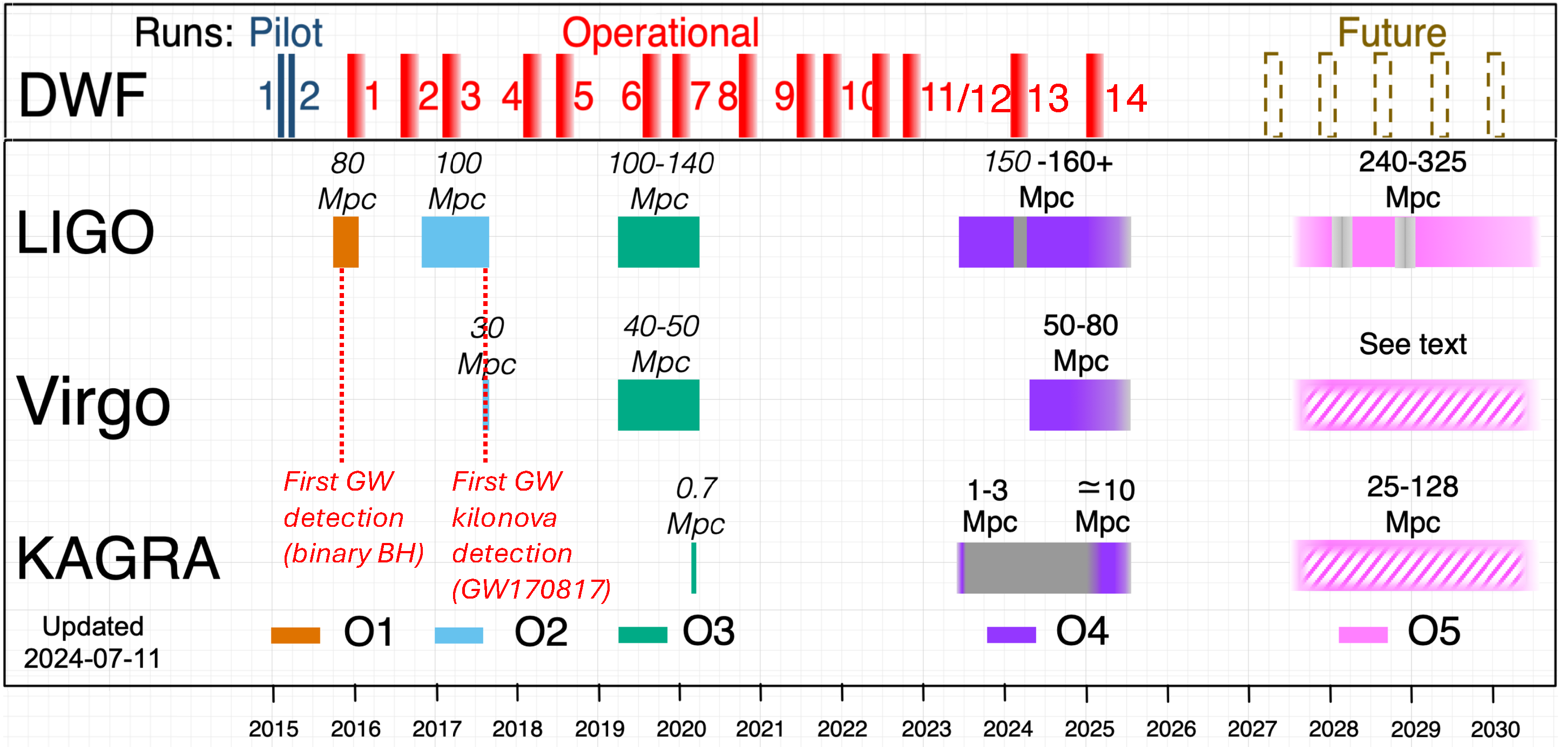
Credit: J. Cooke
Notes:
- Back in the day O1 and O2, DWF was the only multi-wavelength before GW170817

Slide 19
ADDITIONAL SLIDES

Slide 20
Classically, we discover kilonovae through GW and GRB follow-up
BUT
There is another approach…
Advantages of
Search beyond the GW range (In O4, BNS range is ~0.16 Gpc) [1]
Not limited by GW localization area
Not inclination angle dependent
Catch early evolution
Not restricted by Sun/ Earth being in the way
Non-disruptive
Efficient use of telescope time
Search while GW detectors are offline
an optically-led search
[1] Capote et al. (2024)
Notes:
In O4, BNS range is ~0.16 Gpc,

Slide 21
Transient Survey | Depth | Field of View (deg²) | Telescope Size (m)
Catalina | ~17-21 (V) | 8 | 0.5, 0.7, 1.5
SkyMapper | ~20.5 (g) | 5.7 | 1.35
ZTF | ~20.5 (i) | 47 | 1.2
ASAS-SN | ~17 (V) | 4.5 | 0.14
GOTO | ~19.5 (L) | ~40 (GOTO-8) | 0.4
ATLAS | ~19 (o) | 28.9 | 0.5
YSE | ~21.5 (gri) | 7 | 1.8

Slide 22
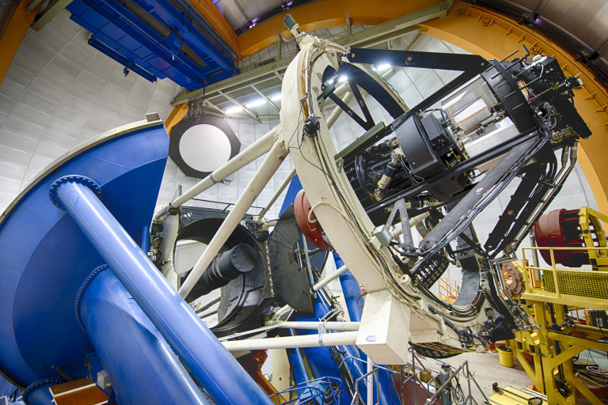
Uses the Dark Energy Camera (DECam)
CTIO Blanco 4m telescope
3 degree² FOV
Fast readout time ~20 secs
Fast filter exchange
High sensitivity (1.0 arcsec seeing)
Reidar Hahn, Fermilab

Slide 23
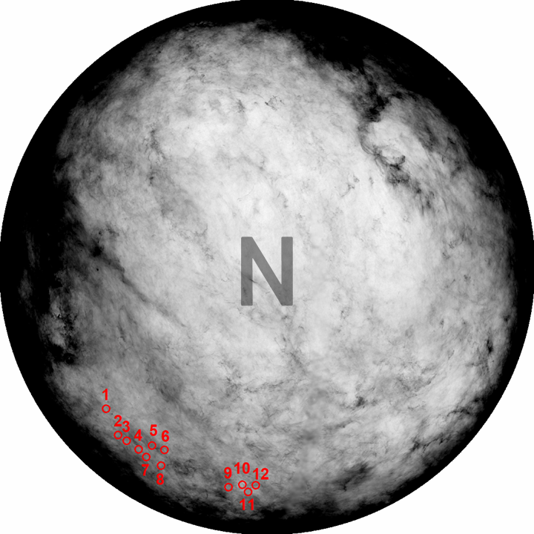
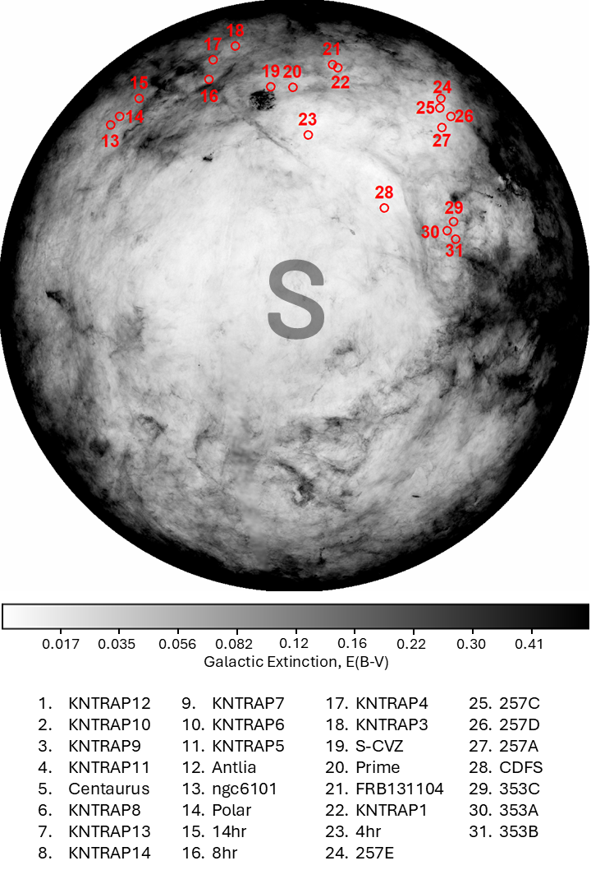
Extinction < 0.1
Known fields
High galactic density
Template images
Equatorial for follow-up
Avoids moon and bright stars
Notes:
E(B-V) < 0.1
Known fields with high galactic density
Existing fields for template images
~Equatorial to maximise facilities able to follow-up
Used under-utilised bright time, moon was up, so had to be >30 deg away from moon + away from bright stars

Slide 24
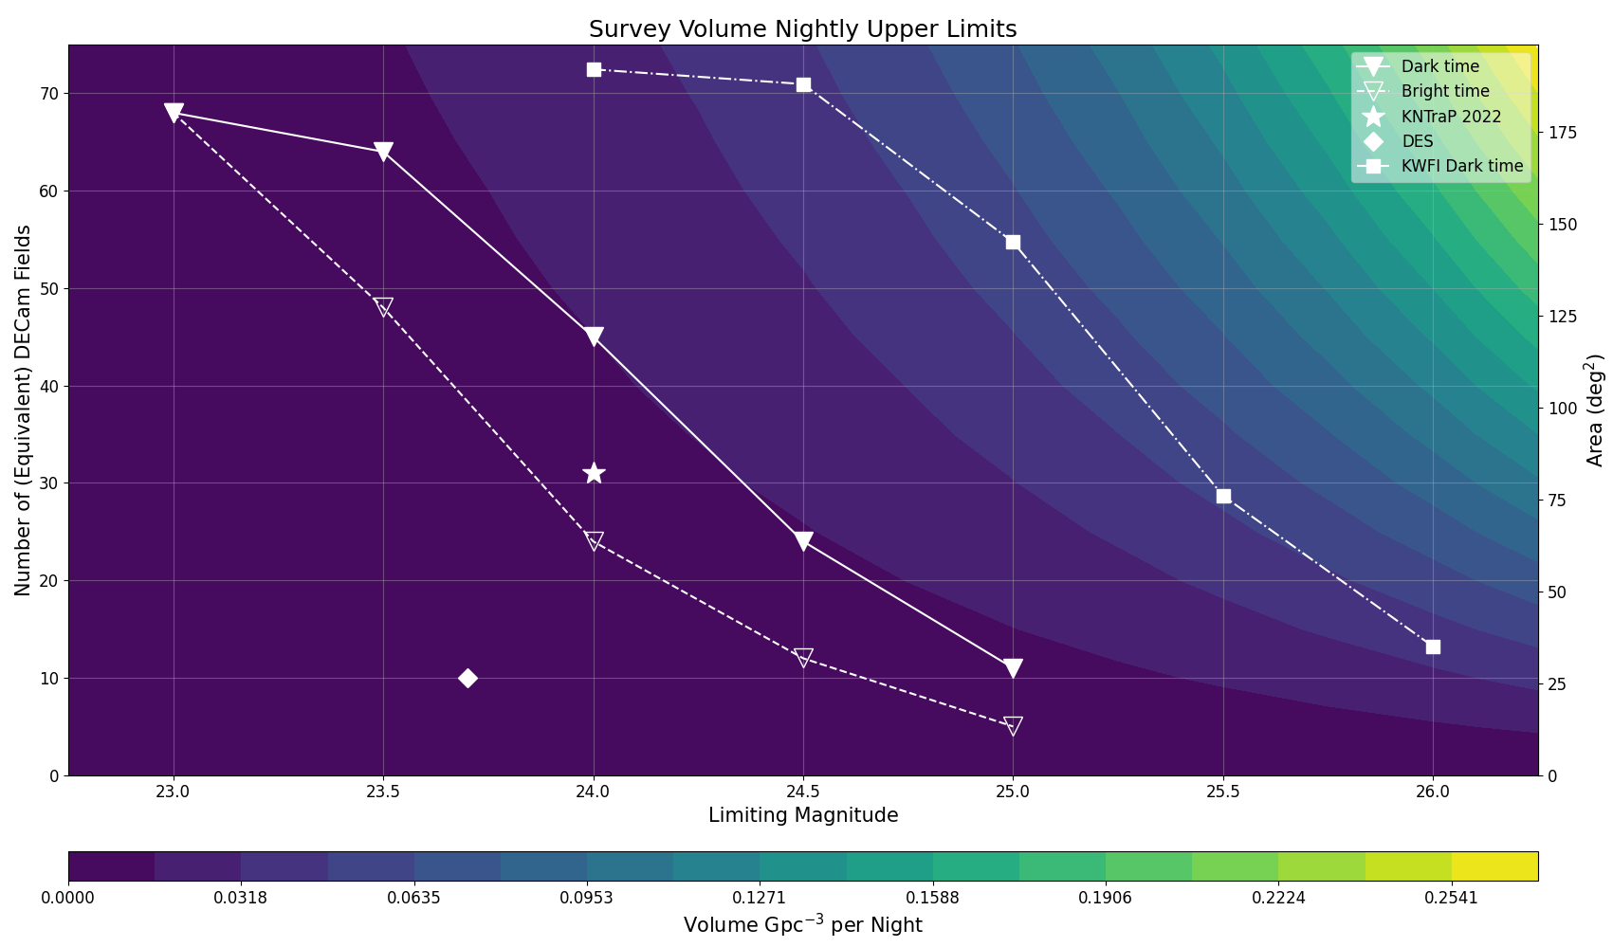
VOLUME
Notes:
Trade off between depth and area is not immediately obvious

Slide 25
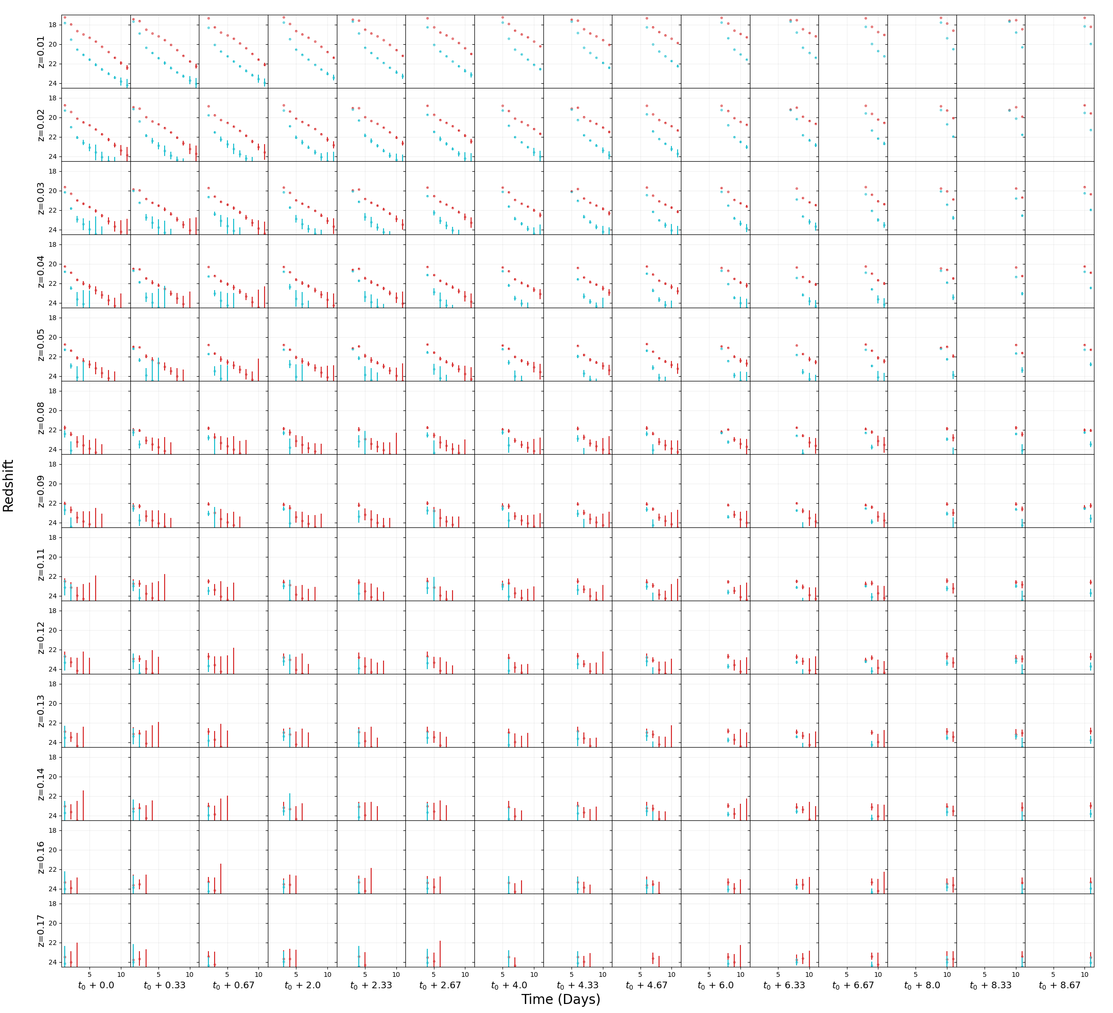
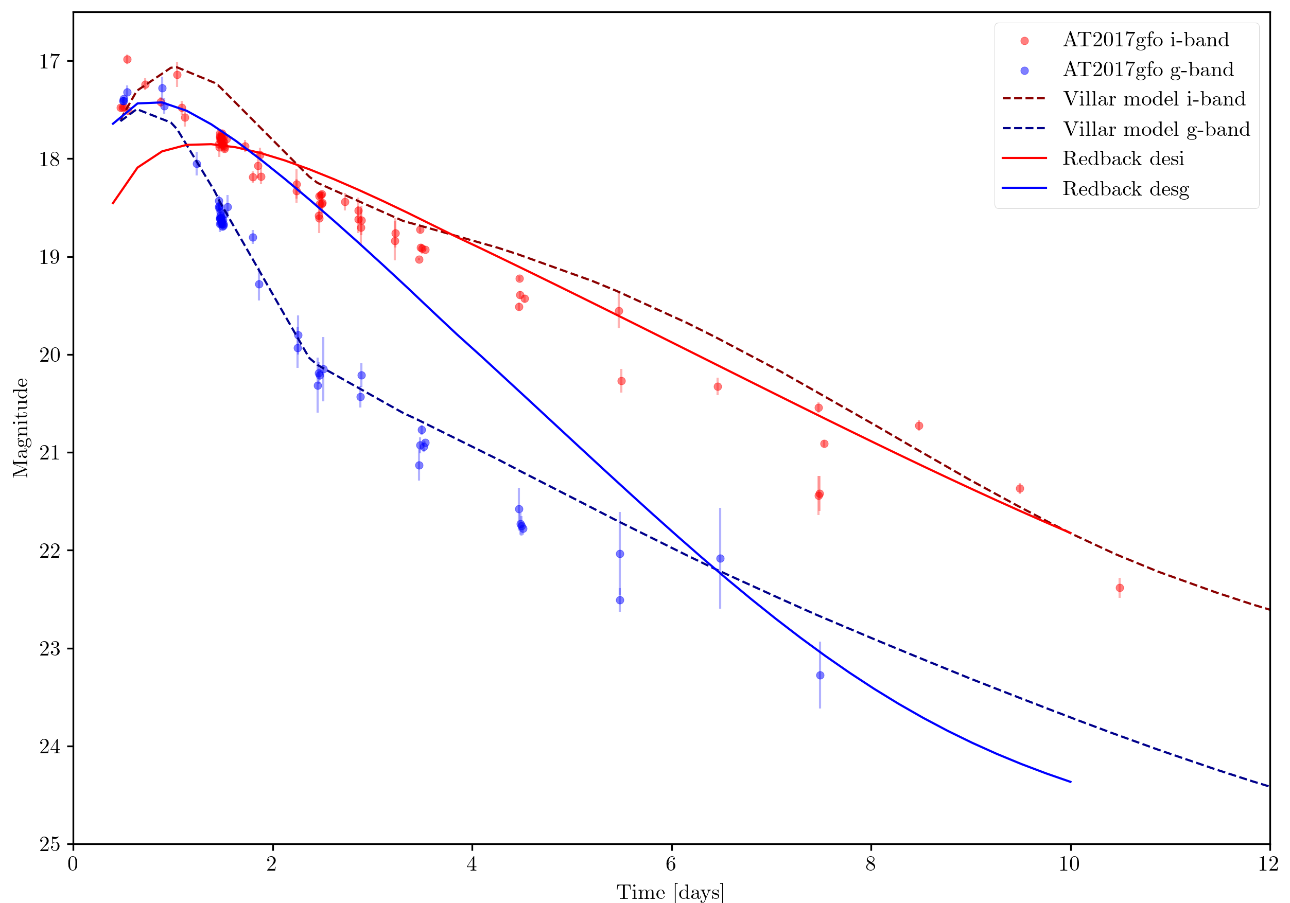
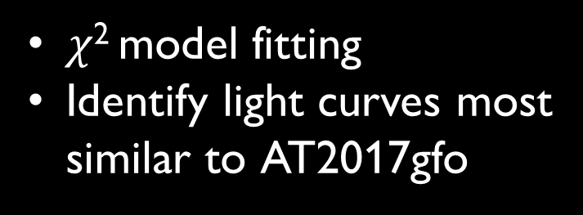
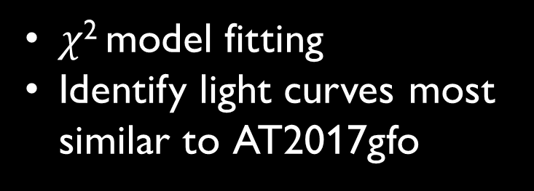
18
20
22
24
$χ$² model fitting
Identify light curves most similar to AT2017gfo
0 2 4 6 8 10
Notes:
Tried 2 different modelling software, 1 was not converging to LC fits, 2 did not recreate gfo
Then decided to do DIY

Slide 26
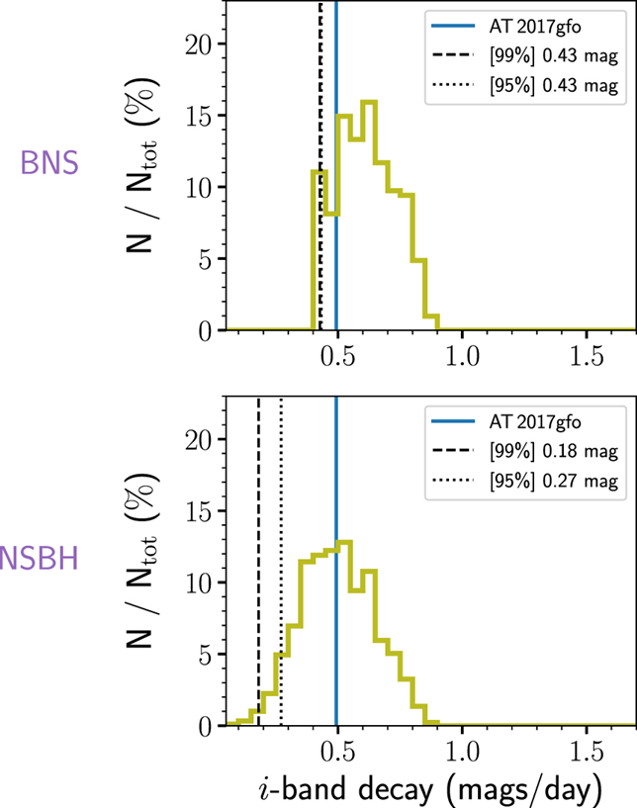
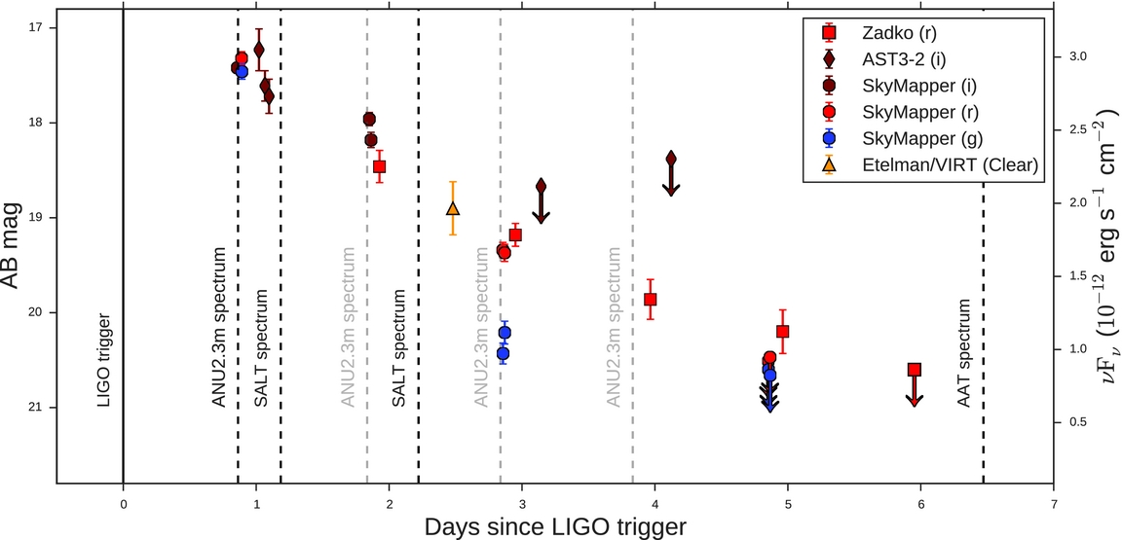
Star-like/ “good”
New event?
Rapid (KN-like) evolution
Consecutive detections
KN simulations
AT2017gfo data
BNS
NSBH
Andreoni et al. (2017)
Rise > 1 mag day⁻¹
Fade > 0.3 mag day⁻¹
Andreoni et al. (2020)

Slide 27
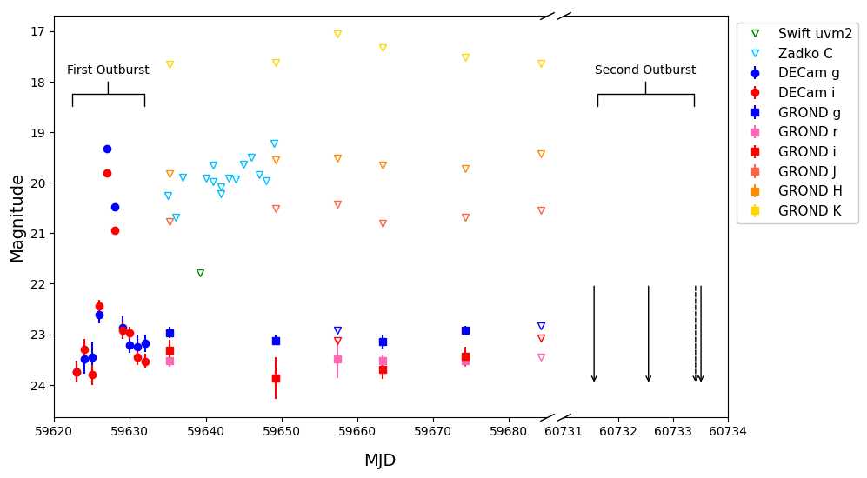
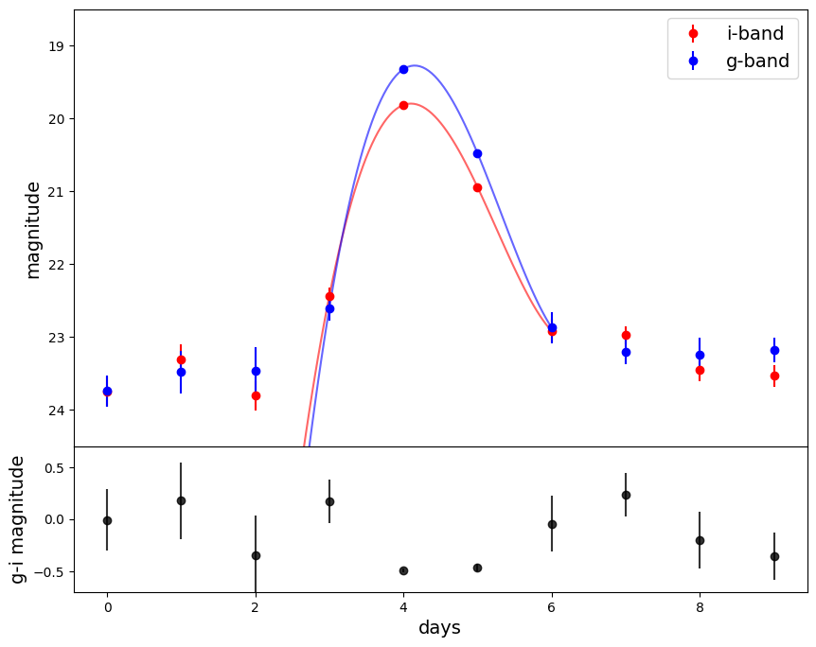
Van Bemmel et al. (submitted 2025)

Slide 28
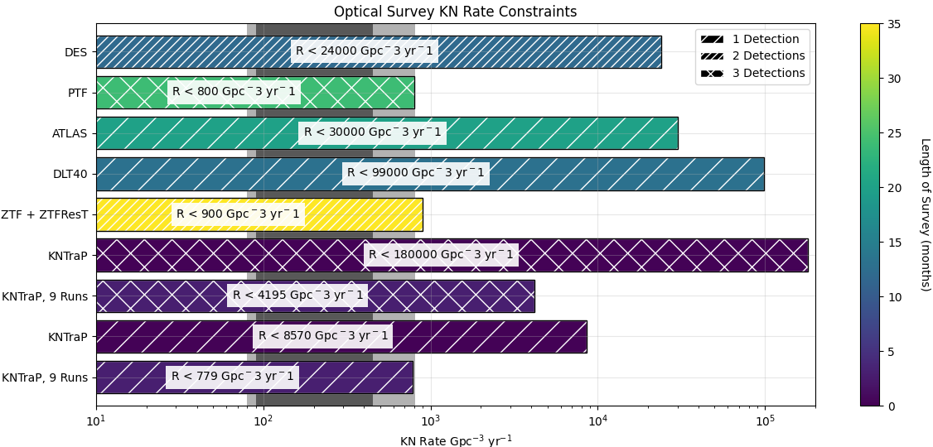
Other optical
surveys
KNTraP
LVK O3
LVK O4

