Slide 1
News, group meeting ‘Particles’
R&D for future collider news:
Scientific Council internal to the lab, on our R&D for future colliders was held on Sept 16th
Entretiens Annuels Projets (EAP) : T-MRPC on October 16th, GRAM on Nov 4th, FCC in November (date TBD).
CMS news:
EAP CMS : October 16th
Budget: Subvention 2nd semester arrived, 14 k€ for CMSPH.
IP2I pledges on CMS central shifts. Pledged/expected = 0,94. Thanks to all the shifters, almost there!
Workshop CMS France in March 2026 to be held in Lyon (date TBD)
Other IN2P3/UCBL/lab news:
HCERES visit foreseen January 21-23. President of the committee Yorik Blumenfeld.
No administrative responsible before January
Start of Anthony Laravine et Jerôme Magnin at the financial service.
3 new professor positions in 2026 (following retirement of P. Nedelec, F. Gieres, S. Gascon): one for each of the 3 poles: infinitely small, infinitely large, theory. Suzanne emerita starting mid-2026.
Today’s talk at Particle group meeting: Guillaume Garillot (PICMIC)

Slide 2
Upcoming (known) events and deadlines
❑ Sept 29-Oct 3: CMS week, CERN
❑ Oct 9: AG IP2I
❑ Oct 20-24: DRD1 Collaboration meeting, Warsaw (Poland)
❑ Oct 10: IP2I séminaire Marianne Van Panhuys, LHC epistemology
❑ Oct 13-17: CMS DAS school, DESY
❑ Oct 15: PhD defense Mattia Verzerolli
❑ Oct 16: Entretien Annuel Projet: CMS au CC-IN2P3, T-MRPC par zoom
❑ Oct 20-24: LCWS 2025, Valencia (Spain)
❑ Oct 24: PhD defense David Amram
❑ Nov 3-7: CMS Tracker week, CERN
❑ Nov 4: Entretien Annuel Projet: GRAM par zoom?
❑ Nov 4: PhD defense Elise Jourd’huy
❑ Nov 12-14: FCC France, Strasbourg
❑ Nov 13: HDR Gaelle Boudoul
❑ Nov 17-21: Ecole de GIF on future colliders, Strasbourg
❑ Nov 24 – Nov 26: IRN Terascale, Montpellier
❑ Nov 30 – Dec 6: JRJC, Côtes d’Armor
❑ Dec 4: PhD defense Ji-Eun Choi, Seoul (Korea)
❑ Dec 8-12: CMS week, Seoul (Korea)
+ Colloquium on the history of particle physics by Gautier Hamel de Monchenault expected in Fall

Slide 3
News on our activities (tour de table)

Slide 4
Back-up slides

Slide 5
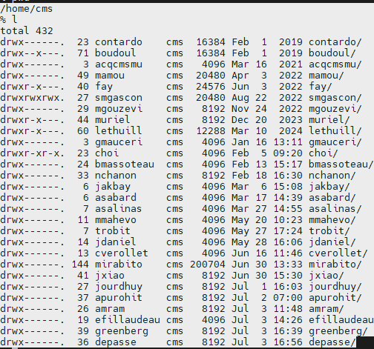
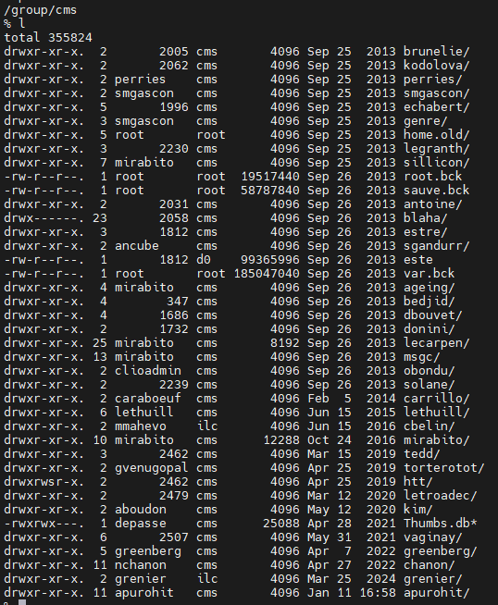
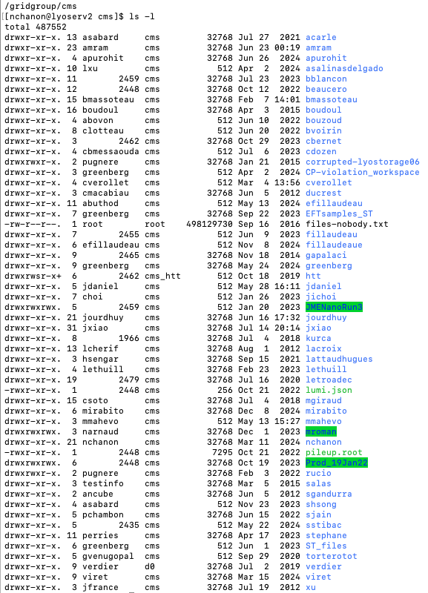
CMS IP2I Data cleaning

Slide 6
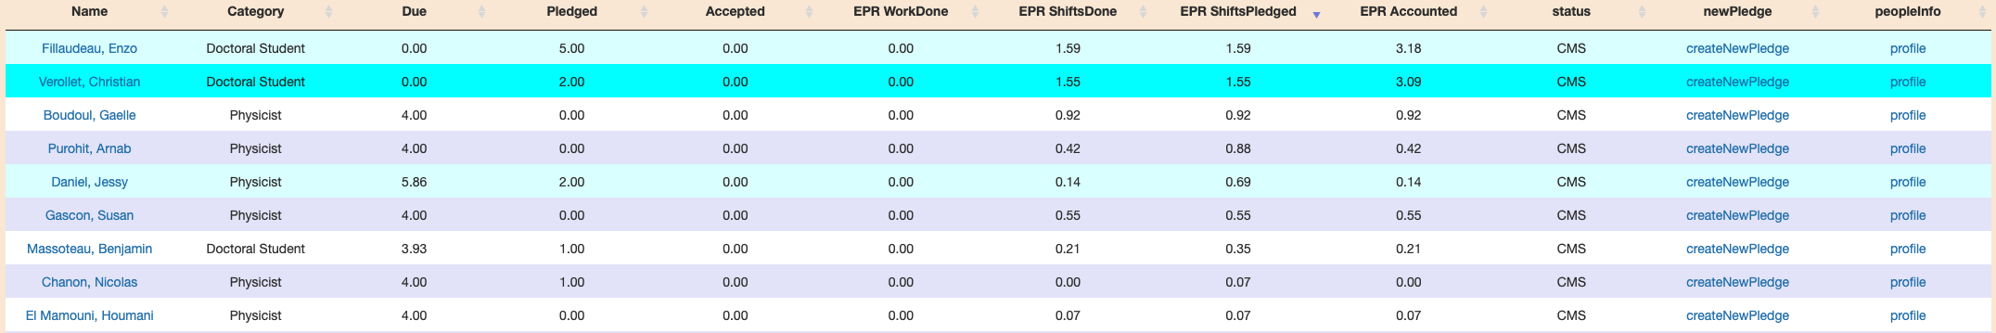
CMS Shifts

Slide 7
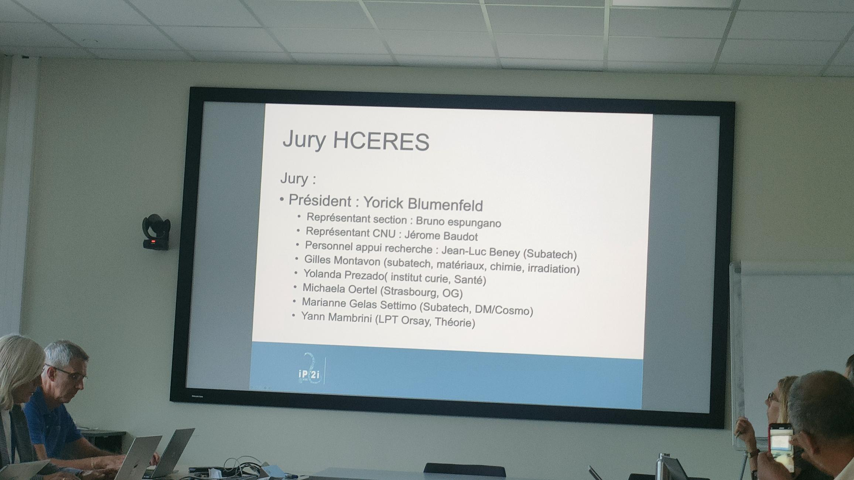
HCERES

