Slide 1




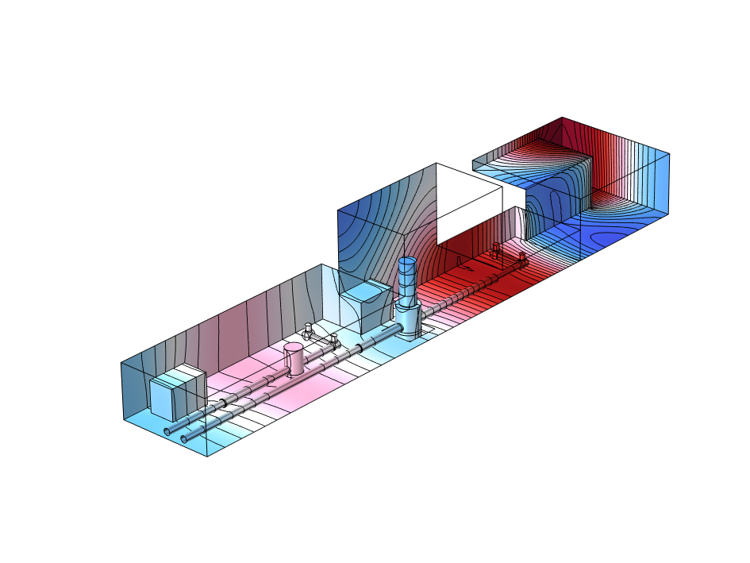
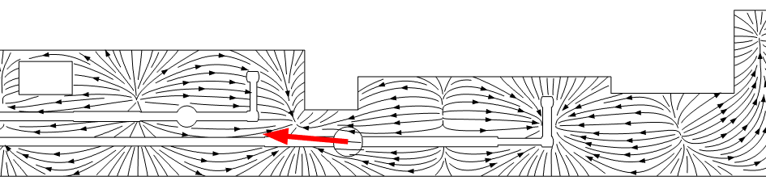
Modelisation of Acoustic Newtonian noise in Einstein Telescope caverns :
Application to the design of HVAC systems
L. Maurin (PhD), S. Terrien, F. Gautier
M. Barsuglia
Réunion ET France 2025
7-8 oct. 2025, IN2P3, Lyon

Slide 2
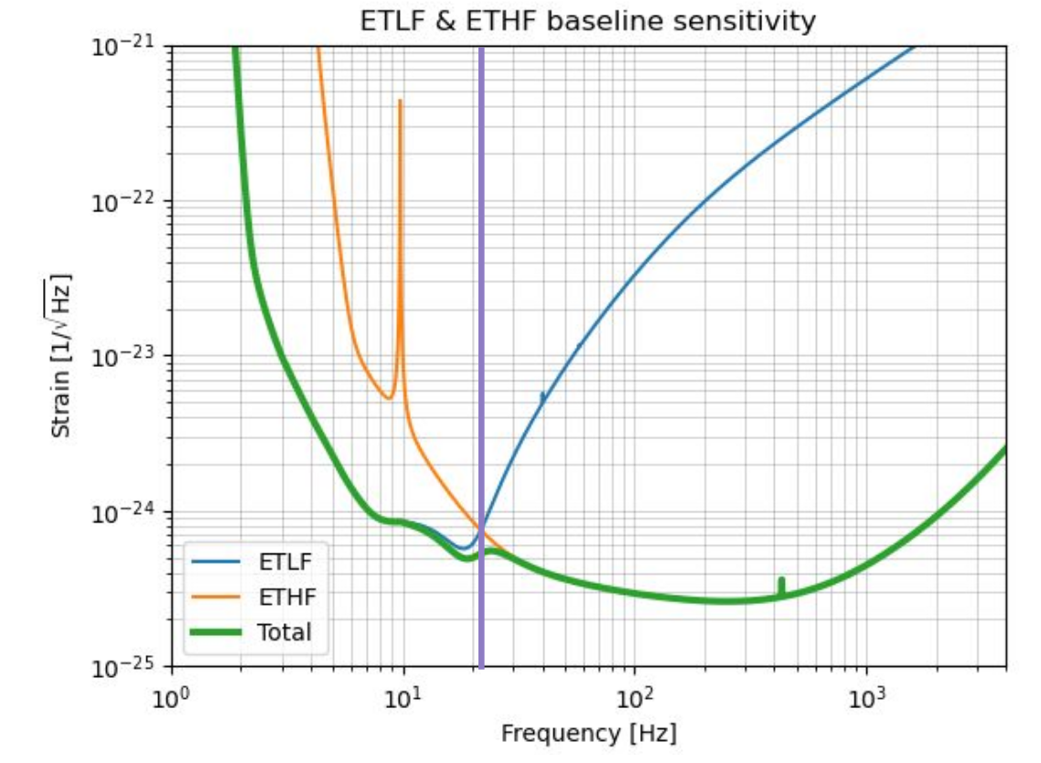
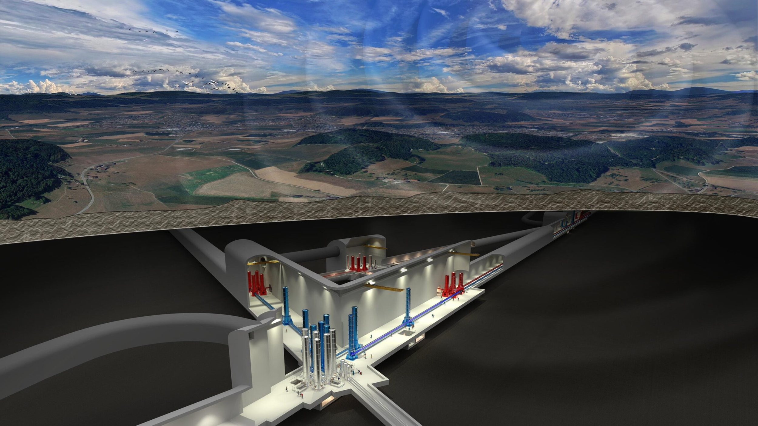
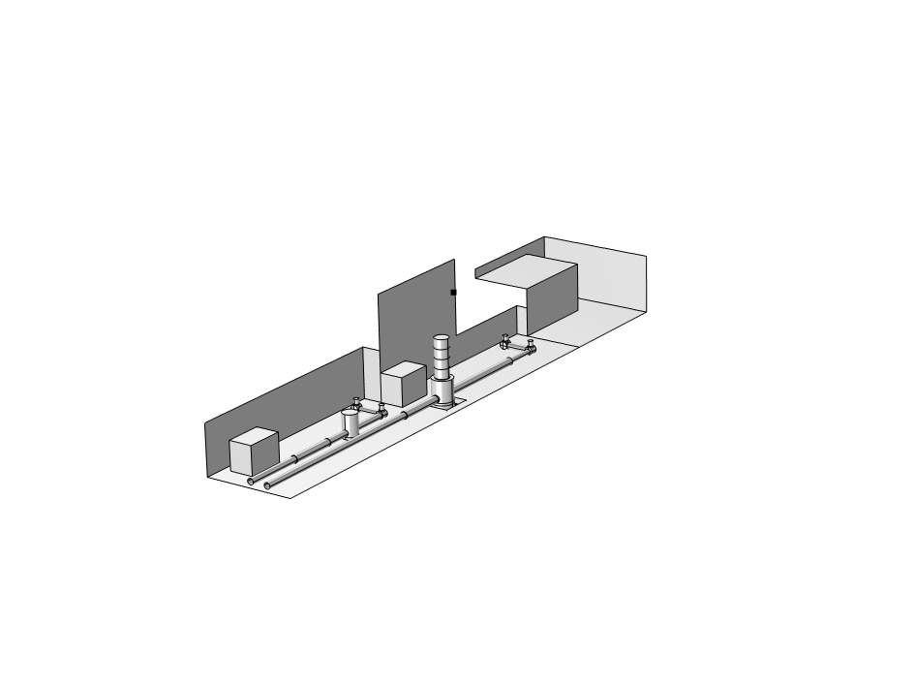
Einstein Telescope (ET) - layout and sensitivity
Artist view of ET – Triangle configuration
Credits : M. Kraan
ETLF and ET HF baseline sensitivity
Order of magnitude : 10⁻²⁴@10Hz
Geometry of an end cavern
ET design sensitivity

Slide 3
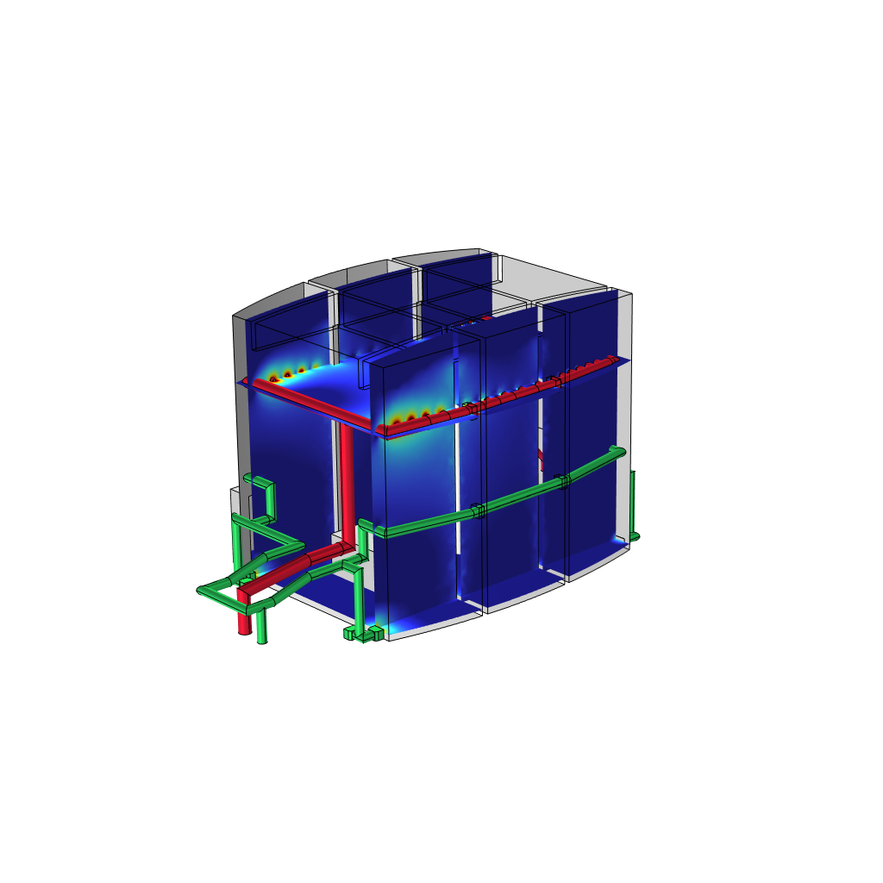
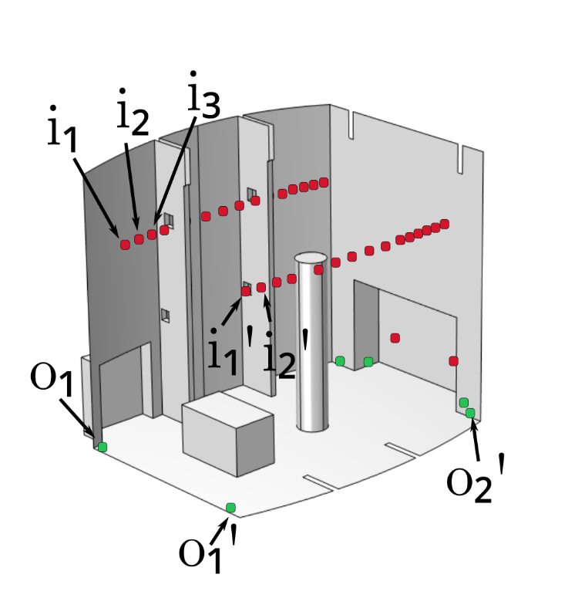
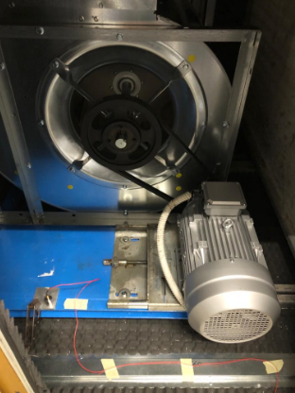
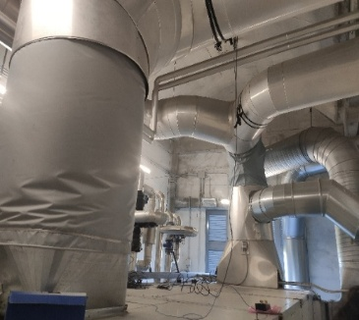
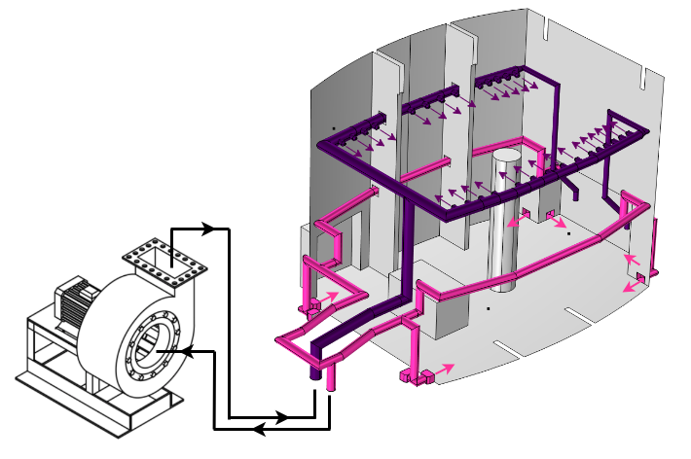
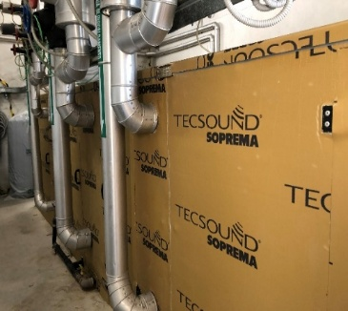
Acoustic Noise in GW detector : what do we learn from Virgo ?
The main acoustic source in the experimental halls comes from the Air Conditioning system
Virgo’s current air handling unit
Pressure field
Inlets/outlets

Slide 4
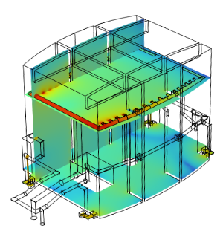
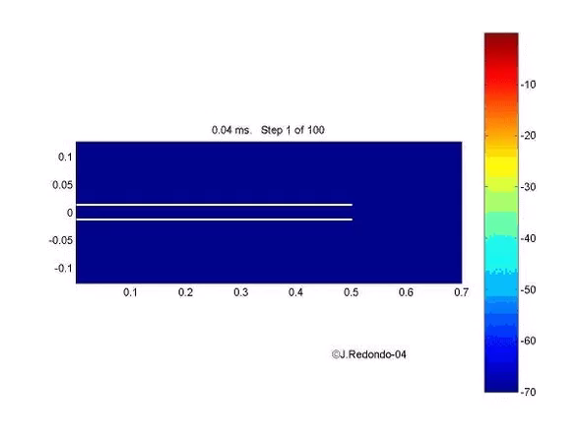
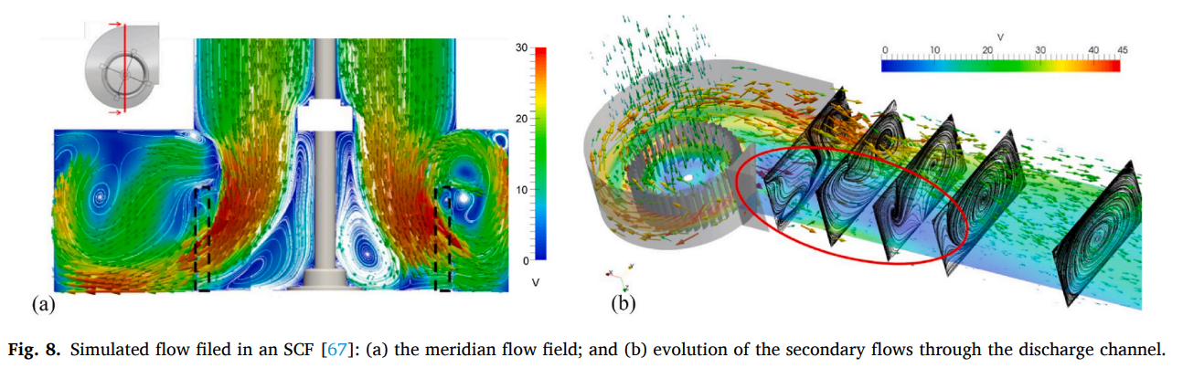
Sound generation in the experimental halls
HVAC system
heating ventilation and air conditioning
airborne source
responsible for acoustic noise
structure borne source
responsible for ground/walls vibrations
Air flow
Local turbulence
Generation of acoustic
disturbances (pressure pulsations)
Acoustic radiation by inlets/outlets
Equivalent monopolar source
Horn geometry
HEPA filter
Simulation of acoustic field
Clear modal behaviour below 30Hz
Positions of inlets/outlets are key factors
inlets
outlets

Slide 5





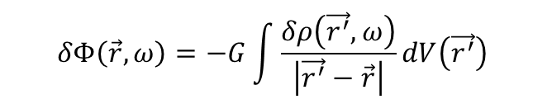
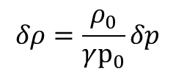

Newtonian noise from acoustic origin – methodology for the modelling
Acoustic pressure ~ density fluctuations
Potential and gravity field
$$δρ=\frac{ρ_{0}}{γp_{0}}δp$$
$$δΦ\left(\vec{r},ω\right)=−G\int{\frac{δρ\left(\vec{r^{′}},ω\right)}{\left|\vec{r^{′}}−\vec{r}\right|}dV\left(\vec{r^{′}}\right)}$$
$$\vec{g}\left(\vec{r},ω\right)=−\vec{∇}Φ(\vec{r},ω)$$
Modal expansion of the pressure field
Expansion of the gravity field = newtonian noise
amplitude
Acoustic mode
amplitude
Functional basis

Slide 6
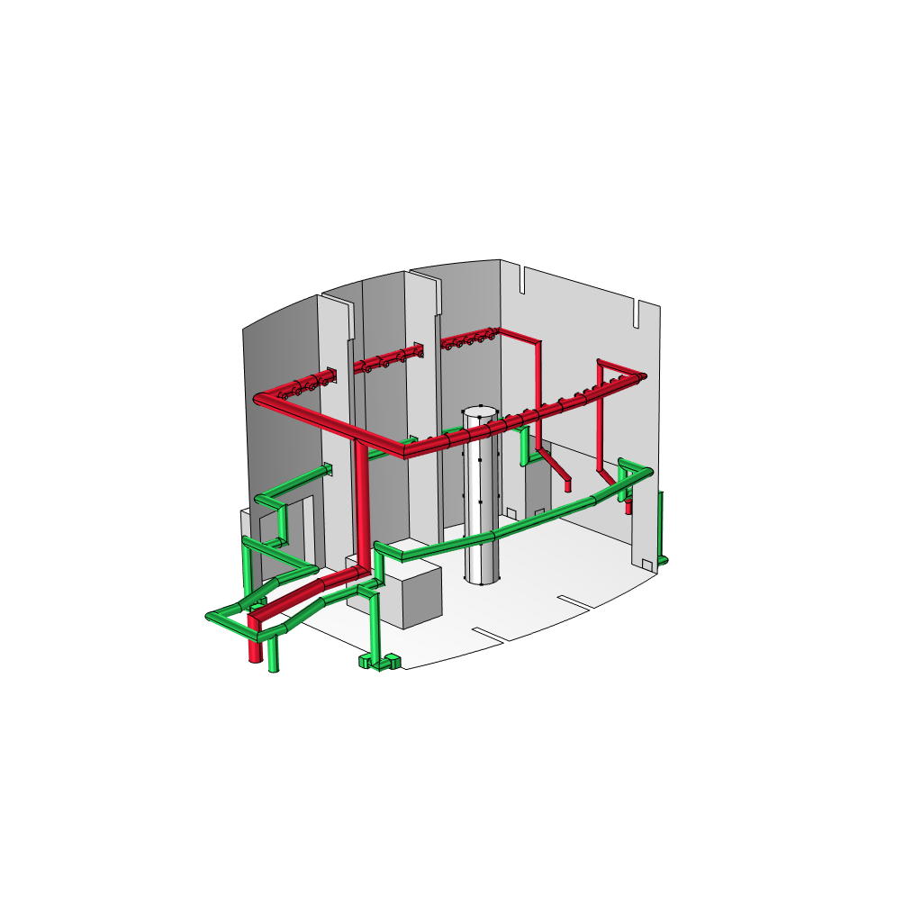
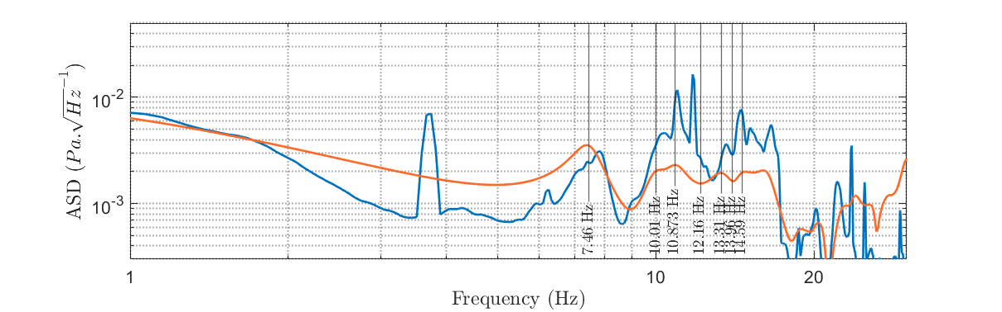
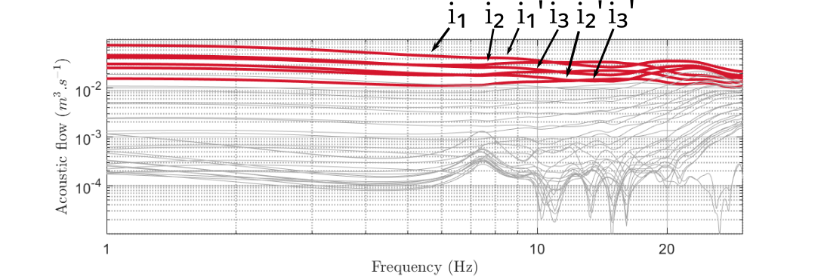
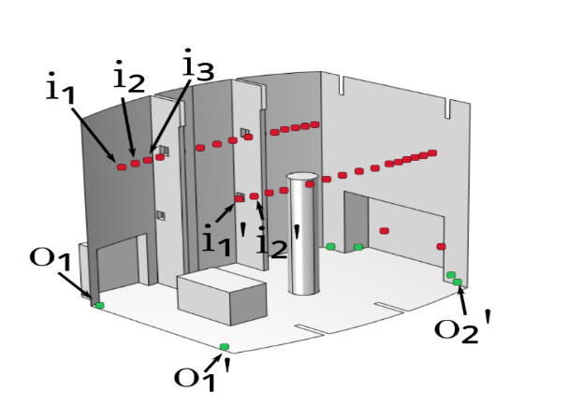
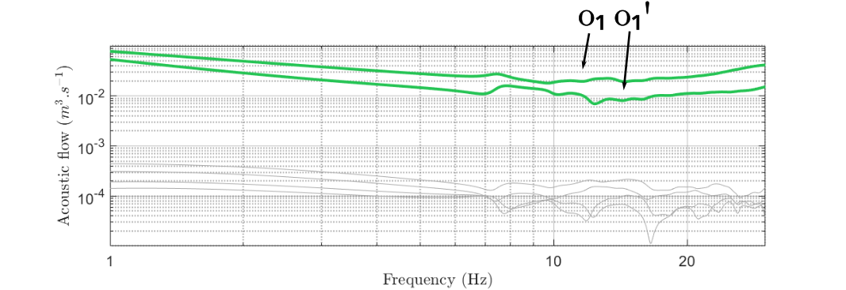
Acoustic Noise from air conditioning unit – Full and simplified model
Full model : ducts and room are coupled and excited by 2 pistons
Simplified model : inlets and outlets are replaced by equivalent monopoles whose flow is computed from the full model.
a selection of dominant inlets/outlets is considered only.
Simulation
Measurement
Good aggreement between direct measurement and simplified model !
Pressure
harmonic pistons
Inlets
Acoustic flows
Outlets Acoustic flow
Meet Workshop, Italy, Orosei 6-10 October 2025

Slide 7

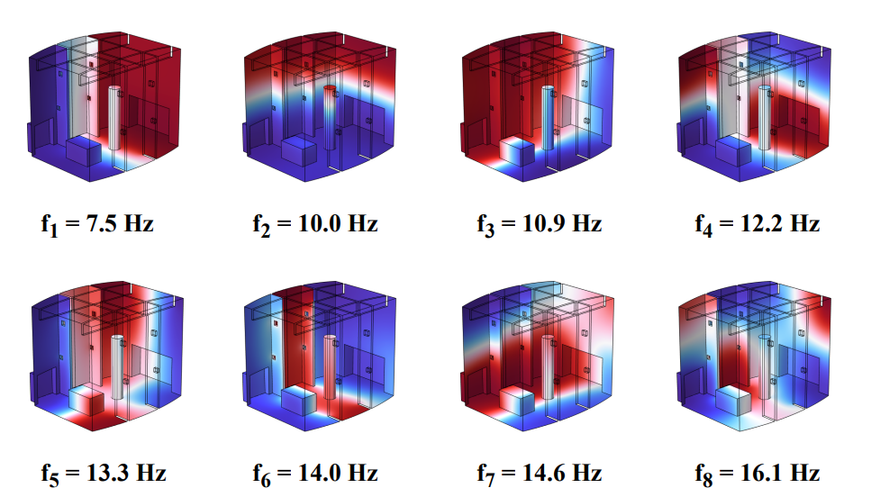
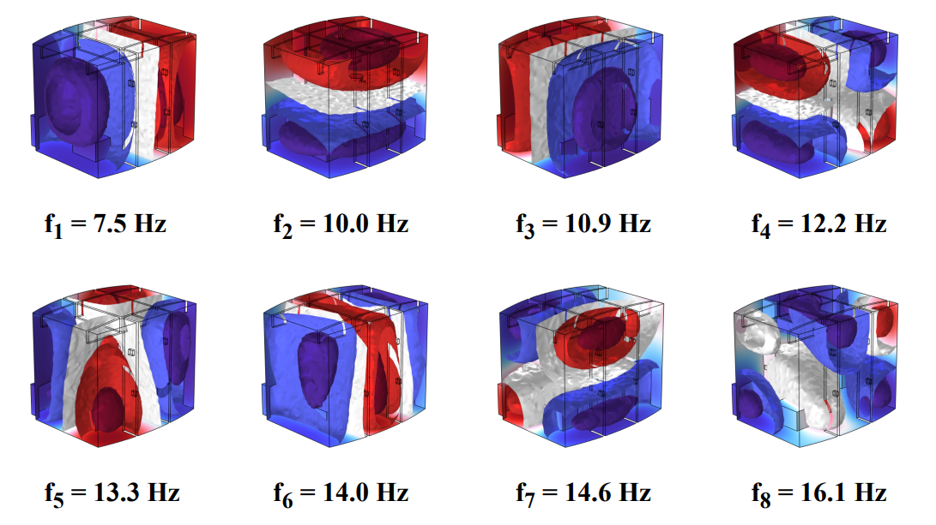


Modal and functional bases
Acoustic field
Potential of gravity field
Modal basis
Functional basis
$φn$ Function
$Ψn$ Function

Slide 8
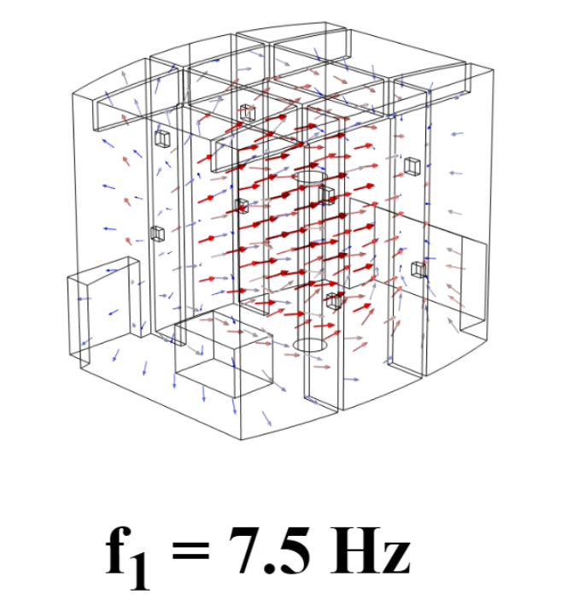
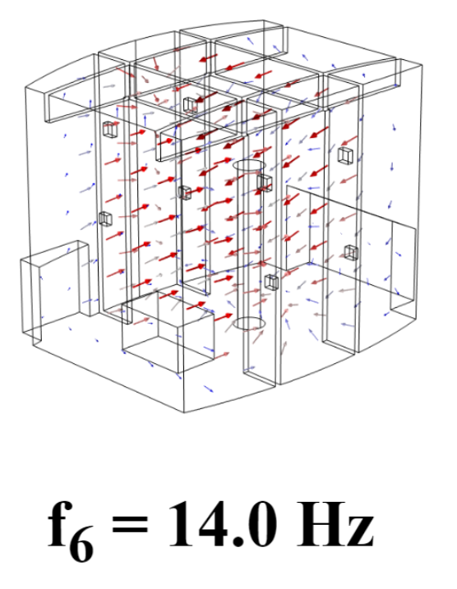


Modal and functional bases
Acoustic field
Gravity field
$φn$ Function
$\vec{∇}Ψn$ Function

Slide 9
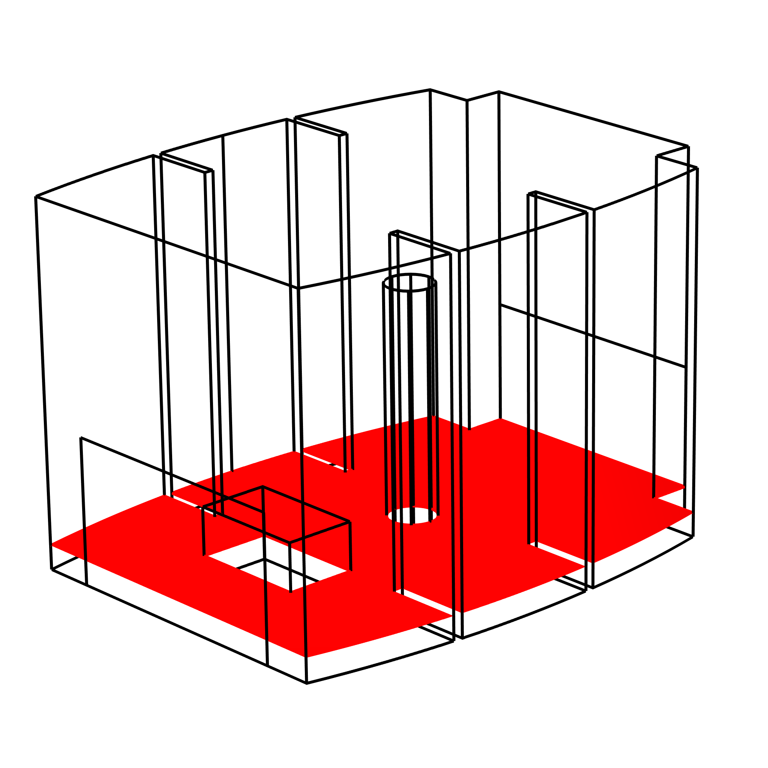
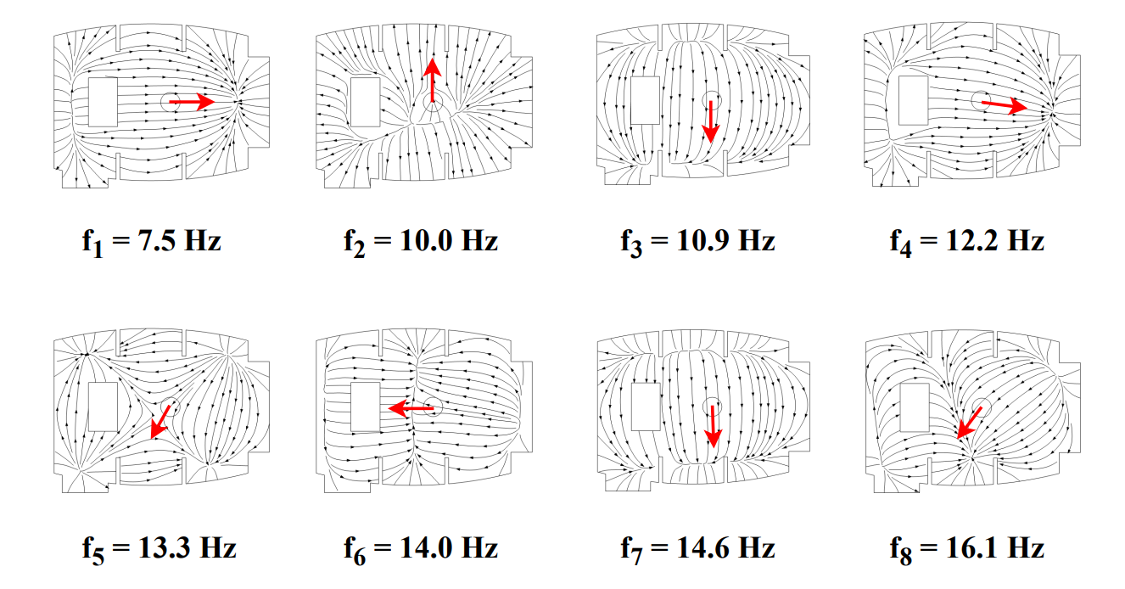
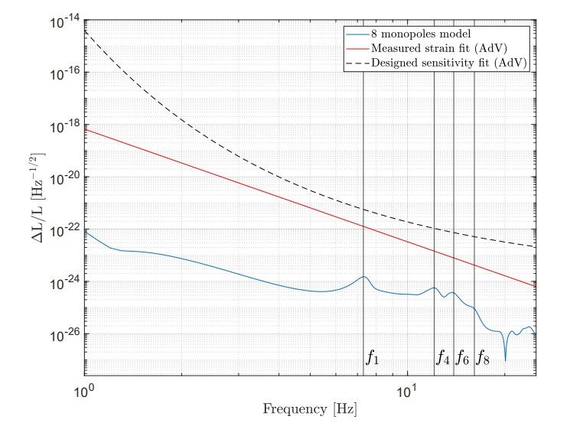
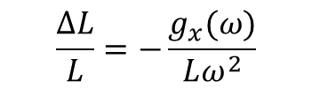
Estimating the NN from a simplified model
$$\frac{ΔL}{L}=−\frac{g_{x}(ω)}{Lω^{2}}$$
What is the impact of the Newtonian noise on the suspended test mass?
estimate of the NN of acoustic origin
Streamlines for the gravity field in the room in the 2D
cross-section at one meter from the ground.
NN is far below Virgo sensitivity

Slide 10
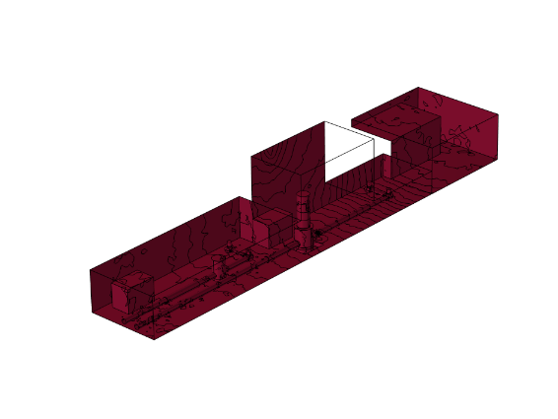
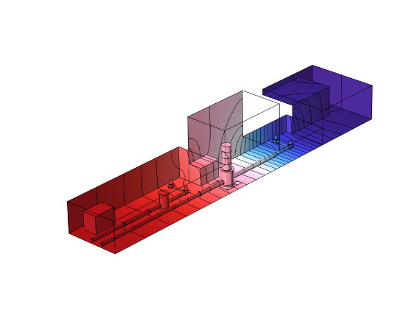
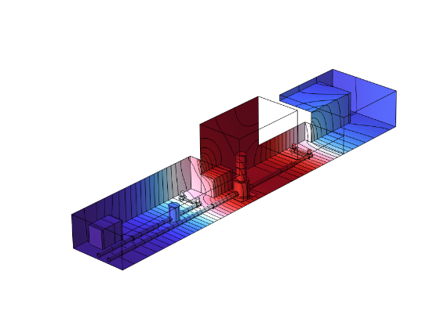
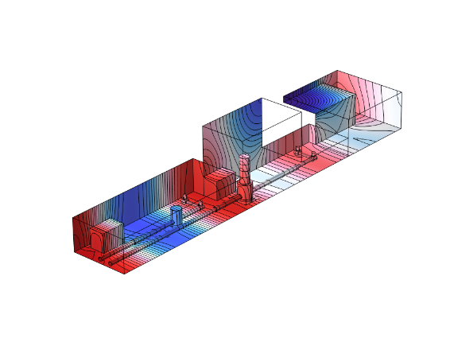
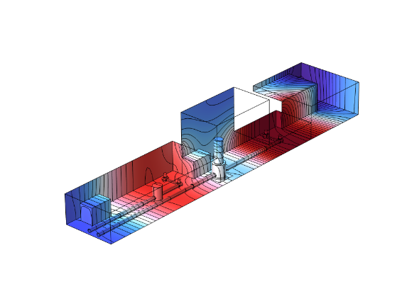
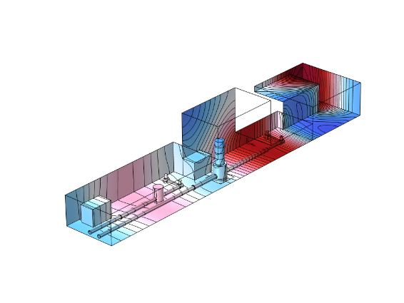
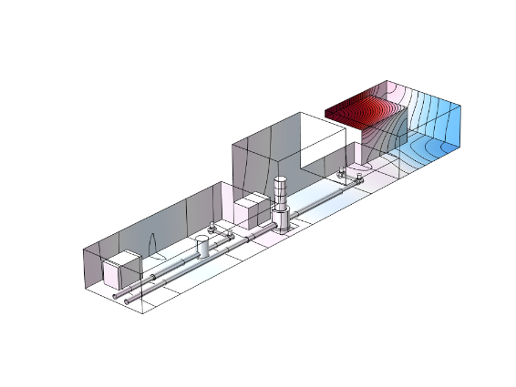
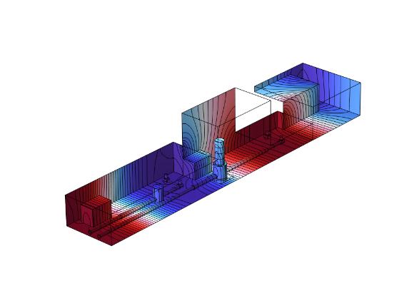
Acoustic modal basis of an end cavern
Mode count function
200
f1=0Hz
f2=1.2Hz
f3=2.2Hz
f4=4.3Hz
100
f5=4.8Hz
f6=6.3Hz
f7=6.9Hz
f8=7.1Hz
50
0
10
20
30
40Hz
High acoustic modal density due to the large size of the room
Remarks
The cave is supposed to be closed... and disconnected from the tunnel(s)!
The sound inside the tunnel is ignored, but the acoustic modal density inside is enormous (!)

Slide 11
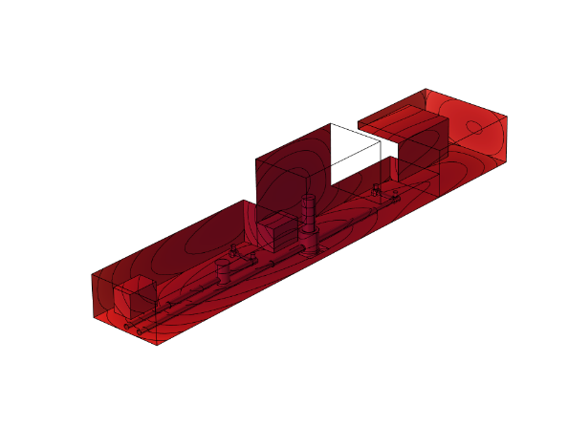
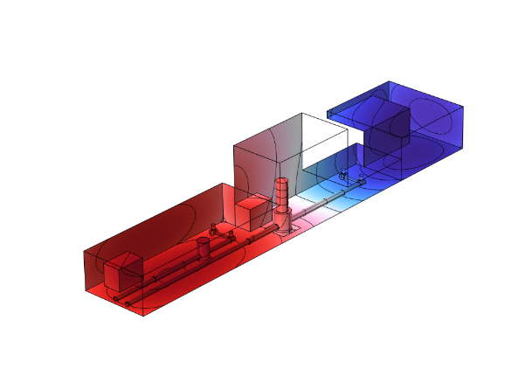
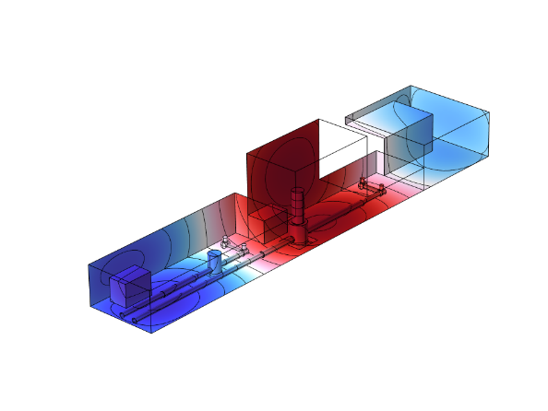
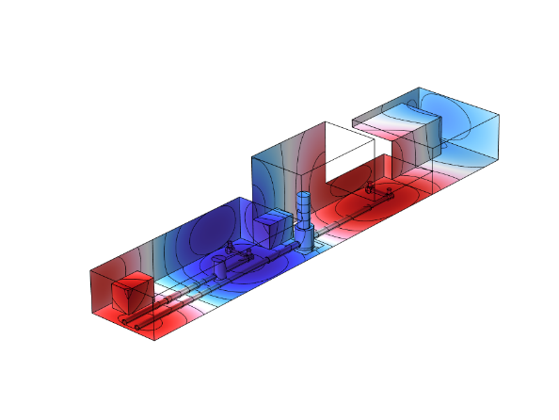
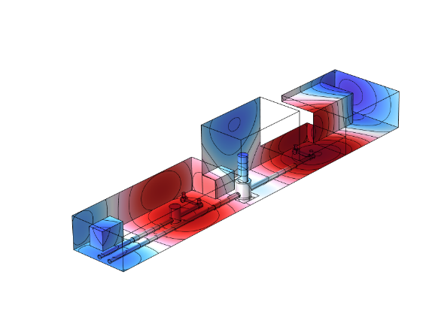
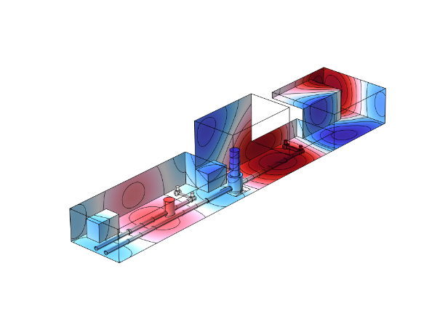
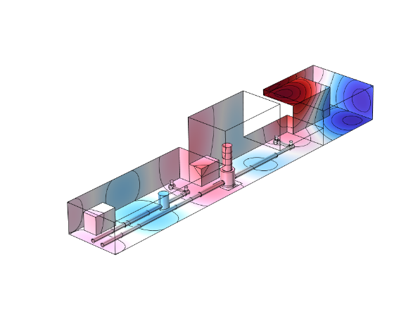
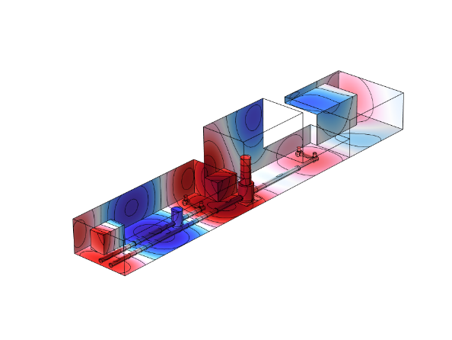
Functional basis for the potential expansion
f1=0Hz
f2=1.2Hz
f3=2.2Hz
f4=4.3Hz
f5=4.8Hz
f6=6.3Hz
f7=6.9Hz
f8=7.1Hz

Slide 12
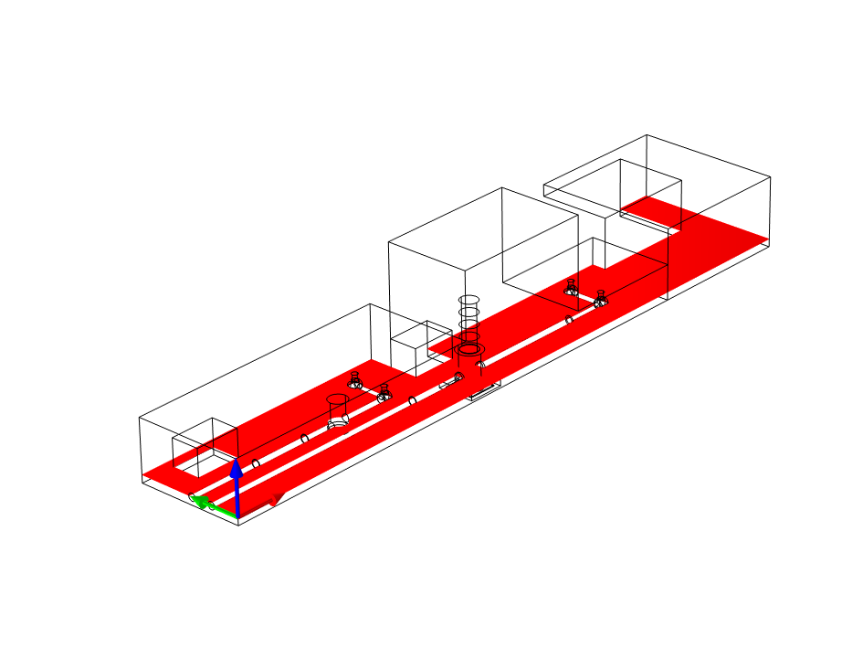
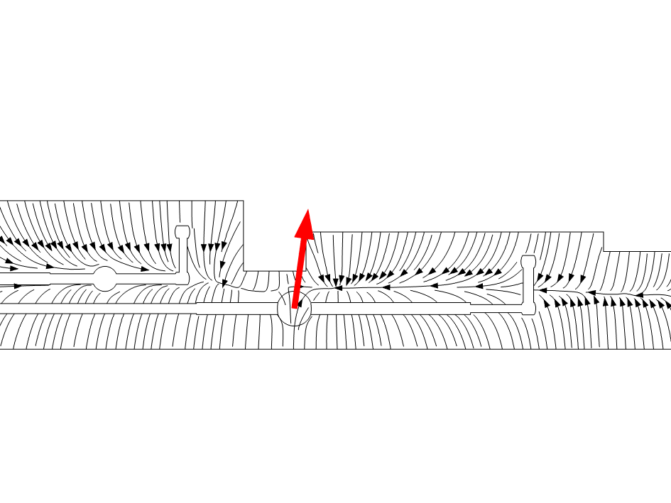
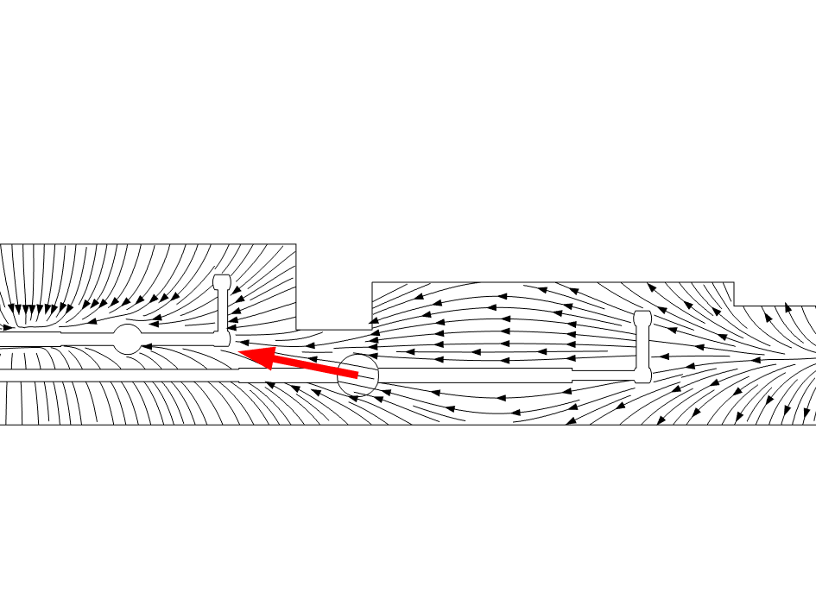
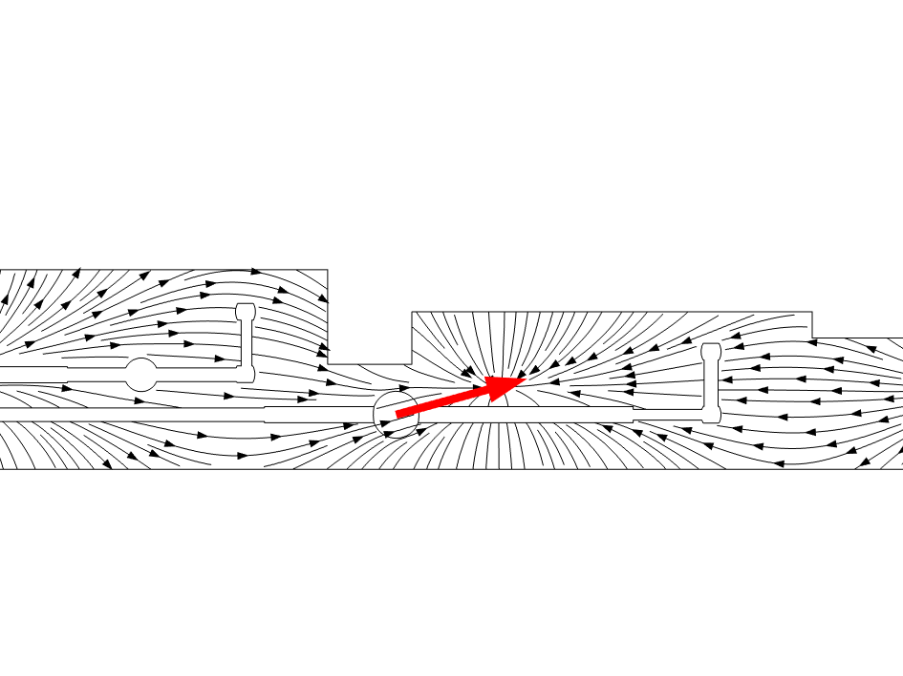
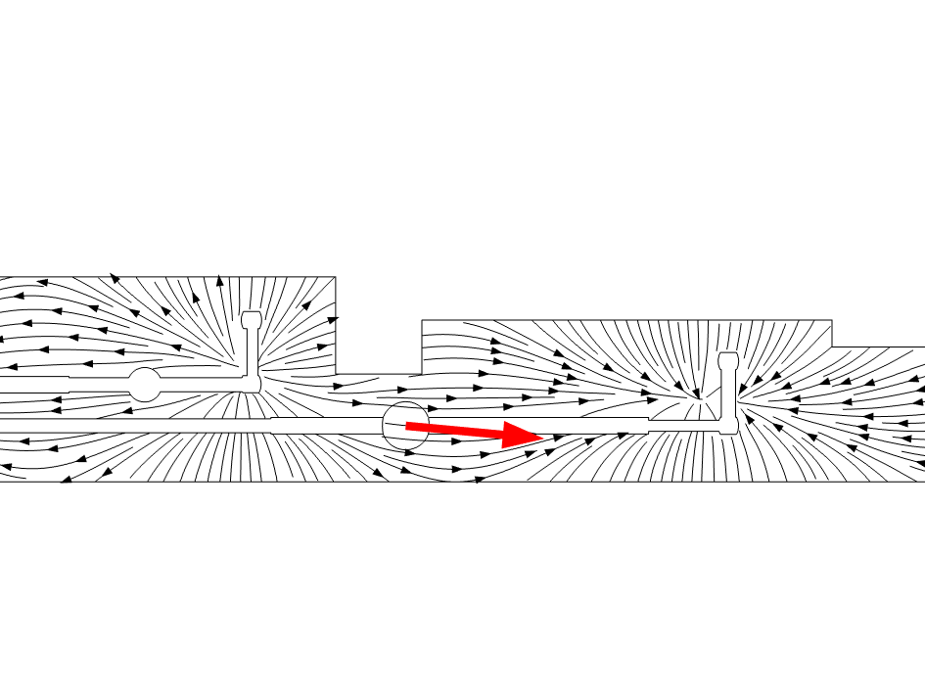




Functional basis for the gravity field
f1=0Hz
f2=1.2Hz
f3=2.2Hz
f4=4.3Hz
f5=4.8Hz
f6=6.3Hz
f7=6.9Hz
f8=7.1Hz
Numerous longitudinal modes => orientation of the NN gravity field is mostly in the laser beam direction !

Slide 13




Simulated NN of acoustic origin – effect of the inlets/outlets positions
Integration of thh Virgo sources inside the ET cavern
Test of 2 configurations for the inlets/outlets
8 inlets
4 outlets
10⁻²²
10⁻²³
10⁻²⁴
Configuration 1
10⁻²⁵
10⁻²⁶
10⁻²⁷
10⁻²⁸
Configuration 2
NN level is above the sensitivity curve !!!

Slide 14


Simulated NN of acoustic origin – effect of the fan rotation speed
The fan rotation speed is the most influent parameter on the noise level (power law)
Simulations for
Virgo’s source amplitude
2 x Virgo
0.5 x Virgo
=> The methodology can be used to estimate the acoustic threshold
10⁻²²
10⁻²³
10⁻²⁴
10⁻²⁵
10⁻²⁶
10⁻²⁷
Air flow variation
10⁻²⁸

Slide 15



Simulated NN of acoustic origin – effect of acoustic absorption
Adding acoustic absorption helps to limit NN
In practice, acoustic absorption at low frequency is very difficult to achieve
10⁻²²
10⁻²³
Melamine foam
10⁻²⁴
10⁻²⁵
10⁻²⁶
10⁻²⁷
Wiremesh
10⁻²⁸

Slide 16


Concluding remarks
HVAC is necessary for the thermal stability and also for the health of the operators
Acoustic noise due to HVAC induces Newtonian Noise, visible by ET
Acoustic Newtonian noise must be considered as an issue in the design of Einstein Telescope’s cavern
The developped approach can give insight
on the geometry of caverns
on the positions of the inlets/outlets
on the positions of the towers
On the specification of the HVAC
Collaboration with ETO, P. Werneke has started. Collaboration with the CERN engineers in charge of the HVAC system would be useful. How to formalize this collaboration?
Short-term perspectives
extension to the analysis of NN of vibratory origin (vacuum pumps, cryogenic pumps …)
Starting collaboration with C. Collette (Univ. Liege). links between NN and active control

