Slide 1

ET-PP project
WP5 Status and Future
Preparatory Phase for the Einstein Telescope Gravitational Wave Observatory
08/10/2025
WP5 Coordinator: Christian.olivetto@ijclab.in2p3.fr

Slide 2
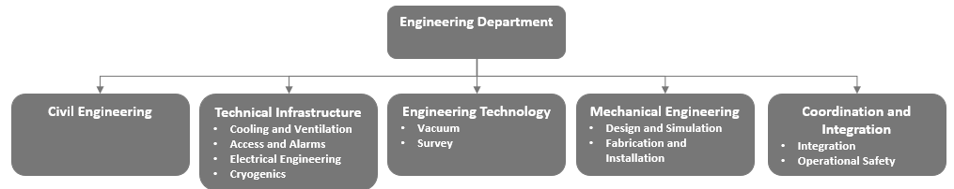

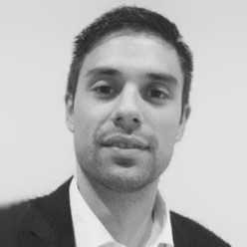
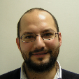

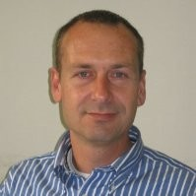

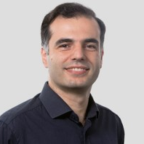
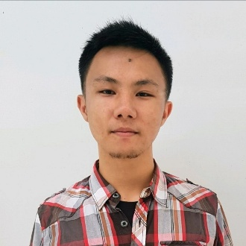
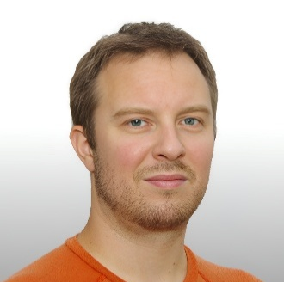

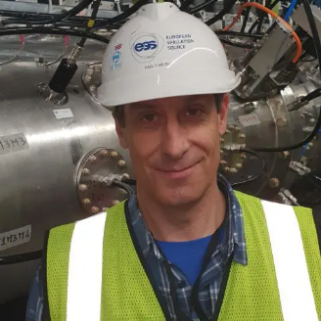

WP5: Engineering Department
Preparatory Phase for the Einstein Telescope Gravitational Wave Observatory
10.07.2025
Kevin Pressard
Philippe Rosier
Gregory Laquaniello
Alexandre Lacroix
Project: 101079696 — ET-PP, 2nd review meeting

Slide 3
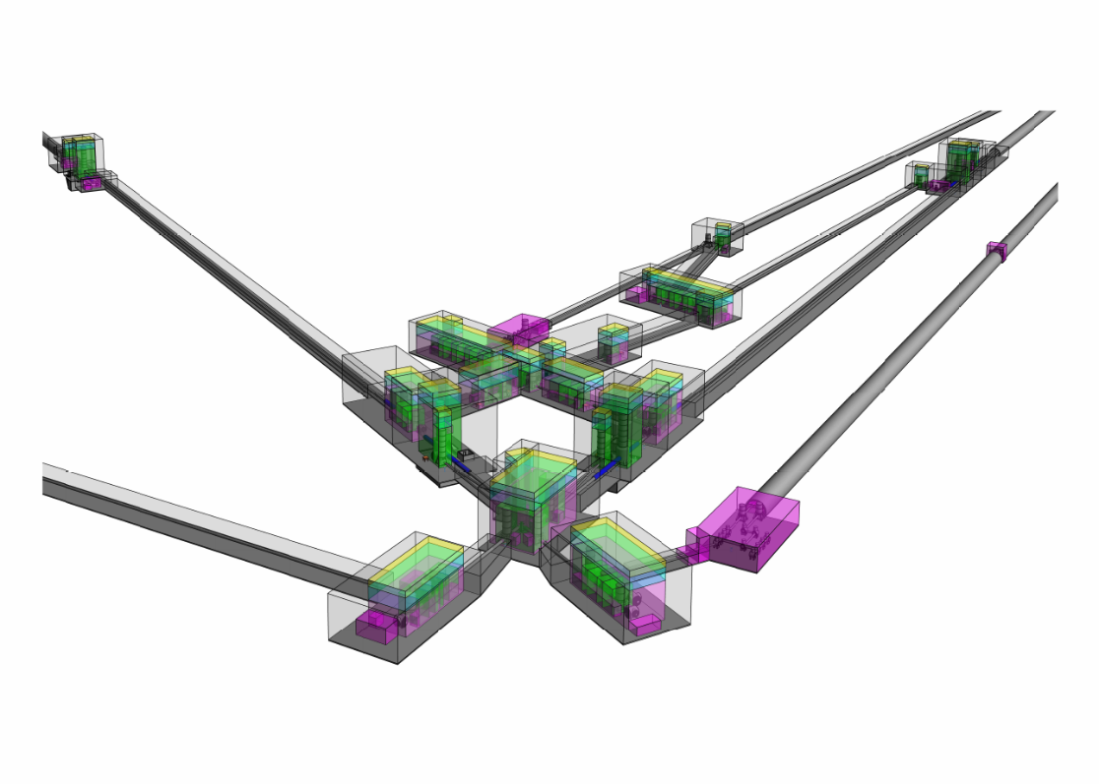
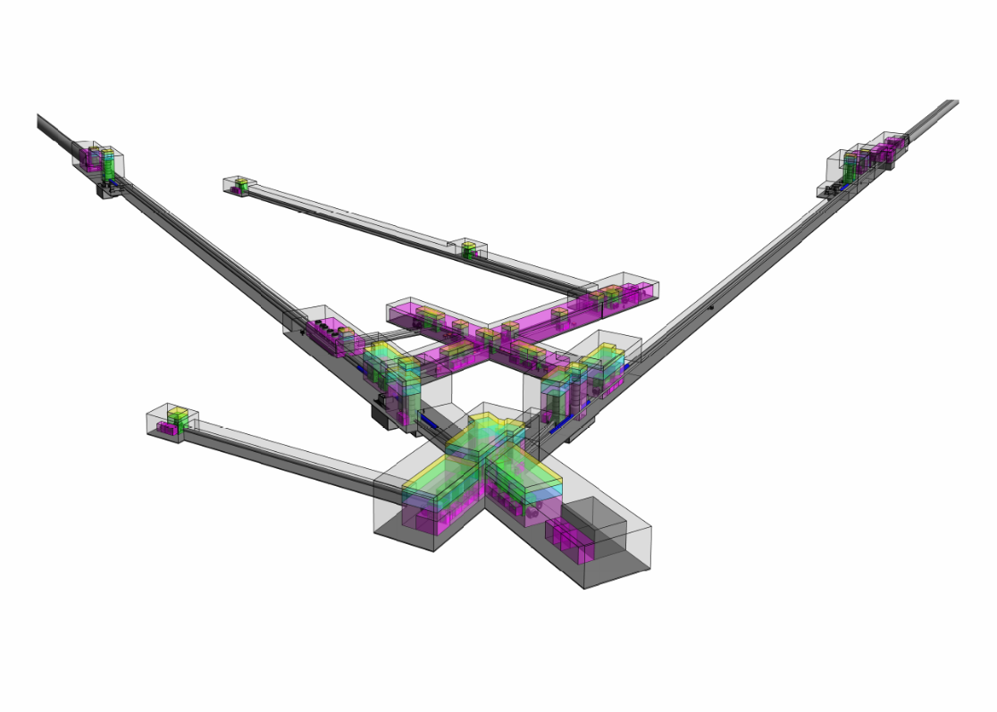
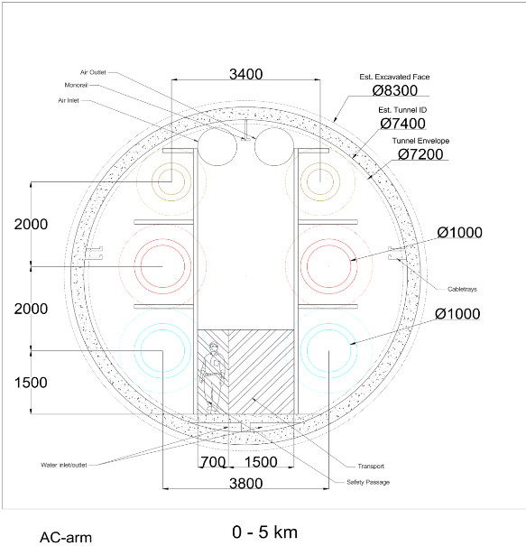
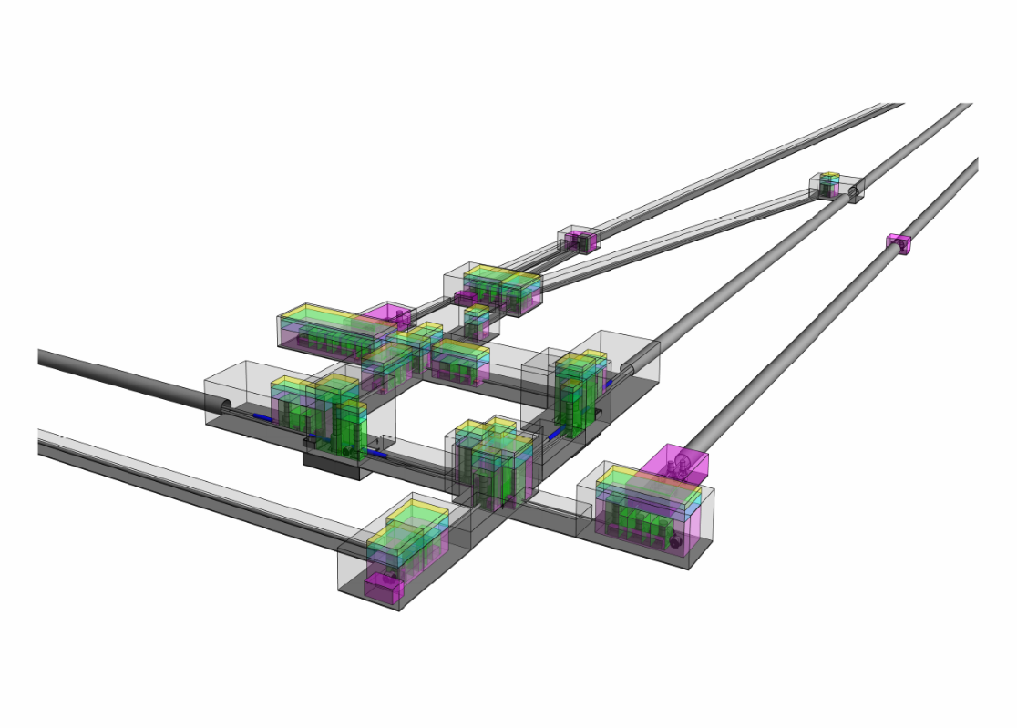
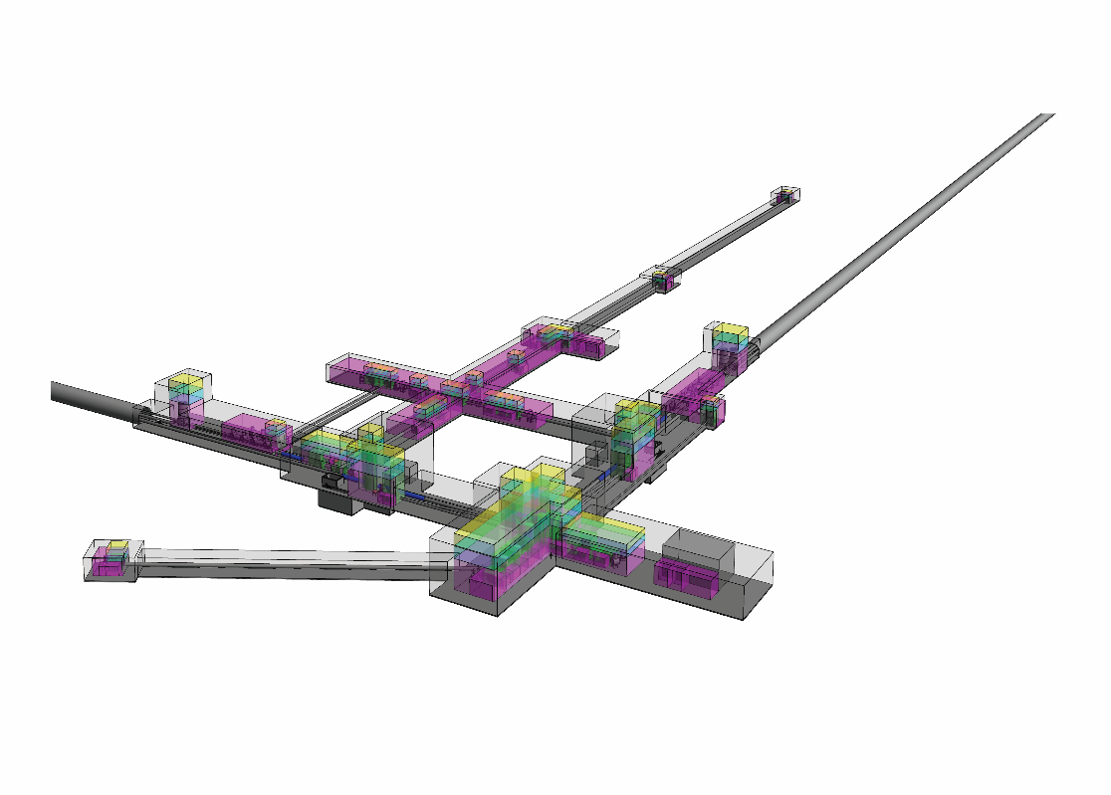
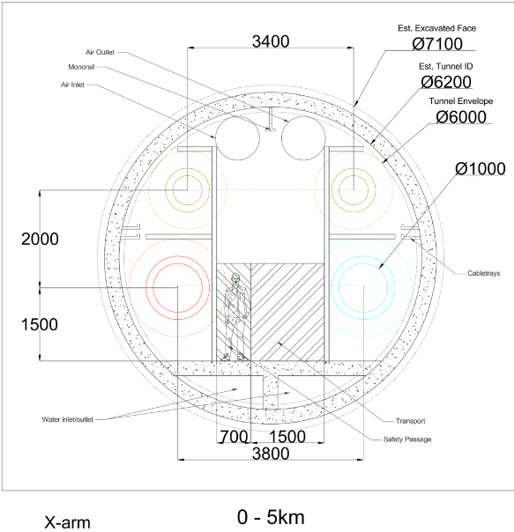
Detector Layout Update
Δ 2024 reference
New Δ baseline design:
~25% volume reduction
2L 2024 reference
New 2L baseline design:
~28% volume reduction
Web viewable 3D Detector Layout(s): https://wiki.et-gw.eu/ED/WebHome

Slide 4
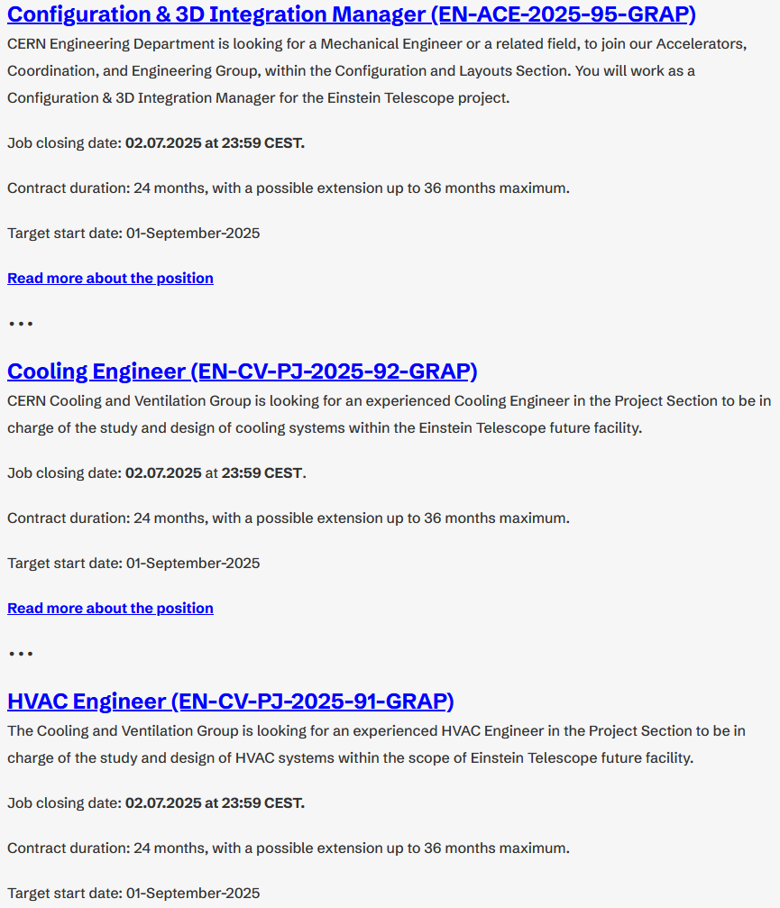
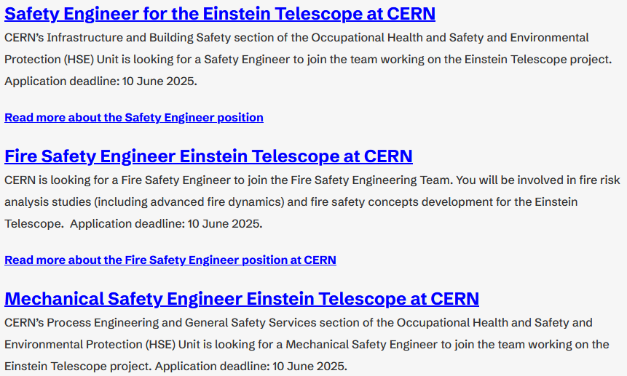
WP5: Engineering Department (MoU with CERN)
Preparatory Phase for the Einstein Telescope Gravitational Wave Observatory
10.07.2025
ETO has a MoU with CERN for their support on technical topics:
  Arm vacuum pipe
  Civil Engineering
  Technical Infrastructure
    HVAC, Electricity,
    Access & Alarms
  Safety
  Integration
Hiring process is ongoing (10 FTE)

Slide 5
WP5 Project Office: ET-PP Deliverables
Preparatory Phase for the Einstein Telescope Gravitational Wave Observatory
08/10/2025
D5.1 Structure and Mandate of the Project Office. V1:Validated
D5.2 Functionalities required from the tools in support of the project management V1:Validated
D5.3 Structure and Mandate of the Engineering Department V1:Validated
D5.4 Functional Engineering Department V1:Validated
D5.5 Functional Project office V1:Validated
All final version due date in May 2026

Slide 6





WP5 Project Office: Involments of French Teams
Preparatory Phase for the Einstein Telescope Gravitational Wave Observatory
08/10/2025
Risk Management
1 ETP: CDD
0,2 ETP
PBS Data-Base
1 ETP: CDD
0,2 ETP
Schedule Management
0,8 + 0,2 ETP
Configuration Management
0,8 ETP
Risks management plan V1
Risk identification at the level of each PBS/WBS group
Merging of all these risks information
Training session to raise awareness and explain risk management
Risk management Wiki Page: https://wiki.et-gw.eu/PO/Risk
Configuration management plan V1
Validation of configuration management process
Configuration Wiki page: https://wiki.et-gw.eu/PO/Configuration
Evaluation more than 20 schedule and project management tools
Schedule requirements identification document
Deployment of a complete schedule tool configuration
Validated individual training session based of youtube channel tutorial videos:
https://www.youtube.com/@ETTelescopeSchedule/featured
Validated project managers group training session
Validation of automatic schedule consolidation
Schedule management Wiki Page: https://wiki.et-gw.eu/PO/Schedule
Data-Base development for PBS implementation
Data-Base operational V1
Data-Base User Manual
Data-Base Technical Implementation
importing PBS data following PBS reviews held throughout the 2024/2025 academic year

Slide 7
WP5 PO: Involments of French Teams: Future in ETO
Preparatory Phase for the Einstein Telescope Gravitational Wave Observatory
08/10/2025
Risk Management
1 ETP: CDD
0,2 ETP
PBS Data-Base
1 ETP: CDD
0,2 ETP
Schedule Management
0,8 + 0,2 ETP
Configuration Management
0,8 ETP
Risk Management
1 ETP: CDD ends in summer 2026
0,2 ETP
PBS Data-Base
1 ETP: CDD ends in summer 2026
0,2 ETP
Schedule Management
0,8 + 0,2 ETP
New position at CERN for 1 CDD
Configuration Management
0,8 ETP
New position at CERN for 1 CDD
New Rule for Project Office ETO involments: > 0,5 ETP

Slide 8
WP5 Project Office: ET-PP & ETO futur
Preparatory Phase for the Einstein Telescope Gravitational Wave Observatory
08/10/2025
Nous devons terminer au mieux le projet ET-PP en livrant les dernières versions
des 5 délivrables sur lesquels WP5 s’est engagé (Lead CNRS).
Ceci en incluant la nouvelle organisation ETO et dont les interfaces et
responsabilités sont encore à définir.
Le TDR (Technical Design Report) Infra suite à la revue avec reviewers Europe
devait être transféré de WP6 à WP5. Finalement reste sur WP6 mais sous
responsabilité ETO pour sa rédaction mais sera transformé en CDR (Conceptual
Design Report)
Consolidation des implications Risques et PBS Data-Base côté français à finaliser
Demande de 30 à 35 ETP pour mettre en place un Project Office sous tutelle CERN
et INFN.

