Slide 1
SIRIUS → SHEXI
ANR « D-SHEXI » the SHEXI Demonstrator
D-SHEXI (Demonstrator of Super Heavy Element X-ray Identification)

Slide 2
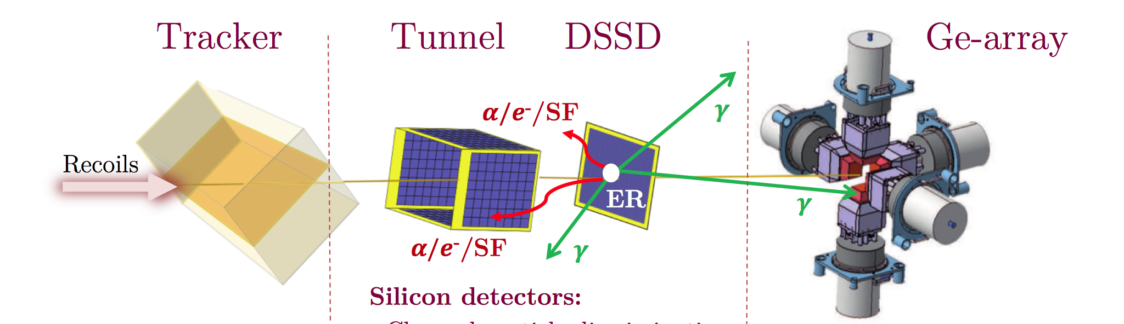
Overview…
X- and γ-ray spectroscopy
Isomer tagging
α – γ/X
SED (Tracker)
provides Time-of-Flight start
position information → A/ΔA ~ 3-500
marker to distinguish implanted
recoils from decays
DSSD
Time-of-Flight stop → (E_{DSSD} vs TOF)
  recoils / transfer / scattered beam
Position/time correlations
  isomer tagging
  decay chain construction
Tunnel
discrete internal conversion spectroscopy (multipolarities)
Isomer tagging
α – ICE
D-SHEXI

Slide 3
Main Motivation for the upgrade:
Z Identification of the isolated SHE.
X-rays: energies characteristic of atomic number
→ unique identification (historically K X-rays)
S. Hofmann, EPJ Web of Conferences 182, 02054 (2018)

Slide 4
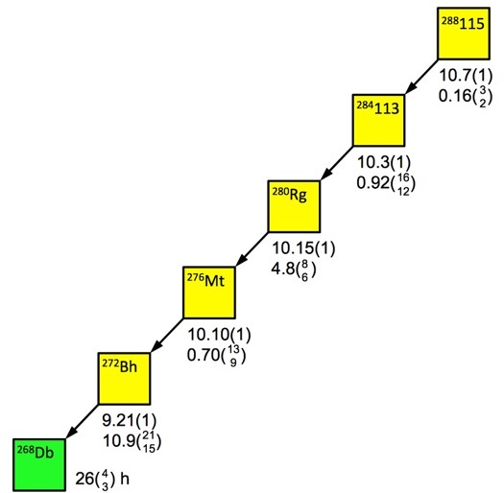
SIRIUS upgrade →SHEXI (Super Heavy Element X-ray Identification) R&D
X-rays: energies characteristic of atomic number → unique identification (historically K X-rays)
⁴⁸Ca+²⁴³Am → ²⁹¹Mc*
Difficulties in SHE:
1) Excitation energies are compressed
→ K X-rays unlikely (E_{B}[Z=109]=178 keV)
2) Some nuclear transitions do not favour K X-rays
Physics Solution:
L X-rays (lower E) and always produced
but E(L,Z+1) – E(L,Z) ~ 0.4 keV for Z~110
α_{K}(194:E1) = 0.099
α_{L}(43:M1) = 244
α_{L}(86:E2) = 84
Based on D. Rudolph et al, Phys. Rev. Lett. 111 (2013) 112502

Slide 5
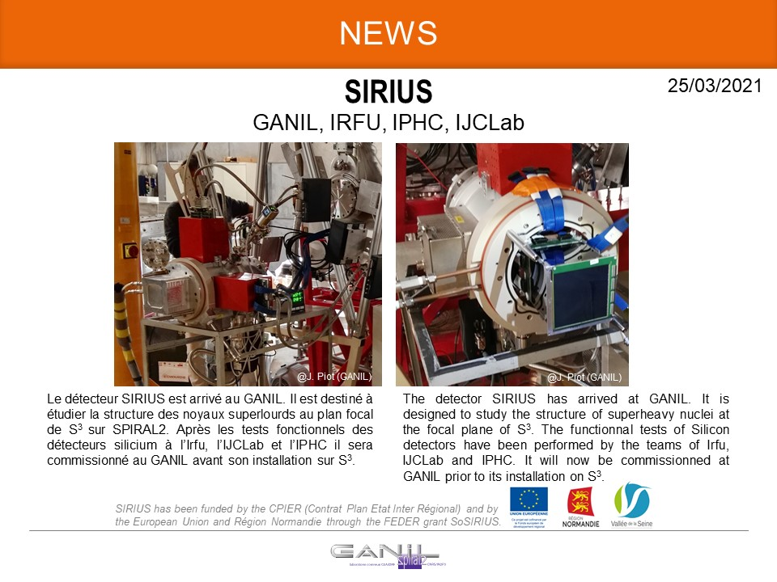
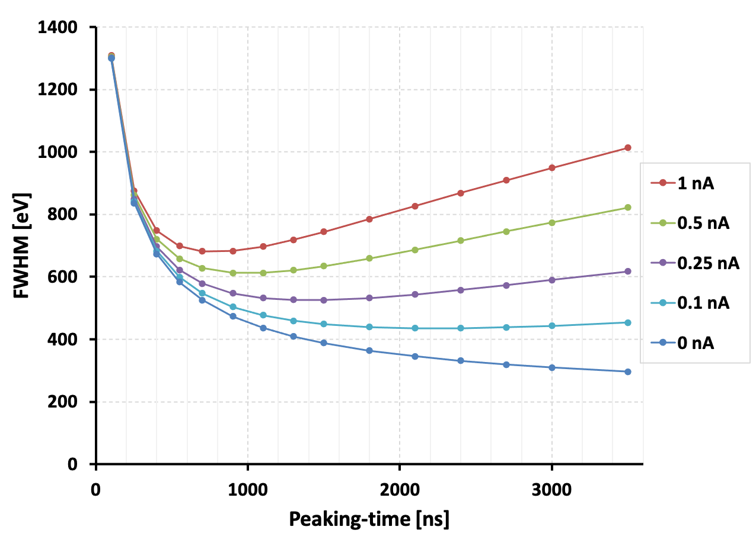
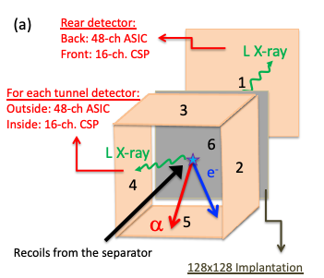
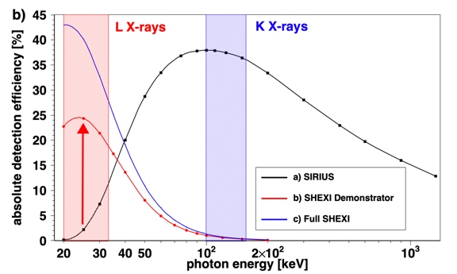
SHEXI Concept
State-of-the-art ASICs from XGLab (0.4 keV FWHM)
→ capacitance-matched DSSDs (1.5 mm thick)
COOLING
Z identification of SHE
improved ICE resolution
other side of DSSD:alpha/fission range
16 standard CSPs (HV)
(also needs developing/testing)
(ASIC range ~2.5 MeV: 1000 mV/MeV

Slide 6
D-SHEXI – accepted July 2025: 42 months & ~675 k€
Partner | Surname | First name | Current Position | Rôle & responsabilités dans le projet (4 lignes max) Need to add tasks | months
CNRS Université Paris-Saclay IJCLab | HAUSCHILD | Karl | CNRS-CRHC | Project coordinator, scientific leader | 20.0
 | LOPEZ-MARTENS | Araceli | CNRS-DR | Experimental setup,Online data quality control, data analysis, GEANT4 simulations: WP7. Management: WP8 | 8.4
 | ANR Funded |  | Ph. D. student | Electronics tests: WP2; Fast timing feasibility study: WP4, Experimental setup and data analysis: WP7 | 36.0
 | GEORGIEV | Georgi | CNRS-DR | Prevision of LaBr3 and expertise: WP4 | 2.1
 | WILSON | Jonathan | CNRS-DR | Prevision of LaBr3 and expertise: WP4 | 2.1
 | KARKOUR | Nabil | CNRS-IRHC | Coordinator WP3; WP6; WP8 | 10,8
 | VALLERAND | Phillipe | CNRS-IRHC | WP3 | 7.2
 | ALAPHILLIPE | Vincent | CNRS-IR | WP3 | 10.8
 | GIBELIN | Laurent | CNRS-AI | WP3, WP6 | 10.8
 | ANR Funded |  | 6 masters students | WP3, WP4, WP5, WP6, WP7 | 30.0
IPHC | DORVAUX | Olivier | Professor | Scientific leader. WP1 coordinator; WP2, W7, WP8 | 8.4
 | MATHIEU | Cedric | CNRS Engineer | Detector customer acceptance tests (CAT): WP1& WP2 | 6.0
 | GALL | Benoit | Professor | Mechanical design WP4 &WP6. Experimental setup WP7; WP8 | 8.4
 | FILLIGER | Michel | CNRS Engineer | Mechanical design, validation and tests WP4 | 3.0
 | MÜLLER | Linda | Ph. D. student | Detector customer acceptance tests : WP1 & WP2 | 5.0
GANIL | PIOT | Julien | CNRS-CRCN | Scientific leader. Coordinator WP6 and WP7; WP8 | 8.4
 | ACKERMANN | Dieter | CEA-DRCE | Supervision of student. SHEXI commissioning. WP7 | 4.2
 | LUTTON | Franck | CNRS-IRHC | Integration of SHEXI and vacuum chamber WP6 | 8.4
 | HERLANT | Sébestien | CEA-IR | Integration of SHEXI and vacuum chamber. WP6 | 2.1
 | GOUPIL | Johan | CNRS-IECN | Installation of SHEXI at GANIL. WP6 | 2.5
 | ? |  | Post-doc | Setting up at GANIL and experimental runs: WP6 & WP7 | 2.0
 | GANIL funded | Ph. D. student | To be hired | Electronics tests. Experimental setup and data analysis. | 12
Funding for 1 PhD starts ASAP
6x 3-month masters stagiers
Detectors, electronics (front and back-end)
Radioactive sources and thin foils
Densimet shielding
DAQ upgrade
Vacuum chamber(s)

Slide 7
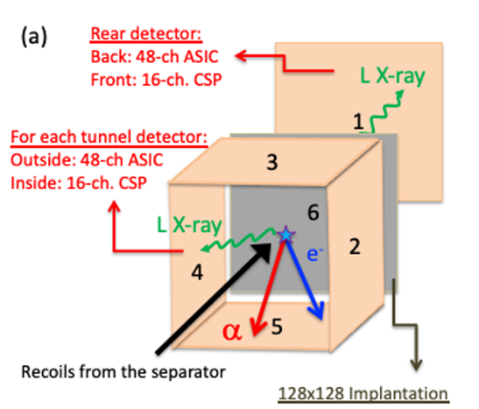
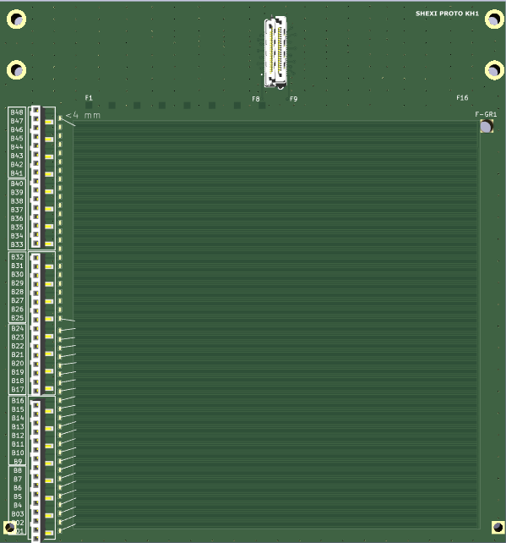
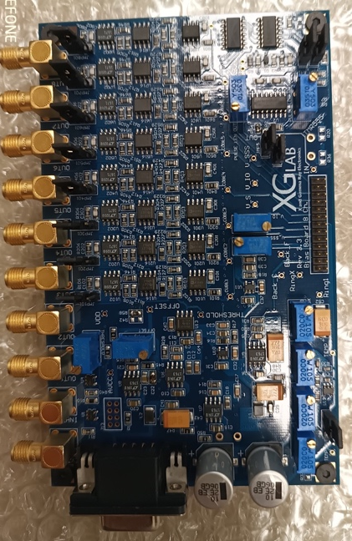
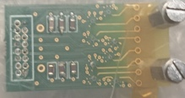
Proof-of-principle with two 48x16 DSSDs: One “tunnel” + a “veto” [#2 & #1]
TUNNEL configuration
air
vacuum
16 CSP
digitisers
buffered
signals
cold
Bias + signal
conditioning
Power supply,
Reset logic
x6
8 ASIC
DET
signal
3 signal conditioning
boards bought
(but need housing)
16 CSP
  Xray ASICs [96 needed]
    24 bought [GABRIELA]
    24 P2I [this year]
    24 GANIL [promise after CS]
    24 in the ANR
  Carrier boards [8 ASICs]
    Same 25% break down
24 channels
need to be
instrumented
Detector PCB
under development
Detector design
approved by
Micronsemiconductor
(paid by GABRIELA)
3x 8-ASIC
boards bought

Slide 8
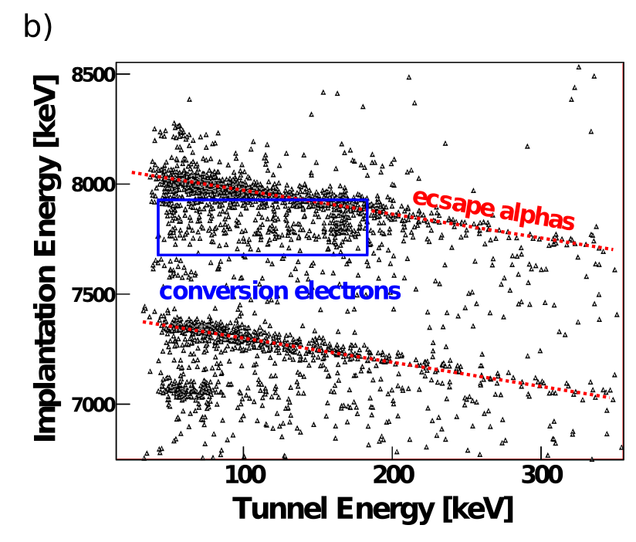
SHEXI Proof-of-principle: tunnel 48x16 DSSD
  Standard CSP
    Apply HV
    Escape alpha and fission fragments
      Range up to 100 MeV
air
vacuum
16 CSP
cold
x6
8 ASIC
DET
^{254,255}No
  ASIC CSP
      conversion electrons + X-rays
      Range down to 25 keV ?
      ➔ PIXELS:
Can we use PSA to distinguish these event types ?
➔ FAST preamplifier rise time (& faster digitisers?)

Slide 9
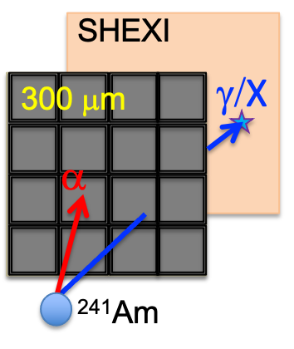
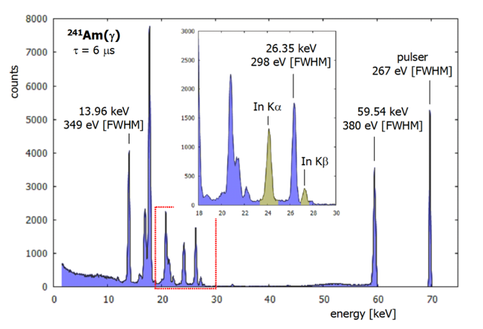
SHEXI Proof-of-principle: VETO 48x16 DSSD [X-ray discrimination]
Using ²⁴¹Am (Np L X-rays 11-20 keV) and ¹³⁷Cs(Ba K X-rays of 32-37 keV) sources will allow us to qualify the X-ray detection performance
Photons from the decay of ²⁴¹Am detected in a 4 mm thick Si(Li) detector instrumented with a XGLab ASIC preamplifier (taken from T. Krings et al.)

Slide 10
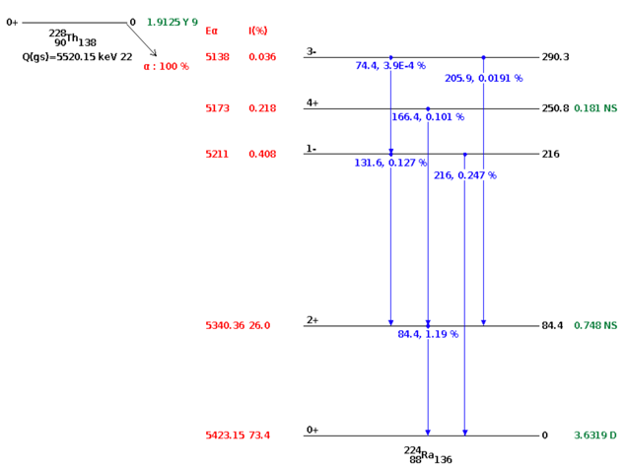
SHEXI: Fast timing the focal plane ? Proof-of-principle
T_{1/2}(2⁺) = 748(19) ps @ 84 keV
Iγ=1.19% → simple α(start) – γ(stop) curve fit method
→ sub-ns Si(α)-LaBr₃(84-keV) coincidences to be investigated.
α_{TOT}(84-keV:E2) =21.1
→ study for Si(α)-Si(CE:66,80) and Si(α)-Si(L X-ray) coincidences.
T_{1/2}(4⁺) 181(9) ps, decays via a 166-keV E2 transition (Iγ=0.10%) and the 1- decays with an E1 transition of 216 keV having an intensity of 0.247%.
And similar transitions in the daughter ²²⁰Rn
e.g. T_{1/2}(2+) = 146(5) ps @ 241-keV & Iγ=4.1%
Fine structure α decay of ²²⁸Th populating excited states in ²²⁴Ra
(taken from NNDC).
Needs loan of LaBr₃

Slide 11
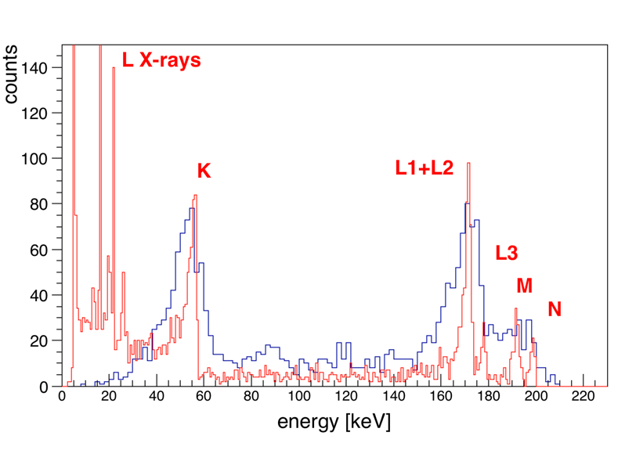
ANR Tasks
Task 1: Detector customer acceptance tests will be performed in collaboration with the IPHC using the experience gained from the SIRIUS tunnel detector development
Task 2: The ASIC performance will be qualified at the IJCLab using 241Am (Np L X-rays 11-20 keV) and 137Cs(Ba K X-rays of 32-37 keV) sources.
Task 3: A Complementary energy range will be needed for alpha and fission-fragment detection.
We will perform R&D to improve the IJCLab preamplifier that was under development for GABRIELA and evaluate other fast, low-noise preamplifiers.
Using a digitiser with more effective bits will provide a larger full-scale and will also be investigated.
Task 4: “Fast-timing”: Using LaBr3 detectors available at the IJCLab within the collaboration, we will investigate α and conversion-electron gated LaBr – LaBr coincidence timing.
The fast rise times of the ASICs (~10 ns) will also allow us to study Si-LaBr timing.
Task 5: For the SHEXI detection system, a new vacuum chamber needs to be developed.
To implement additional tungsten shielding, kiln-processed 3D printing of tungsten-loaded filament instead of expensive 3rd party tungsten powder sintering will be investigated at the IJCLab.
Task 6: The in-beam demonstration of SHEXI: As a first step, it is proposed to study the decay of the 5/2+ isomer in ²⁵¹Fm, which we have previously studied with GABRIELA.
As shown, L X-rays are expected to be detected in the SHEXI demonstrator and would provide in-situ proof of the resolutions achievable with the XGLab ASICs.
The K-isomer in $^{255}$Lr is also populated in this reaction.
Another high cross-section example (~2nb effective) is the fine-structure alpha decay from 257Rf populating the
same 5/2+ isomeric state in $^{253}$No, for which we have observed L X-rays in the Ge detectors of GABRIELA
……..And after ?
²⁵⁵No → ²⁵¹Fm as test example:
GABRIELA data vs SHEXI simul
280Rg → 276Mt

Slide 12
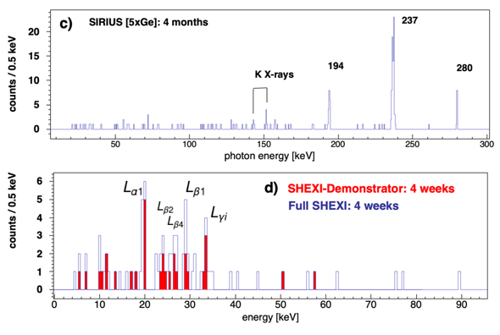
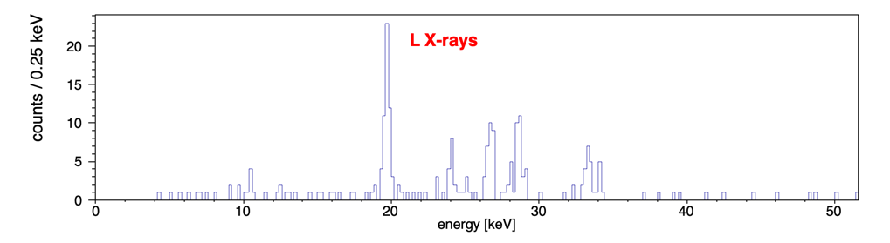
two physics examples
Near future: high-resolution conversion electron spectroscopy
²⁵⁵No → ²⁵¹Fm as an example:
GABRIELA data vs SHEXI simul
⁴⁸Ca+²⁴³Am → ²⁹¹Mc*
NEWGAIN@GANIL: 5 pμA x 3.5 pb x 300 μg/cm² x 45%
K. Rezynkina et al., Phys. Rev. C 97 (2018) 054332
SHEXI:
45 days → ~125 ²⁸⁸Mc

Slide 13
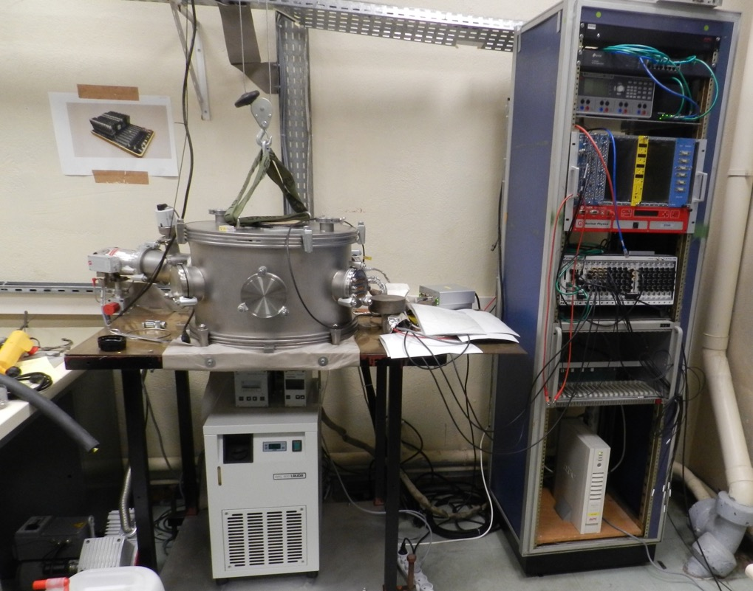
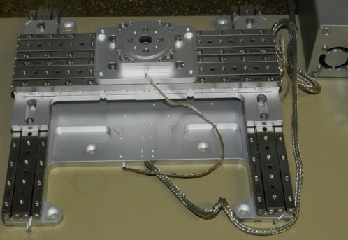
Back-end electronics infrastructure
DAQ Bay
eth
NIM
VME
PXIe
XY-theta table
(sources)
Vacuum chamber
new controller:
Storage:
Vacuum pumps
Cooling
^{Digital GABRIELA}
R.S. Mukhin, et al., Part. Phys. Nucl. Lett. 18 (2021) 652.
R.S. Mukhin, et al., Acta Phys. Pol. B Proc. Suppl. 14 (2021) 75.
Recently EMC and shielding have been improved

Slide 14
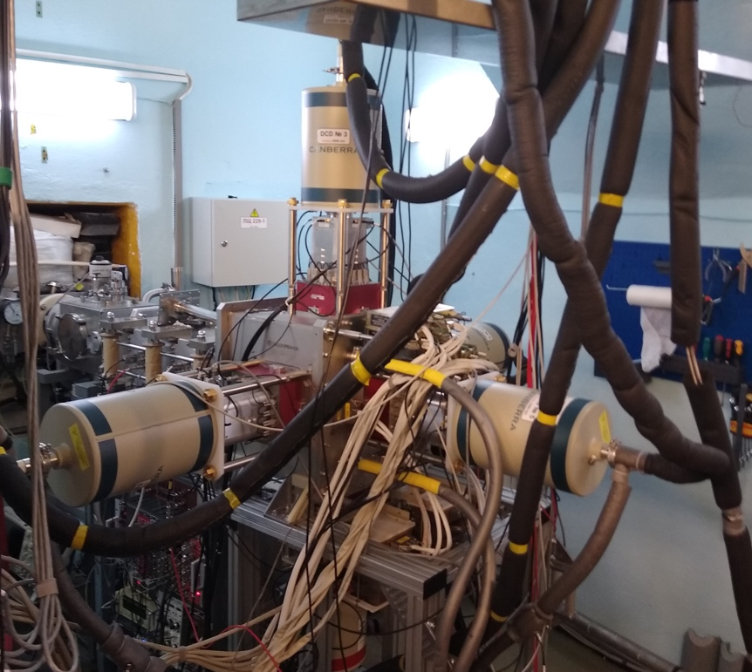
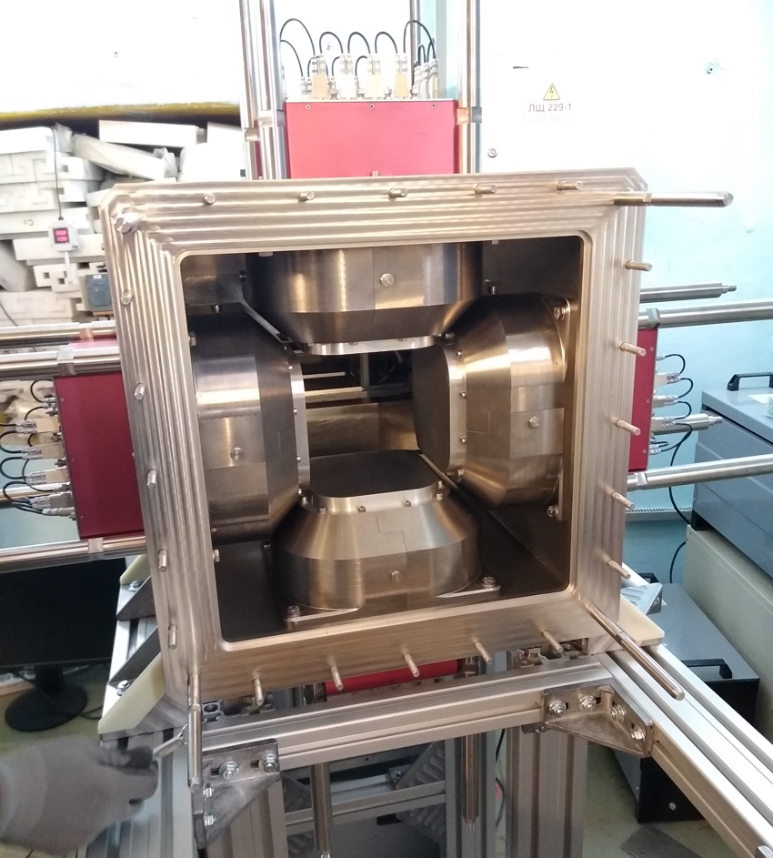
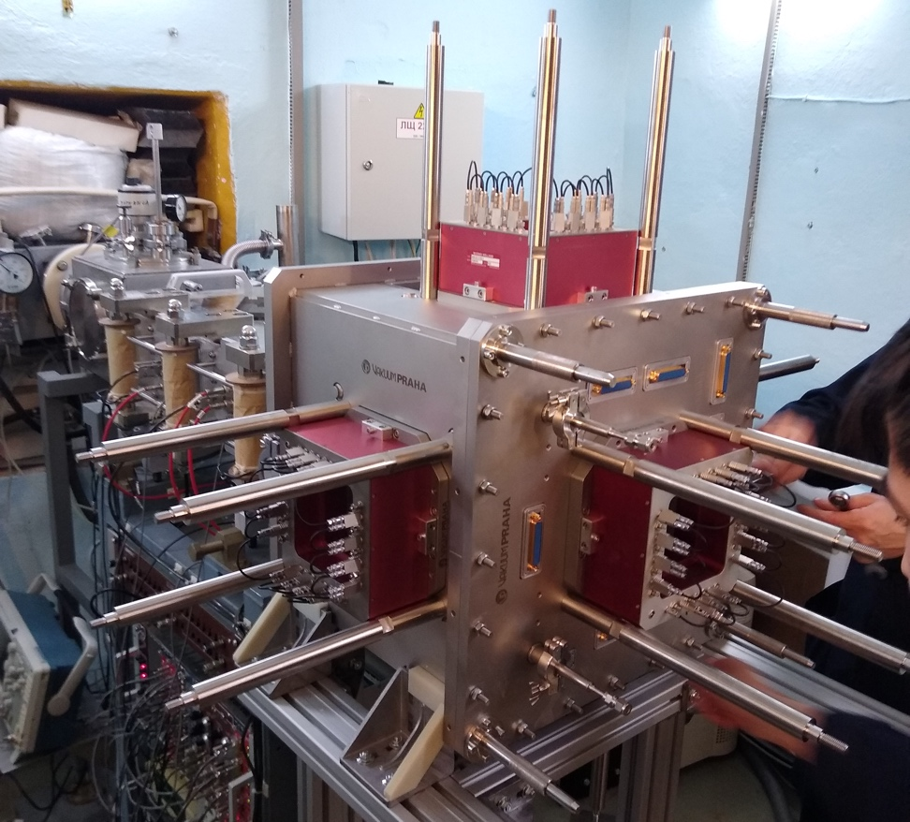
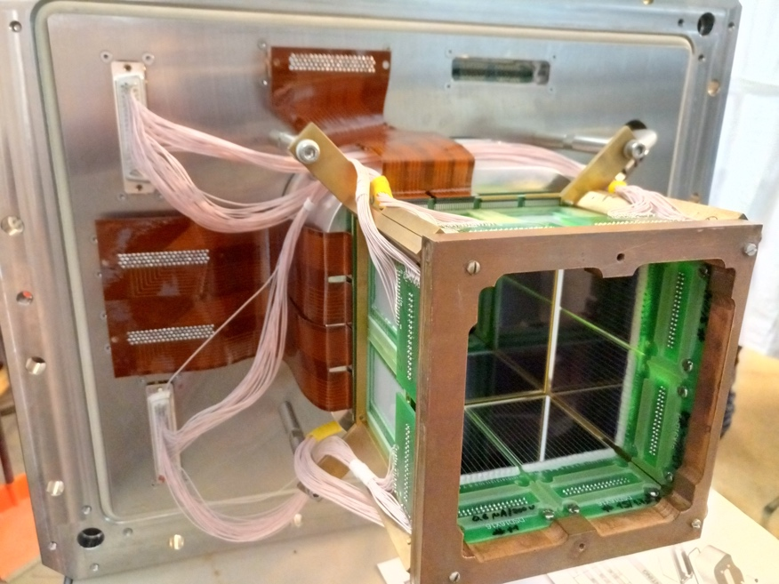
Possible upgrades
Looking at parallel developments at other sites:
“Lundium” array
basically sticking your (unshielded) clovers in the chamber
5 Clover GABRIELA upgrade:
array with active (outside) and passive shielding inside
Notes:
Yes – it seems odd to bring this up when we have not even had an experiment with SIRIUS yet, but conditions change, the competition move forward and we also have our own ideas for improvements.

Slide 15
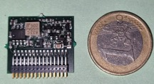
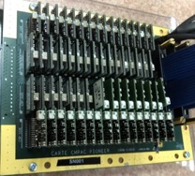
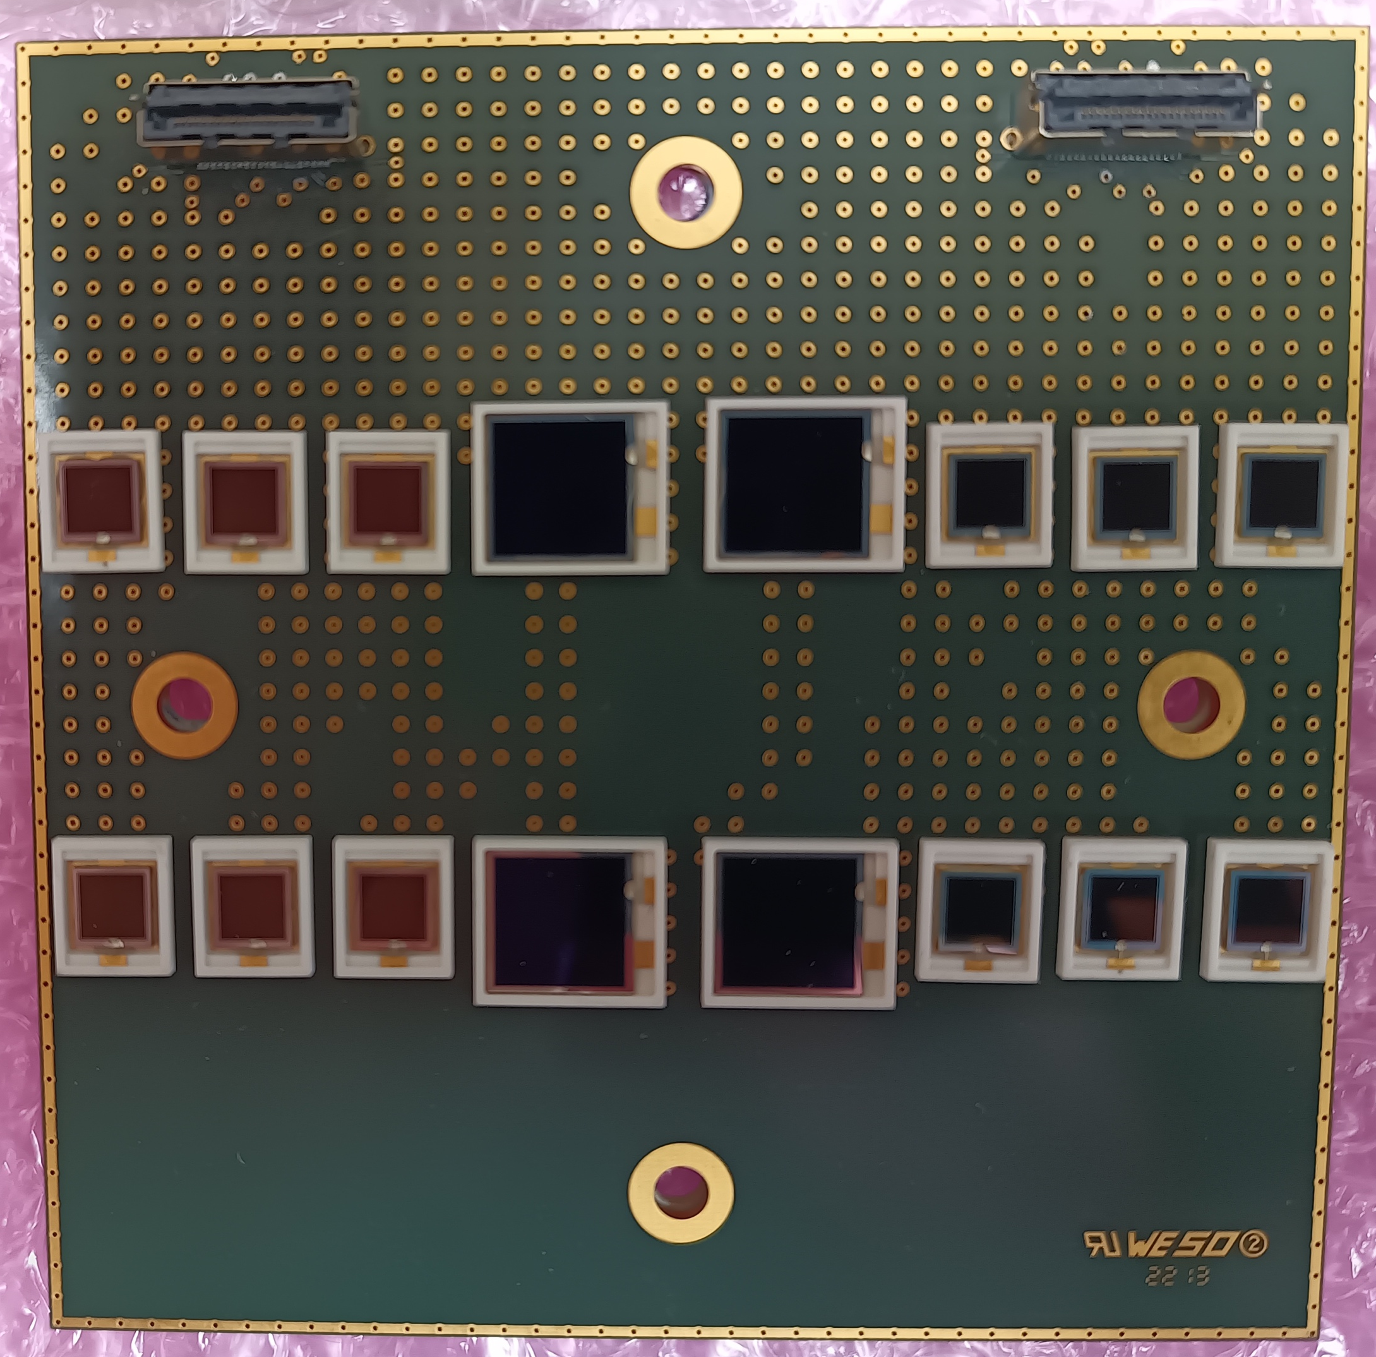
SHEXI Proof-of-principle: one 48x16 DSSD [CSP]
1)
Spin-off from SIRIUS CSP modified for the GABRIELA DSSD ➔ 64 channel board
range ~60 MeV, threshold ~50 keV, FWHM(α) ~14 keV, FWHM(e-) ~6 keV
(initial tests in 2018 following experimental runs @ DUBNA)
  TO DO
    CSP motherboards (#1 & #2)
    (1) new CSP version: reduce rise-time
    (2) produce a batch of CSP
    Feedthroughs, Interconnection & adapters (all)
    (#1 & #3) adapter board (NUMEXO)
    Improve trigger → lower threshold (DAQ)
2)
Atomki low-power preamp – fast (<15 ns) (have schematics)
NIM A366 (1995) 146 base-line noise < 2 keV
does not use BF862 FET
3)
NetInstruments: 16-channel CSP - 100 MeV into 2Vpp
10 ns rise-time (<100 pF load)
pulser tests <3.9 keV FWHM
Other solutions ?

