Slide 1
WP1 Secondment Task 1.2
Name: Butti, Daniele
Institution: CERN
Research Period: 2025/11/15 – 2025/11/29
Contact person/supervisor at your institute: Thibaut Lefevre
Contact person/supervisor at KEK, if any: Gaku Mitsuka
Overview of your research
Research Plan
Working on the upgrade of the existing LHC synchrotron radiation transverse diagnostics for the HL-LHC era
Studying transverse diagnostics options for FCC-ee collider ring
Assist in the commissioning of the SuperKEKB transverse diagnostic monitors. Learn their typical use cases, performance and limitations, and understand how transverse diagnostics are exploited during machine operation.
Study if solutions developed for SuperKEKB can be applied to the HL-LHC and FCC-ee transverse diagnostics systems.
1

Slide 2
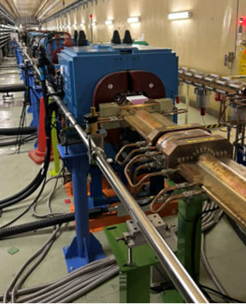
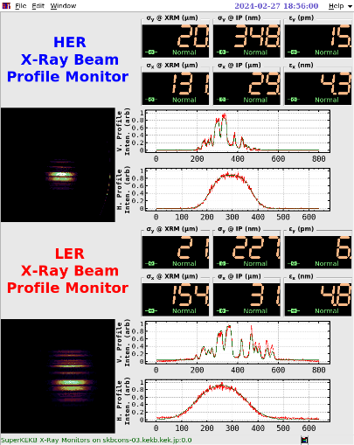
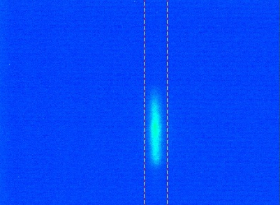
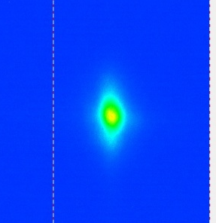
Synchrotron Radiation transverse diagnostics
Visible SR monitors
CERN Beam Instrumentation group is designing upgraded visible SR diagnostics for HL-LHC and studying X-ray transverse diagnostics scenarios for FCC-ee.
SuperKEKB features both visible and X-ray transverse diagnostics, with characteristics similar to HL-LHC (long diffraction-limited optical lines) and FCC-ee (~10 µm beam size resolution with high photon flux).
Secondment goal: understand the critical aspects of these instruments and learn how the main challenges were addressed.
Visit timing: early stage of SuperKEKB operation, to follow the setup of these diagnostics and observe how the measurements are used for machine tuning.
X-Ray diagnostics line ​
Events of vertical blow-up induced by SBL, detected by the visible SR monitors
Display of XRM
Credit G. Mitsuka, H. Ikeda, T. Mitsuhashi
2

