Slide 1
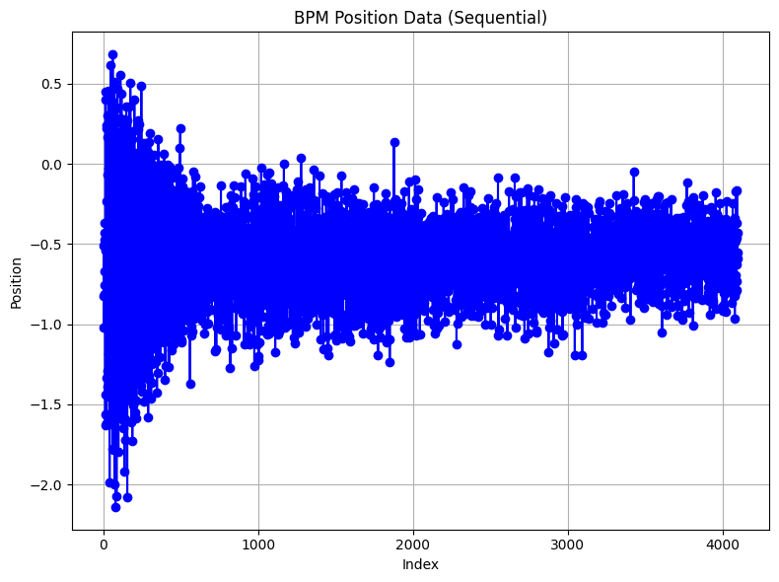

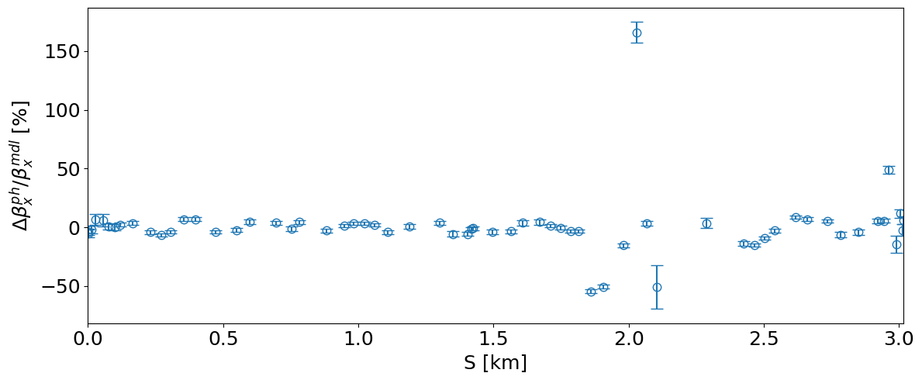
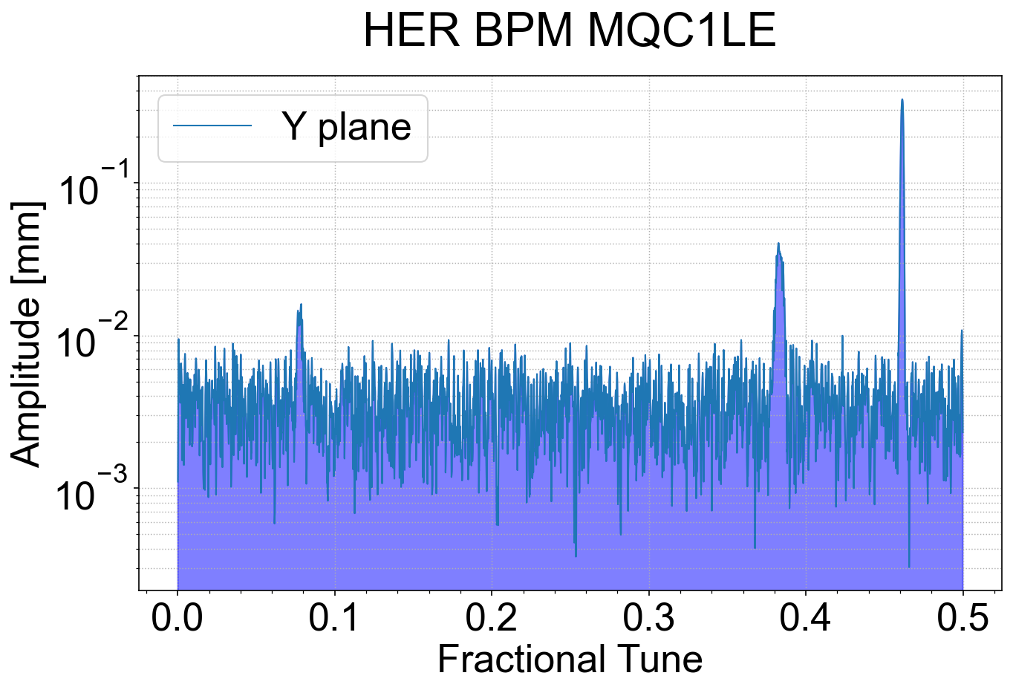
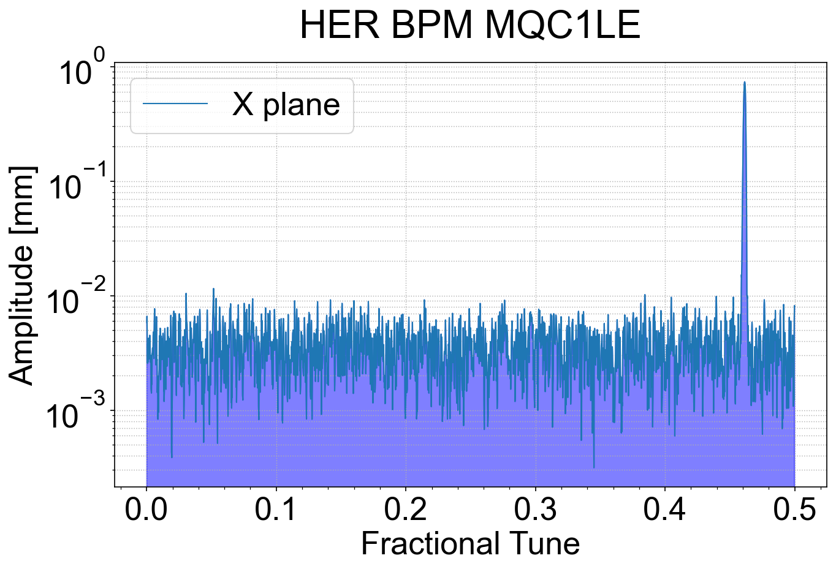
WP1/WP3 Secondment Task 1.2
Name: Bruant, Quentin
Institution: CEA/IRFU & Paris-Saclay University
Research Period: 2025/12/01 – 2025/12/15 – 2026 to be defined
Contact person/supervisor at your institute: Barbara Dalena
Contact person/supervisor at KEK, if any: Y. Ohnishi
Improve optics measurements based on the Turn-by-turn Beam Position Monitors
BPM data (gen. sdds format)
SVD cleaning
BPM data
Synchronization
If high singular
intrinsic errors
Else
SOMA
ACCELERATOR
Position [mm]
BPM cuts
Optics parameters reconstruction
Harmonic analysis
Turn number
1

Slide 2
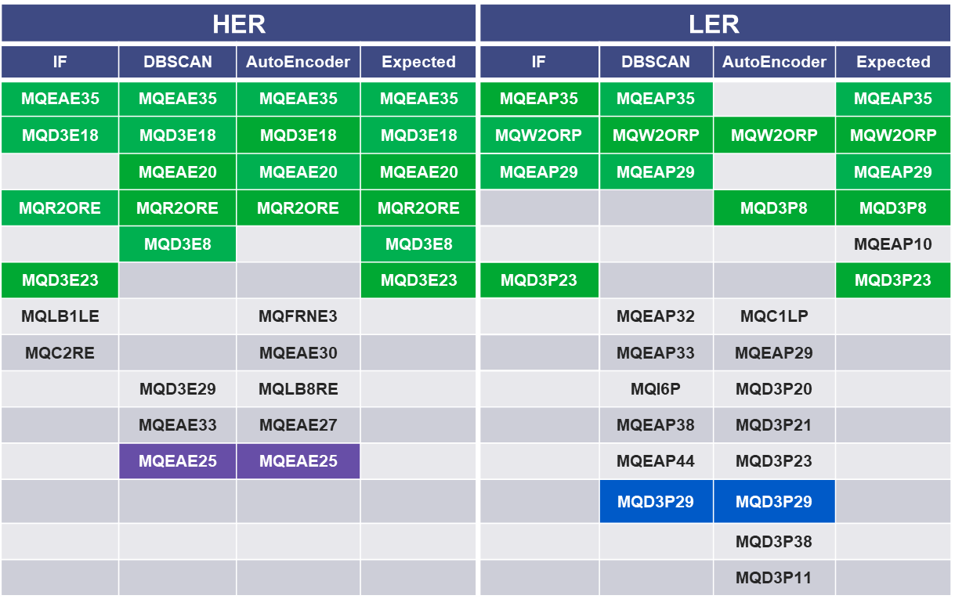
WP1/WP3 Secondment Task 1.2
We are investigating unsupervised, density-based clustering methods such as DBSCAN to automatically detect anomalous TbT BPMs and comparing them with neural architectures such as autoencoders and with Isolation Forest.
Research Plan
Acquire TbT BPM data during aperture measurements and IP knob and Lumi scan studies
Work on denoising of BPMs frequency spectra to improve non-linear optics reconstruction
2

