Slide 1

SuperKEKB run 2025-2026 WP1: R&D&I at currently operating state-of-the-art accelerator facilities
H2020-MSCA-RISE 2019
A. Faus-Golfe

Slide 2
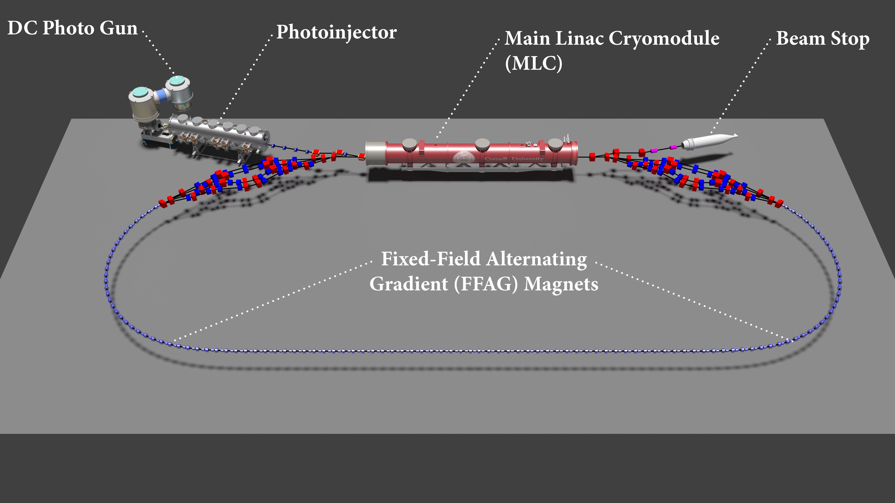
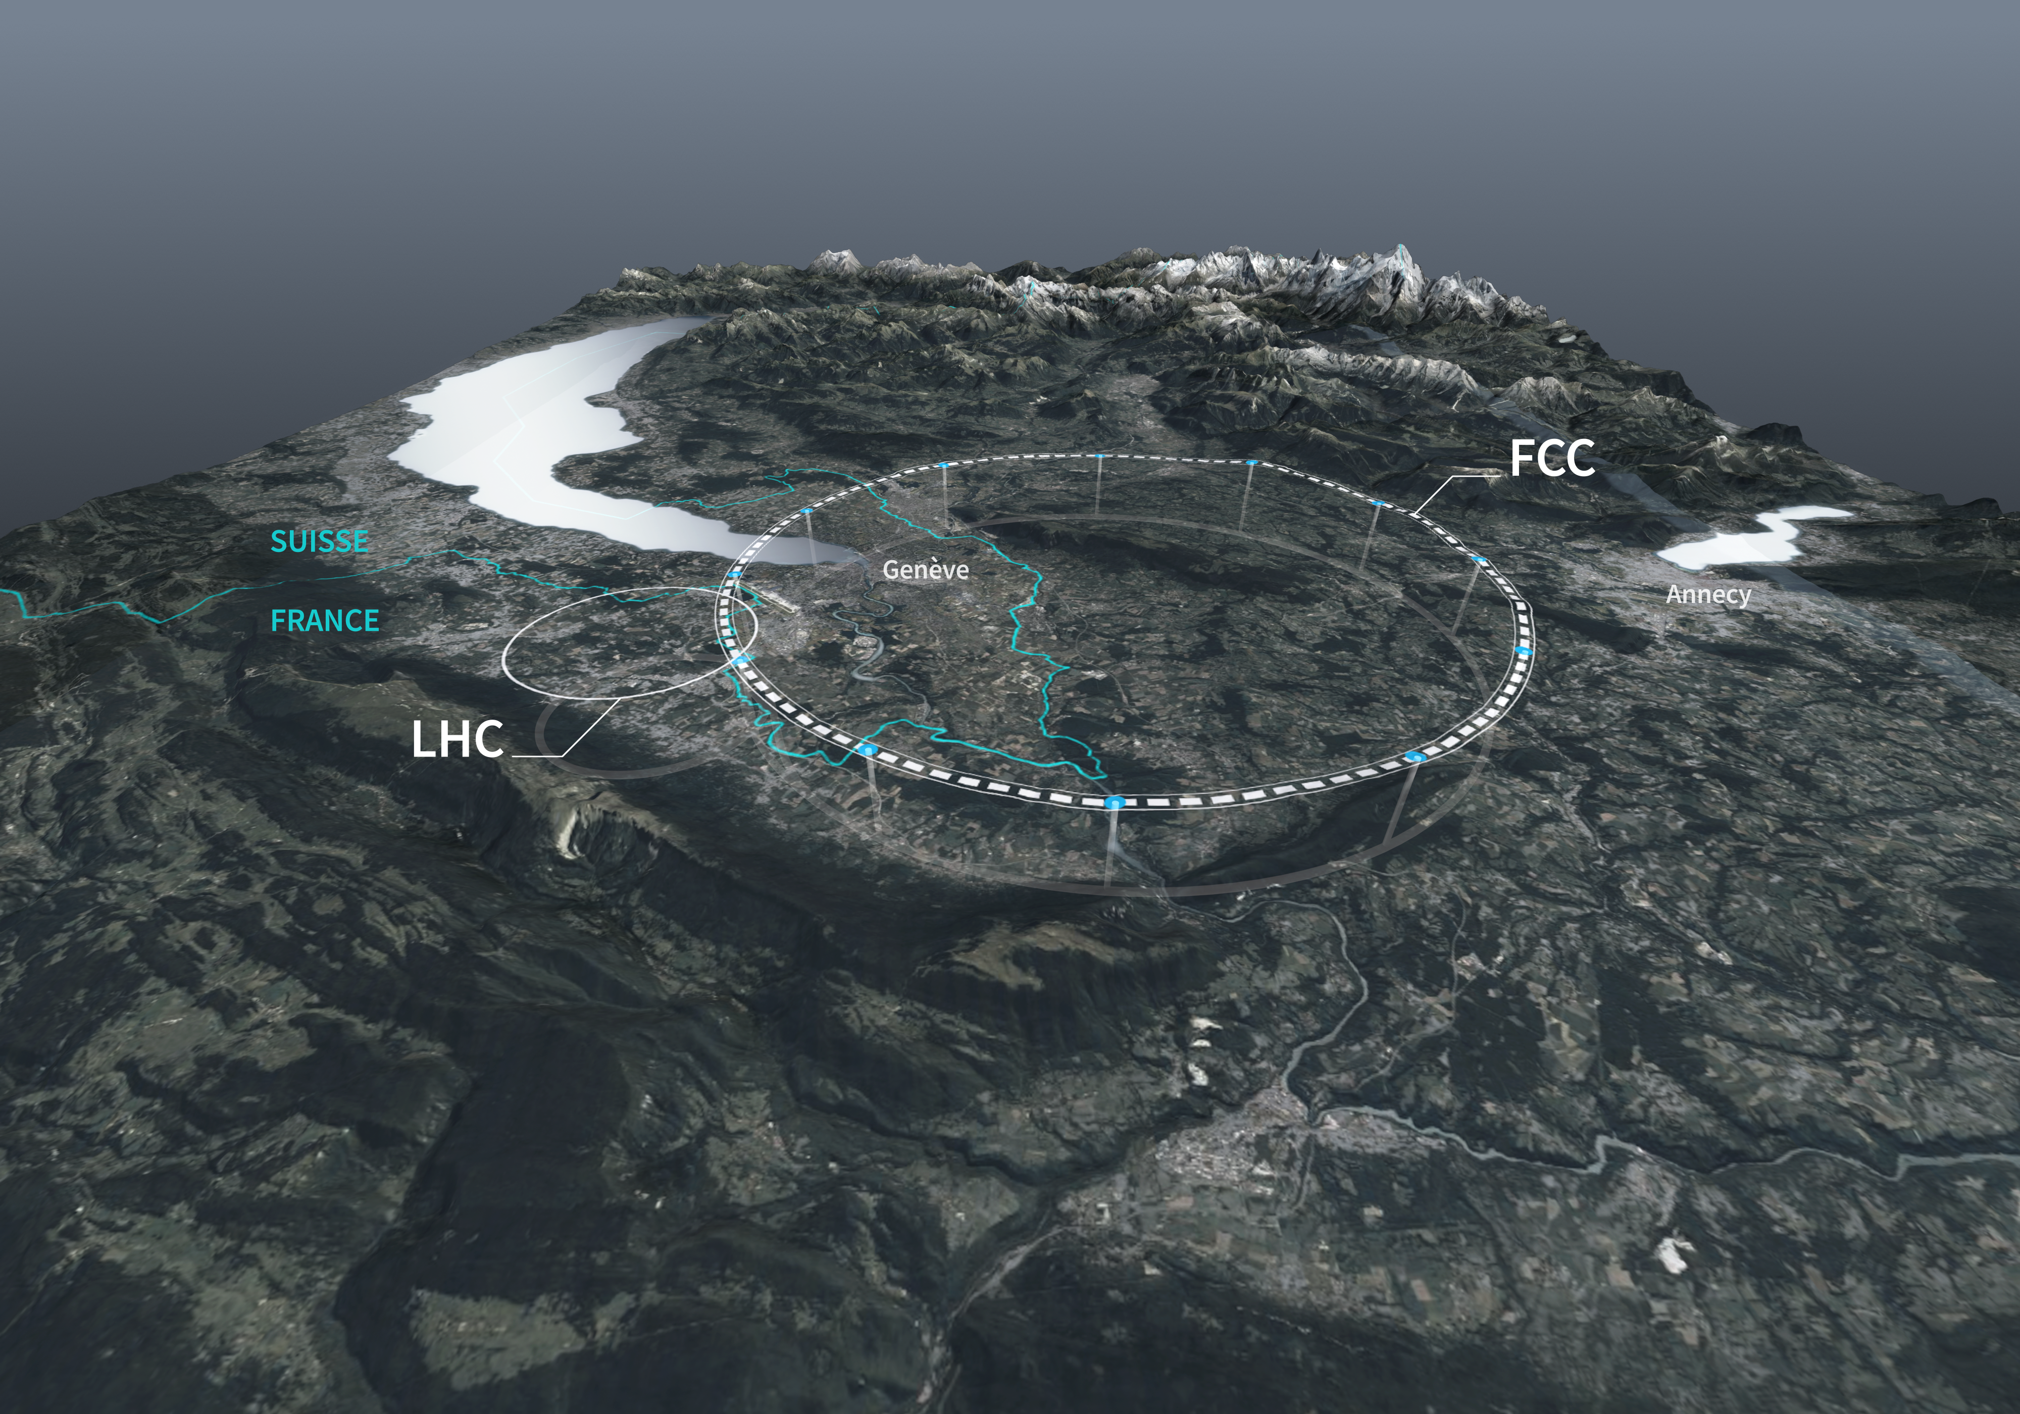
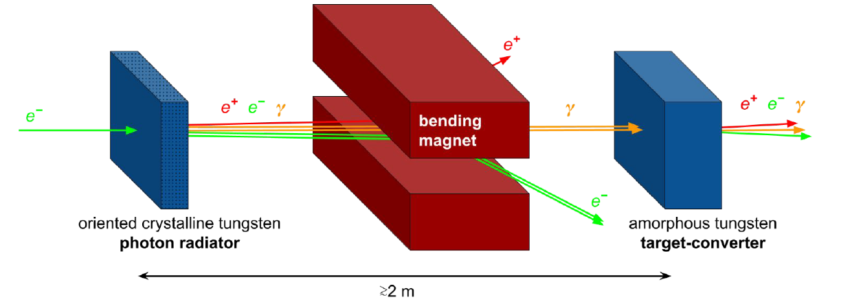
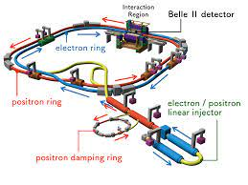
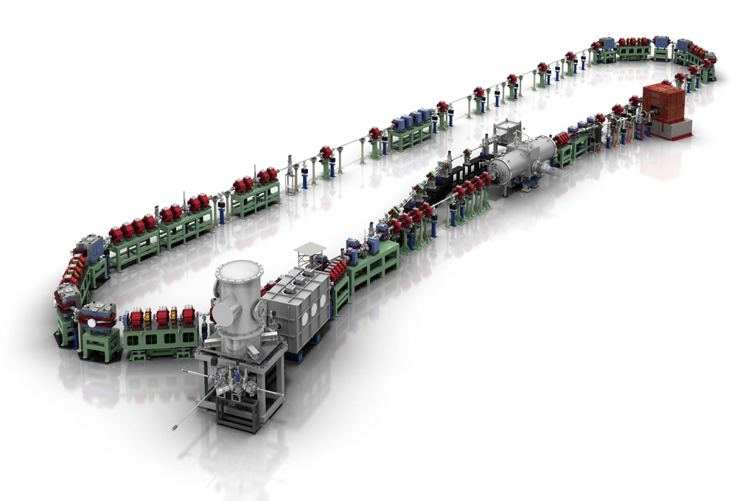
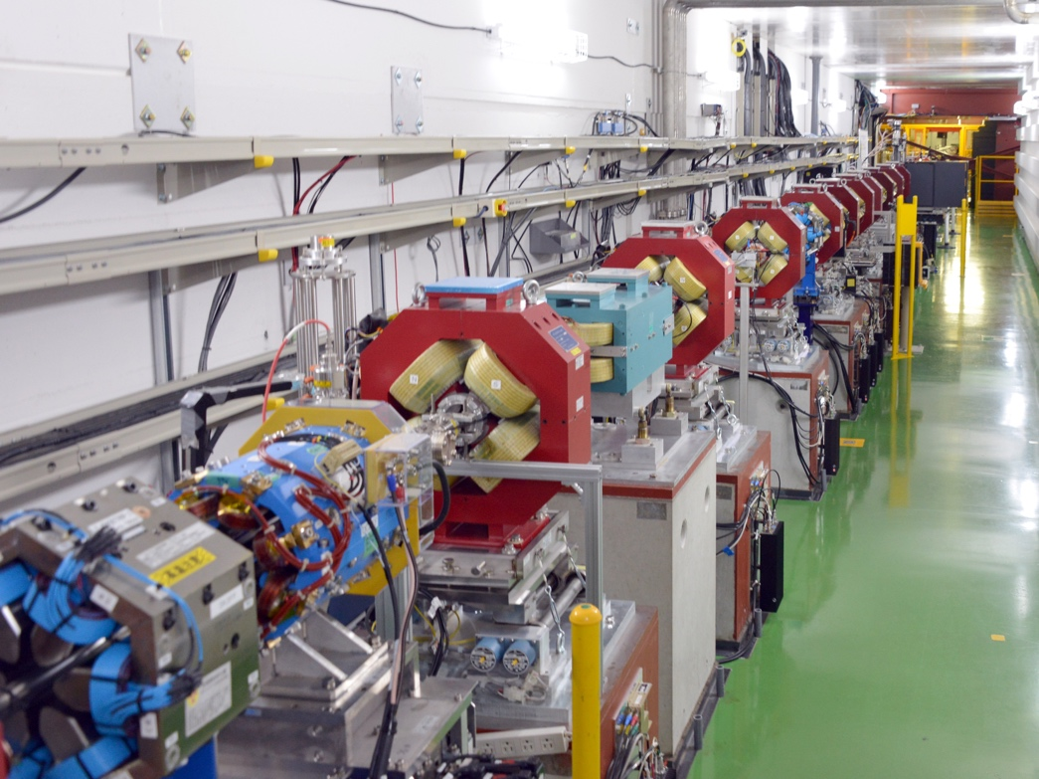
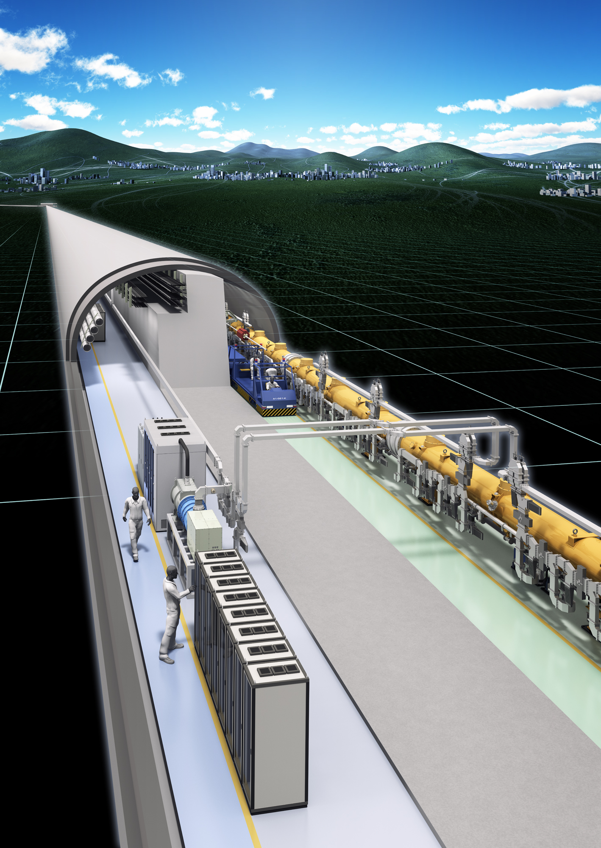
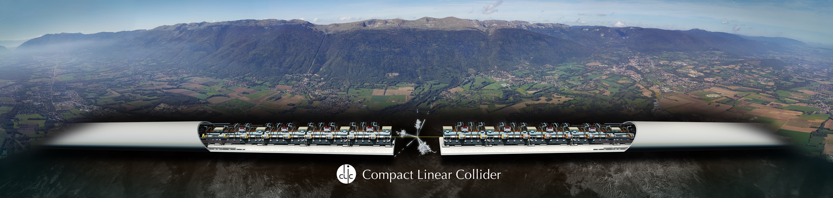
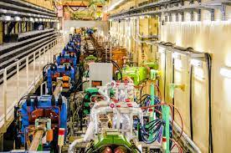
WP1 (112 months):
R&D&I at currently operating state-of-the-art accelerator facilities
Task 1.1 (57 months)
Future e⁺e⁻ linear collider studies
Task 1.2 (30 months)
Future e⁺e⁻ circular collider studies
Task 1.3 (19 months)
e⁺ production for e⁺e⁻ colliders
Task 1.4 (6 months)
R&D on ERLs
ATF3 (KEK) – 46 months
LCLSII (SLAC) – 5 months
IOTA (FNAL) – 6 months
SuperKEKB – 30 months
SuperKEKB – 17 months
FACETII (SLAC) – 1 month
CEBAF (JLAB) – 1 month
CBETA (JLAB) – 3 months
CERL (KEK) – 3 months
CERN – 7 months
CEA – 2 months
CNRS – 16 months
INFN – 5 months
CNRS – 6 months
CERN – 18 months
CEA – 2 months
CNRS – 16 months
CSIC-IFIC – 17 months
DESY - 4 months
UOXF – (34 months)
CERN – 4 months
CNRS – 15 months
Notes:
WP1 in a nutshell

Slide 3
WP1 (112 months):
R&D&I at currently operating state-of-the-art accelerator facilities
Task 1.1 (57 months)
Future e⁺e⁻ linear collider studies
Task 1.2 (30 months)
Future e⁺e⁻ circular collider studies
Task 1.3 (19 months)
e⁺ production for e⁺e⁻ colliders
Task 1.4 (6 months)
R&D on ERLs
ATF3 (KEK) – 46 months
LCLSII (SLAC) – 5 months
IOTA (FNAL) – 6 months
SuperKEKB – 30 months
SuperKEKB – 17 months
FACETII (SLAC) – 1 month
CEBAF (JLAB) – 1 month
CBETA (JLAB) – 3 months
CERL (KEK) – 3 months
CERN – 7 months
CEA – 2 months
CNRS – 16 months
INFN – 5 months
CNRS – 6 months
CERN – 18 months
CEA – 2 months
CNRS – 16 months
CSIC-IFIC – 17 months
DESY - 4 months
UOXF – (34 months)
CERN – 4 months
CNRS – 15 months
Notes:
WP1 in a nutshell

Slide 4
Task 1.2: Future e⁺e⁻ circular collider studies (CERN, CEA, CNRS, INFN, 30 person-months)
SuperKEKB is a state-of-the-art facility operated at KEK which is particularly well suited to study some of the main issues and challenges for future circular colliders, especially the FCC-ee Higgs factory under consideration at CERN. The main topics to be addressed are: (1) luminosity monitoring and extraction of beam parameters at interaction point (IP), (2) feedback control of IP beam offsets, (3) monitoring of final focus magnet vibration with benchmarking of simulation and evaluation of luminosity impact, (4) beam optics tuning with very low β_{y}* and crab-waist collision scheme, (5) impact of collective effects on performance, (6) benchmarking of linear and non-linear optics, (7) beam lifetime, (8) evaluation of beam-induced background in interaction region and mitigation via collimation, (9) machine-detector interfacing.
SuperKEKB @ KEK

Slide 5
WP1 Secondment Task 1.2
Name: Family name, First name, Middle name
Institution:
Research Period: YYYY/MM/DD – YYYY/MM/DD
Contact person/supervisor at your institute:
Contact person/supervisor at KEK, if any:
Overview of your research
Research Plan
Find improved..
Optimizing...
Find improved..
Optimizing...
5

Slide 6
WP1 Secondment Task 1.2
Similar to the one to send to Super KEKB ICB
6

