Slide 1


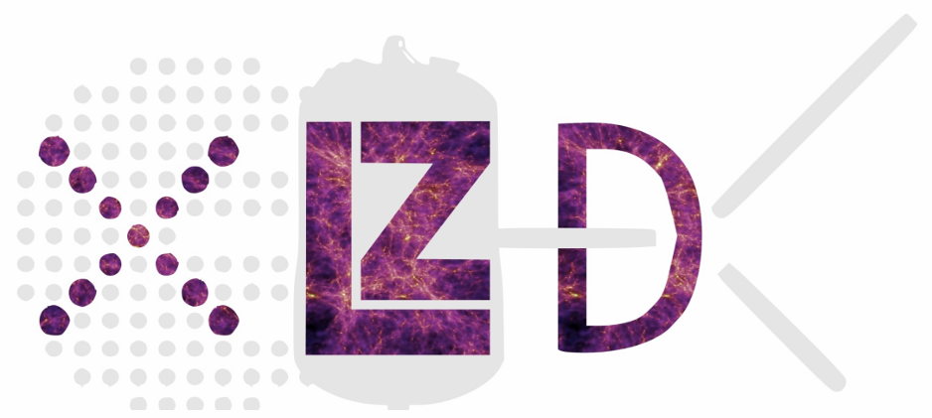
XLZD Sensitivity Studies to WIMP via Migdal Effect
Lorenzo Principe
on behalf of the XLZD low-mass Migdal team
IRN Terascale 2025 @ Montpellier

Slide 2
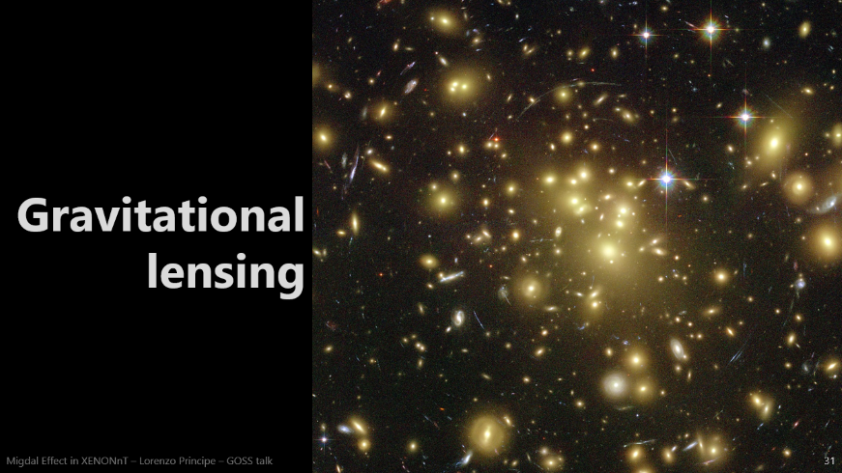
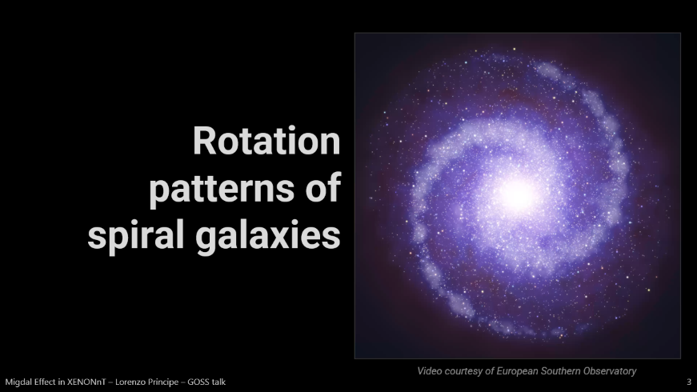
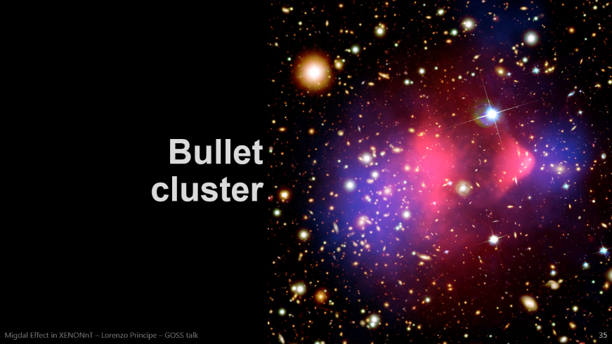

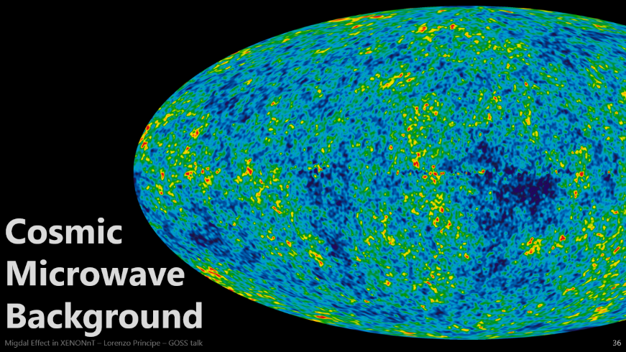



Evidence for Dark Matter

Slide 3
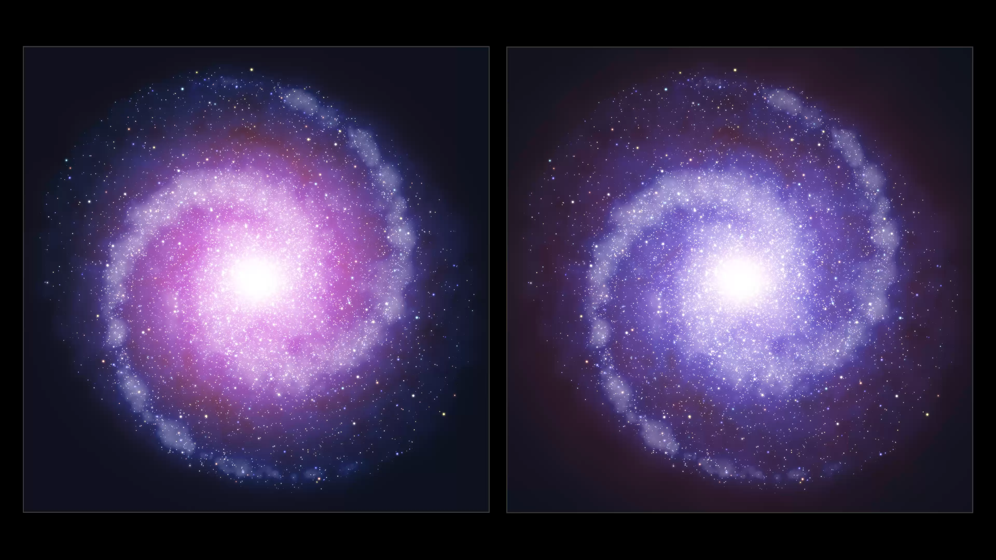
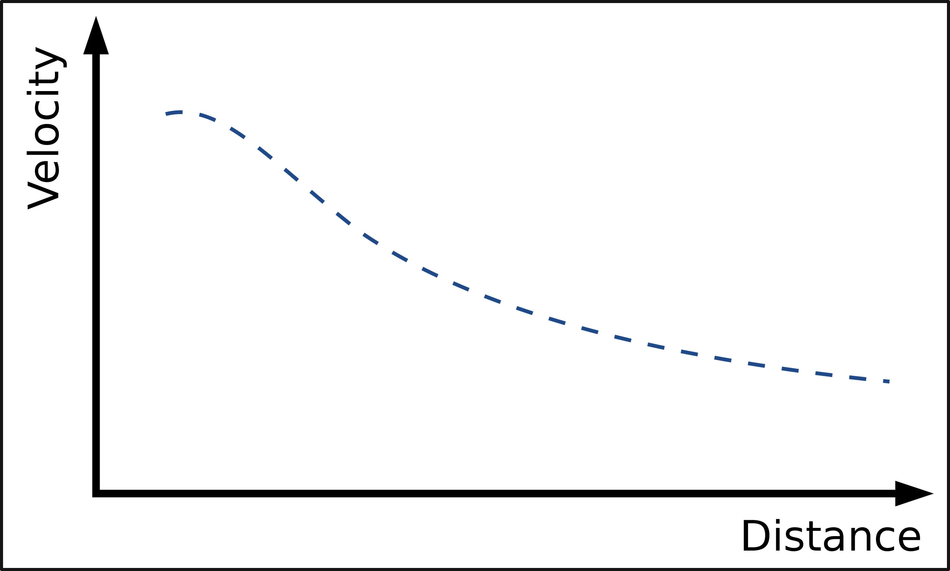
Rotation patterns of spiral galaxies
Expected
Video courtesy of European Southern Observatory

Slide 4
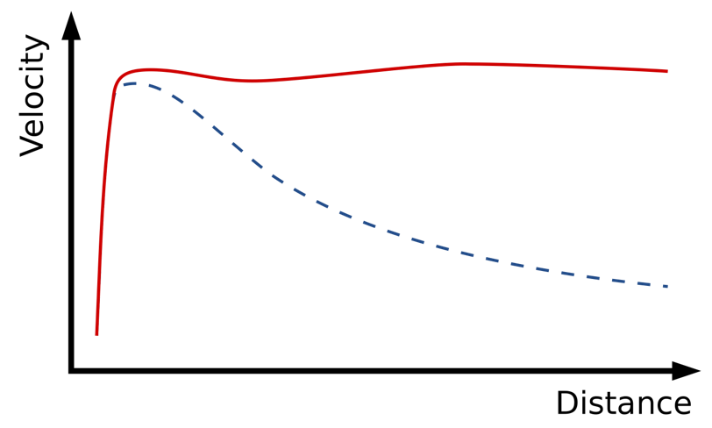

A halo of Dark Matter
Observed
As the Earth moves through the halo, it experiences a Dark Matter wind.
Direct Detection experiments aim to detect the interaction between a terrestrial target and DM in the “wind”.
Expected
Video courtesy of European Southern Observatory
Notes:
The imaginary galaxy on the left is in the nearby Universe and the stars in its outer parts are orbiting rapidly due to the presence of large amounts of dark matter around the central regions. On the other hand the galaxy at the right, which is in the distant Universe, and seen as it was about ten billion years ago, is rotating more slowly in its outer parts as dark matter is more diffuse.

Slide 5
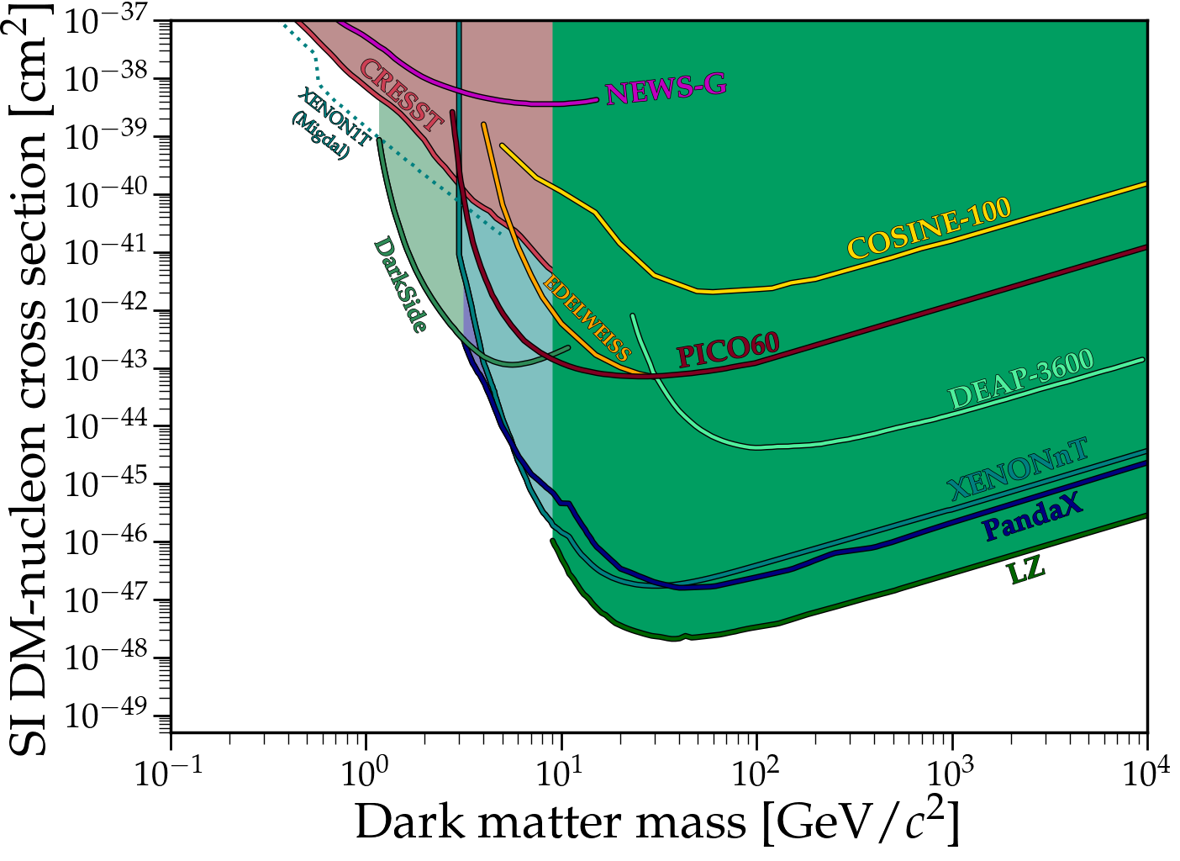



WIMP Direct Detection experiments
Different technologies
One shared phase space
Common astrophysics assumptions
Standardised Halo Model
Common signal models
Spin-independent & spin-dependent channels
Standard nuclear response functions
Common analysis conventions
Profile Likelihood Ratio method
Power-Constrained Limits
90% Confidence Intervals
Plot made using Ciaran O'Hare’s code: github.com/cajohare/DirectDetectionPlots.git
White Paper: Eur. Phys. J. C 81, 907 (2021)

Slide 6
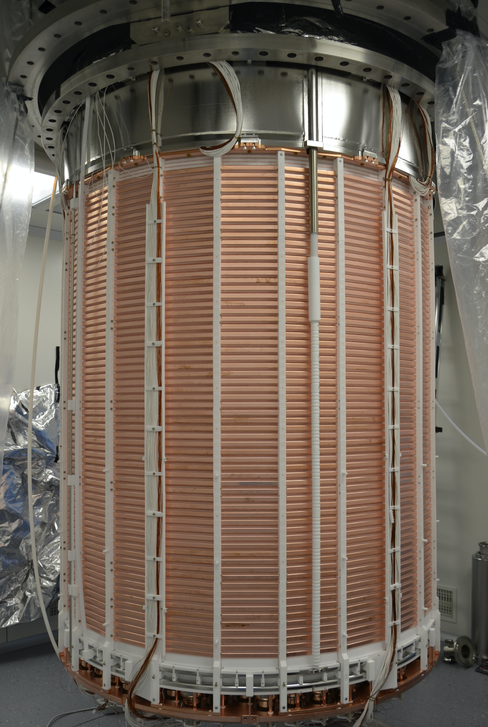
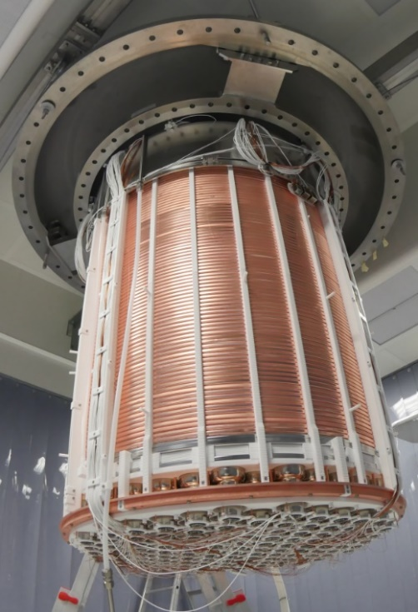
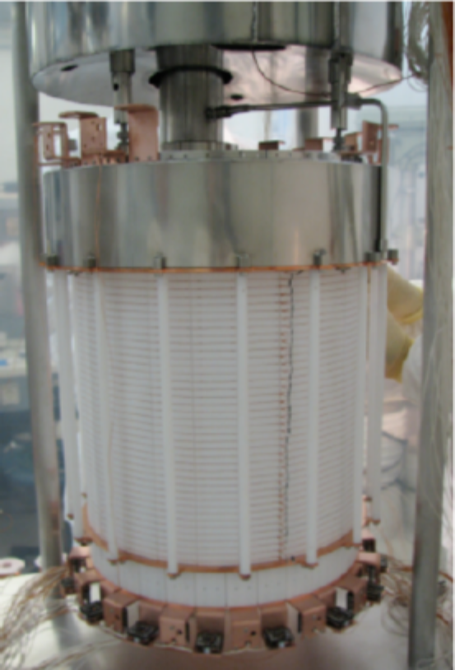
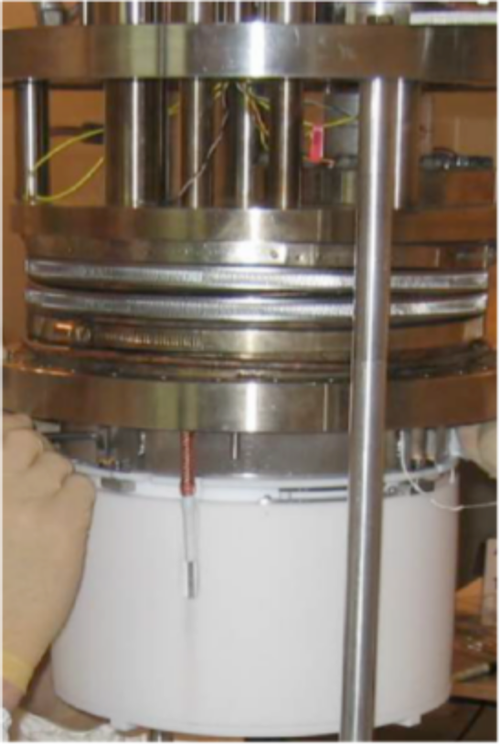
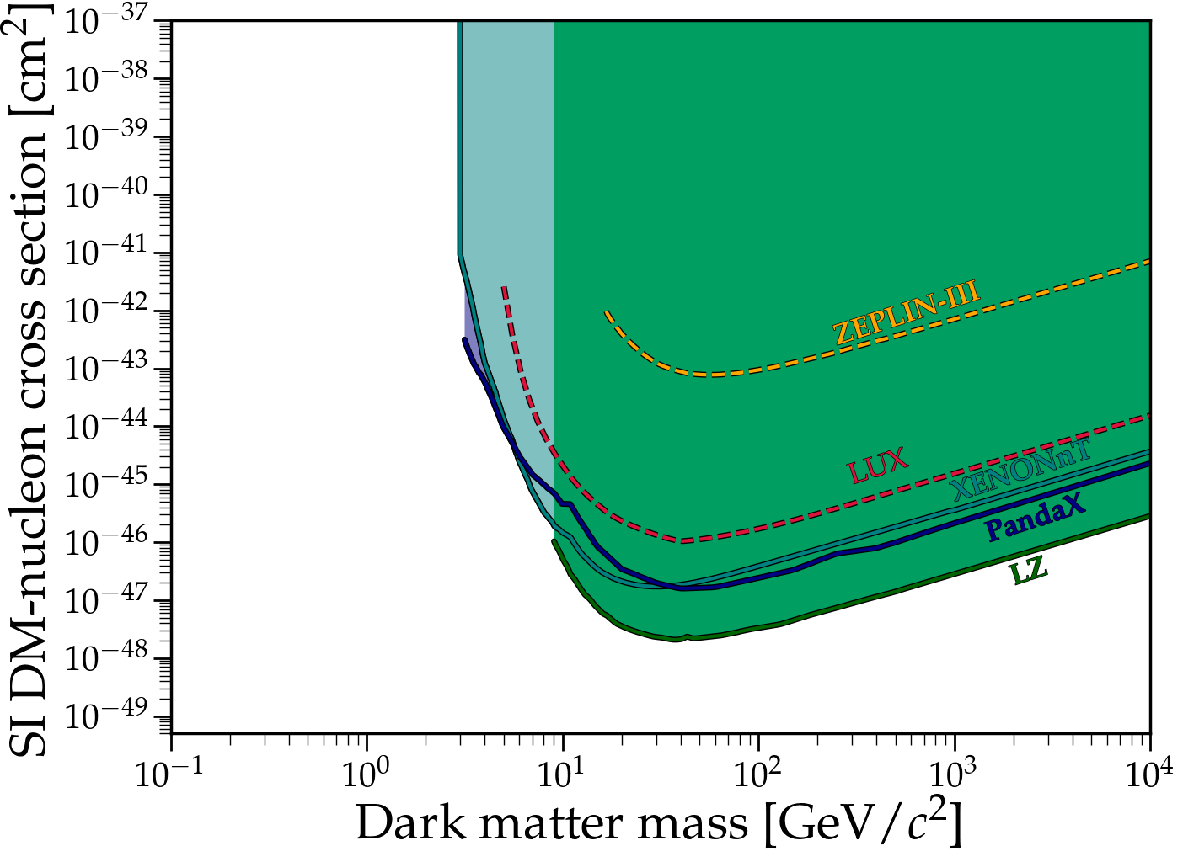
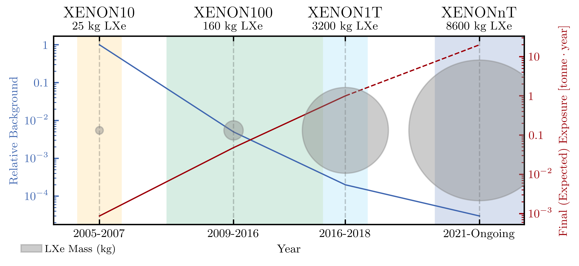
WIMP Direct Detection experiments
Liquid Xenon Time Projection Chambers
Early prototypes demonstrated the feasibility of LXe TPCs
Detector scaling enables increasingly stringent limits
Plot made using Ciaran O'Hare’s code: github.com/cajohare/DirectDetectionPlots.git
Similar evolution for PandaX experiments

Slide 7
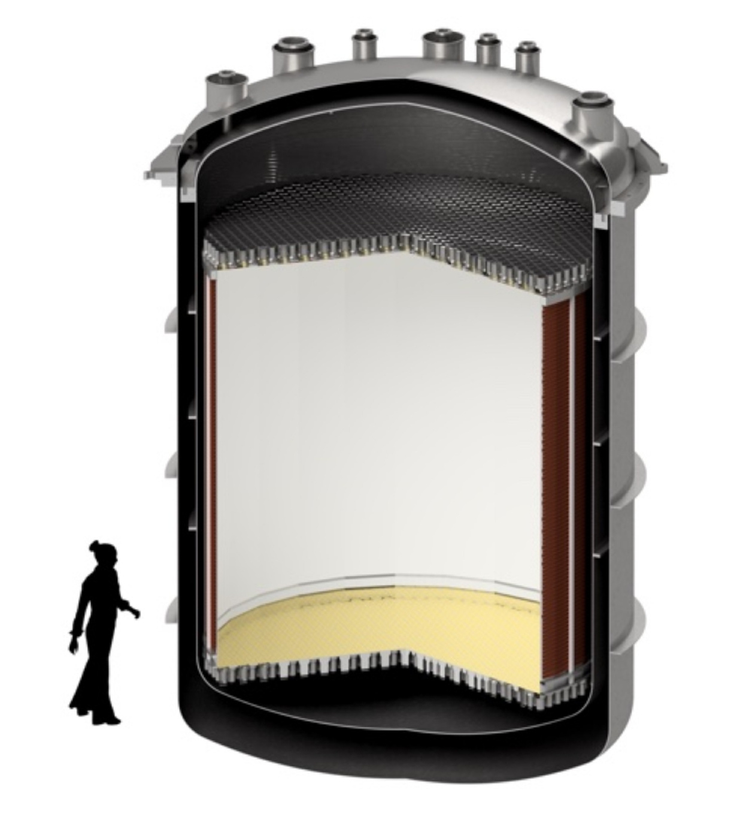
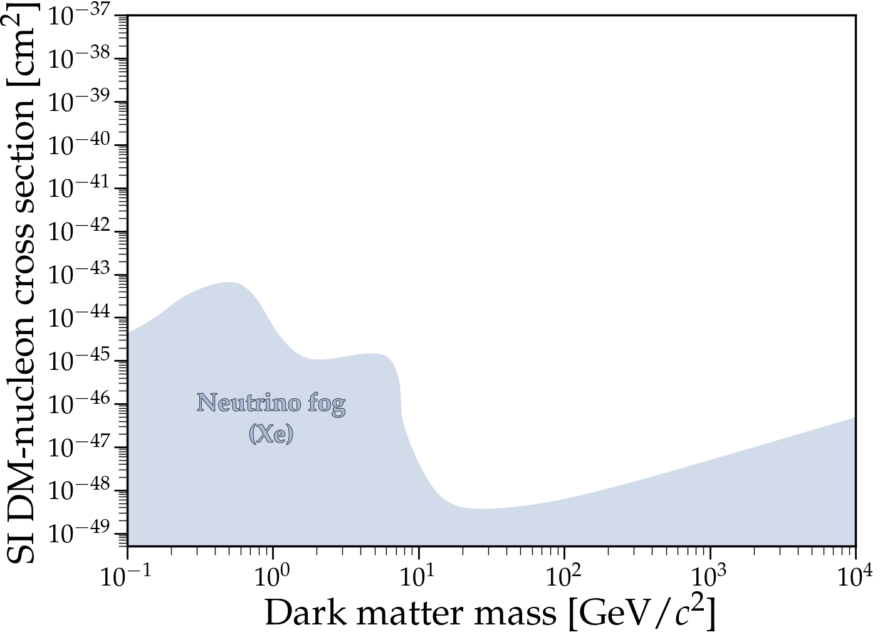
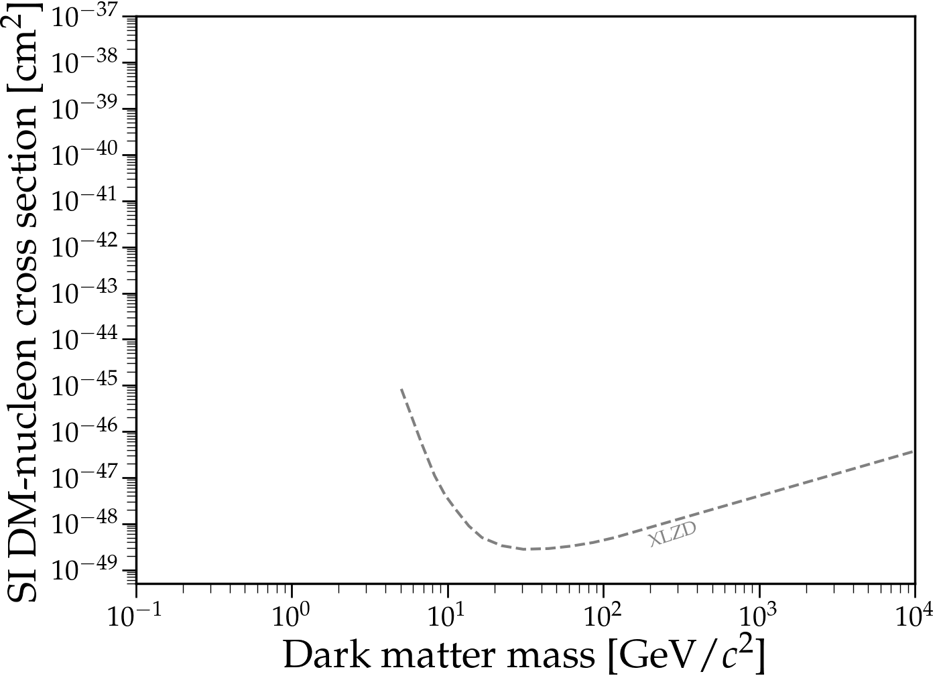
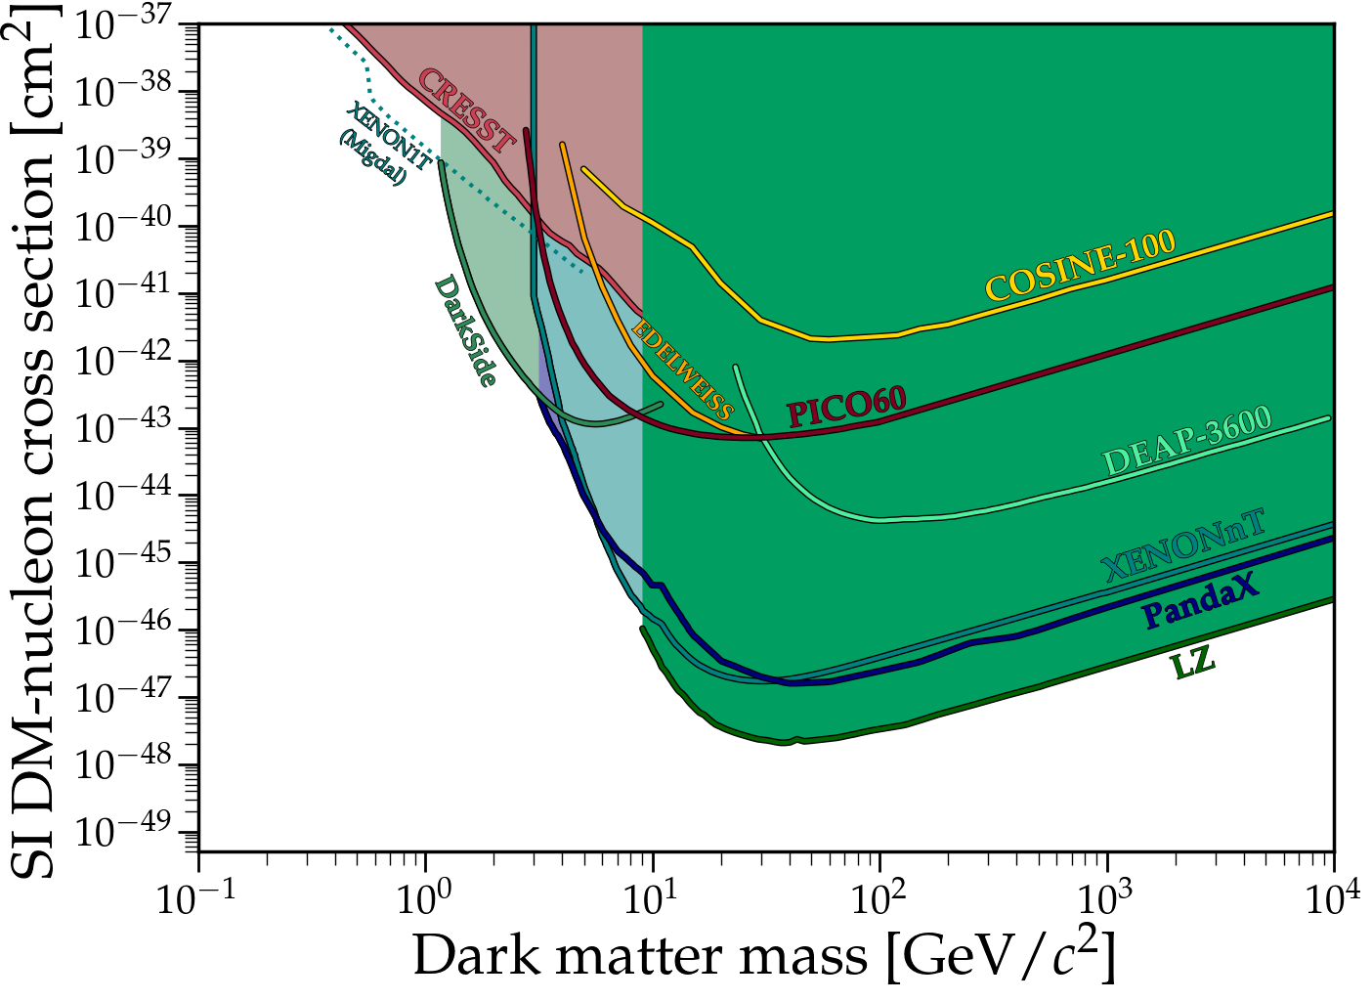

International Collaboration of Collaborations:
XENON
LZ
DARWIN (R&D project)
60-80 tonne LXe
Nominal design:
$3 \text{m} × 3 \text{m}$
Drift field: 240-290 V/cm
Extraction field: 6-8 kV/cm
~ 2200 PMTs
Possible locations:
LNGS (Italy)
Boulby (UK)
SURF (USA)
SNOLAB (Canada)
…
Plot made using Ciaran O'Hare’s code: github.com/cajohare/DirectDetectionPlots.git

Slide 8
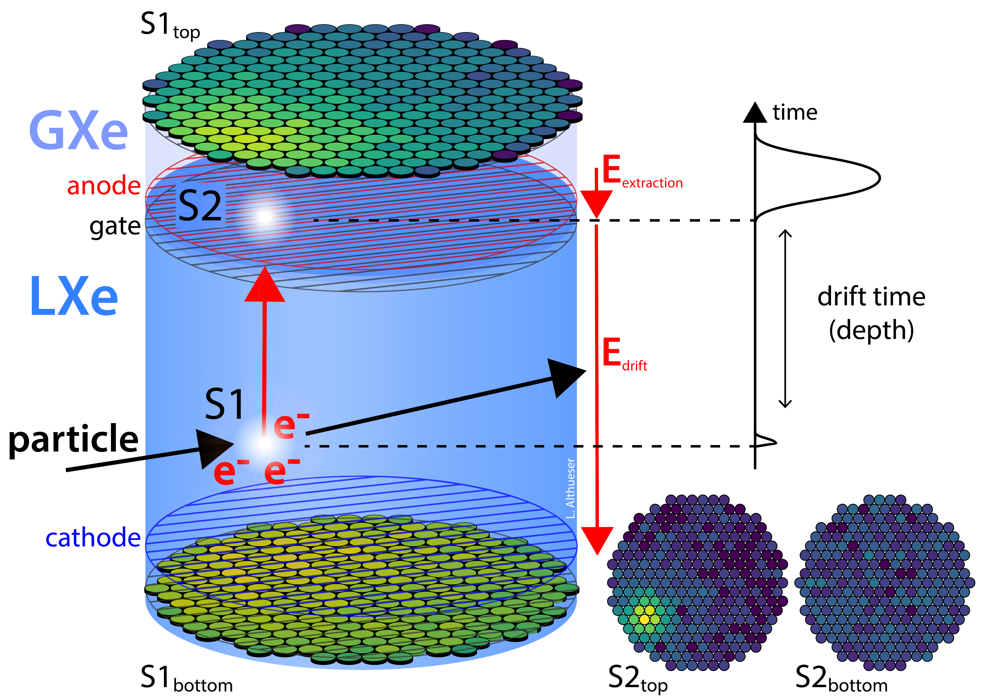
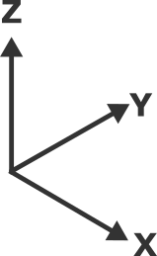



Dual-Phase Xenon TPC
Working Principles
3D Position Reconstruction
X, Y
from S2 pattern on top PMT array
Z
from electron drift time
$$2.9 kV/cm$$
Allows for volume fiducialisation and position dependent corrections
$$23 V/cm$$
Energy Reconstruction
Deposited energy inferred from corrected S1 and S2 intensities
$$E∝\left(\frac{\text{cS}\text{1}}{g_{1}}+\frac{c\text{S}2}{g_{2}}\right)$$
Designer: Lutz Althüser

Slide 9
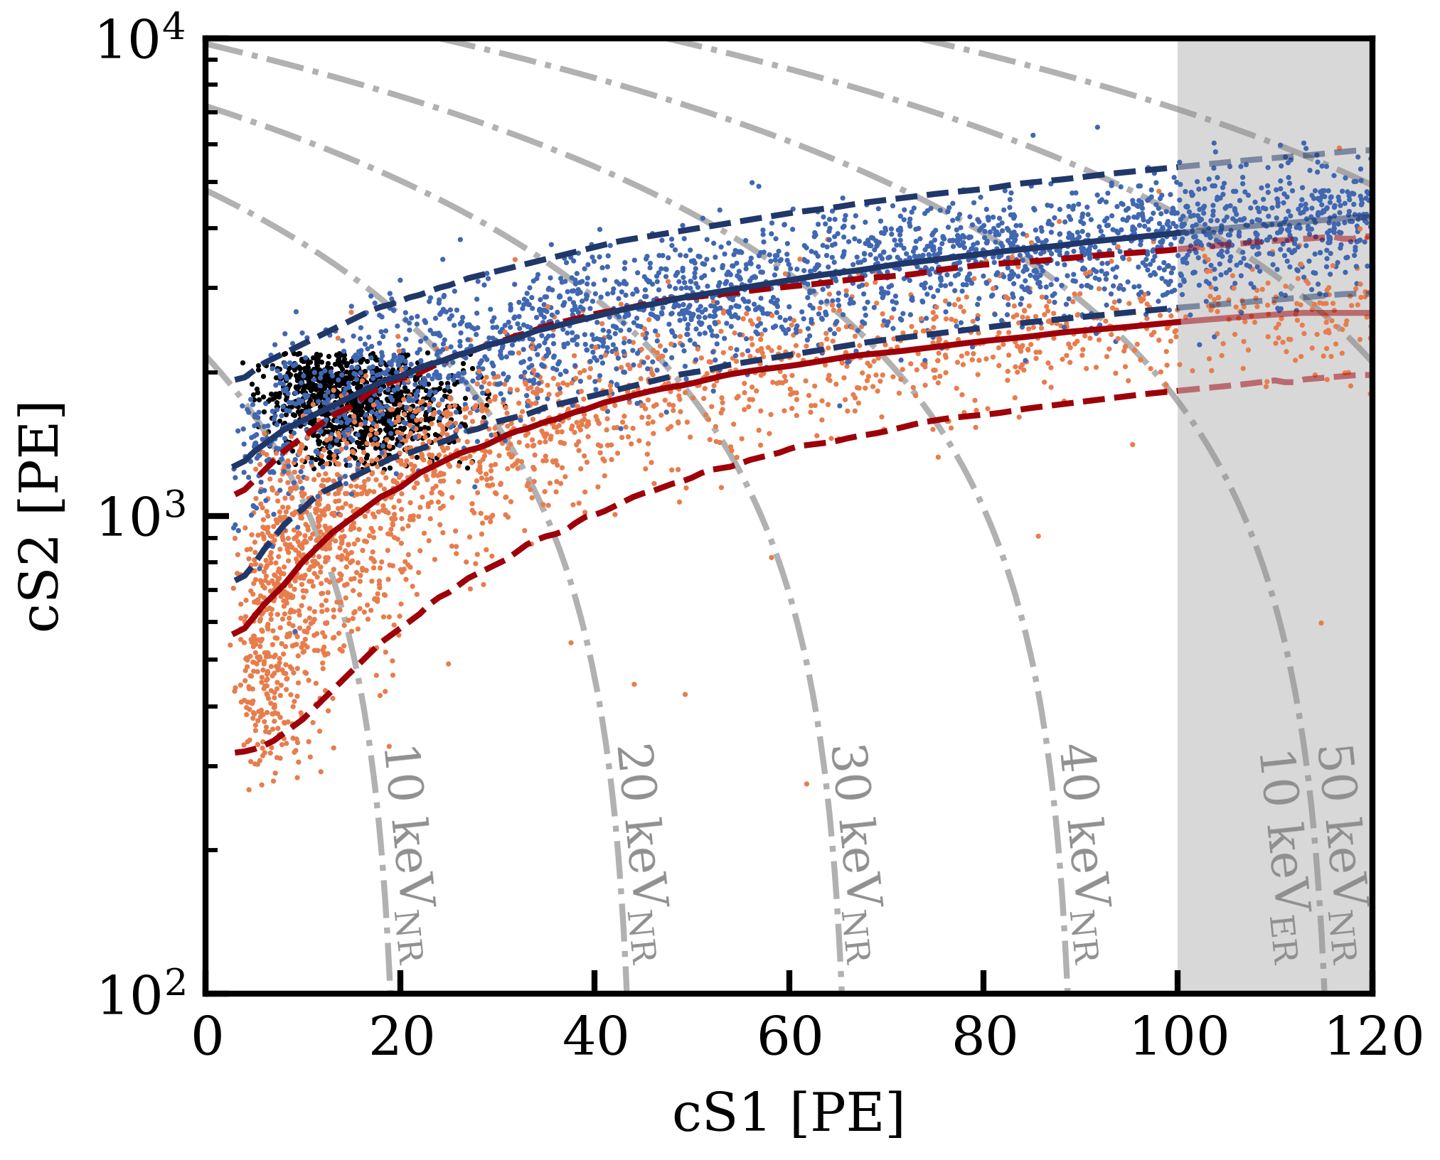
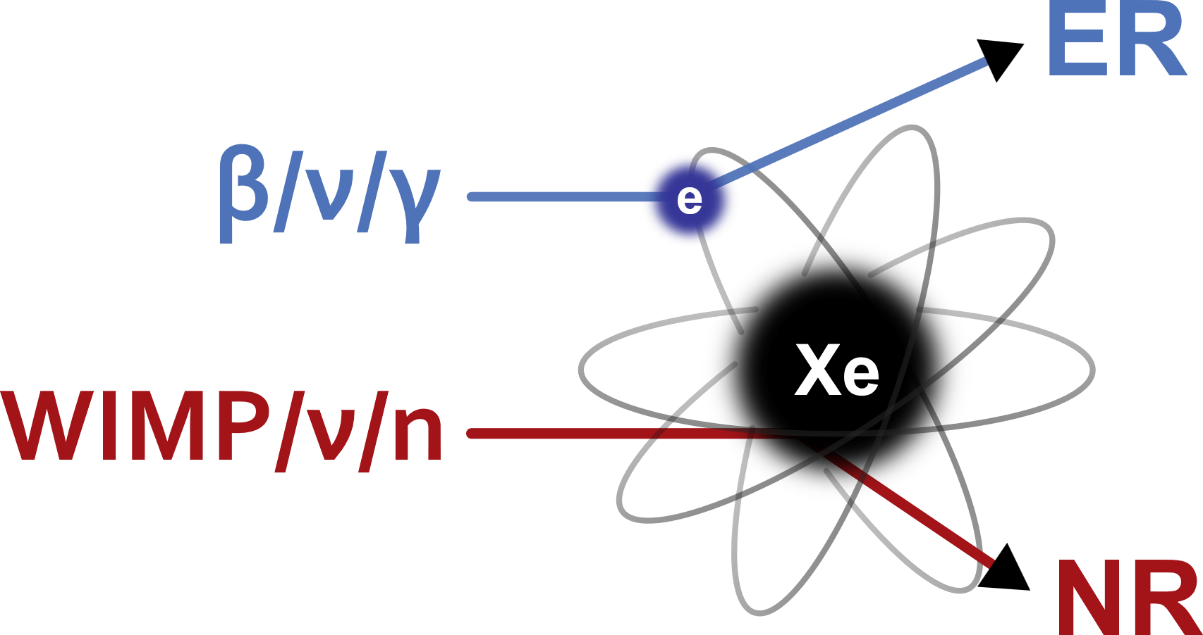
Dual-Phase Xenon TPC
3D Position Reconstruction
X, Y
from S2 pattern on top PMT array
Working Principles
Z
from electron drift time
Energy Reconstruction
Deposited energy inferred from corrected S1 and S2 intensities
$$2.9 kV/cm$$
Interaction type discrimination
Electronic Recoil (ER)
$$23 V/cm$$
Nuclear Recoil (NR)
Calibration sources:
AmBe for NR
²²⁰Rn for ER
³⁷Ar for Low ER
Designer: Lutz Althüser

Slide 10

Migdal Effect
Deposited Energy:
NR
Migdal electron
Binding energy (X-ray + Auger e⁻)
{
ER

Slide 11
Migdal Effect
Electronic Recoil (ER)
Deposited Energy:
NR
Migdal electron
Binding energy (X-ray + Auger e⁻)
{
ER
Nuclear Recoil (NR)
Possible studies
Observe the Migdal Effect using neutron calibration data
Use the Migdal Effect for sub-GeV mass WIMP search

Slide 12
Migdal Effect
Electronic Recoil (ER)
Deposited Energy:
NR
Migdal electron
Binding energy (X-ray + Auger e⁻)
{
ER
Nuclear Recoil (NR)
Possible studies
Observe the Migdal Effect using neutron calibration data
Use the Migdal Effect for sub-GeV mass WIMP search

Slide 13


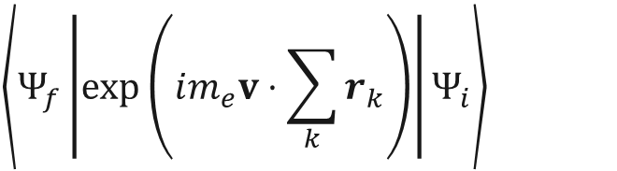
Migdal Effect – Transition Probabilities
Provided by Peter Cox, et al.
Cox, Peter, et al. "Precise predictions and new insights for atomic ionization from the Migdal effect." Physical Review D 107.3 (2023): 035032.
$$\left\langle \left.Ψ_{f}\left|\exp\left(im_{e}v⋅\sum_{k}{r_{k}}\right)\right|Ψ_{i}\right.\right\rangle$$
From nucleus’ rest frame, the electronic cloud recoils.
Transition matrix element obtained using Galilean boost operator.
Initial and final states of the electron cloud can be rewritten as products of single-electron wavefunctions.
Exclusive transition probability

Slide 14
Migdal Effect – Transition Probabilities
Exclusive transition probability
Cox et al. provides exclusive transition probabilities from ground state to a final state where only one or two electrons are NOT in ground state

Slide 15
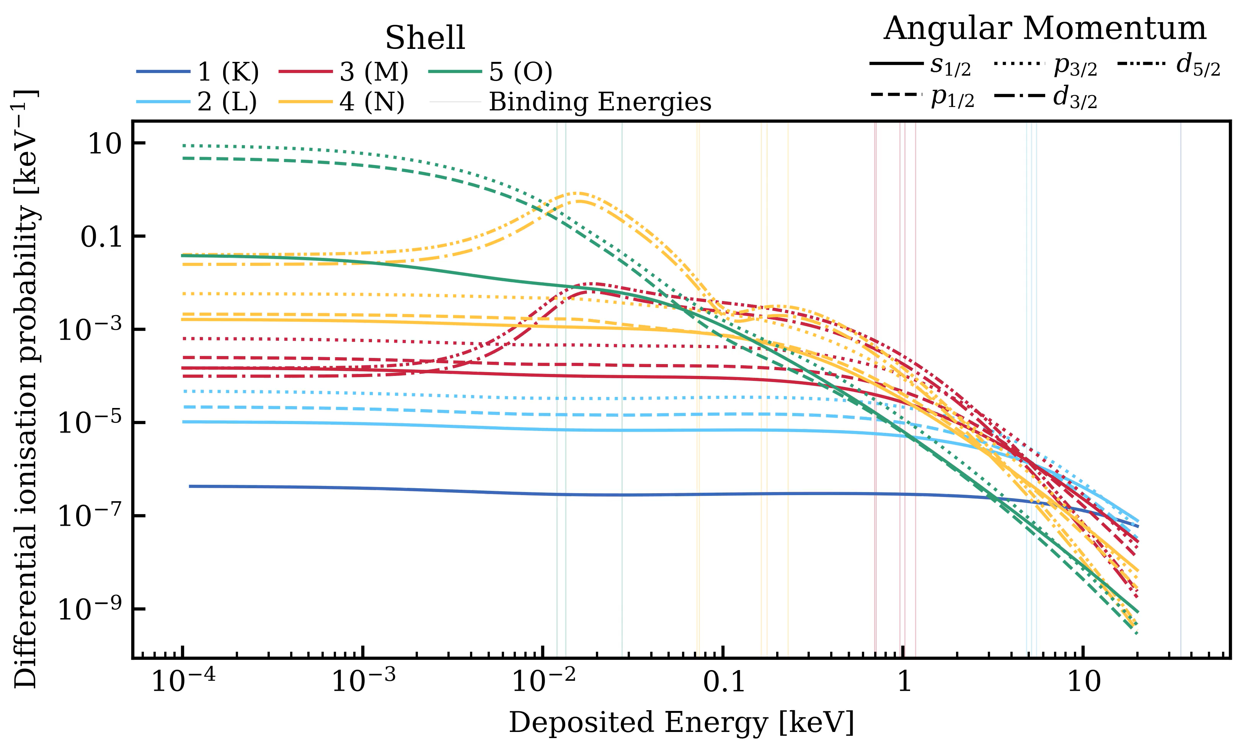
Migdal Effect – Sampling deposited energy
Exclusive transition probability

Slide 16

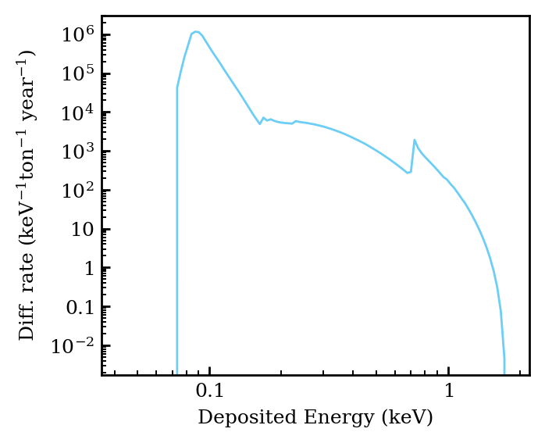
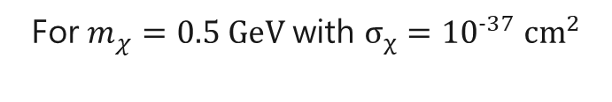
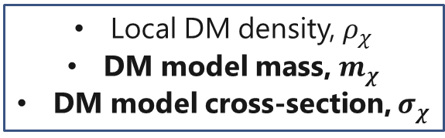
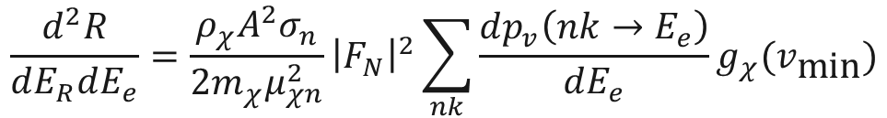
Migdal Rate Calculation
JelleAalbers/wimprates
For $m_{χ}=0.5 \text{GeV}$ with $σ_{χ}={10}^{−37} {\text{cm}}^{2}$
Local DM density, $ρ_{χ}$
DM model mass, $m_{χ}$
DM model cross-section, $σ_{χ}$
DM local velocity distribution
Helm nuclear form factor
$$\frac{d^{2}R}{dE_{R}dE_{e}}=\frac{ρ_{χ}A^{2}σ_{n}}{2m_{χ}μ_{χn}^{2}}{\left|F_{N}\right|}^{2}\sum_{nk}{\frac{dp_{v}\left(nk→E_{e}\right)}{dE_{e}}}g_{χ}(v_{\text{min}})$$
Migdal transition probabilities

Slide 17
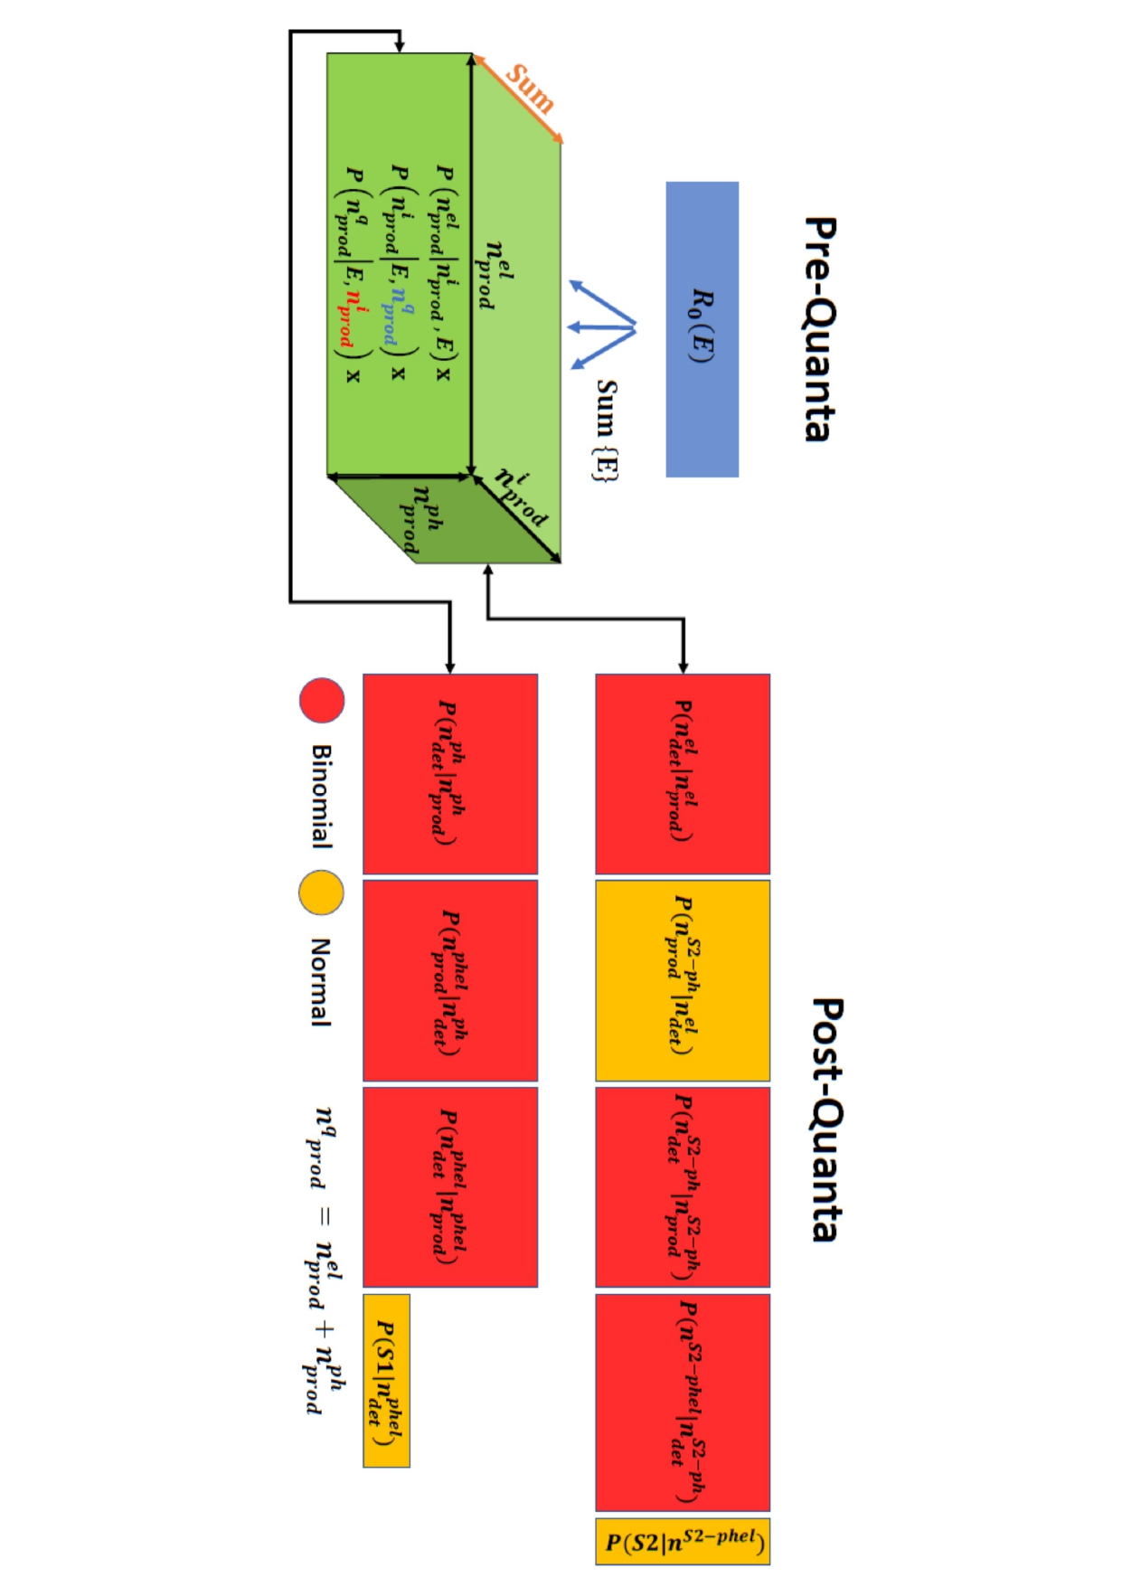
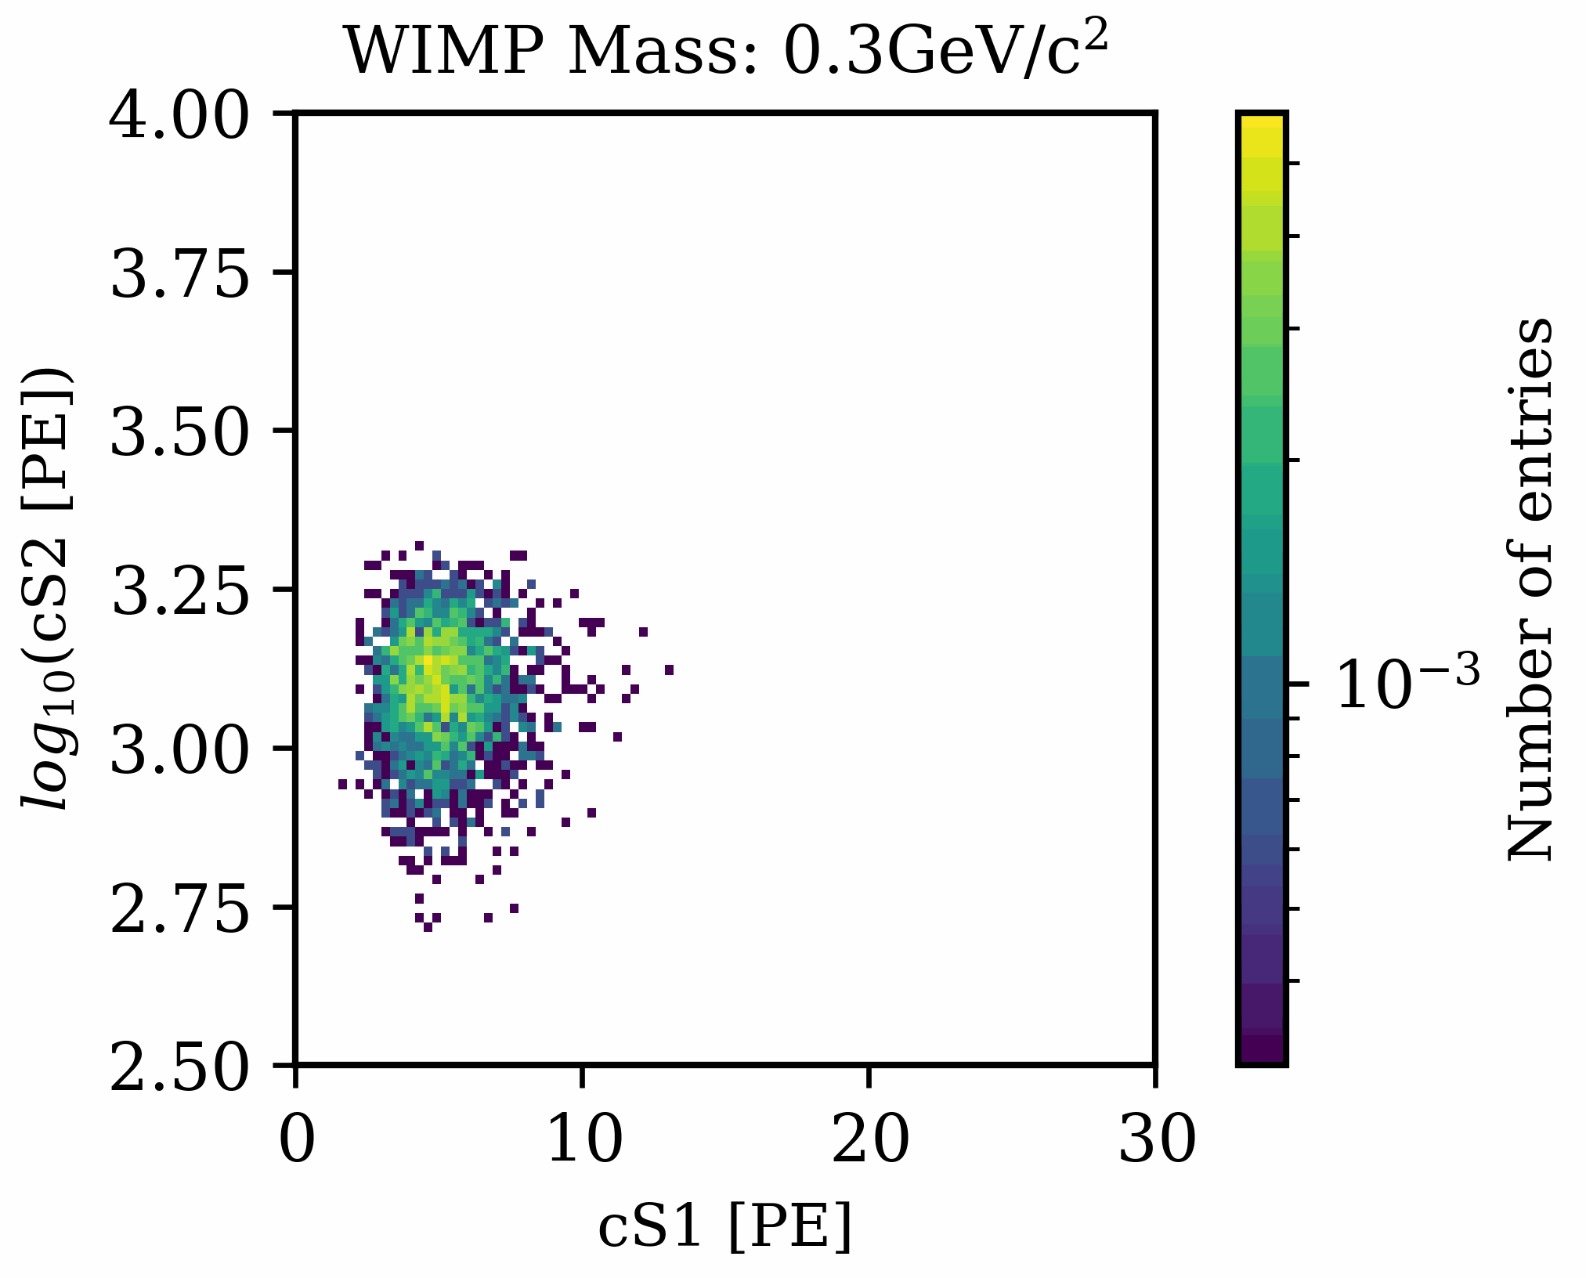
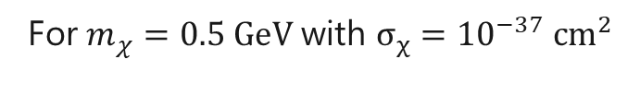
Template generation
Lorenzomag/flamedisx
For $m_{χ}=0.5 \text{GeV}$ with $σ_{χ}={10}^{−37} {\text{cm}}^{2}$
FlameNEST
R.S. James et al 2022 JINST 17 P08012
Owen produced new and updated Light Collection Efficiency maps for FlameNEST

Slide 18
Light Collection Efficiency map update
Simulated isotropic photon emissions at different z-coordinates of TPC
GXe Layer
Measure efficiency of light collection
LXe Layer
LXe Layer

Slide 19
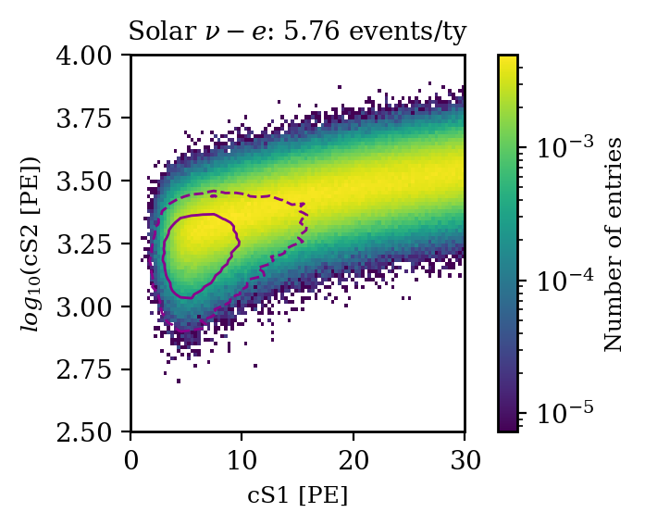
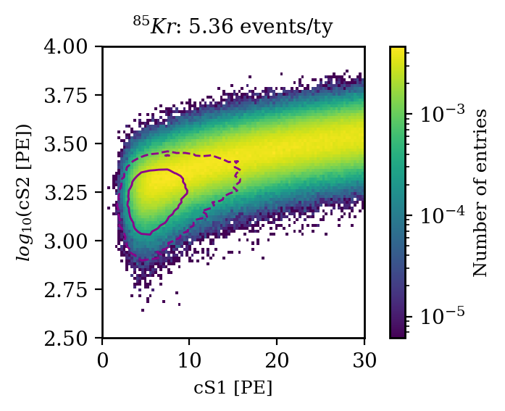
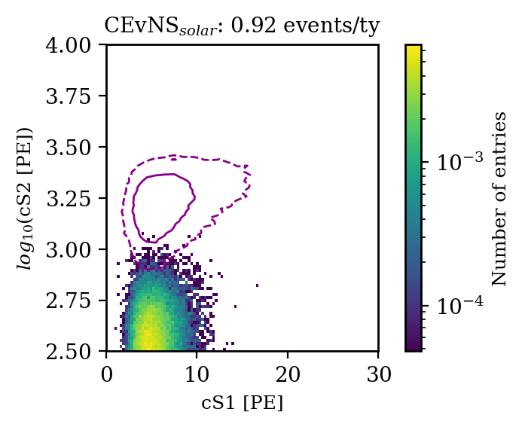
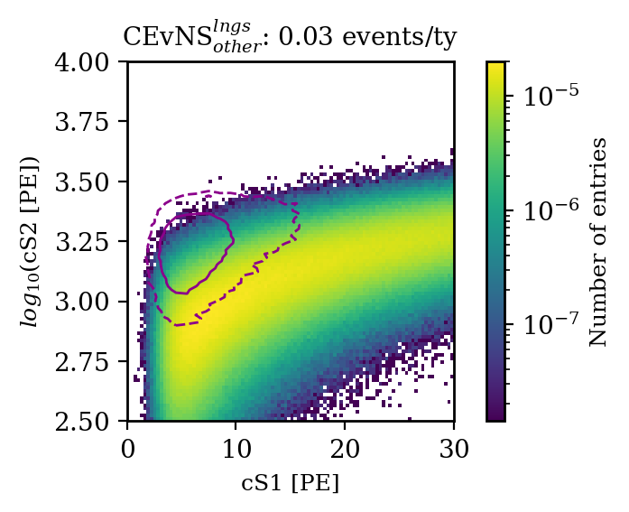

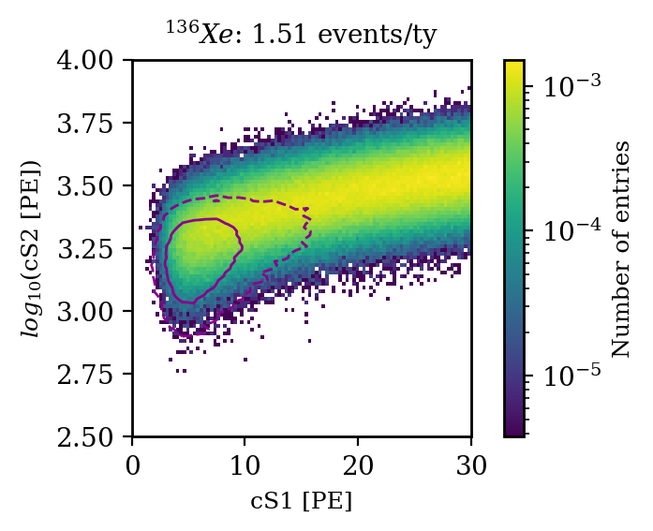
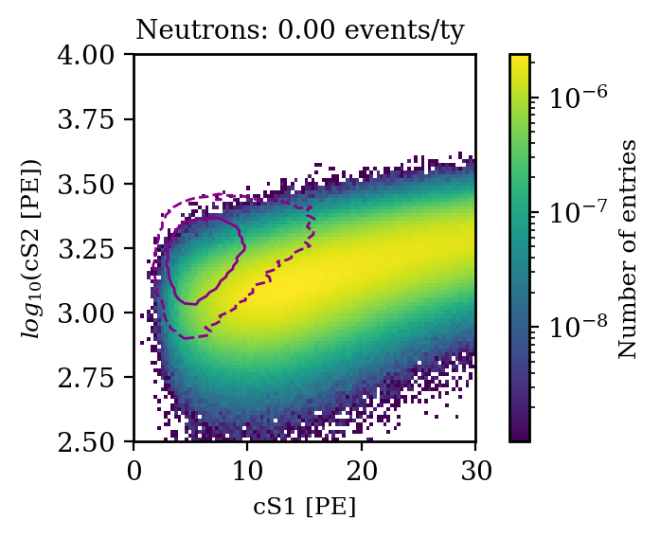
Background Model
Backgrounds from impurities in LXe (⁸⁵Kr, ²¹⁴Pb) expected to be lower than irreducible backgrounds from solar neutrinos
ER Backgrounds
NR Backgrounds
Signal
Irreducible astrophysical neutrinos
Impurities in LXe
Radioactive Xe isotopes
External (eg, detector materials)

Slide 20
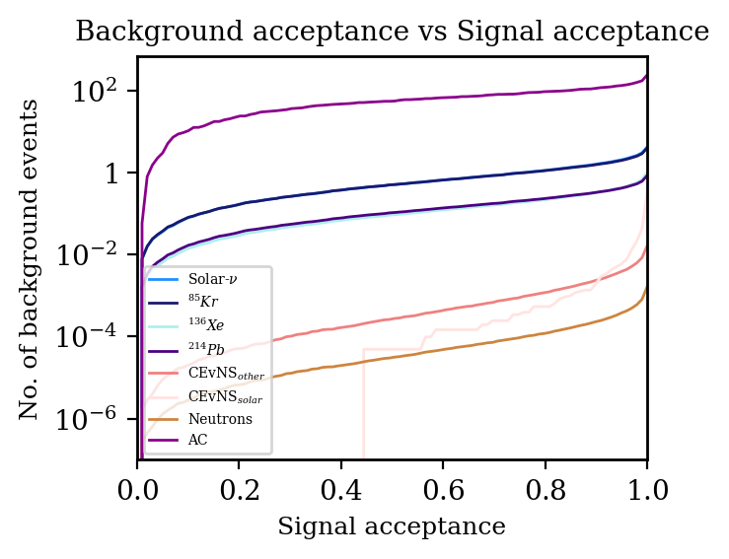
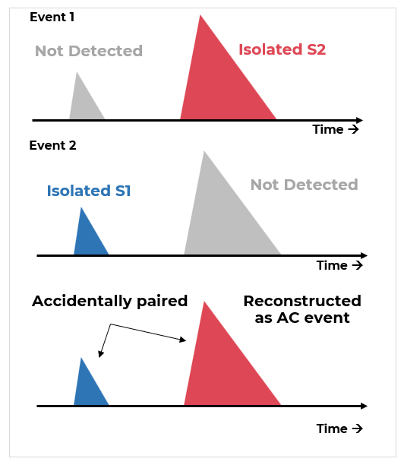
Background model
Accidental Coincidences (ACs) are dominant background
Preliminary Rates
A complete model for these backgrounds do not exist yet.
Researchers at Nikhef have been trying to phenomenologically model it by matching to XENON1T and scale to larger detectors.
40T - 113.7 e/ty
60T - 530.8 e/ty
80T - 3252.4 e/ty

Slide 21
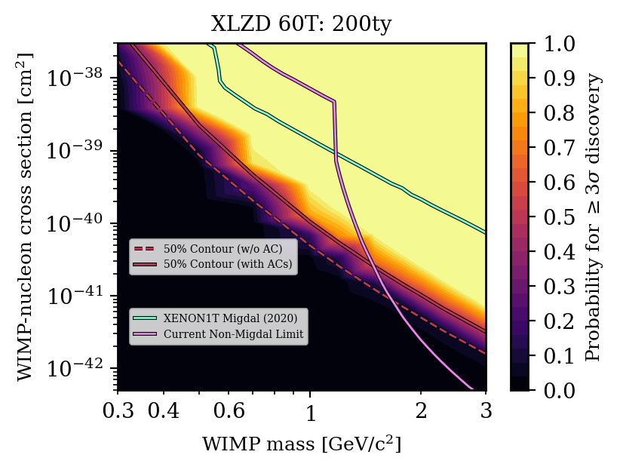
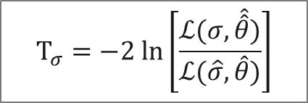
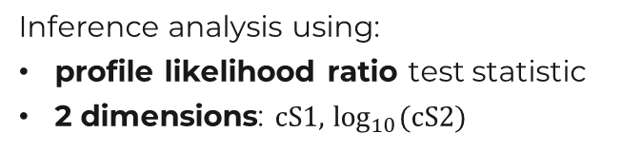
Sensitivity Projections
Trying to discover something we don’t know exists (WIMPs) using a phenomenon we don’t know exists (Migdal Effect)
$$T_{σ}=−2 ln\left[\frac{ℒ(σ,\hat{\hat{θ}})}{ℒ(\hat{σ},\hat{θ})}\right]$$
Inference analysis using:
profile likelihood ratio test statistic
2 dimensions: $cS1,$ $\log_{10}{(\text{cS}\text{2)}}$
Preliminary
Decent power for WIMP mass < 2 GeV/c² already at 200ty
Worse discovery potential (as expected) when including the large AC background; but still better than current limits.

Slide 22
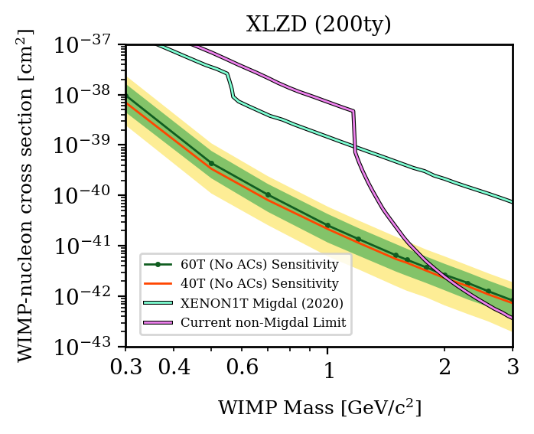
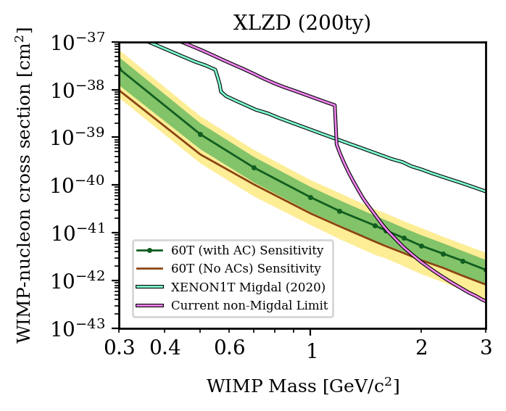
Sensitivity Projections @ 90% CL
Preliminary
Preliminary
No-AC scenario
Comparing detector sizes
Comparing AC/no-AC scenarios
Same detector sizes

Slide 23
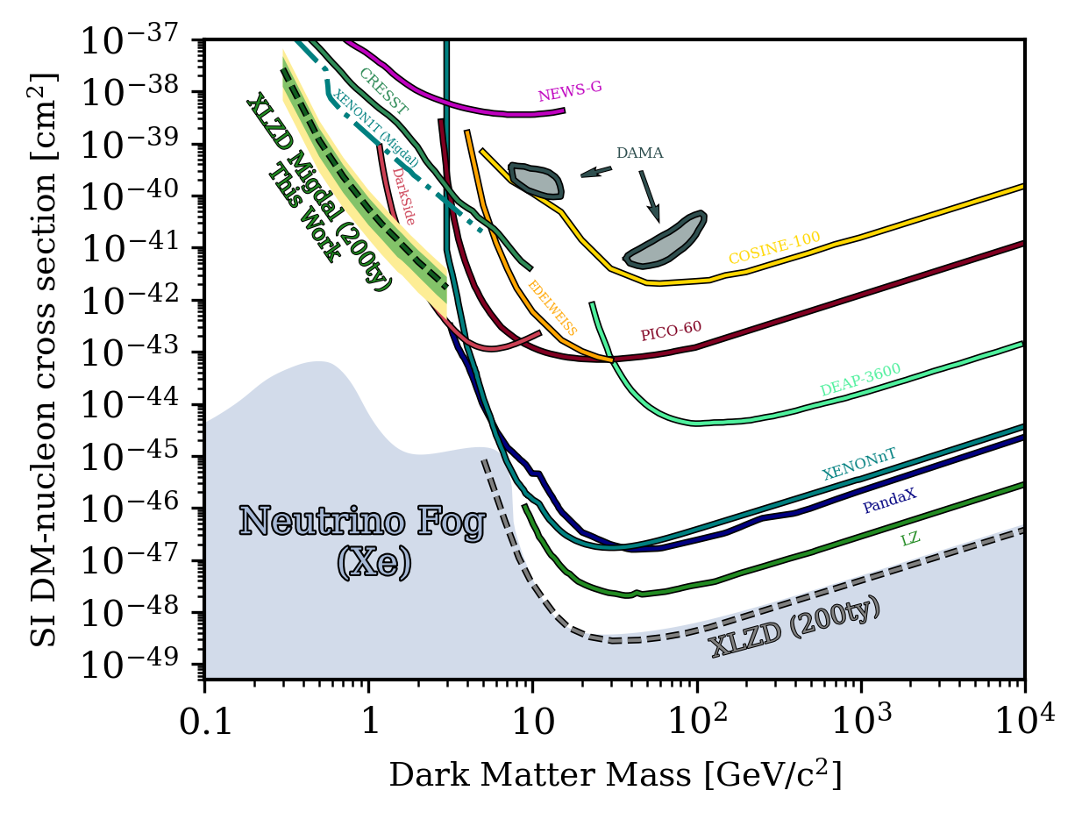
Summary
XLZD will have sensitivity for WIMP-nucleon cross section all the way to the neutrino fog for m_{wimp} > 10 GeV/c²
Utilize the Migdal Effect to enhance sensitivity for Sub-GeV WIMPs.
Modelled using the Transition Probabilities from Peter Cox et al.
Using FlameNEST with new LCE maps for template generation
ACs are the major backgrounds; phenomenological model being developed.
Projected to have world leading sensitivity for WIMP masses from 0.3 to 1.8 GeV/c²
Preliminary

Slide 24


Affiliations
Dr Sara DIGLIO
Prof Elisabetta BARBERIO
Joint-PhD
Home
Host
Collaborations

Slide 25
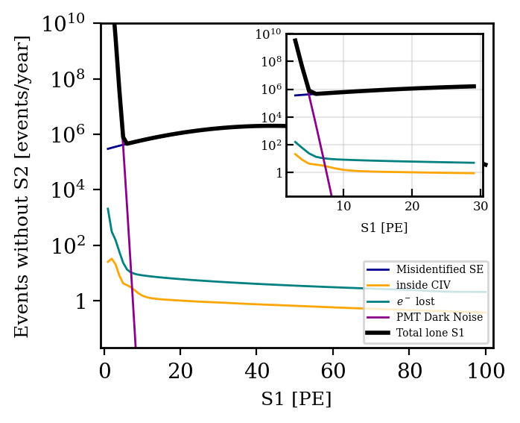
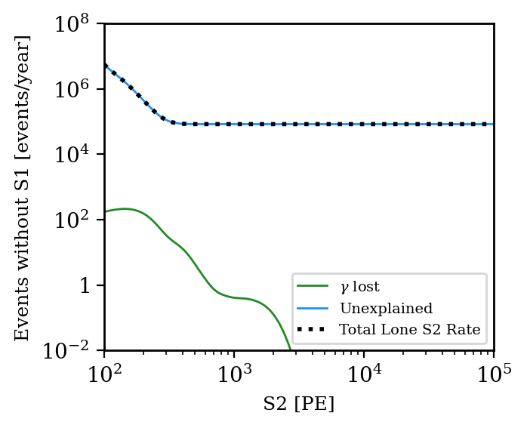

Background Model
Accidental Coincidence Backgrounds
Unphysical signals produced by the accidental pairings of Isolated S1s and Isolated S2s: Major background for searches near threshold.
Complete model for these backgrounds do not exist yet
Researchers at Nikhef have been trying to phenomenologically model it by matching to XENON1T and scale to larger detectors.
Very Preliminary!
Very Preliminary!
Lone S1s
Lone S2s
Very Preliminary!

Slide 26


Migdal Effect – Transition Probabilities
From nucleus’ rest frame, the electronic cloud recoils.
Transition matrix element obtained using Galilean boost operator.
Initial and final states of the electron cloud can be rewritten as products of single-electron wavefunctions.
Exclusive transition probability
Semi-inclusive transition probability

Slide 27
Migdal Effect – Transition Probabilities
Exclusive transition probability
Cox et al. provides exclusive transition probabilities from ground state to a final state where only one or two electrons are NOT in ground state
Semi-inclusive transition probability

Slide 28




Migdal Effect – Transition Probabilities
Exclusive transition probability
Semi-inclusive transition probability
Probability to transition from ground state to a final state where one electron is in a definite hard state and all others are in any combination of states with energies lower than a set threshold.
This probability is computed using closure relations assuming that only one electron in the final state is a hard electron
More realistic choice
Any state with
$$E<E_{th}$$
However, only available for
$$E_{th}≥0.56 \text{keV}$$

Slide 29


Migdal Effect – Transition Probabilities
Semi-inclusive transition probability
More realistic choice
However, only available for
$$E_{th}≥0.56 \text{keV}$$

Slide 30

Migdal Effect – Dipole Approximation
$$\left\langle \left.Ψ_{f}\left|\exp\left(im_{e}v⋅\sum_{k}{r_{k}}\right)\right|Ψ_{i}\right.\right\rangle$$

Slide 31



Migdal Effect – Dipole Approximation
$$\left\langle Ψ_{f}\left|\left(1+im_{e}v⋅\sum_{k}{r_{k}}\right)\right|Ψ_{i}\right\rangle$$
First order approximation, allows only single-ionisation
Good approximation for semi-inclusive probabilities at low-$v$ to mid-$v$

Slide 32


Gravitational lensing

Slide 33
Gravitational lensing

Slide 34
Image Credit: Hubble Space Telescope
Gravitational lensing

Slide 35

Bullet cluster

Slide 36
Image credit: NASA/CXC/M. Weiss
Intergalactic gasses
Dark Matter
Bullet cluster

Slide 37

Cosmic Microwave Background

