Slide 1
News, group meeting ‘Particles’
Results of the CNRS Concours 01/06: Kenneth Long (CMS) accepted the position. Start IP2I Lyon Jan 2026.
Thank you for your help on filling the NSIP table.
Request for funding: Fiches DIALOG CMS, FCC, T-MRPC and PICMIC should have been sent to the lab direction (COMET is being finalized)
Data cleaning “week”: please tell which directory need to be kept! otherwise, we will erase directories of previous collaborators (proposal is to remove if untouched since 2020). See back-up slides for the list.
Today’s talk at Particle group meeting: Jie Xiao
CMS:
News: CMS Spokesperson Gautier Hamel de Monchenault nominated as CERN Director for Research and Computing for the period 2026–2030
CMS week 2026 vote: Mexico was selected at the 2nd round against CERN.
Lyon pledges on CMS central shifts. We are reaching pledged/expected = 0,84. Thank you so much to all the shifters! However a little help is still needed to reach our quota!

Slide 2
Upcoming events and deadlines
❑ July 14-18 : Tracker week, Colmar
❑ July 15-17 : Higgs Hunting, Paris
❑ July 21-27 : Workshop FCPPL, Qinddao (China)
❑ Sept 21-26: TOP 2025, Korea
❑ Sept 16-19: DRD6 Collaboration Meeting, Ancona (Italy)
❑ Sept 29-Oct 3: CMS week, CERN
❑ Oct 10: IP2I séminaire Marianne Van Panhuys, LHC epistemology
❑ Oct 13-17: CMS DAS school, DESY
❑ Oct 20-24: LCWS 2025, Valencia (Spain)
❑ Oct 24: PhD defense David Amram
❑ Nov 3-7: CMS Tracker week, CERN
❑ Nov 4: PhD defense Elise Jourd’huy
❑ Dec 8-12: CMS week, Korea
Visit of Gautier Hamel de Monchenault expected in Fall, for a Colloquium on the history of particle physics + visiting Tracker installations
Many more events

Slide 3
News on our activities (tour de table)

Slide 4
Back-up slides

Slide 5
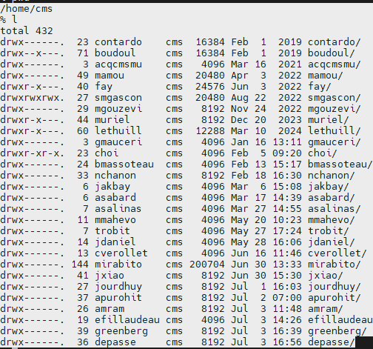
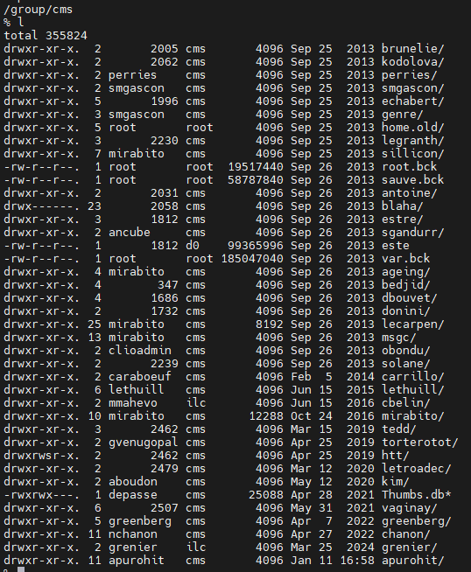
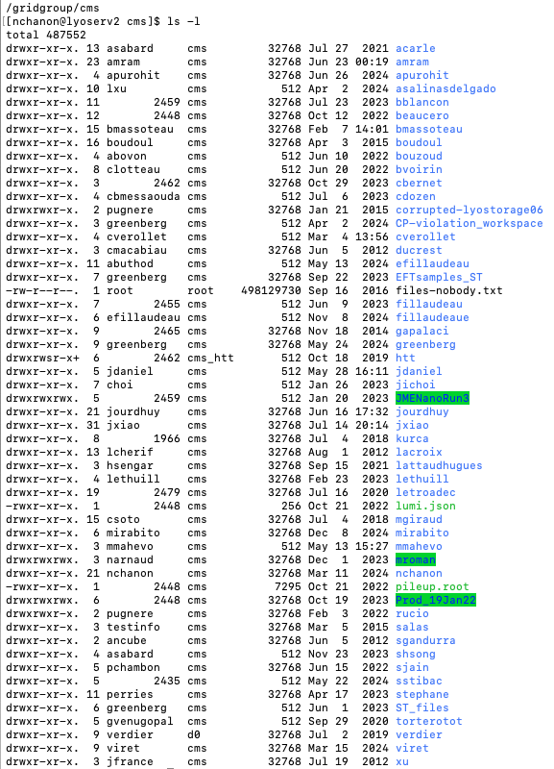
Back-up slides

