Slide 1
Stratégie Européenne pour la Physique des Particules Contribution de la communauté HEP française
Cristinel Diaconu
Centre de Physique des Particules de Marseille

Slide 2
Content
Introduction
European Strategy in Particle Physics ESPP 2026
French organization and contribution to ESPP 2026

Slide 3
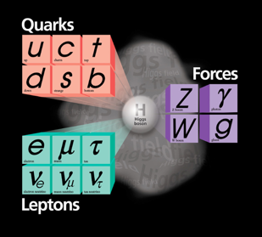
…. far into Universe

Slide 4
The “microscope”moderne Accelerateurs / Collisionneurs
Detecteur de particules
Detecteur de particules
Proton
Proton

Slide 5
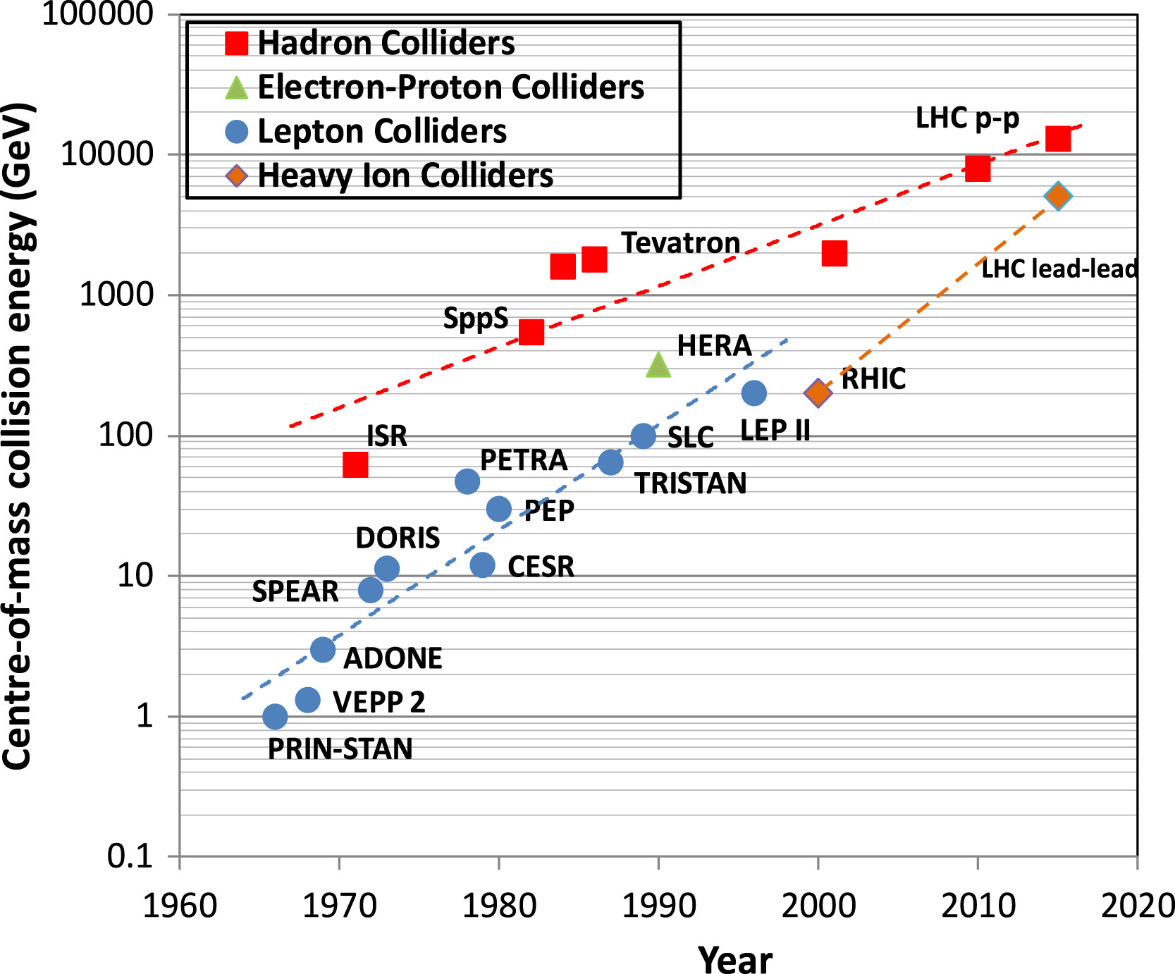
What did we learn?
What’s
Next?
M. Benedikt/F. ZImmerman
2030
2040
2050

Slide 6
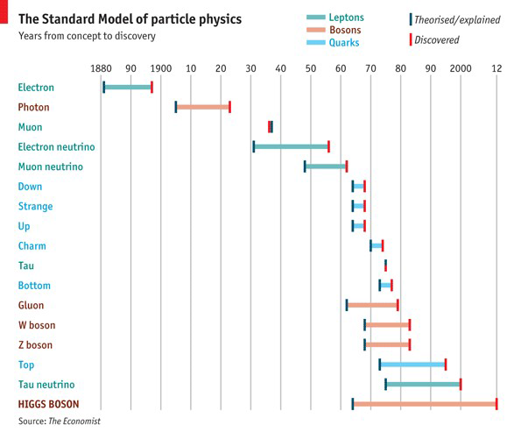
30 years of discoveries…..

Slide 7
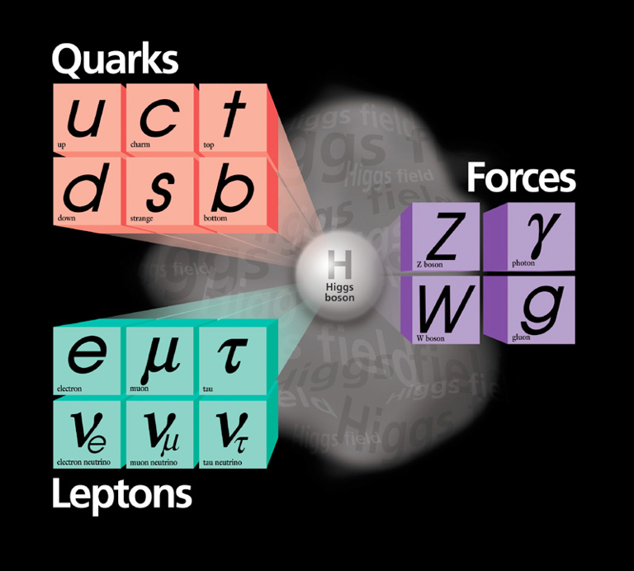
Le modèle Standard
Electro-
magnetique
M(Z)= 91.1880±0.0020 GeV
M(W)= 80.3692±0.0133 GeV
M(H)= 125.20±0.11 GeV
M(photon)<1×10−18eV
M(g)=0
Precision 10⁻³-10⁻⁵
faible
forte
gravitation

Slide 8
Precision and energy frontier explorers

Slide 10
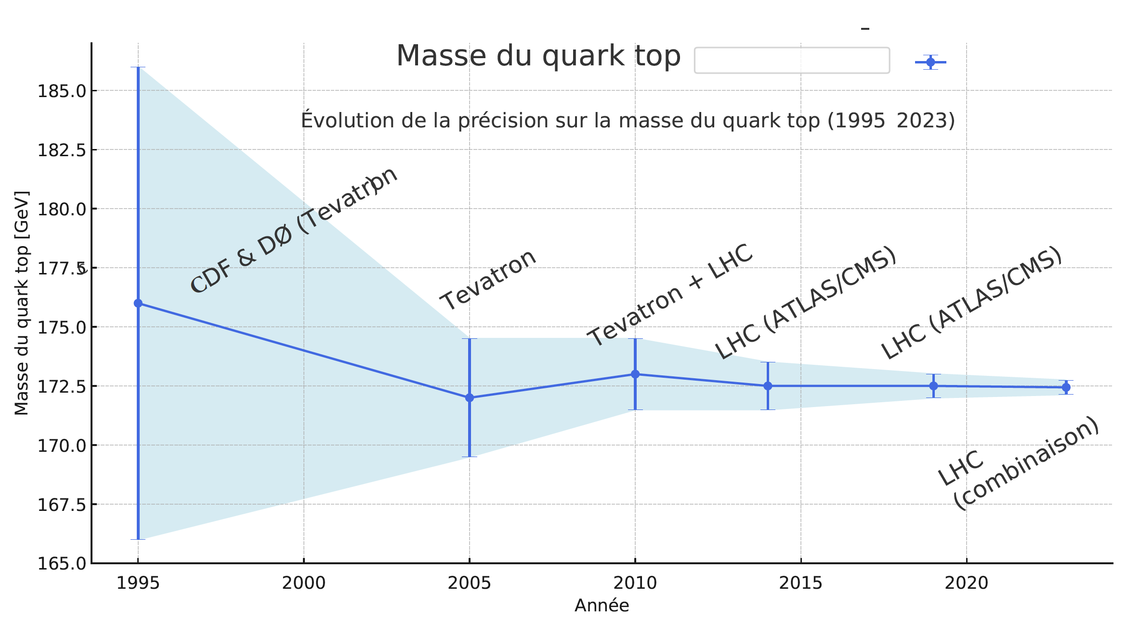
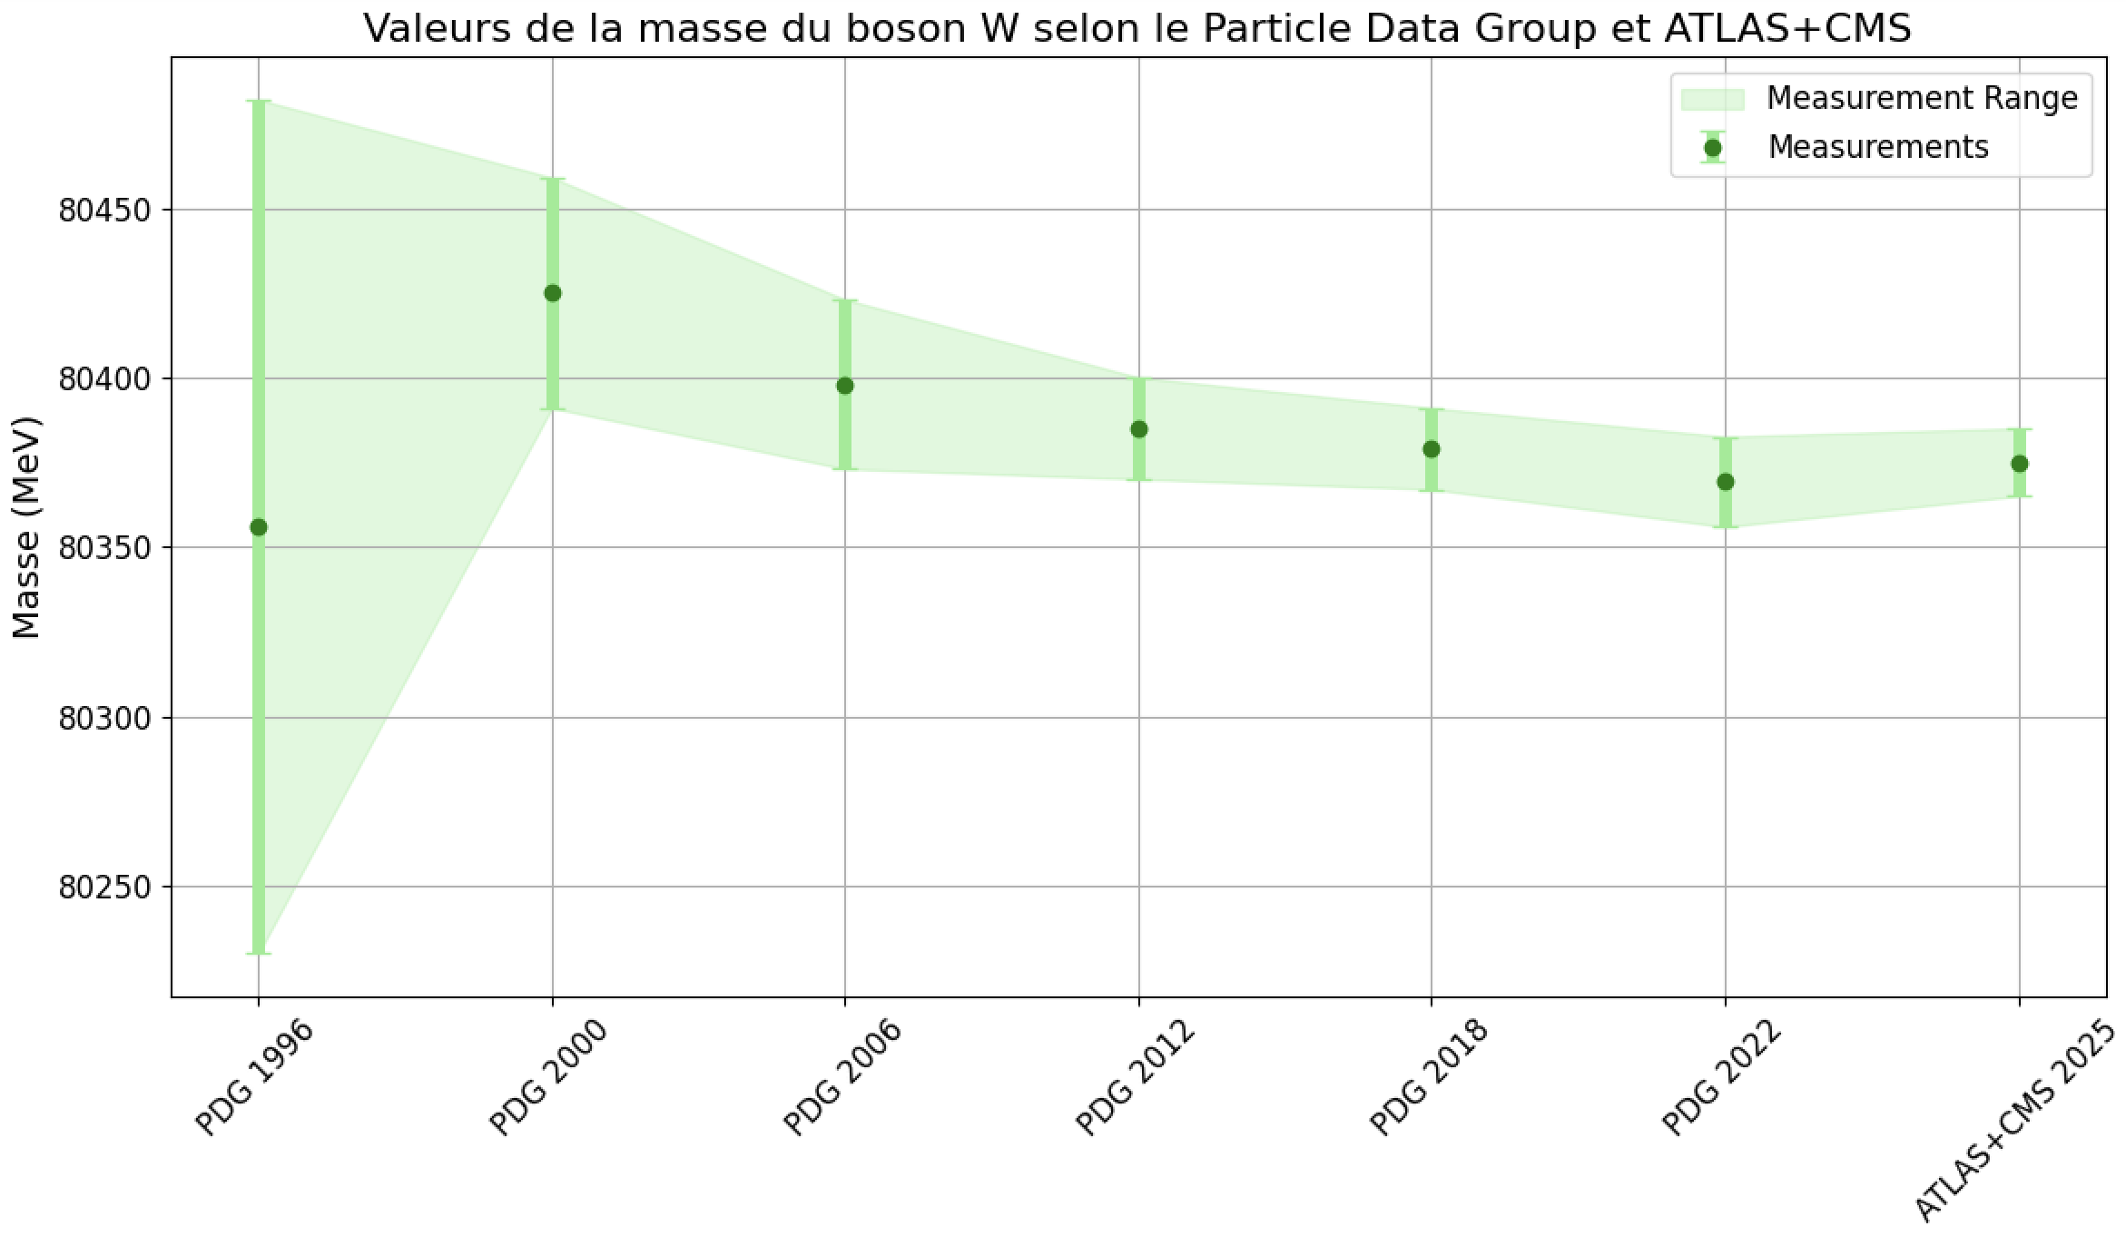
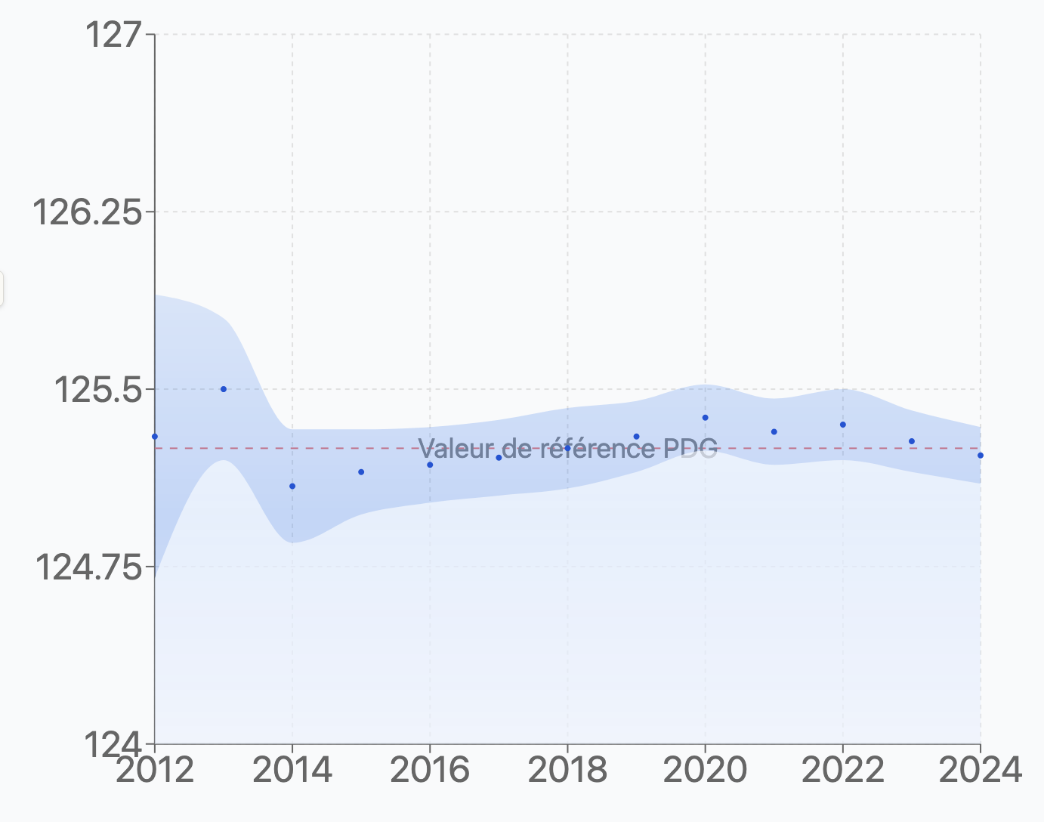
….. and 30 years of precision
M_{W}
M_{top}
91.1880+-0.0020
M_{Higgs}
SM Parameter | Precision 2025 | Precision FCC | Improvements factor
MW | 10 MeV | 1 MeV | 10
MTop | 300 MeV | 7 MeV | 40
Mhiggs (0.1%) | 110 MeV | 5 MeV | 25

Slide 11
Exploring the frontiers within the SM and beyond

Slide 12
How do we get there?

Slide 13
The European Strategy for Particle Physics
The European Strategy for Particle Physics is a cornerstone of Europe’s decision-making process for the long-term future of the field.
Mandated by the CERN Council, the Strategy is formed through a broad consultation of the particle physics communities in the CERN Member and Associate Member States, and beyond.
In the Strategy process recommendations are developed which will be submitted to the CERN Council for an update of the Strategy.
The European Strategy for Particle Physics is not a project approval process. Projects are approved by the
CERN Council through a separate decision process, taking the Strategy recommendations into account.
Original Strategy (2006): LHC, mooting of luminosity upgrade of LHC, R&D in accelerator technologies,
coordination with a potential ILC project
1st Update (2013): High Luminosity LHC, need for a post-LHC programme
2nd Update (2020): FCC feasibility study
3rd Update (2026): → recommendation for the next large-scale accelerator project at CERN
(reach consensus on the preferred option and possible alternatives)

Slide 14
ESPP Organisation
European Strategy Group (ESG):
Secretariat (secretary chairs ESG);
One rep per CERN member state;
One rep per lab in LDG;
CERN DG, CERN DG-elect;
Invitees: PPG, President of Council, 1 rep from each Associate Member State and Observer State, 1 rep from
EC; chairs of ApPEC, NuPECC, ESFRI
"Secretariat”:
Secretary (chair): K. Jakobs
CERN SPC chair: H. Montgomery
ECFA chair: P. S
LDG chair: D. Newbold
M. Seidel from 1/1/2025
PPG:
Physics + Technology working groups
Electroweak physics (including Higgs physics)
Strong interaction
Flavour physics
Beyond the Standard Model physics
Neutrino physics and cosmic messengers
Dark matter and dark sector
Accelerator science and technology
Detector instrumentation
Computing
à Physics Briefing Book
ESG: Overarching topics
National input / roadmaps (à strategic)
Projects (FCC, LC, LE-FCC-hh, MC, ..)
(timeline, costs, …. (physics à PPG) )
Comparisons across proposed projects
Relations with other fields of physics
Implementation of the Strategy
(role of CERN and National Labs, coordination of European participation in projects sited outside Europe, …)
Knowledge and Technology transfer
Sustainability, environmental impact
Public engagement, education, communication
- …

Slide 15
Remit of the European Strategy Group (ESG)
The aim of the Strategy update should be to develop a visionary and concrete plan that greatly advances human
knowledge in fundamental physics through the realisation of the next flagship project at CERN. This plan should
attract and value international collaboration and should allow Europe to continue to play a leading role
in the field.”
The ESG should take into consideration:
- Input of the particle physics community;
- Status of implementation of the 2020 Strategy update;
- Accomplishments over recent years
(Results from the LHC and other experiments and facilities worldwide, progress in the construction of the High-Luminosity LHC,
outcome of the FCC Feasibility Study, recent technological developments in accelerator, detector and computing areas)
- International landscape of the field
The Strategy update should include the preferred option for the next collider at CERN and prioritised
alternative options to be pursued if the chosen preferred plan turns out not to be feasible or competitive.
The Strategy update should also indicate areas of priority for exploration complementary to colliders and for
other experiments to be considered at CERN and at other laboratories in Europe, as well as for participation in
projects outside Europe.

Slide 16
(in Venice)
We are here
(Monte Verita /
Ascona, CH)
More details on ESPP web page: https://europeanstrategyupdate.web.cern.ch/

Slide 17
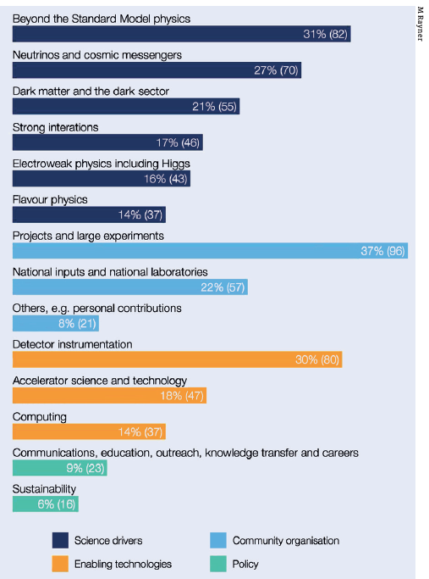
Input received
266 contributions received
Major flagship projects, projects in other physics areas
Input from national HEP communities in ECFA countries and beyond
Input from National European Labs (e.g. DESY, Frascati, …)
Input from Early Career Researchers (via ECFA ECR panel)
Input from APPEC, NuPECC, ..
All contributions are public:
https://indico.cern.ch/event/1439855/contributions/
These submissions are analysed by the Physics Preparatory Group (PPG) and ESG working groups;
They provide the input for the presentations and discussions at this Open Symposium
Self-attributed themes of the 263 community inputs

Slide 18
French contribution to ESPPU: Process and structure
Context: The French particle physics community conducted a bottom-up approach to discuss future experimental scenarios in Europe, focusing on major facilities and scientific excellence.
Physics Motivation: several thematic axes, including:
The energy frontier and the need for precise measurements of the Higgs boson properties.
The intensity frontier, emphasizing experiments with wide physics programs and dedicated experiments.
Neutrino physics and the importance of long baseline oscillation experiments.
Strong interactions and the study of QCD.
The broader landscape of particle physics, including connections to nuclear physics, astrophysics, and societal applications.
Further Considerations: Theory, computing, software, data handling, R&D activities, sustainability, and the role of early career researchers.

Slide 19
French contribution to ESPPU
National CNRS/IN2P3 +CEA/IRFU open process July 2024-March 2025
4 working groups + Strategy Group
About 60 contributions received from laboratories, projects, etc.
Many projects represented
FCC, LCF, Muon Collider, LHCb, Belle2, EIC, LHeC...
Various topical contributions to GT1-4
Higgs, EWK, top, QCD, detector concepts, networking, computing, AI, sustainability etc...
Covers several options for the next collider at CERN, and also discuss other colliders and experiments (Belle 2, EIC, LHC, HL-LHC etc…).
Transversal : sustainability, computing/AI, R&D.
Open Symposium January 20-21 Paris https://indico.in2p3.fr/event/34662/
280 participants

Slide 20
Key Consensual Views
The Standard Model has been verified with high precision, necessitating a significant step in precision for future particle physics research.
Full physics potential of the LHC should be exploited
Ensure a flagship project at CERN starts seamlessly after the completion of the HL-LHC.
There is a consensus on the need for an e+e− collider as a priority.
Determine the energy scale of new physics through direct searches and high-precision data.
Sustain R&D in support of energy-frontier facilities.
Maintain experimental diversity: physics beyond collider, neutrino physics etc.
Emphasize sustainability and positive societal impact from the early stages of the next flagship project.

Slide 21
Findings and recomendations
Despite the strong involvement of the FR-HEP in various future projects, a consensus has emerged in this strategy-making work/process.
The French community supports the FCC-ee machine as the next flagship project at CERN. The opportunity to prepare a FCC-hh collider as the next machine is acknowledged as an asset but we take note that the community support is given at this stage to the electron machine.
Experimental diversity alongside the flagship project is necessary
Strong support onto DRD, Initial training attractiveness and ECR integrative approach.
The sustainability /eco-responsibility is a requirement. It must be part of the flagship project from the early design phase.

Slide 22
Preferred Option for the Next Collider at CERN: FCCee:
Strong support from the French community for the Future Circular Collider (FCCee) project.
FCCee aims to advance knowledge of Higgs boson couplings, electroweak and strong gauge couplings, and prominent electroweak observables.
Operation at the Z pole is expected to improve fundamental measurements by factors of 10-100 compared to LEP1.
Potential for a future ~100 TeV hadron collider reusing the FCCee tunnel.
CERN is considered the best place to host FCCee due to its expertise, infrastructure, and sustainability practices.

Slide 23
Fall-back Options if FCCee is Not Feasible:
If no comparable e+e−e+e− collider is established outside Europe:
A linear e+e−e+e− collider facility (LCF) at CERN as the next best option for a Higgs factory.
Consideration of LEP3 as a last-resort fallback, with limitations in luminosity and energy range.
If a comparable e+e− collider is established outside Europe:
Development of a high-energy hh/eh program in a new tunnel, with reduced energy reach.
Complement both FCChh and HL-LHC with an electron-hadron collider such as the LHeC.
Scientific Complementarity and Return:
Fall-back scenarios offer faster scientific return and increased complementarity.
Programs including eeee, pppp, and epep collisions on similar timescales can compensate for the scientific loss compared to the FCC program.

Slide 24
The view of the national HEP communities
Completing the full HL-LHC programme is essential and must remain a high priority for CERN;
It is paramount to fully exploit the High-Luminosity LHC (HL-LHC) to maximise scientific returns
It is important that the next flagship collider supports a broad physics programme, given that it is not clear where new physics will show up.
Should a dedicated energy-frontier collider or a high-luminosity e⁺e⁻ machine not prove feasible or face significant delays, intermediate collider projects such as LHeC and LEP3 are recognised as strategically valuable by some member-states HEP communities

Slide 25
What is the preferred large-scale accelerator for CERN
CERN Member States (MS)
… incl. Associate- and Non-Member States (MS)
25
20
15
10
5
0
25
20
15
10
5
0
21
²¹ MS AMS NMS
 |  | 6
 |  |  | ² 0 0 0 ¹ 0 0 ² 0 ²
1
2
0
support / in favour
are opposed
to be decided in
support for any e+e-
support / in favour
are opposed to be decided in support for any
November e+e- collider
November collider
Overwhelming support (21/24 CERN MS HEP communities) in favour of the integrated FCC-ee/hh programme
Support as well from Associate Member states (AMS) and Non-member states (NMS)

Slide 26
What is the alternative if the preferred option is not feasible?
12
CERN Member States (MS) (multiple entries allowed)
10 MS HEP communities list a Linear Collider (LCF, CLIC) as second best choice
(LCF is preferred to be realised with 550 GeV)
multiple entries from each country
10
10
8
6 6
6
3 MS HEP mention LEP3 as a genuinely less costly alternative to FCC-ee
4
3
3
2
6 MS HEP communities support LHeC
2
1 1
0
6 MS HEP communities support a lower-energy hadron collider
L
C
2 MS HEP see no reason for another option, as they would be equally costly.
LCF/C IC
LEP3
LHe
FCC-hh
HE-LHC
e
No good alt
Muon Collider
No alt nam d yet

Slide 27
Towards the recommendations on the next CERN flagship project
(1) Physics Potential
Physics Briefing Book ( à 30 Sept. 2025)
à Assessment of overall Physics Potential
(ESG Working Group)
Project assessment
(Technical feasibility, required R&D, risks, timeline, costs and human resources (including estimates for the associated detectors), environmental impact
(ESG working group)
Final input by the National HEP communities
(à 14 Nov. 2025)

Slide 28
Backup

Slide 29
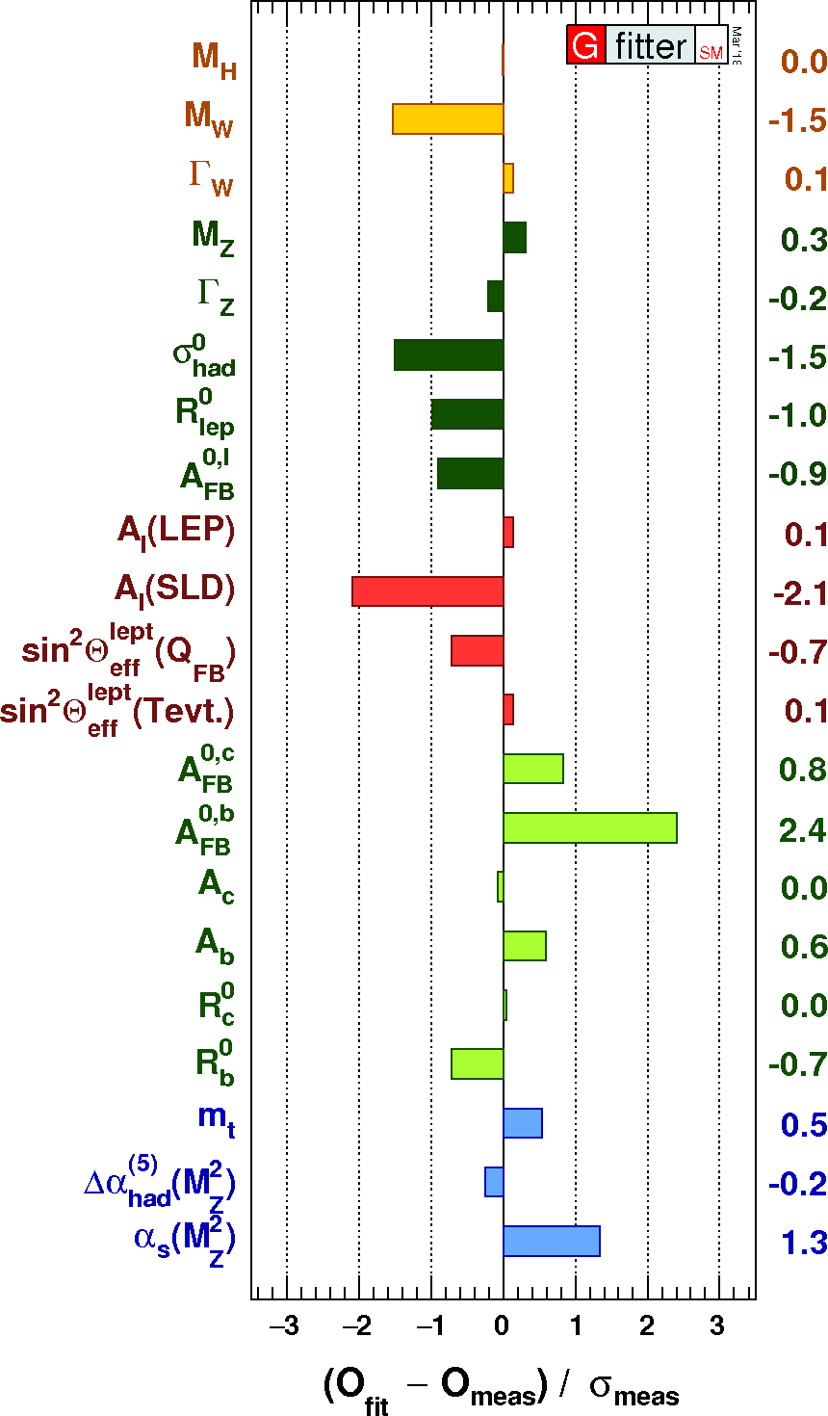
SM is the hub for new physics
Precisely tested
Squeezing further

Slide 30
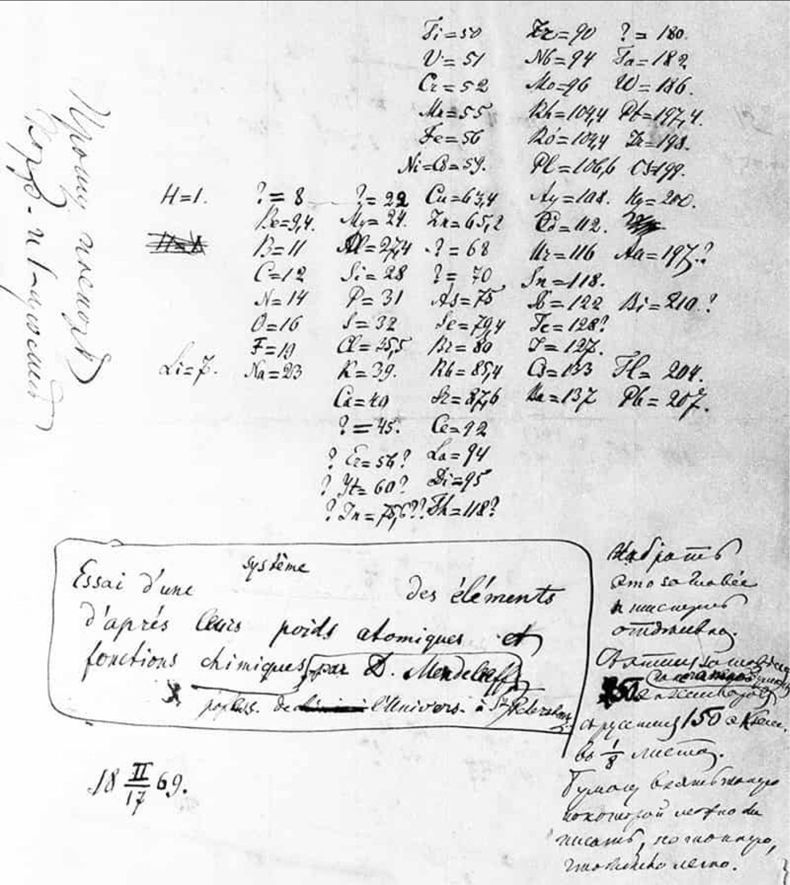
Precision leads to discovery?
Remember that question marks appear when data make a jump in precision
Discrepancies are place holders for future discoveries
Crosssing borders in precision and energy are equivalent
Physics World

Slide 32
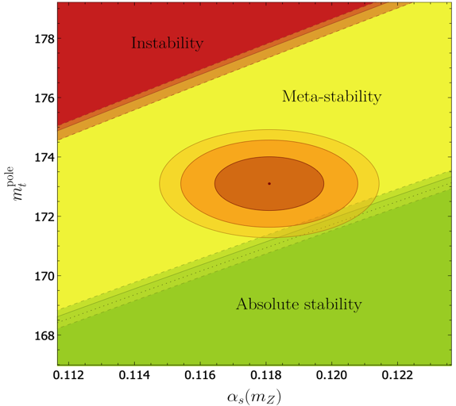
Preamble
The strong force is everywhere and mainly responsible for the visible nuclear matter composition
It drives vacuum (asymptotic freedom) as well as collective (confinement) phenomena accessible by experiments ; and maybe the axion?
The strong(est) fundamental coupling is the least known amongst the four forces
1%
“To rule out absolute stability to 3sigma confidence
Mtop precision 250 MeV
𝛂_{s}(m_{Z}) precision below 0.00025”
[arXiv:1707.08124]
[hep-ph/0410364]
Lifetime (Universe)=10⁶⁵ years.

Slide 33
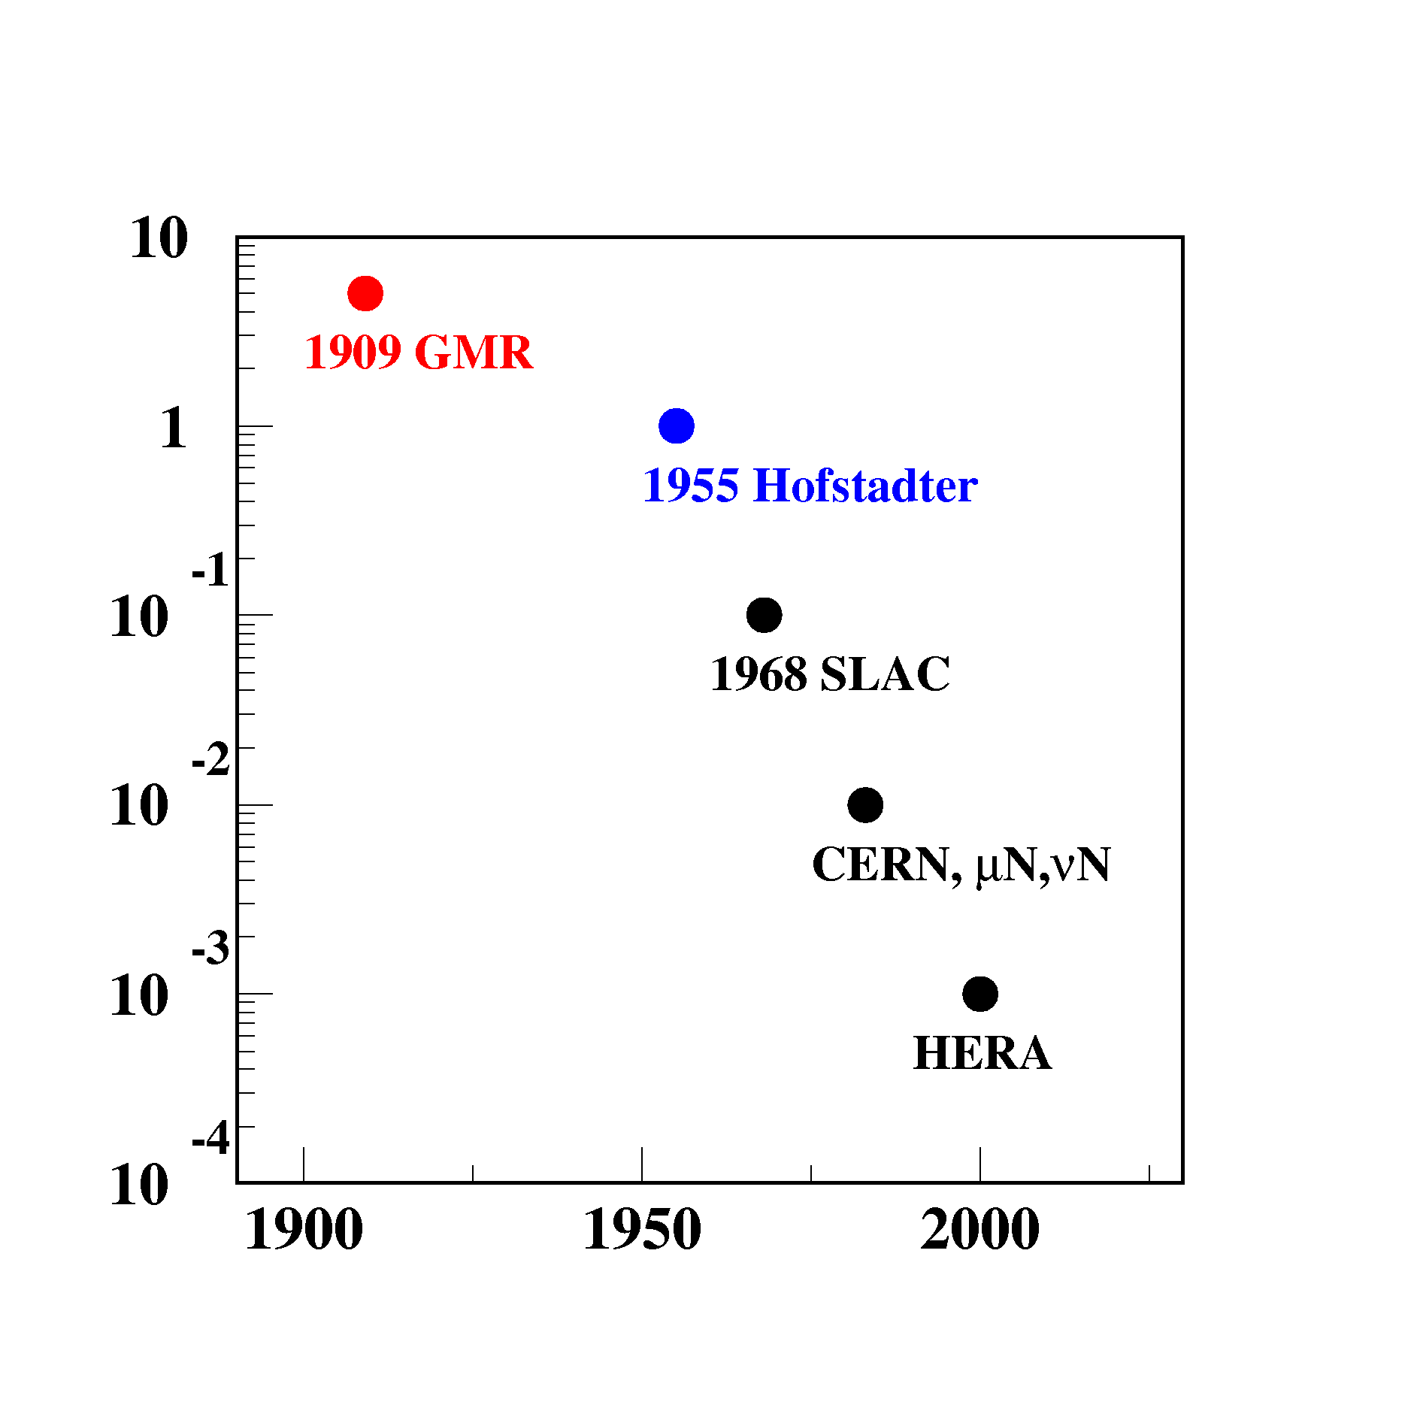
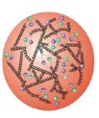
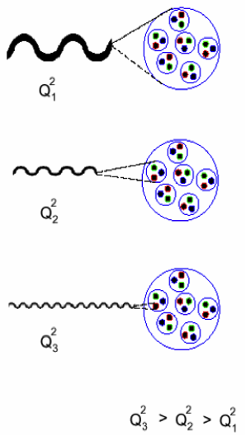
Deep into the matter…..
Proton Size [1fm=10⁻¹⁵ m]
Precision ⬅➔ Energy
Nucleus
(~1910)
Nucleon (p,n)
(~1950)
Quarks
(~1970)
LHC .
2041

Slide 34
Exploring the frontiers within the SM and beyond

