Slide 1



Studying the Vector Boson Scattering process
Panagiotis Ziakas

Slide 2
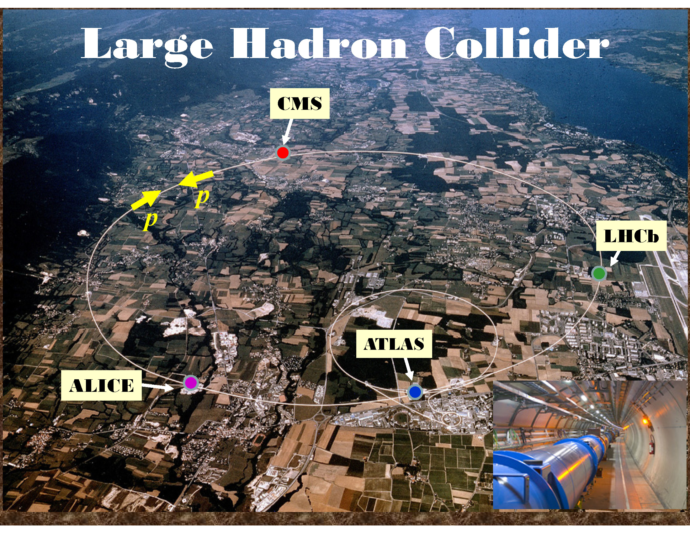
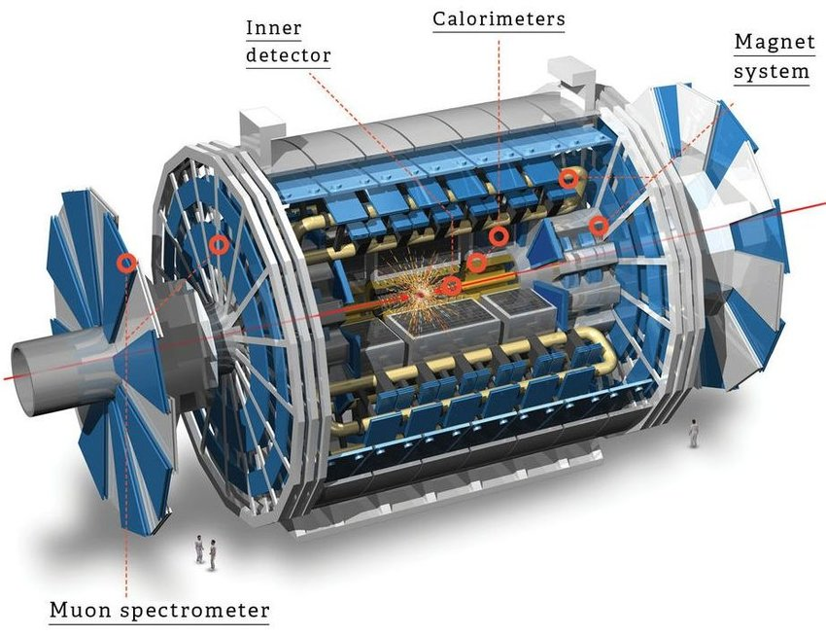
Large Hadron Collider & ATLAS experiment
Deeper understanding of the existing processes & exploration of New Physics
Higgs boson Discovery
Observation and precise measurements of rare processes

Slide 3
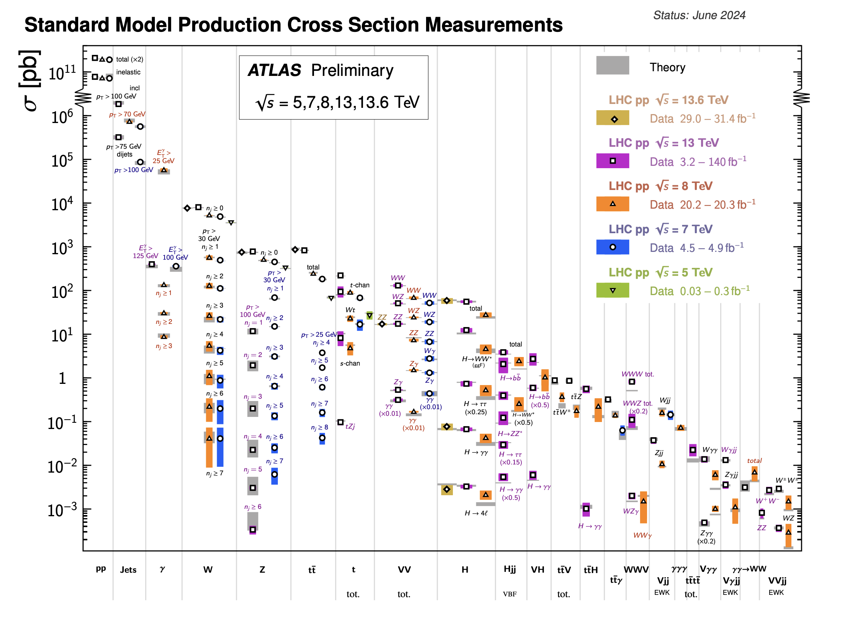
Studying rare processes
Vector Boson Scattering (VBS)
ATL-PHYS-PUB-2024-011
Rare but very important process!
EW symmetry breaking
Vector boson self -couplings

Slide 4
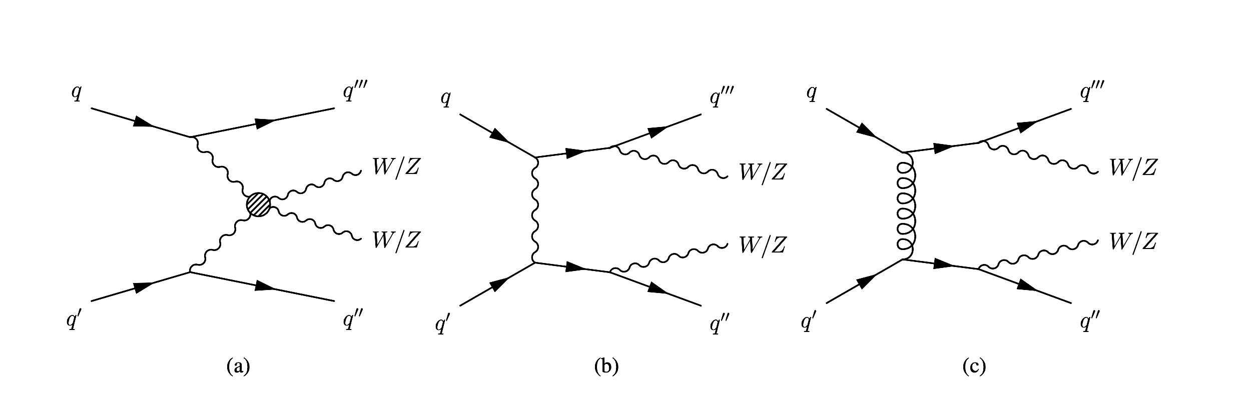
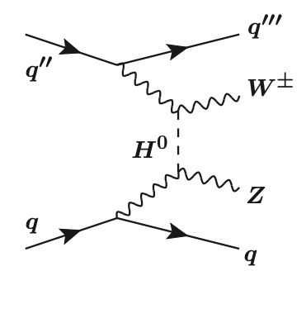
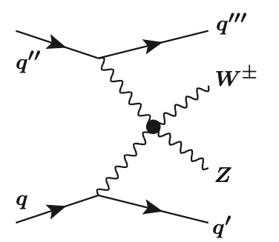
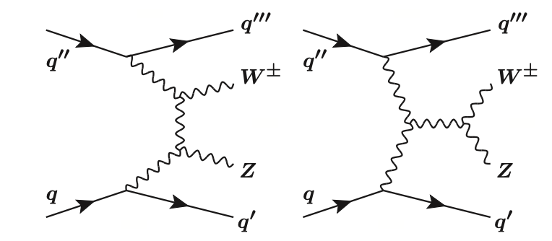


The Vector Boson Scattering process
$\sim a_{EW}$
$\sim a_{EW}$
EWK VVjj via VBS

Slide 5
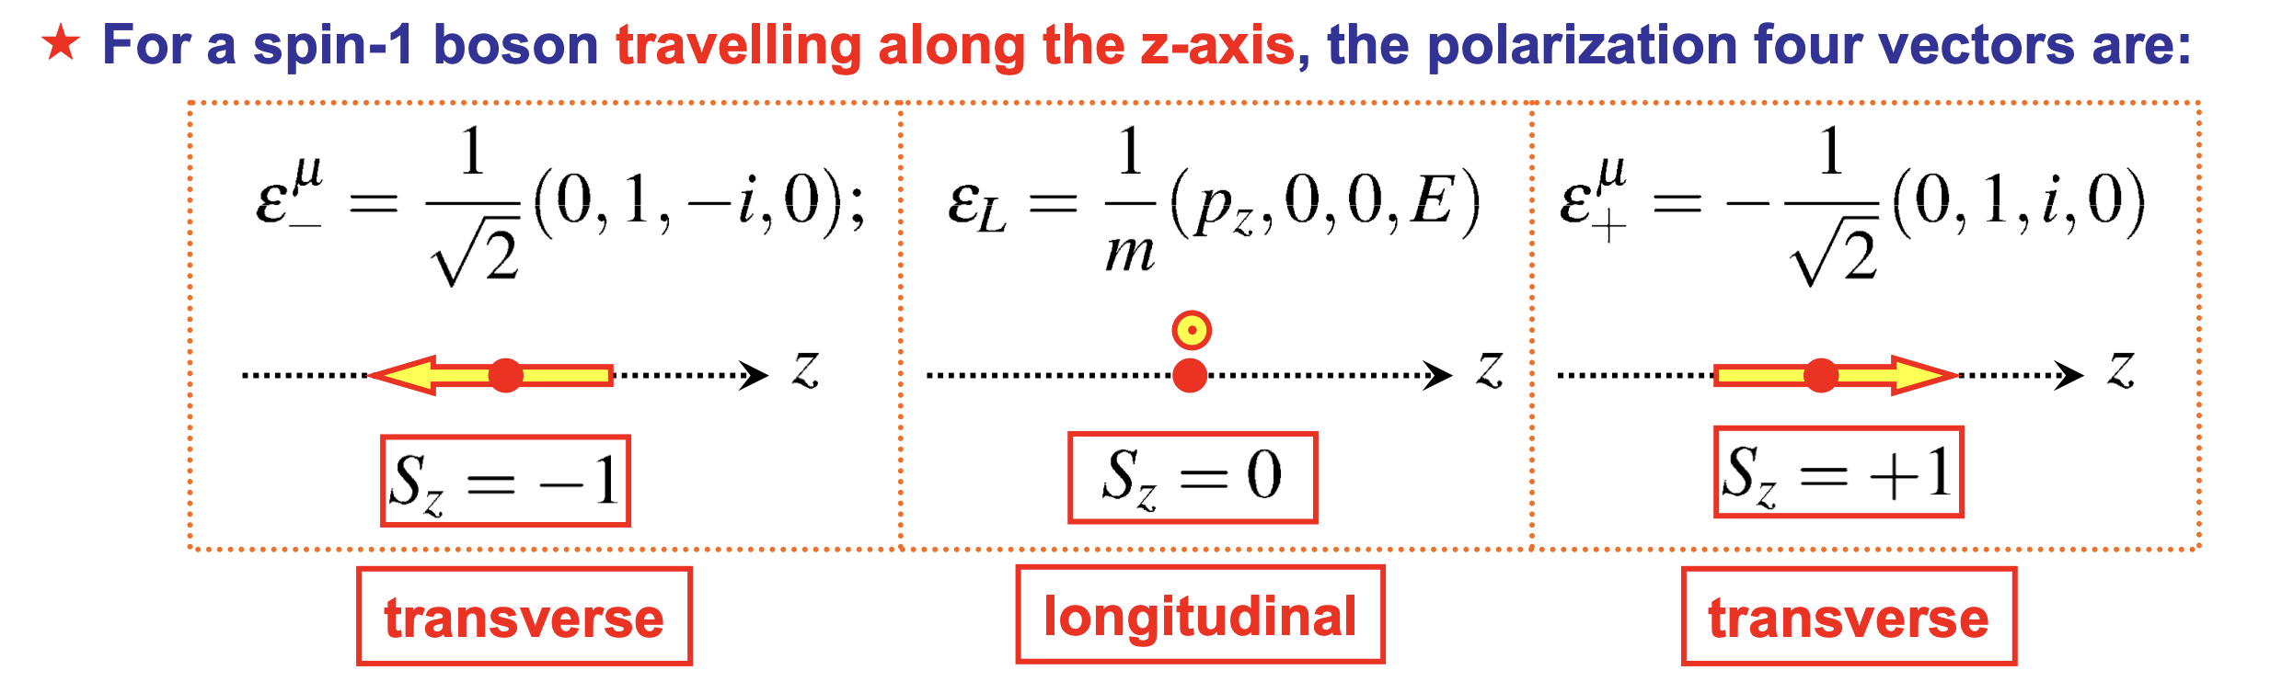
Polarized boson production

Slide 6
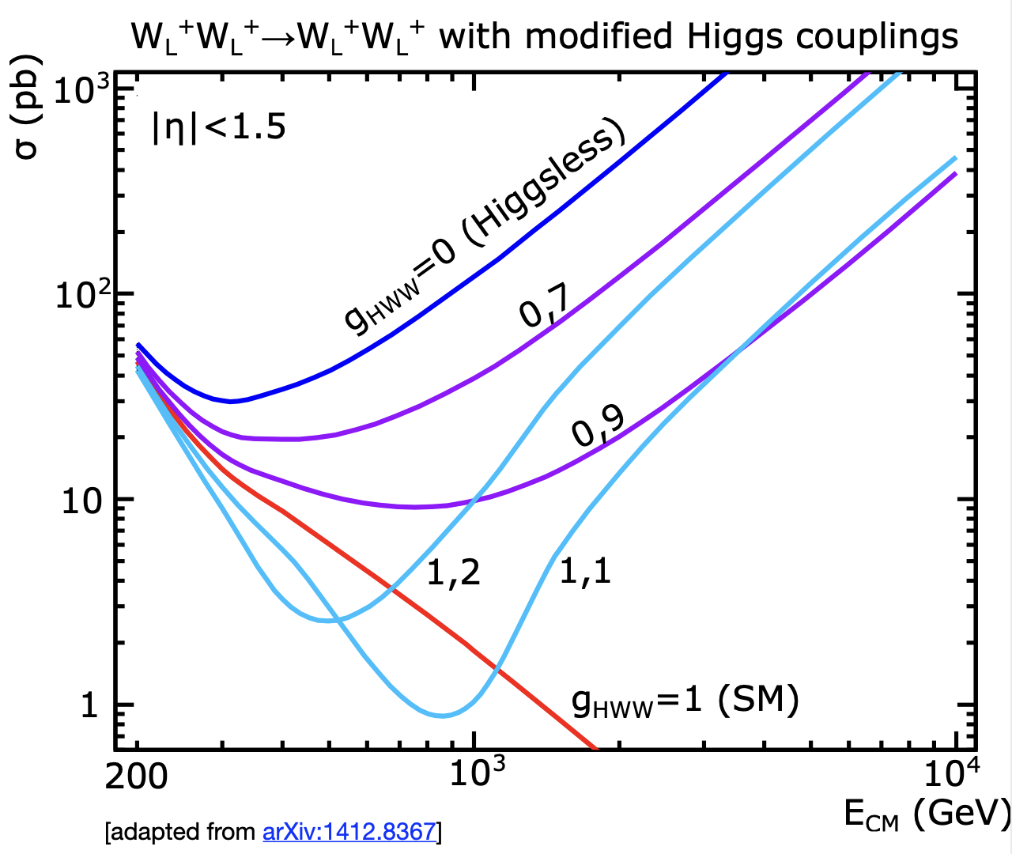
Polarized ssWW production
Polarized boson prodcuction offers an excellent test of the electroweak symmetry breaking!
Unitarity violation if Higgs coupling deviates from SM!

Slide 7
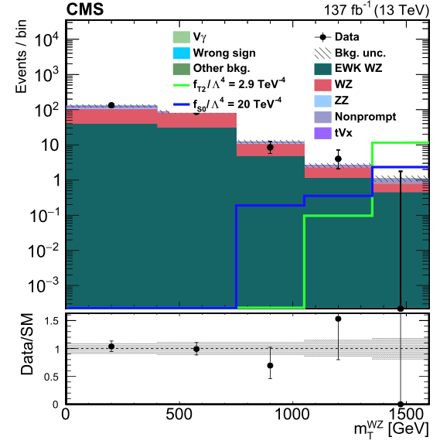
Why is VBS important?
Quartic Gauge Coupling (QGCs)
Beyond SM theories predict enhanced couplings!
Any deviation might signal the existence of new physics!
Senisitivity to the presence of new Physics!

Slide 8
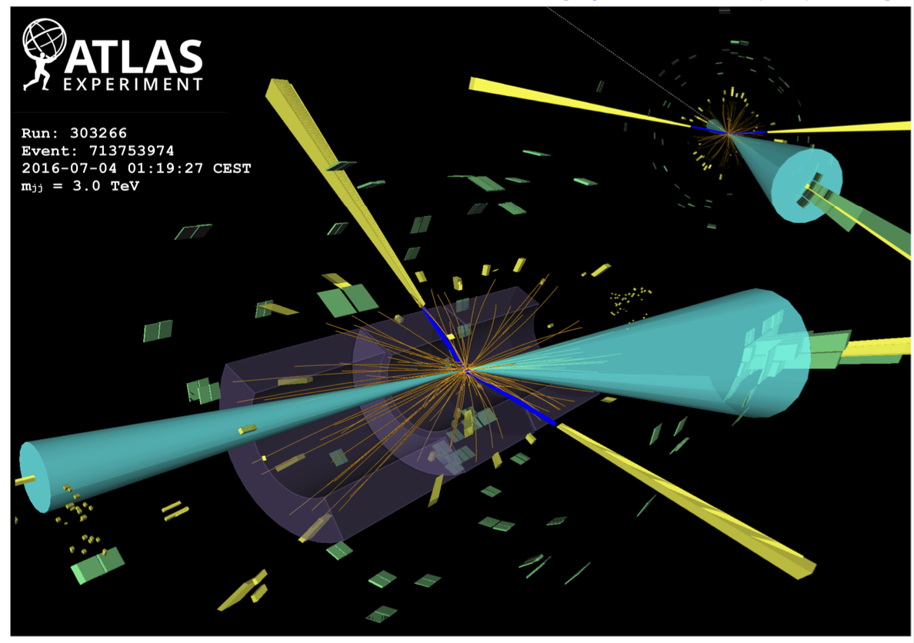

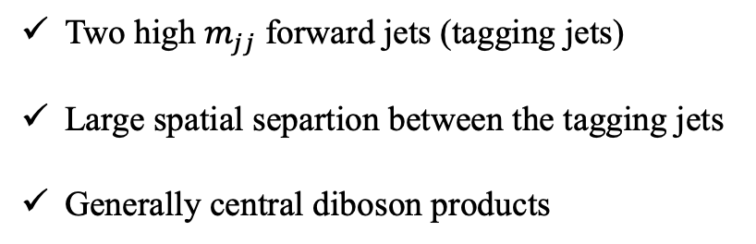

VBS event topology
Two high $m_{jj}$ forward jets (tagging jets)
Large spatial separtion between the tagging jets
Generally central diboson products
$\sim a_{s}$
Major background source!
Fortunately, different topology!
$\sim a_{s}$
QCD VVjj

Slide 9
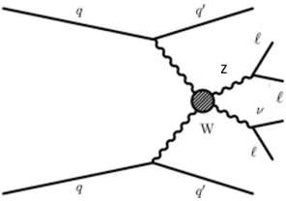
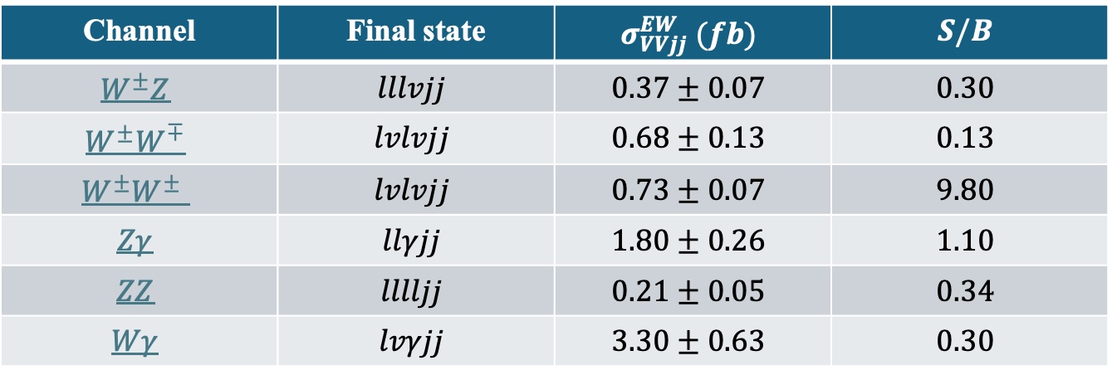
VBS Channels
Channel | Final state | $$σ_{VVjj}^{EW} (fb)$$ | $$S/B$$
$$W^{±}Z$$ | $$lllvjj$$ | $$0.37±0.07$$ | $$0.30$$
$$W^{±}W^{∓}$$ | $$lvlvjj$$ | $$0.68±0.13$$ | $$0.13$$
$$W^{±}W^{±}$$ | $$lvlvjj$$ | $$0.73±0.07$$ | $$9.80$$
$$Zγ$$ | $$llγjj$$ | $$1.80±0.26$$ | $$1.10$$
$$ZZ$$ | $$lllljj$$ | $$0.21±0.05$$ | $$0.34$$
$$Wγ$$ | $$lvγjj$$ | $$3.30±0.63$$ | $$0.30$$
WZ: first observation in 2018 (Phys. Lett. B 793 (2019) 469 and PLB 809 (2020) 135710 )
Experimental signature:
  2 opposite sign leptons
  1 lepton
  2 hadronic jets
Challenge: high QCD background

Slide 10
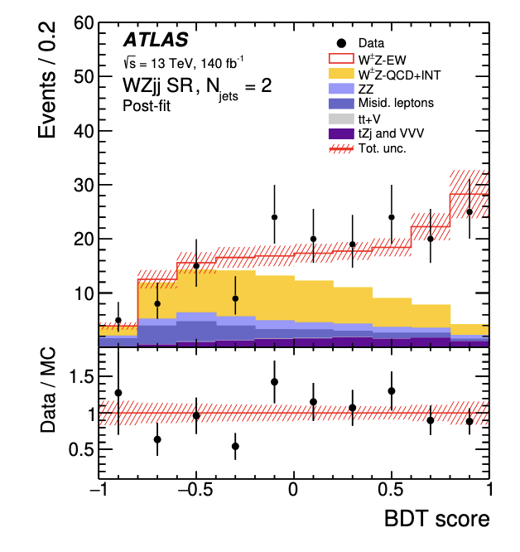
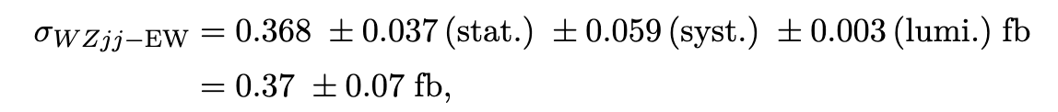
Measurement of WZjj-EW integrated cross section
JHEP06(2024)192
Background-only hypothesis excluded with a 6.03$σ$ significance!
Suffering from important theoretical uncertainties
WZ-QCD is dominant in the SR, so machine learning techniques are used to separate the signal from the background based on the VBS topology

Slide 11
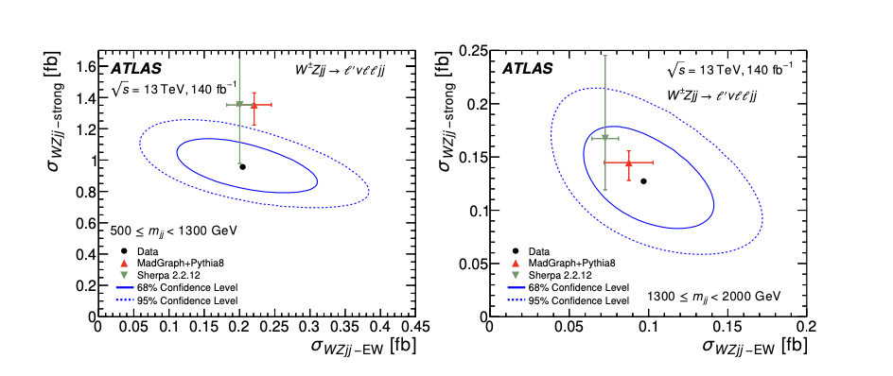
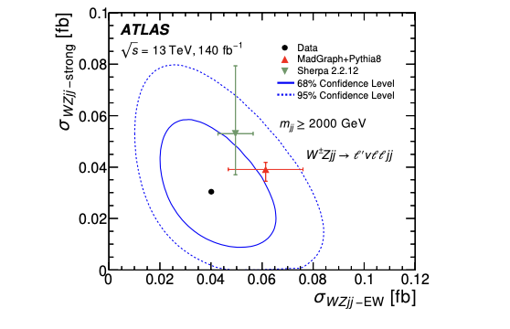
Differential WZjj cross section measurements
JHEP06(2024)192

Slide 12
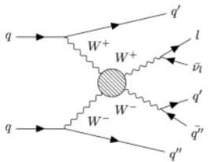

VBS Channels
Channel | Final state | $$σ_{VVjj}^{EW} (fb)$$ | $$S/B$$
$$W^{±}Z$$ | $$lllvjj$$ | $$0.37±0.07$$ | $$0.30$$
$$W^{±}W^{∓}$$ | $$lvlvjj$$ | $$0.68±0.13$$ | $$0.13$$
$$W^{±}W^{±}$$ | $$lvlvjj$$ | $$0.73±0.07$$ | $$9.80$$
$$Zγ$$ | $$llγjj$$ | $$1.80±0.26$$ | $$1.10$$
$$ZZ$$ | $$lllljj$$ | $$0.21±0.05$$ | $$0.34$$
$$Wγ$$ | $$lvγjj$$ | $$3.30±0.63$$ | $$0.30$$
W±W ± : first observation in 2018 (PRL 123 (2019) 161801 and PRL 120 (2018) 081801)
Experimental signature:
2 same sign leptons
2 hadronic jets
_{W}±
Challenge: two neutrinos in the final state
_{W}±

Slide 13
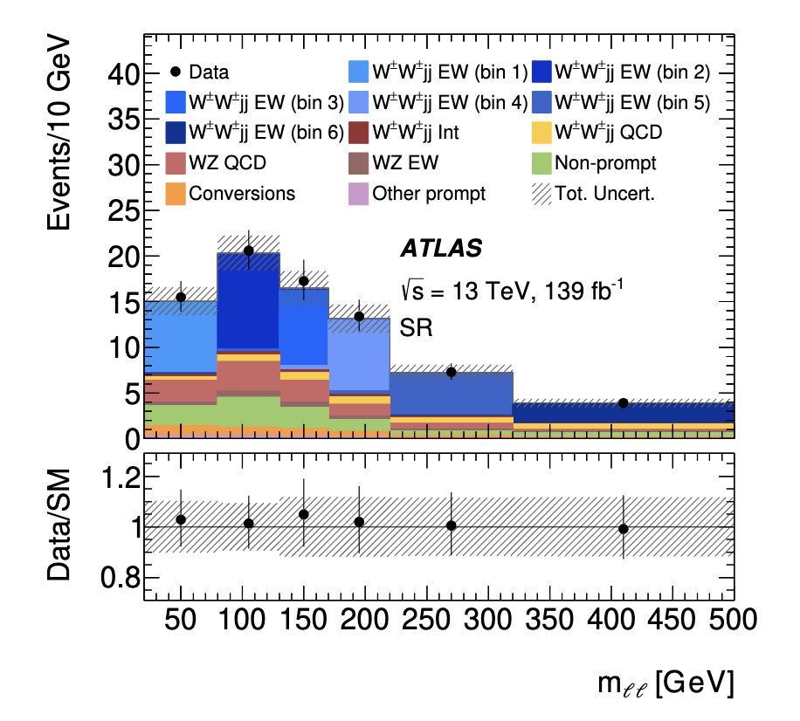
Measurement of ssWWjj-EW integrated cross section
Background-only hypothesis excluded with a 6.5$σ$ significance!
Highest uncertainty
JHEP04(2024)026

Slide 14
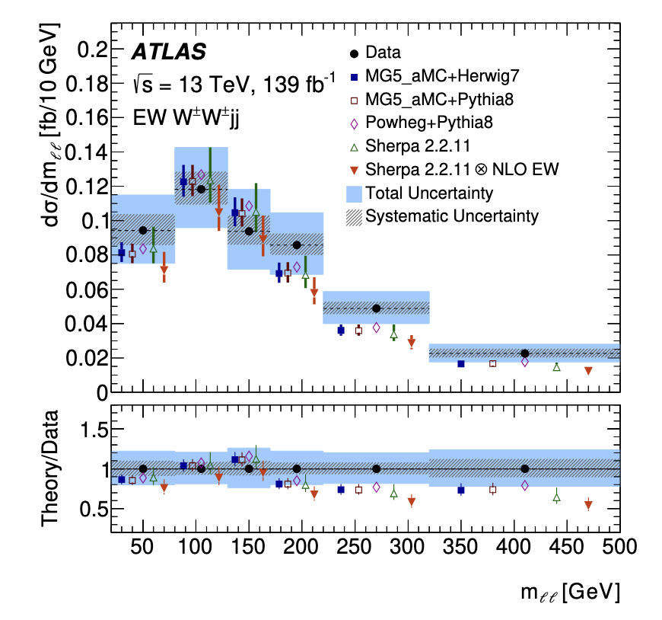
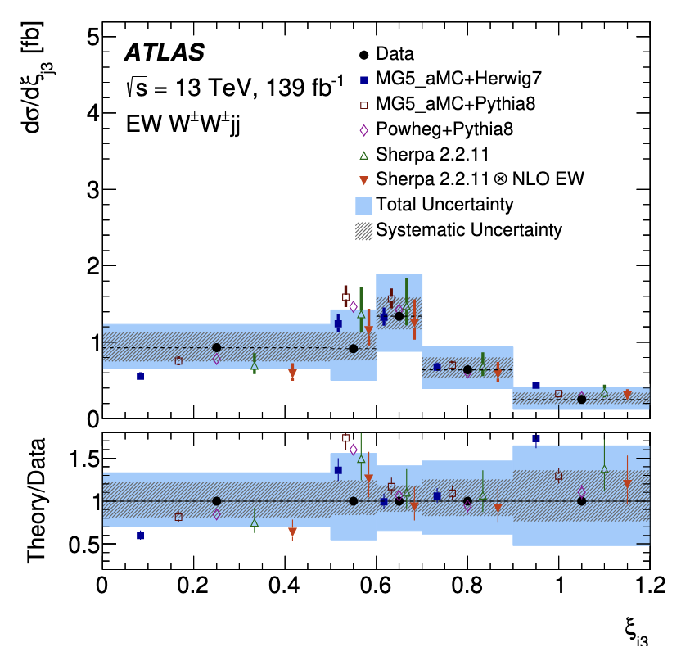
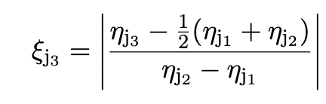
EW ssWWjj Differential Cross Section measurements
Sensitive to New Physics!
JHEP04(2024)026

Slide 15
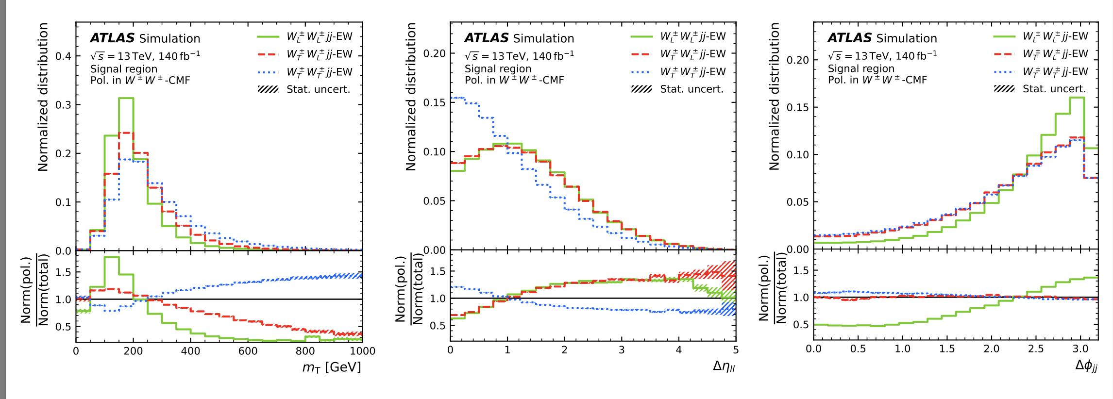





Polarization States
$W_{T}^{±}W_{T}^{±}$ (61%)
arXiv:2503.11317
$$W^{±}W^{±}$$
$W_{T}^{±}W_{L}^{±}$ (29%)
$W_{L}^{±}W^{±}$ (39%)
$W_{L}^{±}W_{L}^{±}$ (10%)

Slide 16
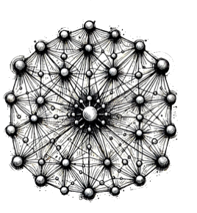
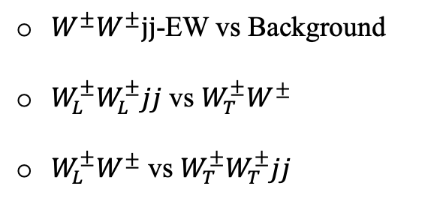
Polarization state separation
$W^{±}W^{±}jj$-EW vs Background
$W_{L}^{±}W_{L}^{±}jj$ vs $W_{T}^{±}W^{±}$
$W_{L}^{±}W^{±}$ vs $W_{T}^{±}W_{T}^{±}jj$
DNNs are trained to separete:

Slide 17
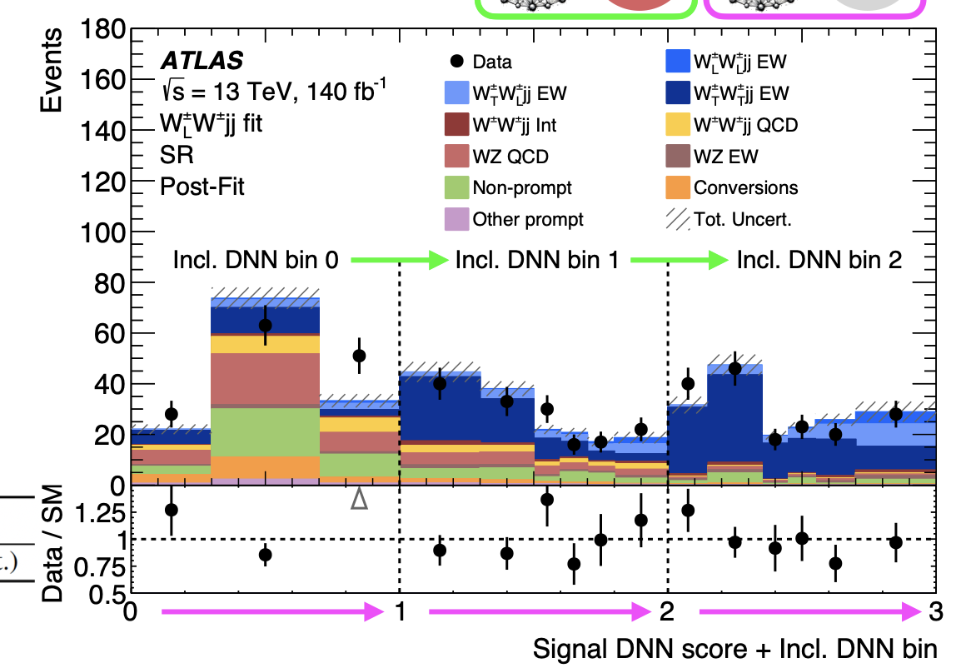
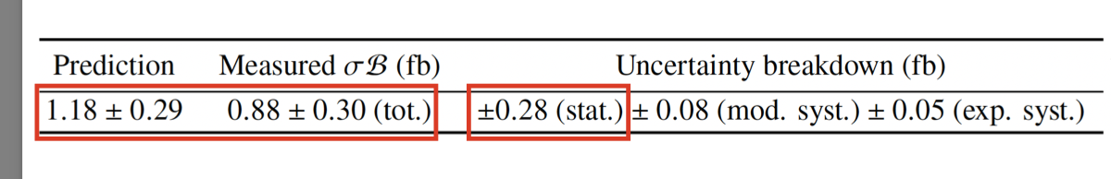

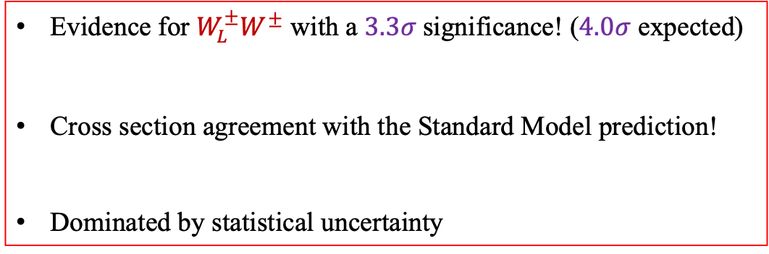
Single boson polarization
Evidence for $W_{L}^{±}W^{±}$ with a $3.3σ$significance! ($4.0σ$ expected)
Cross section agreement with the Standard Model prediction!
Dominated by statistical uncertainty
$$±30\%$$
arXiv:2503.11317

Slide 18
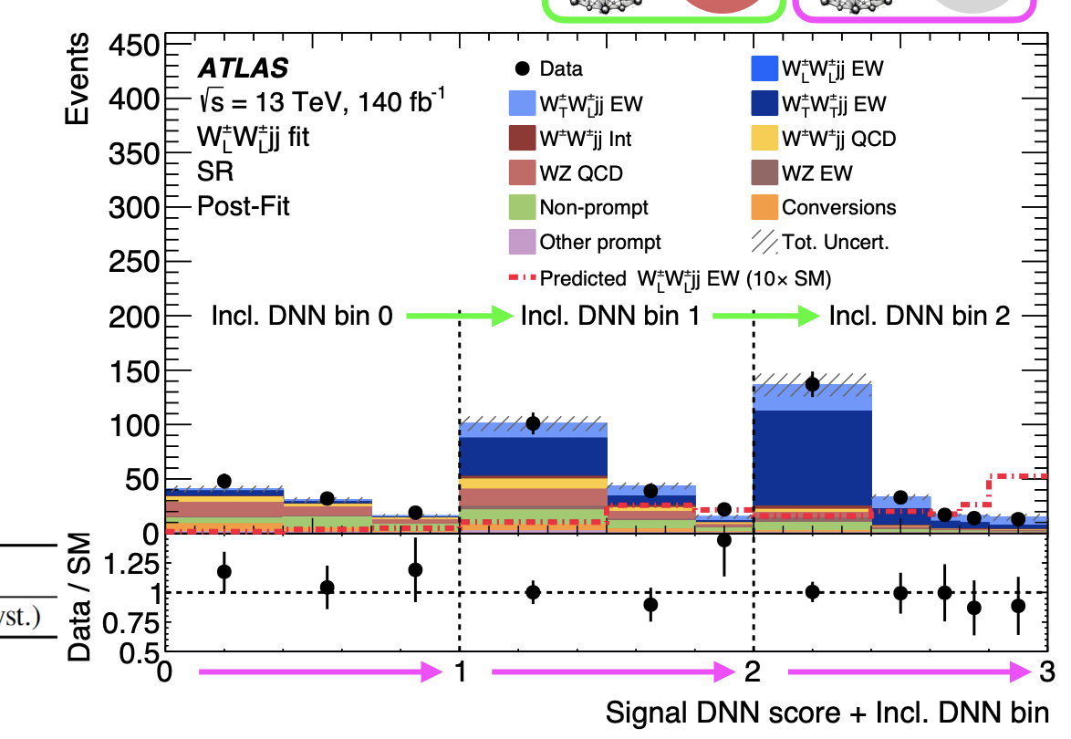
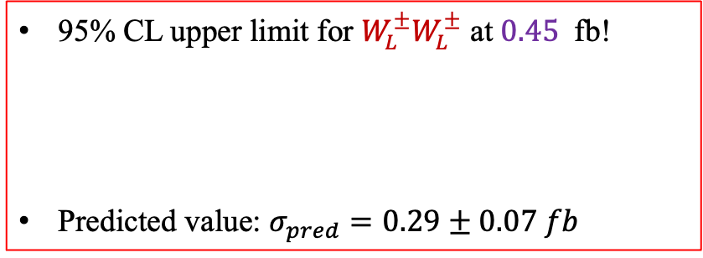
Double boson polarization
95% CL upper limit for $W_{L}^{±}W_{L}^{±}$ at $0.45$ fb!
Predicted value: $σ_{pred}=0.29±0.07 fb$
arXiv:2503.11317

Slide 19
Conclusions & Prospects
So far…
  Observation and studies of all electroweak VBS channels
  For the moment, no evidence of New Physics but…
What Run3 and HL-LHC have to offer…
  By the end of Run3, 2.5× more data will have been acquired
  By the end of HL-LHC era, there will be a 15× more data will have been acquired
  Study of rare processes, sensitive to new Physics
  Deeper investigation of the electroweak symmetry breaking through double longitudinally polarized bosons

Slide 20
THANKS FOR YOU ATTENTION!

Slide 21
Backup Slides

Slide 22
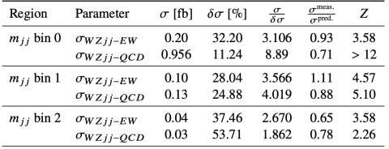
Differential Cross Section measurements

Slide 23

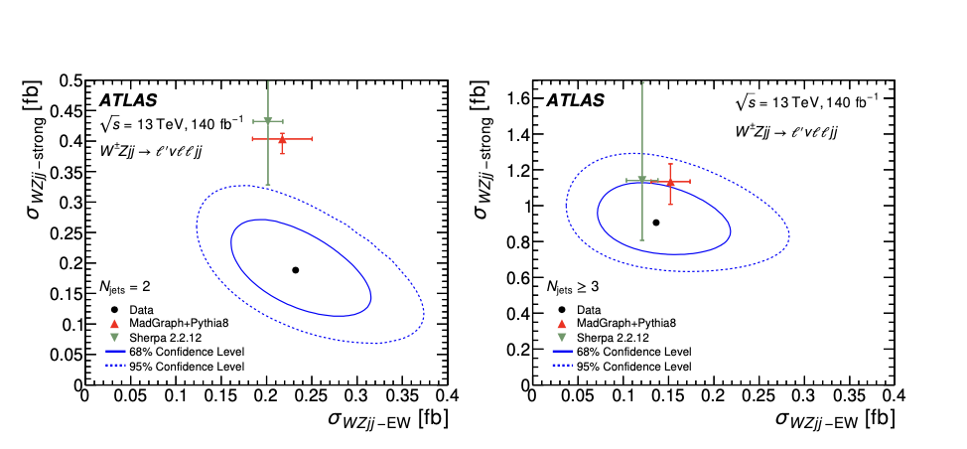
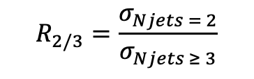
Differential Cross Section measurements
$$R_{2/3}=\frac{σ_{Njets = 2}}{σ_{Njets ≥ 3}}$$

Slide 24
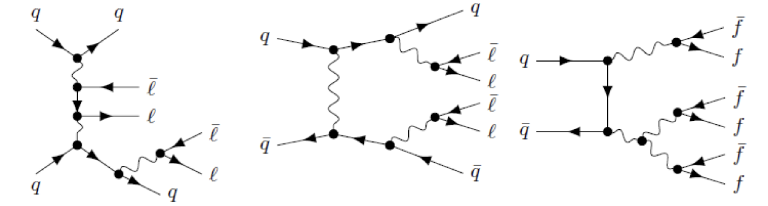
Electroweak Diboson Production
EWK VVjj

Slide 25
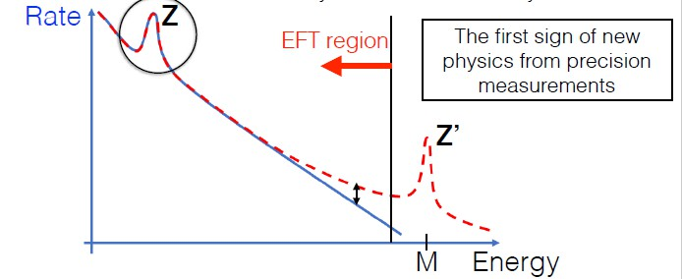
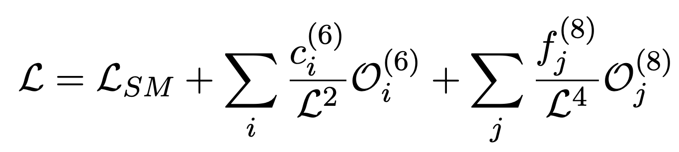
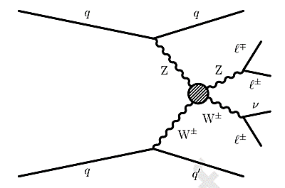
Searching for New Physics
Direct Searches
Particles predicted by Beyond Standard Model theories
New Physics searches
Indirect Searches
Precise measurements and quantification of deviations
Effective Field Theory: A natural expansion to SM
Vector Boson Scattering
Quartic Gauge Couplings (QGCs)!
Dimension 8 operators describing aQGCs
Standard Model Lagrangian
Sensitive to new Physics!!
Dimension 6 operators describing aTGCs
Standard Model Lagrangian
Dimension 6 operators describing TGCs

Slide 26
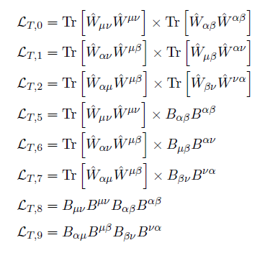
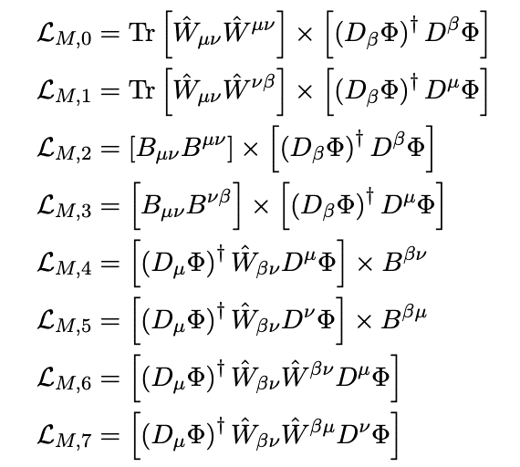
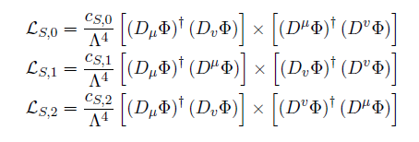
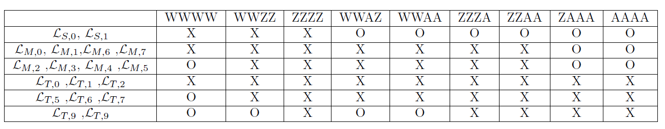
EFT dim-8 operators
Tensor operators
Mixed operators
Scalar operators

Slide 27
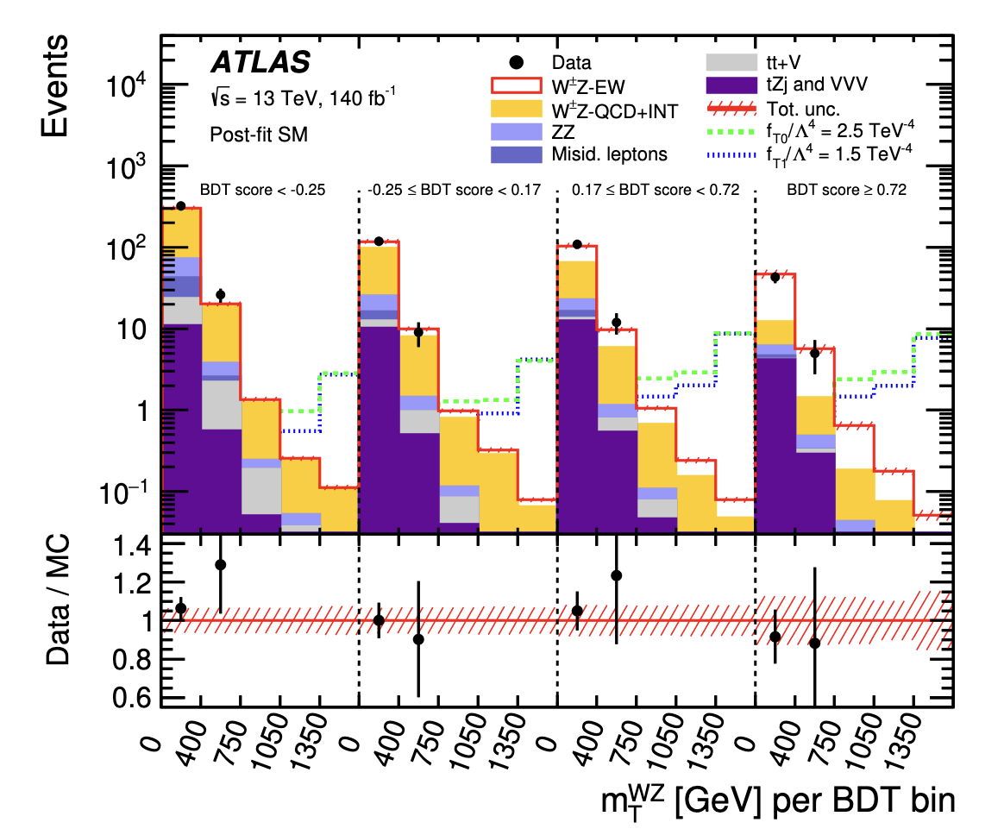
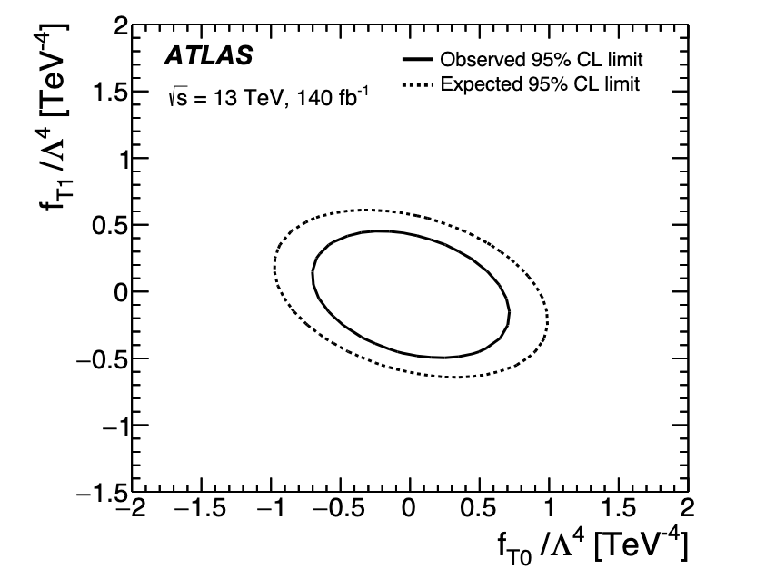
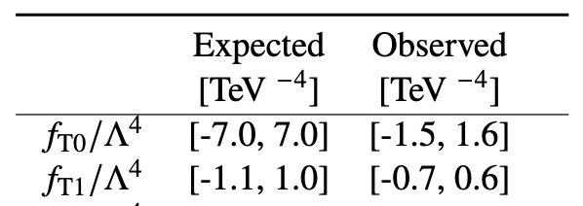
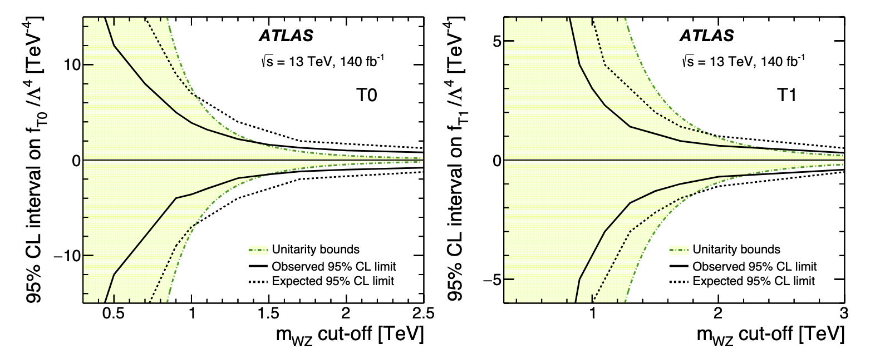
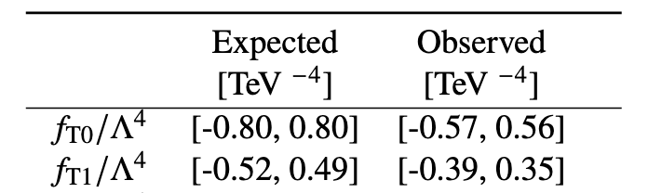
EFT re-interpretation of WZjj-EW measurement
2D 95% CL limits
1D 95% CL unitarity limits
1D 95% CL limits

Slide 28
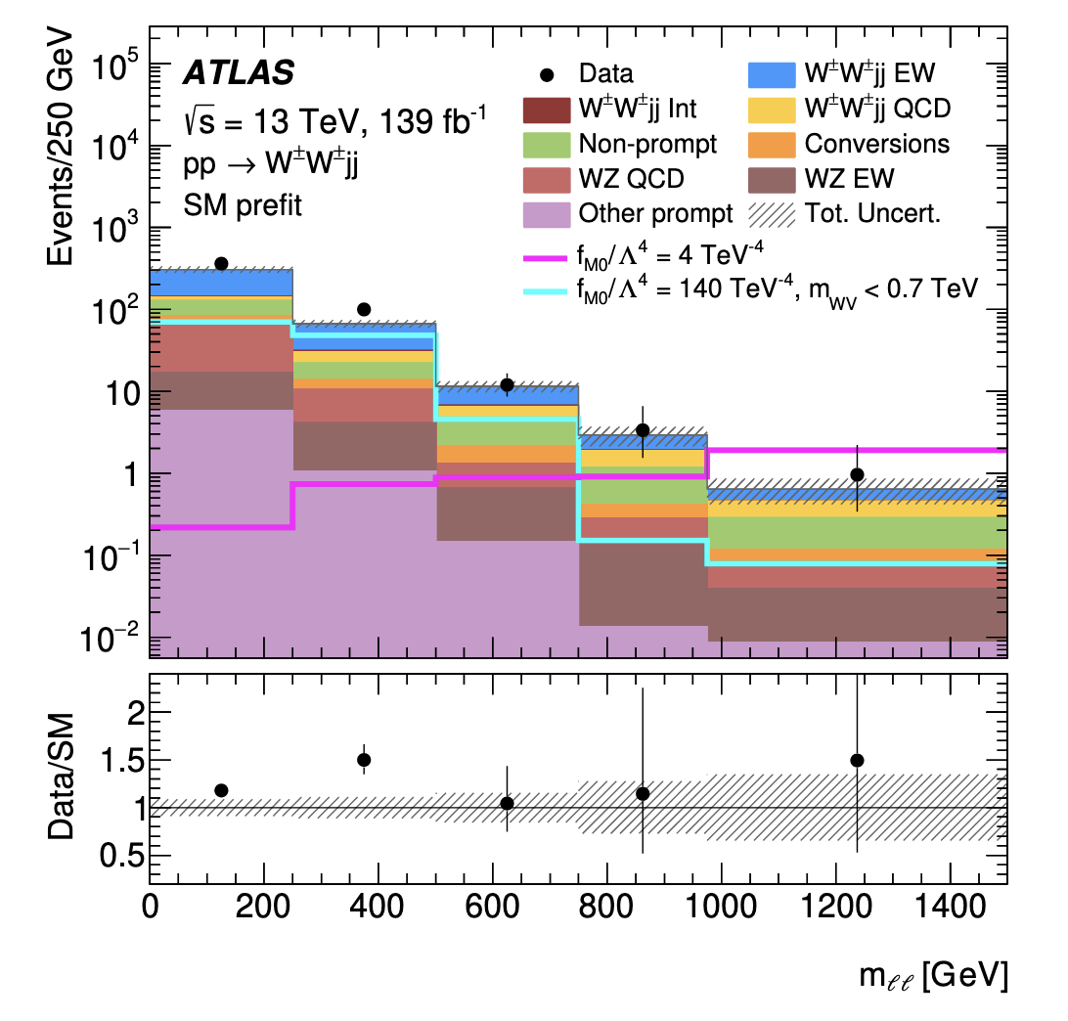
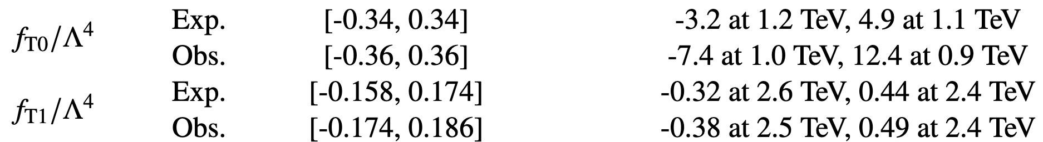
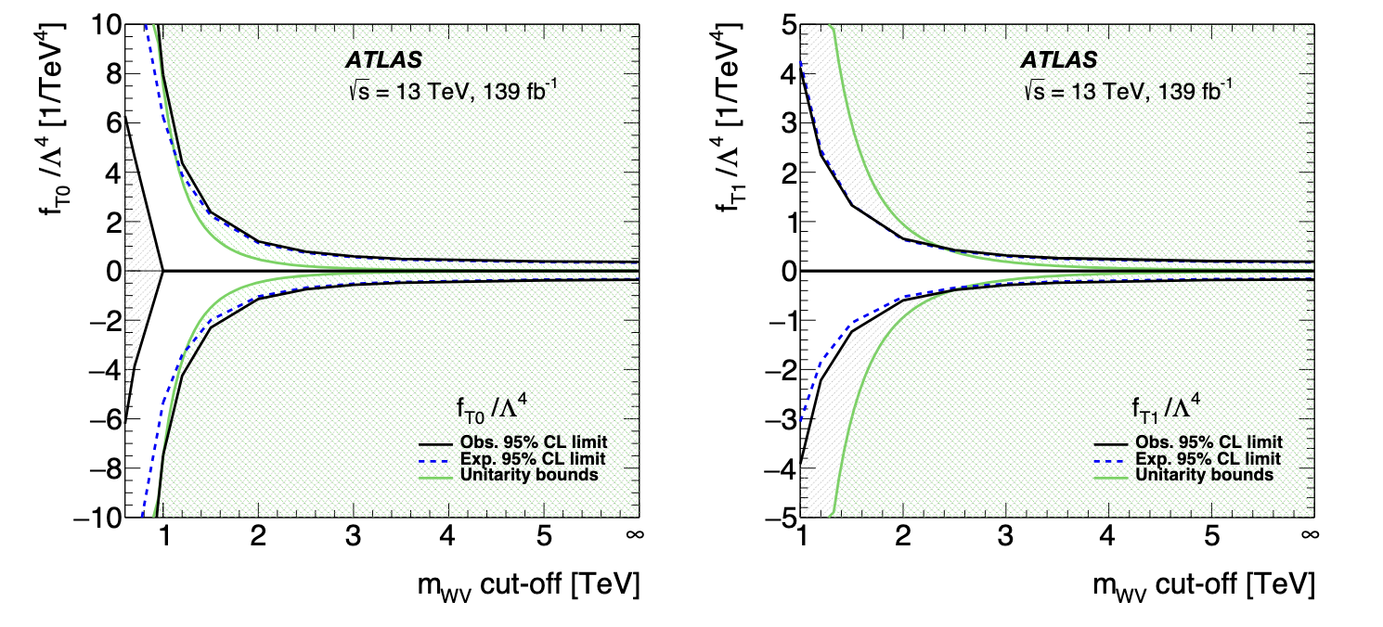
EFT re-interpretation of ssWWjj-EW measurement
1D 95% CL limits
1D 95% CL unitarity limits

