Slide 1
Charge signal formation in the Vertical Drift design for DUNE
IRN Neutrino, LPNHE Paris – 3 & 4 November
Notes:
Thanks for the invitation and the opportinuty to present reasearch done during my phd

Slide 2
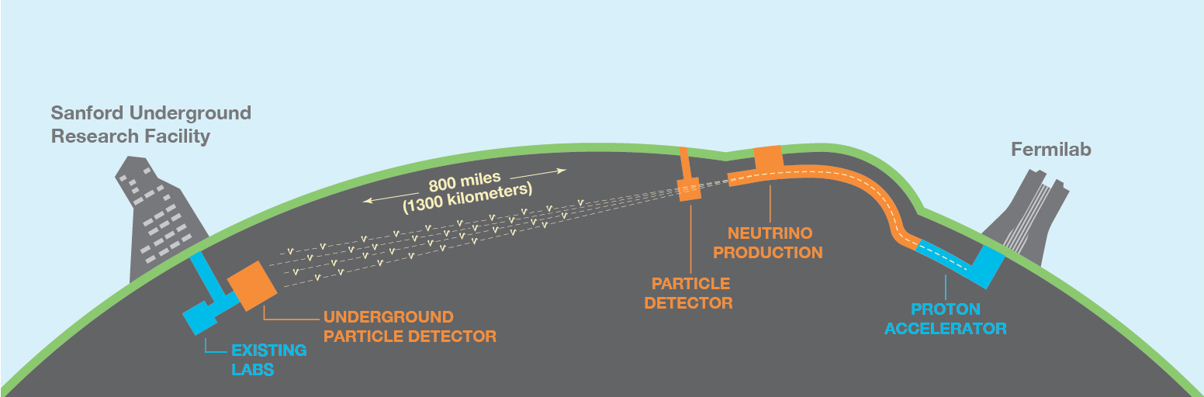
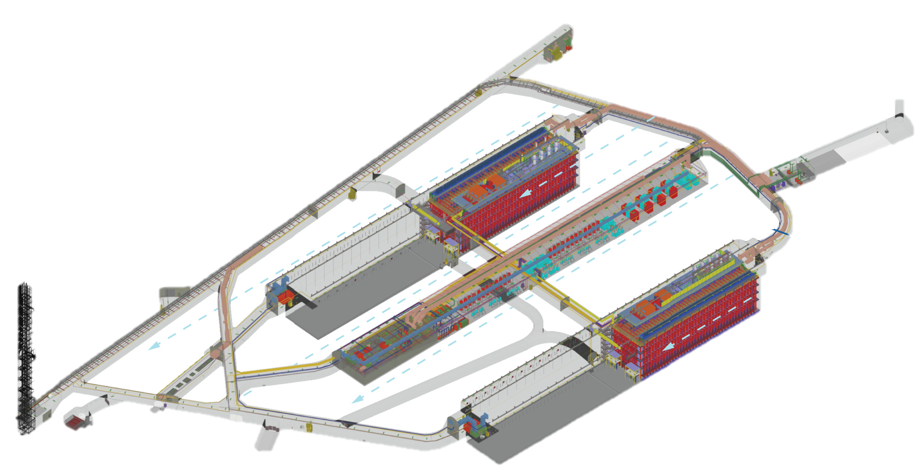
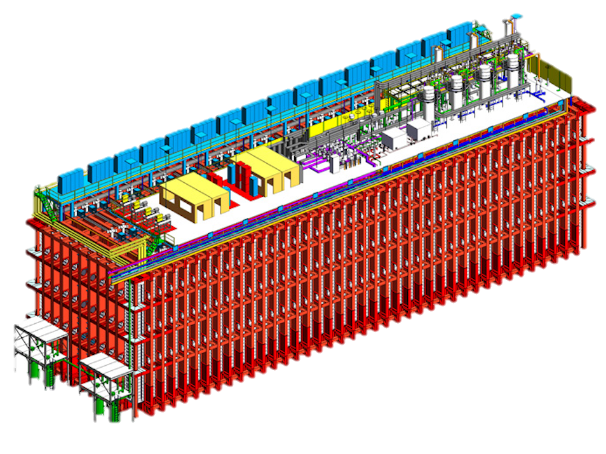
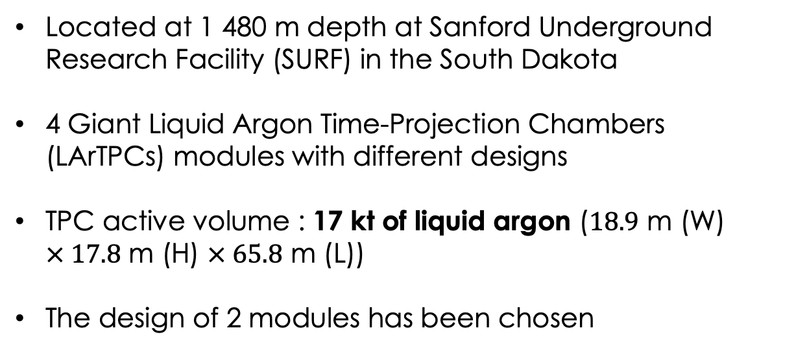
Deep Underground Neutrino Experiment
Far Detector (FD) at 1 300 km from Fermilab
Near Detector (ND) close to neutrino target
PIP II : from 1.2 MW (~2027) to 2.4 MW (~2030) beam
Located at 1 480 m depth at Sanford Underground Research Facility (SURF) in the South Dakota
4 Giant Liquid Argon Time-Projection Chambers (LArTPCs) modules with different designs
TPC active volume : 17 kt of liquid argon ($18.9$ m (W) $× 17.8$ m (H) $× 65.8$ m (L))
The design of 2 modules has been chosen
DUNE Phase 1: 2 detectors
DUNE Phase 2: 4 detectors
Notes:
At the end of the 4 Giant module using the liquid Argon Time Projection Chambers will be install at 1 480 m depth at SURF at 1300 km away with an active volume equal to 17 kt each. For now, 2 modules has been chosen, the horizontal drift and the vertical drift which i will develop later.

Slide 3
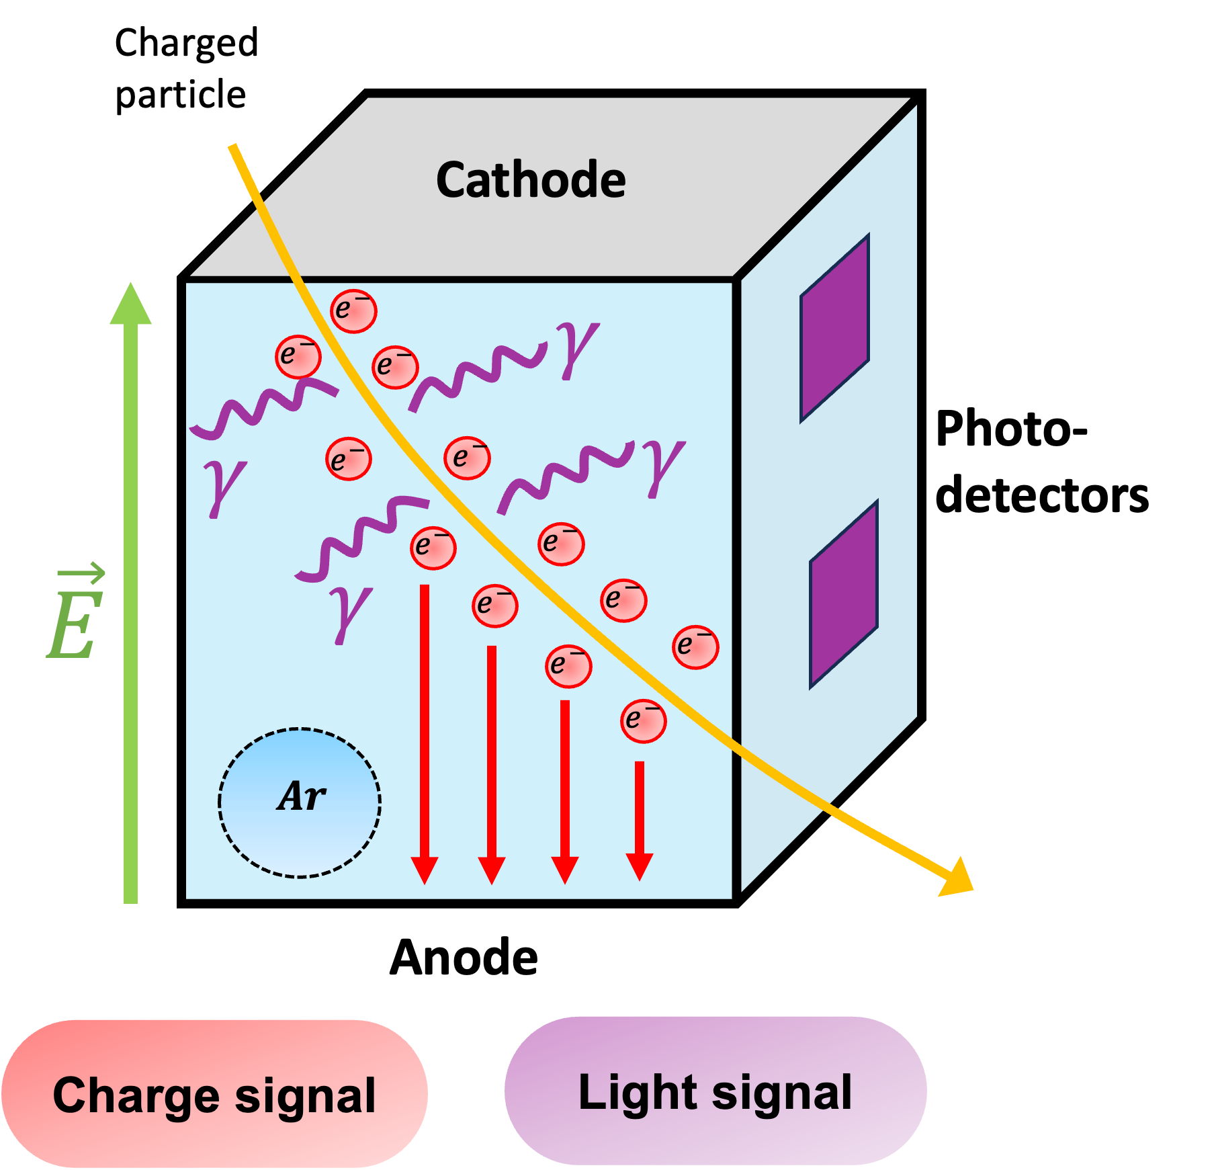
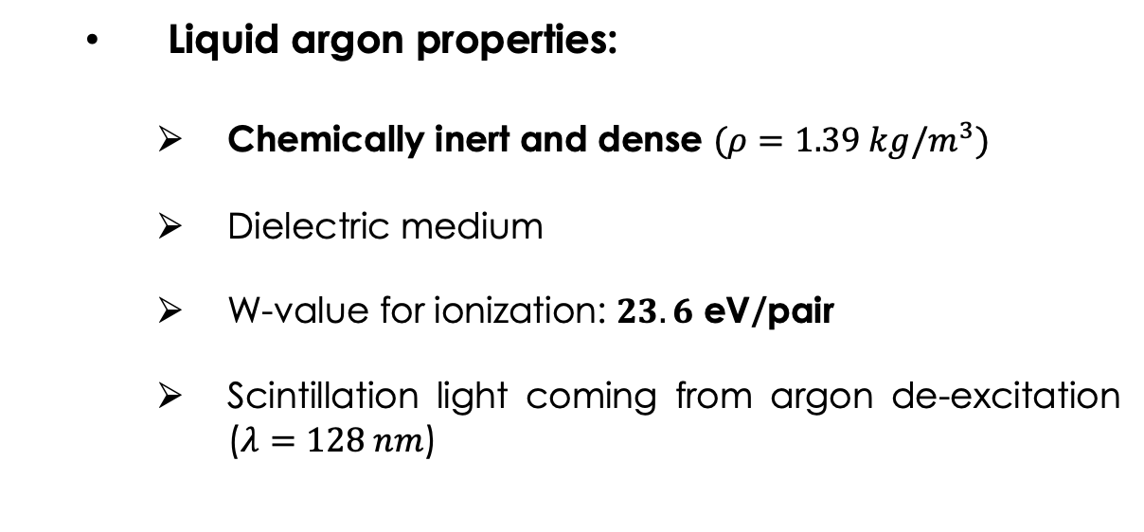
Principle of LArTPC detection
Liquid argon properties:
Chemically inert and dense $(ρ=1.39 kg/m^{3})$
Dielectric medium
W-value for ionization: $23.6$ eV/pair
Scintillation light coming from argon de-excitation ($λ=128 nm$)
Time Projection Chamber:
Segmented anodes used to collect charge signal → reconstruct track
Light detection: Calorimetry and Trigger
Enables large volume and high spatial resolution
Notes:
The overall principle of LArTPC is that when a charged particle passes through the active volume, it will ionize and excite the argon atoms. Since argon is chemically inert, the ionizing electrons will drift through the volume to an anode, following the electric field lines. The excited argon atoms emit scintillation light, which is detected by photodetectors. Using an anode segmenter we can locate the charge deposit in the volume and reconstruct the trace. Light information is much faster than charge information and will enable us to trigger detection. The last advantage of using

Slide 4
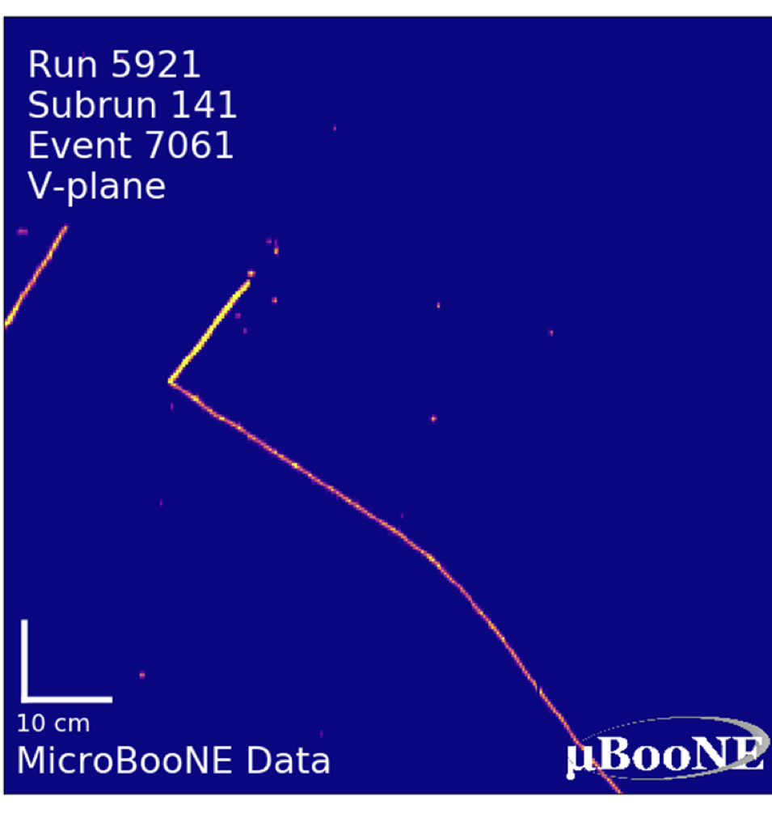
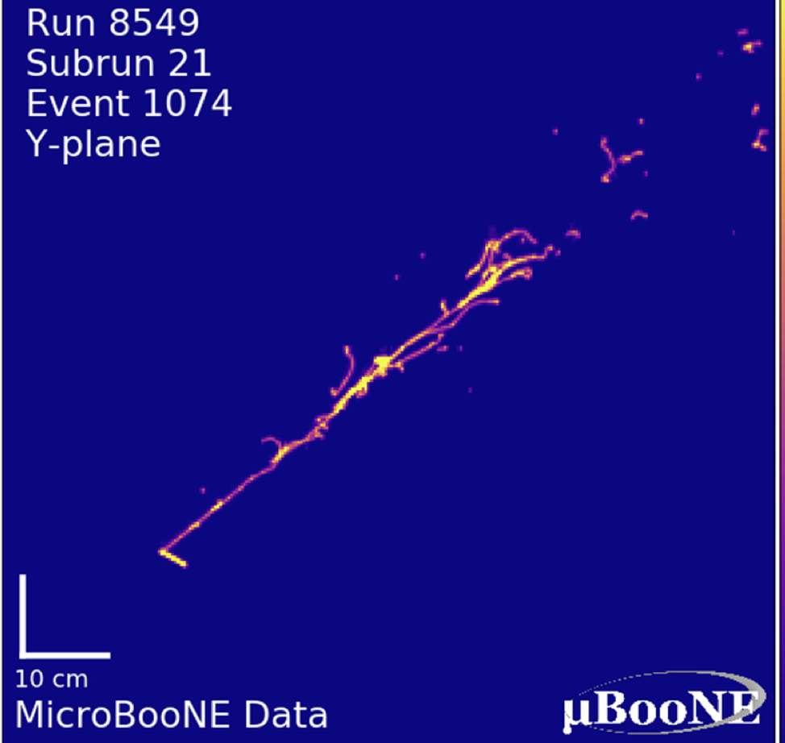
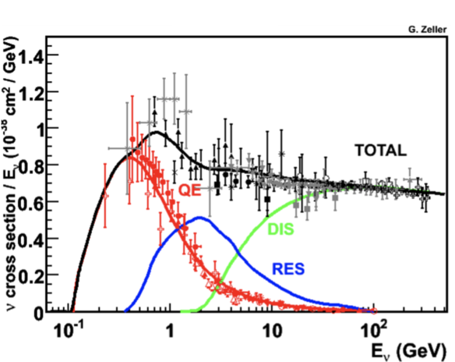


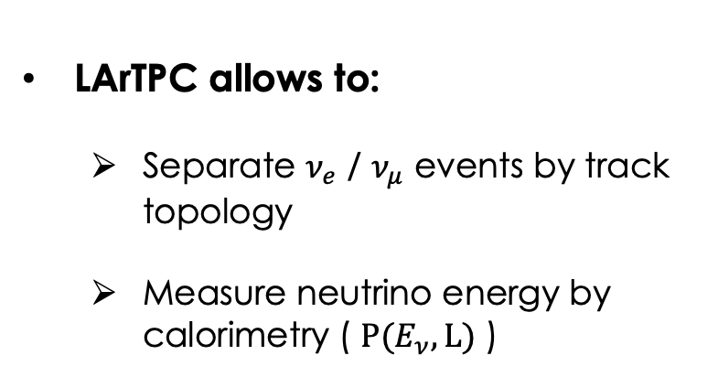








Track topologies
Charged current interaction gives a charged lepton in the final state used to tag the neutrino flavor:
$$ν_{l}+n→l^{−}+p$$
$$\overline{ν_{l}}+p→l^{+}+n$$
$$p$$
LArTPC allows to:
Separate $ν_{e}$ / $ν_{μ}$ events by track topology
Measure neutrino energy by calorimetry ( $P(E_{ν}, L)$ )
$$ν_{μ}$$
$$μ$$
$$e^{−}$$
$$ν_{e}$$
$$p$$
At GeV-scale (1 – 10 GeV) neutrino interactions are dominated by deep inelastic scattering and resonant processes
$ν_{μ}$ candidate
$ν_{e}$ candidate
Both are essential to measure the neutrino oscillation probabilities: $P(ν_{μ}→ν_{e})$ and $P(\overline{ν_{μ}}→\overline{ν_{e}})$
Notes:
The main challenge is to tag the neutrino flavor thanks to the track topologies inside the active volume.
LARTPC allows to determinate the initial neutrino energy as well

Slide 5
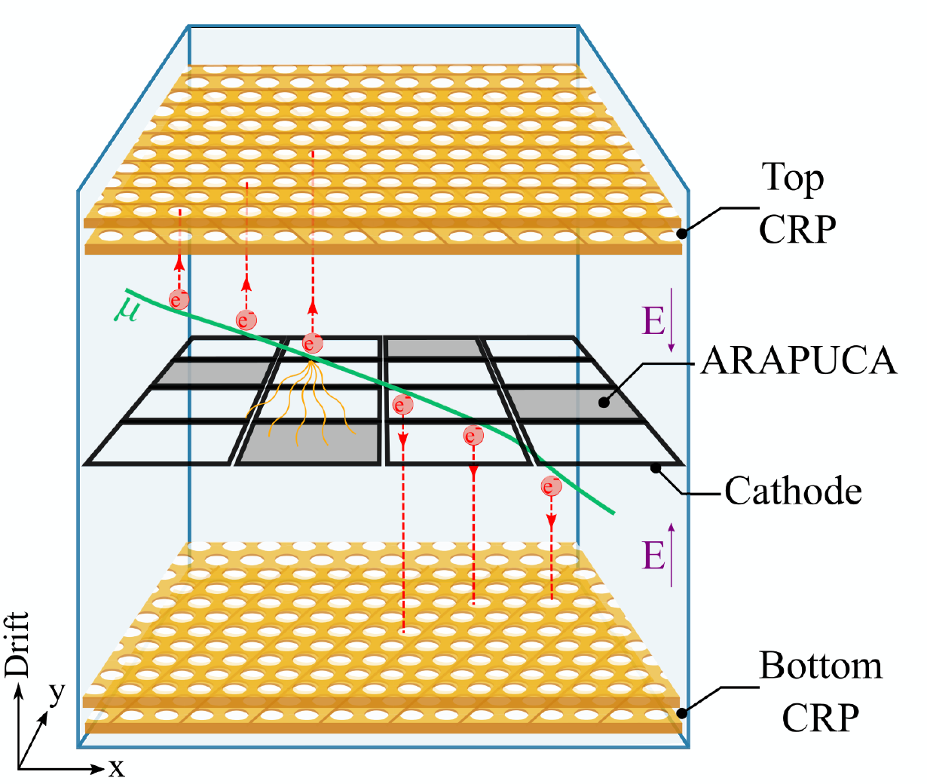
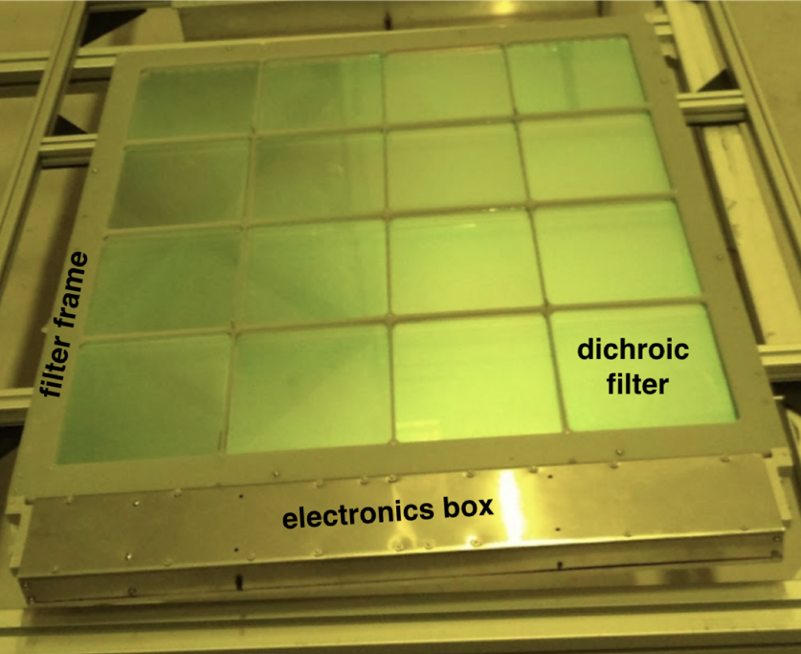
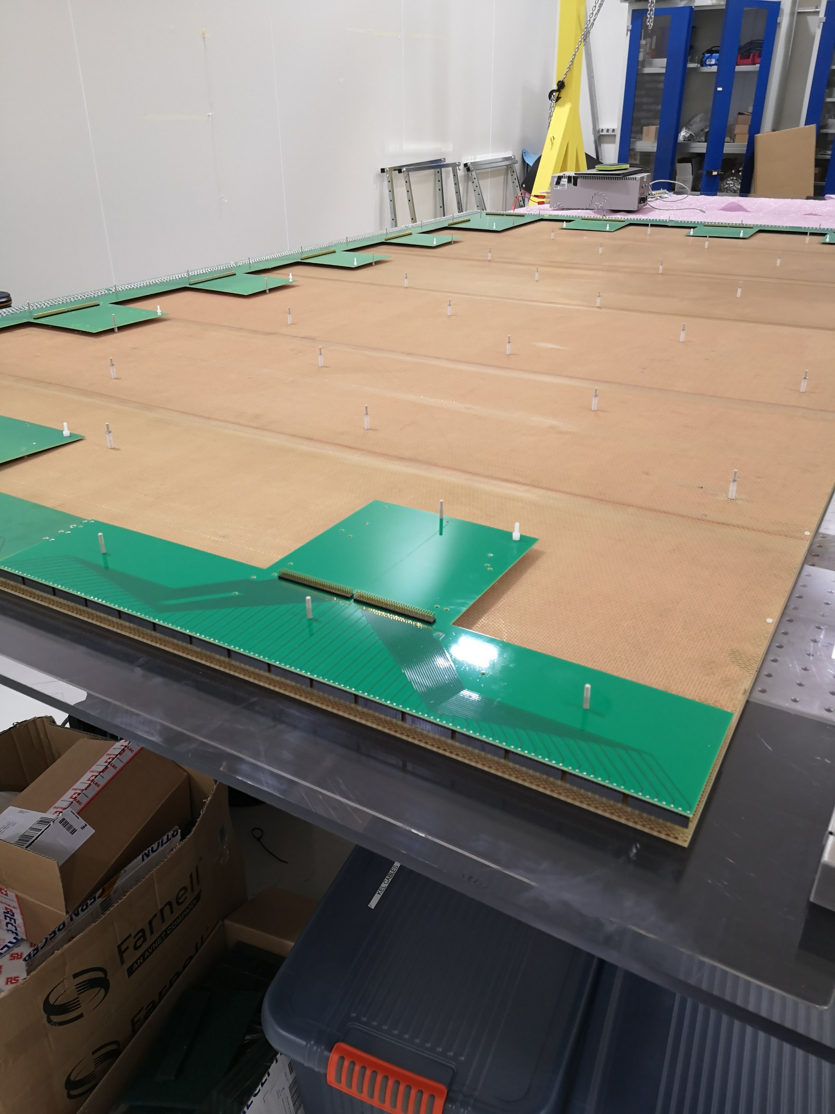
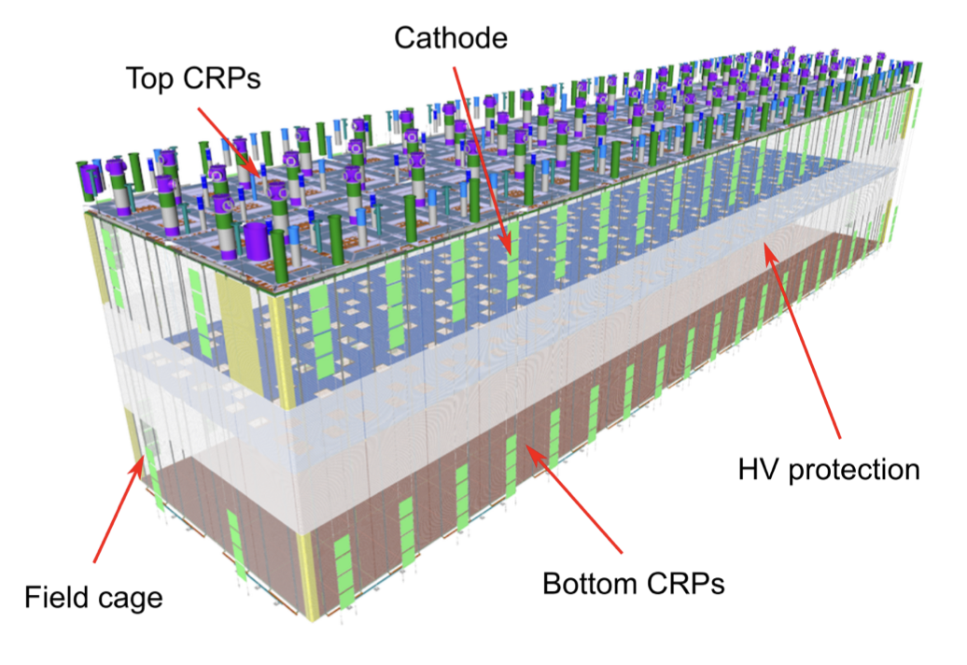
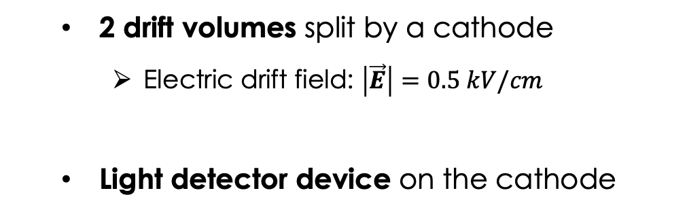
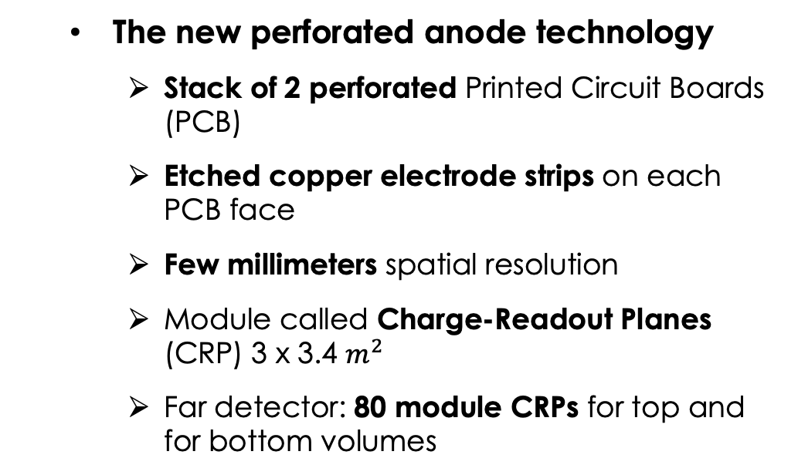
Vertical drift (VD) design
2 drift volumes split by a cathode
Electric drift field: $\left|\vec{E}\right|=0.5 kV/cm$
Light detector device on the cathode
X-ARAPUCA
The new perforated anode technology
Stack of 2 perforated Printed Circuit Boards (PCB)
Etched copper electrode strips on each PCB face
Few millimeters spatial resolution
Module called Charge-Readout Planes (CRP) 3 x 3.4 $m^{2}$
Far detector: 80 module CRPs for top and for bottom volumes
Credit: L. Zambelli
Perforated anode
Notes:
My work focused on one of the two far detector designs chosen called the Vertical Drift

Slide 6
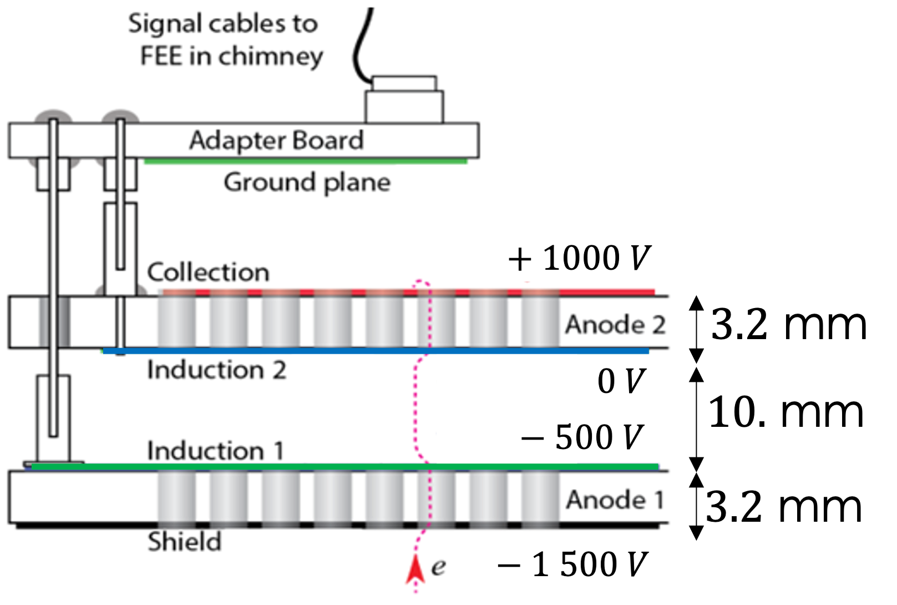
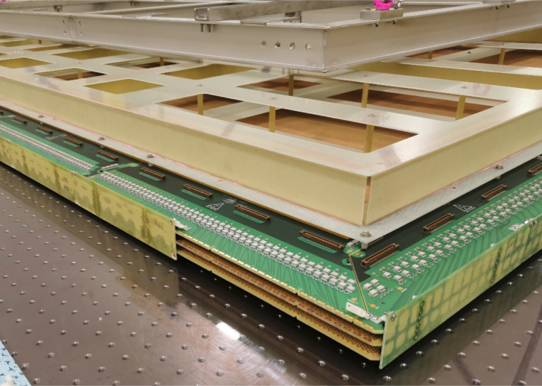
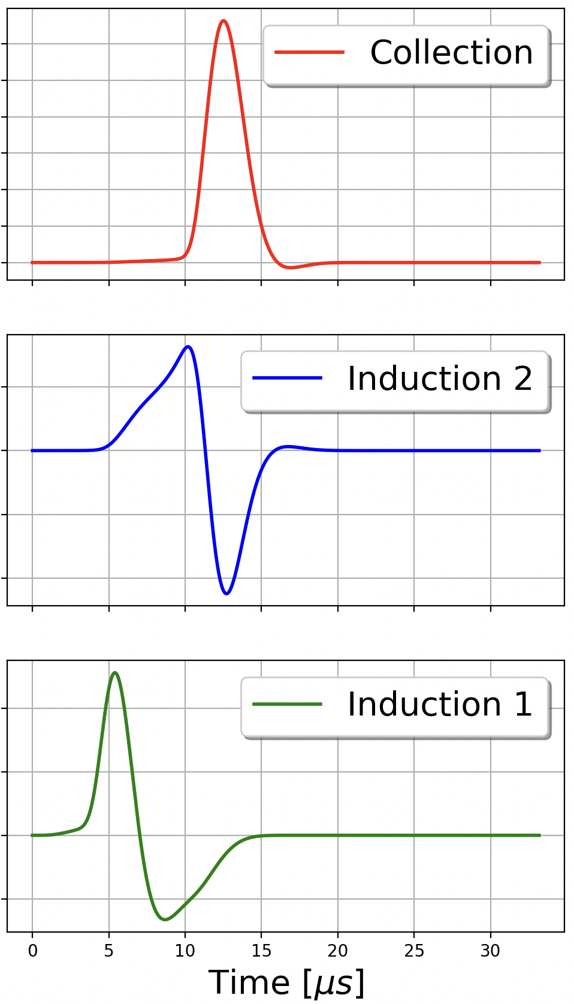
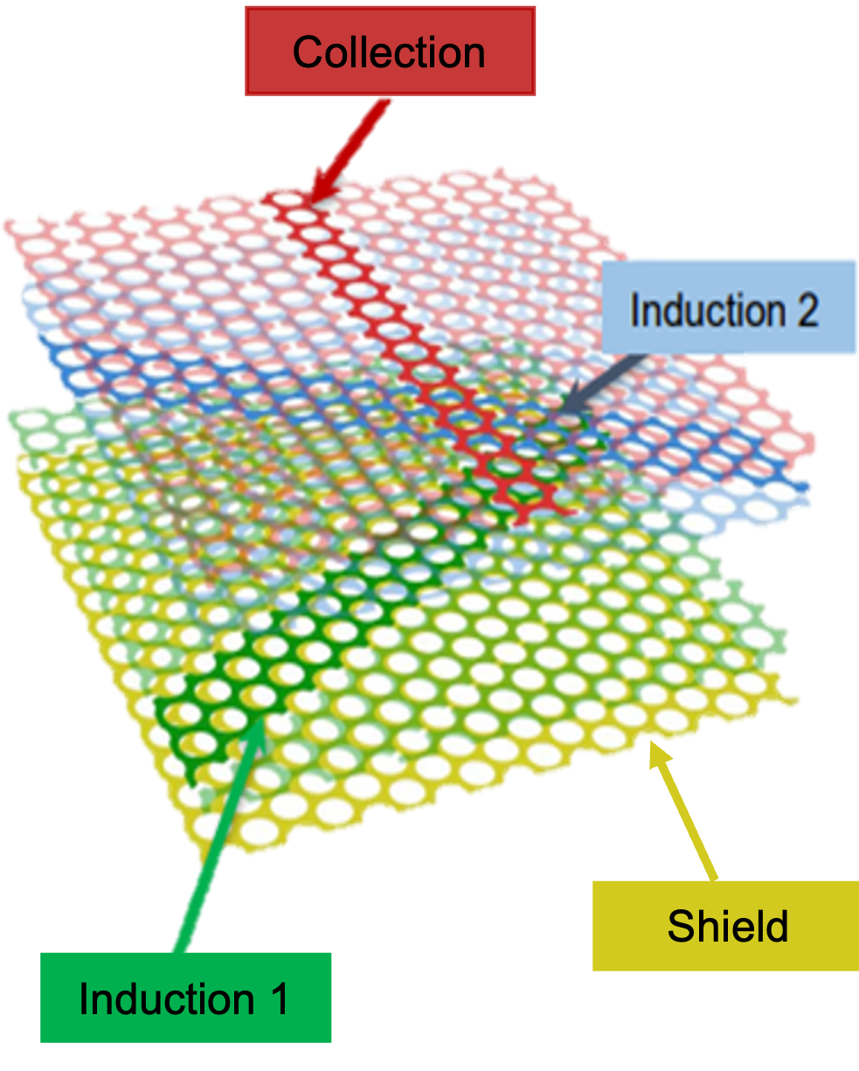
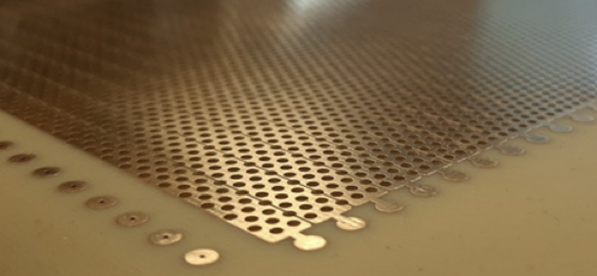
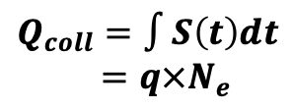

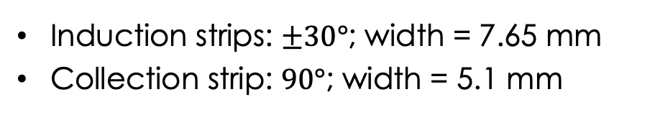

The perforated anode technology
Shielding + 3 readout views
$$Q_{coll}=∫S\left(t\right)dt$$
$=q×N_{e}$
Induction strips: $±30°$; width = 7.65 mm
Collection strip: $90°$; width = 5.1 mm
$$Q_{ind}=0$$
Beam direction
$$Q_{ind}=0$$
Notes:
This anode is composed to 2 pcb with 3 readout views. Among views, we have two induction views then a charge collection view to make calorimetry. Each layer has etched copper strips with different orientation. Those different orientations of the strips allow the topology of the track to be projected onto the anode plane.
Under nominal operating conditions, inductors do not collect charge and generate a bipolar electrical signal whose integral must be zero. The shape of these signals can be understood by charge conservation. Since the charge is not collected, the measured integral must be zero.

Slide 7

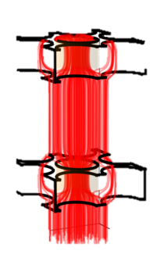
Study motivations
I’ve designed a numerical Python simulation of the charge signal formation
VD design is a new anode technology → need 3D simulation unlike typical LArTPCs with anode made of wires
Main goal is to understand the signal formation and study the shape of the waveforms in more details
Study the different sources of charge losses inside the anode
Local irregularities of anode geometry (e.g. PCB thickness, hole sizes and misalignment)
Effect of the anode biases
Diffusion effect in the anode holes
Notes:
I’ve designed a numerical python simulation
It was designed to give an answer for different problematic. The horizontal drift design use a well-known anode made of wires whose the geometry has already implemented on the DUNE main workflow.

Slide 8
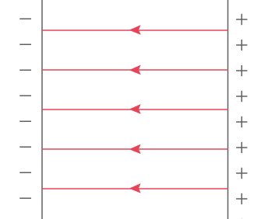
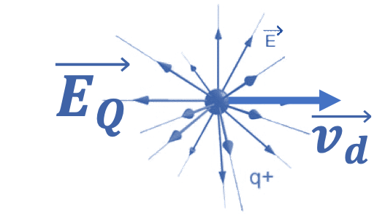
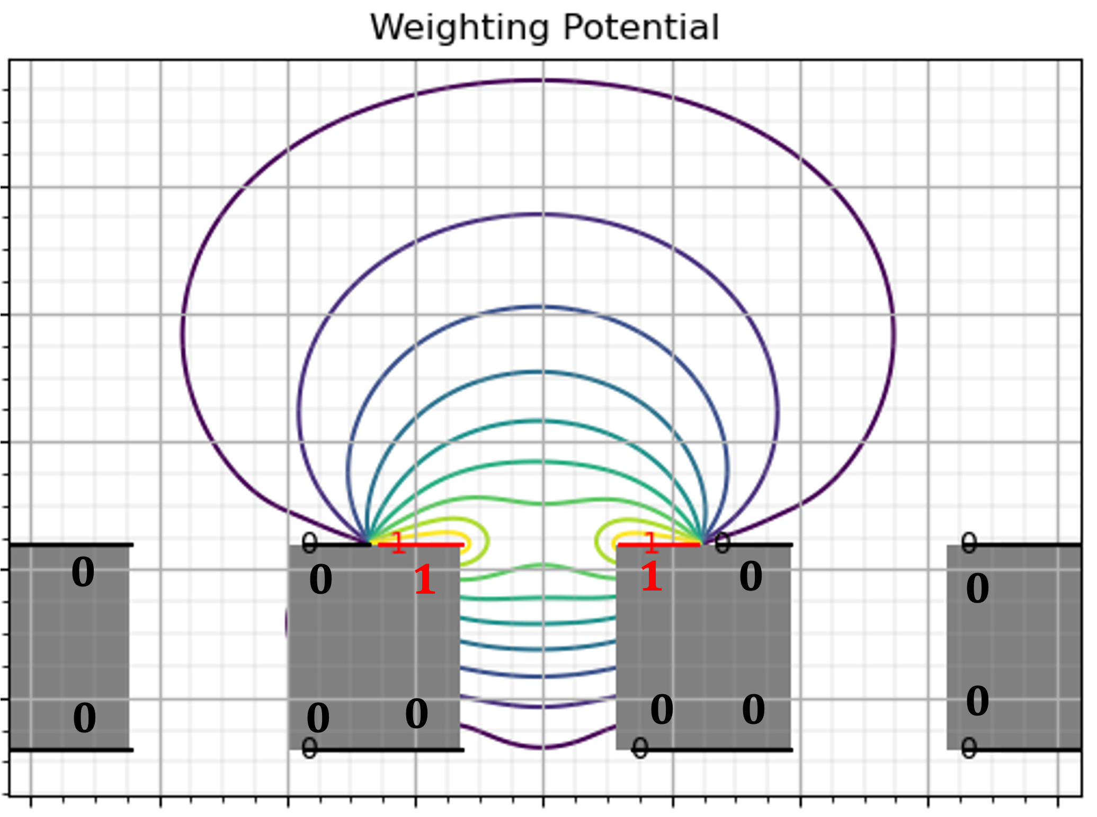


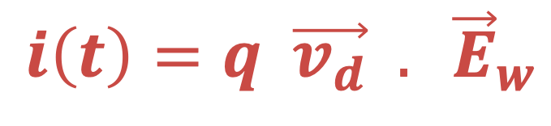
Charge signal formation
Cathode
Anode
A charge drifting inside the TPC will modify the local electric field as a function of time:
$${\vec{E}}_{tot}\left(t\right)=\vec{E_{Q}}+\vec{E_{d}}$$
Induced current from Shockley-Ramo Theorem:
$$i\left(t\right)=q \vec{v_{d}} . {\vec{E}}_{w}$$
Drift velocity
Weighting Field
$$\vec{E_{d}}$$
Incident charged particle
Weighting field is a mathematic tool which depends only on the spatial distribution of the electrodes
The instantaneous current is induced by charge motion only
Weighting equipotential
Notes:
When a charge particle pass through the active volume, the electron of ionization drift to the anode. These electrons will modify the local electric field which will get a time dependence.
Theorem derives from Maxwell equations
2D example on the orthogonal direction to readout strip
Others electrodes will screen the weighting potential
Induced current near to the readout electrode
The main point is the instantaneous current is induced by charge motion only

Slide 9
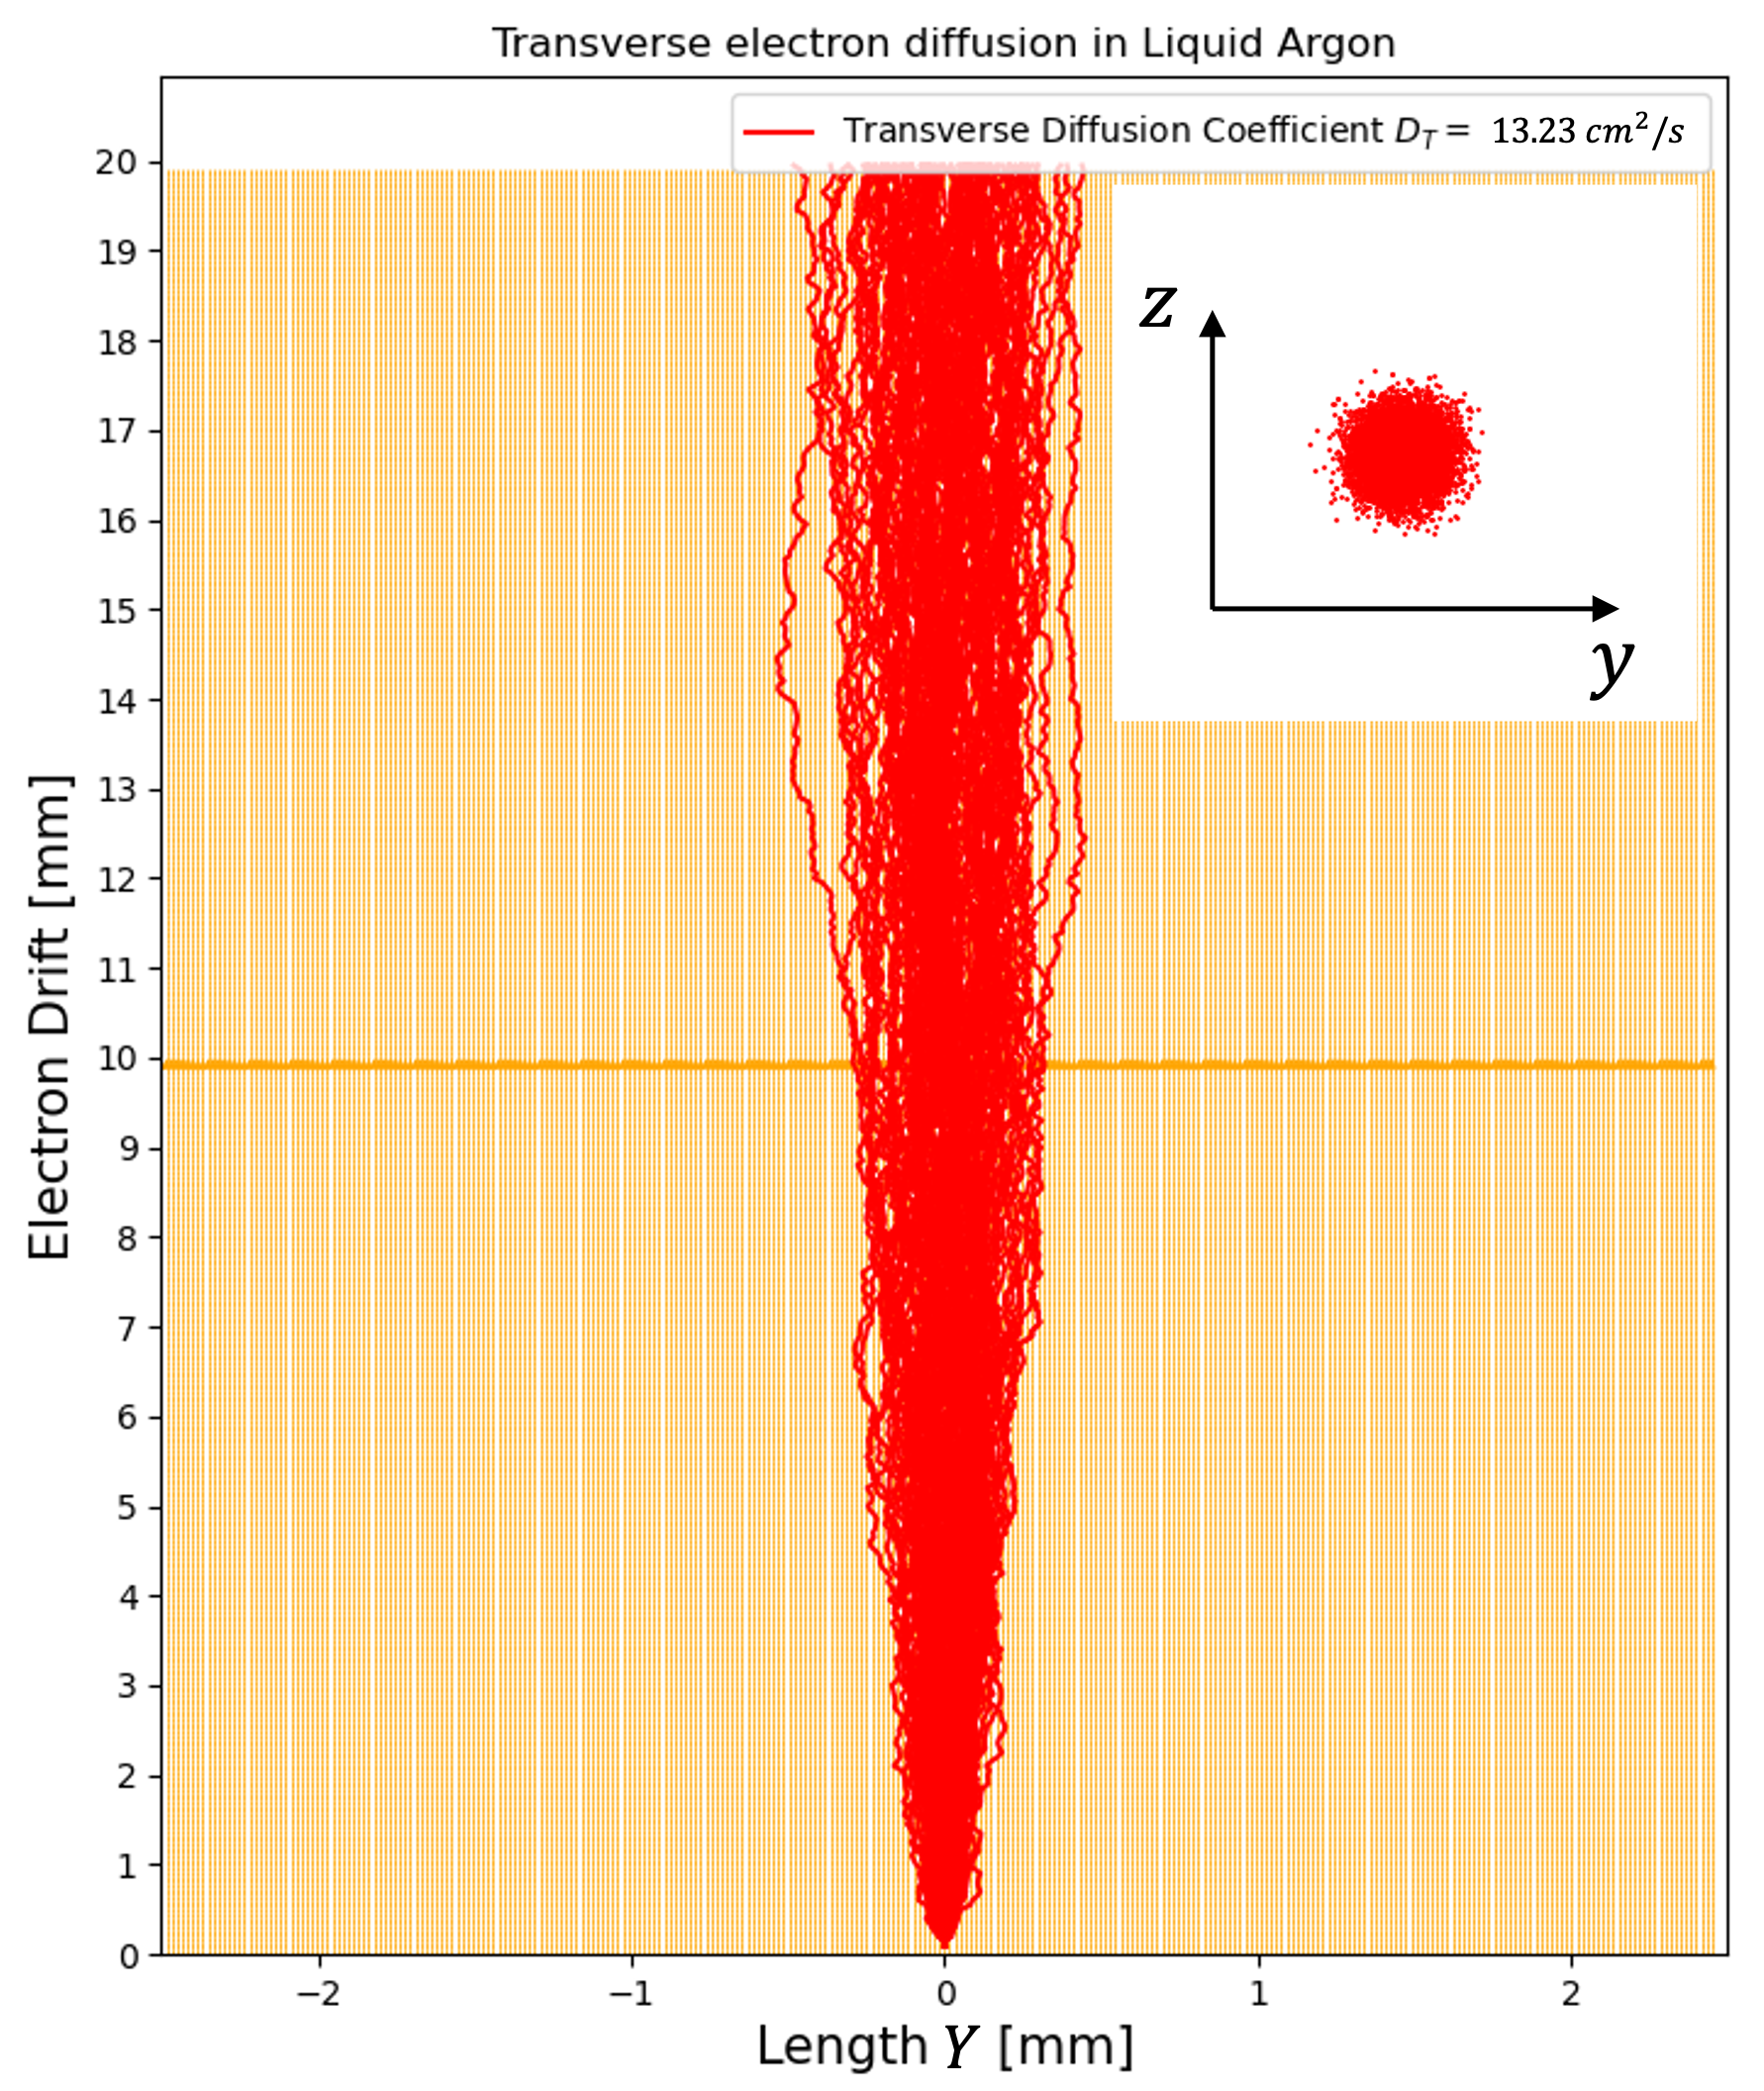
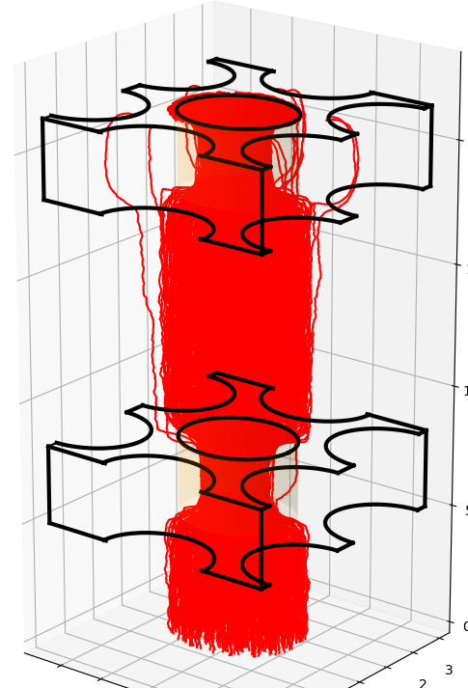
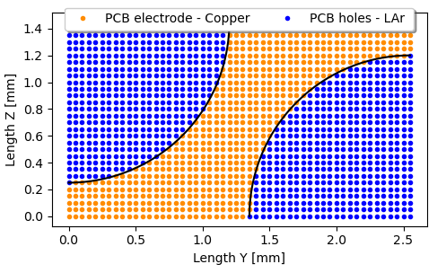
Signal formation simulation
STEAK = Shockley-Ramo Theorem for Electron to Anode Kinematics
Fields calculation in cartesian representation thanks to the Finite Difference Method to solve Poisson’s equation
Electron drift inside the anode using several transportation models
Take into account the diffusion effect
Include the dielectric interfaces between liquid argon and PCB
Mesh unit: Quarter of hexagonal pattern
Notes:
The simulation is composed in two parts :
First :
Second :

Slide 10
Field calculation results
collection
induction 2
induction 1
shield
Drift field: mirror boundary conditions → infinite plan
Weighting field: 2D approximation to establish boundary conditions
Notes:
Mirror boundary conditions for each transverse plane.
For the weighting field: first we calculate a 2D field at a larger calculation window to astrablish the boundary conditions, then we calculate the same field in 3D geometry which contains 3 strips around the interest readout strip.

Slide 11
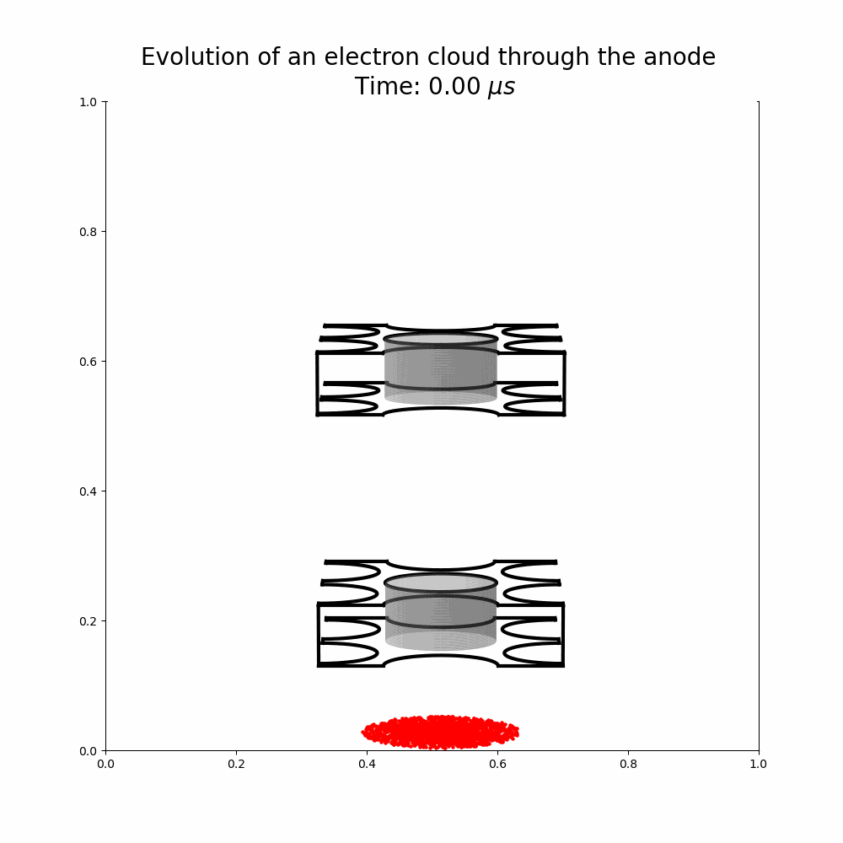
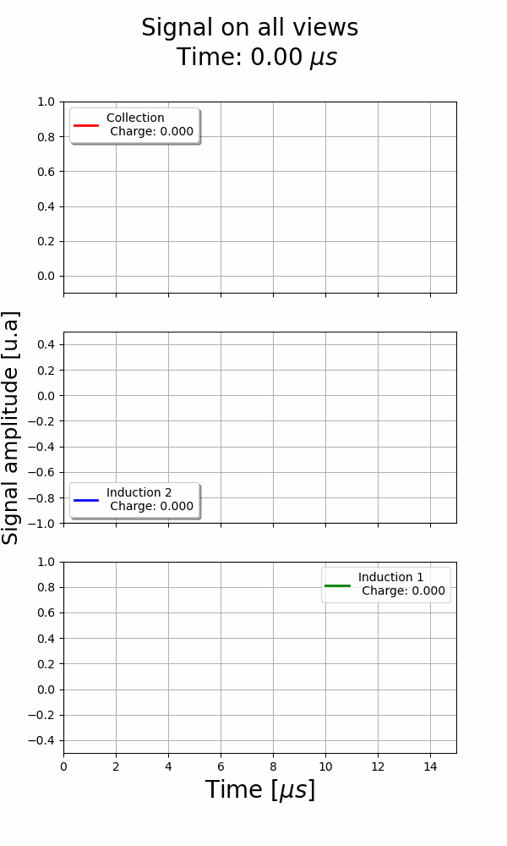
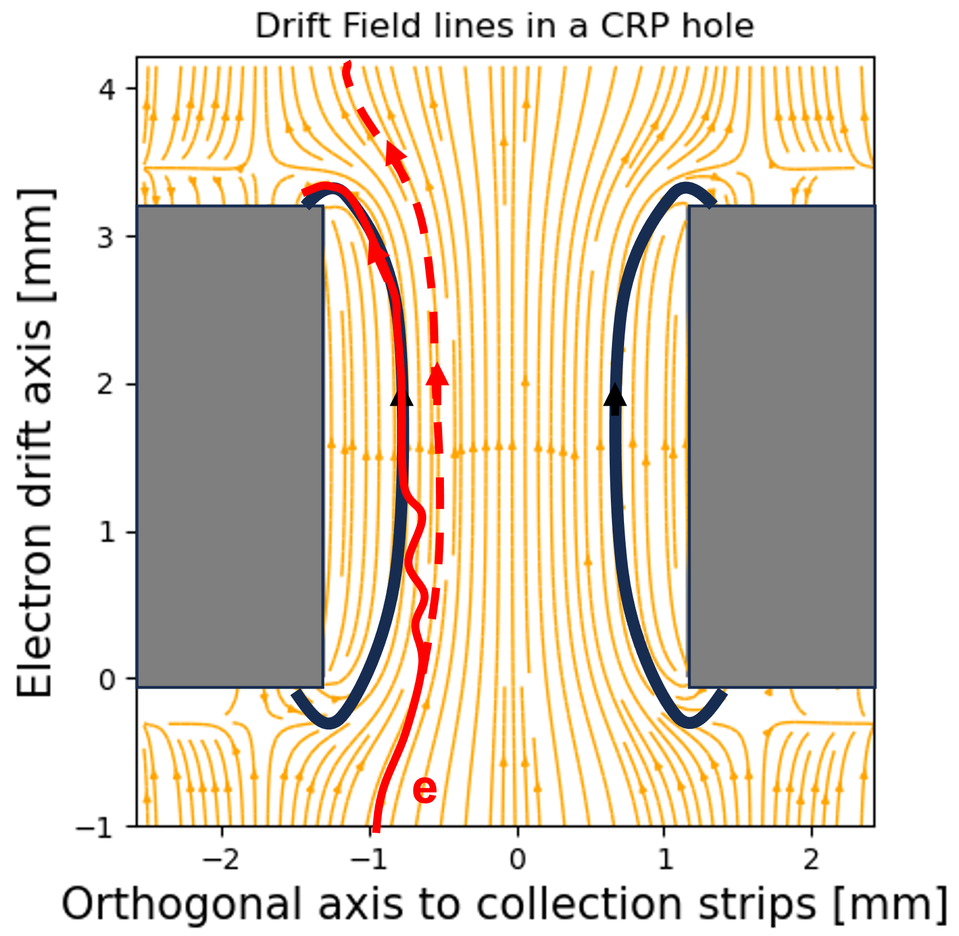
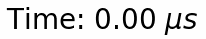



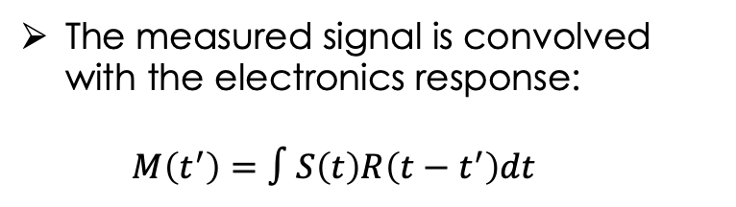


Electron cloud drifting inside the anode
The measured signal is convolved with the electronics response:
$$M\left(t^{′}\right)=∫S\left(t\right)R\left(t−t^{′}\right)dt$$
View 2 / Z
$$U_{2}=1000 V$$
Diffusion effects cause charge loss on the induction view.
View 1 / V
$$U_{1}=0 V$$
View 0 / U
$$U_{0}=− 500 V$$
PCB1
Shield
$$U_{s}=−1 500 V$$
$$\vec{|E_{d}|}=0.5 V/cm$$
Notes:
Here is an animation of the electron cloud drift inside the anode. The cloud reach to collection views passing through the first PCB with the view 0 and the second PCB. The purpose of the animation is to visualize the formation of the signal with the charges motion near the electrodes. The change in polarity of the inductions appears for induction 1 when the cloud passes beyond the electrode. Is it same for the induction 2. We can see that the width of the collection signal depends directly on the thickness of the PCBs. These are validation points for the simulation.
The diffusion effects are taken into account on this simulation. We remarks are small charge loss in the shielding plane which not instrumented. The charge loss is greater on the view0. We can explain this
We remarks
Border effect while the electrons are collected
Bipolar for induction and unipolar for collection
The field lines that loop in black

Slide 12
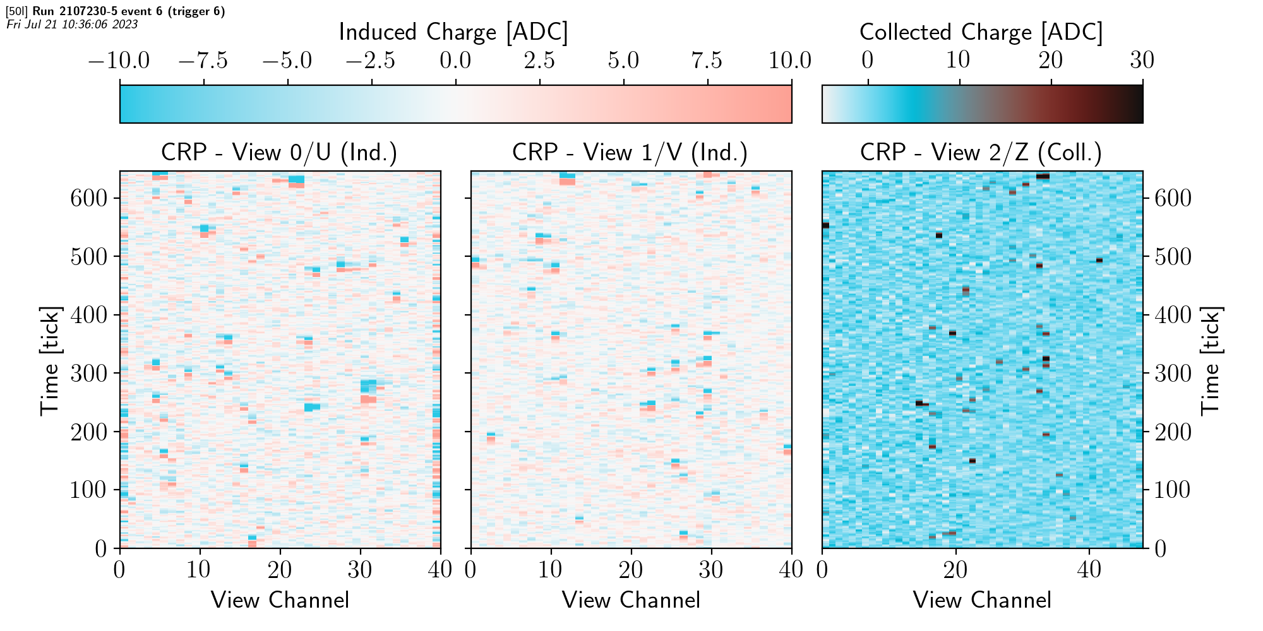
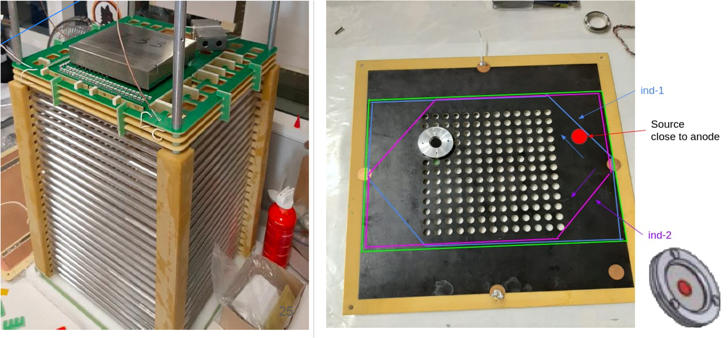

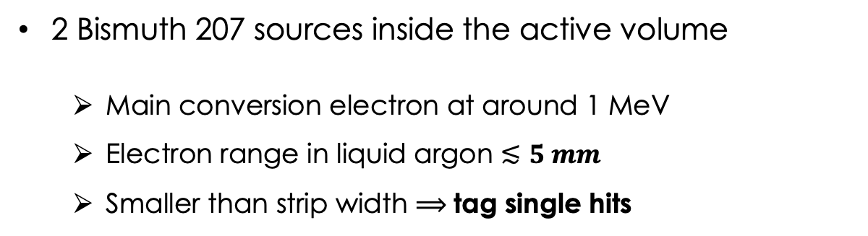
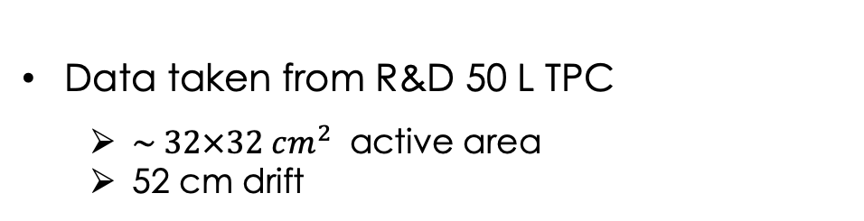
50 L TPC – Bismuth sources
Data taken from R&D 50 L TPC
$\sim 32×32 cm^{2}$ active area
52 cm drift
Single hits are defined as:
Isolated hit: far away from track
Hits correlated in space and time
Close to anode
Close to cathode
2 Bismuth 207 sources inside the active volume
Main conversion electron at around 1 MeV
Electron range in liquid argon $≲5 mm$
Smaller than strip width $⟹$tag single hits
Data reconstructed with LARDON software
Notes:
To validate the simulation results, I’ve compared to the data from a small TPC called 50L at CERN used for the R&D.
The surface active of the

Slide 13
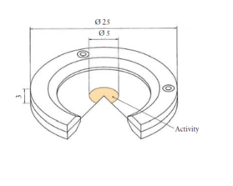
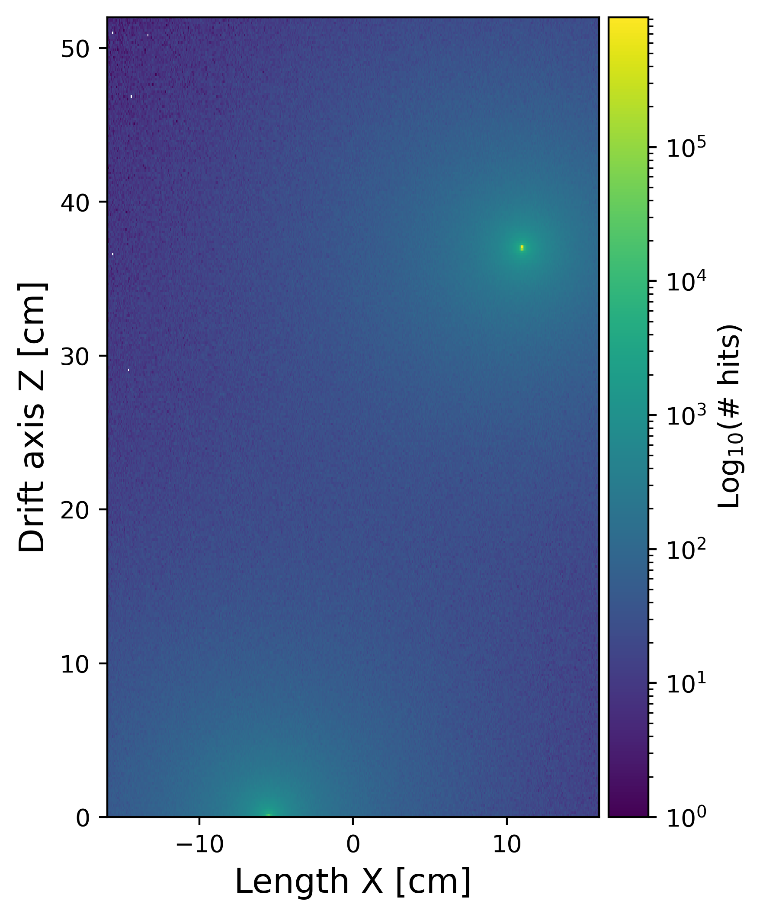
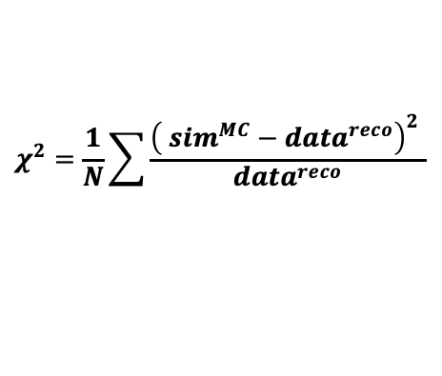
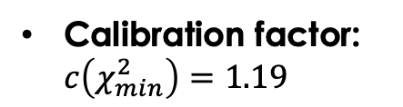
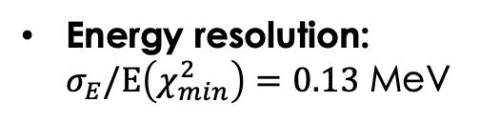
Reconstructed energy spectra
anode
DUNE - Preliminary
cathode
$$χ^{2}=\frac{1}{N}\sum{\frac{{\left( sim^{MC}−data^{reco}\right)}^{2} }{data^{reco}}}$$
: Cut off around anode source
A good agreement between the spectrum from the MC simulation and the reconstructed spectrum
Calibration factor: $c\left(χ_{min}^{2}\right)=1.19$
Energy resolution: $σ_{E}/E\left(χ_{min}^{2}\right)=0.13$ MeV
We will use all the reconstructed single hits to compare them with the simulation

Slide 14
Validating the simulation
Comparison between reconstructed single hits from anode source and simulation
DUNE - Preliminary
DUNE - Preliminary
DUNE - Preliminary
Simulated waveforms in good agreement with data taken
Global shape including the time duration for each view is in good agreement
Notes:
Bonne largeur et bonne shape

Slide 15
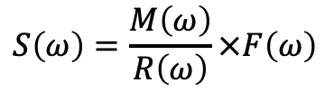
Information from shape of signals
The main DUNE workflow uses deconvolution method to identify hits and measure charge
Using Fourier’s transform:
$$S\left(ω\right)=\frac{M\left(ω\right)}{R\left(ω\right)}×F\left(ω\right)$$
Use to perfom the reconstructed hits
The raw signal shape is lost, together with the information it carries
*B. Abi, R. Acciarri, M. A. Acero et al., “Deep Underground Neutrino Experiment (DUNE), Far Detector Technical Design Report, volume II : Dune physics,” arXiv preprint arXiv :2002.03005, 2020
The hypothesis: is it possible to improve the hits reconstruction using the signal shape on each view ?
Extend the simulation to a large drift volume

Slide 16

Diffusion effect for a single hit at large volume
Drift of a point-like event across 6 m, with an active area matching the CRP surface
Improve the single hit reconstruction along the drift axis thanks to the longitudinal diffusion
Diffusion coefficient given by extrapolation of data *
$$σ_{L}(L_{d}= 6 m)=2.42 mm ⟺ time window: 6 ticks$$
Relatively weak diffusion effect:
$$σ_{T}(L_{d}= 6 m)=3.12 mm ⟺ ≥2 strips$$
No significant change in the waveform shape on each view under the most optimistic conditions (noise-free and point-like) → Diffusion effect cannot be used to improve reconstruction
*Li, et al., "Measurement of Longitudinal Electron Diffusion in Liquid Argon", NIMA 816, 160 (2016). [arXiv]

Slide 17
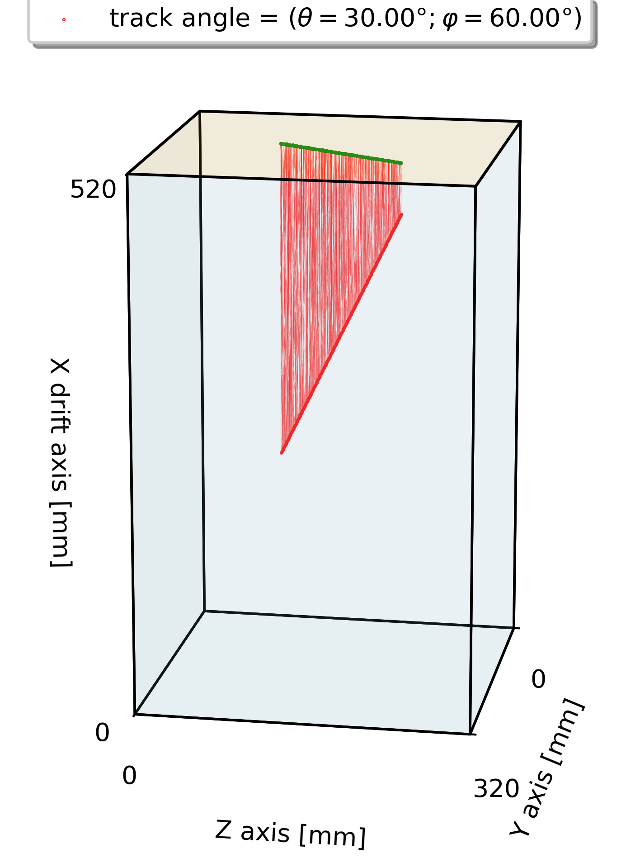
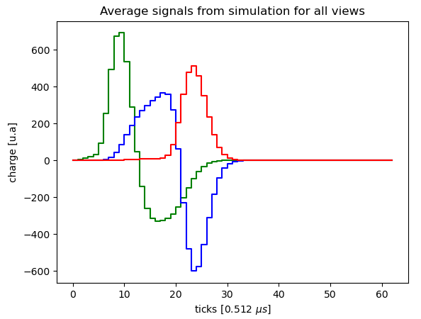
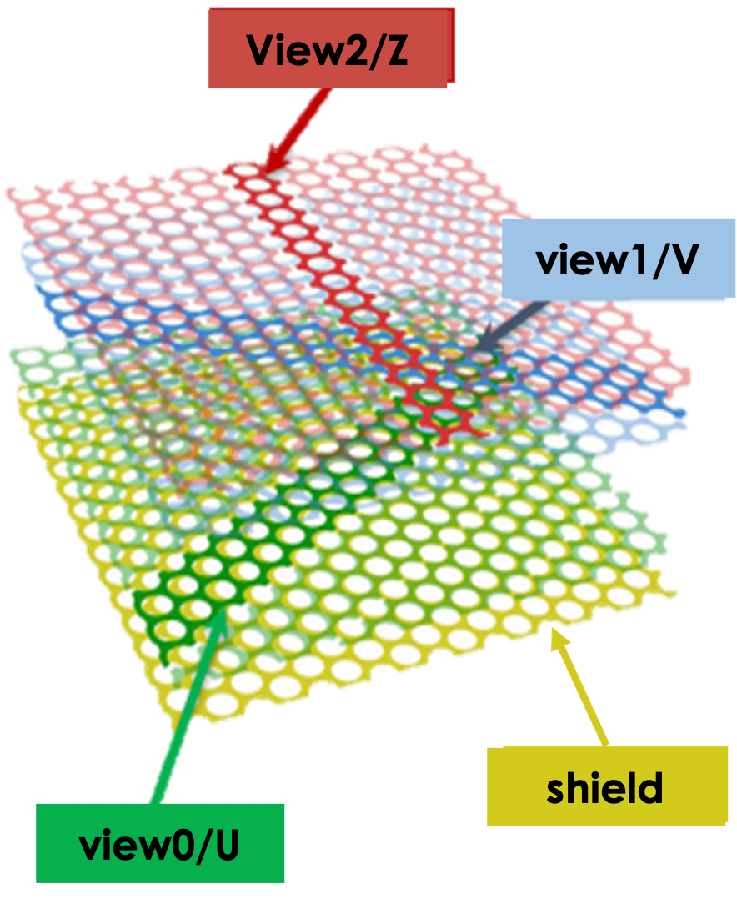










Moving from single hits to tracks
$$drift axis$$
M
$$θ$$
anode
$$φ$$
$$Y$$
$$Z$$
$$Z$$
collection
Induction 1
$$30°$$
cathode
$$−30°$$
$$Y$$
$$drift axis$$
Each electron arriving at the anode will generate the average signal obtained previously
The shape of the waveform will be modified as a function of the track angle
Induction 2
Ideal simulation of muons → constant linear charge deposited
Will improve simulation thanks to G4

Slide 18
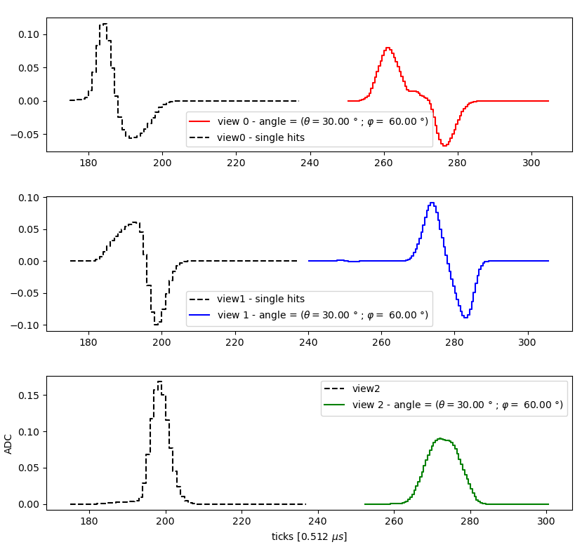

Track angle study (work in progress)
Waveform shape is changing
Event display from simulation for the track $θ=30°, φ=60°$
Single hit – like
DUNE –
Work in Progress
DUNE –
Work in Progress
DUNE –
Work in Progress
DUNE –
Work in Progress
DUNE –
Work in Progress
Single hit – like
The different electrons’ time delay change the signal shape
The waveforms depend on the angle of the track.
It may be possible to use the shape of the waveform to improve the track reconstruction
Single hit – like
DUNE –
Work in Progress

Slide 19



Varying the track angles
The variation in waveform shape is caused by the shift in the electron arrival time on the charge readout strips and is influenced by the factor: $δt_{max}$
Variation of waveform shapes with track angle, to be compared with PDVD data

Slide 20



Summary
I’ve designed a simulation for charge signal formation specific to VD validated thanks to 50 L data.
Development and integration of the 3D anode geometry for the Vertical Drift design
Simulation of electron transportation in liquid argon inside the anode
Continue to study the shape waveforms as a function of the track angles
ProtoDUNE-VD is begin data taking at CERN (cosmic + beam)
Test the Vertical Drift design at large scale ($3.0$ m (W) $× 6.8$ m (H) $× 6.8$ m (L))
Further modeling thanks to G4 simulation
Comparison with data taken (ProtoDUNE-VD)
It may be possible to improve the reconstruction
Further tests of my simulation:
Study of charge losses in the anode with greater statistics
Study more precisely the influence of track angles on the measured waveforms
NP02 cryostat at CERN
Notes:
Ce qui n’est pas fait dans le main workflow de DUNE
These data will enable us to study the loss of charge in the anode in greater detail, as well as the distortion of signals as a function of track angle, in order to extract information.

Slide 21


Thanks for your attention

Slide 22
Backup

Slide 23








Neutrino oscillation
There are three leptonic flavors $ν_{e}, ν_{μ}, ν_{τ}$
Neutrinos only interact by weak interaction → Small cross section
Neutrino oscillation:
Assumes neutrino masses (SM predict massless for these ones)
Flavor eigenstates (which couple $W^{±},Z^{0}$) are different from mass eigenstates during their propagation
$$\left|ν_{α}\right\rangle =\sum_{i}{U_{αi}^{∗}}|ν_{i}⟩$$
$$α=e, μ, τ$$
Flavor states are a linear combination of mass states:
avec
i$=1,2,3$
PMNS mixed matrix (Pontecorvo-Maki-Nakagawa-Sakata):
$$U_{PMNS}=\left(\begin{matrix}1 & 0 & 0 \\ 0 & cos⁡θ_{23} & \sin{θ_{23}} \\ 0 & −\sin{θ_{23}} & \cos{θ_{23}}\end{matrix}\right)\left(\begin{matrix}\cos{θ_{13}} & 0 & \sin{θ_{13}e^{−iδ_{CP}}} \\ 0 & 1 & 0 \\ −{\sin{θ}}_{13}e^{iδ_{CP}} & 0 & \cos{θ_{13}}\end{matrix}\right)\left(\begin{matrix}\cos{θ_{12}} & \sin{θ_{12}} & 0 \\ −\sin{θ_{12}} & \cos{θ_{12}} & 0 \\ 0 & 0 & 1\end{matrix}\right)$$
Atmospheric
$$ν_{μ}↔ν_{τ}$$
Reactor & accelerator
$$ν_{μ}↔ν_{e}$$
Solar
$$ν_{e}↔ν_{X}$$

Slide 24



Neutrino oscillation
Probability of neutrino oscillations:
$$P(ν_{α}→ν_{β})≡P(E_{ν},L)$$
Depends on 6 parameters: $Δm_{31}^{2}$, $Δm_{21}^{2}$, $θ_{12}$, $θ_{23}$, $θ_{13}$, $δ_{CP}$
Unknown parameters:
Sign of $\left|Δm_{31}^{2}\right|$ → Mass ordering
$δ_{CP}$ value → CP symmetry broken on lepton sector
$θ_{23}$ value and octant
Notes:
Matrice PMNS s’agit d’une matrice de rotation qui permet de passer des états propres de saveurs intervenant dans le lagrangien de l’interaction faible avec les états propres de masses diagonalisant l’hamiltonien libre. Mathématiquement, nous pouvons rajouter une phase complexe qui s’interprête ici comme la violation de symétrie CP.

Slide 25












Principle of LArTPC detection
Charge particle
Liquid argon volume
Charge signal
$$Ar^{+}$$
$$e^{−}$$
~45 % - Drift electron
$79 \%$ ionize
Recombination
$$Ar^{∗}$$
Light signal
$$Ar$$
$$Ar^{+}$$
Photons emission
$$e^{−}$$
$$Ar^{∗}$$
$$λ=128 nm$$
$$Ar^{∗}$$
$21 \%$ excite
$$Ar^{∗}$$
Excimer
Liquid argon is chemically inert and dense $(ρ=1.39)$
Charged particles ionize (79 %) and excite (21 %) argon atoms.
Electrons of ionization drift to the anodes thanks to an electric field
Scintillation light coming from argon de-excitation ($λ=128 nm$)

Slide 26
Field response for each view
The current induced at the interest readout electrode for an electron cloud drifting inside the anode
collection
induction 2
induction 1
shield
Notes:
Weighting Field is screened by other electrodes and quickly reach 0
The shape of the waveform is driven by the anode geometry, the weighting field has a great dependency with geometry

Slide 27
Induced signal for adjacent strips

Slide 28


Output pulses
$$M(t)=$$
$$*$$

Slide 29
Diffusion model
V. Atrazhev and I. Timoshkin, “Transport of electrons in atomic liquids in high electricfields,” IEEE transactions on dielectrics and electrical insulation, vol. 5, no. 3, pp. 450–457,2002.

Slide 30
Notes:
La simulation prédit une perte de charge de la transparence lorsque l’on tien compte de la diffusion des électrons

Slide 31
Anode transparency

Slide 32
Holes misalignment

Slide 33

Filtered waveforms
$$χ^{2}= \frac{1}{N_{ticks}}\sum_{i=0}^{N_{ticks}}{{\left(\frac{ŝ\left[t_{i}\right]–s_{n}\left[t_{i}\right]}{σ_{i}}\right)}^{2}}$$

Slide 34
Average waveforms

