Slide 1

Introduction to Semiconductor Detectors with focus on applications at Hadron Colliders Michael Moll, CERN EP-DT, Geneva, Switzerland
https://indico.in2p3.fr/event/36667/
SIMDET 2025, 1-3 October 2025, LPNHE Paris

Slide 2
OUTLINE
The Large Hadron Collider (LHC) at CERN
Where are the silicon detectors?
Silicon Detectors for High Energy Physics Applications
The basic concept of Semiconductor Detectors: A reverse biased pn-junction
Strip and Pixel Detectors at the Large Hadron Collider (LHC) at CERN
Upgrade of the Large Hadron Collider (HL-LHC)
Beyond the LHC: Recent developments in Silicon Detectors and the R&D landscape
Radiation Damage to Silicon Detectors
Radiation damage mechanisms
Microscopic defects and macroscopic damage
Mitigation techniques: What can we do against radiation damage?
Examples of radiation hard devices for the HL-LHC: p-type strip sensors and 3D sensors
Why do we need (TCAD) device simulations (introduction)?
Summary & Further reading
Details in following presentations: Marco Bomben; Arianna Morozzi; Jairo Villegas; Ashish Bisht, Alexander Bähr; Giulio Borghello

Slide 3
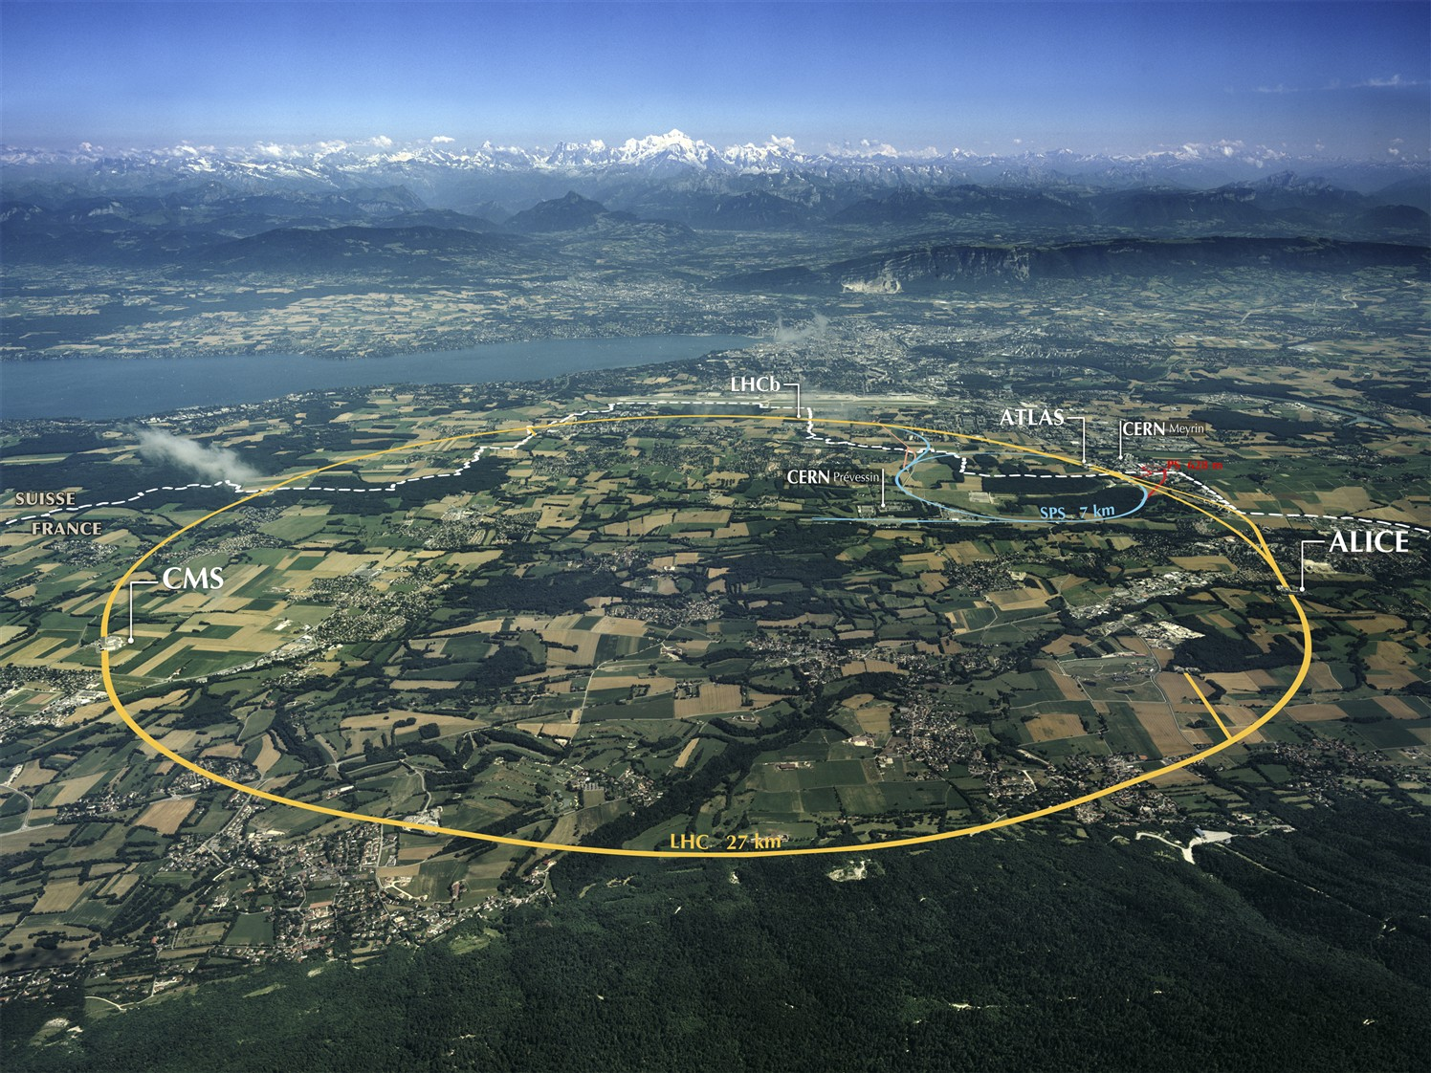
CERN & LHC - Large Hadron Collider
CERN (2023):
23 member states (25 member states in 2025)
~13400 scientists (users)
~ 2660 personnel (staff) + 900 Fellows
Budget ~1230 MCHF (France: 13.2%)
LHC: 27 km tunnel
≈ 4600 MCHF + 1200 MCHF (accelerator + experiments)
1232 dipoles B=8.3T
Design: pp √s = 14 TeV (L_{design} = 10³⁴ cm⁻² s⁻¹)
heavy ions (e.g. Pb-Pb; 5TeV)
Circulating beams:
2008: first beam
2009-13: Run 1 at 2 x 4 TeV
2012: Higgs Boson “discovered”
2015-18: Run 2 at 2 x 6.5 TeV (10³⁴cm⁻²s⁻¹ reached)
2018-22: Long Shutdown 2 (LS2)
2022-26: Run 3 at 2 x 6.8 TeV
2026-30: Long Shutdown 3 (LS3)
2030: HighLumi-LHC (Run 4, ….)
collect 3000-4000 fb⁻¹ until ~ 2042 (20 times more than today)
Alps
Geneva
27 Km
CERN
p
p
CERN Large Hadron Collider (LHC) - 27 km accelerator ring
proton-proton beams of 6.8 TeV each collide in 4 experiments
today 13.6 TeV
also a program with Pb beams at up to 5.36 TeV per nucleon
Notes:
https://en.wikipedia.org/wiki/Large_Hadron_Collider
Estonia joined in 2024 and Slovenia in 2025

Slide 4
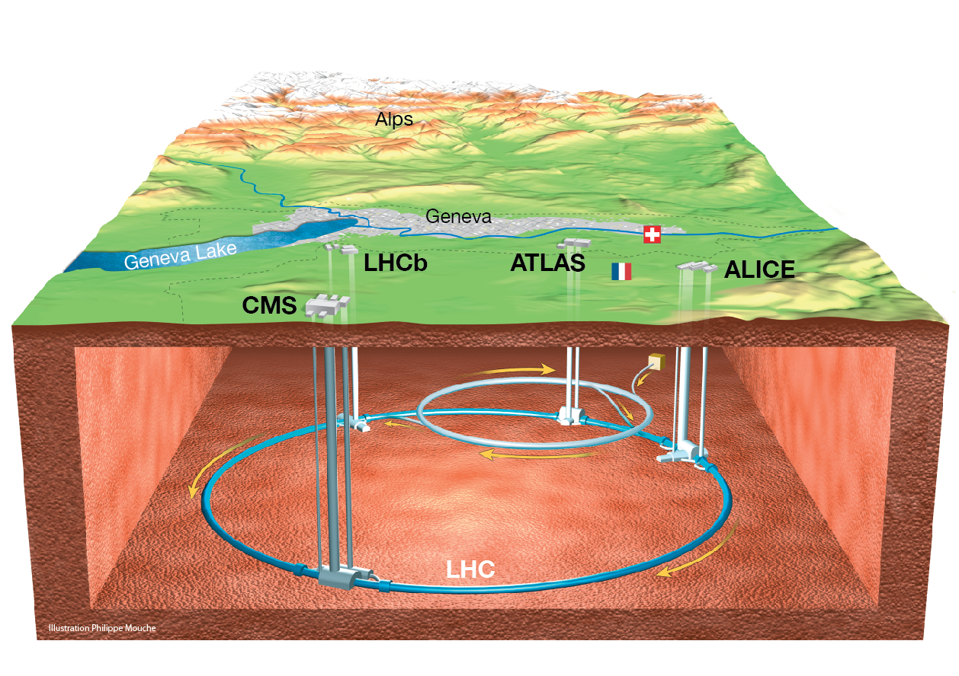
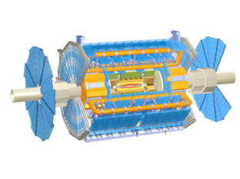
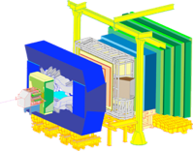
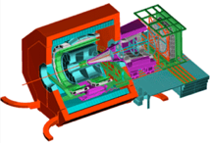
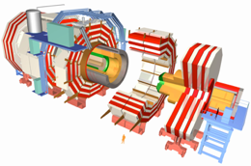
The LHC Experiments
ATLAS
LHCb
Alps
Geneva
CERN
ALICE
CMS
Notes:
2023: LHC 6.8+6.8 TeV Large Hadron Collider, 27 km in circumference; 9 active experiments: ALICE, ATLAS, CMS, FASER, LHCb,
LHCf, MoEDAL-MAPP, SND and TOTEM

Slide 5
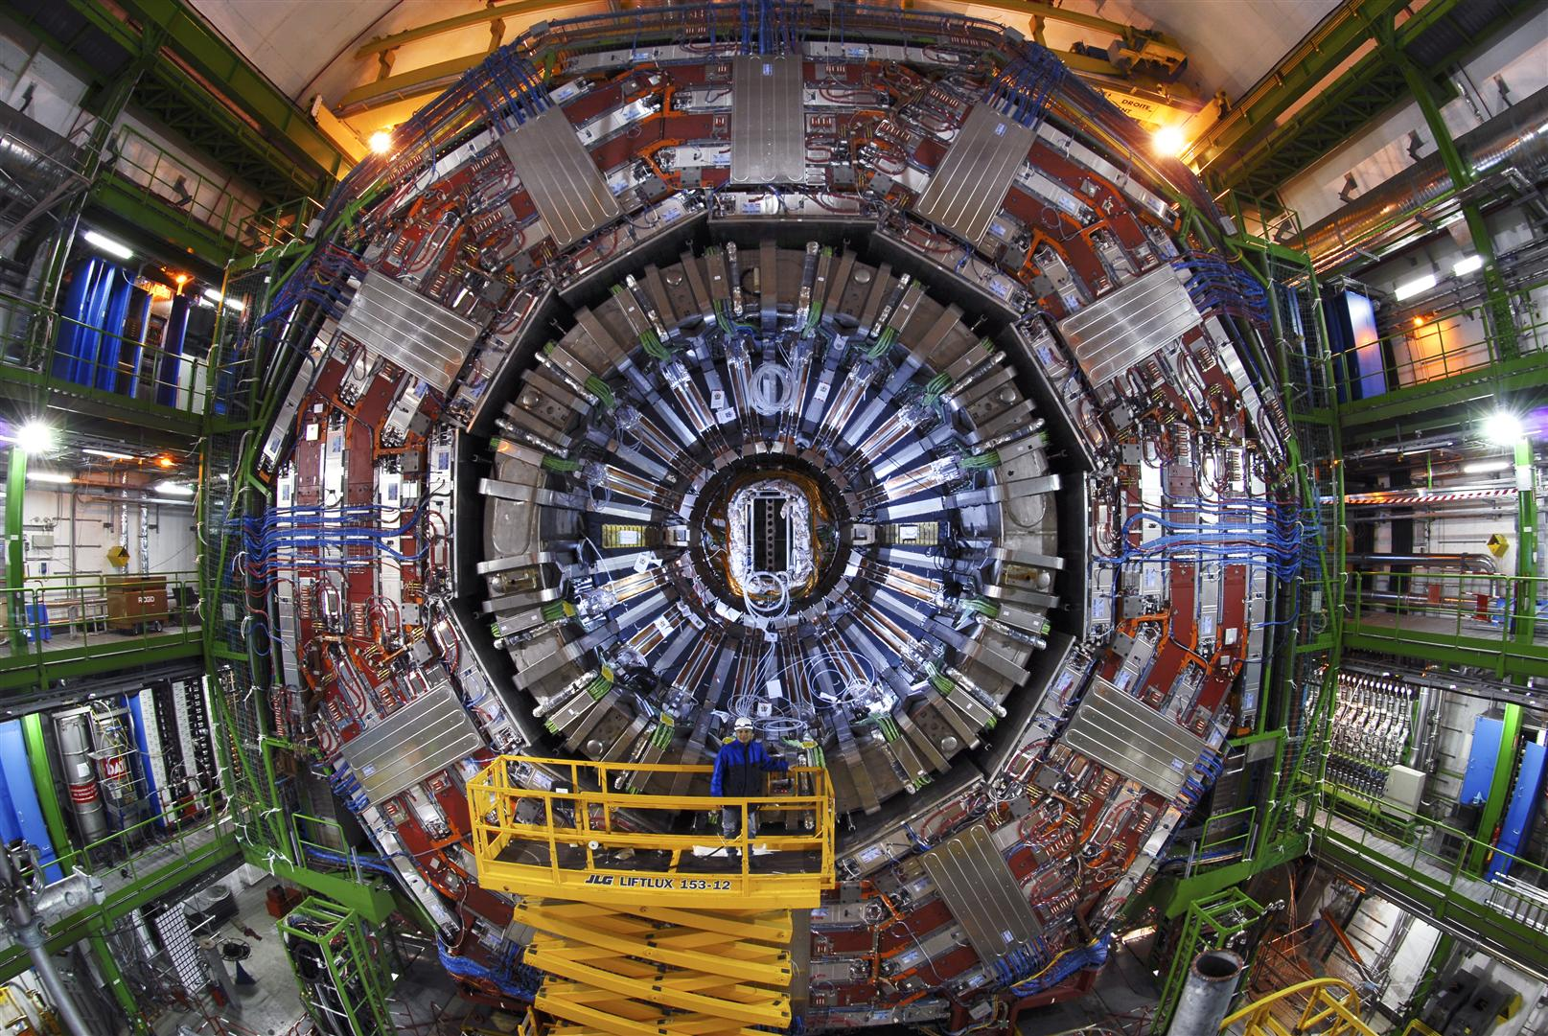
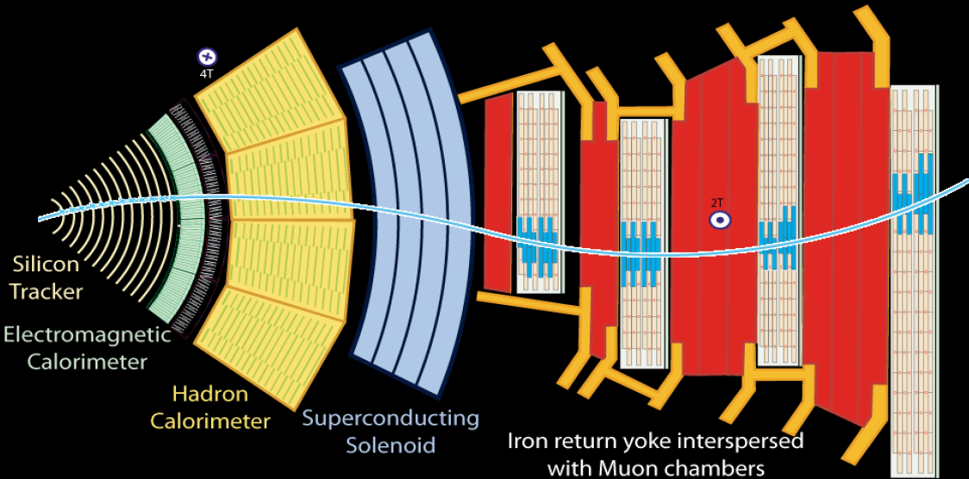
Collisions in the LHC
every 25ns (40 MHz)
CMS
CMS DETECTOR
Weight: 14000 t
Diameter: 15.0 m
Length: 28.7m
Field: 3.8T
Electromagnetic Calorimeter
Hadron Calorimeter
Muon chambers
Silicon Tracker
Superconducting Solenoid
Iron return yoke
event seen in 2011 Higgs → 2 photons
Notes:
Eiffel Tower – 10.000 tons

Slide 6
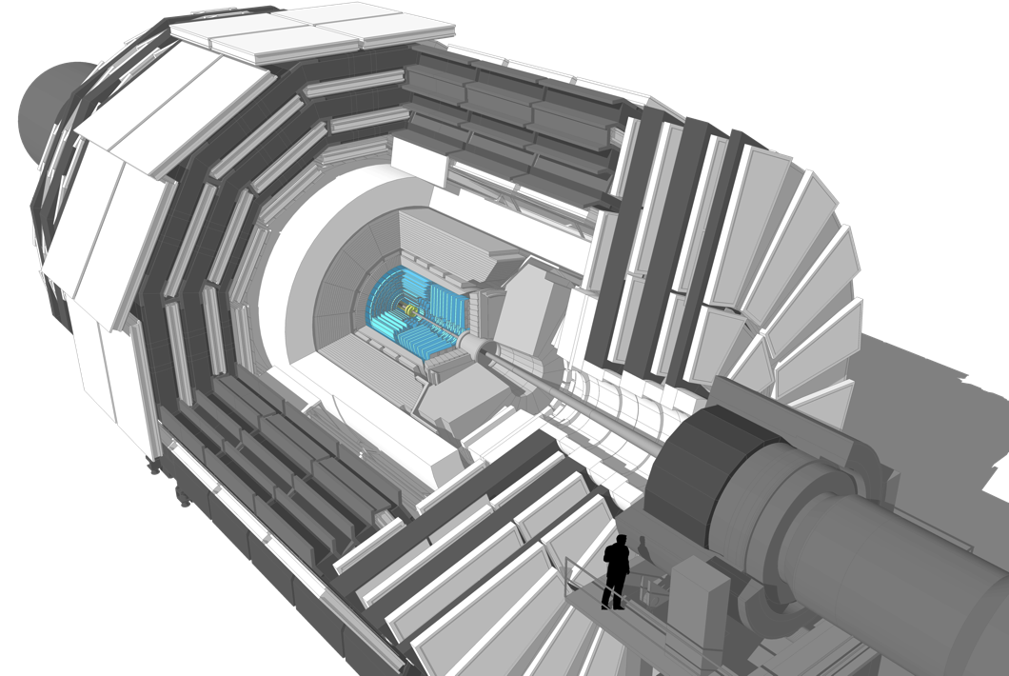
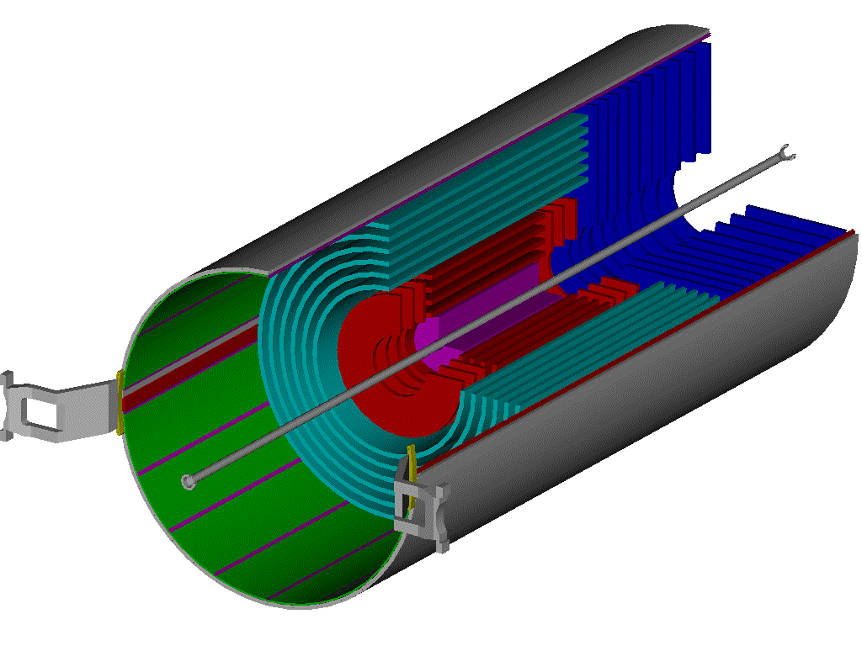
Silicon Tracking Detector
LHC example: The CMS DETECTOR
Inner Tracker
Outer Barrel (TOB)
Inner Barrel (TIB)
Inner Disks (TID)
End Cap (TEC)
2.4 m
CMS DETECTOR
Weight: 14000 t
Diameter: 15.0 m
Length: 28.7m
Field: 3.8T
5.4 m
scientist
Pixel Detector
CMS – Inner Tracker & Pixel Detector
Micro Strip:
~ 214 m² of silicon strip sensors, 11.4 million strips
Pixel:
4 layers & 2 x 3 disks: silicon pixels (~ 1m²)
124 million pixels (100x150μm²)
Resolution: σ(rφ) ~ 10 μm, σ(z) ~ 25μm
32 cm
104 cm

Slide 7
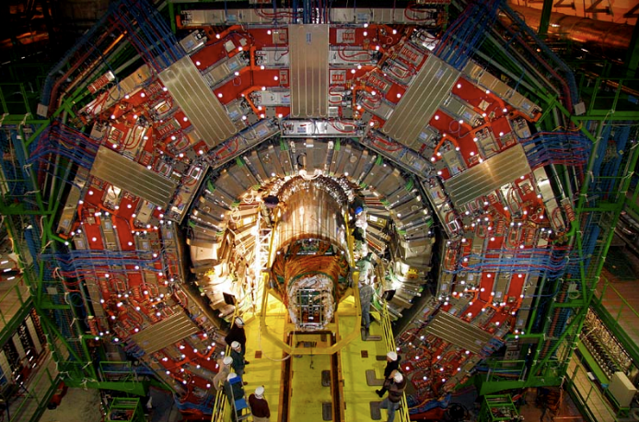
Present LHC Tracking Sensors
CMS Tracker insertion
December 2007

Slide 8
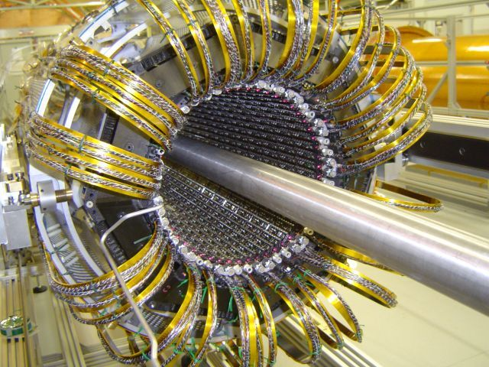
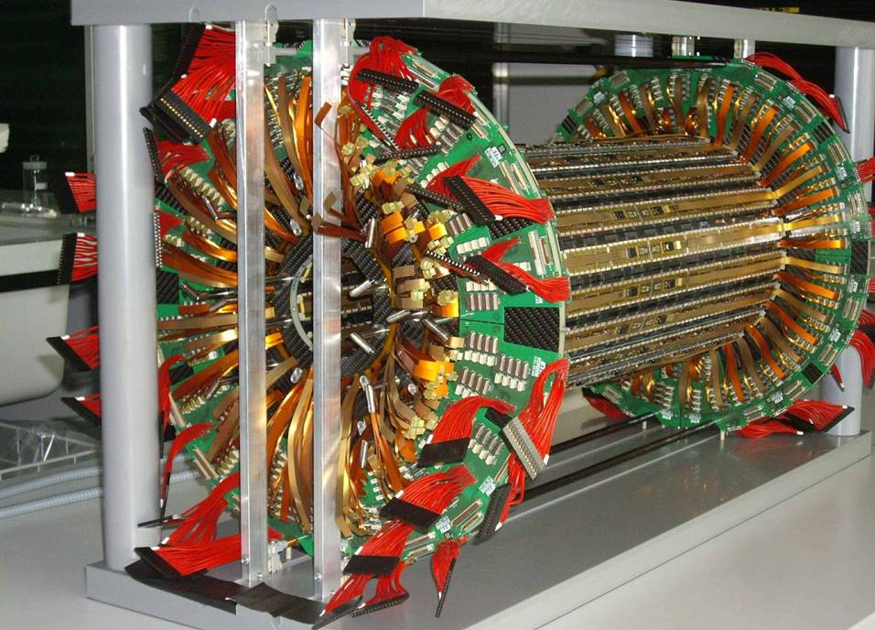
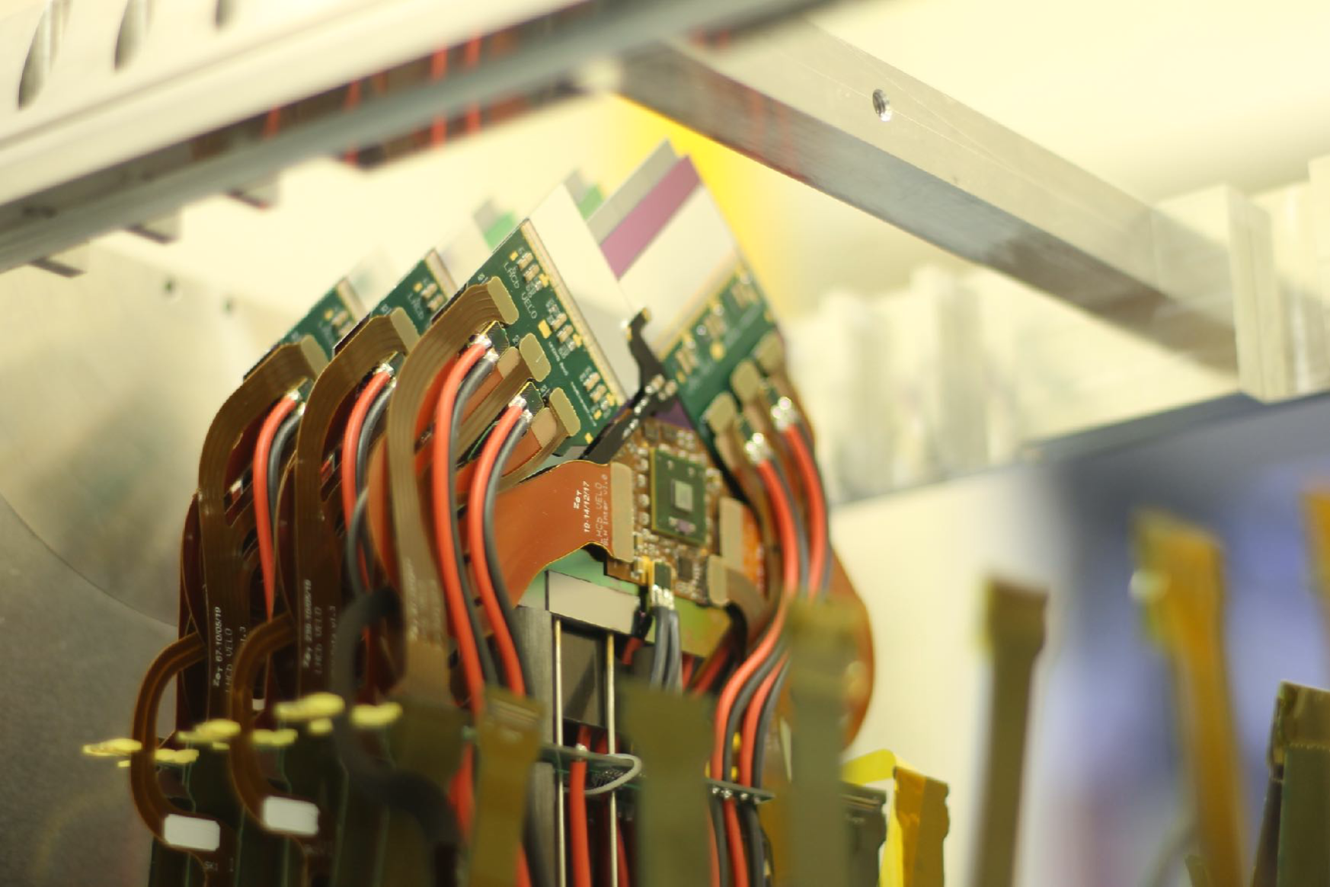
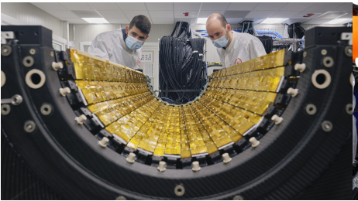
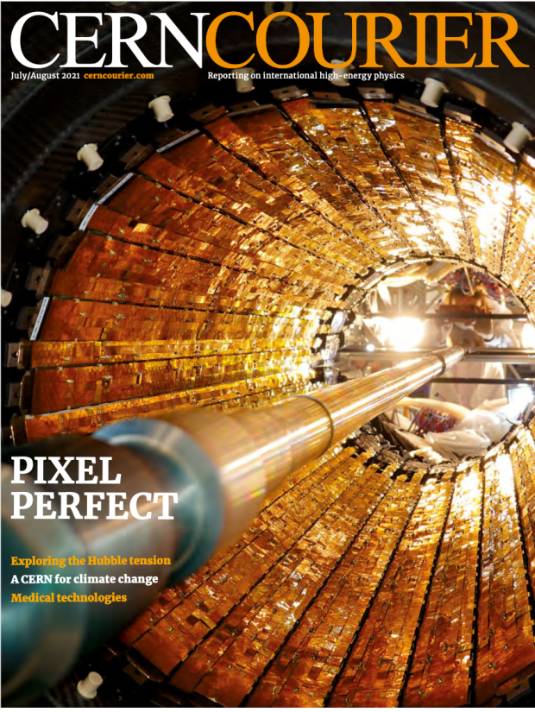
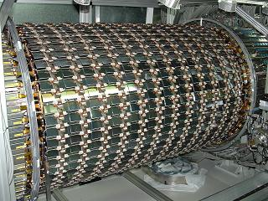
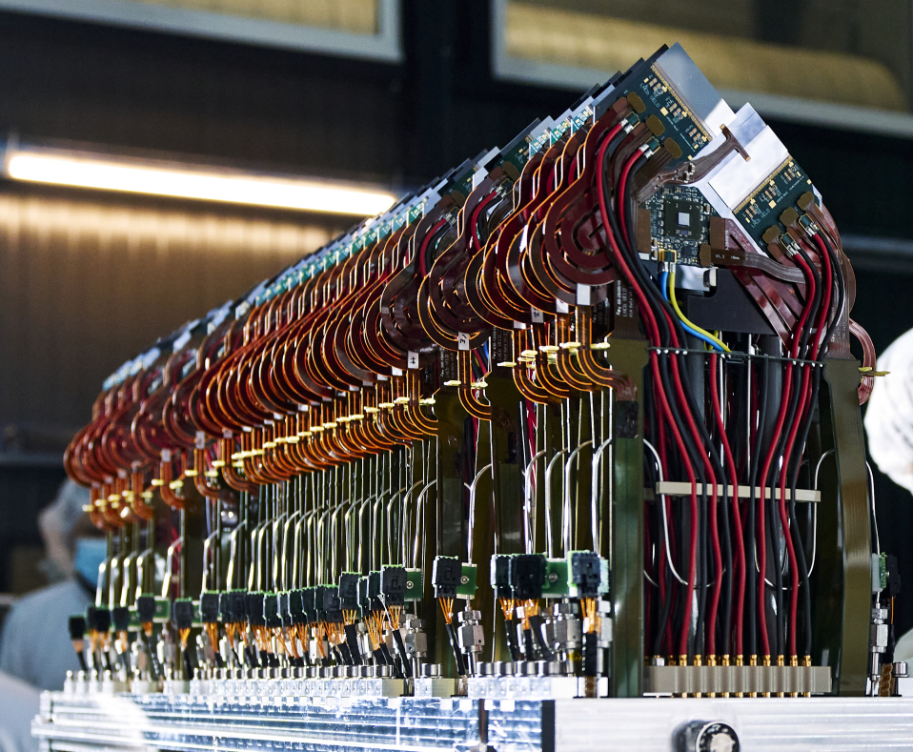
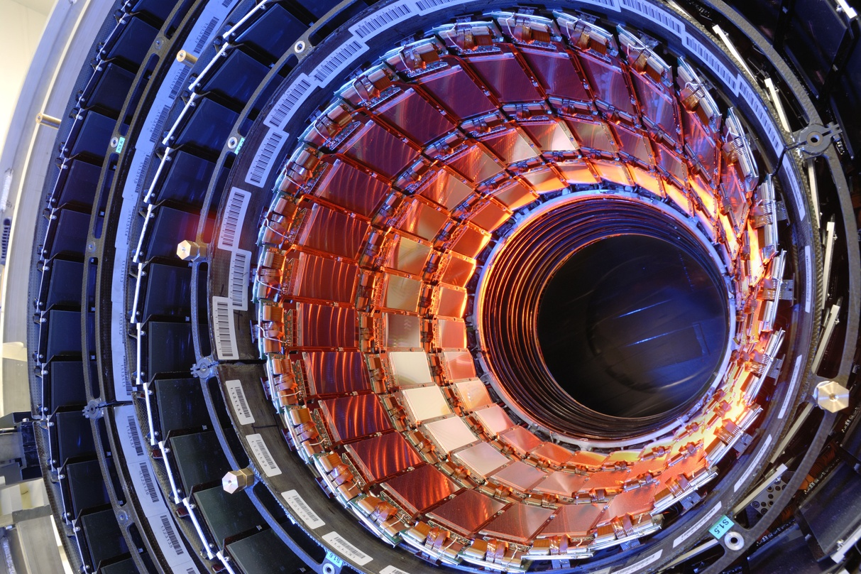
Silicon Tracking Detectors
Silicon tracking detectors are used in almost all HEP experiments:
Different sensor technologies, designs, operating conditions,….
ALICE ITS Barrel New ITS for Run3:2022
ATLAS Pixel Detector
CMS Pixel Detector
LHCb VELO (New VELO for Run3:2022)
ATLAS SCT Barrel
CMS Strip Tracker IB
ALICE ITS Outer Barrel (Foto:Insertion Test 2021)
LHCb VELO (New VELO for Run3:2022)

Slide 9
Silicon Sensors

Slide 10
Solid State Detectors – Why Silicon?
Some characteristics of Silicon crystals
Small band gap E_{g} = 1.12 eV ⇒ E(e-h pair) = 3.6 eV (≈ 30 eV for gas detectors)
High specific density 2.33 g/cm³ ; dE/dx (M.I.P.) ≈ 3.8 MeV/cm ≈ 106 e-h/μm (average)
High carrier mobility μ_{e} =1450 cm²/Vs, μ_{h} = 450 cm²/Vs ⇒ fast charge collection (<10 ns)
Very pure < 1ppm impurities and < 0.1ppb electrical active impurities
Rigidity of silicon allows thin self supporting structures
Detector production by microelectronic techniques ⇒ well known industrial technology, relatively low price, small structures easily possible
Alternative semiconductors
Diamond
Gallium arsenide (GaAs)
Gallium nitride (GaN)
Silicon Carbide (SiC)
Germanium (Ge)

Slide 11
How to obtain the signal?
In a pure intrinsic (undoped) semiconductor the electron density n and hole density p are equal.
E
conduction band
e
For Silicon: n_{i} ≈ 1.45⋅10¹⁰ cm⁻³
E
f
h
valence band
4.5 ⋅10⁸ free charge carriers in this volume, but only 3.2 ⋅10⁴ e-h pairs produced by a M.I.P.
⇒ Reduce number of free charge carriers, i.e. deplete the detector
⇒ Most detectors make use of reverse biased p-n junctions

Slide 12
Doping, resistivity and p-n junction
e.g. Phosphorus
Doping: n-type silicon
add elements from Vth group ⇒ donors (P, As,..)
electrons are majority carriers
Doping: p-type silicon
add elements from IIIrd group ⇒ acceptors (B,..)
holes are majority carriers
Si
Si
Si
Si
P
Si
Si
Si
Si
resistivity ρ
carrier concentration n, p
carrier mobility μ_{n}, μ_{p}
p-n junction There must be a single Fermi level! ⇒ band structure deformation ⇒ potential difference ⇒ depleted zone
 | detector grade | electronics grade
doping | ≈ 10¹² cm⁻³ | ≈ 10¹⁷ cm⁻³
resistivity ρ | ≈ 5 kΩ·cm | ≈1 Ω·cm

Slide 13
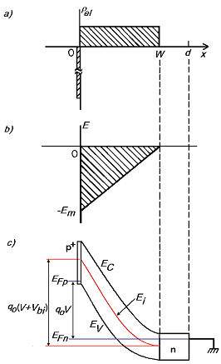
Reverse biased p-n junction
Positive space charge, N_{eff} =[P] (ionized Phosphorus atoms)
Poisson’s equation
Depleted zone growth with increasing voltage ( )
neutral bulk (no electric field)
Electrical charge density
Electrical field strength
Electron potential energy
Full charge collection only for fully depleted detector (V_{B}>V_{dep})
depletion voltage V_{dep}
detector thickness d
effective space charge density N_{eff}

Slide 14
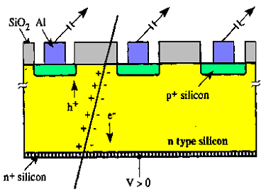
Single Sided Strip Detector
Segmentation of the p⁺ layer into strips (Diode Strip Detector) and connection of strips to individual read-out channels gives spatial information
pitch
typical thickness: 300μm (150μm-500μm used)
using n-type silicon with a resistivity of ρ = 2 KΩcm (N_{D} ~2.2.10¹²cm⁻³) results in a depletion voltage ~ 150 V
Resolution σ depends on the pitch p (distance from strip to strip) - e.g. detection of charge in binary way (threshold discrimination) and using center of strip as measured coordinate results in
typical pitch values are 20 μm– 150 μm ⇒ 50 μm pitch results in 14.4 μm resolution

Slide 15
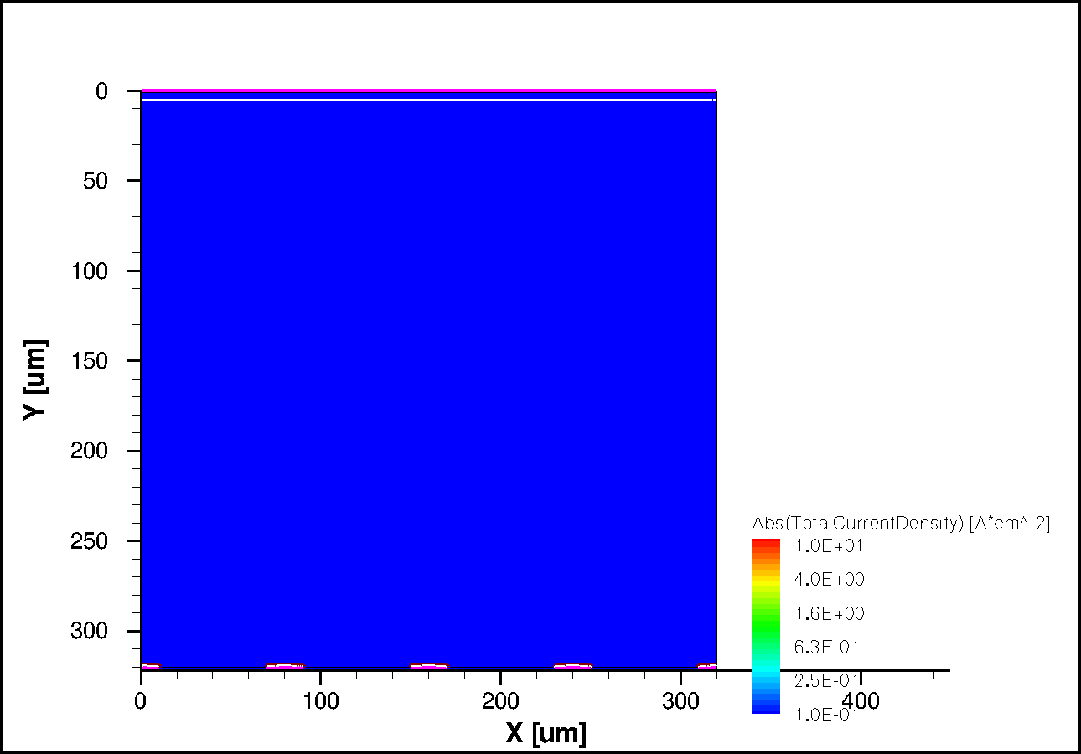
Signal Formation in a strip sensor
TCAD simulation: minimum ionizing particle traversing the sensor
with typical dimensions for presently operating large LHC trackers (p-in-n devices)
electrons
n-type bulk
p⁺ readout electrodes
TCAD
holes

Slide 16
Signal Formation in a strip sensor
TCAD simulation: minimum ionizing particle traversing the sensor
with typical dimensions for presently operating large LHC trackers (p-in-n devices)
electrons
n-type bulk
p⁺ readout electrodes
TCAD
holes

Slide 17
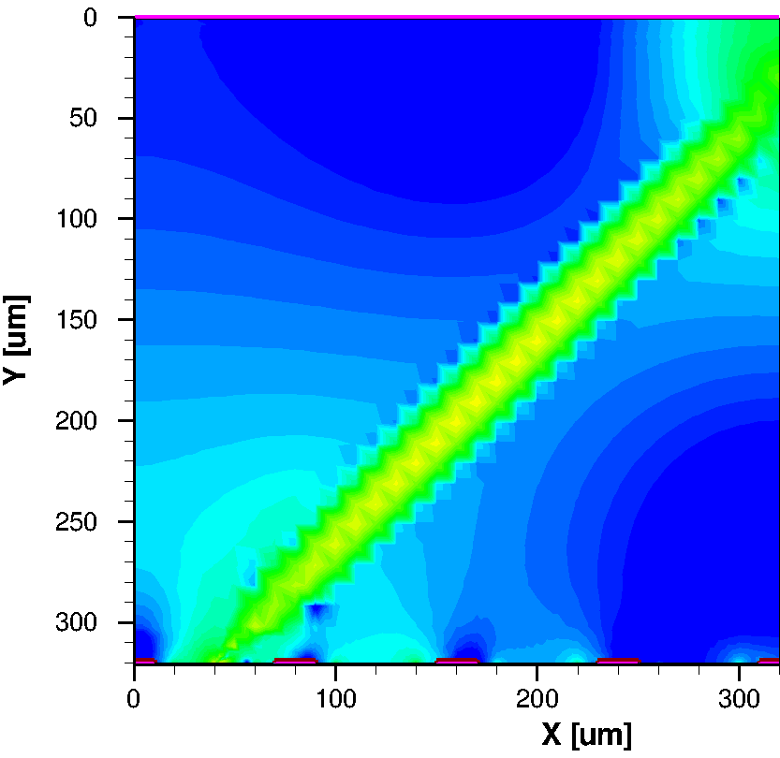
Signal formation in a strip sensor
Simulation:
Current density
mip, 45° angle
holes
electrons
t = 1 ns
Simulation: Thomas.Eichhorn@kit.edu

Slide 18
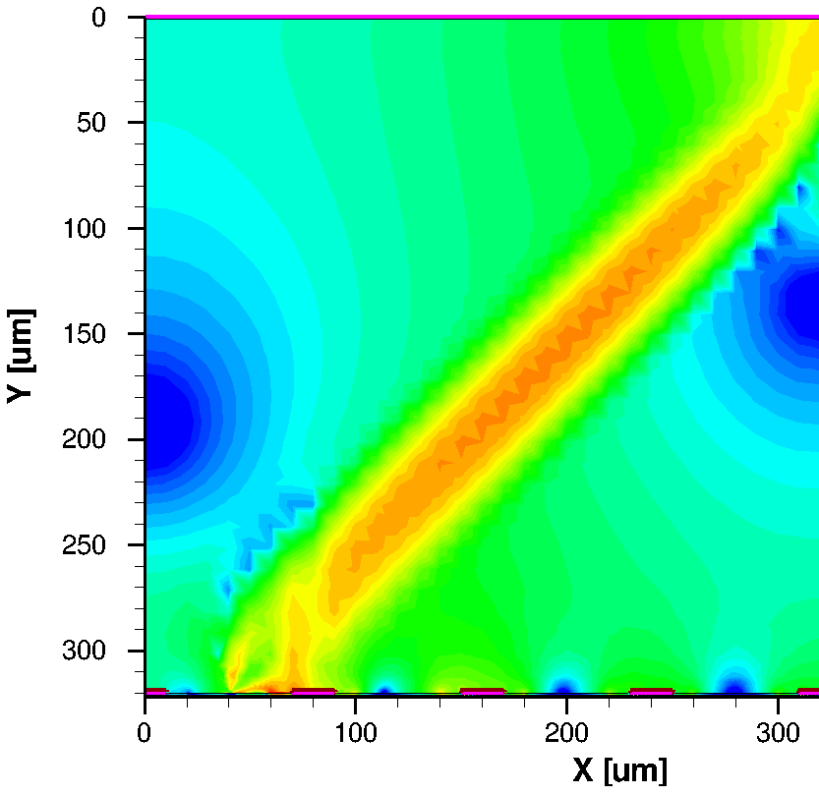
Signal formation in a strip sensor
Simulation:
Current density
mip, 45° angle
holes
electrons
t = 1.2 ns
Simulation: Thomas.Eichhorn@kit.edu

Slide 19
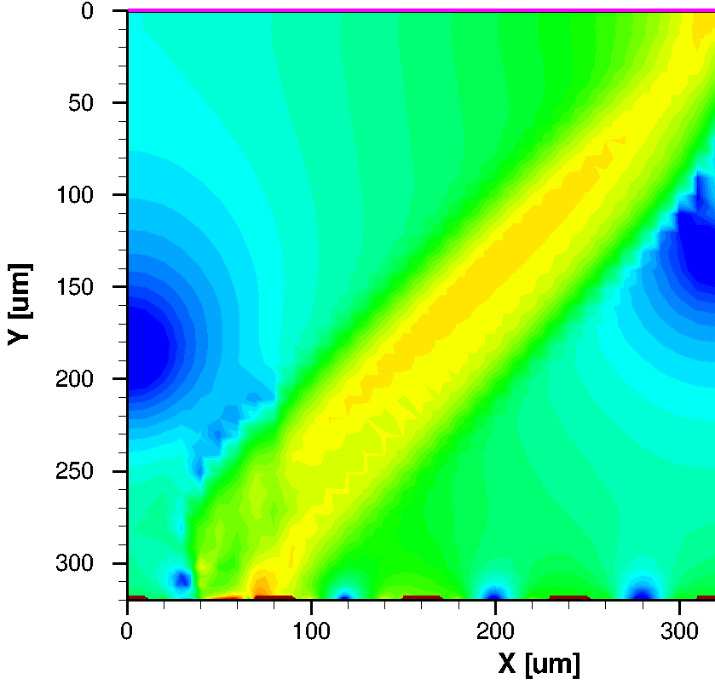
Signal formation in a strip sensor
Simulation:
Current density
mip, 45° angle
holes
electrons
t = 1.4 ns
Simulation: Thomas.Eichhorn@kit.edu

Slide 20
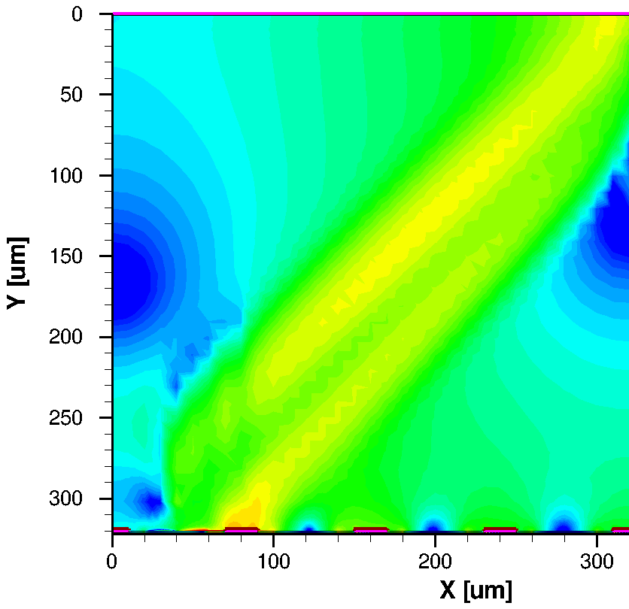
Signal formation in a strip sensor
Simulation:
Current density
mip, 45° angle
holes
electrons
t = 1.6 ns
Simulation: Thomas.Eichhorn@kit.edu

Slide 21
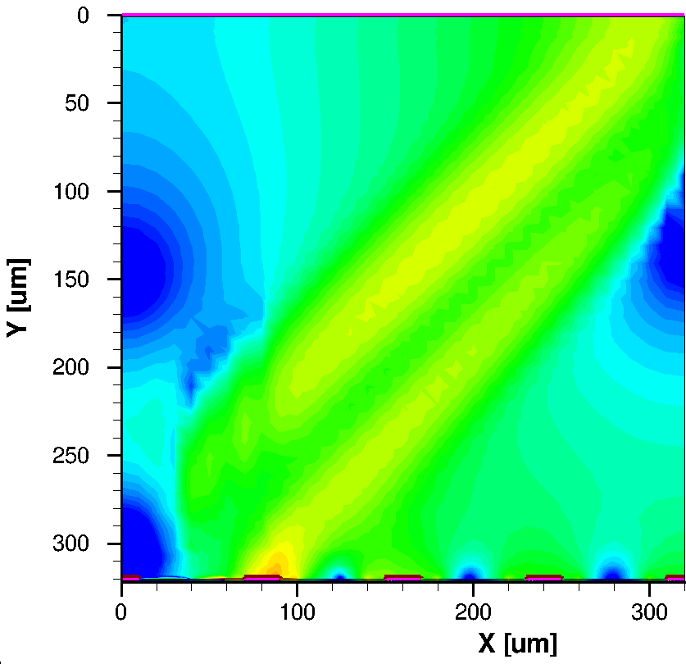
Signal formation in a strip sensor
Simulation:
Current density
mip, 45° angle
holes
electrons
t = 1.8 ns
Simulation: Thomas.Eichhorn@kit.edu

Slide 22
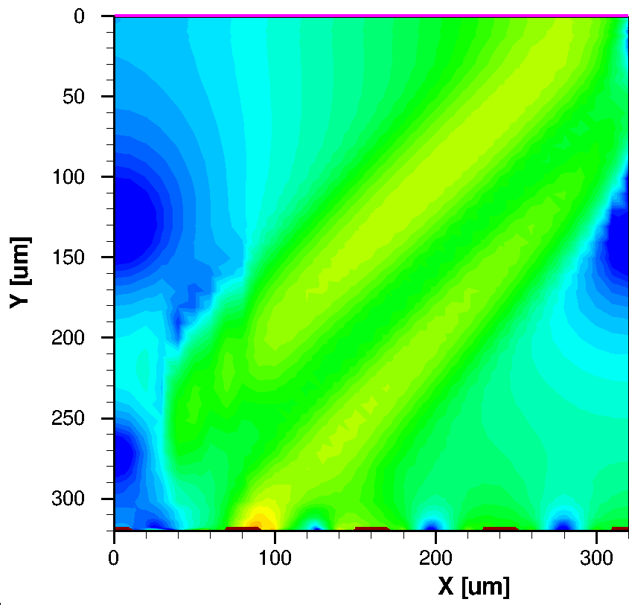
Signal formation in a strip sensor
Simulation:
Current density
mip, 45° angle
holes
electrons
t = 2.0 ns
Simulation: Thomas.Eichhorn@kit.edu

Slide 23
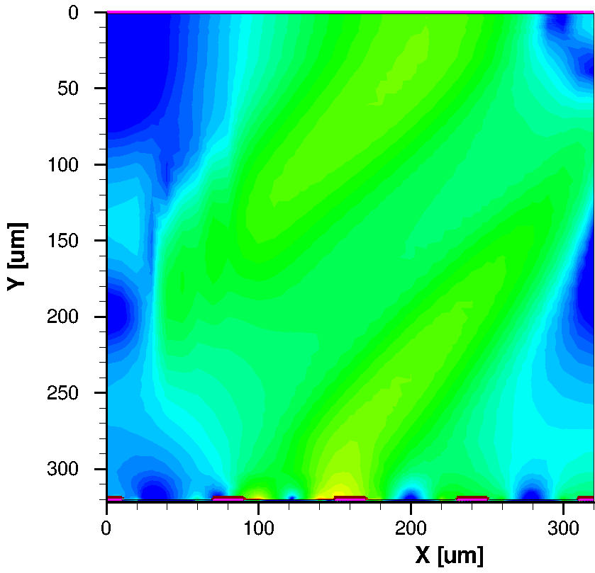
Signal formation in a strip sensor
Simulation:
Current density
mip, 45° angle
holes
electrons
t = 3.0 ns
Simulation: Thomas.Eichhorn@kit.edu

Slide 24
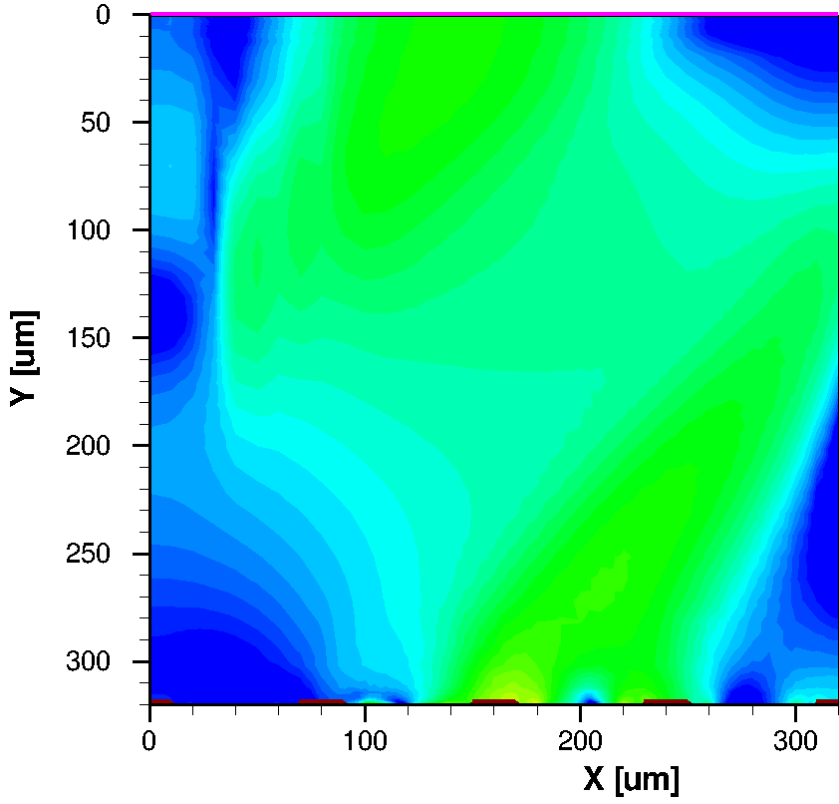
Signal formation in a strip sensor
Simulation:
Current density
mip, 45° angle
holes
electrons
t = 4.0 ns
Simulation: Thomas.Eichhorn@kit.edu

Slide 25
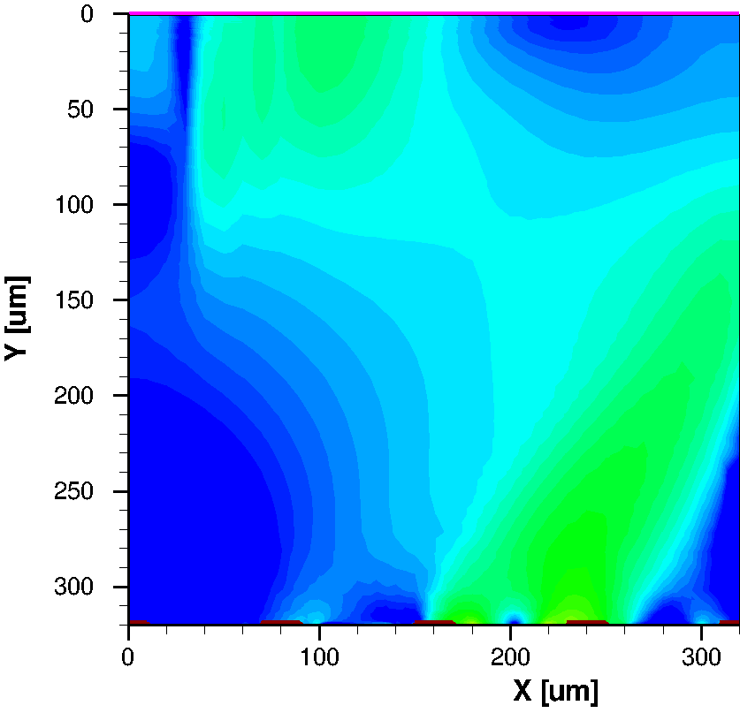
Signal formation in a strip sensor
Simulation:
Current density
mip, 45° angle
holes
electrons
t = 5.0 ns
Simulation: Thomas.Eichhorn@kit.edu

Slide 26
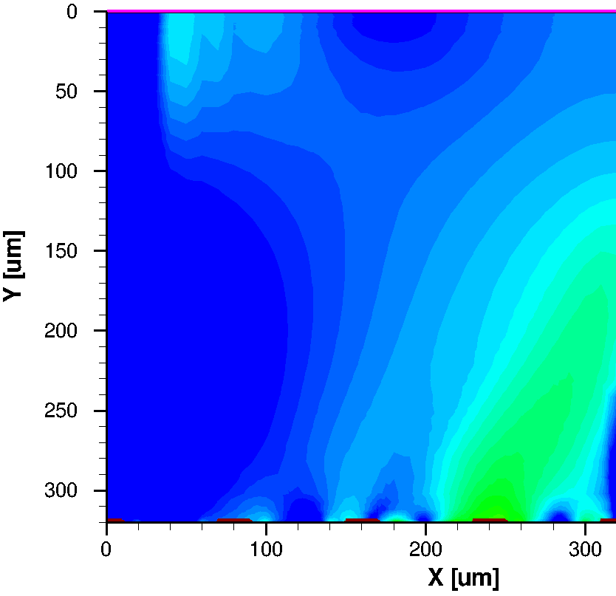
Signal formation in a strip sensor
Simulation:
Current density
mip, 45° angle
holes
electrons
t = 6.0 ns
Simulation: Thomas.Eichhorn@kit.edu

Slide 27
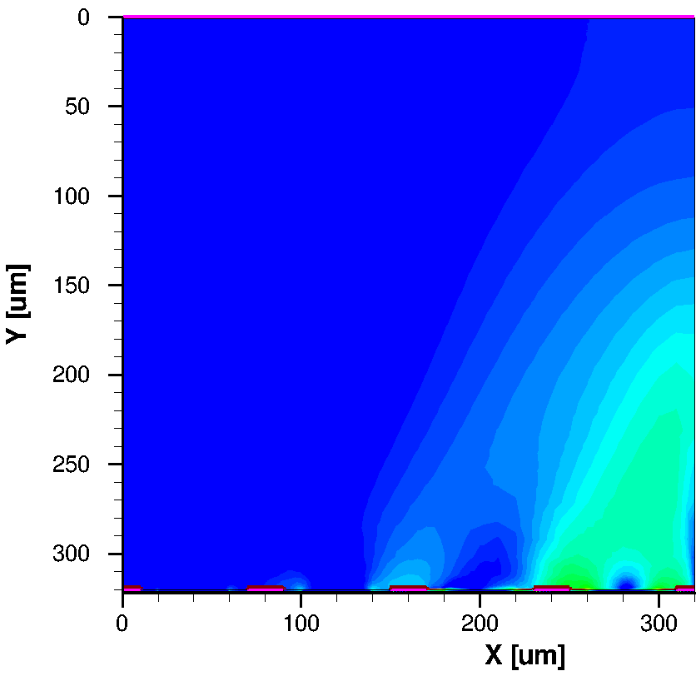
Signal formation in a strip sensor
Simulation:
Current density
mip, 45° angle
holes
electrons
t = 7.0 ns
Simulation: Thomas.Eichhorn@kit.edu

Slide 28
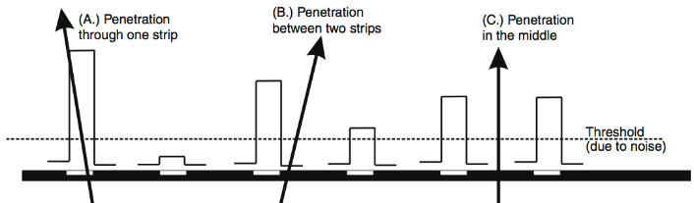
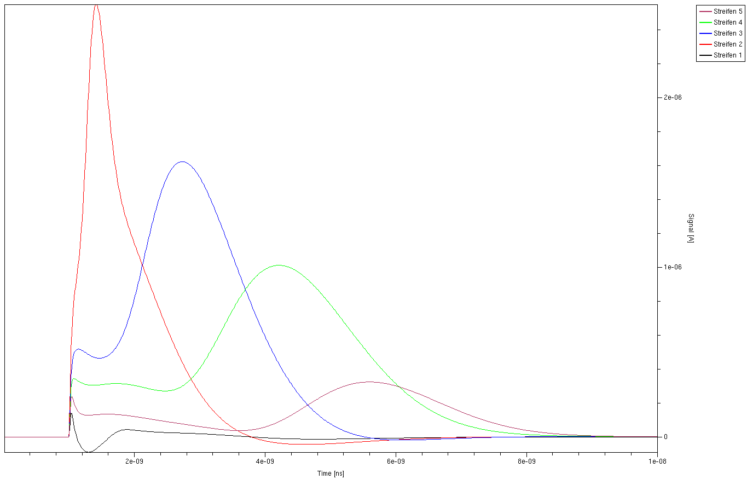
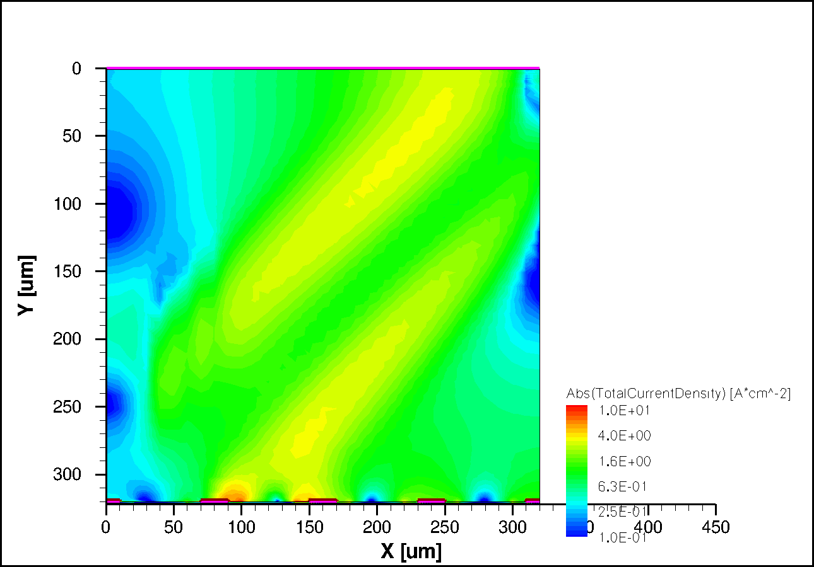
Signal formation in a strip sensor
Simulation:
mip, 45° angle
Plot:
Signals induced on electrodes
Integration gives collected charge
t = 2.0 ns
2,27e-15C
Strip 1
3,04e-15C
1 2 3 4
Strip 2
3,27e-15C
Simulation: Thomas.Eichhorn@kit.edu
Strip 3
Strip 4
1,08e-15C
2ns
4ns
6ns
8ns

Slide 29
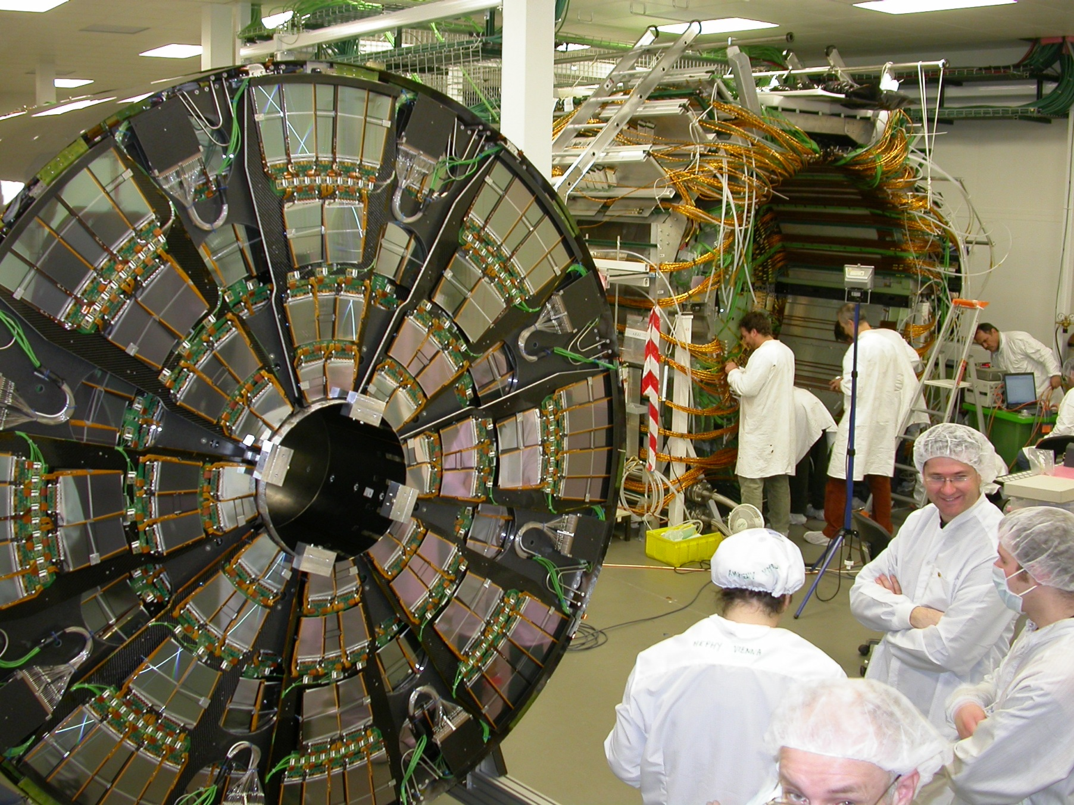
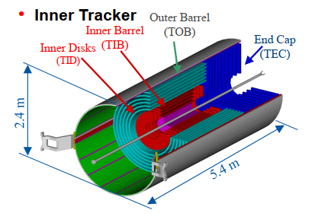
Present LHC Tracking Sensors
CMS Tracker
M.Krammer, ICFA School, Bogota, 2013

Slide 30
Present LHC Tracking Sensors
CMS Tracker
… 11.4 million strips
M.Krammer, ICFA School, Bogota, 2013

Slide 31
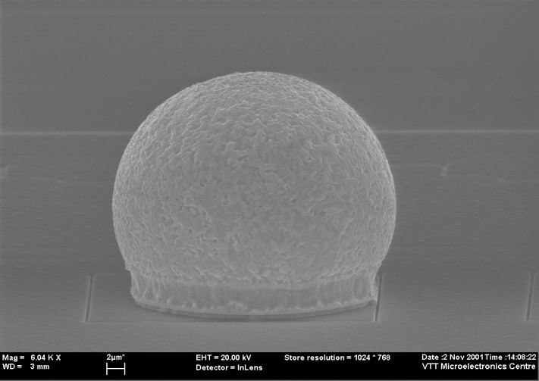
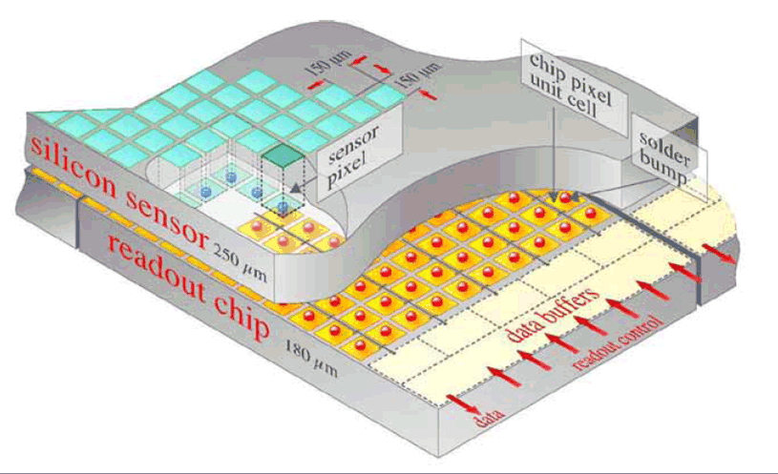
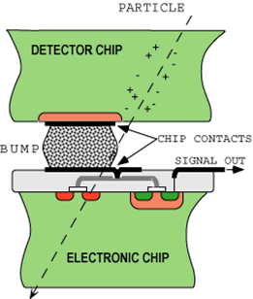
Hybrid Pixel Detectors
HAPS – Hybrid Active Pixel Sensors
segment silicon to diode matrix with high granularity (⇒ true 2D, no reconstruction ambiguity)
readout electronic with same geometry (every cell connected to its own processing electronics)
connection by “bump bonding”
requires sophisticated readout architecture
Hybrid pixel detectors are used in LHC experiments: ATLAS, ALICE (from Run3 monolithic), CMS and LHCb (from Run 3)
Solder Bump: Pb-Sn
~ 15μm
(VTT/Finland)
Flip-chip technique

Slide 32
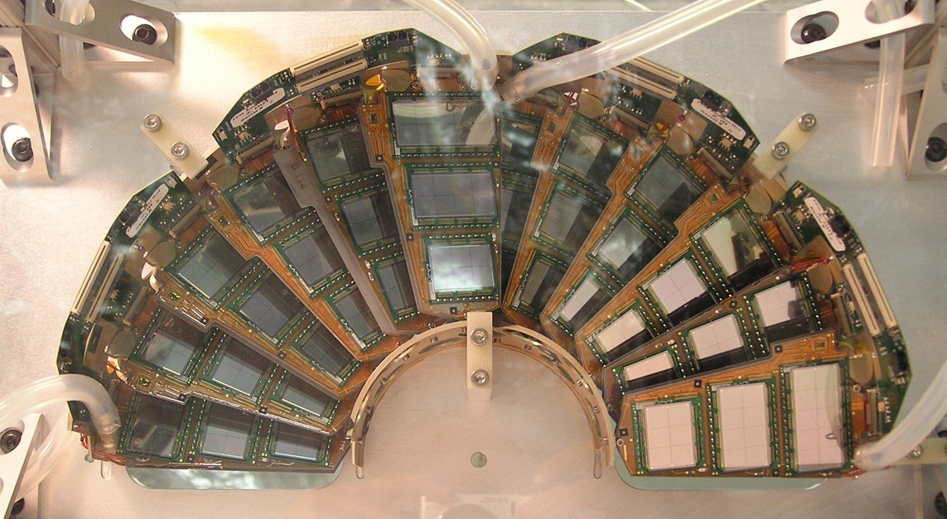
Present LHC Tracking Sensors
CMS Pixel (Half disk forward pixel)
M.Krammer, ICFA School, Bogota, 2013

Slide 33
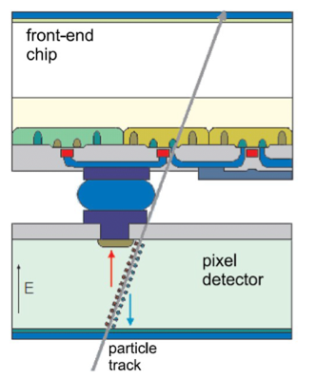
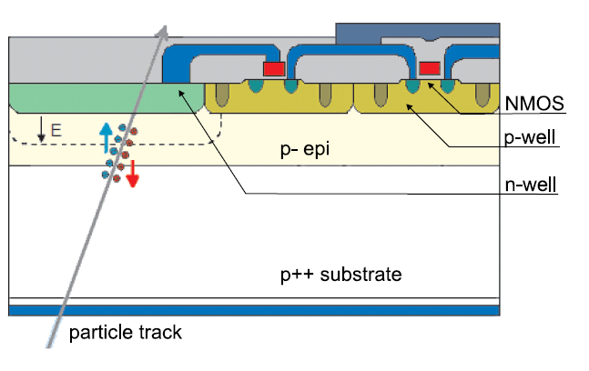
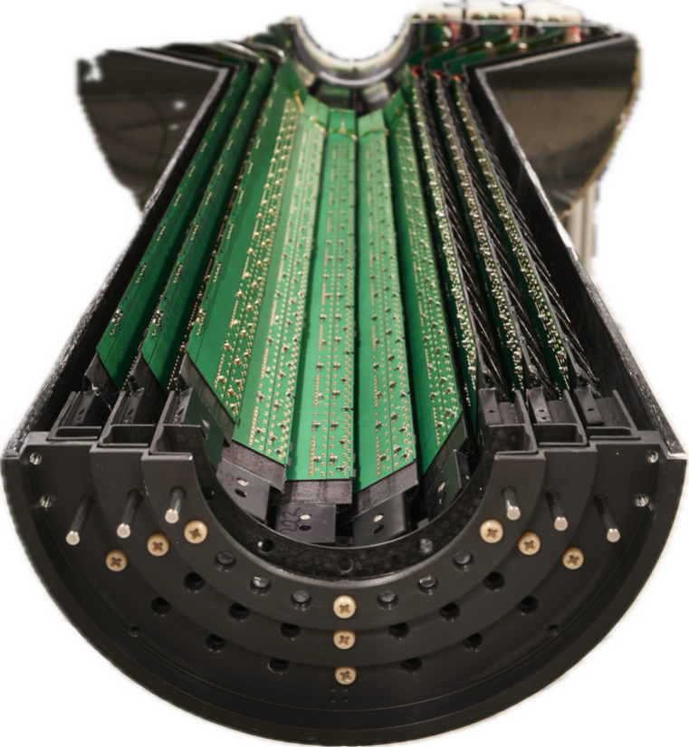
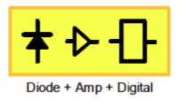

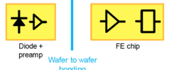
Hybrid Pixels - Monolithic Pixels
s
Monolithic Pixel
Hybrid Pixel
Example: ALICE – Alpide Chip
TowerJazz 0.18µm CMOS imaging process
N-well collection electrode in high resistivity epitaxial layer
State-of-art: based on quadruple well allows full CMOS
High resistivity (> 1kΩ cm) epi-layer (p-type, 20-40 μm thick) on p-substrate
Moderate reverse bias => increase depletion region around N-well collection diode to collect more charges by drift
or
Charge generation volume integrated into the ASIC, but many different variants!
Thin monolithic CMOS sensor, on-chip digital readout architecture
Separately optimize sensor and FE-chip for very high radiation environment
Fine pitch bump bonding to connect sensor and readout chip
Foto: ITS2 inner 3 layers (1st layer at 24 mm)
Installed in LS2
In operation since 2021
Notes:
5 um resolution
28um x 28um pixel pitch; 1.5 x 3 cm2 chip
10m2; 24120 pixel sensors with 12.5 Gpixel

Slide 34
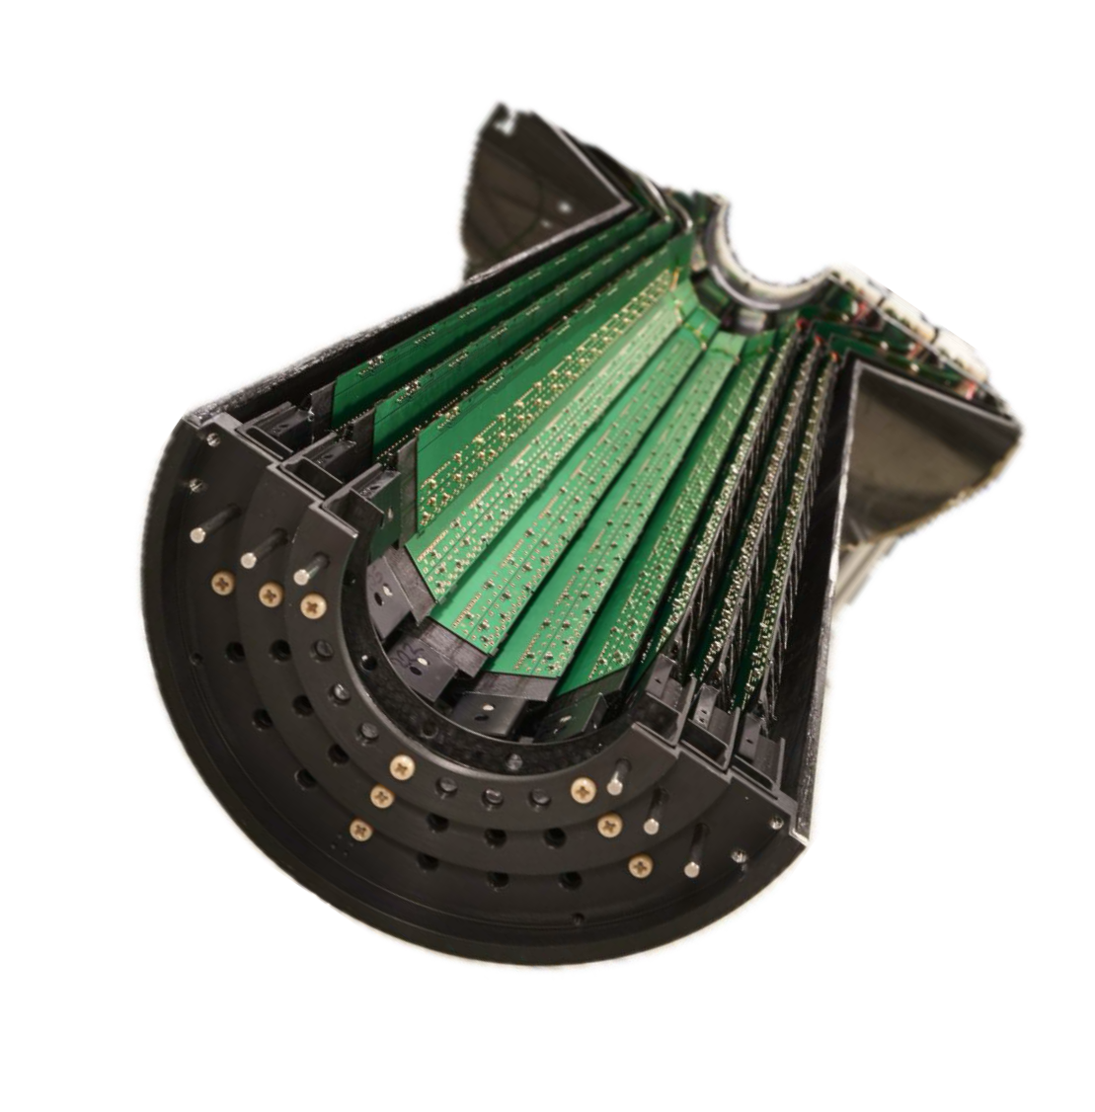
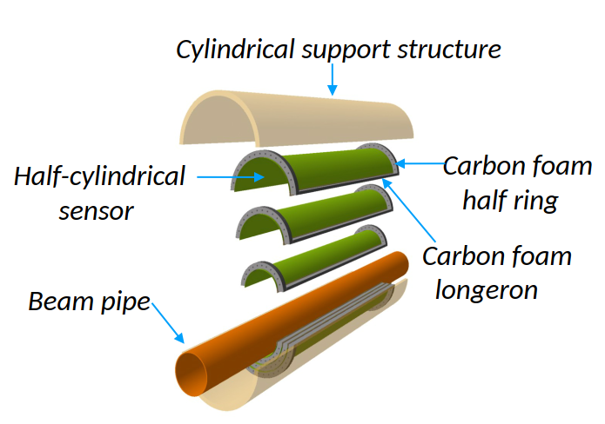
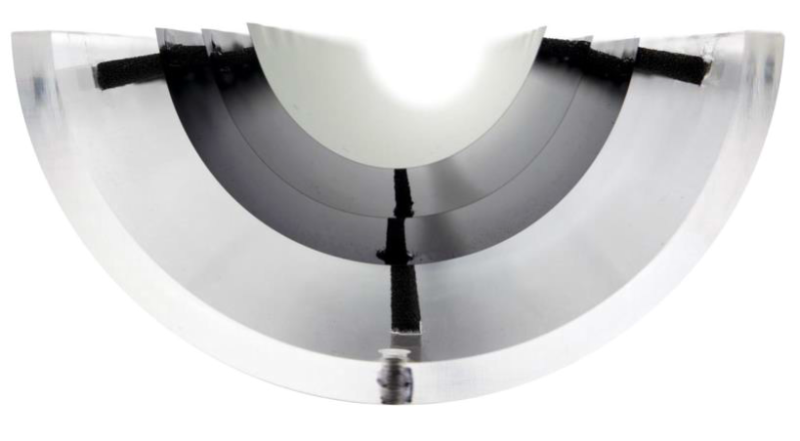



The future: Going full wafer monolithic!
ALICE ITS3 project (targeting installation in LS3 2026-2030)
Use of 300mm wafer-scale MAPS chips in 65 nm CMOS !
thinned down to ≤ 50 um making them flexible
sensor length 266 mm x width 55 / 74 / 93 mm (stitching)
spatial resolution requirement 5 μm
ITS3 detector with 3 layers comprised of 6 chips only!
..meanwhile (2025) some more ☺
Mechanically held in place by carbon foam spacers
ITS2
ITS3
full scale chip (50 μm thick) bent to 19 mm radius
[Filip Krizek, VERTEX 2023]
Notes:
20-40um thick → 0.02X to 0.04% X0

Slide 35

ALICE ITS3 project - prototypes
air cooling
300mm wafer
MOSS chip – MOnolithic Stiched Sensor (14x259mm²)
1 segment with 10 RSU (Repeated Sensor Units)
MOST – MOnolithic Stiched Sensor with Timing next (final):
MOSAIC - MOnolithic Stitched Active pIXel
up to 5 x segments combined (layer 2)
[ALICE – Sept.2025]
ITS3 installation in LS3 (2026-2030)
[VERTEX 2025 – L.Terlizzi & J.Lalic – August 2025]

Slide 36

The Charge Signal
Collected charge for a Minimum Ionizing Particle (MIP)
Mean energy loss dE/dx (Si) = 3.88 MeV/cm ⇒ 116 keV for 300μm thickness
Most probable energy loss ≈ 0.7 ×mean ⇒ 81 keV
3.6 eV to create an e-h pair ⇒ 108 e-h / μm (mean) ⇒ 72 e-h / μm (most probable)
Most probable charge (300 μm) ≈ 22500 e ≈ 3.6 fC
Most probable charge ≈ 0.7× mean
Mean charge
number of events
charge deposited [fC]

Slide 37
The Charge Signal
Collected Charge for a Minimum Ionizing Particle (MIP)
Landau distribution has a low energy tail
becomes even lower by noise broadening
Noise sources: (ENC = Equivalent Noise Charge) - Capacitance - Leakage Current - Thermal Noise (bias resistor)
Good hits selected by requiring N_{ADC} > noise tail If cut too high ⇒ efficiency loss If cut too low ⇒ noise occupancy
Figure of Merit: Signal-to-Noise Ratio S/N
Typical values >10-15, people get nervous below 10. Radiation damage severely degrades the S/N.
Signal
Cut (threshold)

Slide 38



Summary: Silicon Sensors in HEP
Main sensor concepts:
(Mini) Strip Detector [AC coupled]
p-in-n
strip
n-in-p
pixel/pad
Need inter strip isolation!
Hybrid Pixel Detector
Monolithic CMOS Pixel Detector
See backup slide “DRD3: Paths of present silicon detector R&D“ for a more detailed “map” on sensor types under development

Slide 39
The LHC Upgrade …and beyond

Slide 40


LHC and HL-LHC
today
[HL-LHC schedule – Sept.2025]
Example ATLAS:

Slide 41


Phase 2 upgrades - High Lumi (HL)-LHC
Installation in LS3 (2026-2030)
s
s
CMS Phase-2 upgrade
About 800 m² of silicon sensors for the phase 2 upgrades of ATLAS & CMS (RUN 4 from 2030)
..and all based on p-type silicon and no longer n-type silicon. Why? … let's see last part of this talk
Notes:
600m2 HGCAL
13m2 ATLAS Pixel
165m2 ATLAS Strip
200m2 CMS outer Tracker

Slide 42


HL-LHC upgrades: ALICE & LHCb
2034-35
HL-LHC: further proposed upgrades of ALICE (ALICE 3) and LHCb (Upgrade II) in LS4
s
s
Goal is to operate at L = 1 x 10³⁴ cm⁻² s⁻¹(2 x 10³³ today) and record 300 fb⁻¹ by end of HL-LHC (cfr 50 fb-1 before LS4).
Full replacement of tracking detectors (high-granularity, radiation-hard detectors with fast timing capability), new readout for ECAL and RICH.
Significant improvements in precision, world-best sensitivity to most key flavour physics observables, broad programme beyond flavour
Goal is to record ~ 35 nb⁻¹ in Run 5 (cfr 13 nb⁻¹ before LS4)
Fully new detector, CMOS silicon tracker, monolithic time-of-flight sensors, RICH, and new superconducting magnet with 1-2 T.
Significant improvement in pointing precision and acceptance. Unprecedented studies of quark-gluon plasma using in particular heavy flavour hadrons and di-electron mass spectra
From F.Gianotti – June 2025

Slide 43



Future Large Experiments ??
today
Community discussing on future options
ESPP 2026 update in progress
European Strategy for Particle Physics
CERN performed feasibility study on FCC
Future Circular Collider (FCC-ee then FCC-hh)
..many other proposals on how to proceed
[LHC schedule – Sept.25]
ALICE & LHCb
upgrades ?
(HL-) LHC timeline
?
?
?
For any choice of project: more advanced detectors will be needed!
Need to keep detector development running (preserve know-how & community) while next large project is being decided

Slide 44


R&D on Solid-state Detector Technologies for High Energy Physics applications
previous R&D
Long and very successful history on global R&D collaborations anchored at CERN is presently continued in form of DRDs born out of the 2021 ECFA detector roadmap
RD48
RD39
https://drd3.web.cern.ch/
RD42
145 Institutes with > 700 scientists
History of this R&D: Michael Moll et al., CERN: A Global Hub for Materials Science, Chapter in book: Between Science and Industry: Institutions in the History of Materials Research; May 2024;; Part of Encyclopedia of the Development and History of Materials Science
https://doi.org/10.1142/13625
since 2024
All academic speakers at SIMDET are DRD3 members: LPNHE Paris (Giovanni), APC (Marco), Aix-Marseille Uni, CEA-Irfu, CPPM Marseille, IJCLAB Orsay (Anna), IHC, IP2I Lyon, LPSC; CERN (Michael), Uni.Perugia (Arianna), CNM/CNA (Jairo), FBK(Ashish), HLL Munich (Alexander),… and further 130 institutes

Slide 45

The DRD Collaborations
DRD3 - Solid-State Detectors: part of the overall Detector R&D (DRD) program

Slide 46


Silicon Detector Challenges beyond LHC
RD50 collaboration
and many others
s
Past: remarkable challenges were over come in the last decade for the LHC upgrade!
Radiation hardness at levels not imagined decades ago (few 10¹⁶ n cm⁻², tens of MGy) - 25x100, 50x50 μm² cells, device and defect engineered sensors
Not only the position but precise timing (~30 ps) resolution should be measured for the particle collisions Endcap Timing detectors for ATLAS and CMS (4D tracking)
Superb resolution at low mass (ALICE ITS)
New Major Challenges for the future:
FCC-ee/CEPC:
Vertex detectors with low mass, high resolution Target per layer spatial resolution of ≤ 3 µm and X/X0≤ 0.05%
FCC-hh/SppC:
low power and high radiation hardness up to 8·10¹⁷ n_{eq}cm⁻²
Resolving many pp hits in a bunch by ultra-fast timing in O(10-100ps)
Full integration with electronics, mechanics, services
Large area sensors at low cost for calorimetry
s
Targeted by the DRD3 collaboration
(see Annex for present work program)
European Commission for Future Accelerators (ECFA)
2021 road map document on sensors [CERN CDS]

Slide 47
Radiation Damage
Damage to dielectric layers and interfaces (not covered)
Damage to the semiconductor bulk (introduction)
Radiation damage is just one of the many challenges in conceiving a High Energy Physics detector for hadron colliders.
Constraints like needs for high granularity, low mass, efficient cooling and low power consumption, low cost, high-rate capability, precision timing capability, …. are adding up to the challenge of building a detector.

Slide 48

Motivation and Challenge
Silicon detectors upgrades and operation - Radiation Hardness -
LHC operation
HL-LHC (High Luminosity LHC)
detector developments for HL-LHC
starting after LS3 (~2026-28);
expect 4000 fb⁻¹ (nominal LHC was 300 fb⁻¹)
HL-LHC operation & upgrades
operation of HL-LHC
damage modelling, evaluation, mitigation
ATLAS Pixel replacement, LHCb upgrade, …
FCC – Future Circular Collider
..also FCC-ee
[I. Dawson, P. S. Miyagawa, Sheffield University, Atlas]
Increasing radiation levels
Semiconductor detectors will face >10¹⁶ n_{eq}/cm² (HL-LHC) and >7x10¹⁷ n_{eq}/cm² (FCC-hh) → detectors used at LHC cannot be operated after such irradiation
New requirement and new detector technologies
New requirements or opportunities lead to new technologies (e.g. HV-CMOS, LGAD,…) which need to be evaluated and optimized in terms of radiation hardness and/or 4D tracking capabilities

Slide 49



Displacement Damage
particle
Si_{S}
E_{K}>25 eV
V
Vacancy + Interstitial
….. a wide range of point defects
I
E_{K}>5 keV
point defects and clusters of defects
s
Can we see the defects?
HRTEM on Si: n-irradiated 10¹⁹ n_{eq}/cm²
High Resolution Transmission Electron Microscopy
V
I
I
V
example of point defect reactions:
V: V+O → VO; V+P →VP
I: I+C_{S} → C_{i} → C_{i} + O →C_{i}O_{i} I+B_{S} → B_{i} → B_{i} + O →B_{i}O_{i} … many more reactions!
“dopant removal”
[van Lint 1980]
[C.Besleaga et al. arXiv 2021]

Slide 50

Impact of Defects on Detector Properties
Shockley-Read-Hall statistics
s
Defect spectroscopy
e.g. DLTS, TSC
allows to measure the defect properties (see backup)
Extracted parameters serve as input to TCAD simulations (see backup and following talks)
charged defects ⇒ N_{eff} , V_{dep} e.g. donors in upper half, acceptors in lower half of the band gap
trapping (e and h) ⇒ CCE shallow defects do not contribute at RT due to fast de-trapping
generation ⇒ leakage current levels close to midgap most effective
Impact on detector properties can be calculated if defect parameters are known:
σ_{n,p} : cross sections ΔE : ionization energy N_{t} : concentration

Slide 51
Radiation Damage Summary
Macroscopic bulk effects:
Depletion Voltage (N_{eff}) Leakage Current Charge Trapping
Signal to Noise ratio is quantity to watch (material + geometry + electronics)
signal
noise
Cut (threshold)

Slide 52
Device engineering example: n-in-p sensors
Why will we use p-type strip/pixel sensors (n-in-p) for the LHC upgrade in ATLAS and CMS instead of p-in-n sensors?
Why are segmented sensors⁽*⁾ build on p-type silicon sensors radiation harder than n-type sensors?
⁽*⁾ 300 μm
p-in-n
Need inter strip isolation!
n-in-p

Slide 53

Sensor Signal: Pad vs. Strip/Pixel
Signal = Induced charge on read-out electrode
Described by Shockley-Ramo Theorem
Charged induced on electrode by moving charge can be calculated from the weighting potential (field)
Pad
Strip
Total collected charge in both cases 100% (Q = q) when charges have reached the electrodes, however
Diode: 50% from (+q); 50% from (-q)
Strip: 87% from (+q); 13% from (-q)
In a p-in-n strip sensor the holes give a higher contribution to the (m.i.p.) signal than the electrons!

Slide 54
Device engineering: p-in-n vs. n-in-p (or n-in-n)
n-type silicon after high fluences: (type inverted)
p-type silicon after high fluences: (still p-type)
p⁺in-n
n⁺in-p
p-in-n silicon, under-depleted:
Charge spread – degraded resolution
Charge loss – reduced CCE
n-in-p silicon, under-depleted:
Limited loss in CCE
Less degradation with under-depletion
Collect electrons (3 x faster than holes)
Comments: - Instead of n-in-p also n-in-n devices could be used - Reality is much more complex: Usually double junctions form leading to fields at front and back! (next slide)

Slide 55




E-Field after irradiation: “double junctions”
Investigation by measurement
n-in-p sensor still “p-type” (i.e. highest field at front electrode) after high level of radiation
…to add more complexity
different particle irradiation on identical sensors
[G.Kramberger et al, 2014 JINST 9 P10016]
neutron irradiated 7×10¹⁵ n_{eq}/cm²
Dominant junction close to n+ readout strip for FZ n-in-p
proton irradiated 7×10¹⁵ n_{eq}/cm²
[S.Pape, 43rd RD50 Workshop, 29. November 2023]

Slide 56


Double Junction
Double Junction = Polarization Effect
Double junction in TCAD (see e.g. M.Bomben, SIMDET 2023)
[V.Eremin et al., NIMA 476 (2002) 556-564]

Slide 57
Device engineering example: n-in-p sensors
p-in-n
Need inter strip isolation!
n-in-p
Sensors in LHC trackers today HL-LHC trackers tomorrow (2028) (ATLAS/CMS) (… in production now)

Slide 58




ATLAS Phase II
Strips & Pixel
all n-in-p
F.Hartmann, Last RD50 Workshop, Nov.2023

Slide 59



CMS Phase II
Outer Tracker modules in final configuration – n-in-p
Pixel Tracker module – n-in-p
High Granularity Calorimeter – n-in-p
F.Hartmann, Last RD50 Workshop, Nov.2023

Slide 60

Device engineering example: 3D Hybrid Pixel Detectors
Array of narrow electrode columns (~ 5-10μm) passing through the silicon thickness (micromaching):
Depletion voltage prop. spacing²
Collection time prop. spacing
Reduced charge sharing
→ More suited to high radiation environment
Connected to standard pixel ASIC – hybrid pixel detector
Installed 2014 in ATLAS IBL (Inner b-layer)
& inner pixel layers for LHC phase II (2030)

Slide 61
TCAD simulations

Slide 62


TCAD simulations
Why do we need TCAD simulations for understanding (irradiated) sensors ?
Complexity of the problem: Coupled differential equations (semiconductor equations)
Complex device geometry and complex signal formation in segmented devices ….
Evaluation of new an innovative design approaches
Impact of defects depending on local charge densities, field-strength, … (“feedback loop”)
Interplay of surface and bulk damage..
Details in the following presentations
3D detector
Vbias
n⁺
Electric field distribution in 3D detector (Al & oxide layer transparent for clarity)
Doping profiles
N_{p,n} = 5e18 cm⁻³
Vbias
V=0
p⁺
Vbias
3D sensor: T.Peltola (HIP, Helsinki): CMS & RD50
Column depth =
bulk thickness
N_{bulk} = 1.7e12 cm⁻³
n+
n+
Vbias

Slide 63
Device simulation: TCAD & signal simulators
Status of TCAD device simulations
Required by complexity of the problem:
solve semiconductor equations with physics properties, complex geometry and radiation damage
mainly commercial tools used (Silvaco and Synopsis)
Excellent tools for sensor optimization
Radiation damage TCAD: enormous progress over recent years
getting predictive power but need further optimization!
“effective” defect levels (2 to 5 levels) are used
Signal simulators
TCAD simulations for signal formation are complex (time consuming, TCAD is not a fitting tool!)
Custom build signal simulators (open code) developed: sensor optimization, parameter fitting
..using E-Field and other parameters (e.g. charge trapping) from TCAD as input
Measured defects TCAD input
needs more work !
Allpix2, KdetSim, Garfield++, Weightfield2, TRACS,
(unpublished codes), ...

Slide 64
Summary
Silicon Sensors are based on reverse biased pn-junctions (silicon sensors are reverse biased diodes)
Silicon Detectors at the LHC and upgrade of LHC
Inner tracking at LHC and HL-LHC done by silicon detectors
Hybrid-pixel (planar and 3D) and strip sensors implemented in LHC experiments (ALICE upgraded to monolithic sensors)
Radiation Hard Monolithic sensors under development (competing beyond LS3 for HL-LHC upgrades)
Radiation Damage in Silicon Sensors
Damage: displacement damage that is evidenced as defect levels in the band gap of the semiconductor (+ some impact of surface damage in segmented sensors)
Modification of internal electric field (space charge distribution, depletion voltage, “type inversion”, reverse annealing, loss of active volume, …), defect engineering possible!
Increase of Leakage Current and Charge Trapping (same for all silicon materials)
Signal to Noise ratio is quantity to watch (material + geometry + electronics)
Radiation tolerant silicon sensors
Several examples of successful Material and Device Engineering (mitigation strategies) oxygenation, carbonation, 3D sensors, p-type (n-readout) sensors
“Hot topics” in silicon sensor R&D
Sensors for timing (i.e. LGAD with intrinsic gain, acceptor removal,3D,4D); monolithic sensors; SiC and Diamond sensors, large area low cost
Radiation resistance to extreme particle fluences (longterm: FCC-hh)
Reliability of TCAD simulations with defects; characterization of damage beyond 10¹⁶ cm⁻²

Slide 65
Acknowledgements & References
Most references to particular works given on the slides
RD50 workshop presentations: http://www.cern.ch/rd50/ ; DRD3 workshop presentations: https://drd3.web.cern.ch/
Conferences: VERTEX, PIXEL, RESMDD, …
Instrumentation Schools
ICFA, EDIT, CERN & DESY Summer Student Lectures
Books about silicon tracking detectors (and radiation damage)
Helmuth Spieler, “Semiconductor Detector Systems”, Oxford University Press 2005
C.Leroy, P-G.Rancoita, “Silicon Solid State Devices and Radiation Detection”, World Scientific 2012
Frank Hartmann, “Evolution of silicon sensor technology in particle physics”, Springer 2024: third edition
L.Rossi, P.Fischer, T.Rohe, N.Wermes “Pixel Detectors”, Springer, 2006
Gerhard Lutz, “Semiconductor radiation detectors”, Springer 1999
Hermann Kolanoski and Norbert Wermes, “Particle Detectors – Fundamentals and Appilcations”, Oxford University Press 2020
Review Articles
2018: Garcia-Sciveres and Wermes, A review of advances in pixel detectors for experiments with high rate and radiation, https://doi.org/10.1088/1361-6633/aab064
2018: M.Moll, Displacement Damage in Silicon Detectors for High Energy Physics https://doi.org/10.1109/TNS.2018.2819506
2021: Radiation Effects in the LHC-Experiments, 154 pages, CERN Yellow Report https://cds.cern.ch/record/2764325
Research collaborations and web sites
CERN RD50 collaboration (http://www.cern.ch/rd50 ) - Radiation Tolerant Silicon Sensors
DRD3 collaboration (https://drd3.web.cern.ch/) – R&D on Solid State Detectors
Inter-Experiment Working Group on Radiation Damage in Silicon Detectors (CERN) – CERN Yellow Report
ATLAS and CMS upgrade groups, LHCb and ALICE upgrades

Slide 66
Backup Slides

Slide 67

EDIT - Instrumentation School 2026
EDIT (Excellence in Detector and Instrumentation Technologies)
aimed at young researchers, including graduate students and early-career postdocs, who seek to deepen their knowledge of detector technologies and instrumentation for particle physics
CERN, 3-13 March 2026 (15 years since its first edition)
Deadline was 1.10.2025 … but all lectures will be broadcasted!
Website: https://indico.cern.ch/e/edit2026
EDIT 2026
10 days with lectures, key-note talks and hands-on sessions
48 students – split into groups of two to six students for hands-on
Local organizers: F.Brunbauer, D.Dannheim, M.Moll, E.Oliveri (DRD1,DRD3, CERN EP-DT)
Core Lectures:
Particle Interactions with Matter
Silicon Detectors
Gaseous Detectors
Photon Detectors
Noble Liquid Detectors
Signal Processing & Front-End Electronics
Modelling and Simulation
Key-note talks:
Avenues for the Physics to Come
Particle Accelerators
Collider Physics and Beyond
Future Detectors for Tracking, Calorimetry, and Timing
Quantum Sensors
Applications Outside HEP
Lab sessions:
Silicon Detectors
Gaseous Detectors
Photon Detectors
Signal Processing & Front-End Electronics
Modelling and Simulation
DAQ and Trigger
Beam Instrumentation/Radiation Monitoring and Instrumentation
Past EDIT schools:
2024 at FNAL, Link
2023 at BNL, Link
2020 at DESY, Link
2018 at FNAL, Link
2015 at Frascati, Link
2013 at KEK, Link
2012 at FNAL, Link
2011 at CERN, Link

Slide 68



Collisions in the LHC
2012 – Discovery of the Higgs Boson

Slide 69
Timing Detectors

Slide 70

Timing Detectors: Motivation
“sorting the mess”
[F.Hartmann, CMS, Feb.2025]

Slide 71

Timing Detectors: Motivation
“sorting the mess”
[F.Hartmann, CMS, Feb.2025]

Slide 72

Timing Detectors: Motivation
“sorting the mess”
[F.Hartmann, CMS, Feb.2025]

Slide 73

Timing Detectors: Motivation
“sorting the mess”
[F.Hartmann, CMS, Feb.2025]

Slide 74
Timing Detectors: Motivation
“sorting the mess”
[F.Hartmann, CMS, Feb.2025]

Slide 75

Timing Detectors: Motivation
“sorting the mess”
[F.Hartmann, CMS, Feb.2025]

Slide 76



Timing: Time of arrival measurement
Time of arrival measurements will be critical for pileup suppression at HL-LHC (pileup 200)
Targeted time resolution per sensor < 50 ps
ATLAS High Granularity Timing Detector and CMS Endcap Timing Layer
We want to measure the time of arrival with respect to a reference time
Reference at LHC the 25 ns clock (bunch crossing time)
In lab a reference signal (from reference detector or laser trigger pulse)
At least two channels are recorded
Time of Arrival: time when signal crosses a selected threshold
Time resolution defined as RMS of the time difference $σ^{2}=RMS(t_{REF}−t_{DUT})$; ${σ_{DUT}^{2}=σ}^{2}−σ_{REF}^{2}$
Radiation hard sensor technologies for timing:
Low Gain Avalanche Diode (LGAD)
Internal charge multiplication by impact ionization in the p+ gain layer
→Gain
3D sensor
Short drift path, independent of thickness
Radiation hard
[B.Hiti – 2nd TCT school – Sept.2025]

Slide 77

Timing: Contributions to time resolution
$${σ_{det}}^{2}=σ_{jitter}^{2}+σ_{pulse shape}^{2}+σ_{TDC}^{2}$$
Jitter contribution minimized by high signal-to-noise ratio, fast signal rise time
Pulse shape contribution:
Time walk (signal size) – correctable (constant fraction discriminator)
LGAD: nonhomogenous MIP charge deposition (Landau fluctuations) – uncorrectable – not present in laser measurements
3D: Weighting field distortion (weighting field not constant within a cell) – focused laser good tool to probe this
[B.Hiti – 2nd TCT school – Sept.2025]

Slide 78
R&D on Solid-State Detectors DRD3 collaboration

Slide 79

DRD3 Organizational Structure
A working group dedicated to simulations!
Michael
Giovanni

Slide 80

DRD3: Paths of present silicon detector R&D
[G.Kramberger, Sept.2025]

Slide 81

DRD3: WG1/WP1 Monolithic silicon sensors
[G.Kramberger, Sept.2025]

Slide 82

DRD3 WG2/WP2: Hybrid silicon technologies and 4D tracking
[G.Kramberger, Sept.2025]

Slide 83

DRD3: WG2/WP2: LGADs
[G.Kramberger, Sept.2025]

Slide 84

DRD3: WG2/WP2: LGAD flavours

Slide 85

DRD3 WG2/WP2: 3D detectors
[G.Kramberger, Sept.2025]

Slide 86

DRD3: WG3/WP3: Radiation damage characterization and sensor operation at extreme fluence

Slide 87


DRD3 WG6/WP3: Other materials – non silicon
[G.Kramberger, Sept.2025]

Slide 88

DRD3: WG4 Simulations

Slide 89

DRD3 WG7/WP4: In house bonding and wafer-wafer
[G.Kramberger, Sept.2025]

Slide 90
Microscopic Damage Formation of Defects and Impact on Detectors

Slide 91

Radiation Damage – Microscopic effects
Spatial distribution of vacancies created by a 50 keV Si-ion in silicon. (typical recoil energy for 1 MeV neutrons)
V
I
I
V
M.Huhtinen 2001
van Lint 1980
Si_{S}
V
Vacancy + Interstitial
point defects (V-O, C-O, .. )
particle
E_{K}>25 eV
I
E_{K} > 5 keV
point defects and clusters of defects

Slide 92



NIEL – Non Ionizing Energy Loss
Displacement Damage Function
Normalization of radiation fields to 1 MeV neutron equivalent damage (n_{eq})
NIEL Hypothesis:
Assumption: NIEL scaling of damage parameters
Applied to predict damage of radiation fields in HEP
NIEL violation observed:
Material dependence
Proton vs. neutron damage
…
Acceptor removal ?
1 MeV
$Φ_{eq}=$ ${κ_{x }Φ}_{x}$
1
$κ_{p }=$ 0.62 (23 GeV protons)
$κ_{p }=$ 1.85 (26 MeV protons)
$κ_{p }=$ 2.20 (23 MeV protons)
$κ_{π }=$ 1.14 (192 MeV pions)
$κ_{n }=$ 0.92 (TRIGA reactor neutrons)
[Data: A.Vasilescu and G.Lindstroem]
Simulation: Vacancies in (1μm)³ after 10¹⁴ particles/cm²
[M.Huhtinen, NIMA 491(2002), 194]
10 MeV protons 23 GeV protons 1 MeV neutrons
Notes:
Allport 2019

Slide 93

Radiation induced defects with impact on device performance
RD50 map of most relevant defects for device performance near room temperature:
BD: positive charge higher introduction after proton than after neutron irradiation, oxygen dependent
E30: positive charge higher introduction after proton irradiation than after neutron irradiation
Phosphorus: shallow dopant (positive charge)
BiOi (acceptor removal)
Leakage current: V₃
leakage current & neg. charge current after γ irrad, V₂O (?)
Reverse annealing (negative charge)
Boron: shallow dopant (negative charge)
Trapping: Indications that E205a and H152K are important (further work needed)
Converging on consistent set of defects observed after p, π, n, γ and e irradiation.
Defect introduction rates are depending on particle type and energy, and some on material!

Slide 94

Some TCAD models from literature
Several models available (non exhaustive list):
Table: M.Moll, Displacement Damage in Silicon Detectors, doi.org/10.1109/TNS.2018.2819506

Slide 95
Macroscopic Damage Degradation of Detector Performance

Slide 96
Summary: Basics of Radiation Damage in Silicon Sensors
Two general types of radiation damage to the detector materials:
• Bulk (Crystal) damage due to Non Ionizing Energy Loss (NIEL) - displacement damage, built up of crystal defects –
Change of effective doping concentration & acceptor/donor removal (higher depletion voltage, under- depletion)
Increase of leakage current (increase of shot noise, thermal runaway)
Increase of charge carrier trapping (loss of charge)
• Surface damage due to Ionizing Energy Loss (IEL) - accumulation of positive in the oxide (SiO₂) and the Si/SiO₂ interface – affects: interstrip capacitance (noise factor), breakdown behavior, …
Impact on detector performance and Charge Collection Efficiency (depending on detector type and geometry and readout electronics!) Signal/noise ratio is the quantity to watch
⇒ Sensors can fail from radiation damage !
Influenced by impurities in Si – Defect Engineering is possible!
Same for all tested Silicon materials!
Can be optimized!
Notes:
96
96
efficacité de collection de charge influencé par deux mécanisme
piégeage – porteurs de charge sont pièges par les défaut profond
déficit de collection de charge augmente en fonction de la fluence

Slide 97
Radiation Damage in the LHC Experiments (Silicon Detectors)

Slide 98


Radiation Effects in LHC Experiments
5 workshops on “Radiation Effects at LHC Experiments and Impact on Operation and Performance” organized (2011 - 2019)
Common Workshop: (ALICE), ATLAS, CMS, LHCb, RD50
Sensor Measurements
Electronics/Optoelectronics
Radiation Simulation and Monitoring
Sensor Simulation
Outcome and follow-up:
Generally good agreement between RD50 damage prediction models (e.g.“Hamburg model”) and radiation damage observed by the LHC experiments.
More coherent approach in data analyses agreed and documented.
Modelling will have to be refined in some areas for run 3 !
CERN Yellow Report written and edited by a team from RD50 & all LHC experiments has been published (154 pages, Radiation effects in the LHC experiments https://cds.cern.ch/record/2764325) summarizing observations, comparing results from different experiments against each other, listing open questions and outlining further work towards Run 3.
[https://indico.cern.ch/event/769192]
[https://cds.cern.ch/record/2764325 ]

Slide 99





Radiation Effects in LHC Experiments
Review of radiation effects in the LHC Experiments in several workshops [INDICO]
Common working group: RD50 & LHC experiments → Publication of a summary report in April 2021 [CERN Yellow Report link]
Leakage currents in ATLAS SCT and CMS tracker and model predictions
LHCb Velo depletion voltage reduced by annealing; according to model
ATLAS B-layer data vs. MC&NIEL strong z-dependence; unexpected
CMS pixel layers; deviation of V_{dep} from modelling at high fluences
Plots: Radiation Effects Workshop Feb.2019 K.Mochizuki(ATLAS SCT) J.L.Agram (CMS Tracker), Aiden Grummer (ATLAS Pixel) , G.Sarpis (LHCb Velo) , F.Feindt (ATLAS Pixel)

Slide 100
How to increase the radiation hardness?

Slide 101
Approaches to develop radiation harder solid state tracking detectors
Defect Engineering of Silicon Deliberate incorporation of impurities or defects into the silicon bulk to improve radiation tolerance of detectors
Needs: Profound understanding of radiation damage
microscopic defects, macroscopic parameters
dependence on particle type and energy
defect formation kinetics and annealing
Examples:
Oxygen rich Silicon (DOFZ, Cz, MCZ, EPI)
Carbon enriched LGAD gain layers
Oxygen dimer & hydrogen enriched Si
Pre-irradiated Si
Influence of processing technology
New Materials
Silicon Carbide (SiC), Gallium Nitride (GaN)
Diamond , Amorphous silicon, Gallium Arsenide
Device Engineering (New Detector Designs)
p-type silicon detectors (n-in-p)
thin detectors, epitaxial detectors
3D detectors and LGAD - Low Gain Avalanche
Cost effective detectors
Monolithic devices – HV-CMOS
Scientific strategies:
Material engineering
Device engineering
Change of detector operational conditions
Regular exchange of detectors
“Cryogenic Tracking Detectors” operation at 100-200K to reduce charge loss (not followed up in the moment)

