Slide 1


Searches for CP Violation in the Higgs sector:
The Quest to Understand the Baryon Asymmetry in the Universe
Andrea Cardini – Universidad de Oviedo, Spain

Slide 3

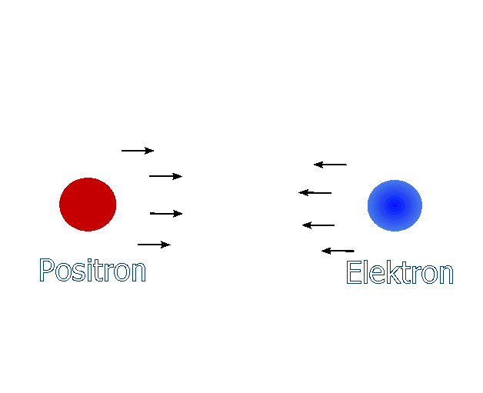
Once upon a time...
the Universe was not like we see it today:
  No people
  No Earth
  No Galaxies
  and it was much much smaller
The primordial Universe contained both matter and anti-matter
Energy was converting into matter and anti-matter which then annihilated to create again energy
This cycle was broken, and the Universe now is made just of matter
Where did the anti-matter go?

Slide 4
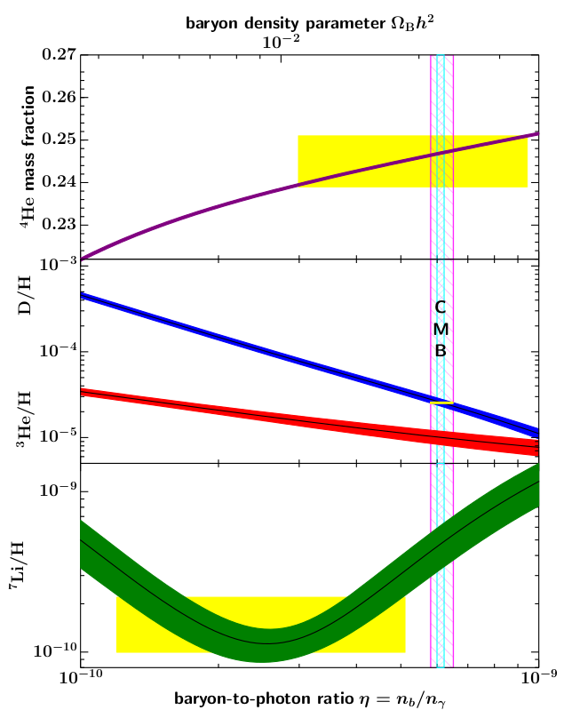
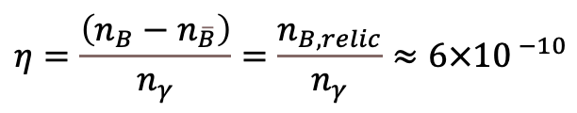
The Universe
Our Universe is now made of matter, forming the baryons and leptons which make up the atoms and molecules we are made of
This required an asymmetry between matter and
anti-matter in the primordial Universe
  Baryon Asymmetry in the Universe (BAU)
  Matter : Antimatter
  1’000’000’001 : 1’000’000’000
More specifically, the asymmetry is encoded in
the ratio of baryons over photons in the Universe
From the cosmic microwave background this is
$$η=\frac{\left(n_{B}−n_{\overline{B}}\right)}{n_{γ}}=\frac{n_{B,relic}}{n_{γ}}≈6×{10}^{ −10}$$
Eur. Phys. J. A 57, 128 (2021)

Slide 5
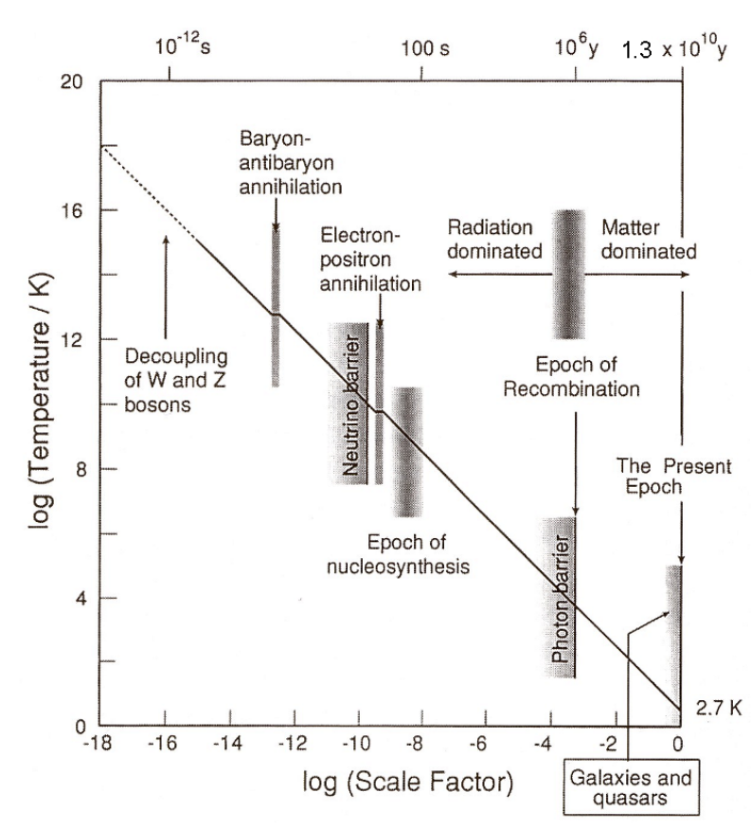
Evolution of the Universe
The cosmic microwave background originated when the Universe cooled off enough that the photons were free to propagate
  Epoch or recombination: formation of atoms
Going backward in time particle density and temperature increase:
  formation of nuclei
  cosmic neutrino background
  the baryon-antibaryon annihilation→ the matter asymmetry
  should have been present before this moment
Sakharov theorized 3 conditions necessary for a
CPT conserving theory to explain the BAU:
  Baryon number violation: generate asymmetry in a symmetric Universe
  C and CP violation: asymmetric interaction to remove antimatter
  Deviation from thermal equilibrium: to prevent reverting to a symmetric state
Is there a theory that satisfies all 3 conditions?

Slide 6
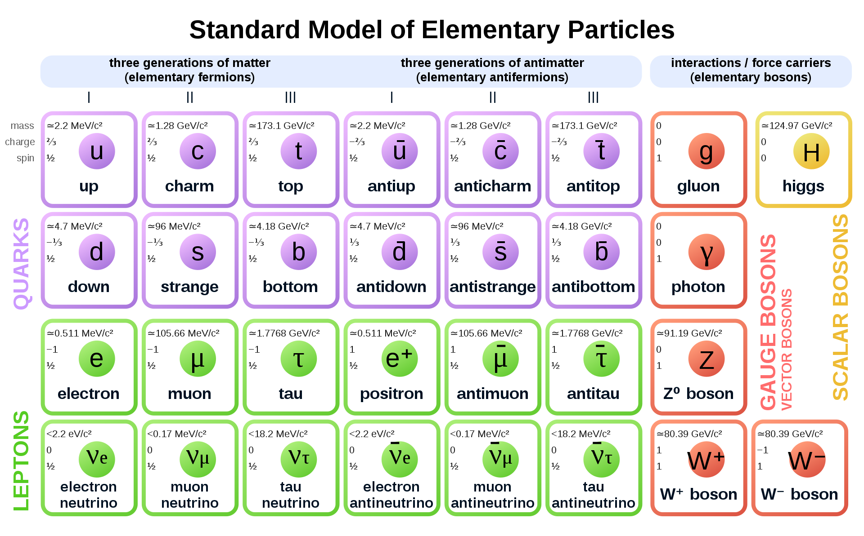

The Standard Model of particle physics
Successful theory predicting the behavior of matter constituents (fermions)
Interactions mediated by gauge bosons, gravity not included
Relevant symmetries:
  Gauge: SU(3)_{C} ⊗ SU(2)_{L} ⊗ U(1)_{Y}
  Parity (P)
  Charge conjugation (C)
  Time reversal (T)
  Chirality: χ_{L} , χ_{R}
The decoupling of the weak and electromagnetic forces is a key moment
in the history of the Universe
CP
C
Inversion of additive quantum numbers

Slide 7
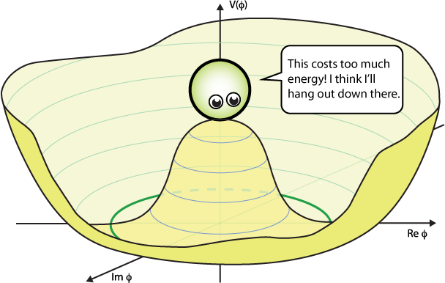
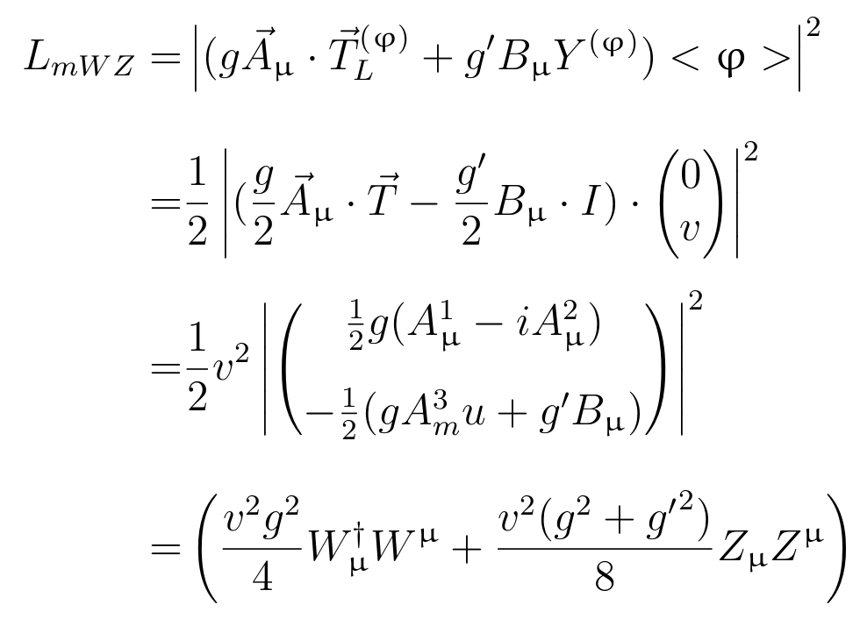
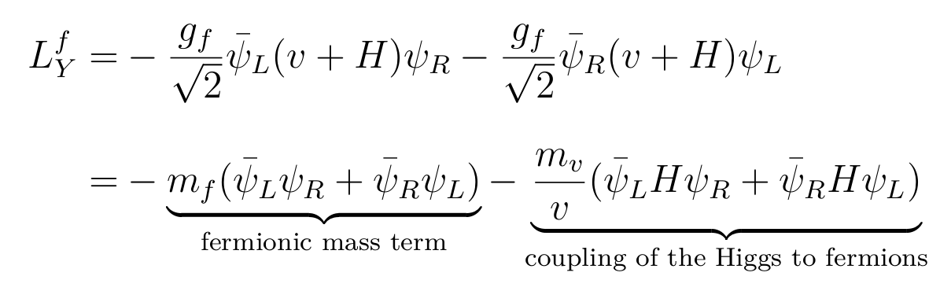
Electroweak Symmetry Breaking
The gauge invariance of the SM would prevent mass terms for the vector bosons and the fermions
The Higgs boson was introduced to softly break the electroweak symmetry and give mass to the particles
EWSB: SU(2)_{L} ⊗ U(1)_{Y} → U(1)_{em}
  Gauge bosons gain mass directly through Higgs kinetic term
  Fermions gain mass via Yukawa coupling
Fermions form the matter our Universe is made of → Look for CP violation in the Higgs sector
Η

Slide 8
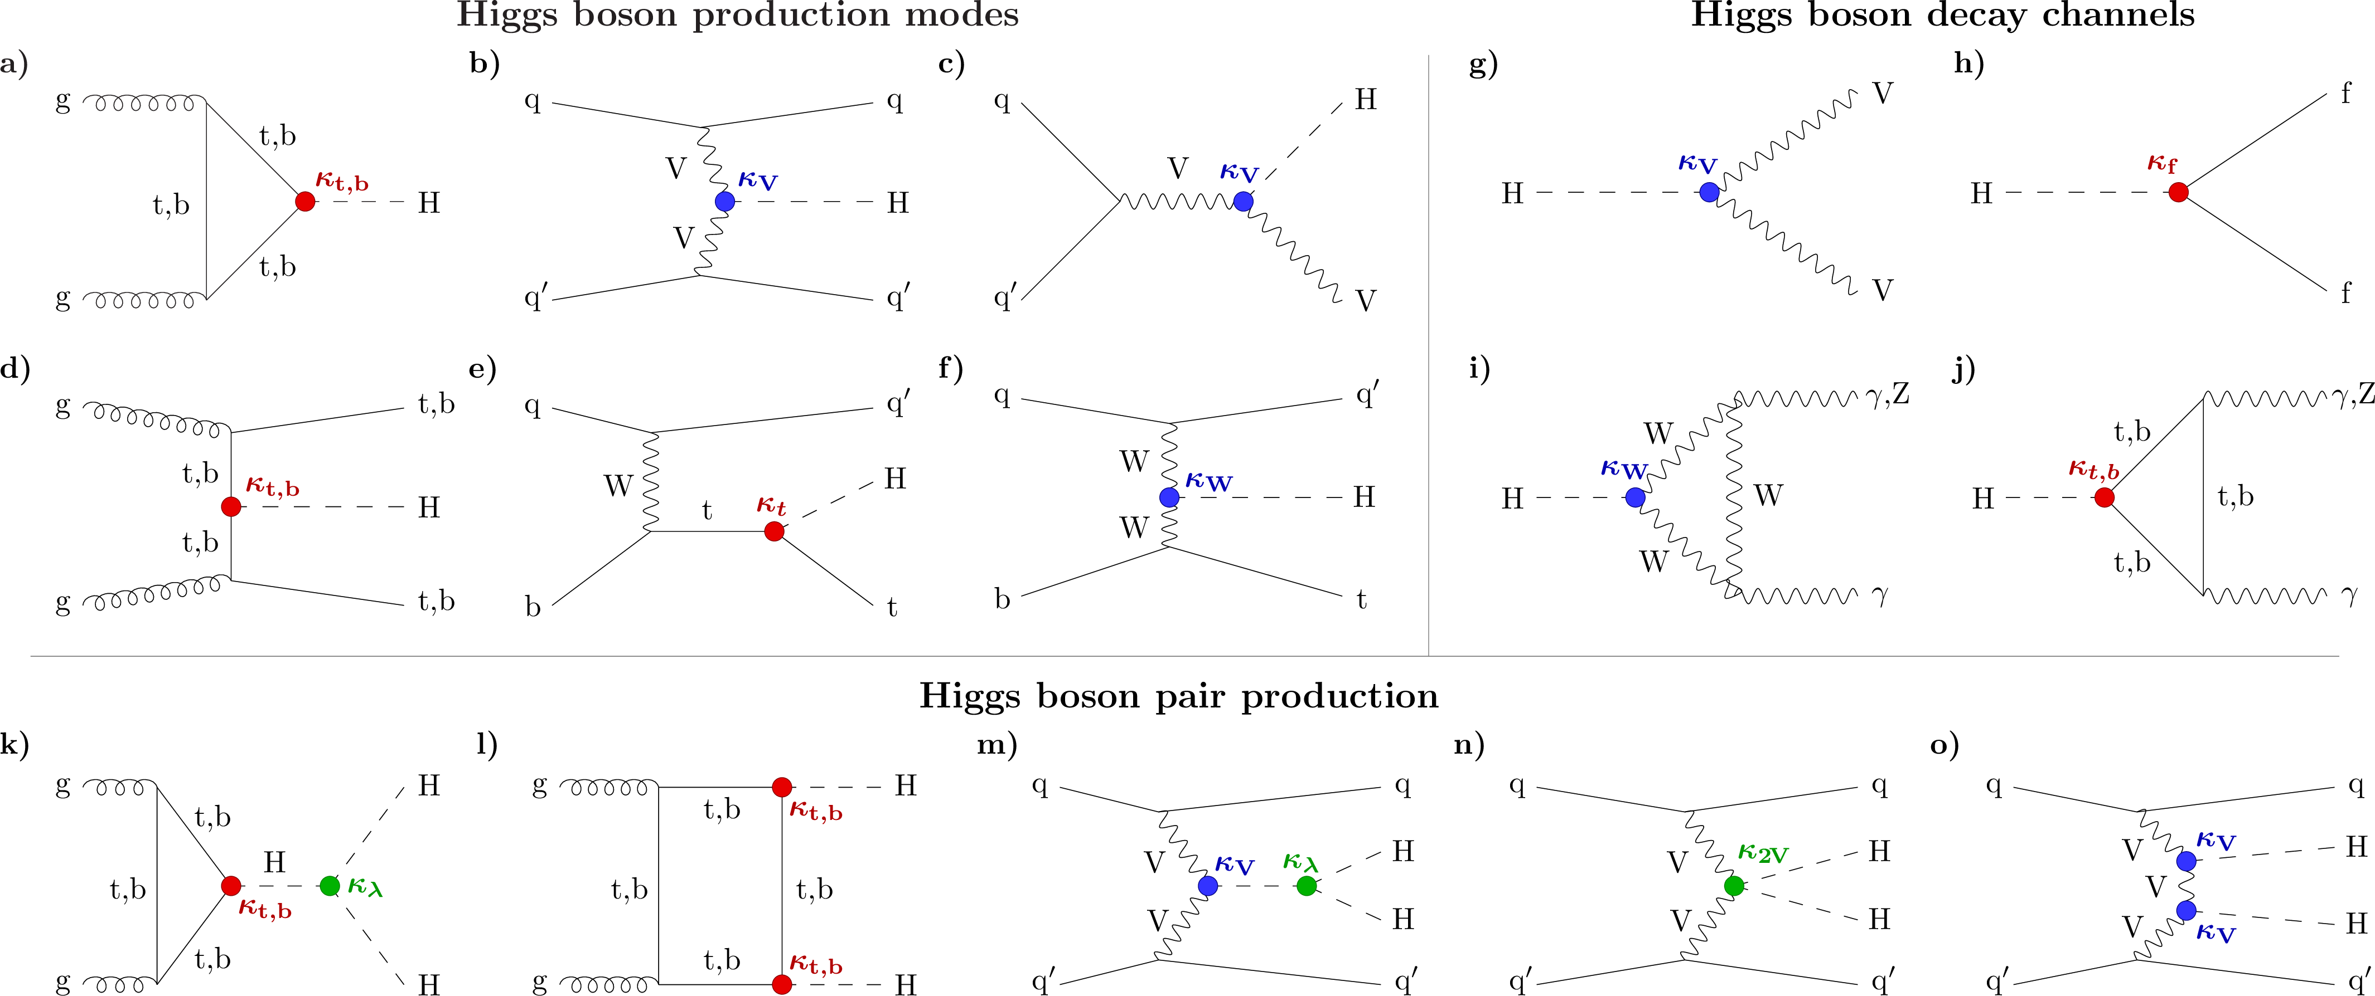
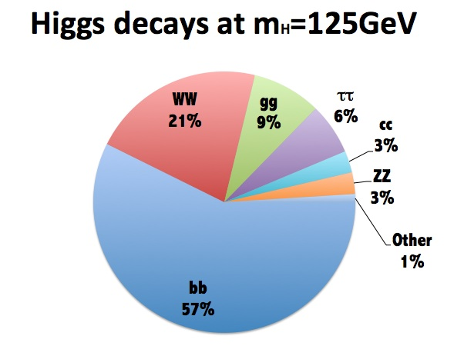
The Higgs boson – short recap
At the LHC the main way to produce the
Higgs boson is via gluon-gluon fusion
Production via vector boson fusion,
Higgs-strahlung and in association with
top or bottom quarks are rarer
The Higgs boson is not stable and decays immediately
It can decay directly to W and Z bosons, and to all fermions via Yukawa coupling
Via intermediate fermion or boson loop it can also decay to photons and gluons

Slide 9
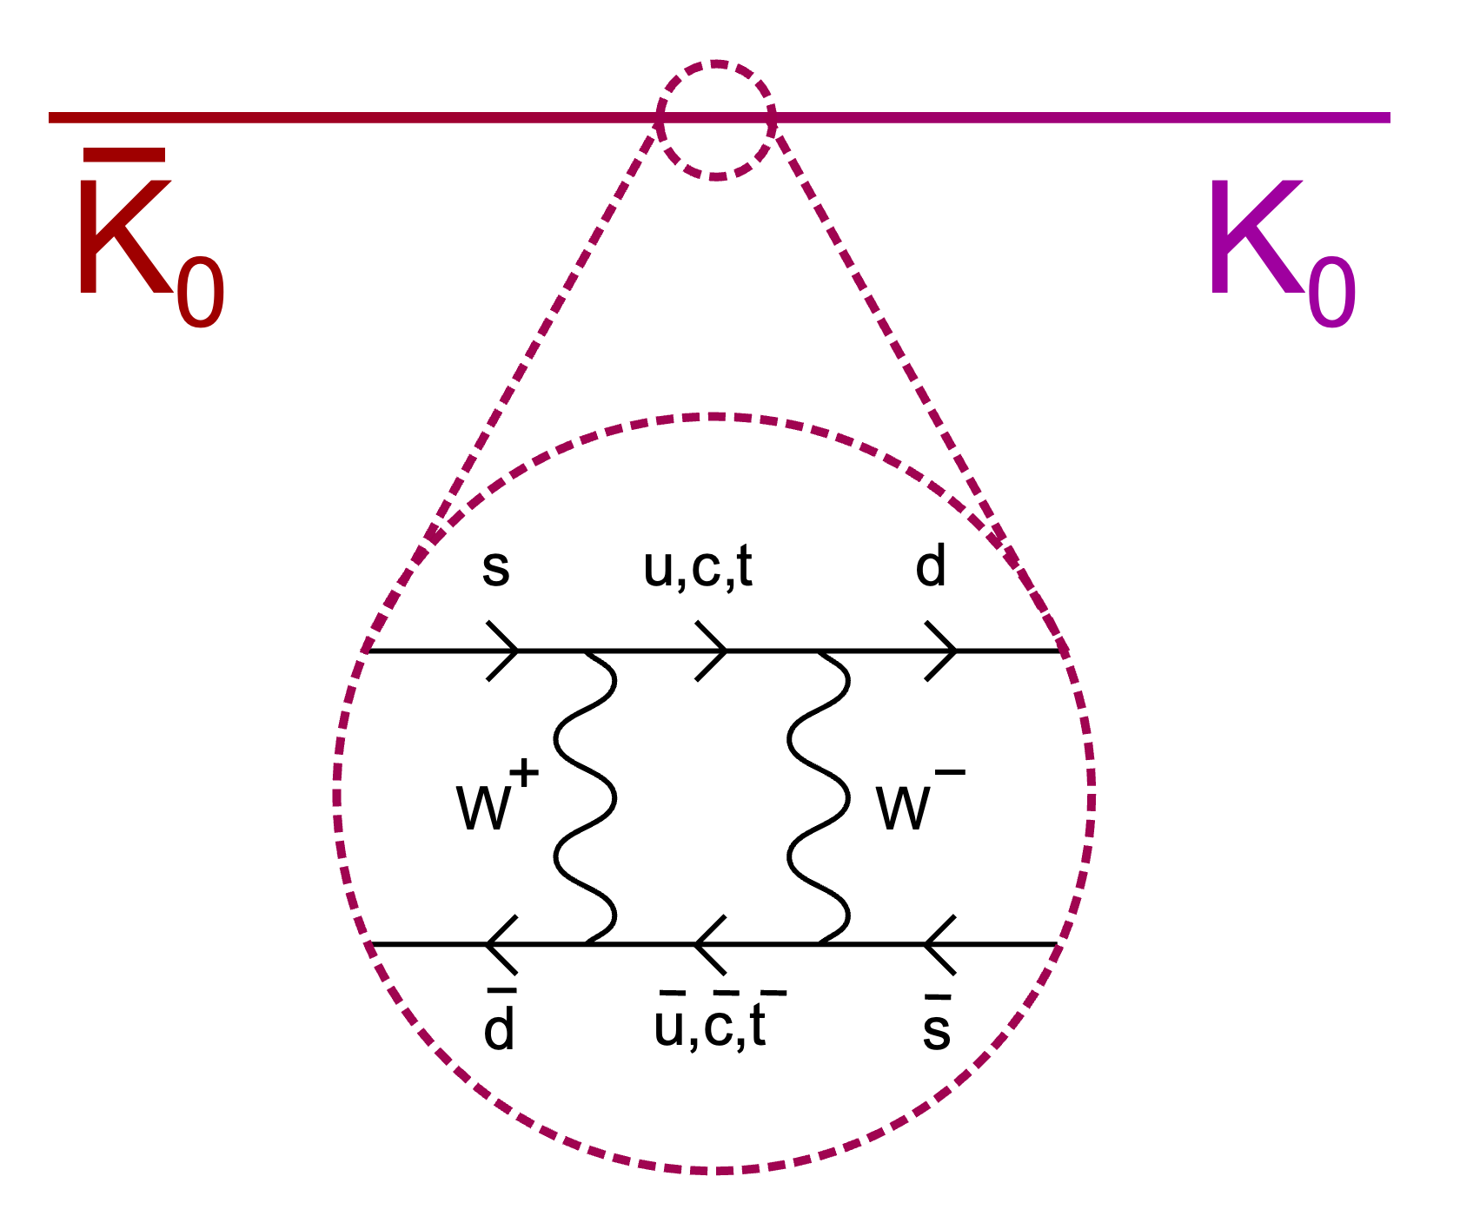
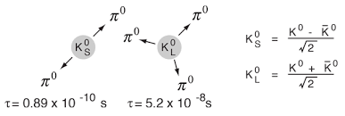
CP violation
Weak interactions massively violates C and P symmetries, it also violates CP:
K₀ oscillation → K_{S} and K_{L} decays – Cronin and Fitch in the 60s
The most notable violation of C, P and CP in the SM comes from flavor changing currents in the weak interaction
CP violation located in the complex phase in the Cabibbo-Kobayashi-Maskawa matrix
The matrix was introduced to describe the quark mixing in the weak interaction

Slide 10
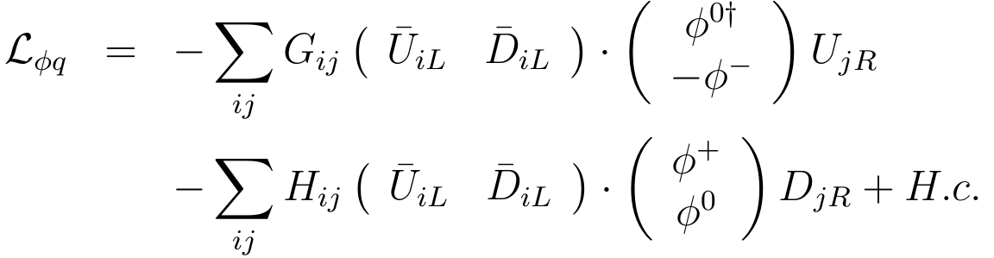
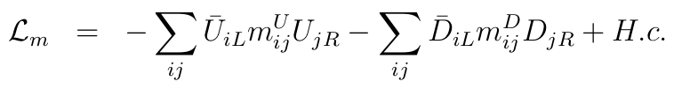
The CKM matrix and Yukawa interaction
The quark mixing and the quark masses have a common origin: the Yukawa interaction
The Higgs boson gives mass to the particles and defines the fermion generations
with the indices i,j running over the quark generations
After EWSB the quarks acquire mass via the Higgs vacuum expectation value
No theoretical requirement for the m_{ij} matrices to be diagonal but the SM Lagrangian is invariant under unitarity transformations
Yukawa for up-type quarks
C
Yukawa for down-type quarks

Slide 11
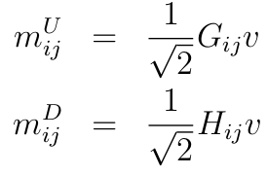
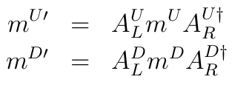

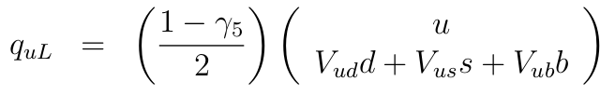
The CKM matrix
We can multiply all fields by unitary matrices and redefine the quark fields to diagonalize the mass matrices
Cannot diagonalize both mass matrices at once → diagonalize one mass matrix and redefines the fields for either up or down type quarks
The lightest quarks are u, d and s → the quark mixing was observed for kaon decays between the d and s quarks → the mass term diagonalized is the one for up-type quarks

Slide 12
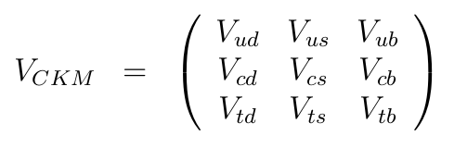
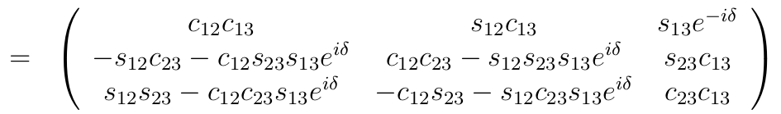
CP violation in the SM
The CKM matrix is unitary but is not required to be Real → it can have a complex phase leading to direct CP violation in the electroweak sector
The complex phase δ = 1.196 ± 0.045 [rad] is the main source of CP violation allowed in the SM
The strong interaction does not seem to violate CP experimentally… however in QCD CP-violating terms can arise leading to the question of why no signs of CP violation have been observed
Another source of CP violation could* be found in the neutrino oscillation if the PMNS matrix presents a complex phase
*there is no experimental consensus on a CP-violating phase in the PMNS matrix

Slide 13
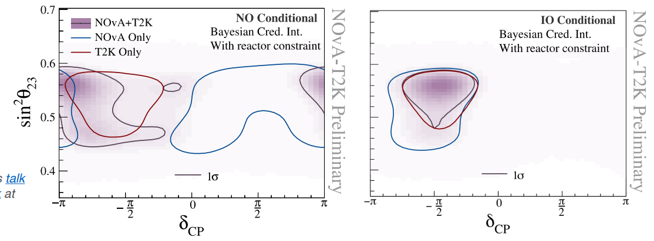
NovA and T2K results on the PMNS CP-phase
The CP-phase in the PMNS matrix is investigated studying the neutrino oscillation process
Most precise results at hand from the NOvA and the T2K experiments
The measurement constrains the CP-phase together with the mass differences between the neutrino mass states
At present the two experiments prefer different CP-phases in the normal mass ordering (NO), and maximum CP violation
in the inverted mass
ordering (IO)
Plots from
J.P. Ochoa Ricoux's talk at ICHEP2024

Slide 14
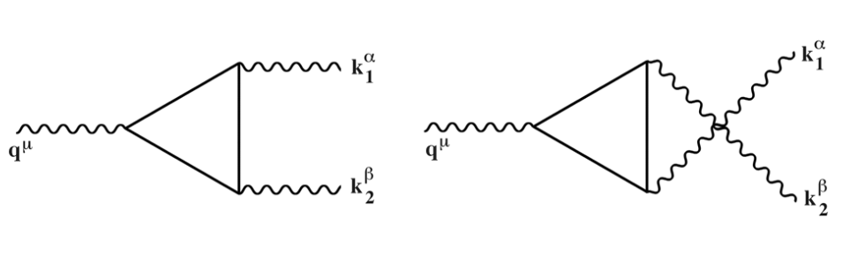
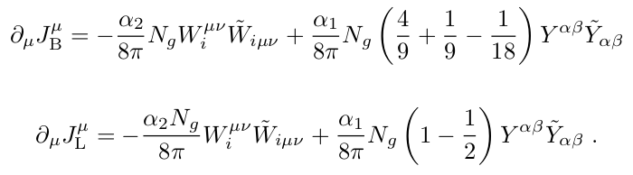
EW baryogenesis – B violation
The main source of CP violation in the SM comes from the EW sector and is linked to the Higgs boson
What about the other 2 Sakharov’s conditions?
  Baryon number violation → is there baryon number violation in the SM?
    In the SM the baryon (B) and lepton (L) number are conserved only via accidental symmetries – there are no gauge invariant operators of dim 4 that violate them
    Anomalies appear at triangular loop level due to the chiral structure of the SM – Adler, Bell and Jackiw
    (ABJ) anomalies
Violation of baryon and lepton number violation at loop level

Slide 15
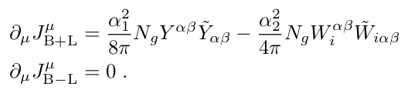
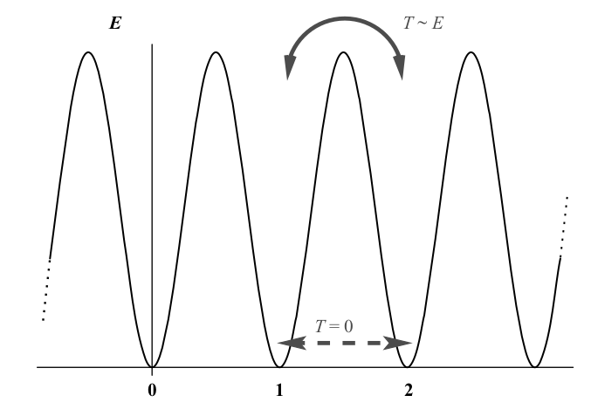
Sphalerons
U(1)_{B} and U(1)_{L} are broken at quantum level, as is B+L, however B-L is preserved
At low temperatures the B violation is low, but at high temperature it can proceed via sphaleron production
  A Sphaleron – from Greek Σφαλερός ready to fall –
  is a static, but unstable, solution for the electroweak theory
  It allows the transition between distinct EW vacuum states
  (different baryon or lepton number)
  E_{sph} ~ 8π v(T)/g_{W} – the energy is proportional to the
  vacuum expectation value of the Higgs field
F. R. Klinkhamer and N. S. Manton Phys. Rev. D 30, 2212
EW vacua
M. Dine (2016). Supersymmetry and String Theory

Slide 16
Electroweak phase transition
The last condition necessary for matter-antimatter asymmetry to occur is that the CP violating interactions take place out of thermal equilibrium
We need a phase transition: an interaction outside of thermal equilibrium
The electroweak symmetry breaking provides
the appropriate conditions
The Higgs potential in the present has the
usual sombrero shape you are familiar with
The electroweak phase transition started at
T<T_{C} – when the the absolute minima of the
system became |Φ|² > 0
  1st order PT: the system goes to the absolute
  minima via tunnelling
V(Φ)
T>>T_{C}
T=T_{C}
T>T_{C}
T<T_{C}
Η
T=0
|Φ|²
<Φ> = v_{EW}

Slide 17
Electroweak phase transition
1st order PT: the system goes to the absolute
minima via tunnelling
2nd order PT: there is no energy barrier and
the system goes to the minimum smoothly
V(Φ)
T>>T_{C}
V(Φ)
T>>T_{C}
T=T_{C}
T=T_{C}
T>T_{C}
T>T_{C}
T<T_{C}
T<T_{C}
T=0
T=0
|Φ|²
|Φ|²
<Φ> = v_{EW}
<Φ> = v_{EW}

Slide 18

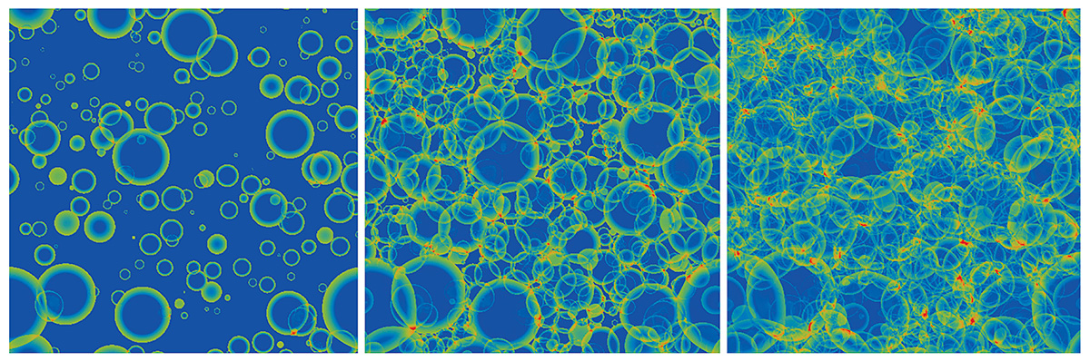
Higgs bubbles
Like when boiling water, the entire Universe did not reach EWPT instantaneously everywhere
The transition happened along expanding bubbles where the EW symmetry breaks
Along the bubble walls – transition from the symmetric state to the broken EW one
Fields on the bubble walls are highly out of equilibrium → satisfy the 3rd Sakharov’s condition
EW symmetry
EWSB
time
time
EWSB
giphy.com
JCAP 04(2021)014
EW symmetry

Slide 19
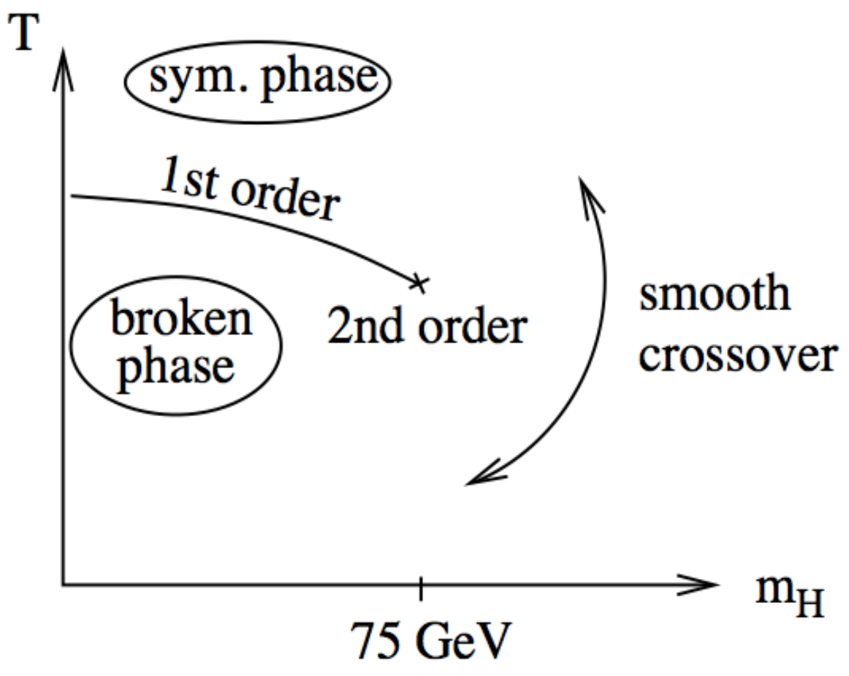
The SM Higgs and the EWPT
B violating processes have different rates in the EW symmetric or broken phases
  In the unbroken phase T is high enough to have a continuous sphaleron production → B-L is preserved but the rate of B violating processes is high
  At the wall they are Boltzmann suppressed
  In the broken phase they are exponentially suppressed
To have baryon asymmetry inside the bubble
and freeze it, the sphaleron processes need to shut
down quickly
→ require a strong 1st order phase transition
Problem: this would require a Higgs of mass < 80 GeV
  The SM provides the conditions for generating some
  baryon asymmetry but not enough for the observed BAU
Nucl.Phys. B443 (1995) 47
Phys. Rev. Lett. 77, 2887

Slide 20
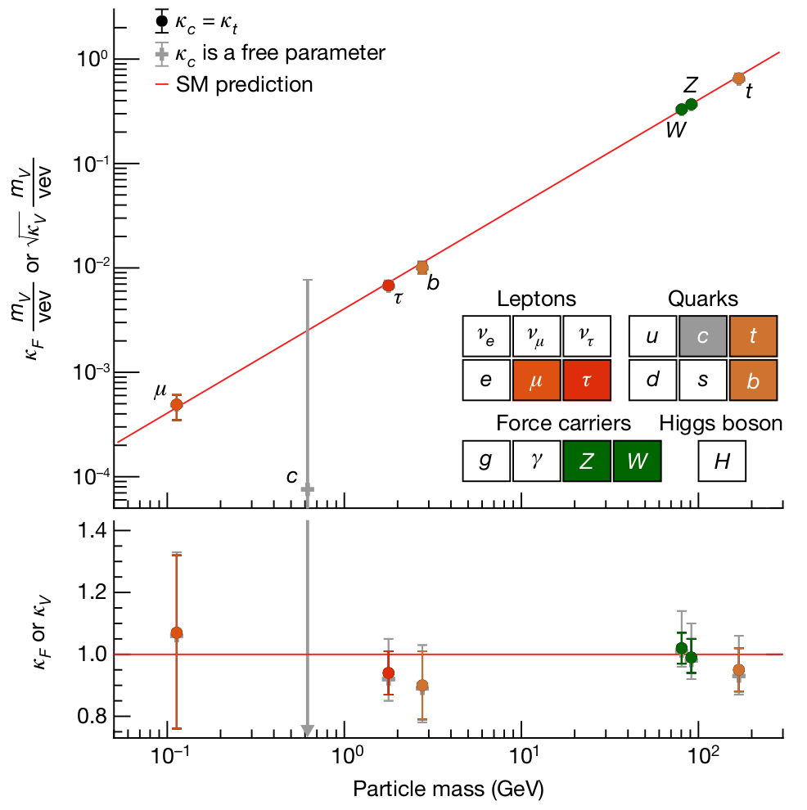
Explaining the BAU with CPV in the Higgs sector
To explain the BAU we need either
  More Higgs bosons extra Higgs doublets/singlets, SUSY, etc.
  More sources of CP violation today’s topic
    As the Higgs boson is intrinsically linked to the SM contributions to the baryogenesis it is a good candidate to look for additional CPV
What do we know about the Higgs boson now?
  Discovery announced in 2012 by the ATLAS and CMS
  experiments – over 10 years ago
  Established couplings to 3rd generation fermions
  Coupling to W and Z well studied since Run 1
  More recently studied are decays to muons and charm quarks,
  and evidence for Zγ has been established
Not mutually exclusive
10
Nature 607, 52–59 (2022)

Slide 21
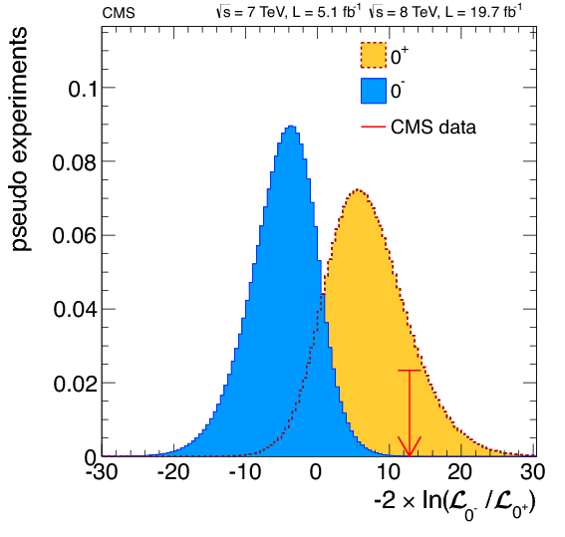
CP violation in the Higgs sector
Higgs boson predicted to have spin-parity 0⁺ → direct coupling to Z and W bosons
CP violation in the Higgs sector:
  HVV couplings (V= Z,W bosons)
      studied in 4 lepton final state / VBF production
Run 1
Phys. Rev. D 104 (2021) 052004
Phys. Rev. D 108 (2023) 032013
Pure CP odd excluded
already with Run 1 data →
search for anomalous couplings
  Yukawa coupling of Higgs to fermions
    gg→H +jets: effective Higgs-gluon coupling via top quark loop
      Phys. Rev. D 104 (2021) 052004
    gg→ttH: direct Yukawa coupling of Higgs to top quarks
      JHEP 07 (2023) 092
    H→ττ decays: exploit spin correlation between tau leptons and their
    decay products
      JHEP 06 (2022) 012
Phys. Rev. D 89 (2014), 092007

Slide 22
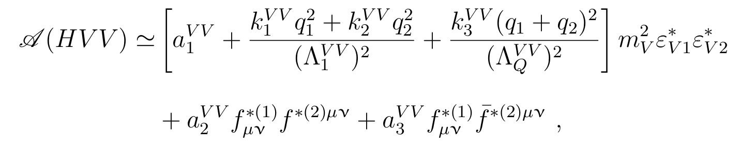
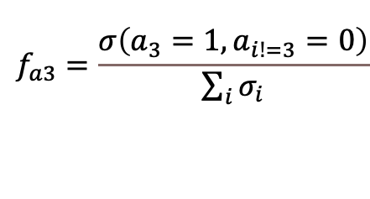
CP violation in HVV (and ggH)
Investigating CP violation in HVV couplings with an EFT approach
  Amplitude for Higgs coupling to two spin 1 particles (VV= WW, ZZ, Zγ, γγ, gg etc.) with operators up to dimension 6
  Effect on cross-section parametrized as the fractional contribution
  of the anomalous coupling to the total cross-section
Theoretical approach includes also Hγγ and Hgg with tree level coupling being set to 0
Tree level CP-even coupling (=0 if absent in SM)
CP-even anomalous higher order couplings
CP-even anomalous coupling
CP-odd anomalous coupling
$$f_{a3}=\frac{σ\left(a_{3}=1,a_{i!=3}=0\right)}{\sum_{i}{σ_{i}}}$$

Slide 23
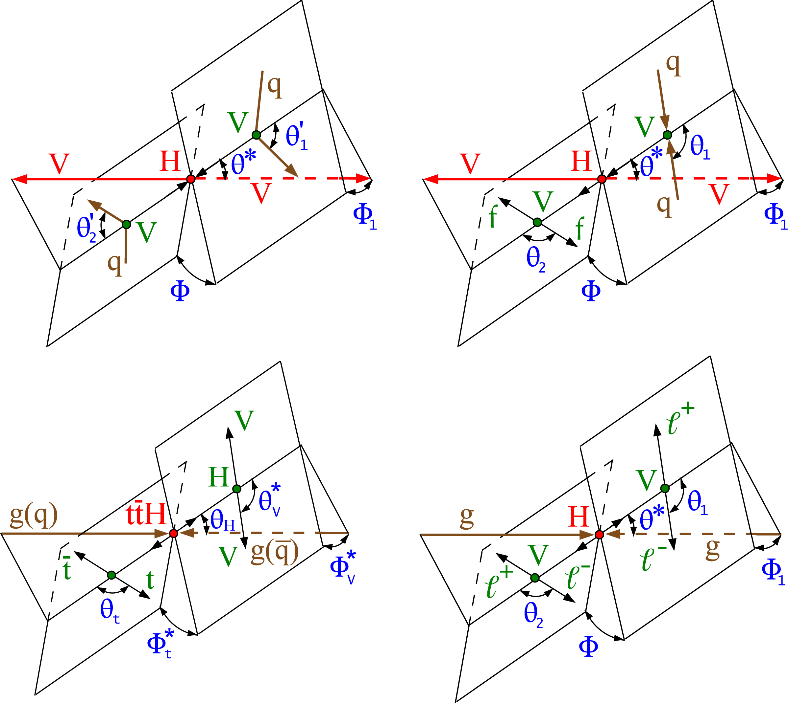
CP violation in HVV (and ggH)
Higgs direct and effective couplings to vector bosons studied both in production and decay
Decay:
  Target process: H→VV→ 4 leptons
  Uses kinematics of leptons in the final state
Production:
  Target process: Vector Boson Fusion (VBF)
  Higgs CP nature affects kinematics of jets
  from the initial state
  Studied in Higgs decays to ττ, 4 leptons and γγ
Phys. Rev. D 104 (2021) 052004

Slide 24
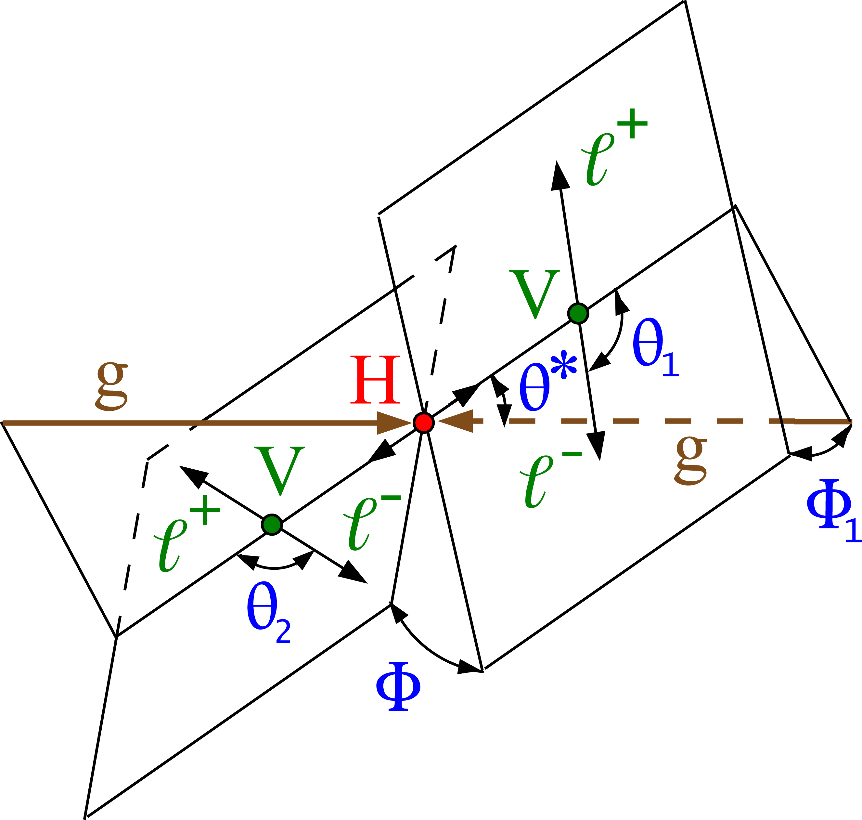
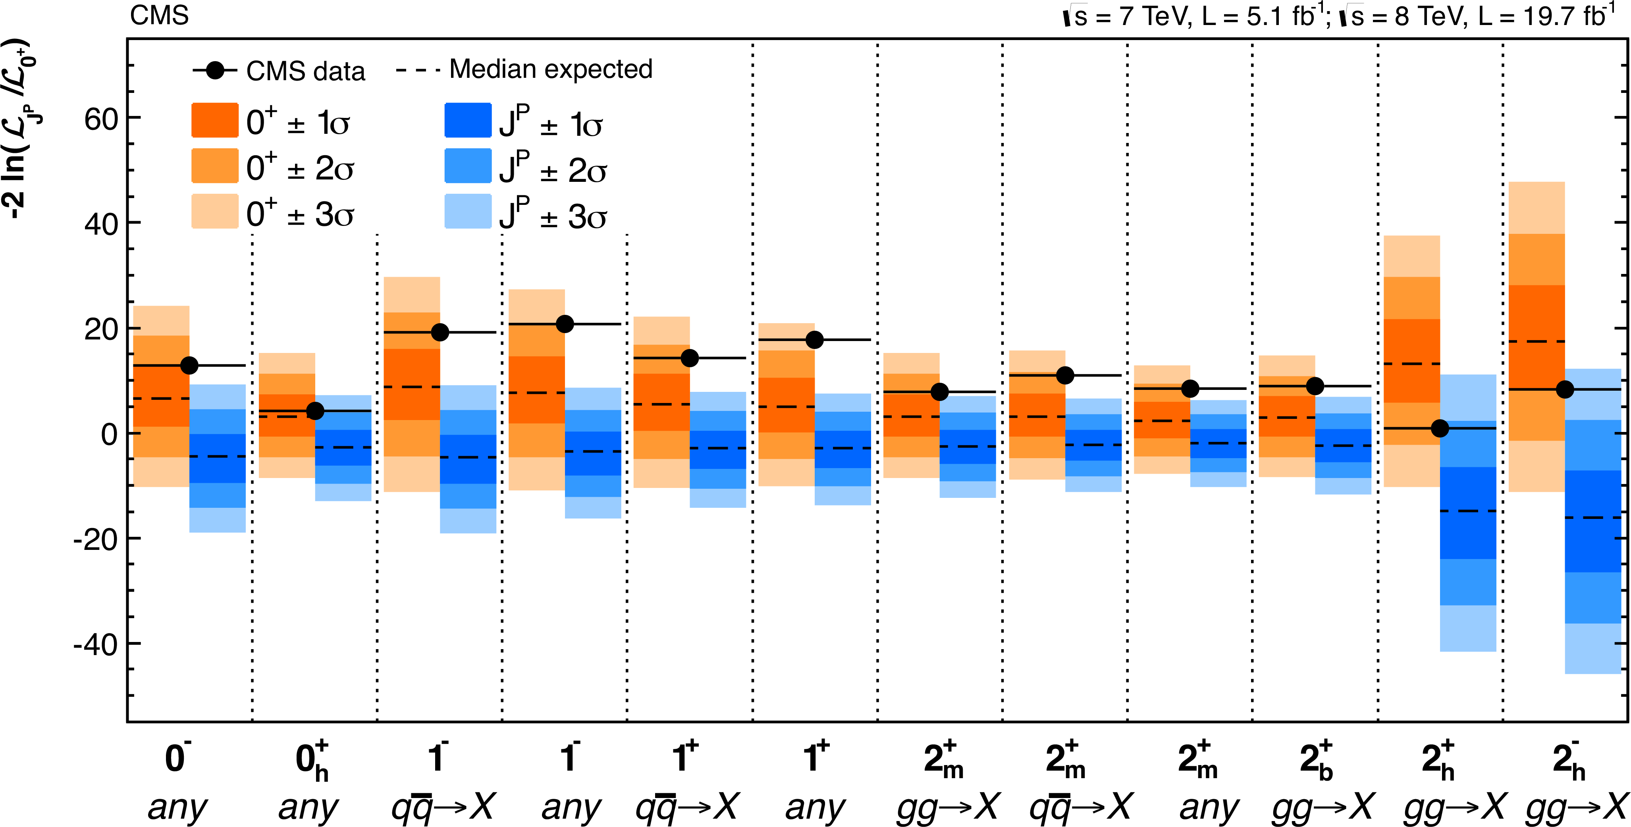
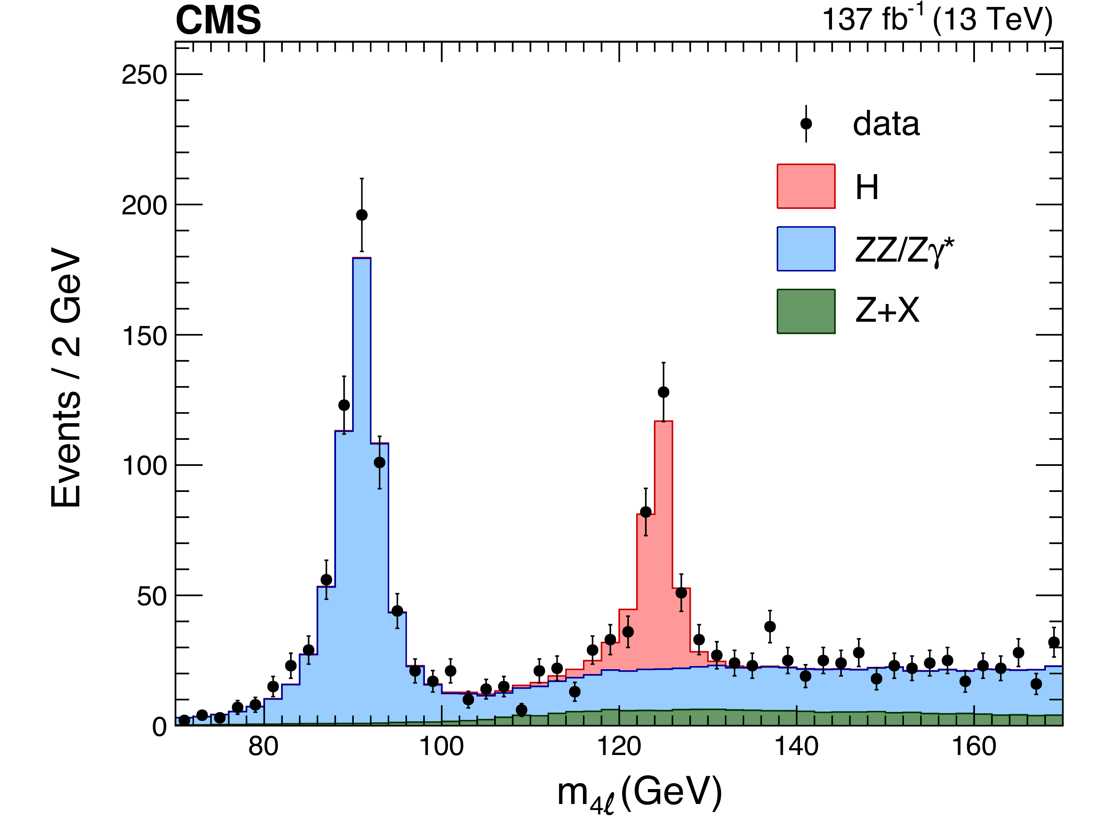
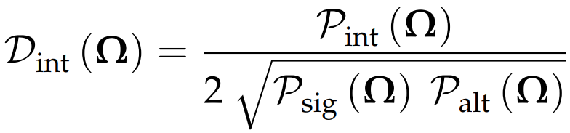
CP violation in H→4 leptons
Higgs decays to 4 leptons were used already in the Higgs discovery
Excellent handle to measure Higgs properties: mass, spin, width, and CP properties
  Used in Run 1 to exclude pure pseudoscalar HVV coupling and investigate
  other spin hypotheses
  Analysis with full Run 2 also targets interference terms of anomalous
  couplings with other hypothesis using MVA classifiers
Phys. Rev. D 104 (2021) 052004
Phys. Rev. D 89 (2014) 092007
Run 1

Slide 25

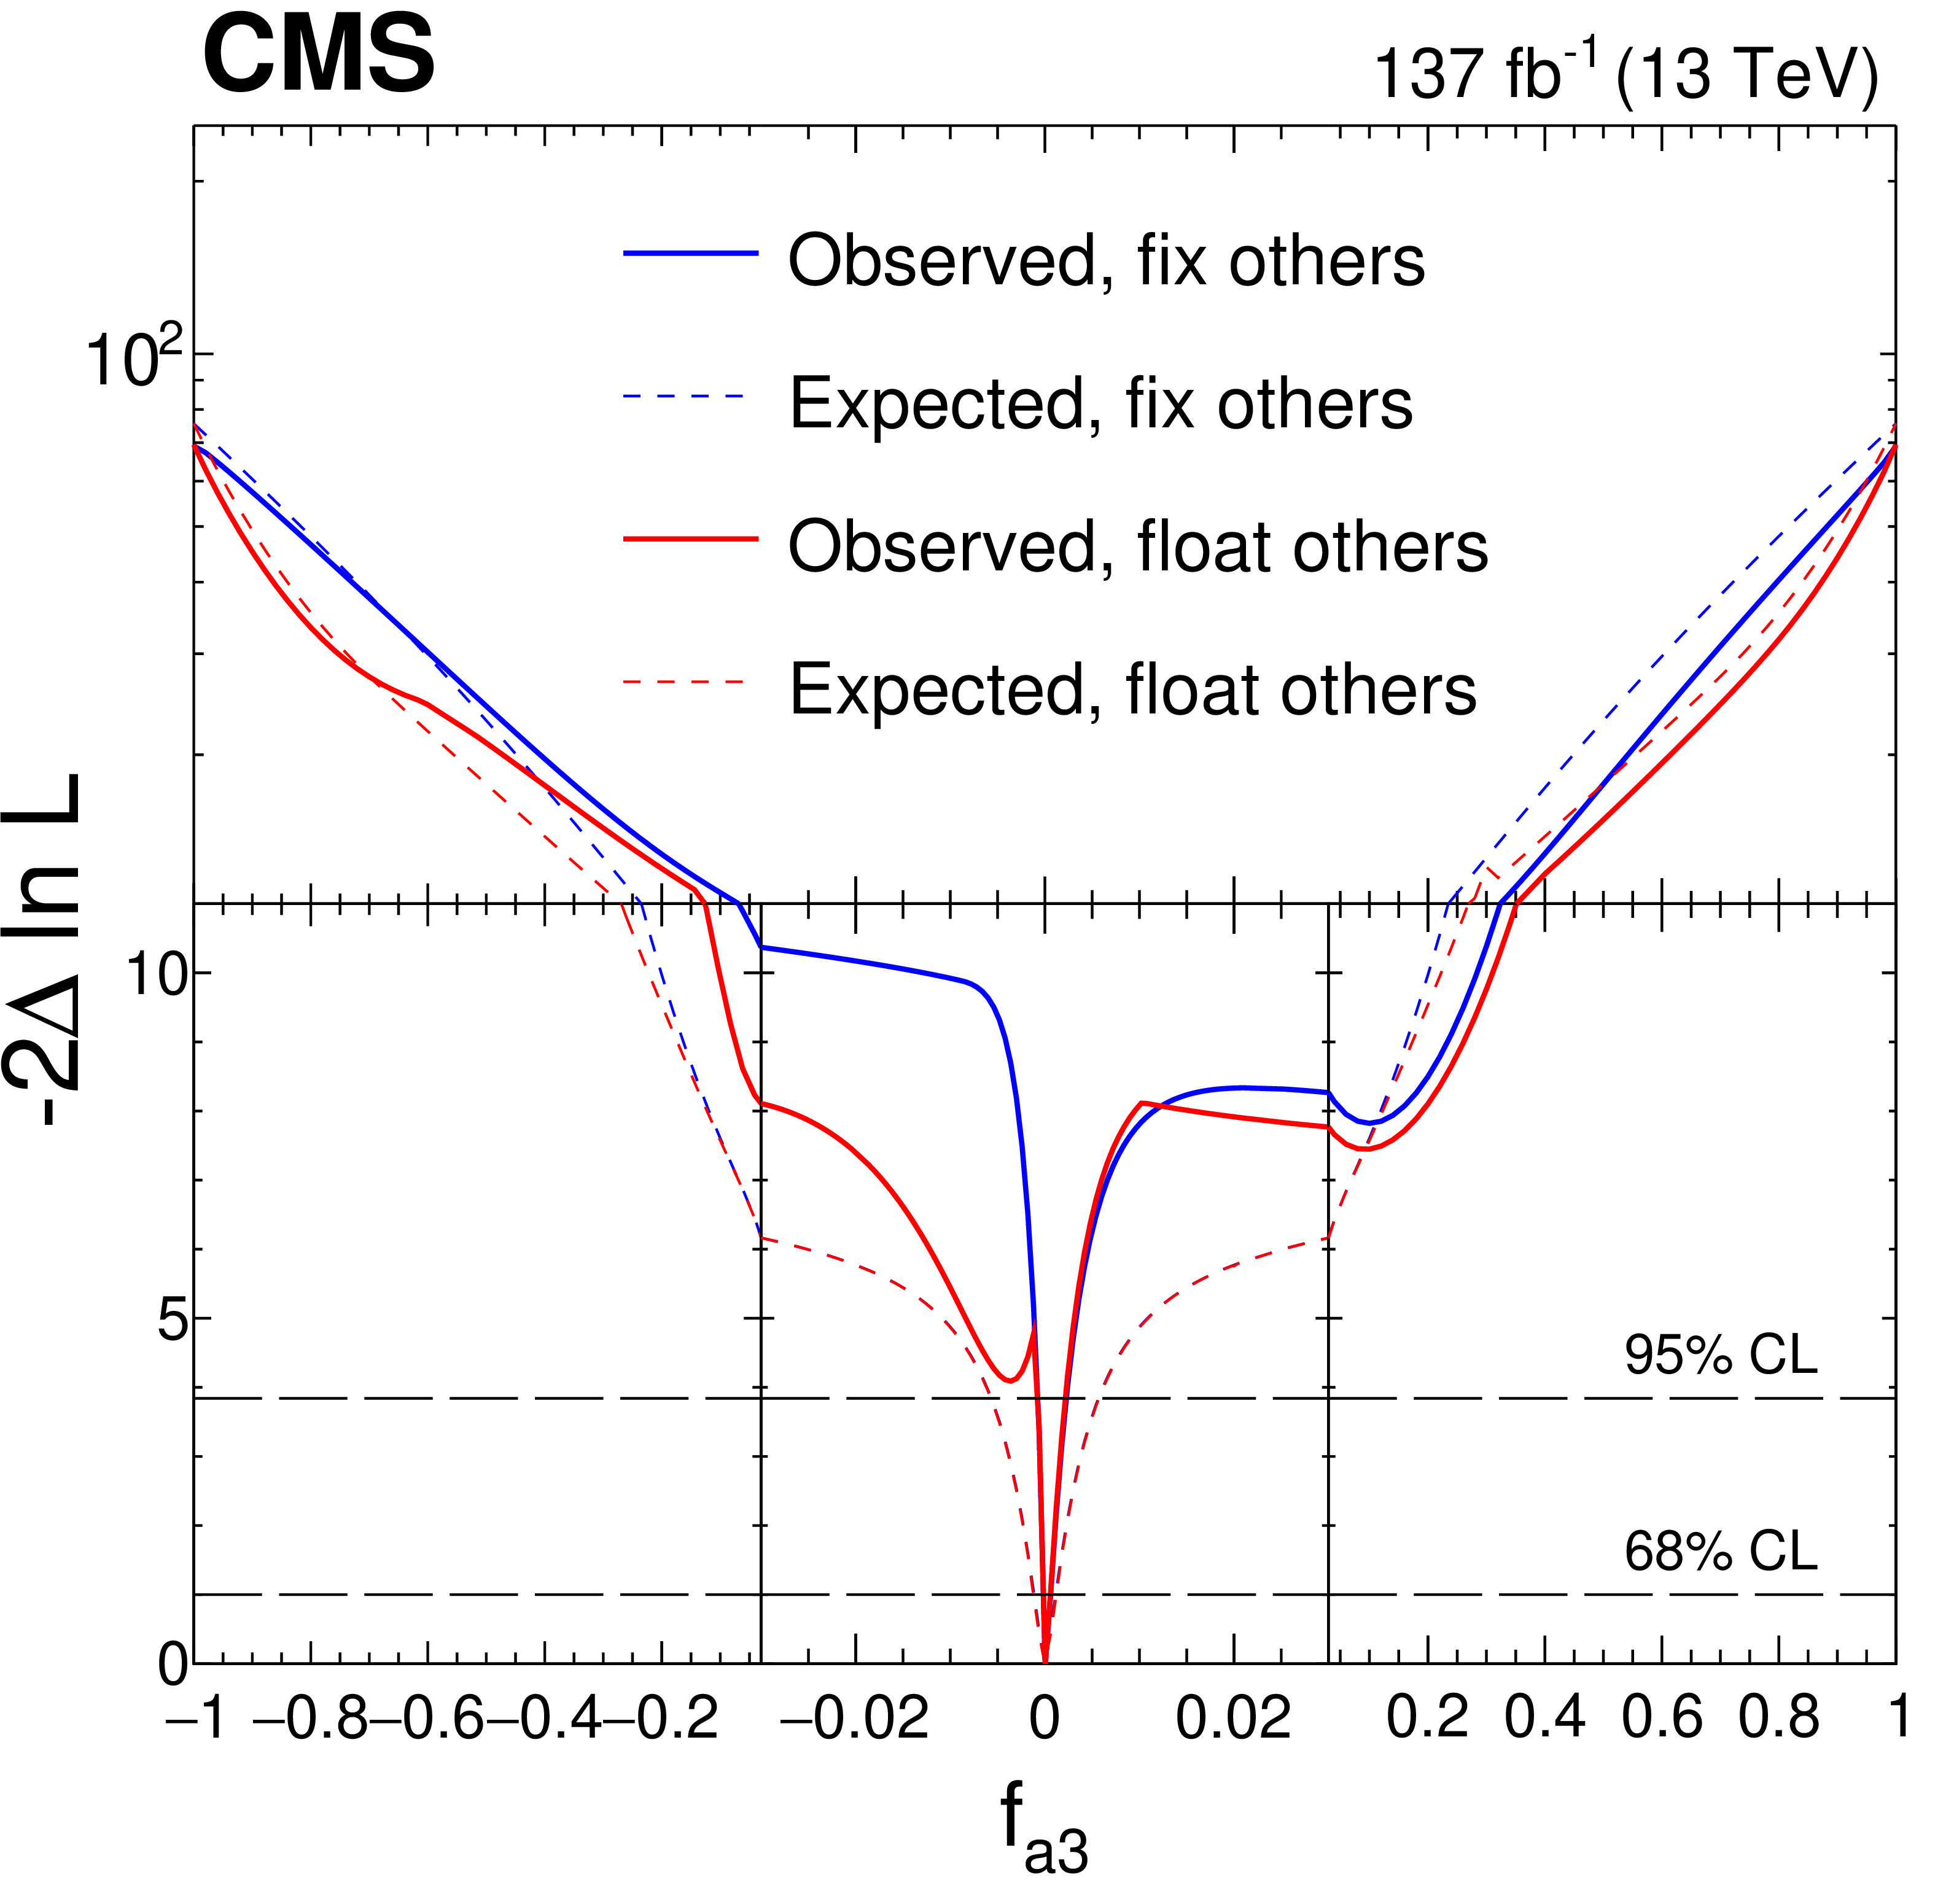
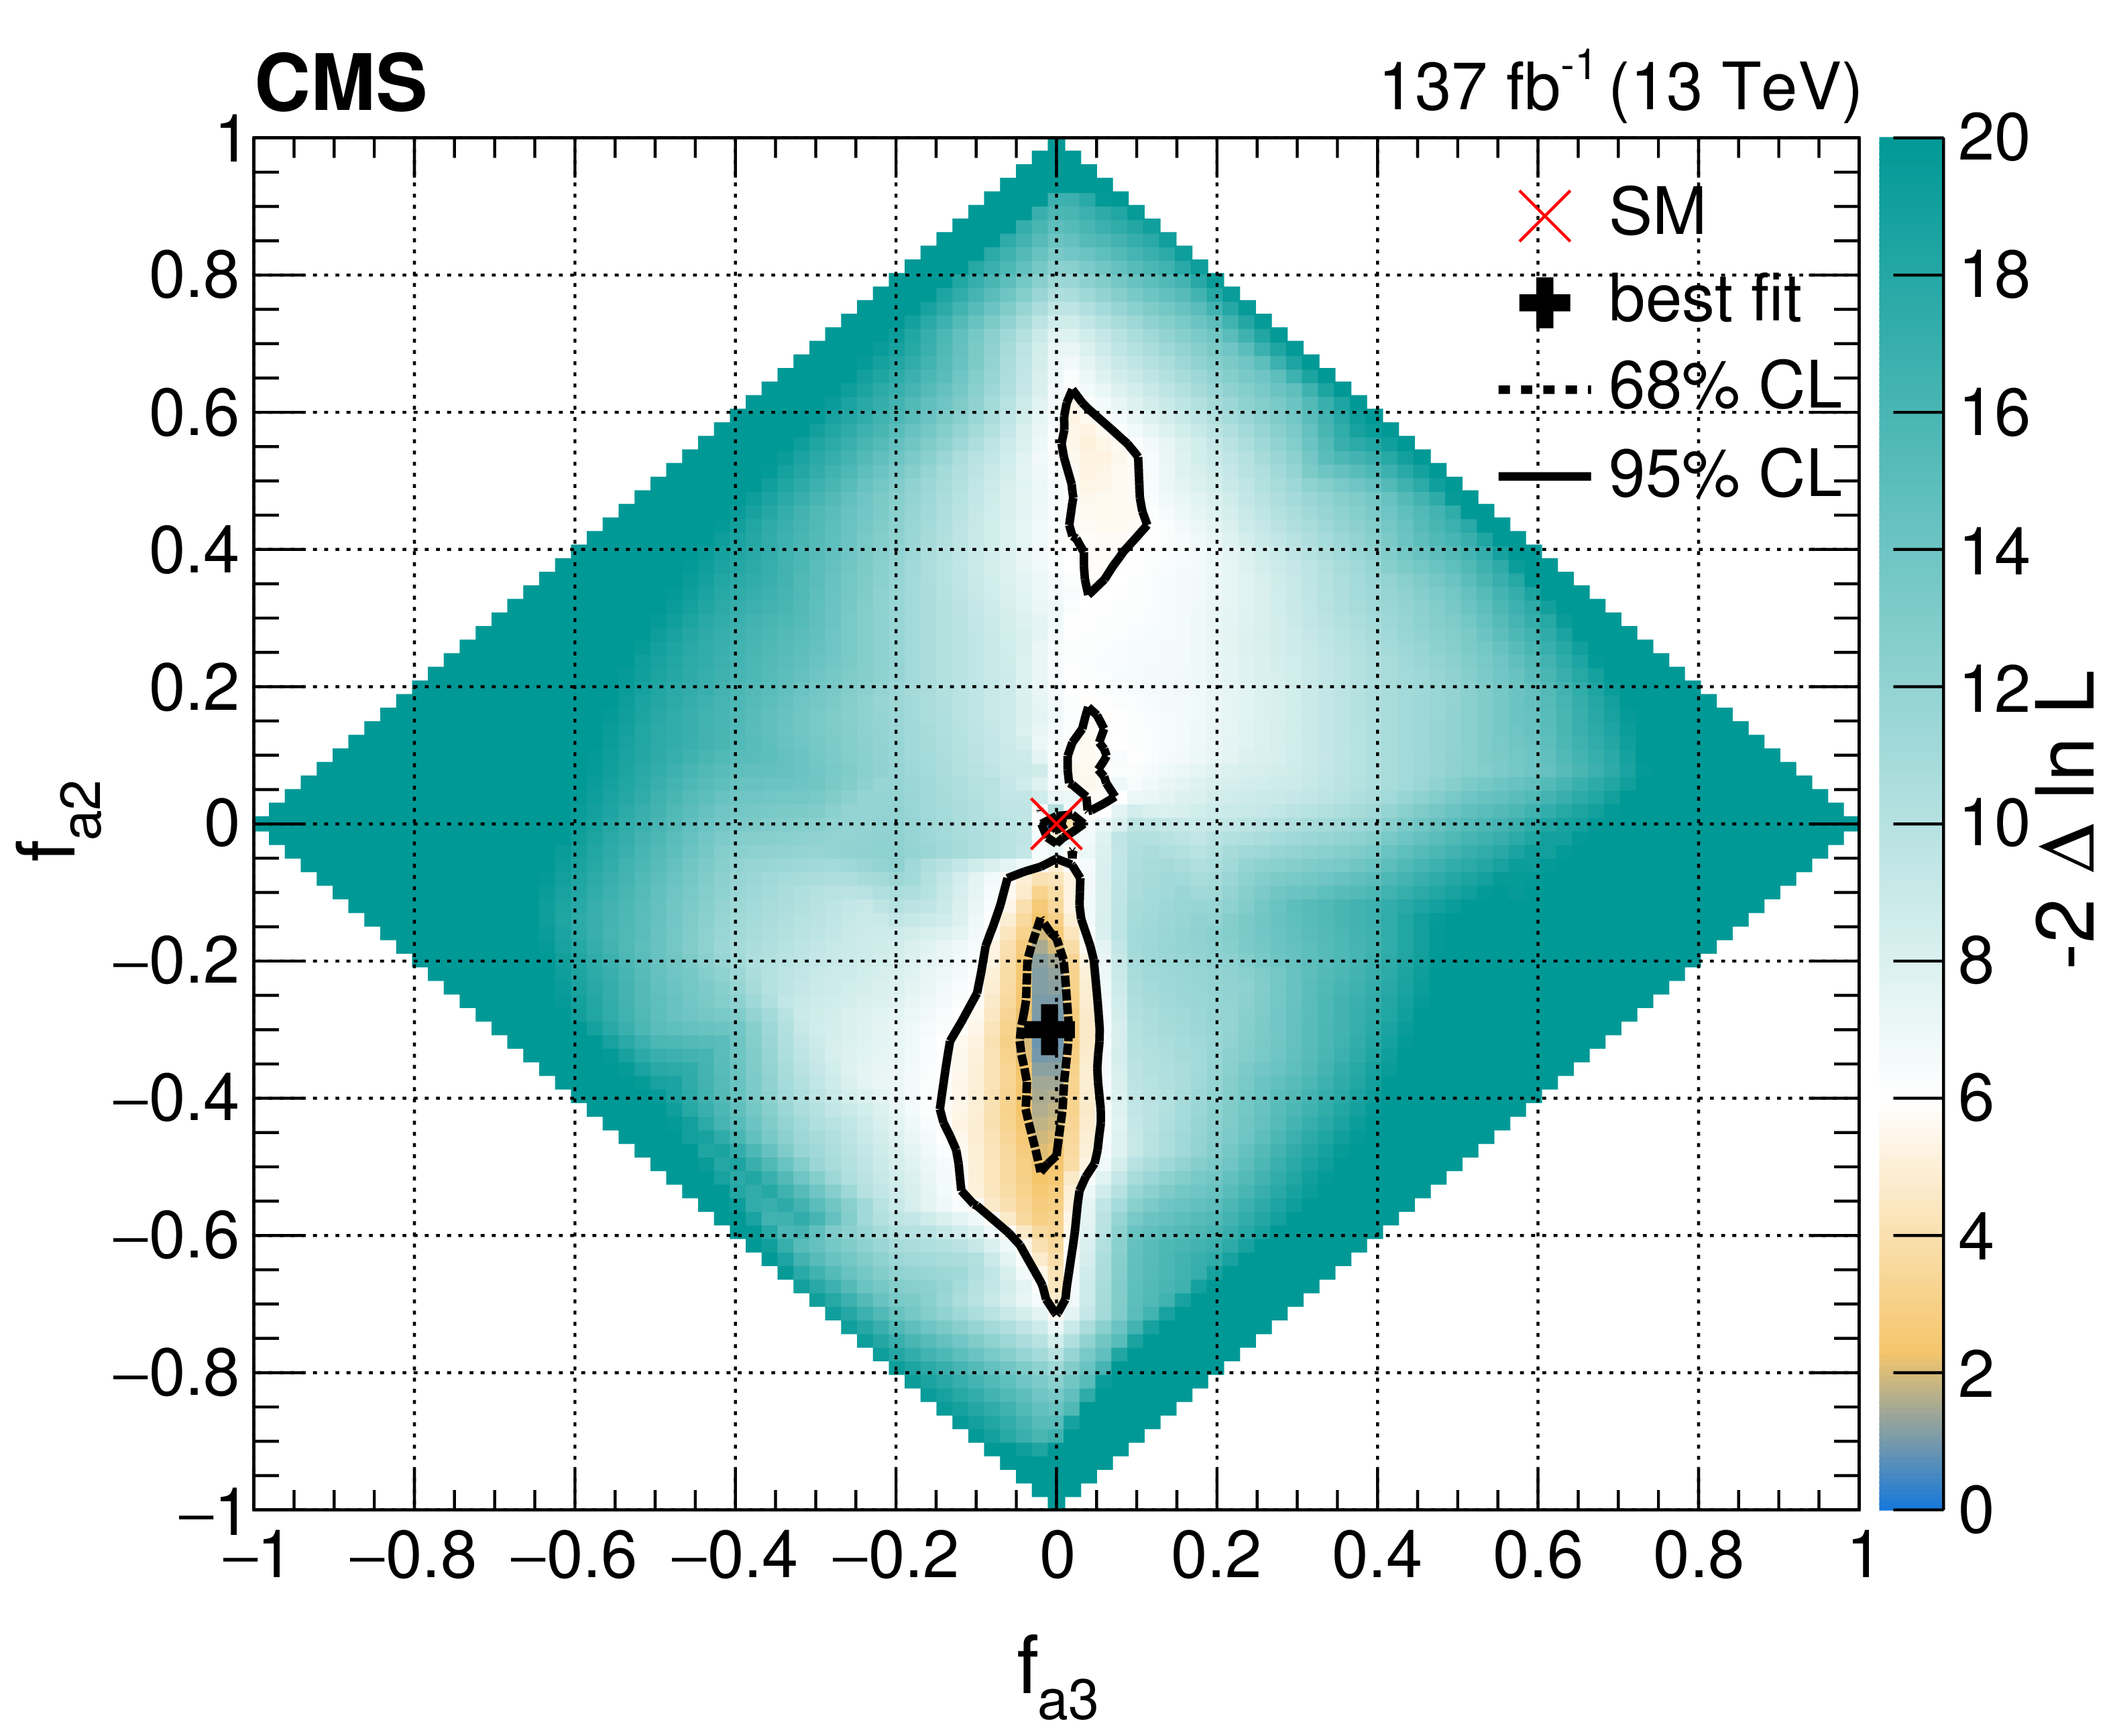
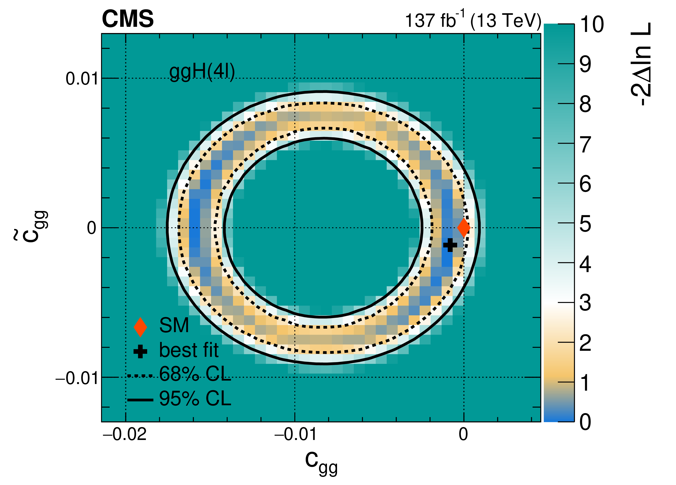
CP violation in H→4 leptons
Constraints expressed in several scenarios based on the possible symmetries imposed on the couplings:
  Approach 1:
  Approach 2: SU(2) × U(1) symmetry
The 4 lepton final state is also used
to target Hgg and Htt couplings
Phys. Rev. D 104 (2021) 052004
Approach 1
Approach 2

Slide 26
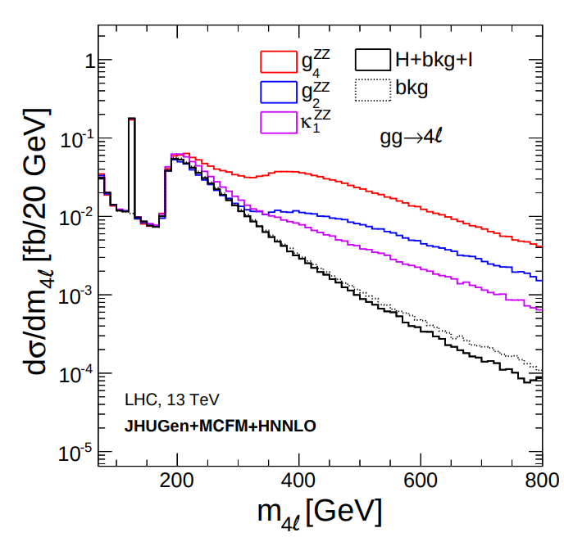
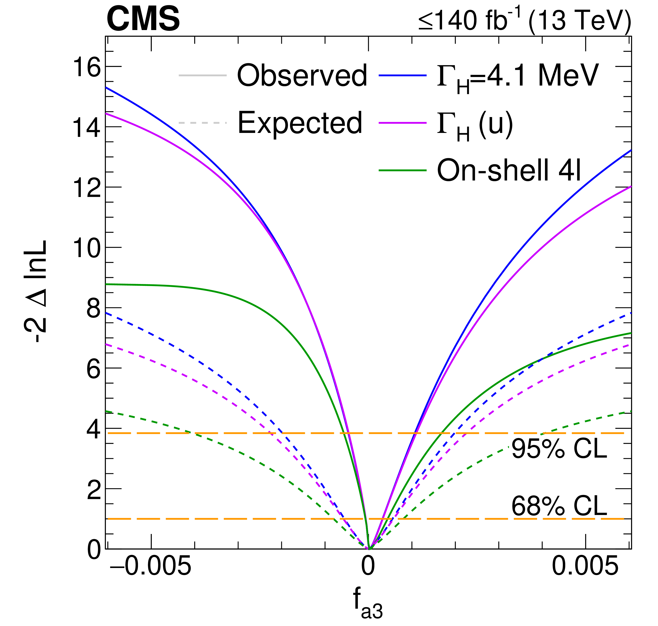
Combination with off-shell H→2l2ν/4 lepton
Off-shell Higgs production can provide additional sensitivity to anomalous couplings
  CP-odd anomalous coupling constrained between [-4.6,11] × 10⁻⁴ at 95% CL
CP-odd anomalous coupling
CP-even a.c.
CP-even higher order
SM
Nat. Phys. 18, 1329–1334 (2022)
Phys.Rev.D102(2020)056022

Slide 27
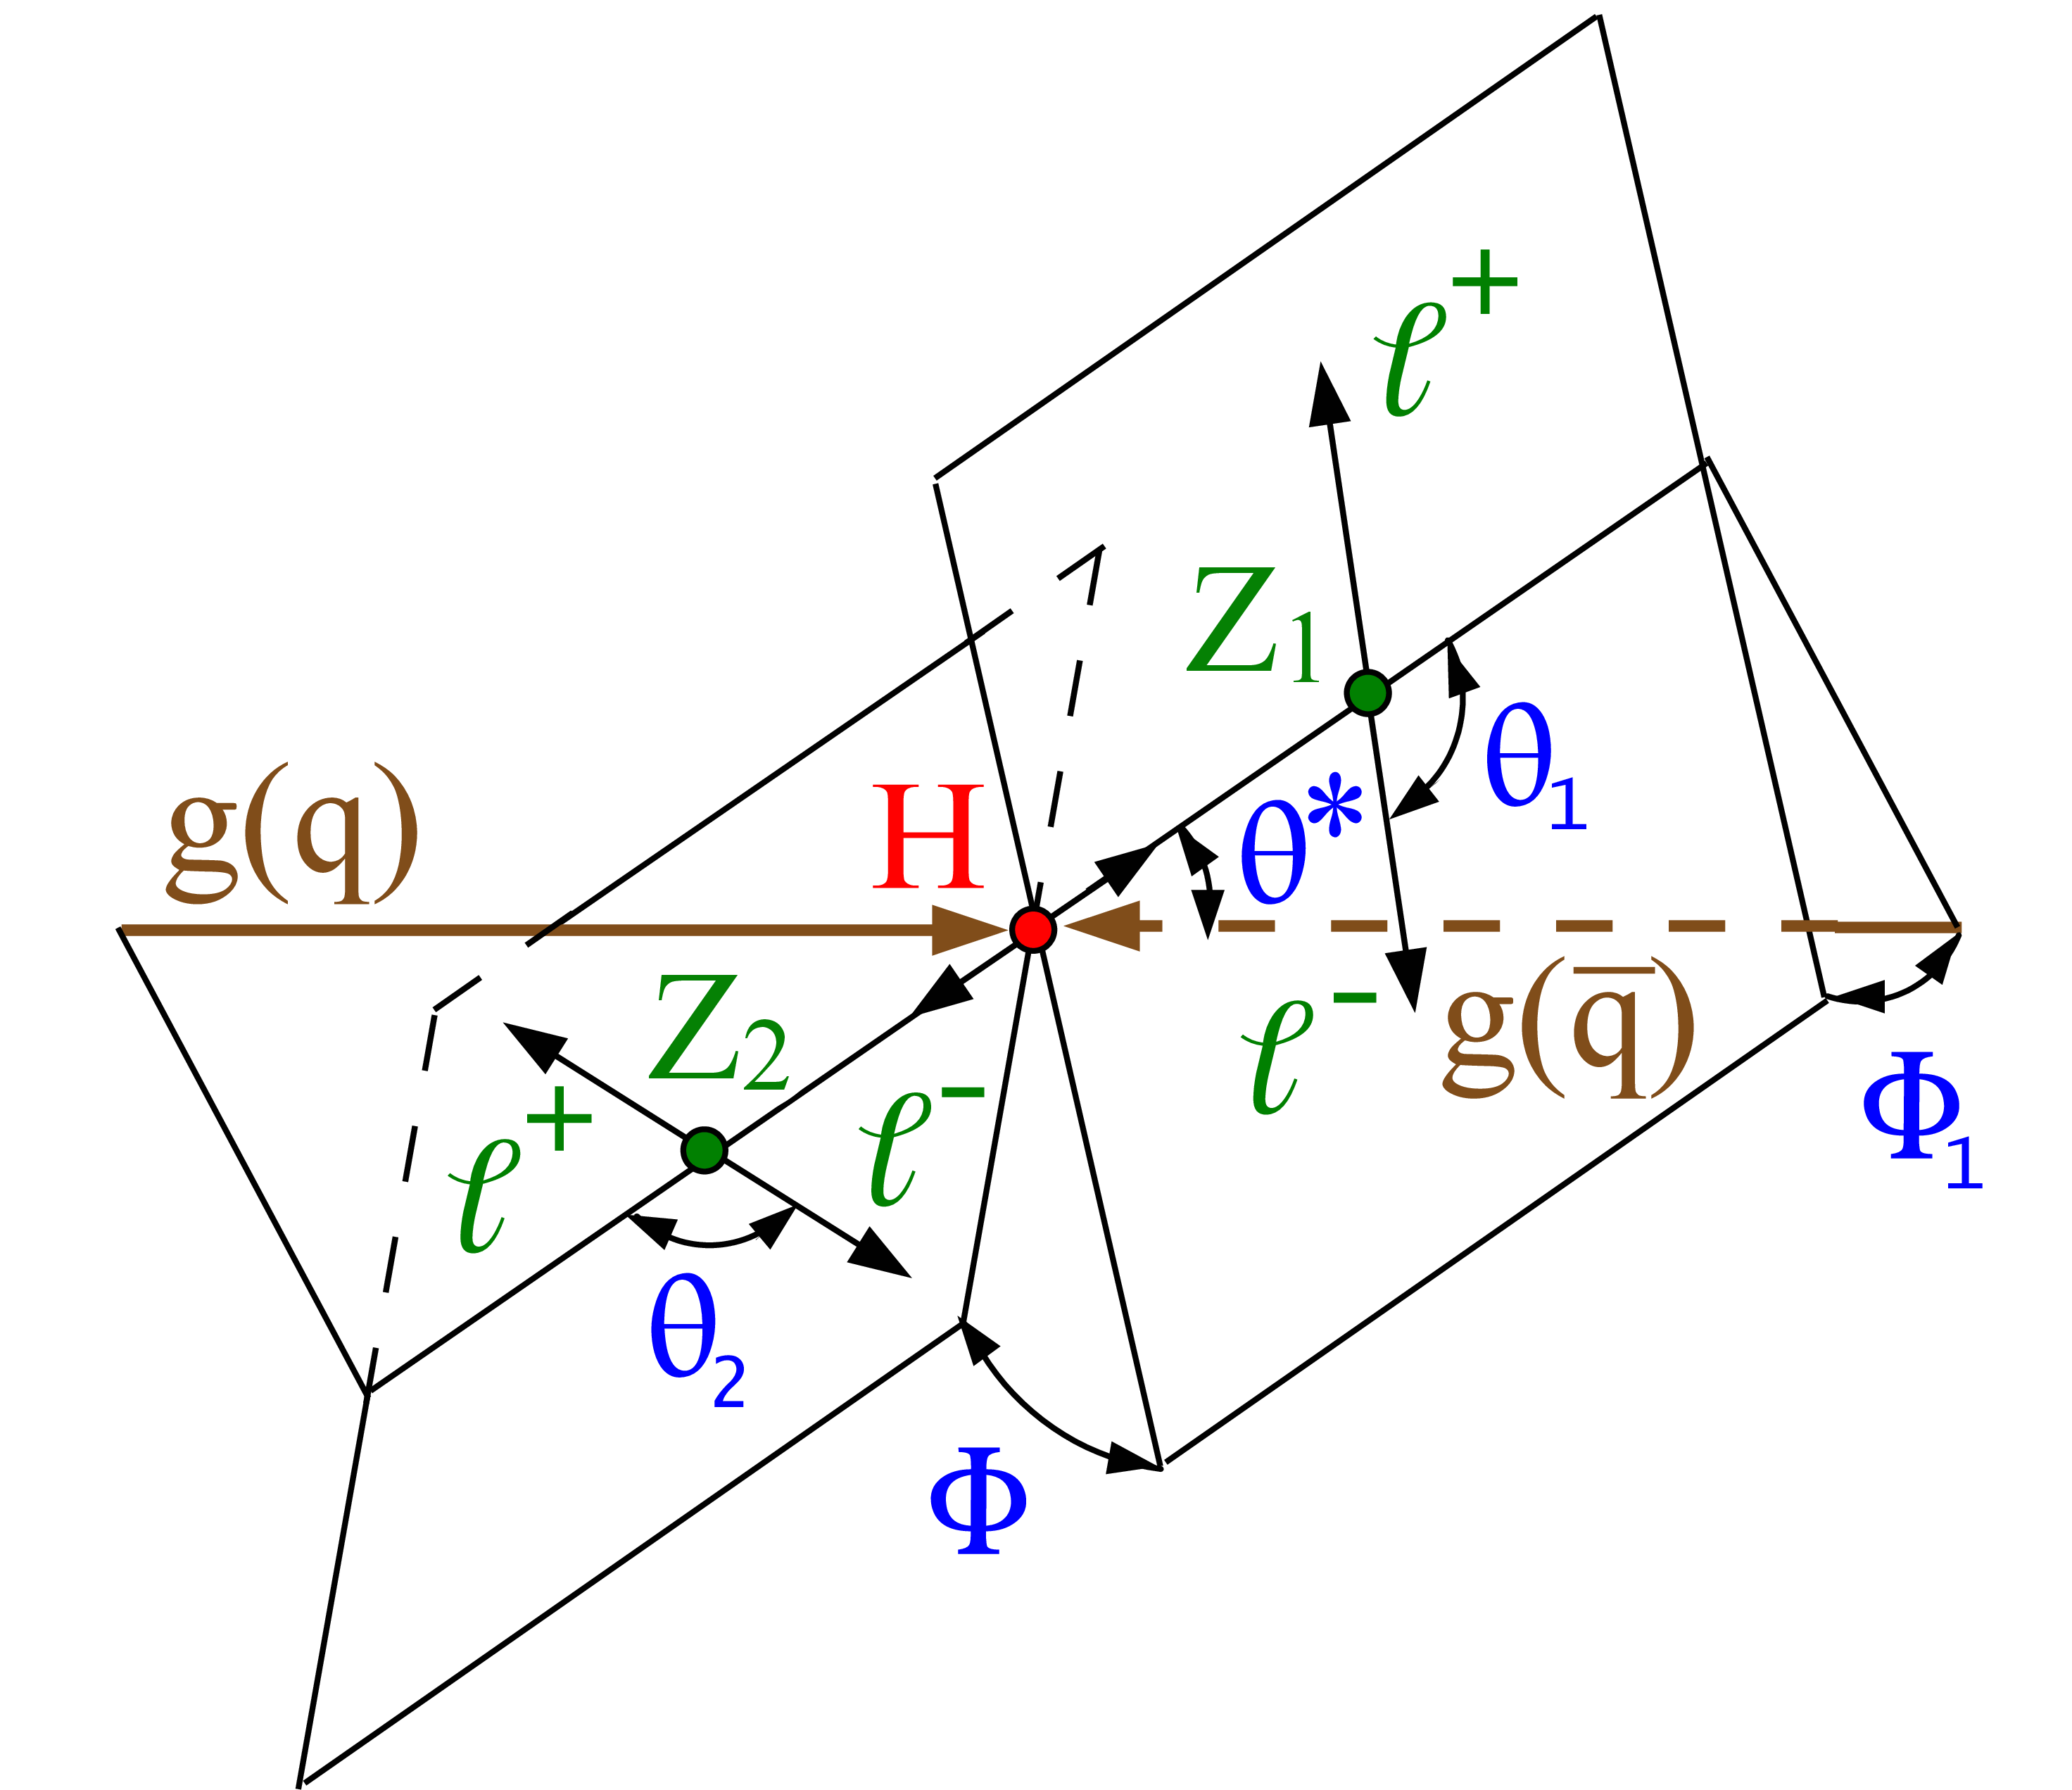
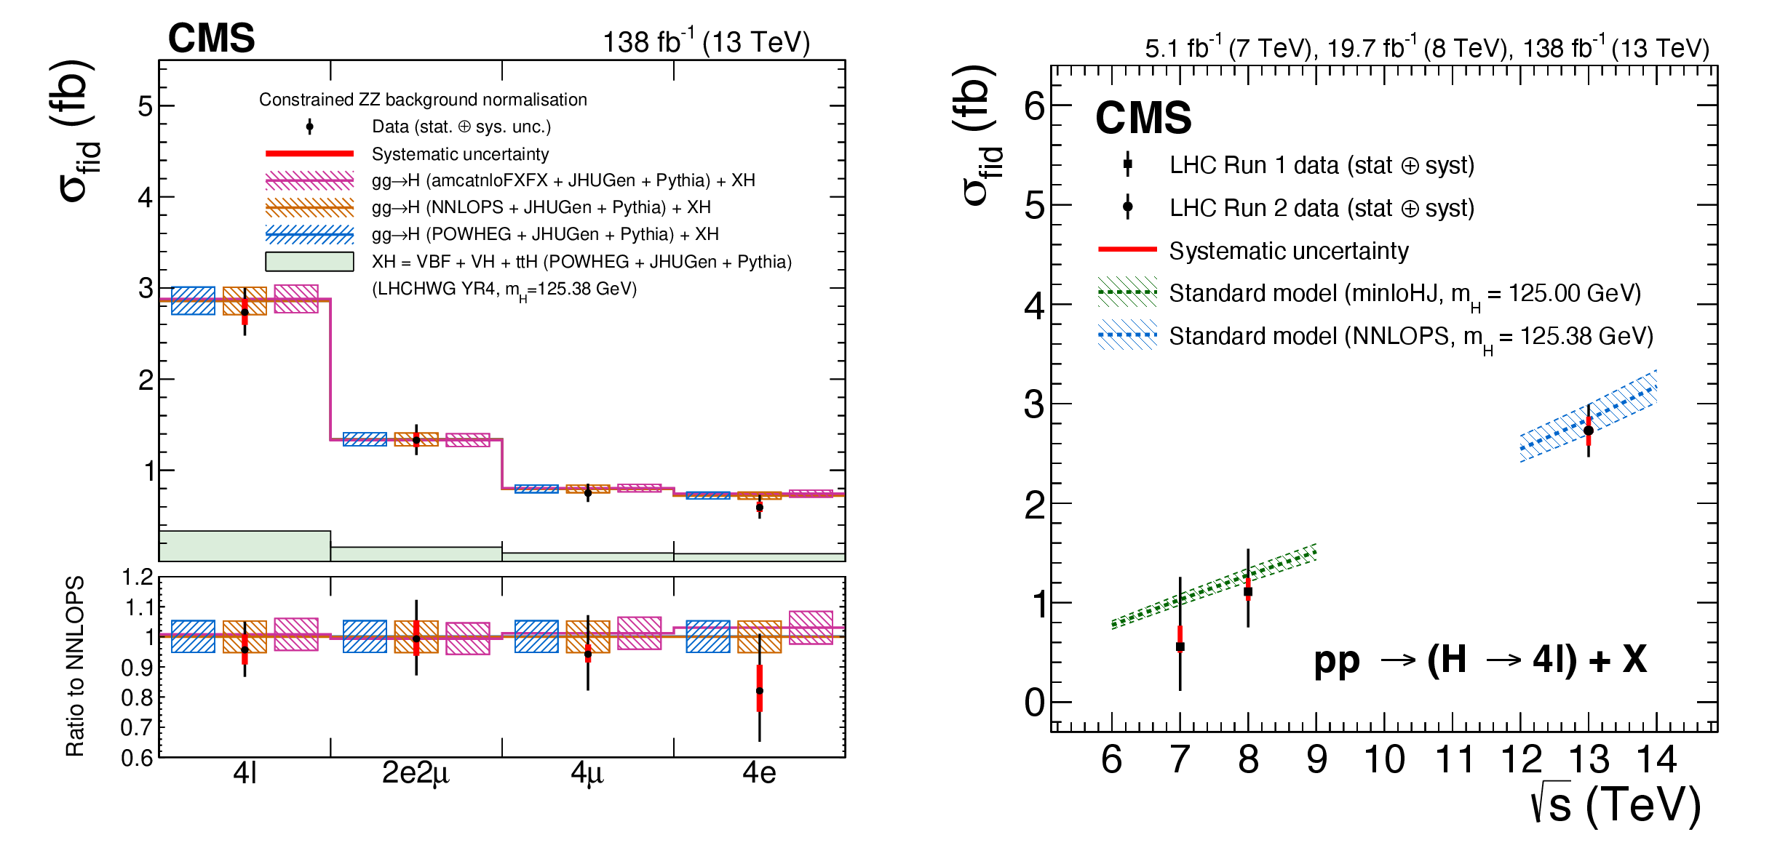
H→ZZ*→4 leptons differential cross-section
H→4 leptons also studied differentially
Differential measurement performed with respect to angular variables, Higgs momentum, and accompanying jet pT → sensitivity to loop correction and BSM operators
Inclusive fiducial cross-section
JHEP2023,40(2023)

Slide 28
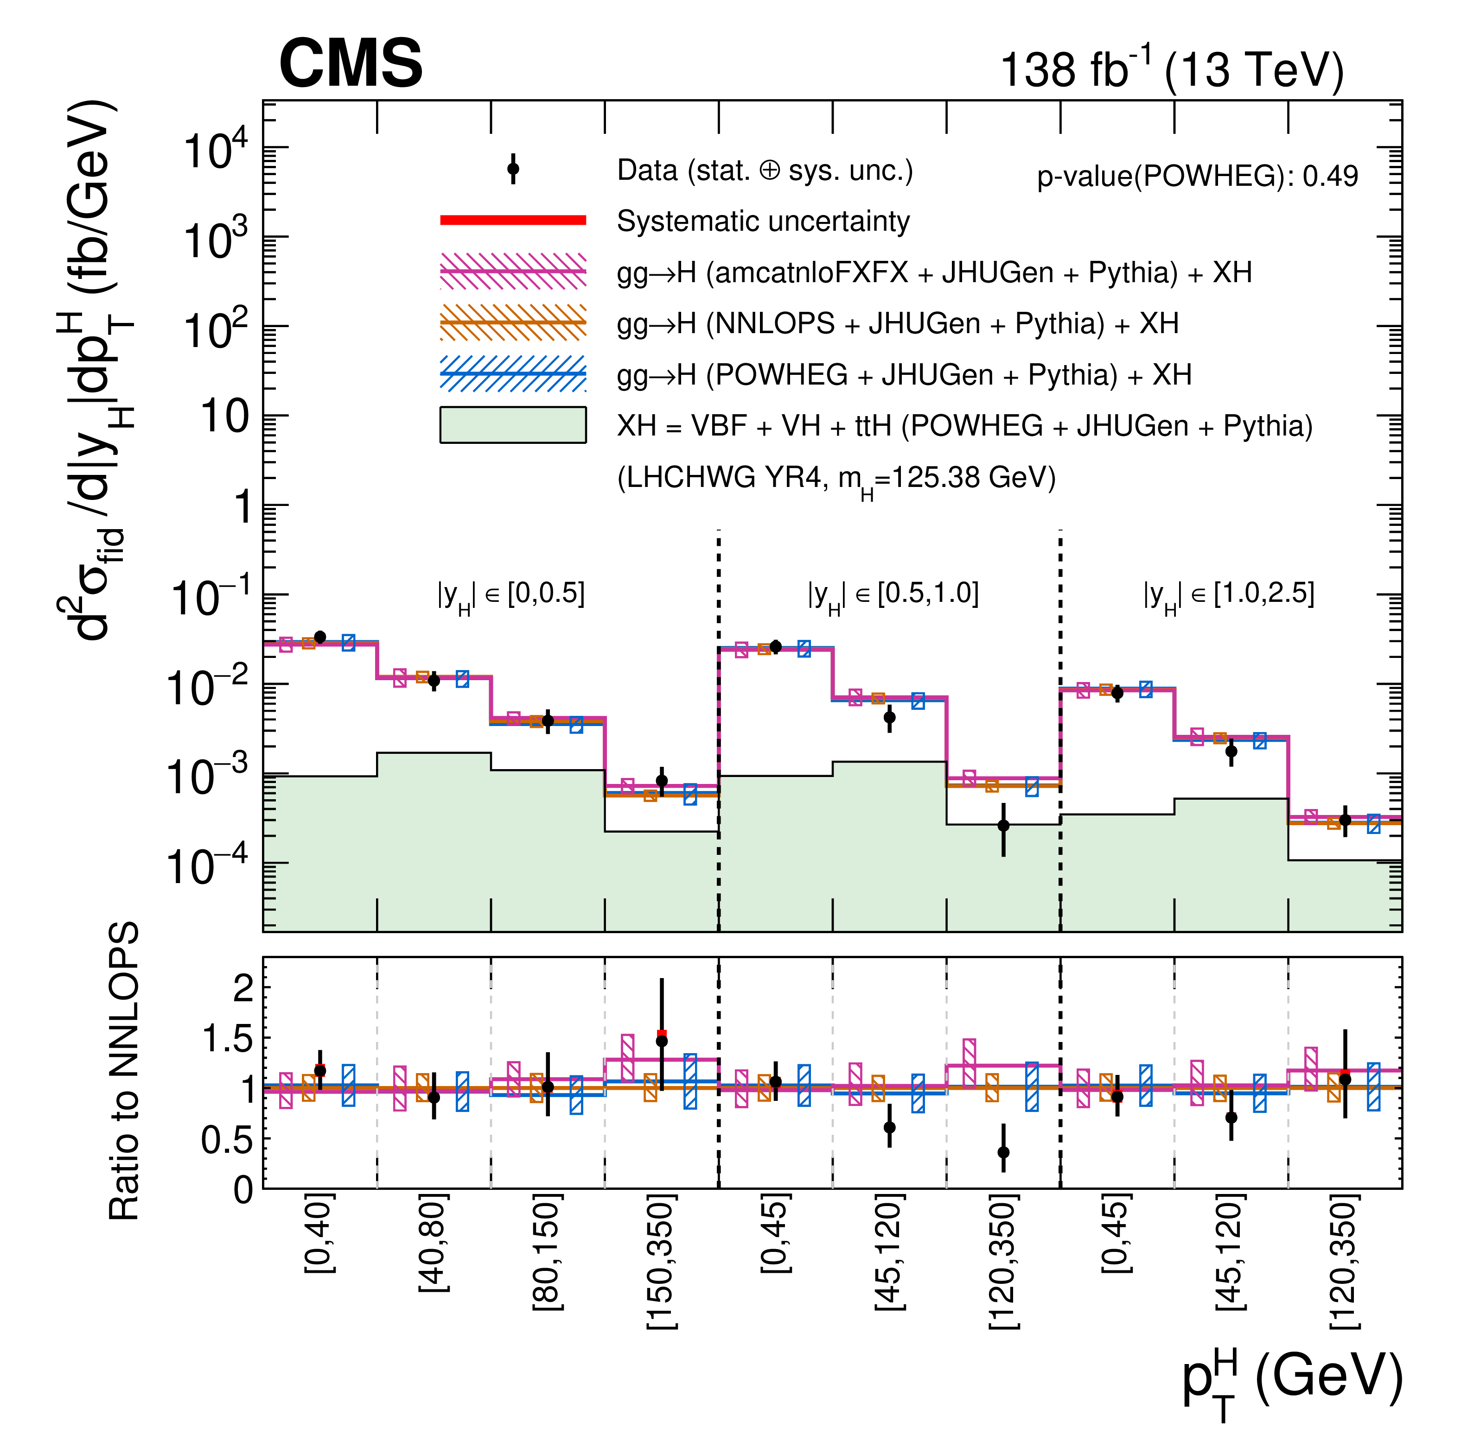
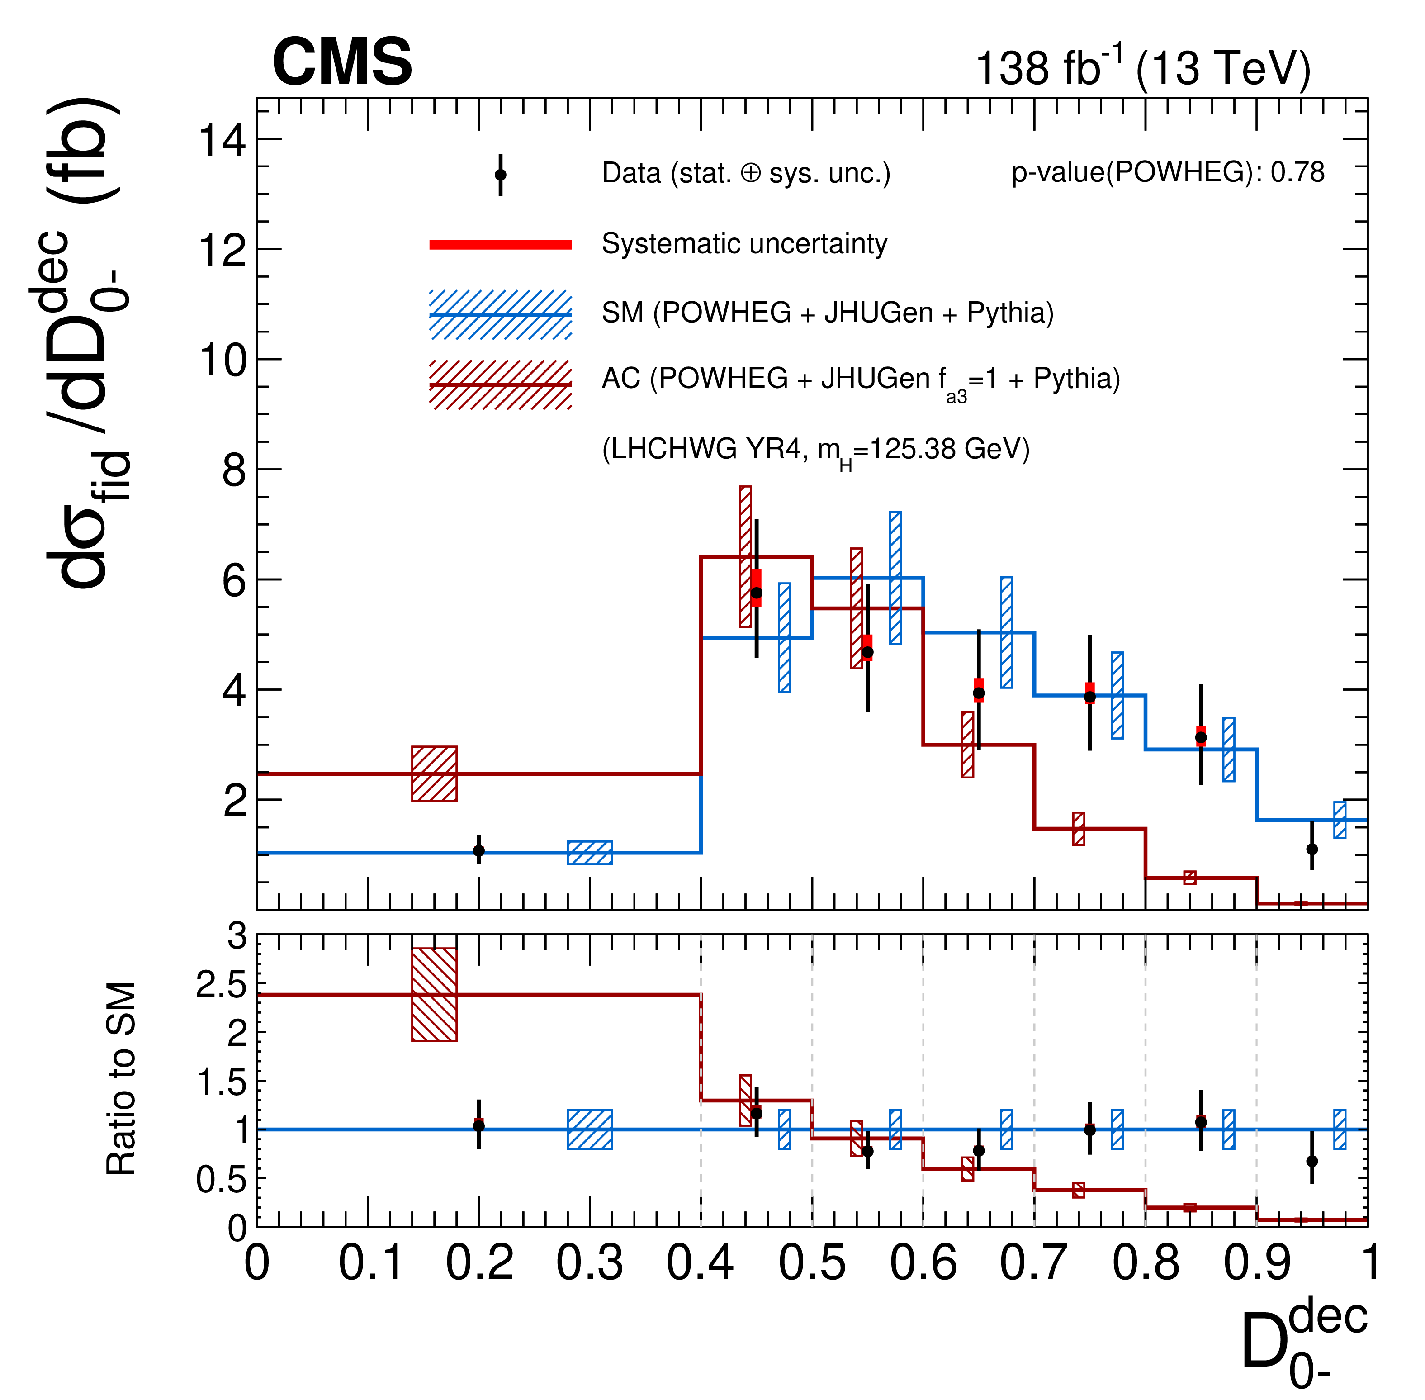
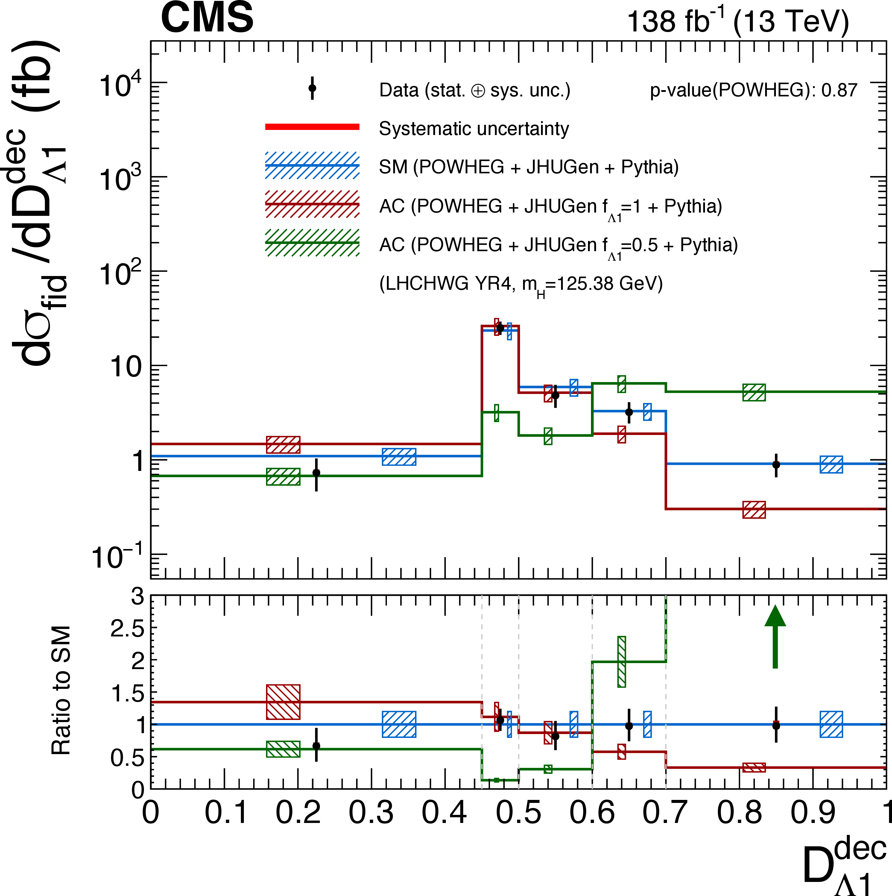
H→ZZ*→4 leptons differential cross-section
The increased sensitivity allows to constrain better CP-violating terms and validate our current theoretical understanding
JHEP2023,40(2023)
All differential distributions agree with the
latest SM predictions

Slide 29
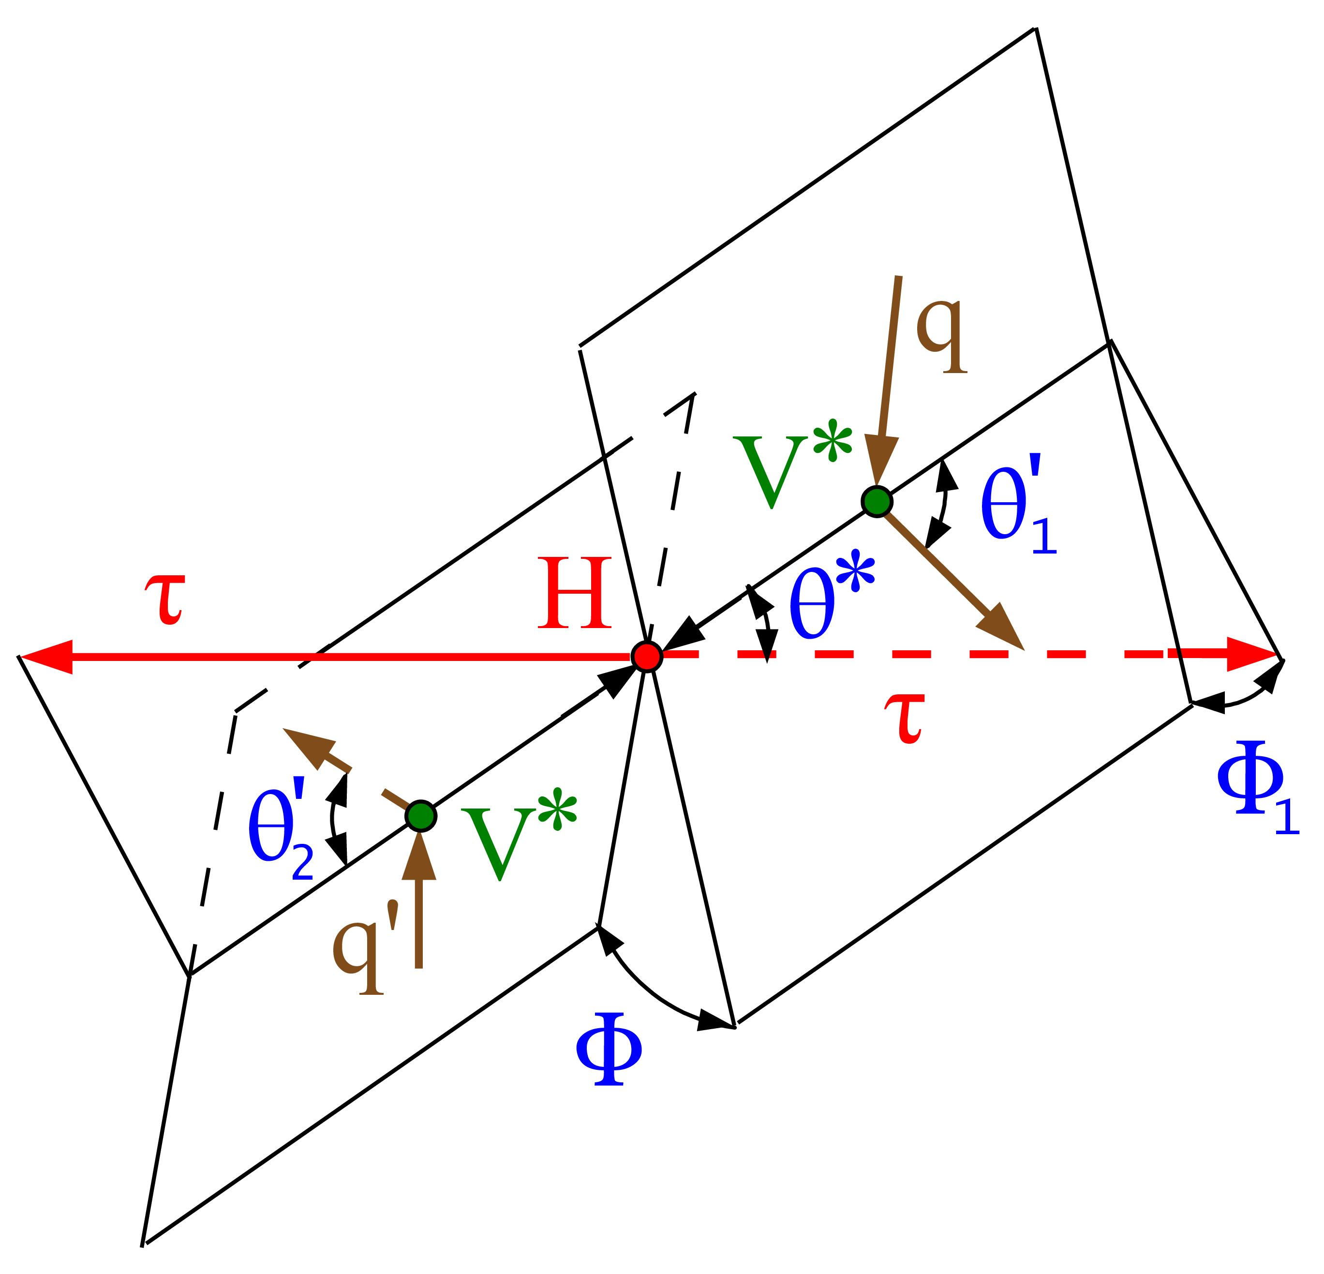
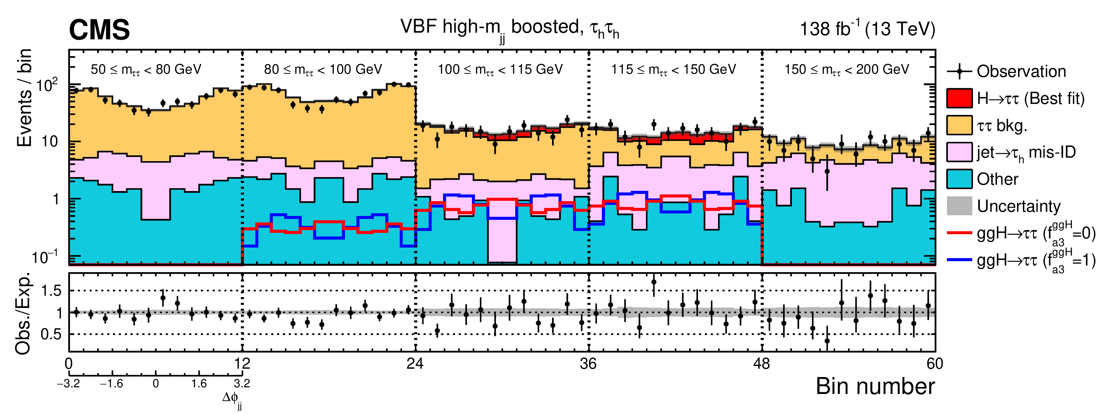
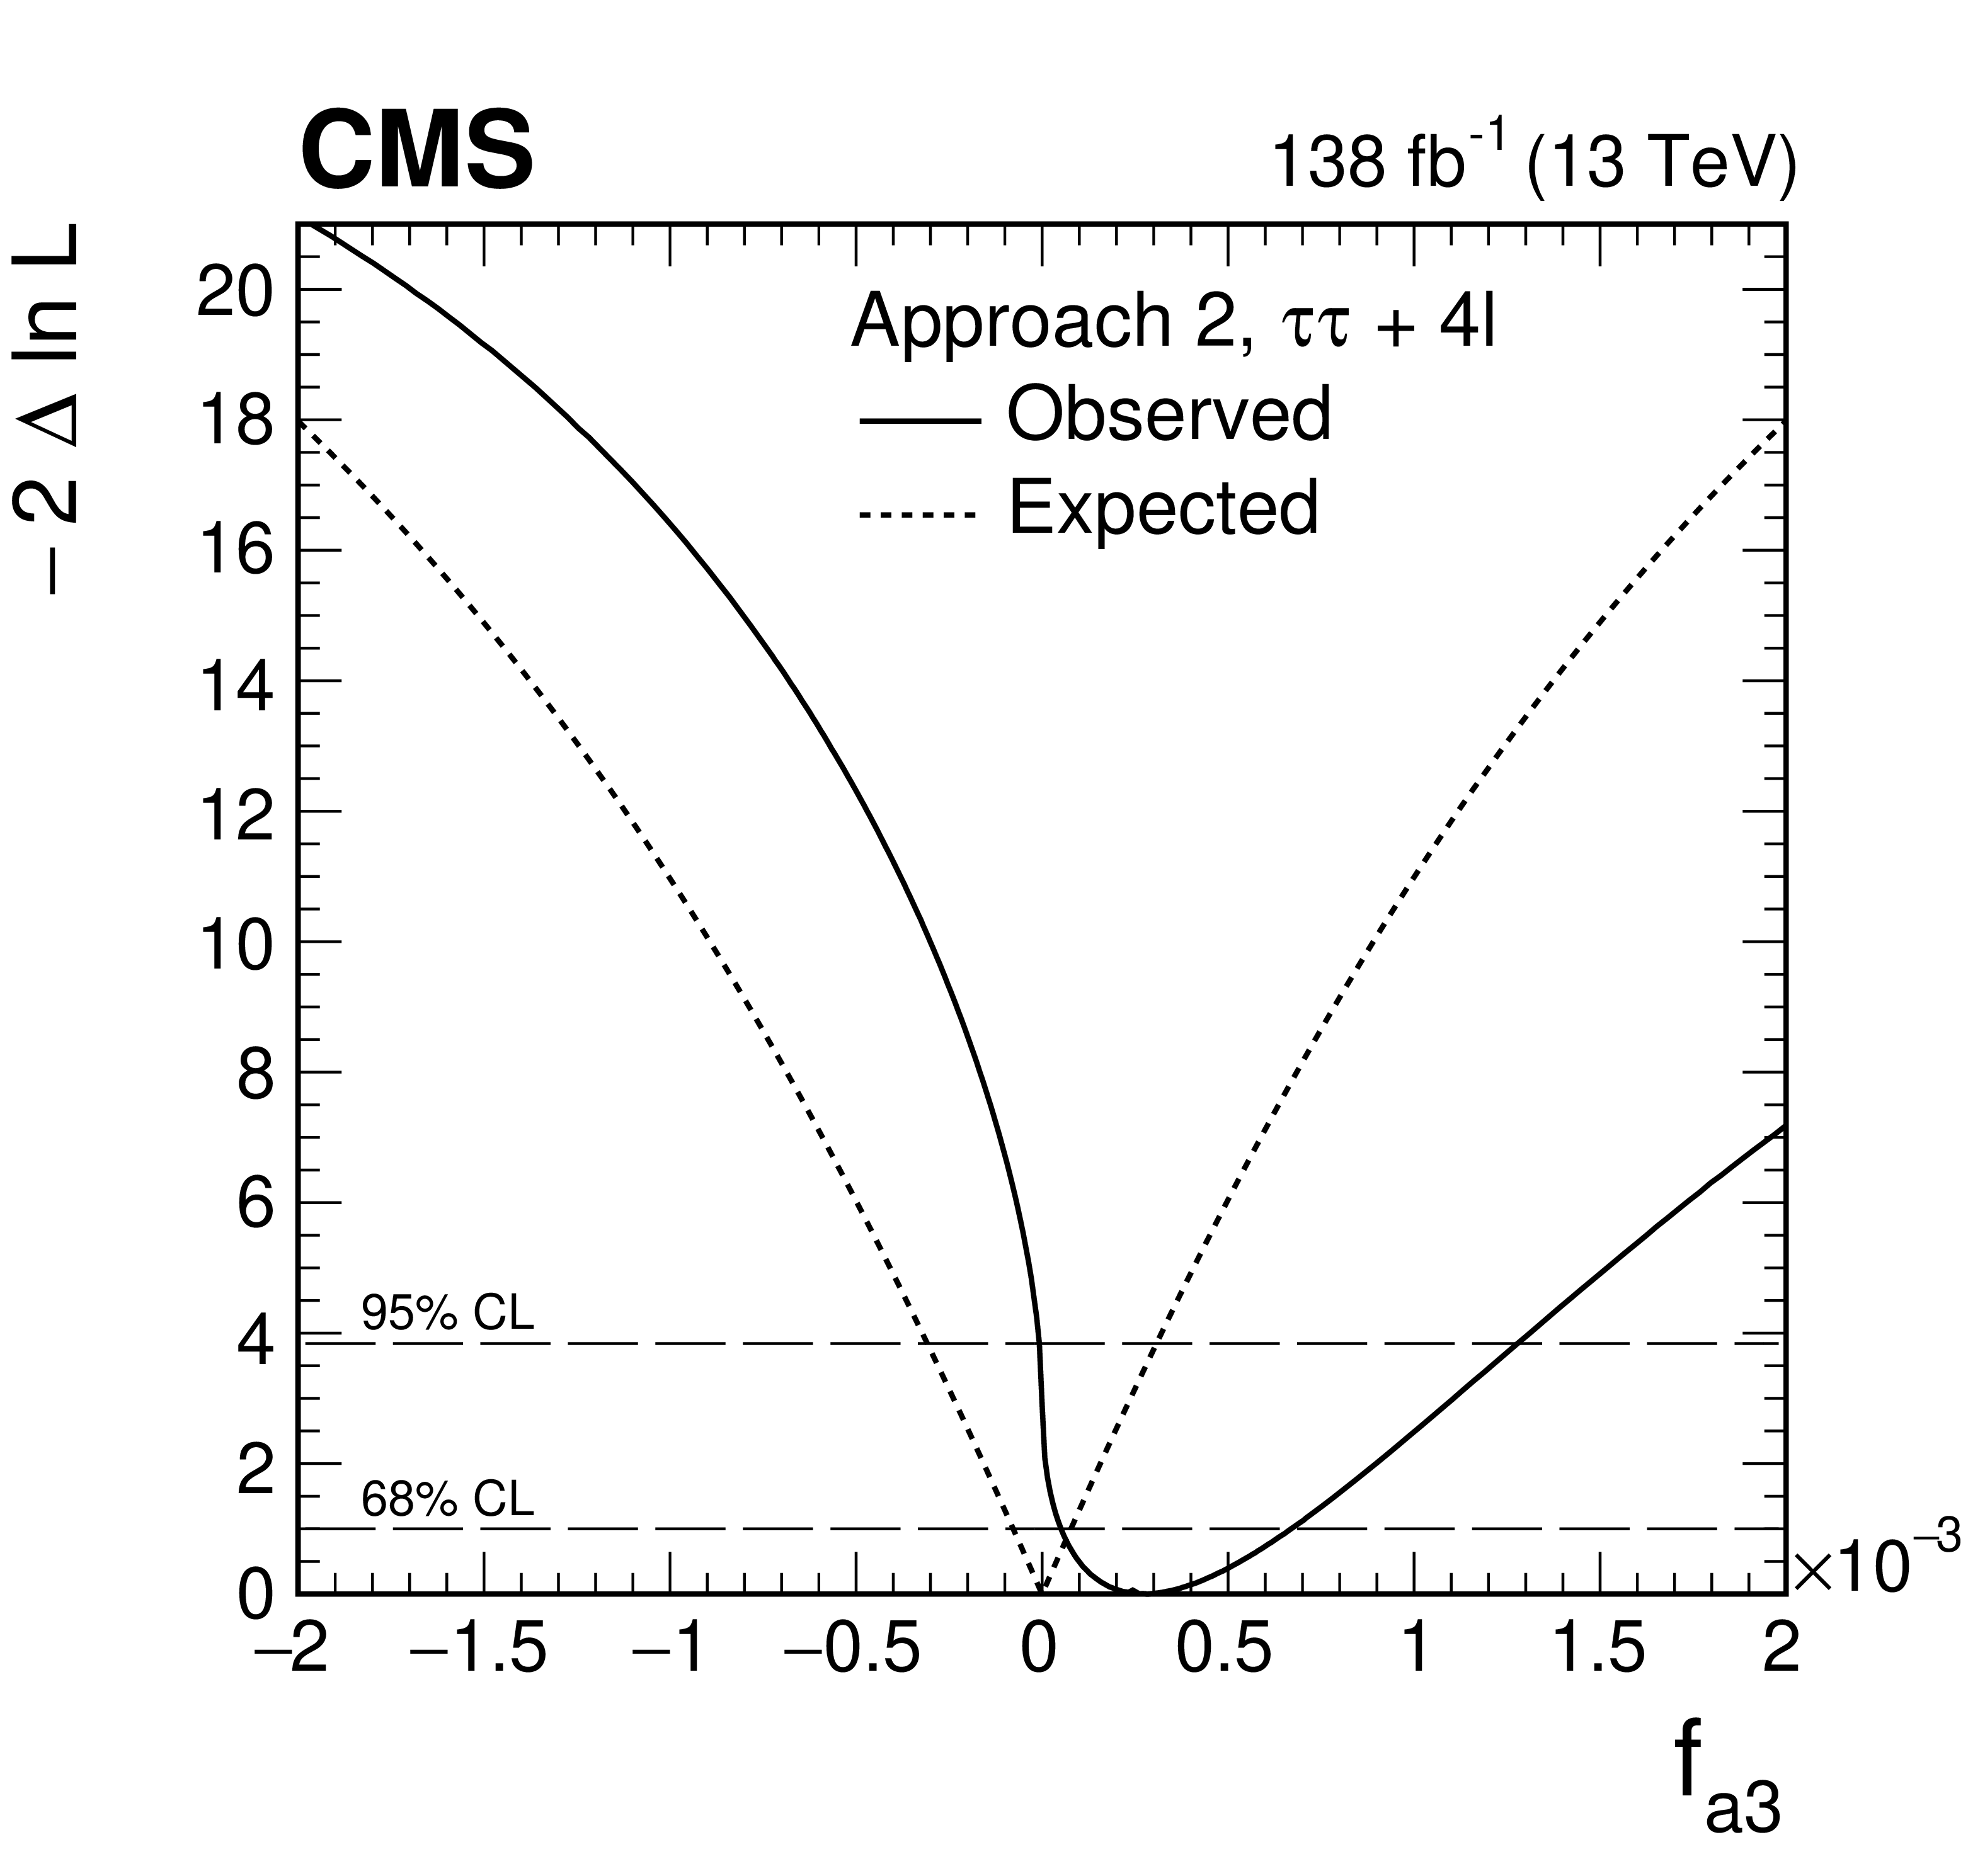
VBF production with H→ττ decays
Higgs decays to tau leptons can be used as a probe both for CP violation in Higgs decays and in combination with H→ 4l for the search of CP violation in production
  When studying Higgs CP in production the H→ττ vertex is kept SM-like
  The azimuthal angle between jets coming from the initial state offers
  sensitivity to the Higgs CP quantum number
Phys. Rev. D 108 (2023) 032013

Slide 30
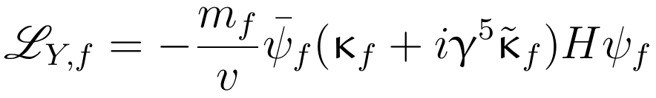
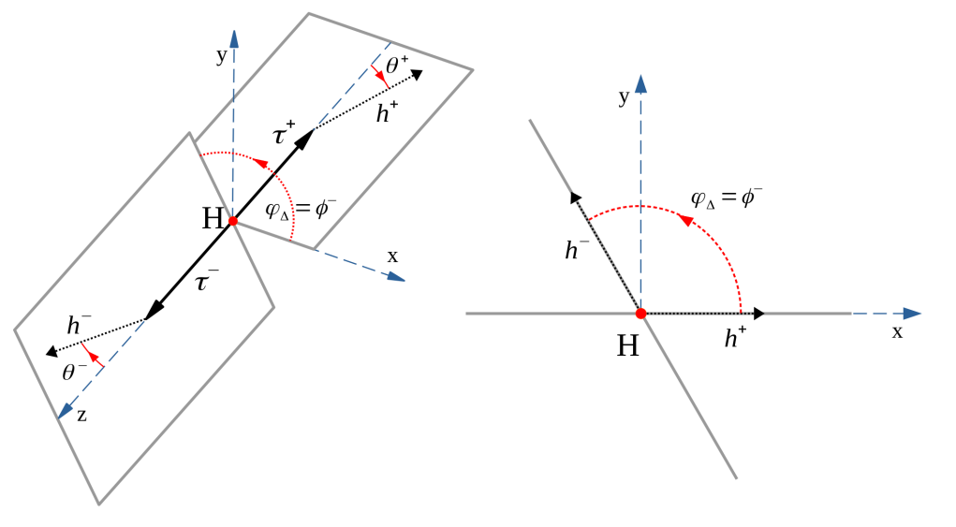

CP properties of Yukawa couplings
Higgs Yukawa interaction can be parametrized as follows:
  Higgs direct coupling to top quarks investigated in ttH and tH production
    CP-odd anomalous coupling affects top quark(s) kinematics
    Investigated with MVA techniques
  Higgs coupling to τ leptons investigated in decays via τ spin correlation
    CP mixing encoded in α^{Hττ} :
    Mixing angle can be accessed via the angle between
    τ decay planes
Higgs rest frame
Universe 2022, 8(5), 256

Slide 31

Lepton Flavor Violation
Beyond the coupling to top quarks and tau leptons we also look for lepton flavor violation
  Lepton flavor is conserved → the Yukawa matrix is diagonal wrt lepton generations
In analogy with the CKM matrix we can look for CP violation also by studying off-diagonal elements of
the lepton Yukawa matrix
  A search for H→eμ decays can hint towards sources
  of new physics
  Search performed in mass window 110< m_{eμ} <160 GeV
  Analysis exploits BDT to improve S/B ratio in two signal
  categories: ggH and VBF
Phys. Rev. D 108, 072004

Slide 32


H→eμ LFV decays
Constraints on the H→eμ branching fraction determined for SM-like H(125) and more generally for generic scalar particle X of mass between 110 and 160 GeV
  First direct search for eμ resonance in chosen mass range
Observed (expected) limit on 𝓑(H→eμ) < 4.4 (4.7) × 10⁻⁵ at 95% for a SM-like Higgs
The X→eμ search presents a local (global) excess of 3.8σ (2.8σ) for the 146 GeV mass point
3.8σ local excess
The best fit signal for this mass point has a cross-section of 3.89±1.25 fb
More data is needed to investigate this excess
Phys. Rev. D 108, 072004

Slide 33



CP violation in Higgs-top couplings
Higgs couplings are proportional to the mass → enhanced coupling with the top quark → target ttH and tH production
Htt coupling CP structure was probed in the H→ WW, ττ (multilepton) γγ and ZZ decays
Phys. Rev. D 104 (2021) 052004
JHEP 07 (2023) 092
Top quark loop has leading contribution to ggH effective coupling → simultaneous fit of CP-odd contribution ggH and ttH production
  Combination performed under hypothesis that ggH loop is dominated by top quark

Slide 34



CP violation in H→ ττ decays
The cross section of the H→ττ decay acquires a sinusoidal dependence on the azymuthal angle spanned between the two τ polarimeters
CP mixing appears as a phase-shift in the distribution
Measuring the Higgs CP mixing angle requires accessing the azymuthal difference between the polarimetric vectors
This angle can be generalized to the angle between the
τ decay planes, an acoplanarity angle
Universe 2022, 8(5), 256
$$\frac{dσ}{dφ_{CP}} ∝ const − cos\left(φ_{CP}−2φ_{ττ}\right)$$
JHEP 06 (2022) 012

Slide 35


CP violation in H→ ττ decays
doi:10.3204/PUBDB-2021-03550
Use of ML classifiers to identify the Higgs boson
Modulation of the differential cross-section can be used to probe the CP mixing angle
JHEP 06 (2022) 012
Exclusion for CP-odd hypothesis:

Slide 36



CP-even/odd couplings
CP mixing angle:
Interesting for MSSM interpretation to test CP mixing angle of 7° → good target for future measurement
JHEP 06 (2022) 012
Couplings consistent with SM hypothesis at 68% CL
  Observed (exp.) exclusion of pure CP-odd hypothesis significance = 3.0σ (2.6σ)
Eur. Phys. J. C 82, 604 (2022)

Slide 37


Summary and prospects
Higgs boson couplings have been investigated looking for CP-odd contributions which could help explaining the baryon asymmetry in the Universe
Exclusion limits for pure CP-odd Higgs couplings:
  HVV couplings: |f_{a3}| < O(10⁻³) at 95% CL in combination with off-shell production
  Htt: at 68% CL
  Hττ: tan (α^{Hττ}) < 0.36 at 68% CL
All analyses exclude pure CP-odd hypothesis and agree with SM prediction
Studies are continuing in Run 3 and we will hopefully
get new results about CP violation
$$\left|f_{CP}^{Htt}\right|<0.55$$
JHEP 06 (2022) 012
Continuing
in Run 3

Slide 38
Searches for CP Violation in the Higgs sector:
The Quest to Understand the Baryon Asymmetry in the Universe
Keep looking for more!
Andrea Cardini – Universidad de Oviedo, Spain

