Slide 1
Validation of WCSimFQTuningTools
Lorenzo Restrepo Orrantia

Slide 2
Introduction
New tuning tools for HK: WCSimFQTuningTools (mainly in python)
Developped by Gonzalo Diaz (https://git.hyperk.org/pyfitqun/WCSimFQTuningTools)
Same principle as the usual tuning tools
Commented, documented and easy to use
1

Slide 3
Introduction
New tuning tools for HK: WCSimFQTuningTools (mainly in python)
Developped by Gonzalo Diaz (https://git.hyperk.org/pyfitqun/WCSimFQTuningTools)
Same principle as the usual tuning tools
Commented, documented and easy to use
My work: Validation
Goal: same reconstruction performances using the new tuning and the HK2024 official tuning
1

Slide 4
Introduction
New tuning tools for HK: WCSimFQTuningTools (mainly in python)
Developped by Gonzalo Diaz (https://git.hyperk.org/pyfitqun/WCSimFQTuningTools)
Same principle as the usual tuning tools
Commented, documented and easy to use
My work: Validation
Goal: same reconstruction performances using the new tuning and the HK2024 official tuning
This presentation: final results and current status
1

Slide 5
Reminder: Likelihood
Charge PDF:
Probability of detecting charge qi knowing mui
Unhit probability
Predicted charge deposit in each PMT knowing x
Time PDF:
Probability of measuring time ti knowing x
2

Slide 6
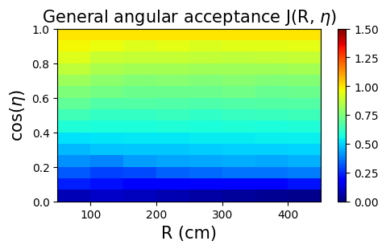
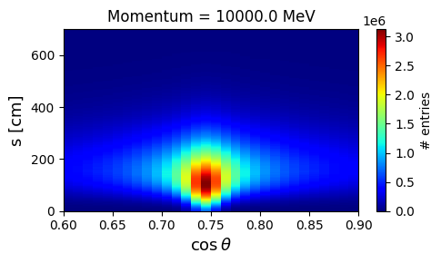
Reminder: Predicted charges
s
= Track length
e
Angular response
Cherenkov profiles
= photon emission per track length and solid angle
3

Slide 7
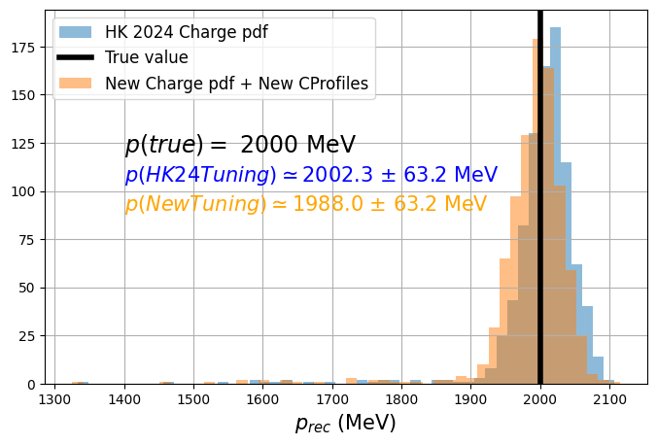
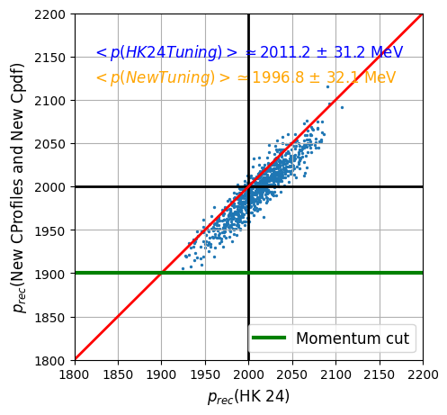
Cherenkov profiles & Charge pdf validation
Momentum reconstruction using a 2GeV electron particle gun at the center (without scattering)
Also good vertex and direction reconstruction
4

Slide 8
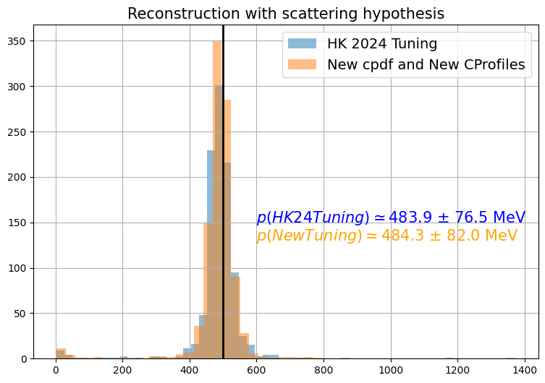
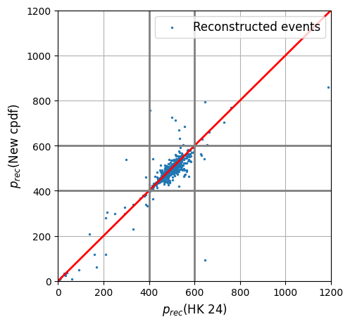
Cherenkov profiles & Charge pdf validation
Momentum reconstruction using a 500MeV electron particle gun isotropic (with scattering)
Official validation simulation
5

Slide 9
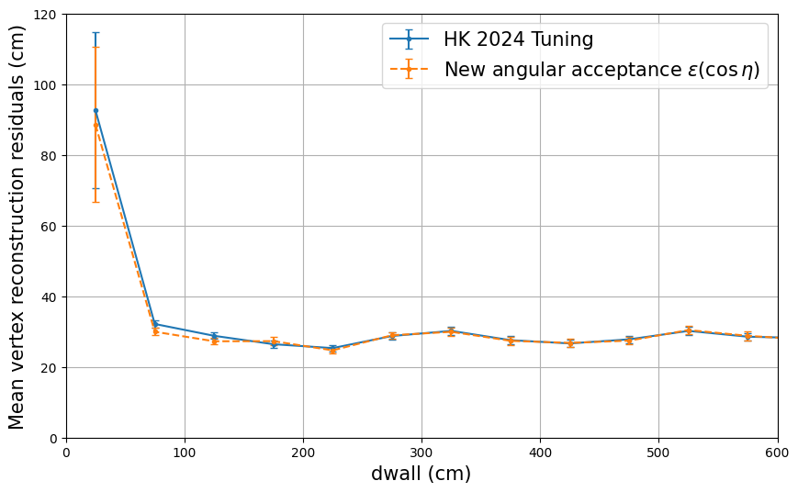
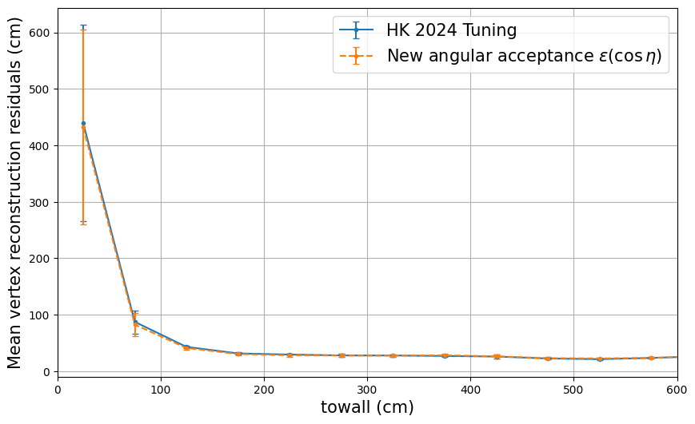
Angular acceptance validation
Vertex reconstruction using a 500MeV electron particle gun isotropic (with scattering)
Official validation simulation
→ Excellent agreement on the vertex reconstruction
6

Slide 10
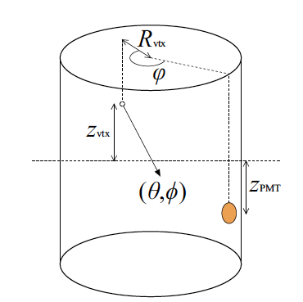
Scattering Table
HK2024 STable
New tools STable (with 10^8 electron bombs)
7

Slide 11
Conclusion
Cherenkov profiles ✅
Scattering table 🚧
Charge pdf (and unhit probability) ✅
Time pdf 🚧
Angular response ✅
→ Finished before August
Optimisations, documentation and cosmetics
Write a technote about the tuning (with instructions)
→ Finished by September
7

Slide 12
Backup

Slide 13
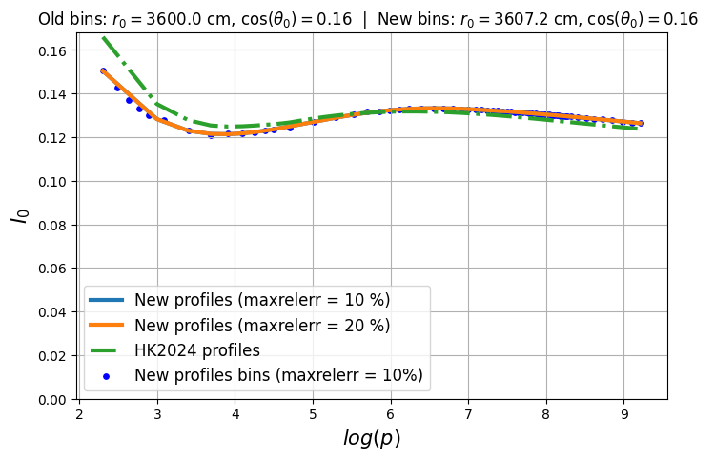
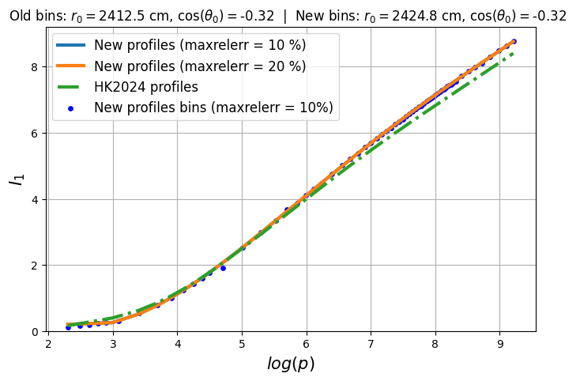
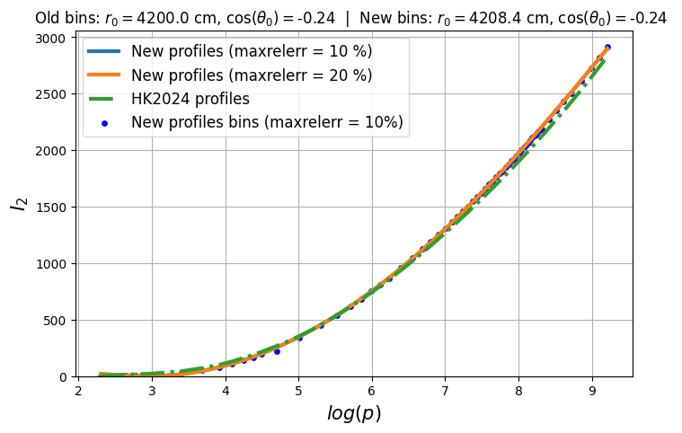
Cherenkov integrals

Slide 14
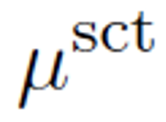
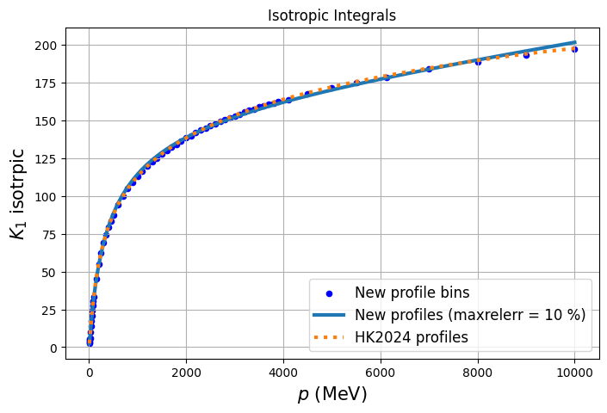
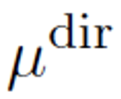
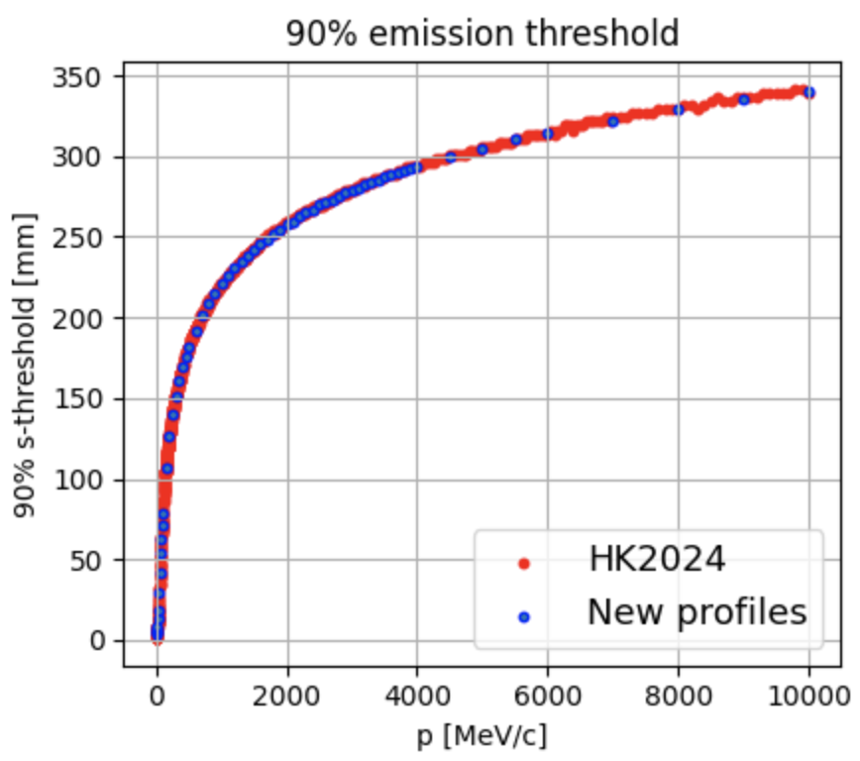
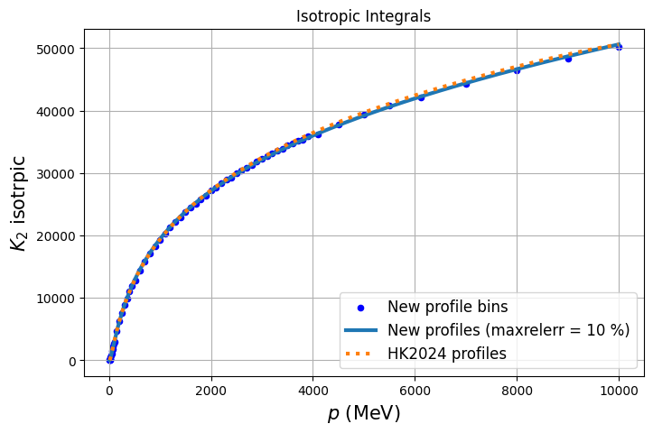
Isotropic integrals:
→ Used to
compute
90% emission. threshold:
Track length s at which 90% of the photons are emitted
→ Used to compute and

Slide 15
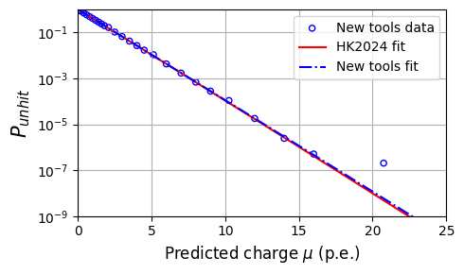
Unhit probability comparison
HK2024 file:
(cPDFpar_20inchBandL.root)

Slide 16
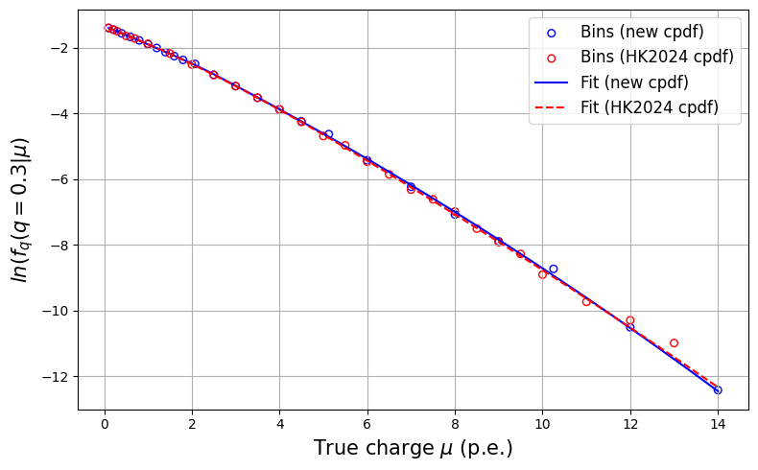
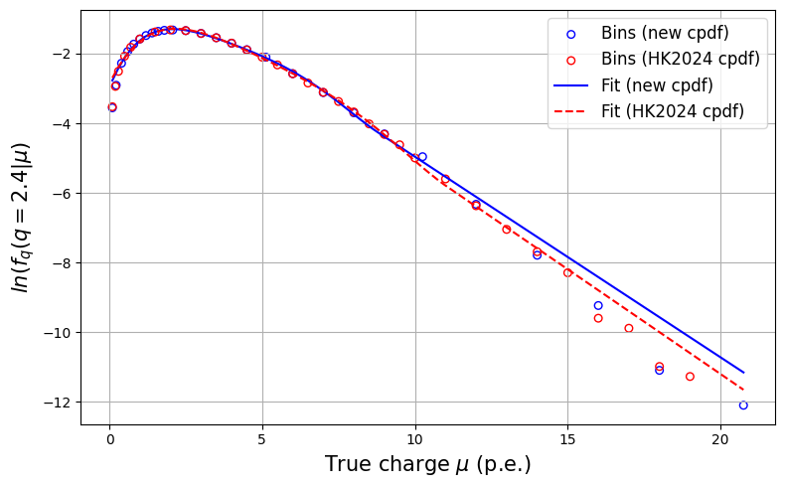
Charge pdf :Status now (comparisons)
Note: here the “old pdf” refers to HK2024 official charge pdf
HK2024 file:
(cPDFpar_20inchBandL.root)

Slide 17
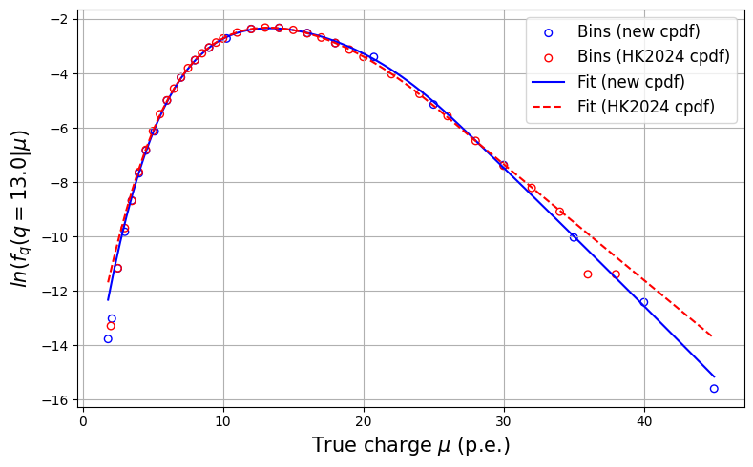
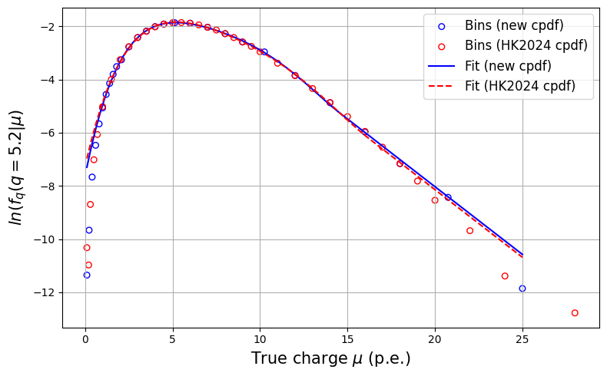
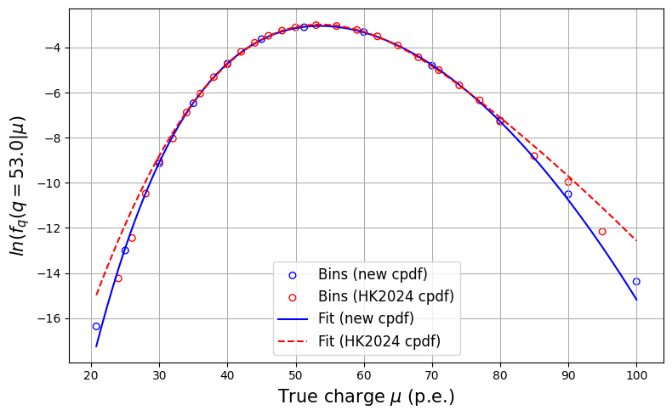
Excellent agreement between the old and new datapoints and fits ✅

Slide 18
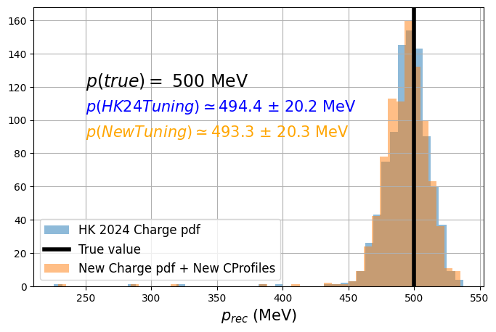
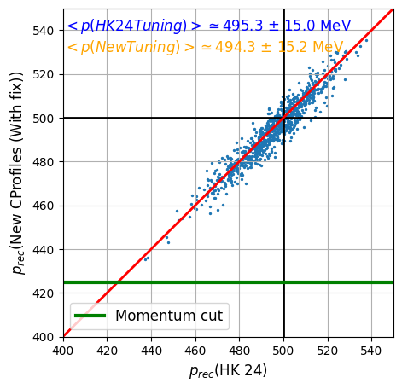
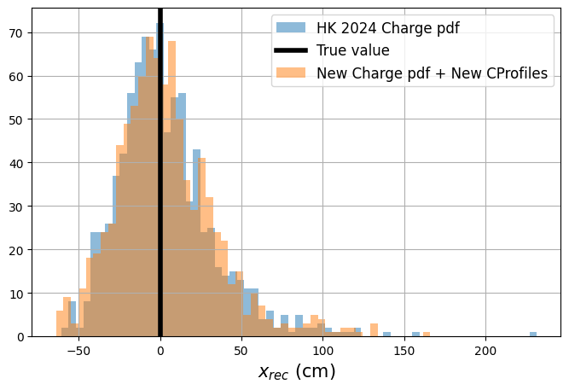
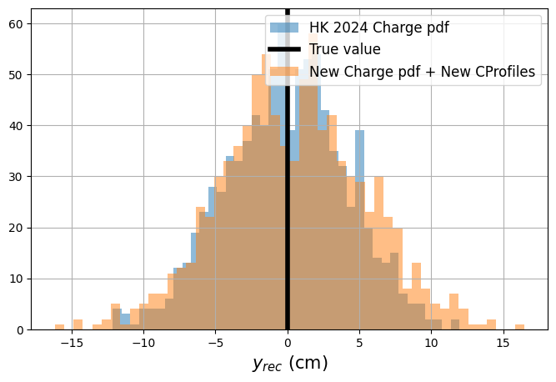
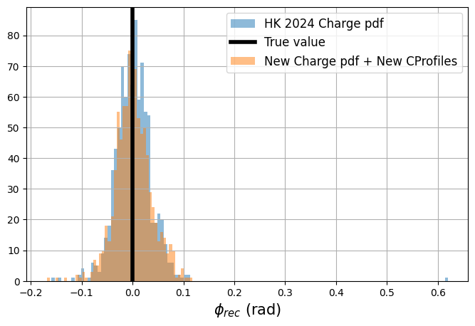
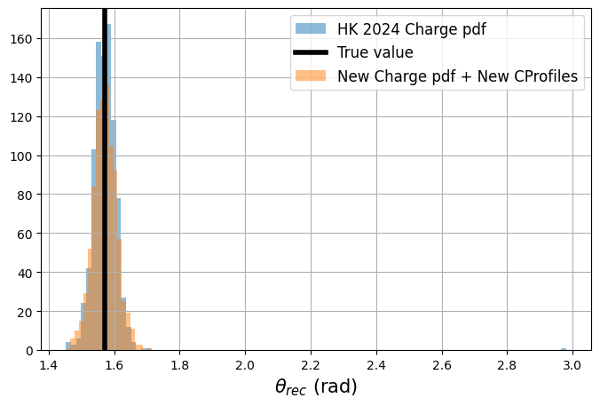
Validation on fiTQun C++
p
x
y
𝞱
𝞿

Slide 19
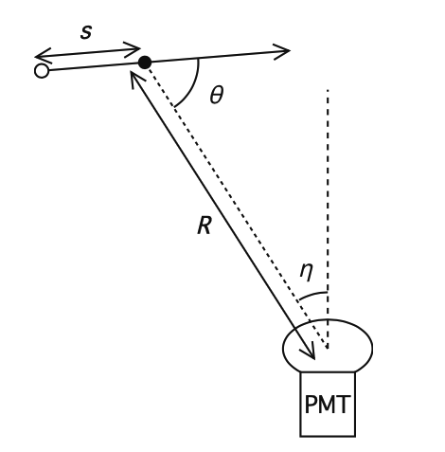
Reminder
PMT angular acceptance
(needs tuning)
General angular acceptance:
Solid angle
Transmission factor
100 million electron bombs

Slide 20
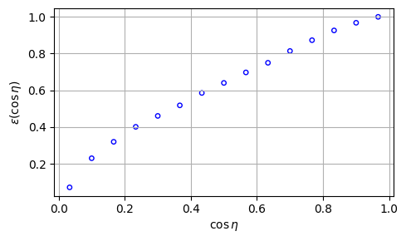
PMT angular acceptance 𝜀
→ can be approximated by the first R-bin
𝜀(𝜂)

Slide 21
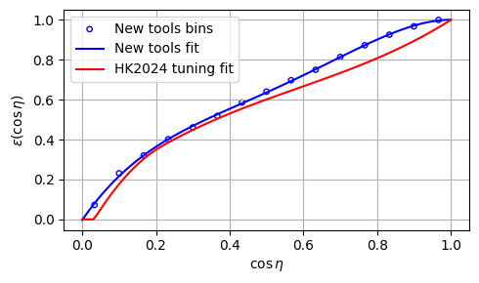
PMT angular acceptance 𝜀
Comparison with HK2024 official tuning
→ Impact on the vertex reconstruction?

