Slide 1
Welcome to LPCA
& Clermont!
Laboratoire de Physique Clermont Auvergne
Jean ORLOFF
Newcomer’s Welcome Day, October 16 2025

Slide 2
LPCA: what do we do?
3 research departments:
  TH (Theory):
  Analyses BSM in Flavour Physics and Dark Matter;
  Percolation model of pandemics
  PU (Particles and Universe):
  Instrumental and physics contributions to ATLAS, LHCb, ALICE
  CKMfitter, COMET, Future Colliders,
  Observational cosmology through SuperNovae with LSST/ZTF,
  Development of Fink broker for transient objects with LSST/ZTF (beyond SN) & others
  SE (Health & Environment): effects of radiation on living organisms and environment:
  Conception et efficiency of biomaterials
  Dosimetry and modeling of life
  Radiobiology & Biophysics of single molecule
  Mitochondrial DNA reparation
4 support & technical services: Administration, Informatics, Electronics, Mechanics
4 technical platforms:
  MICA: micro-electronics developments (ALTIROC for HGTD in ATLAS, SPIDER for LHCb, EIC… IoT devices)
  E2CA: electronics complex cabling and characterization of components (eg. from MICA)
  PAVIRMA: controlled X-irradiation of biological samples, small animals or electronic components
  LCG: Tier2 node of the LHC Computing Grid
1 double bachelor (Maths-Physics), 2 masters: Physics with IMAPP Erasmus Mundus, & Nucl. Engineering, with Health
NB: UMR = Mixte : 2 supervising bodies, both CNRS (IN2P3) and University Clermont Auvergne (UCA)
  Radioactivity in environment (e.g. radon…)
  Developing innovative connected captors (IoT)
  Developing data clouds for environment studies
Notes:
Play acronym game…

Slide 3


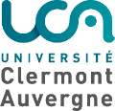
Conseil Scientifique
Président : Pascal PERRET
Conseil d’Unité
Vice-Président : ? (en cours)
Commission Locale Santé et Sécurité au Travail
Commission Paritaire Locale
Chargés de mission
QVCT Emmanuel GANGLER
Valorisation Emmanuel BERGERET
Isite-Instruments Laurent ROYER
Communication Aurélie TERRISSE,
ndreas GOUDELIS, Vincent TISSERAND
Eco-Responsabilité Samuel CALVET
RPS Eric COGNERAS - Géraldine FETTAHI
Parité Eric COGNERAS - Laurine PERROT
Agents de Prévention Christine GASQ,
Thierry PILLEYRE,
Adèle PORCAN
CRP et radioprotection Thierry PILLEYRE,
Guillaume RIVRAIS
Séminaires Andreas GOUDELIS, Corentin RAVOUX
DIRECTION
Directeur Jean ORLOFF
Adjoints au Directeur
David CALVET – Vincent BRETON
Directeur Technique Nicolas PILLET
Assistante de Direction Géraldine FETTAHI
SERVICES SUPPORTS & TECHNIQUES
Administration
Cyril GALPIER
Correspondants
Formation Continue, RH Géraldine FETTAHI
Web Alexandre CLAUDE
Information Sc et Tech Olivier DESCHAMPS
GED Dominique BONNET
CSSI Jean Claude CHEVALEYRE, Thierry MALLETx@
Informatique
Support Info ASR Dominique BONNET
Calcul et données Bogdan VULPESCU
Responsable Administratif
Cyril GALPIER
Électronique
Nicolas PILLET
ÉQUIPES
Mécanique
Nicolas PILLET
PÔLES DE RECHERCHE
Correspondants
Éric COGNERAS
Philippe CROCHET
ATLAS ALICE LHCb COMET
Djamel BOUMÉDIENE Xavier LOPEZ Stéphane MONTEIL Cristina CÂRLOGANU
PLATEFORMES & PLATEAUX
Particules et Univers
MiCA Frédéric JOUVE – Laurent ROYER
Romain MADAR
LSST/ZTF FINK
Philippe GRIS Emille ISHIDA
E2CA Frédéric JOUVE
Emmanuel Bergeret
Correspondante
Ana M. TEIXEIRA
THÉORIE
Ana M. TEIXEIRA
Théorie
PAVIRMA Guillaume RIVRAIS
Patrick CHARDON
Santé Environnement
Énergie
Correspondante
Lydia MAIGNE
ENVIRONNEMENT / ÉNERGIE
Vincent BRETON
SANTÉ
Patrick VERNET
TIER 2 – LCG Jean-Claude Chevaleyre
Eric Cogneras
LPCA - Laboratoire de Physique de Clermont Auvergne
octobre 2025
https://lpca.in2p3.fr/

Slide 4
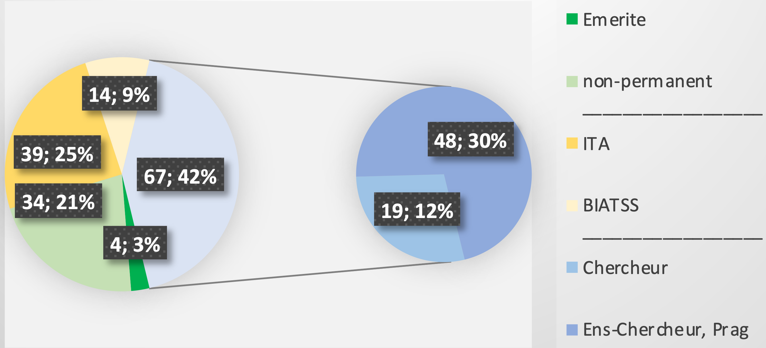
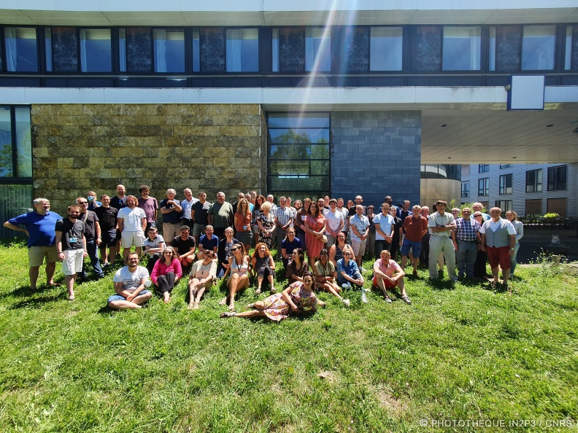


LPCA: who are we?
158 people (28% women, 17% non-French)
120 permanent (80%, average age: 50.3 yr)
  67 researchers (3/4 are university teachers)
  53 technicians & engineers (3/4 are CNRS)
~500k€/yr (CNRS+UCA fundings, + salaries)
~400k€/yr (projects)
3000 m² at Cézeaux
+ extension in Montluçon

Slide 5
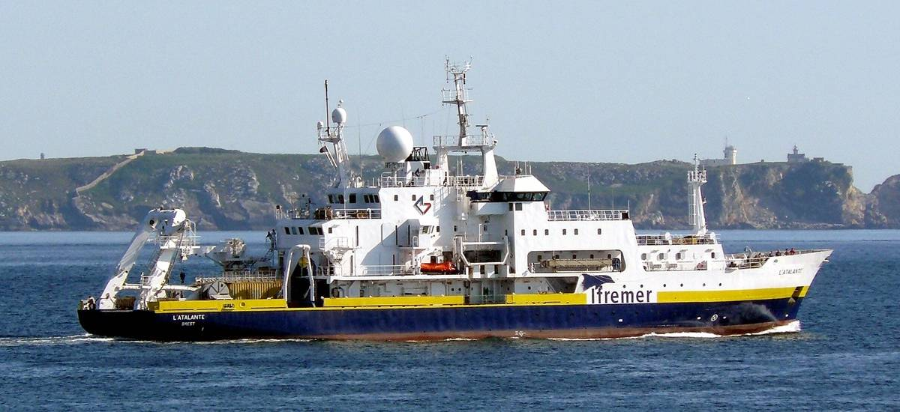
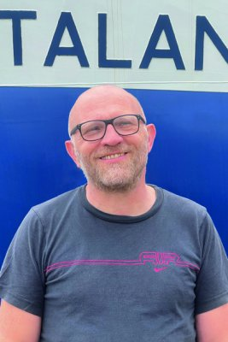

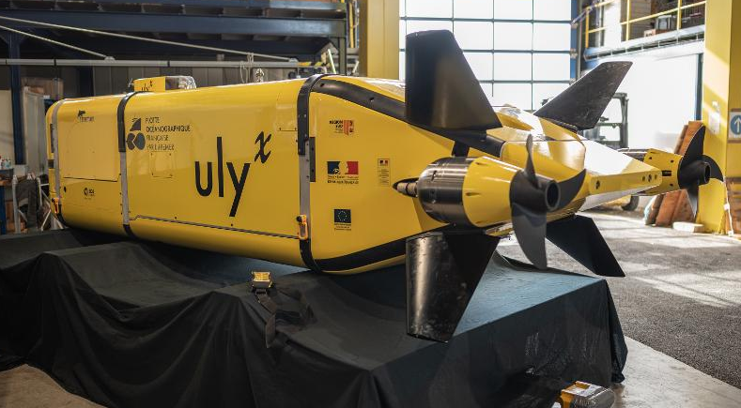
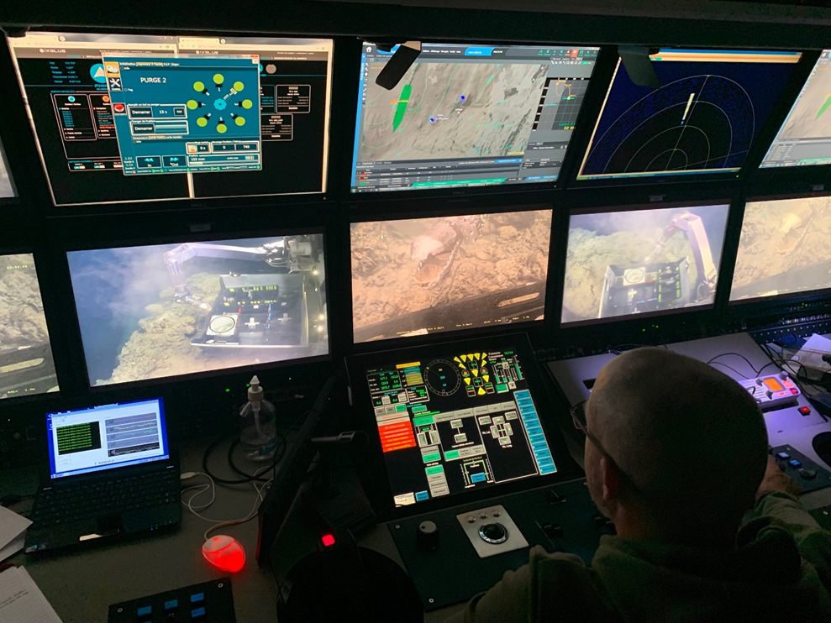
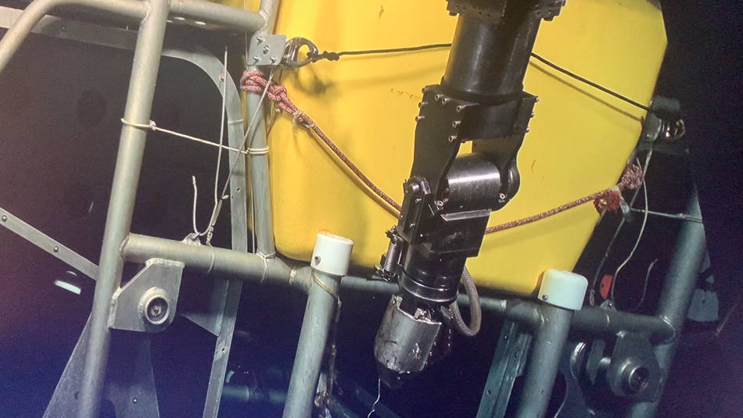
Recent highlight: NODSSUM
On June 15- July 12, 4 lab members are on board the ATALANTE
in the Atlantic, 1000km West of Brittany
The mission Nuclear Ocean Dump Site Survey Monitoring
was co-planned with Ecole Normale Supérieure by
Patrick Chardon (médaille de cristal du CNRS 2025) to
investigate the fate and effects of the 200.000 barrels with low activity nuclear
waste (97% < 40y lifetime) dumped by 4000m depth between 1950 and 1990:
  Identify and map the barrels with the pilotless submarine Ulyx with sonar & ultra high res. cameras
  Evaluate the state of barrels selected by Ulyx using the Remote Operated Vehicle Victor 6000
  by sampling water, sediments and animals at different distances from 10km to next to the barrels
  Evaluate the impacts on ecosystems, e.g. deep sea fish collected by intelligent targeted traps

Slide 6
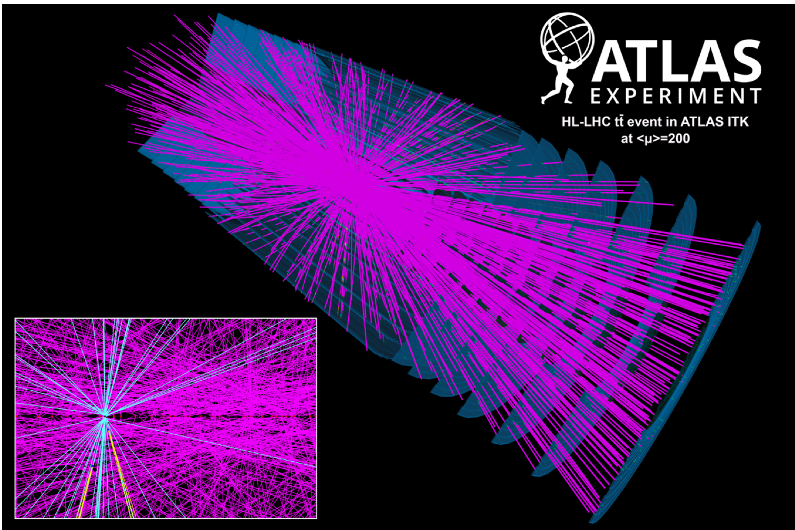
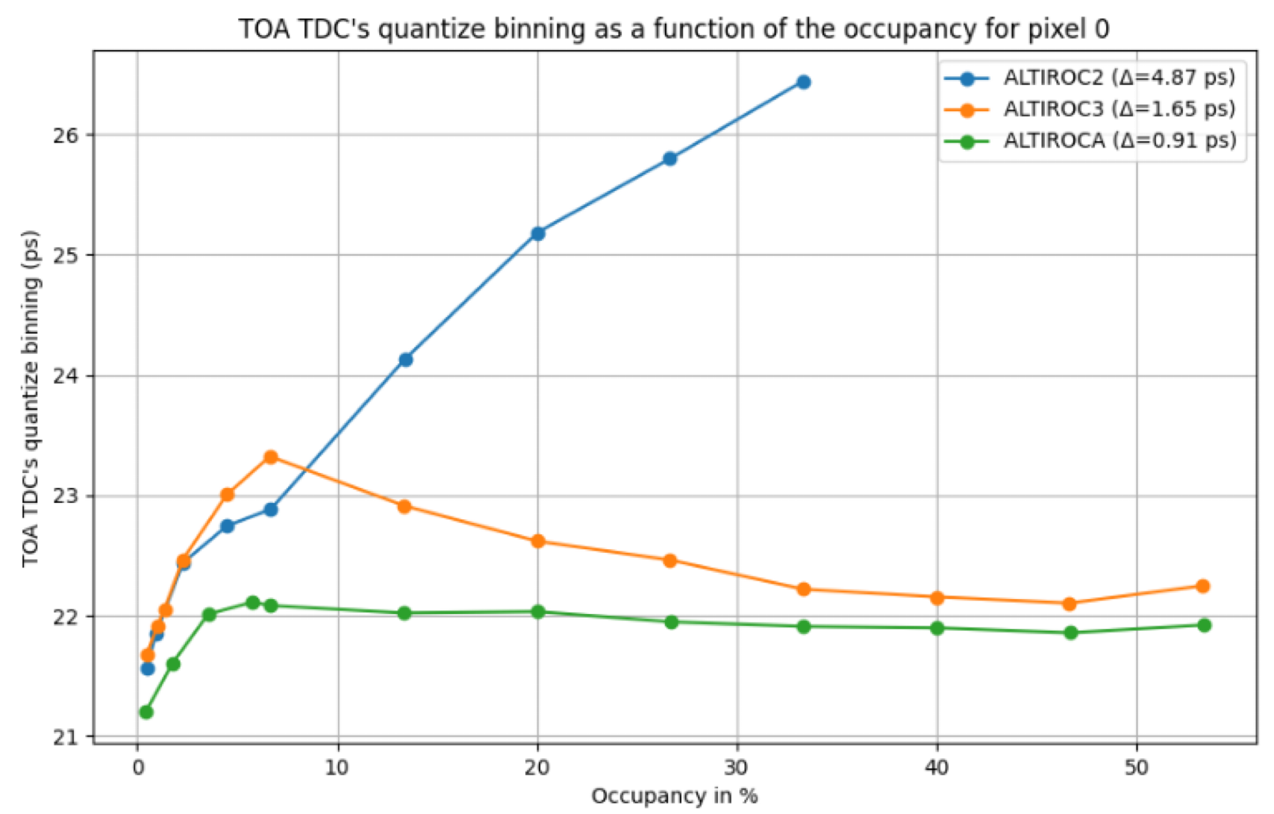
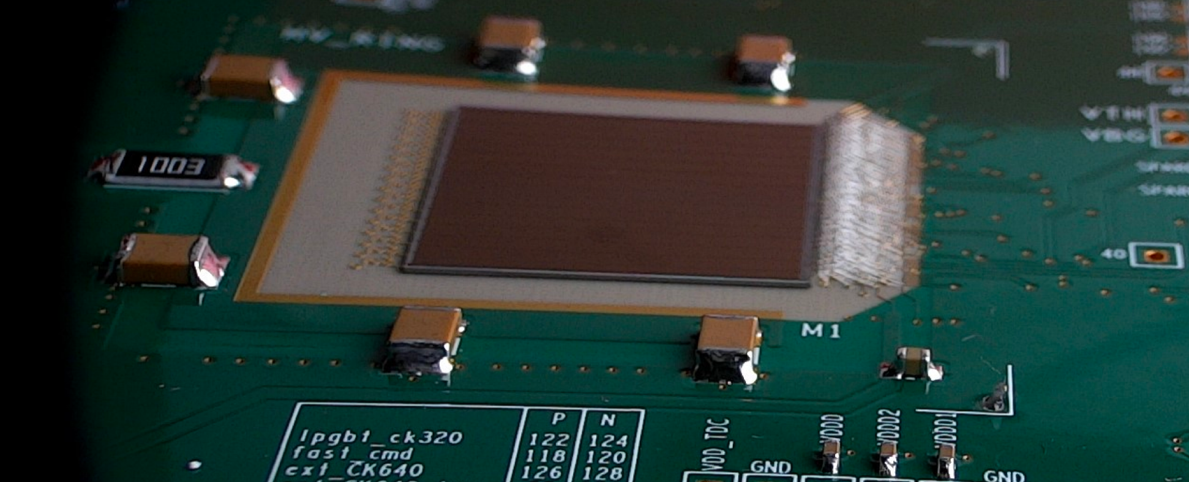
Recent highlight: HGTD/ATLAS@LPCA
Clermont welcomed in July’25 the collaboration meeting of the
ATLAS High Granularity Time Detector week 2025
HGTD is absolutely crucial to fight pile-up and take full advantage of HL-LHC,
eg. for extracting the coupling of H with itself.
Delivering a 30-50 ps time resolution for each track is a real technical
challenge: never been done at this scale!
LPCA plays its role in HGTD:
  Responsible for grounding and shielding
  Responsible for Timing calibration and clock
  MICA designed the ASIC ALTIROC-A
  Its time resolution was greatly improved
Notes:
30ps = 3E-11 s corresponds ~1cm light travel!!!

Slide 7
Why Clermont?
A bit of LPCA (pre)history…

Slide 8
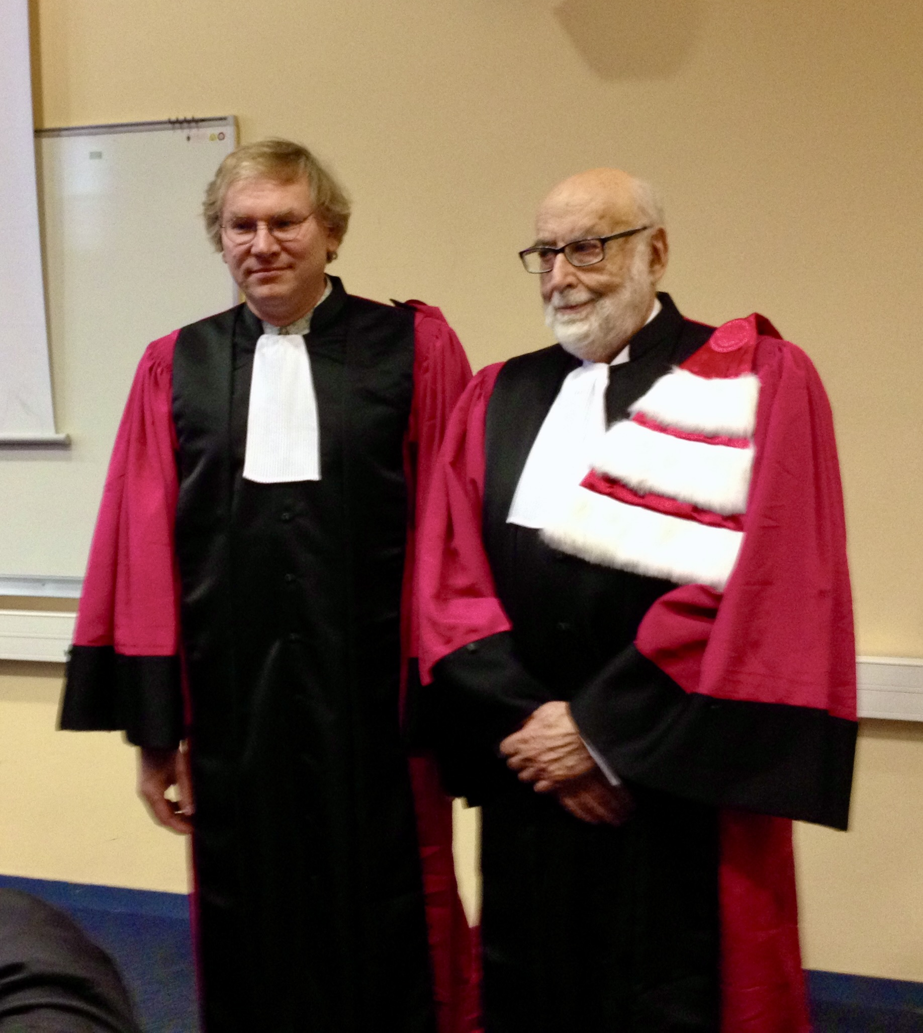
LPCA, 12 years ago
12 novembre 2013: François Englert receives a Honoris Causa Doctorate in Clermont, shortly before receiving his Nobel in Stockhom after the discovery by ATLAS and CMS of the (Brout-Englert-)Higgs boson imagined in 1964.
LPCA activities in ATLAS at CERN, and personal connections with Theory made this possible.
But upon closer look, activities of the Theory, Particles et Universe at LPCA do have a longer history in Clermont…

Slide 9
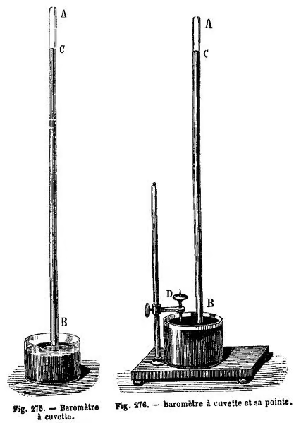
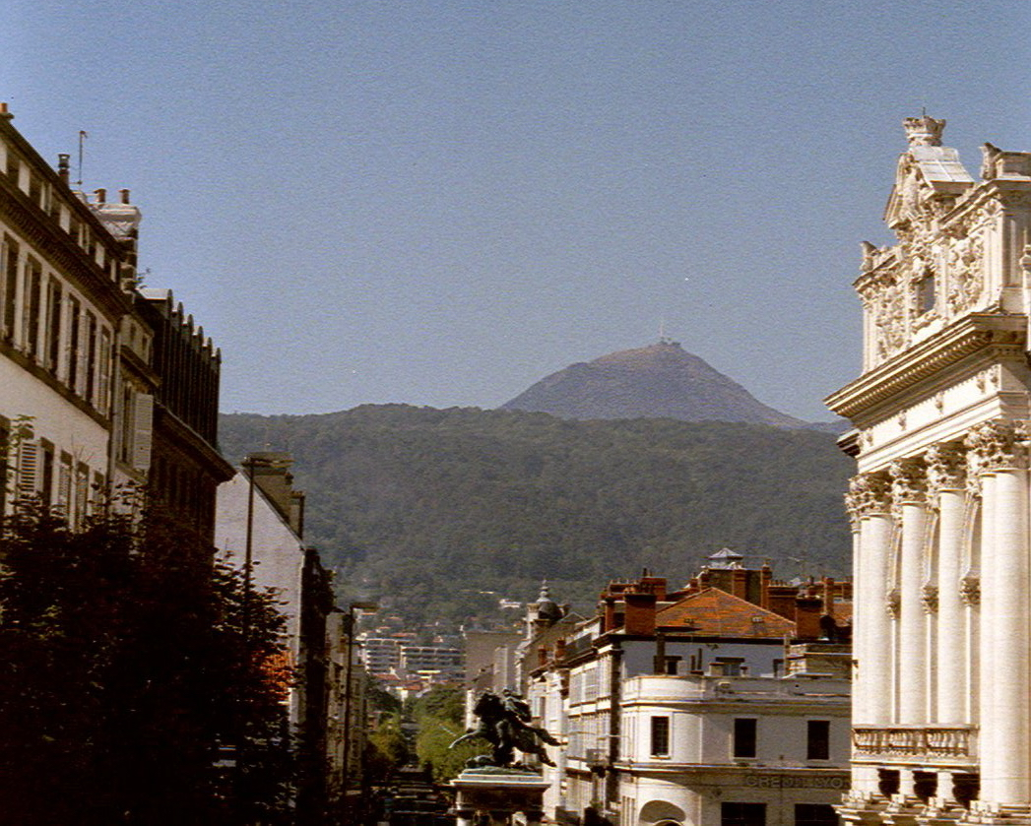
1648: Pascal’s experiment and the nature of vacuum
before: “Nature abhors vacuum” is supposed to explain the rising of mercury in a Torricelli barometer…?!?
Not for Pascal (born next to Clermont cathedral, living in Paris)
1648 F. Perier, asked by Pascal, carries a barometer to the top of Puy de Dôme:
  mercury there rises not as high as in Place de Jaude…
  Nature would abhor vacuum less up there???
  Major founding experiment, for pressure and atmospheric science,
  but not only:
  - extremely modern experimental protocol, and
  - geographic separation (Paris-Clermont), but most of all:
What is vacuum: absence of matter?…
Today LPCA researchers approach this question with experiments in
Geneva and Chile, …

Slide 10
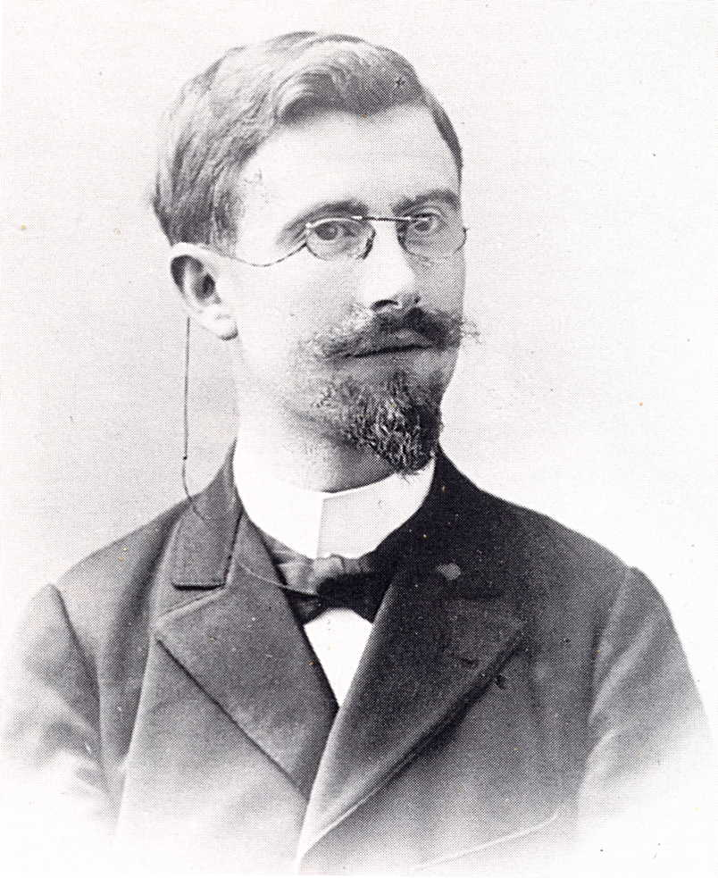
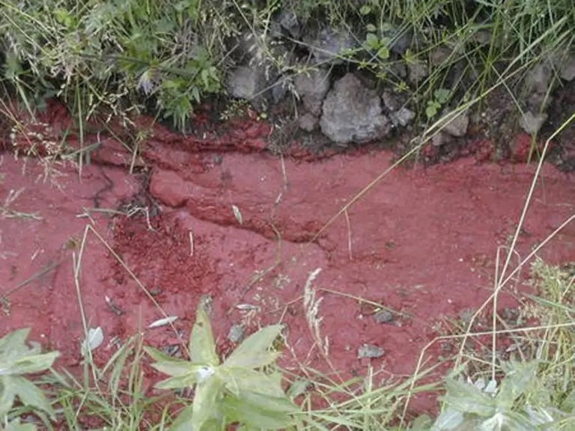
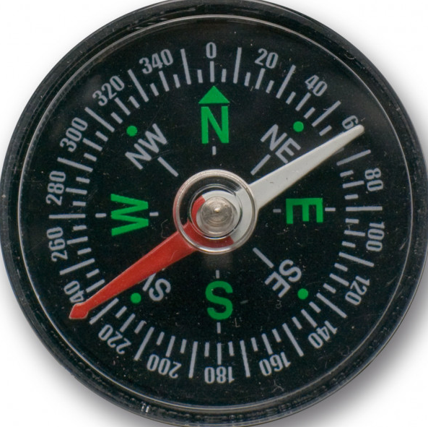

1905: variation of earth magnetism and symmetry breaking
B. Brunhes (Clermont Observatory director)
1905: in Cantal, he discovers volcanic “porcelanites” which are magnetised “upside down”
Hypothesis: when they cooled down 6 My ago, the (weak) earth magnetic field was inverted (verified 50 years later in the Atlantic rift)
Spontaneous symmetry breaking: while cooling down, a magnetic material chooses for its magnetisation the direction of an external magnetic field, however small.
(Of course, this is not in vacuum: need magnetic dipoles or electric currents to create a magnetic field)
What is vacuum: absence of matter AND fields?…
N
No!!! In vacuum,
a field of Brout-Englert-Higgs (1964) (verified in 2012) is needed to understand the mass of particles,
and another field, dark energy, seems necessary (1998) to account for cosmological expansion.
The study of both is today the main goal of the LPCA Particles and Universe department

Slide 11
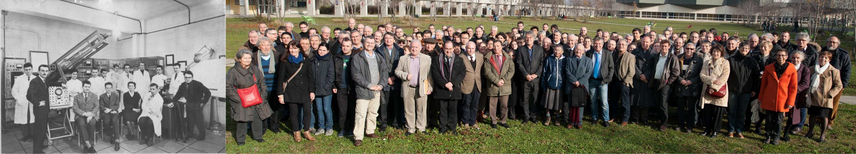
Health & environment applications
From its beginning in 1959, LPCA developed instruments (e.g. gamma spectrometer) and applications for studying the effects of radiation on cells (e.g. weak doses) or environment (e.g. datation by thermoluminescence).
60 years later, this component had been reinforced in 2017 with the addition a team of biologists

Slide 12
  National positioning: IN2P3
IN2P3: National Institute for Nuclear Physics & Particle Physics
25 laboratories
(7 in Auvergne-Rhone-Alpes)
1050 researchers (2/3 CNRS)
1600 ITA (600 research ing.)
800 non-permanent

Slide 13
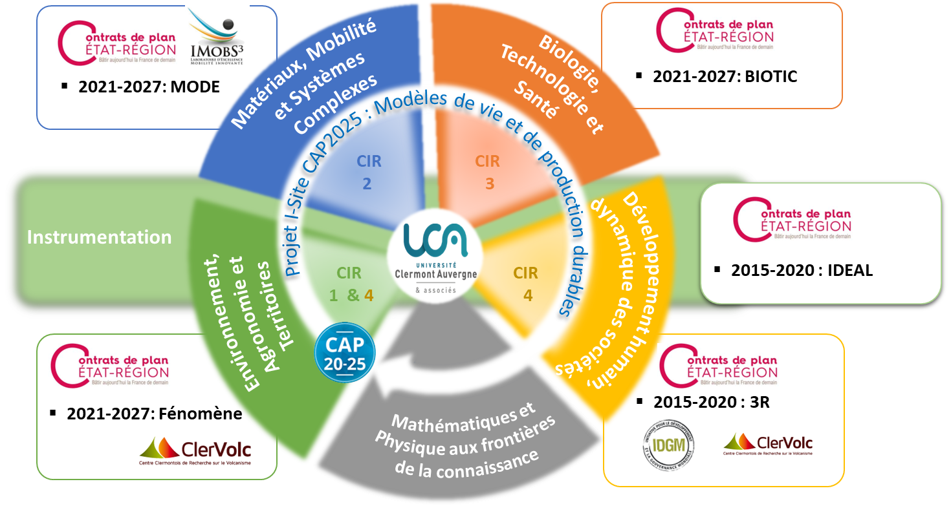

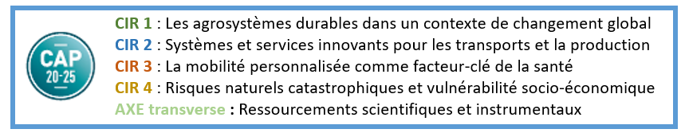
  Position dans le paysage local et régional
Instances et resp. pédagogiques
Copil DD UCA
Master Physique Fondamentale et Applications
Master Ingénierie Nucléaire (PTR-IPM)
Projet ILE
Médiation scientifique en milieu scolaire
International
(Erasmus Mundus)
DU
Data Scientist

Slide 14

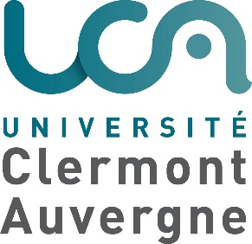











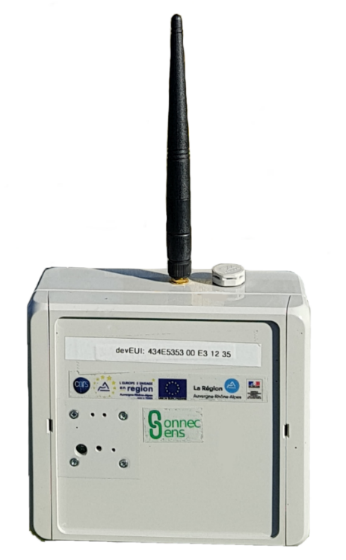
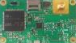
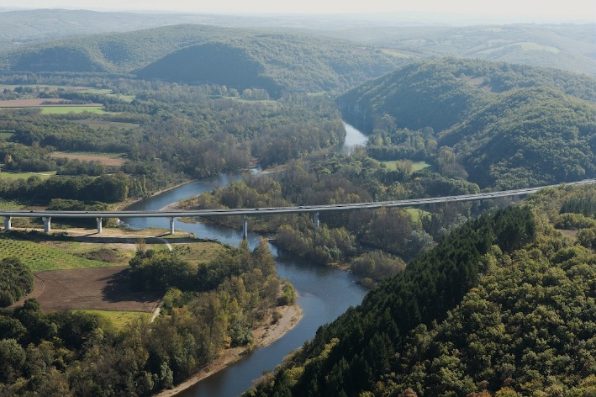
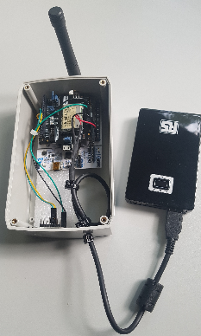

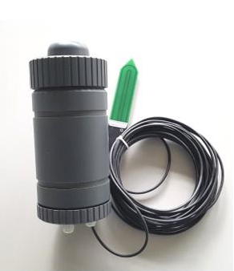
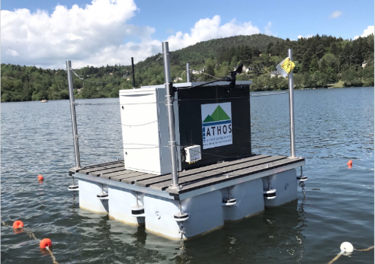
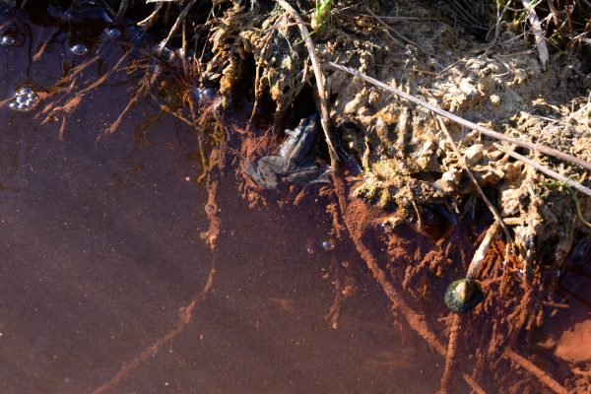
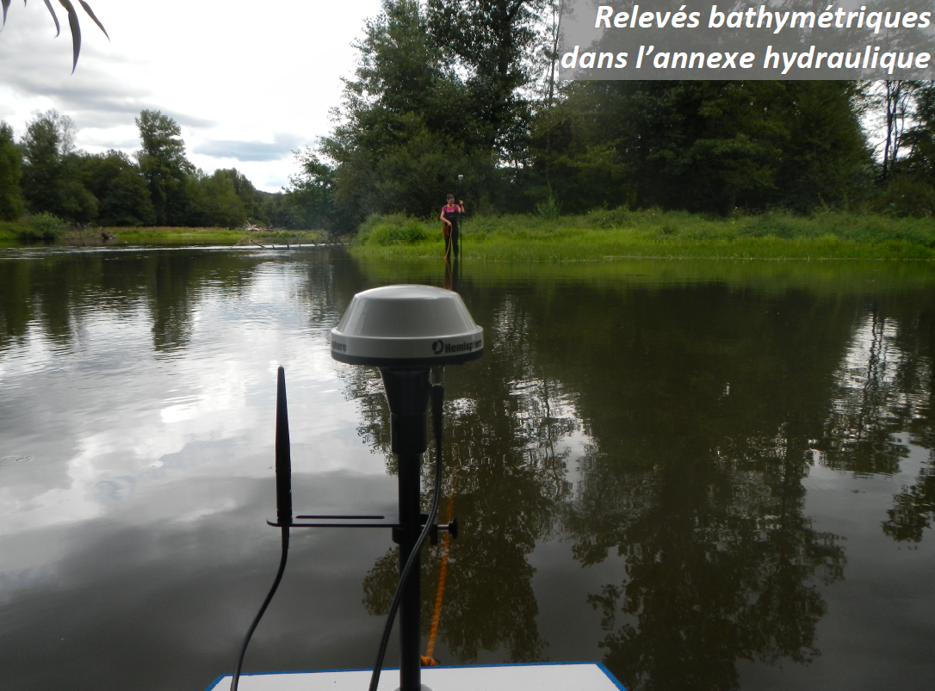

Le LPCA et les Observatoires de l’Eau
Soutiens institutionnels
Cadre collaboratif
Partenaires non-académiques
CEBA
SAGE Allier Aval
Collecte-Transmission-Gestion des données
EAU Grand Sud-Ouest
Gestion de la ressource Eau
Dordogne - Allier
L’Observatoire de l’anthropocène
Lien
Lien
Prolifération des cyanobactéries dans les lacs
Zone Atelier des Territoires Uranifères
Sources minérales
Suivi des services écosystémiques de la rivière Allier (43)
Observatoire du bassin versant de la Veyre (63)
Lien
Lien
Lien
Lien
Lien

Slide 15
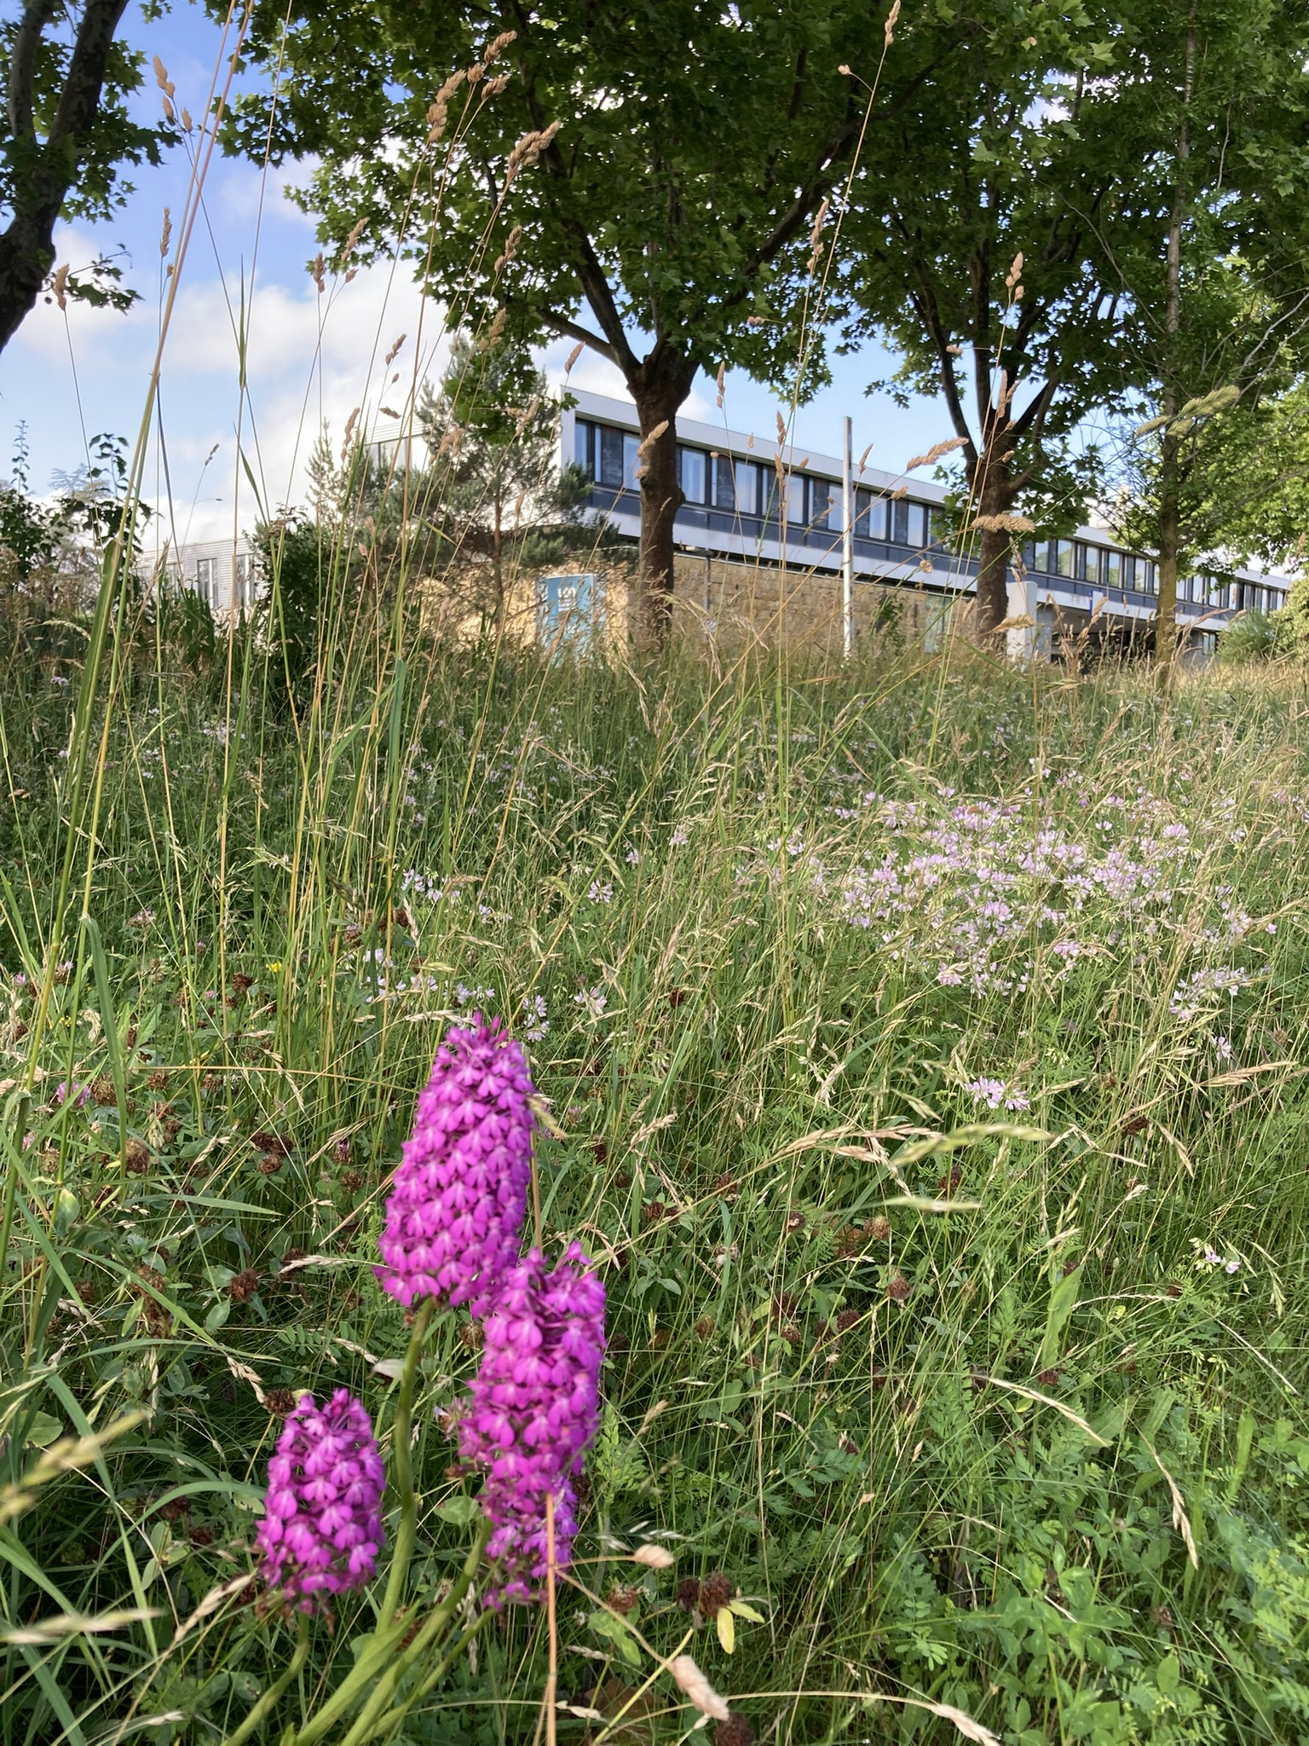
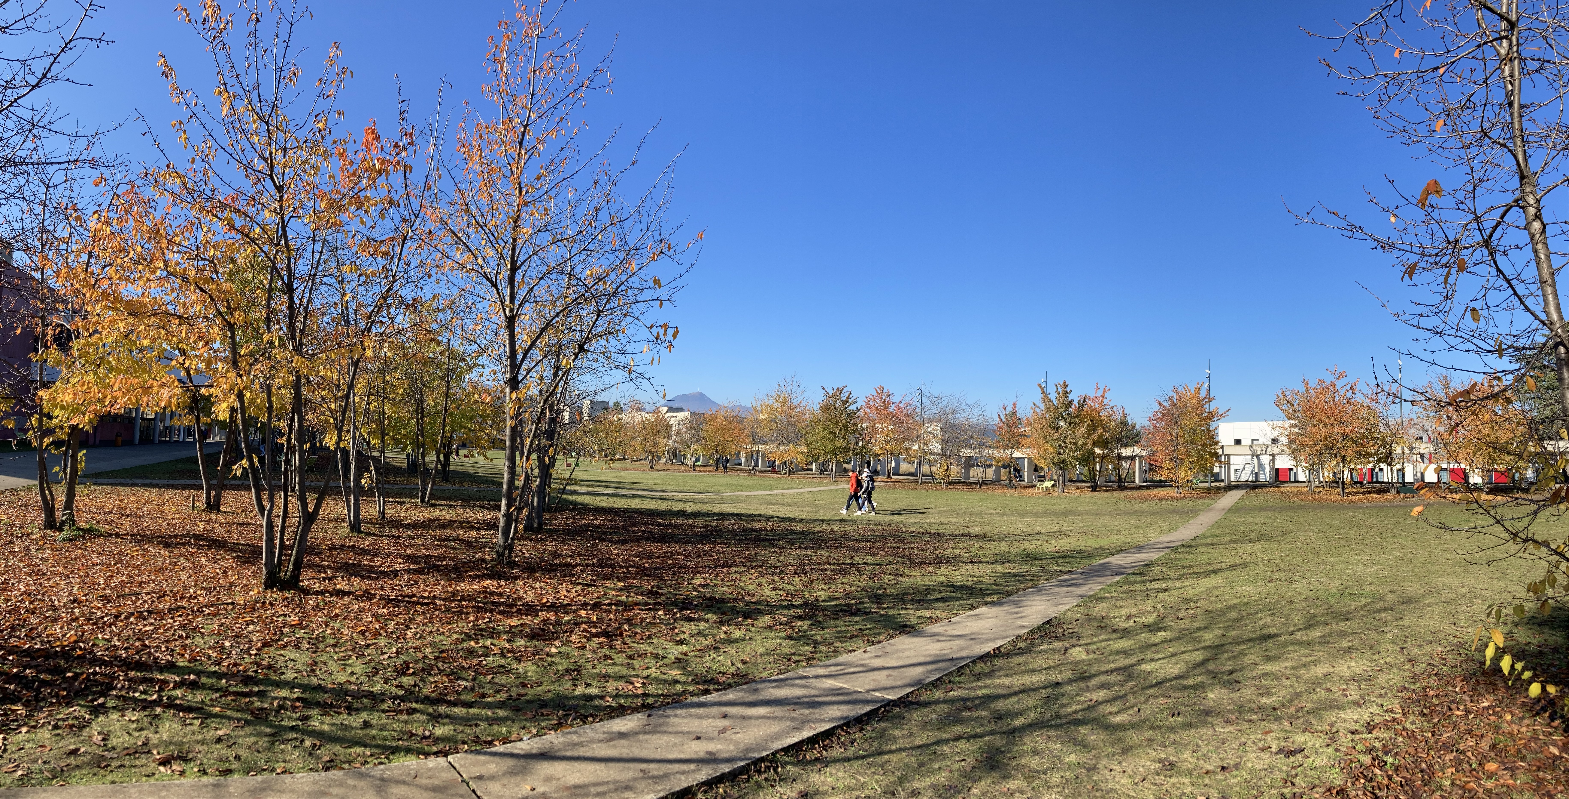
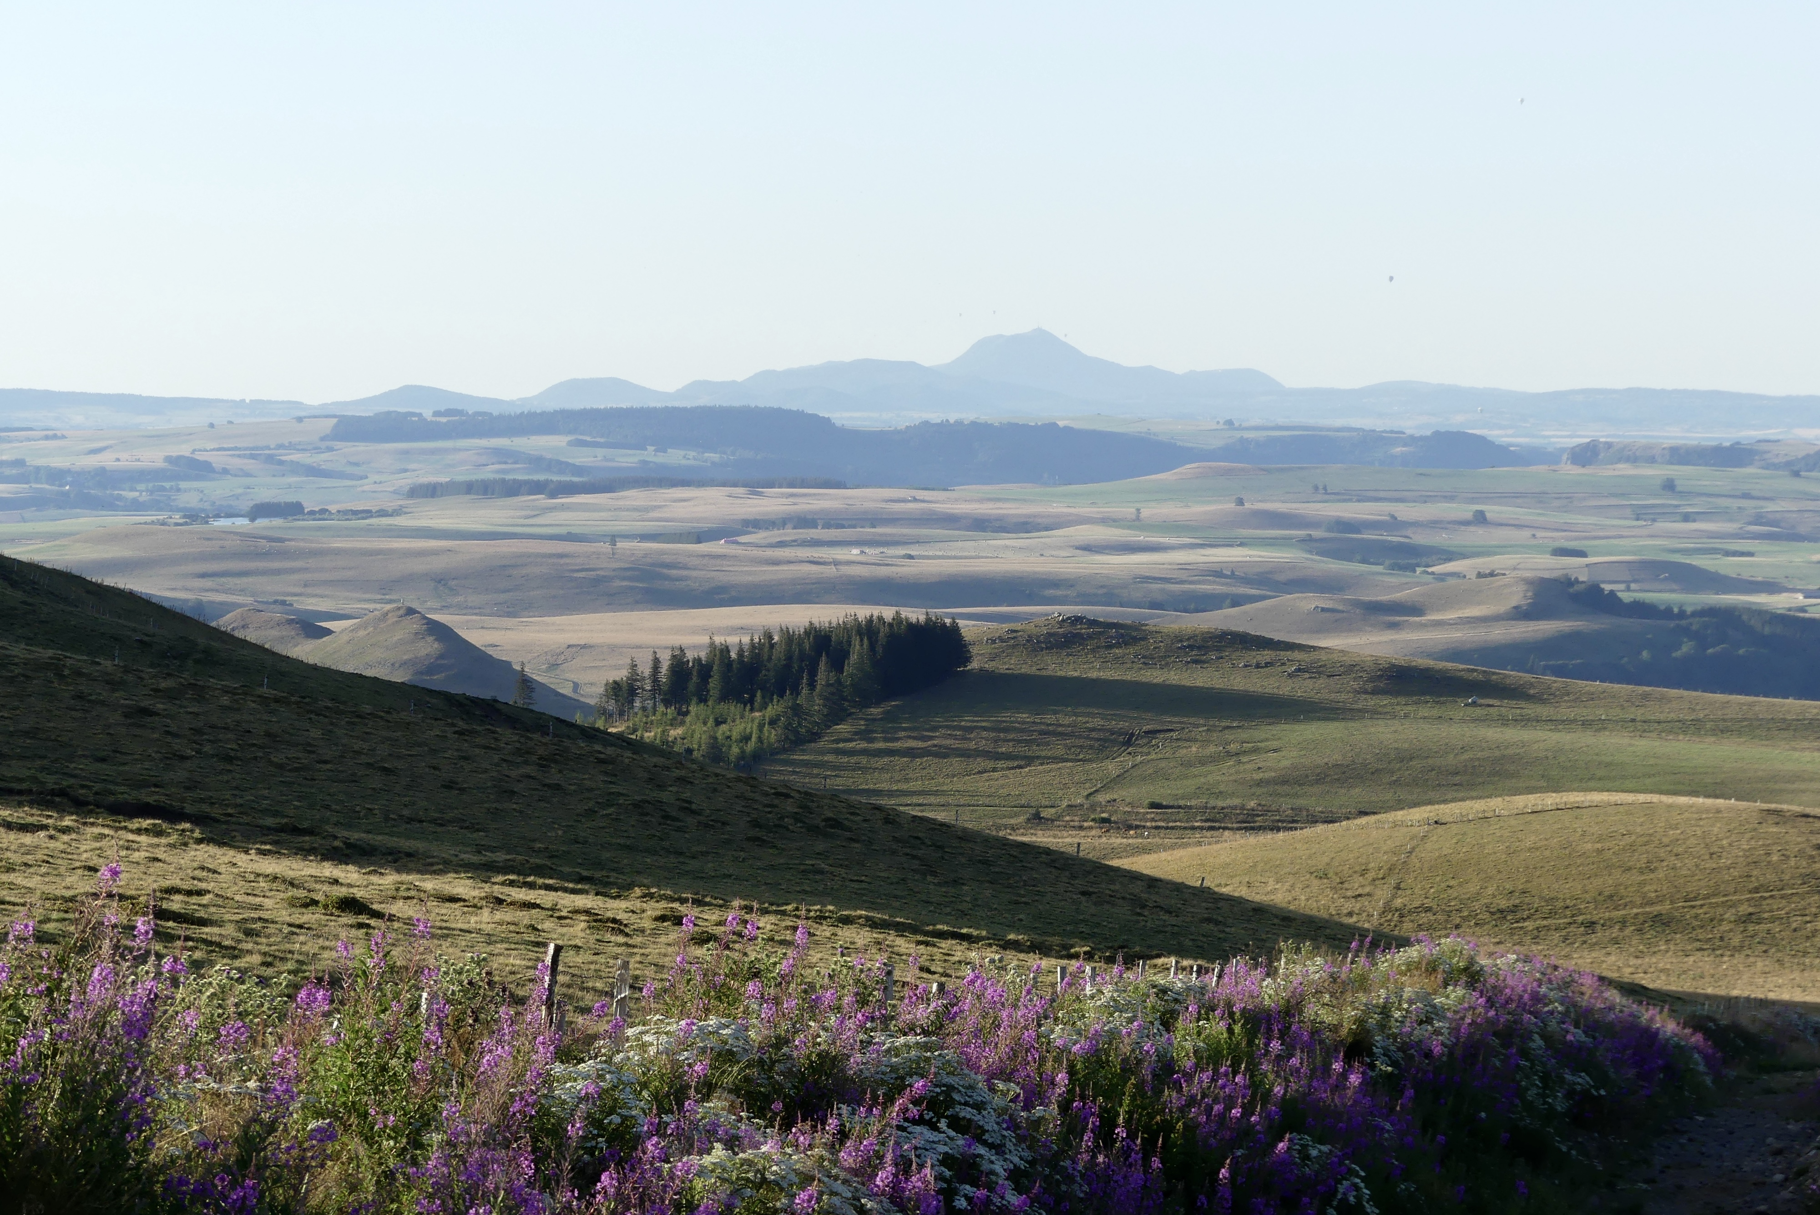
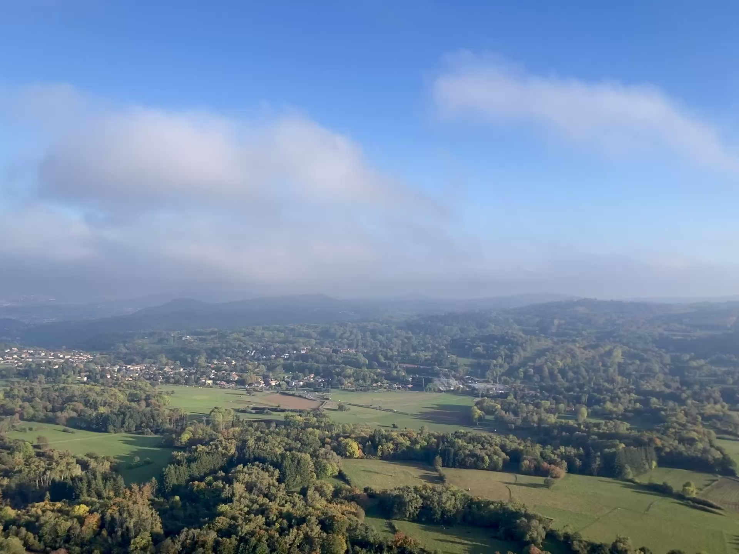
Summary: Welcome & Enjoy!
I wish you to enjoy the pleasure of doing science:
in a vibrant international crew (even locally!)
in a beautiful lab
on a beautiful campus
in a beautiful region
and hope these beauties will help your career
taking off and shining bright!

Slide 16
National and local position

